Slide 1
CCT Superconducting Magnets
17 Feb 2022
Kévin Pepitone

Slide 2
Outline
Channel 5.65 x 2.31 mm2 – First prototype
Channel 6.15 x 2.31 mm2 – Future…

Slide 3
Important values
Pitch of 5.8 mm
Walls are minimum 0.3 mm
148 turns min to magnetic length of 857 mm
Total coil length of 1064 mm (to be confirmed with the model)

Slide 4
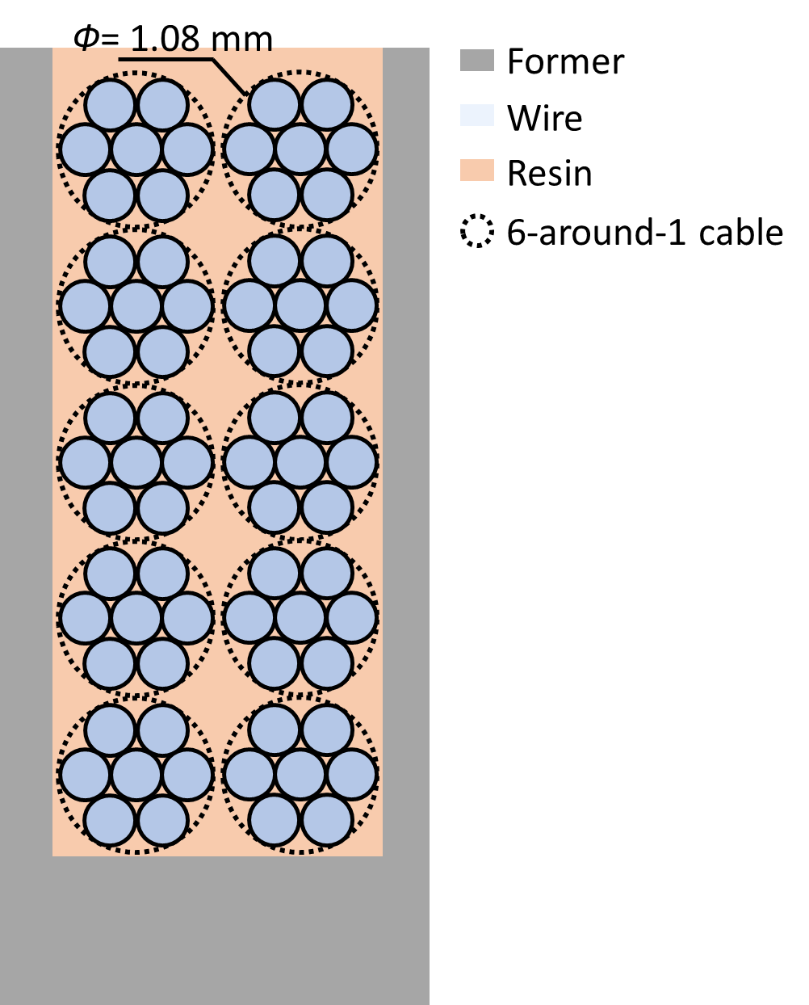
Channels explanation 5.65 x 2.31 mm2
Channel 5.65 x 2.31 mm2
0.05 mm gap cable-cable ; cable-former
Tolerance 0.05 mm
Cable 1.08 mm diameter

Slide 5
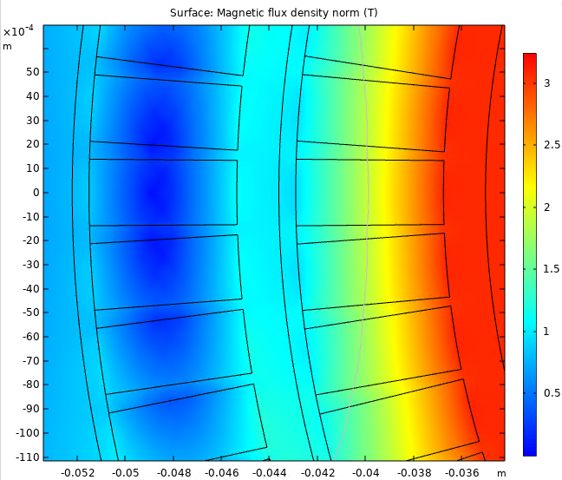
Jungle of numbers 5.65 x 2.31 mm2 – at cold
Inner former inner radius = 35 mm
Channel 5.65 x 2.31 mm2 cable is 1.08 mm
Rcoil 1 inner = Inner former inner radius + 2.85 mm = 37.85 mm
Rcoil 1 outer = Rcoil 1 inner + Tcoil (= 5.65) = 43.5 mm
Outer former inner radius = Rcoil 1 outer + T former gap (= 0.7) = 44.2 mm
Rcoil 2 inner = Outer former inner radius + 2.85 mm = 47.05 mm
Rcoil 2 outer = Rcoil 2 inner + Tcoil (= 5.65)= 52.7 mm
Rsupport inner = Rcoil 2 outer + T former gap (= 0.7) = 53.4 mm
Rsupport outer = Rsupport inner + Tsupport (= 18.15 mm) = 71.55 mm
Ryoke inner = Rsupport outer + Tyoke gap (= 1.6 mm) = 73.15 mm
Ryoke outer = 237.0 mm
Tilt = 30 deg

Slide 6
Jungle of numbers 5.65 x 2.31 mm2 - CATIA
Aluminum shrinks 4 mm/m
Iron shrinks 2mm/m
Inner former inner radius = 35.15 mm
Channel 5.65 x 2.31 mm2 cable is 1.08 mm
Rcoil 1 inner = Inner former inner radius + 2.85 mm = 38.00 mm
Rcoil 1 outer = Rcoil 1 inner + Tcoil (= 5.65) = 43.65 mm
Outer former inner radius = Rcoil 1 outer + T former gap (= 0.7) = 44.35 mm
Rcoil 2 inner = Outer former inner radius + 2.85 mm = 47.25 mm
Rcoil 2 outer = Rcoil 2 inner + Tcoil (= 5.65)= 52.9 mm
Rsupport inner = Rcoil 2 outer + T former gap (= 0.7) = 53.6 mm
Rsupport outer = Rsupport inner + Tsupport (= 18.25 mm) = 71.85 mm
Ryoke inner = Rsupport outer + Tyoke gap (= 1.6 mm) = 73.45 mm
Ryoke outer = 237.5 mm
Tilt = 30 deg

Slide 7
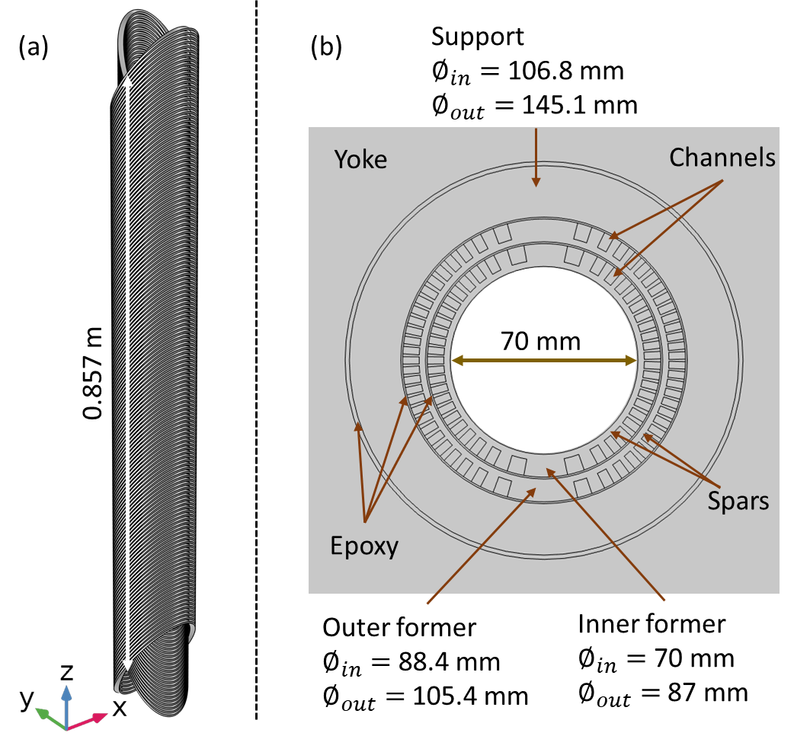
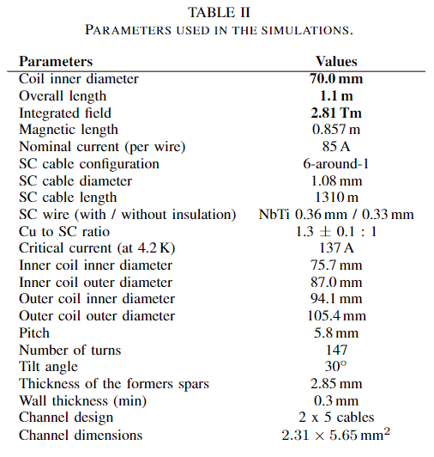
View 5.65 x 2.31 mm2

Slide 8
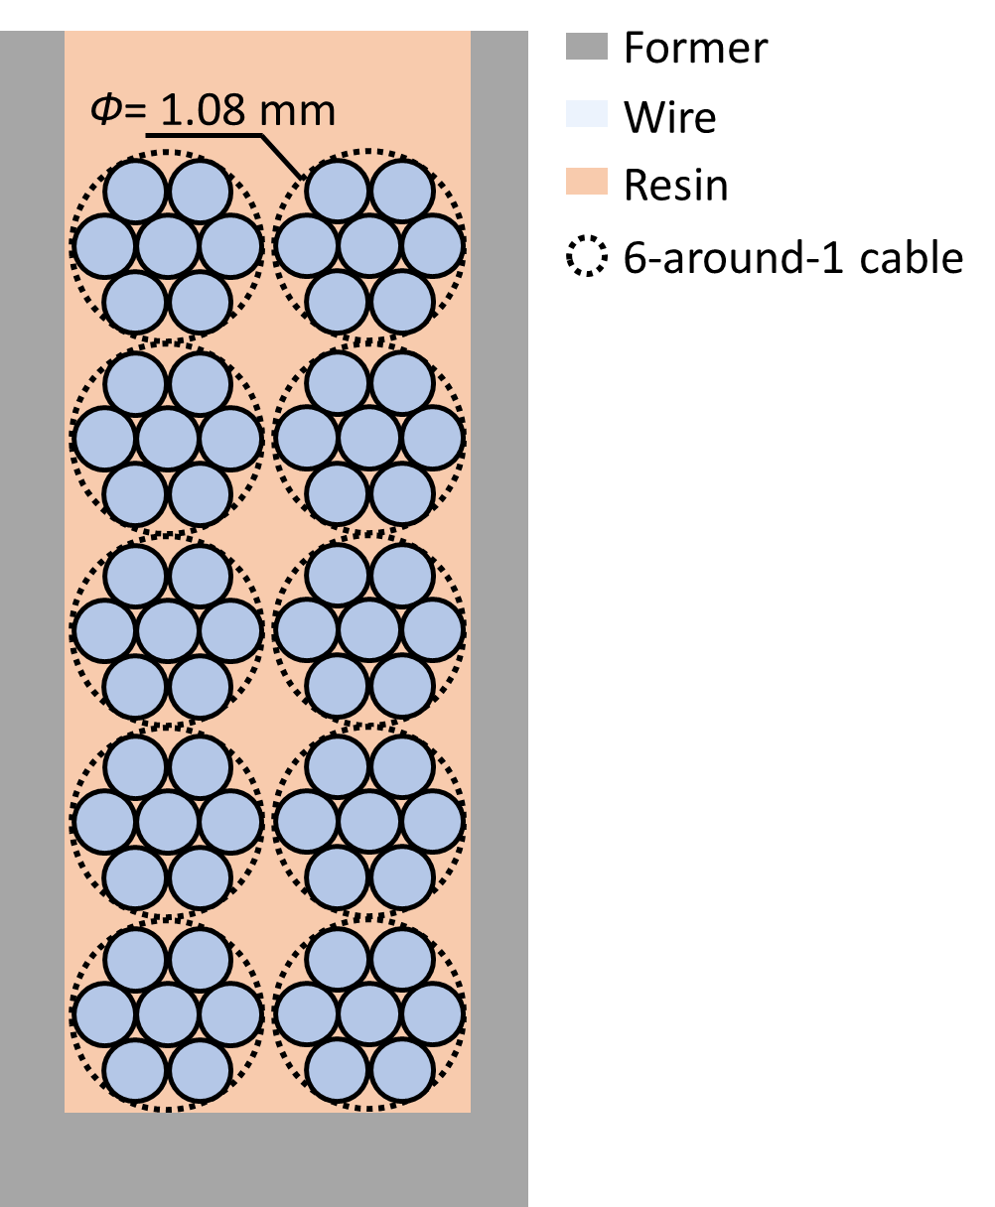
Channels explanation 6.15 x 2.31 mm2
Channel 6.15 x 2.31 mm2
0.05 mm gap cable-cable ; cable-former
0.5 mm on the top of the channel for more cable
Tolerance 0.05 mm
Cable 1.08 mm diameter

Slide 9
Jungle of numbers 6.15 x 2.31 mm2 – at cold
Inner former inner radius = 35 mm
Channel 6.15 x 2.31 mm2 cable is 1.08 mm
Rcoil 1 inner = Inner former inner radius + 2.35 mm = 37.35 mm
Rcoil 1 outer = Rcoil 1 inner + Tcoil (= 6.15) = 43.5 mm
Outer former inner radius = Rcoil 1 outer + T former gap (= 0.7) = 44.2 mm
Rcoil 2 inner = Outer former inner radius + 2.35 mm = 46.55 mm
Rcoil 2 outer = Rcoil 2 inner + Tcoil (= 6.15)= 52.7 mm
Rsupport inner = Rcoil 2 outer + T former gap (= 0.7) = 53.4 mm
Rsupport outer = Rsupport inner + Tsupport (= 18.15 mm) = 71.55 mm
Ryoke inner = Rsupport outer + Tyoke gap (= 1.6 mm) = 73.15 mm
Ryoke outer = 237.0 mm
Tilt = 30 deg

Slide 10
Jungle of numbers 6.15 x 2.31 mm2 - CATIA
Aluminum shrinks 4 mm/m
Iron shrinks 2mm/m
Inner former inner radius = 35.15 mm
Channel 6.15 x 2.31 mm2 cable is 1.08 mm
Rcoil 1 inner = Inner former inner radius + 2.35 mm = 37.50 mm
Rcoil 1 outer = Rcoil 1 inner + Tcoil (= 6.15) = 43.65 mm
Outer former inner radius = Rcoil 1 outer + T former gap (= 0.7) = 44.35 mm
Rcoil 2 inner = Outer former inner radius + 2.40 mm = 46.75 mm
Rcoil 2 outer = Rcoil 2 inner + Tcoil (= 6.15)= 52.90 mm
Rsupport inner = Rcoil 2 outer + T former gap (= 0.7) = 53.6 mm
Rsupport outer = Rsupport inner + Tsupport (= 18.15 mm) = 71.85 mm
Ryoke inner = Rsupport outer + Tyoke gap (= 1.6 mm) = 73.45 mm
Ryoke outer = 237.5 mm
Tilt = 30 deg

Slide 11
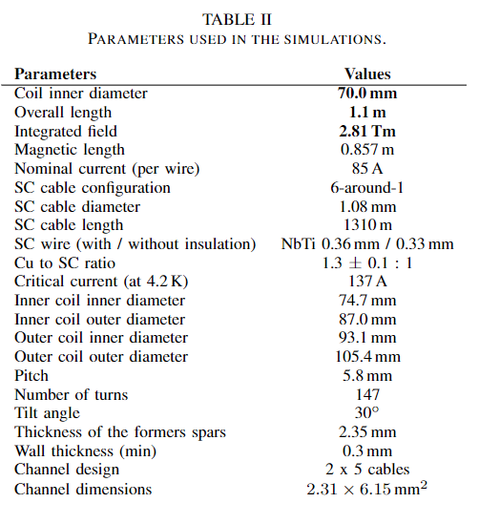
View 6.15 x 2.31 mm2
70.4 mm at warm

Slide 12
Jungle of numbers 5.65 x 2.31 mm2 – at cold
1 - Inner former inner radius = 35 mm
Channel 5.65 x 2.31 mm2 cable is 1.08 mm
2 - Rcoil 1 inner = Inner former inner radius + 2.85 mm = 37.85 mm
3 - Rcoil 1 outer = Rcoil 1 inner + Tcoil (= 5.65) = 43.5 mm
4 - Outer former inner radius = Rcoil 1 outer + T former gap (= 0.7) = 44.2 mm
5 - Rcoil 2 inner = Outer former inner radius + 2.85 mm = 47.05 mm
6 - Rcoil 2 outer = Rcoil 2 inner + Tcoil (= 5.65)= 52.7 mm
7 - Rsupport inner = Rcoil 2 outer + T former gap (= 0.7) = 53.4 mm
Rsupport outer = Rsupport inner + Tsupport (= 18.15 mm) = 71.55 mm
Ryoke inner = Rsupport outer + Tyoke gap (= 1.6 mm) = 73.15 mm
Ryoke outer = 237.0 mm
Tilt = 30 deg
7
6
5
4
3
2
1

