Slide 2

My Working Experience at CERN
2009-2014
Rossana Bonomi
Rossana.Bonomi@cern.ch

Slide 3
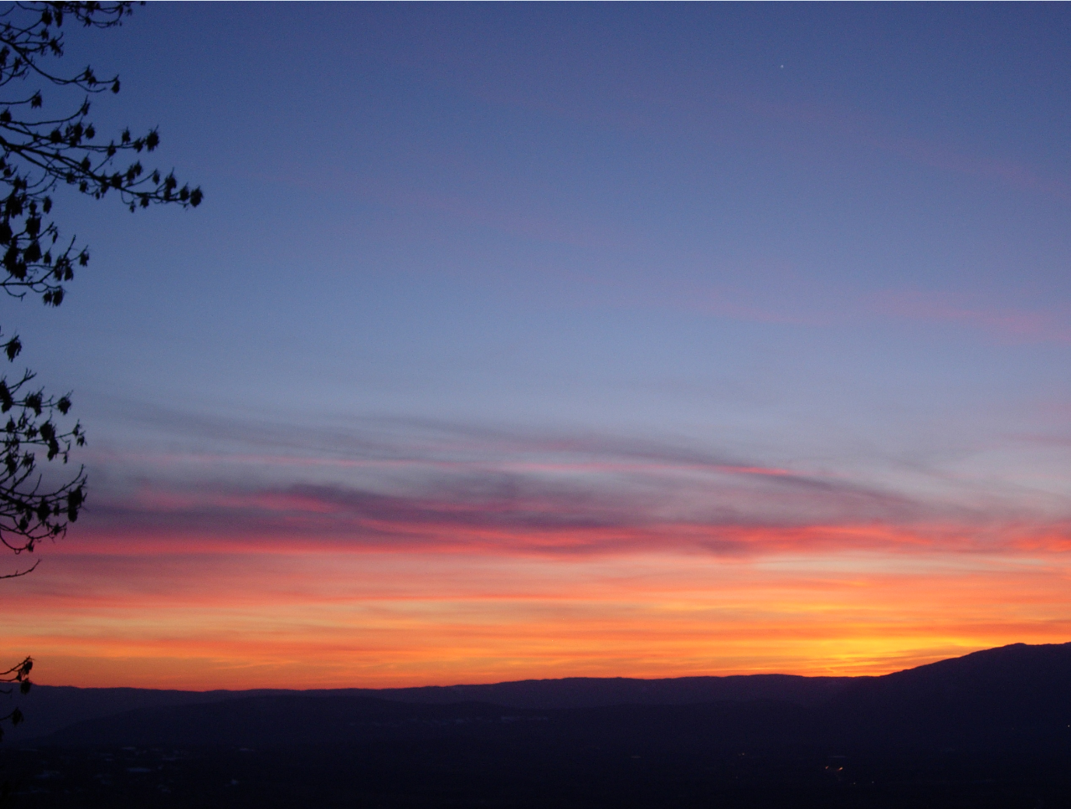
Who am I ?
3
Rossana Bonomi
Energy Engineer (Politecnico of Turin, IT)
2 positions at CERN (Geneva, CH)
  2009-2011 as Ph.D. student
  2011-2014 as CERN-ESS fellow
Theoretical and experimental studies of accelerators / components (“warm” and “cold”)

Slide 4
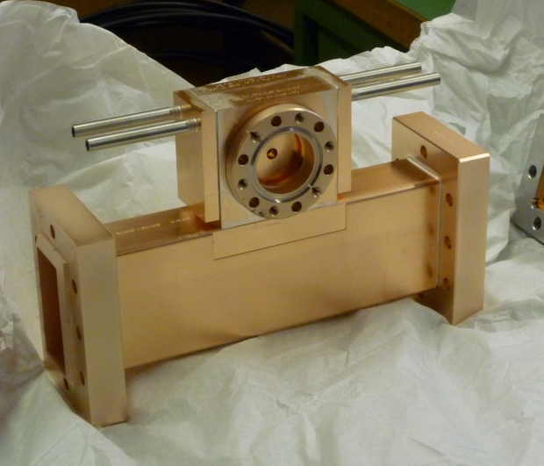
Ph.D. Student at TERA (2009-11)
4
TERA Foundation (CERN)
  Accelerators for tumor treatment with hadrons
Cavities for Medical High-Gradient Linacs
Cooling system design, Frequency shift prediction
Pulsed surface heating (Geometry-fields optimization)
Instrumentation development, Experimental validation
Proved: Thermal performance at high gradient operation
High-gradient
S-band single-cell cavity
R. Bonomi, “Thermo-structural study and experimental analysis of accelerating structures for hadrontherapy linacs.”, Ph.D. Thesis, 2011

Slide 5
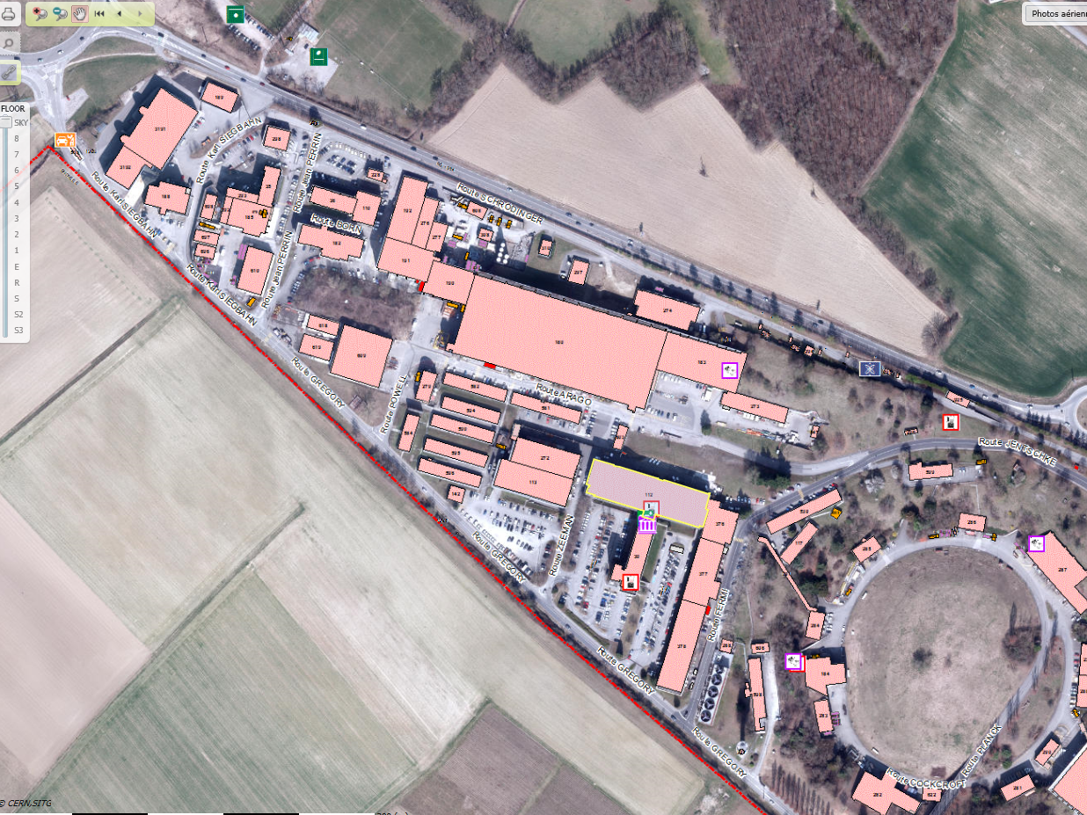
CERN-ESS Fellow (2011-14)
5
TE-MSC-CMI (CERN)
  Technology Dep.
  Magnets, Superconductors, Cryostats Gr.
  Cryostats, Machine Integration Sec.
  Thermal design (SPL Project)
  Experimental validation with full-size cryogenic mock-up

Slide 6
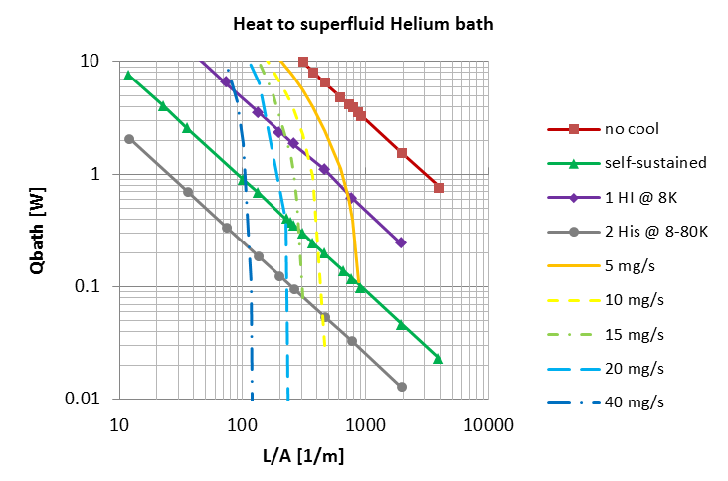
Neck Cooling
6
Generic Component Acting as “Thermal Bridge”
Heat conducted to cold bath for different cooling layouts
Useful for: Type of cooling definition w.r.t. heat load requirement and geometry
Room temp (300K)
x₁
Q @ 80K
length
Cross section
x₂
Q @ 8K
Q @ 2K
Courtesy of V. Parma (CERN)
R. Bonomi, “Neck cooling: theoretical thermal performance”, 2013

Slide 7
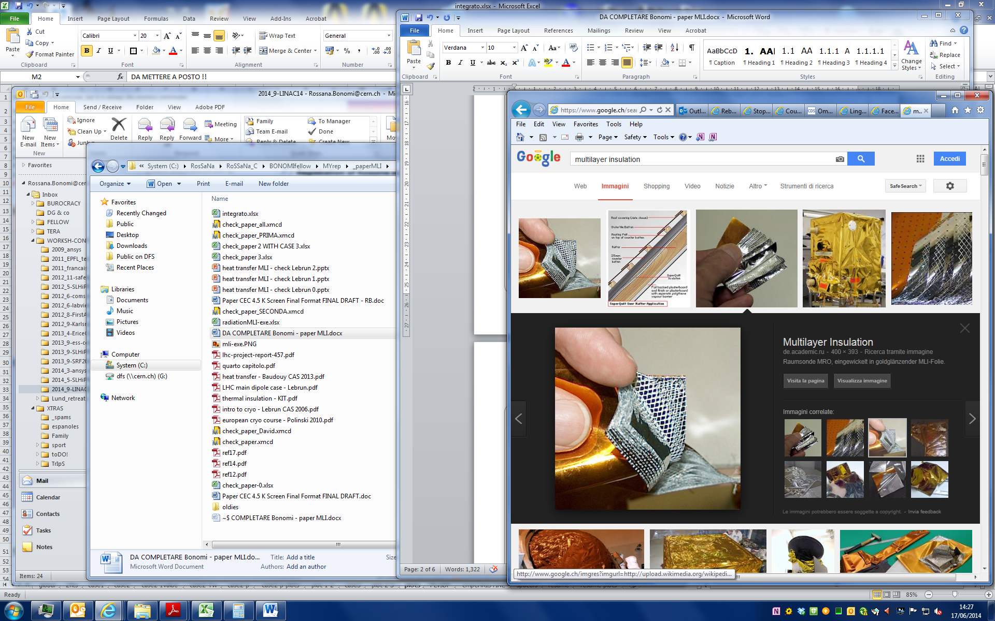
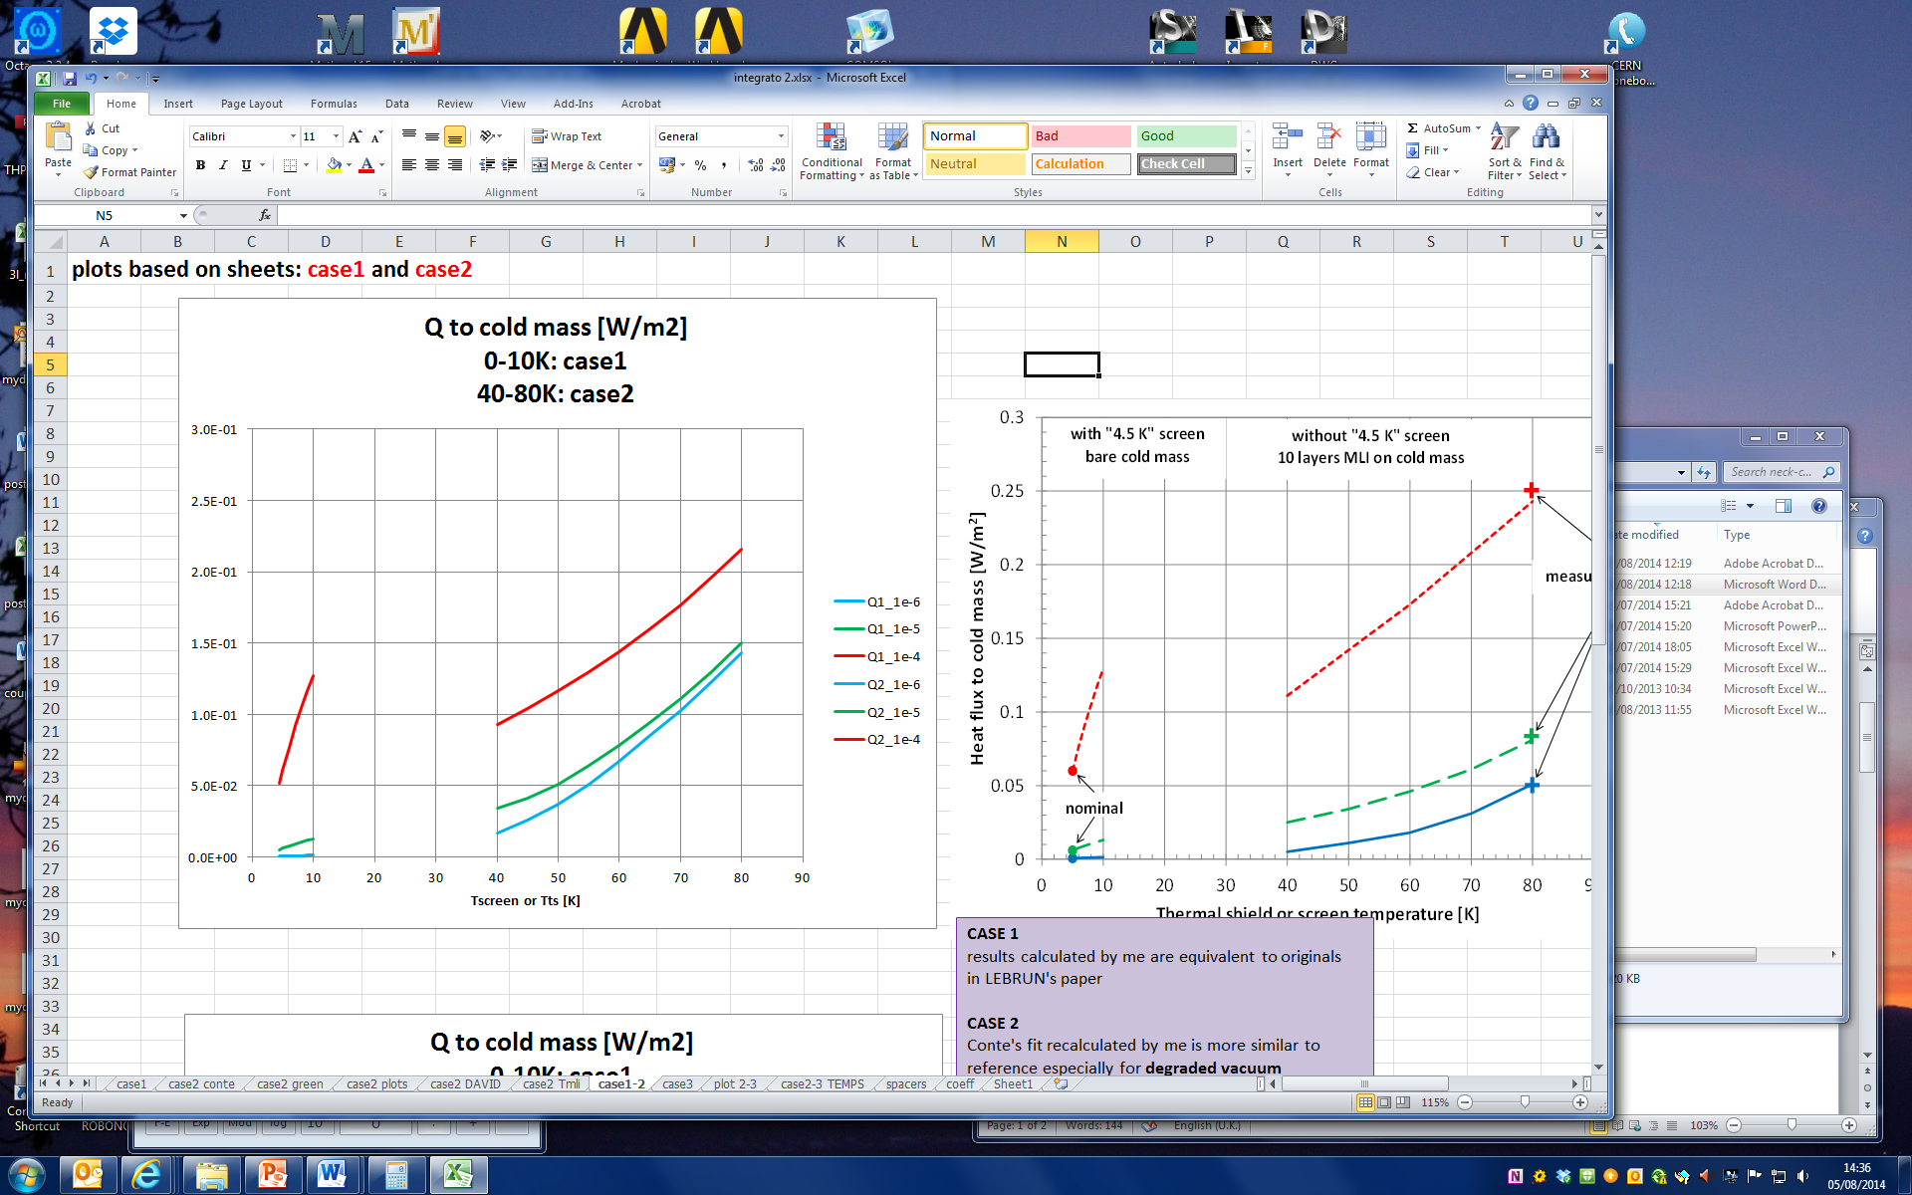
Heat Transfer Through MLI
7
Generic Cryostat
Thermal loads to cold mass covered by MLI (spacers conduction, radiation, residual gas conduction)
Useful for: Cryostat’s thermal design (cold screen?)
P. Lebrun et al., “Does one need a 4.5K screen in cryostats of superconducting accelerator devices operating in superfluid helium?”
R. Bonomi, “Heat transfer through MLI”, 2014

Slide 8
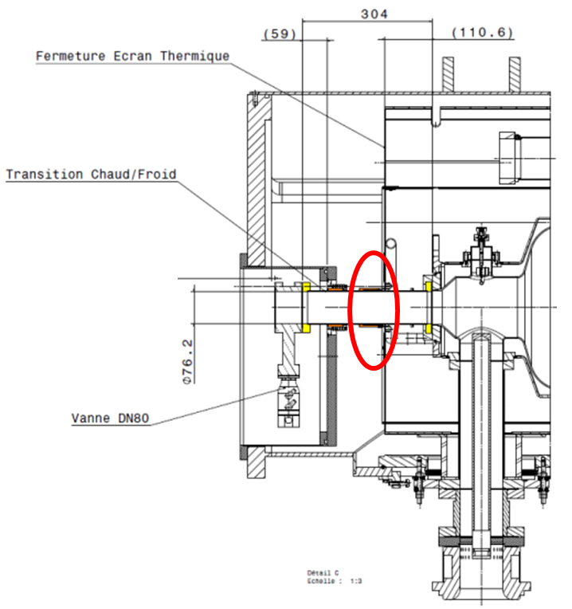
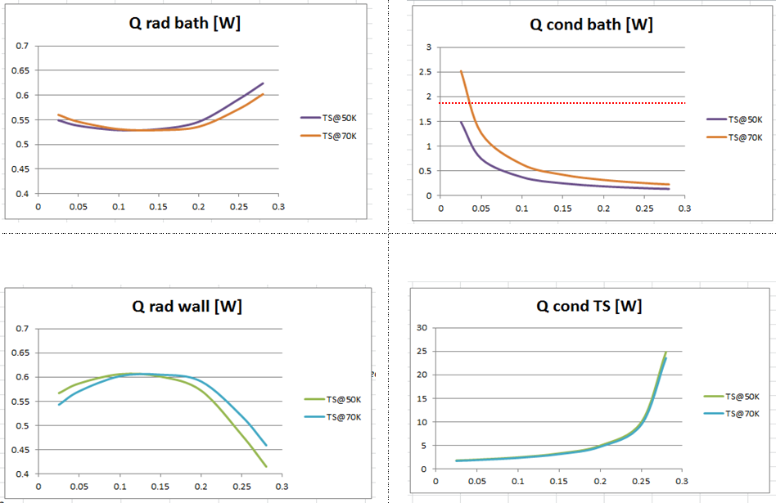
Cold-Warm Transition
8
CWT of the SPL Short Cryomodule
Contributions to heat load (conduction, radiation)
Defined: Optimal thermal shield position
Courtesy of S. Rousselot (CNRS)
R. Bonomi, “Cold-warm transition thermal study”, 2012

Slide 9
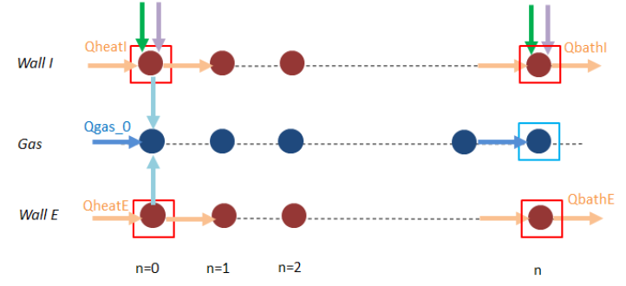
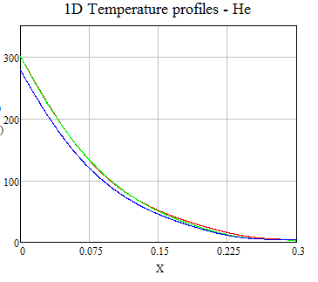
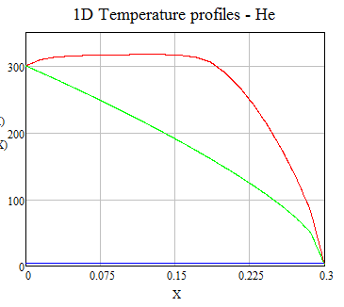
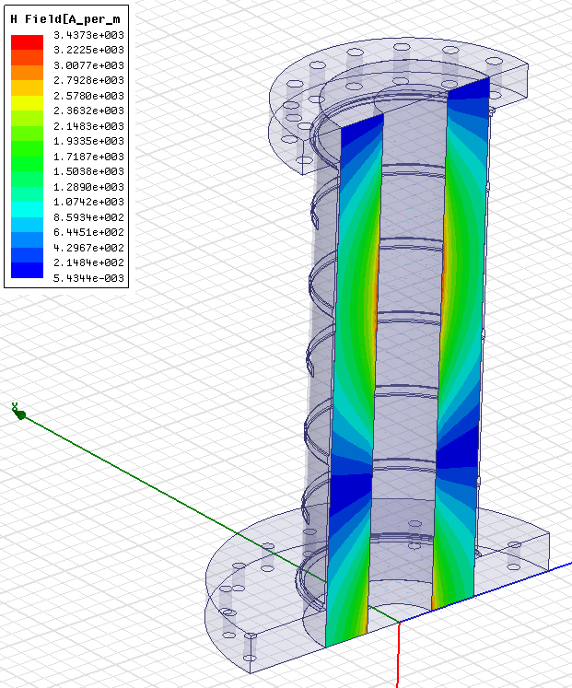
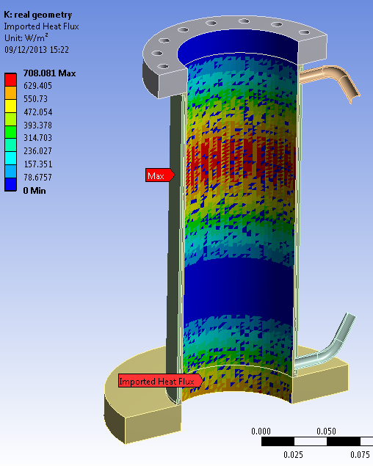
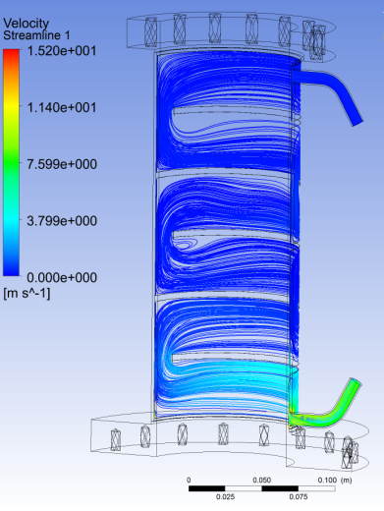
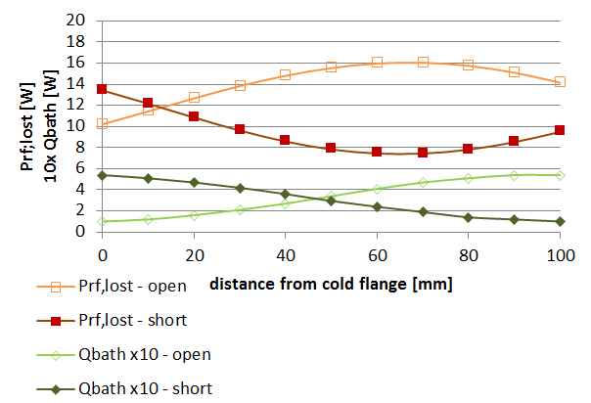
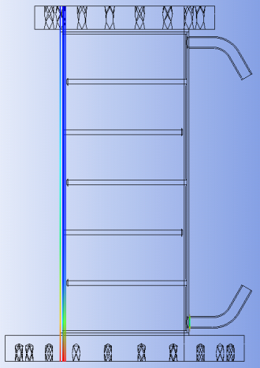
Double Wall Tube for FPC
9
SPL Fundamental Power Coupler
Analytical/Numerical studies of temperature profile and exchanged powers of FPC’s outer conductor
Assessed: Need of gas cooling; DWT theoretical thermal performance (static and dynamic)
R. Bonomi, “A simulation tool for steady state thermal performance applied to the SPL double-walled tube RF power coupler”, CERN-ACC-NOTE 2014

Slide 10
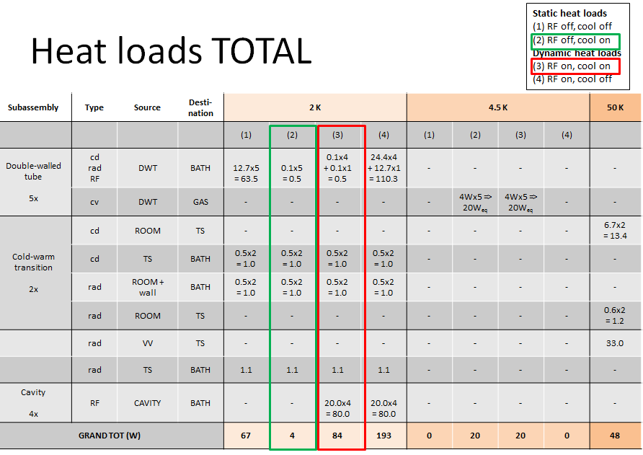
SPL SCM’s Heat Budget
10
SPL Short Cryomodule
Thermal load of each component
Assessed: Static and dynamic loads at every temperature level for cryogen inventory
From SPL SCM Working Group Workspace

Slide 11
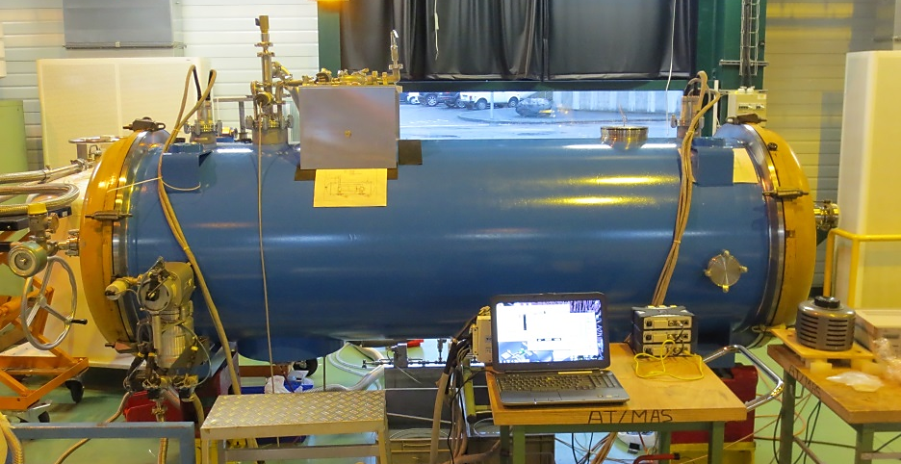
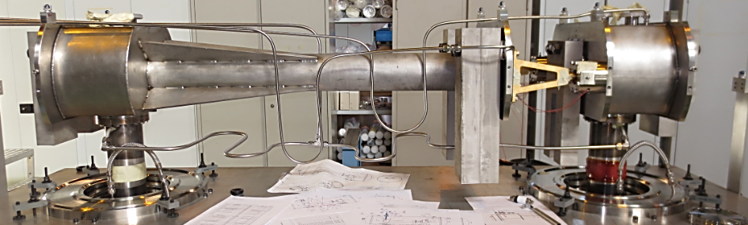
Mock-up in SMI2, CERN
11
Thermo-mechanical cold test of supporting system for SPL cryomodule
Theoretical models adaptation; Safety valve sizing; Test planning/coordination; Intrumentation points definition
Proved: Agreement with theoretical prediction in many cooling conditions

Slide 12
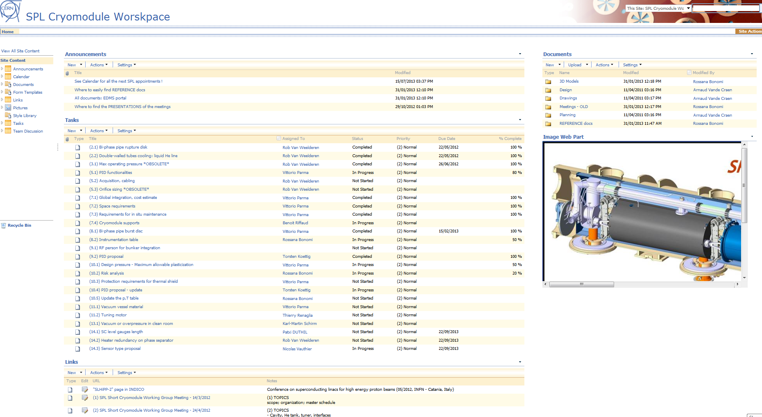
SPL Working Group
12
Scientific secretary of the SPL Working Group Meeting
Monthly meeting organization; Minutes recording; Actions/tasks follow-up; Workspace management

Slide 13
SPL Project at CERN
13
Design/construction/test short version of Superconducting Cryomodule for High Power Proton beam (SCM)
Testing of 704 MHz SC cavities
SCM foreseen to be built/tested in 2014-15
Design/production shared btw CERN, CEA, CNRS and industry

Slide 14
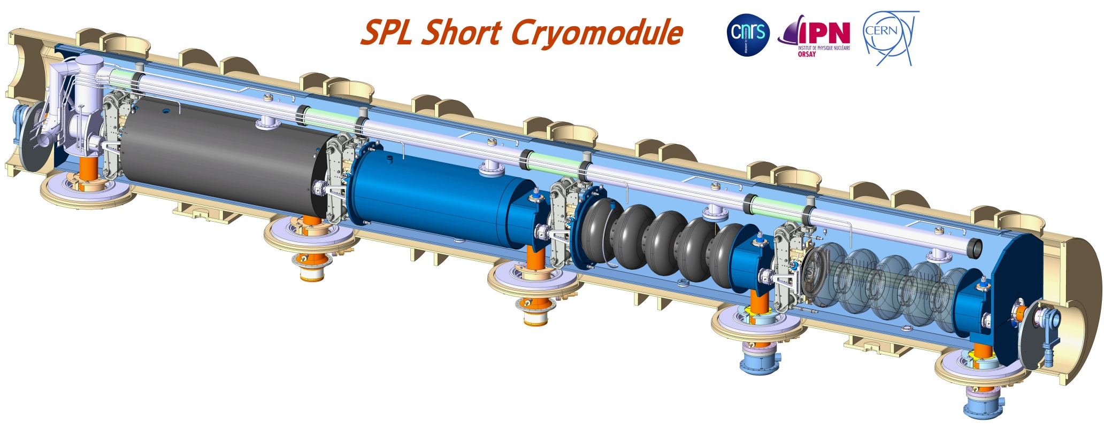
SPL Project at CERN
14
  SPL SCM – Superconducting Proton Linac, Short Cryomodule
  4 MW beam power accelerated up to 5 GeV
  Can be used for neutrino factories, etc.
Intercavity supports
Design: CERN
Production: CERN
Test: CERN (N₂)
He tank
Design: CERN
Production: Industry (CEA)
SC Cavities
Design: CERN
Production: 5-cells, 1-cell in Nb and Cu produced by CERN and industry
Mag. Shield
Design: CNRS (CERN spec)
Production: Industry
Tuner
Design: CEA
Production: CEA
RF Power Coupler
Design: CERN (BE-RF, TE-MSC)
Production: CERN
Test: CEA (He, RF); CERN (N₂)
Vacuum vessel
Design: CNRS
Production: Under procurement
(construction before April 2015)
From SRF2013, Paris, France

Slide 15
Summary
15
Collaborations
  TERA – CLIC (CERN), Switzerland
  ESS, Sweden
  CNRS, France
Contributions
  Thermal design, Test coordination / Set-up, Data analysis

Slide 16
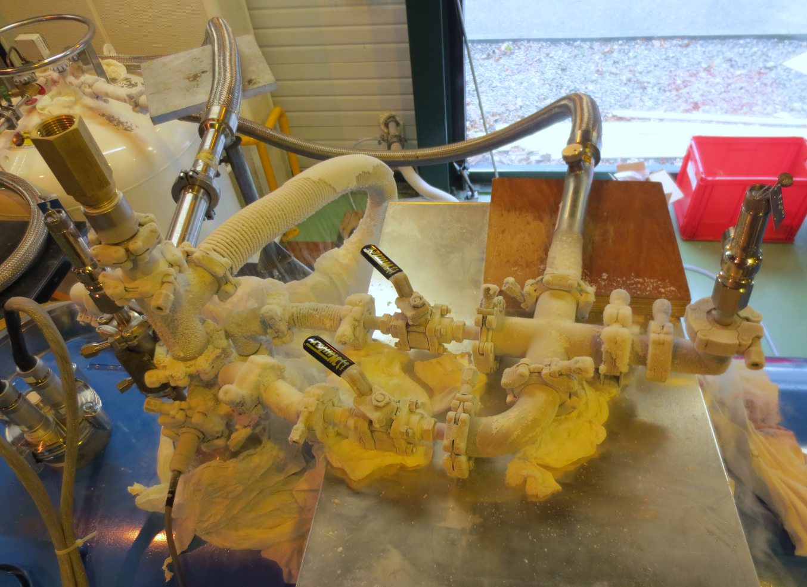
Thank you !

Slide 18
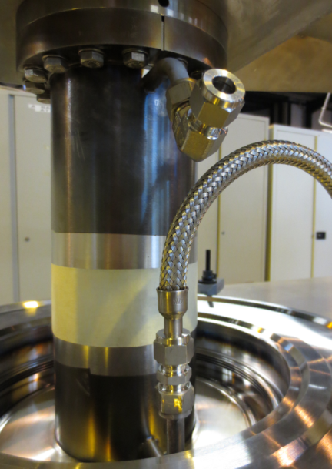
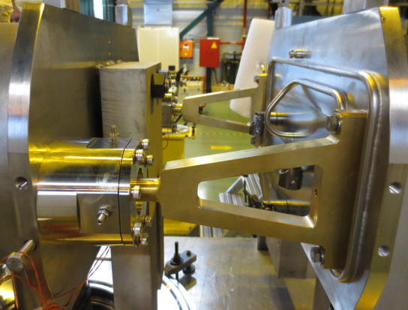
SPL Supporting System
18
Features
  External conductors of main RF couplers (DWT)
  + Intercavity-supports (ICS)
  => No space frame, no rods
Requirements
  Allow for longitudinal and transverse thermal contractions
  Ensure low heat loads to the cold mass => Active gas cooling of DWT

Slide 19
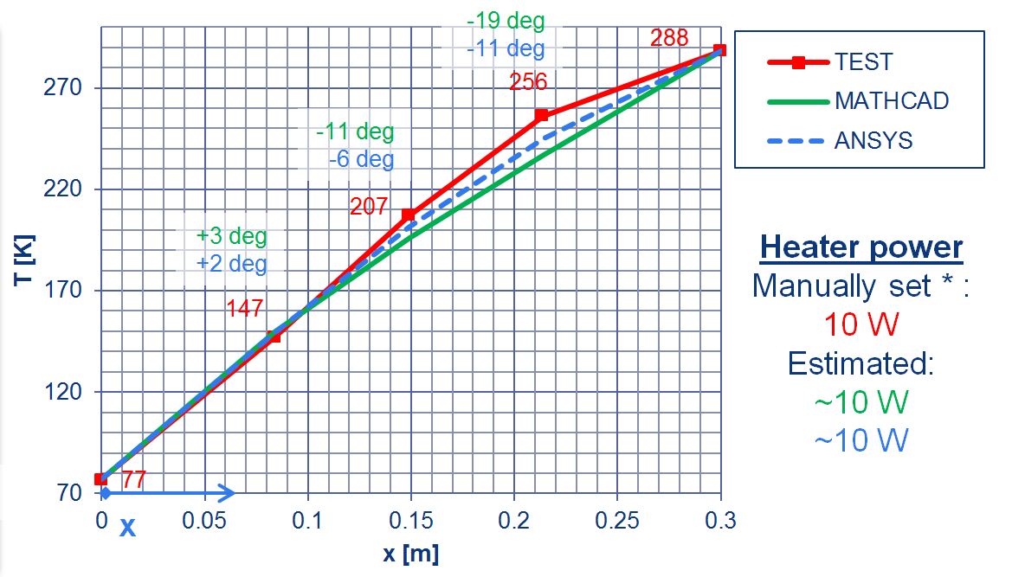
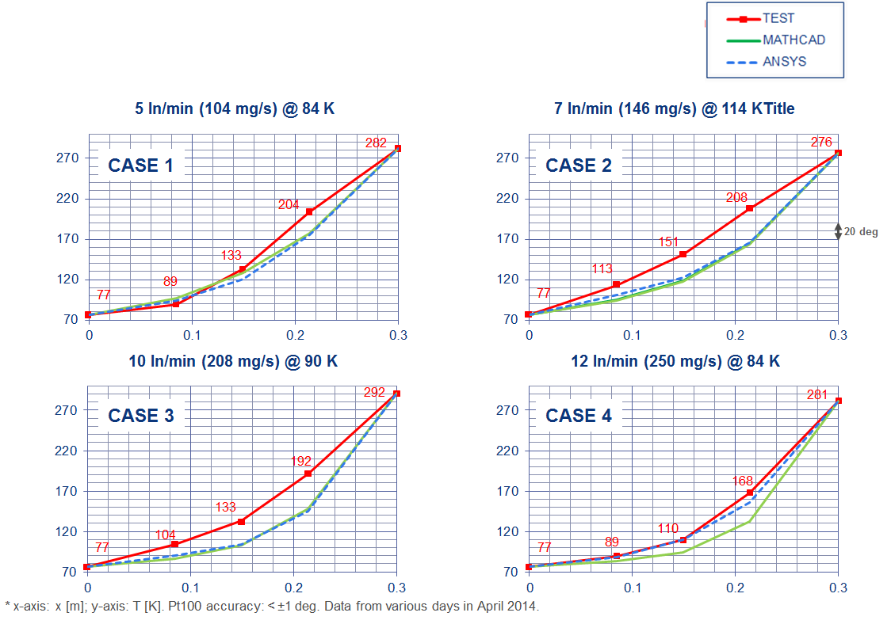
Mock-up
19
…

Slide 20
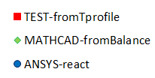

DWT – Exchanged Powers *
20
Tgas,in = 84 K 114 K 90 K 84 K
TRANSIENT NOT OVER
(cases 2, 3)
Heat to Bath
General good agreement; Small loads already with low flows;
Strongly depends on gas T at inlet
NO GAS COOL
Heater Power
Good agreement for fully developed steady conditions; Increases with flow
* Pt100 accuracy: < ±1 deg; Thermocouple type E accuracy: < ±2 deg. Data from various days in April 2014.

