Slide 1
ESS weekly meeting (2022 W42)
M. Zhovner et al

Slide 2
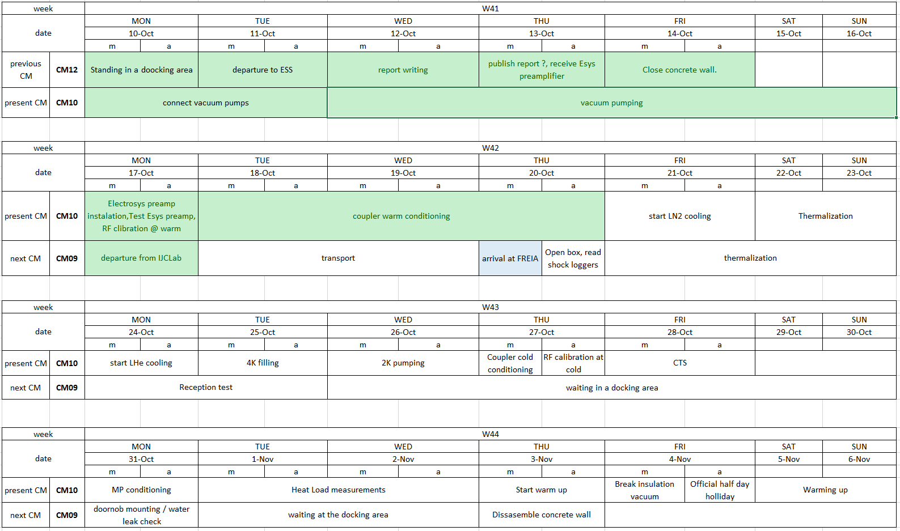
CM10_2: General planning update
CM09 arrival to FREIA for 2nd run.

Slide 3
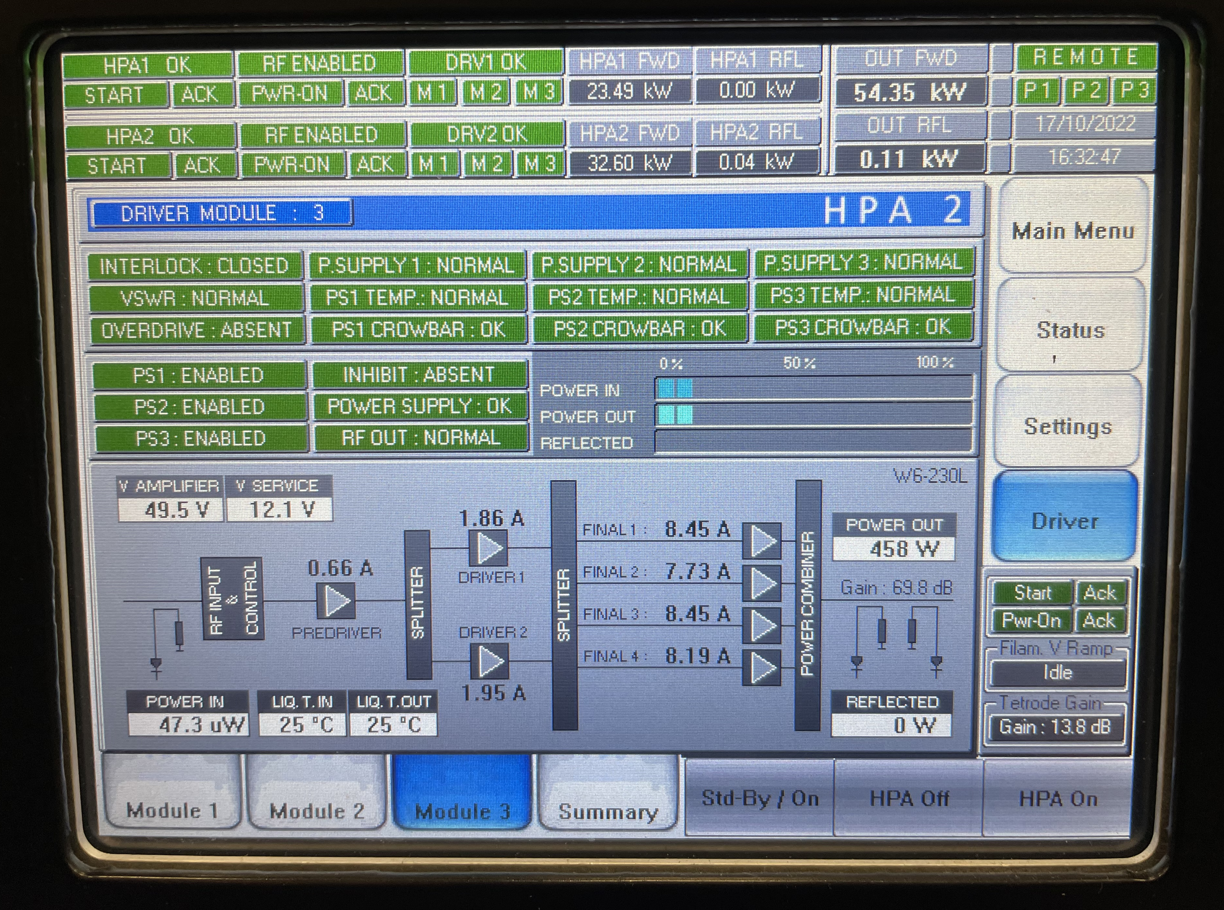
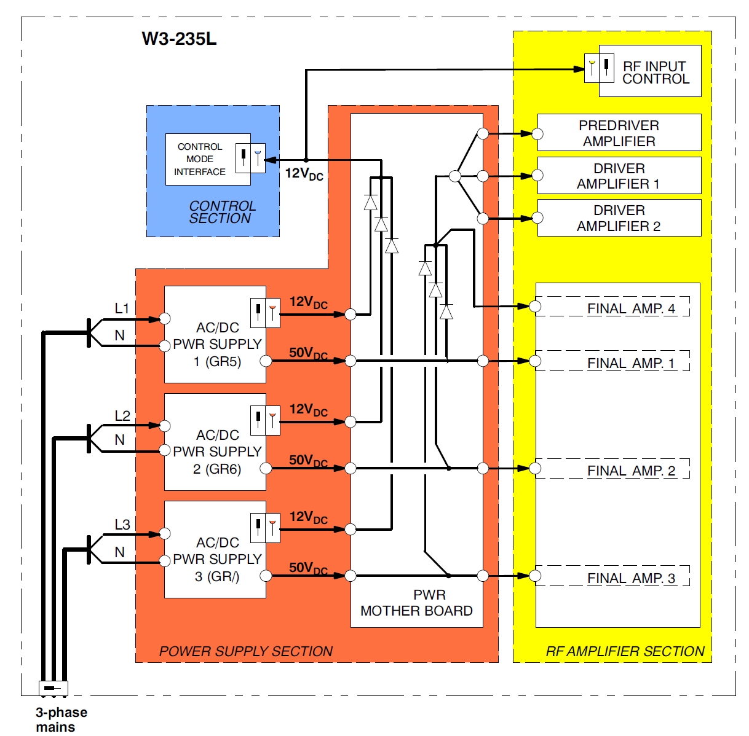
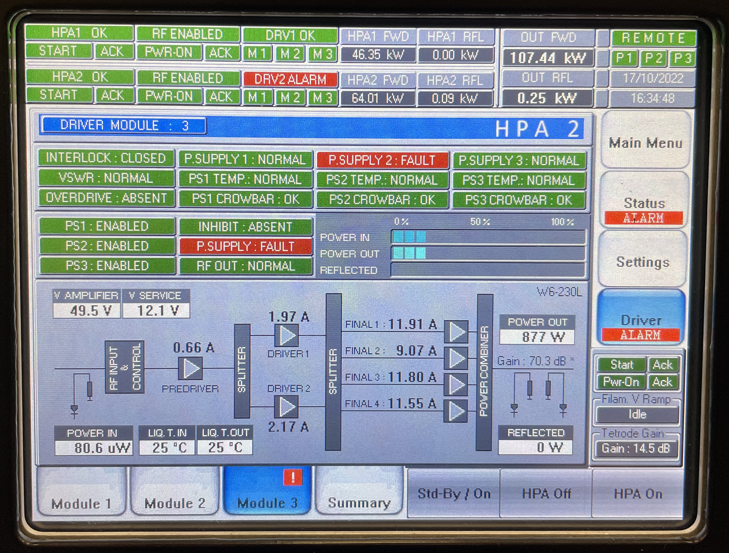
Preamplifier arrival and maintenance
Was replaced PS2 and PS1.
E-sys connected to the load.
At low power (~10kw) all final stages was OK and consume same current from PS (~2A).
When power was increased to 50kW, Final2 current consuming started deviate and decrease around 10% from others.
When power was increased to 110kW, Final2 start show P.SUPPLY.FAULT error.
After some time error was cleared itself but current consuming of Final2 is degraded down to 2A.

Slide 4
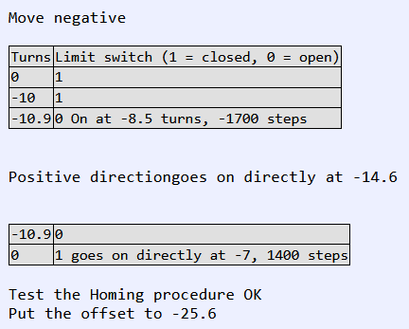
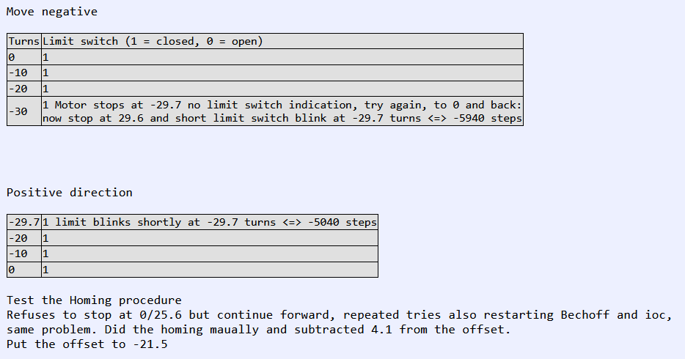
CM10 2nd: CTS at home position
Using Beckhoff driver. Go back by 10 turns at a time until Low limit goes on MTR(1/2).
Then it is not possible to continue negative.
Use the offset variable ESSPMAC:MTR(1/2).OFF to start at 0

Slide 5
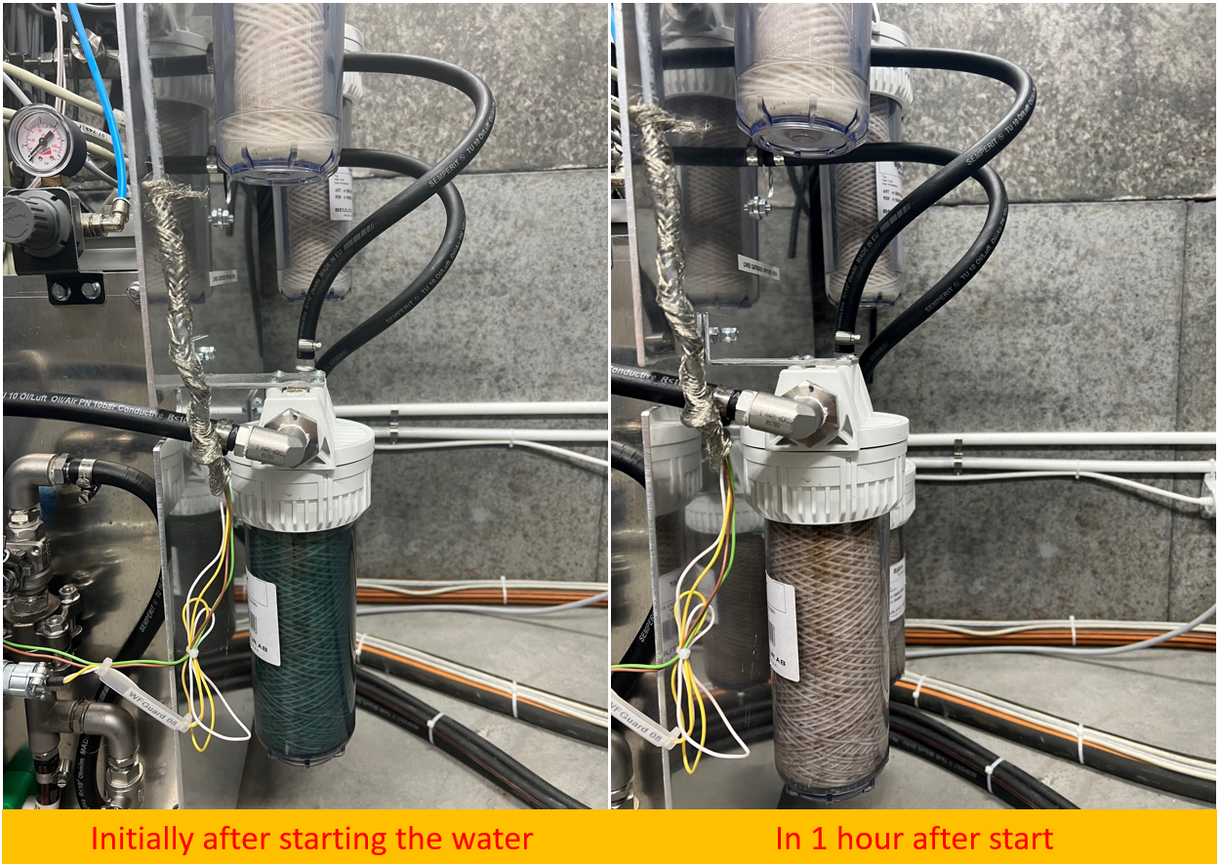
CM10 2nd: Coupler cooling line
When we connecter and run water circulation in couplers cooling system – Filter in coupler 2 return line was colored to blue. Probably by cupper oxidation.
We need to improve the coupler draying procedure!
Also, during warm FPC conditioning the water flow guard was stacked in same line.

Slide 6
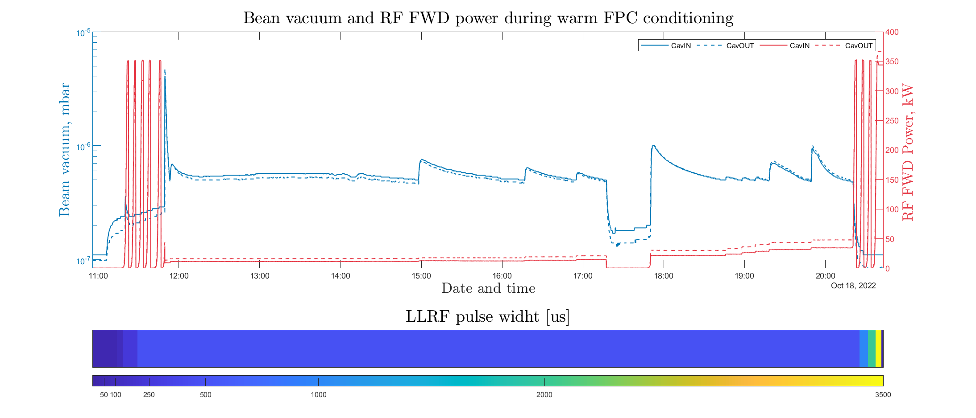
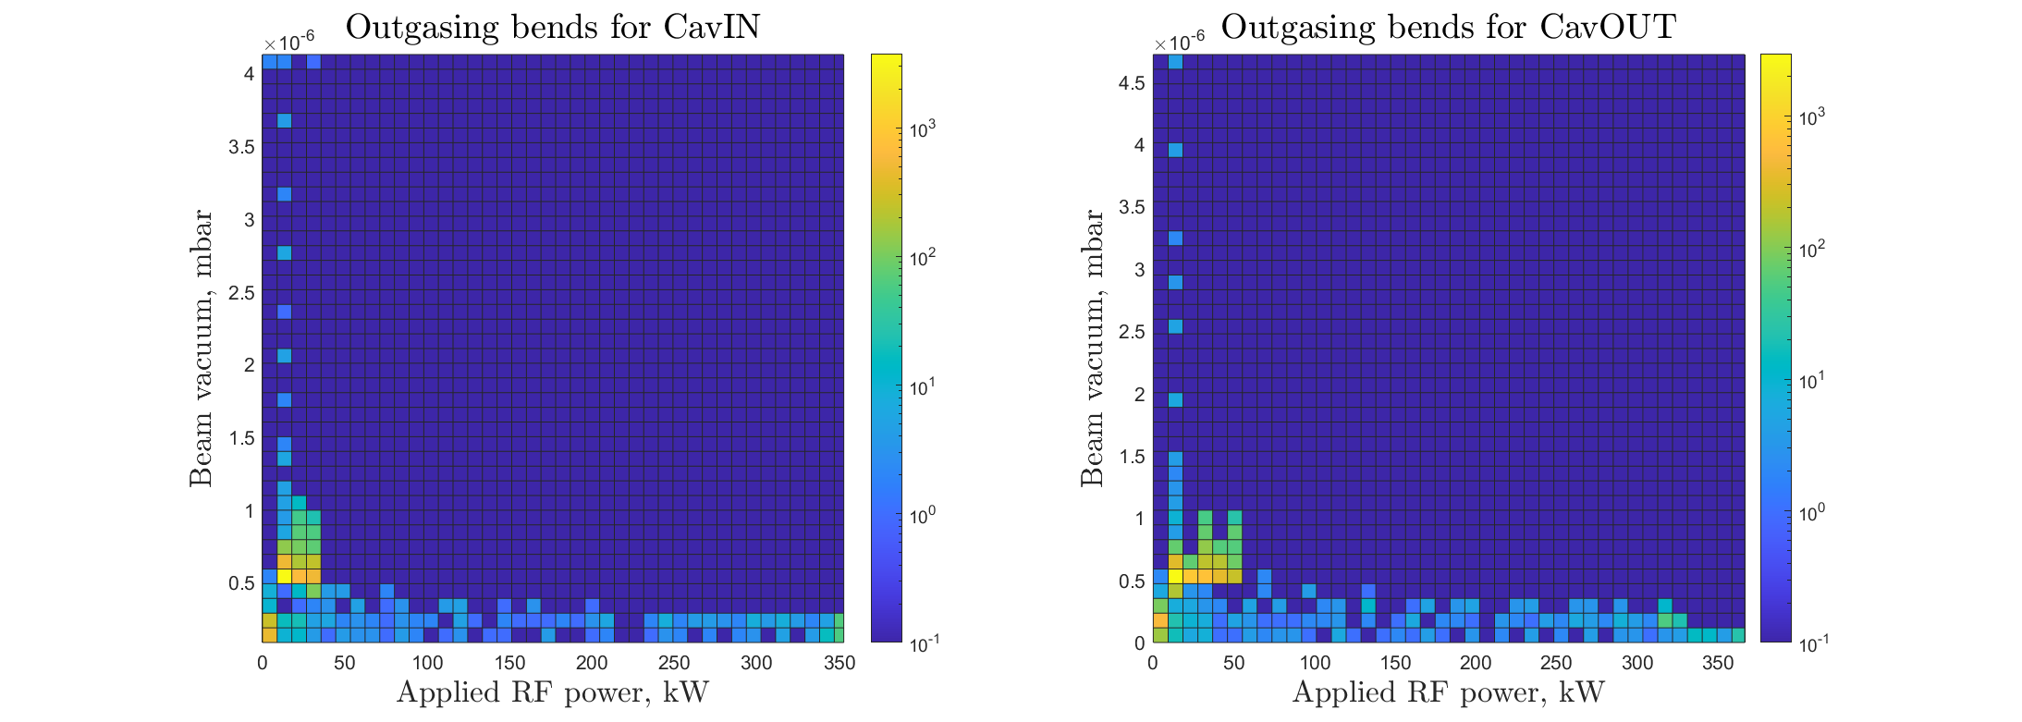
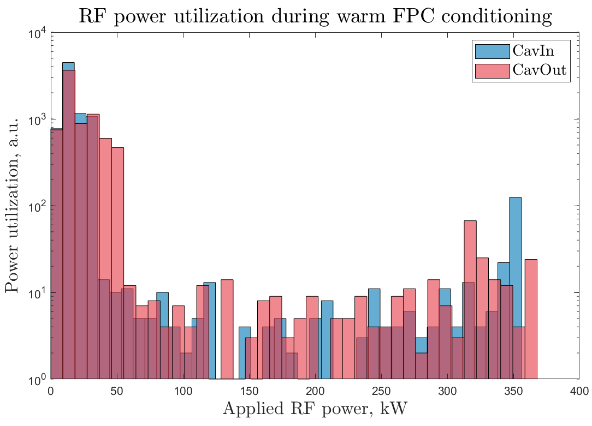
CM10 2nd: warm coupler conditioning
It was 3rd coupler conditioning for this CM
Software interlock tripped
Conditioning time: ~10h
Water guard in coupler cooling line

Slide 7
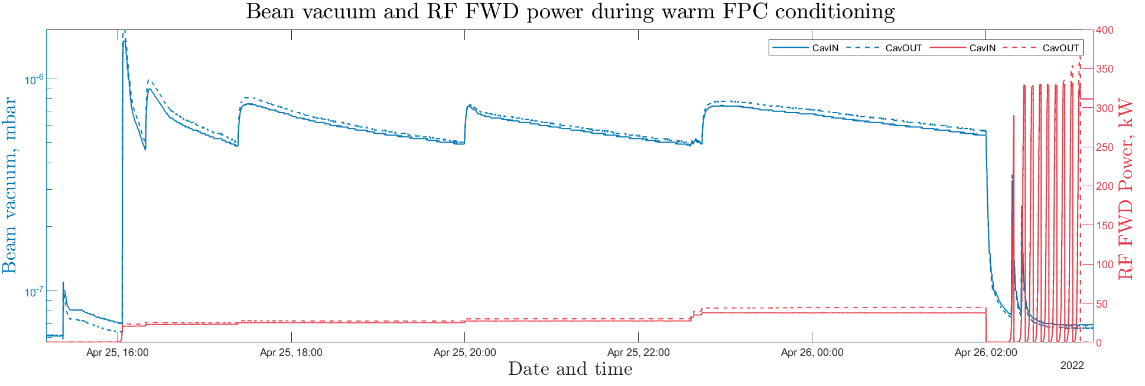
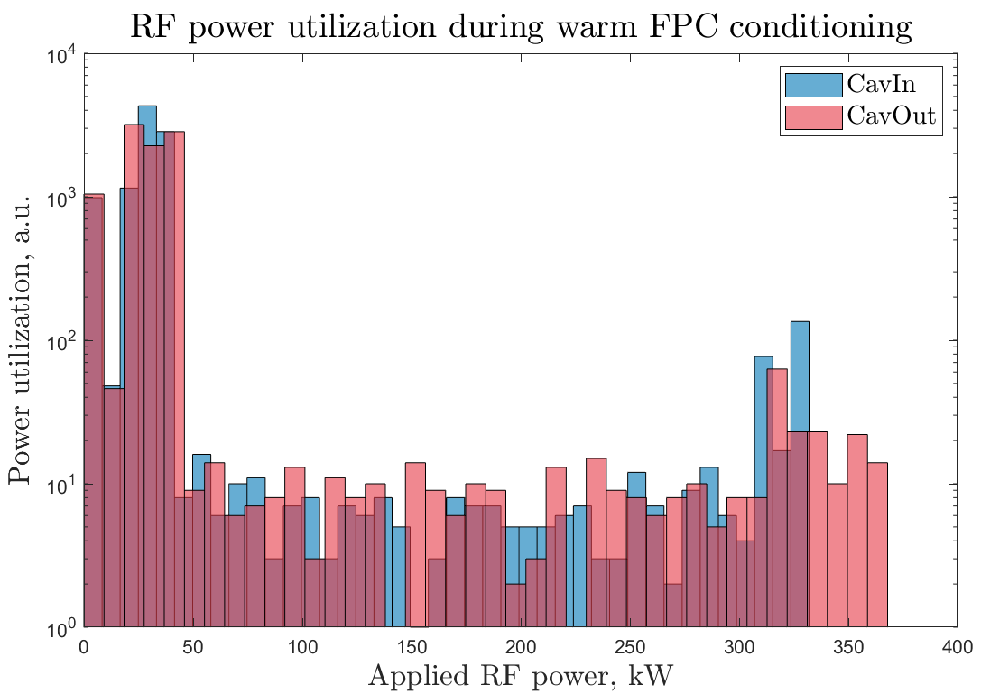
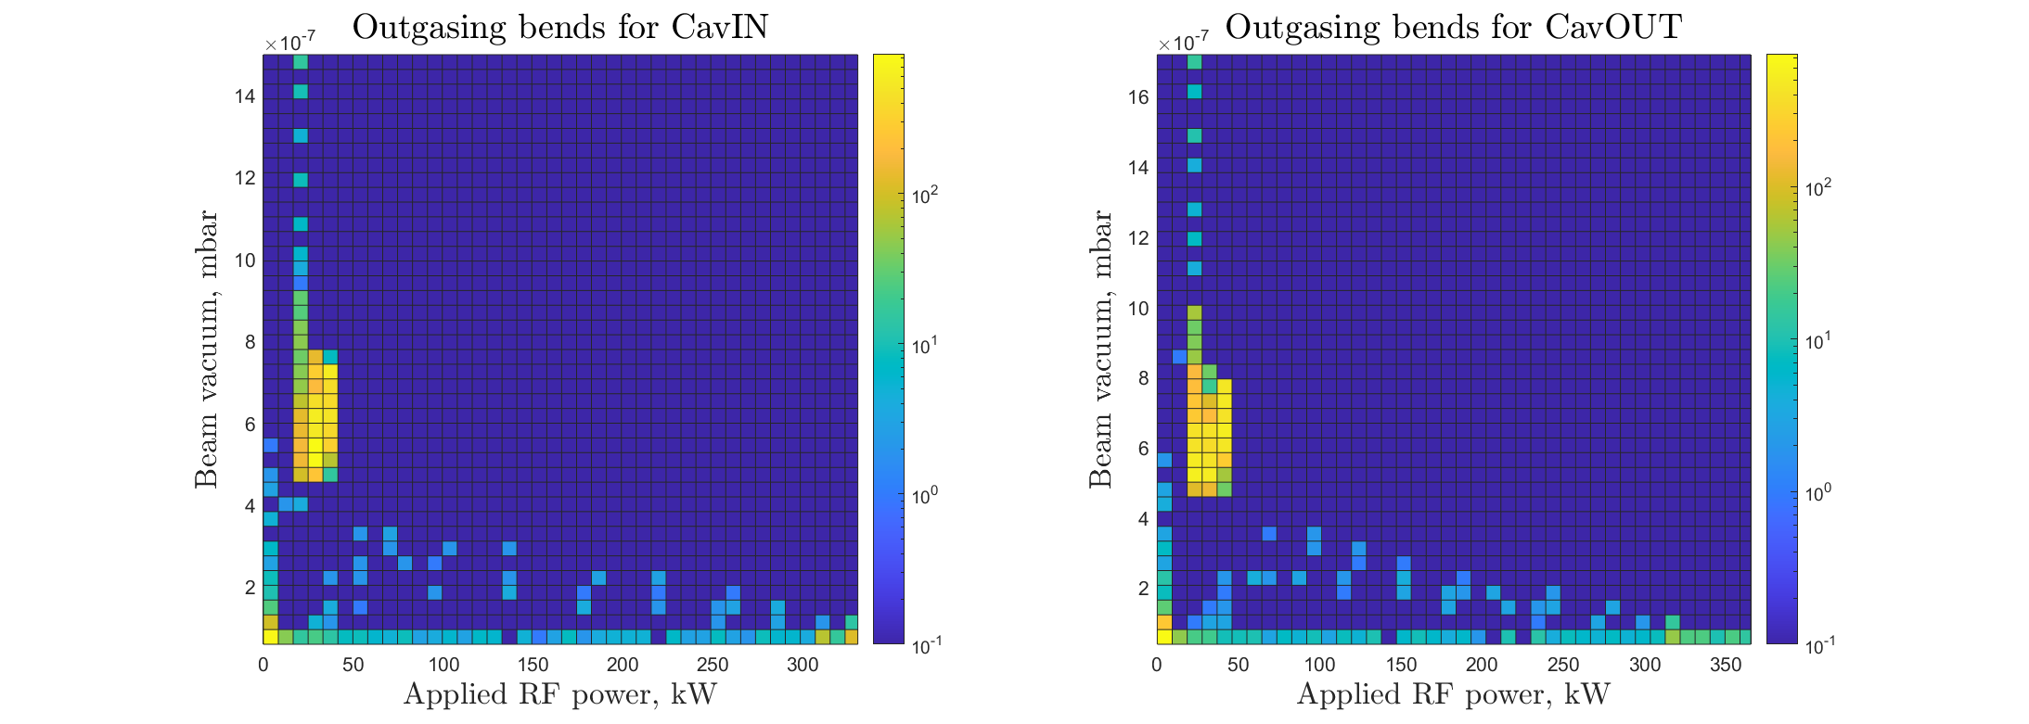
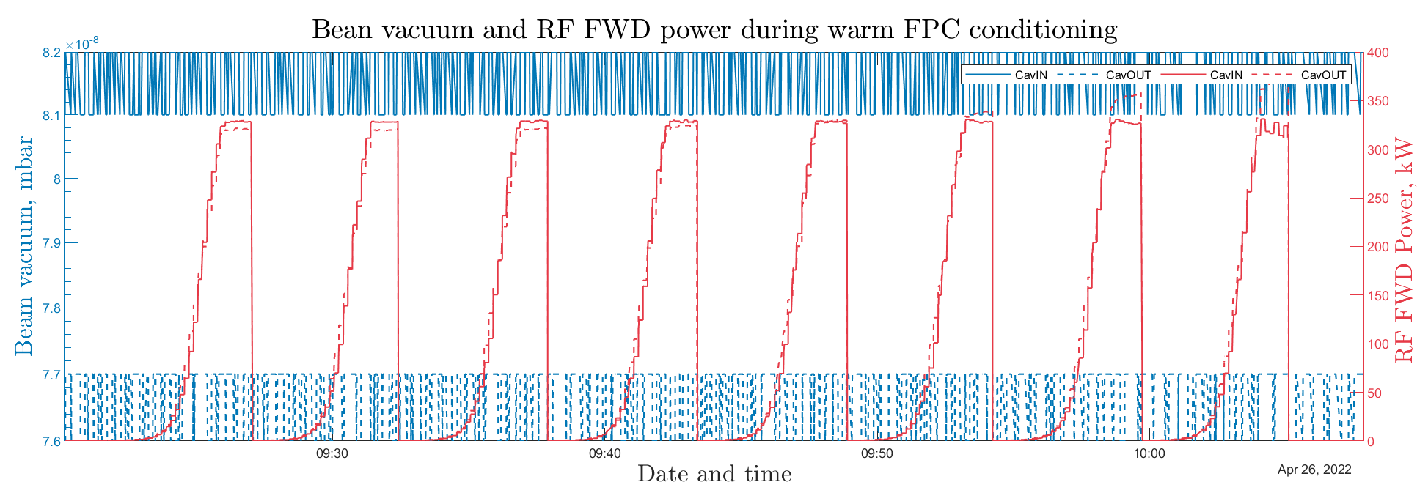
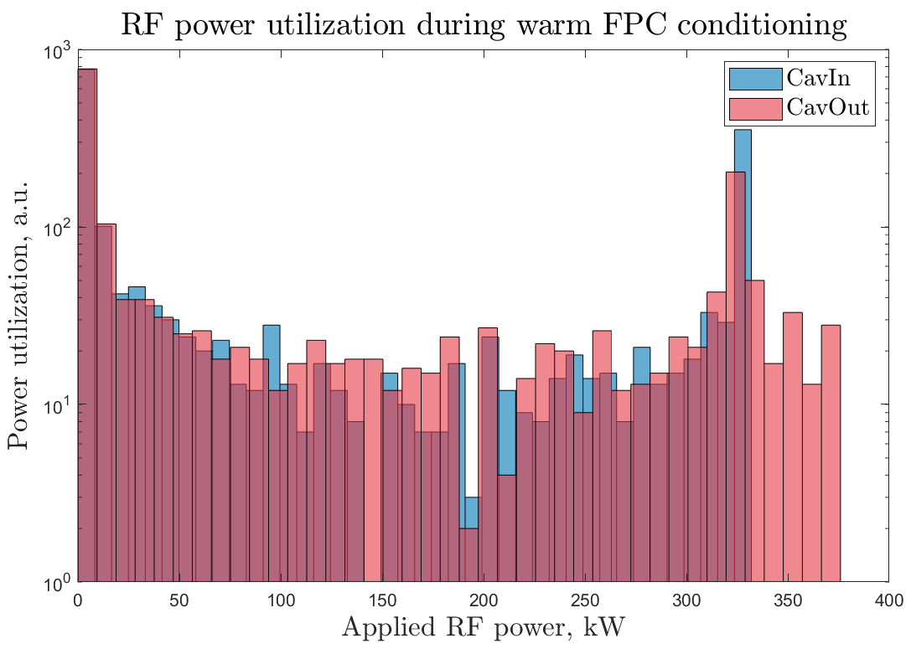
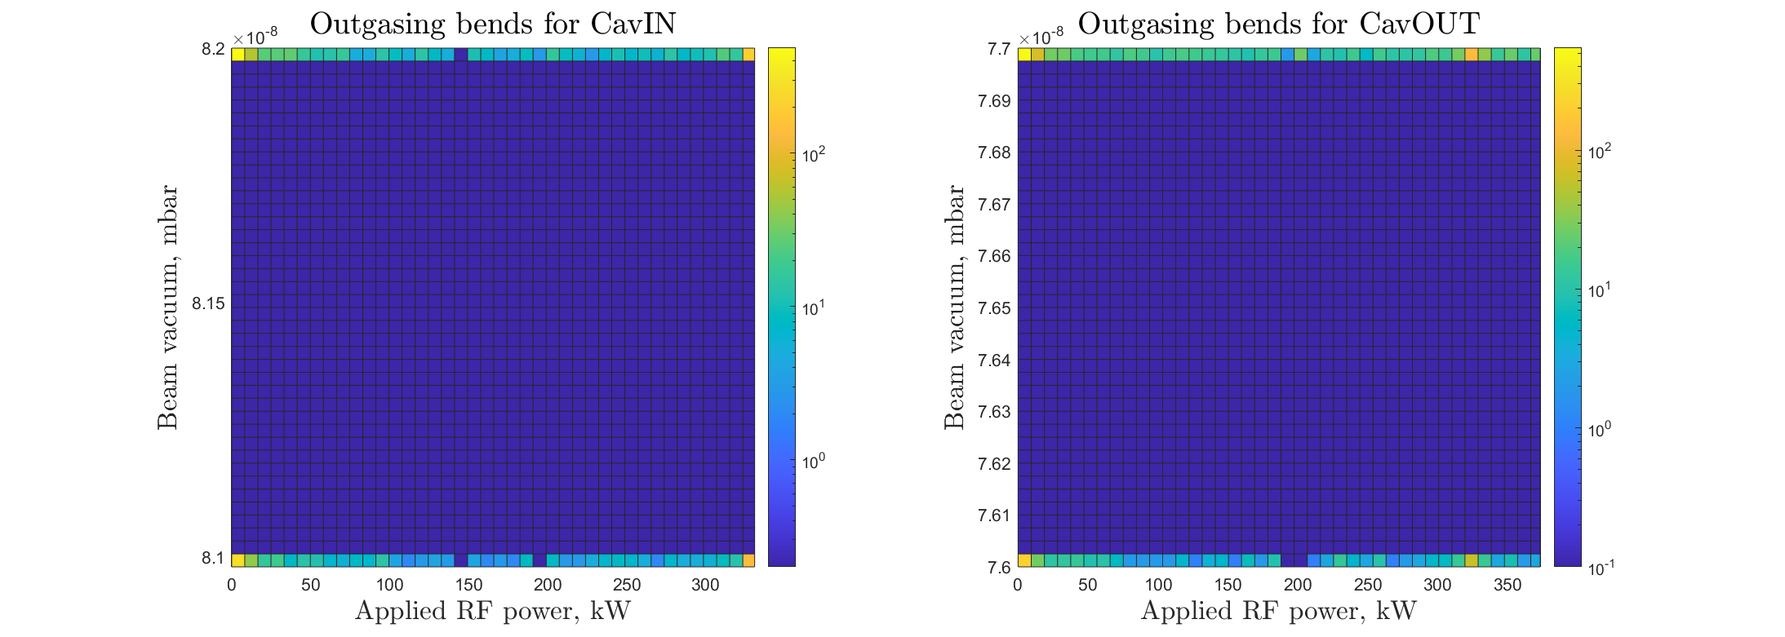
CM10 1st vs 2nd run of warm FPC cond.
CM10 1st run 1st conditioning ~12h + 1h autocycling
~6E-7
mbar
~6E-7
mbar
<50kW
50us
CM10 1st run 2nd conditioning after warmup (stack stepper motor) ~
~8E-8
mbar
~7.6E-8
mbar
CM10 2nd run ~10h
500us
<60kW
~6E-7
mbar
~6E-7
mbar

Slide 8
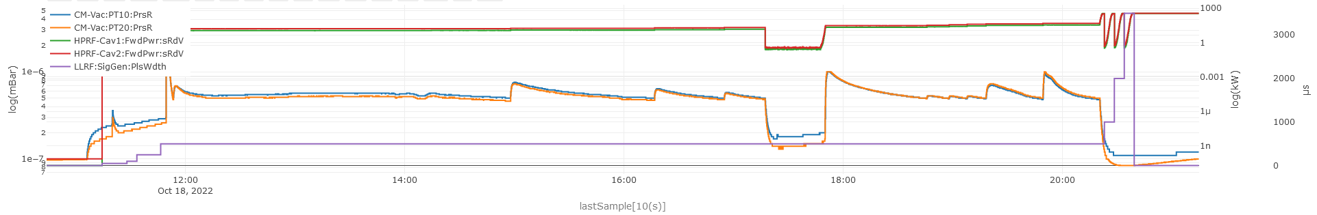
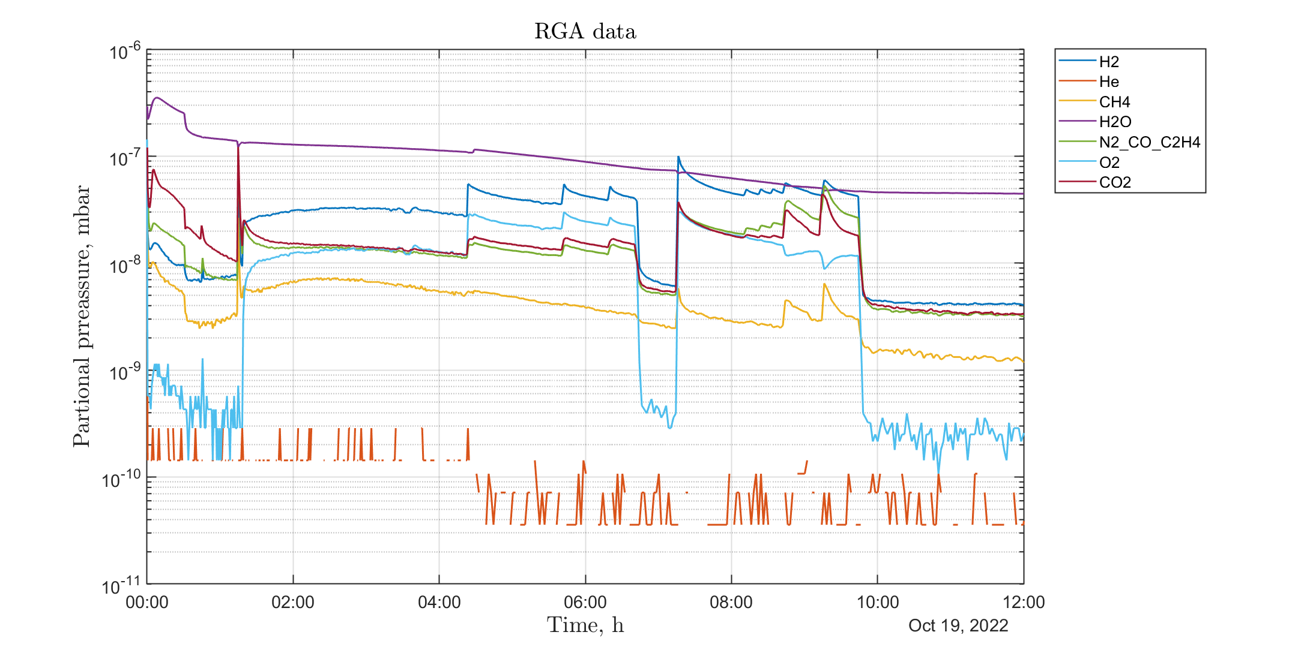
CM10 2nd RGA data
O2 started anticorrelate with other gases (23 and 33 kW)

Slide 9
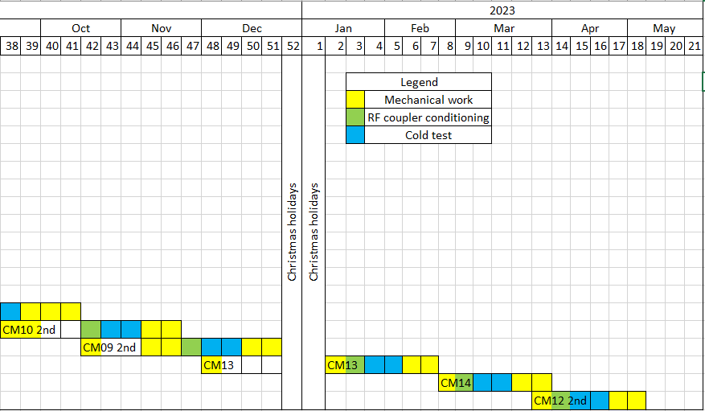
CM10, CM09, CM13 Planning
CM12 arrived to ESS.
CM10_2nd
CM13 arrival date?

Slide 10
Backup slides

Slide 11
CM12: CERNOX issue investigation
TT04 … TT09 showed higher temperature then expected from pressure reading of He circuit.
Was performed swapping of sensor reading channels - Same result

Slide 12
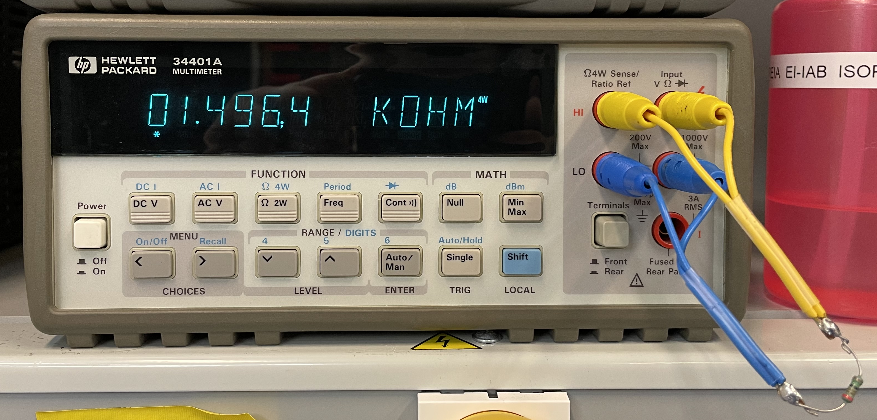
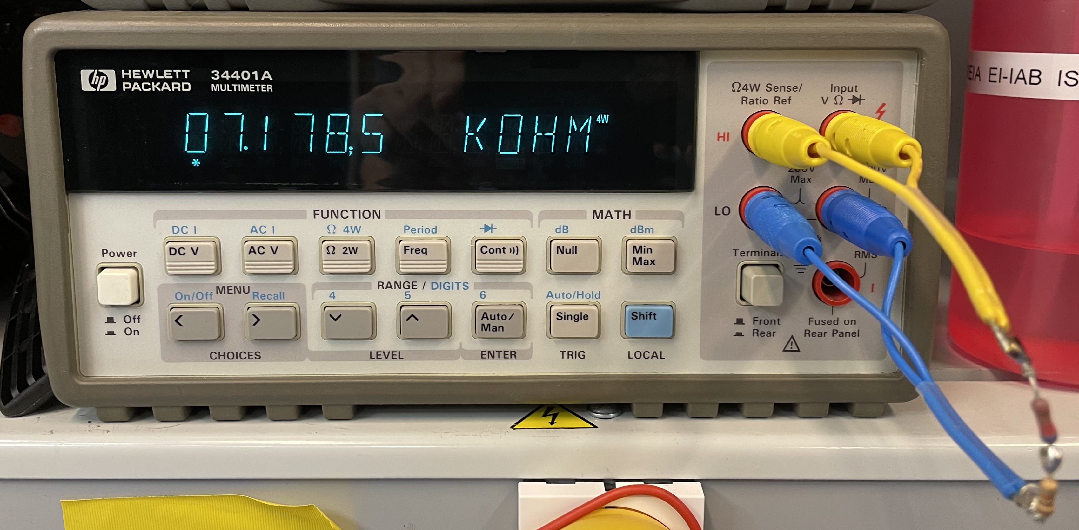
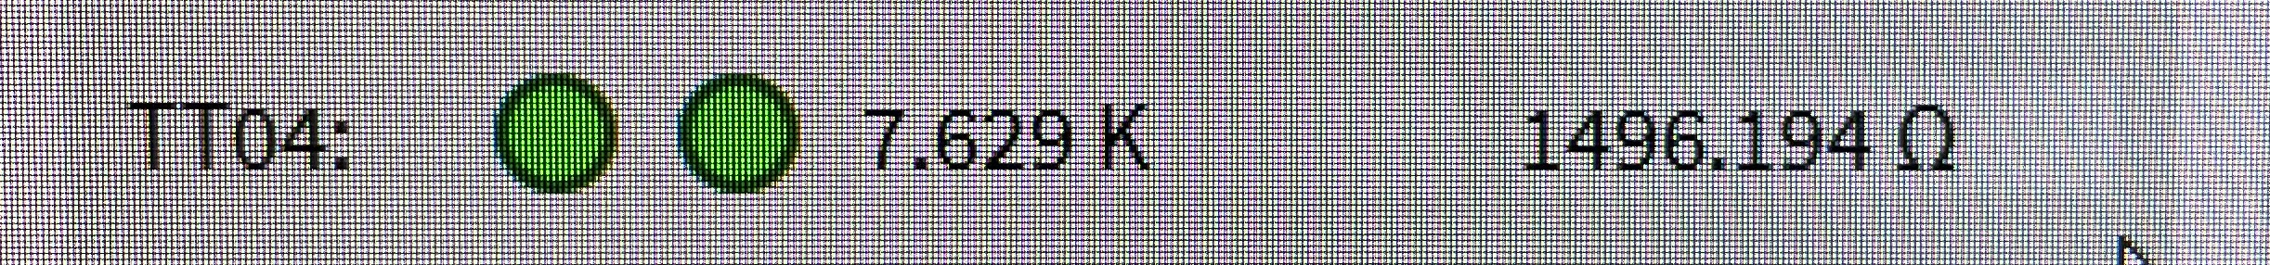
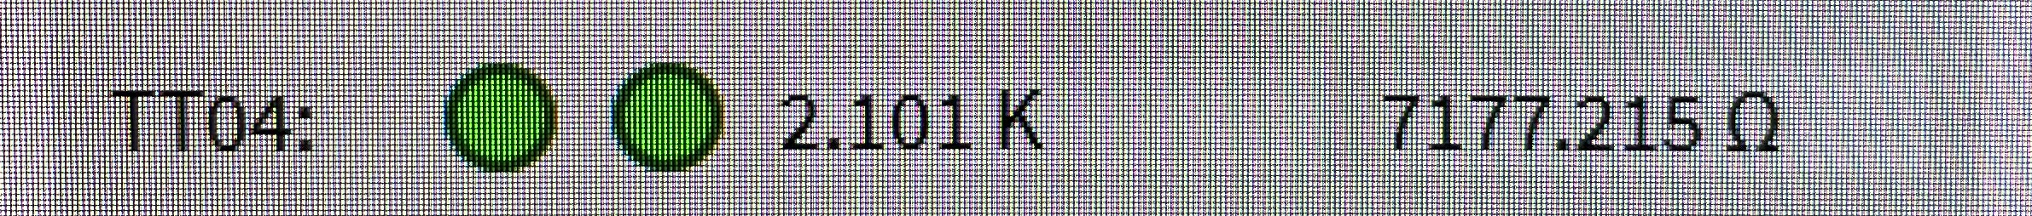
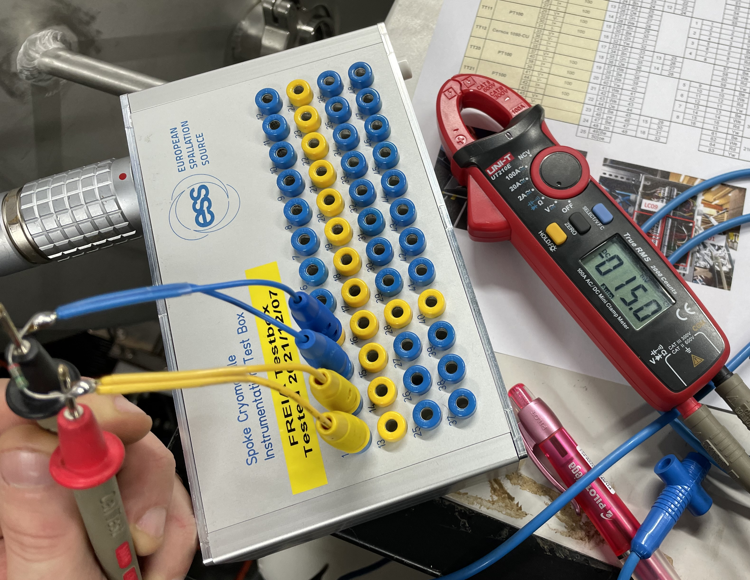
CM12: Constant resistors connected to CABTF (TT04 channel)
1.5 kOhm
7.2 kOhm
Resistance measured by 4W multimeter
Resistance measured by control system
Resistors connected to the end of signal line through ESS test box.
Voltage drop on resistors 15 mV.
Current through1.5 kOhm is 10 uA.

Slide 13
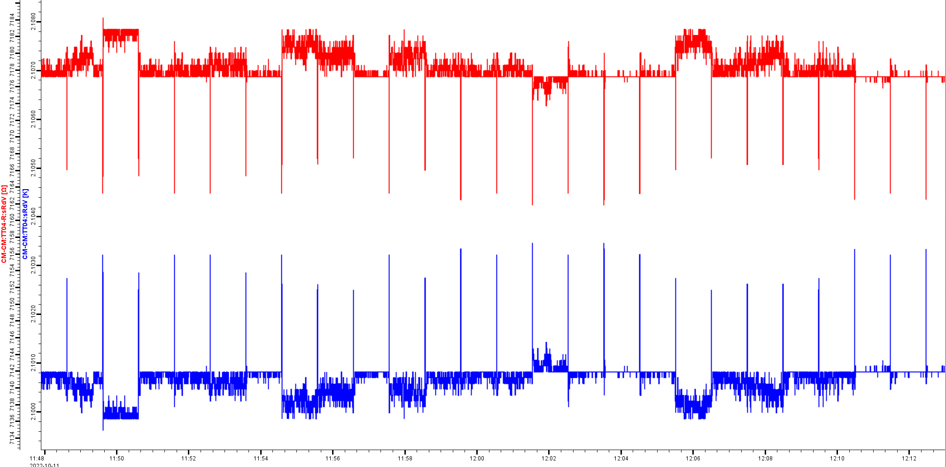
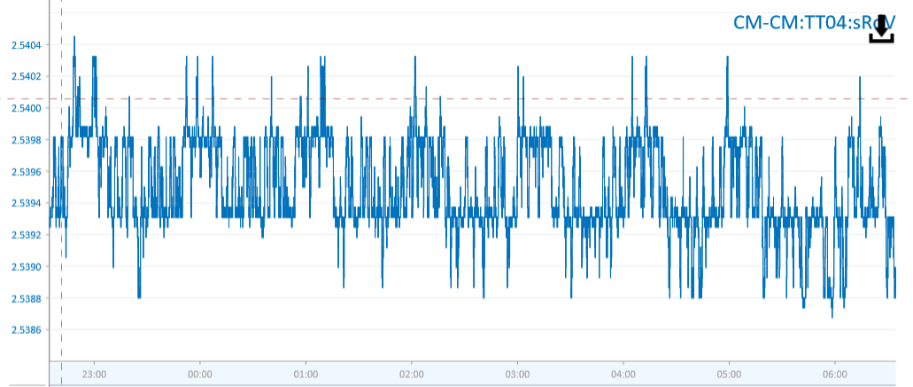
CM12: Constant resistors connected to CABTF (TT04 channel 7.2kOhm)
Resistance
Temperature
Only one “sensor” connected to CABTF.
Every minute the drops in resistance are visible.
No clear visible spikes in archive data
22 Sep 2022. ~2.5K

Slide 14
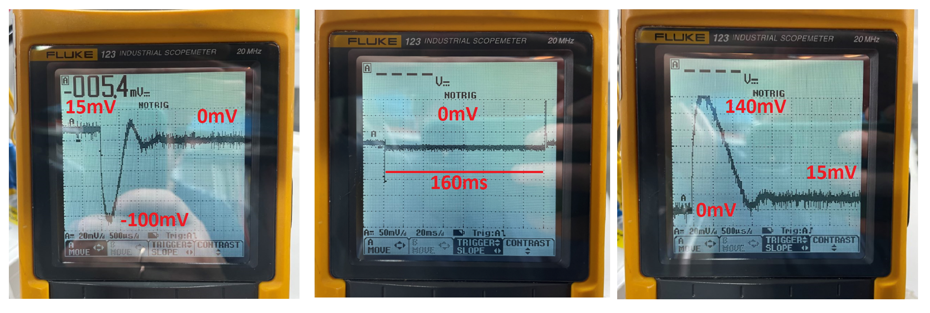
CM12: Constant resistors connected to CABTF (TT04 channel)
Closer looks to change of voltage across resistor
Voltage across resistor drop down +15mV → 0mV for 160ms with 1Hz repetition.
Visible transient effect: +15mV→ -100mV → 0mV; 0mV → +140mV → +15mV.
Goal: Compare measurement result with another CABTF unit. More carefully look to resistance value at real operation.

