Slide 1
ESS weekly meeting (2022 W43)
M. Zhovner et al

Slide 2
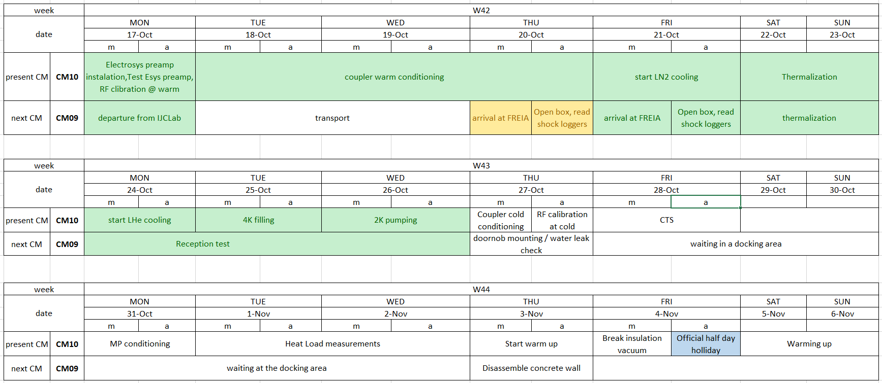
CM10_2: General planning update
CM09 arrival to FREIA for 2nd run.

Slide 3
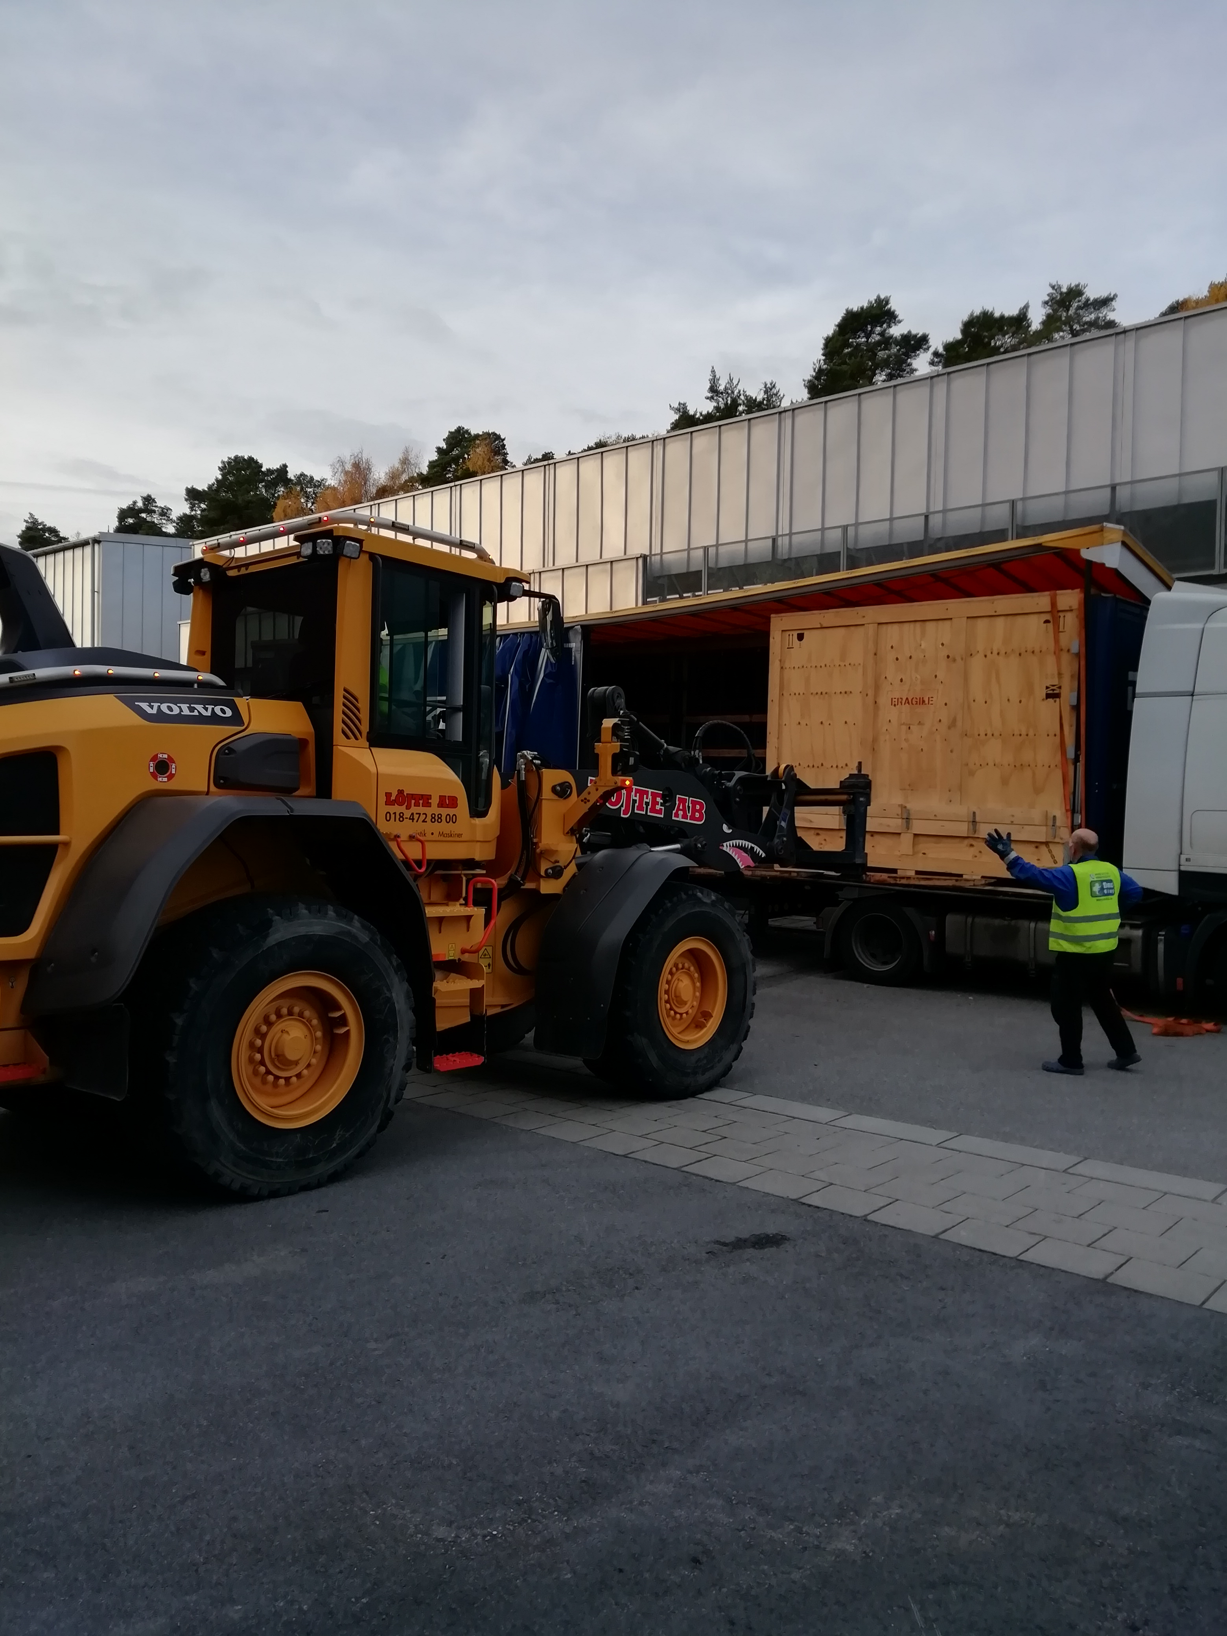
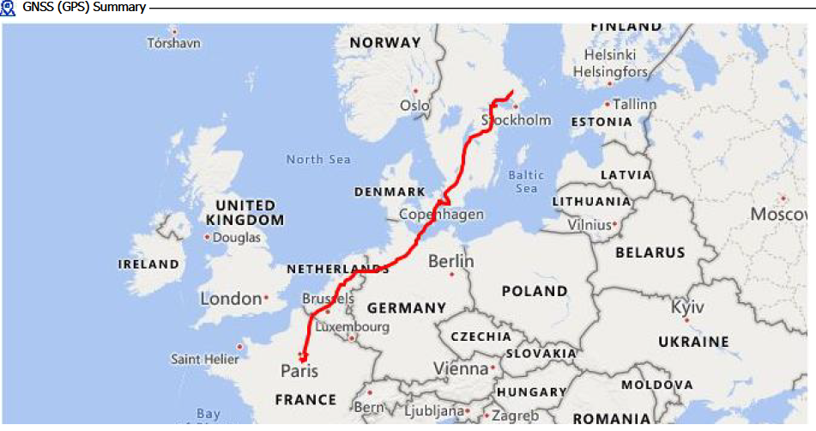
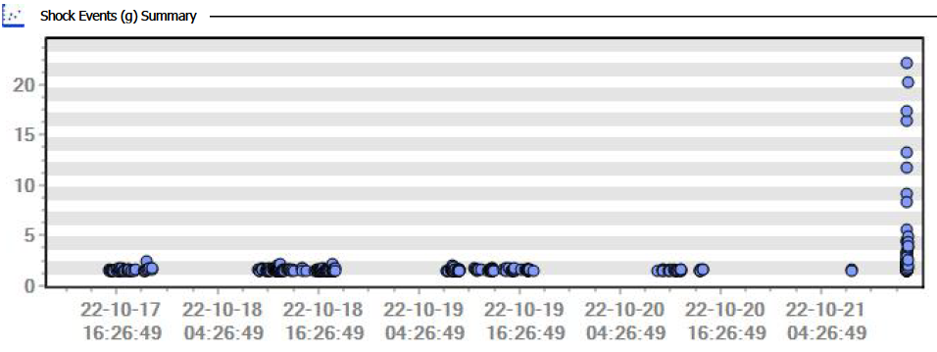
CM09 2nd Arrive to FREIA

Slide 4
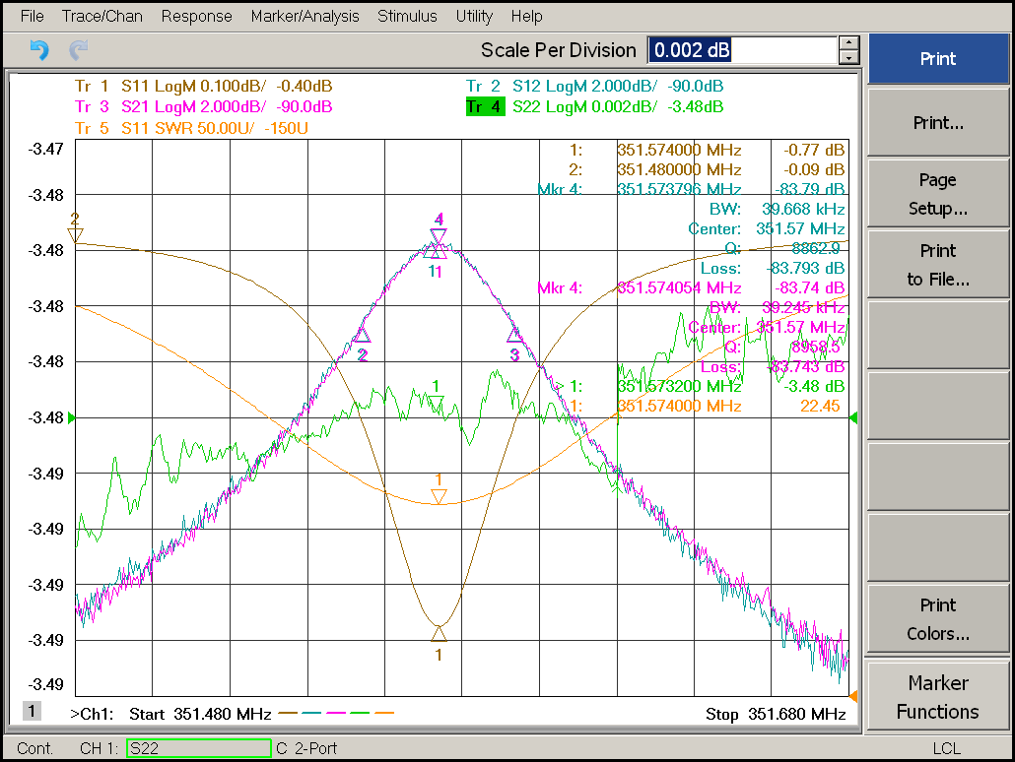
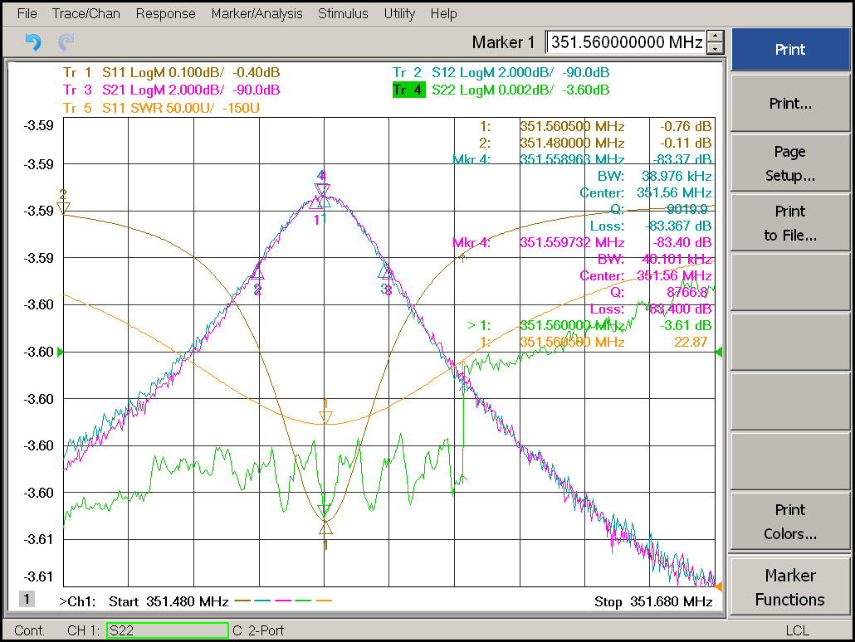
CM09 2nd Reception test
CavIN
CavOUT
fc = 351.574 MHz
BW = 39.67 kHz
S12/21 = -83.8 / -83.7 dBm
fc = 351.559 MHz
BW = 38.987 kHz
S12/21 = -83.4 / -83.4 dBm
All sensors and internal devises looks good.
No shorts to the ground.

Slide 5
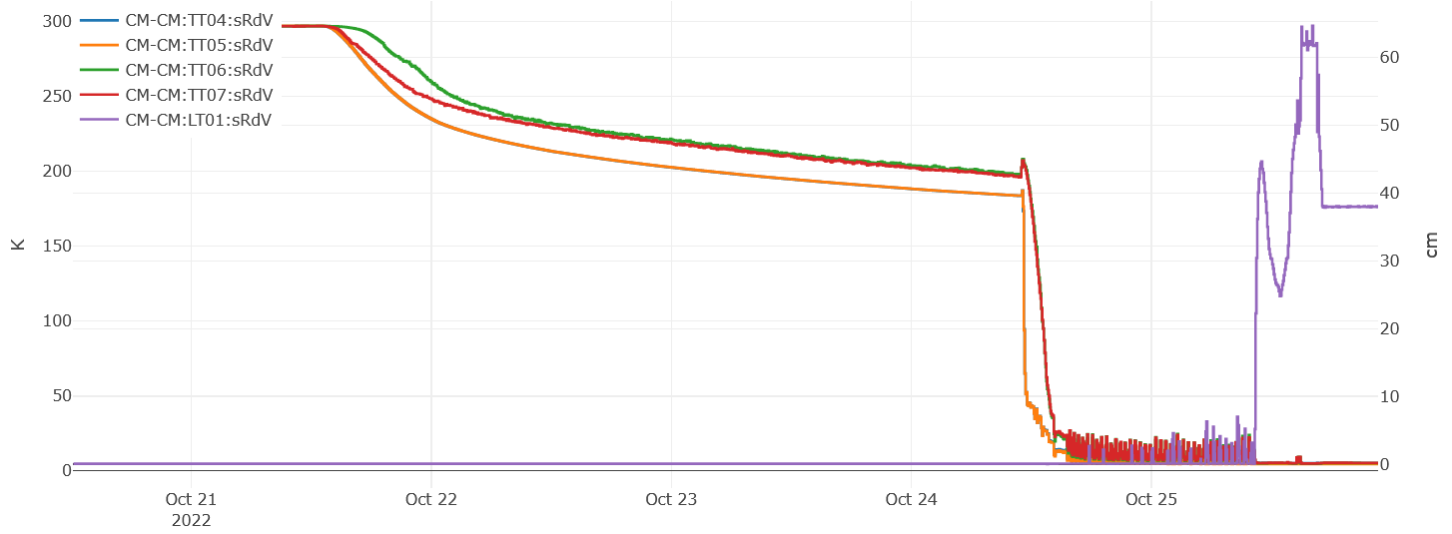
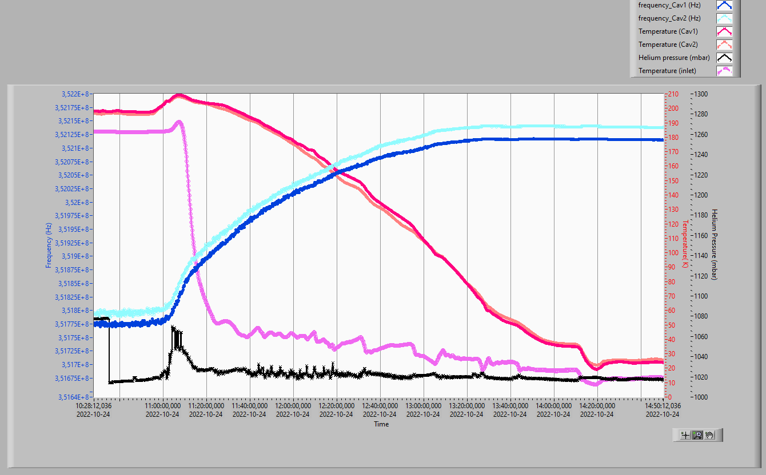
CM10 2nd 4K cooldown
N2 precooling
He cooling with flow limitation
CavIN: 352,138400 MHz
CavOUT: 352,114500 MHz
Spend weekend for N2 precooling.
Start He cooldown with limitation of filling rate to fill up LHe Dewar.
To avoid fluctuation of He gas flow -> LT01 setpoint = 38 cm

Slide 6
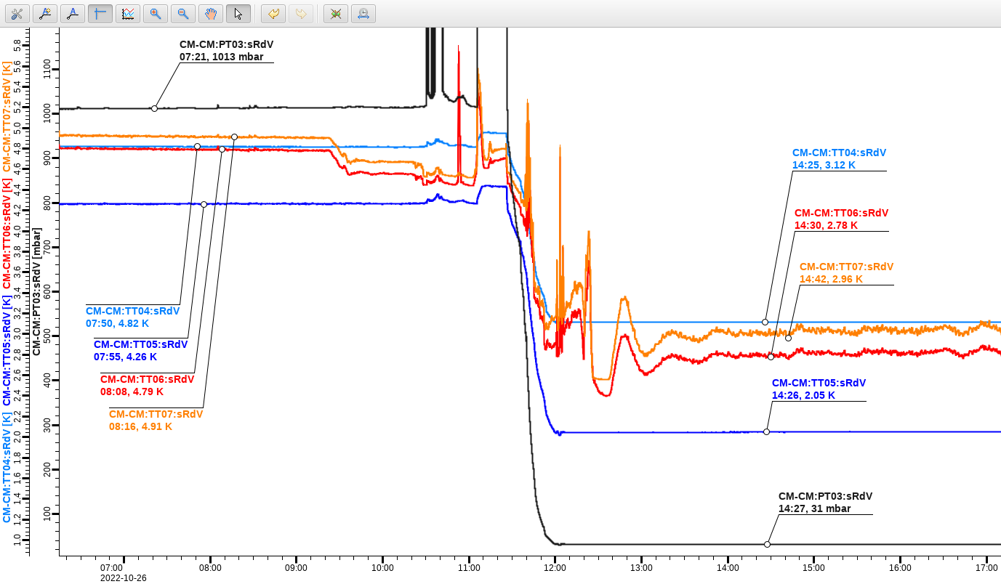
CM10 2nd 2K pumping

Slide 7
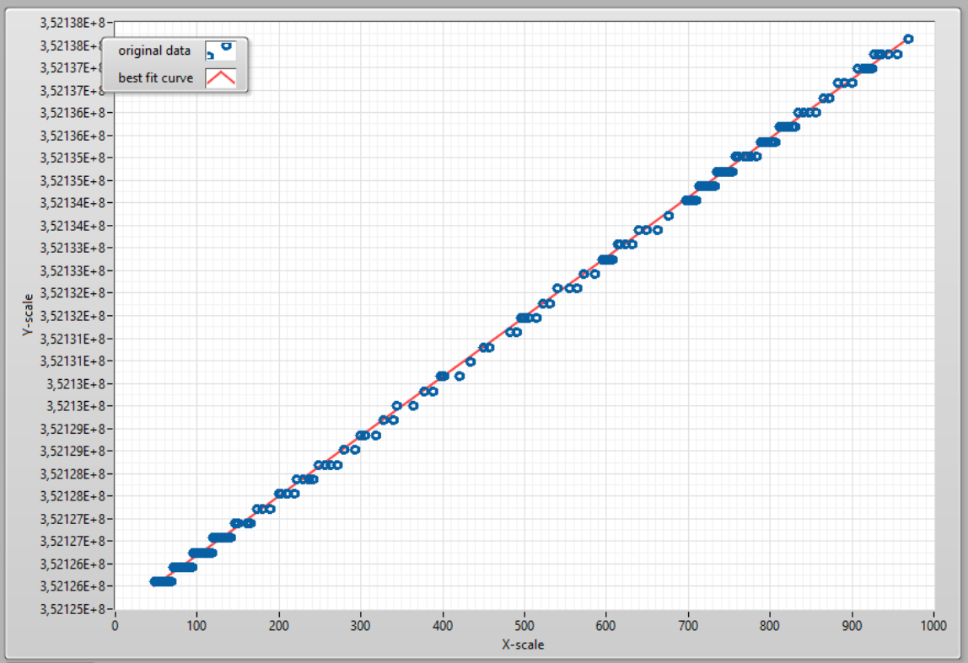

CM10 2nd f vs P
CavIN
CavOUT
13,193 Hz/mbar
16,250 Hz/mbar

Slide 8
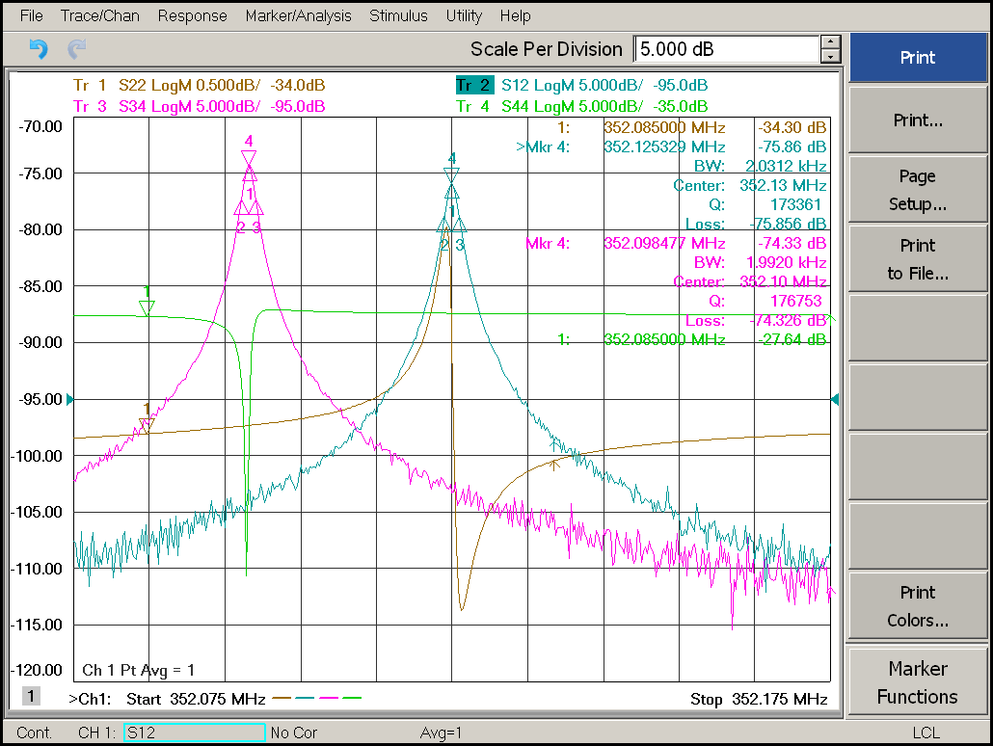
CM10 2nd Cavities at 2K

Slide 9
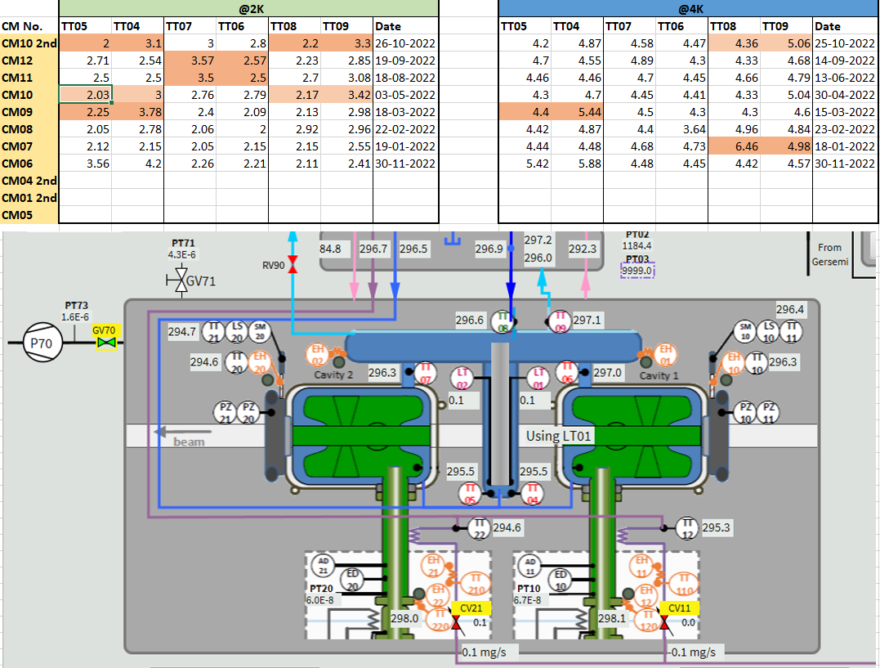
CM10 2nd Cavities temperatures at 2K and 4K

Slide 10
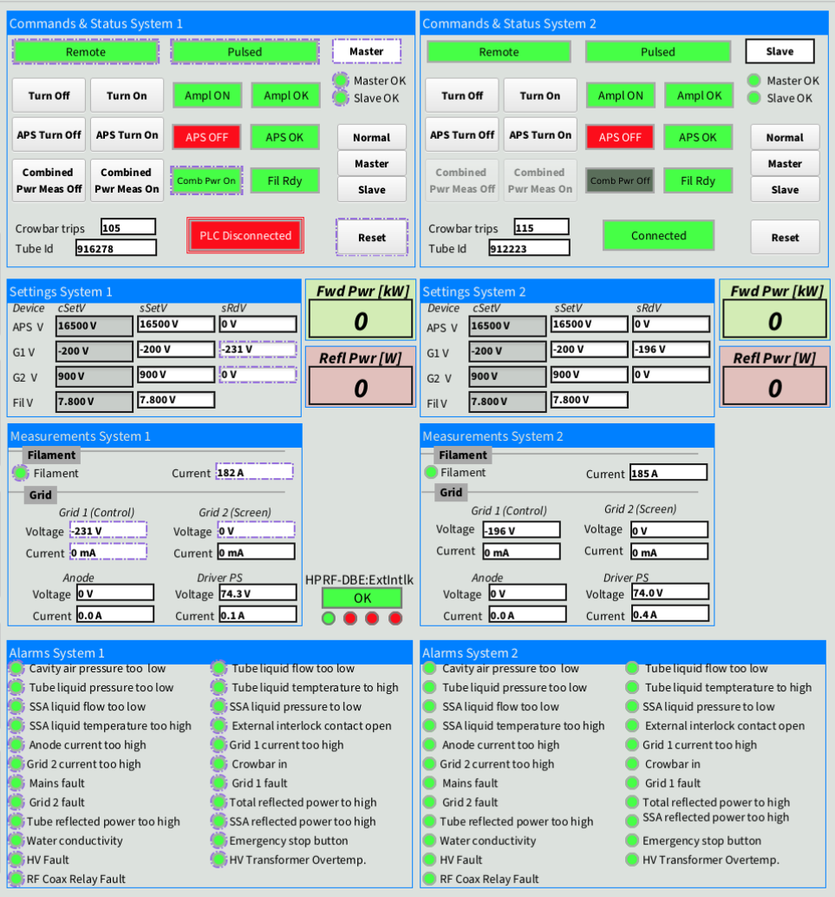
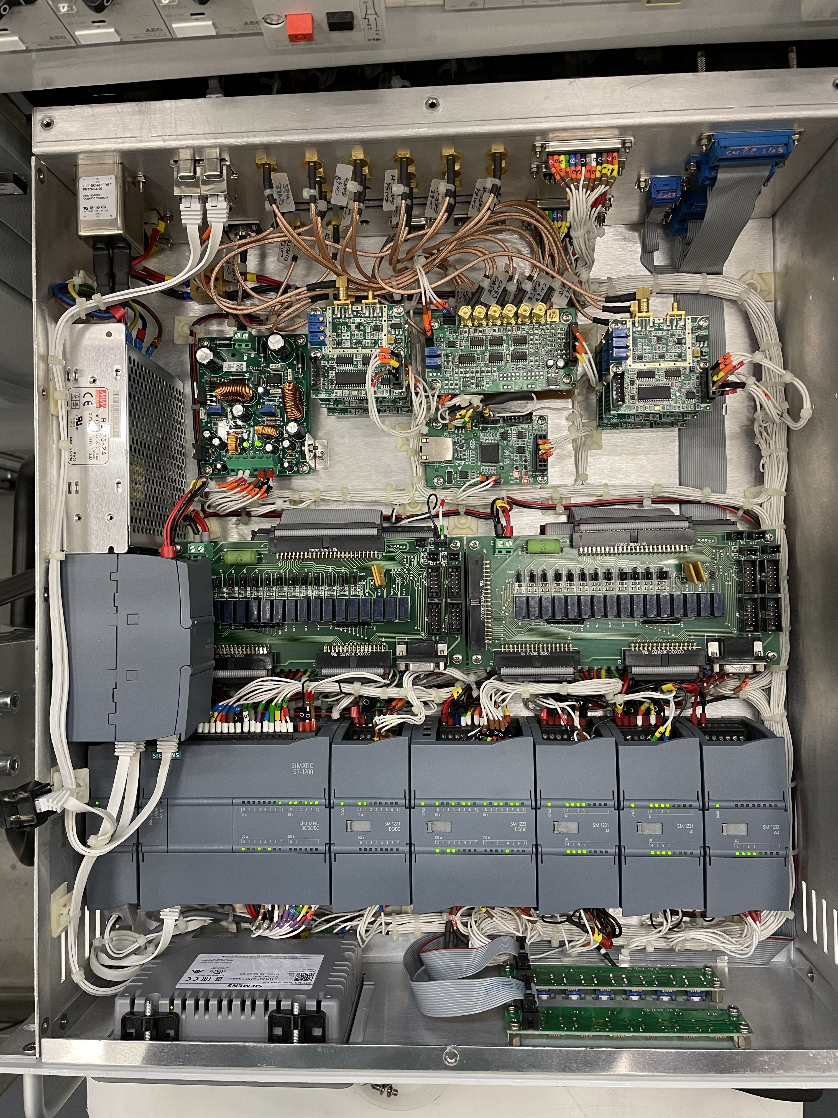
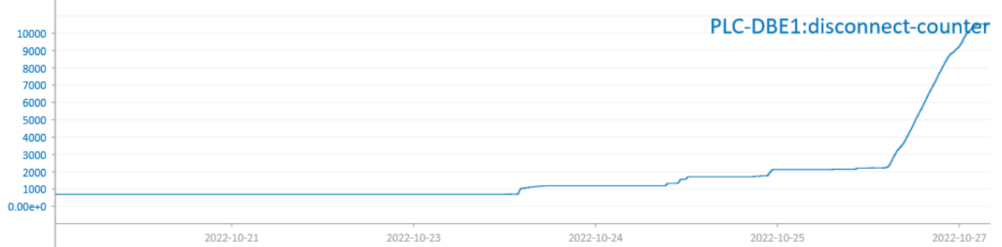
DB sect. A communication problem

Slide 11
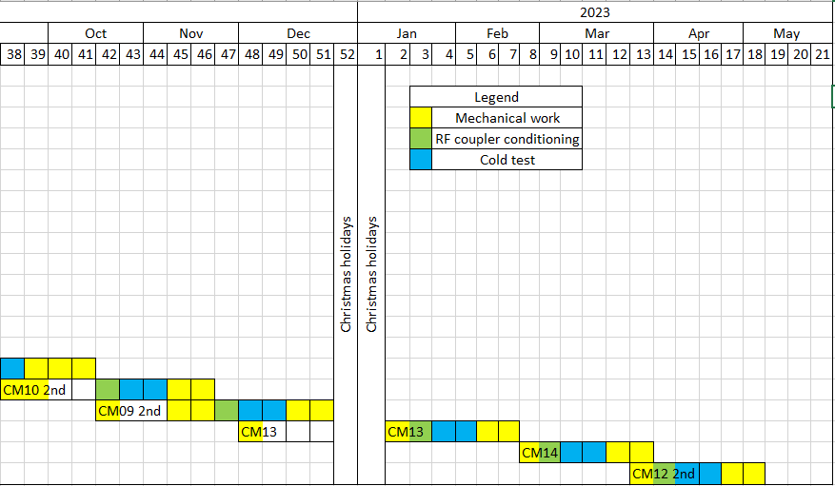
CM10, CM09, CM13 Planning
CM12 arrived to ESS.
CM10_2nd
CM13 arrival date?

