Slide 1
ESS weekly meeting (2023 W18)
M. Zhovner et al

Slide 2
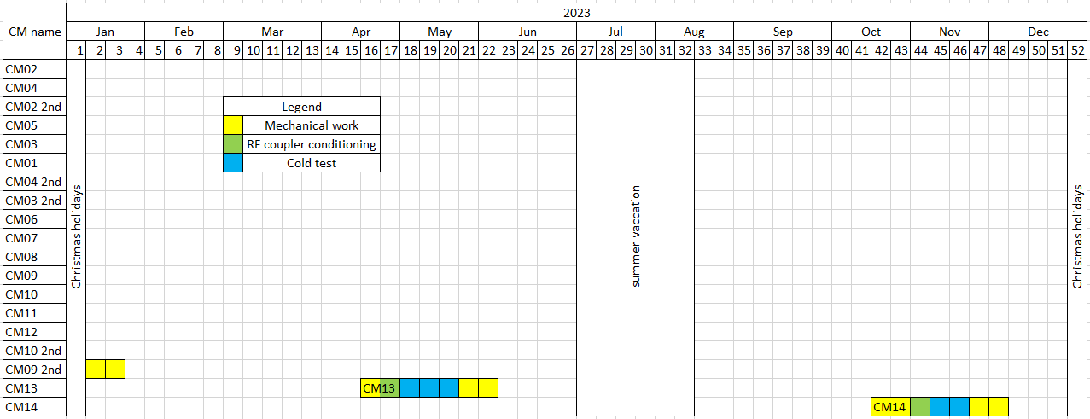
Global planning
Expected CM14 test.
Last information
We are here
CM13 is in Uppsala, warm conditioning done, Cooling down in progress.
CM14 expected delivery time is middle of October 2023.

Slide 3
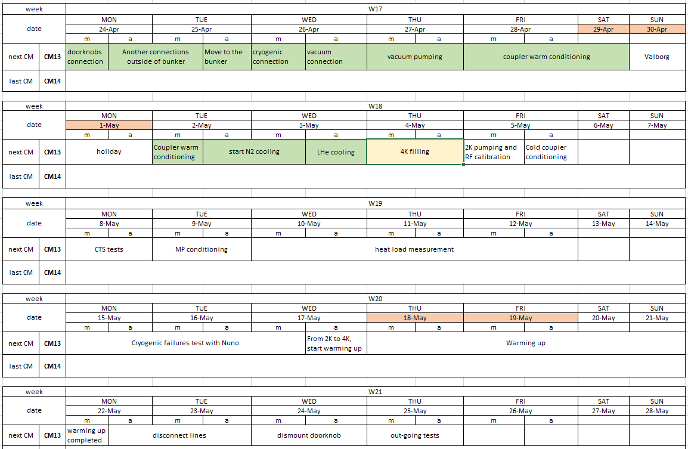
Local planning
We are here
MP conditioning is planned to May 9th. Cecilia will join it.
Akira will be in Uppsala from May 2nd to May 10th
The cryogenic time plan to be extended to W20 for Nuno, but it is short.

Slide 4
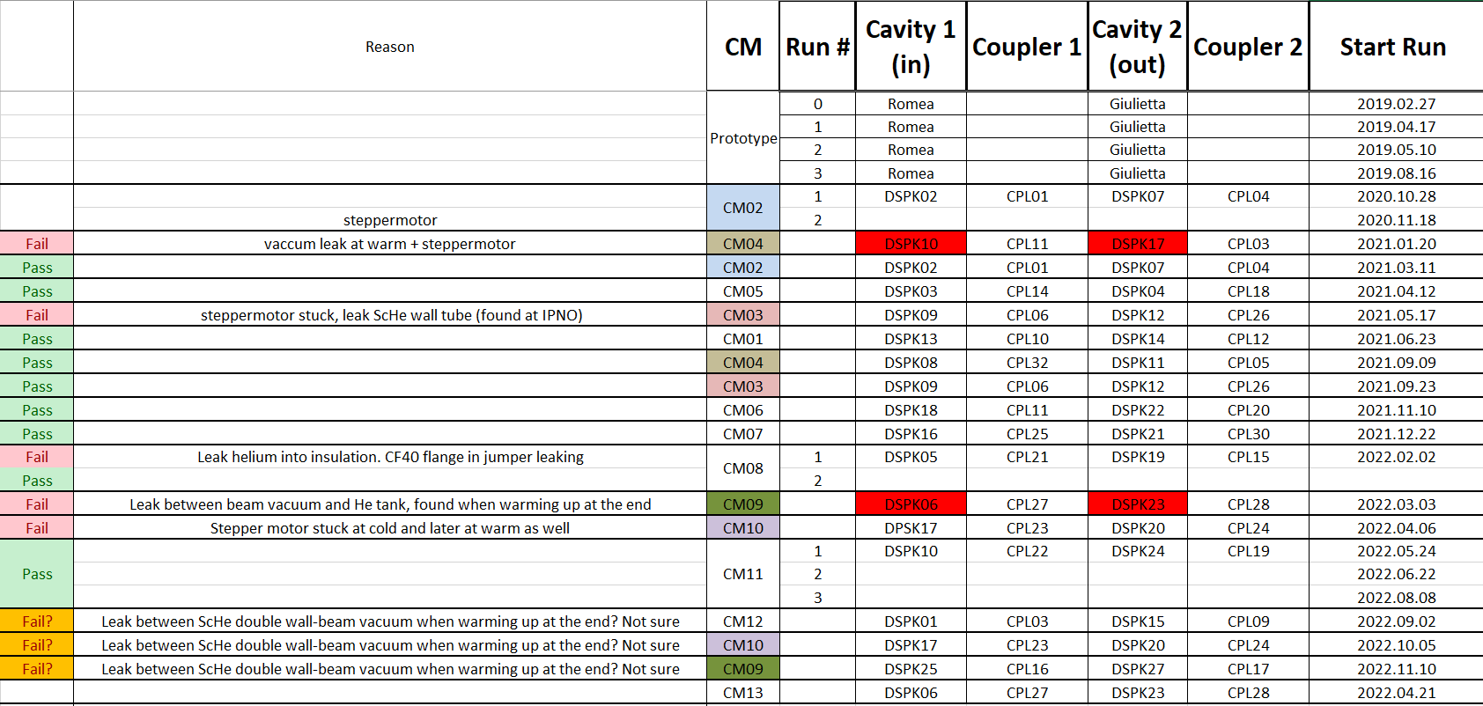
CM13 family tree
CM13 equipped by cavity string from CM09.

Slide 5
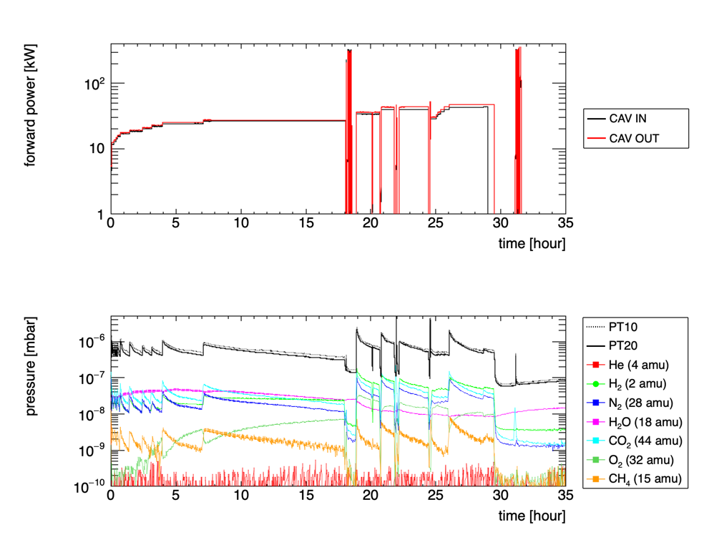
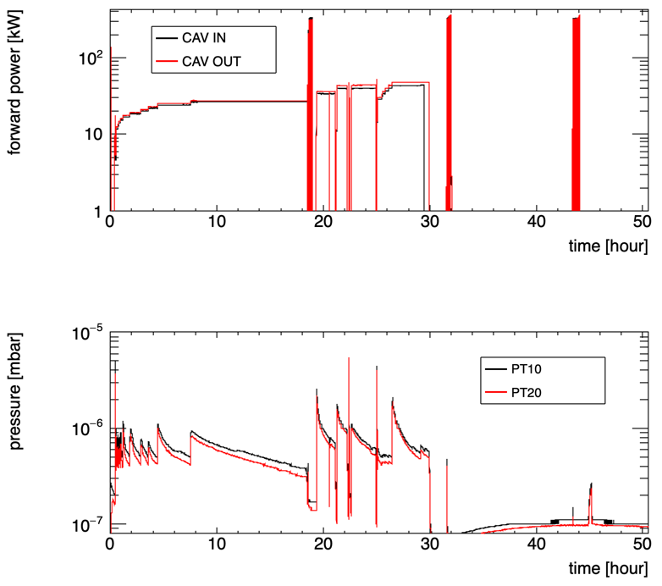
CM09 Warm conditioning
CM09: only < 2 days
STR-10
Coupler-27 (CAVIN)
Coupler-28 (CAVOUT)
The 32 amu signal (one candidate is O₂) appeared from the shortest pulse 50 us
This signal is often observed in longer pulse length (>1 ms)
This signal is anti-correlated to other molecules (H₂, CH₄, 28 amu, CO₂, …)
Any relation to the fast conditioning??
A. Miyazaki. ESS weekly meeting (2022 W11)

Slide 6
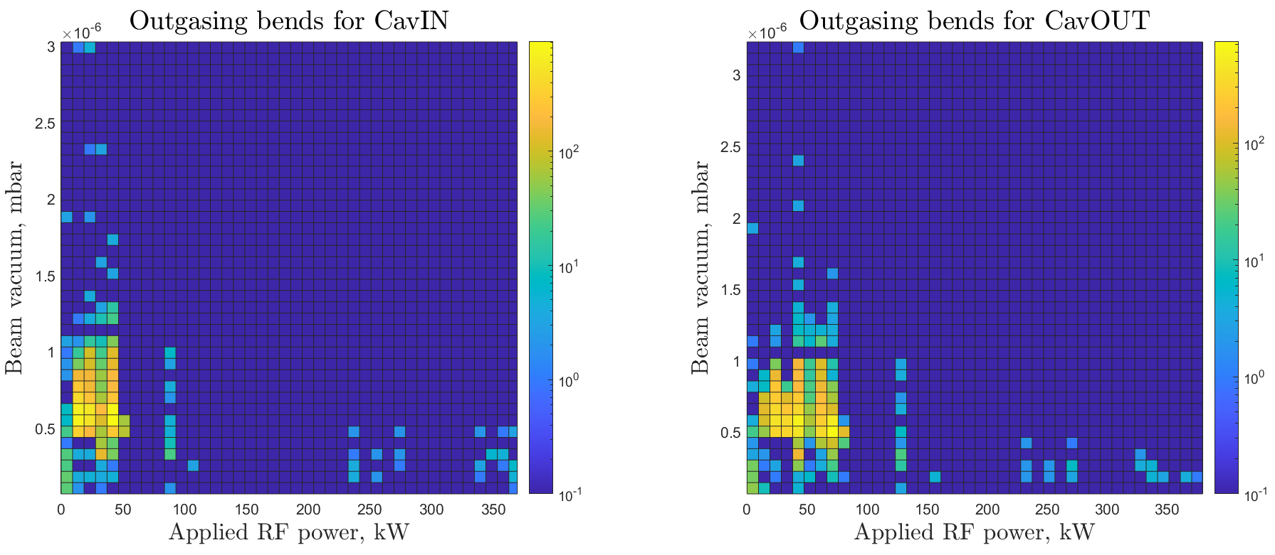
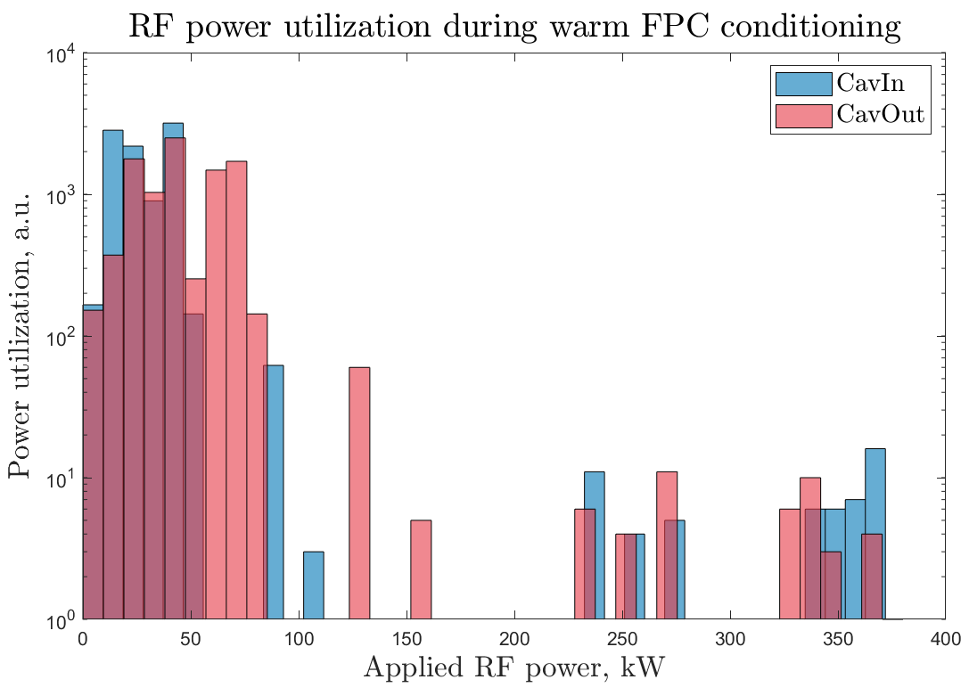
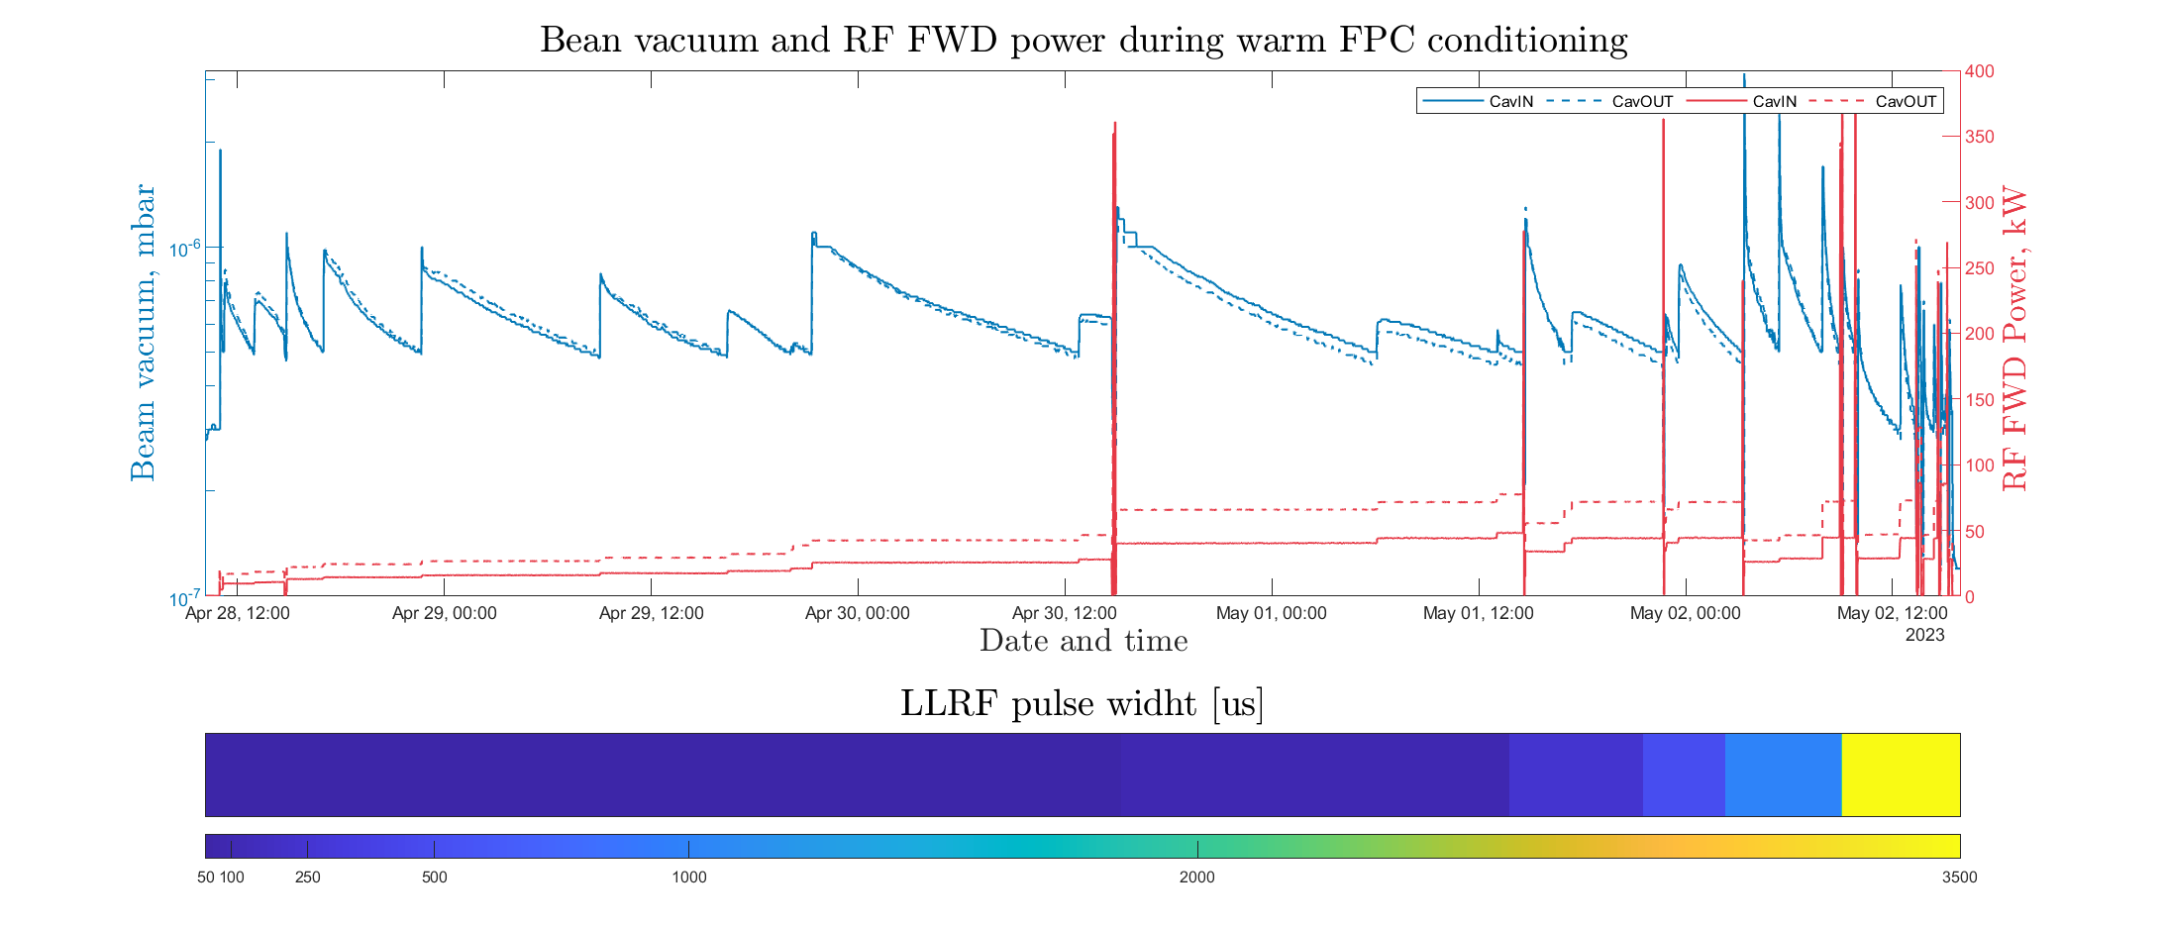
CM13 Warm conditioning
~102h

Slide 7
CM13 Warm conditioning. RGA.

Slide 8
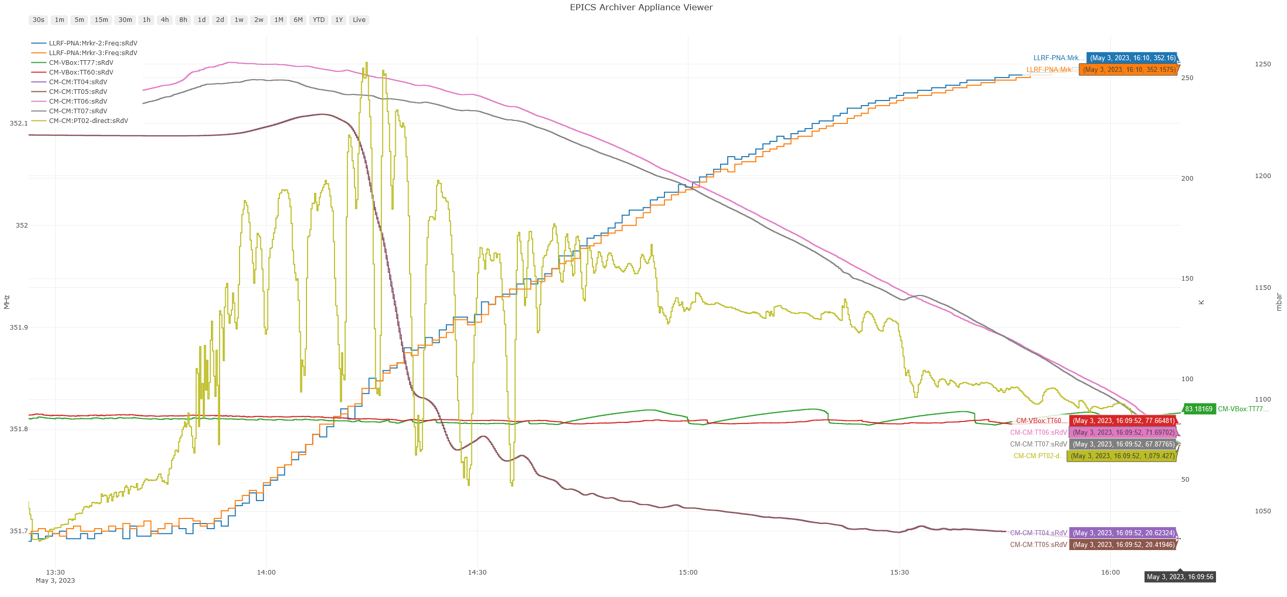
CM13 4K cooling down progress 1/2
 | f_{c} [MHz] Reception, “300K” | f_{c} [MHz] N2 precooling, ~230K | f_{c} [MHz] 4K cooling down, ~20K
CavIN | 351.5790 | 351.6975 | 352.1600
CavOut | 351.5855 | 351.6975 | 352.1575

Slide 9
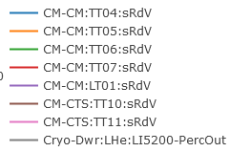
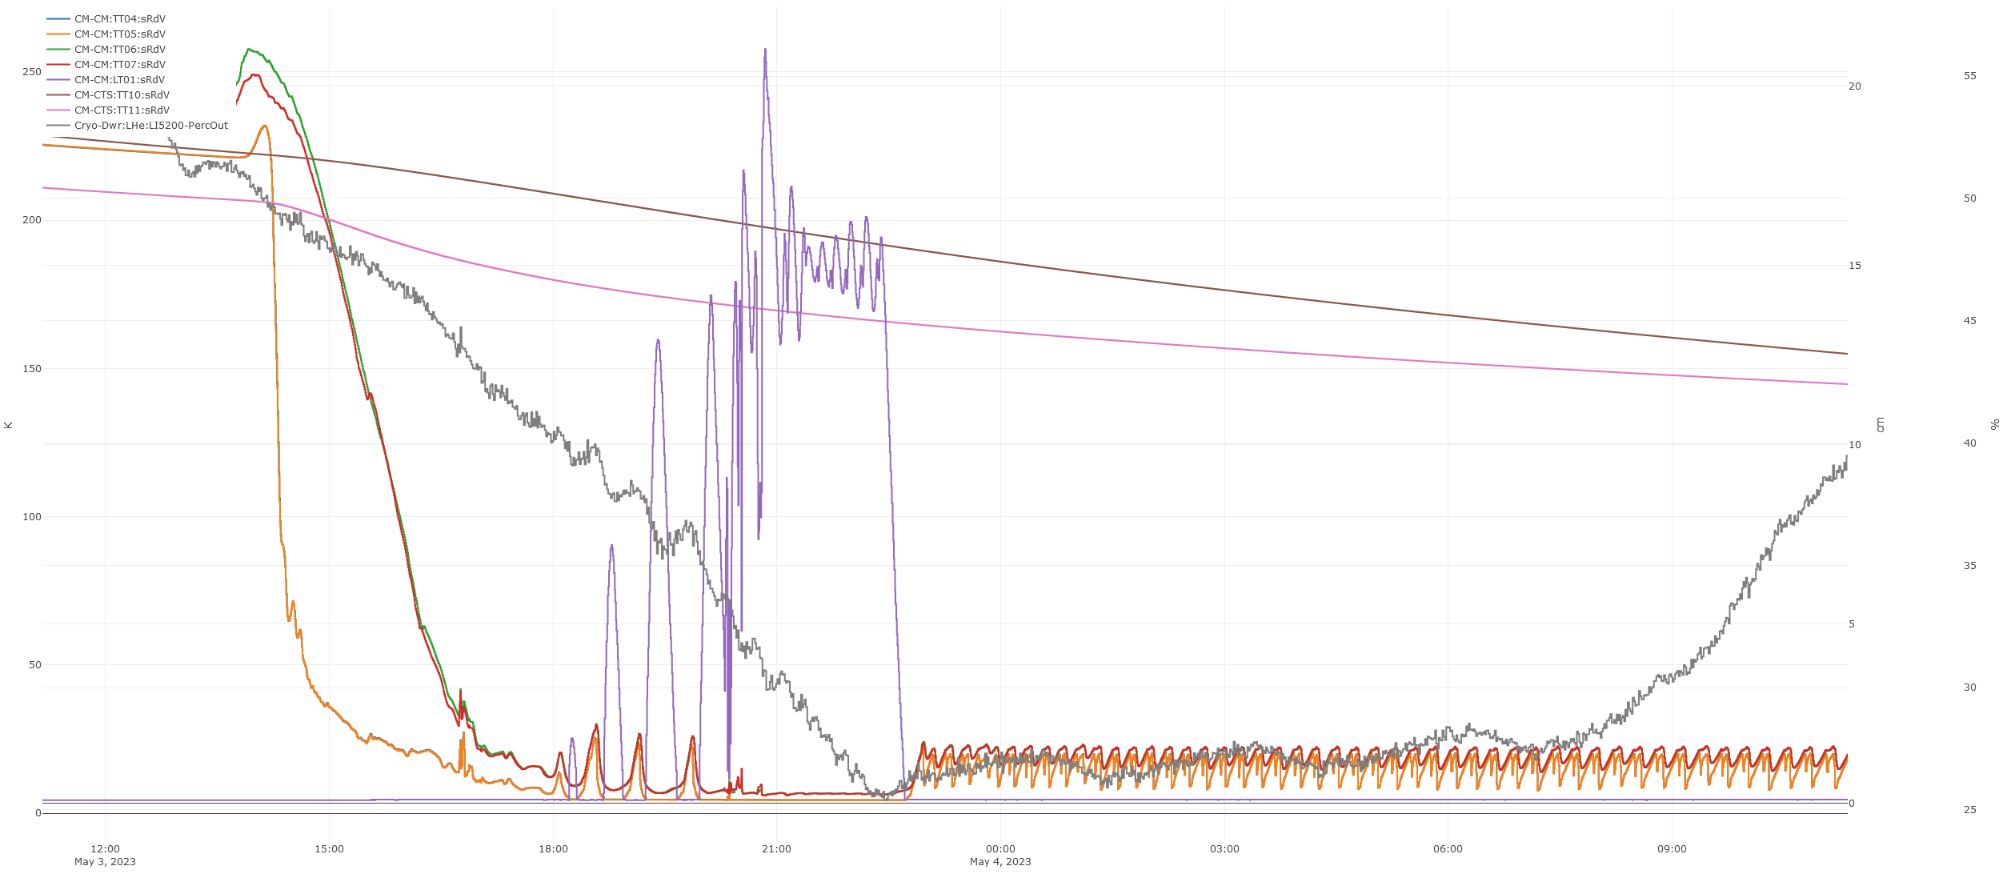
CM13 4K cooling down progress 2/2
LHe level in CM
LHe
dewier %
Go to standby mode
Now Cryoplant back to normal operation. Start filling up LHe dewier.

Slide 10
Local planning
We are here
MP conditioning is planned to May 9th. Cecilia will join it.
Akira will be in Uppsala from May 2nd to May 10th
The cryogenic time plan to be extended to W20 for Nuno, but it is short.

Slide 11
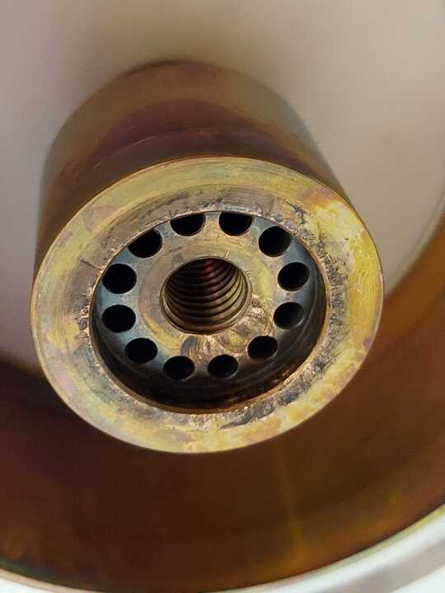
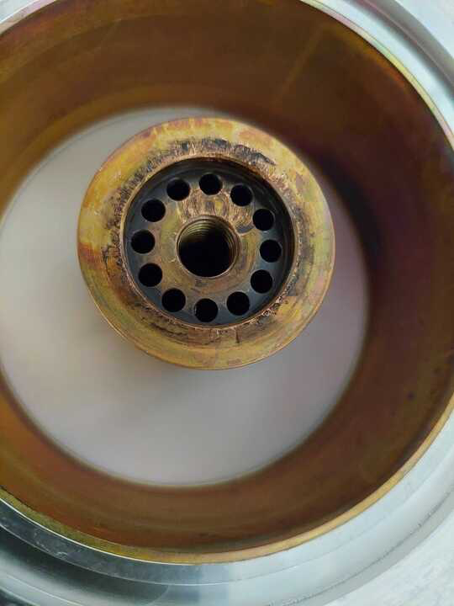
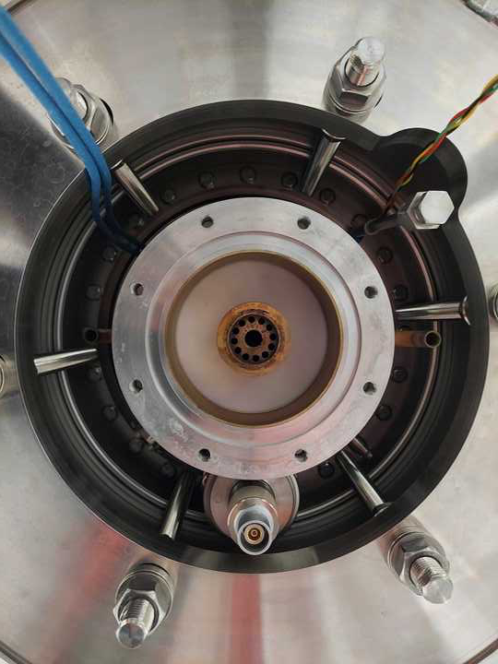
CM11: Bad-looking CavIN coupler flange.
IFJ is performing the mechanical inspection of CM11.
The coupler flange of CAVIN is in really bad conditions and there is a substantial deviation in the position of the coupler He outlet pipe.
We will raise an NCR, but share the images. Please comment if you see problems on proceeding.
It’s not clear if it is a mechanical damage (more likely though) or RF erosion.
Anything abnormal during processing or operation beside what is in the brief report?

Slide 12
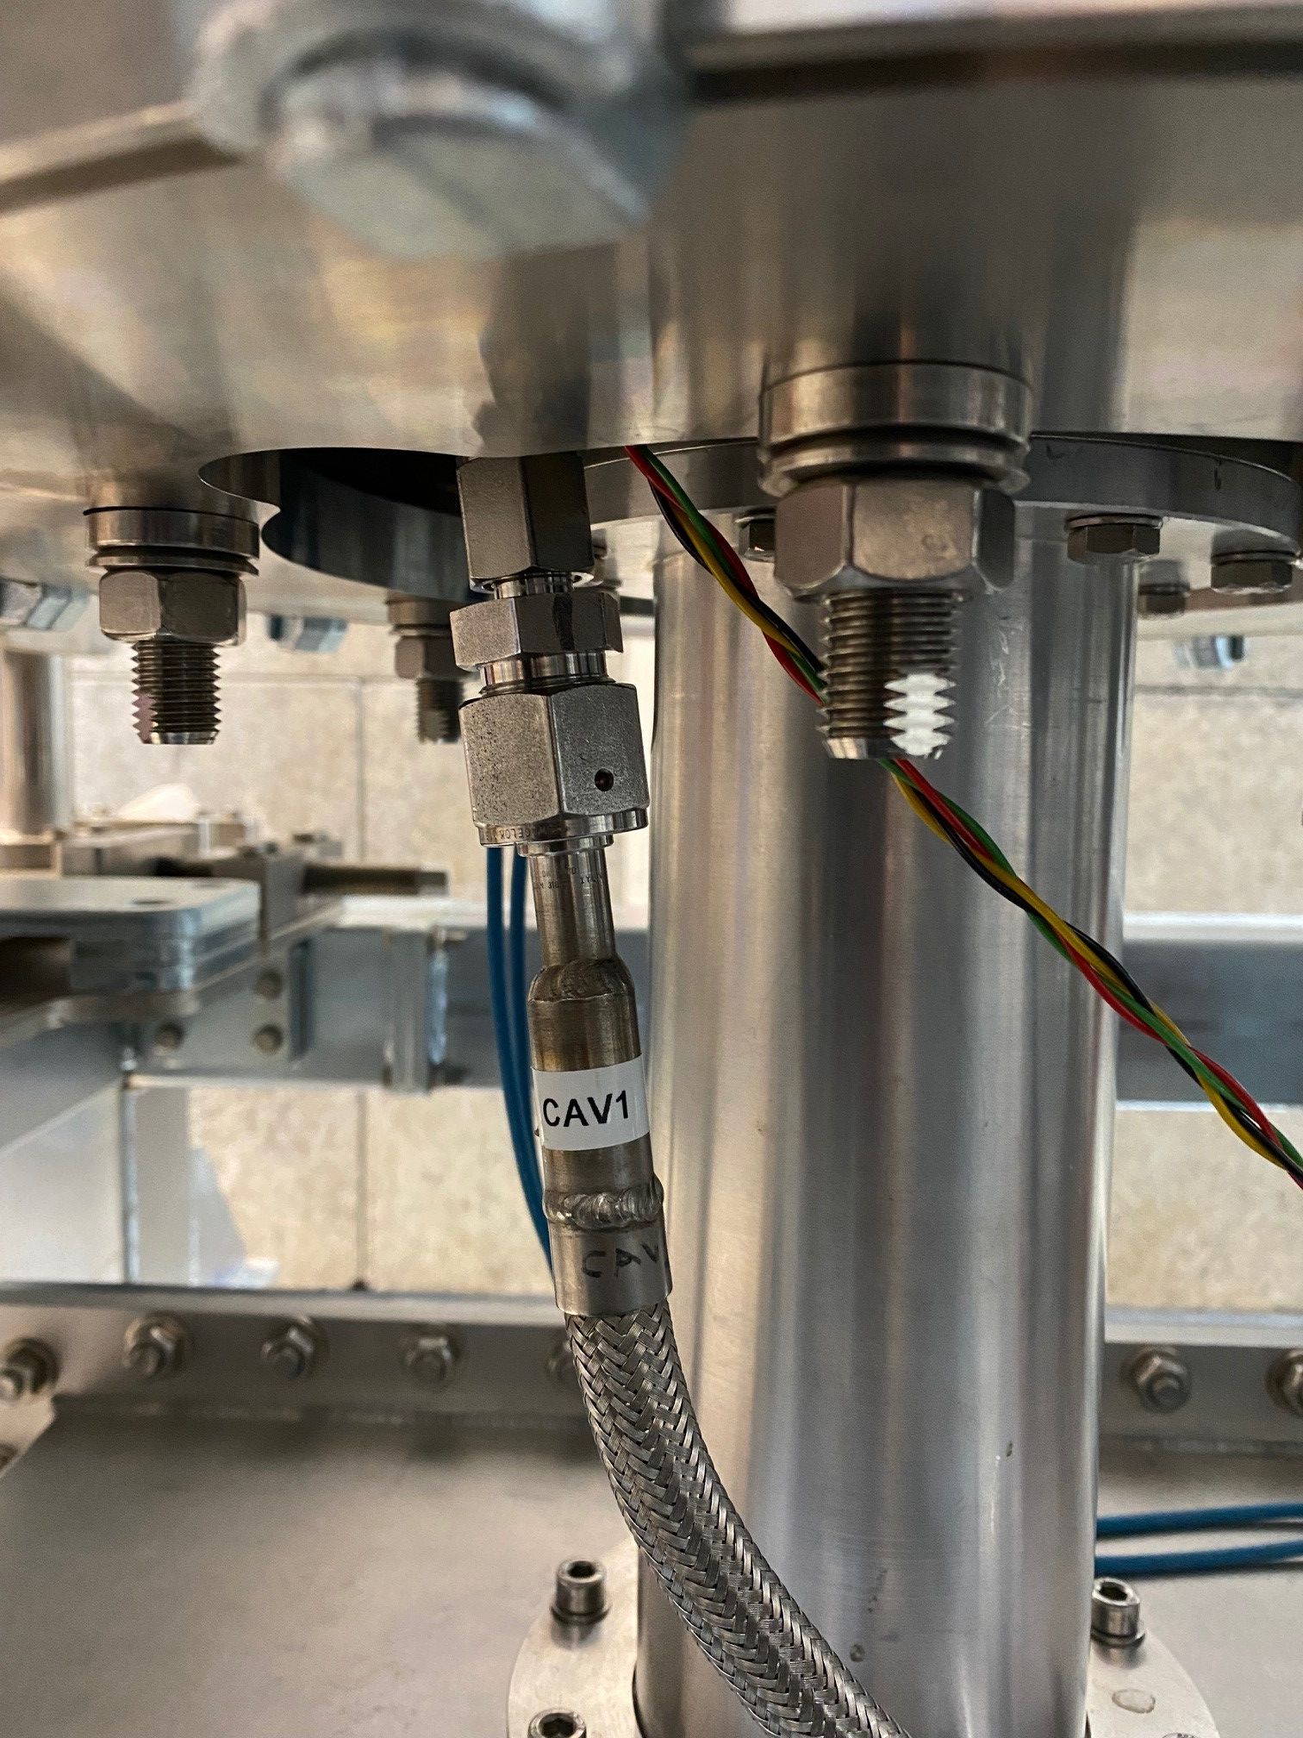
CM11: Bad-looking CavIN coupler flange.
Went to standby 2022.06.10 due to dewar level low. Restarted cooling 2022.06.13. Warmed up fully because wanted to avoid Q-disease
3. Power cut 2022.08.22. Lost He to air. Went to standby mode. 2022.08.24 back to cooling and 2K operation

Slide 13
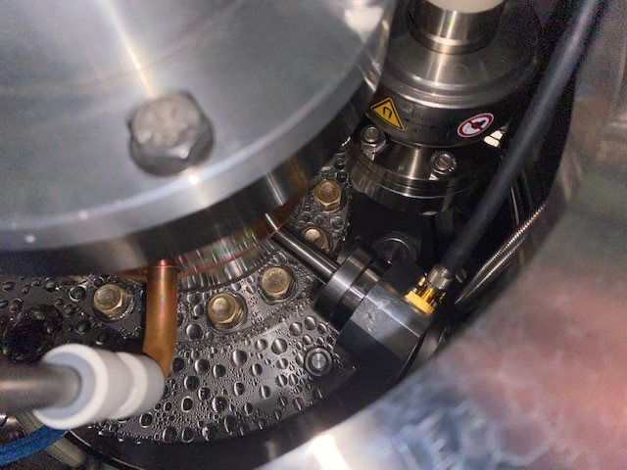
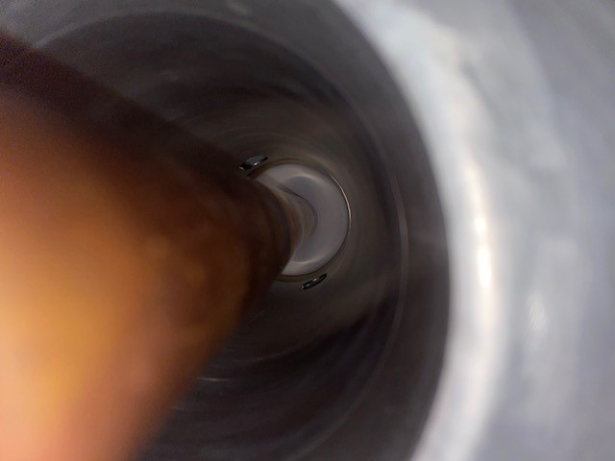
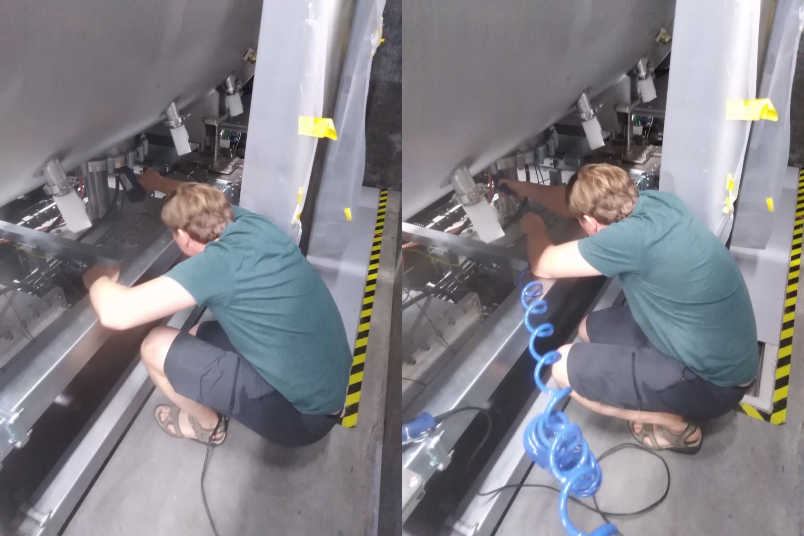
CM11: Bad-looking CavIN coupler flange.
2022-08-17 CM11: Condensed water found on CAV IN ceramic window flange
EH12 is set to 154 W (24.46 V and 6.32 A) EH22 is set to 116 W (21.94 V and 5.30 A)
We will keep CAVIN non-powered by the evening and will check the condensation again.
2022-08-17 CM11: No water found inside the waveguides or on the ceramic window
2022-08-18 CM11: Try to remove remaining water drops in CAVIN with a heat-gun and compressed air
We will keep CAVIN non-powered by the evening and will check the condensation again.

Slide 14
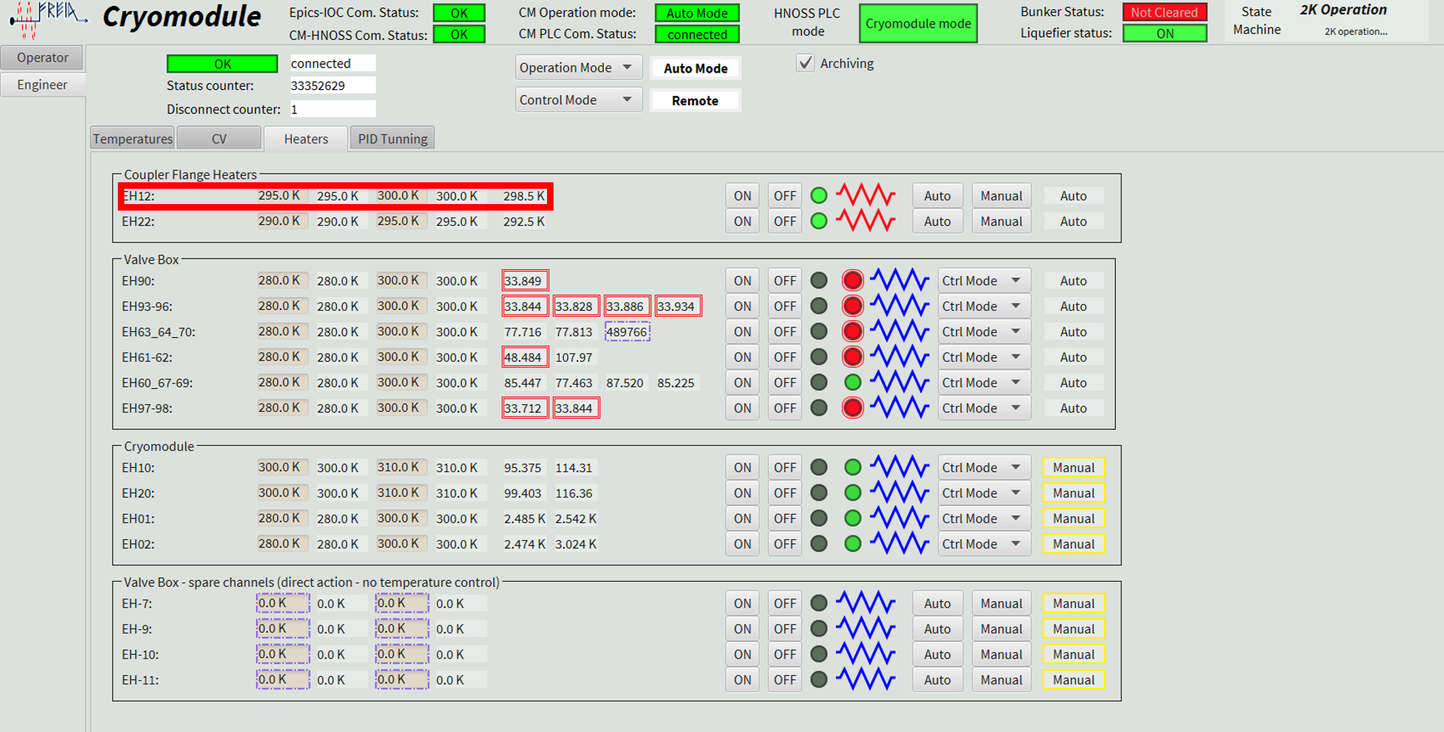
CM11: Bad-looking CavIN coupler flange.
2022-08-18 CM11: change CAVIN's coupler flange target temperature by 5C
We have condensation in CAVIN's flange above the doorknob: http://freia.physics.uu.se/FREIAelog/show.jsp?dir=/2022/33/17.08&pos=2022-08-17T10:58:20 MZ checked the temperature by an IR sensor and its temperature was 11C while CAVOUT's flange was 23C. The CAVIN's pt100 (TT120) shows the same value as CAVOUT (TT220). We doubt TT120. We changed the regulation temperature of EH12 from 290K < T < 295K to 295K < T < 300K. The directly measured temperature became 18C

