Slide 1
ESS weekly meeting (2023 W19)
M. Zhovner et al

Slide 2
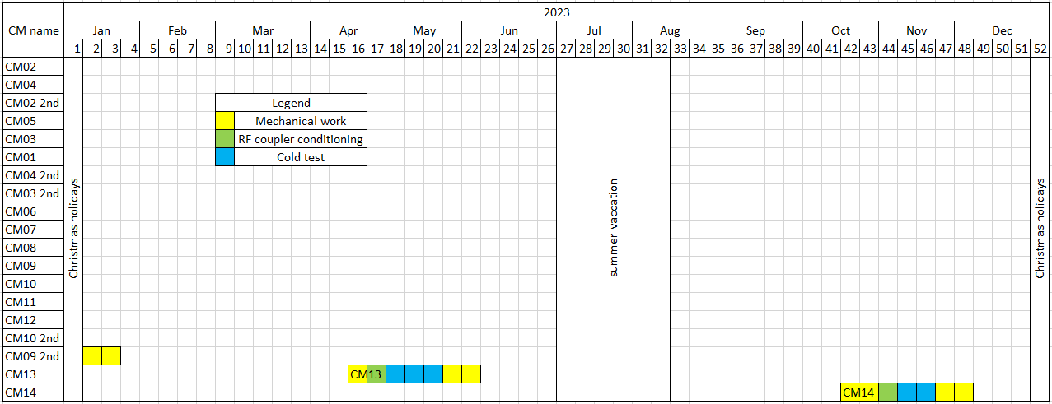
Global planning
Expected CM14 test.
Last information
We are here
CM13 is in Uppsala, warm conditioning done, Cool state in a progress.
CM14 expected delivery time is middle of October 2023.

Slide 3
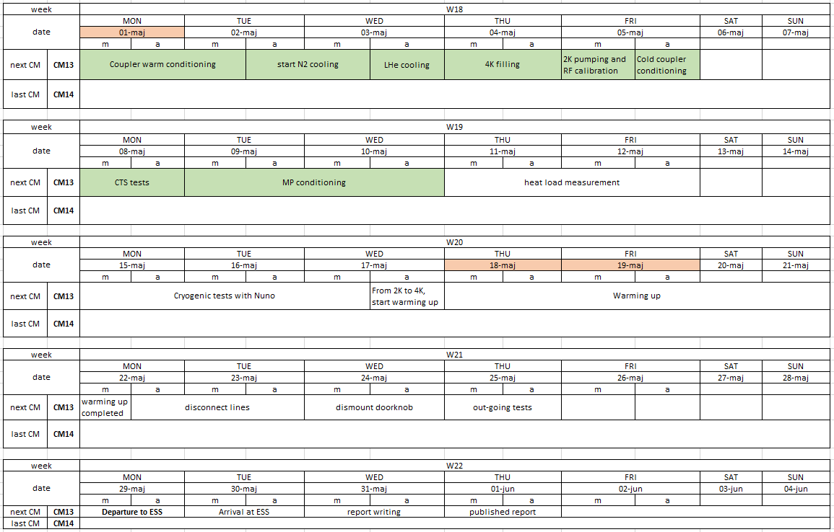
Local planning
We are here
Akira nd Cecilia were in FREIA this week.
The cryogenic time plan to be extended to W20 for cryo failure tests.

Slide 4
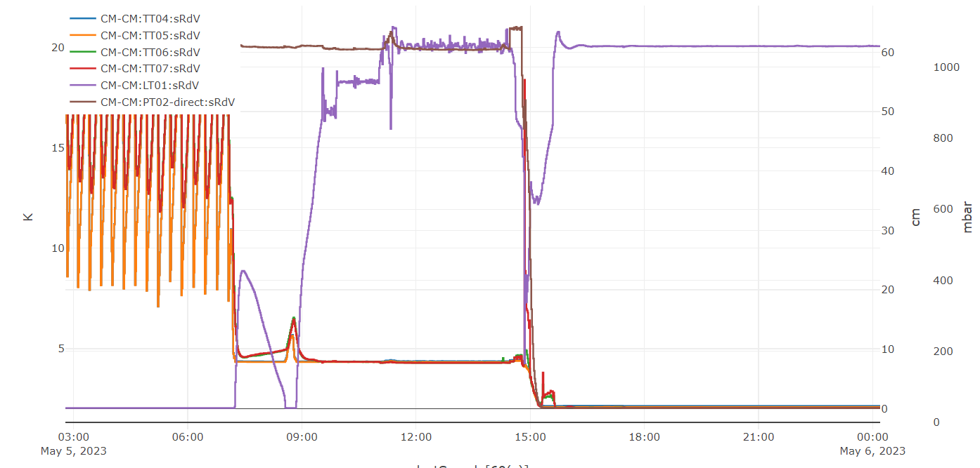
Cooling down to 2K
2K pumping
4K
operation
2K
operation
Stand-by

Slide 5
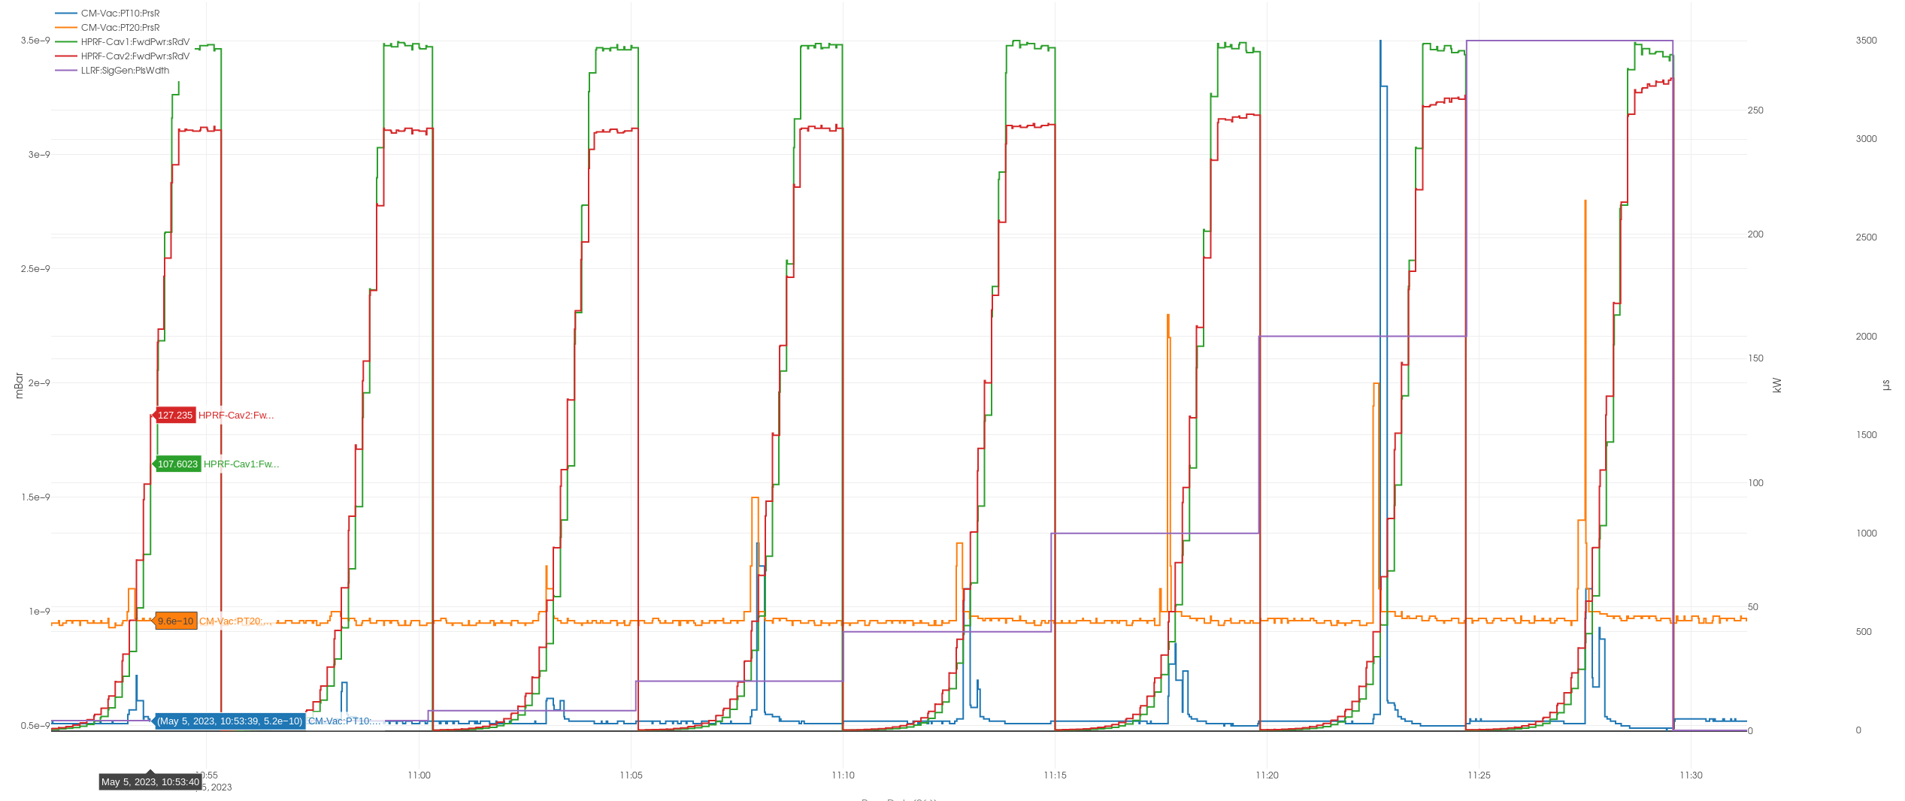
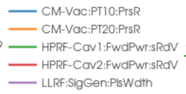
Cold FPC conditioning at 4K
It took less then 1h.
Still visible outgassing below 3.5E-9 mbar.

Slide 6
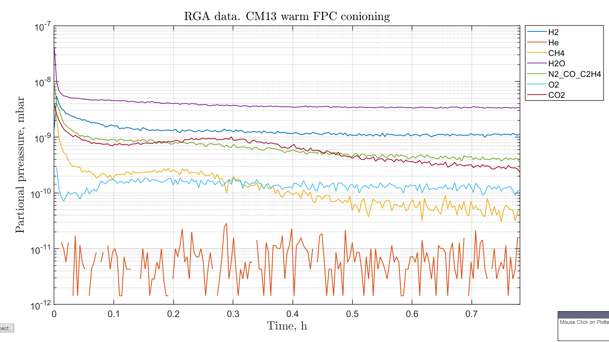
Cold FPC conditioning. RGA data

Slide 7
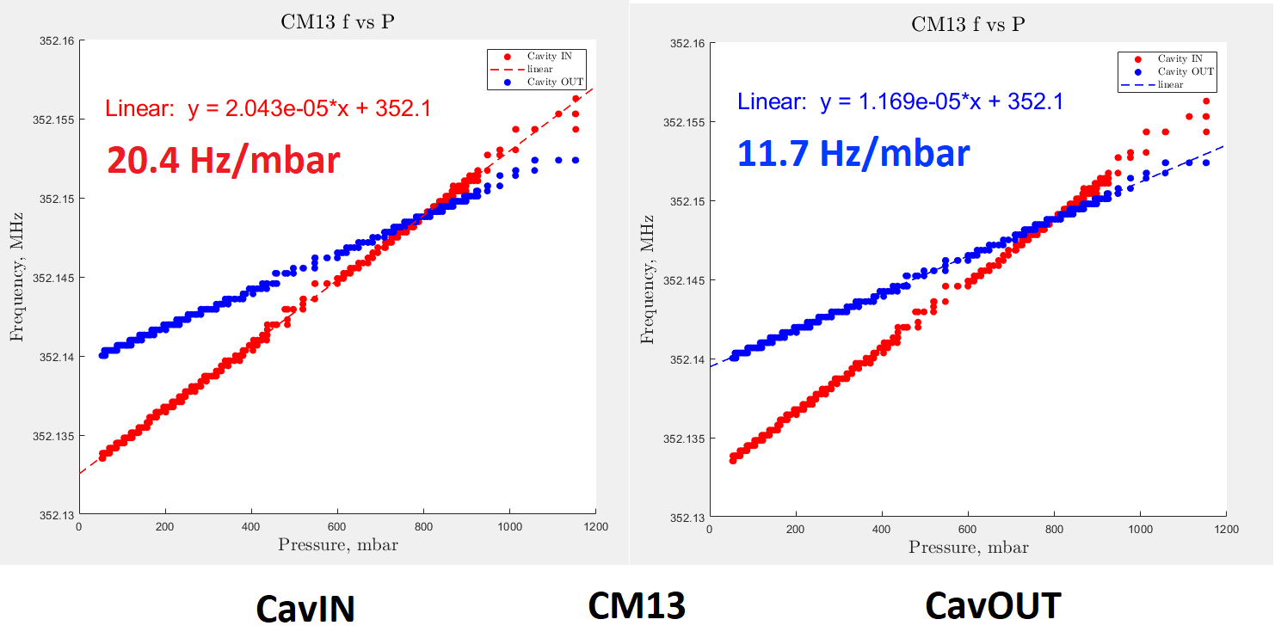
Pressure sensitivity (f vs P)
For cryomodule CM09: CavIN 20Hz/mbar, CavOUT 11.3Hz/mbar

Slide 8
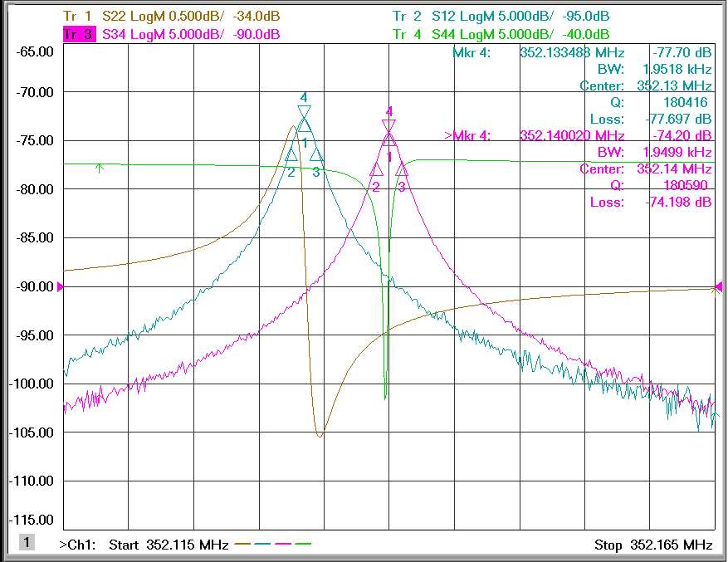
CM13 cavities at 2K
CavIN
352.1334MHz -77.7dB
BW: 1952Hz
Ql: 180416
S11 pick-up: -2.716dB
CavOUT
352,1400MHz -74.2dB
BW: 1950Hz
Ql: 180590
S11 pick-up: -2.490dB
For cryomodule CM09: CavIN 352.1264 Hz, CavOUT 352.1313 Hz

Slide 9
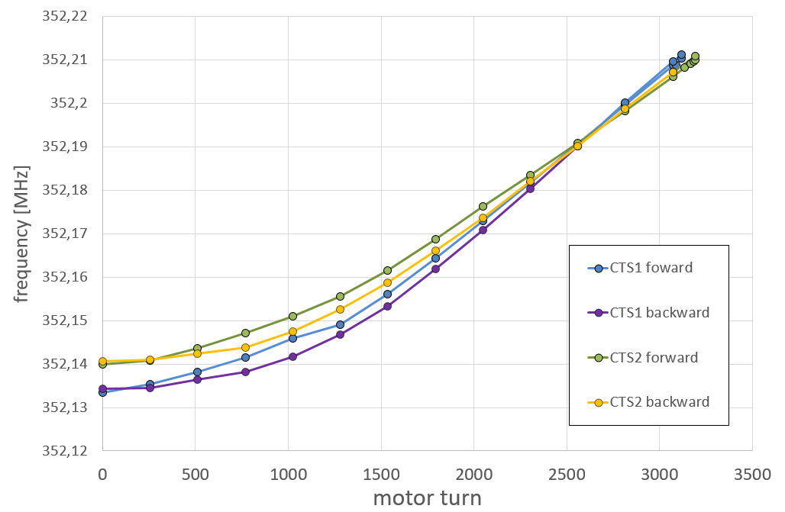
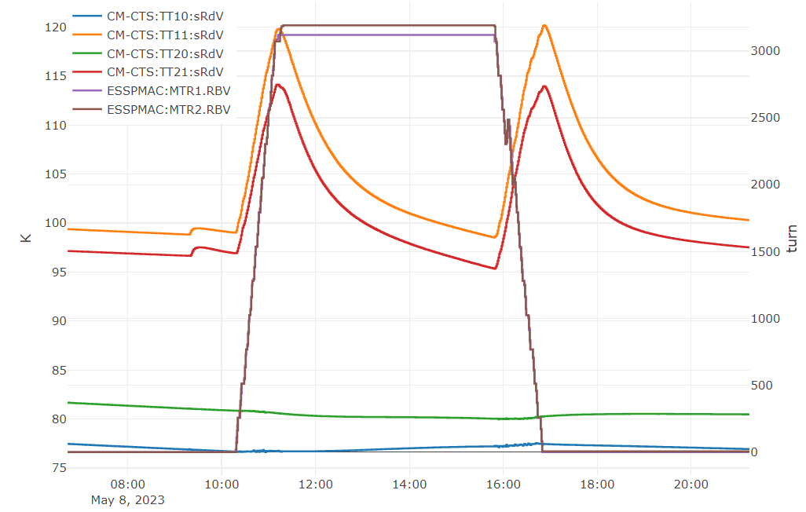
CTS test. Stepper motors
Temperature (TT11, TT21) increase:
CTS1 ~20 K
CTS2 ~17 K
Roughly factor of 2 higher increase than previous CM's.
CTS1 | CTS2
Hz/step = 0.171223958 | Hz/step = 0.15390625
kHZ/mm = 87.66666667 | kHZ/mm = 78.8
Target frequency:
CTS1 = 3120 turns, 624000 steps
CTS2 = 3192 turns, 638400 steps

Slide 10
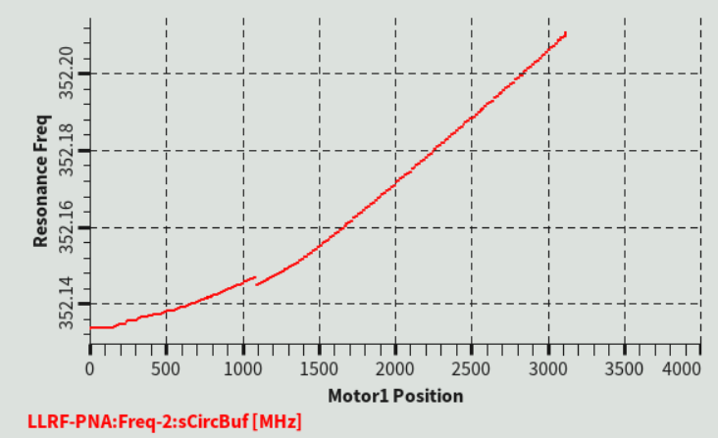
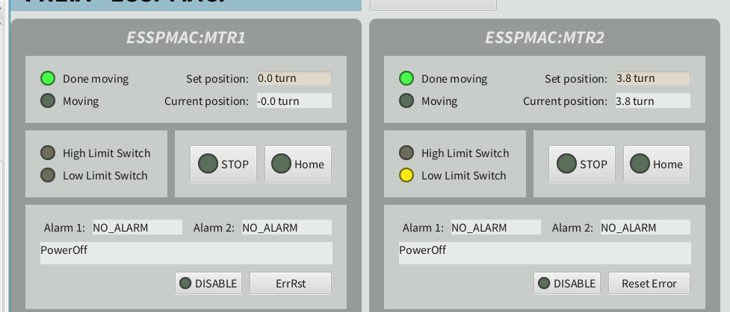
CTS test. Stepper motor
Single back lash in CTS1 at ~1100 turns
After homing procedure, we move CTS2 3192 turns to rich target frequency. To move tuner back we 0 (zero) to “Set position” and motor stop by hitting limit switch and still left 3.8 turns.
CTS2 takes time to release limit indicator during first homing procedure.
Some time during homing procedure motors hit limit switch and, on the way back (26.5 turns) it dint stop.

Slide 11
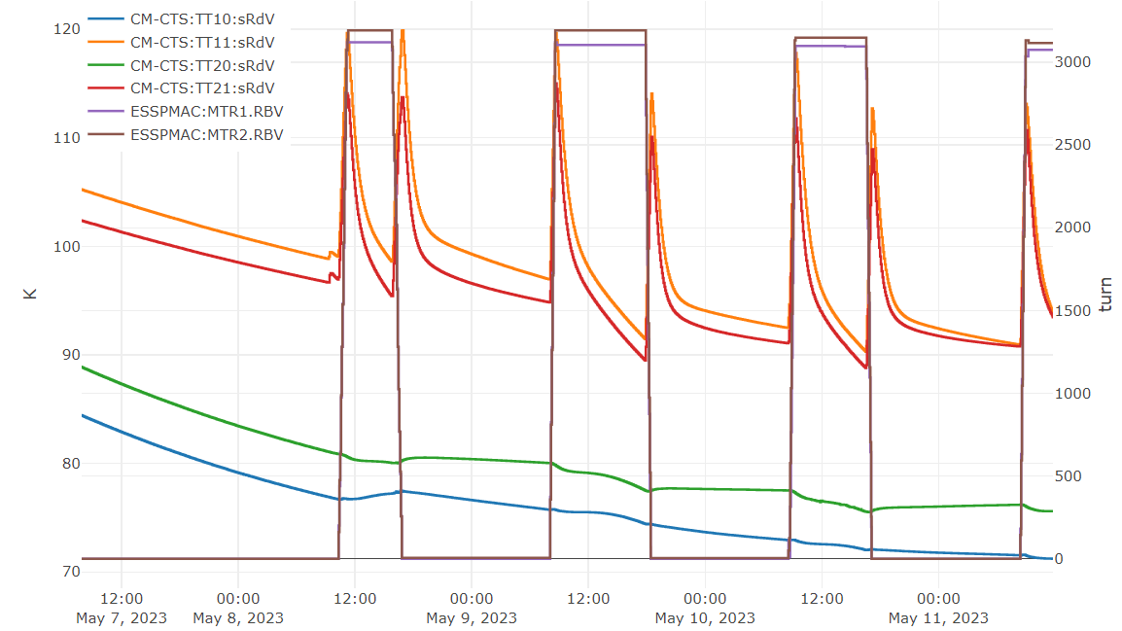
CTS test. Operation cycles.
On 11 May 11:45
3 full cycles
+ 1 full cycle to the end of the day

Slide 12
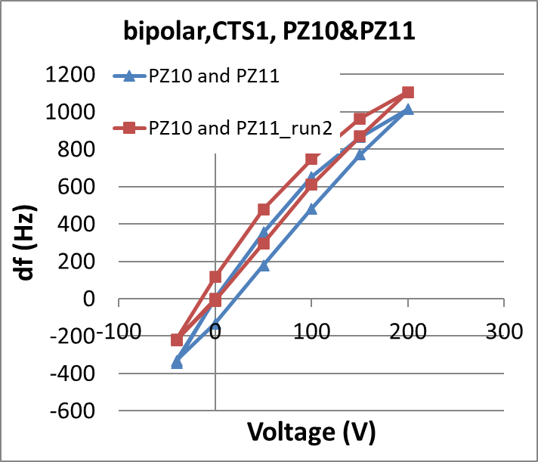
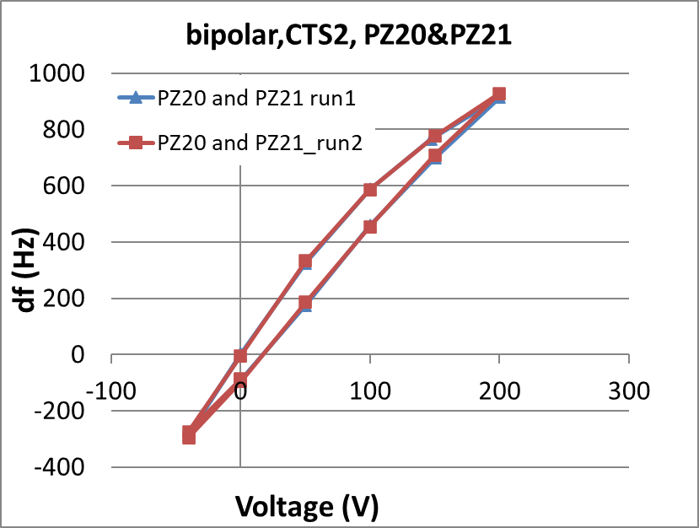
CTS test. Piezzos
CTS1
PZ10
tuning range bp 688.692 Hz
tuning range up 533.2305556 Hz
PZ11
tuning range bp 732.4498889 Hz
tuning range up 582.0458889 Hz
PZ10+PZ11
tuning range bp 1327.249333 Hz
tuning range up 983.7828889 Hz
CTS2
PZ20
tuning range bp 712.7758889 Hz
tuning range up 549.6232222 Hz
PZ21
tuning range bp 659.8904444 Hz
tuning range up 488.6015556 Hz
PZ20+PZ21
tuning range bp 1223.645 Hz
tuning range up 903.1206667 Hz

Slide 13
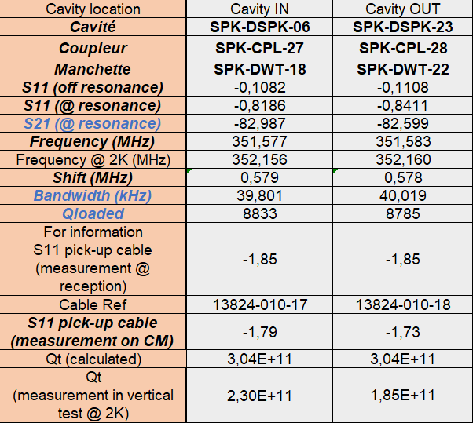
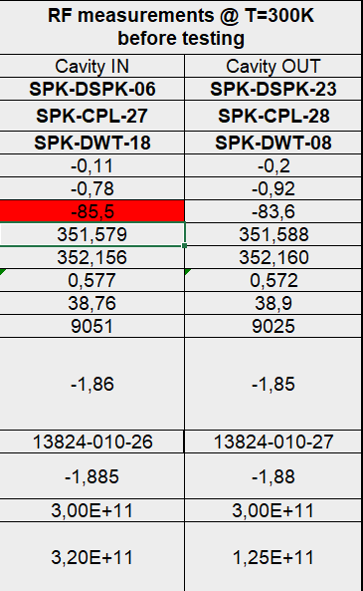
Cavities conditioning.
We found uncertainty in Qt value between CM09 and CM13
CM09
CM13
Answer from IJC Lab:
2.30E11
1.85E11

Slide 14
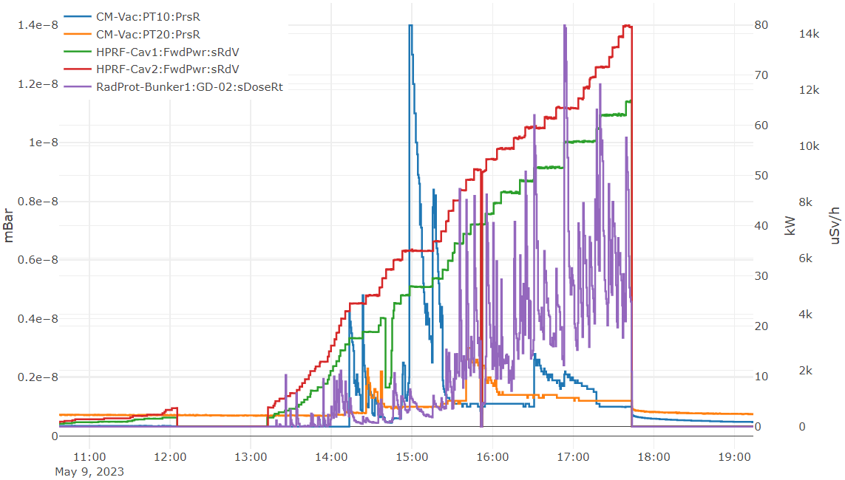
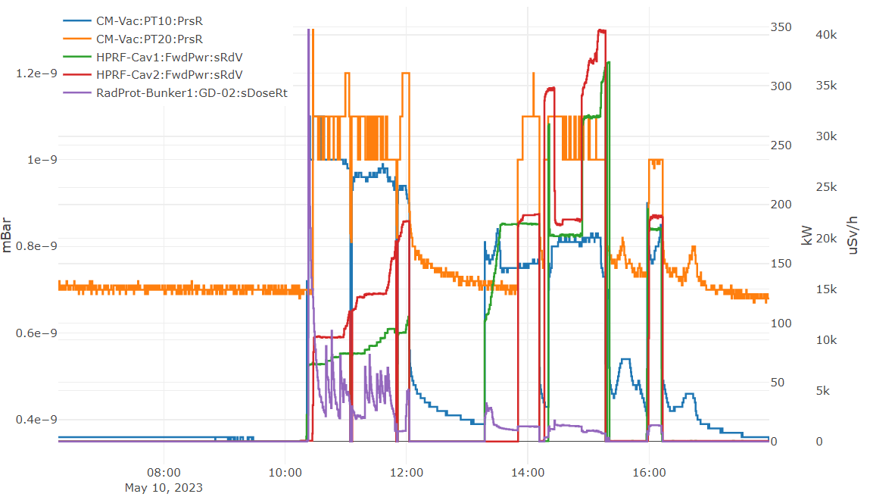
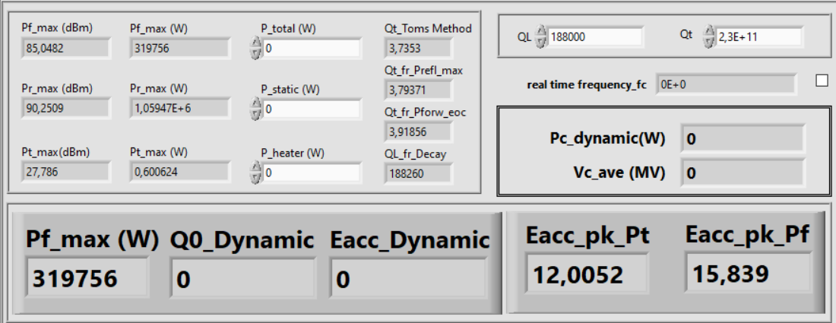
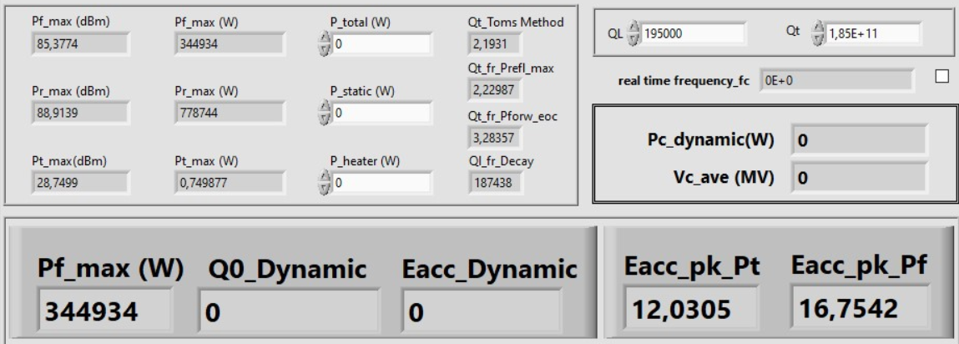
Cavities conditioning. We reached 9 and 12 MV/m
Day 1
Day 2
CavIN
CavOUT

Slide 15
LFD at 9 MV/m
CavIN
CavOUT
|df| = 425Hz
|df| = 420Hz
PZ10+PZ11
tuning range bp 1327.249333 Hz
tuning range up 983.7828889 Hz
PZ20+PZ21
tuning range bp 1223.645 Hz
tuning range up 903.1206667 Hz

Slide 16
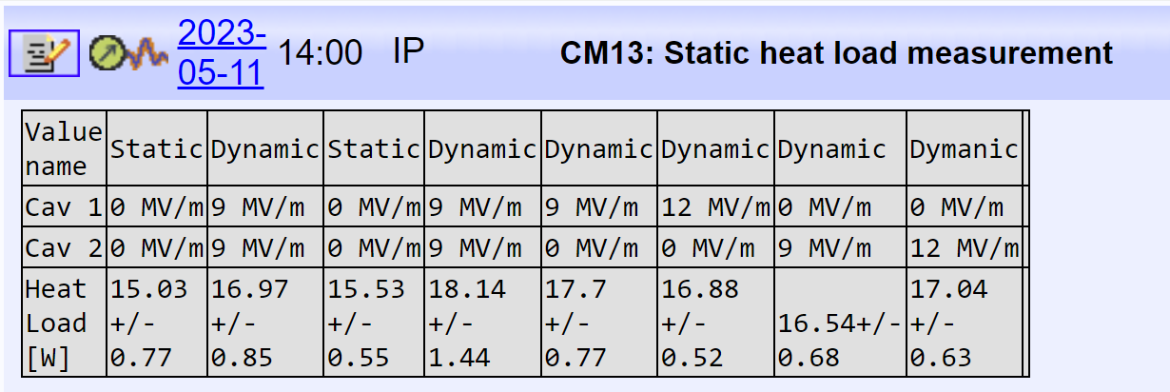
Heat loads
CV551 = 80% CV01 = 0% CV03 = 20-30% CV04 = reg

Slide 17
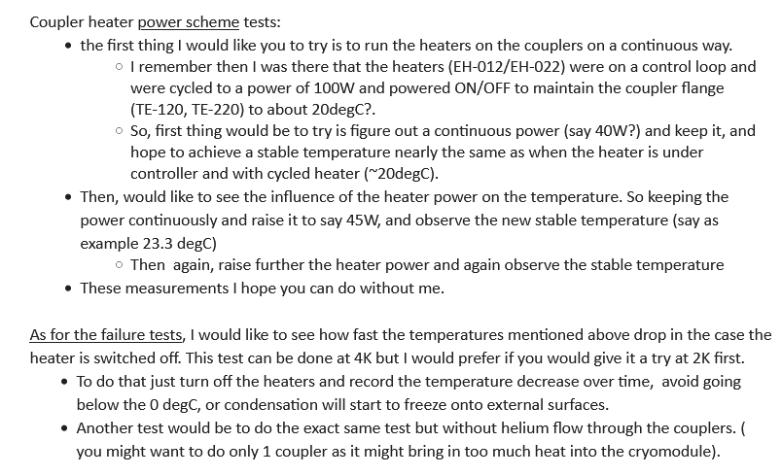
Tasks from Nuno

Slide 18
Local planning
We are here
Akira nd Cecilia were in FREIA this week.
The cryogenic time plan to be extended to W20 for cryo failure tests.

