Slide 1
ESS weekly meeting (2023 W21)
M. Zhovner et al

Slide 2
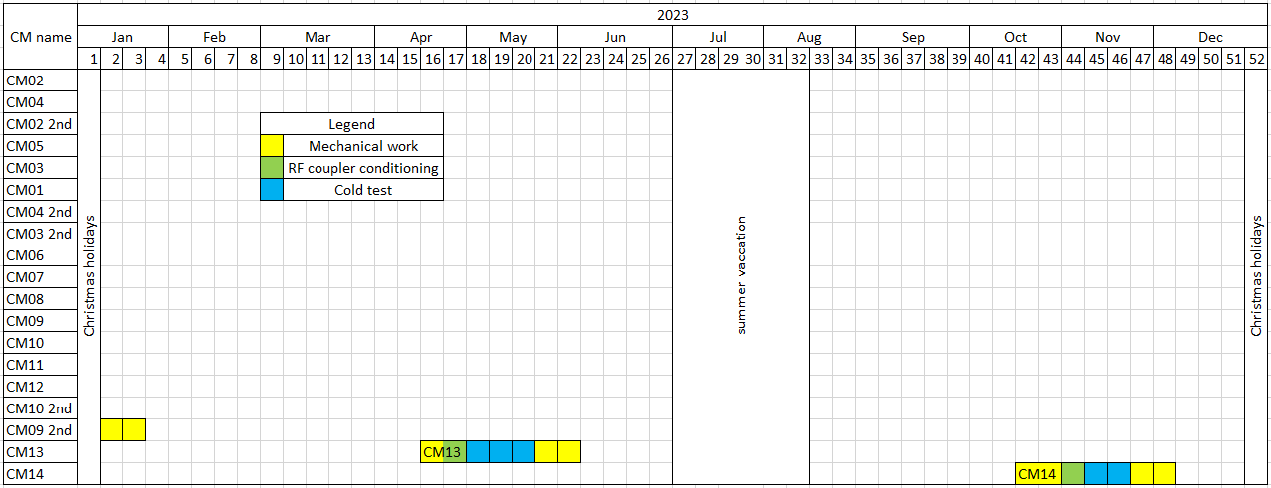
Global planning
Expected CM14 test.
Last information
We are here
CM13 is disconnected, in preparation for departure
CM14 expected arrival time to Uppsala is middle of October 2023.

Slide 3
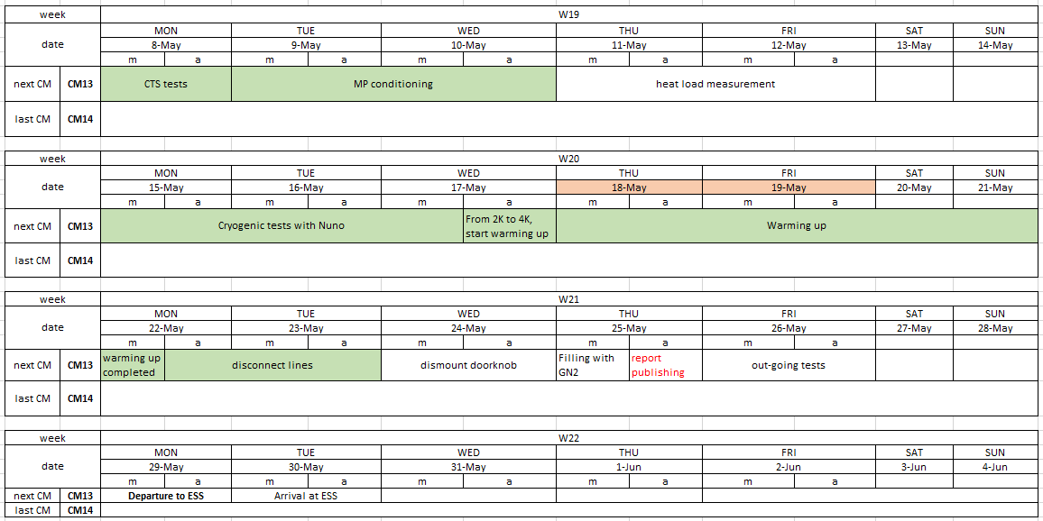
Local planning
Previous meeting
We are here

Slide 4
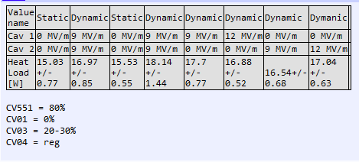
CM13: Summary of heat load measurements
Heat load measurements overview
Additional static heat load measurements
Measurement | Value
With foil on view ports | 16.08±0.88 W
Without foil on view ports | 16.34±0.75 W

Slide 5
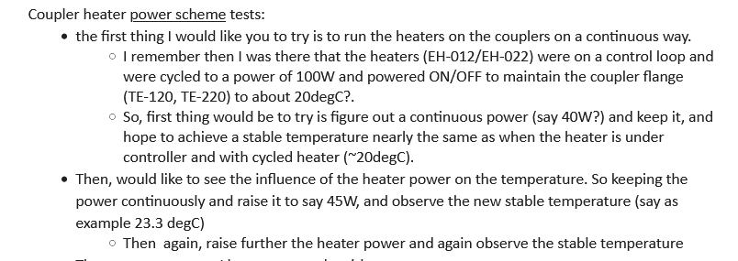
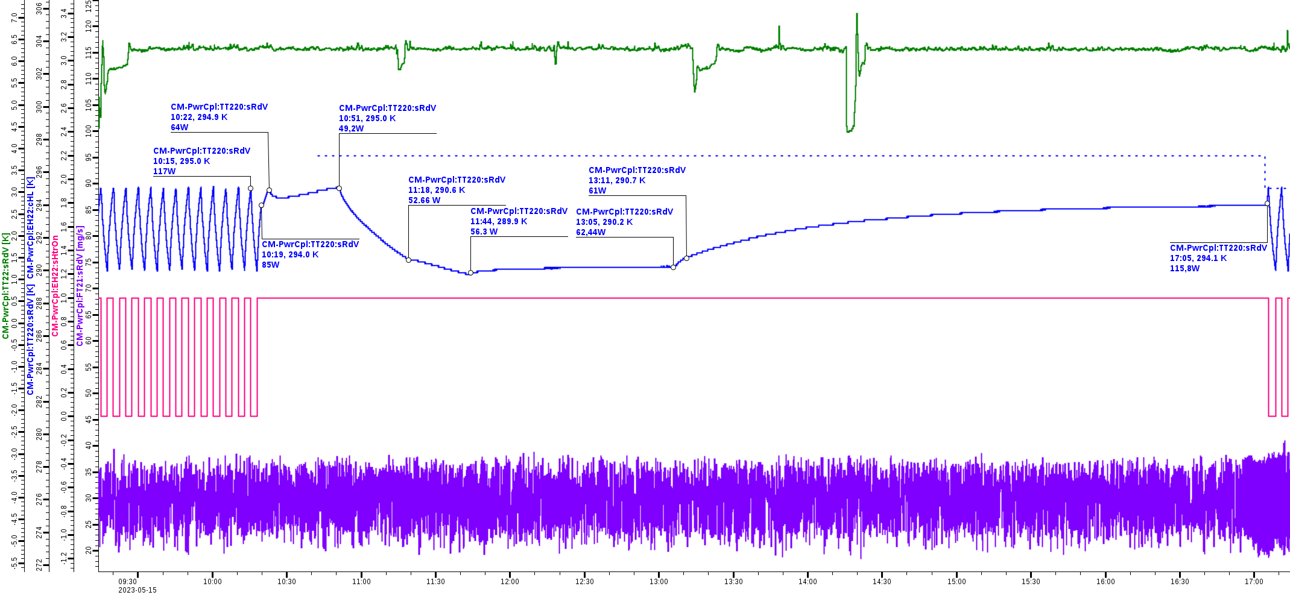
Task from Nuno No.1
(coupler #2, i.e. CavOut)
Green – TT22
Blue – temperature TT220
FT21 mg/s

Slide 6
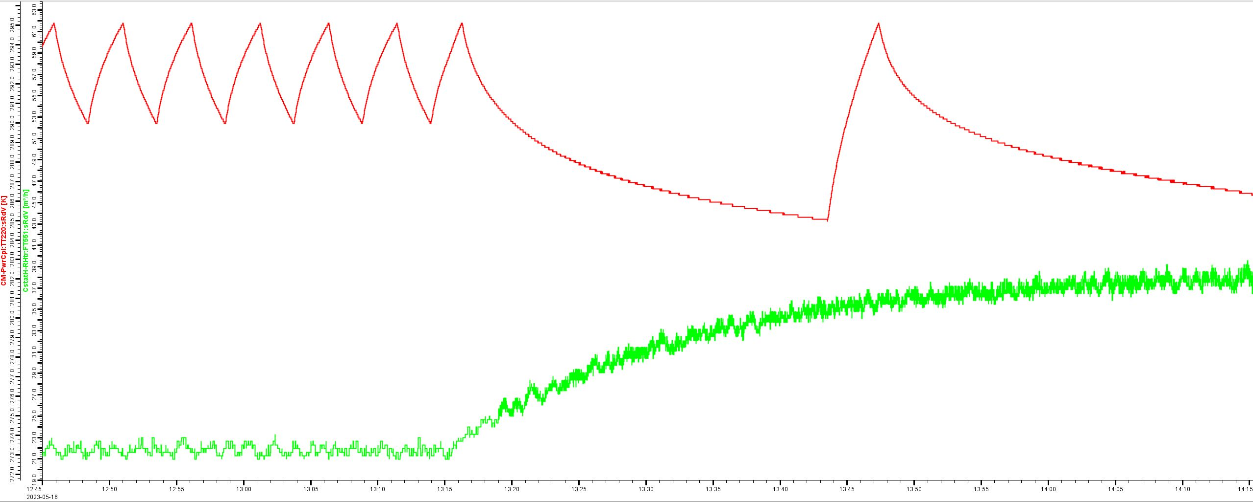
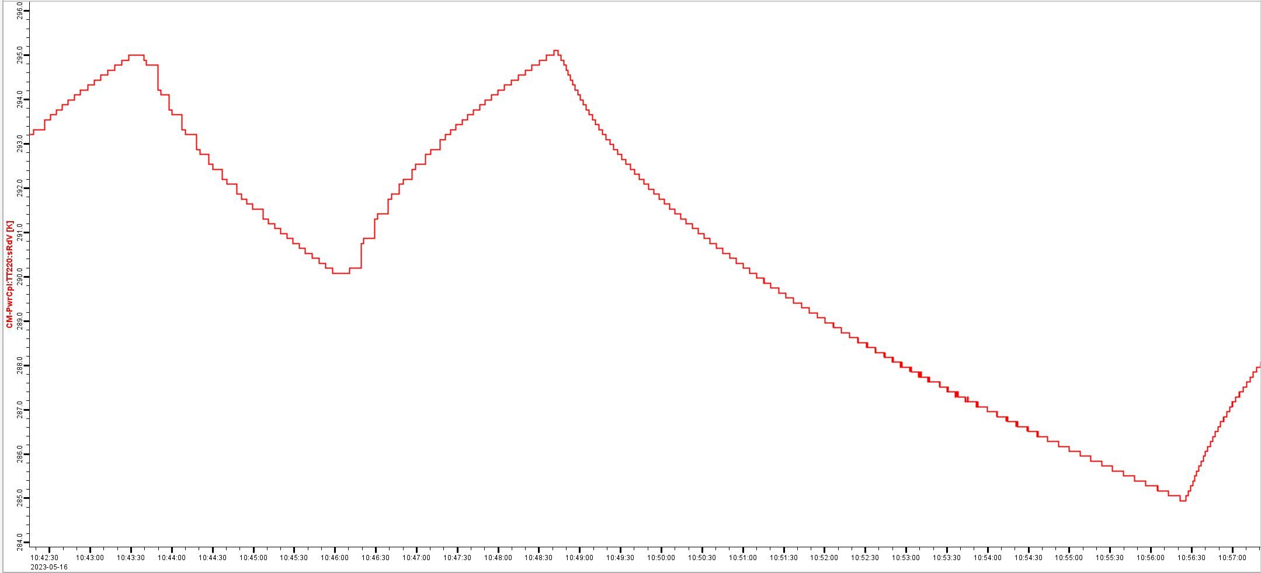
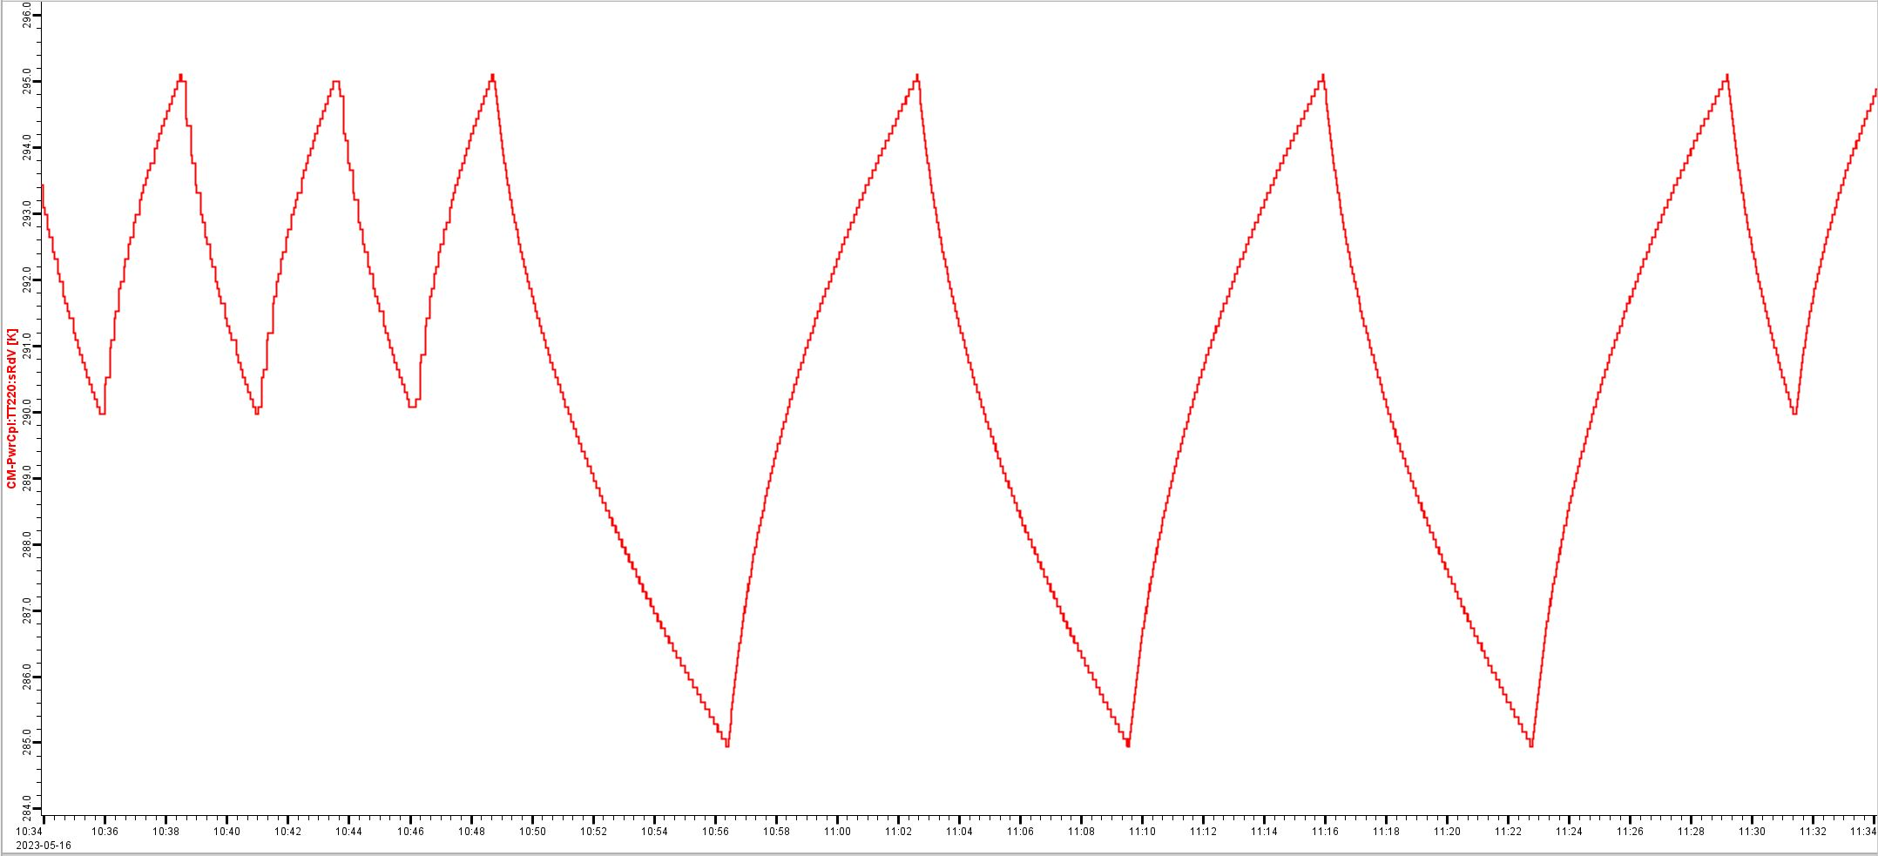
Task from Nuno No.2
Cooling effect of the coupler window with EH22 switched OFF and CV21 closed
Slope between 13:18 (291,8K) and 13:43 (285,0K) gives 0,27K/min
Slope between 13:52 (290,3K) and 14:15 (286,4K) gives 0,17K/min
Flow from 2K tank is highly affected by closing CV21
22 m³/h
37 m³/h
Cooling effect of the coupler window with EH22 switched OFF
EH22 lower limit temporarily set to 285K
Slope between 10:51 (290,2K) and 10:56 (285,2K) gives 1K/min. No change of exhaust flow from the 2K tank during this test.
Slope is similar in all three cycles with lower limit

Slide 7
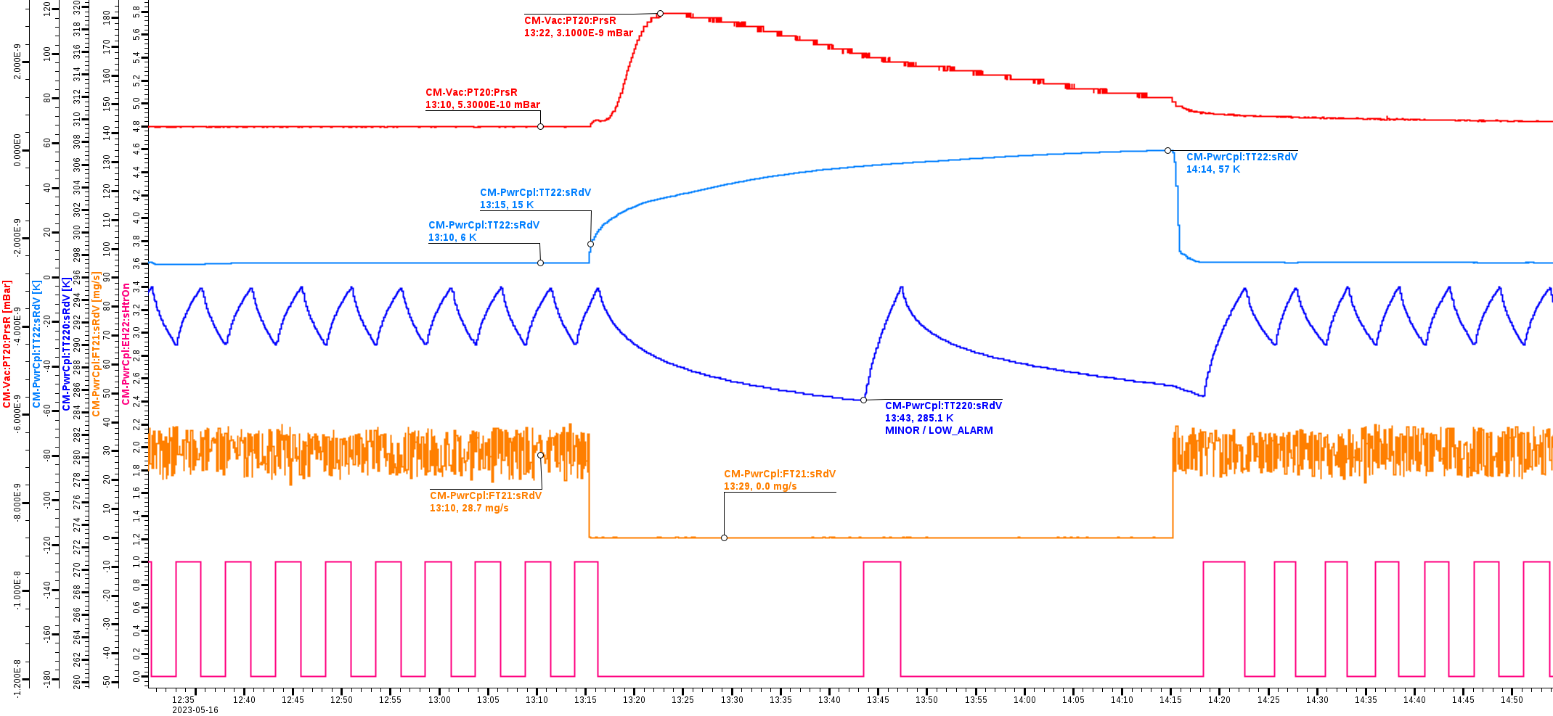
Task from Nuno No.2
Test result of closing SCHe line after DWT of coupler 2
Interesting to see a small bump in beam vacuum when DWT become warmer.
Beam vacuum
TT22

Slide 8
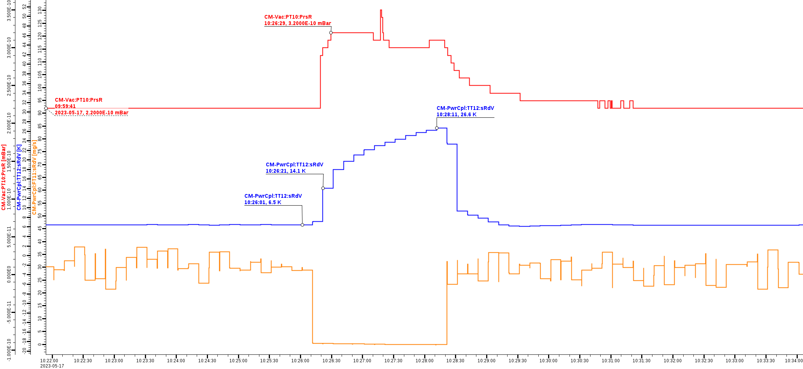
Task from Nuno No.2
Same test was done for coupler 1 side.
Beam vacuum rich one order of magnitude lower then for coupler 2 side.
Beam vacuum
TT12
RGA didn’t show He signal (May be to small outgassing).

Slide 9
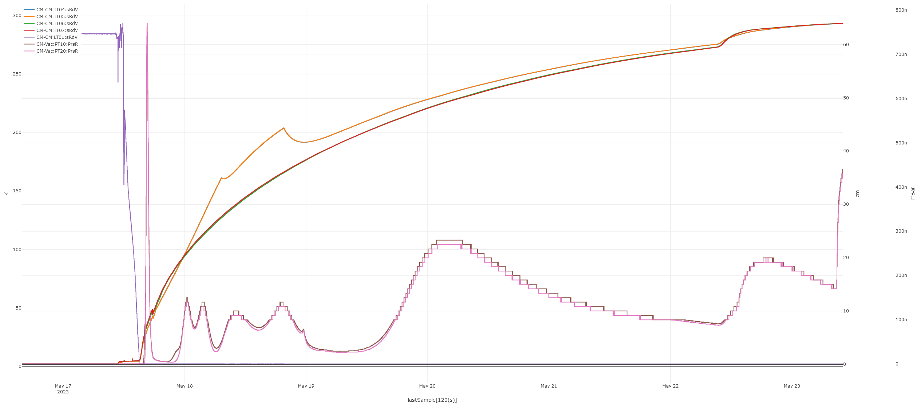
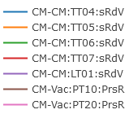
Warm up
293K
275K
Insulation vacuum
Was vented
2K
4K
CTS Home procedure was done before warm up. Success from 2nd try.
 | 2K | 4K | 274K* | 285K**
Cav1 [MHz] | 352,1357 | 352,1555 | 351,7176 | 352.6272
Cav2 [MHz] | 352,1425 | 352,1538 | 351,7231 | 352.6282
* Before venting of insulation vacuum
** After venting of insulation vacuum

Slide 10
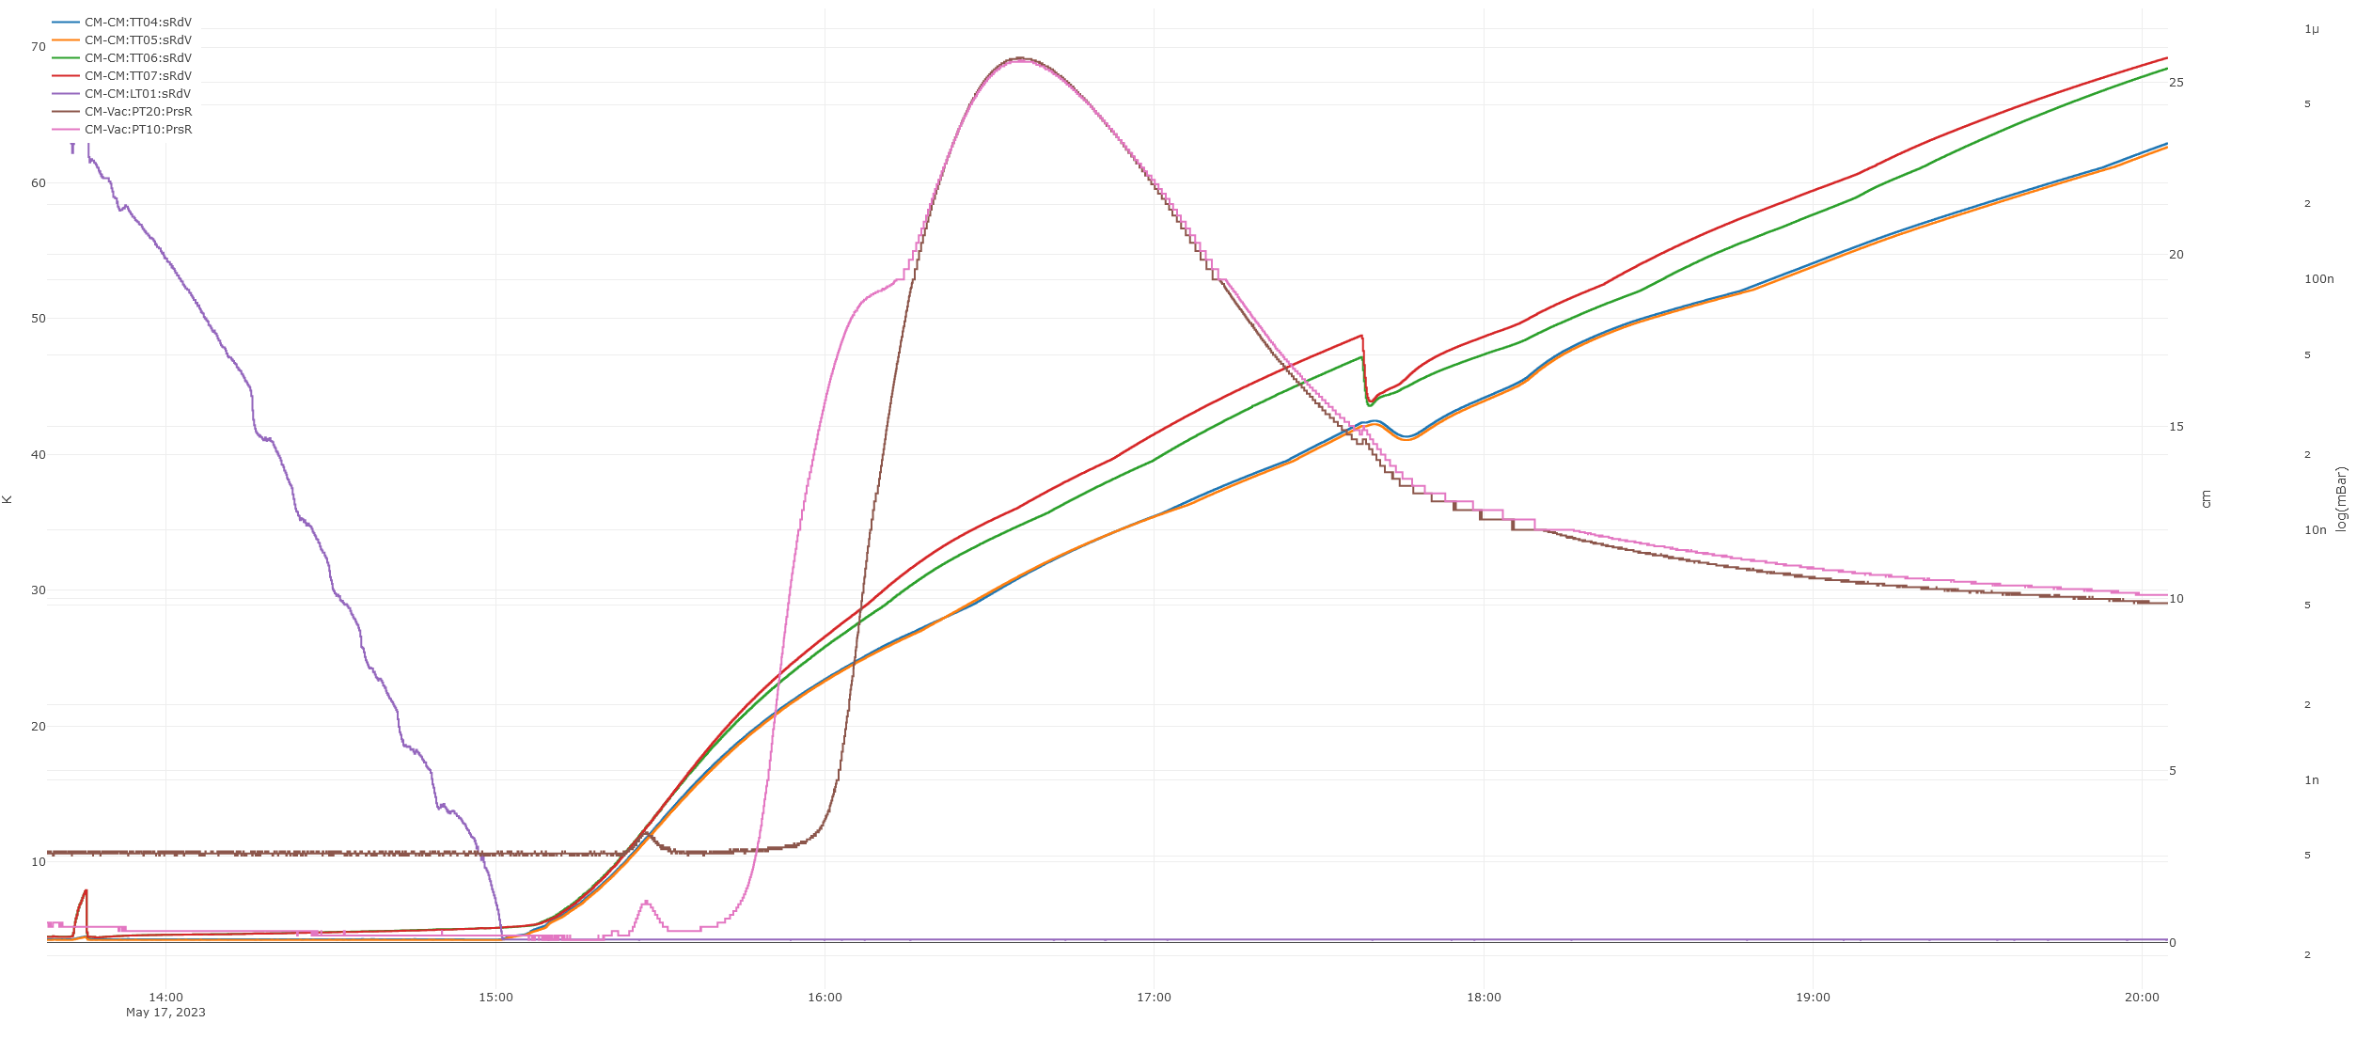
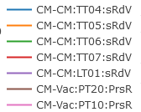
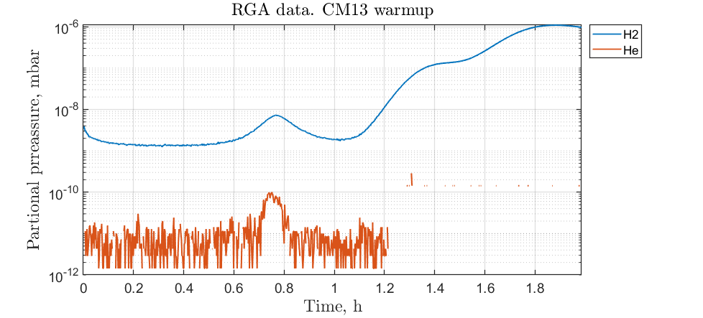
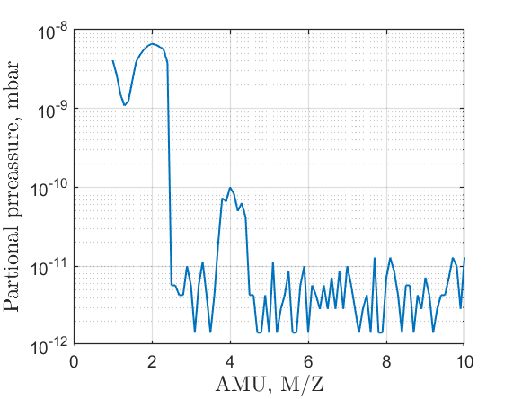
He signal during warm up
“H2”
7.7E-7 mbar
7.4E-7 mbar
“He”
6.2E-10 mbar
3.2E-10 mbar
Slice #322

Slide 11
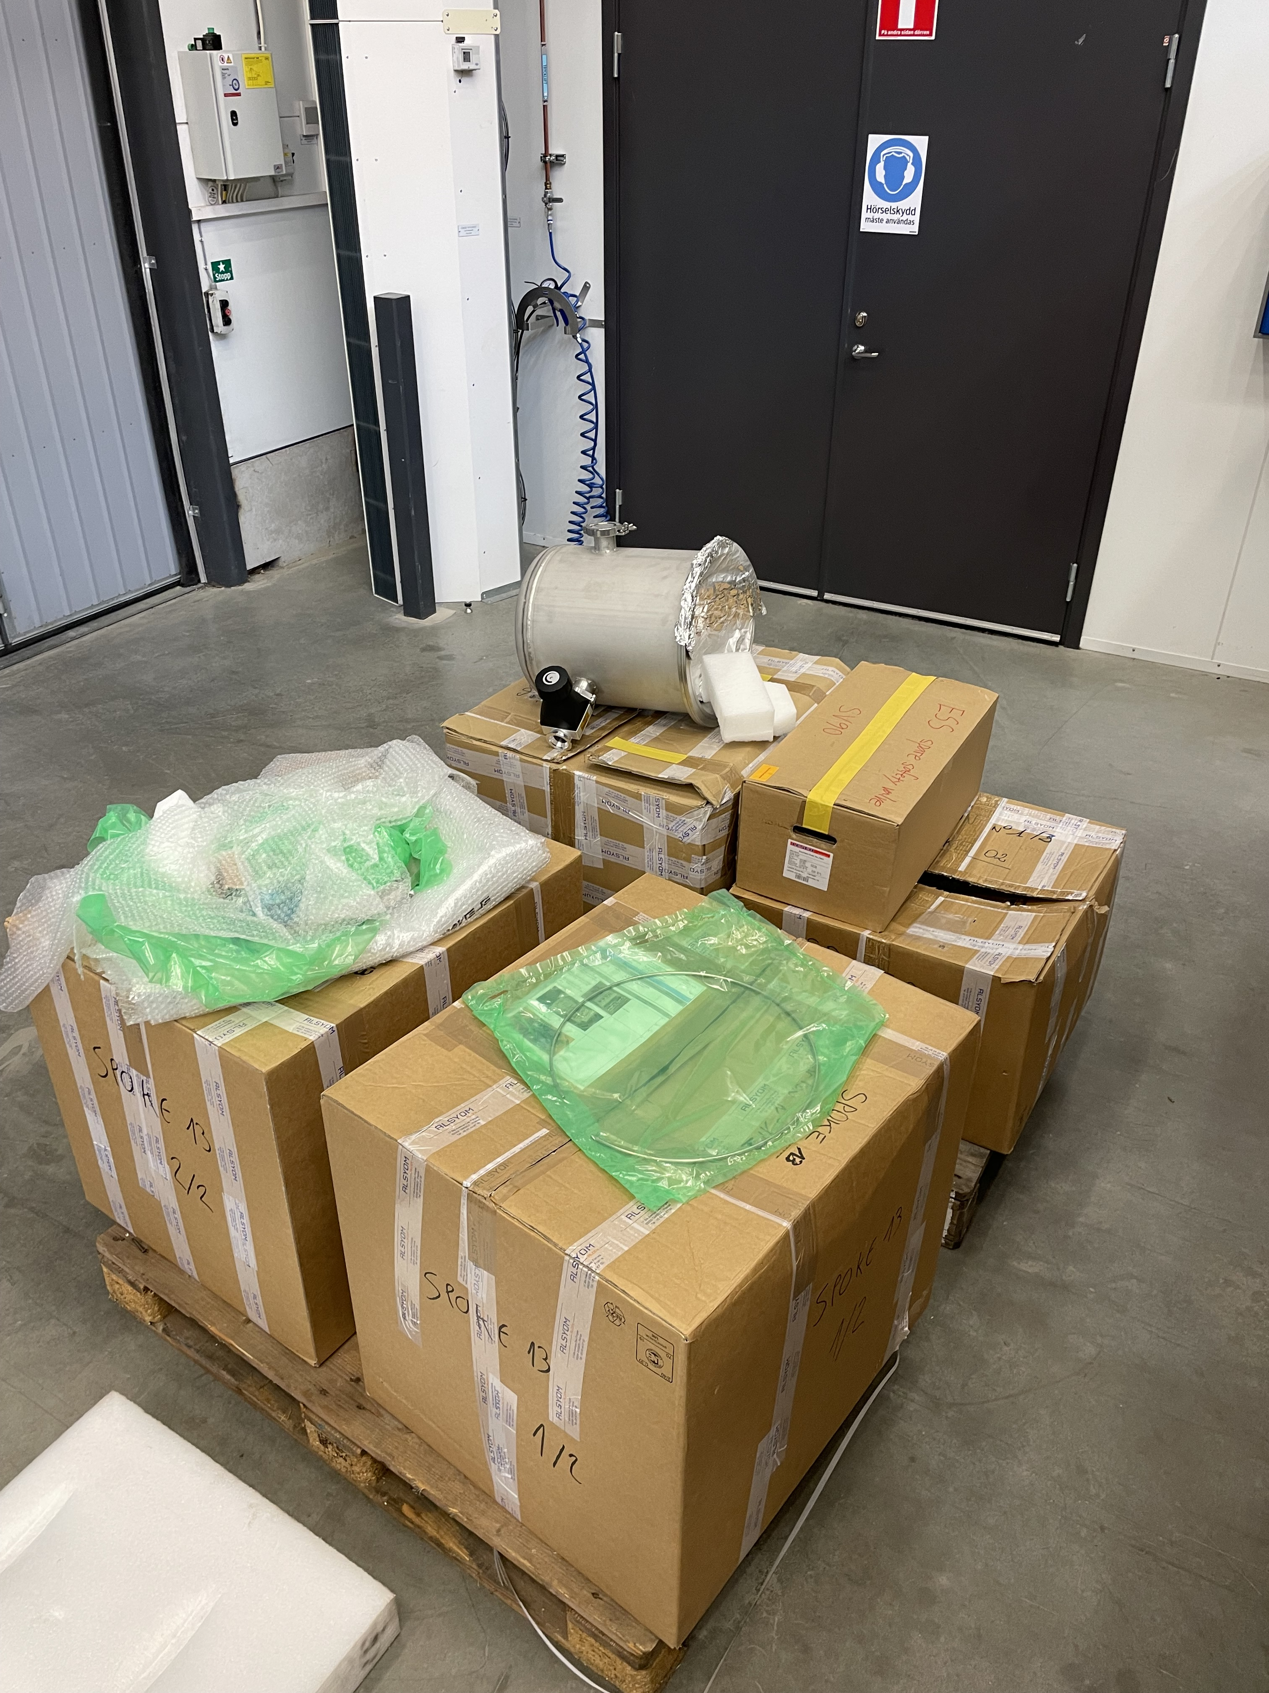
Preparing CM13 for shipment to ESS
We are not sure that we have in FREIA this aluminum parts for CM02
CM02
CM13

Slide 12
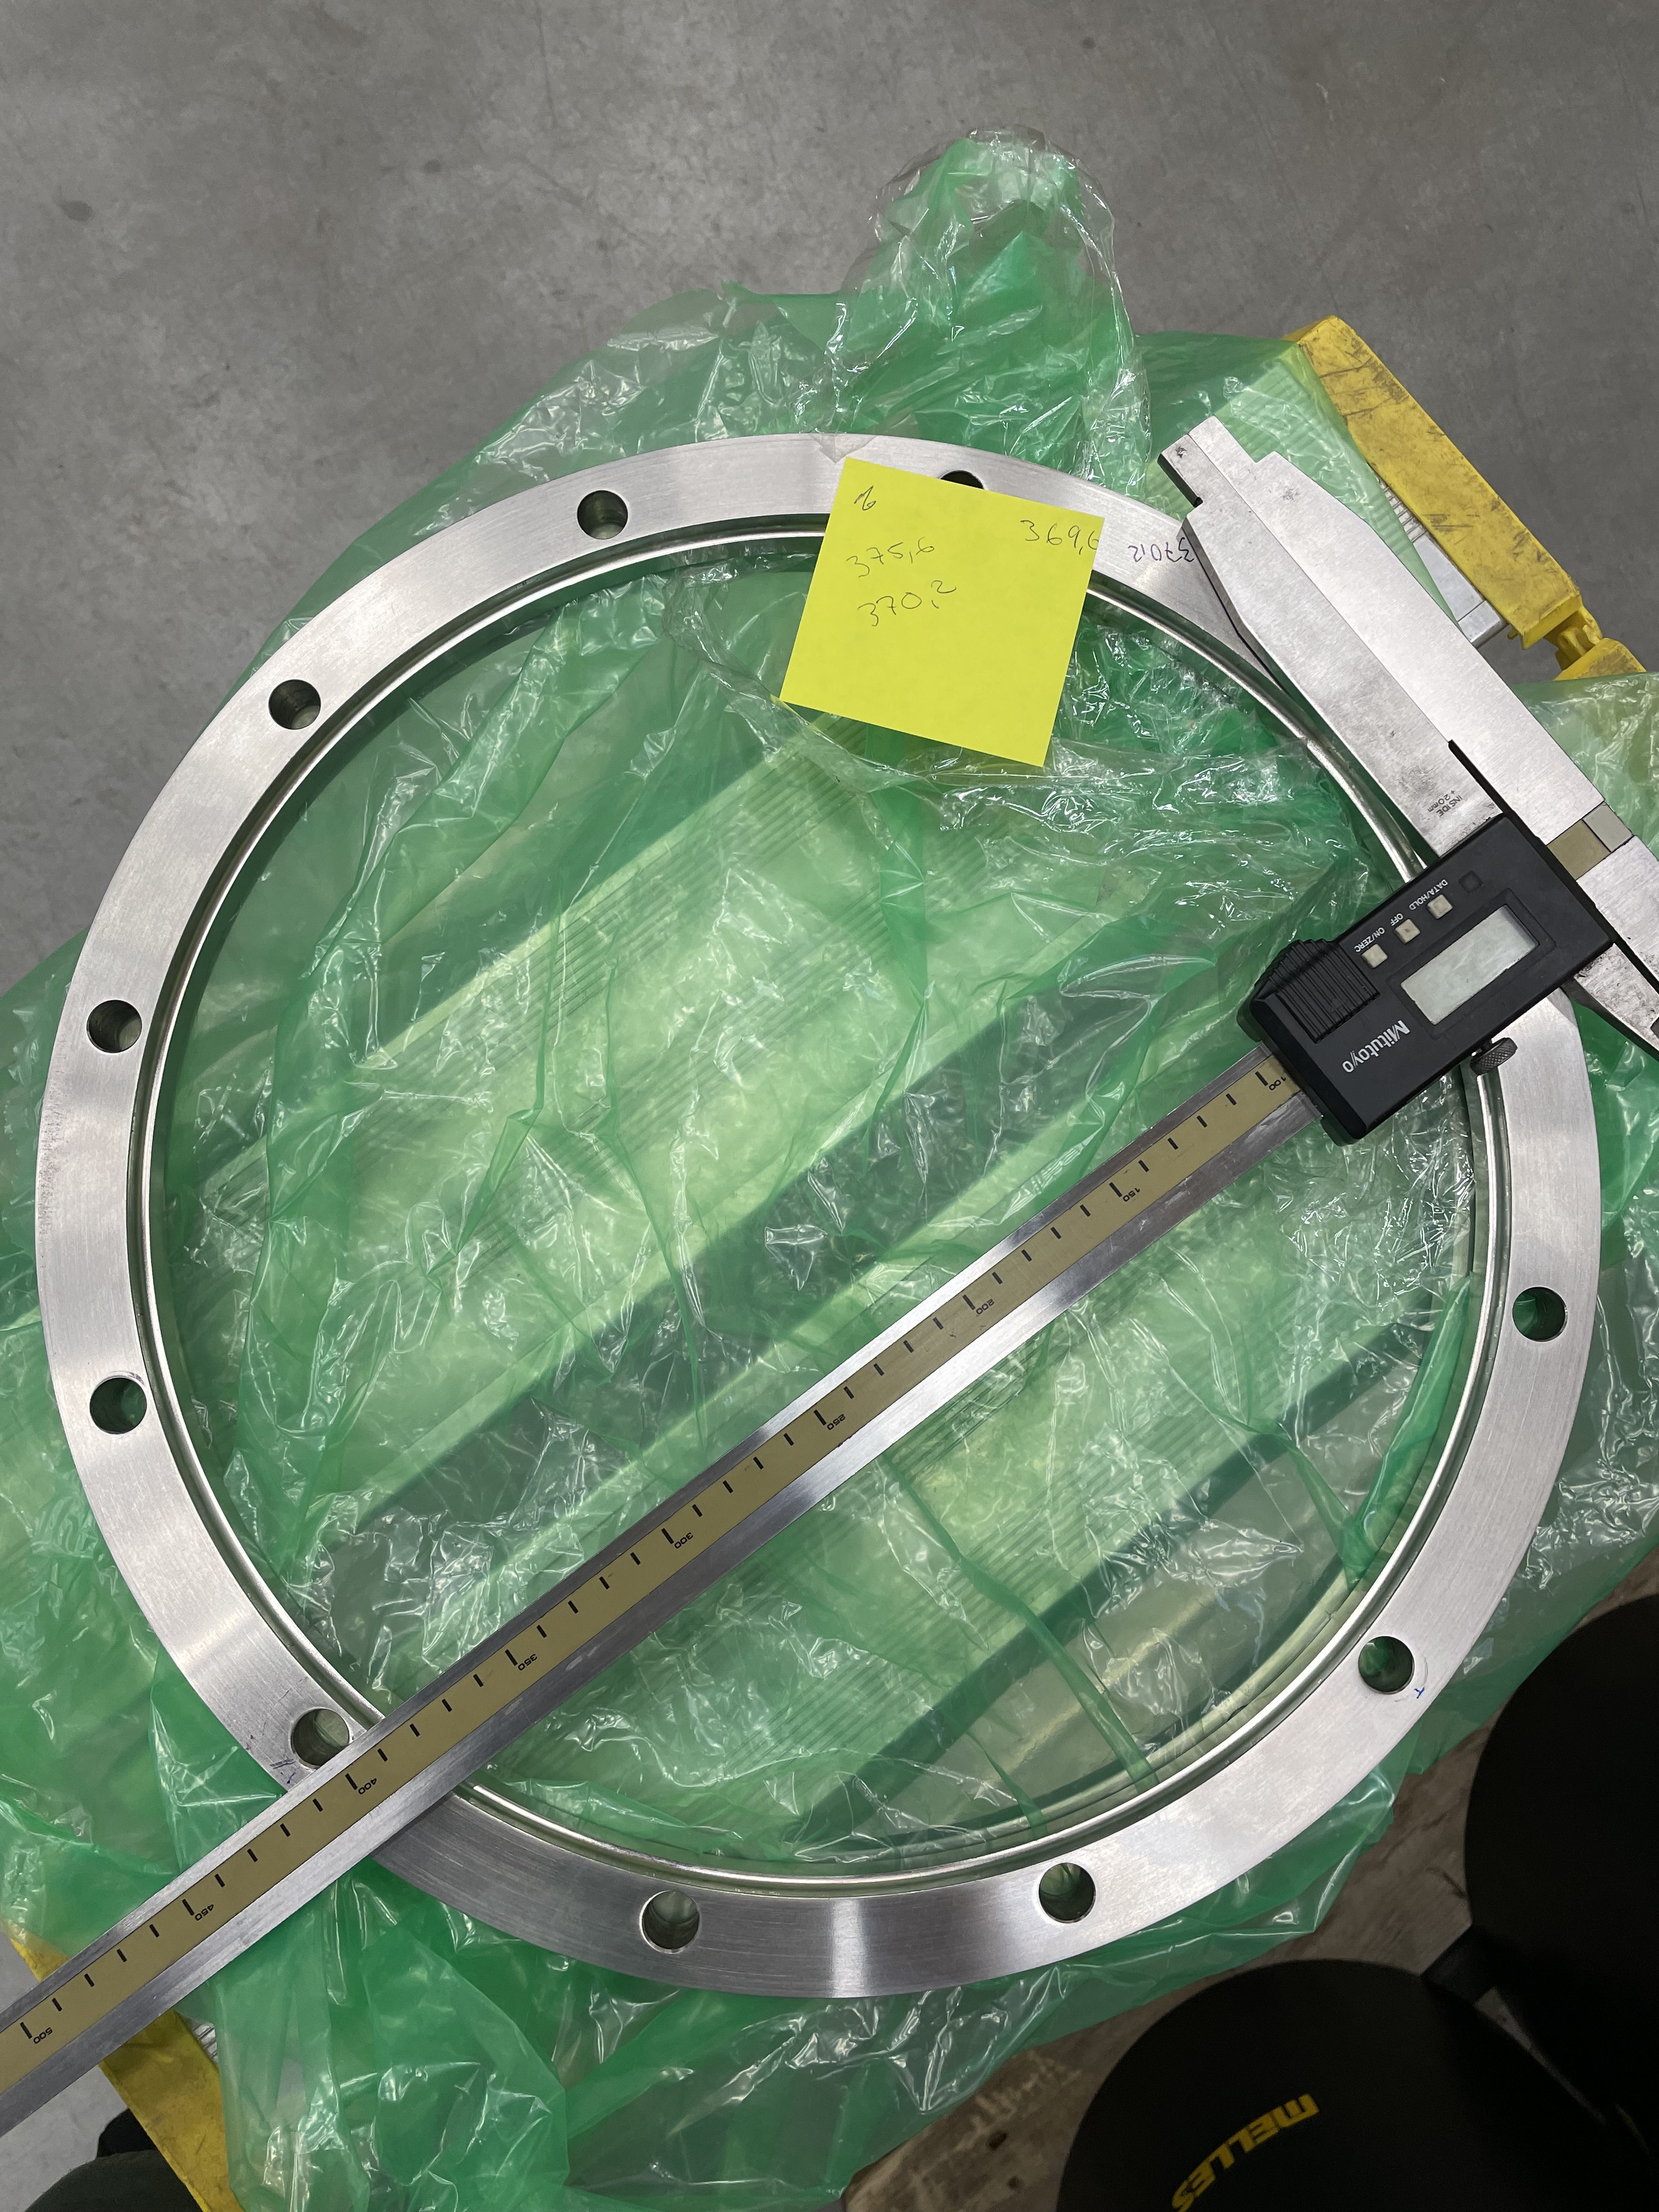
CM13: Non-conformity
The flange between CM and jumper for cryo connection was re-machined 1 mm in radius, as it didn’t fit (from the accessories box for CM13).
Couplers and cavities looks more contaminated than usual. A lot outgassing during couplers and cavities conditioning.
RF power meters in the beginning of cavities conditioning was wrongly setup ( AVG mode instead PECK). So we are under estimate Cavity field. Mistakes was founded and fixed. All measurements was remeasured.

Slide 13
CM13: Non-conformity
Periodical problem with CTS “Homing procedure”. When we press “Home” button in EPICS interface, SM move back until hit Limit SW. After it start move in forward direction for 26.5 turns but some times it didn’t stop and continue move. We are manually stop it and repeat “Homing procedure”.
Limit SW
Home
Target Freq.
-26.5 turns
0 turns
~300 turns
Home
Didn’t stop
Stop
Home
OK
2023-05-17 Issues
CTS1: Homing takes longer than expected. Stop it at 23 turns forward. Repeat homing again works normally. LS switch blinks and stop at 0 (offset 25.6) CTS2: Homing works but limit switch does not go off. Go forward a few turns and it goes off. Home again. LS blinks goes back on but goes off again before homing is finished. So OK.

Slide 14
SRF2023 Contribution
June 26th 9:10 – 9:30 Henry Przybilski, "Progresses in the ESS Superconducting Linac Installation"
June 29th 8:40 – 9:00 Rocio Santiago Kern, "Completion of Testing Series Double-spoke Cryomodules for ESS”.
June 29th 9:00 – 9:20 Guillaume Olry, "Performance Analysis of Spoke Resonators, Statistics from Cavity fabrication to Cryomodule Testing”.
Paper submission deadline is June, 18th

Slide 15
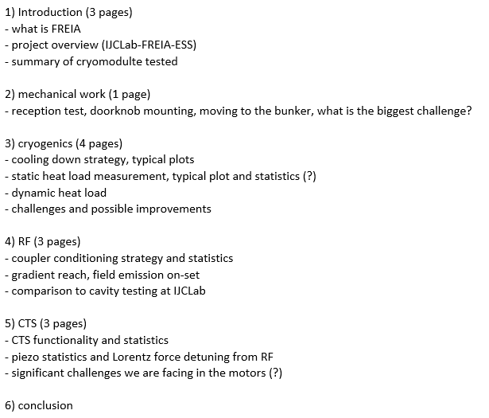
Suggestion for FREIA’s talk from Akira

Slide 16
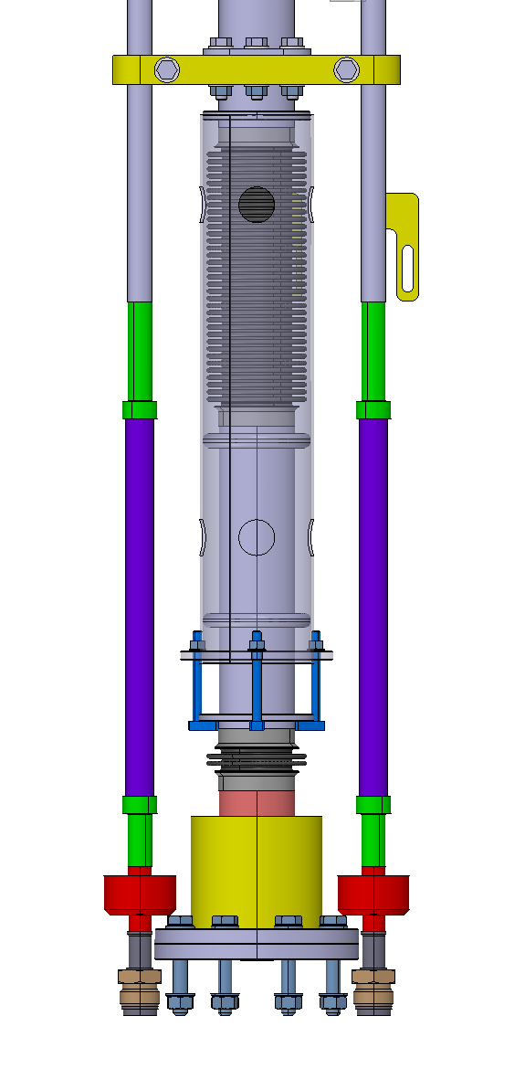
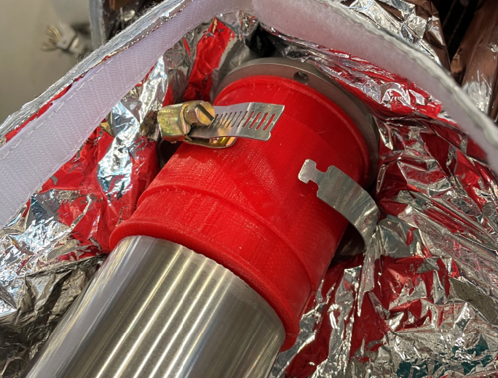
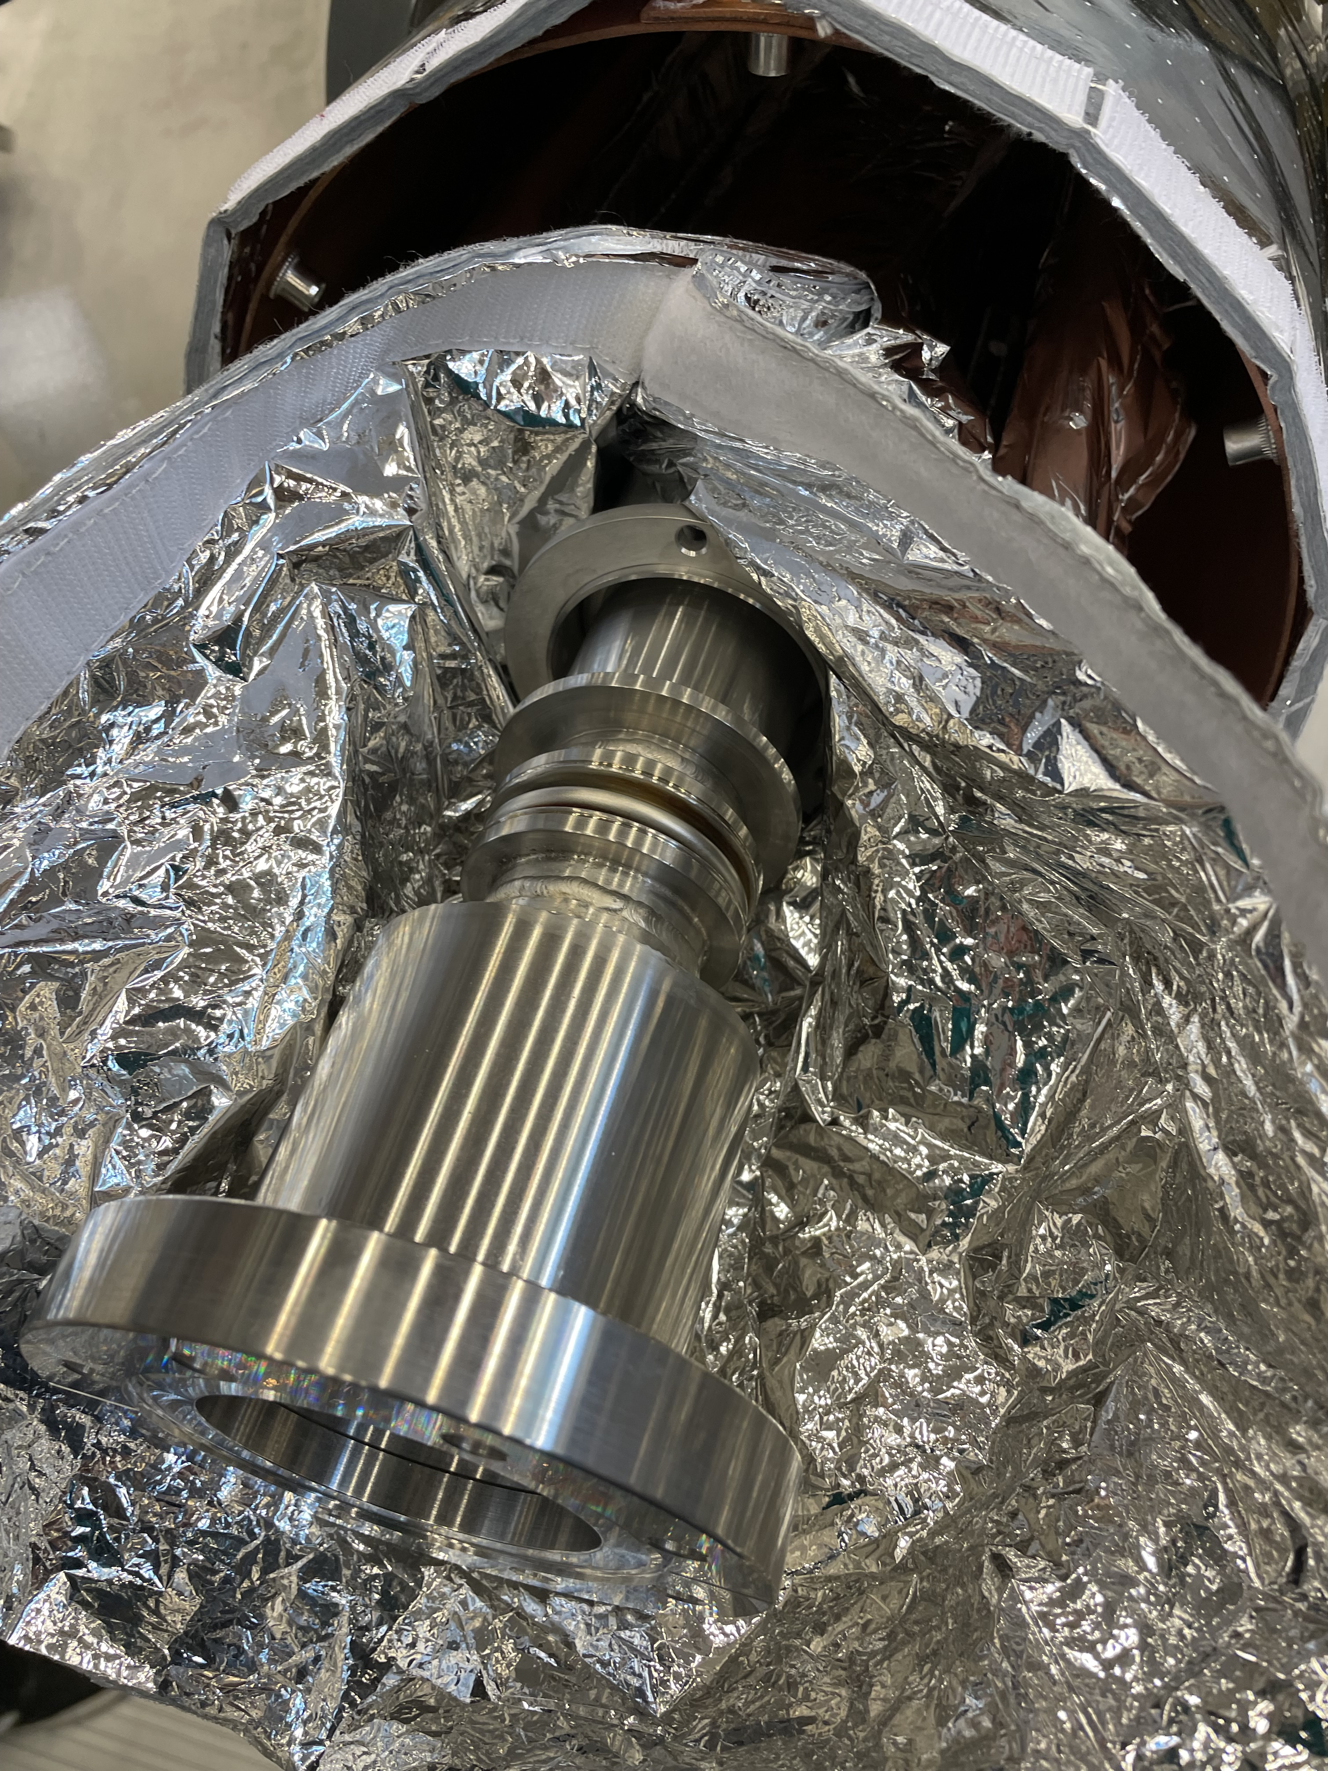
Extra slide
Assembly of bellows are free (didn't stack) inside guiding tube. We think that bellow (2) is stiffer then usual what can explain small longitudinal flexibility.
Red 3D printed part is use all the time for securing of He pumping port.
We have never saw that threaded rods (blue on the drawing). We guess that they need to compress bellow (2) during connection CM to VB
2
1

