Slide 1
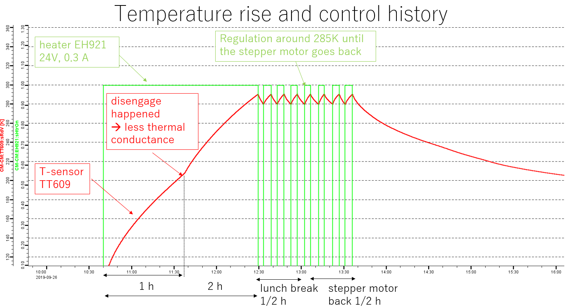
Tuner testing CM14
Test overview
Cryomodule qualification as usual
Include normal tuner qualification, go to 352.210, then back
Disengage system qualification (surprise ☺)
Require 3h for heating, and 40h for cool down
➔ see Akira report 30th September 2019
EOL motor test

Slide 2
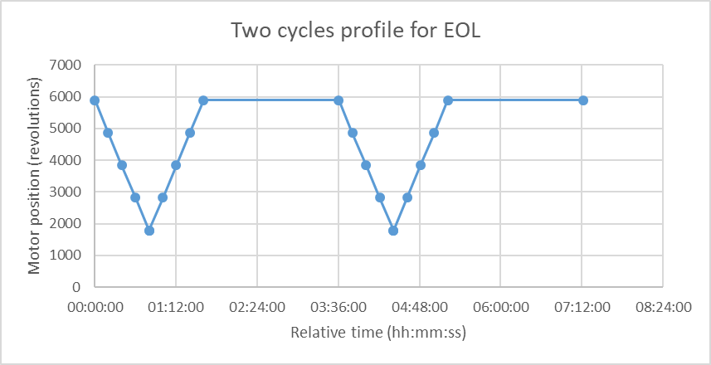
EOL motor test
Require both motors to run at same time
First Go to “EOL test - max position” [5888 ? tbd]
Go for one cycle :
Backward N revolutions ⬅if N = 4096 (max motion from 5888 revolution position), 45 minutes
Then forward N revolutions ⬅ same as above
Then hold for xx minutes to not let the motor reach 200 K (arbitrary) ⬅ Typically 2 hours
Record cavity frequency at least on max and min position for each cycle
Use normal motor parameters (0.6 A motor current & 1.5 revolutions / second)
Motor is expected to fail after 200k revolutions, +/- 200k revolutions
I recommend to stop the test if significant lost of steps is observed (df > 10 % is significant)
Then try to go back home by motor action if possible, otherwise use disengage system to relax cavity
From EOL test at LN2 @IJCLab on April 2023

Slide 3
Cycle profile
Parameters used at IJCLab on April 2023 EOL test at LN2
Motor speed : 1.5 revolution/s
Start point (highest position) : 5888 revolutions
Lowest point (lowest position) : 1792 revolutions
One cycles duration (without pause time): 1 hours 37 minutes
Motor current (0.4 A, tbc)
Cool down time : 2 hours, in order to not exceed 200K on the motor (conventional)
Cool down is applied at max position for motor cool down efficiency
Total time for one cycle : 3 hours 37 minutes
Total working time to achieve 100 full tuner swing : 15.01 days (24h working day)
This assume one tuner swing is only 4096 revolutions, starting from 1792 revolutions
From EOL test at LN2 @IJCLab on April 2023

