Slide 1
ESS weekly meeting (2024 W05)
FREIA team

Slide 2
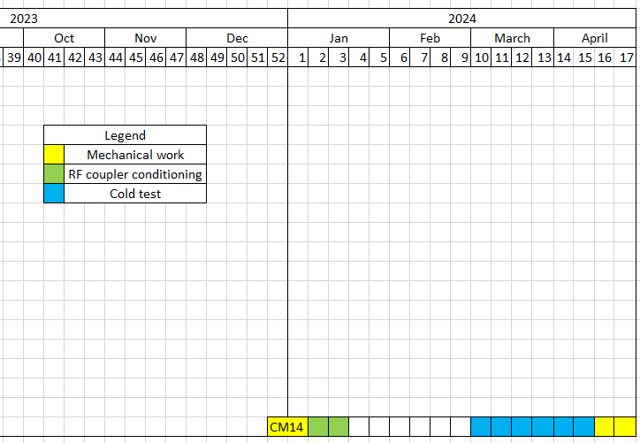
Global planning
We are here
Preliminary

Slide 3
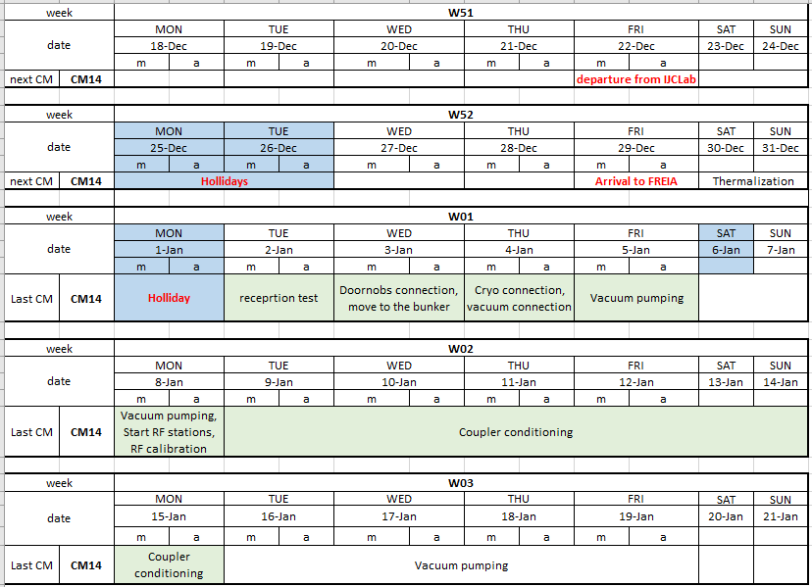
Local planning

Slide 4
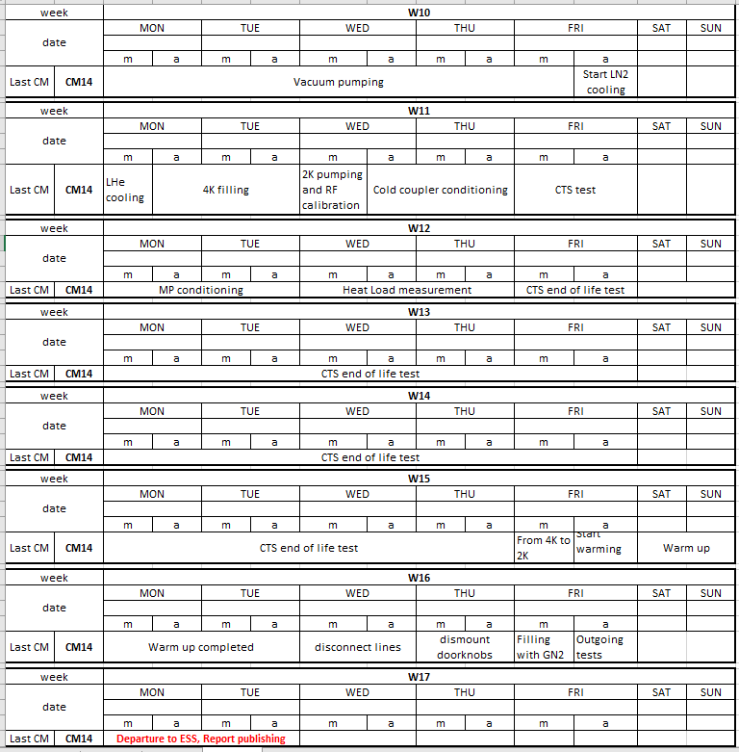
Local planning
~3 weeks for
CTSs end of life test

Slide 5
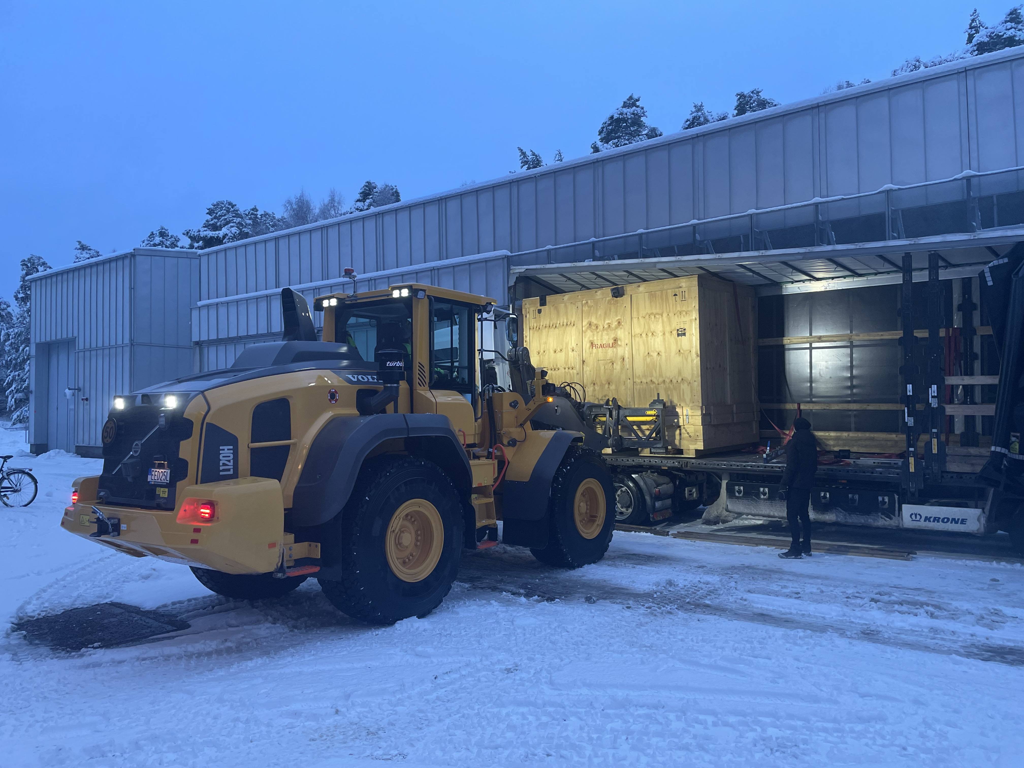
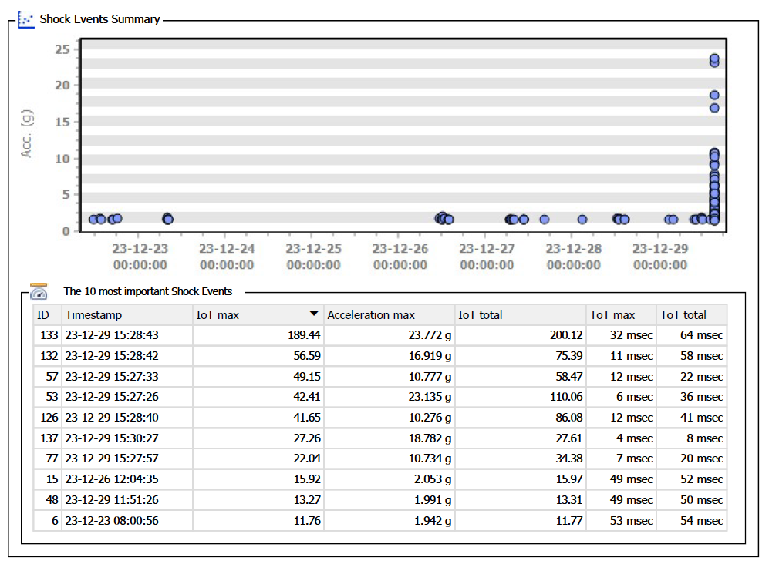
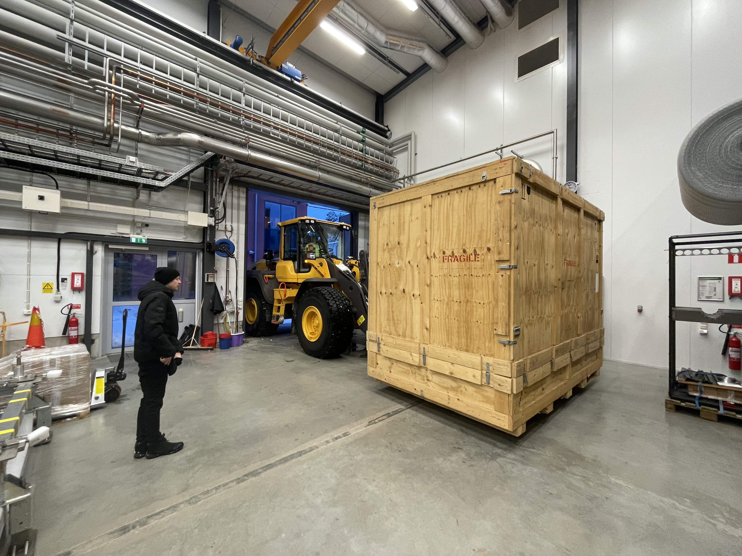
CM14 arrived to FREIA @ 29 Dec 2023
Biggest shock events due to dismounting of shock loggers
14:57

Slide 6
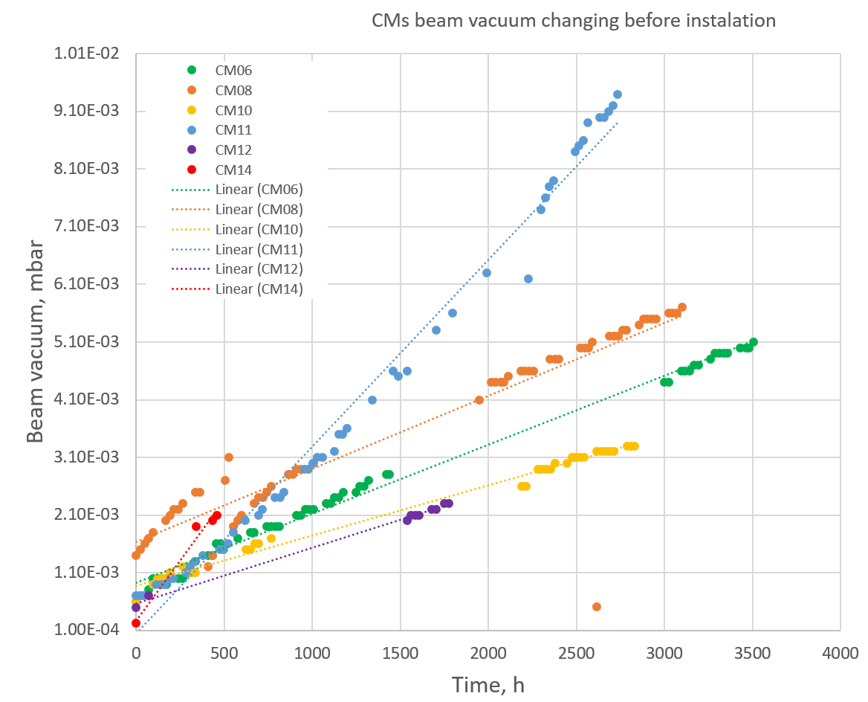
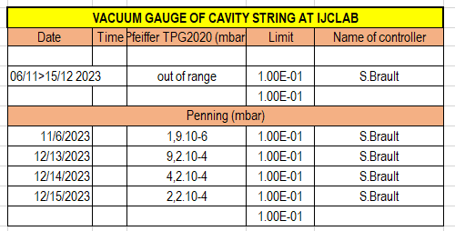
CM14 Beam static vacuum

Slide 7
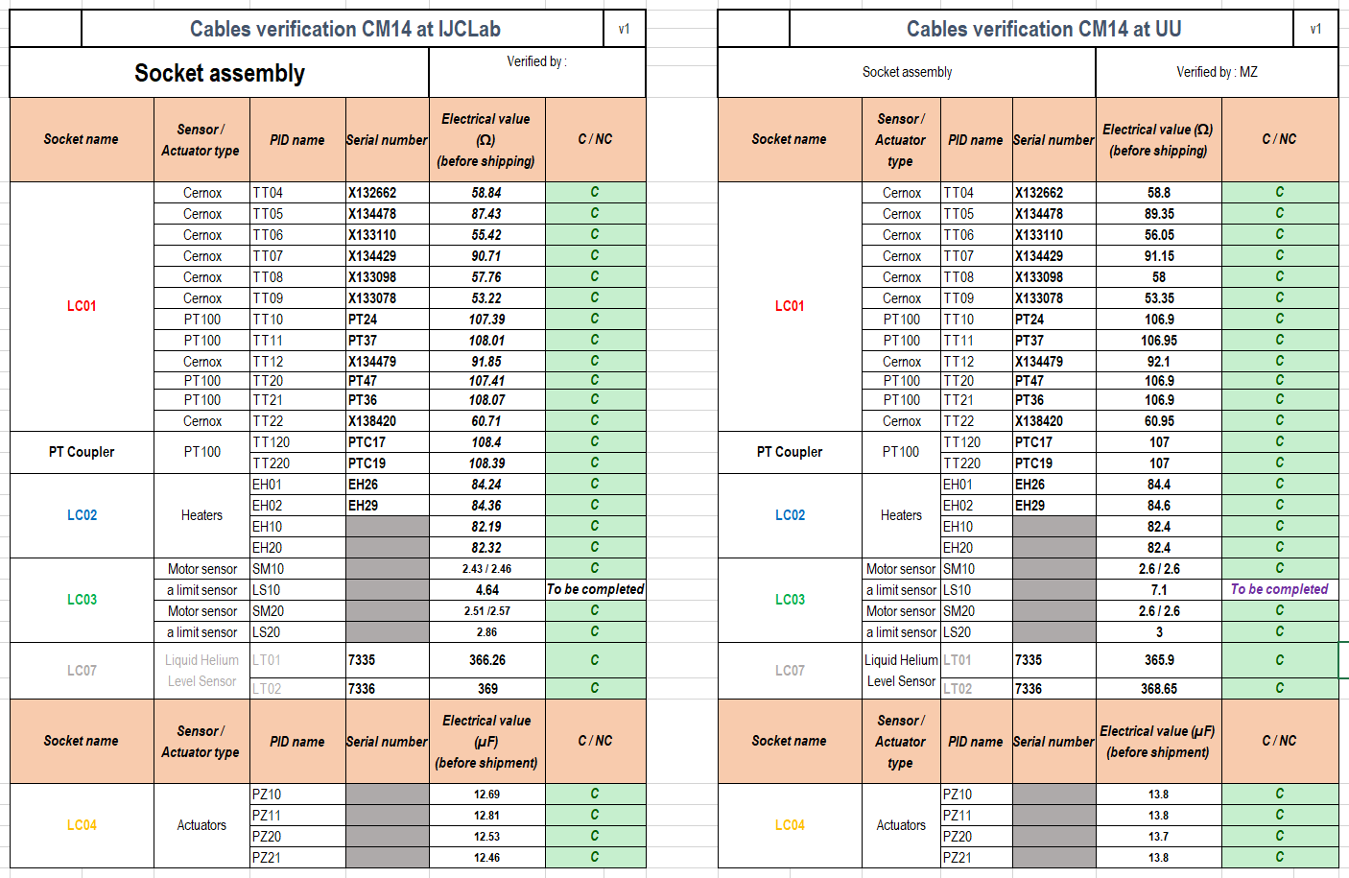
CM14 Instrumentation reception

Slide 8
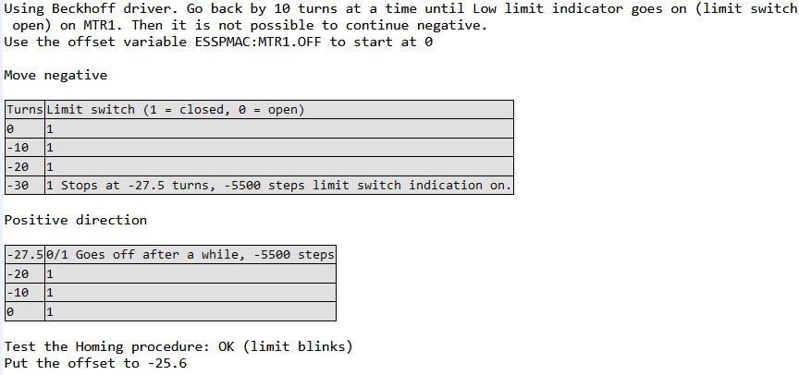
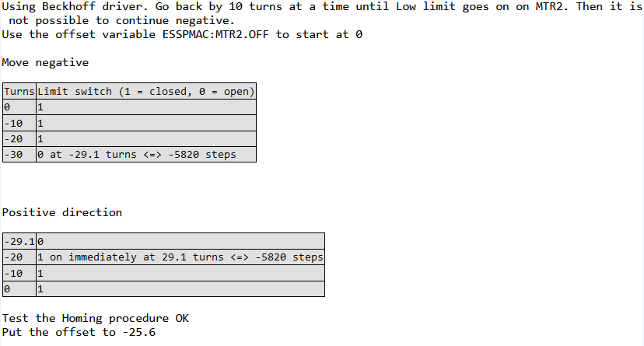
CTS homing test at warm
CTS1
OK
CTS2
OK

Slide 9
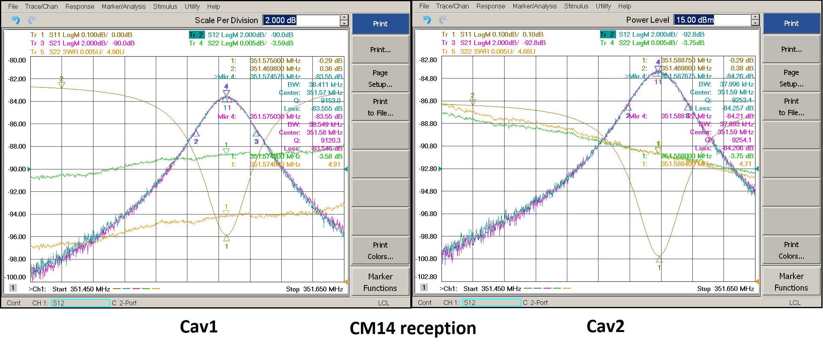
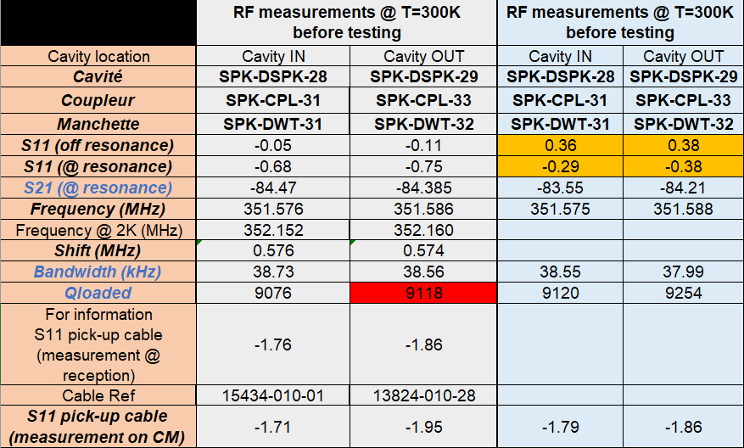
CM14 VNA reception

Slide 10
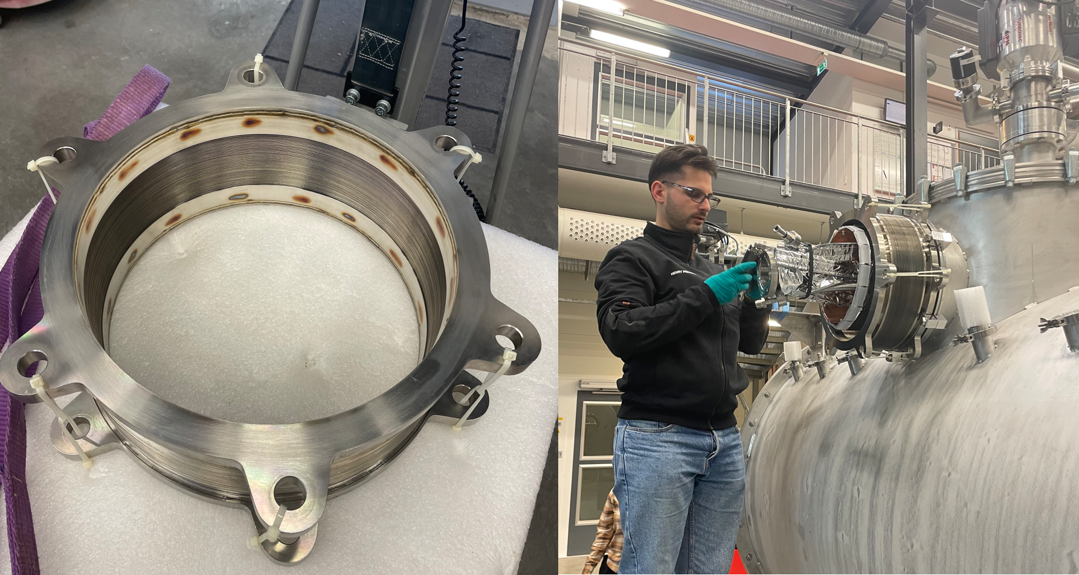
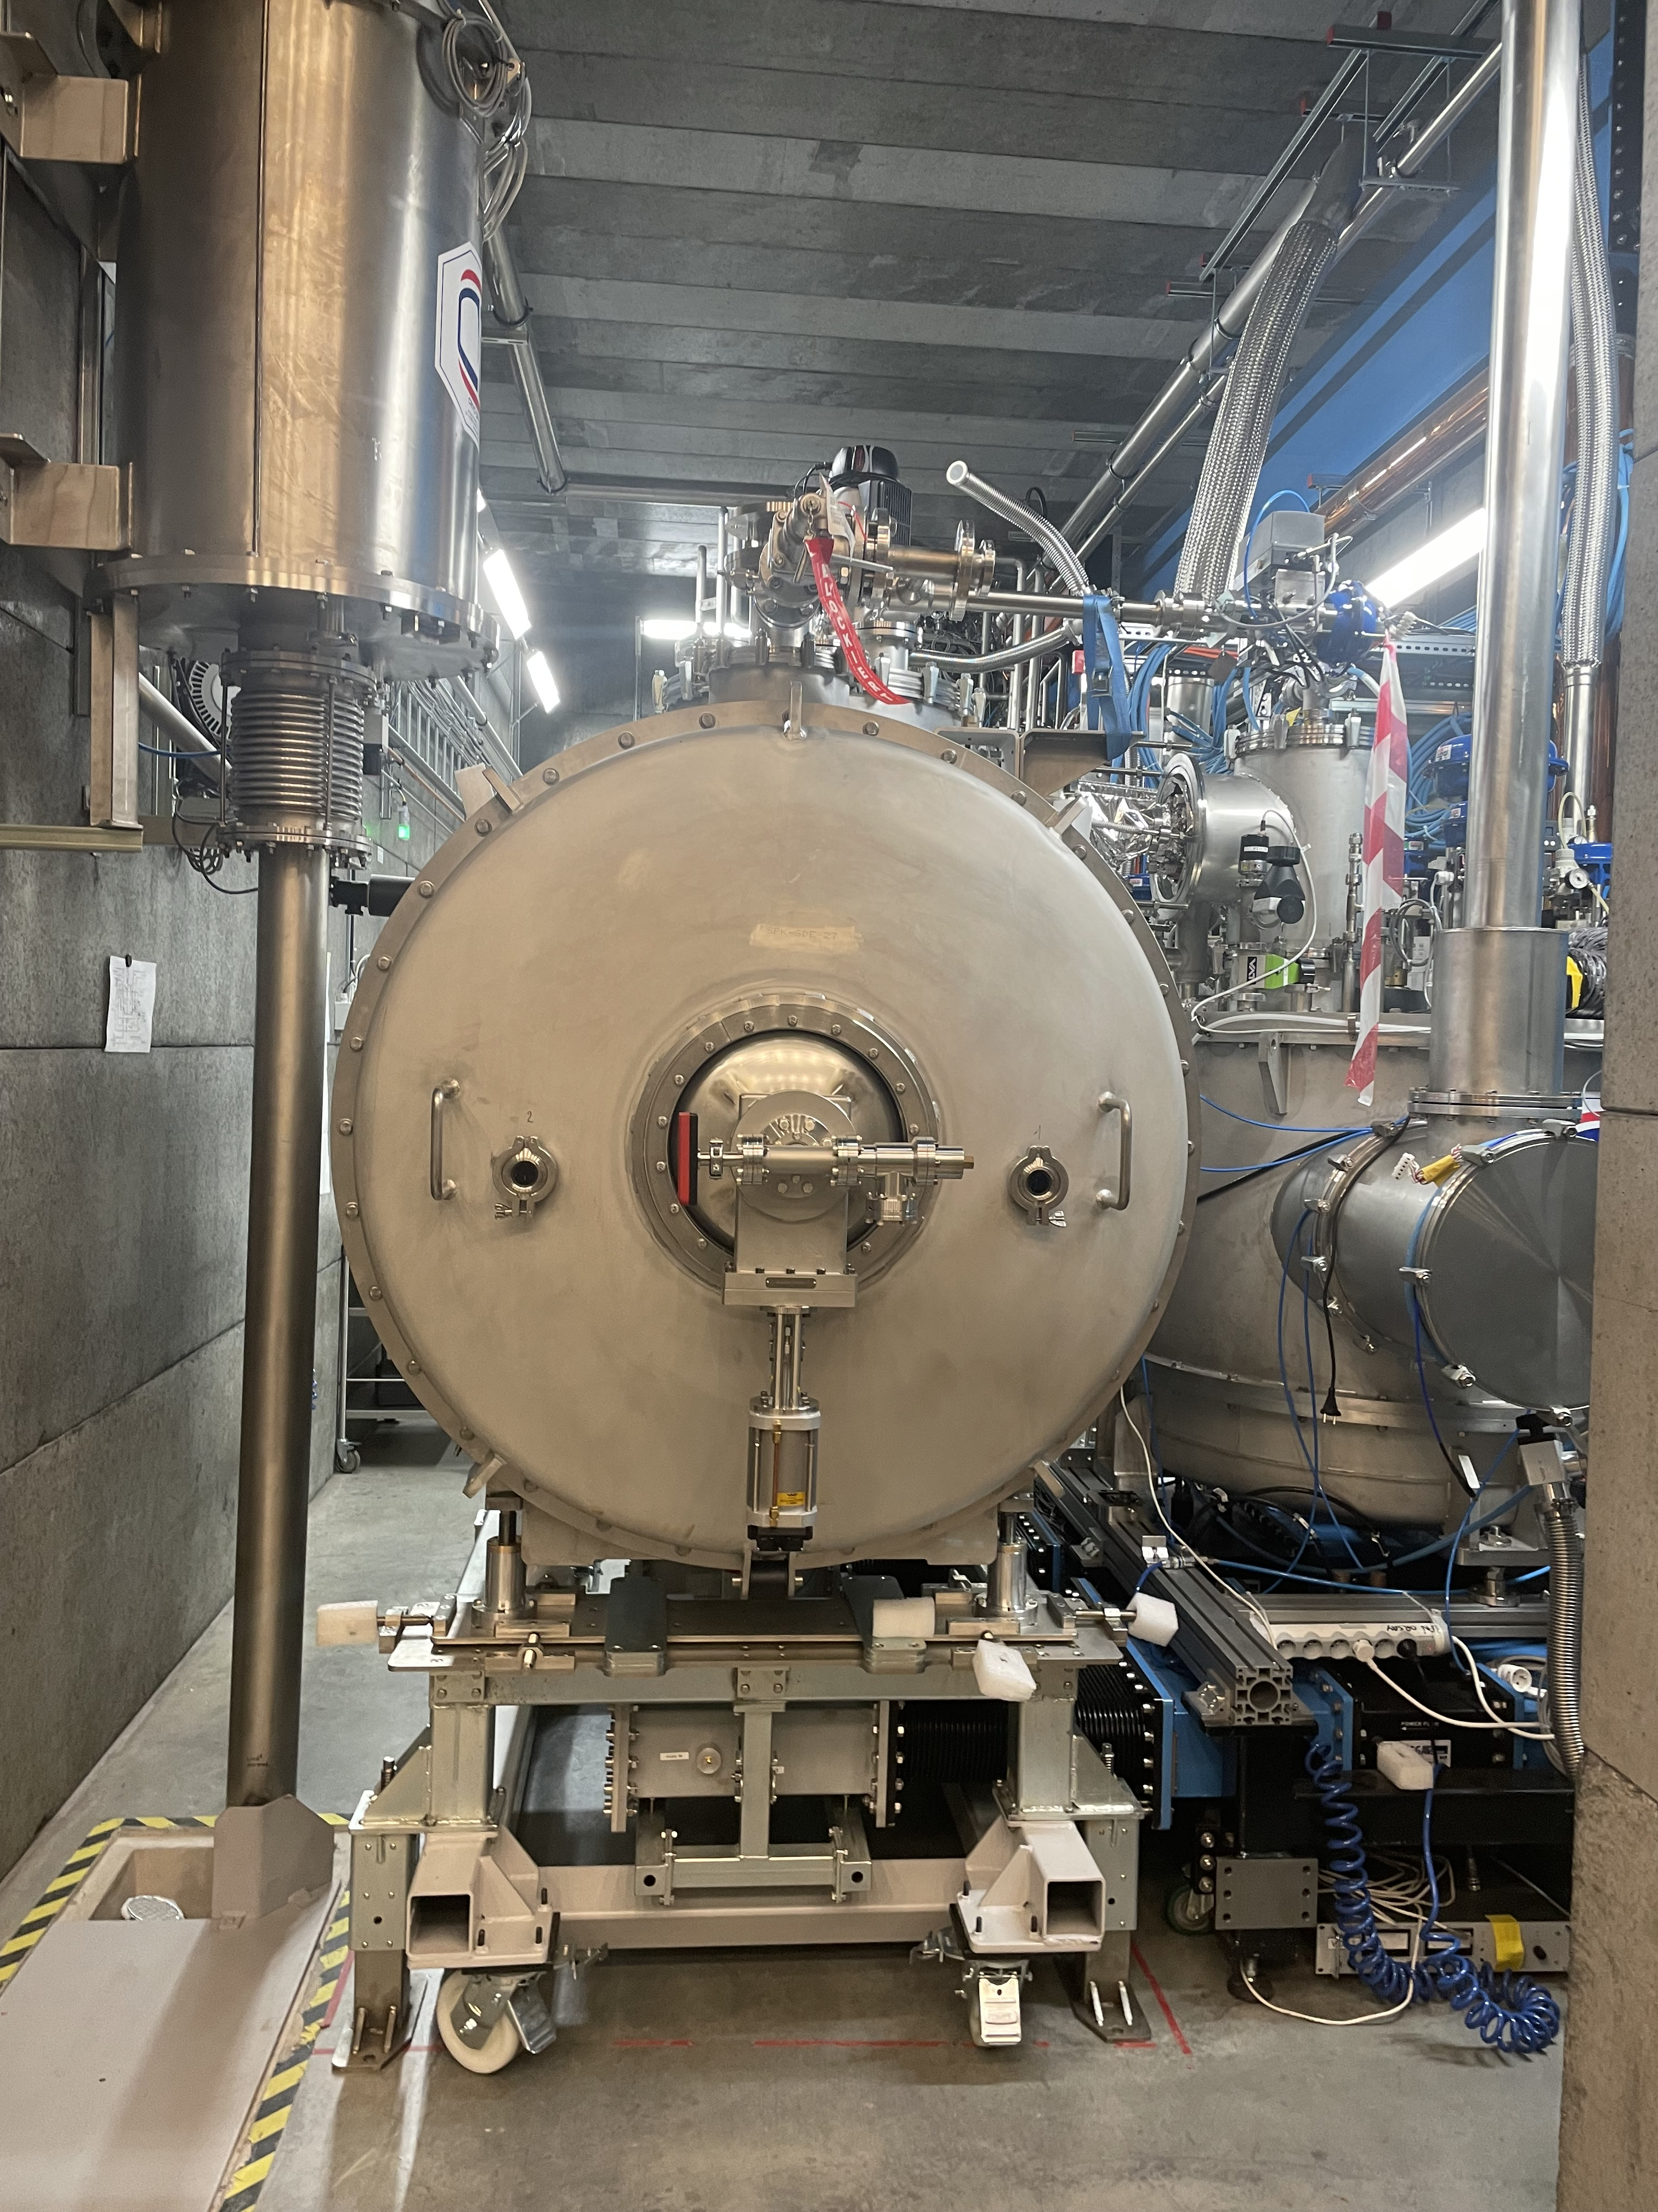
CM14 installation
This time we got a jumper bellow
(2 of them) in new design (prototype?). We think it little bit overstretch.

Slide 11
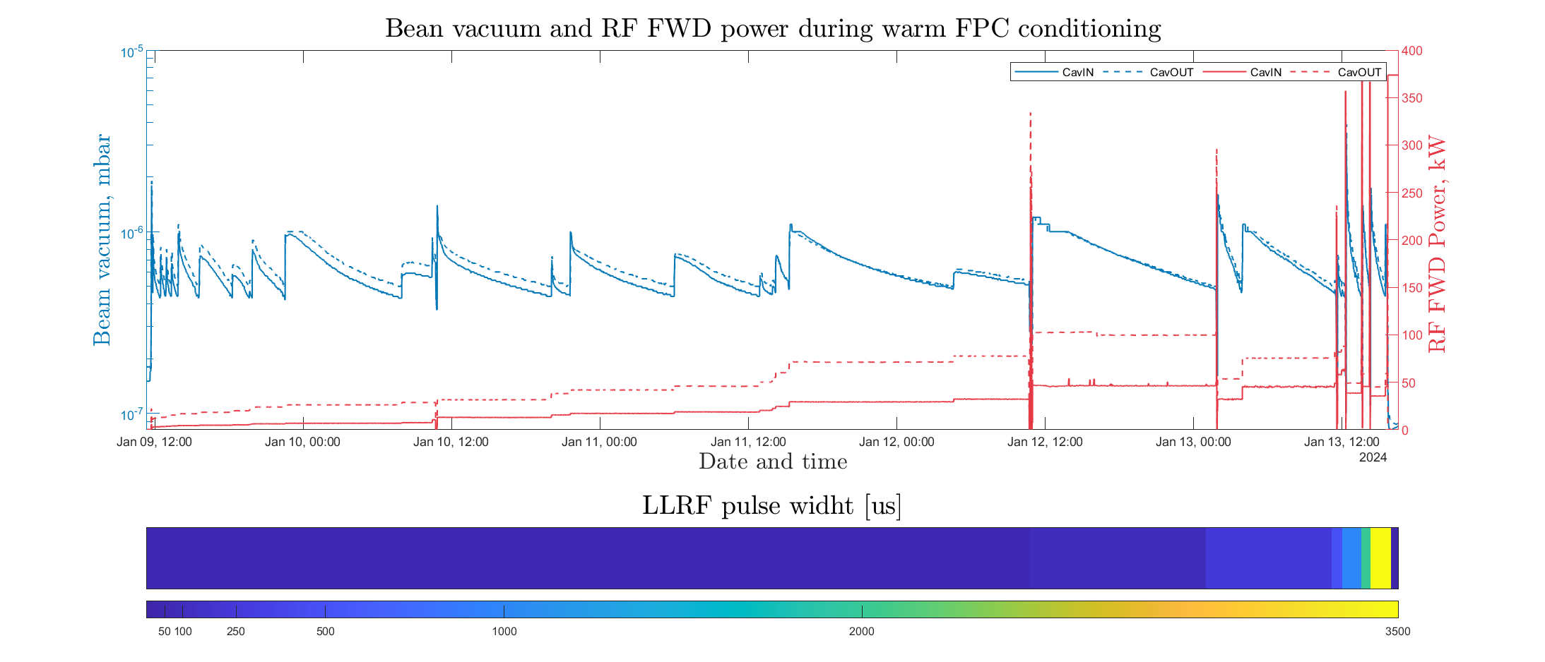
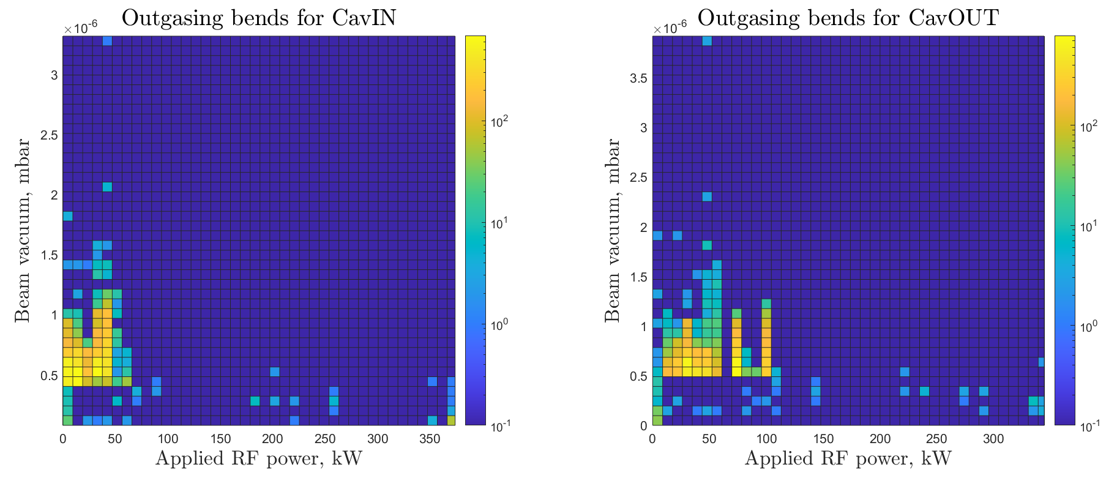
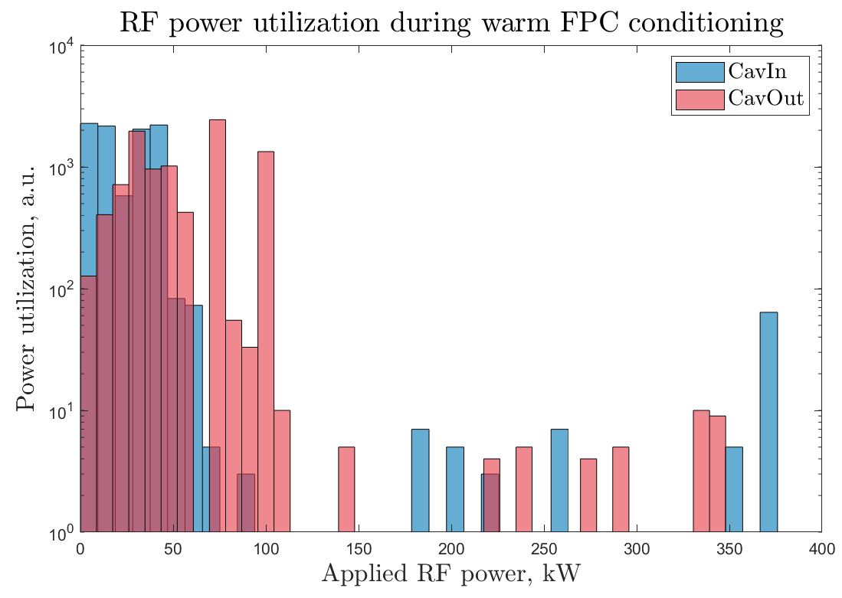
Warm FPC conditioning 1st run
101h
RGA data was lost ☹
50us
100us
250us

Slide 12
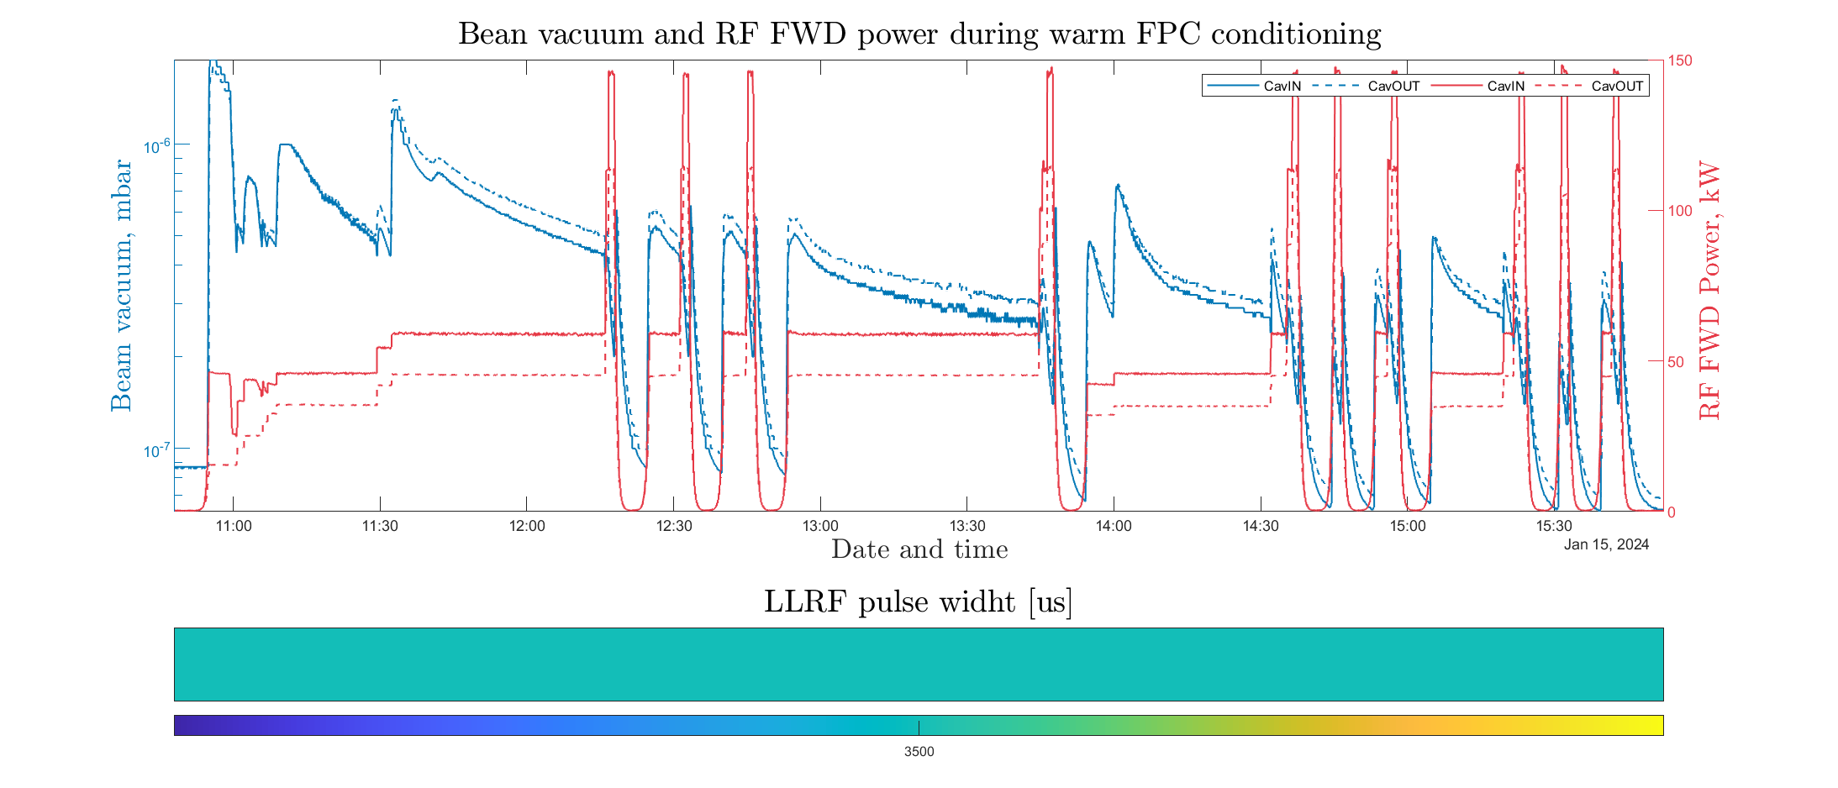
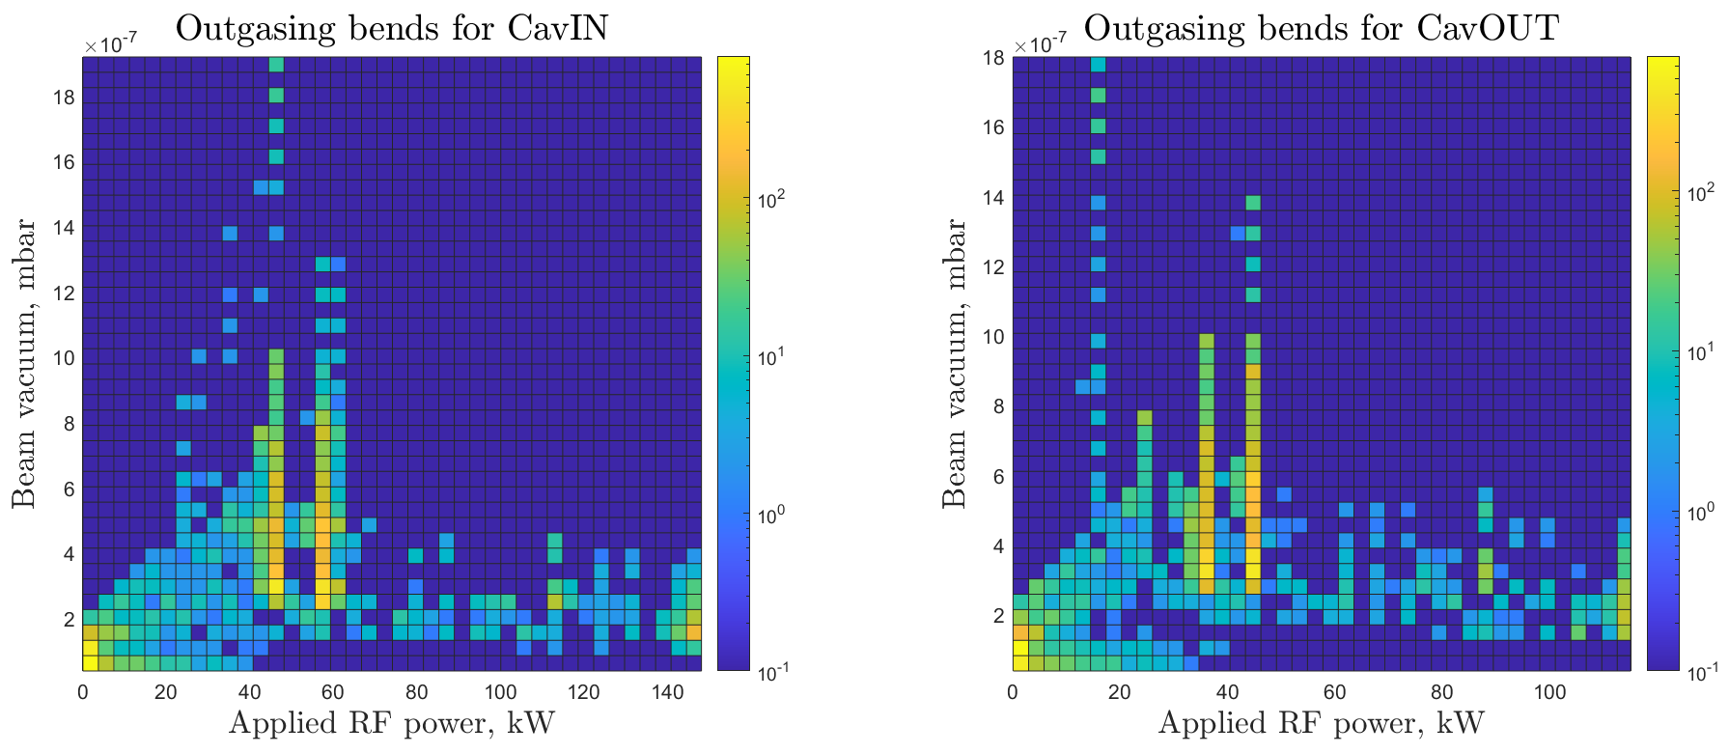
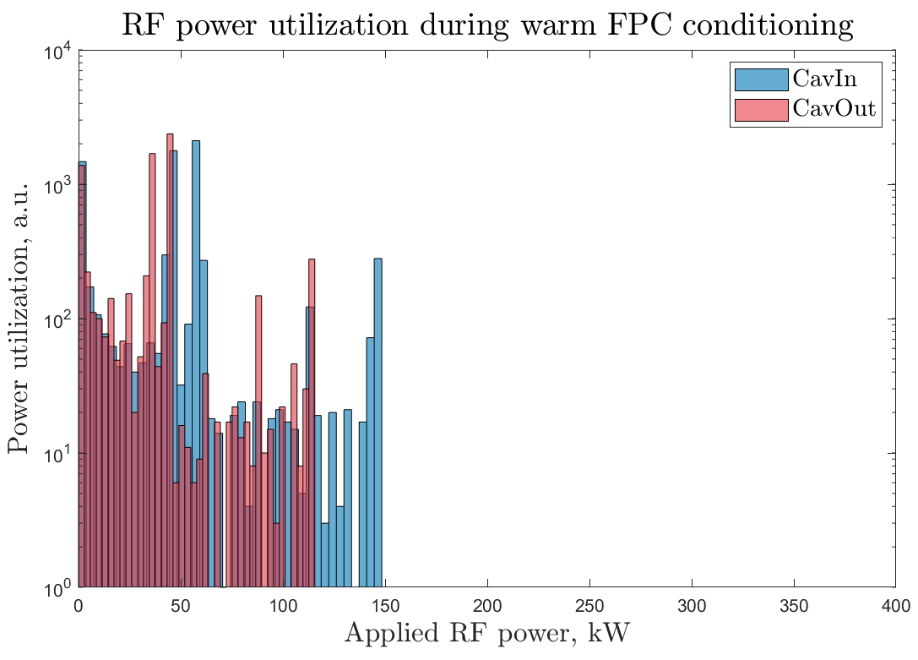
Warm FPC conditioning 2nd run
5h
3500us
Power was limited to cower only multipackting bands

Slide 13
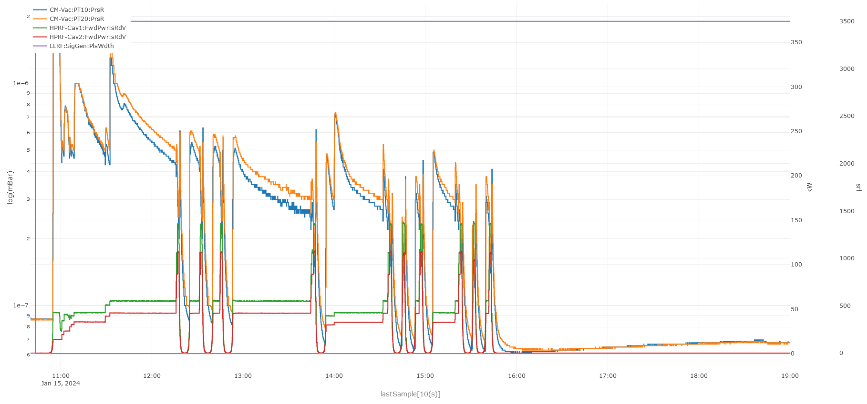
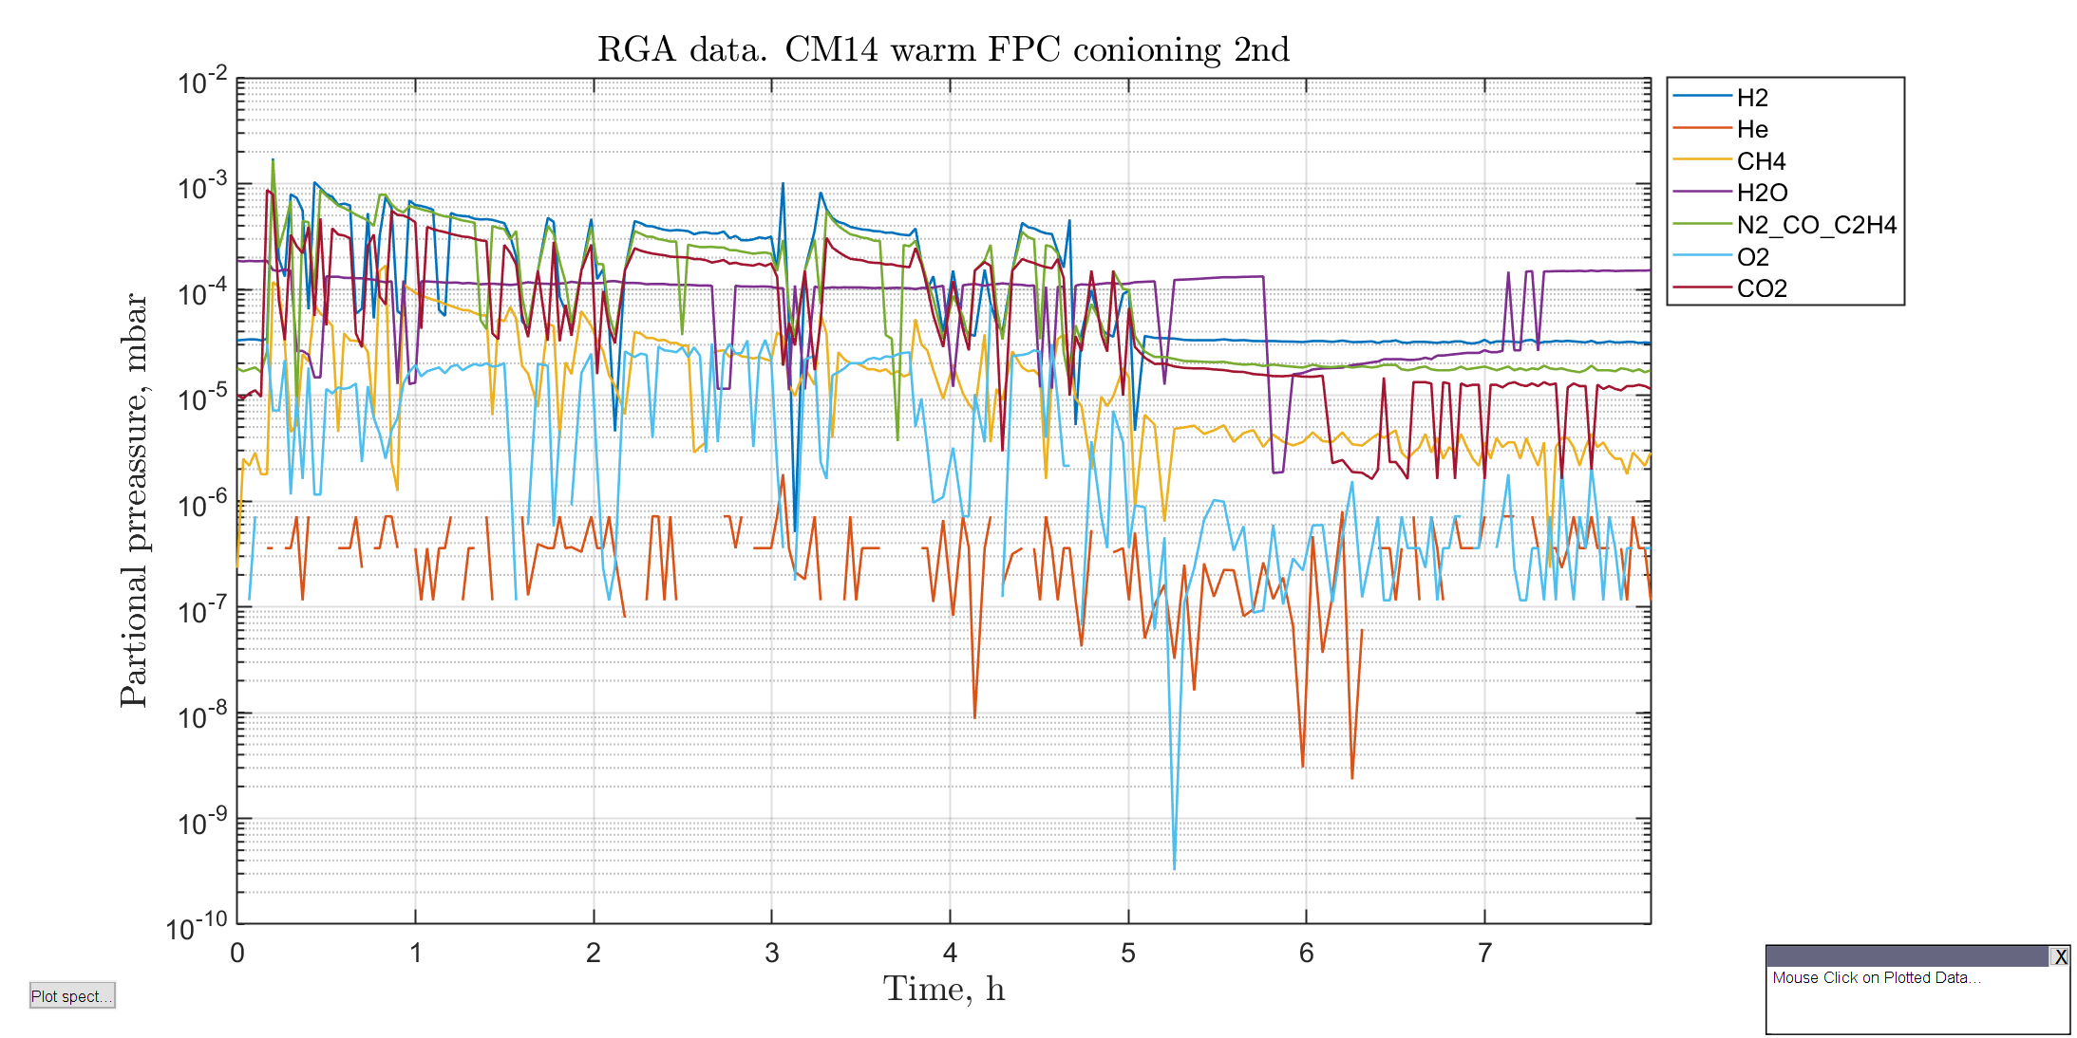
RGA from 2nd FPCC
FPC conditioning

Slide 14
Backup

Slide 15
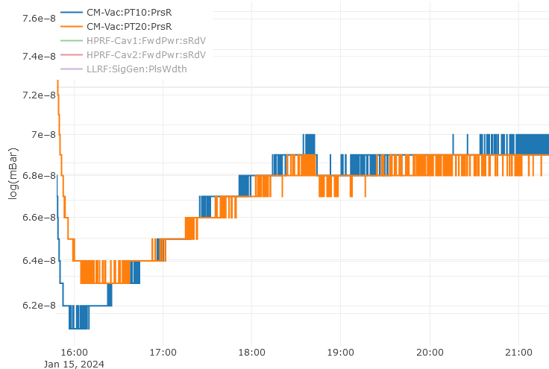
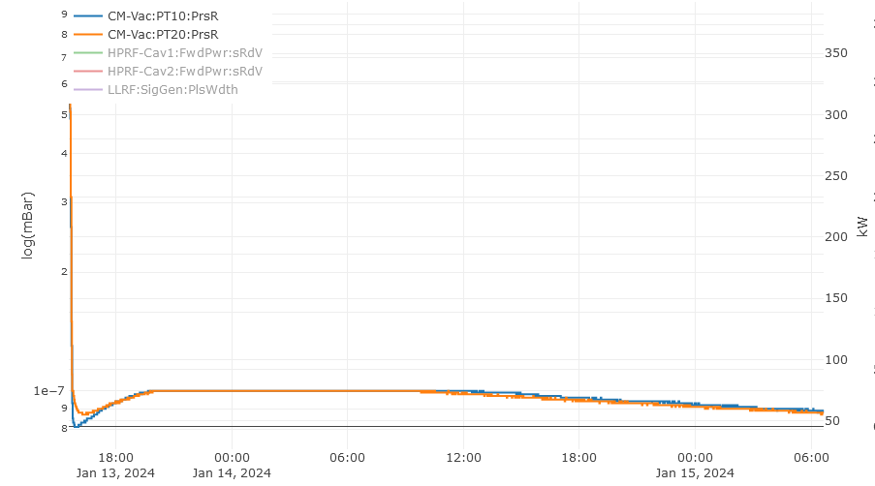
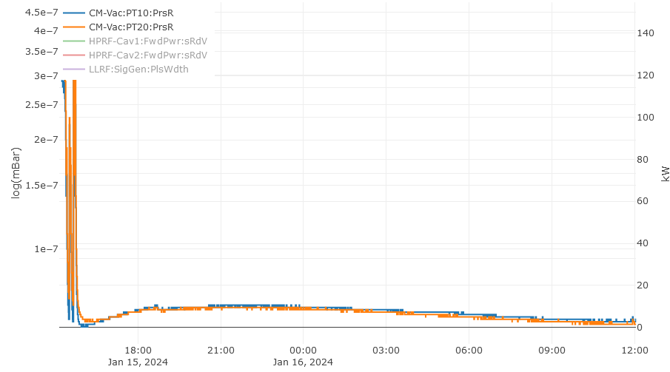
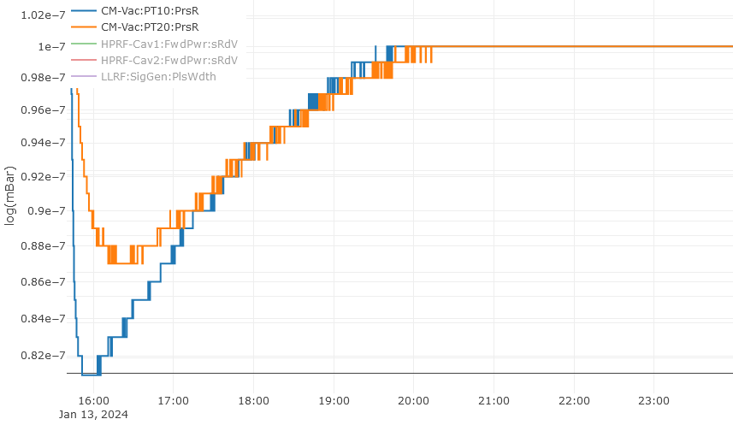
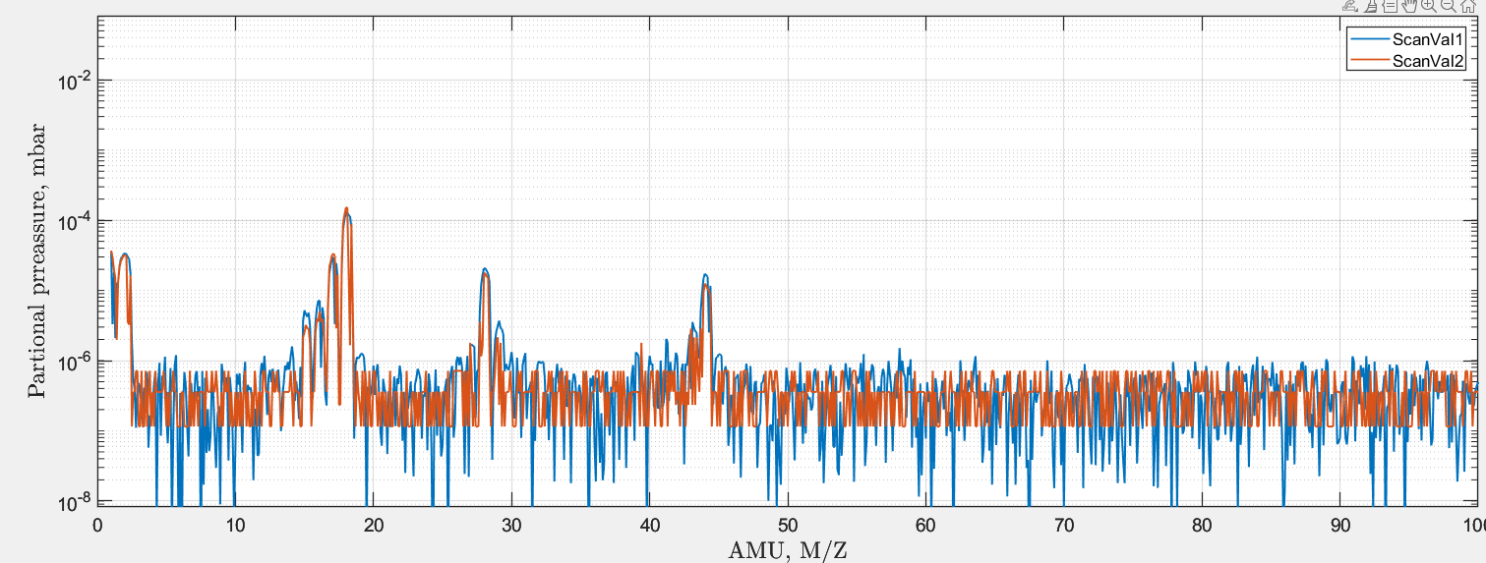
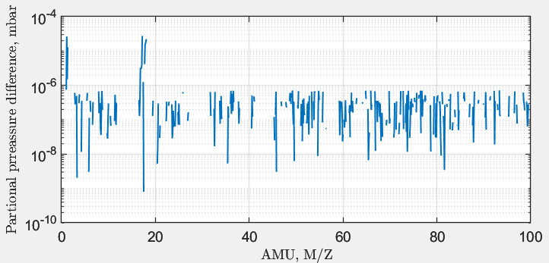
Beam vacuum rebounce after conditioning
1st FPCC
2nd FPCC
7.0E-8
1.0E-7
RF OFF
8.1E-8
RF OFF
6.2E-8
<2
17, 18 = Water
Scan2 – Scan1
Scan2
Scan1

