Slide 2
CM14 Preparation for Installation
PRESENTED BY Cédric LOMBARD On behalf of the ESS SRF TEAM

Slide 3
Events timeline
- Since 2021: Historical problem of reliability with the CTS motors
- November 2023: Decision to install motors with a new type of coating on CM14. Plan to run extended tests to challenge this potential solution
- February the 6th, 2023: Venting incident during the installation of the LWU after CM02 (SPK130).
- February the 7th, 2023: Confirmation received from the IJCLab, CM02 might not be able to provide the expected performances.
CM14 needs to be qualified in order to be installed in the tunnel, as a replacement of CM02.

Slide 4
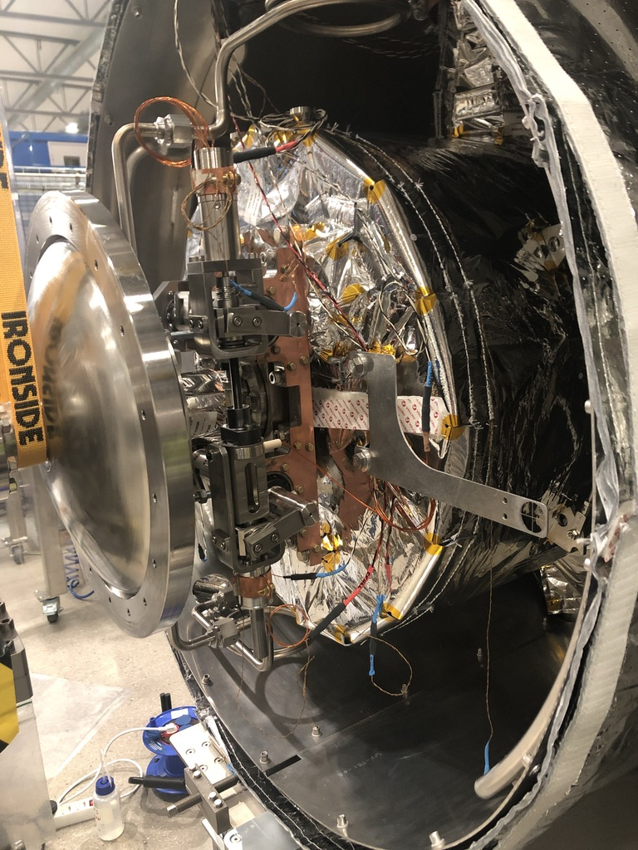
Motors exchange – Why ?
We cannot use the motors currently installed in CM14:
We’ve never properly tested this solution
We don’t have any data, confirming or not their operability
We could change the motors after the qualification of CM14 at FREIA, with an important risk of damaging the cryomodule after it’s qualification and/or not being able to terminate the tests due to a motor failure.
We could transport the cryomodule at ESS, change the motors, and send it back to FREIA, with an important risk of damaging the CM during its transportation.
The best -and less risky- solution is to proceed the motor exchange prior to the CM qualification, directly at FREIA.

Slide 5
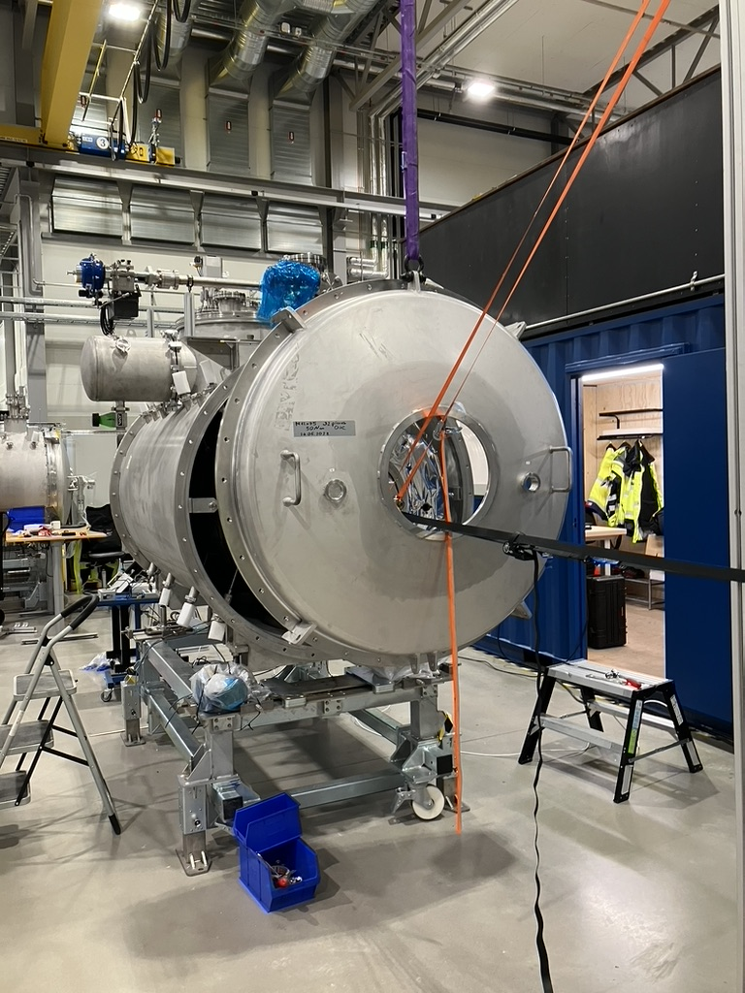
Motors exchange – How ?
The ESS team is now well trained with the motor exchange procedure…
We take care of the whole procedure : from equipment to peoples.
ESS to bring the complete set of needed equipment:
Cryomodule opening / closing
Alignment
Motor exchange
CTS test with the cavity at warm
So far, the only equipment needed from FREIA is the overhead crane (needed to open the CM).
Members of our team have the required training and license to operate the crane.
A team of 3 people, and one truck containing all the equipment

Slide 6
Motors exchange – When
Proposed planning
 | Wk6 | Wk7 | Wk8 | Wk9 | Wk10 | Wk11 | Wk12 | Wk13 | Wk14
ESS | Intervention Prep |  | Spare motor qualification |  | Intervention Prep | Motor Swap at FREIA
IJCLab |  |  | Spare motor qualification |  | Support for preparation
FREAI | Disconnection of CM14 - Displacement out of the bunker |  |  |  |  | Motor Swap at FREIA | Reconnection and start of CM14 qualifiation | Reconnection and start of CM14 qualifiation
Time for FREIA to fix the Cryogenics
Changing the two motors, from the opening of the CM to its closure is a one week long intervention

