Slide 1
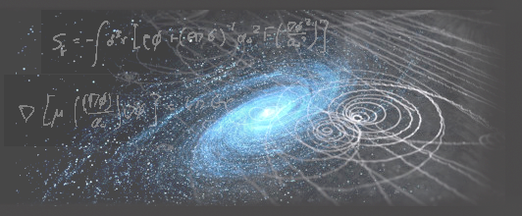



(Future) Experimental Efforts to
Search for Dark Matter Axions at Stockholm University
Junu Jeong (Jun-Woo Jeoung)
Department of Physics, Stockholm Univeristy
Partikeldagarna 2024, 21/10

Slide 2
Outline
Axion Overview
Cavity Haloscope
ALPHA Collaboration
SU Group’s Objective
Summary

Slide 3
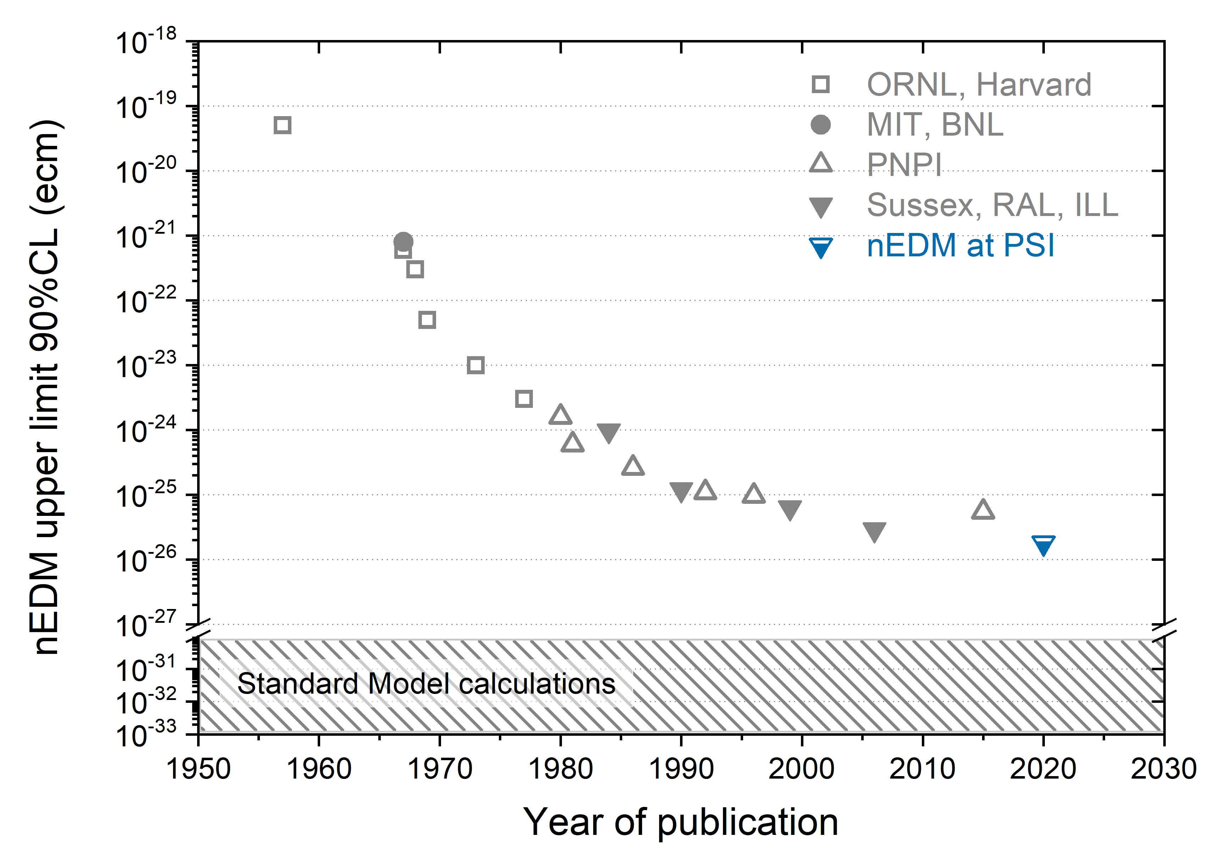
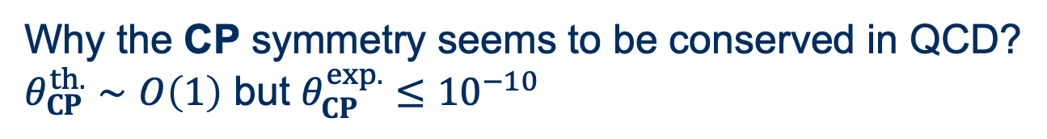
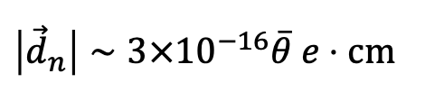
Axion Overview
Strong CP Problem
Why the CP symmetry seems to be conserved in QCD?
$θ_{CP}^{th.}∼O\left(1\right)$ but $θ_{CP}^{exp.}≤{10}^{−10}$
$$\left|{\vec{d}}_{n}\right|∼3×{10}^{−16}\overline{θ} e⋅cm$$

Slide 4
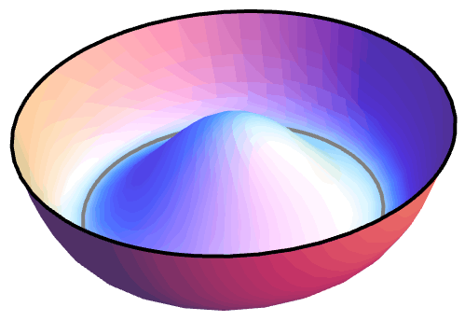
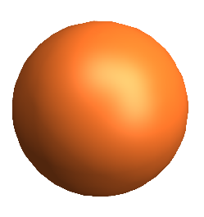

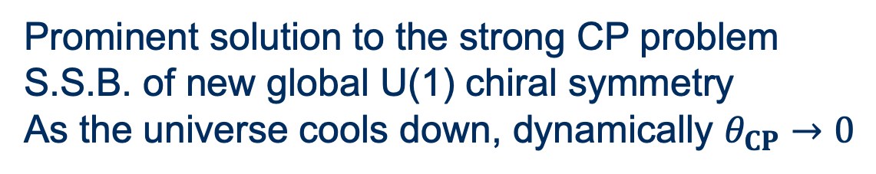
Axion Overview
Strong CP Problem
Why the CP symmetry seems to be conserved in QCD?
$θ_{CP}^{th.}∼O\left(1\right)$ but $θ_{CP}^{exp.}≤{10}^{−10}$
Peccei-Quinn Mechanism
Titled Mexican-Hat Potential
Prominent solution to the strong CP problem
S.S.B. of new global U(1) chiral symmetry
As the universe cools down, dynamically $θ_{CP}→0$
$$θ_{CP}=0$$

Slide 5
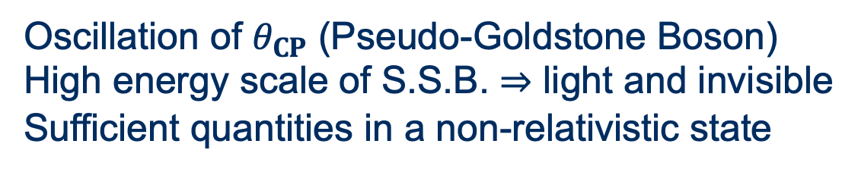
Axion Overview
Strong CP Problem
Why the CP symmetry seems to be conserved in QCD?
$θ_{CP}^{th.}∼O\left(1\right)$ but $θ_{CP}^{exp.}≤{10}^{−10}$
Peccei-Quinn Mechanism
Titled Mexican-Hat Potential
Prominent solution to the strong CP problem
S.S.B. of new global U(1) chiral symmetry
As the universe cools down, dynamically $θ_{CP}→0$
Axion
Oscillation of $θ_{CP}$ (Pseudo-Goldstone Boson)
High energy scale of S.S.B. ⇒ light and invisible
Sufficient quantities in a non-relativistic state
Axion

Slide 6
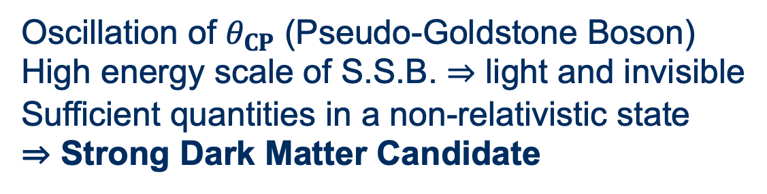
Axion Overview
Strong CP Problem
Why the CP symmetry seems to be conserved in QCD?
$θ_{CP}^{th.}∼O\left(1\right)$ but $θ_{CP}^{exp.}≤{10}^{−10}$
Peccei-Quinn Mechanism
Titled Mexican-Hat Potential
Prominent solution to the strong CP problem
S.S.B. of new global U(1) chiral symmetry
As the universe cools down, dynamically $θ_{CP}→0$
Axion
Oscillation of $θ_{CP}$ (Pseudo-Goldstone Boson)
High energy scale of S.S.B. ⇒ light and invisible
Sufficient quantities in a non-relativistic state
⇒ Strong Dark Matter Candidate
Axion

Slide 7

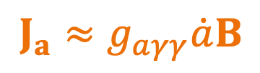

Cavity Haloscope
Solenoid
$$B$$
$$J_{a}$$
$$J_{a}≈g_{aγγ}\dot{a}B$$

Slide 8
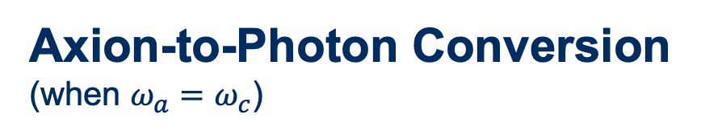
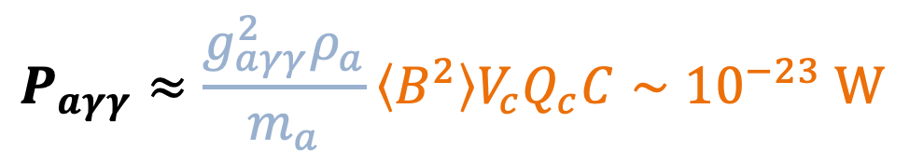
Cavity Haloscope
Solenoid
Cavity
Axion-to-Photon Conversion
(when $ω_{a}=ω_{c}$)
$$P_{aγγ}≈\frac{g_{aγγ}^{2}ρ_{a}}{m_{a}}\left\langle B^{2}\right\rangle V_{c}Q_{c}C∼{10}^{−23} W$$
$$B$$
$$J_{a}$$
$$J_{a}≈g_{aγγ}\dot{a}B$$

Slide 9
Cavity Haloscope
Solenoid
Readout electronics
Cavity
Axion-to-Photon Conversion
(when $ω_{a}=ω_{c}$)
$$P_{aγγ}≈\frac{g_{aγγ}^{2}ρ_{a}}{m_{a}}\left\langle B^{2}\right\rangle V_{c}Q_{c}C∼{10}^{−23} W$$
$$B$$
$$J_{a}$$
$$J_{a}≈g_{aγγ}\dot{a}B$$

Slide 10
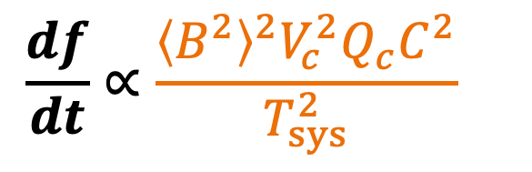
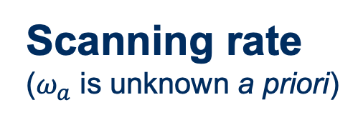
Cavity Haloscope
Solenoid
Readout electronics
Cavity
Scanning rate
($ω_{a}$ is unknown a priori)
$$\frac{df}{dt}∝\frac{{\left\langle B^{2}\right\rangle }^{2}V_{c}^{2}Q_{c}C^{2}}{T_{sys}^{2}}$$
$$B$$
Strong and large magnet
High quality factor cavity
Clever design of cavity
Low system noise temperature
$$J_{a}$$
$$J_{a}≈g_{aγγ}\dot{a}B$$

Slide 11
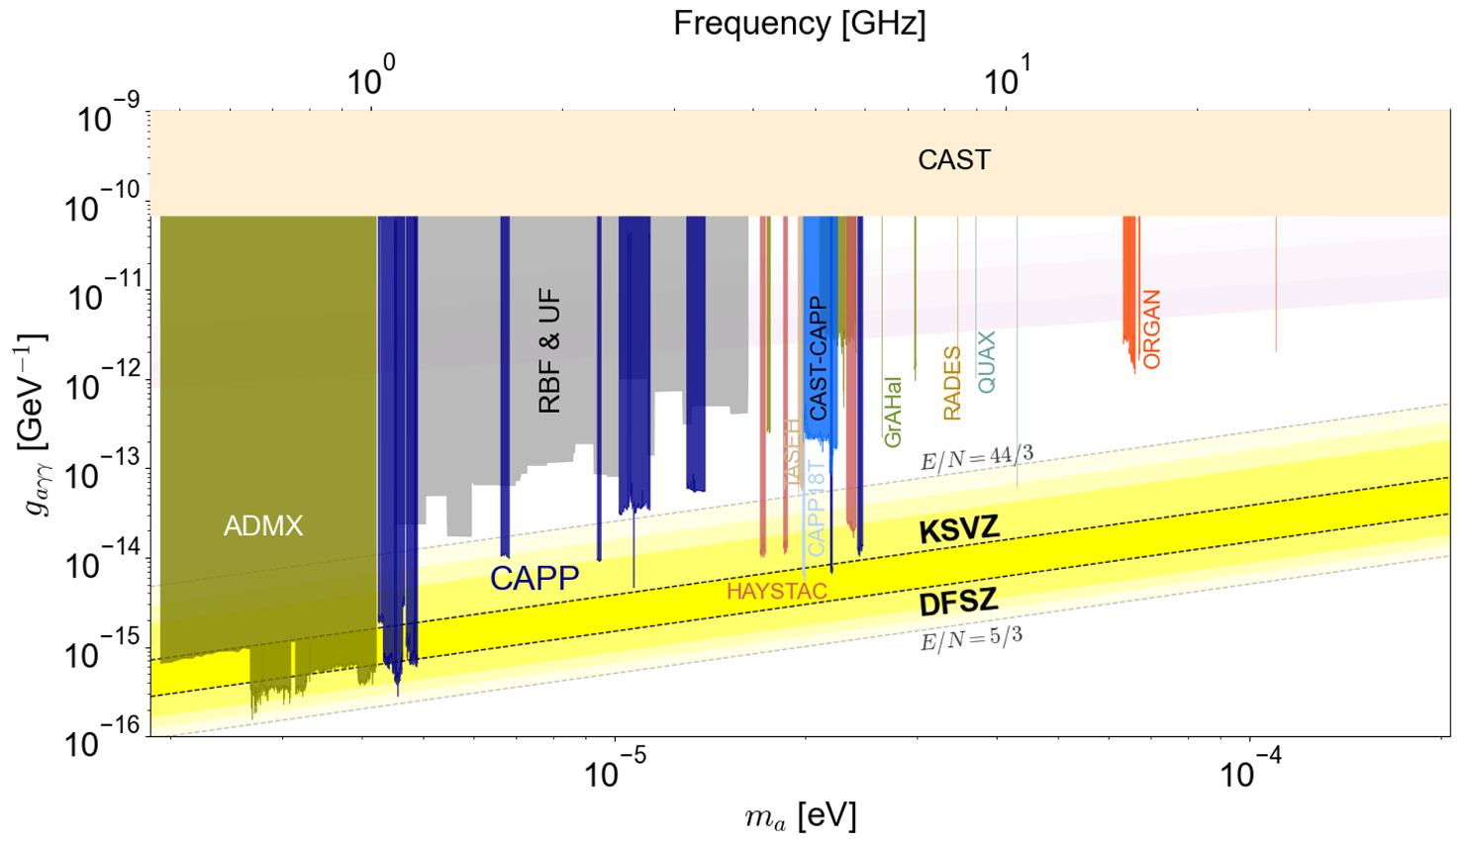
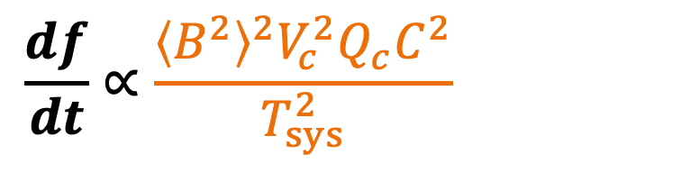
Cavity Haloscope
$$\frac{df}{dt}∝\frac{{\left\langle B^{2}\right\rangle }^{2}V_{c}^{2}Q_{c}C^{2}}{T_{sys}^{2}}∝f^{−20/3}$$

Slide 12
High-Mass Axion Search
$$\frac{df}{dt}∝\frac{{\left\langle B^{2}\right\rangle }^{2}V_{c}^{2}Q_{c}C^{2}}{T_{sys}^{2}}∝f^{−20/3}$$
Dine 2017, Borsanyi 2016, Wantz 2010,
Kawasaki 2015, Buschmann 2022,
Ballesteros 2017, Klaer 2017, …

Slide 13
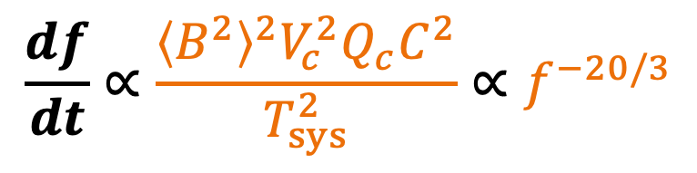
High-Mass Axion Search
$$\frac{df}{dt}∝\frac{{\left\langle B^{2}\right\rangle }^{2}V_{c}^{2}Q_{c}C^{2}}{T_{sys}^{2}}∝f^{−20/3}$$
Cavity
Cavity
Dine 2017, Borsanyi 2016, Wantz 2010,
Kawasaki 2015, Buschmann 2022,
Ballesteros 2017, Klaer 2017, …

Slide 14
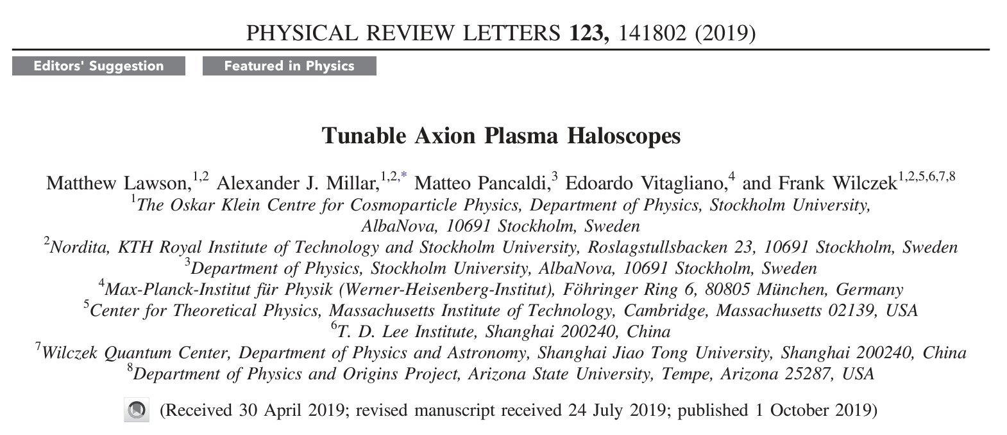
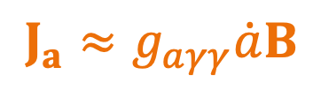
Plasma Haloscope
$$J_{a}≈g_{aγγ}\dot{a}B$$
Resonance occurs at the plasma frequency

Slide 15

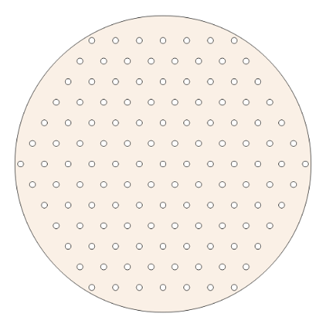
Plasma Haloscope
$$J_{a}≈g_{aγγ}\dot{a}B$$
Resonance occurs at the plasma frequency
The wire array mimics a medium with a reduced plasma frequency
Cylindrical cavity
Array of conducting wires

Slide 16
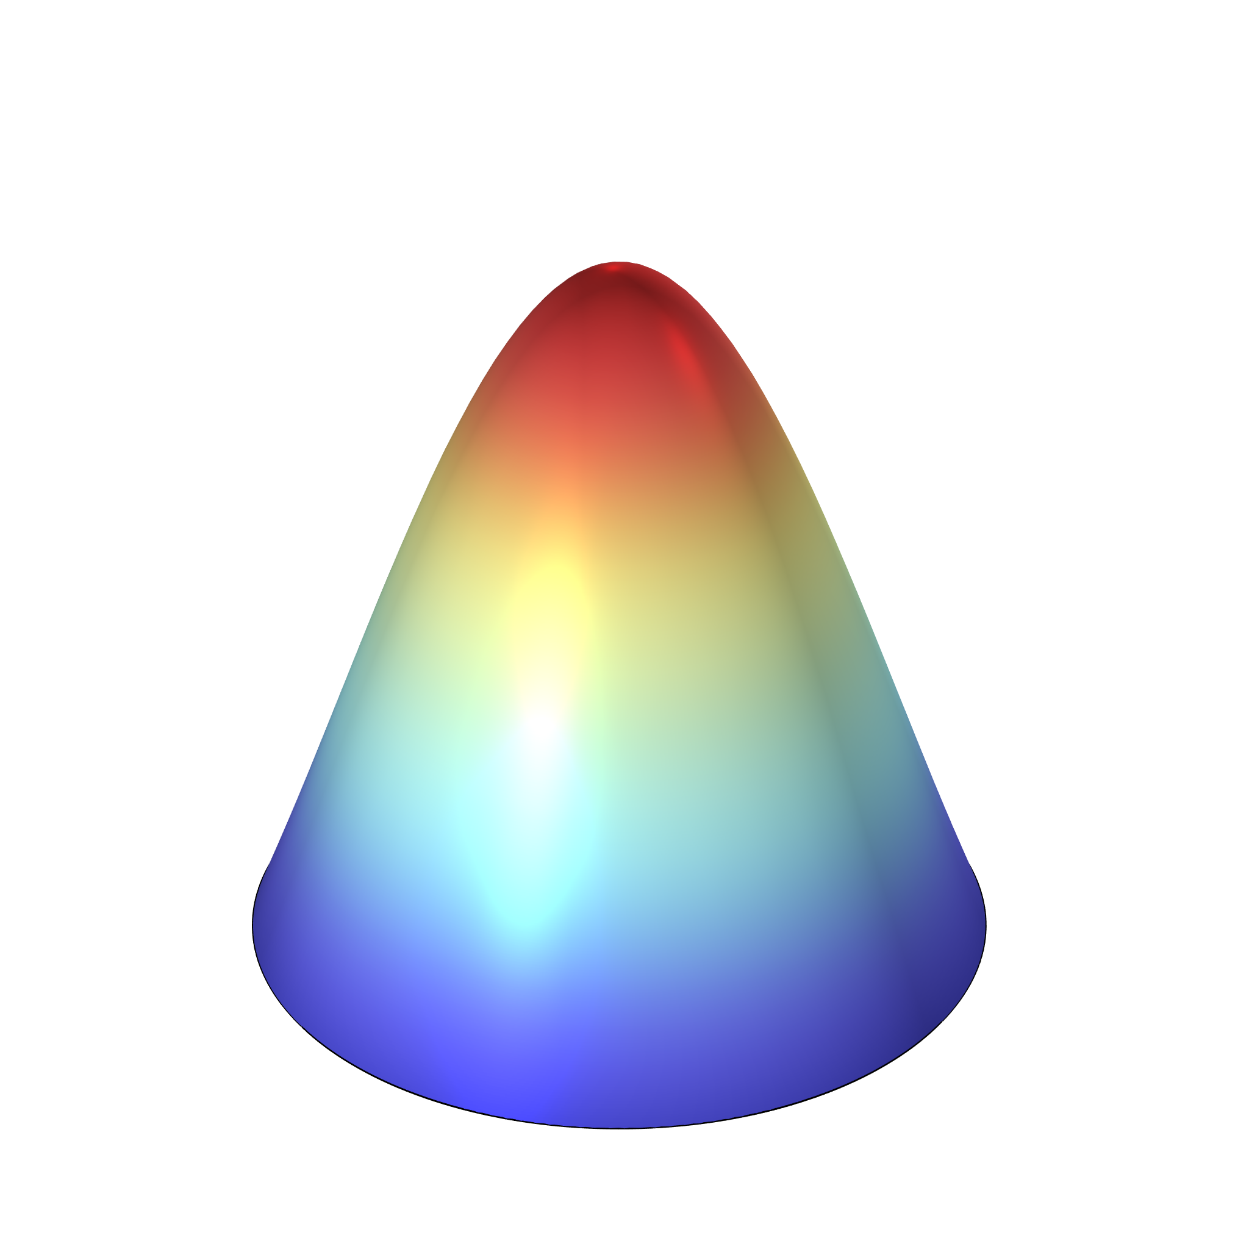
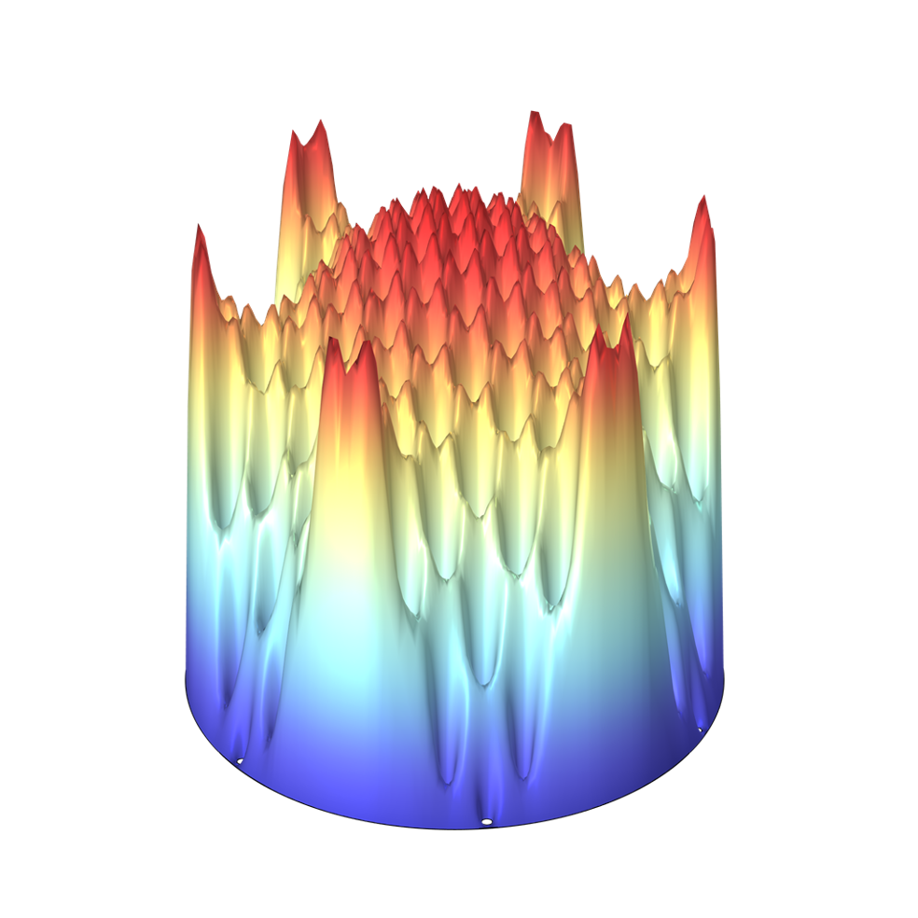
Plasma Haloscope
$$J_{a}≈g_{aγγ}\dot{a}B$$
Resonance occurs at the plasma frequency
The wire array mimics a medium with a reduced plasma frequency
The cavity frequency is independent of its size
A wire spacing of 1 cm results in a frequency of approximately 10 GHz
C ~ 0.7
C ~ 1.0
Cylindrical cavity
Array of conducting wires

Slide 17

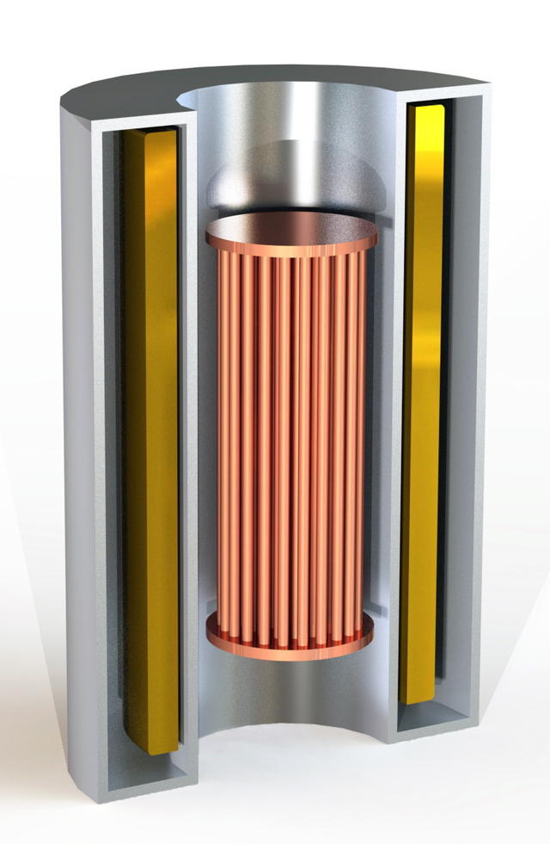





Axion Longitudinal Plasma HAloscope
Collaboration Institutions:
Yale University (Host)
Arizona State University
University of California Berkeley
University of Cambridge
Colorado University
Iceland University
ITMO University
Johns Hopkins University
Massachusetts Institute of Technology
Oak Ridge National Laboratory
Stockholm University
Wellesley College
Project Scientist:
F. Wilczek (MIT/Stockholm University)
Project PI:
K. van Bibber (Berkeley)
Project Technical Director:
M. Jewell (Yale)
Spokes / deputy persons:
J. Gudmundsson (Stockholm University)
R. Maruyama (Yale)
Support is gratefully acknowledged from:

Slide 18
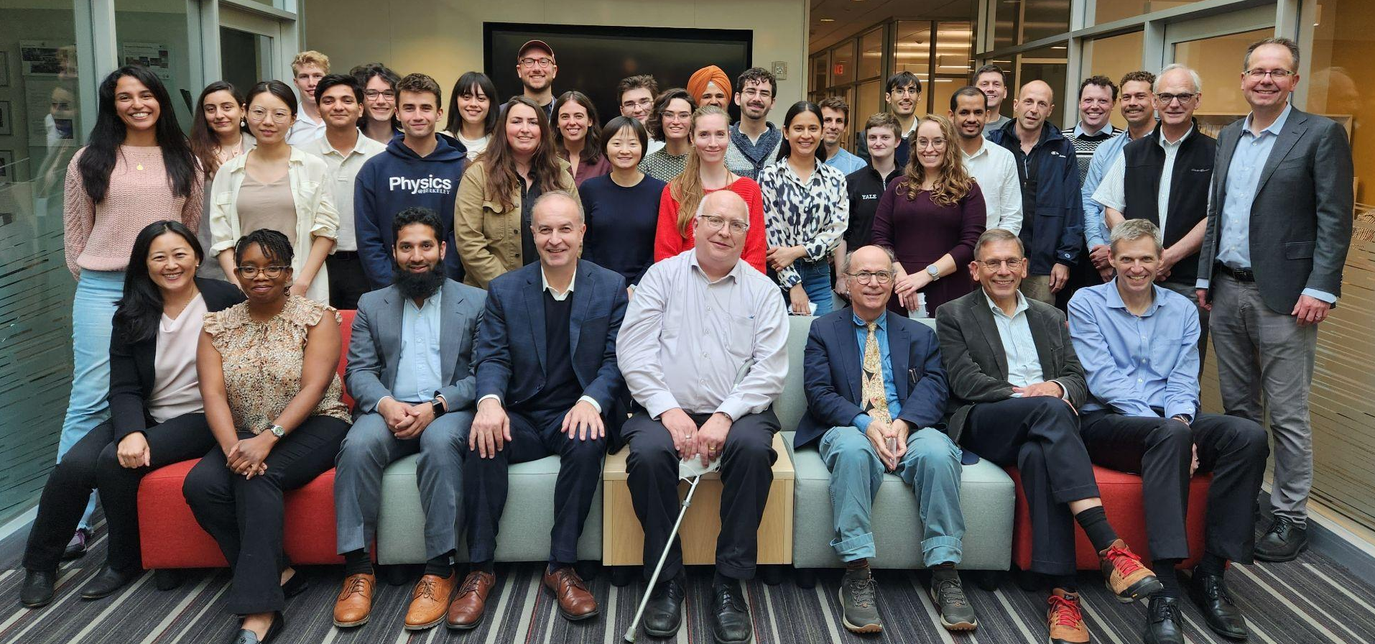
Axion Longitudinal Plasma HAloscope
The 1st ALPHA Collaboration Meeting

Slide 19
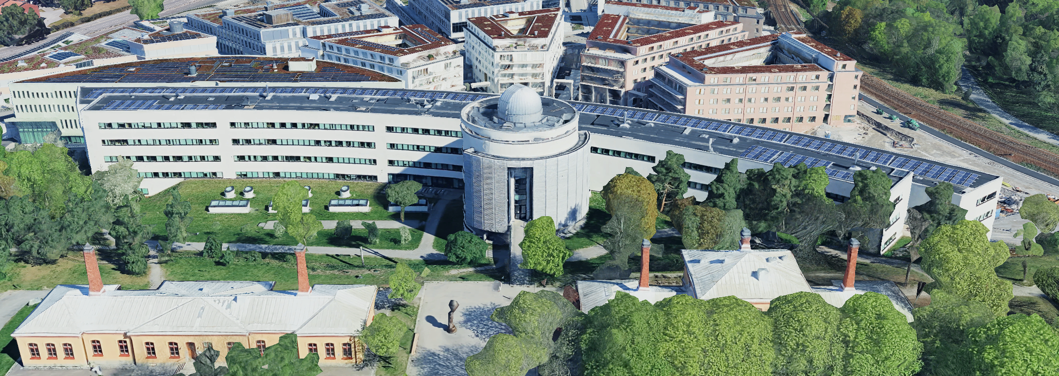
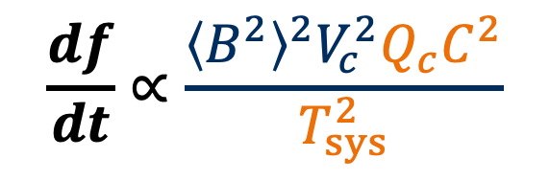
SU Group’s Objective
Albanova University Center, Stockholm (Google Maps)
$$\frac{df}{dt}∝\frac{{\left\langle B^{2}\right\rangle }^{2}V_{c}^{2}Q_{c}C^{2}}{T_{sys}^{2}}$$
Strong and large magnet
High quality factor cavity
Clever design of cavity
Low system noise temperature

Slide 20
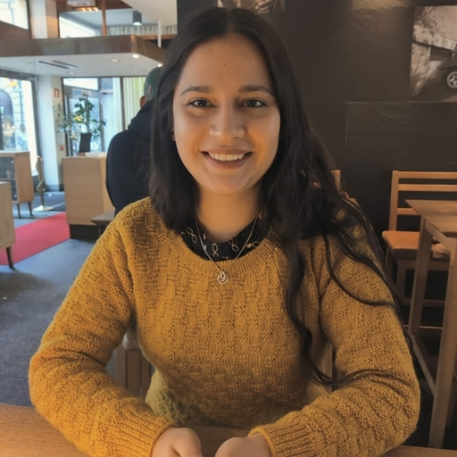
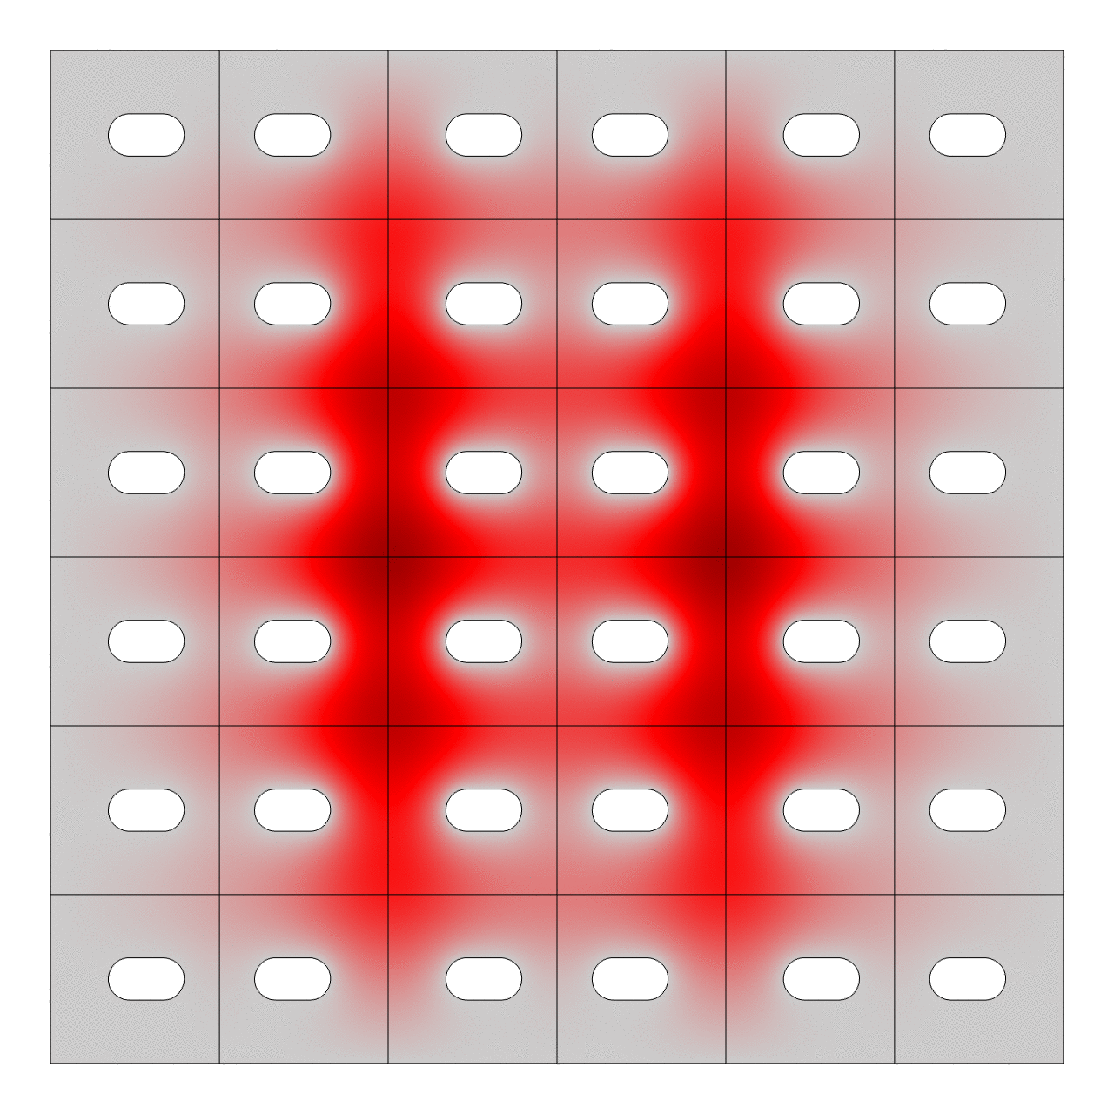
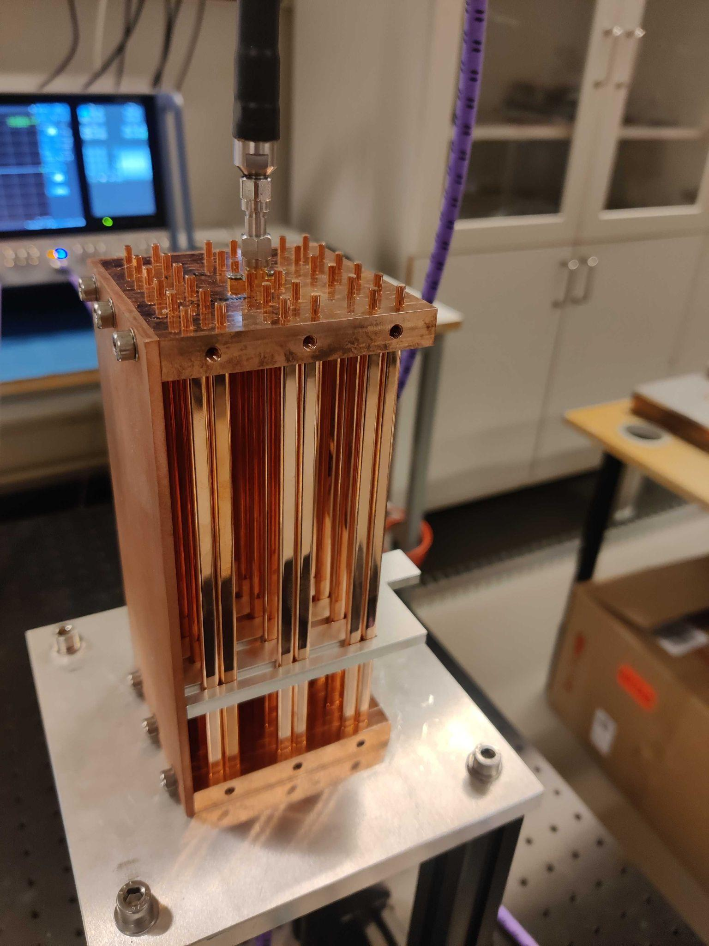
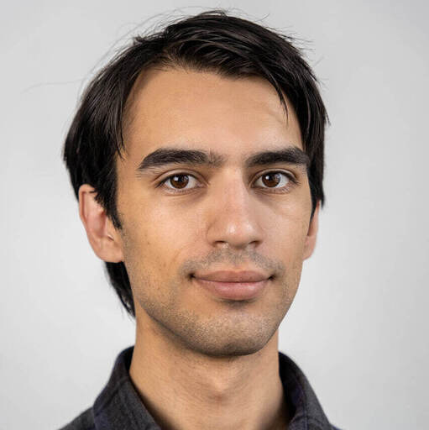
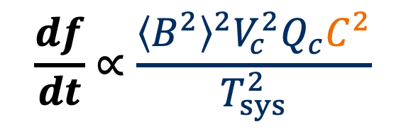
SU Group’s Ongoing Contribution
Development of Tuning system
Gagandeep Kaur
$$\frac{df}{dt}∝\frac{{\left\langle B^{2}\right\rangle }^{2}V_{c}^{2}Q_{c}C^{2}}{T_{sys}^{2}}$$
Strong and large magnet
High quality factor cavity
Clever design of cavity
Low system noise temperature
Rustam Balafendiev

Slide 21
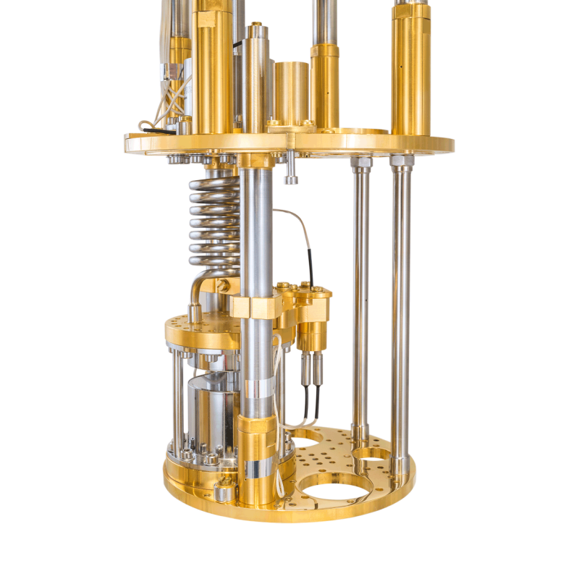
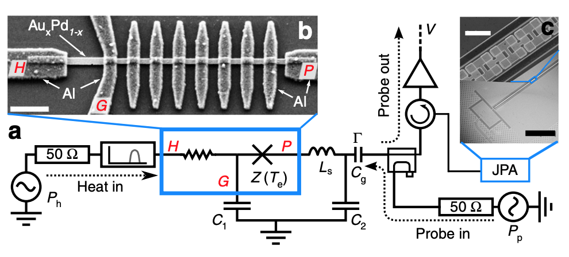
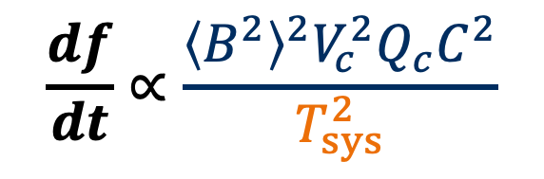
SU Group’s Future Plan
Weak RF Photon Detection System
e.g.
[R. Kokkoniemi et al., Comm. Phys. 2, 124 (2019)]
In the process of procuring DR
Single photon detection
Microwave Interferometer
$$\frac{df}{dt}∝\frac{{\left\langle B^{2}\right\rangle }^{2}V_{c}^{2}Q_{c}C^{2}}{T_{sys}^{2}}$$
Strong and large magnet
High quality factor cavity
Clever design of cavity
Low system noise temperature

Slide 22
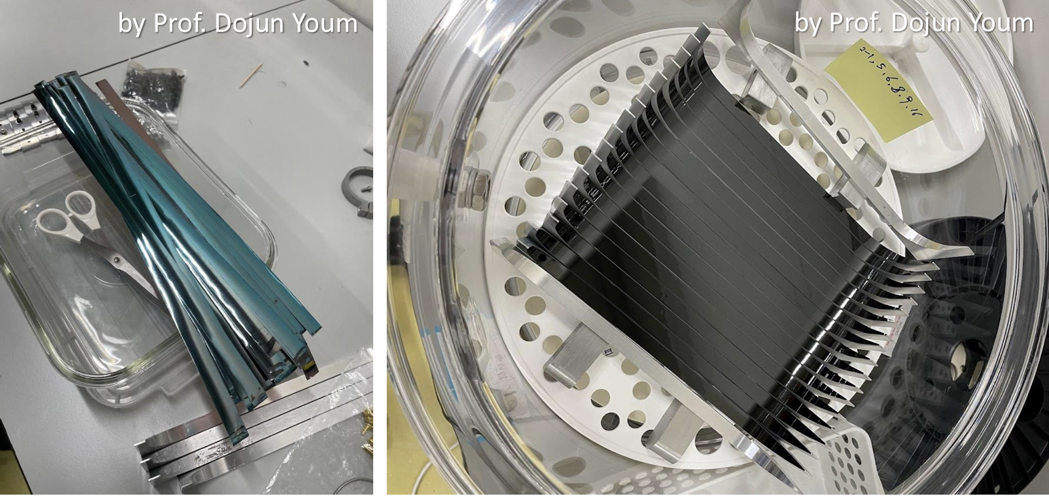
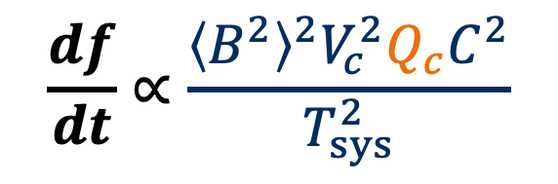
SU Group’s Future Plan
Superconducting Cavity
[D. Ahn, 18th PATRAS]
$$\frac{df}{dt}∝\frac{{\left\langle B^{2}\right\rangle }^{2}V_{c}^{2}Q_{c}C^{2}}{T_{sys}^{2}}$$
Strong and large magnet
High quality factor cavity
Clever design of cavity
Low system noise temperature

Slide 23


Advertisement
https://www.su.se/department-of-physics/about-the-department/work-with-us
Two Postdoctoral Fellows
in Axion Searches with Metamaterials
PhD Student in Physics
for Axion Searches with Metamaterials

Slide 24
Summary
The axion is a theoretically well-motivated particle that resolves the strong CP problem and also provides a compelling solution to the dark matter mystery.
The cavity haloscope is the most sensitive method for searching for dark matter axions in the GHz range.
  High-mass axions are theoretically preferred, but the scanning rate significantly decreases at higher masses.
The plasma haloscope is an innovative approach to efficiently search for high-mass dark matter axions.
The ALPHA collaboration is an international initiative focused on the plasma haloscope.
Stockholm University is a core member of the ALPHA collaboration.
  We are contributing to the development of tunable wire-metamaterial cavities.
  We are planning to contribute to the development of a weak microwave photon detection system and superconducting wire-metamaterial cavities.

Slide 26
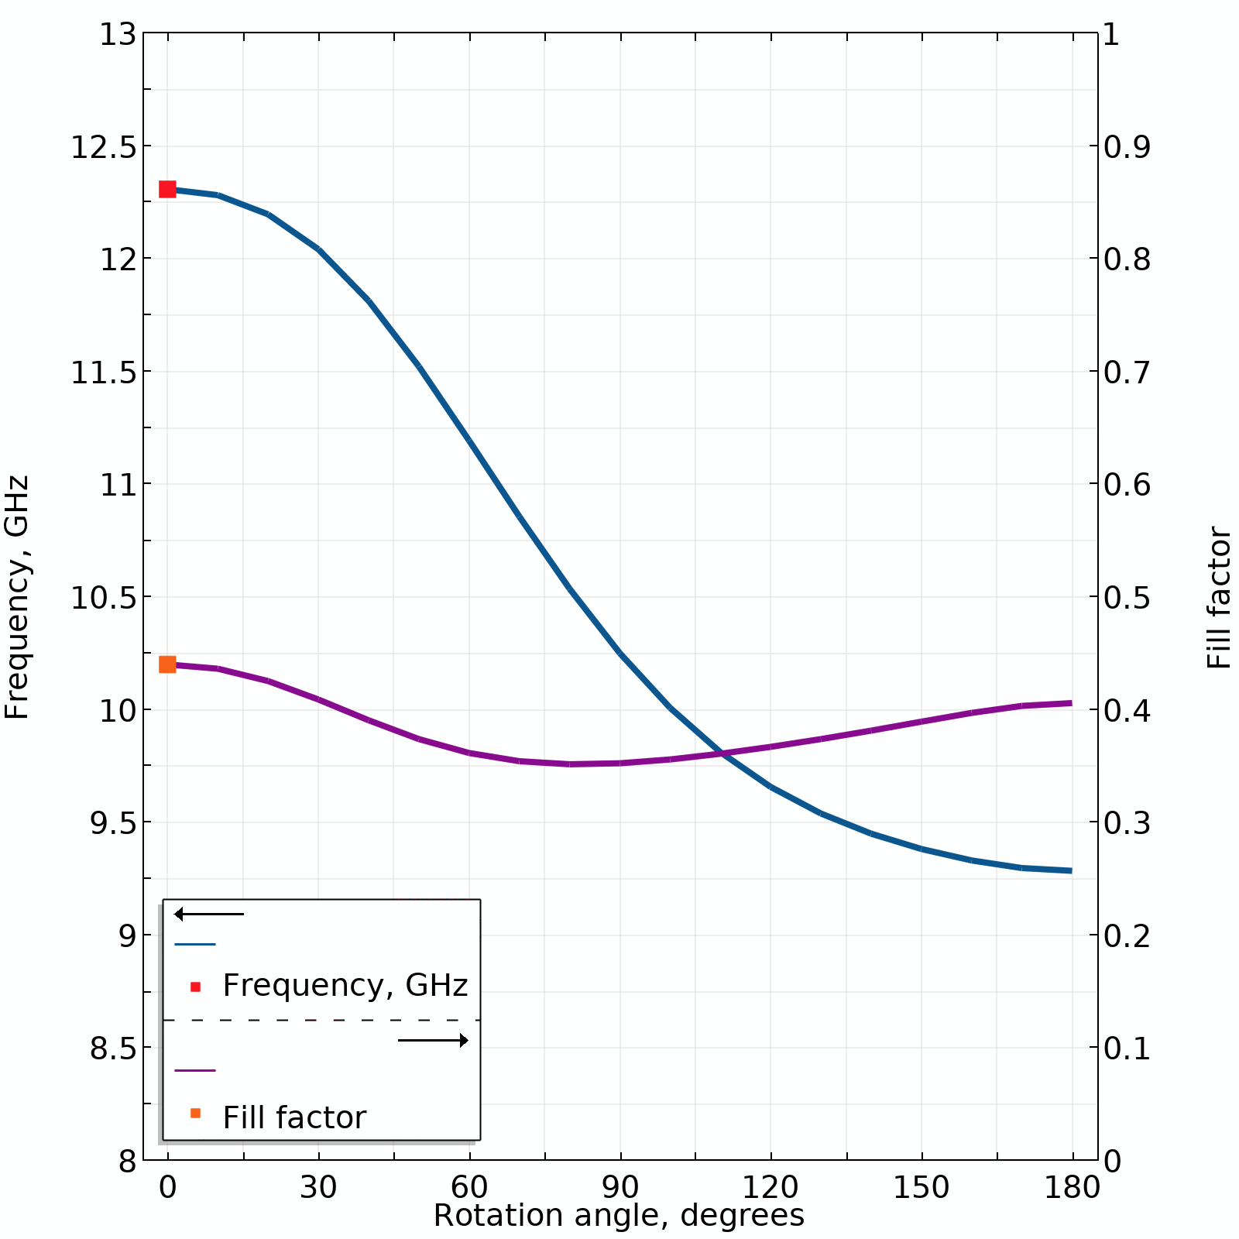
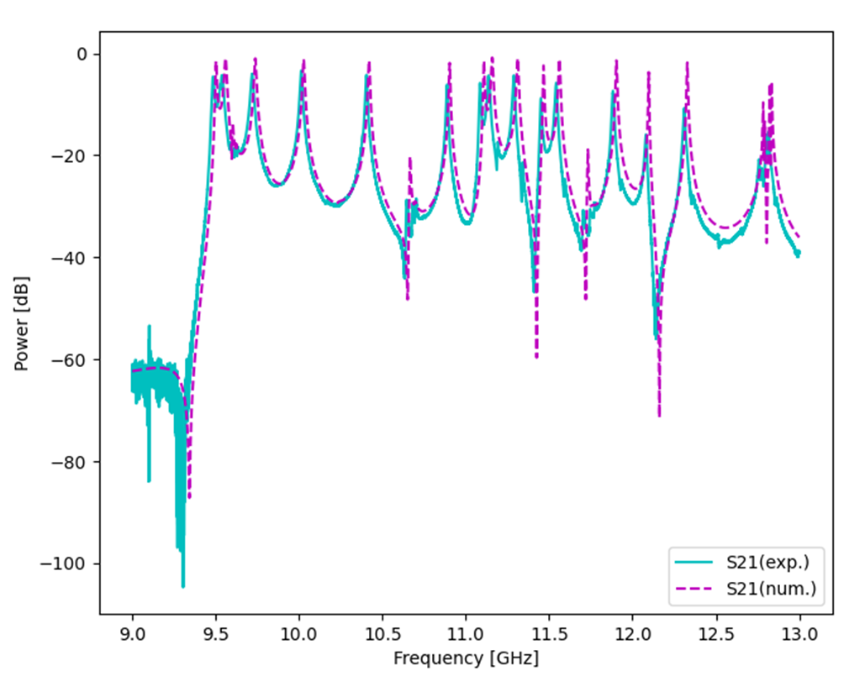
Rustam Balafendiev
Gagandeep Kaur

Slide 27
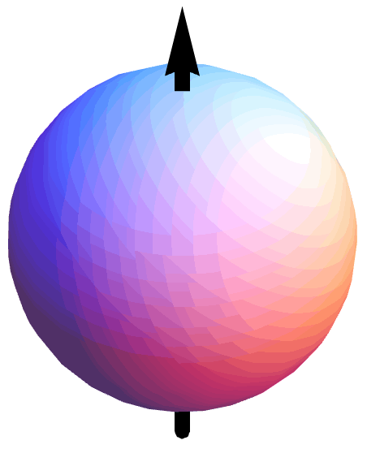
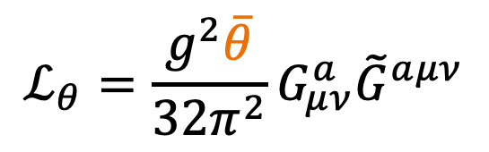
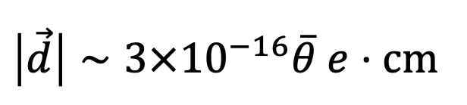
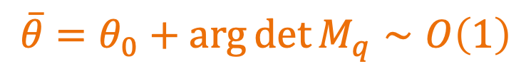
Strong CP Problem
Neutron
CP-violating term in QCD
$$ℒ_{θ}=\frac{g^{2}\overline{θ}}{32π^{2}}G_{μν}^{a}{\tilde{G}}^{aμν}$$
u
(2/3e)
Instanton effect
d
(-1/3e)
Higgs mechanism
d
(-1/3e)
$$\overline{θ}=θ_{0}+\arg{\det{M_{q}}}∼O\left(1\right)$$
$$\left|\vec{d}\right|∼3×{10}^{−16}\overline{θ} e⋅cm$$

Slide 28
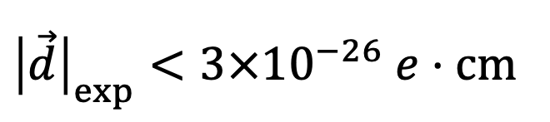
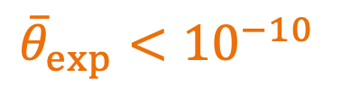
Strong CP Problem
Neutron
CP-violating term in QCD
Electric dipole moment
$$ℒ_{θ}=\frac{g^{2}\overline{θ}}{32π^{2}}G_{μν}^{a}{\tilde{G}}^{aμν}$$
u
(2/3e)
Instanton effect
d
(-1/3e)
Higgs mechanism
d
(-1/3e)
$$\overline{θ}=θ_{0}+\arg{\det{M_{q}}}∼O\left(1\right)$$
$$\left|\vec{d}\right|∼3×{10}^{−16}\overline{θ} e⋅cm$$
$${\left|\vec{d}\right|}_{exp}<3×{10}^{−26} e⋅cm$$
$${\overline{θ}}_{exp}<{10}^{−10}$$

Slide 29
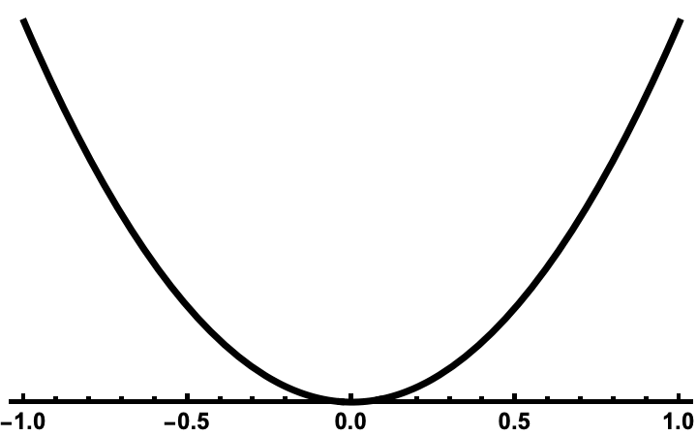
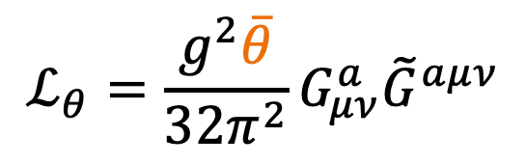

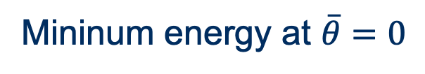
Peccei-Quinn Mechanism
CP-violating term
$$ℒ_{θ}=\frac{g^{2}\overline{θ}}{32π^{2}}G_{μν}^{a}{\tilde{G}}^{aμν}$$
Mininum energy at $\overline{θ}=0$
$$\overline{θ}$$

Slide 30
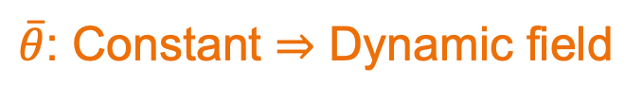
Peccei-Quinn Mechanism
CP-violating term
$$ℒ_{θ}=\frac{g^{2}\overline{θ}}{32π^{2}}G_{μν}^{a}{\tilde{G}}^{aμν}$$
Mininum energy at $\overline{θ}=0$
$\overline{θ}$: Constant ⇒ Dynamic field
Prominent solution to the strong CP problem
As the universe expands
$$\overline{θ}$$

Slide 31

Peccei-Quinn Mechanism
CP-violating term
$$ℒ_{θ}=\frac{g^{2}\overline{θ}}{32π^{2}}G_{μν}^{a}{\tilde{G}}^{aμν}$$
Mininum energy at $\overline{θ}=0$
$\overline{θ}$: Constant ⇒ Dynamic field
Axion
Prominent solution to the strong CP problem
New particle, Axion, is expected!
As the universe expands
$$\overline{θ}$$

Slide 32
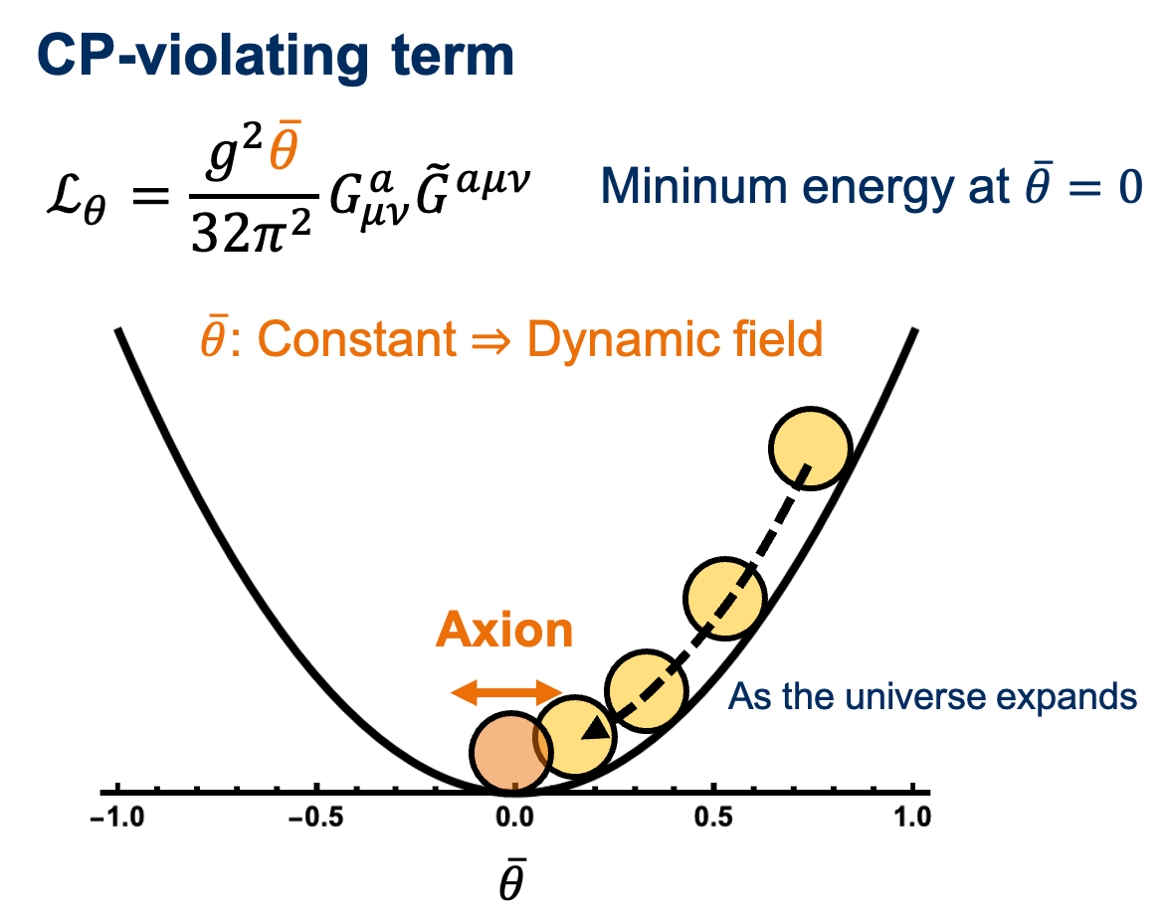


Invisible Axion (KSVZ & DFSZ)
Sufficient high energy scale ($≥$10⁹ GeV)
Prominent solution to the strong CP problem
New particle, Axion, is expected!
Feeble interactions with other particles
Sufficient quantities in a non-relativistic state

Slide 33
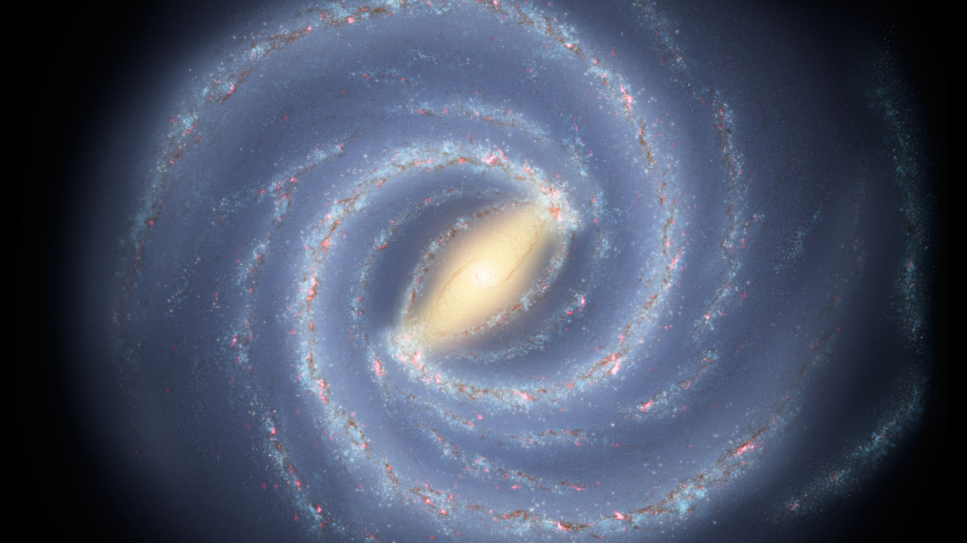

Dark Matter Axion
Feeble interactions with other particles
Sufficient quantities in a non-relativistic state
Strong Dark Matter Candidates

