Slide 1
Cavity Control, Operation, and Test Challenges at ESS and Possible Solutions
Rihua Zeng
RF group, Accelerator division
2015-01-13

Slide 2
Outline
ESS Status
Control, Operation, and Test Challenges at ESS
Promising solutions with powerful infrastructure---MTCA system----based hardware/software/firmware
  Example 1: Heavy quality data
  Example 2: High precision RF measurement
  Example 3: Power overhead reduction
Cavity Turn on Procedures

Slide 3
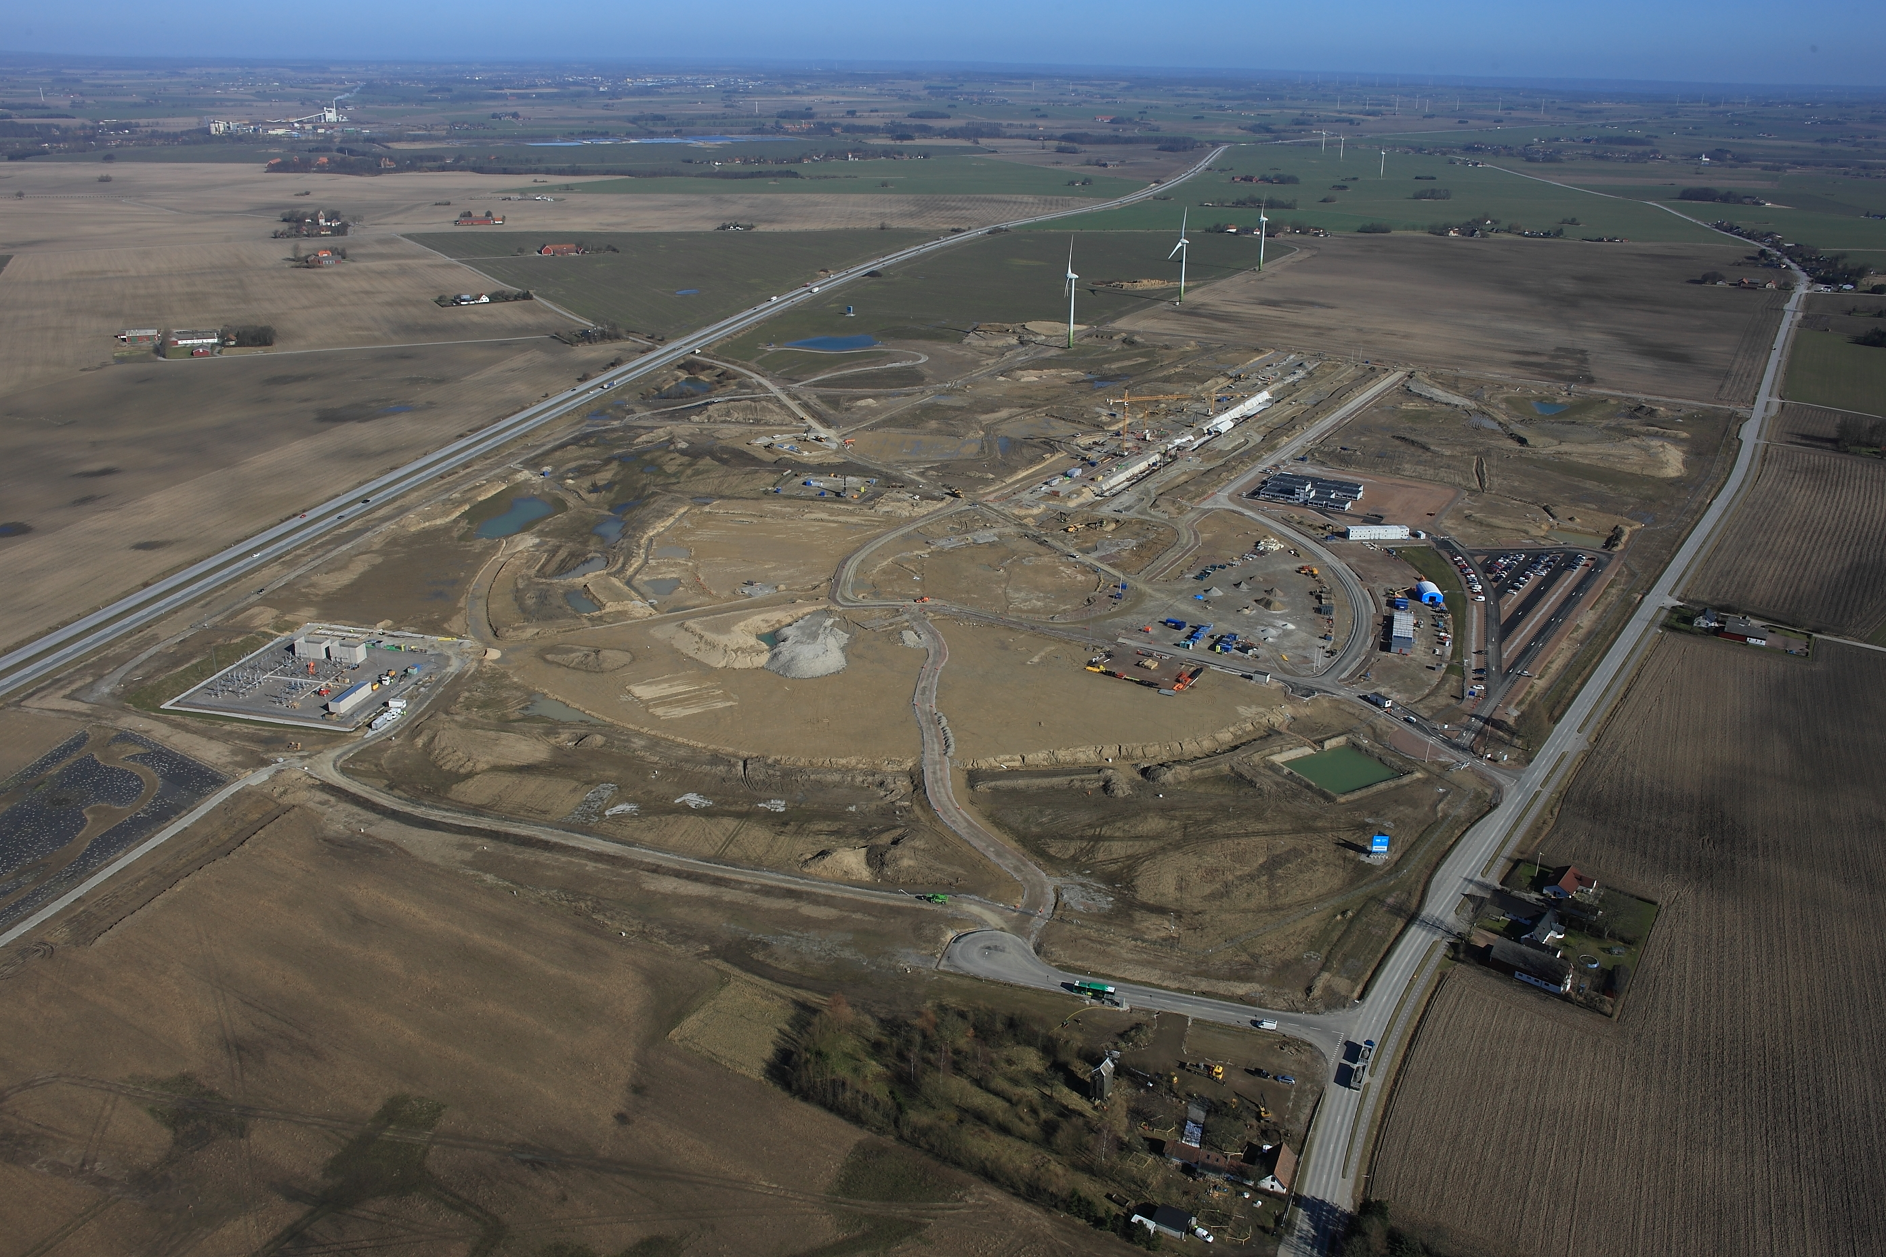

Slide 4
Accelerator
Design is updating
      In Current Design(to date):
      5 MW beam power
      2 GeV protons (H+)
      2.86 ms pulses
      14 Hz rep rate
      62.5 mA pulse current
      352.21 MHz
      704.42 MHz RF frequency

Slide 5
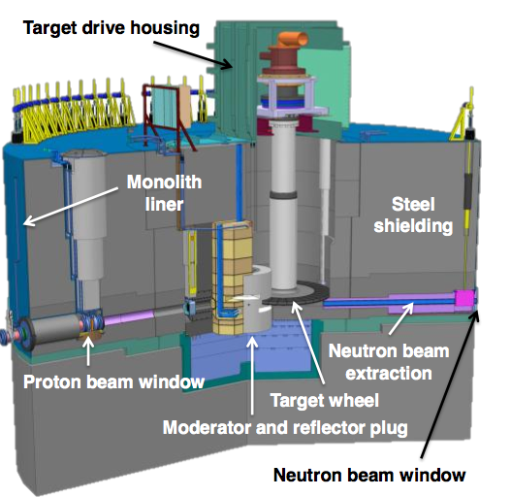
Target at ESS

Slide 6
Amplifiers/Klystron, IOT, Tetrode
(2013 version, A. Sunesson)
Cavity | Pulse power (kW) | RF Frequency (MHz) | Number | Sat Power (kW) | Choice
RFQ | 1300 | 352.21 | 1 | 1700 | Klystron
Bunchers | 15 | 352.21 | 2 | 20 | SS or IOT
DTL | 2200 | 352.21 | 4 | 2900 | Klystron
Spoke | 165-239 | 352.21 | 28 | 310 | Tetrode
Medium β | 122-514 | 704.42 | 60 | 670 | Klystron
High β | 394-872 | 704.42 | 120 | 1150 | Klystron/IOT

Slide 7
Modulator: The Stacked Multi-Level (SML) topology
(Carlos A. Martins, ESS)
DC
(115 kV,
klystrons)
(50 kV,
IOT’s
Module #1
HF
Transf.
Filter
AC /
DC
DC /
DC
DC /
AC
AC /
DC
DC-link
1.1 kV
AC
15 kHz
1 kV
AC
15 kHz
25 kV
AC + DC
15 kHz
25 kV
Capacitor bank 1 kV
Module #N
HF
Transf.
Filter
AC /
DC
DC /
DC
DC /
AC
AC /
DC
DC-link
1.1 kV
AC
15 kHz
1 kV
AC
15 kHz
25 kV
AC + DC
15 kHz
25 kV
Capacitor bank 1 kV

Slide 8
IOT (Morten Jensen)
IOT
(Density modulated)
Reduced velocity spread compared to klystrons
Higher efficiency
No pulsed high voltage
Cheaper modulator
RF input
Biased
Control Grid
RF output

Slide 9
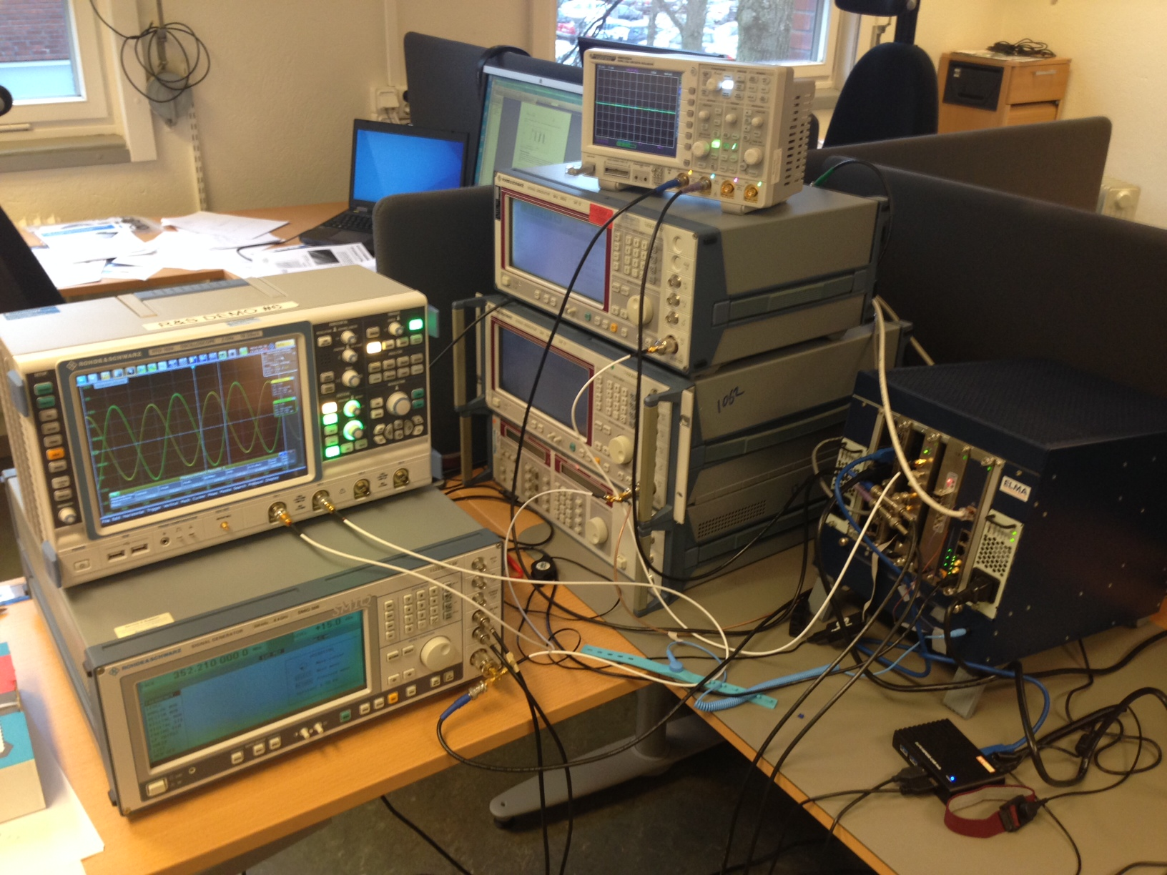
ESS LLRF prototyping
2014-3-26, Anders J. Johansson, Lund U.

Slide 10
The ideal cases

Slide 11
Perturbations in real world
Beam Loading
Cavity
Synchronous phase
Beam chopping
Pulse beam transient
Charge fluctuations
Non-relativistic beam
Pass band modes
HOMs, wake-field
Lorentz force detuning
Microphonics
Thermal effects (Quench…)
Ql spread
Power Supply
Modulator droop and ripple
Klystron nonlinearity
Phase reference distribution
Electronics crates
Reference thermal drift
Master oscillator phase noise
Crates power supply noise
Cross talk, thermal drift
Clock jitter, nonlinearity
Further reading: LLRF Experience at TTF and Development for XFEL and ILC, S. Simrock, DESY, ILC WS 2005

Slide 12
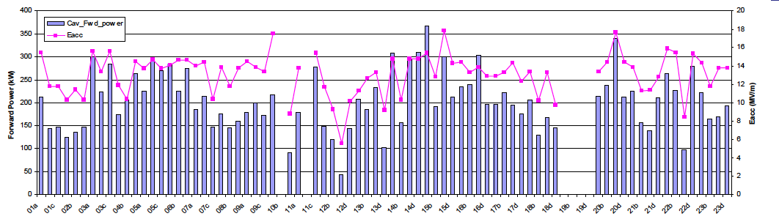
Cavity Control Challenges
Higher Stability requirement(±0.1 deg. ±0.1%, still in discussion with beam physics group)
Long pulse(~3.5ms RF pulses)
  Much longer Lorentz force detuning dynamics during pulse, might not be able to get compensated by traditional way driving the piezo with a simple half-cycle sinusoid impulse
  Klystron output droop and ripple might be bigger due to long RF pulse
High intensity (62.5mA, double than SNS)
  Heavy beam beam loading in cavities, require careful feedforward compensation for each beam mode during pulses, and appropriate adaptive feedforward to reduce the repetitive feedback transient response from pulse to pulse
High gradient (~20MV/m, 5MV higher than SNS)
  44MV/m maximum surface field(Accelerating gradient 19.9MV/m)
High beam power(5MW, 5 times higher than SNS)
  The same situation of RF setting errors (up to 2° in phase and 2% in amplitude) might not be acceptable at ESS due to probably higher beam loss at high power linac of 5MW
Spoke cavity(have not ever used in any accelerator )
  Uncertainties;
Energy Efficient
  Klystron Linearization;
  Minimize RF power overhead for RF control(25%→10%)
High availability
  Fast recovery from quench;
  Fast recovery from single/multiple LLRF, klystron, modulator, cavity, cryomodule failures
45% below saturation
54% below saturation

Slide 13
Control challenges: Klystron/Modulator ripples

Slide 14
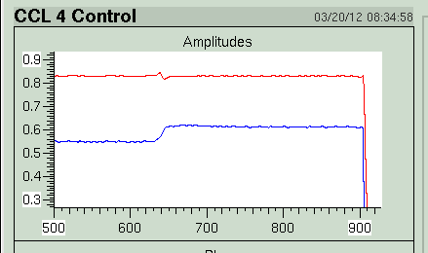
Control challenges: Beam loading issue
Normal conducting cavities (RFQ, DTL) have much lower Ql, ~ factor of 30.
Control is much more difficult due to low loop gain (~2, compared to 50 in superconducting cavity)
Beam loading is a very high frequency perturbations, and cannot be well compensated by integral controller
from presentation of J. Galambos

Slide 15
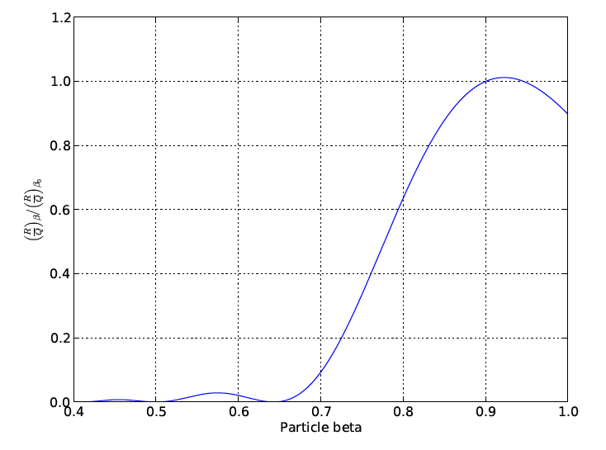
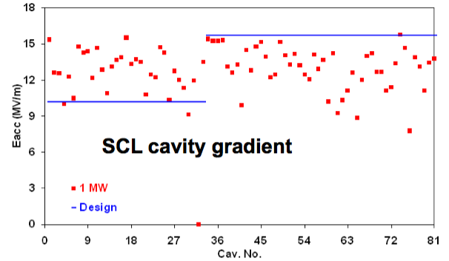
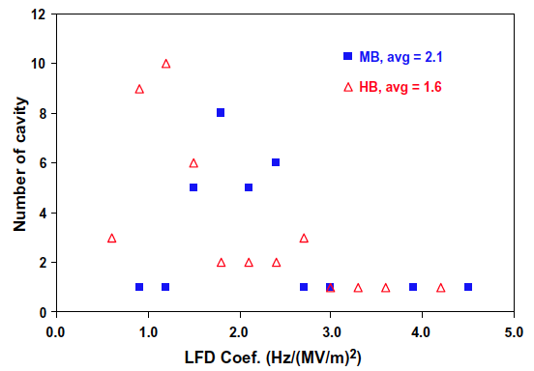
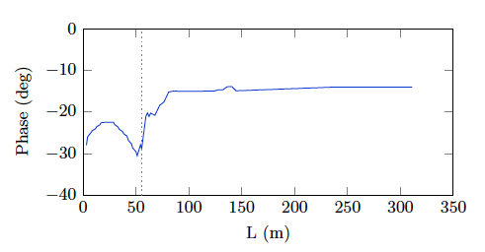
Cavity Operation Challenge
155 Cavities….
Cavity gradient spread(could be up to 50%)
Dynamic detuning spread
Q load value spread >20%
Beam velocity induced R/Q, Vc spread
Synchronous phase

Slide 16
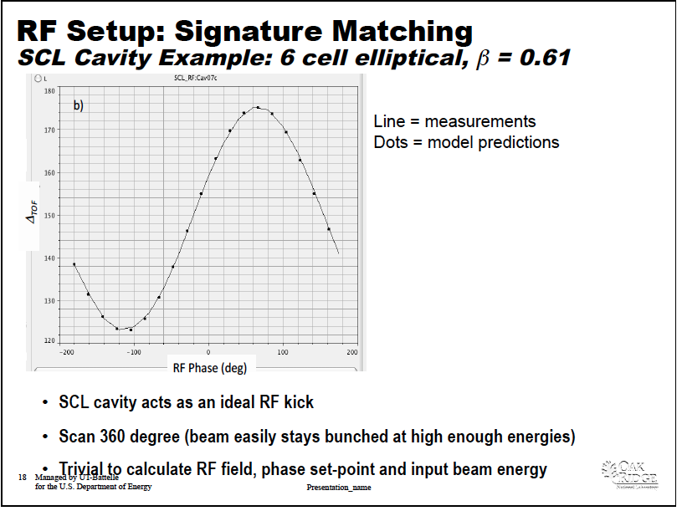
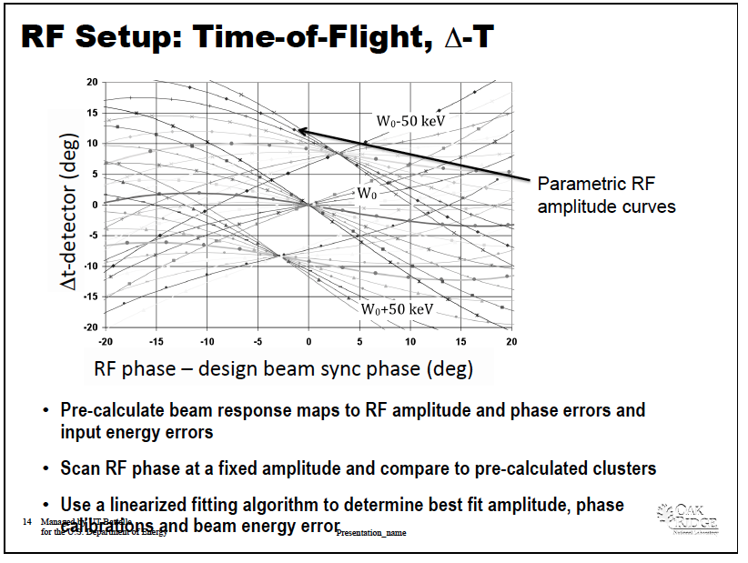
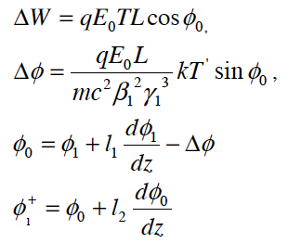
Operation challenges: Beam based calibration

Slide 17
Cavity RF/LLRF Test Challenges
Test stand all over the European, but none of them in Lund(so far)
How to learn as much as possible from a variety of RF tests carried out at different test stands and final accelerator tunnel, in order to better understand the cavity system and know its limitations, thereby operating the cavity system efficiently and effectively.

Slide 18
Advantage at ESS
One cavity driven by one amplifier(klystron, IOT) for RFQ, DTL, elliptical cavities and one cavity by 2 tetrod in spoke
most are cold linac
high cavity bandwidth(>1kHz for SC cavity)
Learn valuable experience from other labs

Slide 19
Advantage of new technology
Powerful new technology: MTCA system
Powerful hardware performance: 10 input channel (2.5 times as SNS ),
~1000 times bigger memory in FPGA,
faster CPU, communication,
higher SNR>70dB
Memory resolution able to <10ns
We should really aware the transformation such new technology could bring, and how to best apply in ESS, make full use of such a technology

Slide 20
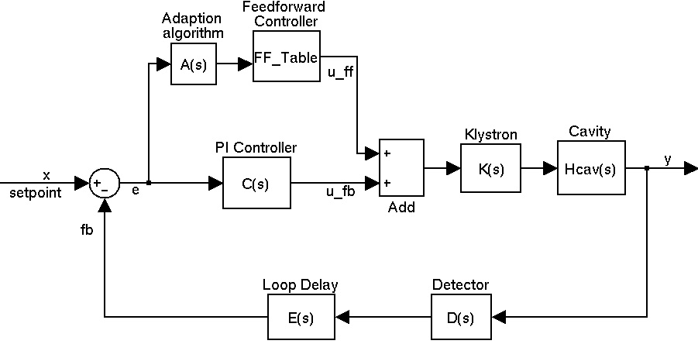
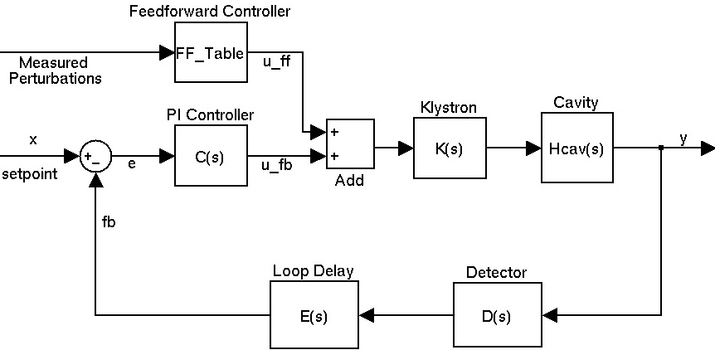

Addressing beam loading issue
Feed forward table adjustable resolution (better performance when resolution <100ns.
FF compensation
Beam loading

Slide 21
We should really aware the transformation such new technology(MTCA) could bring, and how to be best applied in ESS, make full use of such a technology
We could change the way doing things, with such powerful technology and advantages at ESS
But it is only happen if we can fully understand such system and appreciate the beauty it brings

Slide 22
Example 1: See in depth: Higher quality data
  higher resolution, adequate data sets, higher SNR
  Be able to carry out elaborate experimentation and obtain required data for particular purpose
  Real time measurement

Slide 23
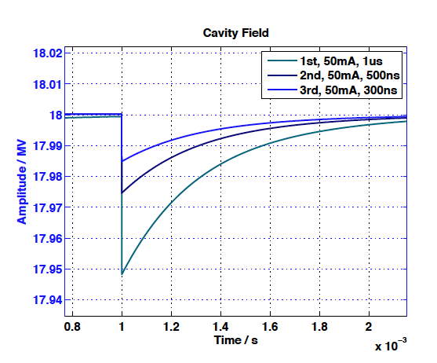
See in depth: Higher Resolution data
Beam loading: What happens during 1us
52.7kV (0.29% of operating voltage 18MV) for the 1μs-long
beam pulse induced voltage
Crucial limitation

Slide 24
Powreful technology: Higher resolution data
What happens in 100ns（3MHz bandwidth system）

Slide 25
Powreful technology:
High Signal to Noise Ratio(SNR)
SNR 75dB from IQ detection:
70dB SNR cause more than 6% power overhead, while 75dB ~3%;
75dB possible?

Slide 26
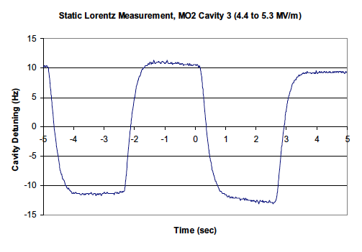
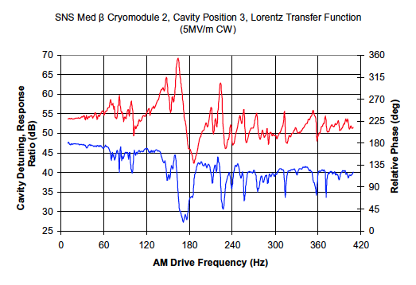
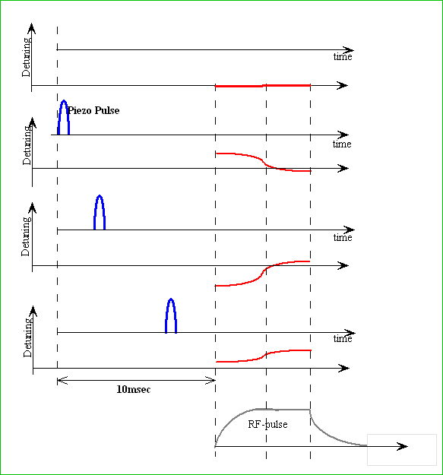
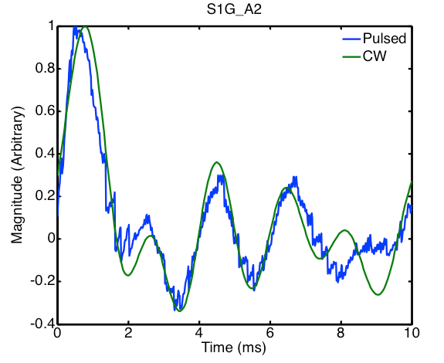
Get data as we required
  With high performance hardware, we are able to carry out elaborate experimentation and obtain required data for particular purpose
Example: Lorentz Force Detuning Compensation
  Static LFD coefficients
  Dynamic LFD spectrum
  Time domain piezo tuner transfer function(pulse mode, impulse response)

Slide 27
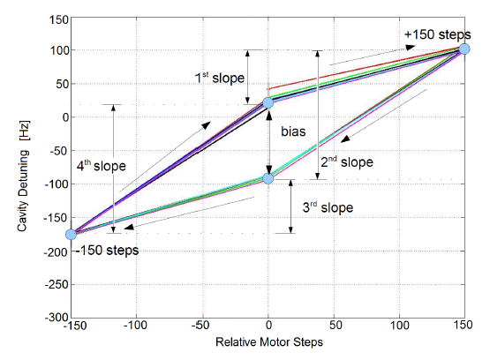
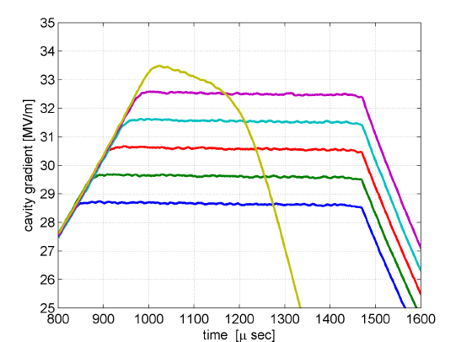
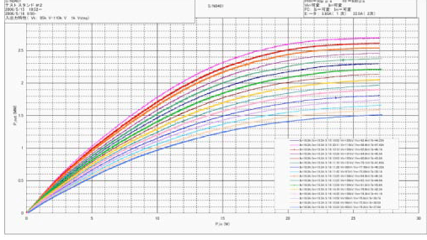
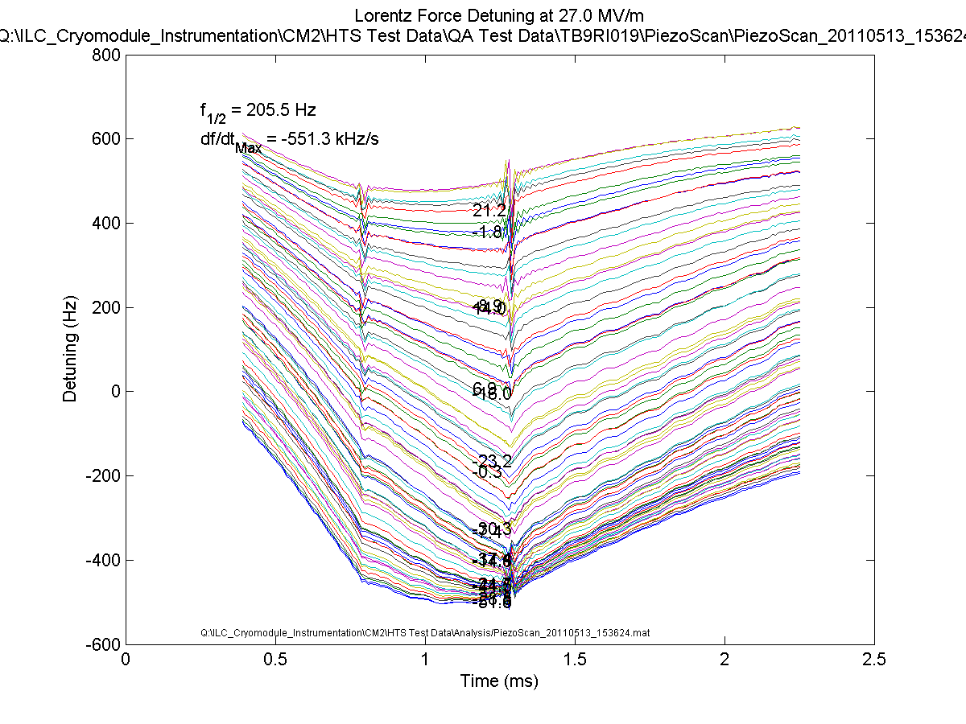
Well-Recorded data in high details
Motor tuner transfer function/DESY
Quench limitation identification/DESY
Klystron input-output characteristics/JPARC
Lorentz force detuning/Fermilab

Slide 28
Example 2: High precision RF measurement for basic cavity parameters
  Ql
  Dynamic detuning
  R/Q
  Phase
  Amplitude

Slide 29
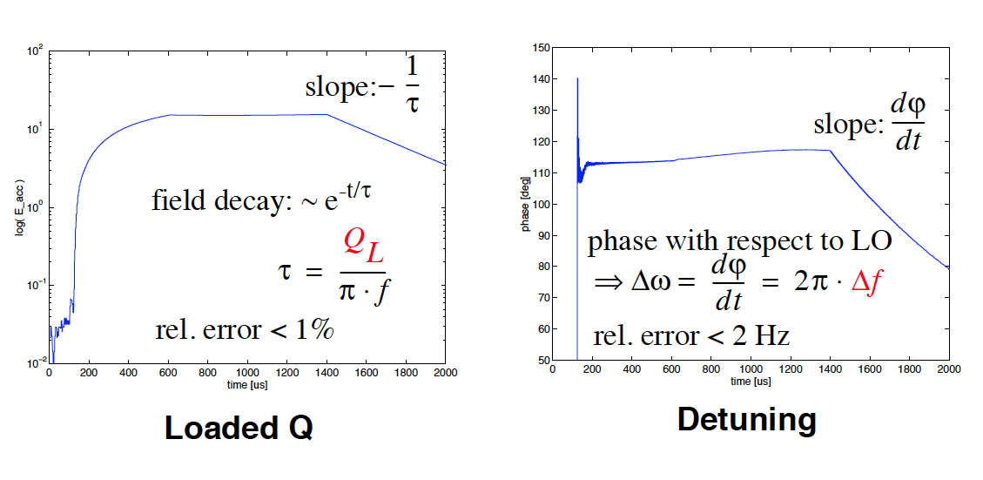
High precision RF measurement:
Ql, detuning

Slide 30
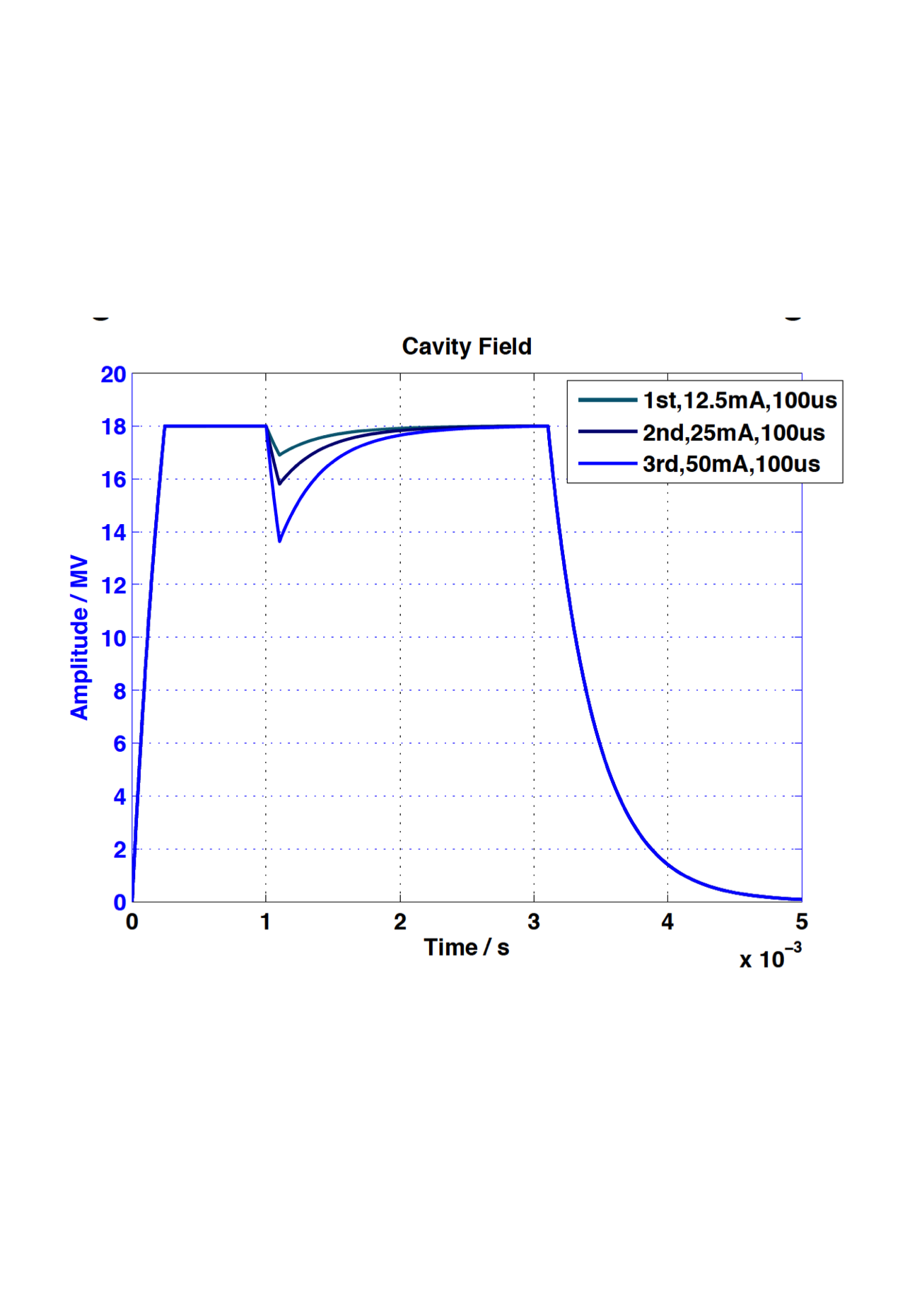
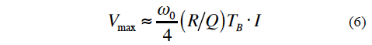
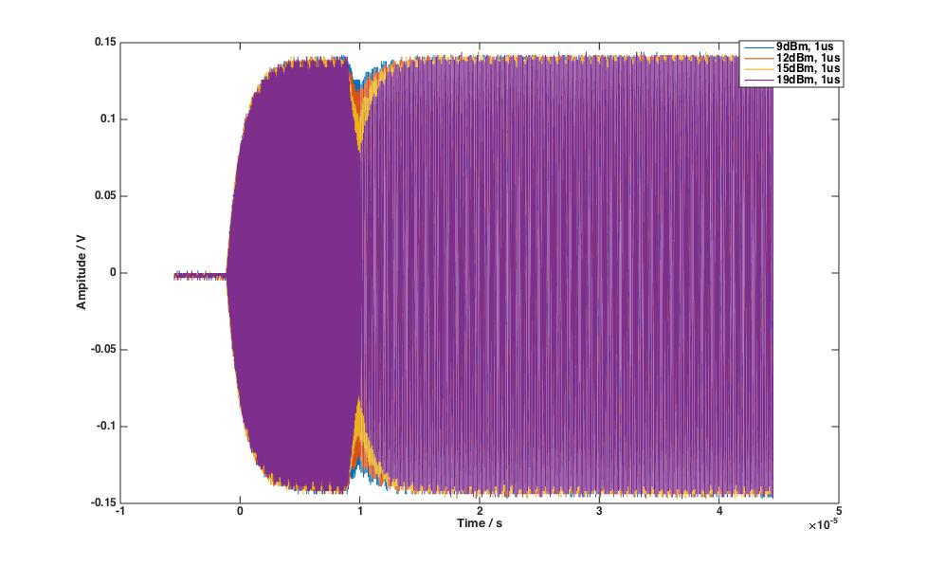
High precision RF measurement:
R/Q Calibration

Slide 31
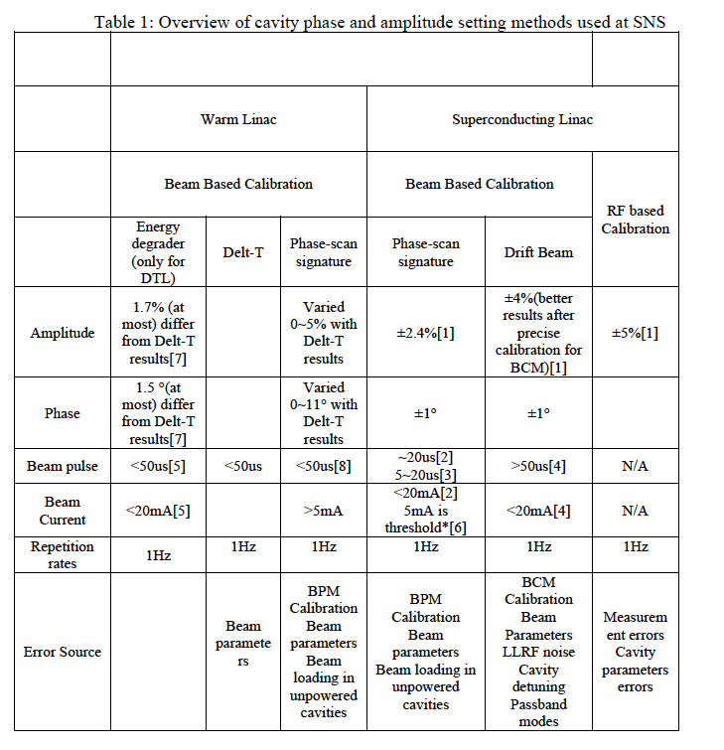
Beam based calibration: Phase&Amplitude

Slide 32
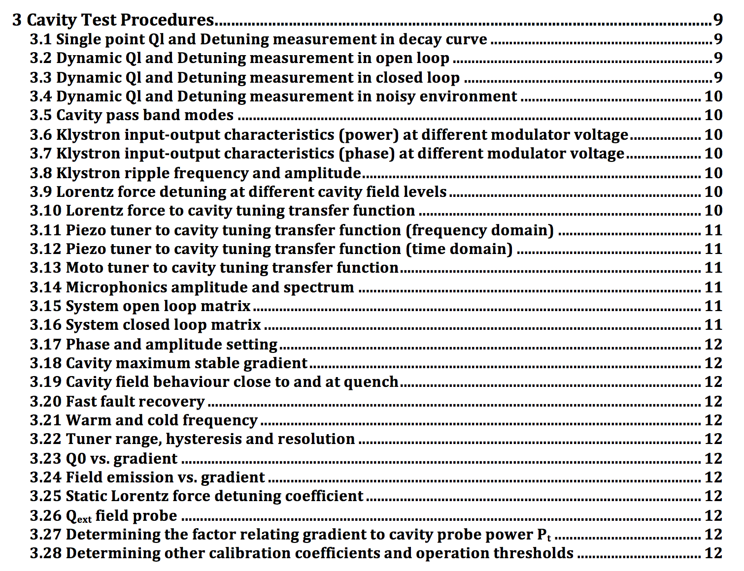
There is more…

Slide 33
Natural way to calibrate system parameters
Focus on converging the model to the “true” system
  Produce output by model predicting/theoretical calculation
  Measure output by doing specific testing
  Least-square methods to identify systematic errors
  Least-square methods to modify model parameters so as to converge to “true” system

Slide 34
However,
There no absolute “true” system, no absolute “true” data, even no “true” parameters(voltage and phase of the cavity?)
In reality, it is less important to identify the true system, but more important to identify a good input-output description of the system

Slide 35
So can we accept a “modified” model having robust/best averaging/or simply constant prediction errors, comparing with measured data?
And use this “modified” model to generate ”modified” parameters, to configure, control, operate the system?
And do it in automatically way?

Slide 36
Example
We accept accelerating voltage Vc, synchronous phase φb, ±1%, ±2%, or even more, with “true” values.
And derive new R/Q*, Ql*, Δω*, aslo t_inj, pre-detuning in model, by referring this voltage, and phase, even if these new generated value different from designed/measured R/Q, Ql, Δω.
A robust model best describing system then is obtained, even if have discrepancy with designed/measured one, as long as the discrepancy is robust and we can control.

Slide 37
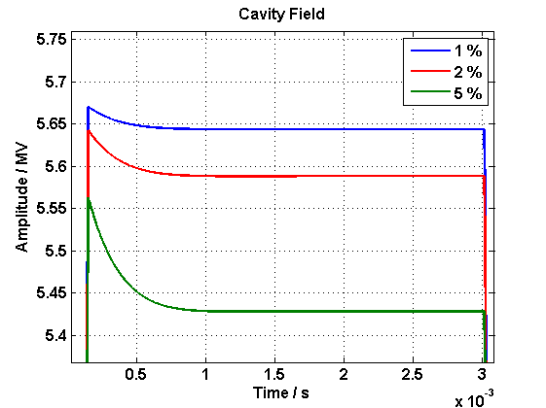
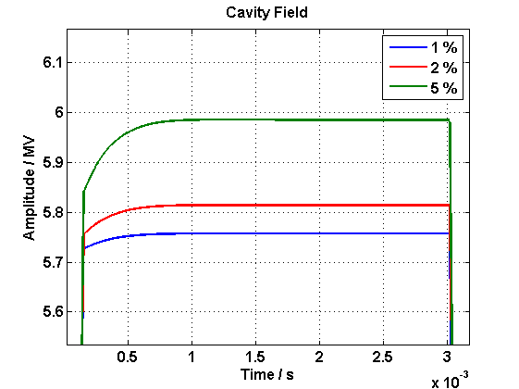
If there is voltage setting errors, but we still accept it as “correct” value in model, and just change R/Q to R/Q* in FF table, to make cavity gradient reach the same level. The R/Q* will be default value.
It will lead changed t_inj, predtuning, and possible other parameter not identical with design value, but that doesn’t matter, since we really care is to maintain constant field.

Slide 38
Example 3: Power overhead reduction----running close to saturation

Slide 39
Overhead at beam commissioning
Behaviors are different among different beam modes
peak power depends on the error when system transient response reaches its first overshoot peak, limited by system bandwidth.

Slide 40
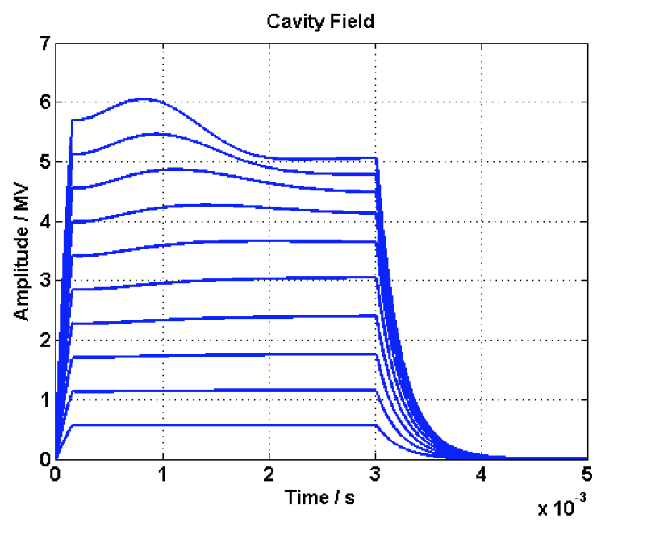
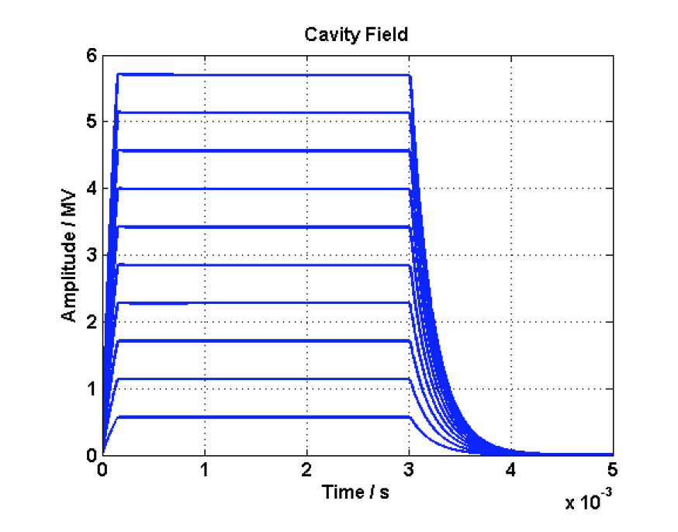
Promising consequence
Doing thing in a simple, straightforward way:
Measured dynamic detuning

Slide 41
Others
Cavity gradient spread(can be up to ±30%)
Ql spread ( can be up to ±20%)
Spoke cavity
Allowable for several cavities failure, fast recovery
Work and change quickly at different gradient, phase

Slide 42
It is in an early stage, but have quite tough schedule..
It is a iterative process. Keep learning, and keep upgrade. The requirement & functionalities would change, as we get more and more understanding the hardware/software/firmware
need more input (theoretical analysis, calculation and simulation, and practical test and knowledge, expertises)
From test, measurement, To decide what is necessary and practical to implement(drift beam calibration? beam based feedback? on-line cavity model? more measurement input? High accuracy? More data?)

Slide 43
Thanks!

