Slide 1
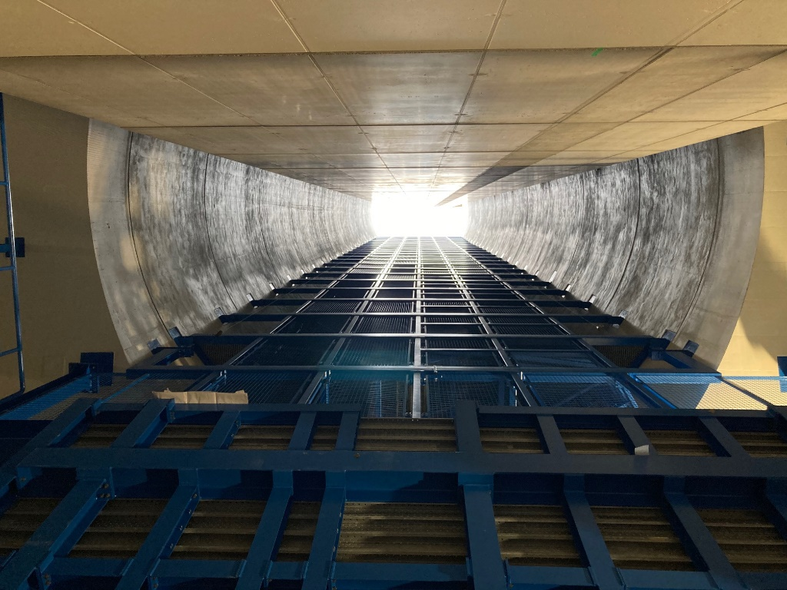
HL-LHC Project
O. Brüning
On behalf of the
HL-LHC Project

Slide 2

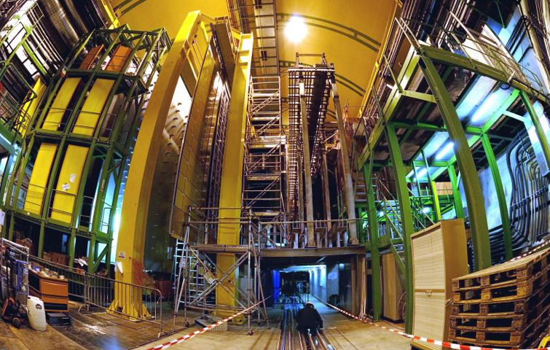


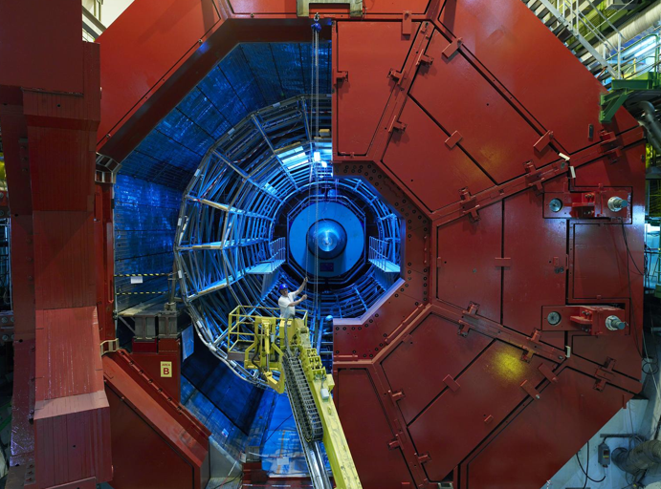

LHC in the Geneva Basin and its Experiments
LHCb
CMS
ATLAS
Features proton-proton and Lead-Lead and Lead-proton collisions!
ALICE
LHC ring:
27 km circumference
22km arcs with
Super Conducting Magnets

Slide 3
LHC (Large Hadron Collider): Magnet Technology
14 TeV proton-proton accelerator-collider built in the LEP tunnel ➔ requires ca. 9T magnets!!!
200000 times the
earth magnetic field!!
    Requires
    Superconducting magnet
    technology
1983 : First studies for the LHC project
1988 : First magnet model (feasibility)
: Approval by the CERN Council
1996-1999 : Series production industrialisation
: Declaration of Public Utility &
Start of civil engineering
1998-2000 : Placement of main production contracts
2004 : Start of the LHC installation
2005-2007 : Magnets Installation in the tunnel
2006-2008 : Hardware commissioning
2008-2009 : Beam commissioning and repair
As of 2010: Physics exploitation
Ca. 20 years magnet development!!!
Ca. 30 years machine development!!!
➔ Significant Time scale extending well beyond that of a physicist career!!!
A 27 km circumference collider…
3

Slide 4
LHC (Large Hadron Collider): Magnet Technology
1983 1991 2000 2010
The LHC dipole magnets mark the
culmination of 30 years of superconducting
magnet technology development!
➔ Requiring 1.9K [-271 degrees Celsius] operating temperature
A 27 km circumference collider…
4

Slide 5
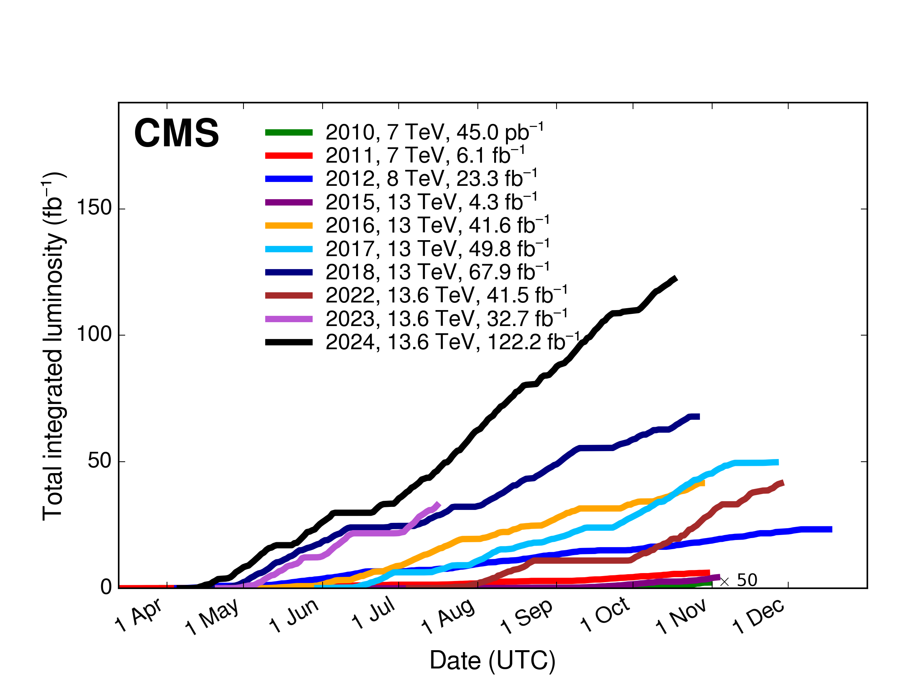
LHC Performance
Higgs discovery in 2012! ➔ But many questions remain and the search continues!!!
Higgs properties [coupling]
More than one Higgs?
BSM Physics? Dark Matter & Dark Energy?
Need for more Data and Statistics!!
➔ Over 389fb⁻¹ at 13 TeV so far with
Higgs Discovery in 2012!
ca. 120fb⁻¹ / year at hand!!!
➔ over 500fb⁻¹ by the end of LHC Run3 by mid 2026!!!
Doubling the statistical accuracy for the experiments implies 4 times the data volume!!!
➔ over 20 Years of operation with current peak performance after Run 3 end (after 2026)!
So Why do we need an Upgrade?
Notes:
To be updated with last version before the CMSDAS meeting

Slide 6
LHC Lifetime Limitation:
Debris from the IP & Radiation damage to magnets!
➔ End of the LHC triplet lifetime by End Run3 in 2026
Cold bore insulation
≈ 35 MGy
Q2
27 MGy
MCBX3 20 MGy
➔ HL-LHC goal: 10 times the LHC data Volume within 10 years of operation
6

Slide 7
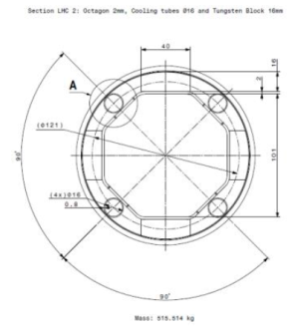
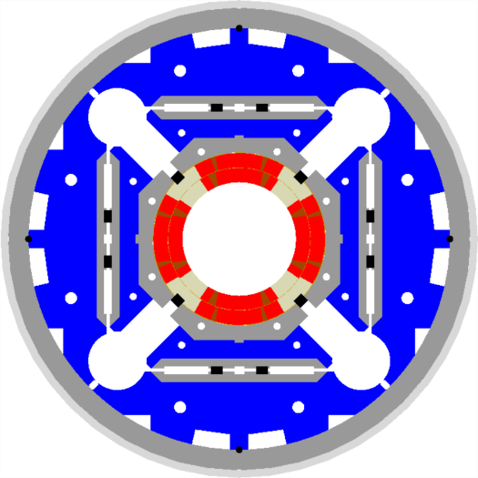
HL-LHC technical bottleneck:
Radiation damage to triplet magnets
Tungsten blocks
Need to replace existing triplet magnets with radiation hard system such that the new magnet coils receive a similar radiation dose @ 10 times higher integrated luminosity!!!!! ➔ Shielding!
US-LARP MQXF magnet design
Based on Nb₃Sn
technology
Requires larger aperture!
70mm at 210 T/m ➔150mm diameter 140 T/m
8T peak field at coils ➔ 12T field at coils (Nb₃Sn)!!!
➔ New magnet technology!
➔ New, brittle superconductor!
Capillaries
➔ Longer magnets
➔ New Superconductor

Slide 8
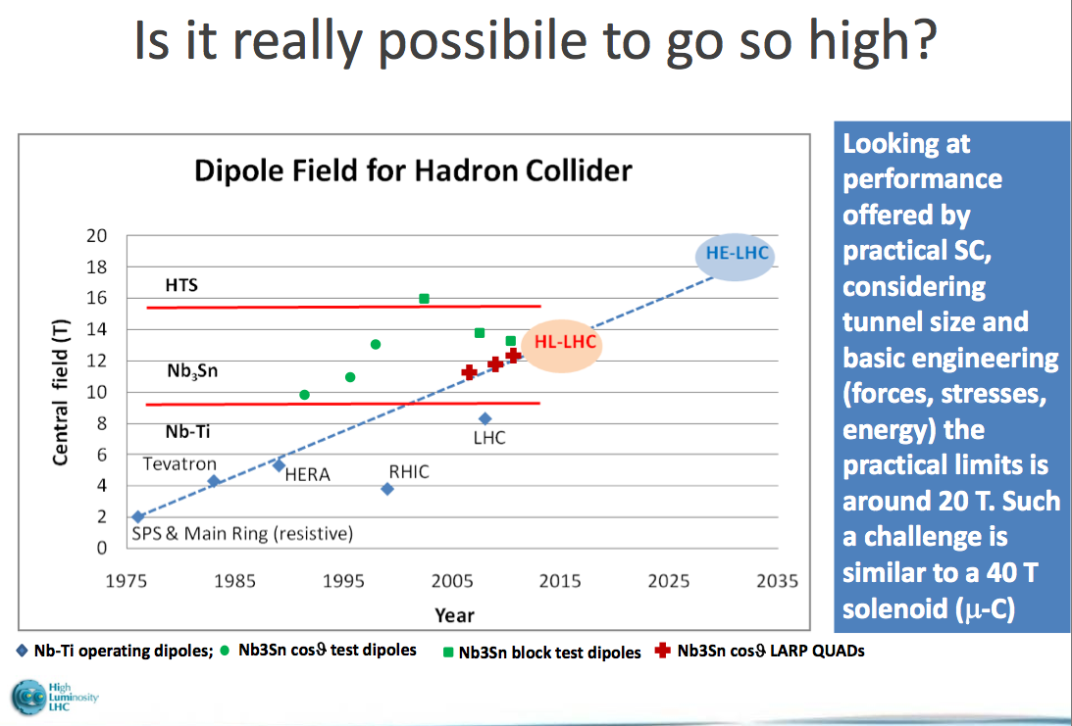
High Field SC Magnets
Magnet development requires substantial R&D effort!!!
Ca. 30 years of NbTi magnet R&D leading up to the LHC dipole magnets!
Transition from NbTi to Nb₃Sn:
HL-LH lead the R&D for 11-15T magnets based on Nb₃Sn technology:
➔15-20 years R&D program
Transition to HTS:
Assume R&D period of similar siz
e ➔ 2035?
Transition from NbTi to Nb₃Sn: required similar length of R&D!
HL-LHC led the R&D for 11-15T magnets based on Nb₃Sn technology:
Started in early 2000
➔15-20 years R&D program
Ready for installation
by 2025
Ready for operation
by 2029
ca. 30 years of
development!!!
FCC-hh
8

Slide 9
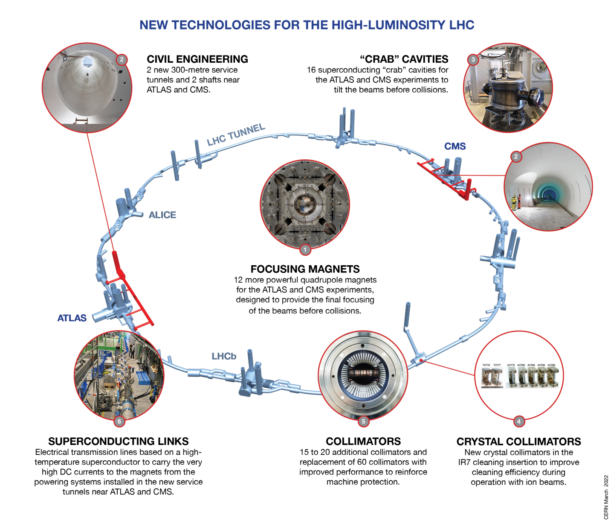
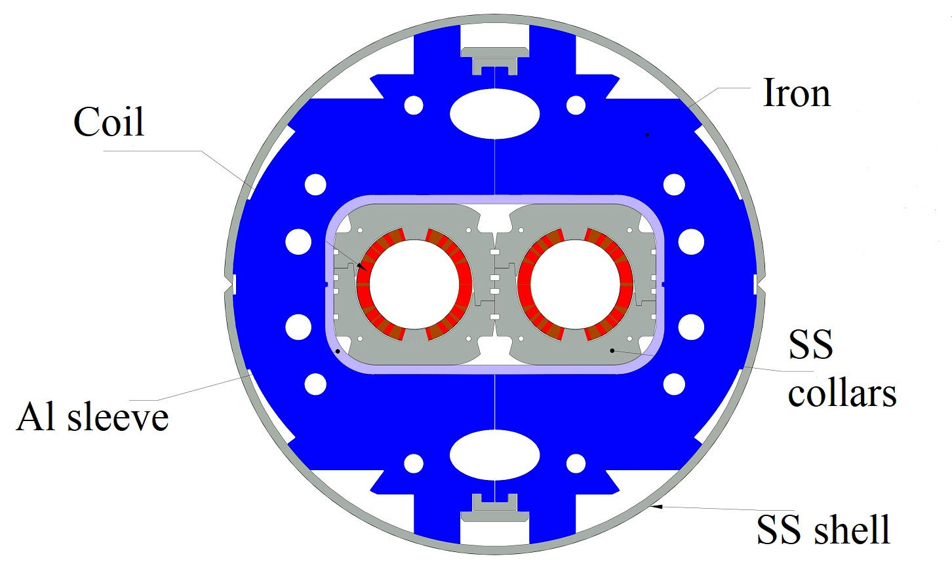
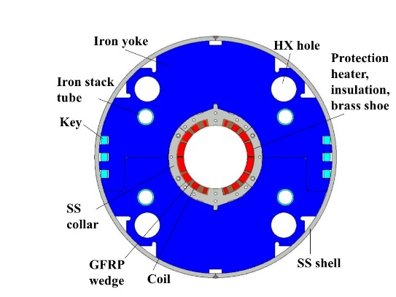
Technology
Landmarks
Separation / Recombination
dipole magnets: D1 & D2
Need to overcome several limitations in the existing LHC machine!!!
Ca. 1BCHF CtC Project

Slide 10
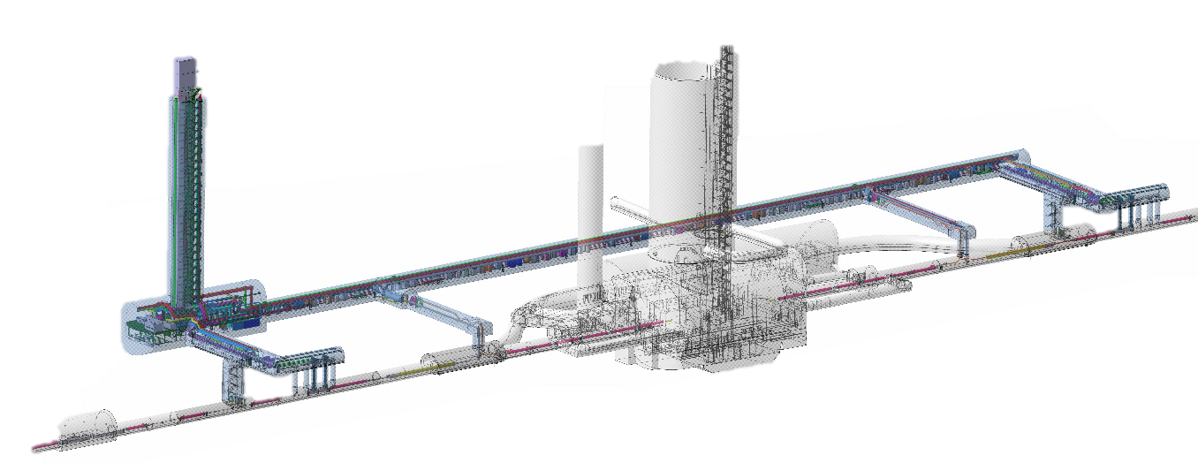
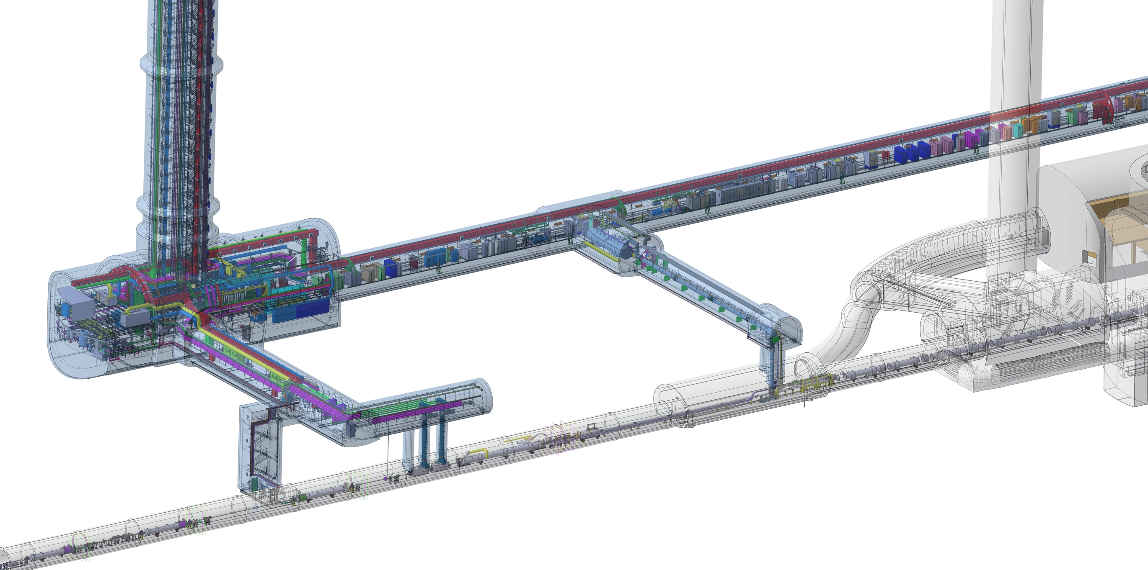
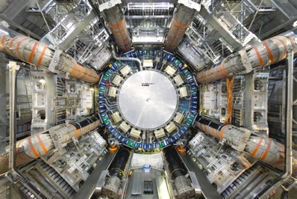
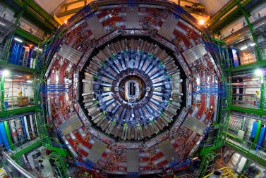
Civil Engineering:
QDS
UR55
Warm Diodes
CLIQ
PIC,BIS
CDBs
OC EE
Valve box
DFHX
D2 OC PCs
DFHM
US57
D2 PC
D1 PC
OC PCs
UW57
PC IT
PCs IT Trims
CDBs
DSHX
D2 OC EE
UL57
Cold box
DSHM
UA57
D1
CP
Q3
Q2B
Q2A
Q1
RF Powering
DFM
DCM
Cooling and Ventilation
DFX
Magnets
UPR57
Cold Diodes
TAXN
Cold Powering
D2
Warm Powering
DQHDS
Crab
Cavities
Q4
Machine Protection
Q5
Underground Civil Engineering Excavation work completed!
Q6

Slide 11
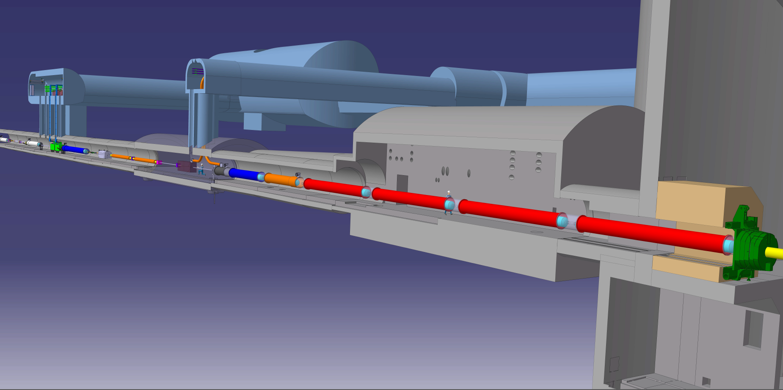






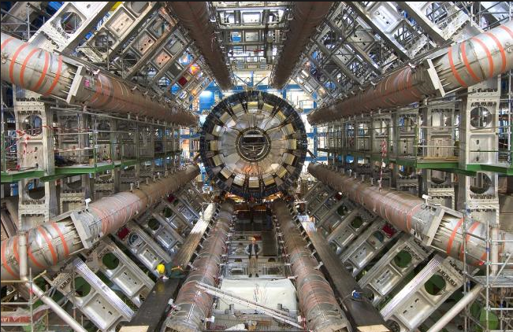


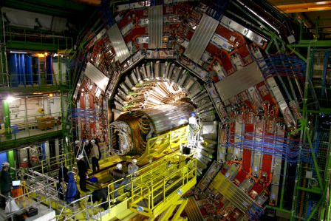
The Insertion Region (up to Q4)
Connection to LHC (UL)
Service gallery (UR)
UA Gallery
Service cavern
SC Links
Q4
Collimators
D2
Crab cavities
D1
CP
Q3
TAXN
DFM
DFX
Q2b
Q2a
Q1
TAXS
O. Brüning CERN ATS-DO: HL-LHC Project

Slide 12
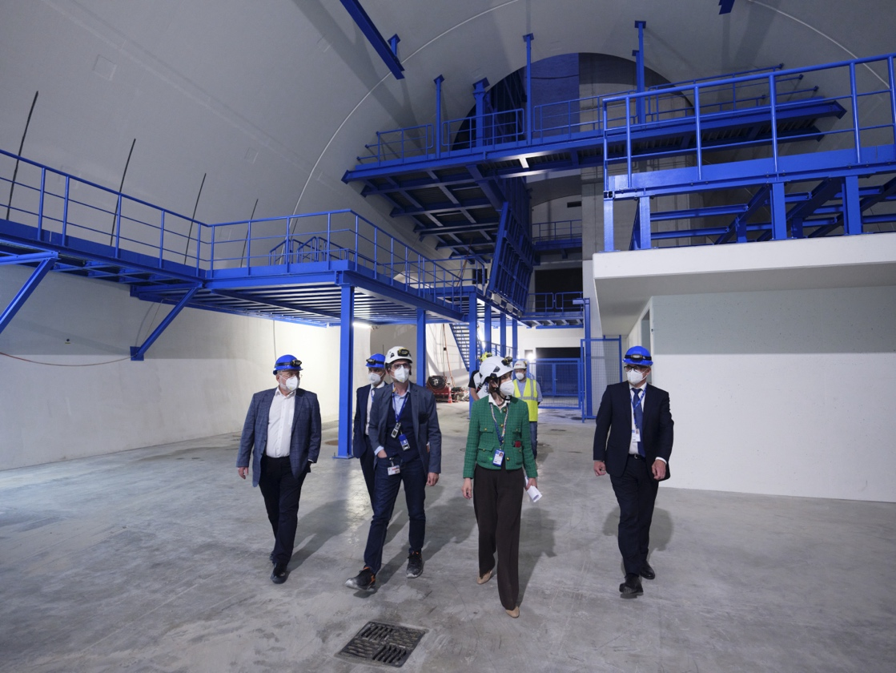
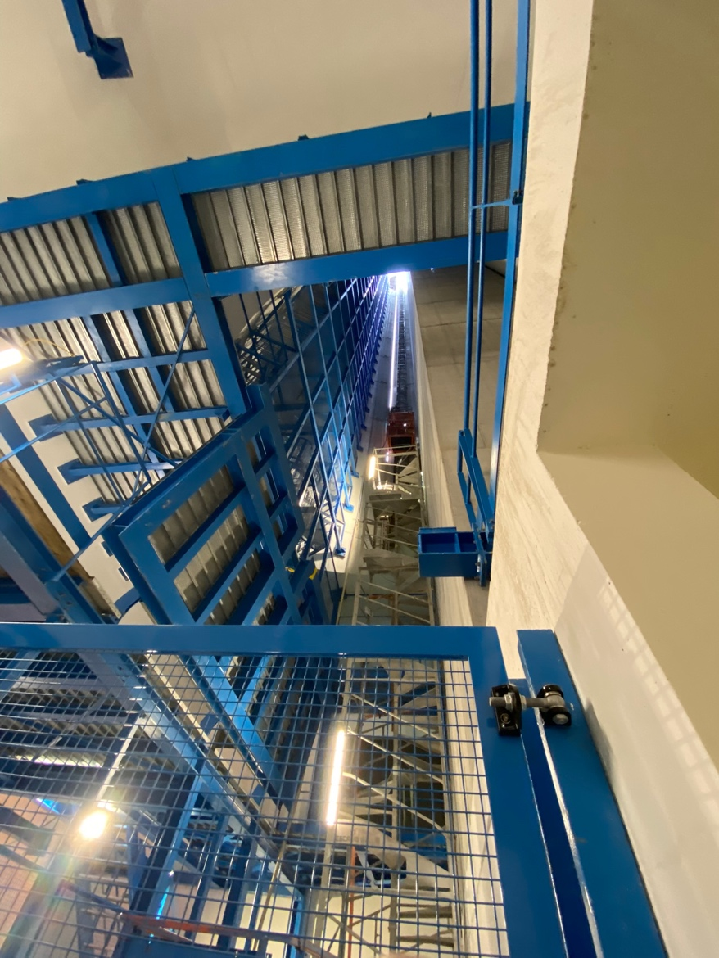
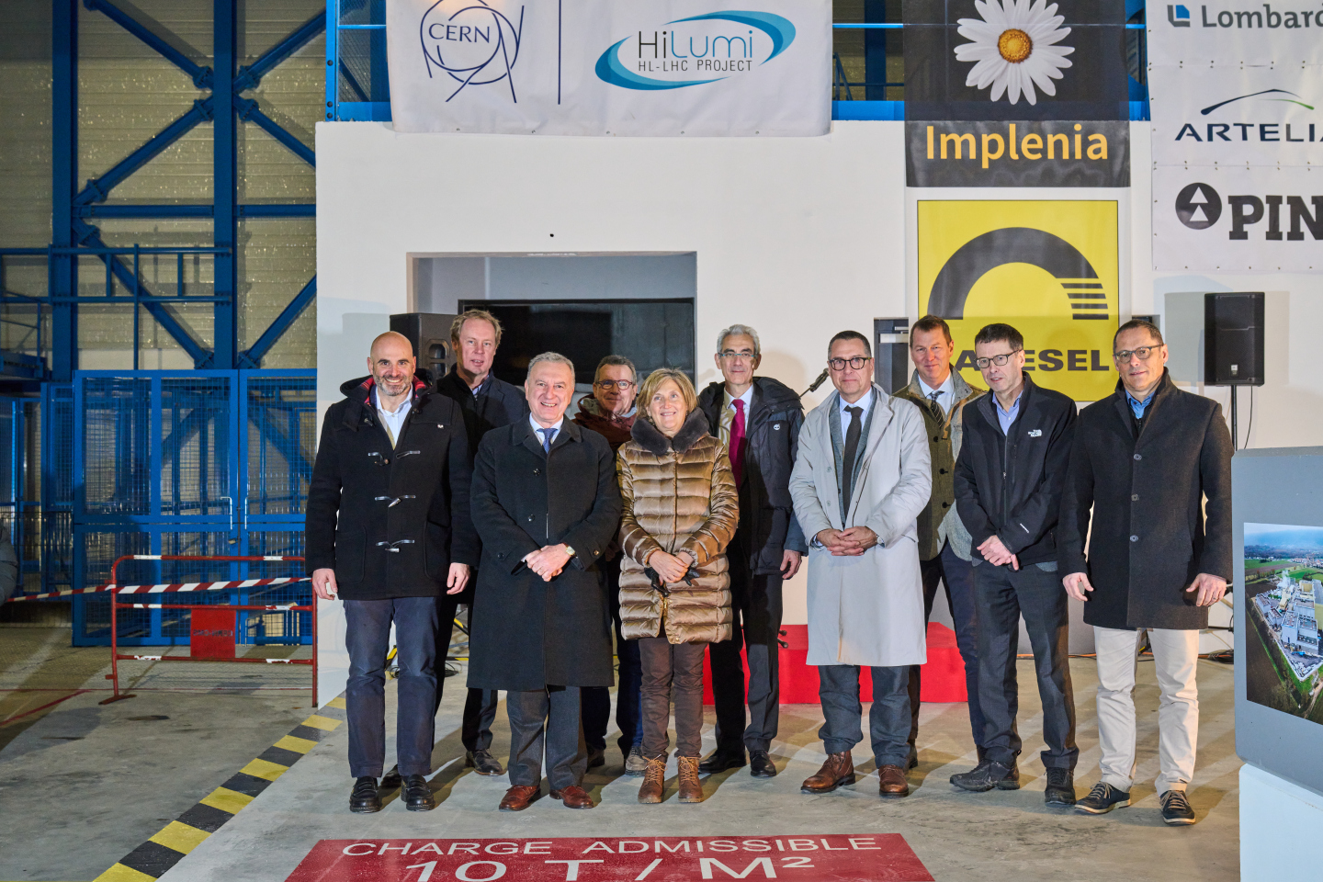
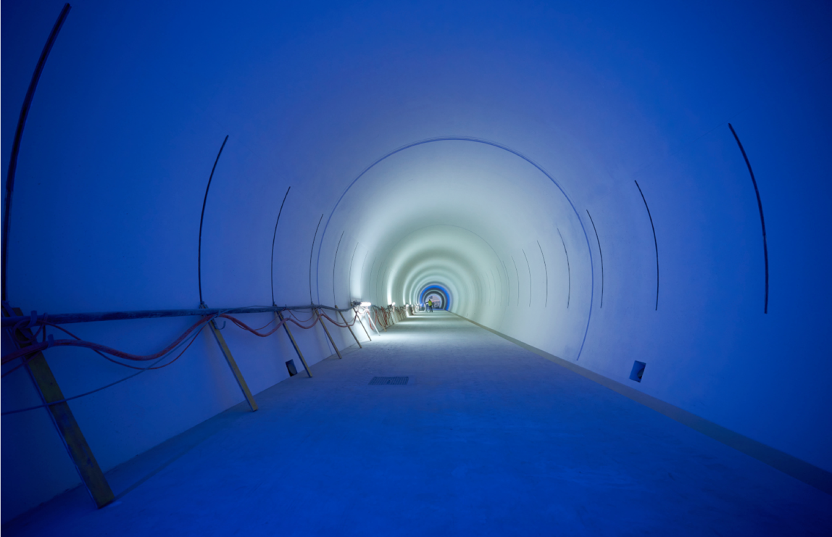
Completion of CE on January 20th 2023
Notes:
To be updated with latest plans for Ceremony

Slide 13
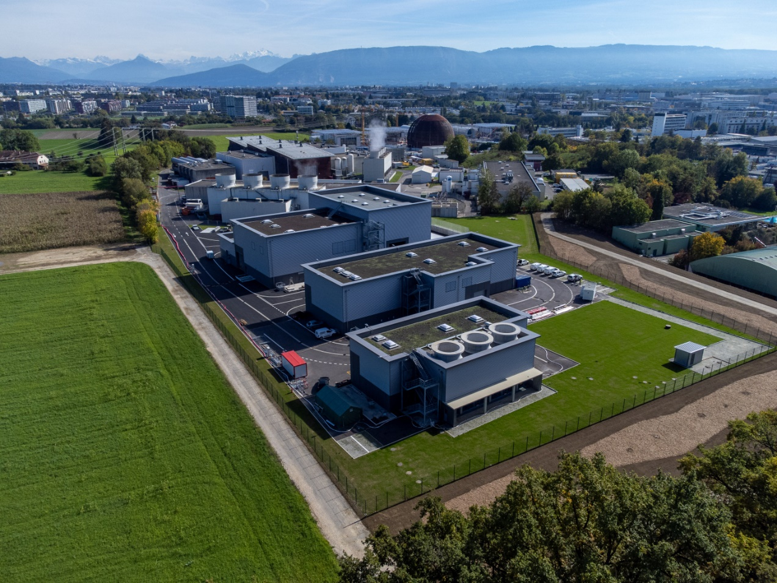
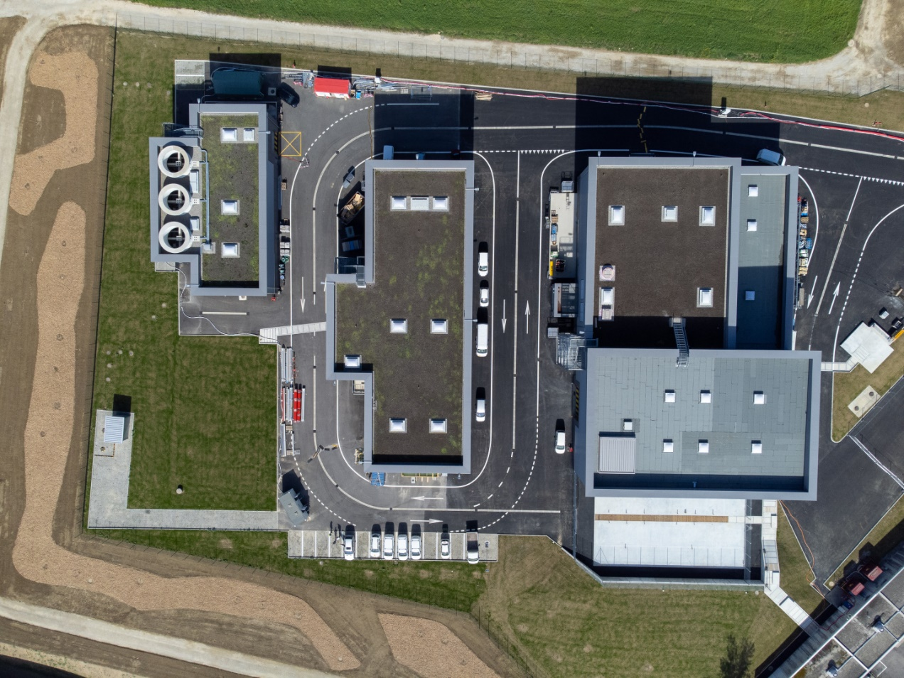
Completion of the civil engineering works:
Surface Buildings finished in 2023
SF17
SU17
SE17
SHM17
SD17
Example Point 1

Slide 14
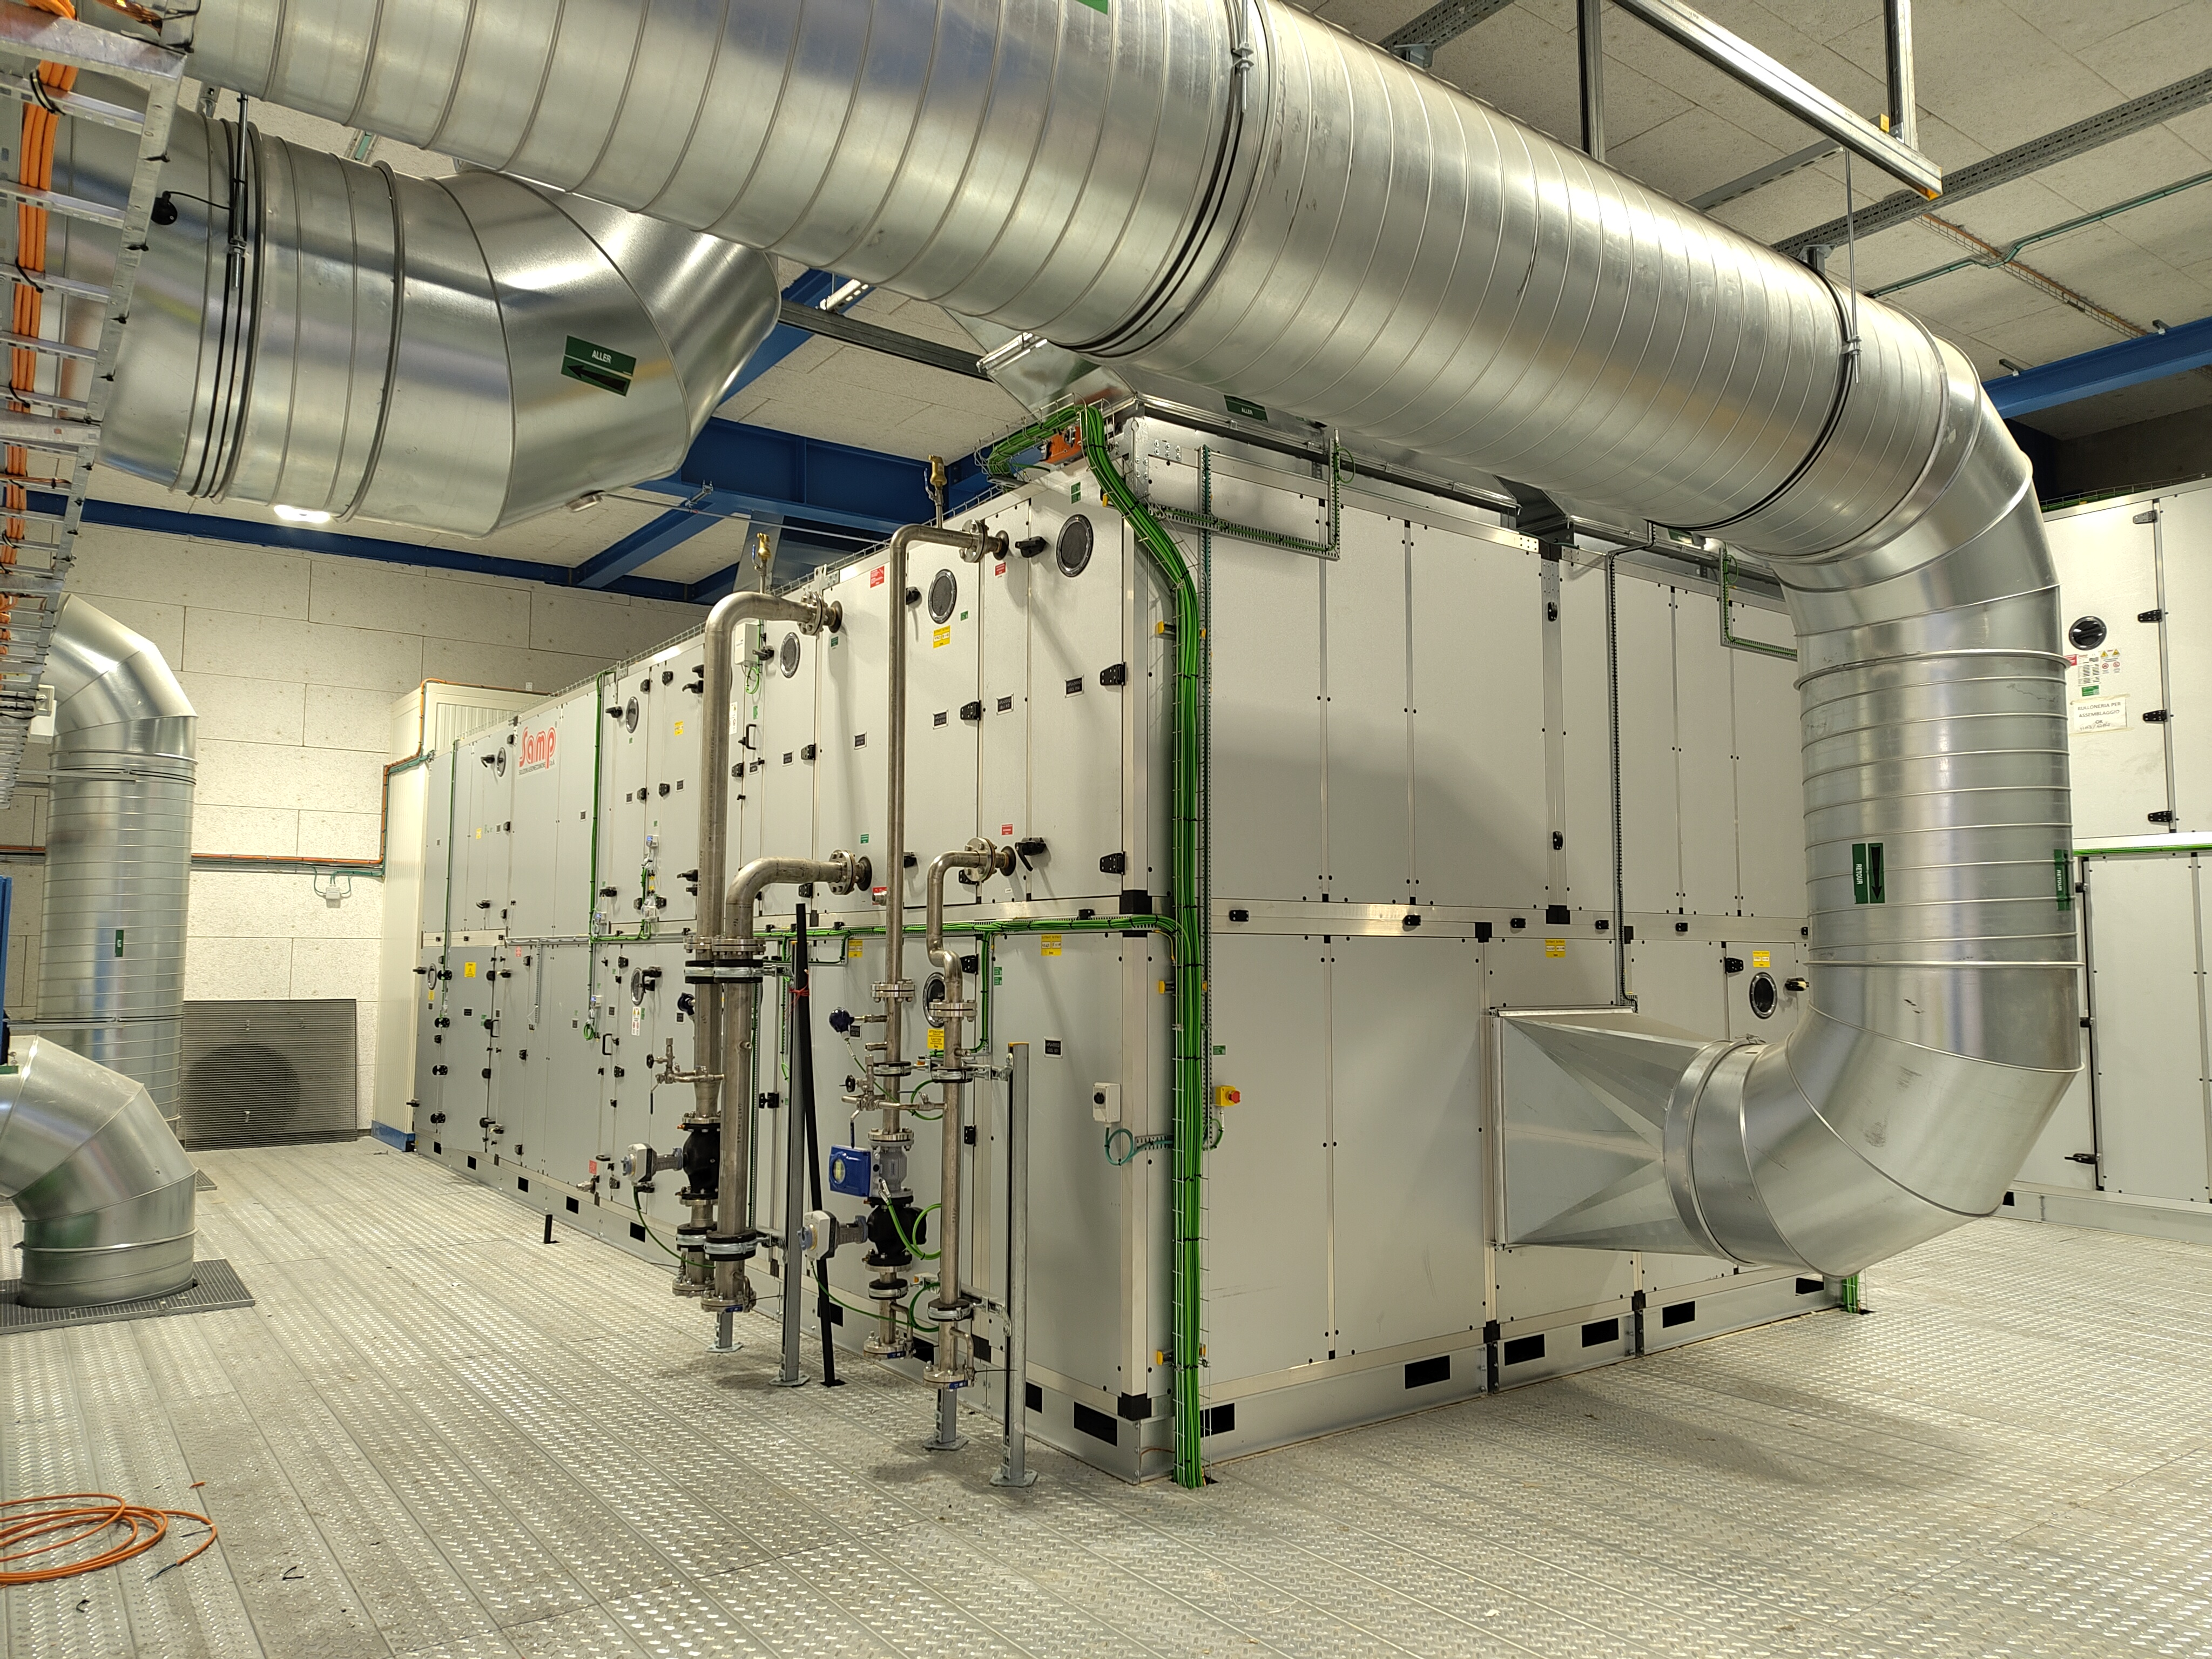
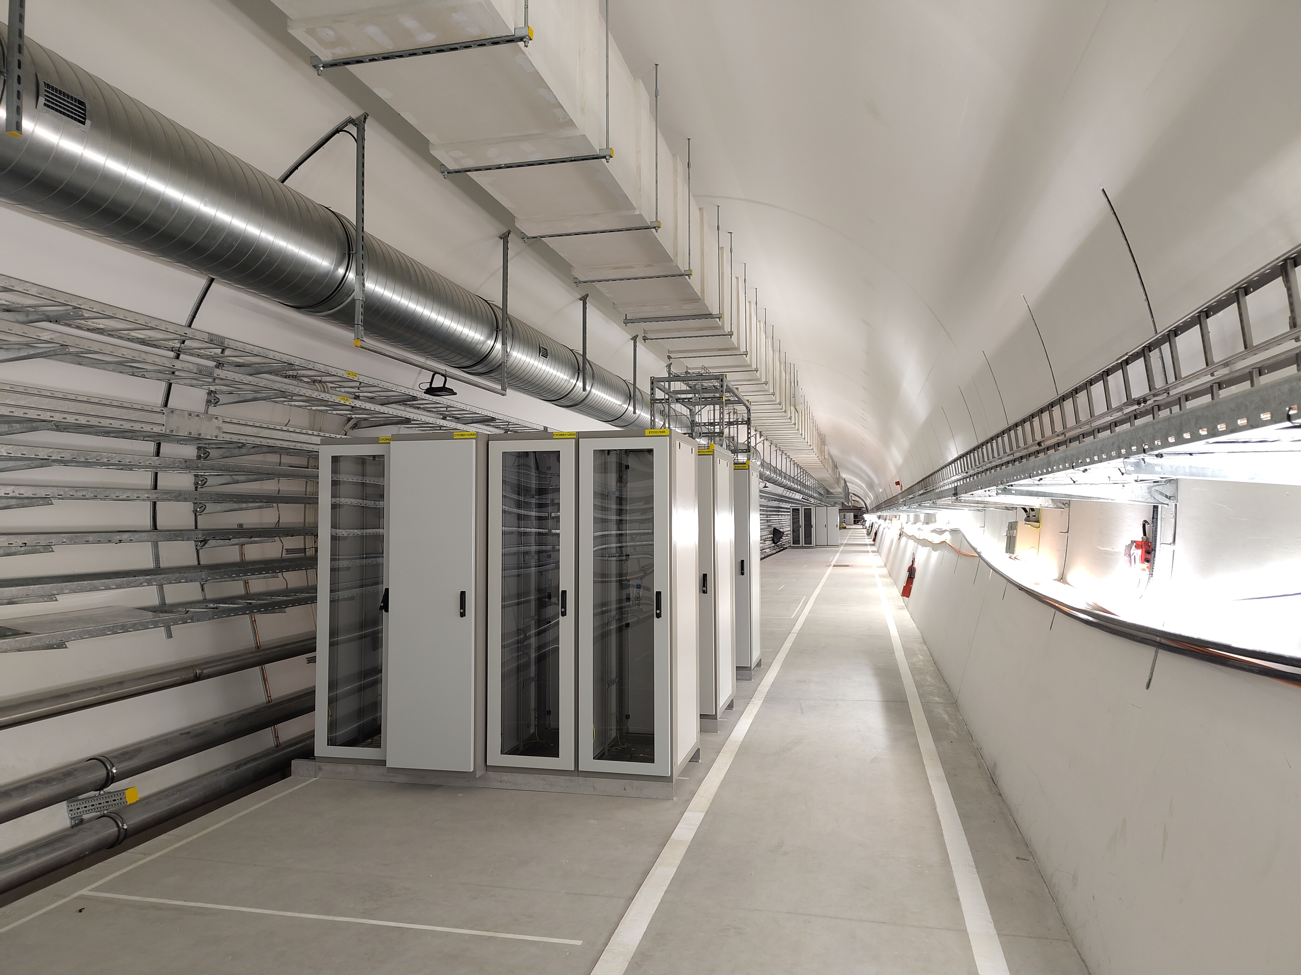
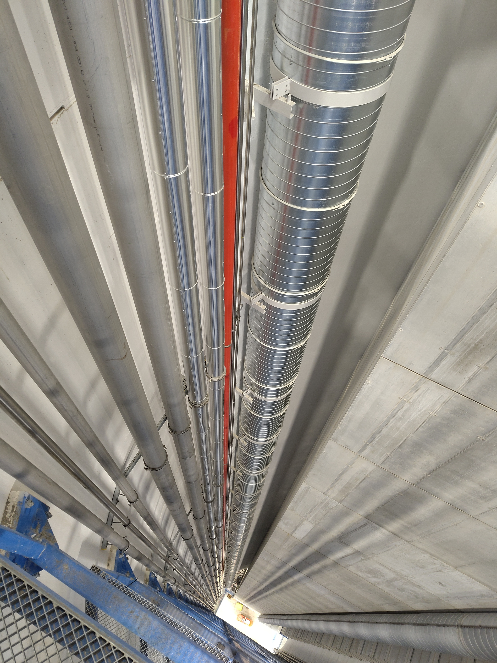
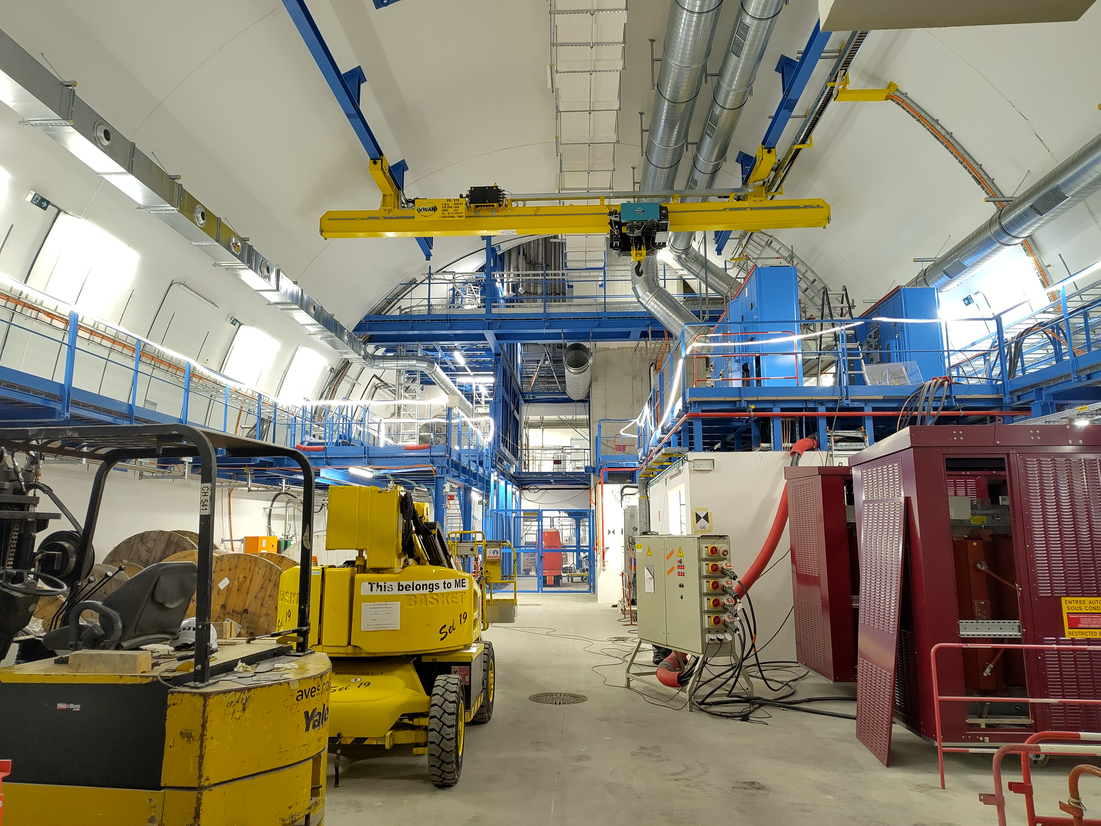
Status of infrastrucuture installations at P5

Slide 15
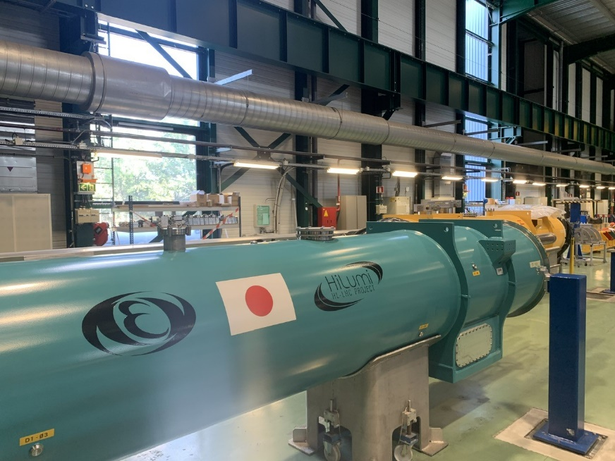
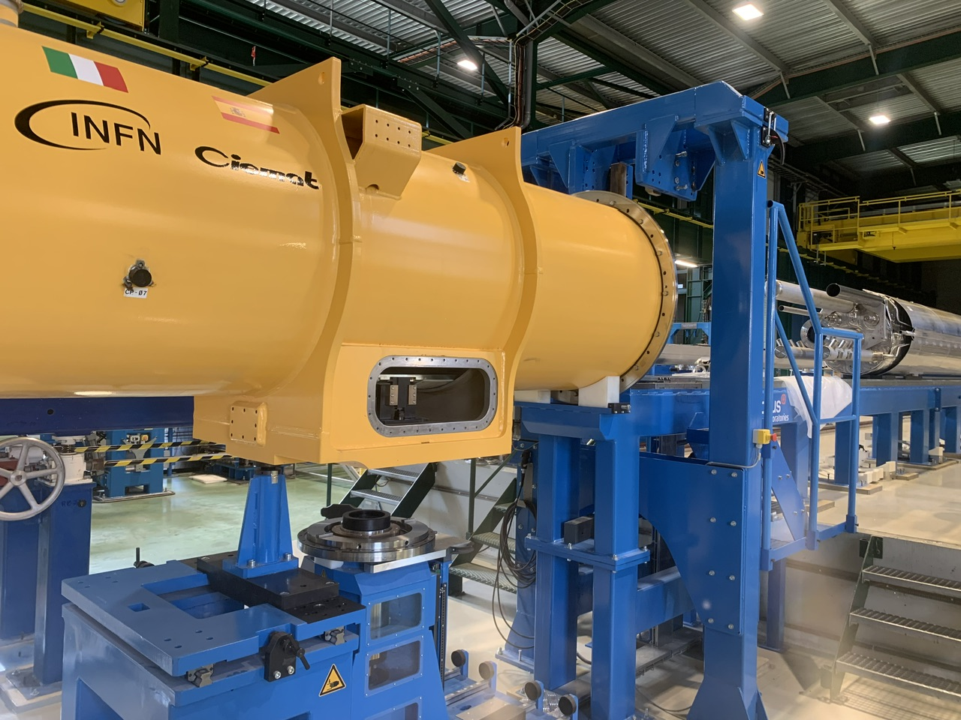
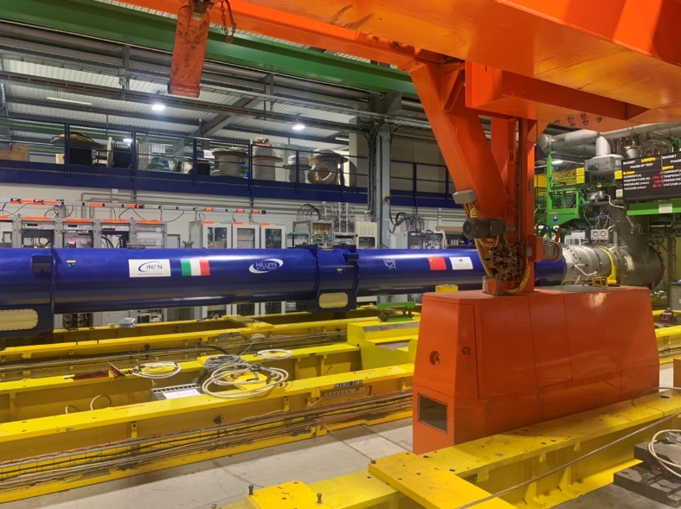
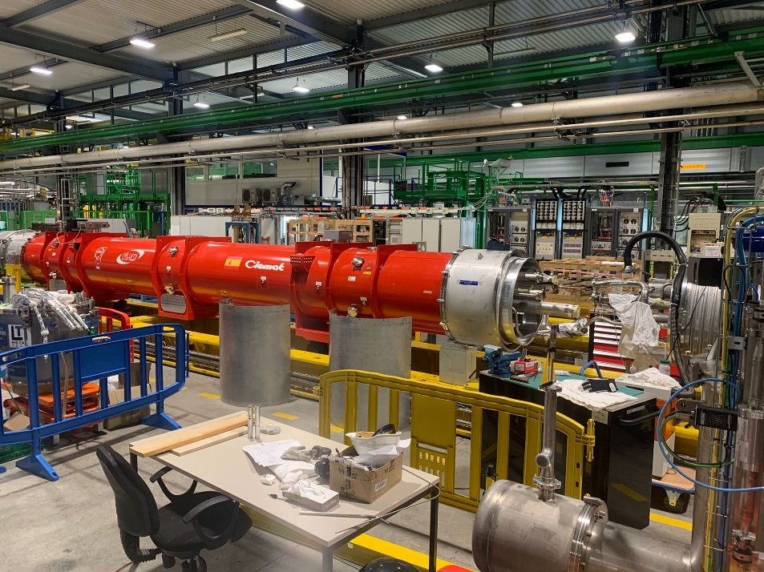
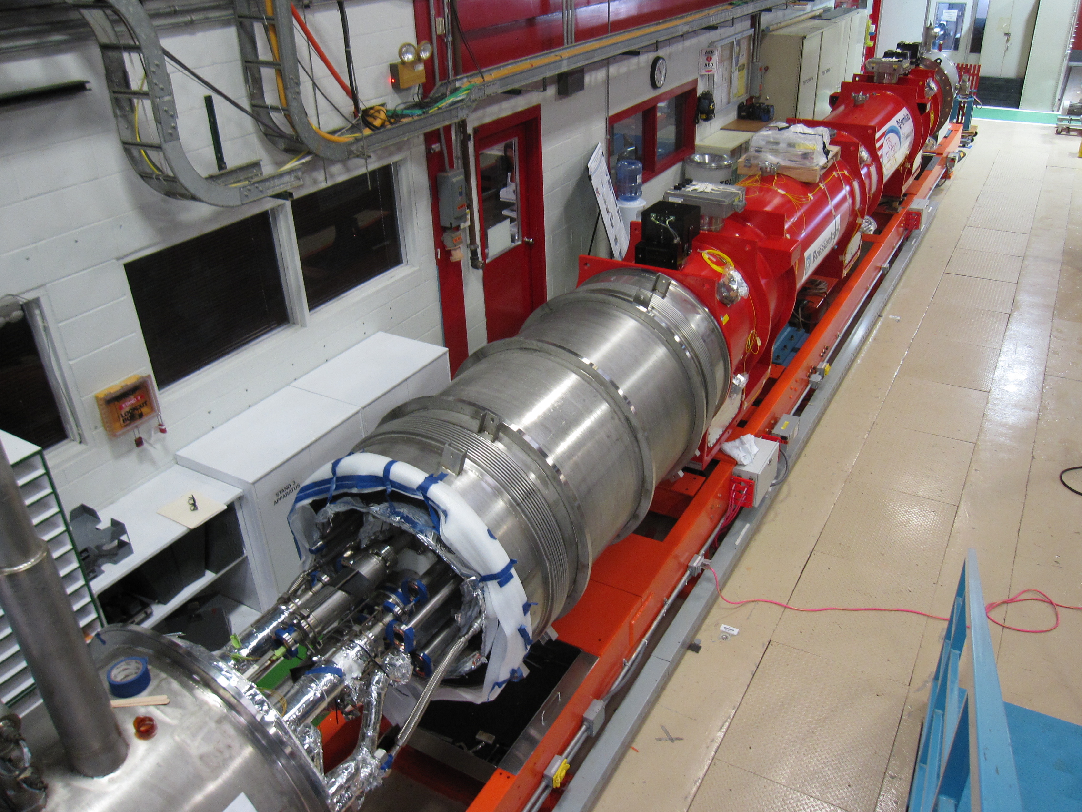
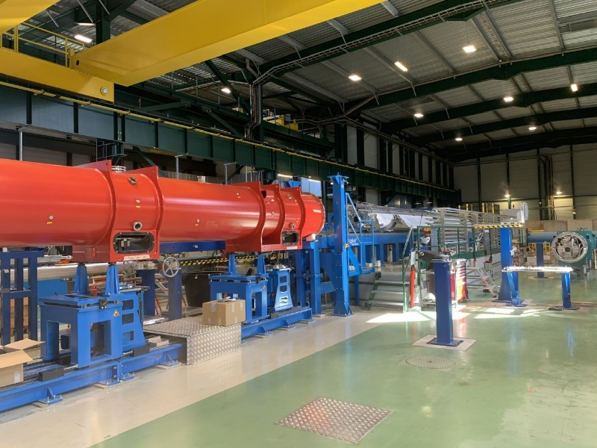

NEW MAGNETS ARE GETTING READY: Fully in Series Production
D1
(in SMI2)
CP
(SMI2)
D2
(in SMI2)
CP
Q2b
In SM18
Q2a
(in SMI2)
Q3
(in FNAL)

Slide 16
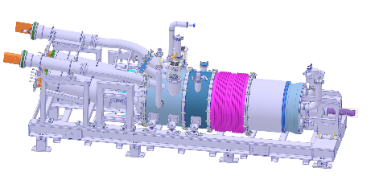
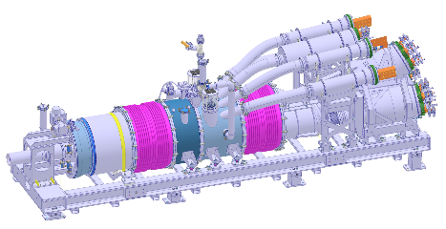
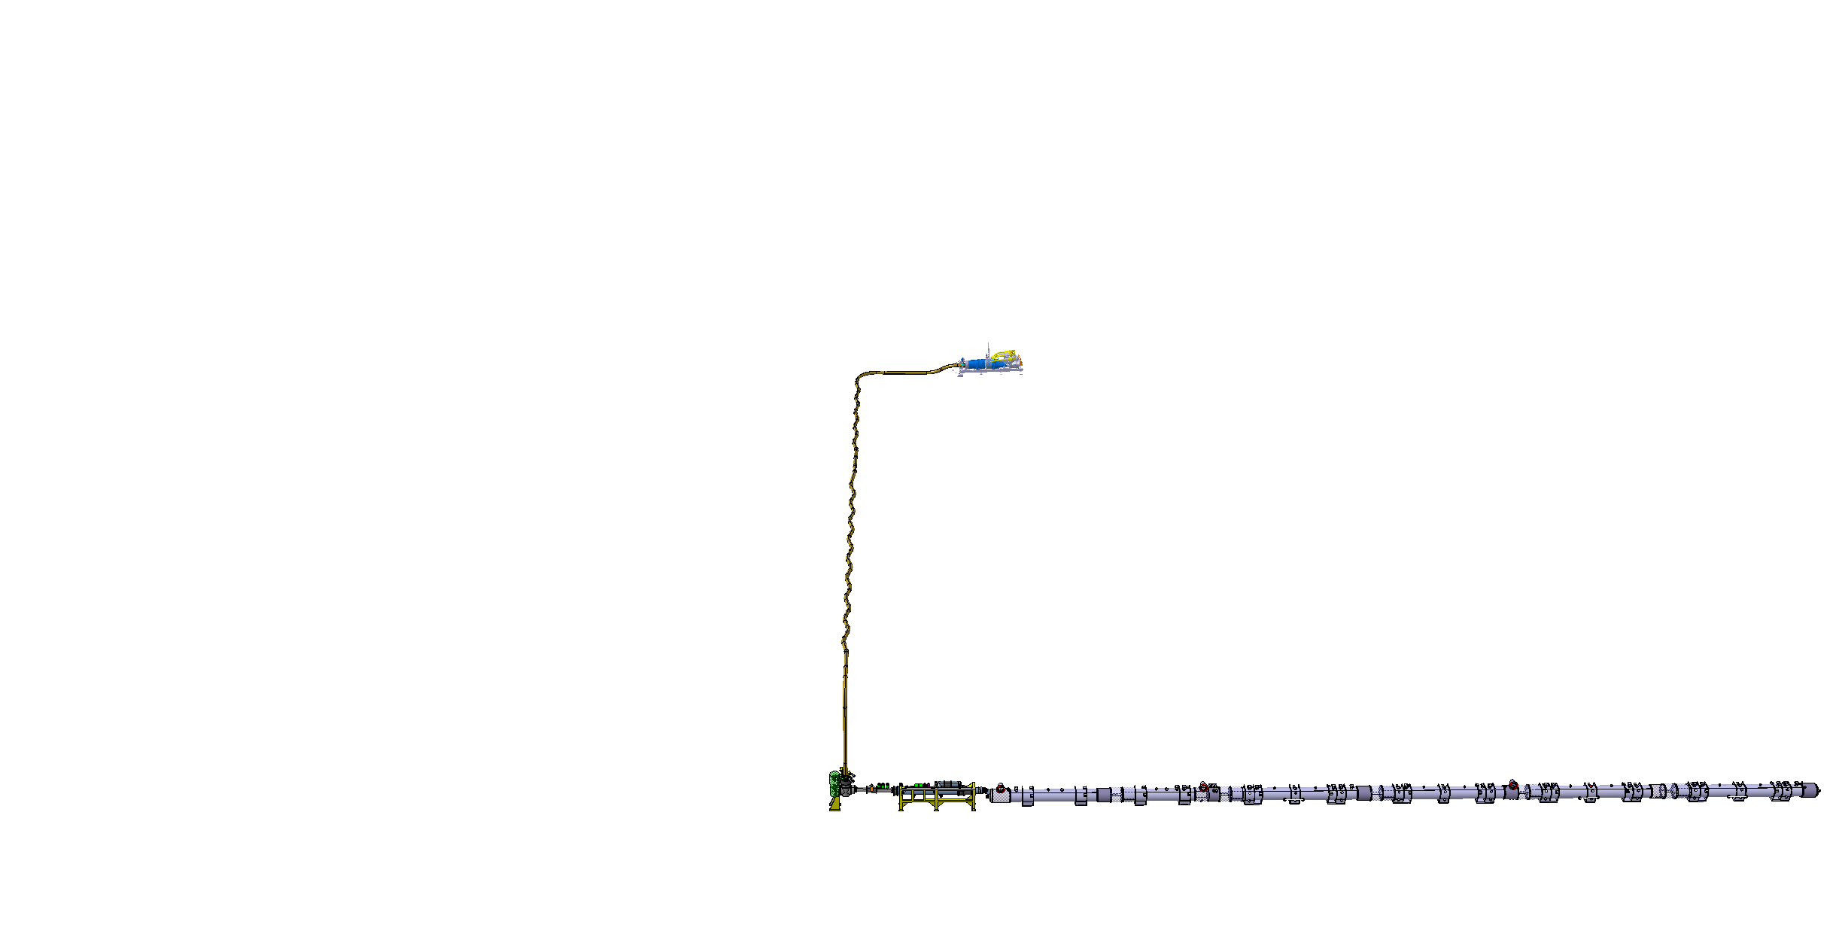
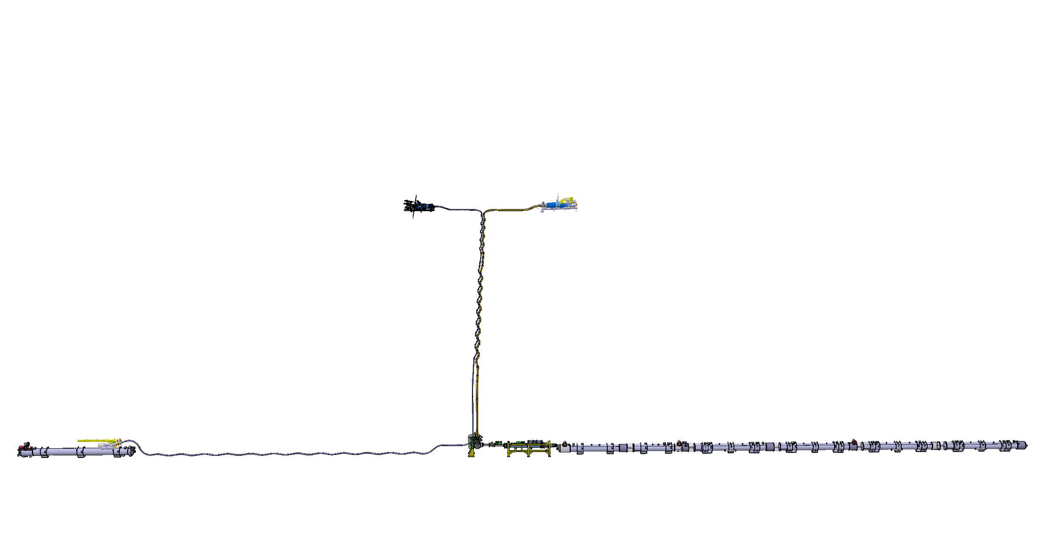
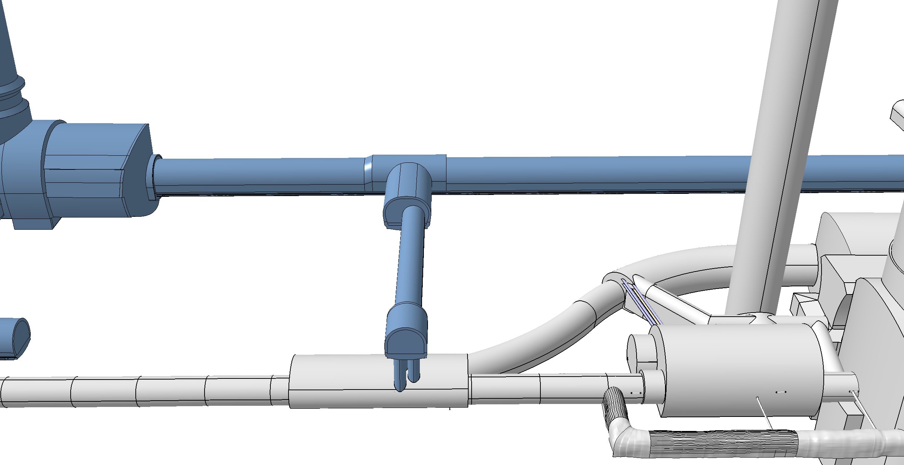
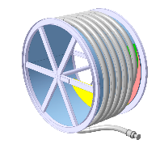
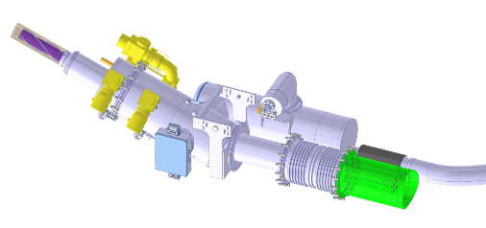
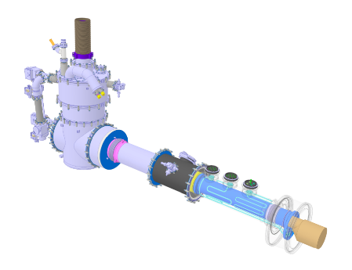
Cold Powering System
DFHM
DFHX
Power converters: (18, 0.6) kA
Power converters: (18, 7, 2) kA
DSHM
DSHX
140 m
89.5 m
Power converters: (60, 120, 200) A
D2
DCM
D1
CP
Q3
Q2B
Q2A
Q1
DFM
DFX

Slide 17
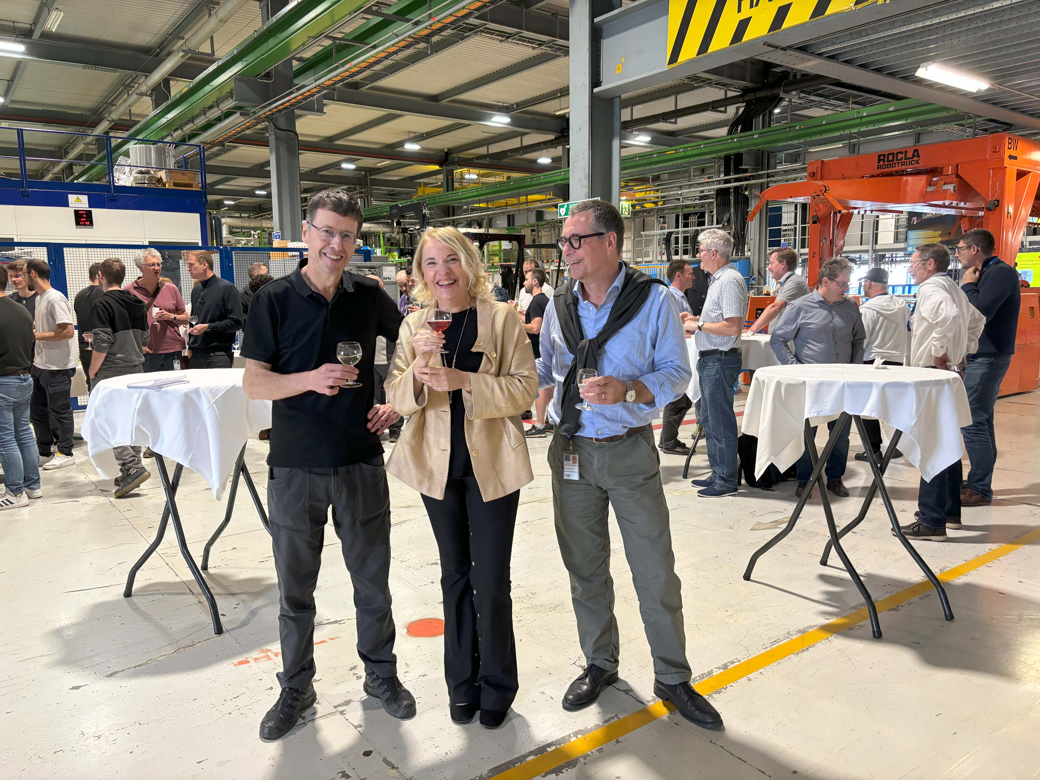
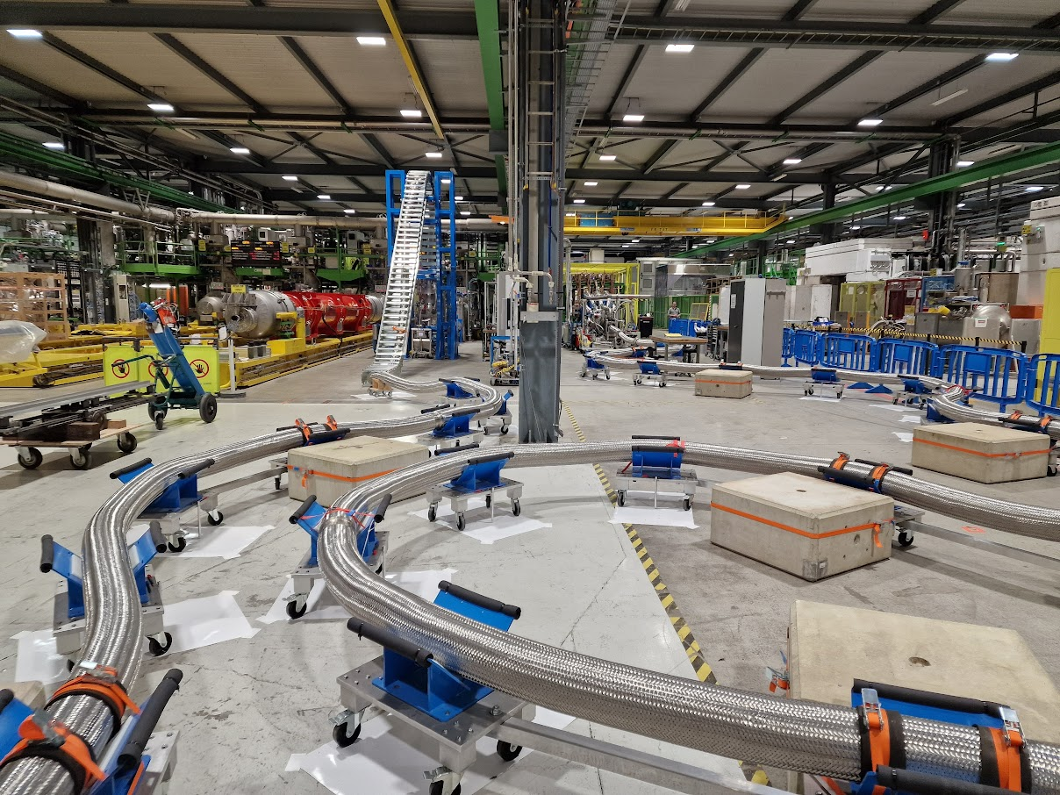
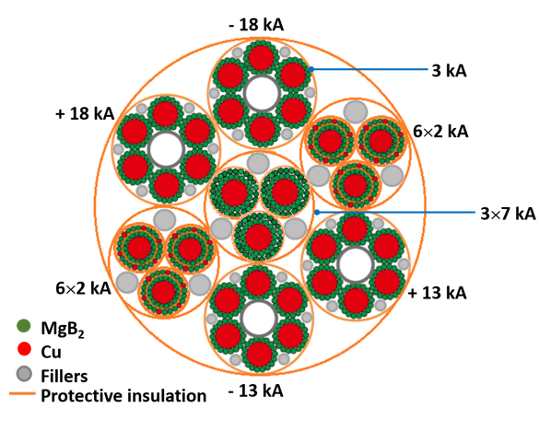
MgB₂ Superconductor and Superconducting link
The flexible, double-wall, corrugated cryostat comprises 19 MgB₂ superconducting cables in a single assembly, twisted together to form a compact bundle. These 19 superconducting cables can transfer altogether a DC current of about 120 kA at ~20 K.
See Amalia Ballarino for more details

Slide 18
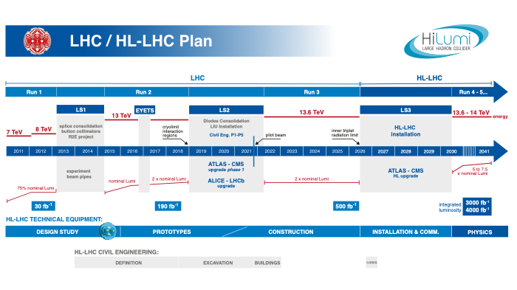
EU funded HiLumi
Design Study
Approval of
HL-LHC Project
Run3 operation
LHC Operation ends in 2026
➔ HL-LHC upgrade to take over as of 2030 after LS3

Slide 19
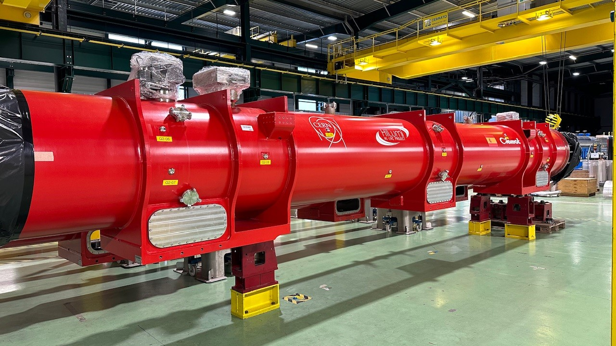
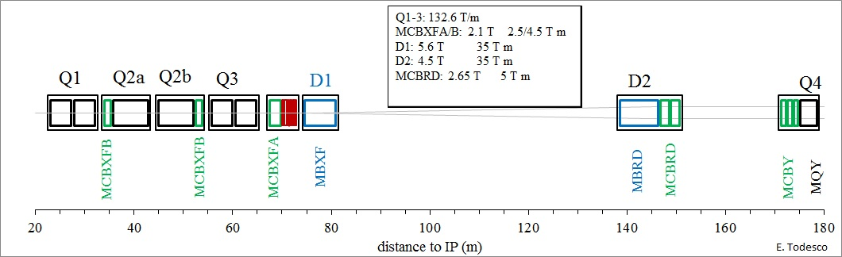
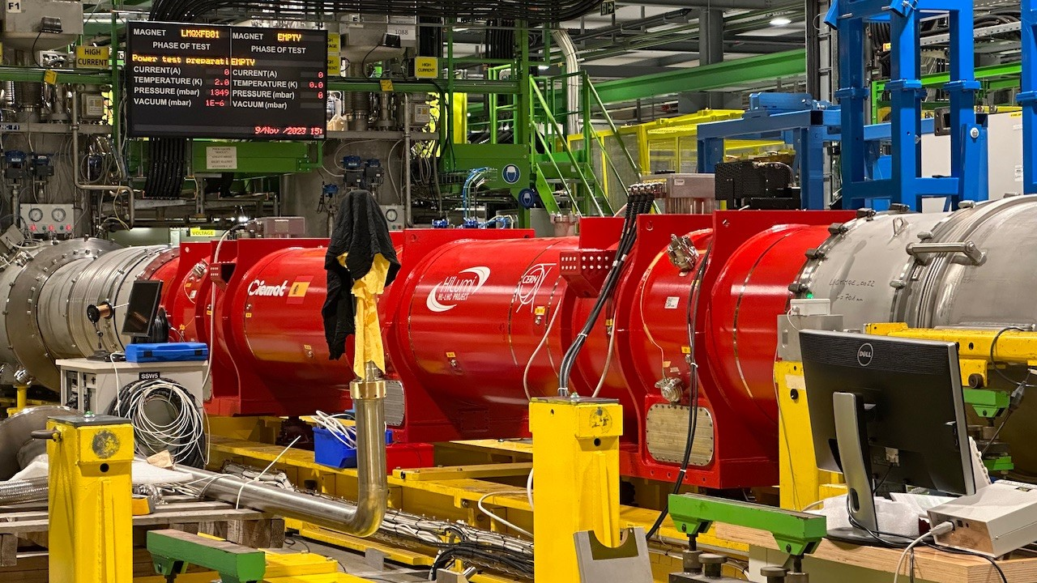
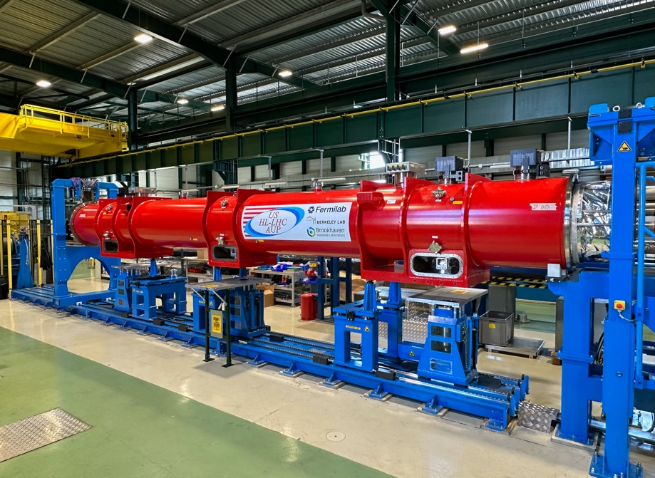
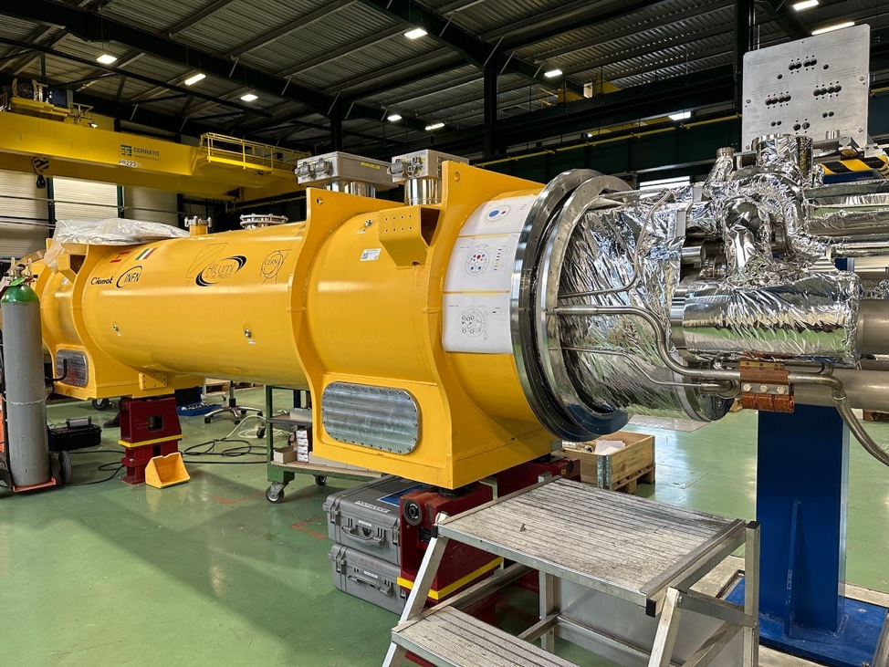

Magnet Validation for IT-String
Completed testing at
FNAL;
Expected @ CERN by
January 2025

Slide 20




Q2a cold mass installation

Slide 21





Sc Link INSTALLATION IN THE IT STRING

Slide 22


HL-LHC Summary
Published in 2024 and available as
Open Access Publication
https://doi.org/10.1142/13487
ISBN: 978-981-127-894-5

Slide 24



HL-LHC cavity designs
RF Dipole: Waveguide or
waveguide-coax couplers
2 Designs with
Different Coupler concepts and
for crossings in the vertical and
horizontal planes
Double ¼-wave: Coaxial couplers with
hook-type antenna
Present baseline: 4 cavities / IP / side ➔ 16 total
Present baseline: 2 cavities within one common cryostat

Slide 25



Industrial DQW Series Cavities
CERN #2 & RI #2 cavities qualified (~4.7 MV)
  Will be used for next string assembly and are already in the UK for assembly
The RI #1 re-tested, but limited to 3.75 MV (NCR)
RI DQW#1
RI & CERN DQW #2
The RI #3 required repair, testing @ CERN still planned for 2024
Last test

Slide 26

See Rama Calaga on Monday for more details
RFD cryomodule assembled in UK and being tested in
M7 bunker (SM18-CERN) in 2024 before installation in SPS in YETS 2024 / 2025
26

Slide 27




Crab Cavity series production well underway
See Leonardo Risori on Monday for more details
  RFD series fabrication launched at Zanon since May 2023
  RFD pre-series 1 and 2
  One of the two cavities reached specifications. The other suffered from field emissions

Slide 28











SC-Link-DFHX assembly in pictures

Slide 29




LHC: was already Considered from the Start of LEP
LEP
Design
Report
1984
Lausanne
ECFA-CERN
Workshop
1984
Notes:
With the mandate to help preparing an update on the ep option for the LHC

