Slide 1
DFH Cold Boxes production in Sweden
By Rocío Santiago Kern
On behalf of FREIA-UU and RFR Solutions

Slide 2
Content
Collaboration Agreement & Funding
Asset distribution between RFR and UU
Delivery Schedule to CERN
Project’s Perspectives
Where does FREIA stand now?

Slide 3
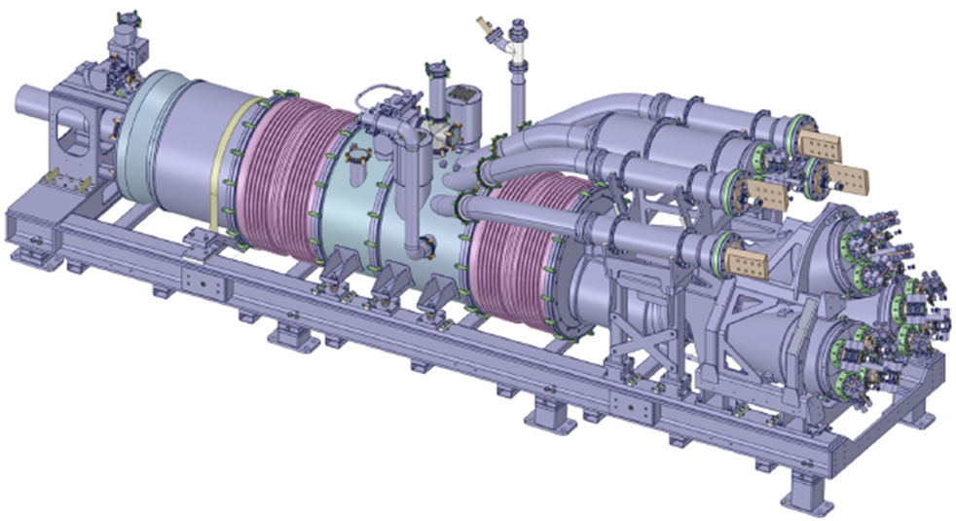
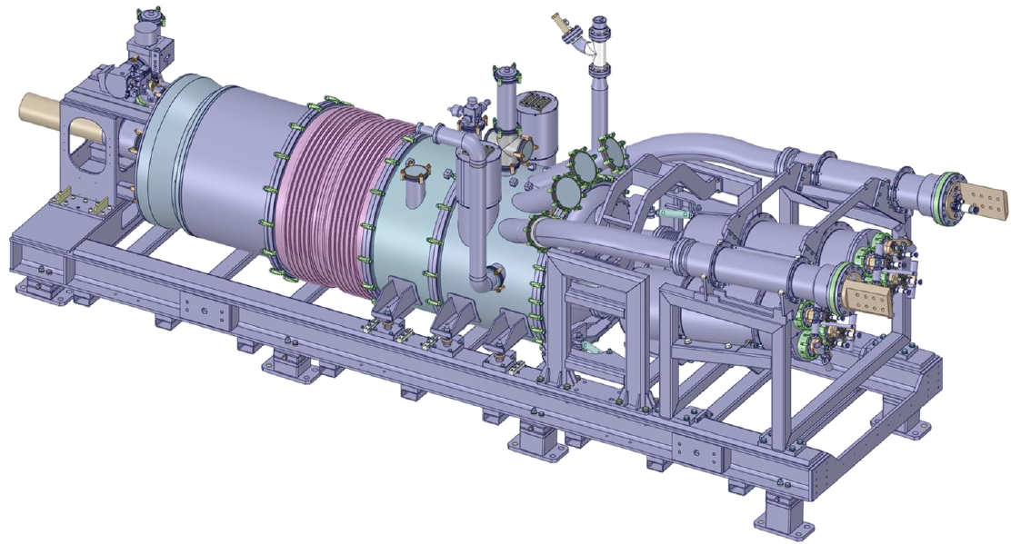
Collaboration Agreement
KE5162, EDMS 1981185
Scope of supply:
  DFHX x4
  DFHM x5
Design made by CERN
Design drawings provided by CERN
Special situation:
  Collaboration among CERN-University-Company
  All parties manufacture pieces
  Uppsala University is the bridge between CERN and the company (RFR)
x4
x5

Slide 4
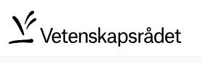
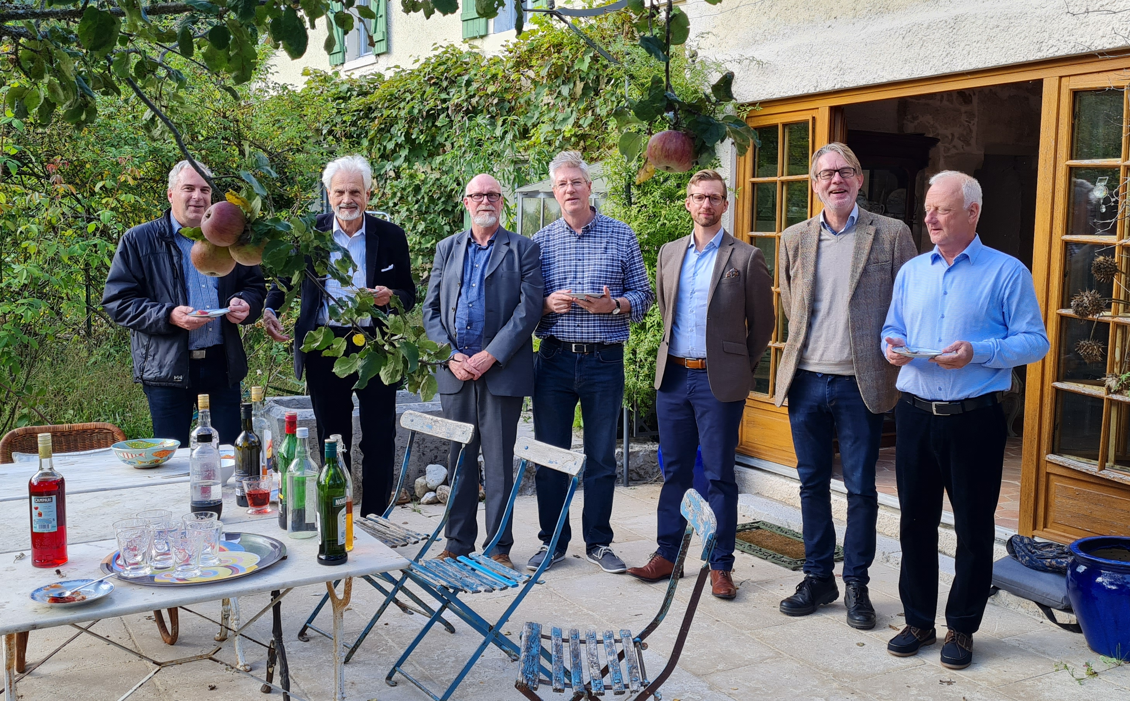
Funding
RFR had experience from Prototype (DFHX1) and would benefit from
    Planning machining requirements: the amount necessary, how to do it and arrangements with subcontractors
    Learning new process with Helium leak testing
    Adapting to strict tolerances
Money invested in the project
  Vetenskapsrådet (VR): 10 000 000 + 1 700 000 SEK
  CERN: 900 000 CHF

Slide 5
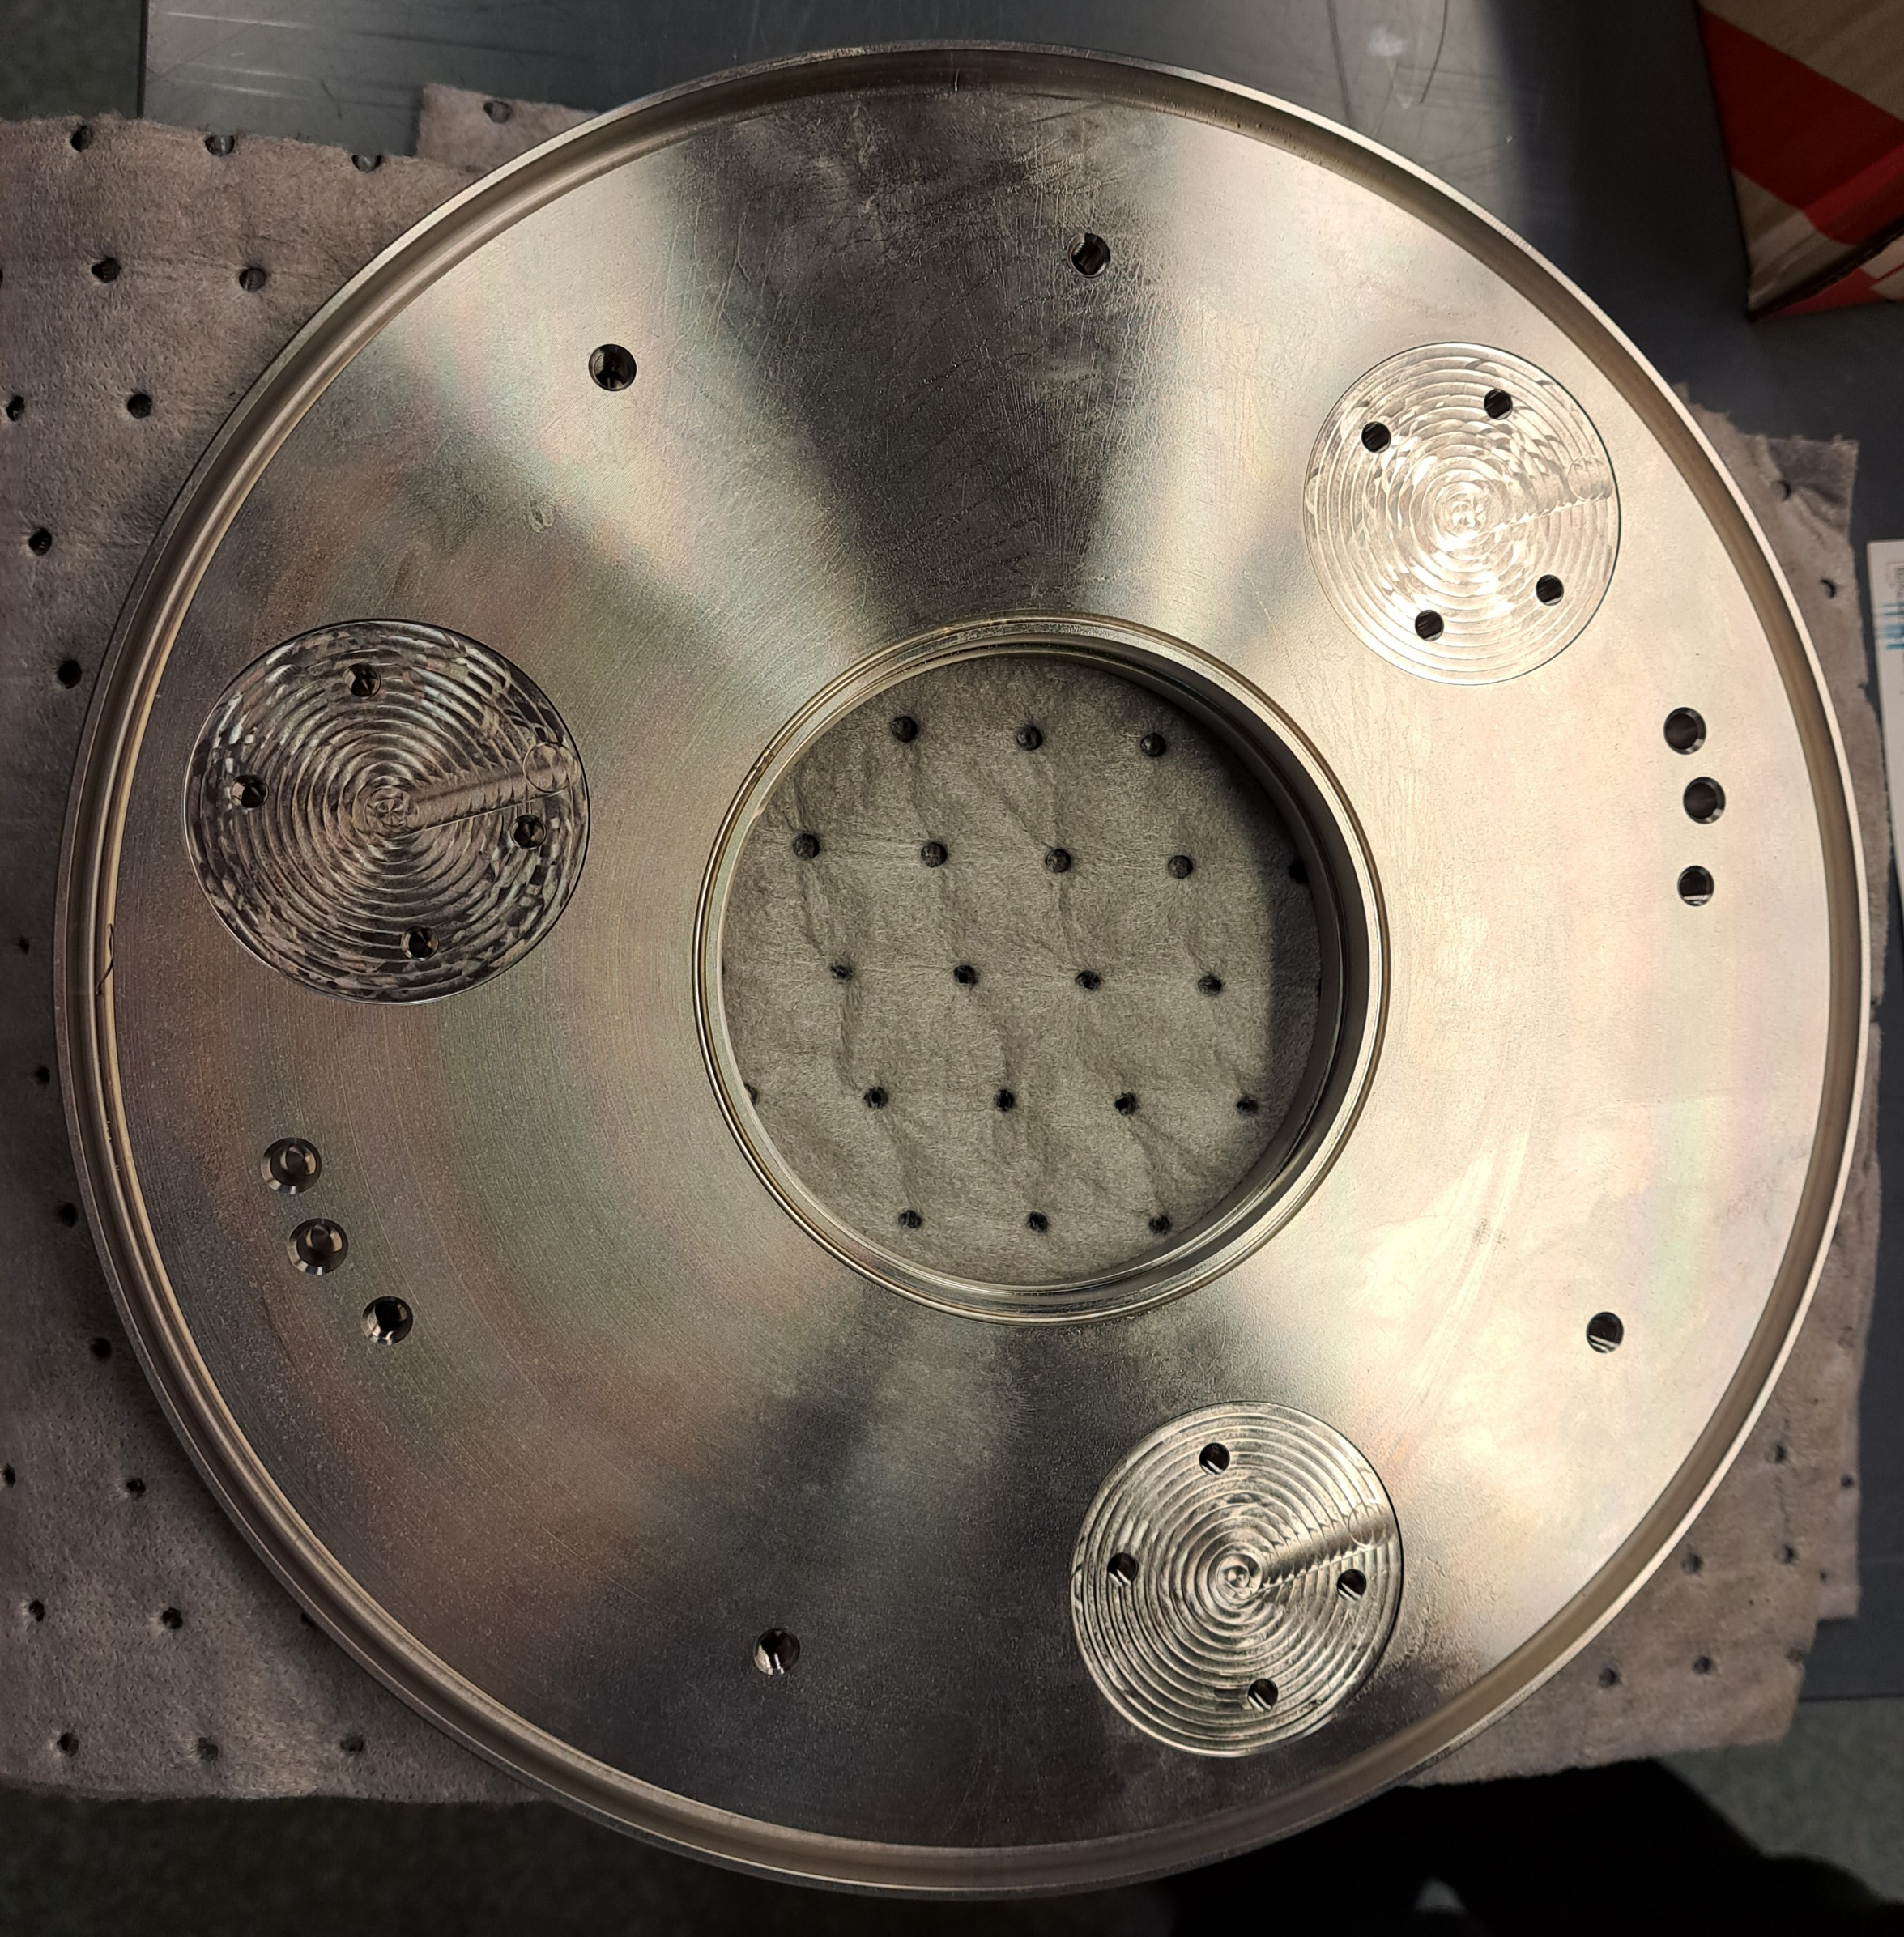
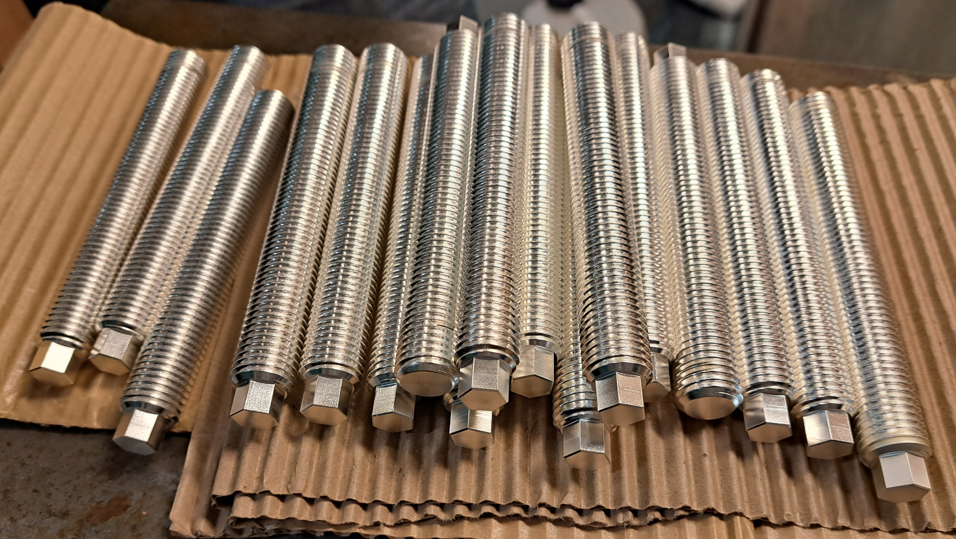
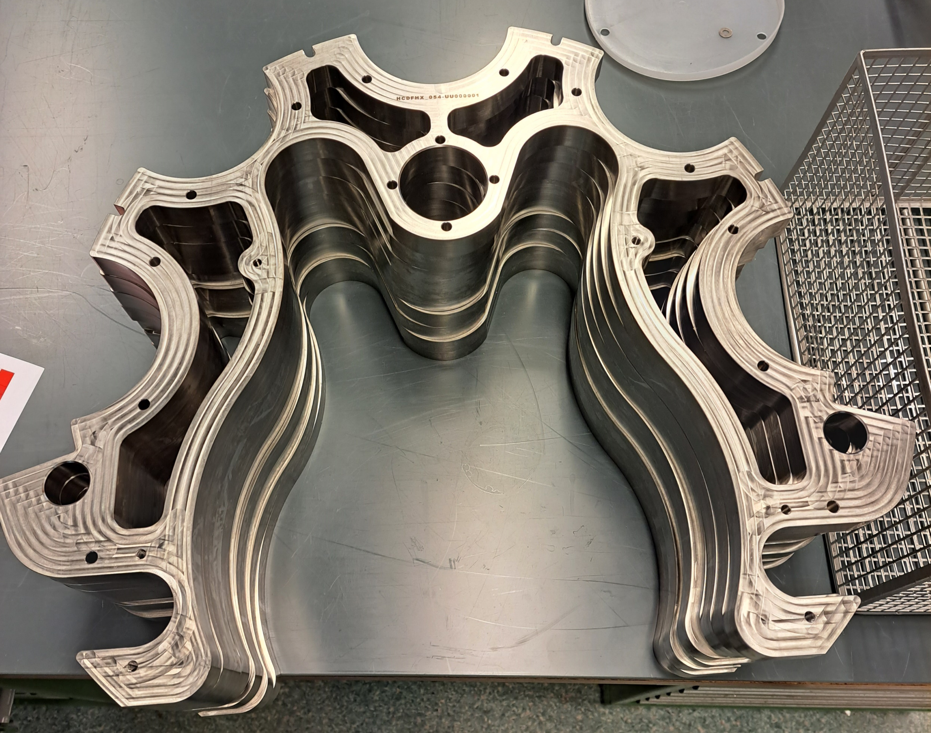
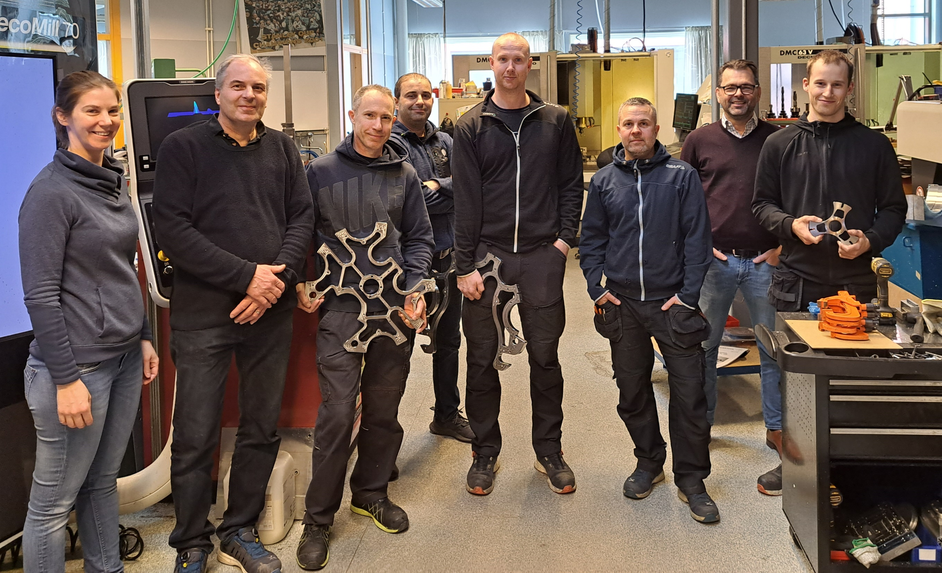
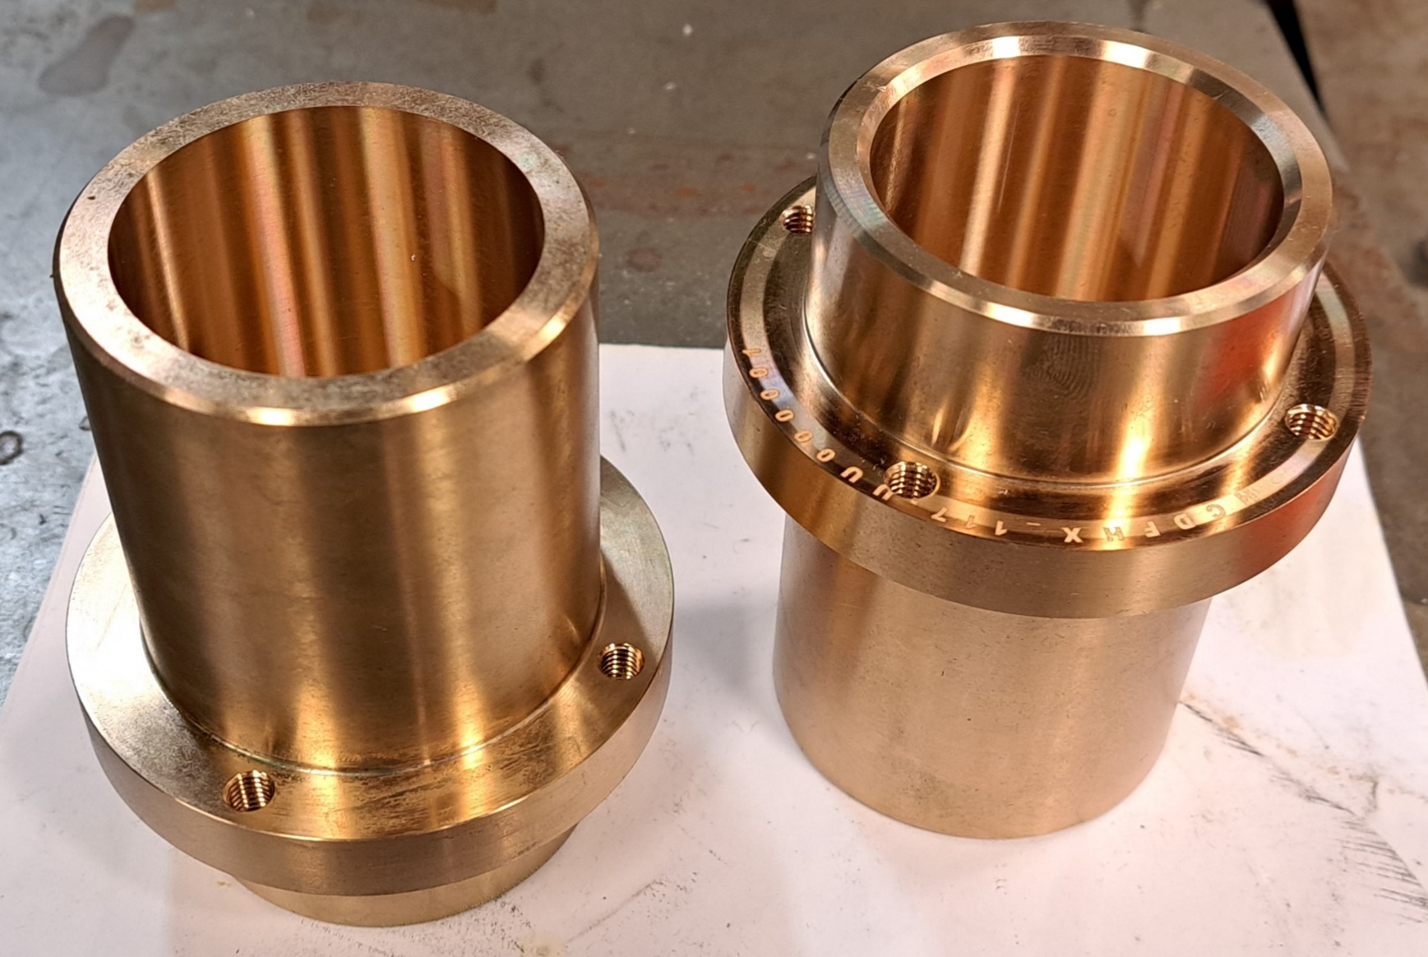
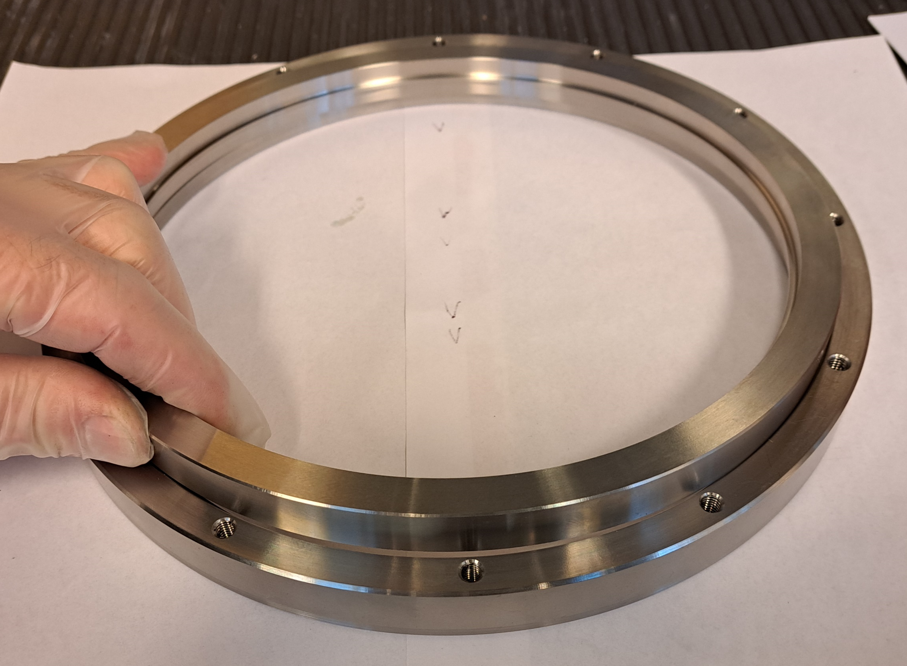
Asset Distribution between UU and RFR
UU/FREIA workshop:
  Smaller-size parts that do not require certified welding
    Max milling length 1035 mm Radius max 500 mm turning machine
  Subsupplier for silver-coating

Slide 6
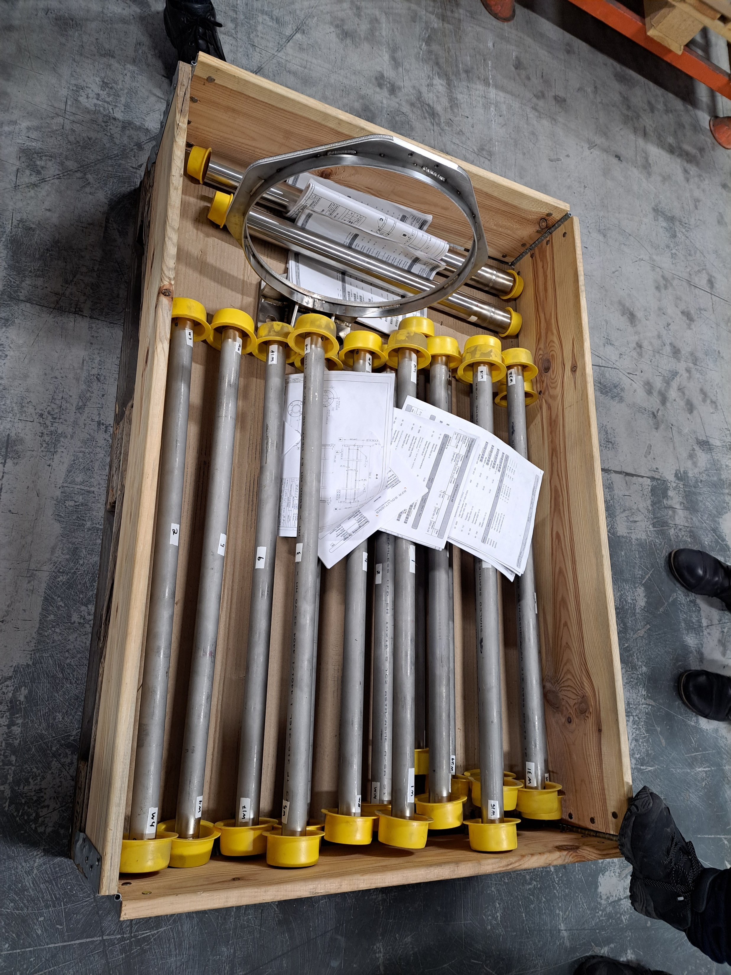
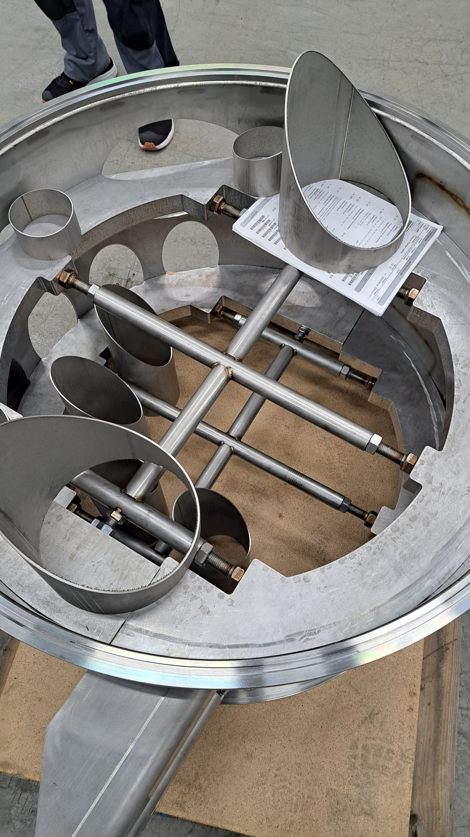
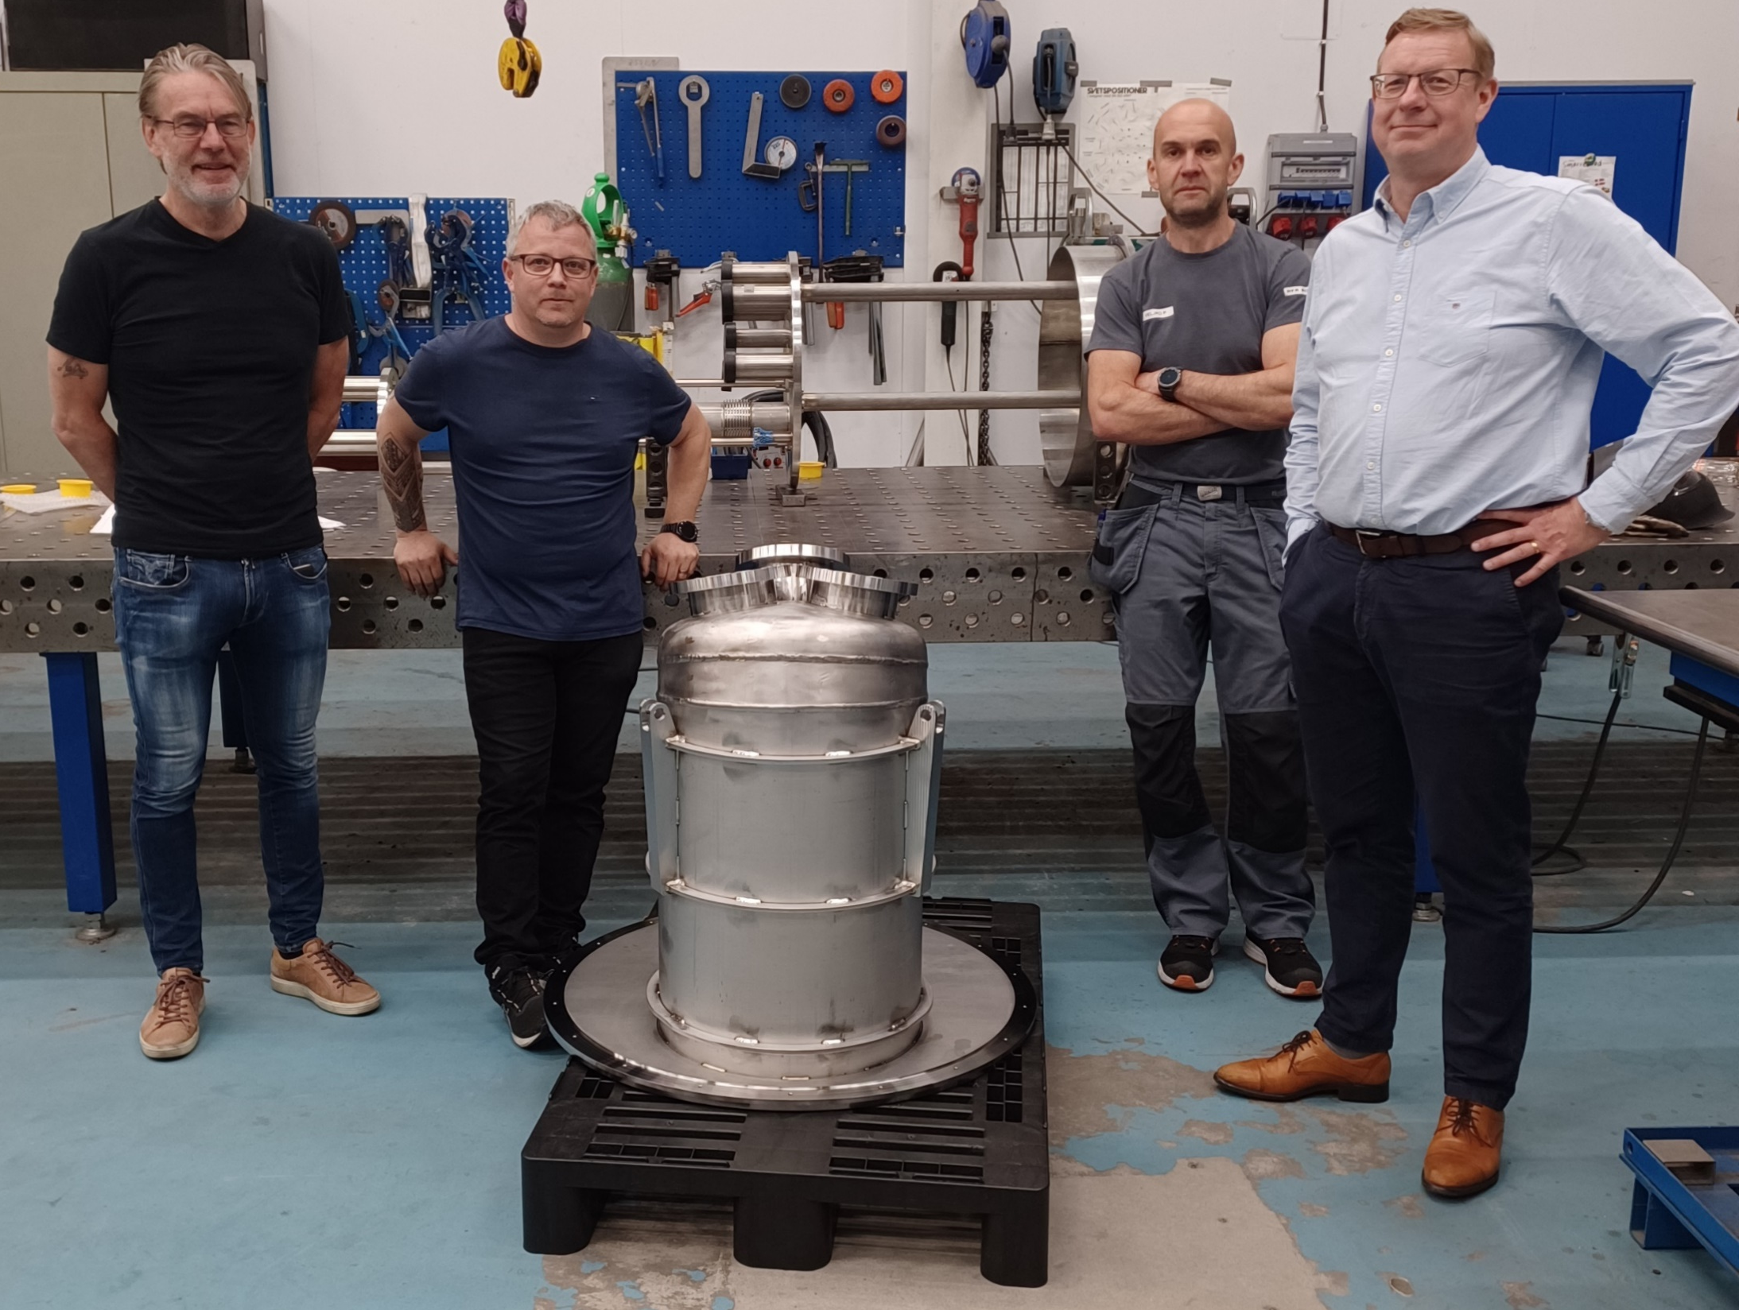
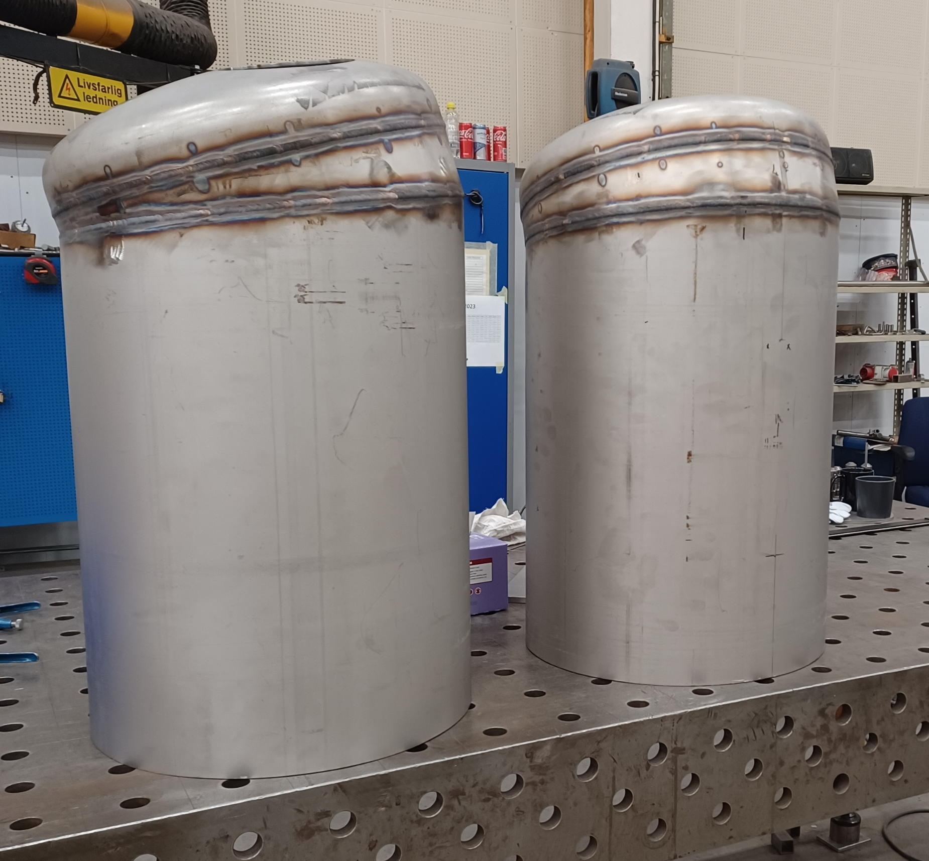
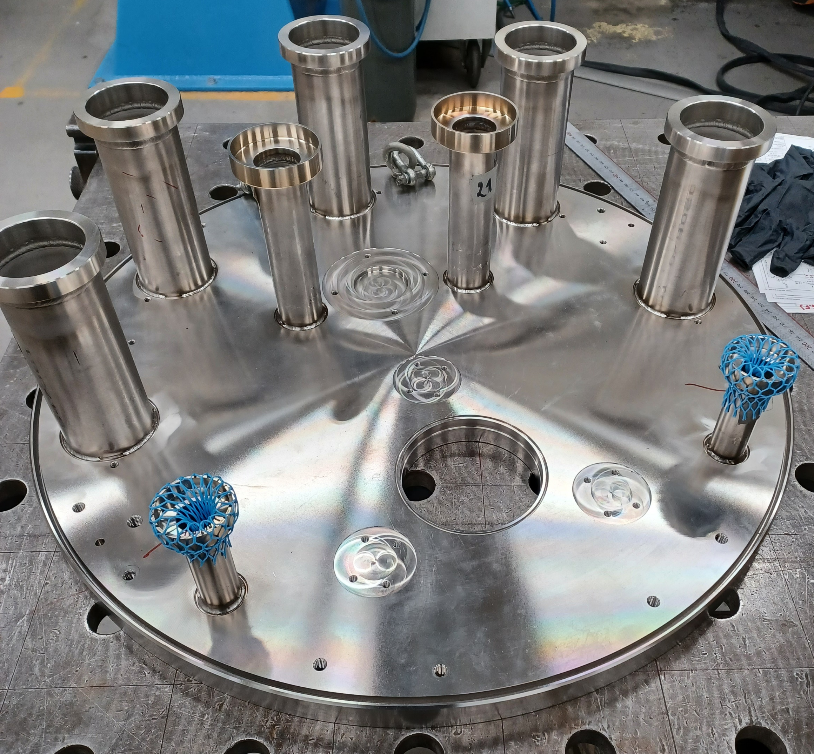
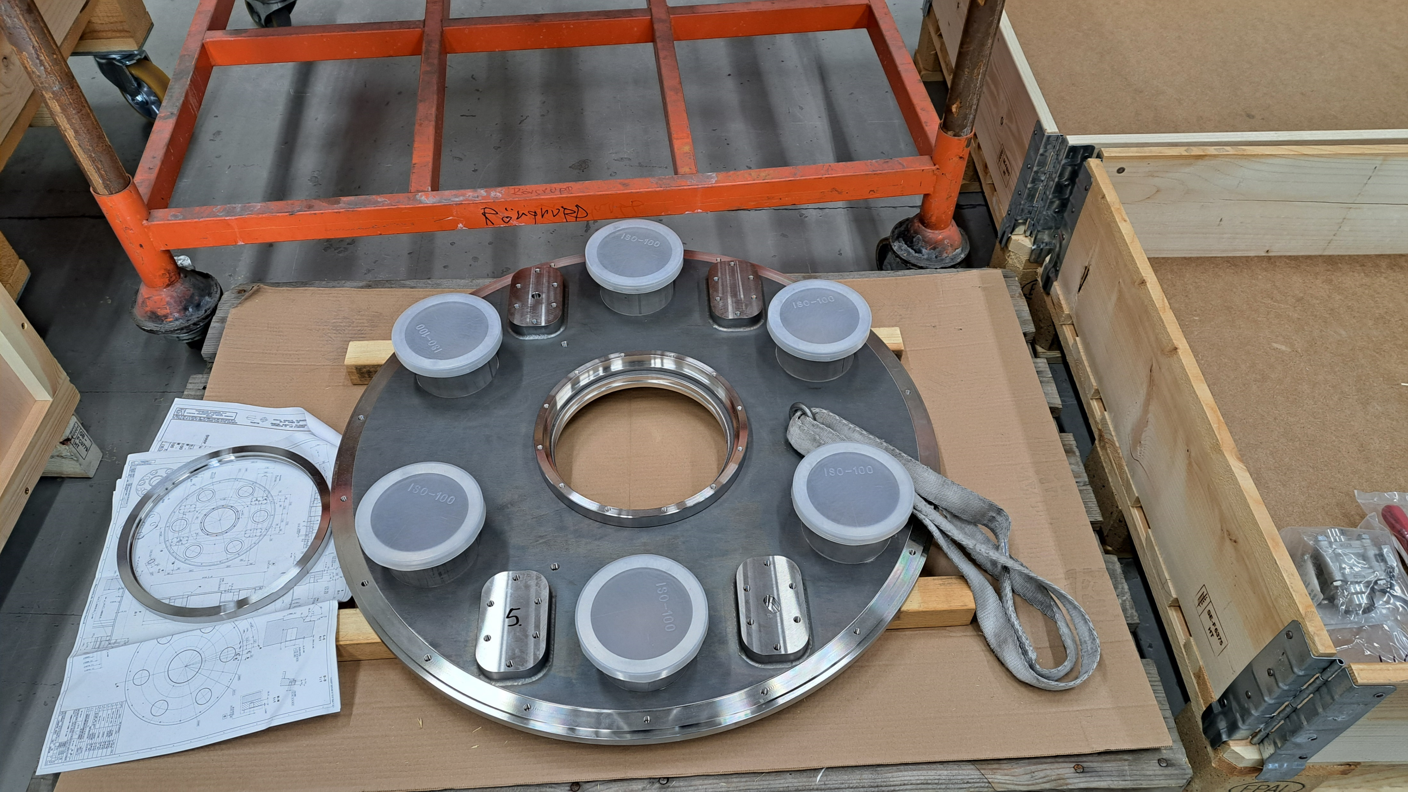
Asset Distribution between UU and RFR
RFR:
  All the rest of the parts
  Subsuppliers:
    Bellows
    Epoxy components
    Machining of big chambers (welding done at RFR)

Slide 7
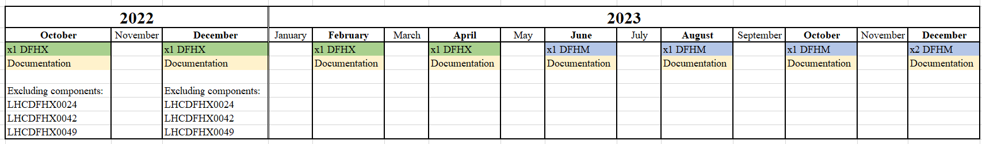
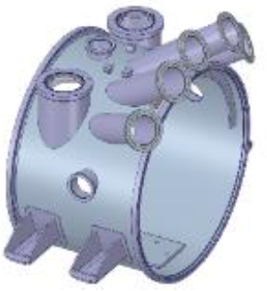
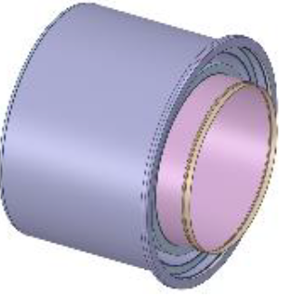
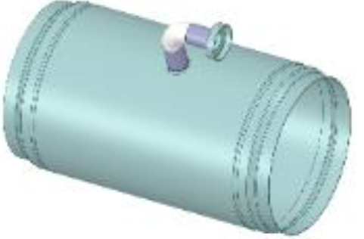
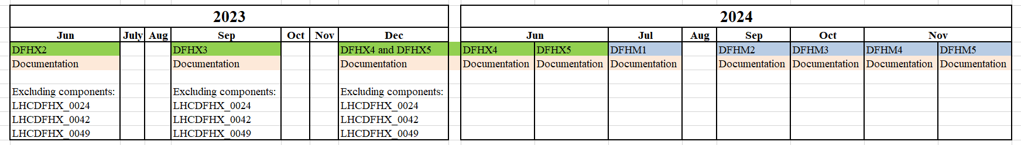
Delivery Schedule to CERN
ORIGINAL PLAN
Vacuum chamber central
LHCDFHX_0024
Vacuum chamber for thermal dissipation
LHCDFHX_0042
Envelope Cryogenic Box
LHCDFHX_0049

Slide 8
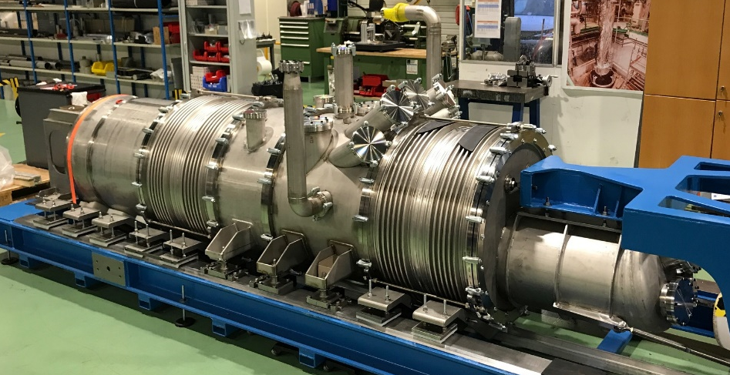
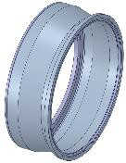
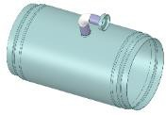
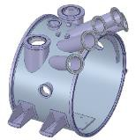
Deliveries
Delivered in total 554 components
13 416 pages of documentation
From all these, there were only 2 pieces that had to be scrapped
  LHCDFHX_0041: the rings were not parallel
  LHCDFHX_0049: one of the edges was machined oval and too thin
Two He-leaks detected, both on welds on LHCDFHX_0024
Up to now, DFHX2, DFHX3 and DFHX4 have been blank assembled at CERN and are leak tight
LHCDFHX_0041 LHCDFHX_0049 LHCDFHX_0024

Slide 9
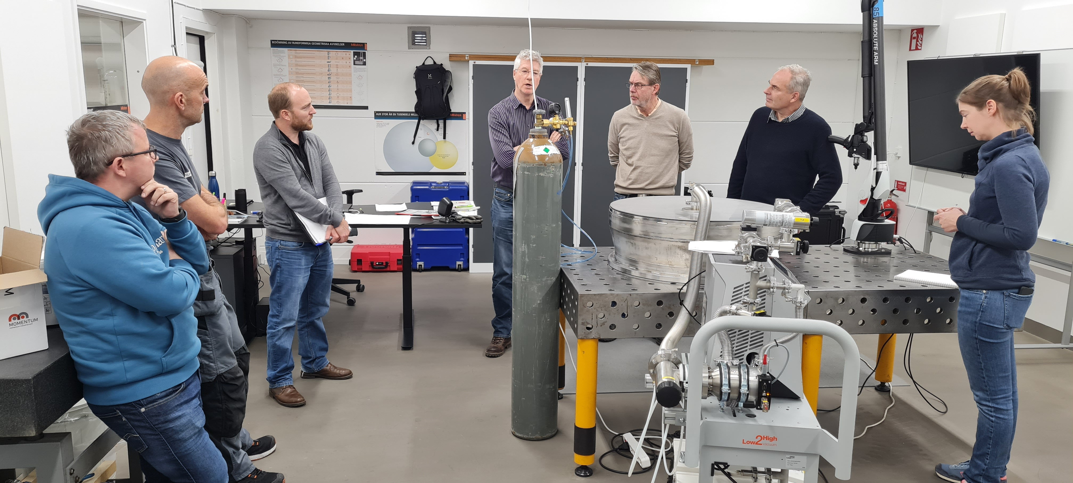
RFR’s Project Perspective: Lessons Learned
Good
To be improved
Preparation of Documentation
Implementation of the first prototype experience in series production
PRR:
  Possibility to think about the manufacturing process
  Made a few changes along the project
Have acquired knowledge for future projects
Planning + start the manufacturing
Production preparation studies
Importance of quality control during manufacturing
The challenges of understanding the leak test results
Continuous reporting

Slide 10
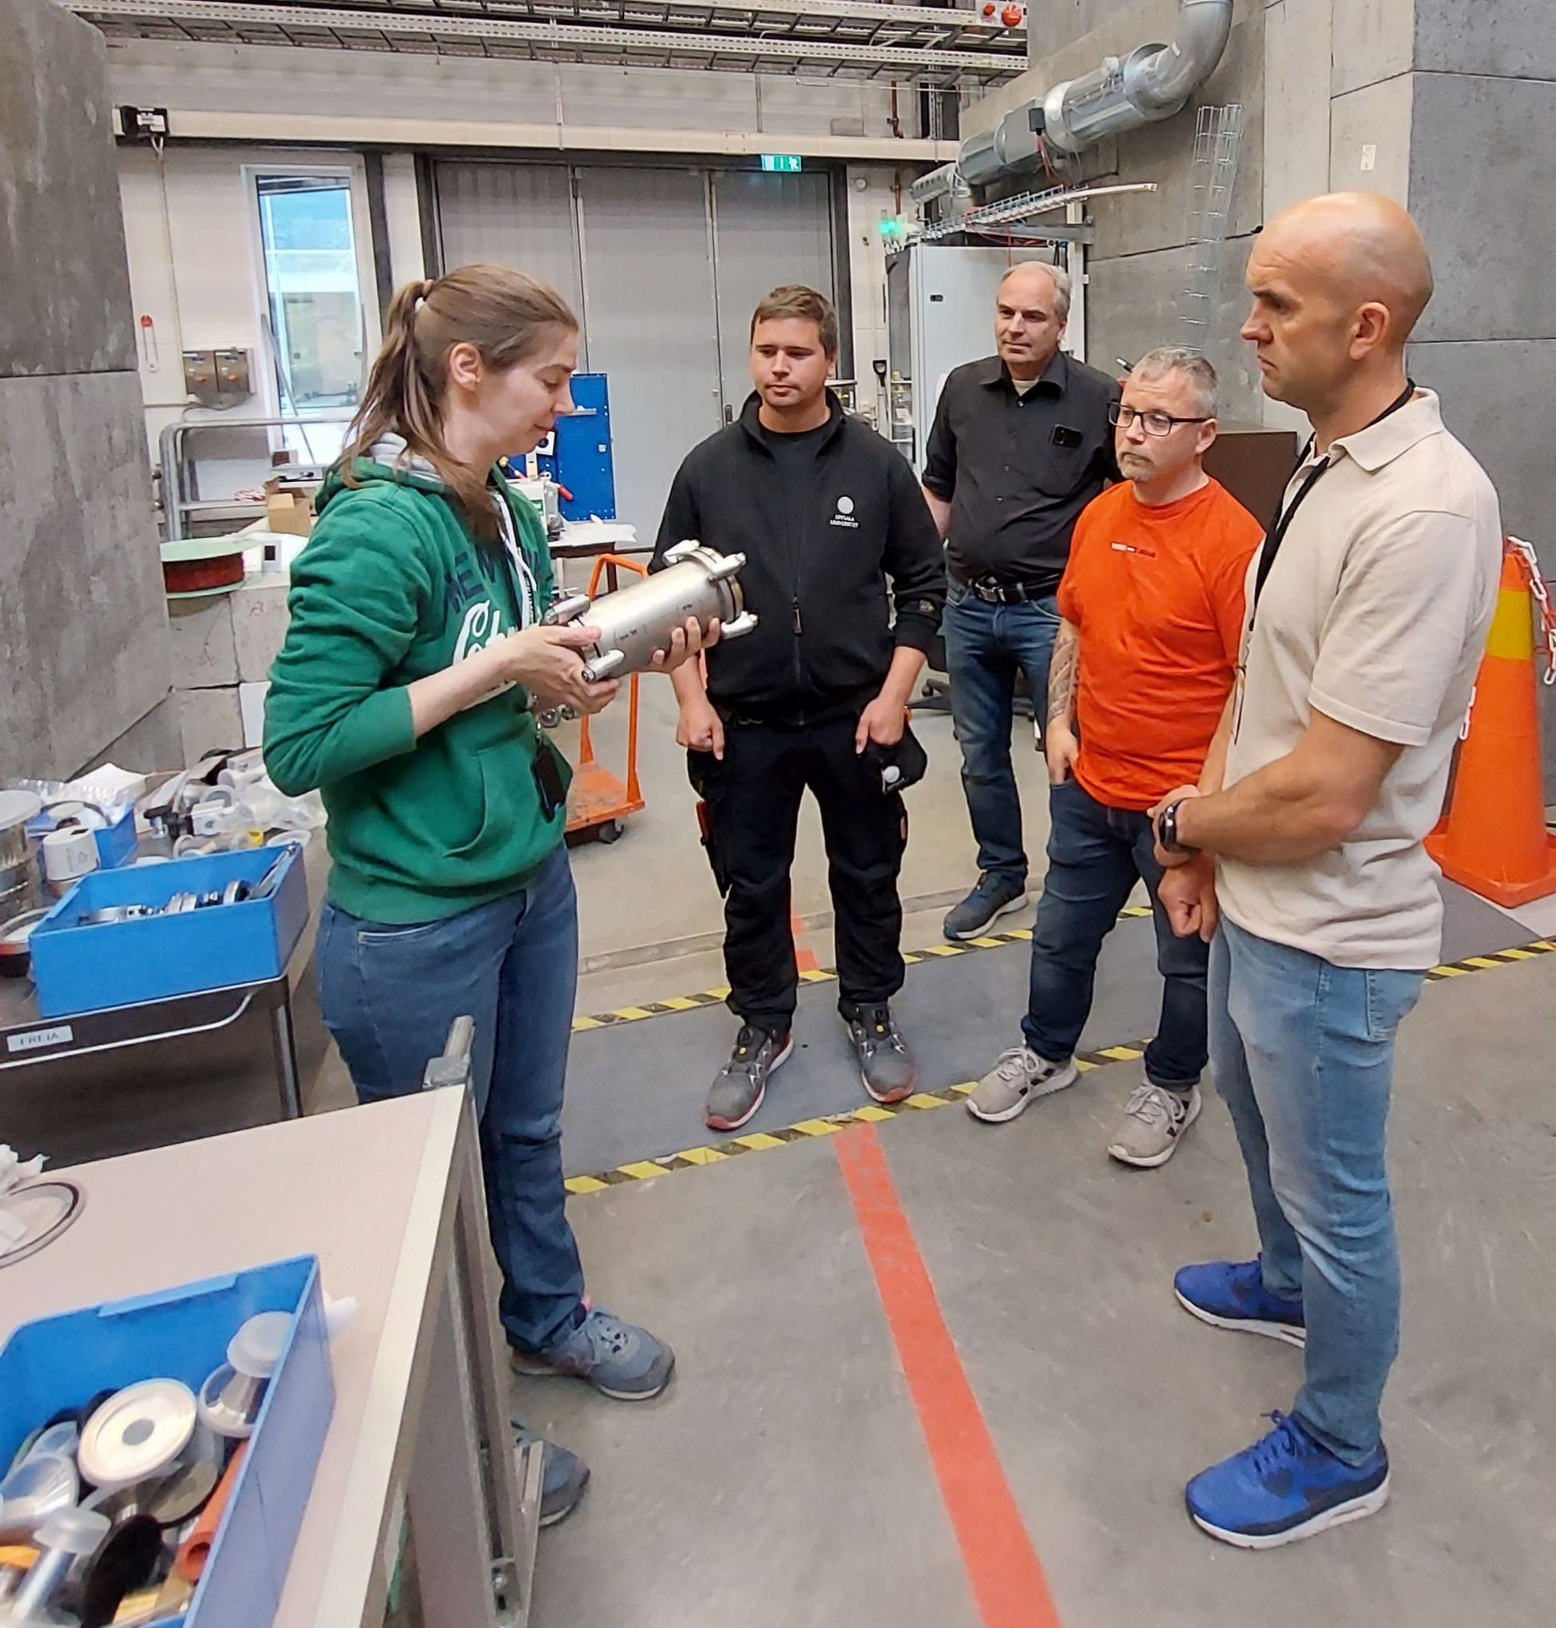
RFR’s Project Perspective: Main Takeaways
Great cooperation, support and learning opportunities (CERN workshop, UU workshop, FREIA)
High competence development within vacuum technology and helium leak testing
Manufacturing for demanding tolerances
Good reference for marketing and brand-building
Possibility of working with CERN in future projects

Slide 11
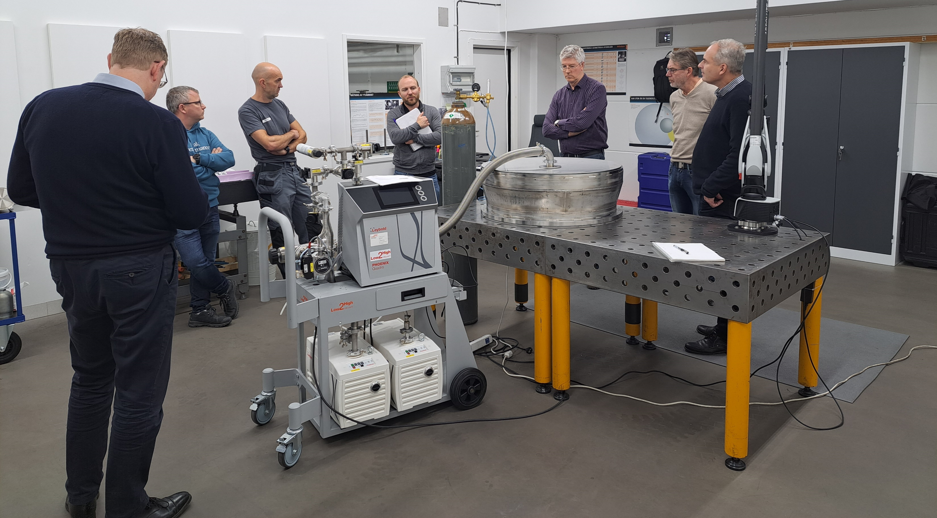
FREIA’s Project Perspective
Valuable insight by examining the project from multiple perspectives: industry and customer (Big Science facility).
Understanding the intricacies of manufacturing processes and the associated timelines
Identifying key aspects of the documentation
Recognizing and addressing potential challenges and complex areas within the project
Defining non-conformities and how to manage them
Great cooperation, support and learning opportunities

Slide 12
Where Does FREIA Stand now?

Slide 13
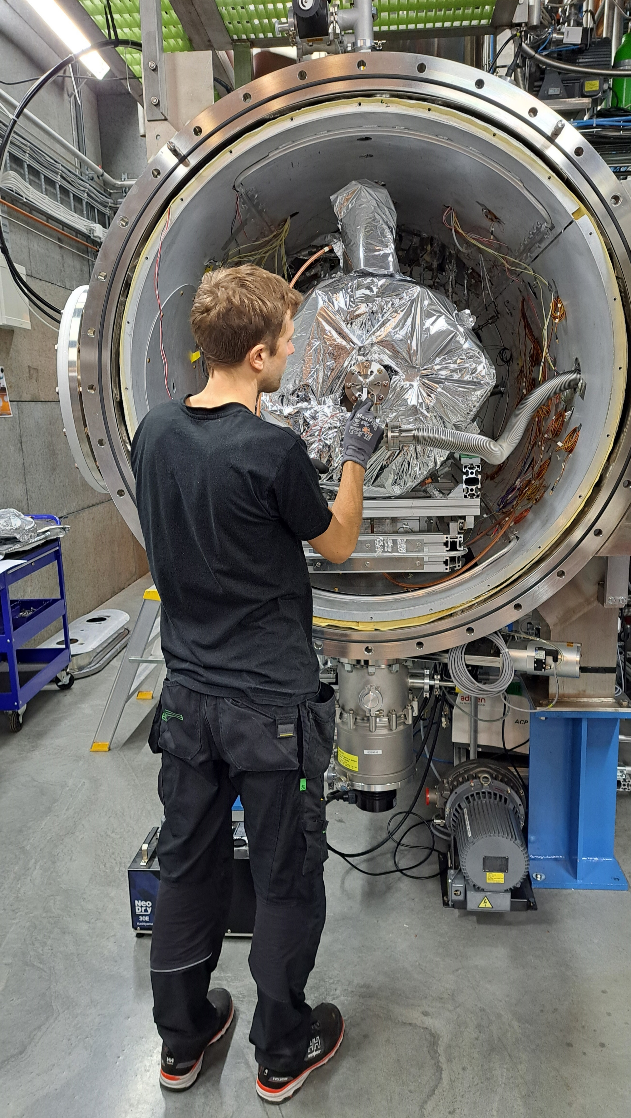
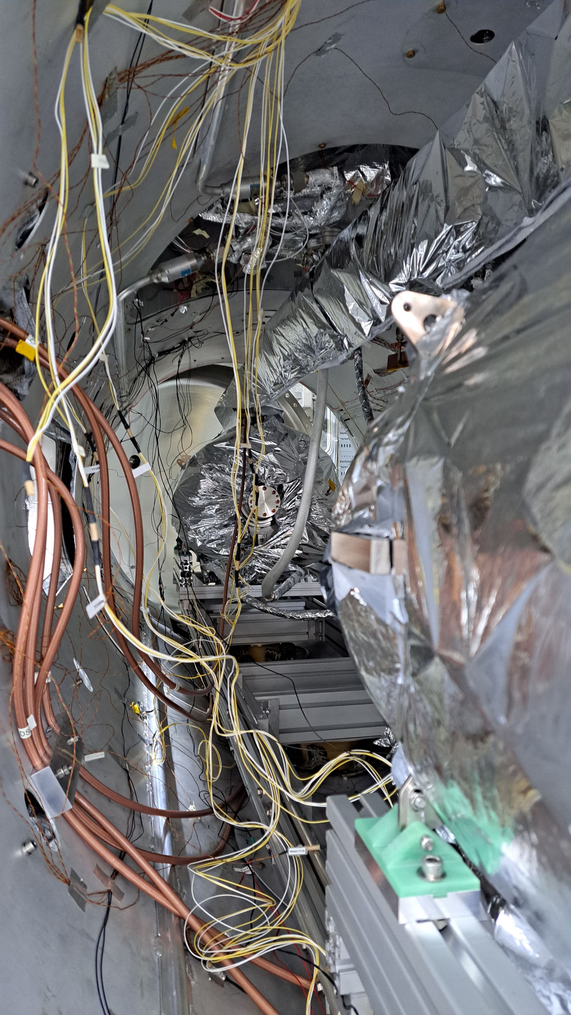
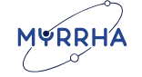

Testing of Supercoducting Cavities for MYRRHA
MYRRHA: Multi-purpose Hybrid Research Reactor for High-tech Applications, for nuclear waste treatment
Phase I of the MYRRHA project (MINERVA): design and construction of the first linac section (up to 100 MeV)
FREIA
  Will test the double spoke cavities for Minerva (up to 60)
  Has already tested the first 2 pre-series cavities

Slide 14
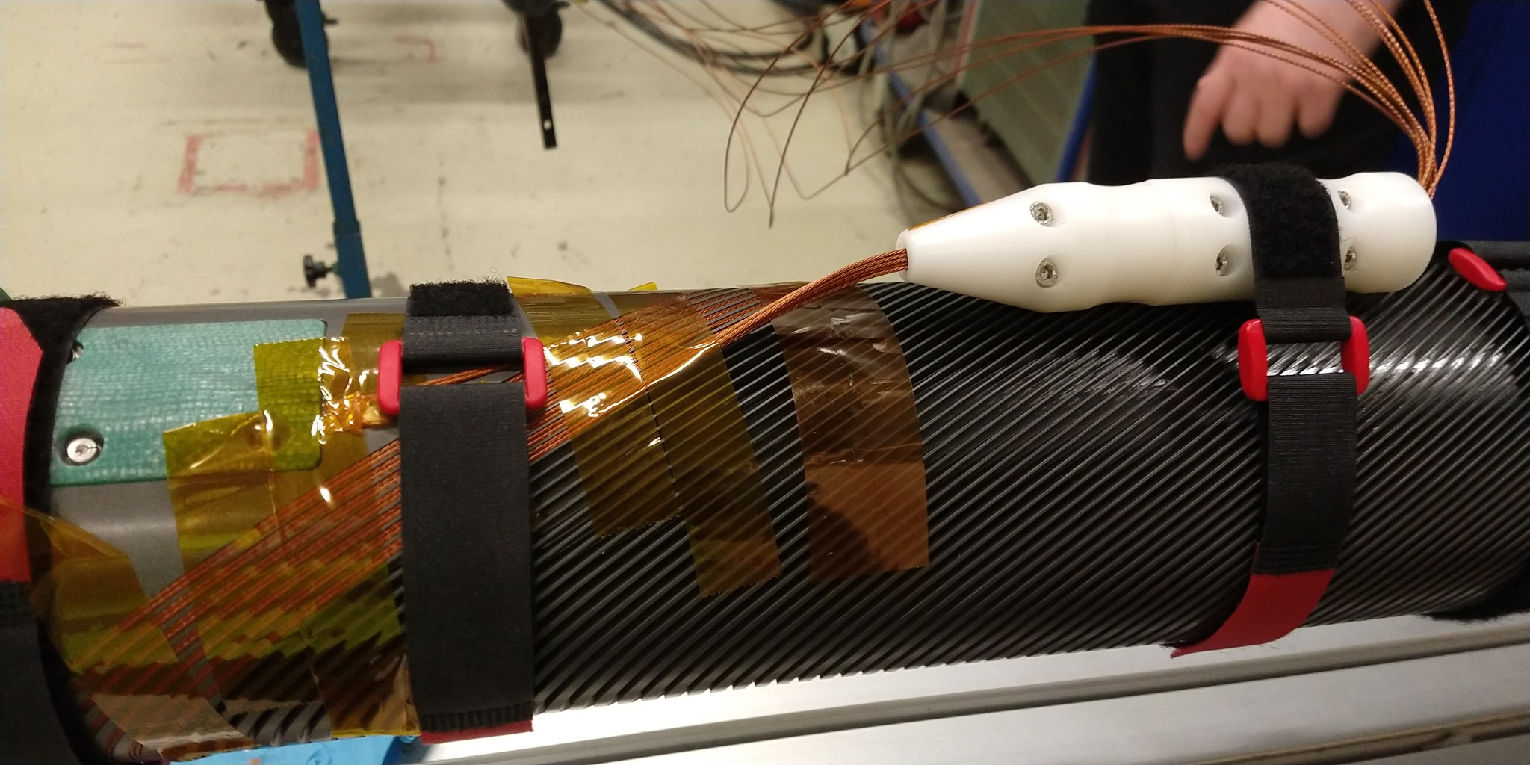
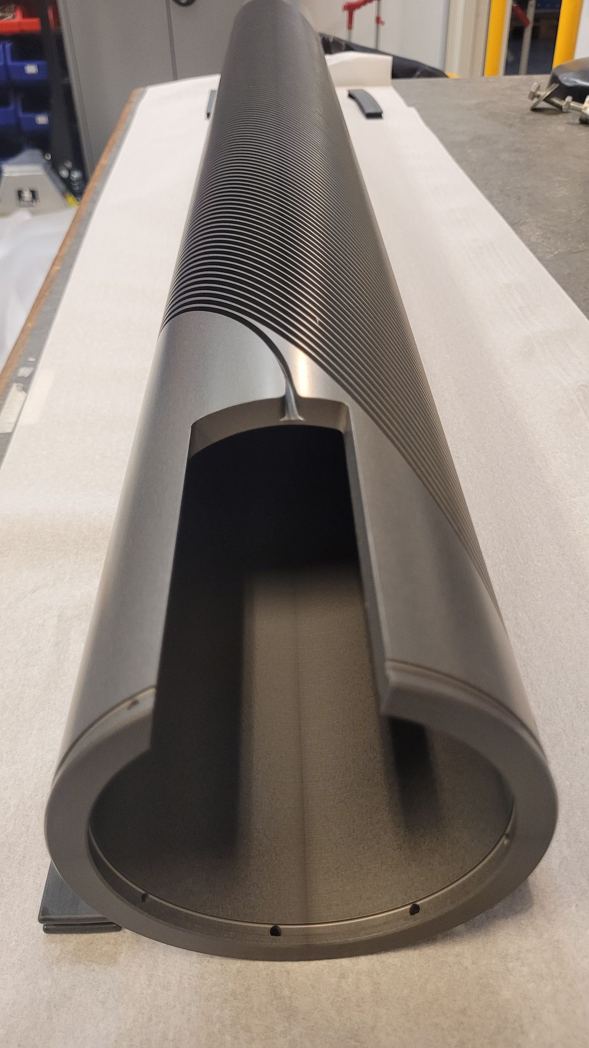



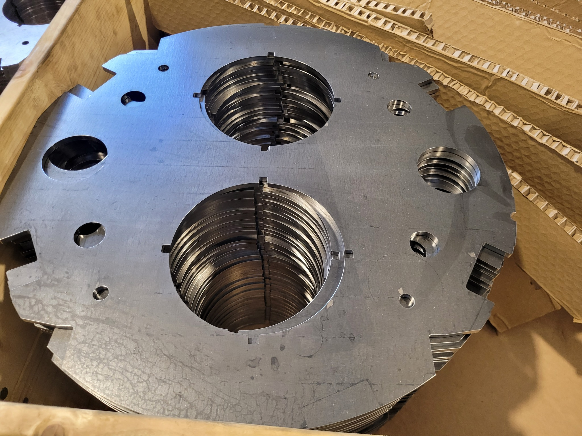

Developing superconducting magnets
Funded by: Swedish Agency for Regional and Economic Growth, Region Kronoberg, Uppsala University

Slide 15
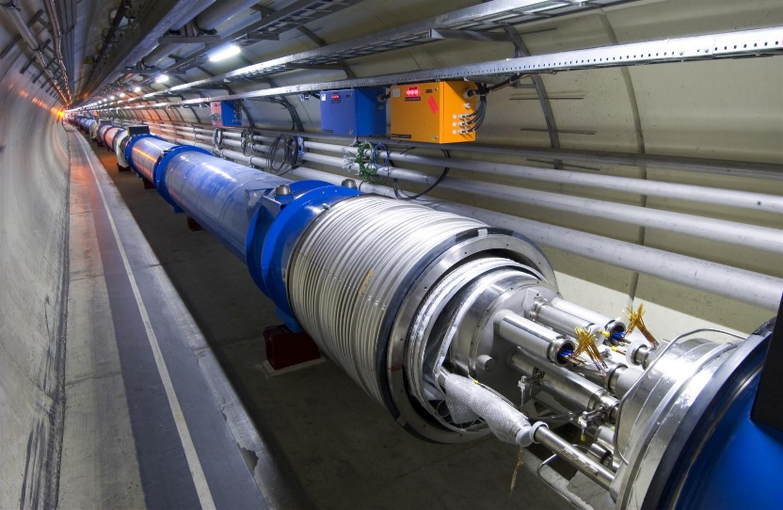
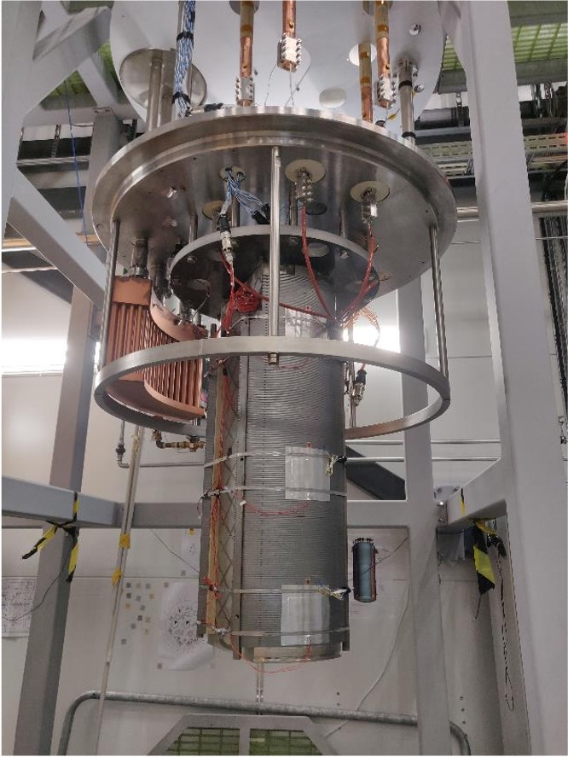
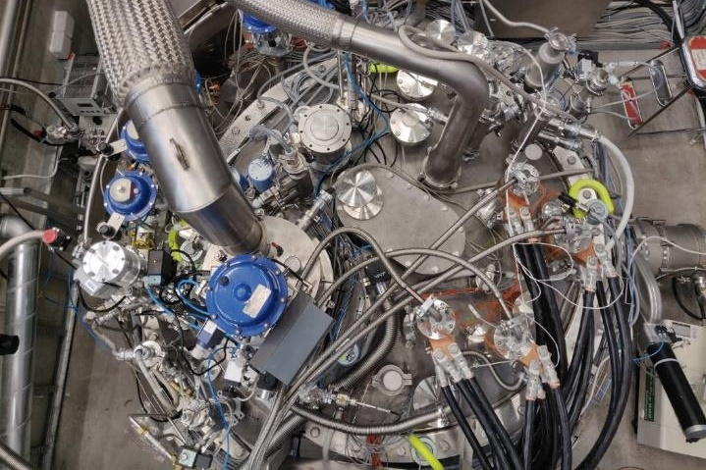

Superconducting accelerator magnets
Field measurement system with anti-cryostat and rotating coil is on its way!

Slide 16
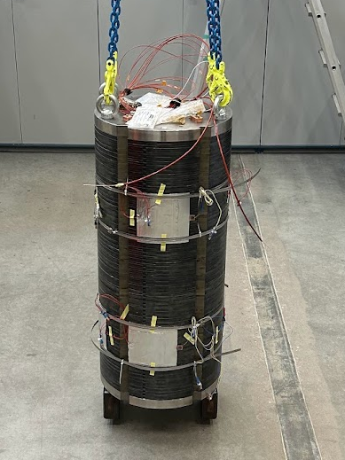
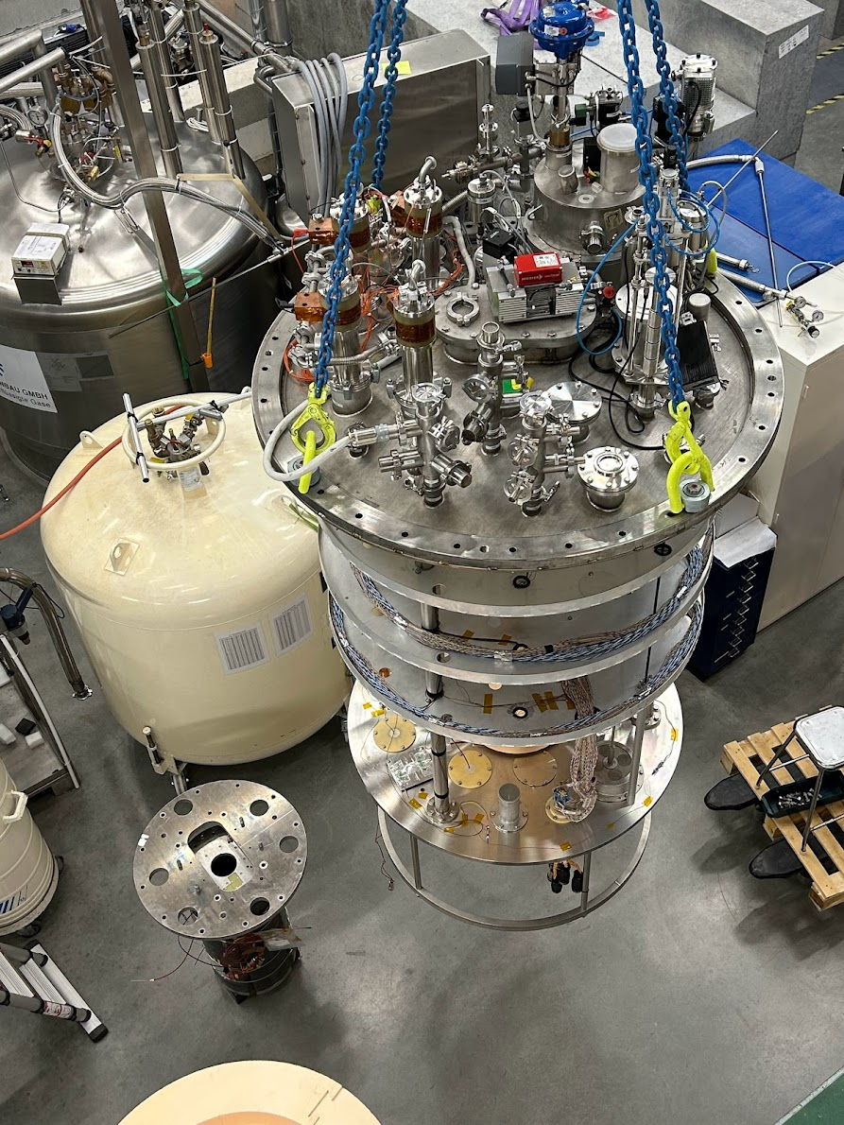
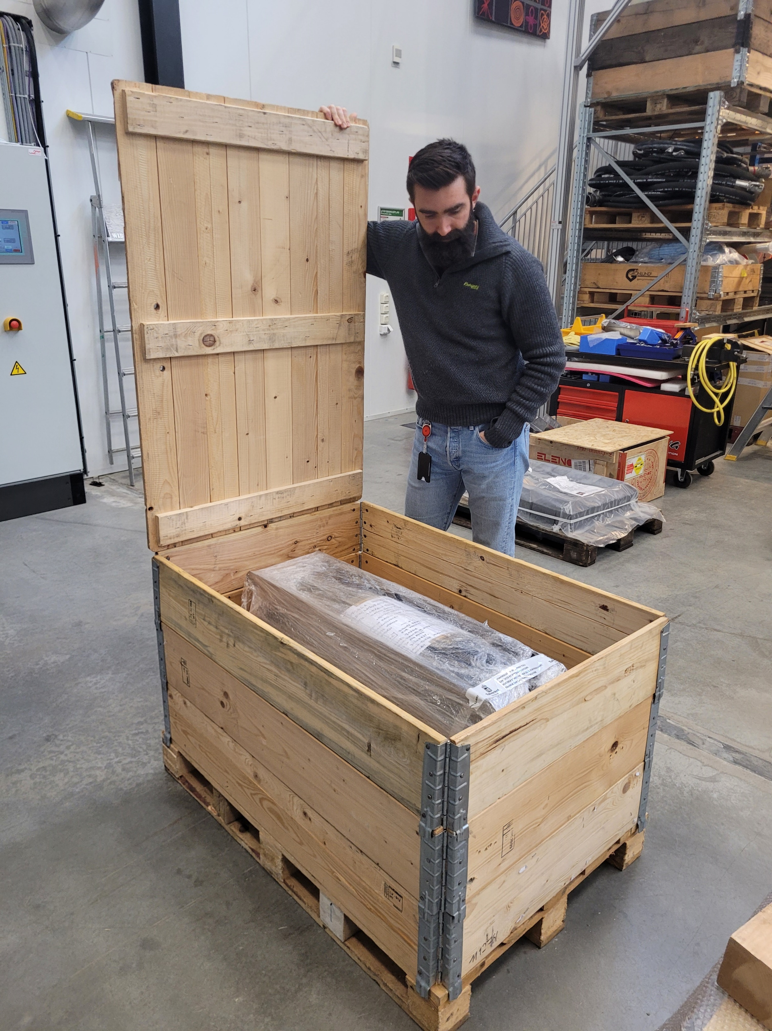
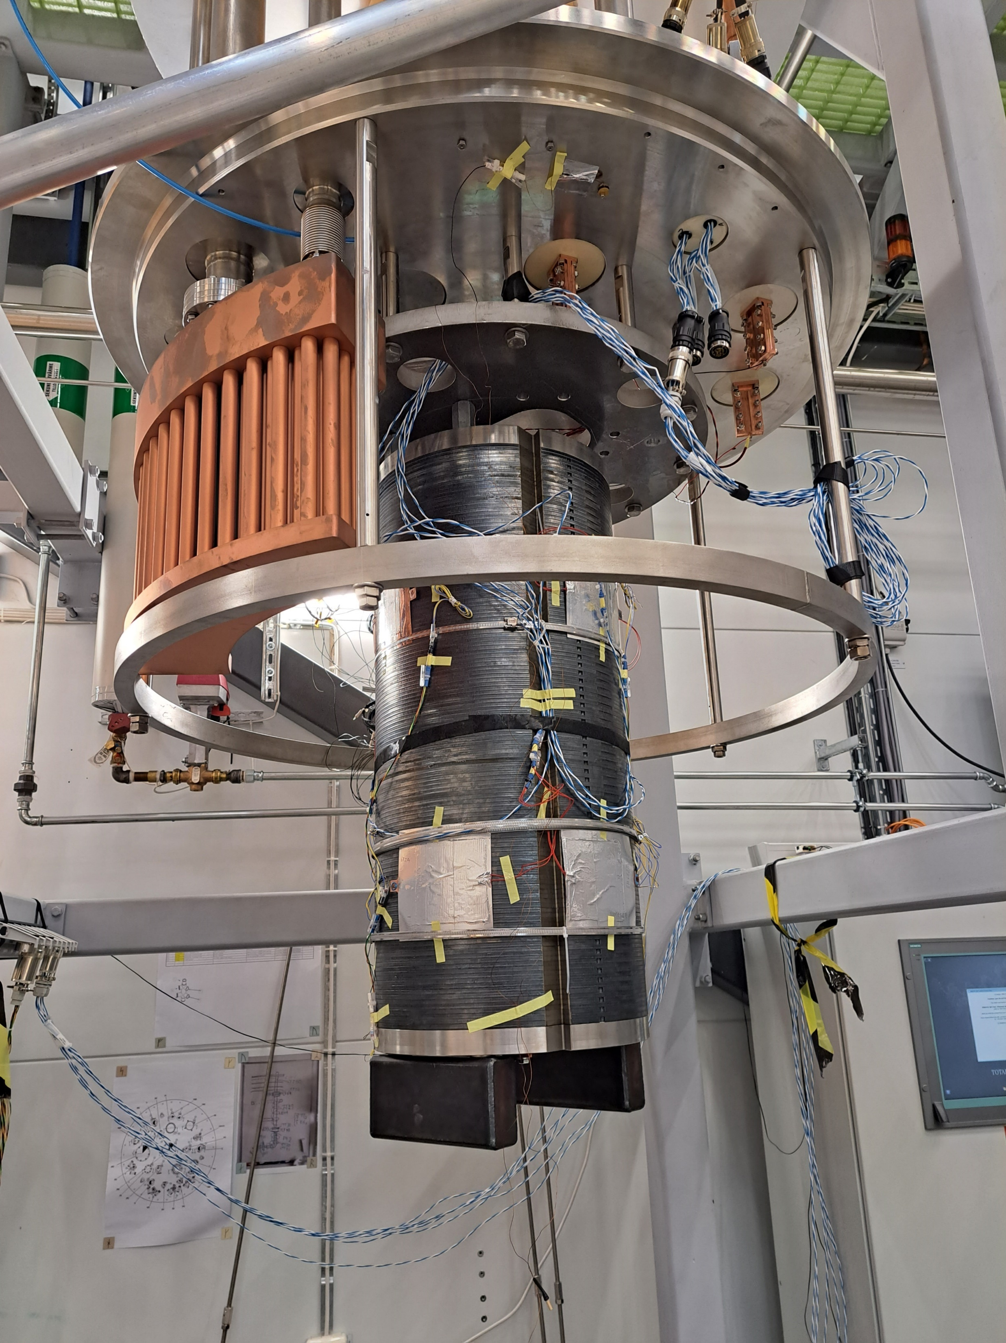
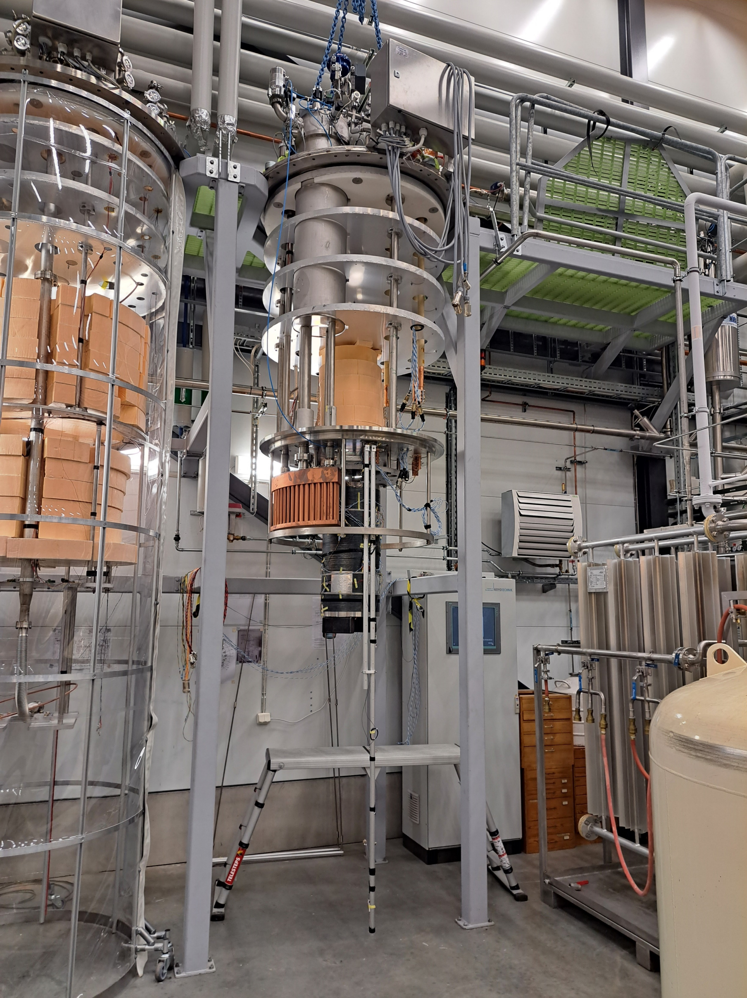
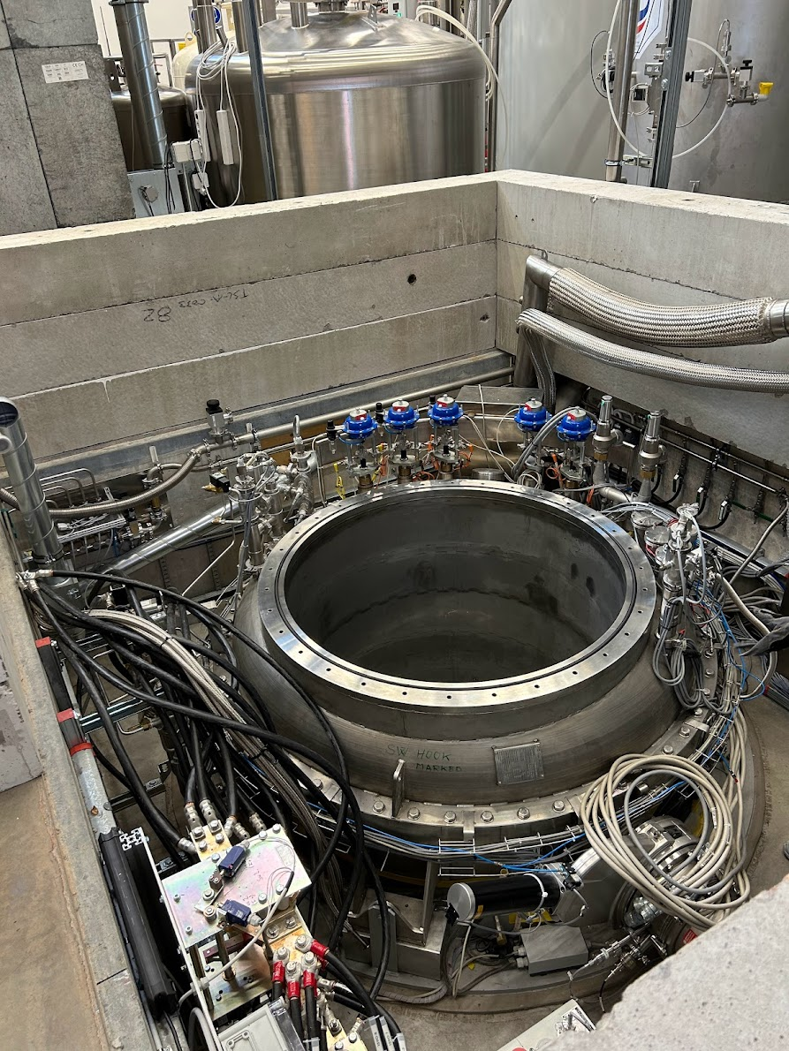
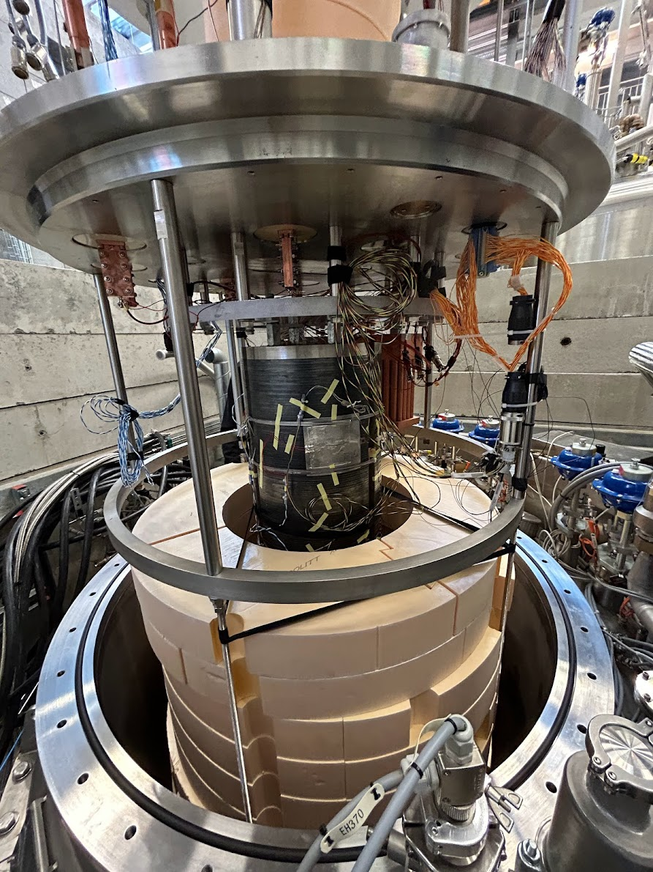
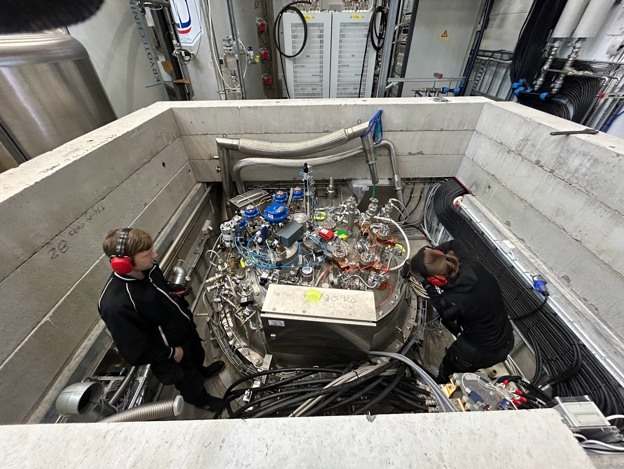
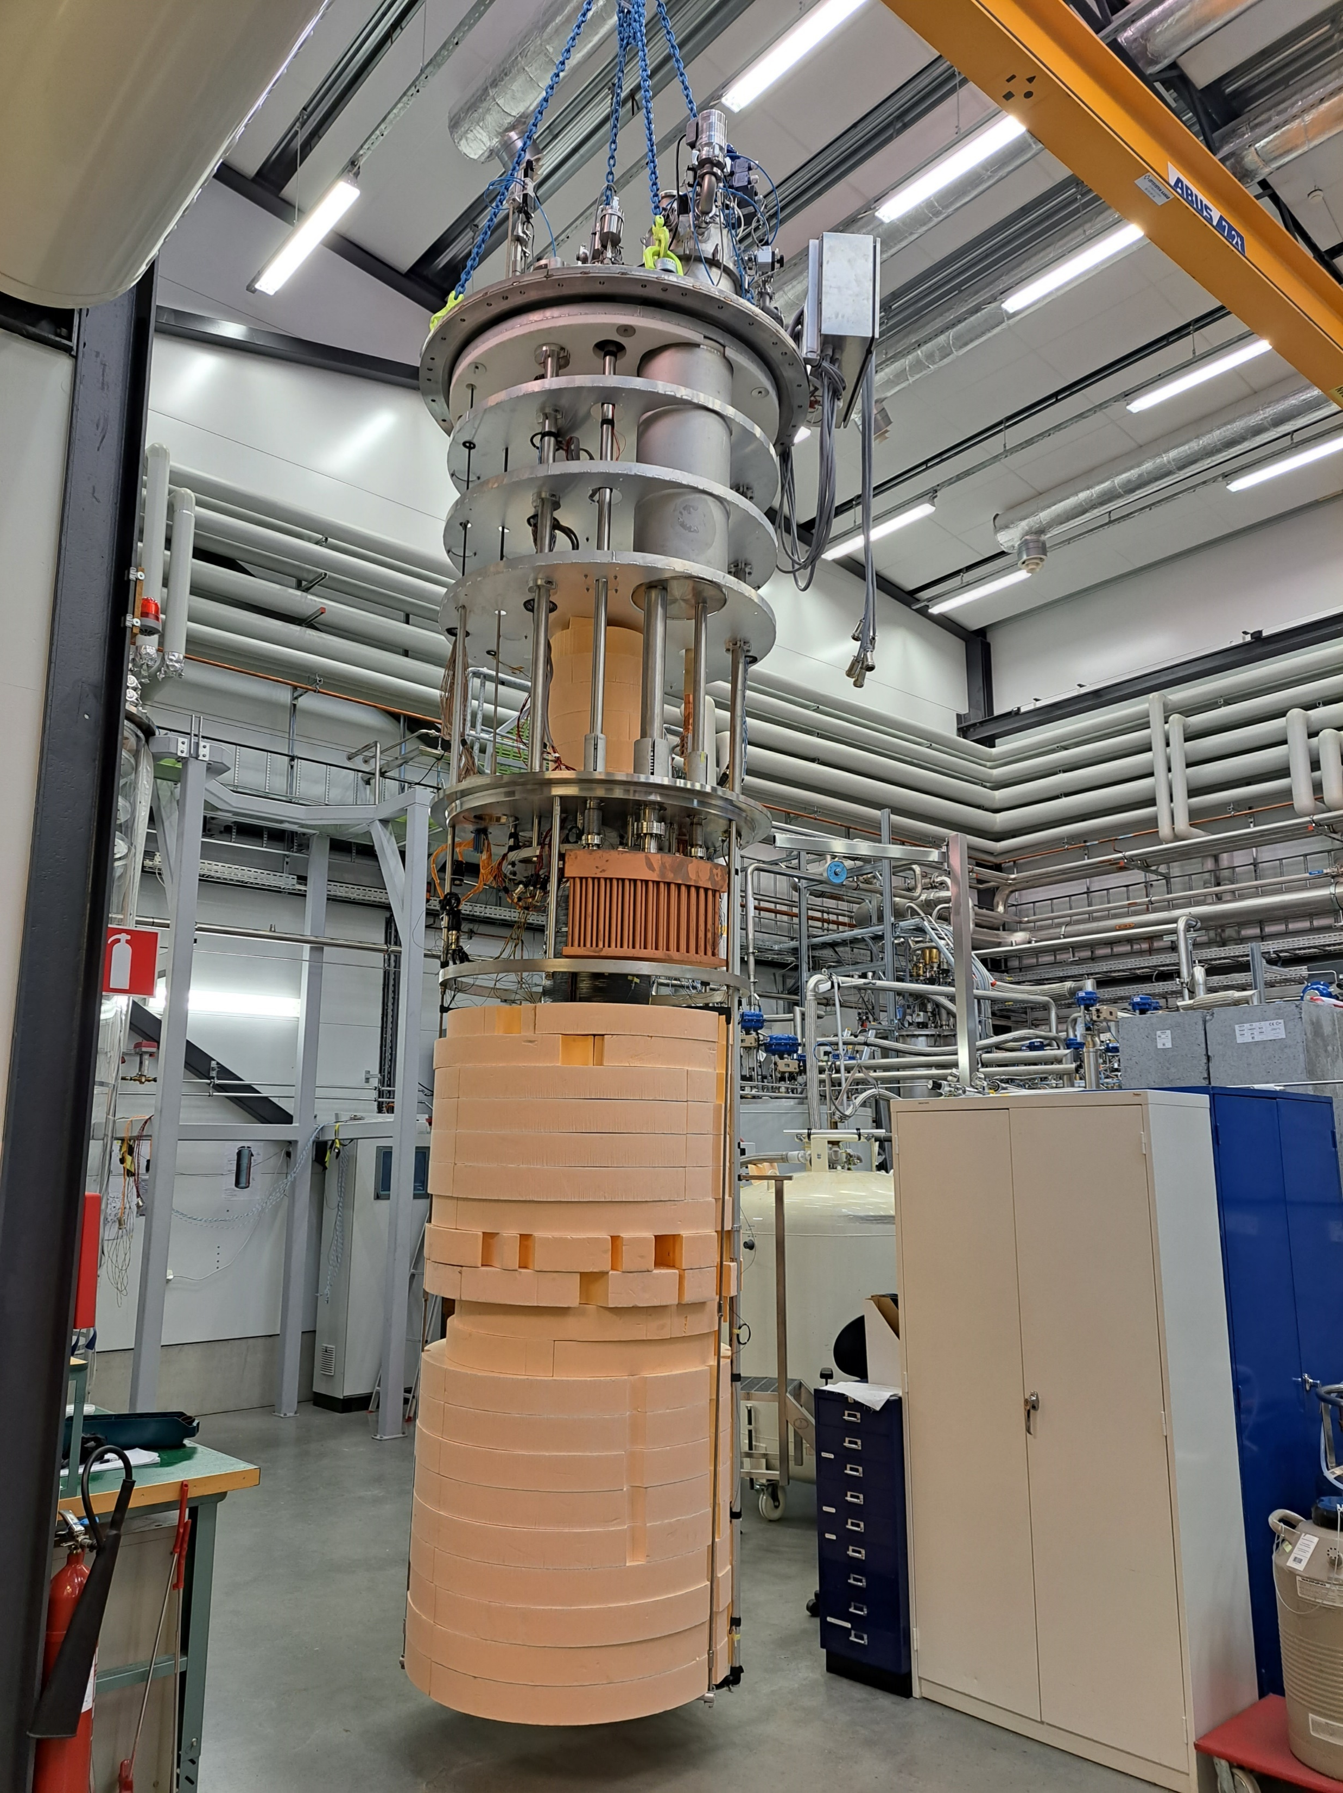
SuShi – Superconducting Shield
Designed and built by the Wigner Research Centre for Physics, Hungary, test supported by Euro-Labs
Tommaso Bagni & team
16

Slide 17
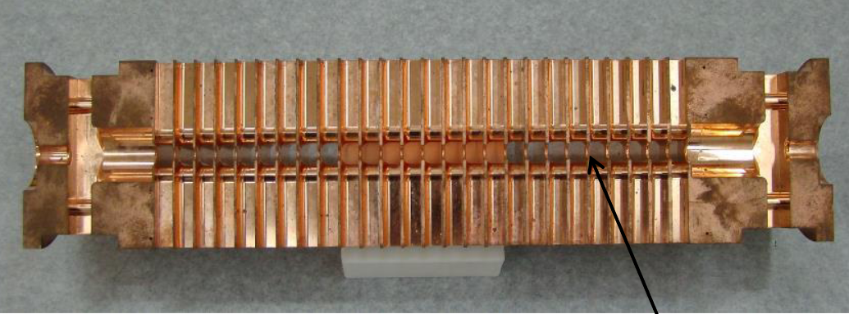
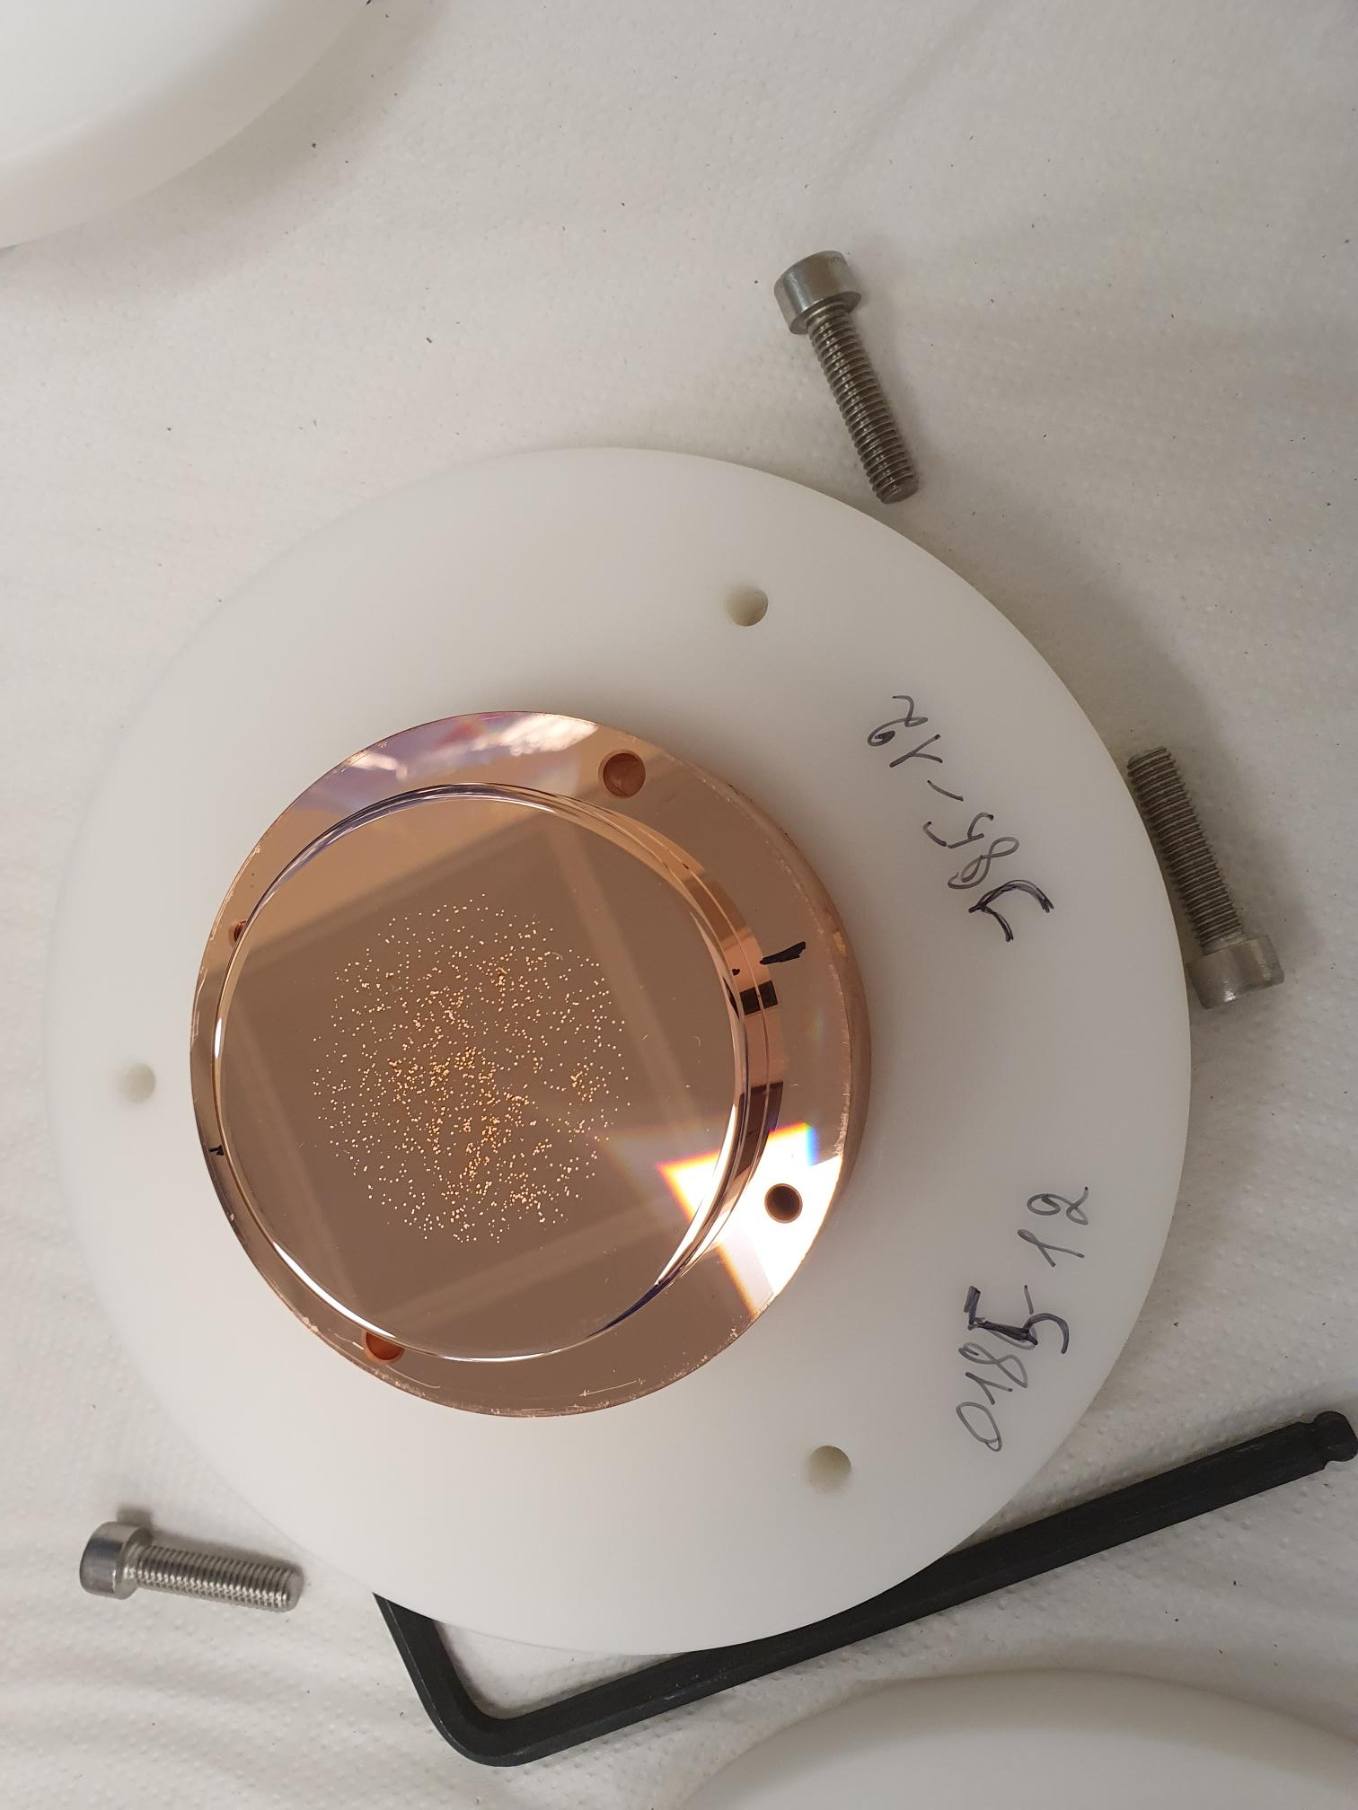
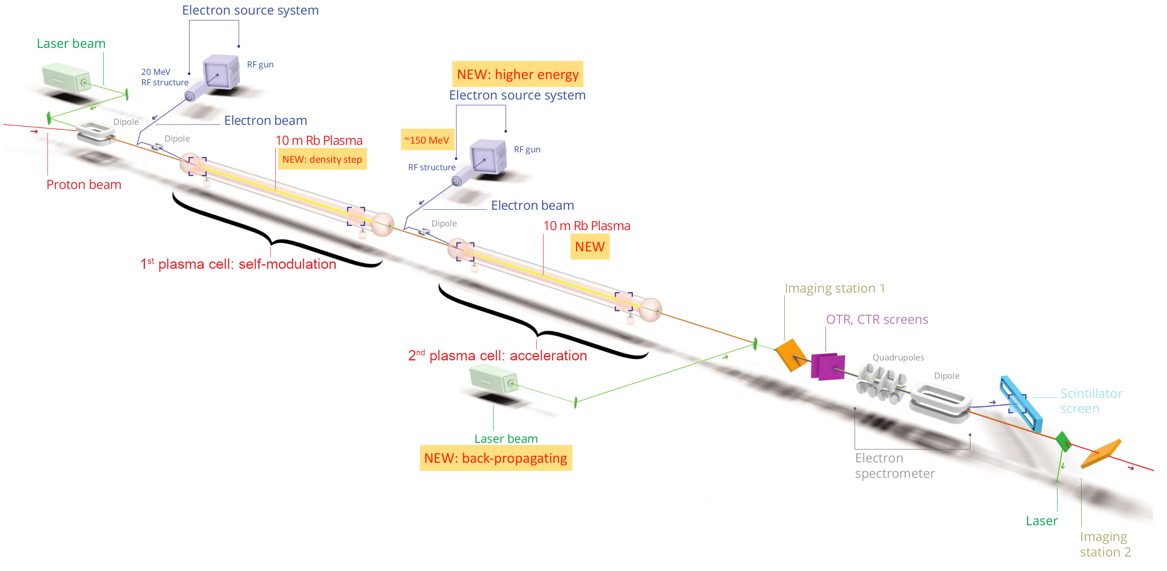
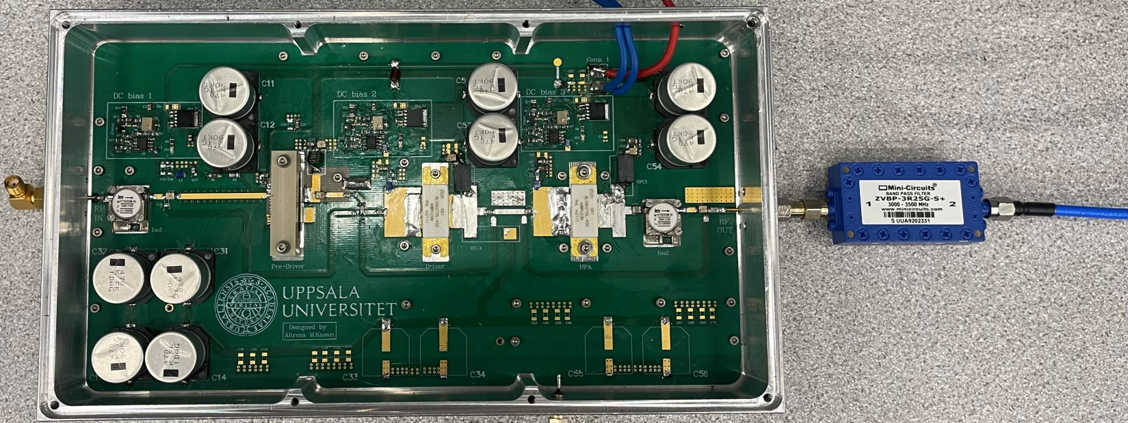

Other projects
AWAKE: Uppsala develops and delivers RF systems for the two electron injectors for the AWAKE project (run 2).
CLIC: Vacuum discharges in acceleration cavities (e.g. X-band technology for CLIC)
ESSnuSB+: Accelerator development for ESS neutrino Super Beam
Courtesy: Kevin Pepitone
3GHz solid-state amplifier

Slide 18
Thank you for listening
Any Questions/Requests/Comments/Suggestions?
And special thanks to (on behalf of UU):
Yann Leclercq, Paul Cruikshank, Stefanos Spathopoulos, Amalia Ballarino, Oliver Brüning,
Benny Björkander, Mats Lavin, Mikael Siversson, Veljko Pribak, Aryan Mohammadi, Mats Orup
and many more…

