Slide 1
Research and Research Strategy
13-May-2025

Slide 2
Schedule
8.30-10.00: KoF24 and future dept research strategy
Fika
10.15-12.00: Cont + Changes to base funding, BUL positions, SFOs

Slide 3
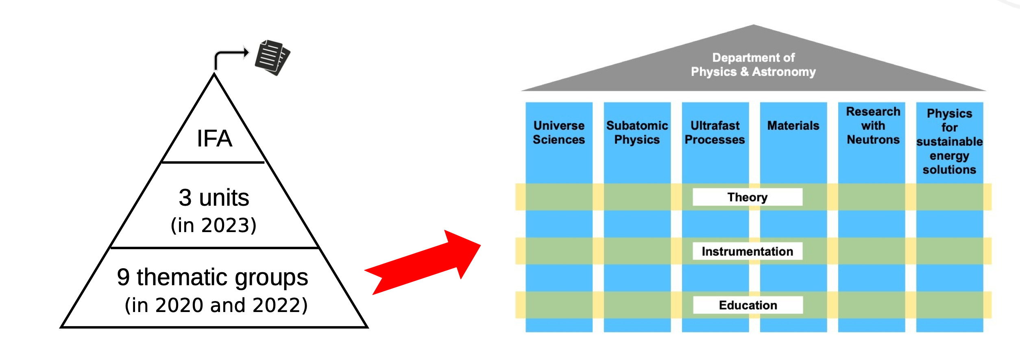
Pre-KoF24 process (reminder)
Before KoF24: Dept strategy work
Long-term strategy plan
(Fall 2023)

Slide 4
KoF24 process
Programs and department self-evaluations (Spring 2024)
Panel report (Fall 2024)
Section priorities (4) of KoF dept priorities (Winter 2024)
Soon: FB and FN take decision on KoF funding priorities
Today:
Update on FB and FN work (Maxim)
How do we continue with our (internal) work?

Slide 5
FN and FB update

Slide 6
To Discuss: How do we continue?
Unfunded KoF priorities maybe be funded later
Internal (IFA) work & priorities:
Updated and/or new priorities?
Changes in programs, new research directions, infrastructure, …
Where do we discuss?
Programs, Units, …
How do we decide?
Units, Department, …
How ambitious?
Continued KoF process at faculty, Dept resources (institutionsresurs), Infrastructure fund, …

Slide 7
Groups
BLUE
Ulrike Heiter
Richard Brenner
Maja Olvegård
Stephan Pomp
Mikael Pettersson
Johan Söderström
Arnaud Ferrari
Camilla Thulin
YELLOW
Eric Stempels
Karin Schönning
Philippe Wernet
Daniel Primetzhofer
Maxim Zabzine
Carolina Wallström-Pan
Andreas Lindblad
Oscar Grånäs
RED
Suzanne Strömberg
Nikolai Piskunov
Michael Papenbrock
Håkan Rensmo
Biplab Sanyal
Gabriella Andersson
Annica Black-Schaffer
GREEN
Daniel Gautam
Nicusor Timneanu
Rikard Enberg
Urban Eriksson
Henrik Sjöstrand
Lars Nordström
Andreas Solders
Group discussion 30 min + collection 30 min
Choose note taker for each group

Slide 8
Research Questions
Changes in basanslag: publications and EU grants
BUL positions
SFOs in Advanced Materials and Quantum Technology

Slide 9
Changes in basanslag
Forskningspropositionen (p 48):
Utvecklade kvalitetsindikatorer för högre kvalitet
Regeringen avser att fortsatt fördela medel via indikatorn för bibliometri,
vilket innebär att den kommer att baseras på de artiklar som har citerats
mest (topp tio procent) även fortsatt. Däremot görs en justering av
indikatorn för externa medel så att konkurrensutsatta medel från EU får en
högre vikt i syfte att ge lärosätena incitament att söka EU-medel. Det ger
också lärosäten som är framgångsrika vid tilldelningen av EU-medel mer
direkta anslag vilket underlättar medfinansiering av sådana projekt.
Regeringen avser att ge Vetenskapsrådet i uppdrag att årligen ta fram de
två indikatorerna, bibliometri och externa medel.
PP10% = % of articles that belong to the 10% most cited per microfield, normalized by author portion
”Quality” over Quantity

Slide 10
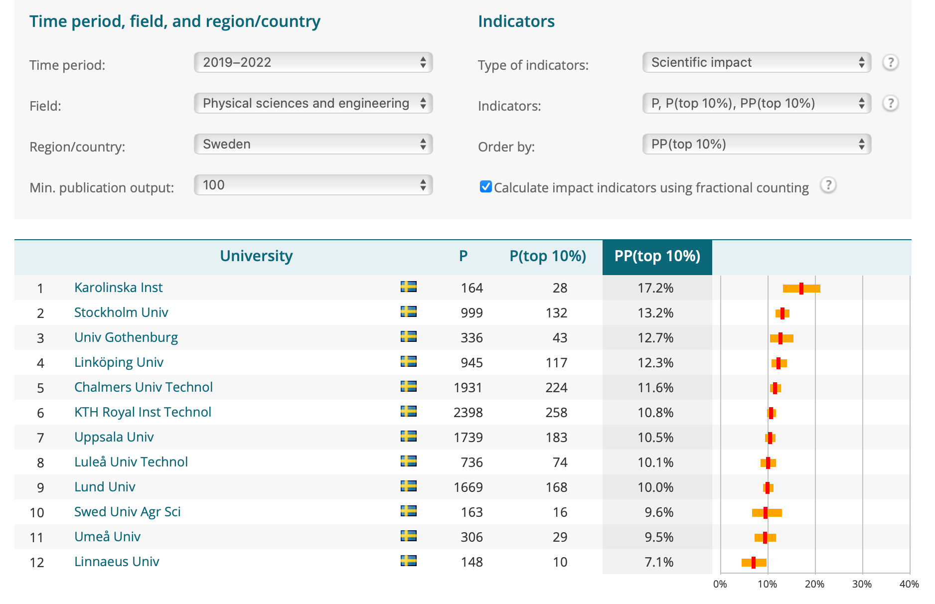
Leiden data for Physics and Engineering https://www.leidenranking.com/ranking/2024/list
Physics
Engineering
Chem-Å
Leiden data (or similar) will also be used by VR and was used for KoF24 data

Slide 11
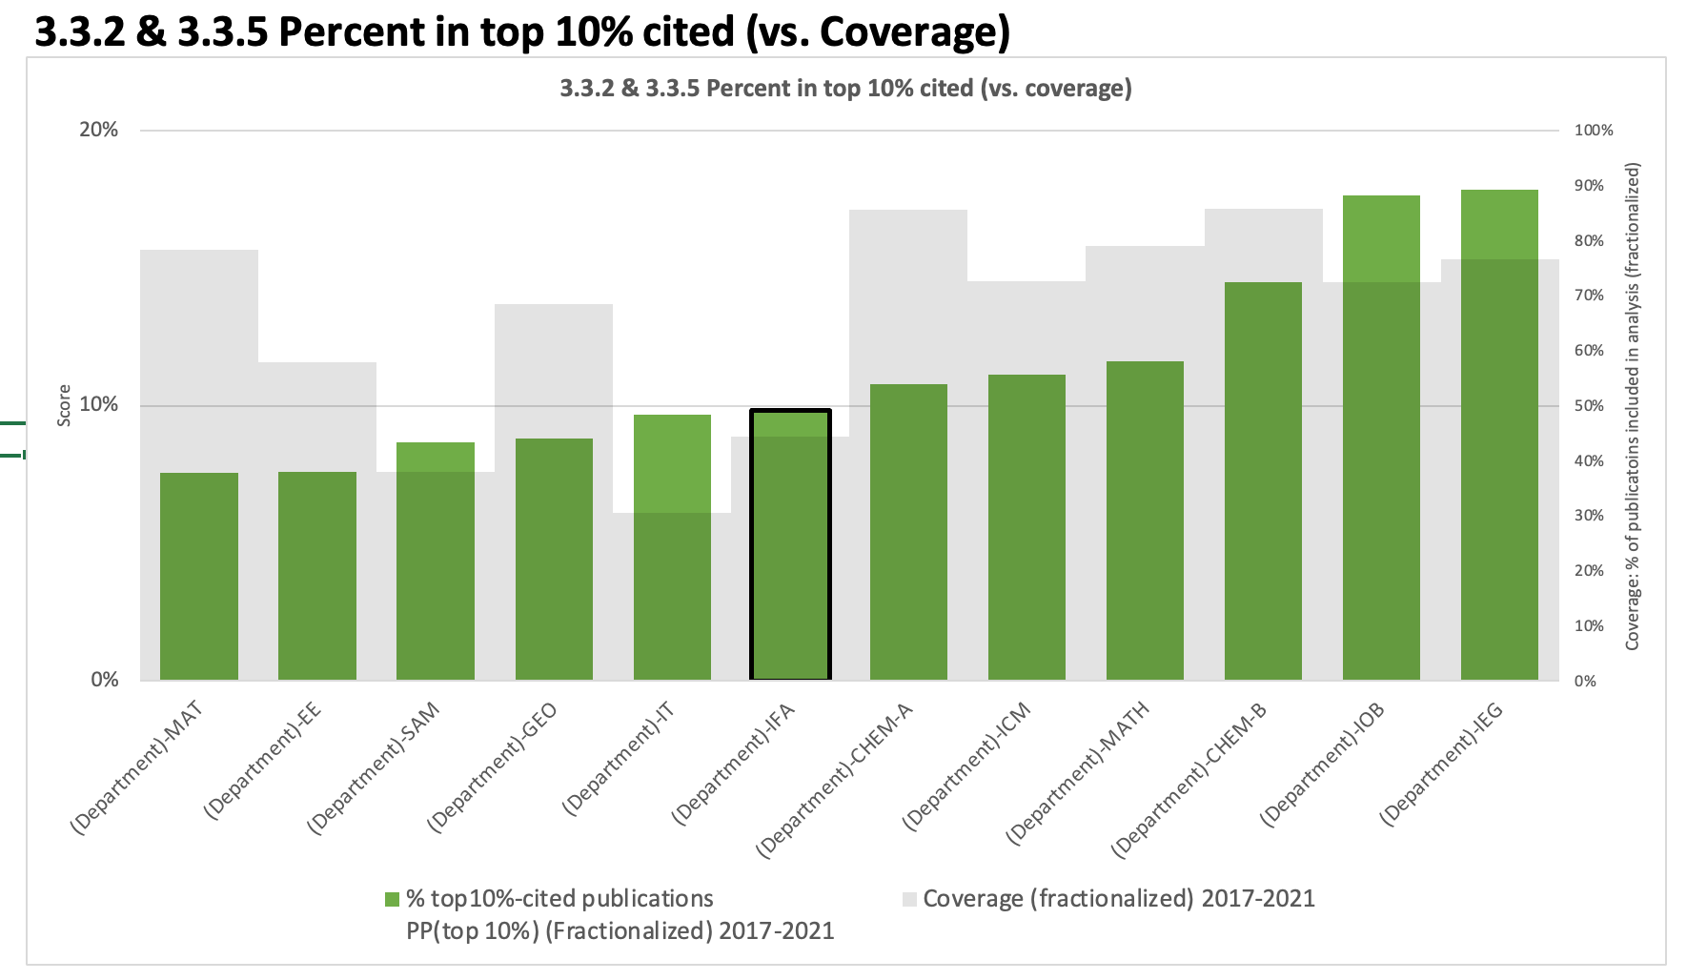
PP10% 2017-2021 Departments

Slide 12
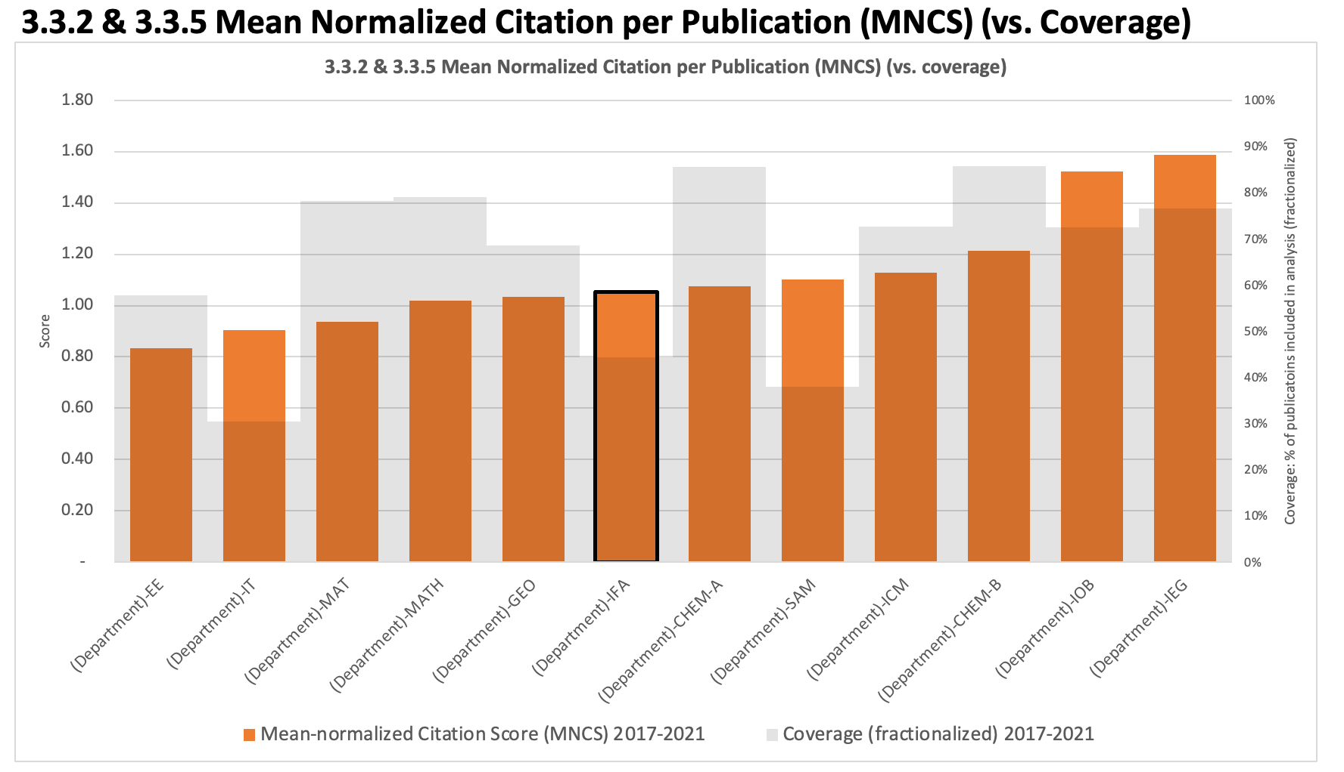
Alternative measure: MNCS
Mean-normalized Citation per Publication, a (micro)field-normalized metric

Slide 13
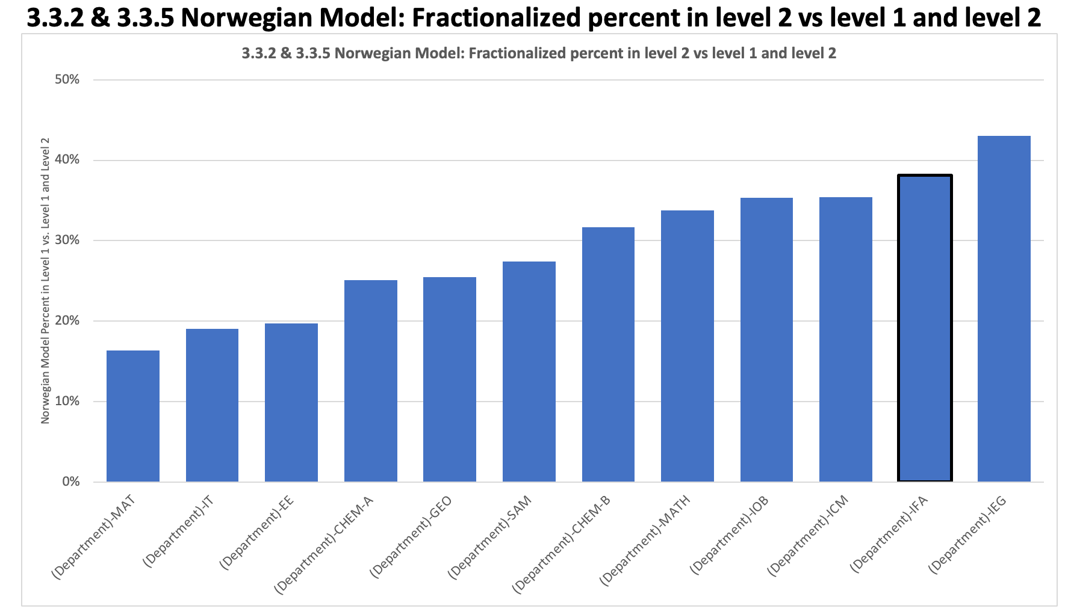
Alternative measure: Norwegian model
% in Norwegian Level 2
IFA ~ 38%, MAT ~ 17%, EE ~ 20%, SAM ~ 27%

Slide 14
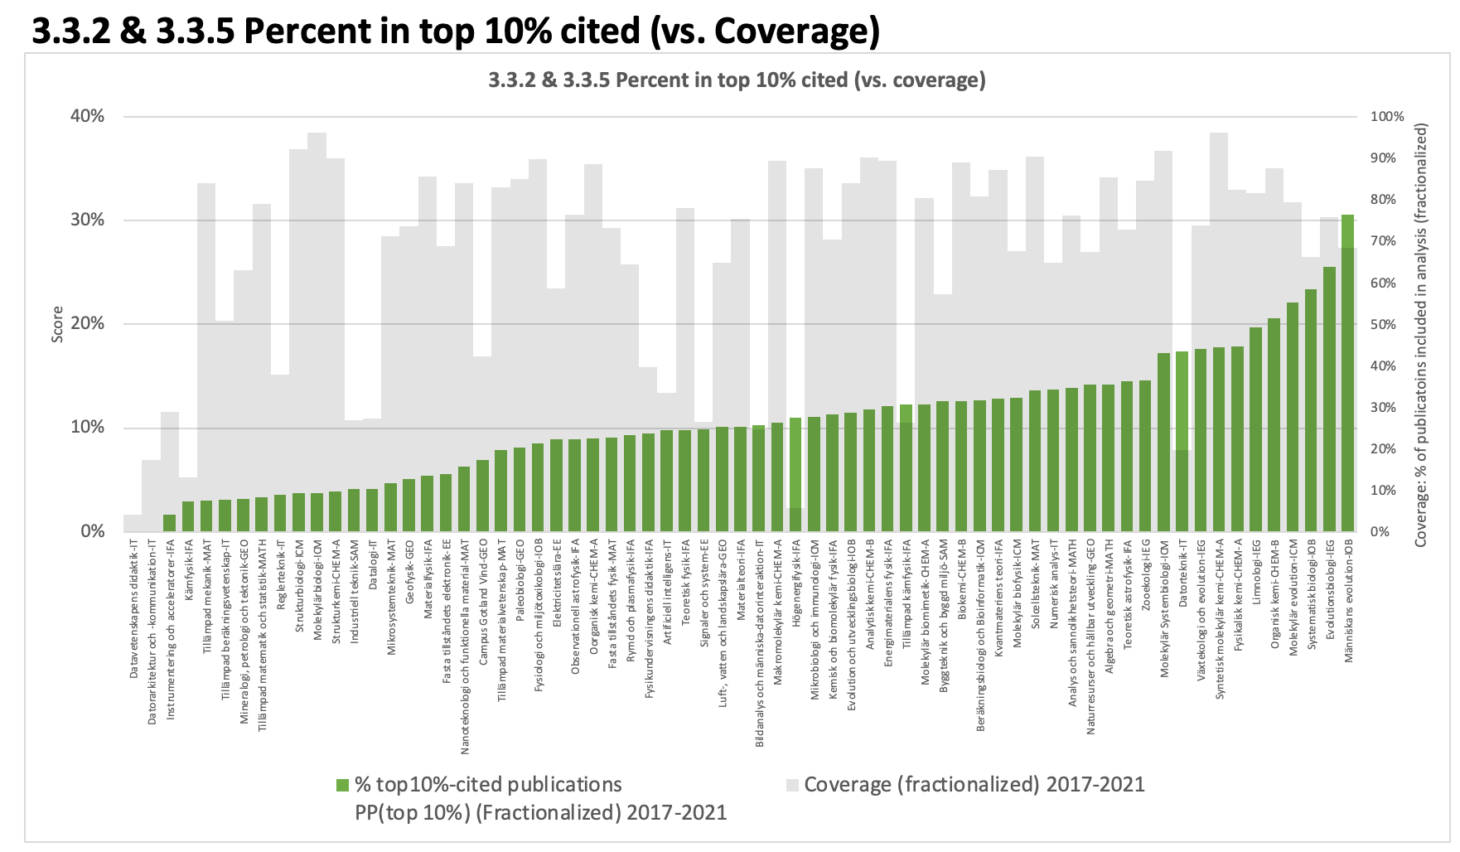
PP10% Programs
Fysik programs in red boxes

Slide 15
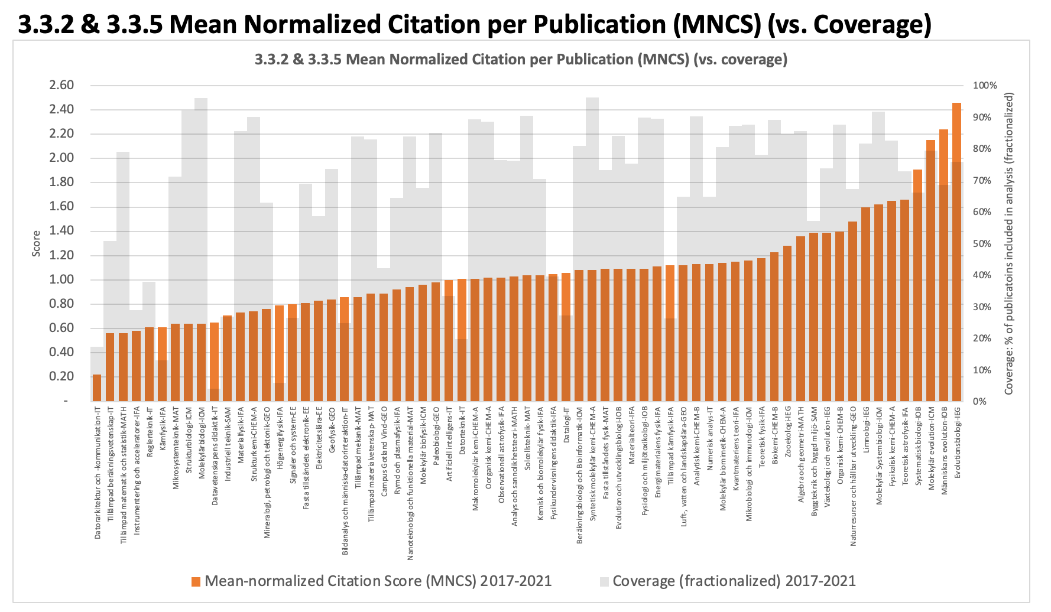
Alternative measure: MNCS

Slide 16
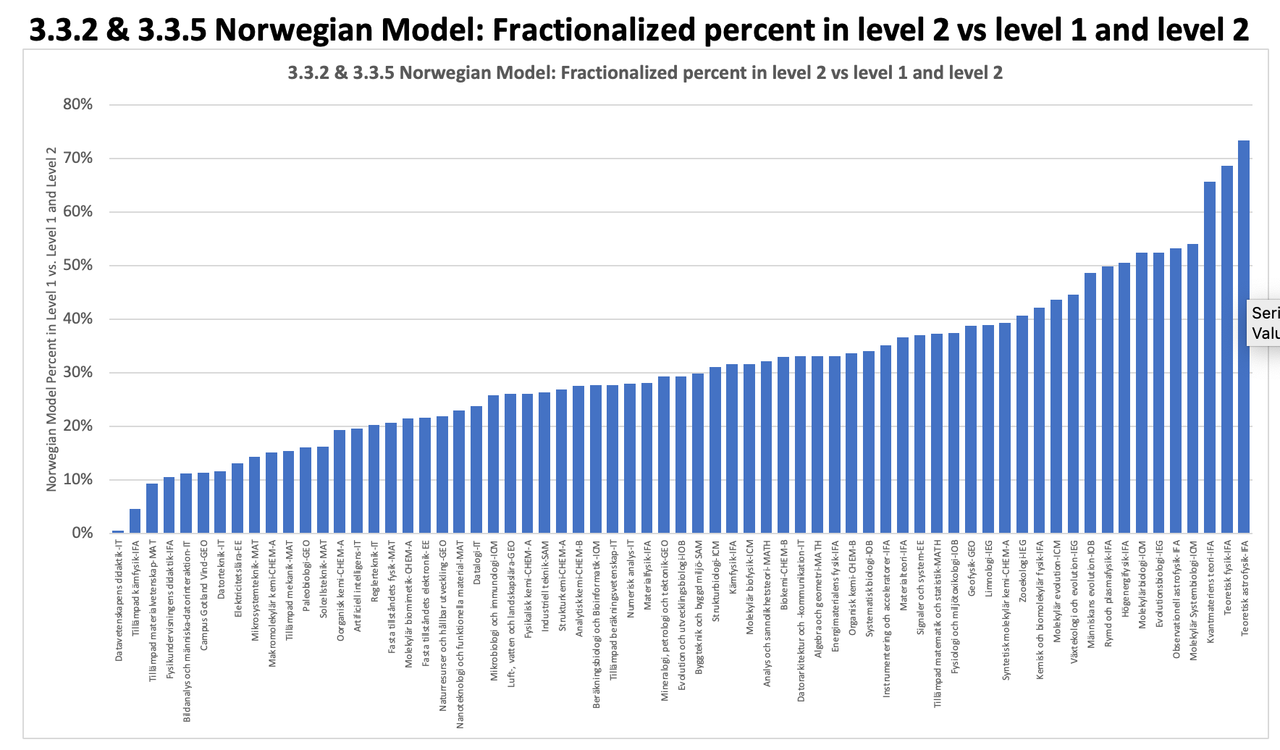
Alternative measures: Norwegian model

Slide 17
Questions for each program
If low coverage, why?
Make sure publications are in DiVA (under the correct program)
KoF24 data sheet contains all included Leiden publications: check against DiVA (and/or what you know is published)
How to increase PP10%?
Make sure work is included in statistics
More impact/citations
Decrease denominator by not publishing incremental work?
Be aware of author normalization?

Slide 18
BULs and SFOs
BUL positions: 5+5 years funding from VR for new BUL (identified candidate) + increased uni base funding
Similar internal process as WAFs (assumed), equal ooprtunites, preference for intl PhD/PD, uni co-finance half
How do we identify good candidates?
SFO in Advanced Materials
Suggestion (synopsis with team) by 27 May
SFO in Quantum Technology
Open meeting 14 May
Discussions in groups (PP10%,BUL,2xSFOs), take notes

Slide 20
Basanlag changes from VR
Regeringen vill även i fortsättningen utgå från ett kombinerat mått på lärosätenas framgång: bibliometrisk statistik över antal publikationer och citeringar som forskningen vid lärosätet resulterat i, samt lärosätenas förmåga att attrahera externa forskningsmedel. Men från och med 2026 ska dessa mått på kvalitet spela en större roll då regeringen fördelar basanslag. Vissa medel från EU kommer att väga extra tungt, men fördelningsmodellen ska ta hänsyn till skillnader mellan olika ämnesområden och att tillgången på externa medel varierar över tid.

Slide 21
KoF24 goals
Maintain and strengthen our research quality
Through program and department self-reflection on strengths and weaknesses
Through developing program and department priorities for the next 5 years
Through internal and external feedback on our performance and plans
Strengthen our collegial culture
By involving all research staff in the process and ensuring everyone is aware of the results
By being respectful of everyone’s time at the faculty, department, and program levels
By communicating clearly as to why we are doing this and how we expect everyone to contribute
Improve our internal understanding
By collecting information on the different ways programs and departments are funded and operate
By collecting explanations of why we work that way and how it supports our research
Improve our resource usage
By generating bottom-up prioritized research plans at the program, department, section, and faculty-levels
By allocating and re-allocating resources based our priorities and the potential to significantly improve research
By identifying opportunities for intra- and inter-program/department/section collaboration and re-organization

Slide 22
Department priorities (no ranking)
AI4Physics: Activity in progress with department money. Led by Magdalena Larfors.
Center for Geometry and Physics: from geometry to quantum information: Activity in progress with excellence grant from VR and Nordita recruitment. Led by Tobias Ekholm.
ANItA- Academic-Industrial Nuclear technology Initiative to Achieve a sustainable energy future: Activity in progress with funding from Energimyndigheten. Led by Ane Håkansson, to be replaced by Sophie Grape.
LigHt, an environment for multi-scale characterization of (energy)materials at Ångströmlab: Activity started with funding from KAW. Led by Andreas Lindblad and Daniel Primetzhofer.
National laboratory for instrumentation and accelerator development: Activity in preparation. Negotiation ongoing with VR. Led by Richard Brenner.
Infrastructure support: Activity in progress with department money. Led by the department management group (internal, not to TekNat).

