Slide 1
Two Higgs Doublet Models
Theoretical Overview
Mathilda Turtola

Slide 2
Table of contents
01
04
02
05
03
06
Motivation for 2HDM
Experimental Signatures
General Theory
Experimental Constraints
Models
Summary and Outlook
2

Slide 3
Motivation for 2HDM
Why not?
SUSY
The scalar sector is much more minimal than other sectors.
Requires two Higgs doublets.
MSSM special case of one 2HDM
Dark Matter
CP-violation
Stable Higgs boson as DM?
Some models for dark matter candidates, e.g. axion models include two Higgs doublets
Needed to explain matter antimatter assymmetry.
Can have CP-violation in extended scalar sector
3

Slide 4
General Theory
Scalar sector constrained from parameter
ρ – experimentally close to one
4

Slide 5
General Theory
Scalar sector constrained from parameter
ρ – experimentally close to one
Introduce additional SU(2) doublet
Neutral scalars: h, H
Neutral pseudoscalar: A
2 charged scalars: H±
4

Slide 6
General Theory
Scalar sector constrained from parameter
ρ – experimentally close to one
Introduce additional SU(2) doublet
2HDM potential
Neutral scalars: h, H
Neutral pseudoscalar: A
2 charged scalars: H±
In CP-conserving case
Couplings are real
4

Slide 7
General Theory
2HDM potential
Both doublets acquire a nonzero vev:
5

Slide 8
General Theory
2HDM potential
Both doublets acquire a nonzero vev:
Diagonalize mass matrices, mass eigenstates:
Charged:
CP-even:
Pseudoscalar:
5

Slide 9
General Theory
Theoretical Constraints
Perturbativity:
Vacuum stability:
6

Slide 10
General Theory
Theoretical Constraints
FCNC
Perturbativity:
Yukawa couplings not simultaneously diagonalizable
Vacuum stability:
2HDMs have tree-level FCNC
Heavily constrained by experiment
Avoid by introducing ℤ₂ symmetries
6

Slide 11
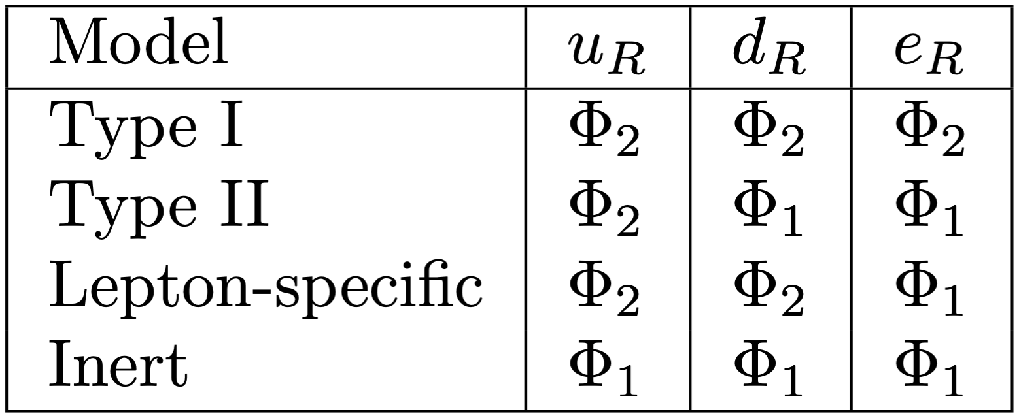
Models
Type I 2HDM
No Yukawa couplings to first doublet
7

Slide 12
Models
Type I 2HDM
Type II 2HDM
No Yukawa couplings to first doublet
Down type fermions and leptons couple to first doublet.
MSSM is a special case
7

Slide 13
Models
Type I 2HDM
Type II 2HDM
No Yukawa couplings to first doublet
Down type fermions and leptons couple to first doublet.
MSSM is a special case
Lepton-specific 2HDM
Leptons couple to first Higgs doublet
7

Slide 14
Models
Type I 2HDM
Type II 2HDM
No Yukawa couplings to first doublet
Down type fermions and leptons couple to first doublet.
MSSM is a special case
Lepton-specific 2HDM
Leptons couple to first Higgs doublet
Inert 2HDM
Second doublet has zero vev
DM candidate as lightest neutral scalar of inert doublet
7

Slide 15
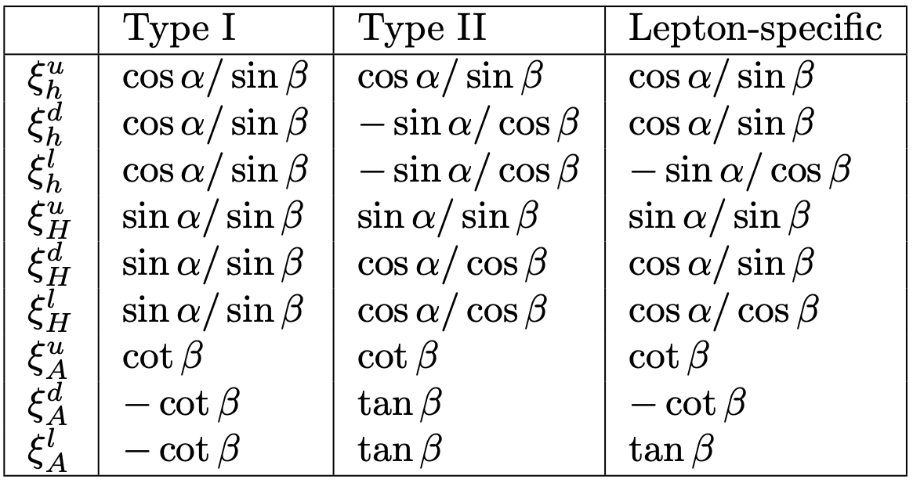
Models
Couplings to SM particles
Yukawa couplings depend on 𝛼 and β
Model dependent
8

Slide 16
Models
Couplings to SM particles
Yukawa couplings depend on 𝛼 and β
Model dependent
Couplings of neutral scalars to WW and ZZ are the same in all models
h: Multiply SM coupling with sin(β – 𝛼)
H: Multiply SM coupling with cos(β – 𝛼)
A: no coupling
8

Slide 17
Models
Couplings to SM particles
Yukawa couplings depend on 𝛼 and β
Model dependent
Alignment limit
Couplings of neutral scalars to WW and ZZ are the same in all models
h: Multiply SM coupling with sin(β – 𝛼)
H: Multiply SM coupling with cos(β – 𝛼)
A: no coupling
SM Higgs = h
SM Higgs = H
8

Slide 18
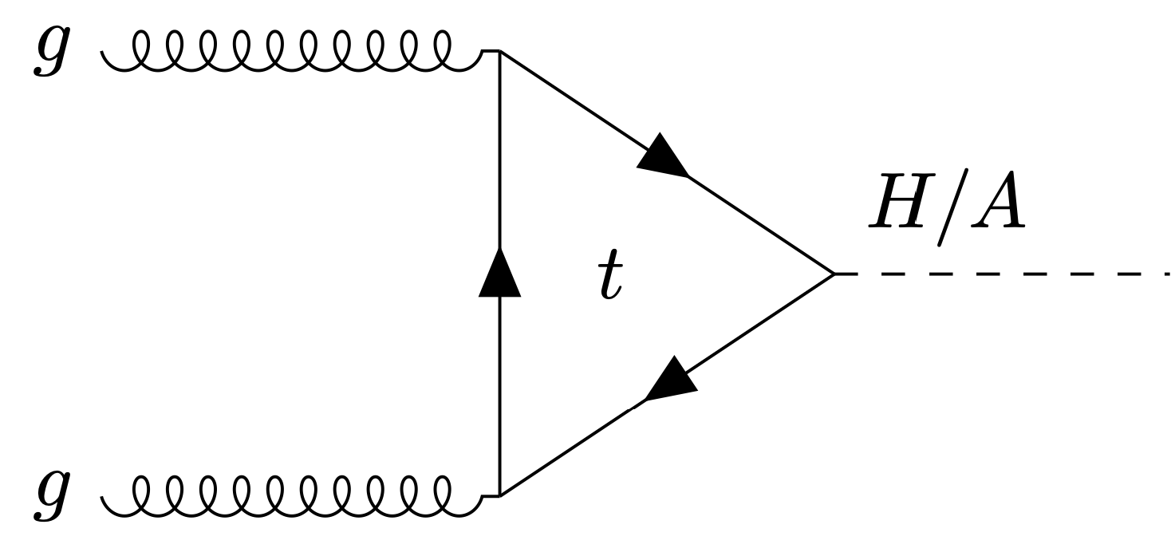
Experimental Signatures
Phenomenology varies between models, many free parameters and depend on masses and 𝛼 and β
Similar to the SM Higgs, the dominant production mode for neutral Higgs bosons is ggF
9

Slide 19
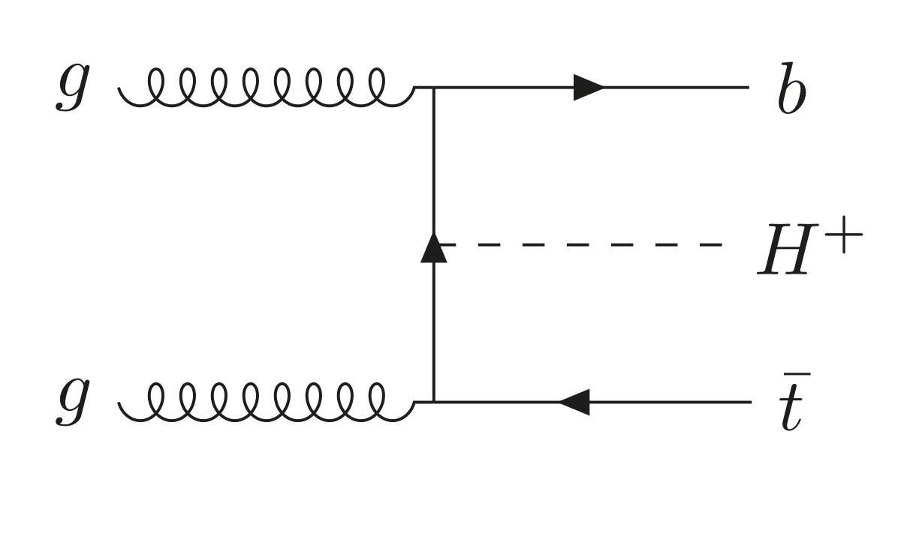
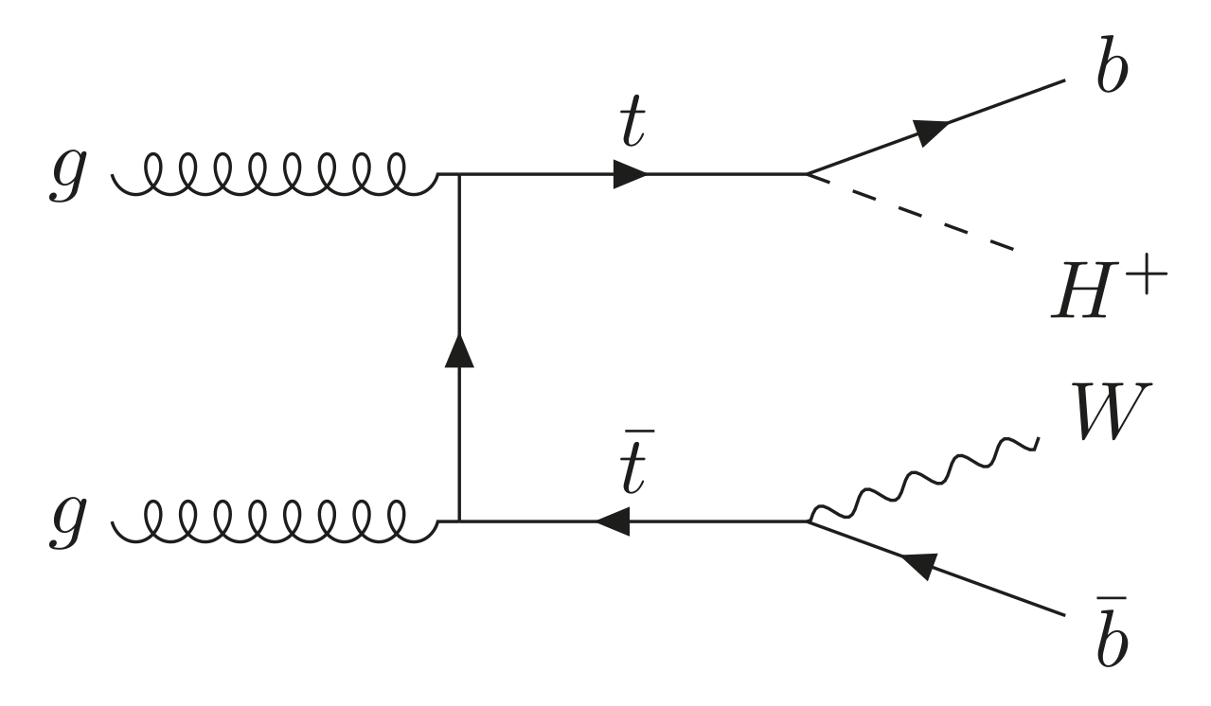
Experimental Signatures
Phenomenology varies between models, many free parameters and depend on masses and 𝛼 and β
Similar to the SM Higgs, the dominant production mode for neutral Higgs bosons is ggF
Charged Higgs bosons produced through ggF and from top quark decays
9

Slide 20
Experimental Signatures
Phenomenology varies between models, many free parameters and depend on masses and 𝛼 and β
Similar to the SM Higgs, the dominant production mode for neutral Higgs bosons is ggF
Charged Higgs bosons produced through ggF and from top quark decays
ATLAS and CMS have searched for additional neutral scalars in many decay channels
9

Slide 21
Experimental Signatures
Decays of neutral Higgs bosons
Largest branching ratio to the heaviest available fermion pair
Search for decays into t, b, 𝜏 and μ
No distinction between CP-even and CP-odd scalar – Degenerate masses
Not favored for pseudoscalar – CP conservation
Assuming
10
Notes:
µμ

Slide 22
Experimental Signatures
Decays of charged Higgs bosons
Decay into tau relevant for large mass range
If allowed tb channel will dominate
Enhanced in certain models
11

Slide 23
Experimental Signatures
Decays of charged Higgs bosons
Decay into tau relevant for large mass range
If allowed tb channel will dominate
Enhanced in certain models
Searches have been carried out by the experiments considering many different final states
Have they found any additional scalars?
11

Slide 24
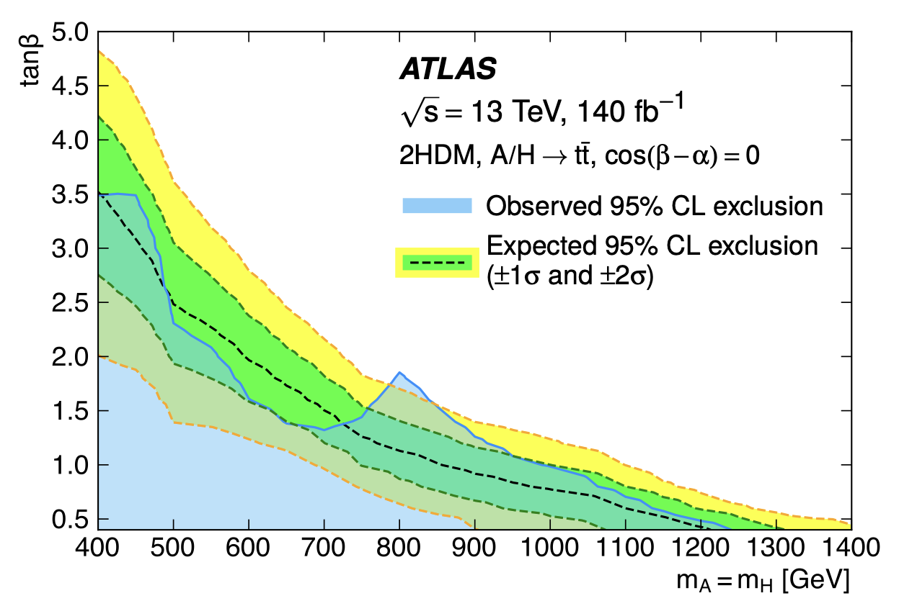
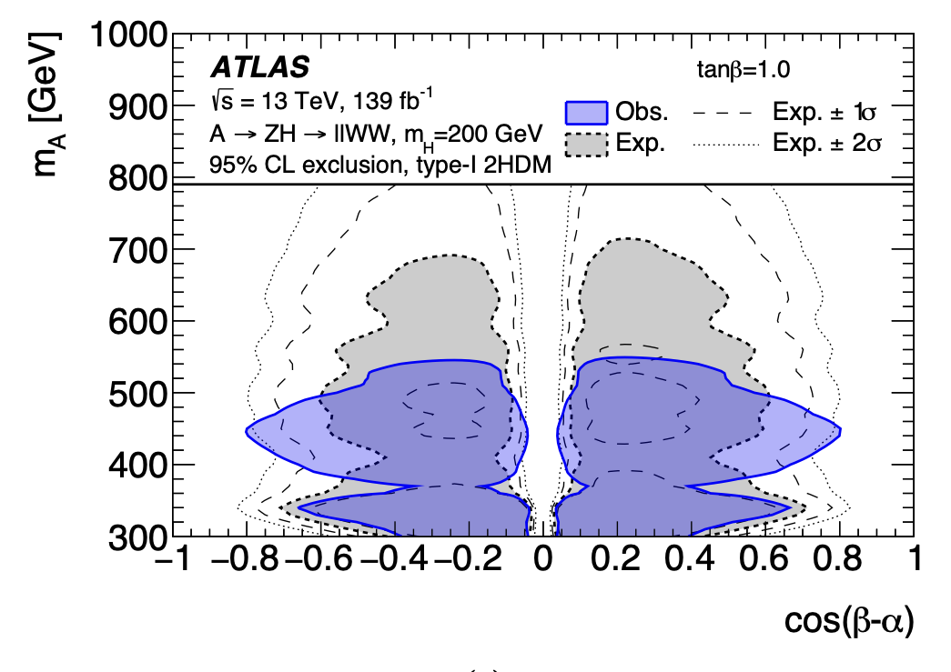
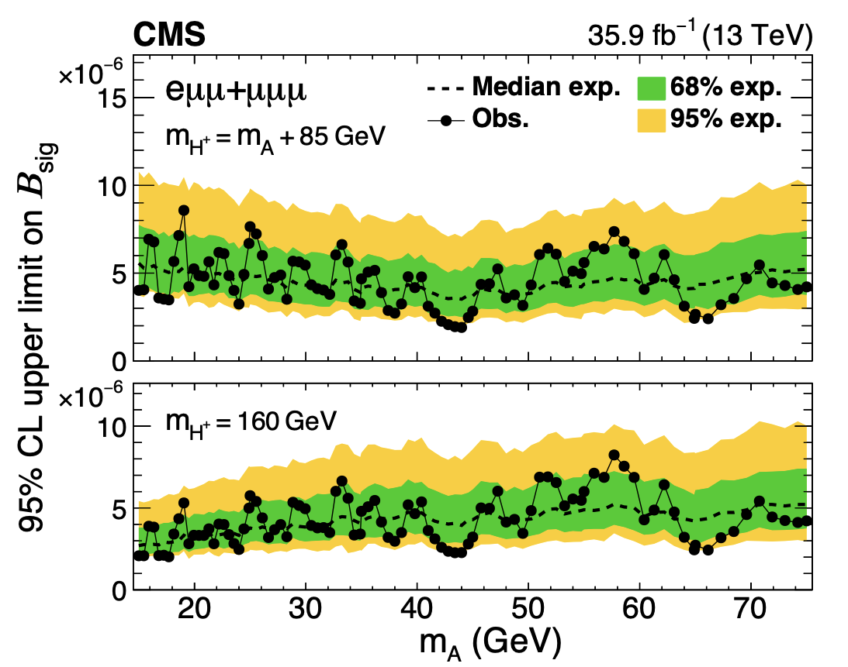
Experimental constraints
Phenomenology model dependent
Difficult to place general constraints
Direct constraints
Measured cross-sections in agreement with SM give constraints on parameter space in the different models
ATLAS Collaboration. (2024). Search for heavy neutral Higgs bosons decaying into a top quark pair in 140 fb⁻¹ of proton-proton collision data at √s = 13 TeV with the ATLAS detector. arXiv:2404.18986
ATLAS Collaboration. (2021) Search for a heavy Higgs boson decaying into a Z boson and another heavy Higgs boson in the ℓℓbb and ℓℓWW final states in pp collisions at √s = 13 TeV with the ATLAS detector. arXiv:2011.05639
CMS Collaboration. (2019 ). "Search for a light charged Higgs boson decaying to a W boson and a CP-odd Higgs boson in final states with eμμ or μμμ in proton-proton collisions at √s = 13 TeV." arXiv:1905.07453 .
12

Slide 25
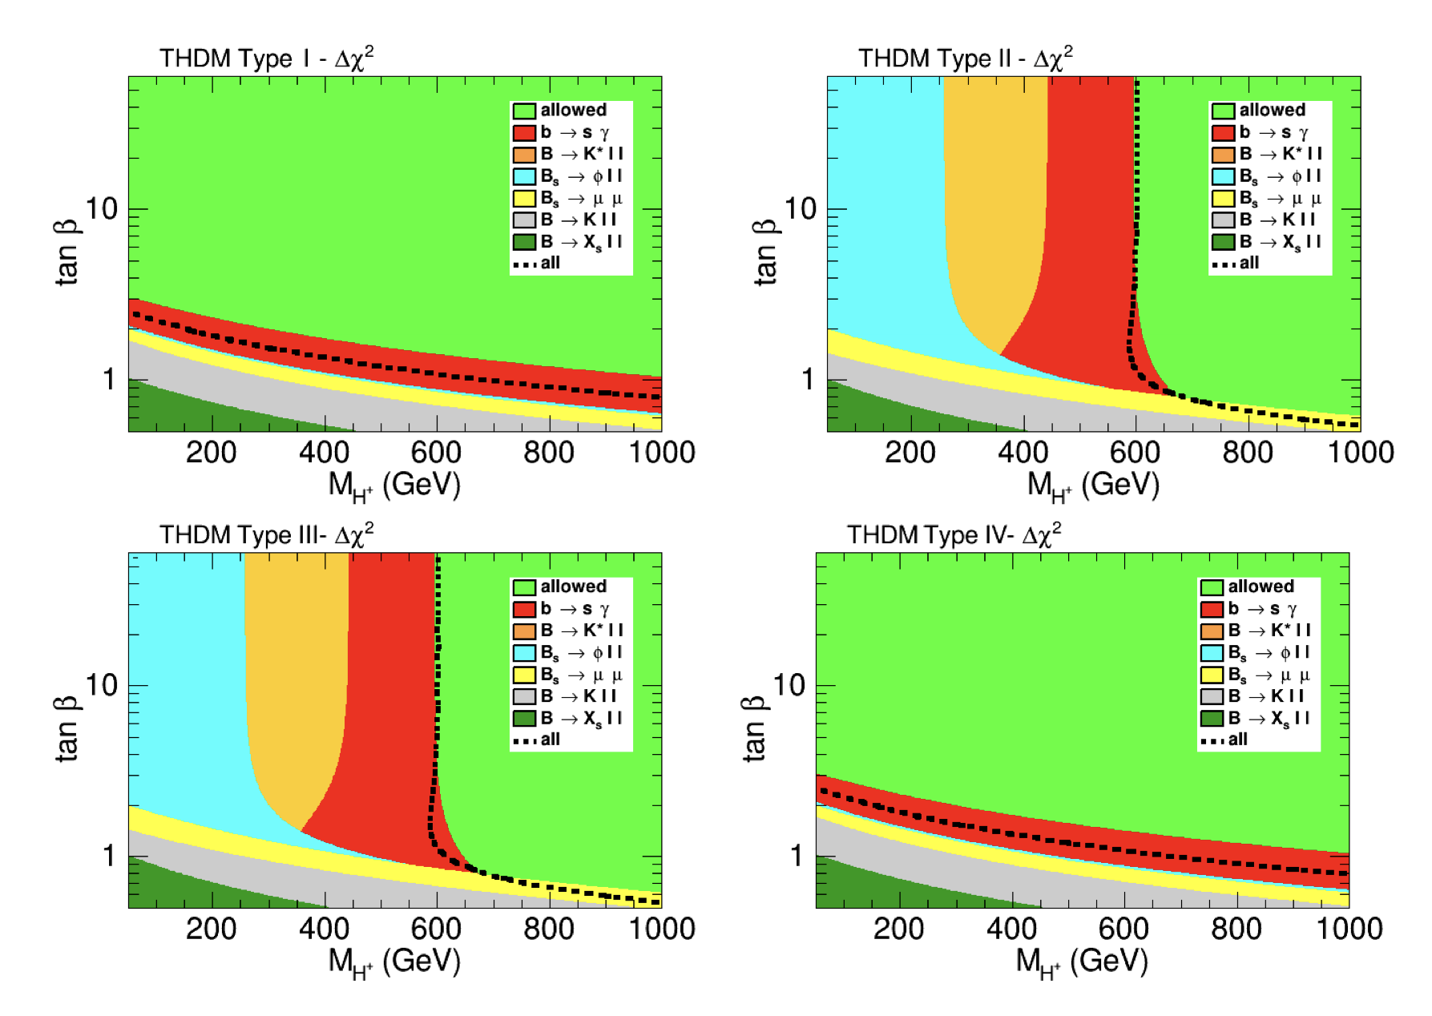
Experimental constraints
Phenomenology model dependent
Difficult to place general constraints
Direct constraints
Measured cross-sections in agreement with SM give constraints on parameter space in the different models
Indirect constraints
Flavour physics – Highly constrains mass of charged scalar in type II 2HDM
Measurements of SM-like Higgs properties
Arbey, A., Mahmoudi, F., Stål, O., & Stefaniak, T. (2018). Status of the Charged Higgs Boson in Two Higgs Doublet Models. arXiv:1706.07414
13

Slide 26
Summary and Outlook
2HDMs are simple extensions of SM scalar sector that can provide solutions to some of the limitations of the SM
There are many models with many free parameters which gives varying phenomenology
Direct searches have been performed, without statistically significant results
EW precision measurements at HL-LHC might give insight into scalar sector.
14

Slide 27
Thanks for listening!
References
Branco, G. C., Ferreira, P. M., Lavoura, L., Rebelo, M. N., Sher, M., & Silva, J. P. (2012). Theory and phenomenology of two-Higgs-doublet models. Physics Reports, 516(1–2), 1–102. https://doi.org/10.1016/j.physrep.2012.02.002
Chen, N., Han, T., Li, S., Su, S., Su, W., Wu, Y. (2019). Type-I Two-Higgs-Doublet Model under the Higgs and Electroweak Precision Measurements. arXiv preprint arXiv:1912.01431.
ATLAS Collaboration. (2024). Search for heavy neutral Higgs bosons decaying into a top quark pair in 140 fb⁻¹ of proton-proton collision data at √s = 13 TeV with the ATLAS detector. arXiv:2404.18986
Atkinson, Oliver, Matthew Black, Christoph Englert, Alexander Lenz, Aleksey Rusov, and James Wynne. 2022. "The Flavourful Present and Future of 2HDMs at the Collider Energy Frontier." arXiv preprint arXiv:2202.08807.
ATLAS Collaboration. (2021) Search for a heavy Higgs boson decaying into a Z boson and another heavy Higgs boson in the ℓℓbb and ℓℓWW final states in pp collisions at √s = 13 TeV with the ATLAS detector. arXiv:2011.05639
Wang, L., Yang, J. M., & Zhang, Y. (2022). Two-Higgs-doublet models in light of current experiments: A brief review. arXiv: 2203.07244
CMS Collaboration. (2019 ). "Search for a light charged Higgs boson decaying to a W boson and a CP-odd Higgs boson in final states with eμμ or μμμ in proton-proton collisions at √s = 13 TeV." arXiv:1905.07453 .
Arbey, A., Mahmoudi, F., Stål, O., Stefaniak, T. (2018). Status of the Charged Higgs Boson in Two Higgs Doublet Models. arXiv:1706.07414

