Slide 1
Supersymmetric Searches: Stop and Neutralino
Krittika Rao
Advanced Particle Physics VT2025

Slide 2
Why Supersymmetry?
Strengths of fundamental forces become unified at short distances— crucial in theories of GUT
Dark matter candidates from superpartners
Solves hierarchy problem

Slide 3
Supersymmetry Background:
Extends symmetries of space and time into quantum domain: connects spin to space-time
From SM, have Poincare symmetry & gauge symmetry SU(3) x SU(2) x U(1)
Add generators in SUSY for left– or right– chiral spinors to preserve handedness of fermions in form of anti-commutating Grassmannian variables: Q⍺Q_{𝛽} = -Q⍺Q_{𝛽}
Superfield formulation:
Chiral superfields for spin-½ fermions & spin-0 bosons
Vector superfields for gauge bosons
Superpartners:
Doubles number of particles; pair SM with SUSY particles: squarks, sleptons, gauginos, higgsinos

Slide 4
Supersymmetry Background:
R-parity:
P_{M} = (-1)^{3(B-L) + 2S}
B and L observed to be conserved in SM : no renormalisable lagrangian terms that violate — take this fact for granted in MSSM (simplest SUSY)
No proton decay
LSP cannot decay into other particles
-1 for SUSY, +1 for SM
Vacuum energy in unbroken SUSY set to 0:
Avoids ‘infinite sea of oscillators’ associated with infinite vacuum energy in QED
Result from sandwiching anti commutation relation between vacuum states + SUSY generators contain annihilation operators
Slightly problematic: means each pair of superpartner should have same mass & internal quantum numbers besides spin — doubling of mass not observed
Can maintain mass differences if have nonzero vacuum energy → spontaneous symmetry breaking

Slide 5
SUSY and the Hierarchy Problem:
Unstable terms in calculation of Higgs boson mass results in larger mass value than observed
Sum rules in SUSY make fermion and boson masses equal
Loop corrections from fermionic superpartners cancel out loop corrections from bosonic

Slide 6
MSSM
Considers only minimum number of new particle states & new interactions
Realises supersymmetry at low energy
Softly broken supersymmetry
Two Higgs doublets required:
Can’t use same Higgs to give masses to up– and down– type fermions (superpotential only relies on chiral superfields)
Need for anomaly cancellation (gauge anomalies)
Superpartners for each particle
Lightest Supersymmetric Particle (LSP) → neutralino

Slide 7
Neutralinos:
Superpartners of EW gauge bosons and Higgs bosons mix with max eigenstates: neutralinos
4 neutralinos:

Slide 8
Neutralinos:
Lightest neutralino (LSP) → Dark matter candidate:
Stabilised by R-parity
Neutral particle: not visible to light
Weakly interacting: good candidate for WIMPs
Heavy particle: mass from linear combination of gauginos and higgsinos; generated through SUSY breaking

Slide 9
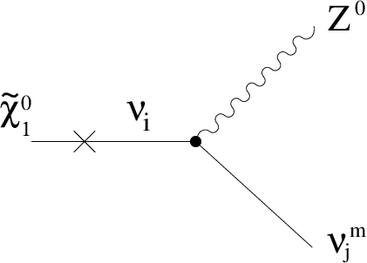
Neutralinos:
Expect neutralinos to be appear in cascade of decays of heavier particles
Heavier neutralinos decay through neutral Z boson to lighter neutralino or through charged W boson to light chargino:
LSP does not leave trace in ATLAS & CMS but will leave imbalance in distribution of energy of visible particles in detector

Slide 10
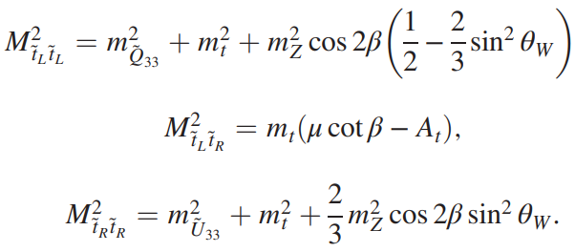
Stop Squarks:
Superpartner of top quark
Important in maintaining Higgs mass in MSSM:
Mass contributions from tree level terms of superpotential and quantum loop corrections from top and stop
Stop mass matrix

Slide 11
Stop Quarks:
Tree level terms have mass limitation: m_{Z} = 91 GeV → below the expected 125 GeV
Raise Higgs Mass by three mechanisms:
Large tan 𝛽
Heavy stops > 1 TeV
Large stop mixing → split two stop mass eigenstates: one light, one heavy

Slide 12
Stop Quarks:
Stop pair production (3rd method): from dominant production channels at the LHC
Gluon fusion
Quark-antiquark annhiliation

Slide 13
Thank You

Slide 14
References:
C-C Jean-Louis, & Moreau, G. (2010). Dark matter and neutrino masses in theR-parity violating NMSSM. Journal of Physics G Nuclear and Particle Physics, 37(10), 105015–105015. https://doi.org/10.1088/0954-3899/37/10/105015
de Jong, P., & Redlinger, G. (2017, December 8). Broken symmetry: searches for supersymmetry at the LHC [Review of Broken symmetry: searches for supersymmetry at the LHC].
ATLAS Experiment; CERN. https://atlas.cern/updates/feature/supersymmetry
Drees, M. (1996). An Introduction to Supersymmetry. ArXiv (Cornell University). https://doi.org/10.48550/arxiv.hep-ph/9611409
Martin, S. P. (1998). A SUPERSYMMETRY PRIMER. Perspectives on Supersymmetry, 1–98. https://doi.org/10.1142/9789812839657_0001
Mitsou, V. (2020). SUSY searches in ATLAS and CMS on behalf of the ATLAS and CMS Collaborations SUSY searches in ATLAS and CMS.
https://cds.cern.ch/record/2714089/files/ATL-PHYS-PROC-2020-031.pdf
Moretti, S., Panizzi, L., Sjölin, J., & Waltari, H. (2023). Deconstructing squark contributions to di-Higgs production at the LHC. Physical Review D, 107(11). https://doi.org/10.1103/physrevd.107.115010
Waltari, H. (2025, April 10). Some paths beyond the Standard Model [PowerPoint slides]. Uppsala University.
‌
‌
‌
‌
‌
‌

