Slide 1
Long Lived Particles
Sarah ben Abdesselem
Advanced Particle Physics VT25
Notes:
Hello and welcome to this presentation where I will discuss long lived particles

Slide 2
Table of contents
01
02
03
04
05
06
Introduction
Simplified models
Experimental Coverage
What are LLPs and their signatures
Production modes and decay channels
Existing LLP research at ATLAS
Background sources
Detector Upgrades
Conclusions
ATLAS upgrades for the HL LHC
Notes:
I will first give an introduction of what LLPs are and their typical signatures, then I will talk about simplified models that capture the most important LLP production modes and decay channels, after that I will talk about the existing searches for LLPs at ATLAS, then I will discuss the typical sources of background in these searches, and finally, before concluding, I will briefly talk about future upgrades at ATLAS and the HL LHC.

Slide 3
01
Introduction
What are LLPs and their signatures

Slide 4
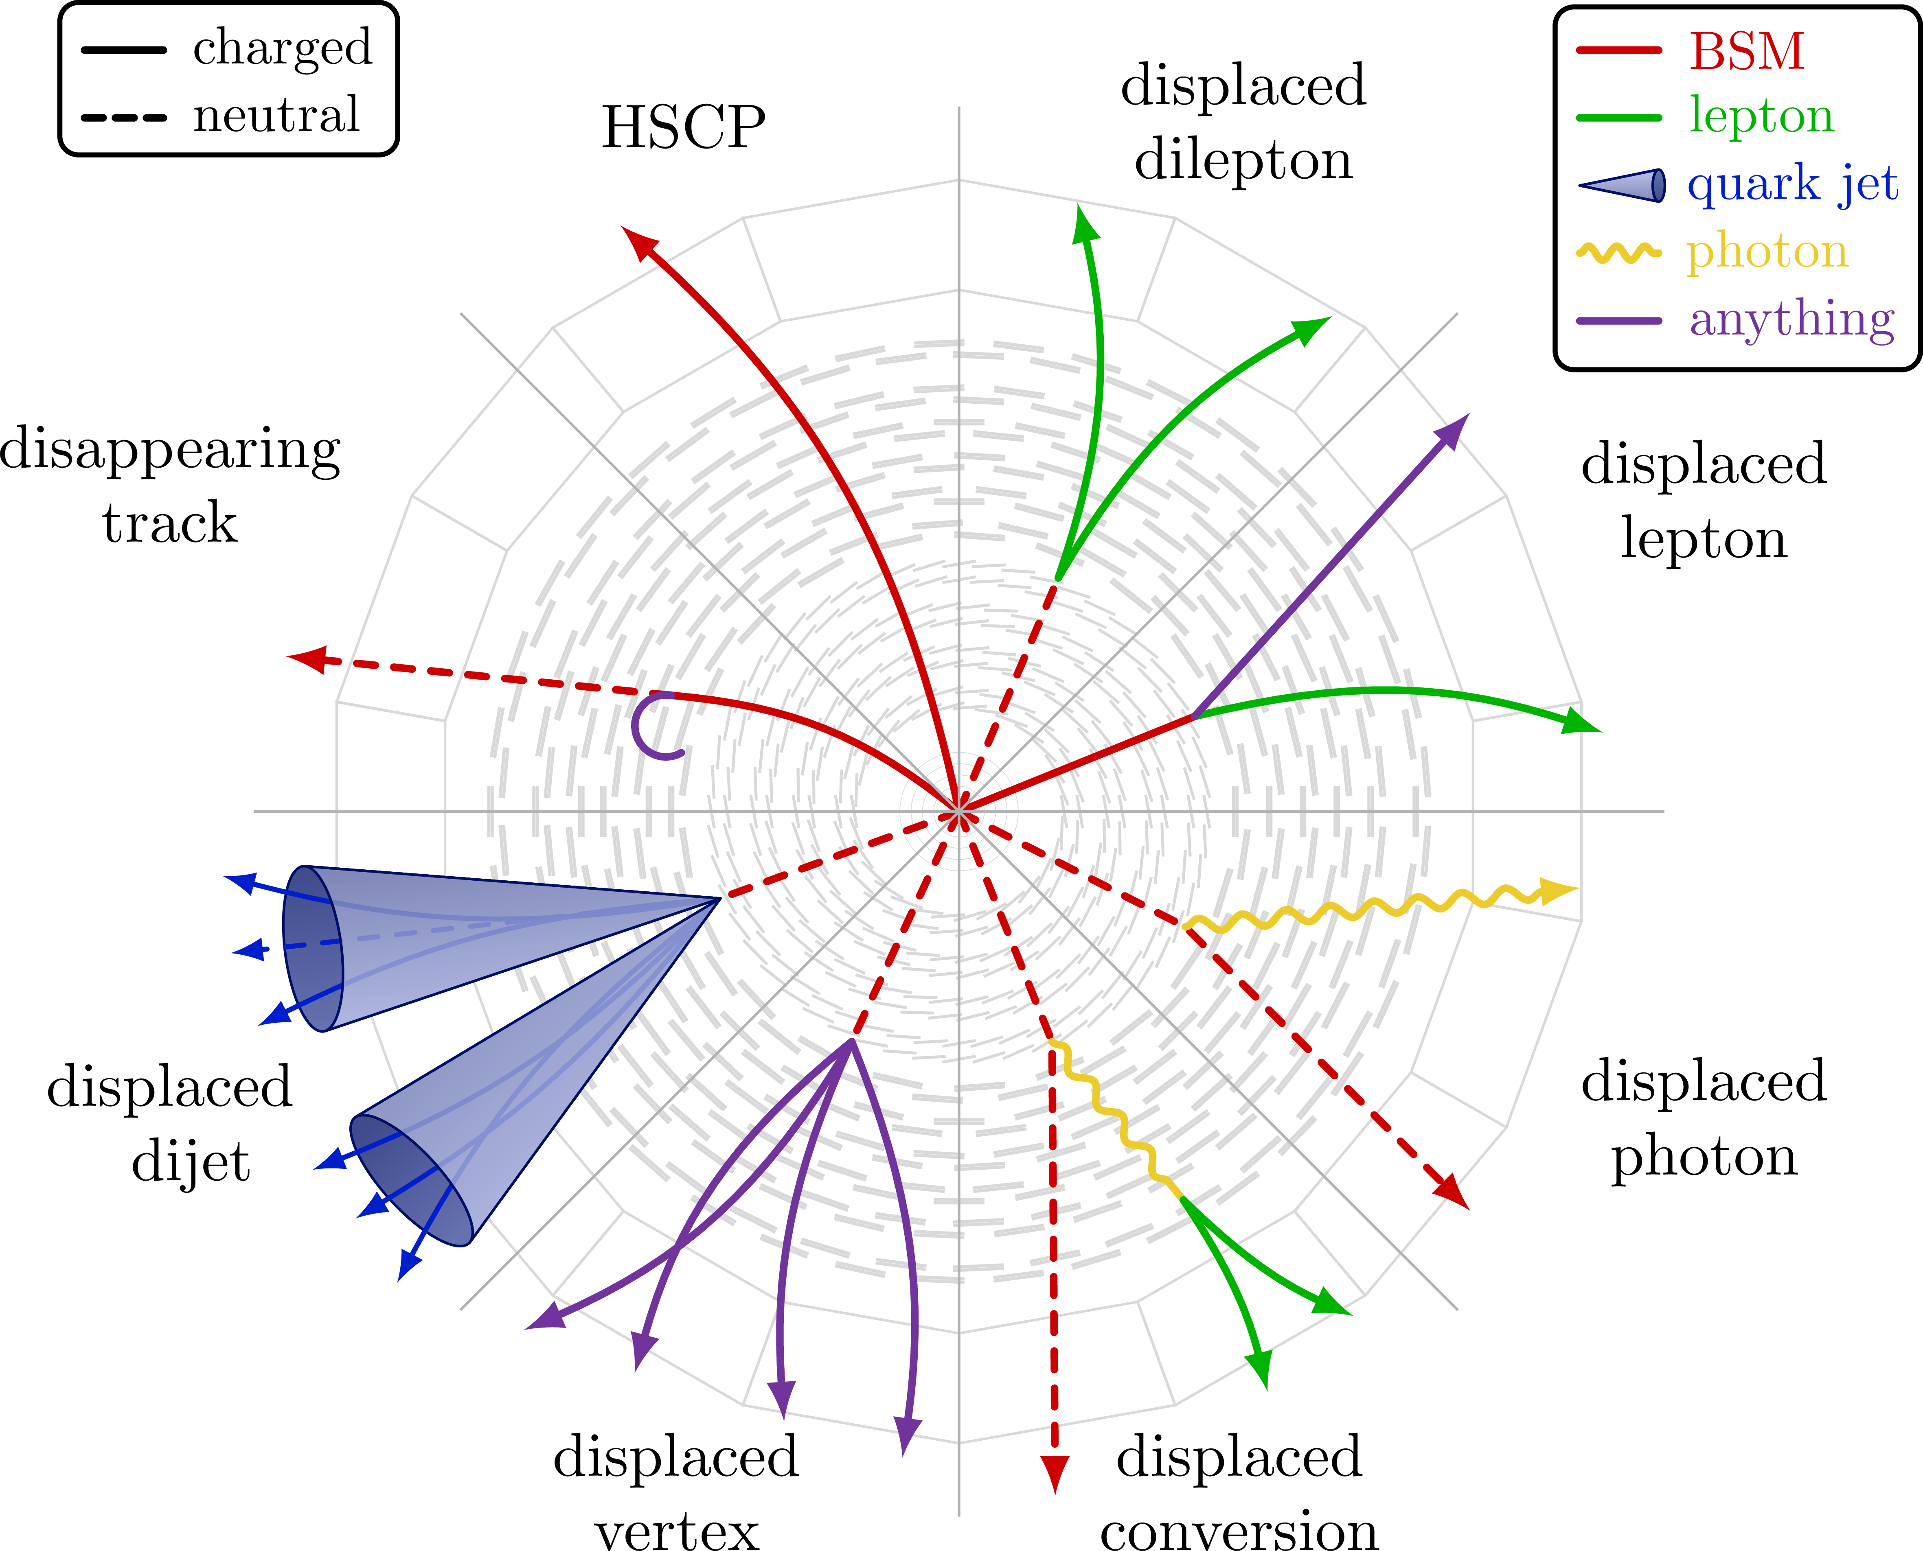
What are LLPs?
Unstable particles with a sizeable lifetime
⇾ travel macroscopic distances before decay
BSM particles could easily reach long lifetimes:
Approximate symmetries
Small coupling between LLP and lighter state
Suppressed phase space of available decays
Unusual signatures ≠ SM processes
Notes:
So what are long lived particles? Per definition, long lived particles or LLPs are unstable particles with a sizeable lifetime. This means we can actually observe the difference between the point where they are created and the point where they decay, so we could also say that they travel macroscopic distances. In theories beyond the standard model, new particles could easily reach long lifetimes for multiple reasons: some BSM theories introduce approx- imate symmetries that forbid certain decays, which causes particles to be stable or metastable. Another reason could be that the coupling between the LLP and the particle it decays into is small, meaning that the interaction strength is small and that the decay is rare. Also, if the phase space of possible decays is suppressed in the theory, the decay of the LLP could become rare implying it would have a longer lifetime. Because of their longer lifetime, LLP’s typically have unusual signatures that are very different from those of SM processes.

Slide 5
Unusual signatures
Unusual ionization + abnormal tracks
Energy deposit without associated track
Stopped particles with out of time decay
Displaced vertices in ID or MS
Disappearing and appearing tracks
Knicked tracks
Notes:
A first typical LLP signature is the ionization level. Charged SM particles have a predictable ionization level, while LLPs might ionize more strongly or travel abnormally slowly which will induce a non standard track. A second signature could be a localized deposit of energy inside the calorimeters without associated track. This could happen if a neutral LLP travels through the tracker and decays into a charged particle inside the calorimeter. Another signature could be the detection of a particle out of time with the collision timing. If a LLP loses its energy and stops in the detector, it could stay there for some time before it decays, which will create a signal at a time we would not expect one. Another signature of LLPs are displaced vertices in the inner tracker. The LLP could decay milimeters away from the primary vertex, inducing a displaced vertex that would appear as a burst of energy that’s not related to the main event. Dissapearing, appearing or knicked tracks are also signatures of LLP. Dissapearing tracks are produced by LLPs that decay into invisible particles, such as neutralinos and soft particles, which are particles that don’t trigger the detectors threshold. Knicked tracks are produced whenever a charged LLP decays into another charged LLP. Since both particles are different, they will have a different bending path which will appear as a knicked track in the inner tracker. The fact that these signatures are so different from SM processes has positive as well as negative consequences

Slide 6
Consequences
..Positive
..Negative
Promising to discover new physics!
Might..
not pass trigger
get rejected by algorithms
get considered as noise or pile up
⇾ We need dedicated detectors, specific reconstruction algorithms and background models
Notes:
Because SM long lived particles have well understood signatures, in theory, the unusual signatures of BSM LLPs offer good prospects for the discovery of new physics. However, because of their unusual signatures, we’re experimentally limited. They might not pass the detectors trigger, might be rejected by our current reconstruction algorithms or might be flagged as errors or noise. Therefore, it’s important for LLP searches to have dedicated detectors, algorithms and background models

Slide 7
02
Simplified Models
Production modes and decay channels
Notes:
LLP’s are motivated by many existing theories such as SUSY, DM theories, Higgs portal theories or heavy neutrino theories. I will go through the main production modes and decay channels of LLP’s and put them together to get an overview of existing models in motivated theories

Slide 8
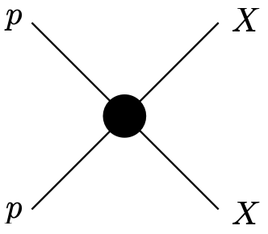
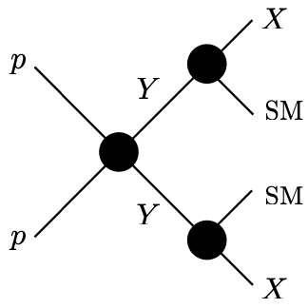
Production modes
Direct Pair Production
Produced from a SM final
No intermediate particle
Heavy Parent
Produced from decay of
heavy
pair produced
on shell parent
Notes:
Let’s start with the different LLP production modes. The first mode is the Direct pair production (DPP). Here an LLP pair is produced directly from a SM initial state without any intermediate onshell particle. The second mode is the Heavy parent (HP). Here, the LLP is produced from the decay of heavy on shell parent particles that are themselves pair produced in the proton proton collision.

Slide 9
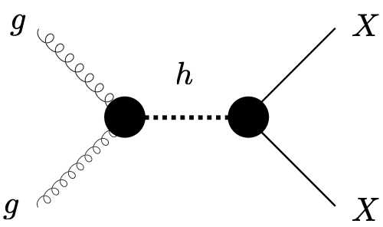
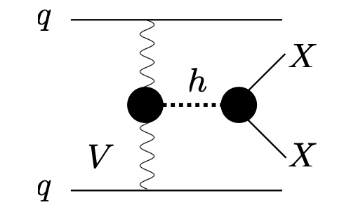
Production modes
Higgs (HIG)
Produced through coupling with SM Higgs boson, both pair or single production
Gluon fusion Vector boson fusion
Notes:
The third mode is the one involving a Higgs (HIG). In this mode, the LLP is produced through its coupling to a SM like Higgs boson. The left process shows the production of the LLP where the Higgs is produced in gluon fusion, and the right one shows the process where the Higgs is produced in vector boson fusion. In this mode, the LLP can be pair produced as well as singly produced

Slide 10
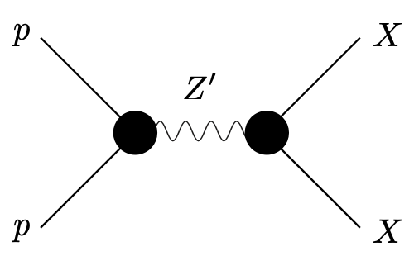
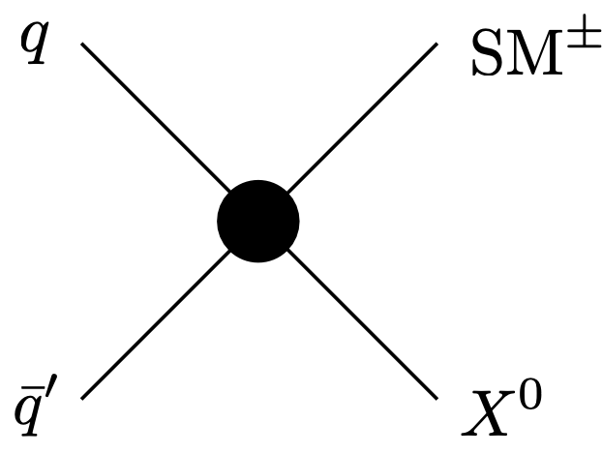
Production modes
Reasonance (RES)
Decay of on shell Z’ boson
Pair production
Charged current (CC)
Leptonic decay of W’ boson
Single production
Notes:
Finally, there are the Heavy reasonance (RES) and Charged Current (CC) production modes. In the first case, the LLP is produced in the decay of a on shell Z’, and in the second case the LLP is produced by the leptonic decay of a W’ boson. RES can incude both pair production and single production. CC induces only single productions.

Slide 11
Decay channels
1
Di-photon
- Resonant decay (Higgs model) or ƔƔ+ invisible (DM model)
2
Single photon
- Ɣ + invisible (SUSY)
3
Hadronic
- jj (Higgs), jj+invisible (SUSY, DM, neutrino), j+invisible (SUSY)
4
Semi-leptonic
- l+jet, jj (SUSY)
5
Leptonic
- l+l- (+invisible) (SUSY, neutrino)
Notes:
The different production modes have different triggers, but to determine which trigger is optimal to detect the LLP we also need to look at the decay channels. So i’m also gonna list those, starting with the di-photon decay. The LLP can decay resonantly into two photons as in Higgs portal models, or in two photons + invisible particle such as in DM models. The second possible decay is into a single photon and an invisible particle as predicted by SUSY. Then there’s also a hadronic decay, where the LLP could decay into two jets as predicted by Higgs model, two jets + invisible as predicted by SUSY, DM and neutrino models, and jet + invisible as predicted by SUSY. The LLP can also decay leptonically or semi leptinically, in lepton pair + invisible as in SUSY and neutrino models, or in lepton pair + a jet as in SUSY

Slide 12
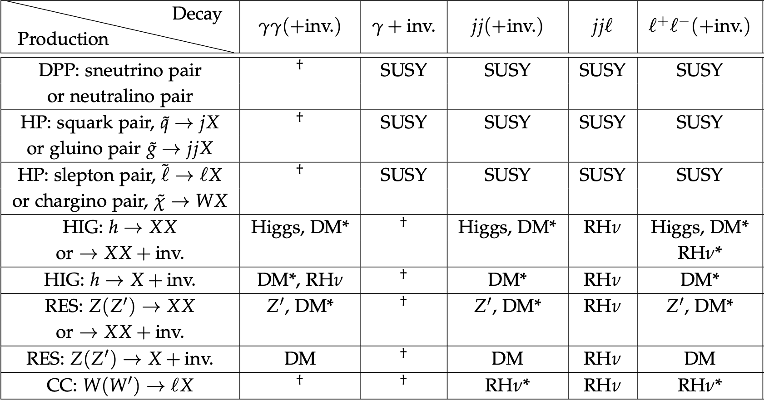
Alimena et al., J. Phys. G 47, 090501 (2020), https://doi.org/10.1088/1361-6471/ab4574.
Notes:
Now with the different production modes and decay channels known, I am gonna show a table that covers the simplified models and the theories that motivate them. Each row represents a different production mode and each column represents a different decay channel. The LLP is indicated by X, and is considered neutral in this example. For example, a direct pair production of a LLP that would decay into a photon + an invisible particle is motivated by supersymmetry. If we now look at the di photon decay, the dagger indicates that this combination of production and decay cannot be predicted by a simple model, but could be by an extension of a model. The asterisk means that this combination is possible, only if we consider missing energy in the LLP decay

Slide 13
03
Experimental coverage
Existing LLP research at ATLAS
Notes:
Now these simplified models are constructed to try to create a complete library of signatures we could detect at the LHC in future searches, but there are already searches being conducted at the LHC. ATLAS, CMS and LHCb have already performed many searches for LLP’s, but I will discuss only the existing searches performed by ATLAS because it would take way too long to discuss every single existing search.

Slide 14
Searches at ATLAS
Hadronic
Leptonic
In ID or HCAL/MS
Photonic
Semi-leptonic
Notes:
Depending on the type of decay of the LLP, the search will consist of different algorithms and will require different triggers

Slide 15
Hadronic LLP decay
In inner detector
In HCAL or MS
Large Radius Tracking algorithm (LRT)
Default track algorithm
2nd run with looser requirements
CPU intensive: only on requested events
$E_{t}$ > 250 GeV
$M_{DV}$ > 10 GeV
High $P_{t}$ jets
5 tracks
CalRatio in HCAL
1 trackless jet, low E deposit in ECAL
MuonRoI in MS
Isolated clusters of L1 RoI in MS
Requires 2 DV:
1in ID and 1 in MS
2 in MS
⇾ Due to high $P_{t}$ requirement: no sensitivity to low mass LLP
⇾ Due to 2 DV requirement: only sensitive to DPP and HP production modes
Notes:
Here, ATLAS uses a two step procedure called the Large Radius Tracking algorithm (LRT). First, a default track identification algorithm is used. It uses the hits in the pixel system, semiconductor tracker and transition radiation tracker to reconstruct the tracks. Then, all the hits that are not associated with a track are used in a second run of the track finder, with looser requirements on the longitudinal and transverse impact parameter, as well as the number of silicon hits that are shared with another track. This procedure however is CPU intensive, so it is only performed on specially requested events. In searches where the LLP decays exclusively in the inner detector, stan- dard triggers are used to select events with high Pt jets, missing transverse energy or high Pt leptons. The missing transverse energy needs to be larger then 250 GeV, the invariant mass of the DV needs to be larger than 10 GeV, and the ID vertex needs to have at least 5 tracks. The LLP’s covered by these searches are typically high mass (more than 100 GeV) and are produced in direct pair production and heavy parent production. These searches are not sensitive to low mass LLP, so they don’t cover the ones produced in the Higgs, Z’ or charged current production modes. In the case where the LLP decays in the hadronic calorimeter or in the muon system, the CalRatio or MuonRoI triggers are used respectively. CalRatio is a trigger that selects events with at least one trackless jet that has a very low fraction of energy deposit in the ECAL. These jets are characteristic of an LLP that would decay in or just before the HCAL. The MuonRoI trigger selects events with clusters of L1 Region of interest (RoIs) in the muon system that are isolated from activity in the inner detector and calorimeter. After trigger selection, the ATLAS analysis requires at least two reconstructed displaced vertex. Either both in the muon system, or one in the muon system and one in the inner detector. To highlight the gaps in these searches: they are only sensitive to high mass LLP parents (above 100 GeV) due to the high Pt requirement at the trigger level, and they are only sensitive to direct pair and heavy parent production modes, because the analysis requires two LLP decays in the detector. A possible way to improve this would be to use triggers based on associated prompt objects, instead of requiring the object to come directly from the LLP. By basing the triggers on objects that come from the initial LLP production process, it would then be possible to reconstruct the displaced vertex offline, even if the displaced vertex itself
didn’t pass the trigger.

Slide 16
Leptonic and Semi-leptonic decays
Leptonic
Semi-leptonic
Search for displaced leptons
Triggered by: $e^{−}, μ, γ$ without track
$μ$ > 50 GeV
$e^{−}$ > 110 GeV
$γ$ > 130 GeV
2 $e^{−}$ in range 38-48 GeV
1 $e^{−}$ 1 $γ$ in range 38-48 GeV
DV at 4mm from PV
Identical to leptonic search
Except:
⇽ 2 opposite sign leptons
⇾ 1 lepton and 4 displaced tracks
Notes:
ATLAS has a search for displaced leptons triggered by photons, electrons and muons without a inner detector track. These triggers require either a muon of at least 50 GeV, an electron of at least 110 GeV, a photon of at least 130 GeV, two electrons or one electron and one photon both in a range of 38-48GeV. Also, the displaced vertex needs to be located at least 4mm away from the primary vertex. As in the hadronic search, the leptonic search is not sensitive to low-mass LLP due to the high Pt requirement for the leptons. This search looks for a vertex with a Lepton accompanied by tracks. It is identical to the leptonic search with exception that the leptonic search looks for a displaced vertex with two opposite sign leptons, while the semi leptonic search needs one lepton in the displaced vertex and four additional associated displaced tracks.

Slide 17
Photonic decay
Delayed photons
Non-pointing photons
⇾ Arrive later at ECAL
⇾ Cannot be traced back to PV
Liquid argon ECAL to measure flight time and direction ⇾ 15mm on $Δz$, 0.25ns on $Δt$.
Based on theories of decay of neutralino into gravitinos and photons ⇾ Requires $E_{t}$!
⇾ Searches don’t cover any processes without $E_{t}$
Notes:
Photons originating from LLP can differ in two ways from standard photons. First, they can arrive later at the ECAL since LLP’s travel slower than the speed of light, those photons are called delayed photons. The second type are the photons that cannot be traced back to the primary vertex. Those photons are called non-pointing photons. ATLAS uses its liquid argon electromagnetic calorimeter to measure the flight direction of the photons and their time of flight. It has a very good resolution in both: a resolution of 15mm on ∆z and 0.25ns on ∆t. I’m not gonna talk about all the trigger requirements cause it’s a lot of technical details, but what’s interesting here is that the search for LLP photonic decays is entirely based on theoretical models of neutralinos decaying into gravitinos and photons, so it systematically requires a fraction of missing energy. This means that these searches do not cover any processes that don’t contain missing transverse energy, so that’s something that should be worked on.

Slide 18
04
Background sources
Notes:
LLP searches deal with very different background than typical prompt searches, so it is worth going through the different background sources one needs to consider.

Slide 19
Background sources
Real particles produced in detector
Real particles originating from outside the detector
Fake particles
Algorithmically induces fakes
Notes:
LLP’s have very different signatures than SM processes, so it is very rare that these signatures get mimicked by irreducible SM processes. The actual background one needs to consider in LLP searches is background that is usually negligible, such as instrumental or algorithmic background. There exist roughly four categories of background: real particles produces in interactions with the detector, real particles originating from outside the detector, fake particles and algorithmically induced fakes

Slide 20
Real particles produced in detector
pp-collisions produce particles
⇾ Interact with nuclei in detector
⇾ Displaced vertex that mimic LLP signals
⇾ Located in high density regions
⇾ Effectively rejected by using material maps
Notes:
Let me start with the particles produced in interactions with the detector. Particles produced in proton-proton collisions can interact with nuclei in the detectors. Those interactions give rise to displaced vertex that can mimic LLP signals. However, the vertices from these interactions are usually located in high density regions of the detec- tor, so they are effectively rejected by using detailed material maps. Here is an example of such a material map of ATLAS for Run 2. Another source of background coming from inside the detector are punch-through jets. These are jets that escape the calorimeters and reach the muon system. Punch through jets are common in transition areas of the calorimeters, where the barrels meet the end-caps, as those regions contain less material so the jets are more likely to escape. The way to deal with this noise is to reject the |η| regions which contains these transition areas, or to require more hits in the muon system. Since push through jets might only produce a few scattered hits, requiring many hits on a relatively straight line will ensure we only keep real muons and not noise

Slide 21
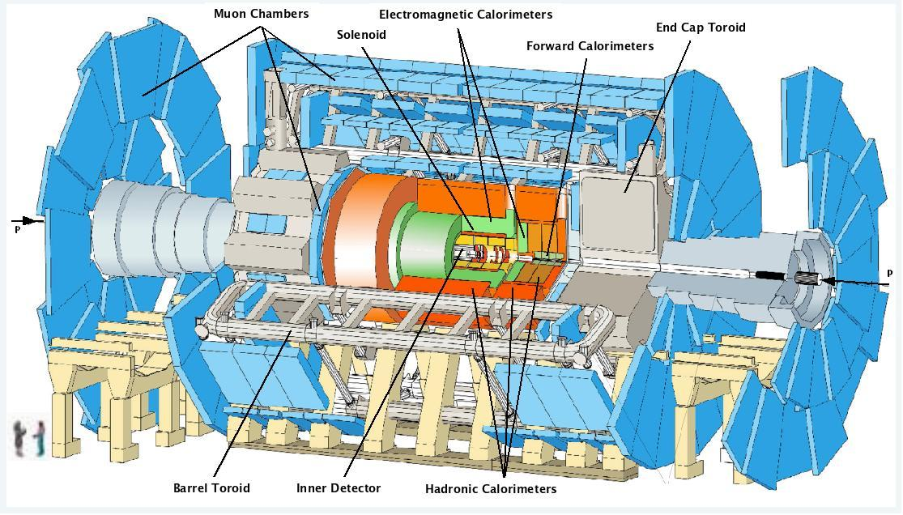
Real particles originating from outside the detector: cosmic muons
Cosmic rays enter detector as cosmic ray muons
⇾ rate of 500 Hz at L1, less in LLP searches (high level trigger and offline selection)
In many cases: back to back di-muon signal can be rejected
= one muon traveling from one side to the other,
reconstructed as two back to back muon tracks
High Pt trigger
= cosmic muos have rapidly falling Pt spectra
Notes:
There are also several particles from outside the detector that can be source of background. Cosmic rays enter the detector as cosmic ray muons. These muons can be reconstructed as displaced muons in the MS or as displaced jets in the calorimeters. The rate of cosmic muons in the detector is 500 Hz at L1, but is typically much less in LLP analysis thanks to the high level trigger (software, slower but smarter selection and cut of data with more info and more specific requirement) and offline selection (the actual analysis people perform once the data is extracted). In many cases, the muon background can be filtrered out by considering back to back di muons. The back to back muon signature is typical from cosmic muons entering the detector say from the left, traveling through the MS, the ID, the center, the ID and the MS again. It will then be reconstructed as two muons with opposite track, but it’s in fact only one muon crossing the entire detector. Moreover, cosmic muons usually have a rapidly falling pt spectrum, so we can impose a trigger that keeps only high energy muons and or jets. Finally, if a search looks exclusively for ID or calorimeter objects, then cosmic muons can be filtered out by requiring little muon system activity.

Slide 22
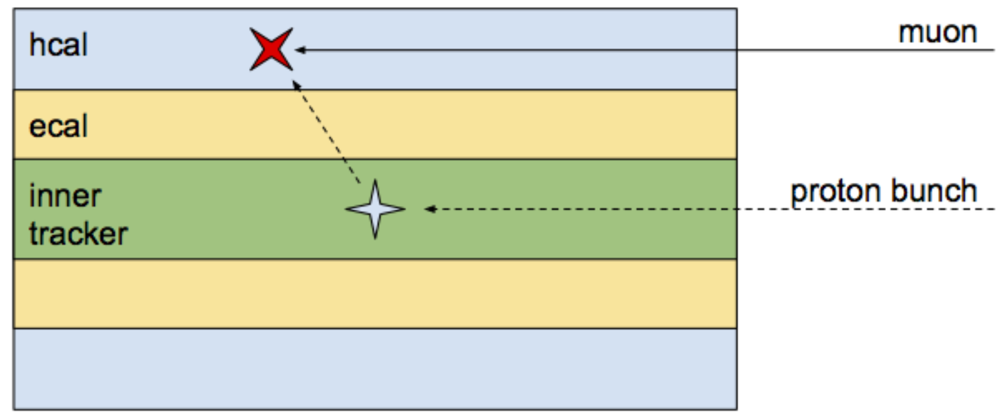
Real particles originating from outside the detector: Beam halo
Particles not centered in the beam (EM effects, scattering)
Travel shorter distances ⇾ faster signal
= LLP signature!
Filter out:
Check timing
Track origin
High $P_{t}$ or E
Notes:
The beam halo is composed of particles that are not centered in the beam, due to electromagnetic effects or scattering off gas molecules in the accelerator tube. When these particles interact with the detector, they can mimic LLP signals. Since these particles travel parallel to the beam, they travel shorter distance before they are detected, so their signal is faster than for particles coming from the center of the cylinder. To filter those out, we can check timing information (beam particles arrive earlier) and track origin (if it doesn’t point toward the center its beam particle). Beam halo particles are aligned with the beam, so their track will not point towards the center of the detector. Halo particles are also typically less energetic, so requiring high energy or high pT is events is also a good filter to reduce this type of background.

Slide 23
Real particles originating from outside the detector: Cavern radiation
pp-collisions produce neutral, long lived SM particles ($n, γ$)
⇾ accumulate in LHC caverns
⇾ wander around and create off timing hits in detector (mostly MS)
= LLP signature!
Hard to simulate
⇾ Measure detector activity when no collisions are expected
Notes:
Because of the pp collisions, neutral low energy long lived SM particles, accumulate in the LHC detector caverns. These are mostly neutrons and photons. These particles don’t interact immediately so they wander around and can create off timing hits in the detectors, especially in the MS, which can mimic LLP signatures. Since this background is hard to simulate, physicists estimate it by measuring detector activity when no collisions are expected.

Slide 24
Fake particle signatures
Signals that mimic real particles, but are not
Actually from detector noise: usually single concentrated energy deposit
⇾ out of time and space!
⇾ Reject single concentrated energy deposits associated to no tracks
Notes:
Another type of background is that of signatures that mimic real particles signals, but are not. Fake particles originate from detector noise, usually as single concentrated energy deposit that is out of space and time compared to other energy deposits or hits in the detector. Hence this type of background can be rejected by rejecting single concentrated energy deposits not associated to any tracks.

Slide 25
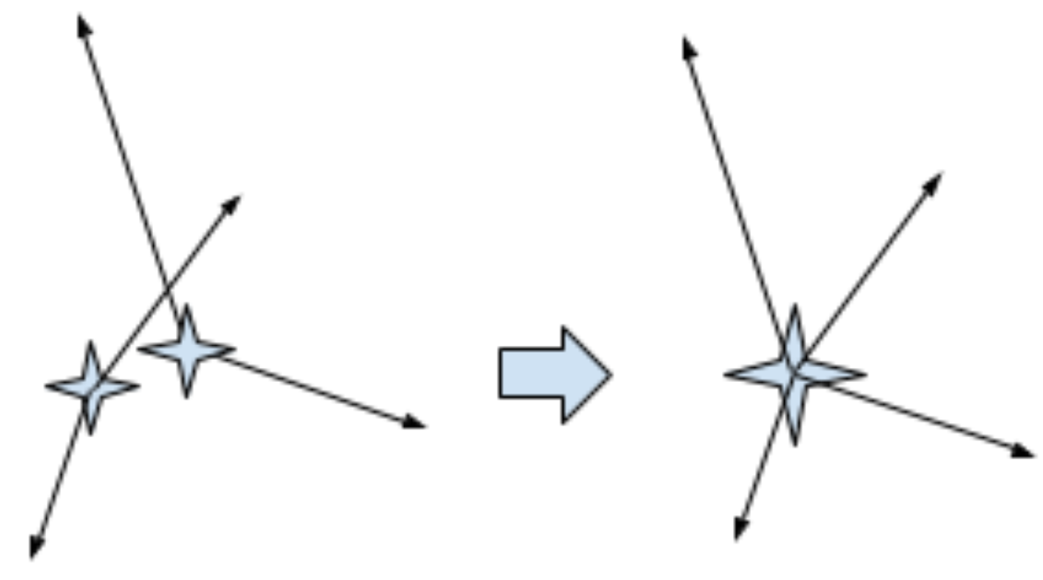
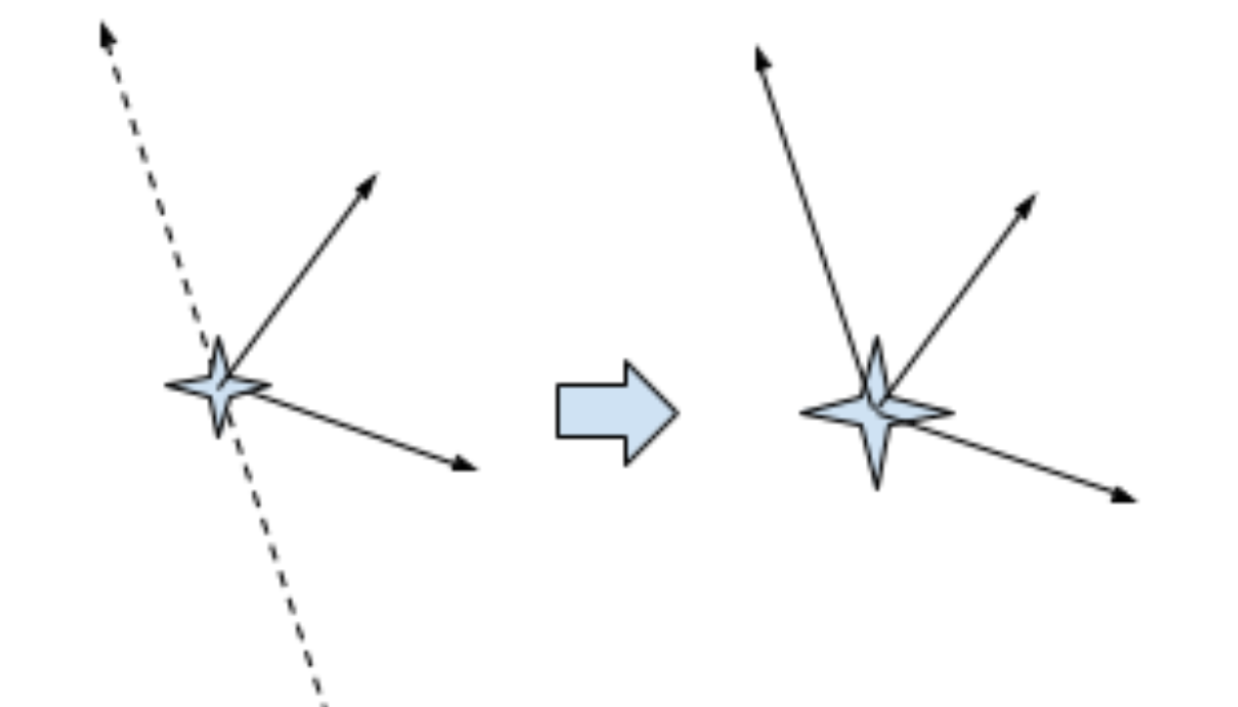
Algorithmically induced fakes
Random merged vertices
2 low mass merged into 1 high
mass DV
Important in region with high track density
Randomly crossing tracks
2 tracks that cross each other ⇾ DV
More relevant that RMv
Reject: removing 1 track significantly decrease
mass of DV
Notes:
Two close-by low mass vertices can be merged into one high mass displaced vertex. This type of noise is relevant in areas close to the interaction regions with high track densities. To estimate this background, ATLAS has artificially merged individual low-mass vertices from different events. Bt studying the number of reconstructed merged vertices as a function of the distance between the two low mass vertices, and scaling them accordingly, ATLAS has been able to succesfully derive an estimate for this background. Two or more individual tracks can cross each other and be reconstructed as a displaced vertex. This background is typically more relevant than the merged vertices. The mass can also be increased when the crossing track is perpendicular to the distance vector pointing from the primary vertex to the displaced vertex. One possible way to suppress this background is to reject events where removing one track significantly decreases the mass of the vertex.

Slide 26
05
Detector Upgrades
ATLAS and the HL LHC

Slide 27
Detector upgrades
Current experimental searches for LLPs: limited by the abilities of ATLAS, CMS and LHCb
LHC upgrade to the HL LHC ⇾ detectors upgrade accordingly (deal with high pile-up)
⇾ improve LLP searches significantly
Notes:
The current experimental searches for LLP’s are limited by the abilities of ATLAS, CMS and LHCb to reconstruct the unusual LLP signatures. When the LHC will upgrade to the high luminosity LHC, all detectors will have to upgrade accordingly to be able to deal with the extremely high pile-up conditions. Most of these upgrades will provide opportunities to improve LLP searches significantly. I refer to the paper I read for technical details on how each subdetector in each detector will be improved and how this will affect the LLP search.

Slide 28
06
Conclusions
And summary

Slide 29
Conclusions
SM is incomplete ⇾ we need BSM. Particles mostly assumed to decay promptly
SM particles have big range of lifetimes... Why not BSM particles?
Long lifetime ⇾ unusual signatures ⇾ we need dedicated analysis
Theoretical overview of simplified models
Existing searches, need to be improved (sensitivity to low mass LLP, singly produced)
Specific background: usually negligible, not in LLP searches
HL LHC offers good prospects for LLP searches!
Notes:
As we know, the SM is incomplete and needs to be extended. Most of the BSM theories assume that the new particles decay promptly. However, given the large range of particles lifetimes in the SM, it is natural to assume that new hypothetical particles could also reach larger lifetimes. This leads to many different unusual signatures that could escape detection in our current prompt searches. Searching for LLPs requires dedicated analysis, because of what less scientists are working on this topic. Therefore, in this presentation I tried to give an overview of where we stand right now, both in the theory as experimentally. I first gave an overview of combinations of production modes and decay channels that result in simplified models. These models cover the LLP signature space among current and future experiments. Then, I talked about the existing LLP searches, with a focus on the ATLAS collaboration. The current searching strategies need to be improved, as we saw no current analysis has a sensitivity for lower mass LLPs. Due to these unusual signatures, most of these analysis are performed with little to no background, hence the usually negligible background becomes relevant. The most important background one needs to deal with in LLp analysis are real particles produced in the detector such as particles produced due to interactions with the detector material. Also particles from outside the detector, such as cosmic muons, beam halo particles and cavern radiation need to be considered. Finally, the detector itself and the reconstruction algorithms can also induce fake particles signatures. I concluded by shortly mentioning that the ATLAS, CMS and LHCb detectors will be upgraded along with the HL LHC, which will open new prospects to significantly improve our search for long lived particles. Thank you for listening!

