Slide 1
Dark sectors and Portals
By Lukas Ulbricht

Slide 2
Outline of the presentation
Overlook on Dark sectors and Portals
Motivation
Most important portals
Other portals
Higgsportal
Concrete example

Slide 3
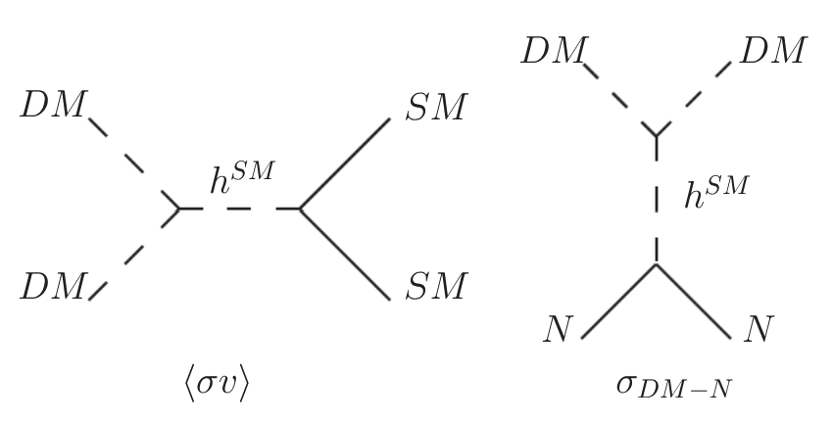
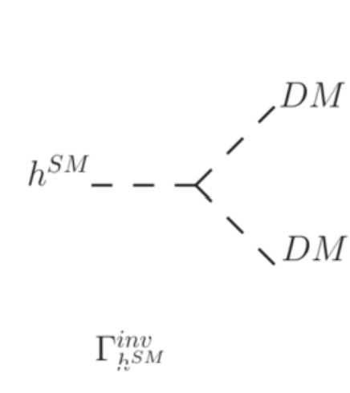
Dark sectors and Portals
Standard Model
summarizes all current knowledge
Dark sectors
Collection of particles
lightest is a DM candidate
(mostly) uncharged under SM interactions
possible new forces
interact thought portal(s) with SM
Figure 1: three possible Higgs portal interaction
by Stefano Moretti https://www.researchgate.net/publication/264385523_Dark_Matter_with_Two_Inert_Doublets_plus_One_Higgs_Doublet
Notes:
The standard Model summarizes all current knowledge about particle physics humanity has. But there are outstanding issues, neutrino masses and matter-anti matter asymmetry in the universe and the dark matter that existence we can infer by gravity lensing and the motion of stars inside galaxies and the evolution and forming of galaxies and galaxies clusters.
Possible solution for the missing Mass is dark matter. In general it could be several particles. That’s why it is called the Dark *sector*. Since they (mostly) uncharged under the SM and therefore we can’t directly see them. Expectation is gravity. The part of the Dark sector that is massive will interact via gravity with the SM, which is sometimes also called visible matter, since. If the theory predicts a sector comprised of only one particle one might also talk about a “trivial sector” instead of DM.
A dark sector also allows for self interaction of its particles and, also new forces which (may) acct only on the content of the dark sector.
The lightest is usually considered the dark matter candidate.
Both the Dark sector and the Standard Model interact though so-called portal interaction, short portals

Slide 4
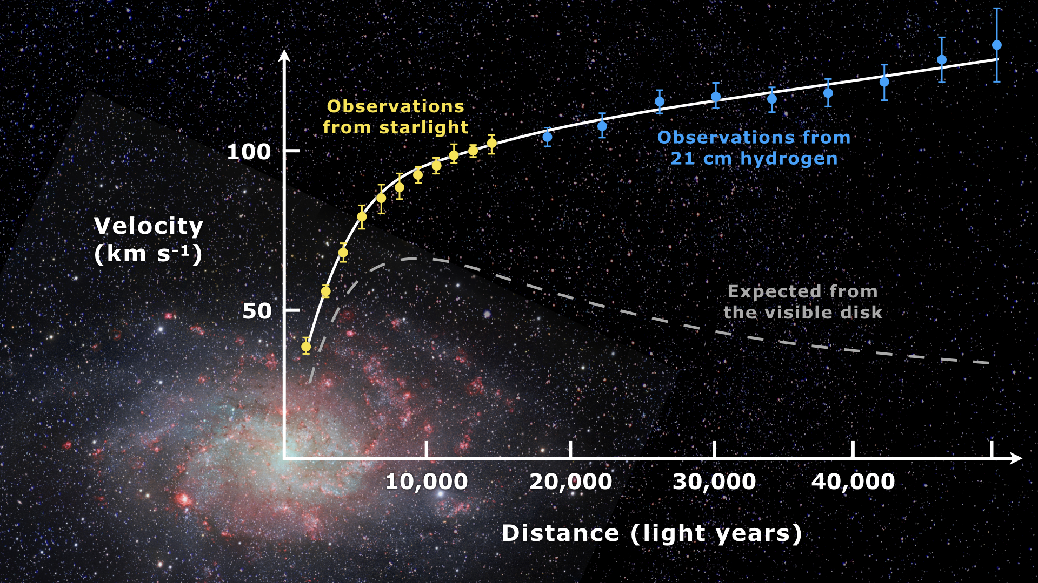
Motivation - Theoretical side
Why an entire sector?
Theoretical side:
origin of the mass of particles
UV-completeness
solving several problems at once
Studies on Galaxies:
Different DM profiles
overabundance of satellite galaxies
Solar neighbourhood lacks dark matter
Figure 2: Rotation curve of spiral galaxy Messier 33
https://en.wikipedia.org/wiki/Galaxy_rotation_curve
Notes:
Where does the mass of the DM particle(s) come from? This is an important question especial for models that predict a trivial Dark sector with just an additional gauge boson. Easiest solution to that problem is, that this gauge boson is coupling to the SM-Higgs mechanism and gains its mass similar to the z and W bosons, there are additional higgs bosons, so called dark higgs bosons which generate the masses, or there is an additional other field that undergoes a spontaus symmetry breaking similar to the higgs mechanism. But as we see already in both cases we see that we need atleast one additional particle to explain the mass of the additional gauge boson.
UV complete (unambiguous results for abitary large energies), some thoeries do this by predicting additional dark matter particles which diagrams cancel out the problematic ones.
Outstanding theoretical problems are, neutrino masses, matter-anti-matter asymmetry
Also there are 3 Lepton generations. One would assume that if dark Matter has a new typ of lepton then there would be three generations of it too.
Astrolophysical reasons:
-On small scalle the Lambda cold dark matte, which is the widest used modell of the big bang wrongly predict dark matter conntents on small scalle (means below galaxy custers).
-most Dwarf Galaxies seem to have a very different DM profile than ”normal” galaxies
-Galaxies and Dwarf Galaxies are believed to have formed in dark matter dense regions. But studies of the nightsky, mapping the satellite galaxies of different galaxies and mapping the Dark matter connet of the MW halo as well as similuations dont are in connflict. There are way to many Dwarf galaxies than predicted due to dense reagions of dark matter.
-The neigboorhood of the Solar system has nearly no Dark matter.
Might be explained by other means, but could be explained through rich dark sectors that have interactions

Slide 5
Different type of Portals
Vector portals:
Kinetic mixing: $ℒ⊃\frac{ε}{2\cos\left(θ_{w}\right)}B_{μν}V^{μν}$
Mass mixing: $ℒ⊃m_{ZV}^{2}Z_{μ}V^{μ}$
Neutrino portal:
$ℒ⊃ y_{n}LHN$
Axion portal:
$ℒ⊃ \frac{a}{f_{a}}F_{μν}F^{μν}$
Lagrangian needs to also include the appropriate mass and kinetic terms
Notes:
B is the hypercharge field strength tensor, so in principle a Vector boson could couple to any of the Gauge bosons of the electro weak interaction. The additional particle is usually assumed to originate from an aditional U(1) gauge group is unchared and only couples to the photon, which is why it is then called the dark photon.
Vector particles could also being mixed with the SM gauge poson through the Higgs mechanismen in that case the missing takes places in the mass and is called Mass mixing.
Any of the Leptons could couple through an interaction with the higsboson to a fermionic mediator which couples to a dark sector, this mediator could be a right handed
neutrino.
Another one is the Axion portal. Axions where proposed in 1977 to solve the problem that QCD is CP conserving. The axion is coupling and mixing with the photon. This portal interaction is not renomalizal because it has mass dimension 5 and is therefore needs a a high mass term f_a.

Slide 6
Higgsportals:
Higgs portal
wide variety of flavours
deepens on the number of Higgs-bosons
For the SM Higgs:
$\text{scalar} \text{case}\text{:} ℒ⊃\left(εS+λS^{2}\right){\left|H\right|}^{2}$
vector case: $ℒ⊃V_{μ}V^{μ}{\left|H\right|}^{2}$
fermion case: $ℒ⊃\frac{ε}{Λ}{\left|H\right|}^{2}{\left|χ\right|}^{2}$
Problem: Not all renormalizable by them self
Lagrangian needs to also include the appropriate mass and kinetic terms
Notes:
Higgsportal are very attractive since we know that the SM is very precise for the interactions that it describes. Through the use of portal interactions we extend the SM
without violating gauge symmetry that are established in it.
For V we need a gauge symmetry otherwise this term is not renormalizable.
the fermion case we have a mass dimension 5, so we need an additional cutoff lambda , to surpress the high energy contributions.
One can use Efftive field theories to solve these problem. But, depending of the sector we are gonna couple to the portal we might get ambiguous results for the
expansion in the operators for high energies. That is quite a problem.
There is also another thing to keep in mind. In the real scalar case we don’t want to have a term which is of order 3 in the fields for a DM candidate. Or atleast we want it to be heavly suppressed. Otherwise Two DM Candidates could fusion into one of the same kind. This would not generate the Dark matter density of the Universe we see nowadays.

Slide 7
Concrete example
Solution:
Mass mixing of S with H due to symmetry breaking:
$V\left(H,S\right)=\frac{λ_{H}}{4}{\left|H\right|}^{4}+\frac{λ_{HS}}{4}{\left|H\right|}^{2}{\left|S\right|}^{2}+\frac{λ_{S}}{4}{\left|S\right|}^{4}+self$
After spontaneous electroweak symmetry breaking:
Mass matrix:
$M=\left(\begin{matrix}2λ_{H}v^{2} & λ_{HS}vw \\ λ_{HS}vw & 2λ_{s}w^{2}\end{matrix}\right)$
need to diagonalize
$O=\left(\begin{matrix}cos⁡(θ) & sin⁡(θ) \\ −sin⁡(θ) & cos⁡(θ)\end{matrix}\right)$ with $\tan\left(2θ\right)=\frac{λ_{HS}vw}{λ_{S}w^{2}−λ_{H}v^{2} }$
Notes:
Self are the self interacting terms, which. v and w are the vacuum expectation values wich H and S due to spontatios symmetrie bracking

Slide 8
Concrete example
Masses of the two Higgs eigenstates:
$M_{H_{1},H_{2}}^{2}=λ_{H}v^{2}+λ_{S}w^{2}∓\frac{λ_{S}w^{2}−λ_{H}v^{2}}{cos⁡(2θ)}$
$ℒ_{SM}=\frac{H_{1}\cos\left(θ\right)+H_{2}\sin\left(θ\right)}{v}(2M_{W}^{2}W_{μ}^{+}W^{−μ}+M_{Z}^{2}Z_{μ}Z^{μ} −m_{f}\overline{f}f)$
$ℒ_{trillinear}=−\frac{c_{1}}{2}vH_{1}^{3}−\frac{c_{2}}{2}H_{1}^{2}H_{2}v\sin\left(θ\right)−\frac{ c_{3}}{2}H_{1}H_{2}^{2}v\cos\left(θ\right)−\frac{c_{4}}{2}H_{2}^{3}v$
becomes a double portal
is renormalizable!
but predicts additional Higgs boson
Notes:
The mixing of the higgsbosons in terms like the SM Term will lead to interfrenze, this interferenze depends on the mass gab between. If the gab is to wide the interfrenze might not be engouth to solve the problem.
But the theory is in an Effective field theory UV complete. Which means we get unambiguous results in an EFT approach

Slide 9
Concrete example
Suppose additional particle of Dark sector: s
$ℒ_{s}=λ_{s}^{H}H^{2}s^{2}+λ_{s}^{S}s^{2}{|S|}^{2}$
Assuming $ℤ^{2}$ symmetry
Vanishing $λ_{S}^{H}$
After symmetry breaking:
$ℒ_{s}=λ_{s}^{S}w^{2}{\left(−\sin\left(θ\right)H_{1}+\cos\left(θ\right)H_{2}\right)s}^{2}+$
$+λ_{s}^{S}\cos^{2}\left(θ\right)H_{1}s^{2}−2\sin\left(θ\right)\cos\left(θ\right)λ_{s}^{S}H_{1}H_{2}s^{2}+λ_{s}^{H}\cos^{2}\left(θ\right)H_{2}^{2}s^{2}$
The fermion case:
e
is now renormalizable and UV complete!
Notes:
sin and cos now swaped in comparison to the higgs mixing! Dark sector couples to the SM via the dark higgs which then mixes into the SM higgs.
The -sin()H_1+cos()H_2 will cause interference terms, the cos und sin terms are flipped in comphereastion of the MS part of the last slide.
This leaves us the possibility of one Higgs boson mainly coupling to the SM and one mainly to the Dark sector

Slide 10
Connclusion
Dark sectors interact with SM via portals
Most important ones:
Higgs portal
Vector portal
Higgs-portals:
different Flavors with different problems
Simple Higgs-portals not renormalizable
points to a no trivial dark sector
Astrophysical observations
Also point to a nontrivial sector

Slide 11
Sources (Papers)
Kinematical and chemical vertical structure of the Galactic thick disk1,2 II. A lack of dark matter in the solar neighborhood
https://www.eso.org/public/archives/releases/sciencepapers/eso1217/eso1217.pdf
The Higgs-portal for Dark Matter effective field theories versus concrete realizations
https://arxiv.org/pdf/2101.02507
Dark Sectors 2016 Workshop: Community Report
https://arxiv.org/pdf/1608.08632

Slide 12
Sources (Papers)
Dark Matter through the Higgs portal
https://arxiv.org/pdf/1903.03616

Slide 13
Sources (pictures and figures)
Figure 1: Dark Matter with Two Inert Doublets plus One Higgs Doublet
https://www.researchgate.net/publication/264385523_Dark_Matter_with_Two_Inert_Doublets_plus_One_Higgs_Doublet
Figure 2: Wikipedia article about Galaxy rotation curves
https://en.wikipedia.org/wiki/Galaxy_rotation_curve

