Slide 1
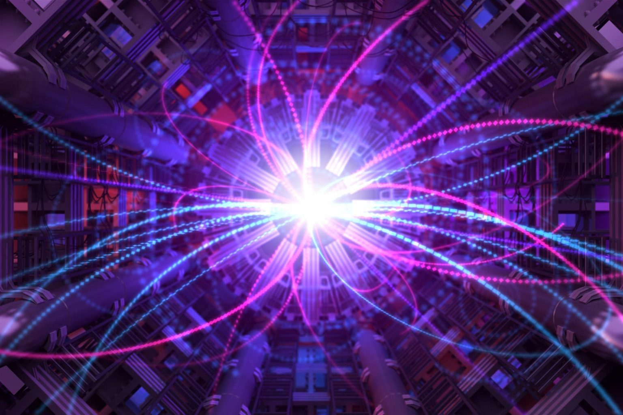
Partikelfysik II-Uppsala University 22/05/2025 Chita Eirini
Searches for Sterile Neutrinos/Heavy Neutral Leptons at Colliders
Source: https://scitechdaily.com/science-made-simple-what-are-sterile-neutrinos/

Slide 2
Why Search For Sterile Neutrinos/HNLs?
Standard Model: $m_{v}=0$
BUT Neutrino oscillations: $m_{v}≠0$
Sterile neutrinos arise naturally in BSM physics
They offer solutions to three major BSM problems:
Neutrino Mass (Type-I Seesaw mechanism)
Dark Matter (light SN ~ keV scale)
Baryon Asymmetry (Heavy SN via leptogenesis)
Heavy sterile neutrinos (HNLs) with MeV–TeV masses are testable at colliders.
Long lifetimes → displaced vertex signatures
SM incomplete!

Slide 3
What Are Sterile Neutrinos-HNLs?
Active Neutrinos
vL
SM particles
Mix through Yukawa (Higgs) couplings
Sterile Neutrinos
vR
SM gauge singlets
(no interaction with W,Z,g,γ)
$$L_{Yukawa}=−Y_{v}\overline{L}\tilde{H}N+h.c.$$
EW SB
$$L_{mass}=−m_{D}\overline{v_{L}}N+h.c.$$
Light sterile neutrinos not collider-accessible
HNLs = sterile neutrinos N with $m_{N}≫eV$→ typically MeV–TeV scale
mass $m_{N}$
mixing angle ${|Ul|}^{2}$(ℓ = e, μ, τ)

Slide 4
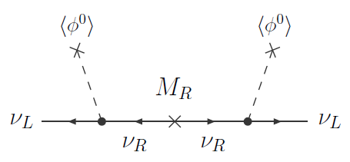
Type I Seesaw Mechanism
Add RH neutrinos → Dirac + Majorana mass terms
Type-I Seesaw mass matrix: $M_{v}=\left(\begin{matrix}0 & m_{D}^{T} \\ m_{D} & M_{R}\end{matrix}\right)$ $m_{v}≈−m_{D}^{T}M_{R}^{−1}m_{D}$ and $M_{HNL}=M_{R}$
with $m_{D}=Y_{v}\frac{u}{\sqrt{2}}$
Sterile neutrinos/HNLs are the heavy Majorana eigenstates
Diagonalised
Fig.1: Type-I seesaw diagram [9]

Slide 5
The vMSM: A Minimal Testable Seesaw Model
SM + 3 sterile (RH) neutrinos $N_{1},N_{2},N_{3}$​
N1
Warm Dark matter candidate
keV-scale
Not Testable at Colliders
N2
N3
Active neutrino masses via low-scale Type-I seesaw
Baryogenesis via leptogenesis
GeV-scale
Testable at Colliders

Slide 6
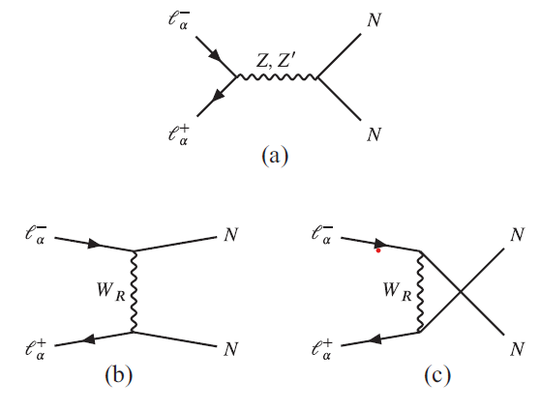
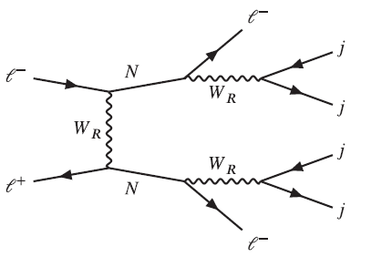
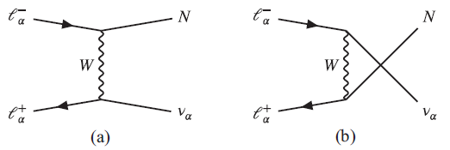
Heavy Neutral Leptons In Left-Right Symmetric Models
SM : ${SU(2)}_{L}×{U(1)}_{Y}$
extended to
LRSM:${SU(2)}_{L}×{SU(2)}_{R}×{U(1)}_{B−L}$
Restores parity at high energies
RH neutrinos N are required → HNLs
Rich collider phenomenology:
HNLs produced via new heavy gauge bosons WR​, Z′ and then decay into leptons and jets
If small mixing → long lived → displaced vertex signatures
Fig.3: $l^{−}l^{+}→2l^{−}+4j$ [6]
Fig.2: Dominant production channels of an HNL pair in the (a) s, (b) t, and (c) u channel[6]
Fig.4: Dominant production channels of a single HNL in the (a) t and (b) u channel[6]

Slide 7
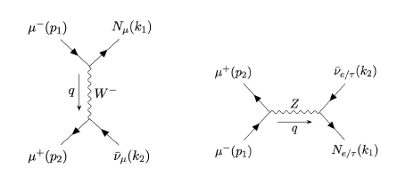
HNL Production Channels At Colliders
Via weak mixing with active neutrinos: SM processes: W→ℓN , Z→νN
Fig.5: Production of a HNL at an e+e− collider via Z boson [5]
Fig.6: Production of HNLs at a muon collider [2]
In LRSM: additional channels via WR, Z′ → higher cross-sections
Production rate depends on:
mN
Mixing angle ${|Ul|}^{2}=\frac{m_{v}}{m_{N}}$
Collider energy

Slide 8
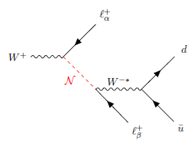
HNL Decays and Signatures
HNLs decay via off-shell W,Z,H bosons: $N→l^{±}W^{∗}, N→νZ^{∗}, N→ νH^{∗}$
Decay final states:
Leptonic : ℓ±ℓ∓ν
Semileptonic : ℓ±jj
Invisible-MET: vjj, 3v
Fig.9:Production and decay chain of a HNL at an e+e− collider via Z boson [5]
Feynman diagrams for the HNL production and decay processes for leptonic (top Fig.7) and semileptonic(bottom Fig.8) [3]

Slide 9
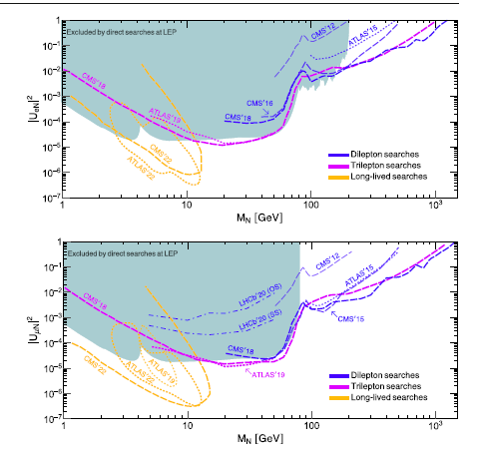
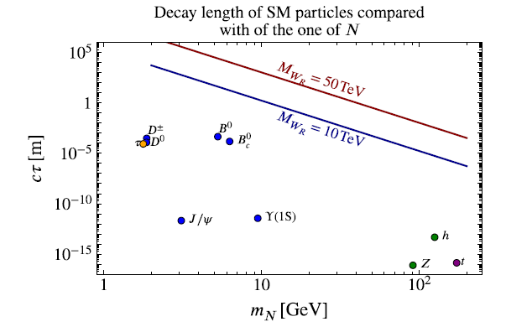
Lifetime $τ∝\frac{1}{Γ_{N}}∝\frac{1}{{|Ul|}^{2}m_{Ν}^{5}}$
Long lifetime
→ displaced vertices
Short lifetime
→ prompt decays
Fig.11[6]
Fig.10: Experimental constraints on sterile neutrinos for electron (bottom) and muon (top) flavor mixing [1]

Slide 10
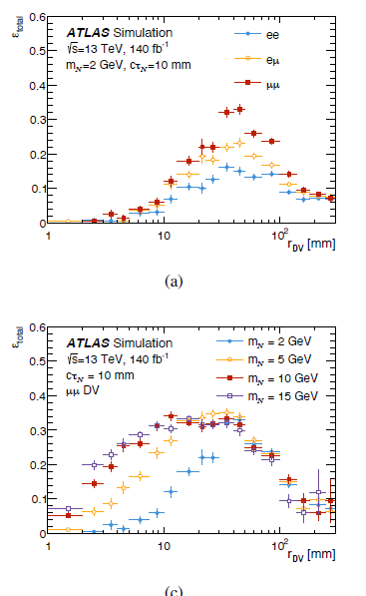
Displaced Vertices (DV): A Key Signature Of Long-lived HNLs
Long-lived HNLs decay far from interaction point
Leads to displaced vertex (DV) signature:
tracks originate from cm–m away
Low SM background → clean signal!
DV searches at:
Current: ATLAS, CMS (LLP triggers)
Future: FCC-ee, Muon Colliders
Probes very small mixings ${|Ul|}^{2} \sim {10}^{−7}$
Fig.12: ATLAS simulation of displaced vertex reconstruction efficiency as a function of the decay radius rDV​ for heavy neutral lepton decays. (Top): Different lepton flavor combinations. (Bottom): Different HNL masses with fixed lifetime[3]

Slide 11
Prompt Decays And Lepton Number Violation
Larger mixings: ${|Ul|}^{2}\text{≳}{10}^{−4}$→ Short-lived HNLs → prompt decays near interaction point
Signature: multilepton final states (dilepton, trilepton) including:
Majorana HNLs that violate lepton number: eg same-sign dileptons from pp→$l^{±}$N→ $l^{±}l^{±}$+nj
Or trileptons with missing energy: pp→$l^{±}$N→ $l^{±}l^{±}l^{∓}v$
Key searches by ATLAS, CMS: prompt LNV channels

Slide 12
Invisible Decays And Missing Energy Signatures
Complementary to DV and prompt searches
HNLs may decay invisibly (or semi invisibly):
N→ννν or
very long-lived: escape detector
Final states: MET + X (jets or leptons)
Example: e+e−→νN→ννjj
Extremely small mixing angles ${|Ul|}^{2}{\text{≲}10}^{−8}$
Search channels:
Monojet, MET + jet/lepton
Beam dump-style searches (e.g. SHiP)

Slide 13
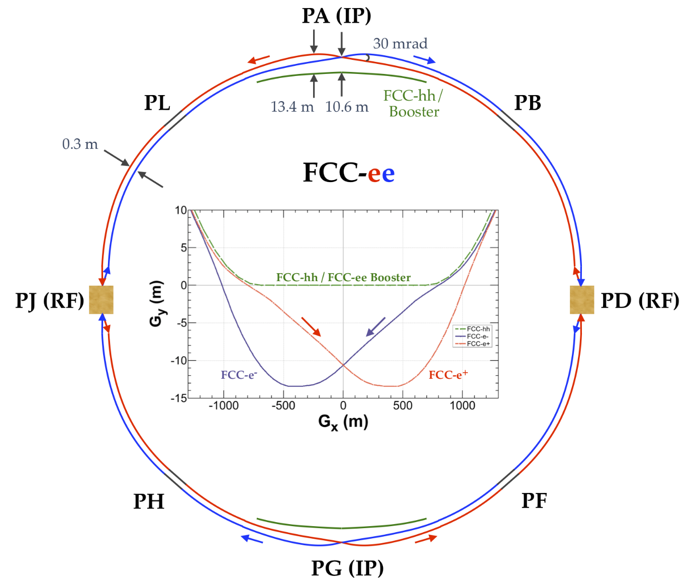
Experimental Limits and Future Sensitivities
Current constraints from ATLAS, CMS, LHCb:
Prompt & displaced searches:
Sensitive to mixings down to ${|Ul|}^{2} \sim {10}^{−5}$ (prompt) and ${|Ul|}^{2} \sim {10}^{−7}$(DV)
Future reach from:
FCC-ee, Muon Colliders (displaced V)
MATHUSLA, SHiP (non-collider)
Flavor-dependent constraints (e, μ, τ)
Collider sensitivity improves with:
Higher luminosity
Optimized triggers (especially for DVs)
Fig.13 https://cds.cern.ch/record/2775933/plots

Slide 14
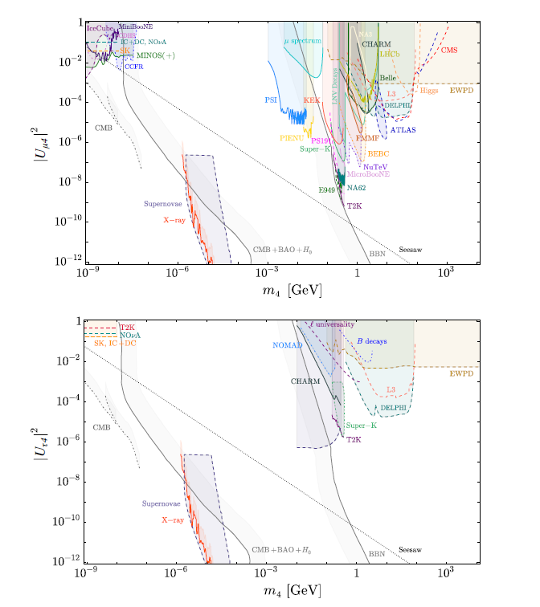
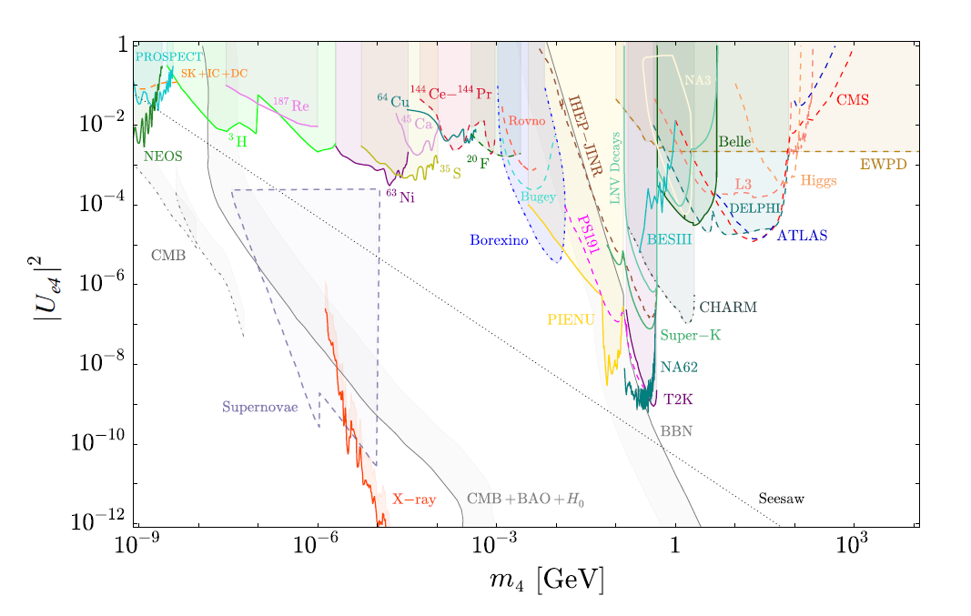
Fig.14: Summary of experimental bounds on active-sterile mixing for muon, electron, and tau flavor sterile neutrinos across many experiments. Includes collider (ATLAS, CMS), beam-dump (NA62, CHARM), astrophysical, and beta-decay constraints[1]

Slide 15
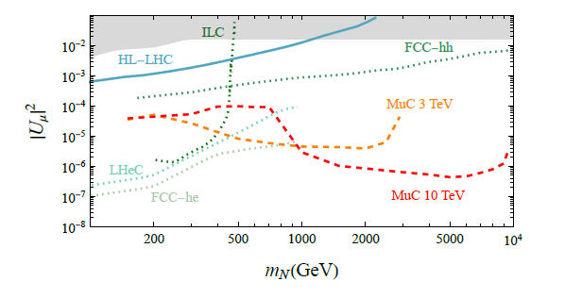
Future lepton colliders offer clean environment for long-lived particle searches
FCC-ee (Z pole, 240 GeV):
Huge statistics → sensitive to tiny ${|Ul|}^{2}$
Excellent displaced vertex resolution
Muon Colliders:
Access to TeV-scale HNLs
Unique reach via μ+μ−→Nℓ+νℓ
Fig.15: Projected sensitivities and current limits on HNLs in the μ mixing channel[2]

Slide 16
Summary
Current constraints (ATLAS, CMS, LHCb):
Mixings down to ∣Uℓ∣2∼10−7
Sterile neutrinos (HNLs) arise in:
Seesaw models
νMSM
Left-Right Symmetric Models (LRSM)
Future prospects:
FCC, Muon Colliders → DV reach for higher masses
Complementary with SHiP, MATHUSLA, FASER
Collider searches target:
Prompt decays
Displaced vertices (DV)
Invisible/MET signatures
Why this matters:
Connects to origin of neutrino mass, leptogenesis, and dark matter

Slide 17
Thank you
References:
Dasgupta, B. & Kopp, J. Sterile neutrinos. Phys. Rept. 928 (2021) 1-63, arXiv:2106.05913
Li, H., Liu, Z., Pascoli, S., & Zhou, Y. Heavy Neutral Leptons at Muon Colliders. JHEP 05 (2023) 007, arXiv:2301.07117
ATLAS Collaboration. Search for heavy neutral leptons in decays of W bosons using leptonic and semi-leptonic displaced vertices within the ATLAS detector. arXiv:2503.16213
Antusch, S., Fischer, O., & Rubio, J. Collider searches for heavy neutral leptons beyond simplified scenarios. JHEP 03 (2022) 131, arXiv:2202.09357
Blondel, A. et al. Towards Vertexing Studies of Heavy Neutral Leptons with the Future Circular Collider at CERN. arXiv:2204.00571
Urquía-Calderón, J. Long-lived heavy neutral leptons at lepton colliders as a probe of left-right-symmetric models. Phys. Rev. D 109, 055002 (2024), arXiv:2310.16432
Asaka, T. & Shaposhnikov, M. The νMSM, dark matter and baryon asymmetry of the Universe. Phys. Lett. B 620 (2005) 17-26, arXiv:hep-ph/0505013
Abada, A., Davidson, S., Ibarra, A., Josse-Michaux, F.X., Losada, M., & Riotto, A. Low energy effects of neutrino masses. JHEP 09 (2007) 137, arXiv:0707.4058
Khalil, S. & Moretti, S. Standard Model Phenomenology. CRC Press (2022).
CERN Document Server (CDS). ATLAS HNL Search Public Plots (2024). http://cds.cern.ch/record/2775933/plots

