Slide 1
Dark matter searches
In signature with missing transverse energy at colliders
Ellen Ivarsson Biebel | Advanced Particle Physics 2025

Slide 2
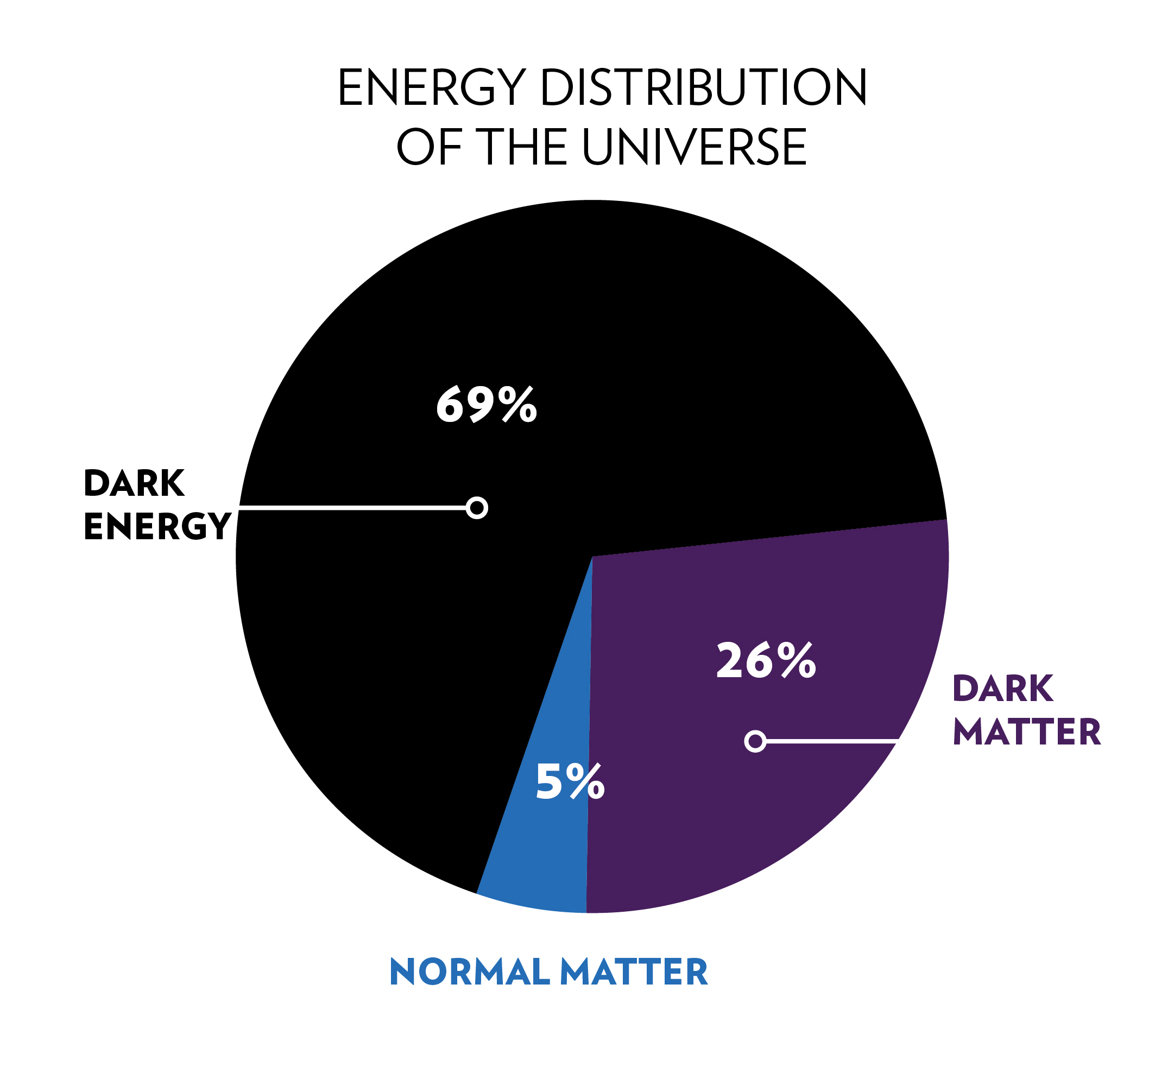
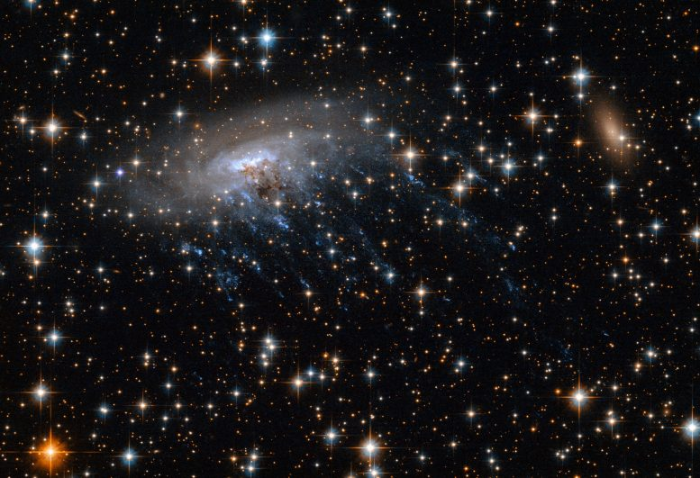
Motivation
Credit: NASA, ESA; NASA, ESA, CXC

Slide 3
Detection of dark matter
Problem: DARK matter – invisible to colliders
Solution: Missing transverse energy (MET)

Slide 4
Content
Theory
Experimental signatures
Experimental searches
Mono-jet
Mono-photon
Mono-W/Z
Mono-Higgs
Results
Complementarity and future

Slide 5
Theory
Generality vs. Plausability
Less assumptions - fewer new parameters
Want to agree with well-established principles
Effective Field Theories (EFTs)
Simplified Models

Slide 6
Effective Field Theories (EFTs)
DM only new BSM particle kinematically accessible
Contact interaction between DM and SM
Λ – Effective supression scale
χ - A spin-1/2 DM particle
Example: Axial-vector operator

Slide 7
Simplified models
If the mediator is BSM and kinematically accessible
Axial-vector
Vector
Pseudoscalar
Scalar

Slide 8
Experimental signatures
Missing transverse energy (MET)
Pseudorapidity
Visible particles
Transverse momentum

Slide 9
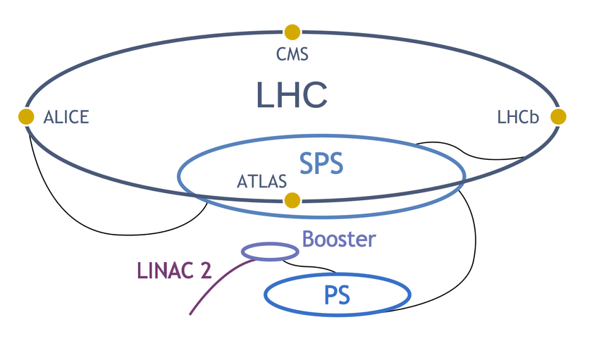
Experimental searches
Searches at ATLAS and CMS
Multiple search channels
Visible particles - SM
Ref: ResearchGate

Slide 10
Mono-jet, Mono-Higgs, Third generation quarks
Mono-jet
Mono-Higgs
Third gen. quarks
QCD – jets
E_{T}^{miss} > 200 GeV
p_{T} > 250/100 GeV
|η| < 2.4/2.5
Background from leptonic Z and W decay
Final states:
$γγ$
$b\overline{b}$
$t\overline{t}$
E_{T}^{miss} > 50 GeV
Non-resonant backgrounds
Promising if DM couples to heavy quarks
$t →bW$
Can distinguish signal from background

Slide 11
Mono-V
Mono-photon
Mono-W
Mono-Z
p_{T} > 145 GeV
|η| < 1.44
E_{T}^{miss} > 130 GeV
Background – jet misidentification
ν adds to E_{t}^{miss}
Mono-lepton
Generally clean signal
Background can be suppressed

Slide 12
Results
ATLAS
CMS
Mono-jet: SM consistent
DM excluded up to 585 GeV
Axial vector mediators excluded up to 2.1 TeV
Mono-Higgs: SM consistent
Can limit cross-sections for the different models
Mono-jet: SM consistent
Vector mediators excluded up to 1.95 TeV
DM up to 5 GeV
Scalar mediators up 100 GeV
DM up to 9 GeV
Pseudoscalar mediators up to 430 GeV
DM up to 550 GeV

Slide 13
Results
ATLAS
CMS
Mono-photon: SM consistent
Exludes axial-vector and vector mediators below 750-1200 GeV
DM 230-480 GeV
Mono-W/Z: SM consistent
Excludes vector mediators up to 650 GeV
DM up to 250 GeV
Mono-photon: SM-consistent
Exclude extra-dimensional Planck-scales between 1.65 and 1.71 TeV
Mono-W/Z: SM consistent
Scalar and Pseudoscalar mediators between 80 and 400 GeV excluded
Axial vector and vector mediators excluded up to 1.5 TeV

Slide 14
Complementarity
Direct detection
Indirect detection
Collider experiments
Dark matter collides with ordinary matter in underground experiments
Searches for annihilation and decay of dark matter in gravitational potential wells
Using accelerators to collide particles to create and investigate dark matter
Different searches are good for different things and should be used to complement each other

Slide 15
Future
HL-LHC - more statistics
FCC or muon collider – higher energy searches

Slide 16
Summary and conclusion
MET is a powerful tool
There are several theoretical models
There are several experimental search channels
No significant activity over background
We can exclude DM particles and mediators below certain energies
We complement collider experiments with direct and indirect searches
HL-LHC will provide more statistics

Slide 17
References
Fermilab. Dark matter and dark energy. 2020. accessed 21/05-25
Boveia, Antonio and Doglioni, Caterina. Dark Matter Searches at Colliders. 2018. Arxiv: [1810.12238v1]
Kahlhoefer, Felix. Review of LHC Dark Matter Searches. 2017. Arxiv: [1702.02430v2]
Alam Malik, Sarah. Search for dark matter at the LHC using missing transverse energy. 2012. Arxiv: [1206.0753]
Daw, E. Lecture 7 - rapidity and pseudorapidity. 2012

Slide 18
References
The ATLAS collaboration. 2013. Search for dark matter candidates and large extra dimensions in events with a jet and missing transverse momentum with the ATLAS detector. Arxiv: [1210.4491v2]
CMS - collaboration. Search for dark matter produced with an energetic jet or a hadronically decaying W or Z boson. 2017
ATLAS Collaboration. Search for dark matter at in final states containing an energetic photon and large missing transverse momentum with the ATLAS detector. 2017. The European Physical Journal C

Slide 19
References
CMS Experiment. Search for Dark Matter and Large Extra Dimensions in pp Collisions Yielding a Photon and Missing Transverse Energy
ATLAS Collaboration. Jetting into the dark side: a precision search for dark matter. 2020
ATLAS Collaboration. Search for dark matter in events with a hadronically decaying vector boson and missing transverse momentum with the ATLAS detector. 2018. Arxiv: [1807.11471]

Slide 20
References
CMS Collaboration. Search for dark matter in proton-proton collisions at 8 TeV with missing transverse momentum and vector boson tagged jets. 2017. Arxiv: [1607.05764]
ATLAS Collaboration. Search for dark matter in events with missing transverse momentum and a Higgs boson decaying into two photons with the ATLAS detector. 2021. Arxiv: [2104.13240]

