Slide 1
Accelerator Research at
Uppsala University
Roger Ruber
Dept. of Physics and Astronomy
Uppsala University
14 July 2015 at ODU

Slide 2


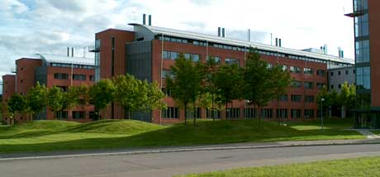
Uppsala University
Oldest university in Scandinavia (1477)
Sweden
  9.7 million (pop.), 450'000 km², 430 GEur (BNP)
Uppsala
  25'000 students, 9'000 staff, 630 MEur annual budget
  faculties of theology, law, medicin, pharmacy,
  arts, social sciences, languages, educational sciences,
  science and technology
  university library and hospital
Science and technology
  10'000 students, 1'800 staff
  historical profiles: Linnaeus, Rudbeck, Celsius,
  Ångström, Siegbahn, Svedberg
  R&D areas
    physics, chemistry, biology, earth sciences,
    engineering, mathematics, IT

Slide 3
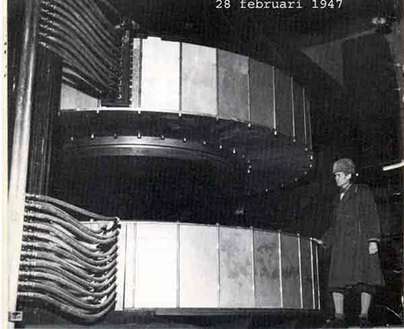
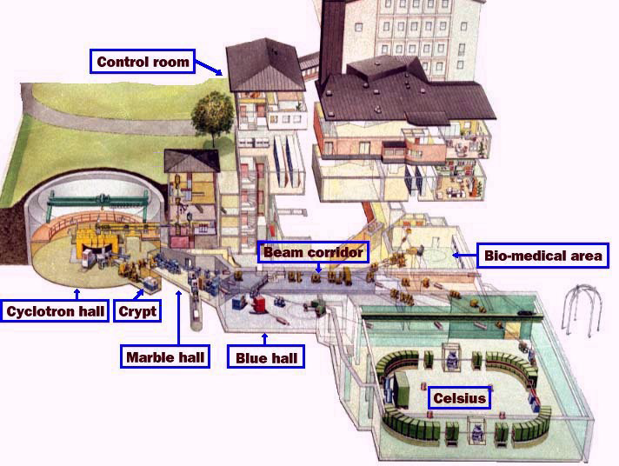
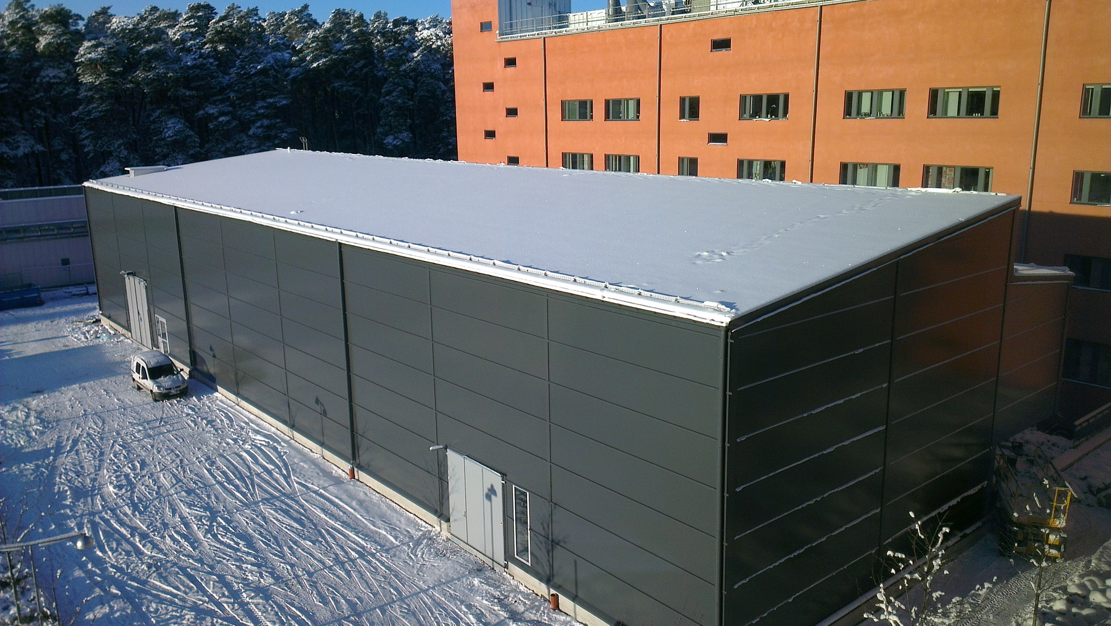
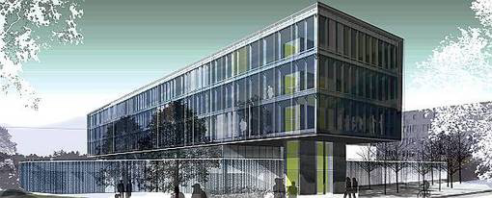
Uppsala Accelerator History
1940's: The(odore) Svedberg proposes to build a cyclotron
Gustaf Werner synchro-cyclotron (1947 - 2015)
  nuclear physics & cancer treatment
CELSIUS ring (1984 - 2005)
  nuclear physics
CTF3/CLIC (since 2005)
FLASH/XFEL (since 2008)
ESS (since 2009)
FREIA laboratory (since 2011)
Skandion clinic (2015)
  cancer treatment

Slide 4
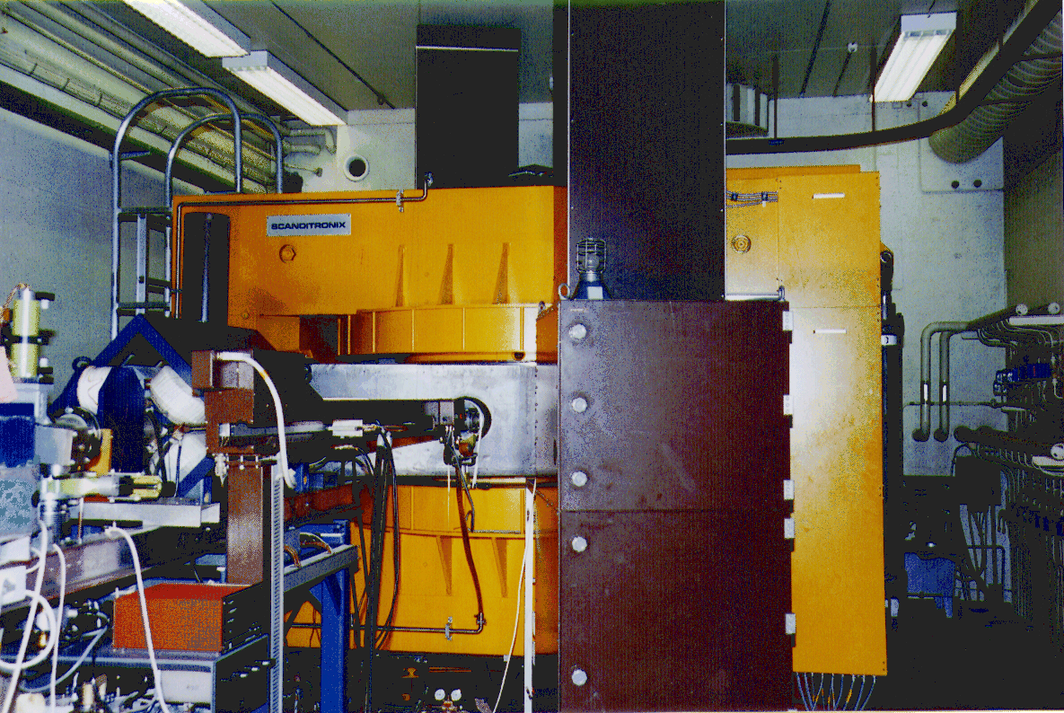

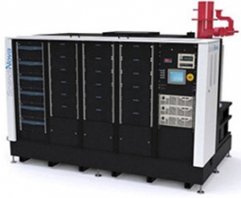

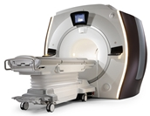
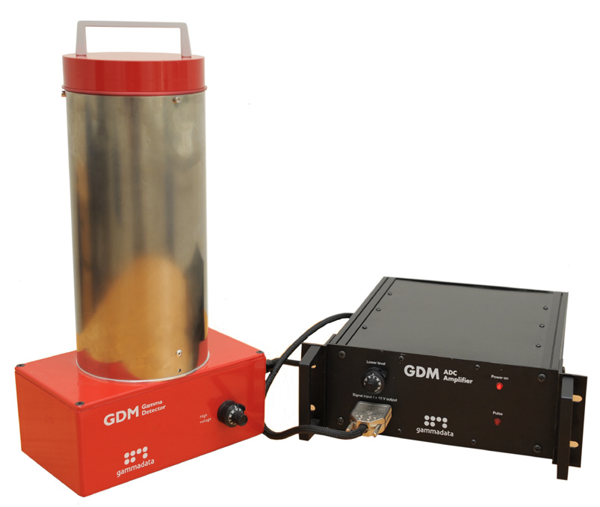

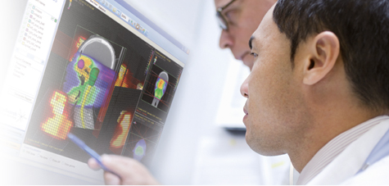




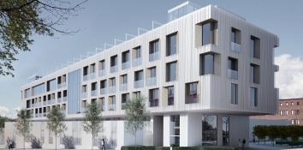
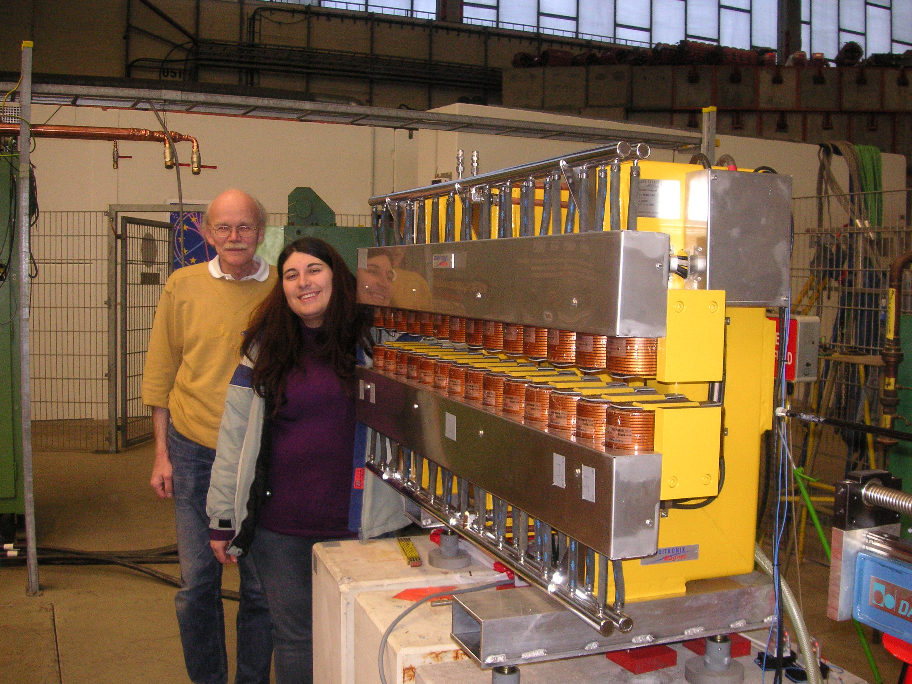
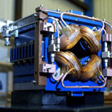
Offshoots from Uppsala Accelerator R&D
Scanditronix
  major supplier
    cyclotrons 1970-80’s
    PETs 1980’s
GE Medical Systems
PET and cyclotrons
  former Scanditronix
IBA Dosimetry
  former Scanditronix Wellhöfer
Scanditronix Magnets
  magnets
ScandiNova
  high voltage
  pulse modulators
Gammadata
  physics tools
  education,
  research,
  industry
Skandionkliniken
  proton therapy centre

Slide 5

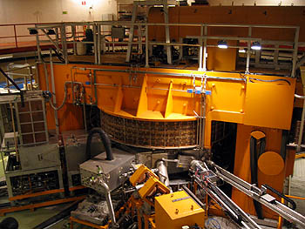
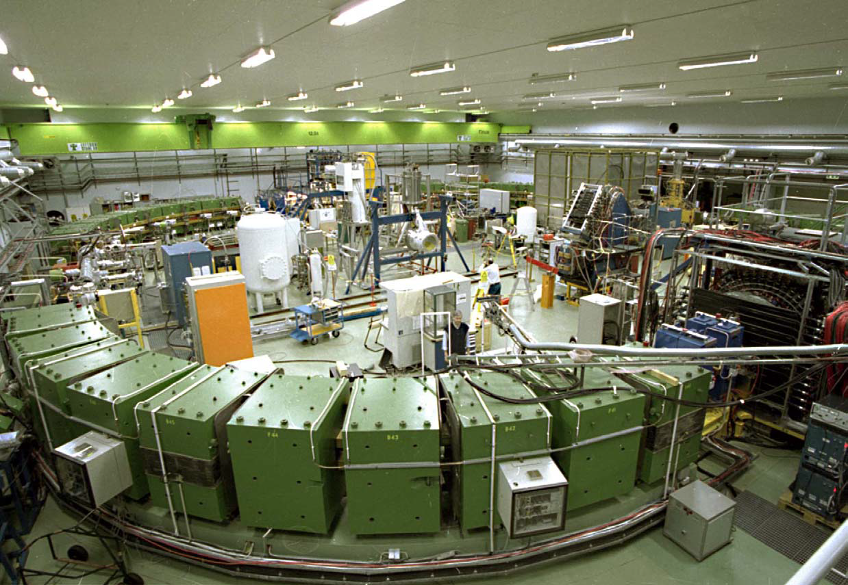
Nuclear Physics and Cancer Treatment
Gustaf Werner synchro-cyclotron
(1947 - 2015†)
  protons (180 MeV) and heavy ions
  proton therapy (first patient treated 1957)
  radio-isotope production
CELSIUS storage and accelerator ring
(1984 - 2006†)
  protons (1360 MeV) and heavy ions
  electron cooler (300 keV)
  gas-jet and pellet target
Skandion clinic (from August 2015)
  proton therapy
  commercial operator
Gustaf Werner cyclotron

Slide 6

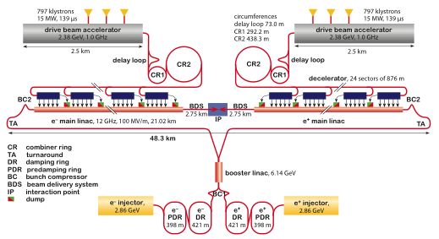
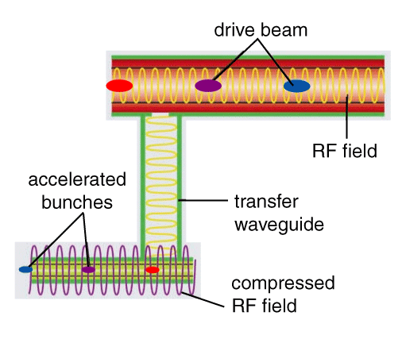
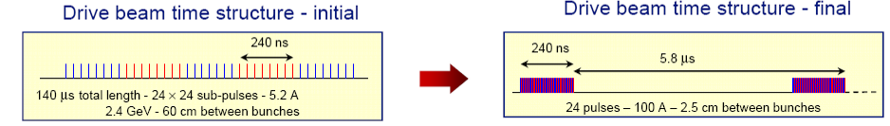
CLIC Compact Linear Collider Study

Slide 7
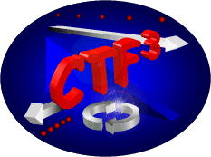
High Gradient X-band Technology
Two-beam Test Stand at CTF3
  proof-of-principle CLIC two-beam
  acceleration scheme
  conditioning and test of PETS and
  accelerating structures
RF breakdown studies
  possible beam kick (in TBTS)
  ejected electrons and ions (in TBTS & Xbox 12GHz klystron test stand)
  in-situ SEM DC-spark study

Slide 8
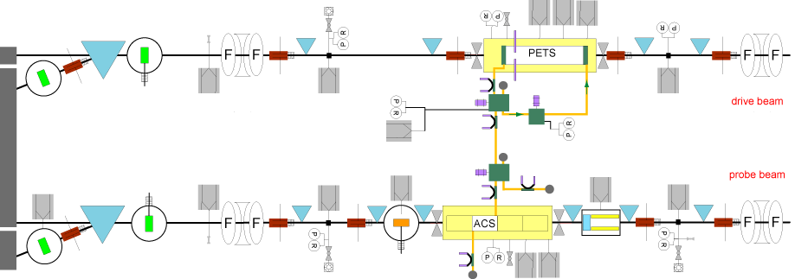
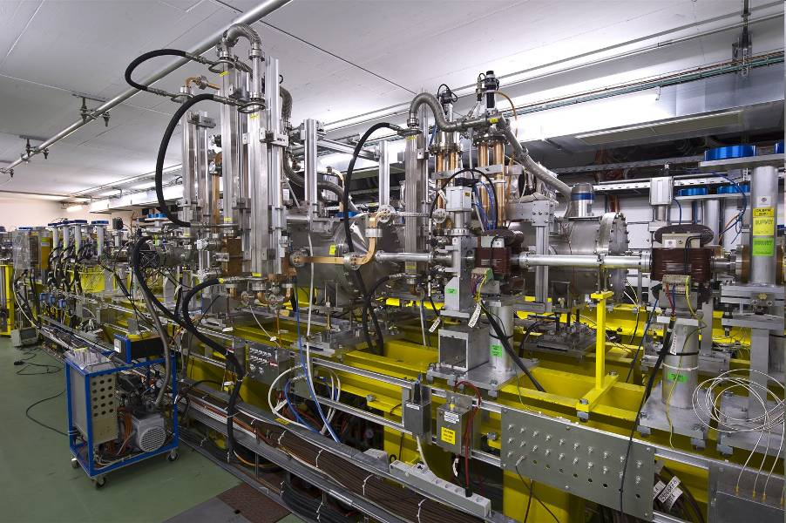
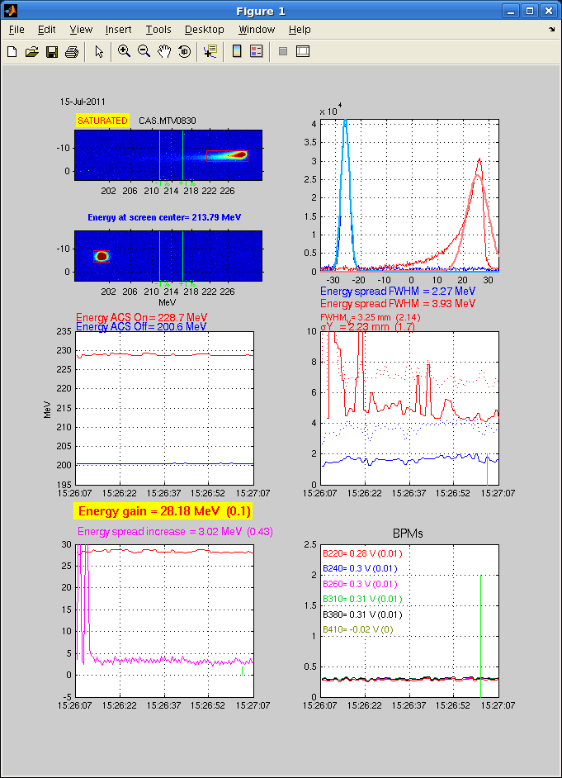
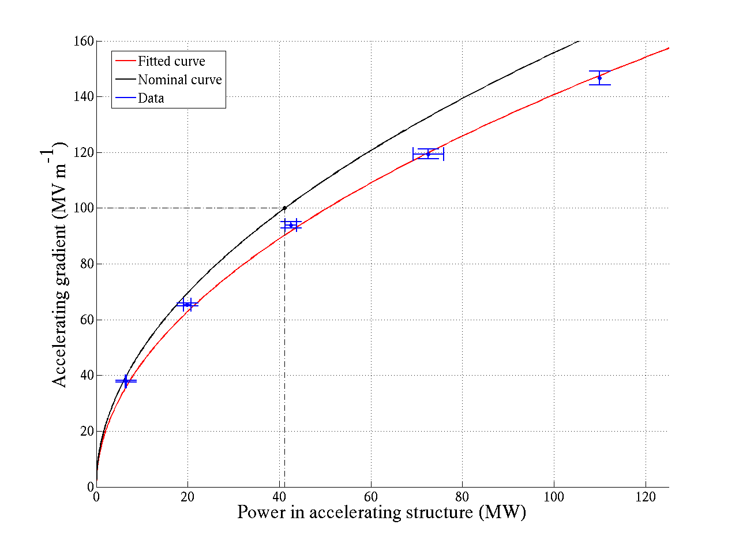
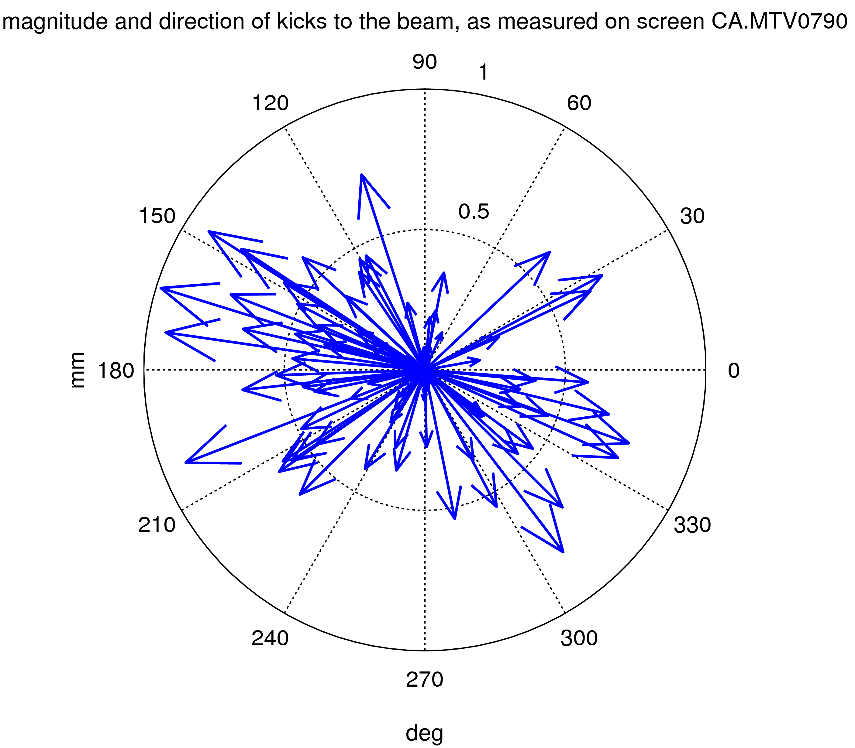
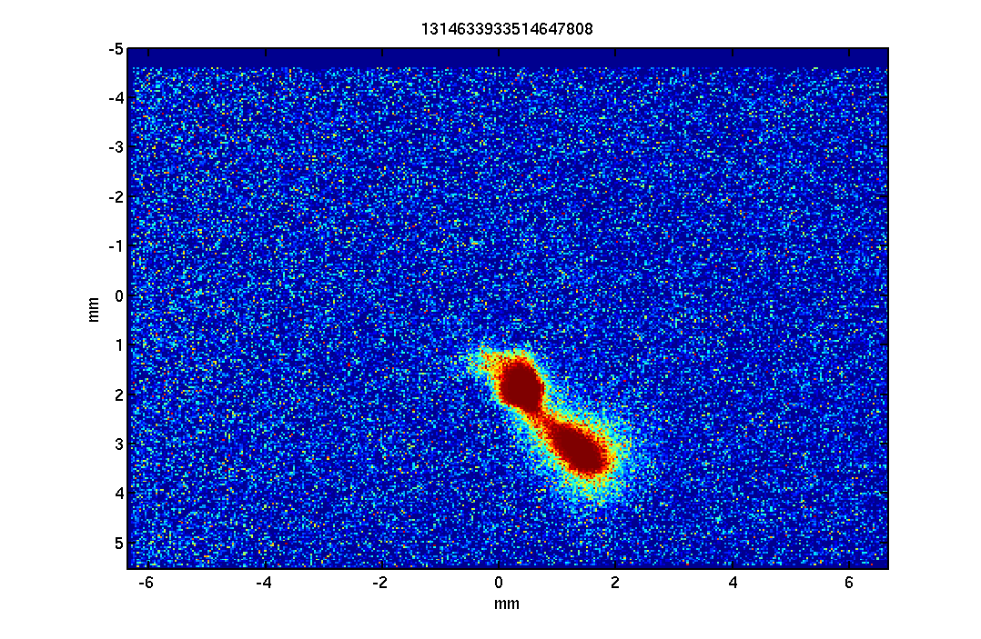
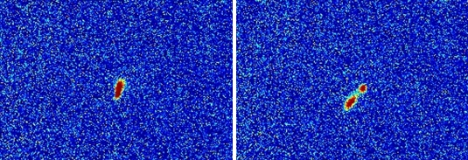
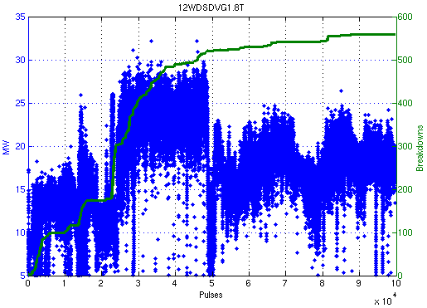
Two-beam Test Stand
Drive Beam Energy Loss
kick magnitude & direction
Accelerating Structure Conditioning
Beam without BD
Beam with BD
Kick : 0.4 mrad

Slide 9
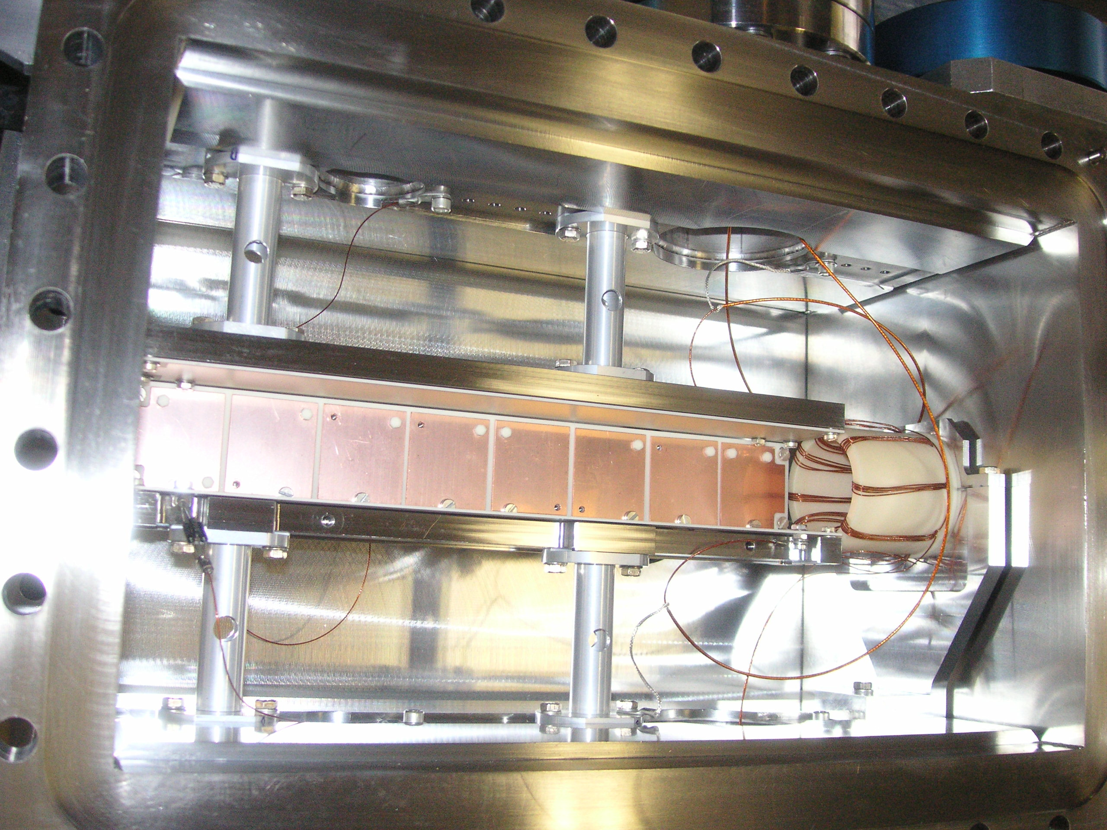
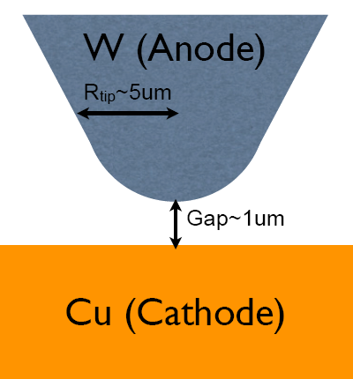
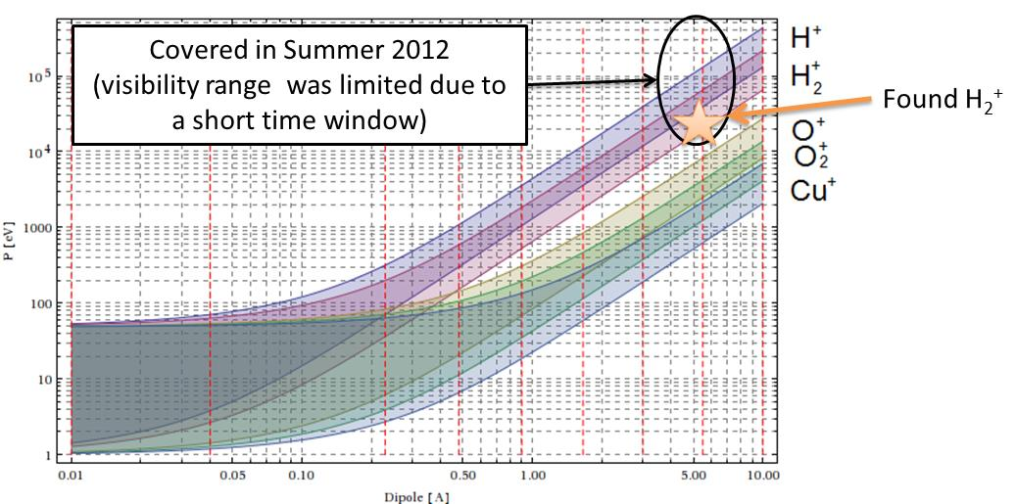
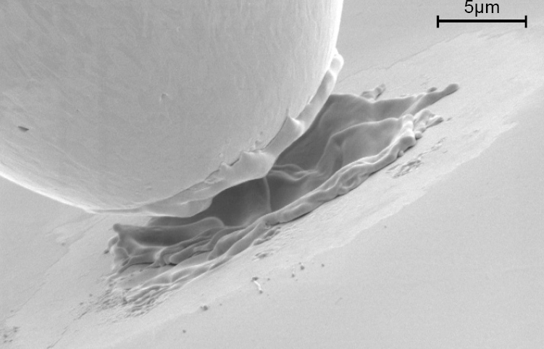
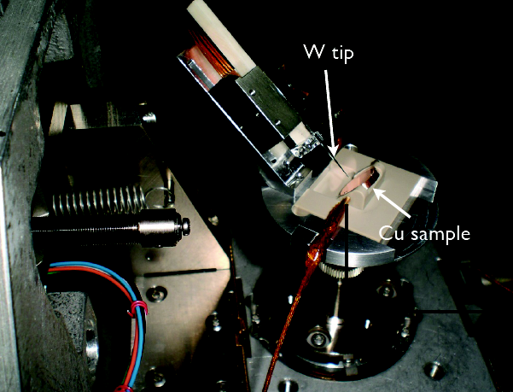
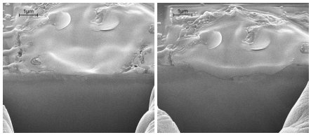
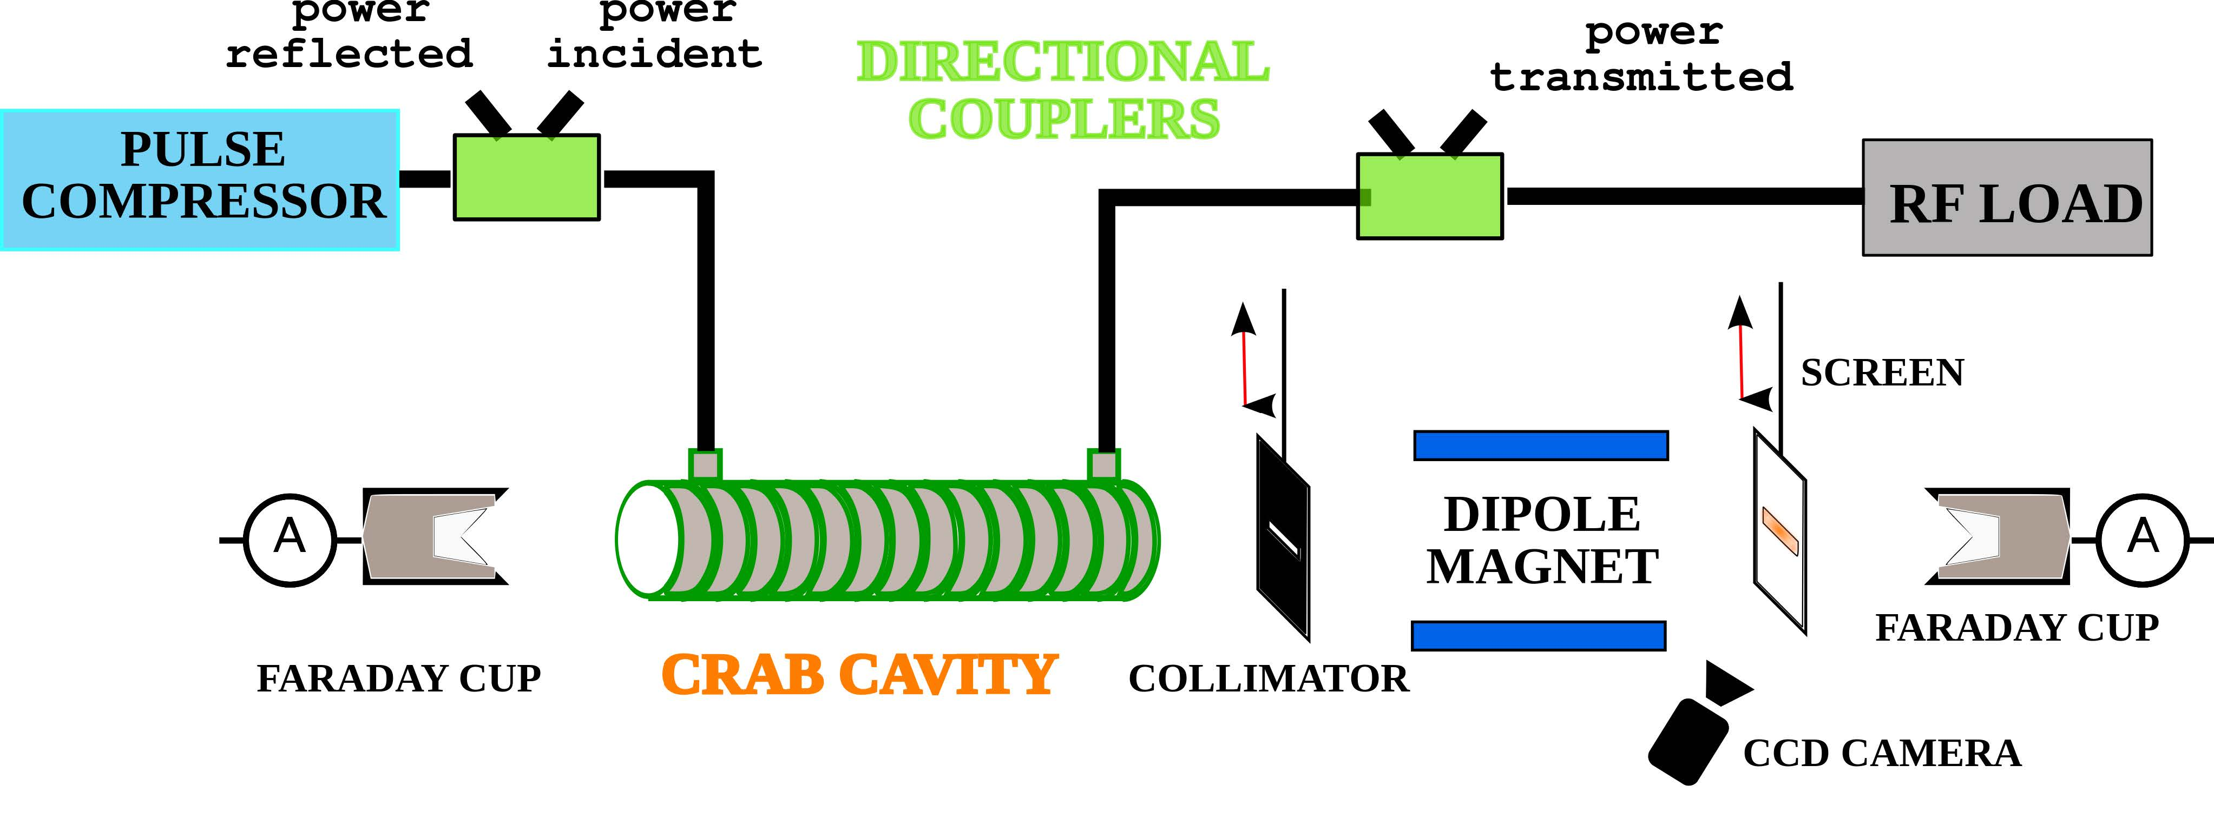
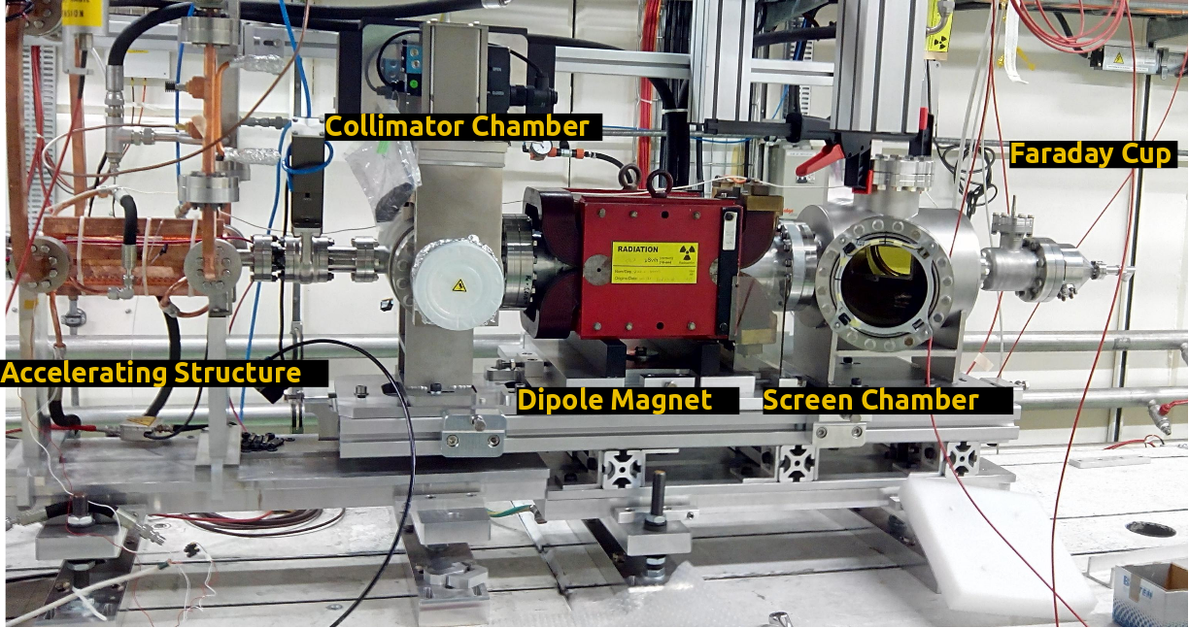
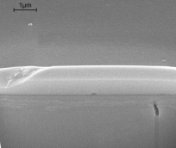
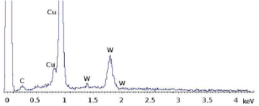
RF Breakdown Studies
1kV/micron=1GV/m

Slide 10

Free Electron Laser Studies
Manipulating bright electron bunches with external laser
Stockholm-Uppsala FEL Centre (www.frielektronlaser.se)
  started after closure of CELSIUS (UU) and CRYRING (SU)
  participate in the XFEL planning phase
    for diagnostic purposes
      Optical Replica Synthesizer (ORS at FLASH)
      measure ultra-short bunches in the 10's of fs range
      too fast for electronics (10 GS/s, 100ps),
      but can be done with optics (so-called FROG)
      make an optical copy of the electron bunch and analyze that with laser methods
  leading to XFEL participation
    for beam stability
      Laser Heater (at European XFEL)
      Swedish in-kind
  and a FEL in the Stockholm-Uppsala region

Slide 11
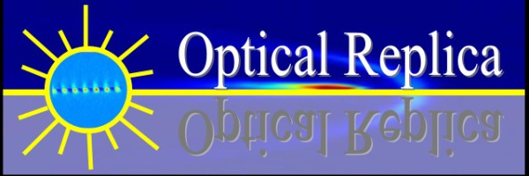
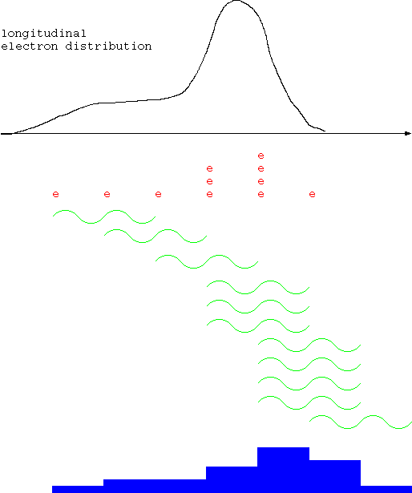
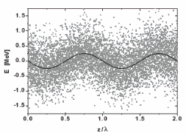

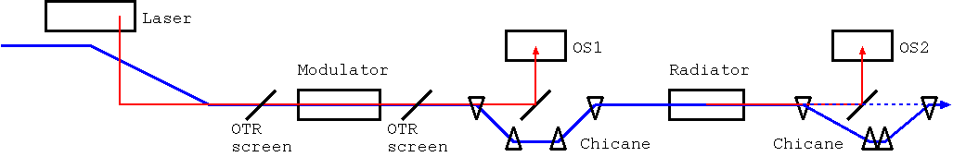
Optical Replica Synthesizer in FLASH
make an optical copy of the electron bunch and analyze that with laser methods.
  temporal overlap of sub-ps electron bunch und laser pulse
  rough adjustment on photo diode on OS1 per synchrotron radiation and laser ~ 100 ps
  fine-tuning on OS2 by observing coherent OTR of modulated electrons

Slide 12
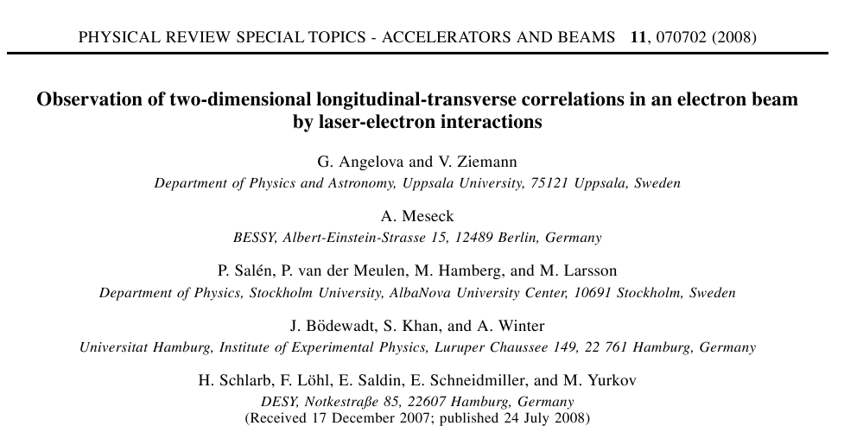
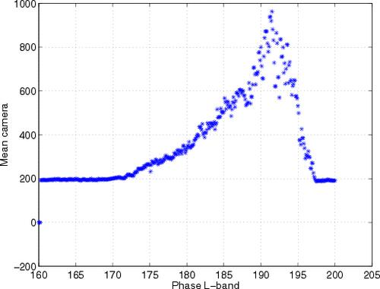
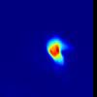

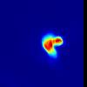
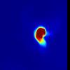
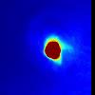
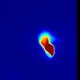
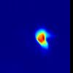
OTR on OS2-camera while 200 fs laser-pulse passes through electron bunch

Slide 13
EuXFEL Laser Heater
Why...
  Electrons are born in the photo cathode with a very small momentum spread (~3 keV)
    makes them susceptible to microbunching instability on their travel through the linear accelerator and bunching chicanes
  Add Landau damping (decoherence) in a well-controlled way to increase momentum spread
    induce moderate momentum modulation by passing a laser over the electrons in an undulator
    and smear out by coupling some of the angular spread into the longitudinal plane
How...
  Pass IR laser over beam in undulator → modulate dE
  R52 of 2nd leg of chicane couples 'transverse heat' into the longitudinal plane and smears out the modulation

Slide 14

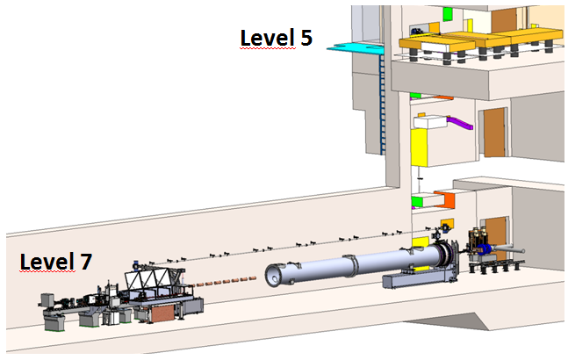





The Installation
use 1030 nm photons, operate between 110 and 160 MeV
permanent undulator with variable gap: 8+2 periods of l=74 mm
chicane offset 30 mm:
  second half has R56=0.003/2 m, R52=0.030 m
pulse energy up to 50 uJ (2.5 MW, 20ps)
Beta functions 9 and 12 m, σ ~ 0.2 mm

Slide 15






The European Spallation Source (ESS)
Lund, Sweden, next to MAX-IV
  to replace aging research reactors
  2019 first neutrons
  2019 – 2025 consolidation and operation
  2025 – 2040 operation
5 MW pulsed cold neutron source, long pulse
  14 Hz rep. rate, 4% duty factor
  >95% reliability for user time
  short pulse requires ring, but user demand
  satisfied by existing facilities (ISIS, SNS, J-PARC)
High intensity allows studies of
  complex materials, weak signals,
  time dependent phenomena
Cost estimates (2008 prices)
  1,5 G€ / 10 years
  50% by Sweden, Denmark, Norway

Slide 16

The ESS Accelerator
 | Length [m] | No. Cavities | No. Magnets | No. Steerers | β | No. Sections | Power [kW]
LEBT | 2.38 |  | 2 Solenoid | 2 x 2 |  | 1
RFQ | 4.6 | 1 |  |  |  | 1 | 1600
MEBT | 3.83 | 3 | 11 Quad | 10 x 2 |  | 1 | 15
DTL | 38.9 | 5 | PMQs | 15 x 2 |  | 5 | 2200
LEDP + Spoke | 55.9 | 26 | 26 Quad | 26 | 0.50 | 13 | 330
Medium Beta | 76.7 | 36 | 18 Quad | 18 | 0.67 | 9 | 870
High Beta | 178.9 | 84 | 42 Quad | 42 | 0.86 | 21 | 1100
HEBP | 130.4 |  | 32 Quad | 32 | (0.86) | 15
DogLeg | 66.2 |  | 12 Q + 2D | 14
A2T | 46.4 |  | 6 Q + 8 Raster
 | 604.21 | 155

Slide 17



Responsibility for ESS Accelerator
Contribution to the technical design & construction effort
  design concept spoke accelerating cavity power source
  design concept radio-frequency (RF) power distribution
  survey test stand infrastructure and requirements
  study of upgrade scenarios RF systems for ESS power upgrade
Development spoke cavity high power RF amplifier
  soak test with water cooled load, then accelerating cavity, incl. controls
  collaboration with industry to develop vacuum tube and solid-state based prototypes
Spoke cavity system test
  dressed prototype cavity (in horizontal cryostat)
  prototype cryomodule (2 spoke cavities)
  LLRF and high power RF amplifier
Acceptance test cryostat-modules
  for all final modules before installation

Slide 18



What & Whom?
Facility for Research Instrumentation and Accelerator Development
State-of-the-art Equipment
cryogenics
- liquid helium
- liquid nitrogen
control room
- equipment controls
- data acquisition
Competent and motivated staff
collaboration with physics (IFA),
engineering (Teknikum), TSL
and Ångström workshop
Funded by
KAWS, Government, Uppsala Univ.
vertical cryostat
3 bunkers
with test stands
horizontal cryostat
RF power sources

Slide 19














Overview of Activities
Cryogenics
SRF Spoke Cavities & Linac
High Power RF Amplifiers
Solid-state & Vacuum Tube
linearcollider.org/M.Grecki
SRF Test Stand
ESS neutrino Super-beam
Controls & Data Acquisition

Slide 20







The Test Stand
Three main subsystems needed
RF Power Source
Cryogenics
Courtesy of P. Duthil
Implementation
Spoke Cavity
(superconducting)
Cryostat

Slide 21



Spoke Cavity & Cryomodule
IPN Orsay design
  single spoke
  f₀ = 352.21 MHz
  T_{oper} = ~2K
Phase 1: Bare cavity test
  with antenna (and helium tank)
  low power
  verify Orsay measurement at FREIA
Phase 2: Dressed cavity test
  with power coupler, tuners
  full power
  verify behaviour before ordering series
Phase 3: Cryomodule & valve box test
  full power on both cavities
  verify behaviour before ordering series
Develop
Criteria
Approve
Test and Approve
Test
Analyze
Results
Retest
deformation

Slide 22











The FREIA Laboratory
18 June 2013
Inauguration
18 June 2013
Germaine
25 February 2015
1 June 2015
17 February 2015
15 October 2013
First
High Power RF Amplifier
Hélène
26 June 2015
5 February 2015
17 October 2013
9 December 2014
25 Oct. 2013
19 February 2014
8 August 2014
Reached 2K
30 January 2014
First Liquid Helium
14 March 2014
HNOSS
Photos courtesy T. Thörnlund & R. Santiago Kern/UU

Slide 23





Cryogenics
Cryogenic System
Commercial tender
Over 150 l/h at 4.5K (LN2 pre-cooling)
2000 l LHe dewar/buffer, 3+1 outlets
20 m3 LN2 tank
100 m3 gasbag + recovery system
HNOSS connected in closed loop

Slide 24



HNOSS Horizontal Cryostat
HNOSS: Horizontal Nugget for Operation of Superconducting Systems
Commercial tender
Main Vacuum Vessel
  3240 x ø1300mm inner volume
  “beam” axis at 1600mm
Valve box (on top of main vessel)
Interconnection box (ICB)
  Distributes cryogens to HNOSS and CM
Cryogenic transfer lines
  LN2 and LHe
Gas heater for return GHe
  from 2K to 300K
Control system
+ mock-up cavity for acceptance test

Slide 25








High Power RF Amplifier
Tetrode based
Commercial tender
based on 2x TH-595, water+air cooled
SSA pre-amplifier
crow-bar with fast solid-state switches
commercial power supplies
Solid-state based
Industry development
4x 100 kW 19” racks
vendor-specific combiners
  different per stage
In-house development
optimized 1 kW transistor modules
100 kW compact combiner
10 kW prototype amplifier

Slide 26





Preliminary Results Germaine Cavity
Using self-excited loop
Resonance frequency
  4.2K: 352.033MHz
  1.8K: 352,029MHz
Q0 vs Eacc
Microphonics
  14 Hz resonance ??

Slide 27
The Bright Future...
Now we have
  FREIA Laboratory
  Stockholm-Uppsala FEL Centre
  experience from NC-RF and SRF; XFEL participation
Volker Ziemann and Atoosa Meseck wrote a memo in 2012 suggesting to consider a smaller THz FEL
  and that has become popular since...
  length max. 10-20 m; beam energy 10-20 MeV
  The FEL center with Mats Larsson as director is now working towards a THz facility as part of FREIA
MAXlab application for FEL extension was rejected recently
Volker Ziemann is preparing another memo suggesting to consider a small X-band FEL in the basement of the Biomedical Center (BMC)
  length max. 300 m; beam energy ~2 GeV

Slide 28



Preliminary Design THz/X-ray Source
Accelerator in CW mode with 10 kHz rep-rate
Purpose of the Compton source is to complement the THz source for pump-probe experiments though it can also be stand-alone.

Slide 29

Why? Low-energy Excitations
from: D. N. Basov et al., Rev. of Mod. Phys. 2011

Slide 30


New Dynamic Materials
New dynamic materials via control of chemical bonds angles
Ultra-short THz pulses
  direct access to low energy excitations
  no parasitic effects from optical transitions
  low heat deposit
Physics
  THz light induced superconductivity
  Metal to insulator transitions
  Giant magnetoresonance

Slide 31
Wish List Intense THz Radiation
 | Half-cycle pulses for time-resolved experiments | Multi-cycle for frequency-resolved experiments
Spectral range [THz] | 0.3-30 | 0.3-30
Pulse duration [ps] | 0.1-1 | 1-10
Energy [uJ] | 1000 | 100
Peak Field [GV/m] | 1 | 0.1
Spectral width [%] | up to 100% | < 10%
Rep. rate [kHz] | 1-100 | 1-100
Polarization control + pulse shape control
Synchronized optical and X-ray pulses for pump-probe experiments

Slide 32

The X-band FEL Collaboration
To promote the use of X-band technology for FEL based
photon sources
started with an idea from KVI (NL) to build a small FEL (100m)
  their proposal was rejected, but the idea is living on
  demand for new FEL facilities is worldwide continuously increasing, spurring plans for new dedicated machines. This led to a general reconsideration of costs and space issues, particularly for the hard X-ray sources, driven by long and expensive multi-GeV NC linacs.
  for these machines the use of
  X-band technology can greatly
  reduce cost and capital investment,
  reducing the linac length and the
  size of buildings, opening the way
  to the construction of a multitude
  of affordable “Regional Facilities”.
http://cern.ch/xbandfel
Courtesy of G. D'Auria

Slide 33



XbFEL Layout
ZFEL proposal (2010)
  ~100m total length
  2.1 GeV beam
  0.766 nm wavelength
XbFEL proposal (2014)
  300 MeV injector
    S-band or X-band
    for high rep-rate
  2 GeV Linac 1
  6 GeV Linac 2
proposing to use CTF3/CALIFES as test bench by converting TBTS to klystron driven line

Slide 34

Conclusions
Uppsala has a long history and is active in several collaborations
cyclotron will be shut down soon, but
several exciting projects ongoing, and
FREIA has opened new opportunities for unique scientific projects
dreaming to construct a small FEL
  but in need of a good science case, a "killer app"
Thanks to my colleagues in
the different collaborations, at
the Dept. of Physics & Astronomy
and the FREIA Laboratory.

