Slide 1
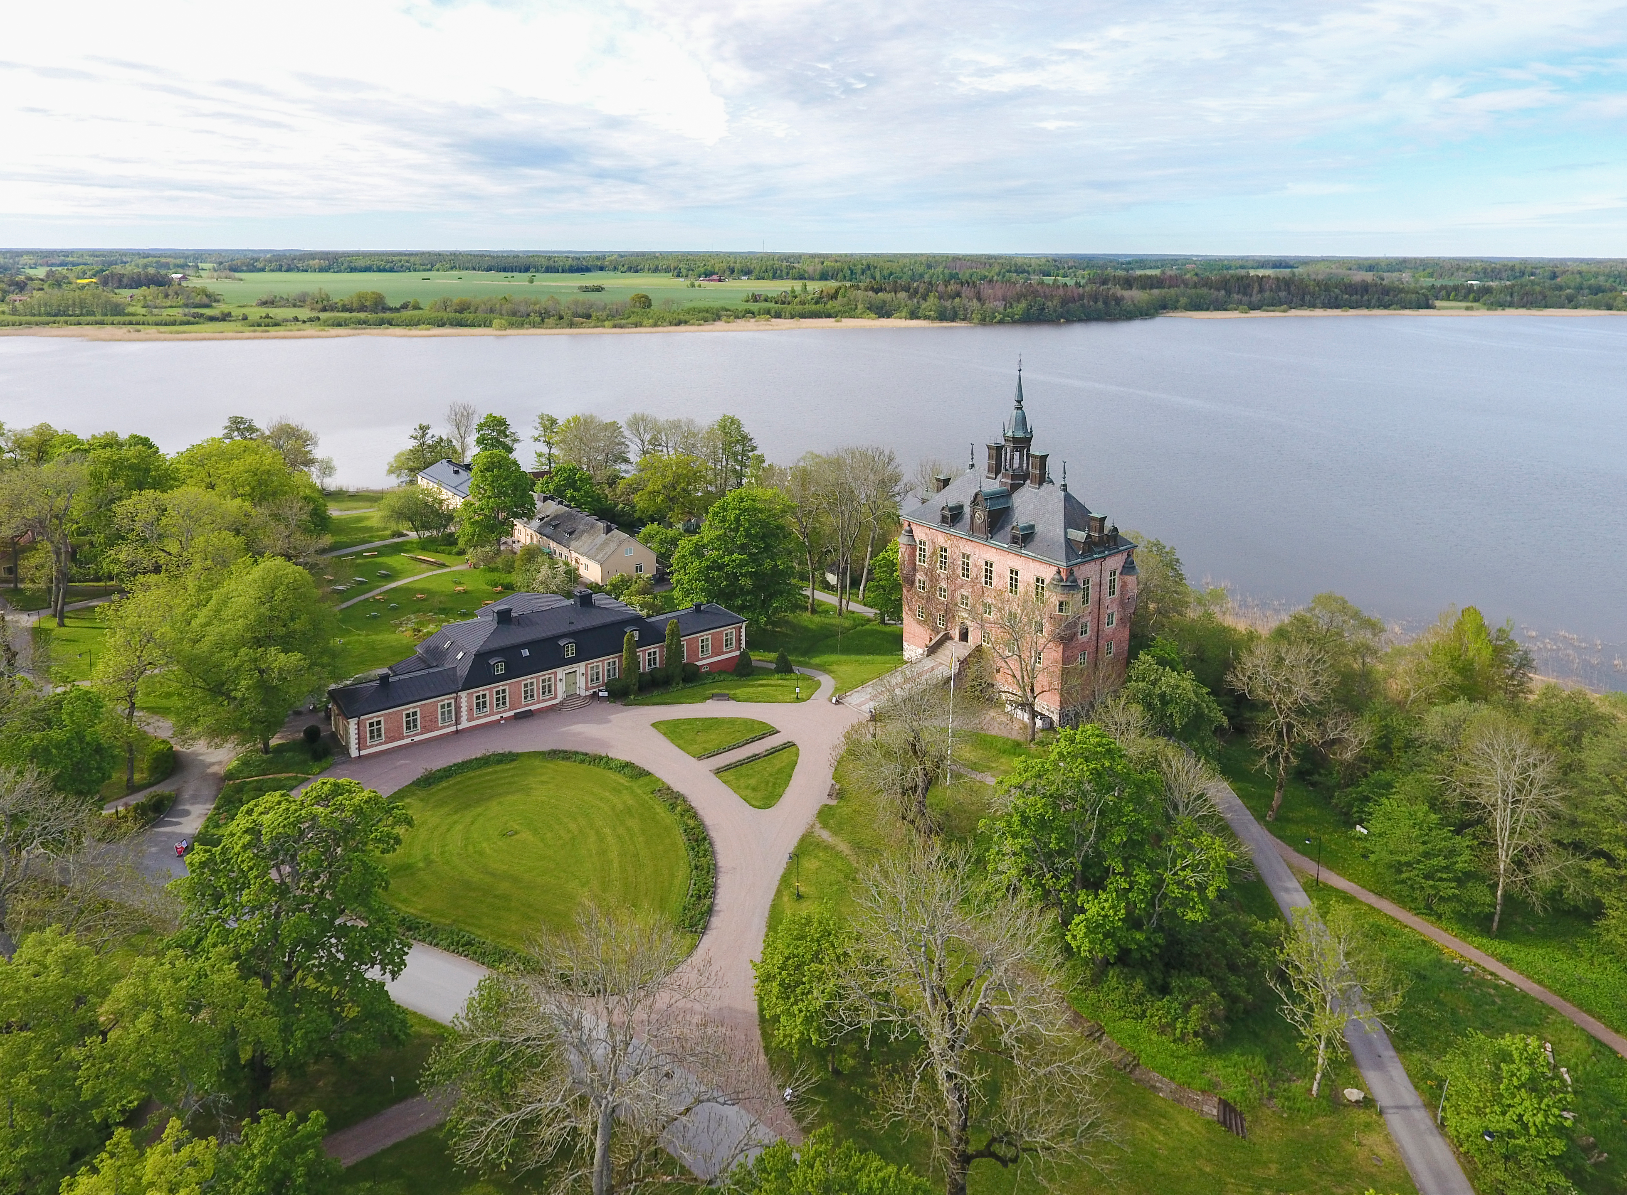
2026 Annual Meeting
Marcos Dracos
IPHC-IN2P3/CNRS/UNISTRA, Strasbourg

Slide 2
Agenda
https://indico.uu.se/event/2057/overview
 | Monday (05/10) | Tuesday (06/10) | Wednesday (07/10) | Thursday (08/10) | Friday (09/10)
Morning | Arrival | WP parallel sessions Collaboration photo | WP parallel sessions | Plenary session: WPs (summary and future plans) discussion | Governing Board +IAP preliminary report (open session)
Afternoon | Plenary session introduction Status of ESSnuSB+ report from DEB WPs (status report) | WP parallel sessions | free Dinner | IAP (closed) MT + EC (open session) DEB (open session)

Slide 3

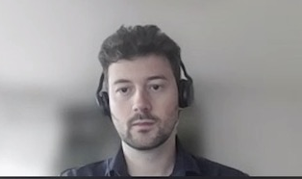
News
  New Project Officer since end 2025: Helinä YLI-KNUUTILA
  New new P.O. since June 2026: Felix Driencourt-Mangin

Slide 4

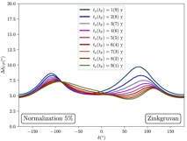





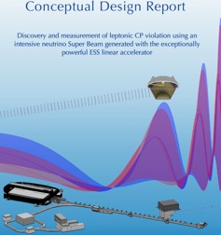
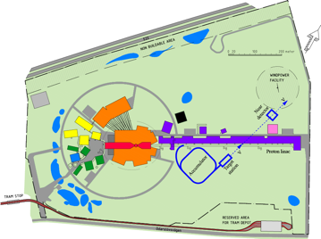
Where are we...
physics
2008-2012: EUROν Design Study (FP7)
2012: inception of the ESSnuSB project
2016-2020: COST Action EuroNuNet
2018-2022: ESSνSB Design Study, CDR (EU-H2020)
2023-2026: ESSνSB+ Design Study, CDR (EU-HE) and preparatory phase
2026-2035: TDR Phase, International Agreement
2035-2045: Construction of the facility and detectors, including commissioning
Data Taking
θ₁₃ measurement
Nobel prize:
T. Kajita &
A. McDonald
2015
X
Nucl. Phys. B 885 (2014) 127
ESSνSB+ CDR
ESSνSB CDR

Slide 5
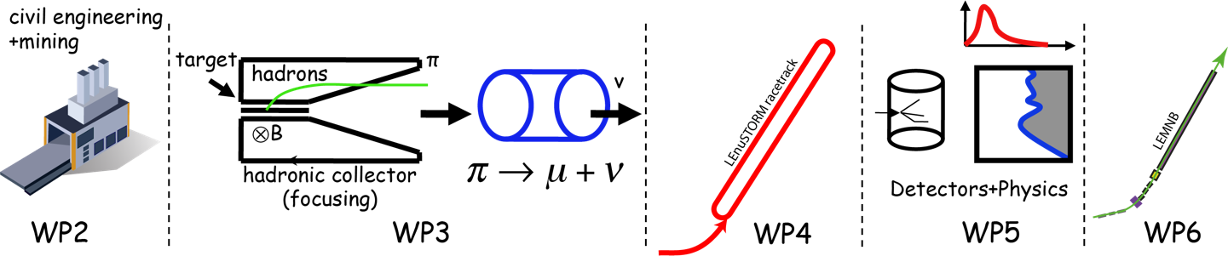
And now at the 4rd year of ESSνSB+
EU Design Study has been submitted end of April (HORIZON-INFRA2022-DEV-01)
Title of Proposal: Study of the use of the ESS facility to accurately measure the neutrino cross-sections for ESSνSB leptonic CP violation measurements and to perform sterile neutrino searches and astroparticle physics
Duration: 4 years
Total cost: 5 M€
Requested budget: 3 M€
20 participating institutes from
11 European countries including CERN and ESS (+ 4 observers)
6 Work Packages
Zinkgruvan mine (location of the far detector)
Ghent University, Belgium;
The Hellenic Open University, Greece;
AGH University in Krakow, Poland.

Slide 6
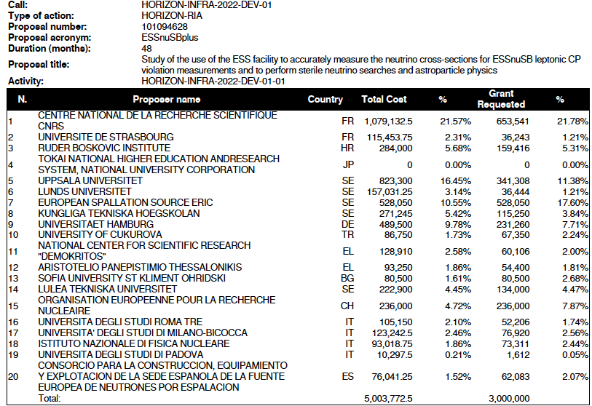
Proposal Evaluation Form

Slide 7
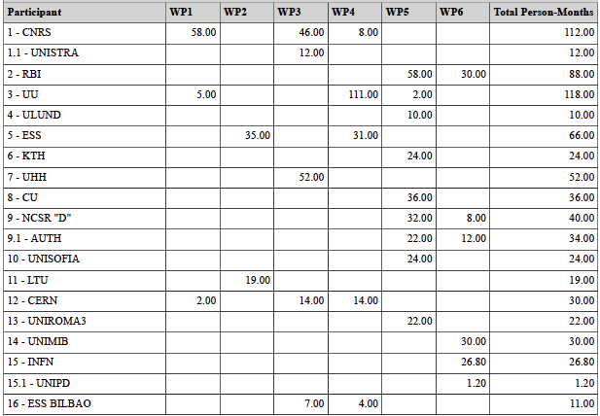
Project Effort in person-months

Slide 8
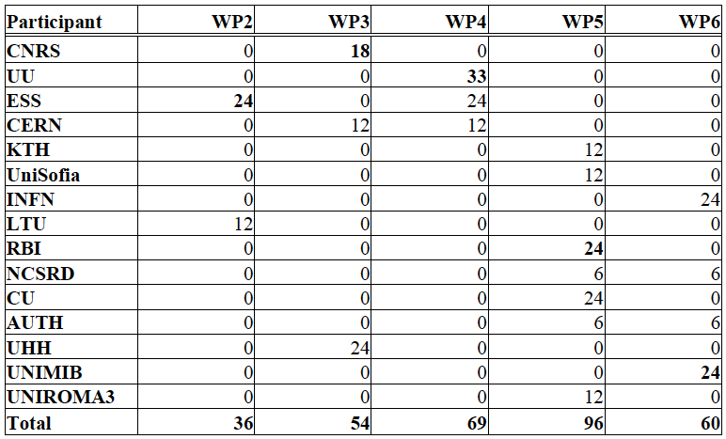
Official Post-doc list
(person-months)
Total: 315 months
~13 two-years postdocs

Slide 9
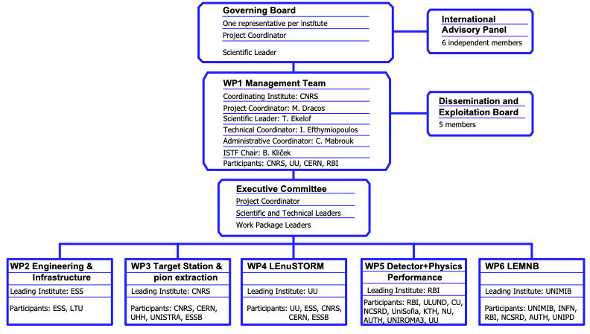
ESSνSB+ Structure

Slide 10
Project Administration
Grant Agreement
  Signed in December 2022
Consortium Agreement
  internal document, required by EU
  signed by all members during Spring 2023
All documents can be found on DocDB
  private part (userid: docdbrw / pw: xxxxxx): https://essnusb.eu/DocDB/private/DocumentDatabase
  public part: https://essnusb.eu/DocDB/public/DocumentDatabase
Our web-site: https://essnusb.eu
EU: https://cordis.europa.eu/project/id/101094628

Slide 11
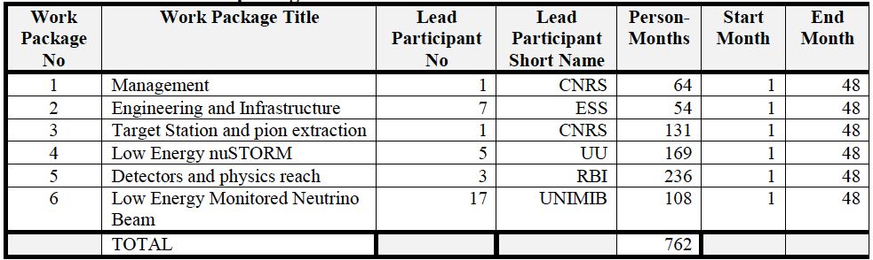
Work Packages

Slide 12
Appointment of the Work Package Coordinators
WP2: Engineering and Infrastructure: leading institute ESS
  Coordinator: Nick Gazis
  Co-coordinator: David Saiang
WP3: Target Station and pion extraction: leading institute CNRS
  Coordinator: Eric Baussan
  Co-coordinator: Tamer Tolba
WP4: Low Energy nuSTORM: leading institute UU
  Coordinator: Maja Olvegård
  Co-coordinator: Natalia Milas
WP5: Detectors and physics reach: leading institute RBI
  Coordinator: Monojit Ghosh
  Co-coordinator: George Fanourakis
WP6: Low Energy Monitored Neutrino Beam: leading institute UNIMiB
  Coordinator: Francesco Terranova
  Co-coordinator: Andrea Longhin

Slide 13
DEB Members
+ PC and SL
5 members
  Tamer Tolba (Chair, Hamburg U.)
  Elian Bouquerel (CNRS)
  Colin Carlile (Lund)
  George Fanourakis (Demokritos)
  Natalia Milas (ESS)

Slide 14
International Advisory Panel
Composed of 6 international experts.
Gives recommendations on:
  the crucial technical choices according to the international context,
  the distribution of resources to comply with priorities,
  activity planning.
It meets once a year (at every ESSνSB+ Annual Meeting).
  presents a preliminary report to the GB,
  provides a written report two months later.

Slide 15
International Advisory Panel
John Osborne, CERN,
  ~Civil engineering / WP2
Yong Joong Lee, Target Systems R&D, Second Target Station, Oak Ridge National Laboratory, USA,
  ~Target station / WP3
Shinji Machida, STFC, ISIS Neutron and Muon Source, UK,
  ~Accelerator / WP4
Teppei Katori, Dept of Physics, King’s College London, UK,
  ~Cross-sections / WP5 + WP6
Livia Ludhova, GS Helmholtzzentrum für Schwerionenforschung GmbH, Darmstadt and JGU Mainz, Germany,
  ~Detectors / WP5 + WP6
Mathieu Terrin-Perrin, CPPM, Marseille, France,
  ~Detectors / WP6

Slide 16
Deliverables
Work Package No | Deliverable Related No | Deliverable No | Description | Lead Beneficiary | Due Date | New Due Date (if delay) | Delivery Date | Approval Date | Status
WP1 | D1.1 | D1 | Data Management Plan | CNRS | 30 Jun 2023 |  | 14 Jun 2023 | 25 Apr 2024 | Approved
WP1 | D1.2 | D2 | Plan for dissemination and exploitation including communication activities | CNRS | 30 Jun 2023 |  | 14 Jun 2023 | 25 Apr 2024 | Approved
WP1 | D1.3 | D3 | Initial facility parameters | CNRS | 31 Aug 2023 |  | 29 Aug 2023 | 25 Apr 2024 | Approved
WP2 | D2.1 | D14 | Conceptual study of civil works with indicative timeline for ESS Site related activities | ESS | 30 Apr 2026 | 31 Aug 2026 | 31 Aug 2026 |  | Submitted
WP2 | D2.2 | D17 | Machine Conceptual Design & Mechanical Design of Linac, 2nd Target Station, near and far detectors, auxiliary systems and infrastructure | ESS | 31 Aug 2026 | 30 Nov 2026 |  |  | Pending
WP2 | D2.3 | D19 | Deliverables for the far detector Civil Engineering Study including far detector site Feasibility Report and far detector Civil Engineering Study Report | LTU | 31 Oct 2026 |  |  |  | Pending
WP3 | D3.1 | D4 | Optimise the ESSvSB+ horn design and its pulse generator | UNISTRA | 30 Jun 2024 |  | 01 Jul 2024 | 16 Sep 2025 | Approved
WP3 | D3.2 | D6 | Design of the pion extraction and focusing systems | UNISTRA | 31 Dec 2024 | 31 Mar 2025 | 31 Mar 2025 | 16 Sep 2025 | Approved
WP3 | D3.3 | D21 | Design of the Target Station | UNISTRA | 31 Oct 2026 |  |  |  | Pending
WP4 | D4.1 | D7 | Review of the LEnuSTORM operation scheme | UU | 31 Dec 2024 |  | 20 Dec 2024 | 16 Sep 2025 | Approved
WP4 | D4.2 | D12 | Racetrack ring design | UU | 28 Feb 2026 |  | 27 Feb 2026 |  | Submitted
WP4 | D4.3 | D18 | Design of the LEnuSTORM transfer and injection systems | CNRS | 31 Aug 2026 |  | 16 Sep 2026 |  | Submitted
WP5 | D5.1 | D5 | Preliminary design of the LEnuSTORM/monitored beam near detector | RBI | 30 Nov 2024 |  | 26 Nov 2024 | 16 Sep 2025 | Approved
WP5 | D5.2 | D10 | Sensitivity of ESSνSB far detectors to non-beam physics | RBI | 30 Nov 2025 |  | 25 Nov 2025 |  | Submitted
WP5 | D5.3 | D13 | Performance of neutrino interaction cross-section measurement | RBI | 30 Apr 2026 | 30 Jun 2026 | 26 Jun 2026 |  | Submitted
WP5 | D5.4 | D15 | Sensitivity of END and LMND to sterile neutrinos and other new physics | RBI | 31 Jul 2026 |  | 27 Jul 2026 |  | Submitted
WP5 | D5.5 | D16 | Effect of the ML approach on event reconstruction performance for ESSνSB and error analysis | ULUND | 31 Jul 2026 |  | 27 Jul 2026 |  | Submitted
WP6 | D6.1 | D8 | Design of the LEMNB transfer line | UNIMIB | 31 Dec 2024 | 30 Sep 2025 | 14 Nov 2025 |  | Submitted
WP6 | D6.2 | D9 | Completion of the LEMNB end-to-end simulation of the beamline | UNIMIB | 30 Jun 2025 | 31 Dec 2025 | 29 Dec 2025 |  | Submitted
WP6 | D6.3 | D11 | Physics performance of the monitored neutrino beam | UNIMIB | 31 Dec 2025 | 30 Jun 2026 | 30 Jun 2026 |  | Submitted
WP6 | D6.4 | D20 | Update of LEMNB physics performance including the full systematic budget | UNIMIB | 31 Oct 2026 |  |  |  | Pending

Slide 17
Milestones
Milestone No | Milestone Name | Work Package No | Lead Beneficiary | Means of Verification | Due Date | New Due Date (if delay) | Achieved
1 | Review of 1st year achievements, deliverables & costs | WP2,WP1,WP4,WP3,WP6,WP5 | CNRS | Report reviewed by GB | 31-Dec-23 |  | o
2 | First design of the hadron collector | WP3 | CNRS | Report reviewed by external experts | 31-Dec-23 |  | o
3 | Identification of requirements for LEnuSTORM / monitored beam near detector | WP4,WP6,WP5 | RBI | Report reviewed by EC | 31-Dec-23 |  | o
4 | Identification of the location and layout of the LINAC transfer line | WP6 | UNIMIB | Internal review | 31-Dec-23 |  | o
5 | Identification of non-beam physics scenarios | WP5 | RBI | Internal review | 31-May-24 |  | o
6 | Evaluation of the LEnuSTORM requirements and parameter range | WP4,WP3,WP5 | UU | Report reviewed by external experts | 30-Jun-24 |  | o
7 | Implementation of the static focusing system in MADX and G4beamline | WP6 | UNIMIB | Internal review | 30-Jun-24 |  | o
8 | Identification of LEnuSTORM physics scenarios | WP5 | RBI | Internal review | 31-Oct-24 |  | o
9 | Preliminary design of the pion extraction and focusing system | WP3 | CNRS | Report qualified by external experts | 31-Dec-24 |  | o
10 | MC simulation framework for all detectors is set up | WP5 | RBI | Internal review | 31-Dec-24 |  | o
11 | Development of ML approach finished and implemented for a data test sequence | WP5 | RBI | Internal review | 31-Dec-24 |  | o
12 | MC simulation framework for the tunnel instrumentation is set up | WP6 | UNIMIB | Internal review | 31-Dec-24 |  | o
13 | Review on interim milestones, deliverables & costs | WP2,WP1,WP4,WP3,WP6,WP5 | CNRS | Report reviewed by GB | 31-Dec-24 |  | o
14 | Update of the physics reach framework | WP5 | RBI | Internal review | 31-Mar-25 |  | o
15 | Conceptual report with indicative timeline for ESS site works | WP2 | ESS | Report internal review | 30-Apr-25 |  | o
16 | Preliminary estimation of cross-section measurement precision | WP5 | RBI | Internal review | 31-May-25 |  | o
17 | Preliminary racetrack ring lattice design | WP4 | UU | Report reviewed by external experts | 30-Jun-25 |  | o
18 | Analysis framework for the evaluation of the systematics is set up | WP6 | UNIMIB | Internal review | 30-Jun-25 |  | o
19 | Preliminary estimate of the neutrino flux in the monitored neutrino beam | WP6,WP5 | UNIMIB | Internal review | 30-Jun-25 | 31-Dec-25 | o
20 | Conceptual Mechanical & Machine Design | WP2 | ESS | Design internal review | 31-Oct-25 | 31-Jan-26 | o
21 | First estimate of the neutrino flux from LEnuSTORM | WP4,WP5 | RBI | Internal review | 30-Sep-25 |  | o
22 | Final estimation of the pion beam | WP3 | CNRS | Report reviewed | 31-Dec-25 |  | o
23 | Review of 3rd year milestones, deliverables & costs | WP2,WP1,WP4,WP3,WP6,WP5 | CNRS | Report reviewed by GB | 31-Dec-25 |  | o
24 | Evaluation of the baseline design of the target station | WP3 | CNRS | Report reviewed by external experts | 30-Jun-26 |  | o
25 | Civil engineering study for the far detector | WP2 | ESS | Study internal review | 31-Oct-26 |  | x
26 | Updated design of the linac, accumulator ring and transfer lines | WP4 | UU | Report reviewed by external experts | 30-Jun-26 |  | o
27 | Cost and performance evaluation complete | WP2,WP1,WP4,WP3,WP6,WP5 | CNRS | Report reviewed by external experts | 31-Dec-26 |  | x

Slide 18
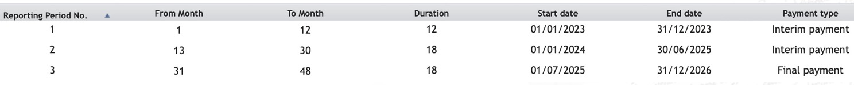
Reporting Periods
(imposed by EU)
for ESSnuSB+:
Three parts:
Financial (administration)
Technical (WPs)
New: Policy brief (2-pages, imposed by EU after approval):
  Implementation of RI
  Access to RI
  Funding of RI
  International cooperation of RI
  Employment and skills in RI
  Greening of RI
  Interaction of RI with industry
  ERIC legal framework
  Technology development, data and digital services, digitalisation
  Level of connection of RI to European Open Science Cloud
  Contribution to other research areas and to broader EU priorities
  Sustainability of RI
2nd Periodic Report submitted end of August 2025

Slide 19
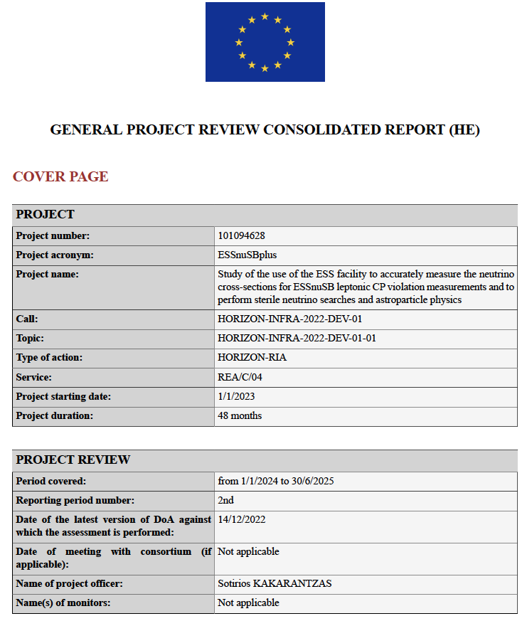
Second Periodic Report
(18 months)
30 days to reply in case of disagreement
(deadline 17/10/2025)
Reviewer:
Ioana MARIS (ULB New York University Abu Dhabi)
Same evaluator for the last evaluation (~March 2027)

Slide 20
Second Periodic Report
(18 months)
3 EU remarks to be addressed before the review of the next reporting period:
For the column “PID of deposited publication”, filling this field is mandatory in the sense that you always need to deposit your publications in a trusted repository, e.g. Zenodo (irrespectively of the versions available in the journals’ websites). We need the link of this repository (e.g. Zenodo link) for all the peer reviewed publications. This is not a blocking step for the acceptance of this periodic report but we need to follow up as soon as possible and have everything settled before the review of the next reporting period.
Updated versions of the data management plan and the dissemination and exploitation plan, before the end of the project, are needed. In particular, these plans need to be revised at least once during the project, as per the HE provisions outlined on pages 390 and 394 of the HE AGA. The updated versions will be treated as deliverables and will be evaluated by the expert in our next review. As no slots were foreseen in the system you will need to send the updated documents through the portal.
Thank you for creating the LinkedIn account. Communication and dissemination is an important aspect/obligation with regard to the implementation of the project as outlined in article 17 of your GA. Having said that, please make efforts to increase the followers as much as possible. It would be also advisable to create some more videos (e.g. interviews, presentation of experimental infrastructures etc) to be uploaded in the YouTube channel and to be advertised through LinkedIn. A detailed presentation of the dissemination and communication activities, that took place in the course of the project, should be included, in a dedicated section, in the technical report in the next reporting period.
now solved by using HAL repository (CNRS)

Slide 21
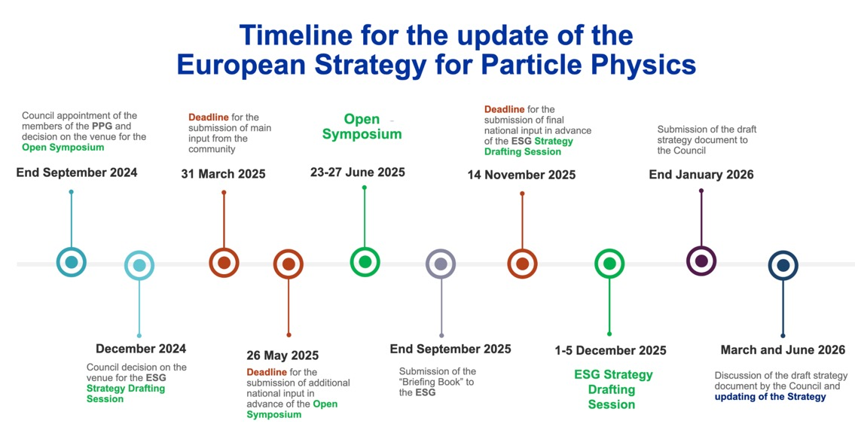
ESFRI/CERN strategy
  Past events & deadlines:
  ESFRI Info Day, Brussels, 8 October 2024
  EU Roadmap
  Deadline for contribution submissions: 31/03/2025

Slide 22
EPPS
Roadmap
Major developments since the 2020 Strategy:
  ... The global neutrino programme has made significant advances towards the determination of neutrino masses and leptonic mixing, and the construction of the next generation of accelerator-based neutrino experiments is progressing rapidly. The CERN Neutrino Platform is a focal point of European participation in the global long-baseline neutrino programme. In particular, the current commitments to the LBNF/DUNE project have been decisive and remain a priority for CERN...
Other research directions in particle physics:
  The origin of neutrino masses is one of the most important open questions in particle physics. The long-baseline experiments DUNE and Hyper-K, along with other neutrino experiments, will be key to determining the neutrino parameters. Searches for rare processes such as proton decay and neutrinoless double-beta decay could provide evidence for new physics at very high energy scales, while studies of neutrino interactions further expand the opportunities for discovery. Improving laboratory measurements of the absolute neutrino mass scale is increasingly important in the era of high-precision cosmology.
  CERN should continue to provide support to the global long-baseline neutrino programme via the Neutrino Platform. The collaboration between CERN and non-accelerator-based experiments on technologies of mutual benefit should be continued.

Slide 23
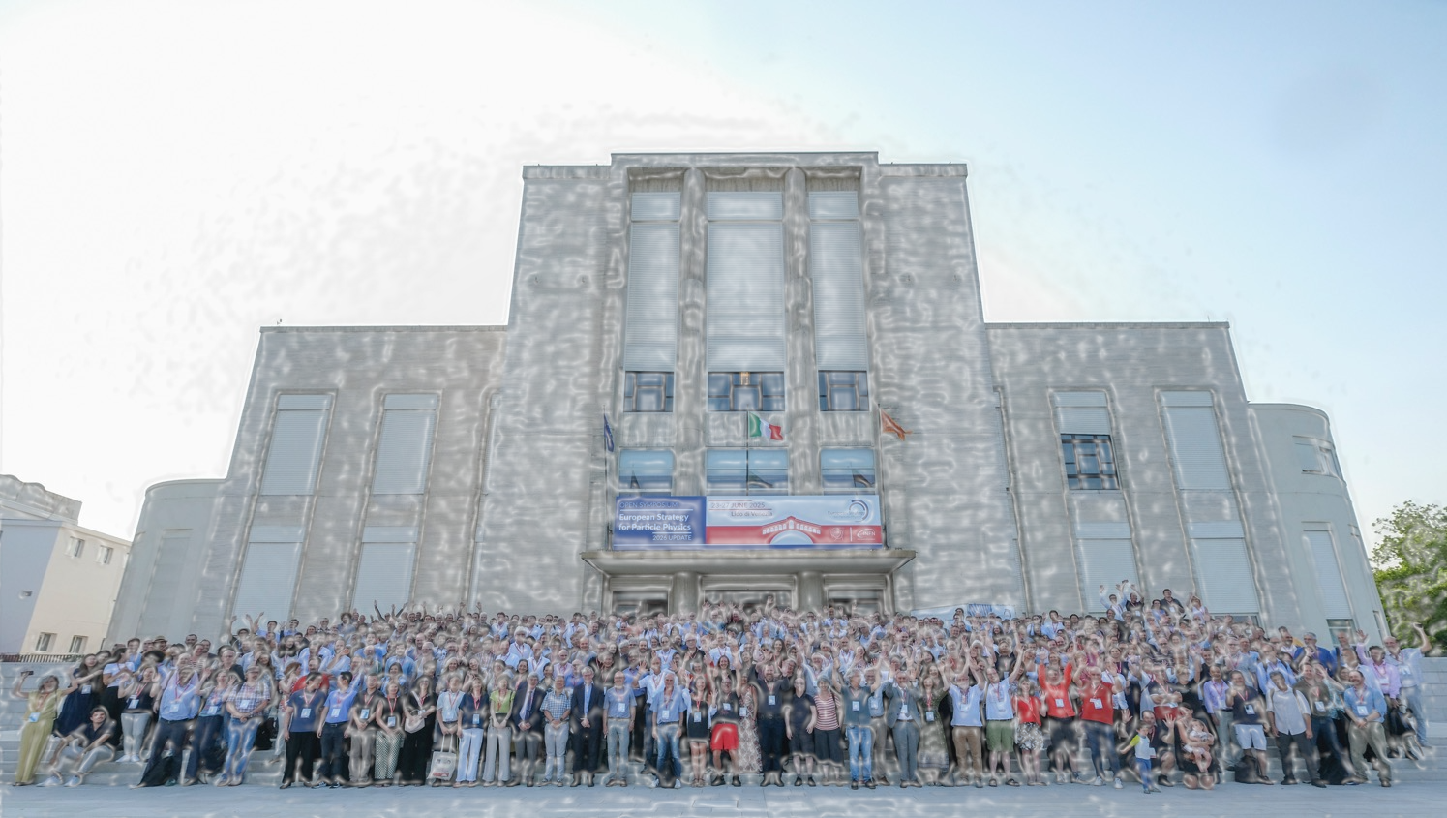
EPPS
Physics Briefing Book
To push the physics reach beyond what is described above, various feasibility studies are being conducted for new experiments in Europe: a new gigantic reactor experiment at Chooz (Super Chooz [13]) and a new neutrino beam at the European Spallation Source (ESSnuSB [ID151]). ESSnuSB proposes to exploit the second oscillation maximum, where the CPV effect is enhanced. Feasibility studies are also being conducted for a possible new far detector technology on the DUNE beam (THEIA [ID263]) with dual readout (water Cherencov doped with liquid scintillator) enabling increased mass and improved reach in the physics program of low-energy neutrinos.

Slide 24

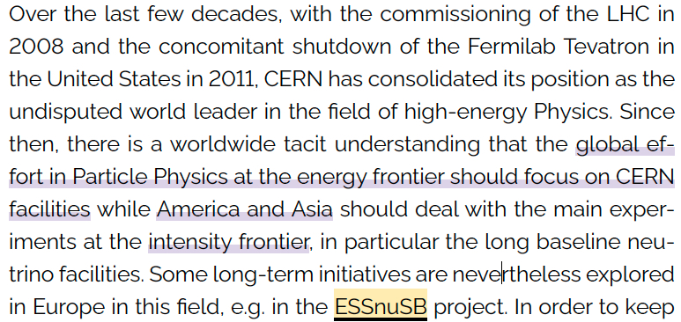
ESFRI
ESFRI Landscape analysis
Very important to remain in the next document (~2029)

Slide 25

Congratulations!

Slide 26
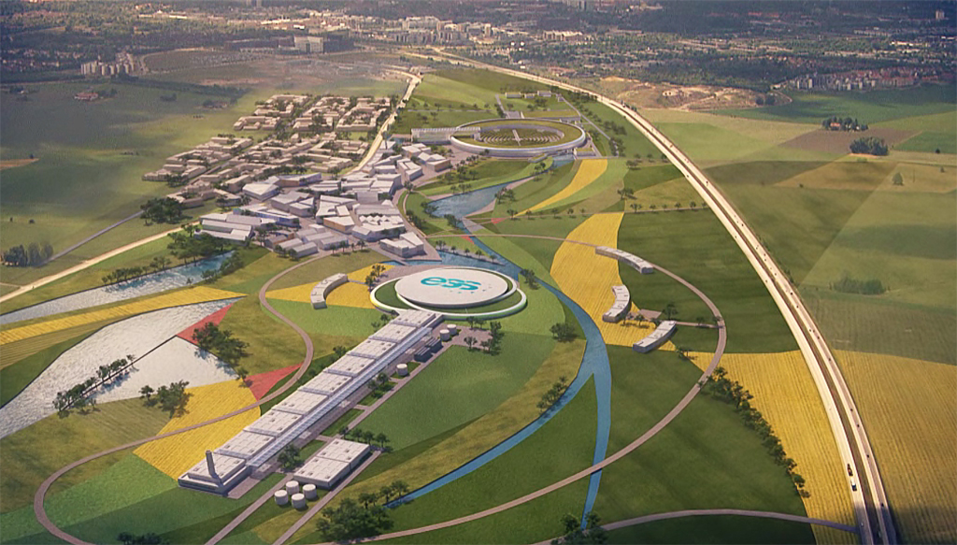
Backup

Slide 27
Meetings
(from CA)
 | Ordinary meeting | Extraordinary meeting
Governing Board | At least once a year | At any time upon written request of the Executive Committee or 1/3 of the Members of the Governing Board.
Executive Committee | At least 3 times per year | At any time upon written request of any Member of the Executive Committee.
Management Team | At least 6 times per year | According to needs.
International Advisory Panel | Once per year | Upon request of the Governing Board.
Dissemination and Exploitation Board | At least 3 times per year | Upon request of the Governing Board.

Slide 28
Meeting in Brussels with RTD
(18 Sep. 2026)
Present: René Martins, Patricia POSTIGO MCLAUGHLIN, another person from DG RTD, DRIENCOURT-MANGIN Felix (our P.O.), Tord and Marcos
In the new frame program, from 2028 on, it is probable that there will be the possibility that EU finance up to 20% of the construction!
We must be ready for the ESFRI list by 2029 for the ~2031 new list (3 letters).
  It is vital to stay mentioned in the ESFRI Landscape analysis report.
Meanwhile, R&D through INFRATECH, next year from 5-15 M€, 2-3 projects, very competitive. Call by spring 2027.
  with 15 M€ we could put all R&D for all WPs together.
No any (at least known) study on the becoming of INFRADEV studies!
Request to have devoted calls to the successful INFRADEV studies for R&D.
For present project:
  if delays on deliverables they have to be announced now,
  for transferring money from dissemination to salaries or traveling we have to do it before the 15th of October.
  meeting with evaluator mid-March 2027.

Slide 29
CDR timeline
Keep the same format as the previous one
Frist draft on overleaf: March 2026
Start filling the WP chapters: April
First "good" draft: November 2026
Include costing: January 2027
Finish: End of February 2027
https://www.overleaf.com/read/dncfhfwmzwnt#eadc4b

Slide 30
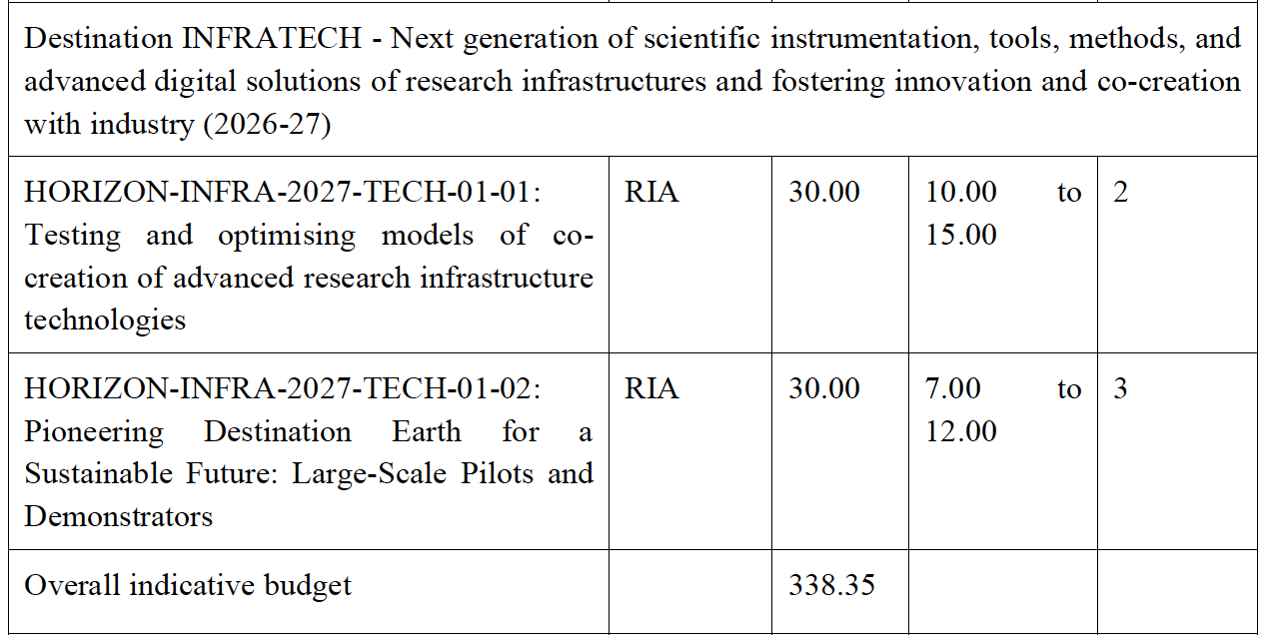
Coming EU calls

