Slide 1


ESSnuSBplus DEB
2026 Report
Tamer Tolba
(on behalf of the Dissemination and Exploitation Board)
05 Oct. 2026

Slide 2

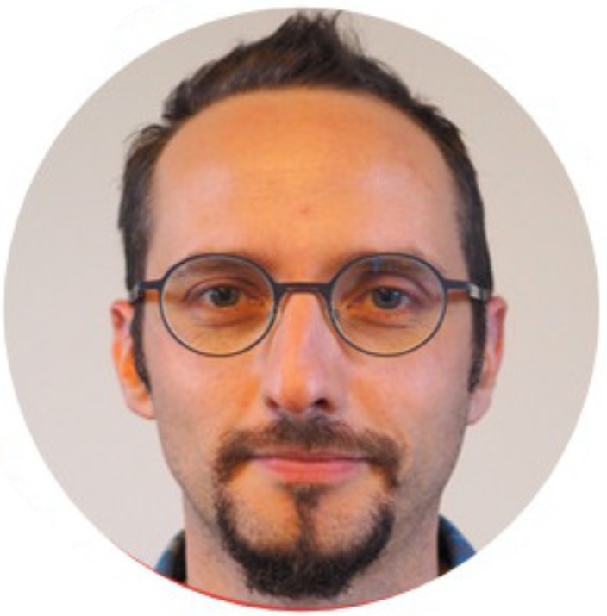
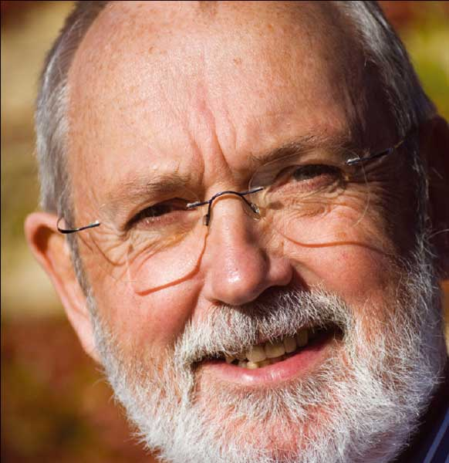
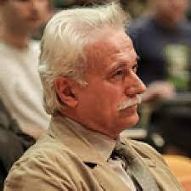
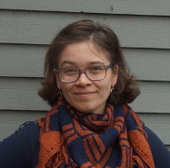
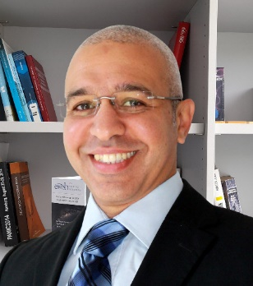

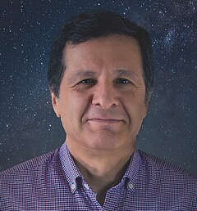
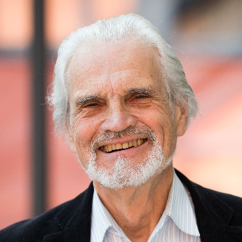
ESSnuSB+ DEB members
Elian BOUQUEREL
Colin CARLILE
Georgios FANOURAKIS
Natalia MILAS
Tamer TOLBA
(Chair)
Marcos DRACOS
(Project coordinator)
Tord EKELÖF
(Scientific coordinator)
Carole MABROUK
(Administration assistance)
https://essnusb.eu/dissemination-exploitation-board-essnusb/
ESSNUSB-DIS-L@in2p3.fr

Slide 3
DEB activities
DEB 2023 meetings:
1st DEB (kick off) meeting, held on 26 & 30 Jan. 2023
2nd DEB meeting, held on 08 June 2023
3rd DEB meeting, held on 21 Sept. 2023
4th DEB meeting, held on 19 Oct. 2023
DEB 2024 meetings:
5th DEB meeting, held on 11 Jan. 2024
6th DEB meeting, held on 15 Apr. 2024
7th DEB meeting, held on 27 Jun. 2024
8th DEB meeting, held on 26 Sept. 2024
DEB 2025 meetings:
9th DEB meeting, held on 20 Jan. 2025
10th DEB meeting, held on 28 Apr. 2025
11th DEB meeting, held on 26 Sept. 2025
DEB 2026 meetings:
12th DEB meeting, held on 12 Jan. 2026
13th DEB meeting, held on 04 May 2026
14th DEB meeting, held on 09 Oct. 2026

Slide 4
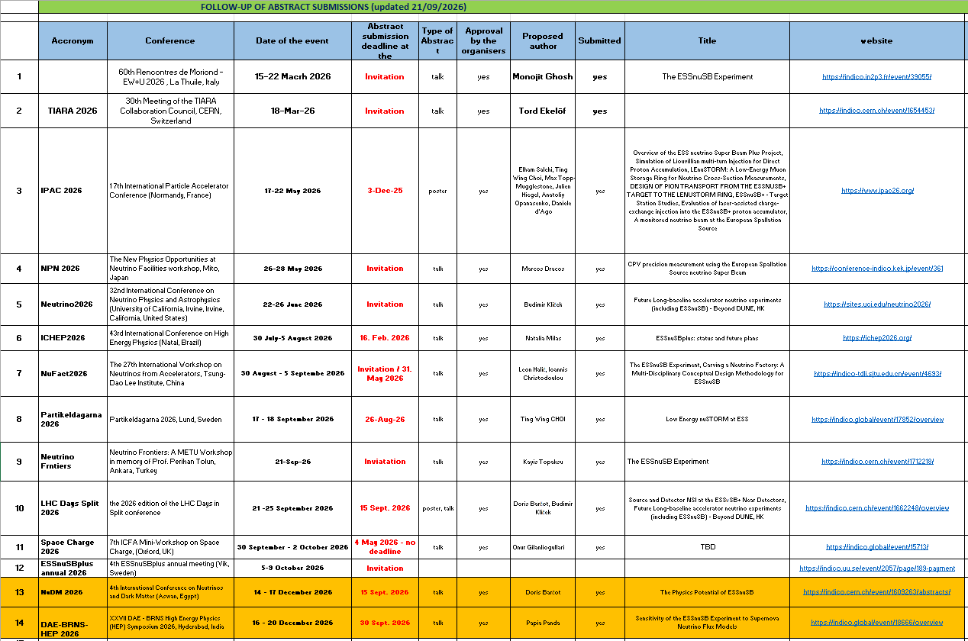
ESSnuSB+ Conferences’ Attendance in 2026

Slide 5
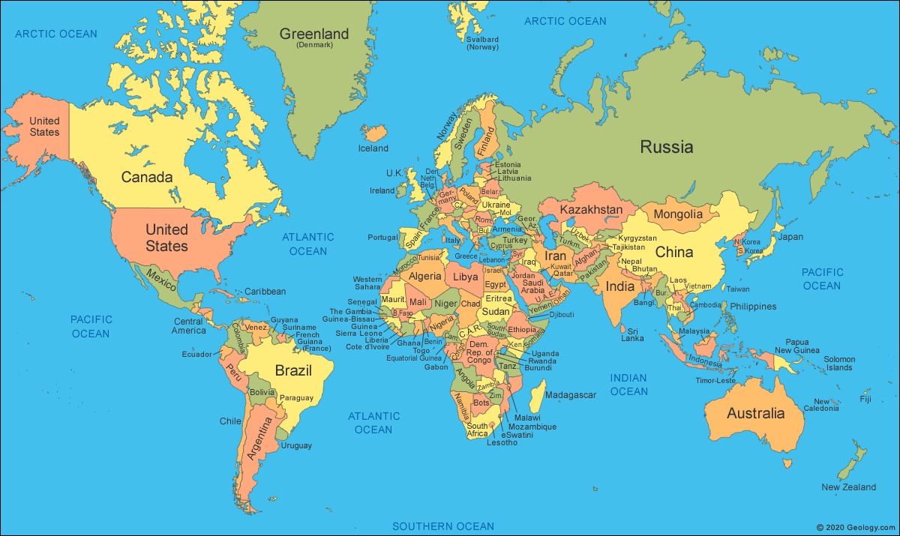

ESSvSB+ conference attendance coverage 2026

Slide 6
Some statistics on 2025 participations
Personnel participations in 2026
8 PIs
8
postdoc
3 PhD students
14 participations in 2026
6 invited talks
5 contributed talks
7
posters
1 outreach activity
WP participations in 2026
WP1
WP2
WP3
WP4
WP5
WP6
e.g.,
Neutrino 2026
NuFact 2026
NBN 2025
e.g.,
ICHEP 2026
NuDM 2026

Slide 7
Publications and Proceedings (2026)
Publications:
S. Choubey, T. Ohlsson, S. Vihonen et al., JHEP05, (2026) 109
“Searching non-standard interactions with atmospheric neutrinos at ESSnuSB”
J. Aguilar et al., Universe 12 (2026) 280
“Study of Supernova Neutrinos at ESSnuSB”
J. Aguilar et al., arXiv:2608.23773v2 [hep-ex] (2026)
“Exploring ESS𝝂SB Near Water Cherenkov Detector Designs Through Graph Neural Network Flavour Identification”
J. Aguilar et al., arXiv:2603.02836 [hep-ex] (2026)
“Complementarity between atmospheric and super-beam neutrinos at ESSnuSB”
“Effect of decay pipe in 3+1 scenario using LEMNB-LEMMOND setup within ESSnuSB+”
Corresponding authors: Doris Barčot, Antonio Branca, Monojit Ghosh, Alessio Giarnetti and Davide Meloni
“An Analytical Model for Fast Design Optimization and Performance Studies of nuSTORM”
Corresponding authors: Ting W. Choi
Submitted to Deb on 16 Sept. 2026
Submitted to Deb on 30 Sept. 2026

Slide 8
Publications and Proceedings (2026)
Proceedings:
1- D. D'Ago et al., "A monitored neutrino beam at the European Spallation Source", presented at IPAC'26, Deauville, France, May 2026, paper THP4052.
2- E. Bouquerel, M. Olvegaard and M. Dracos, "Accumulator-to-Target Beam Transfer Line for ESSnuSB+", presented at IPAC'26, Deauville, France, May 2026, pp. 2849-2852, paper WEP5007. https://www.ipac26.org/prepress/doi/jacow-ipac2026-wep5007/index.html
3- T. Choi, M. Olvegaard and M. Topp-Mugglestone, "LEnuSTORM: A Low-Energy Muon Storage Ring for Neutrino Cross-Section Measurements", presented at IPAC'26, Deauville, France, May 2026, paper SUP1010. 10.18429/JACoW-IPAC2026-MOP1098
4- A. Opanasenko, N. Milas and M. Olvegaard, "Evaluation of laser-assisted charge-exchange injection into the ESSnuSB+ proton accumulator", presented at IPAC'26, Deauville, France, May 2026, pp. 4547-4550, paper THP4084. 10.18429/JACoW-IPAC2026-THP4084
5- M. Topp-Mugglestone, I. Efthymiopoulos, "DESIGN OF PION TRANSPORT FROM THE ESSnuSB+ TARGET TO THE LEnuSTORM RING", presented at IPAC'26, Deauville, France, May 2026, pp. 170-173, paper MOP1043. 10.18429/JACoW-IPAC2026-MOP1098
6- J. Hiegel and E. Baussan, "ESSnuSB+: target station studies", presented at IPAC'26, Deauville, France, May 2026, pp. 318-320, paper MOP1095, 10.18429/JACoW-IPAC2026-MOP1095.
7- George Fanourakis (on behalf of the ESSnuSB/ESSnuSB+ collaboration), “The ESSnuSB-plus (ESSnuSB+) Project:Status and Prospects”, presented at the 32nd International Symposium on Lepton Photon Interactions at High Energies, Madison, Wisconsin, USA, August 25-29, 2025. https://arxiv.org/pdf/2601.15826
8- Monojit Ghosh (on behalf of the ESSnuSB+ collaboration), “Physics with next generation neutrino experiments: ESSnuSB”, presented at Matter to the deepest: Recent developments in physics of fundamental interactions, XLVI international conference of theoretical physics (MTTD 2025), University of Silesia in Katowice, Poland 15 - 19 September 2025 https://arxiv.org/abs/2601.10271

Slide 9
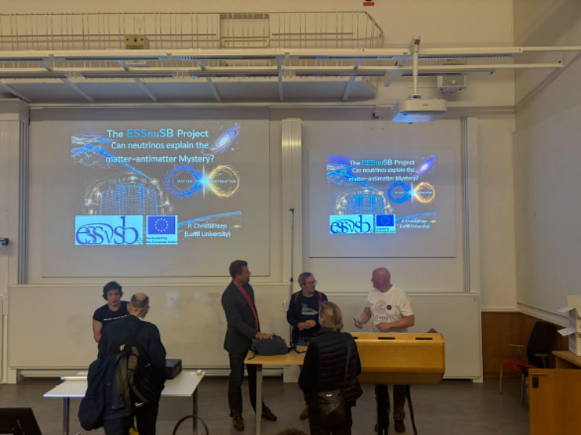
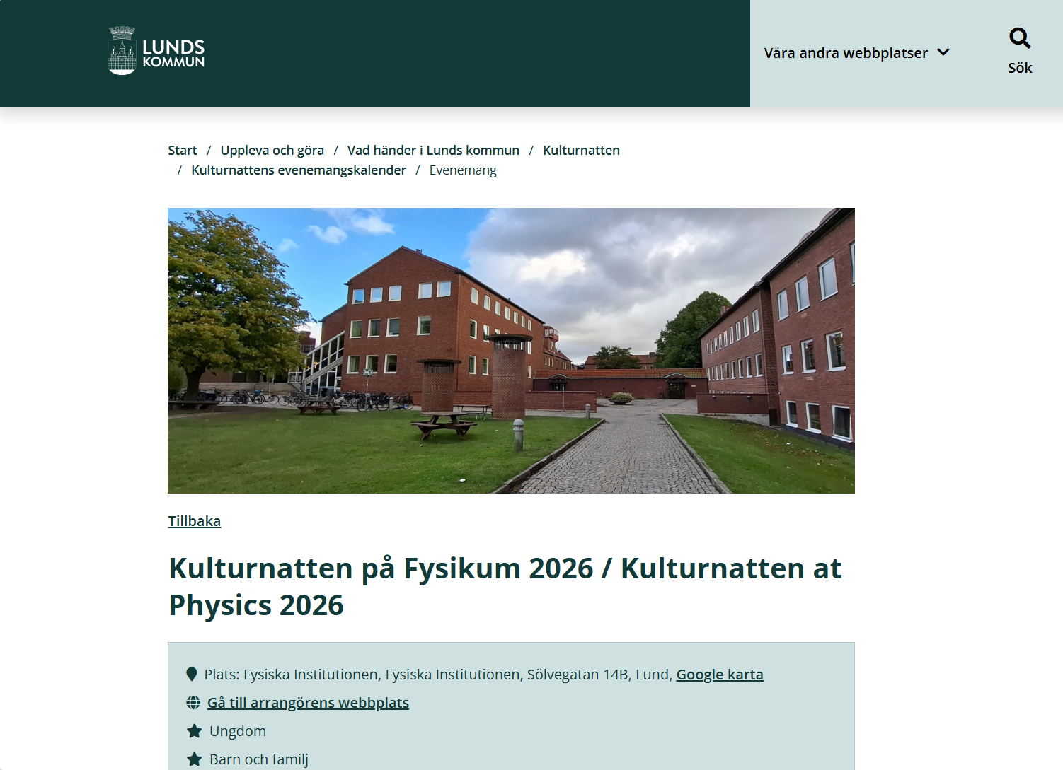
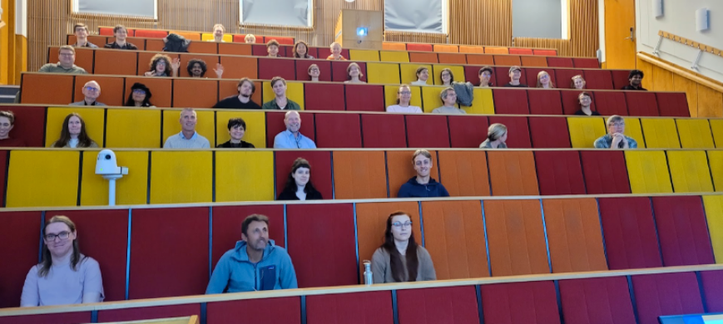
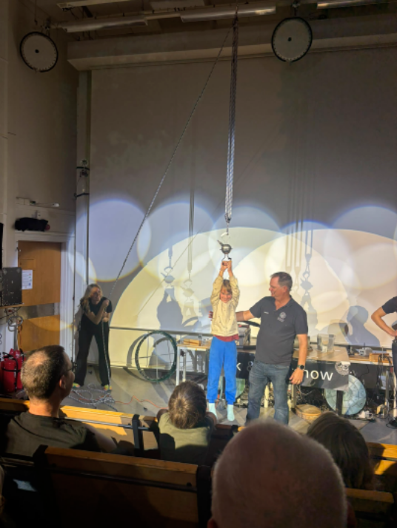
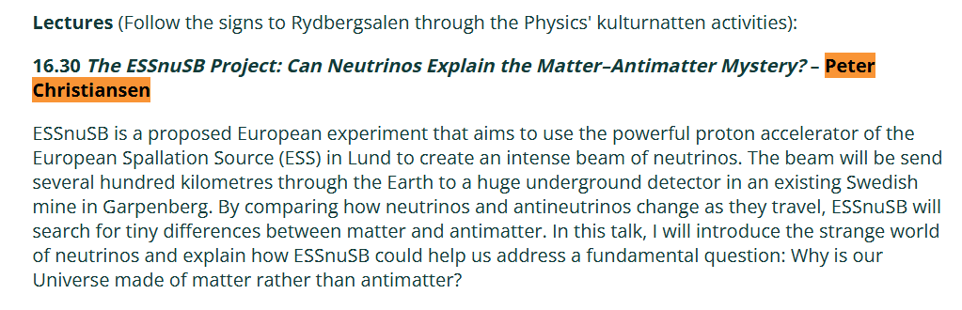
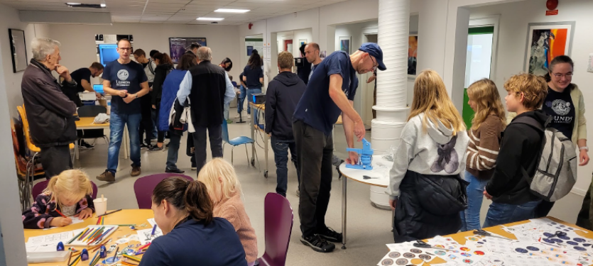
Outreach activity (2026)
Peter Christiansen Speaker and organizer
https://lund.se/uppleva-och-gora/vad-hander-i-lunds-kommun/kulturnatten/kulturnattens-evenemangskalender/evenemang?id=6a79823ce368ec666f8bf4fc

