Slide 1
WP2 Engineering & Infrastructure
ESSnuSB+ 4th Annual Meeting Report
Dawid Patrzalek, nick Gazis

Slide 2
Milestones & Deliverables
What was delivered since the last annual meeting?
  MS20 - Conceptual Mechanical & Machine Design
  MS23 - Review of 3rd year milestones, deliverables & costs
  MS27 - Cost and performance evaluation complete
  Task 2.4 - Timeline estimation for ESS site
  D2.1 - Conceptual study of civil works with indicative timeline for ESS Site related activities (month 40)
    Report fully released
    Update will be provided by Ioannis Christodoulou
  IAP 2025 – WP2 Response to the International Advisory Panel 2025 Report

Slide 3
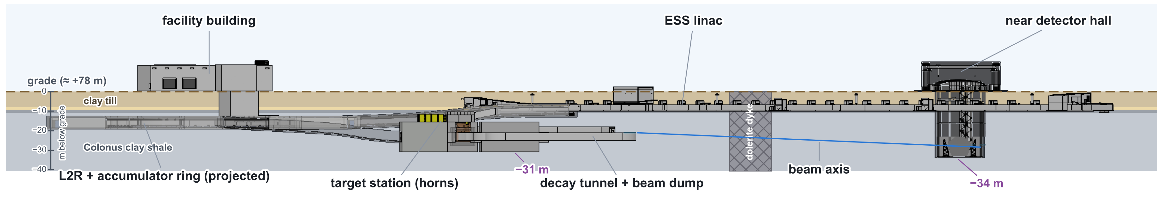
IAP recommendations
Accelerator Complex: long profile, topography and tunnel slope
Finding 1: The long profile for the accelerator complex does not show the real site topography with actual depths of the various underground structures on the ESS site. In addition, the sketch does not indicate the slope of the tunnels to ensure that they are orientated correctly with respect to the ZINKGRUVAN mine.
Recommendation 1: This long profile should be updated with real topography, tunnel slope and the expected geology on the ESS site. If the existing Geological data from the ESS is not sufficient, additional site investigations should be considered.
Response 1: The preliminary site design considers that the facility infrastructure shall be constructed on a level plane throughout, with the exception of the nuSTORM Racetrack.
Incorporating input from CERN civil engineering, the actual site topography is deemed redundant to be captured in the long profile drawings, as the terrain at the ESS site can be modified at circumstances to meet project requirements.
Long profile drawing with relevant details of the geological cross-section of the site has been created. No further site investigations are currently neither planned nor budgeted, as such efforts would necessitate a substantial resource allocation.

Slide 4
IAP recommendations
Accelerator Complex: shielding integration
Finding 2: It was stated at the Milos meeting that “shielding integration is not foreseen at this stage of the project”.
Recommendation 2: The IAP recommends that some early feasibility studies should be carried out at this stage, at least to allow an estimate for the volume of the shielding to allow costing of the facilities.
Response 2: The design study has not yet reached the maturity level for calculation on radiation shielding. Without any such calculation data, the WP2 has very limited input on sizing and/or estimating any shielding requirements and materials.
However, to enable basis for cost estimation, the shielding design of the ESS LINAC has been considered, after adaptation, for the ESSnuSB+ new tunnels. Such approach enabled WP2 to proceed with the costing of the site infrastructure throughout the studies.

Slide 5
IAP recommendations
Accelerator Complex: civil engineering cost estimate
Finding 3: WP2 has been requested to produce a cost estimate for the civil engineering.
Recommendation 3: The IAP recommended that:
  more detailed civil engineering drawings be developed, and basic integration studies be carried out to fix the dimensions of the underground and surface structures;
  access to the ESS construction cost data be obtained, to allow a comparison against this recently constructed project;
  the ESSnuSB+ management define a costing strategy so that all Work Packages follow the same guidelines (for example, the level of accuracy of the costing, and what is and is not included in the estimate, such as manpower);
  a risk assessment for the accelerator complex be produced alongside the costs.
Response 3: Following the recommendation, a more detailed civil engineering design was developed, including the preliminary dimensioning of the ESSnuSB+ structures.
In addition, preliminary electrical consumption estimates were completed, with the ESS Civil Engineering team supporting the costing of the electrical substations. The design package was used for the cost estimation, together with the support of ESS Civil Engineering, and draws on historical data from the original ESS greenfield construction.
Regarding operational impact, preliminary discussions at ESS suggest that the construction and operation of ESSnuSB+ would pose only limited risk to the existing LINAC and only minor disruption to overall facility operations. Close collaboration at senior management level between the ESSnuSB+ project and ESS is nevertheless needed for guidance at this stage, as any implementation of ESSnuSB+ and its associated timeline would significantly affect current and planned ESS expansion activities.
It should be noted that, at present, ESSnuSB+ is identified as a study hosted in part at ESS and is being reviewed before any further formal endorsement as part of the ESS future expansion strategy.

Slide 6
IAP recommendations
Far Detector
Far Detector: long-term rock deformation
Finding 4: It is crucial to understand the long-term deformation of the rock for the Far Detector. These deformations can have a big impact on the design/costs of the underground cavern.
Recommendation 4: The IAP recommends obtaining historical deformation data from the mine as a matter of urgency to feed into these simulations.
Far Detector: safety regulations
Remark 1. Have the safety regulations to be adopted for the Far Detector facility design been clarified? Would the facility be covered under the mining or civil engineering regulations? This decision can obviously have a major impact on the overall design of the facility (e.g. ventilation, safety systems) and should be clarified.
Far Detector related matters will be addressed by David Saiang.

Slide 7
IAP recommendations
Conclusions and recommendations
WP2 has been able to develop a more detailed civil engineering design and to produce a cost estimate for the ESSnuSB+ civil works, despite the limited maturity of the shielding and integration studies. The estimate is an early, concept level figure (AACE Class 5) with a target accuracy of −0%/+80%, reflecting the expected growth of scope as the design matures.
The following actions remain open:
  obtain the historical rock deformation data from the mine and clarify the safety regulation regime (mining versus civil engineering) for the Far Detector;
  define, at ESSnuSB+ management level, a common costing strategy and a risk assessment for the accelerator complex, as recommended by the IAP;
  establish management engagement between ESSnuSB+ and ESS at senior level, given the potential impact on the ESS expansion plans.

Slide 8
Last year’s feedback
Implementation of changes requested
Additional feedback and observations collected during previous annual meeting:
  Update position of the beam dump in the LEnuSTORM Racetrack
  Move the LEnuSTORM Racetrack closer to the LEnuSTORM Near Detector (ideal distance of 5-20 m)
  Create a 2D side view to present infrastructure integration depth
Update will be provided by Ioannis Christodoulou.

Slide 9
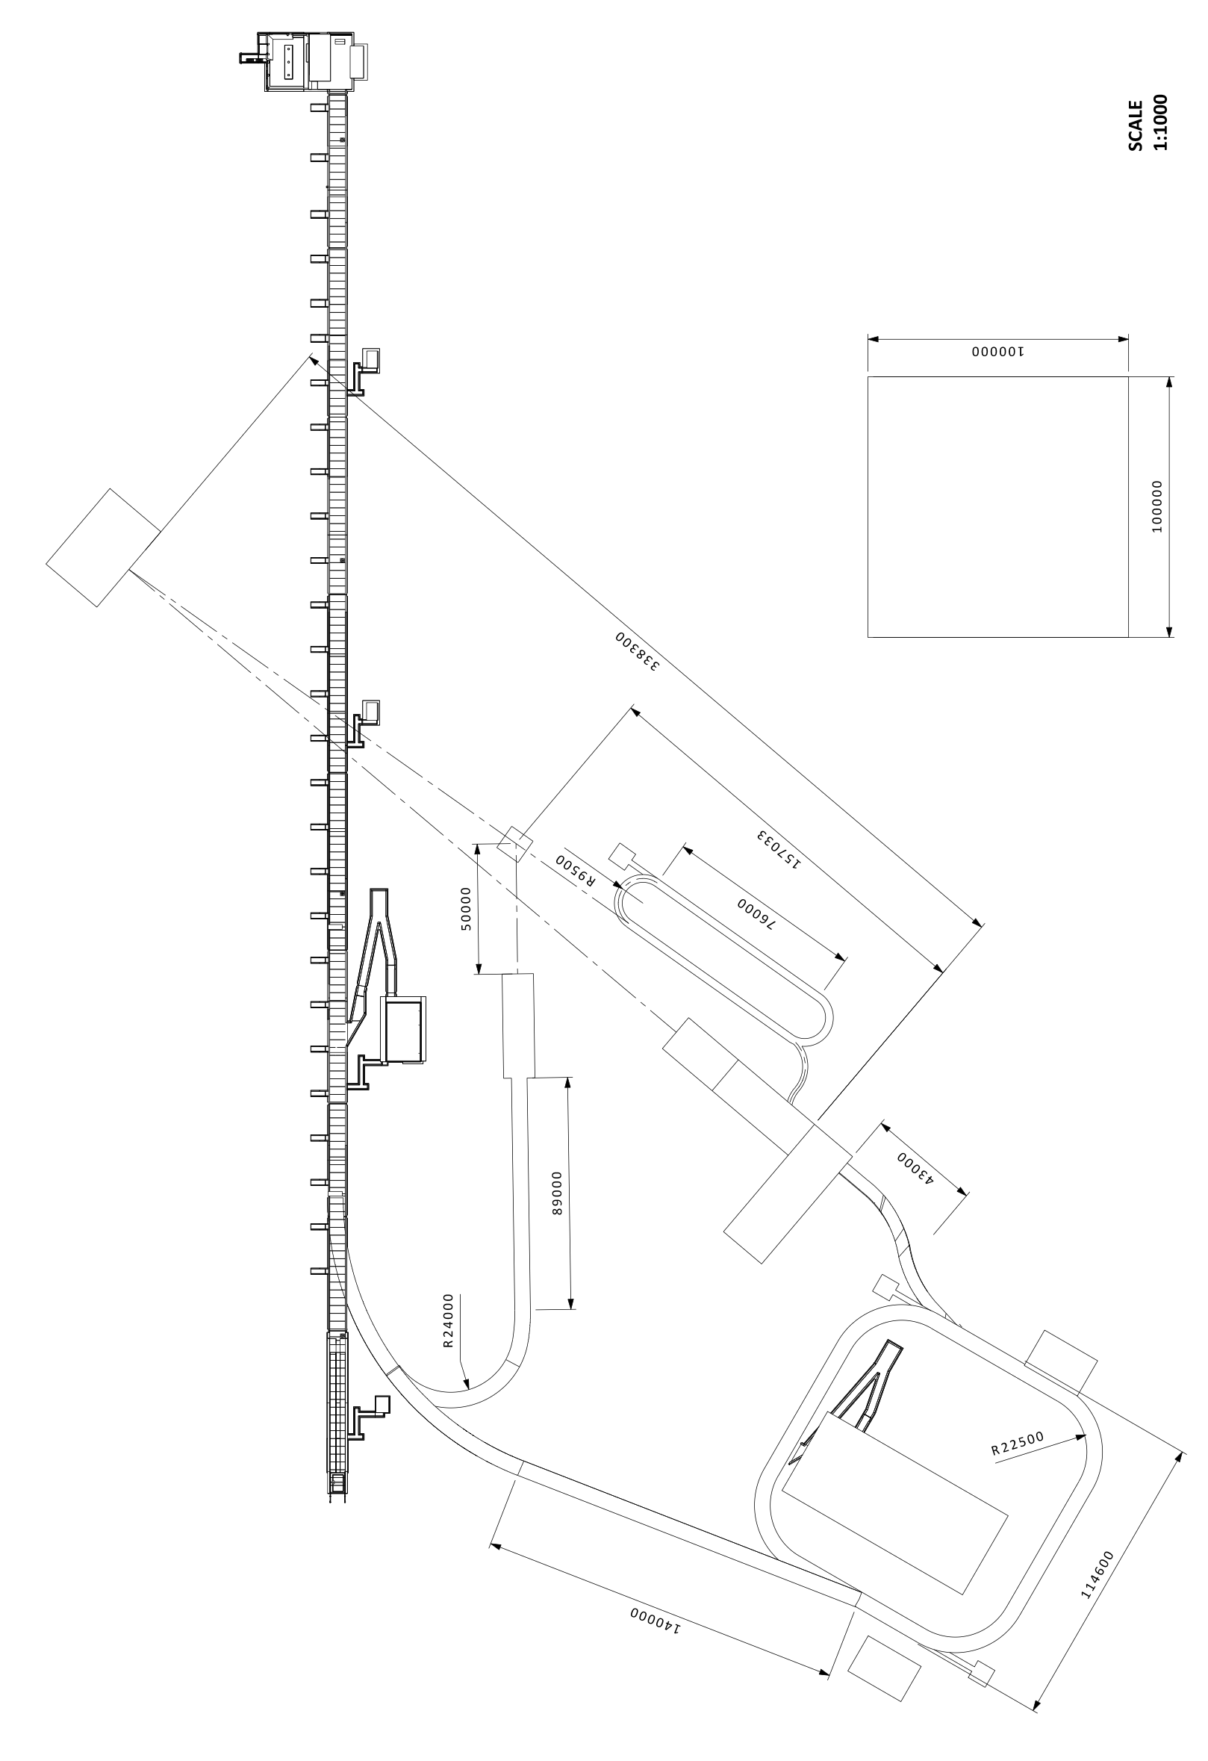
Program’s stages
I. ESSnuSB+ Low Energy Monitored Neutrino Beam (Low Power!)
Accumulator not requested
Specific Target Station with instrumented decay tunnel
Rough integration to the the design at the moment
Proton LINAC, 2.0 GeV and 14 Hz (parasitic operation?)
< 1 MW
II. ESSnuSB+ Low Energy nuSTORM (1.25 MW)
Accumulator requested
Beam Switchyard (assembled but not fully used)
Hadronic collector based on one Horn
Room for Power Supply Units
Morgue and Hot cell
H- LINAC, 2.5 GeV and 28 Hz
ESS Linac Power
Extraction System
+
Racetrack Ring
+
50 m Decay Tunnel
1.25 MW
III. ESSnuSB Target Station (5 MW)
Accumulator requested
Beam Switchyard fully operational
Hadronic collector based on Four Horn
Room for Power Supply Units
Morgue and Hot cell
5 MW

Slide 10
Costing estimation
WPs homework
Every Work Package coordinator shall continue to:
  Identify major cost drivers
  Review configurations for:
  Stage I
  Stage II (only upgrade cost from stage I)
  Stage III (only upgrade cost from stage II)
  Optimize major cost drivers and decide on the scope
  Deliver level-4 details Product Breakdown Structure (PBS) with cost estimation
  No input has been provided by the work packages!

Slide 11
Costing estimation
ESS site civil-works cost estimation
With the support of the ESS Facility Management Group, the cost-estimation methodology and the indicative timeline, were developed on the basis of ESS historical construction data:
  Gross Floor Area (GFA) computed per structure (footprint × floors; tunnels as length × width).
  A base unit rate (€/m²) from ESS historical data is applied, then scaled by adjustment indices.
  Self-classified AACE Cost Class 5 (concept screening).
  The accuracy band was agreed with CERN Civil Engineering and the ESS FM Group at -0 % / +80 %, within the AACE Class 5 reference ranges (-20 % / -50 % to +30 % / +100 %).

Slide 12
Costing estimation
ESS site civil-works cost estimation
  ESS historical unit rates used in the estimate:
Structure type | ESS historical (€/m²) | nuSB+ underground (€/m²) | nuSB+ overground (€/m²)
Tunnel structures | 9 800 | 52 000 | 40 000
Target buildings | 12 500 | 47 000 | 36 000
General buildings | 10 000 | N/A | 28 800
Utility buildings | 17 000 | N/A | 49 000
Electrical substation portion | 28 300 | N/A | 81 500
  Adjustment factors (Total = GFA × rate × method × CCI × accuracy):
Adjustment factor | Value | Purpose
Construction method / height | × ~1.5 (tunnels) | Captures 3.5 m vs 7.5 m height & method variation
Construction Cost Index (escalation) | × ~1.6 | Inflation from the 2015-2021 ESS base period to present
Expected accuracy / contingency | × 1.8 (× 1.9 ring) | Uncertainty allowance; +10% premium for the curved ring

Slide 13
Costing estimation
Underground-construction adjustment
The unit rates presented and the ESS reference structures behind them reflect above-ground construction and the shallow, approximately 6 m deep, cut-and-cover ESS LINAC tunnel.
The ESSnuSB+ structures are, however, placed 10 to 40 m below grade. The additional cost and risk of construction at these depths, namely deeper excavation and earth retention, waterproofing, groundwater control and dewatering, and the related permitting conditions, are not captured by the adjustment factors presented.
Factor | Structures | Basis
1.0 | Facility building, auxiliary buildings, utilities building; LEMNB target line | At grade, or equivalent to the ESS LINAC tunnel reference
1.2 | L2R transfer line, accumulator ring, R2T & switchyard tunnels | Cut-and-cover tunnels 10 to 20 m deep
1.3 | LEMNB target station | Shallow underground box at LINAC level
1.5 | Decay tunnels (Stages II and III) | Deep structure integrated in the target-building complex, 20 to 31 m below grade
2.0 | Target building, near-detector building | Deep underground buildings, bottom slab 31 to 34 m below grade

Slide 14
Construction timeline
Indicative Timeline for ESS Site-Related Activities
The ESS FM Group developed an indicative implementation schedule of roughly 12 years, with several phases running in parallel:
# | Phase | Indicative duration | Notes / dependencies
1 | Feasibility & legal pre-study | 2 + 2 yr | Two-step; precedes permitting
2 | Building programme | 2 yr | In parallel with phase 1
3 | Permitting (environmental court) | 5 yr | Parallel; gates start of construction
4 | Design & planning | 2 + 2 yr | Concept → detailed design
5 | Construction | 5 yr | Staged / parallel; Stage I & II bonded
6 | Connection to ESS LINAC | 1 yr | Starts after ‘first science at ESS’
7 | Commissioning & handover | 2 yr | Final phase
Continuity of ESS operations:
Stage I and Stage II should be bonded so as not to interrupt the construction flow; the LINAC-connection window must align with the ESS schedule.

