Slide 1


WP4
Low Energy nuSTORM
Maja Olvegård
Uppsala University
On behalf of WP4
4th Annual Meeting, Vik, October 5, 2026

Slide 2
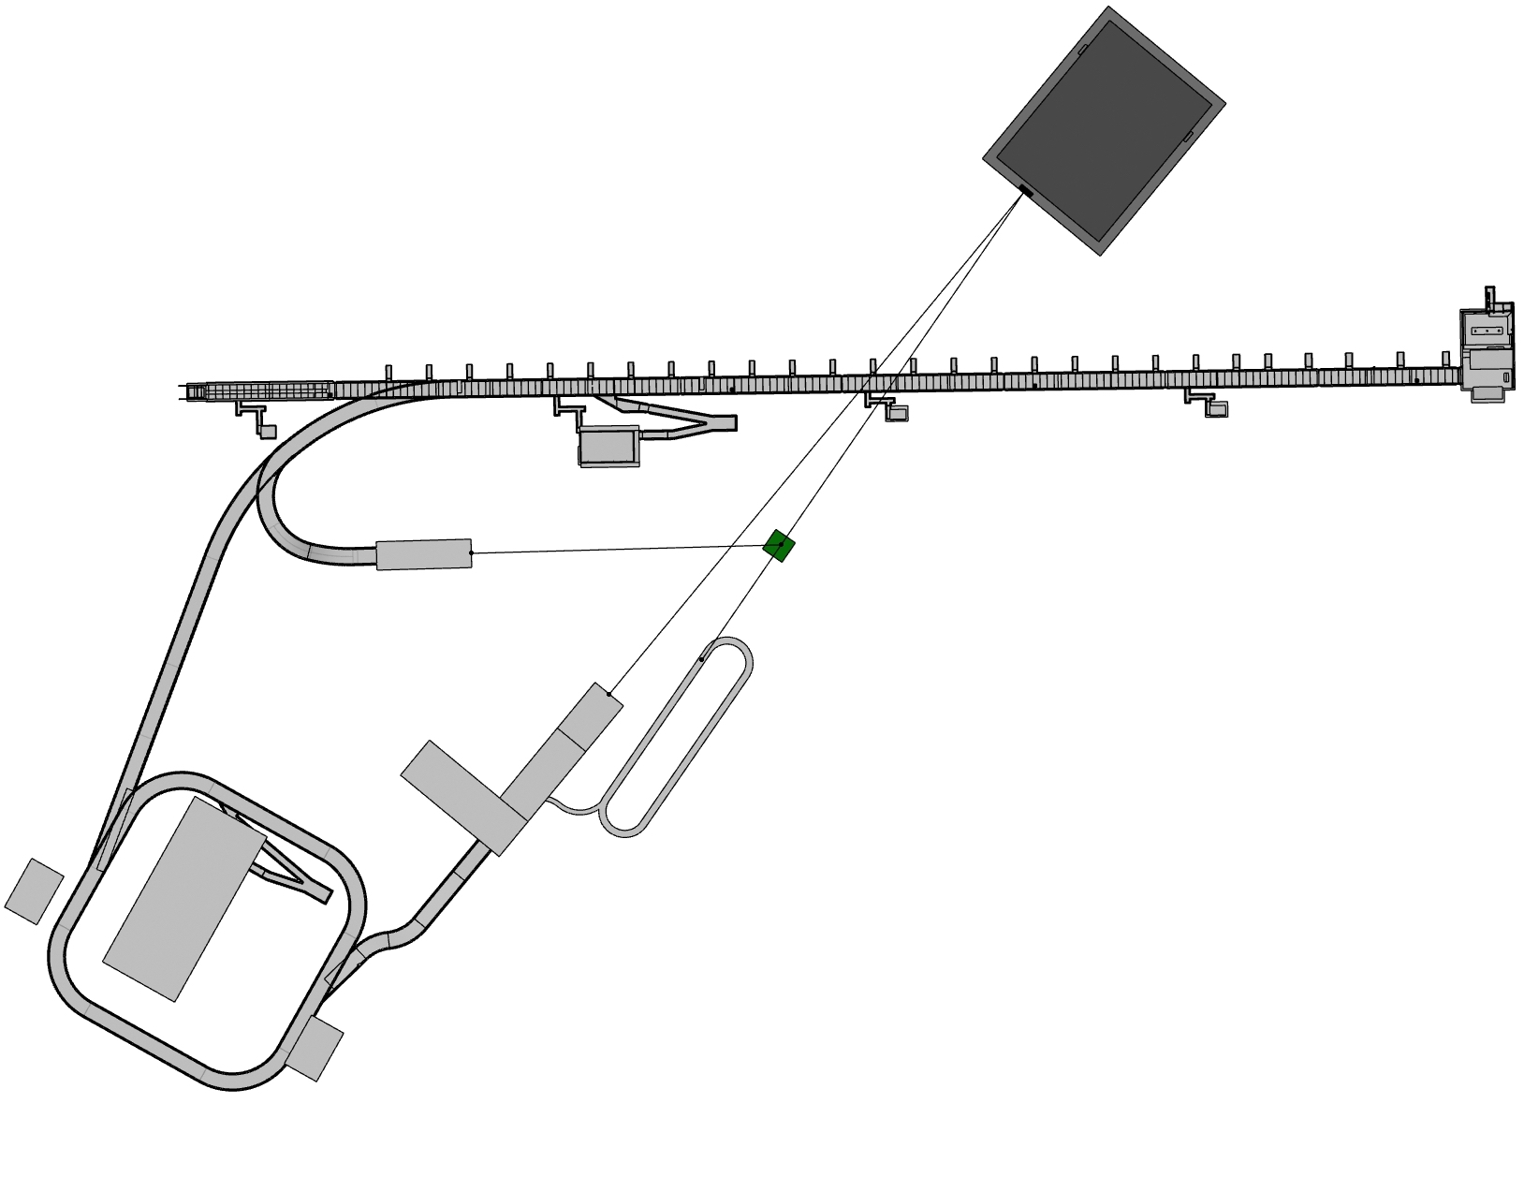
WP4
Linac upgrade
Advice to WP6
H- transfer line
Muon storage ring
Pion transfer
Accumulator ring
Proton transfer

Slide 3
Human Resources and Recruitment
Postdocs
Onur Gilanliogullari started April 2026
Max Topp-Mugglestone started Jan. 2024, finished Dec 2026
Elham Salehi, started December 2024
Wietse Van Goethem, started November 2024, left May 2025
Anatoliy Opanasenko, started May 2025
Other human resources
UU: Ting Wing Choi, Maja Olvegård, …
ESS: Natalia Milas, other ESS specialists
CERN: Ilias Efthymiopoulos
ESSB: Juan Luis Muñoz
IPHC: Elian Bouquerel

Slide 4
Milestones and Deliverables
☑
MS 4.1 (month 18) Evaluation of the LEnuSTORM requirements and parameter range
D4.1: (month 24) Review of the LEnuSTORM operation scheme
MS 4.2 (month 30) Preliminary racetrack ring lattice design
MS 4.3 (month 33) First estimate of the neutrino flux from LEnuSTORM
D4.2: (month 38) Racetrack ring design
MS 4.4 (month 42) Updated design of the linac, accumulator ring and transfer lines
D4.3: (month 44) Design of the capture, transport and injection system
☑
◻
☑
◻
☑
☑
☑
☑
We are here!
Delivered Sep. 2026
D4.3
MS4.1
D4.2
D4.1
MS4.2
MS4.3
MS4.4
Jan. 2023
Dec. 2026

Slide 5
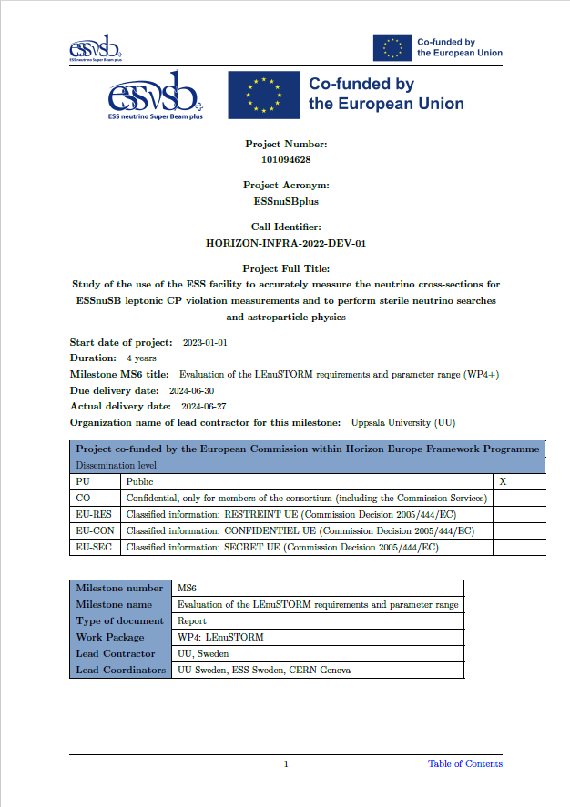
Milestone 4.1 = MS6 https://essnusb.eu/DocDB/private/ShowDocument?docid=1812
Deliverable 4.1 = D 4.1 https://essnusb.eu/DocDB/private/ShowDocument?docid=1958
Milestone 4.2 = MS17 https://essnusb.eu/DocDB/private/ShowDocument?docid=2083
Milestone 4.3 = MS21
(For internal review, but report available) https://essnusb.eu/DocDB/private/ShowDocument?docid=2311
Deliverable 4.2 = D 4.2 https://essnusb.eu/DocDB/private/ShowDocument?docid=2222
Milestone 4.4 = MS26 https://essnusb.eu/DocDB/private/ShowDocument?docid=2271
Deliverable 4.3 = D 4.3 https://essnusb.eu/DocDB/private/ShowDocument?docid=2303

Slide 6
IAP report: Racetrack ring
Small number of turns
Large beam, large energy spread
Compact arcs, tight focusing in the straights
  High chromaticity
  Non-linear effects extra prominent?
Recommendation: Different design approach than usual
  Tracking for 100 turns
  Study dynamics of lost particles to identify cause

Slide 7
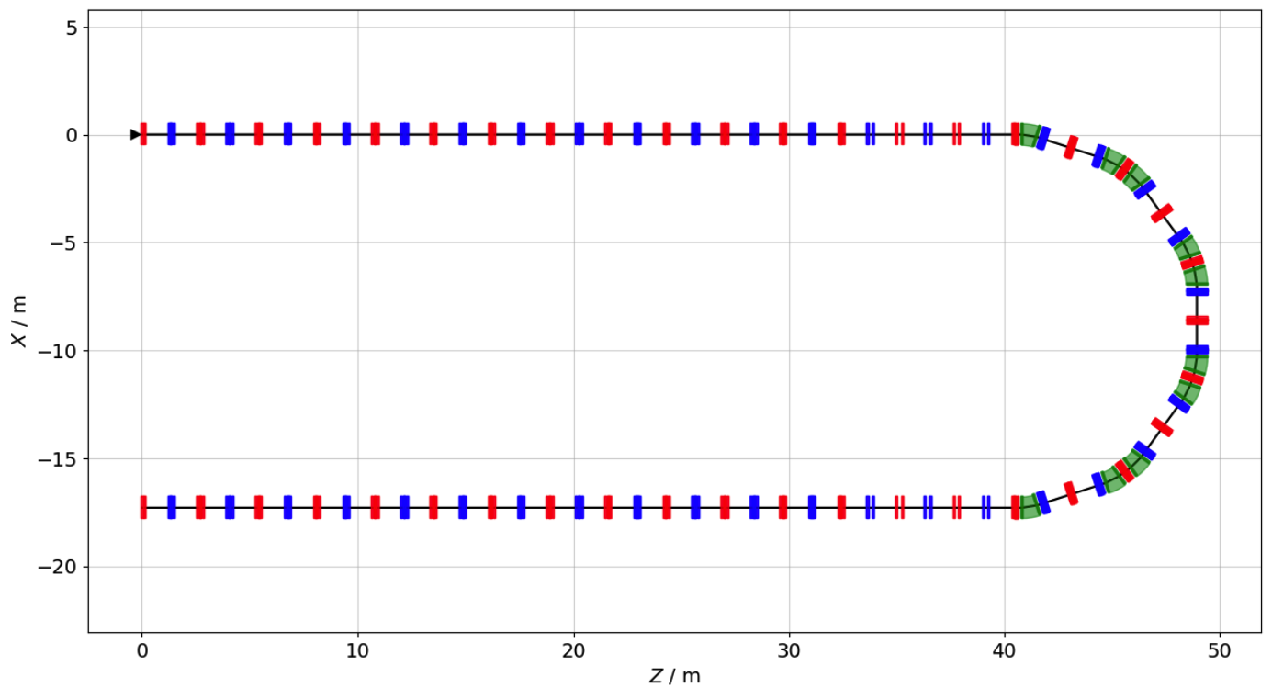
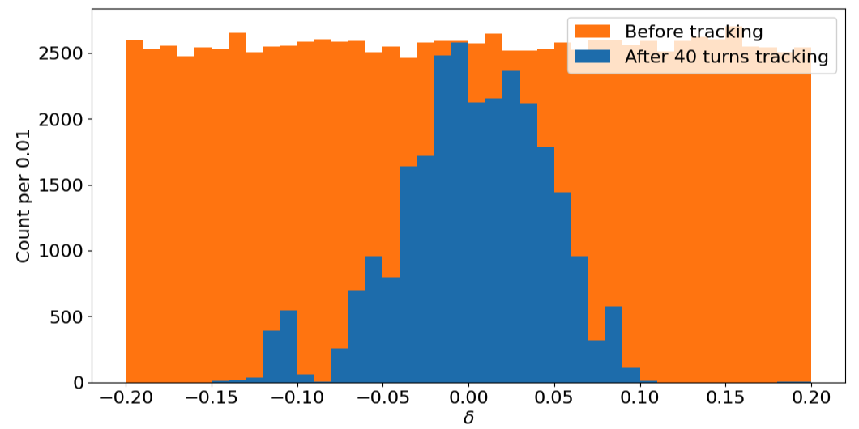

IAP report: Racetrack ring
81 m full straight
27m
2-fold symmetry
216 m ring
A design with 0.7 m dipoles reach 50 % muon survial rate with 9mmrad in 40 turns.
More stable against fringe field and magnets error
Reply to IAP
Strong non-linearity and fringe field effect is reduced by increasing the length of dipoles
resonance excitation is largely avoided by choosing the working points
After the dipole length increase, most particle losses due to aperture only
Ting Wing Choi

Slide 8
IAP Report: Proton injection
Recommendation: Identify emittance and maximum beam charge achievable with space charge.

Slide 9
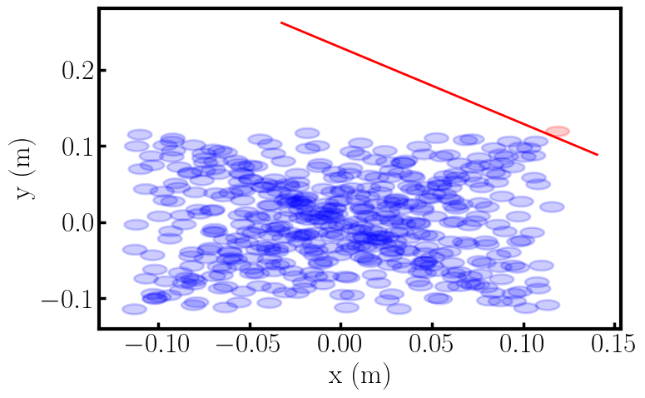
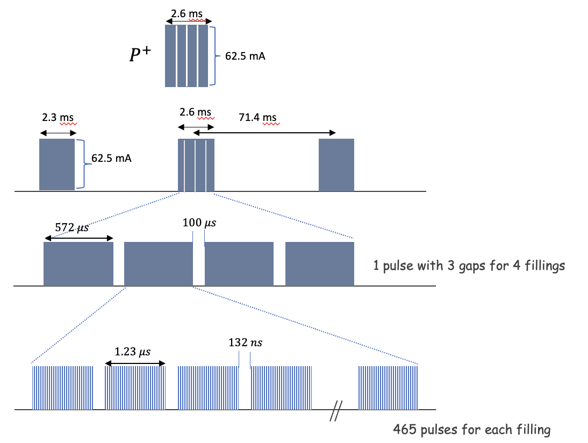
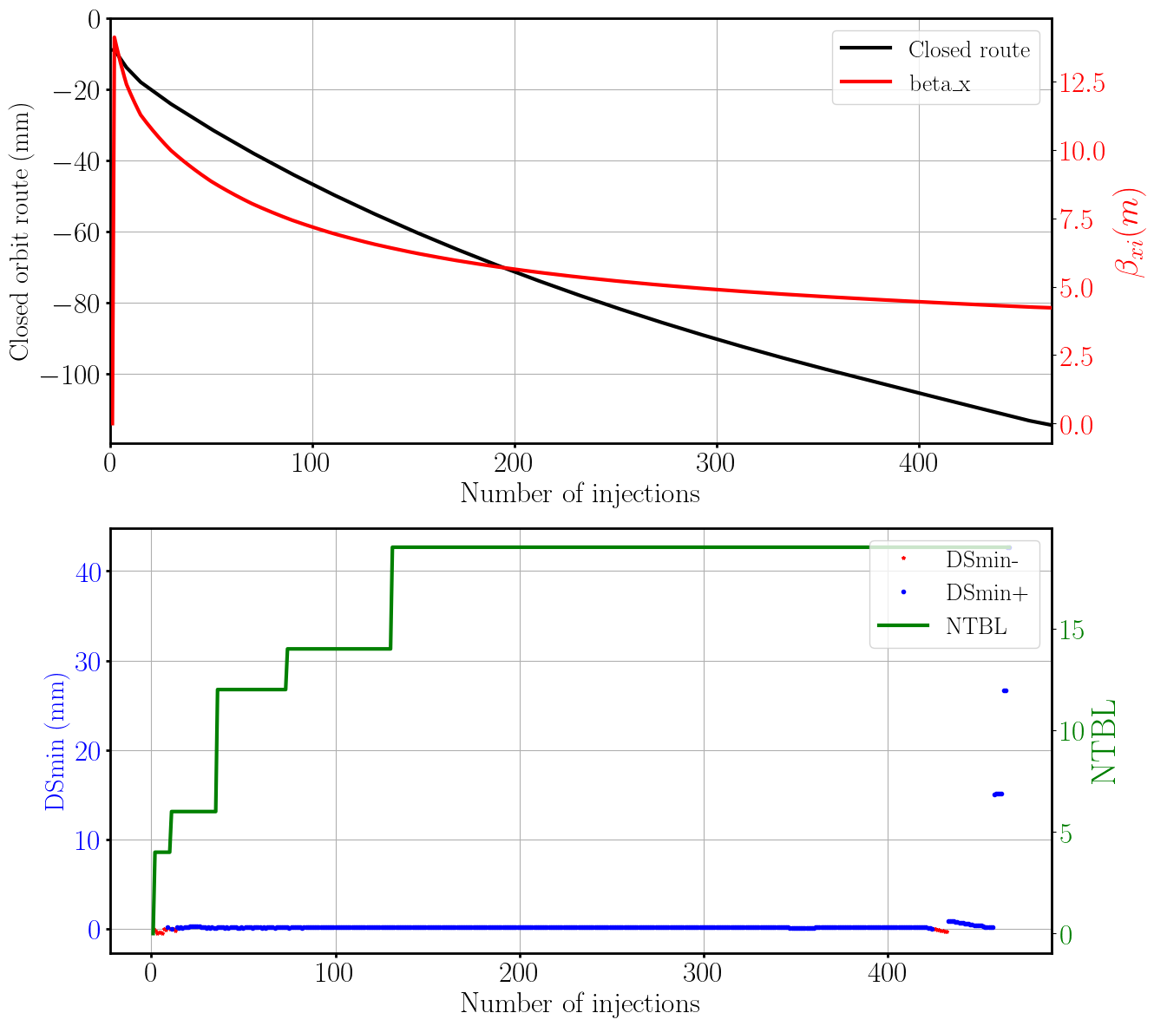
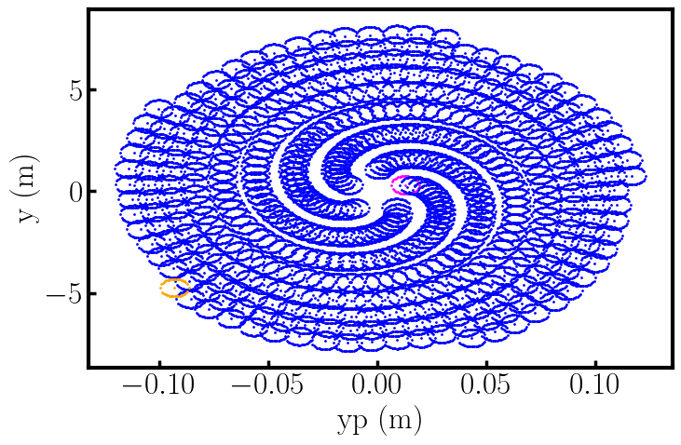
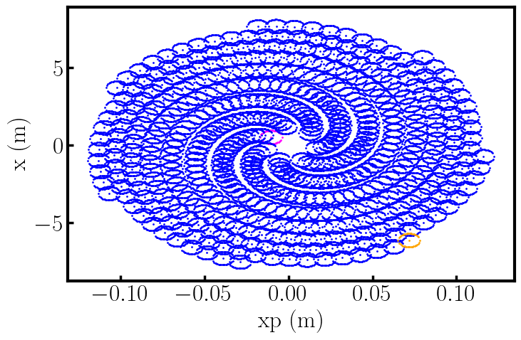
IAP Report: Proton injection
Reduce pulse length
Increase current
2
Consider tune and high order tune shifts
1
3
Find closed-orbit part for loss-free injection
Elham Salehi

Slide 10
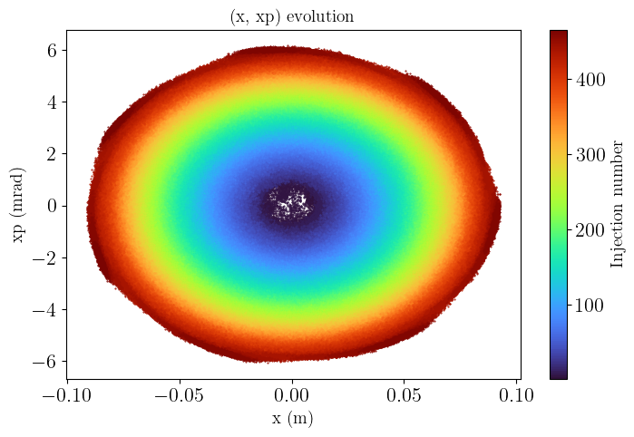
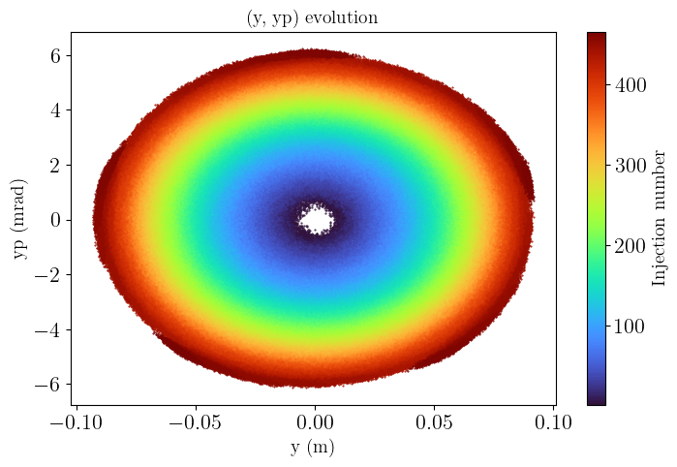
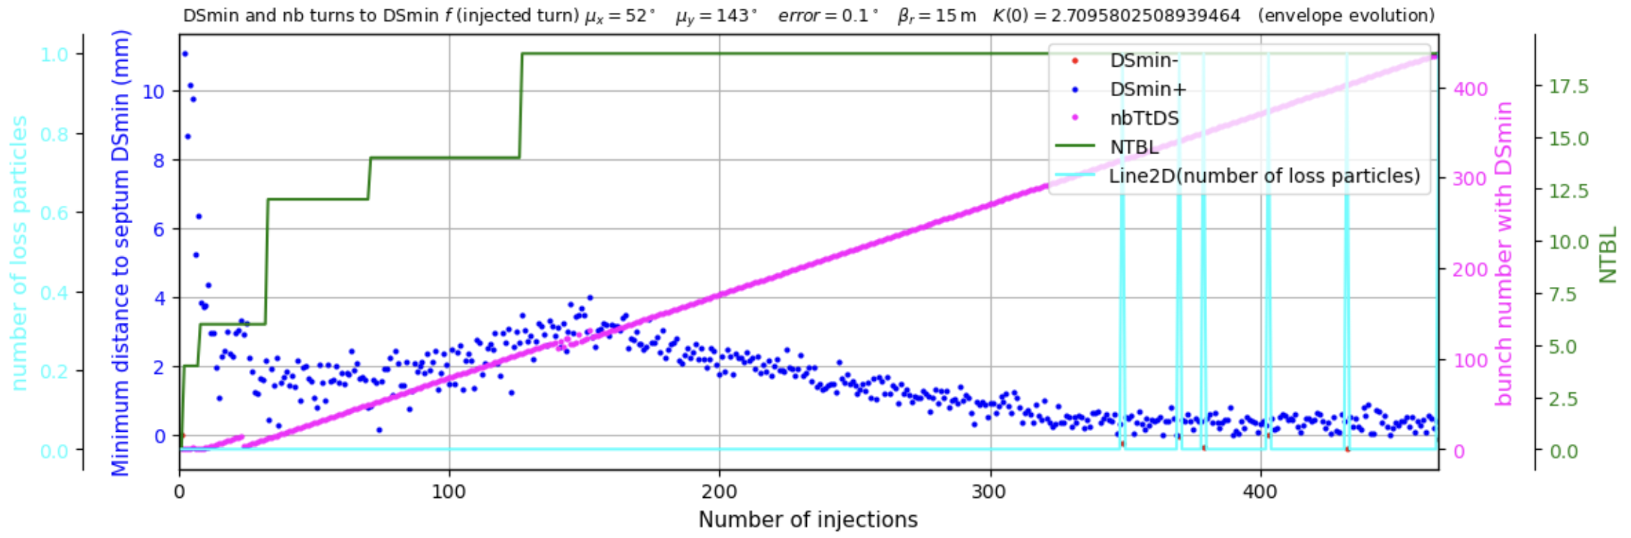
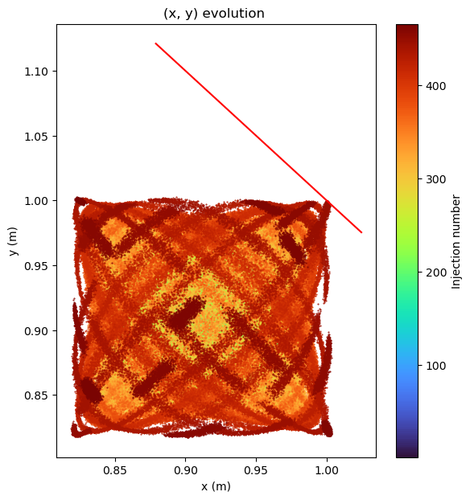
Liouvillean injection, w. space charge
3
  PyORBIT simulations of the injection, with space charge.
    465 turns
    2.23e14 particles
    Final emittance = 210 x (injected emittance)
    Loss-free injection achieved!
Elham Salehi
10

Slide 11
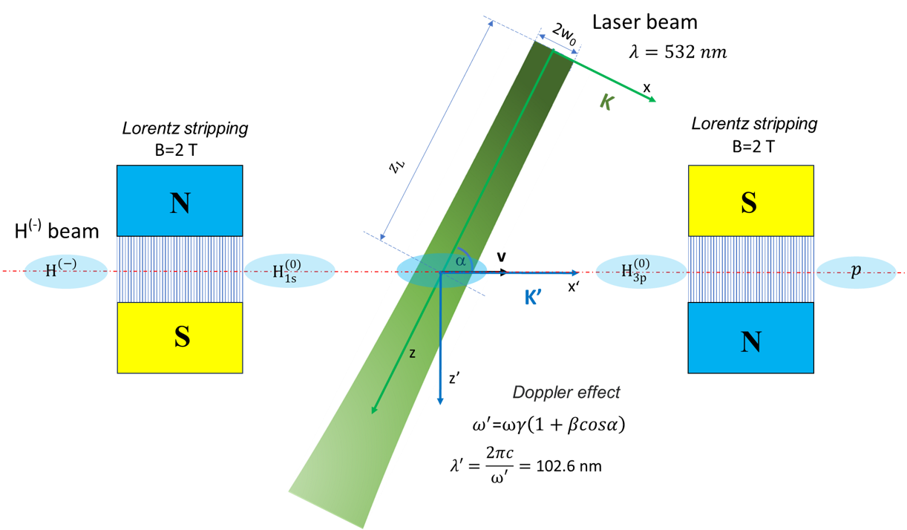
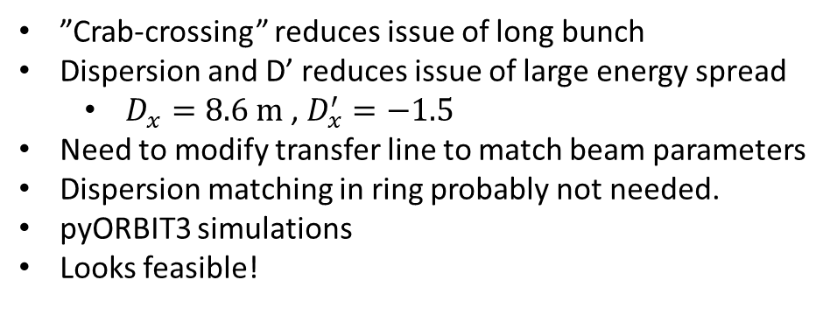


IAP Report: Laser stripping
ESSνSB+ accumulator chicane
”Crab-crossing” reduces issue of long bunch
Dispersion and D’ reduces issue of large energy spread
  $D_{x}=8.6 m$ , $D_{x}^{′}=−1.5$
Need to modify transfer line to match beam parameters
Dispersion matching in ring probably not needed.
pyORBIT3 simulations
Looks feasible!
0.87 m
0.6 T
0.6 T
Laser
Dispersion lattice
$$x$$
$$δp_{z}$$
$\text{D}\text{x }$=$D_{x}δp_{z}$
ϕ₀
α₀
0.14 m
0.14 m
Δz
Δz
0.06 m
0.06 m
0.87 m
Anatoliy Opanasenko

Slide 12
IAP Report: Accumulator ring
Nominal dynamic-aperture scans over 600 and 2048 turns show that the physical pipe limits acceptance. All sampled painted-target launches survive with SC off/on.
Two-family sextupoles suppress linear chromaticity and tune spread, but peak horizontal chromatic beta beating increases from 1.6% to 11.2%.
Completed 600-turn injection and painting simulations with reconstructed barrier RF and self-consistent space-charge and extraction survives.
An illustrative transverse-wake comparison produces less than 0.33% additional rms-emittance change over 600 turns. Coherent amplification also appears without the wake, so the simulations do not establish an impedance-driven instability.
Dispersion-matching for Laser assisted stripping was deemed not necessary due to small number of f turns filamentation of the mismatch well within acceptance.
Onur Gilanliogullari

Slide 13
IAP Report: 10% extra H+ or H- for LEMNB
Double pulse frequency needed
  Can the proton source handle it?
Increase of RF and cryogenic duty cycles will increase along side with additional beam power.
  Additional beam is never ”transparent” but low power may have nominal detrimental effect to ESS nominal operation.
Low power beam irrelevant to long baseline experiment.

Slide 14
IAP Report: Sustainability
Can we do without a large aperture accumulator ring?
  Current aperture defined by peak temperature in stripper foil
    Smaller emittance with laser stripping?
    Much larger with direct proton injection
      Balance linac complexity with ring operation
  Permanent magnets?
    Possible way to reduce power consumption
    Risk: magnetization losses from radiation
      Beam loss control very important
Master project spring 2026
Ring design with permanent magnets
Onur Gilanliogullari
Maja Olvegård

Slide 15
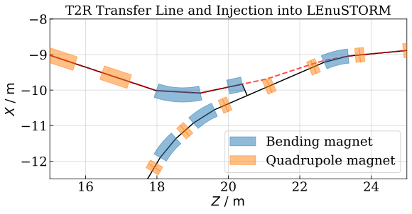
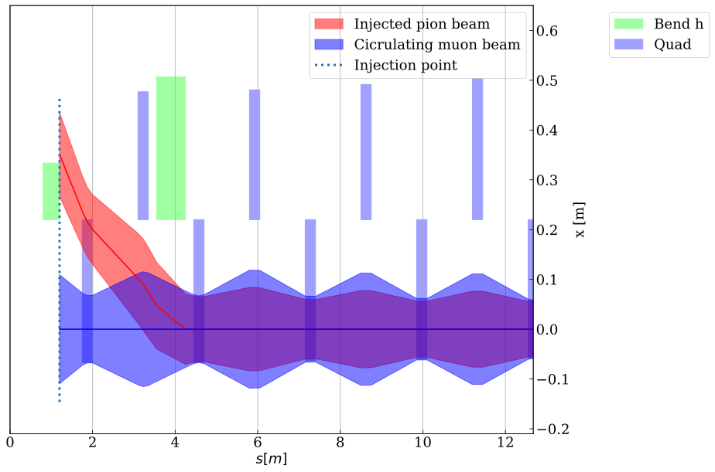
IAP Report: Pion transfer and injection
Baseline now 1050 GeV pions to 600 MeV muons – design w. stochastic injection
Challenge to fit septum and arc quadrupoles -> magnet design
Transmission drops with sextupoles in pion line
configuration | baseline | with sextupoles
b (enlarged apertures, δ = 0) | 84.5 % | 58.1 %
c (enlarged apertures, δ rms 0.10) | 37.4 % | 31.1 %
d (B_pole ≤ 1.9 T, δ rms 0.10) | 16.3 % | 10.2 %
T2R line
end marker
pion trajectory
production straight
injection septum
T2R pion line
nuSTORM ring
I. Eftymiopoulos
M. Topp-Mugglestone

Slide 16
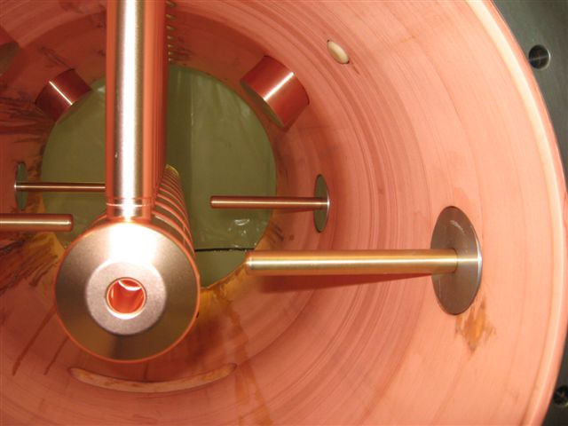
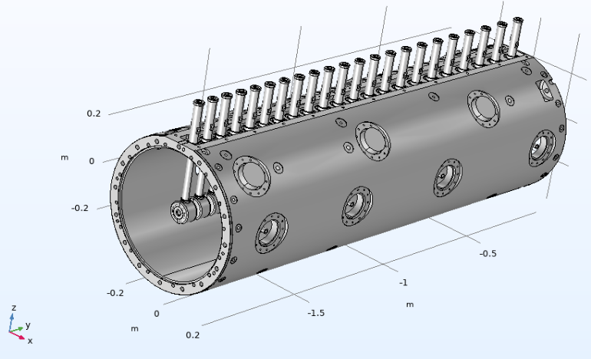
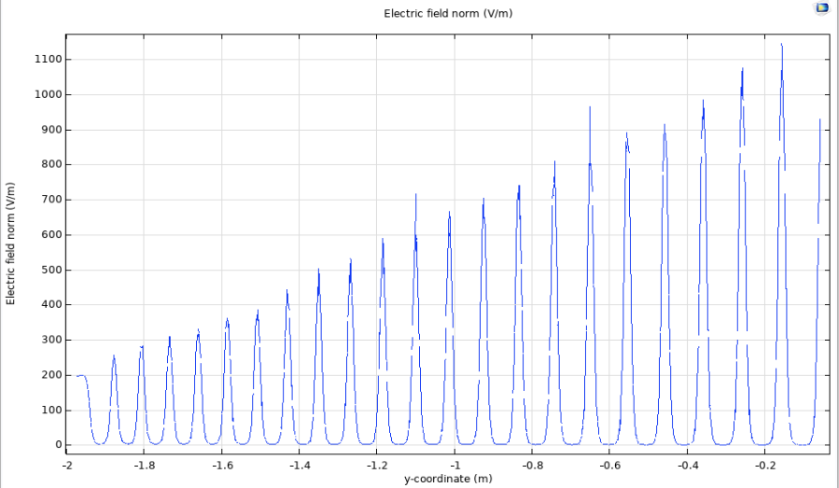
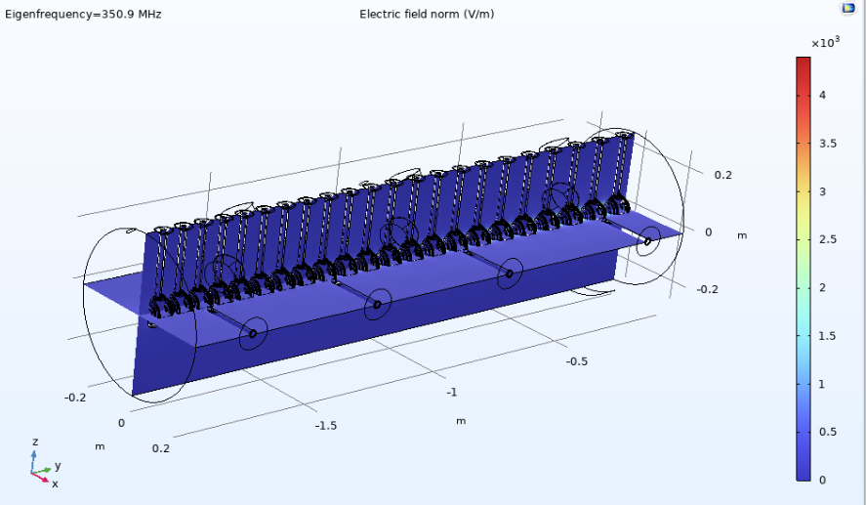
Other highlights: Drift Tube Linac
Juan Luis Muñoz
ESS DTL analysis (ongoing). Using similar design (LINAC4) up to now
Drift tubes + tank thermal expansion at 10% already studied
Current on-going activity: analysis of post-coupler thermal deformation (1 segment / 1 tank).

Slide 17
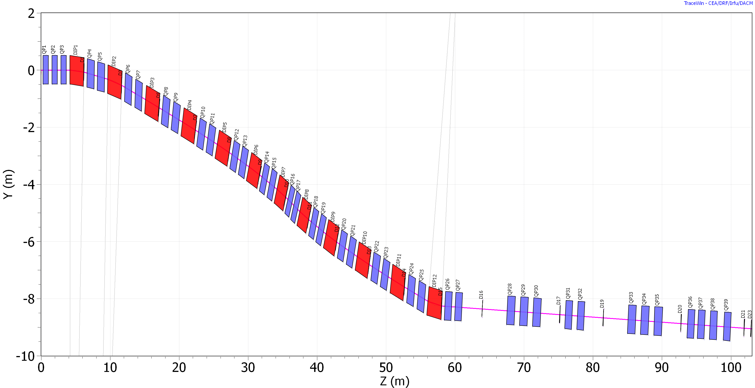
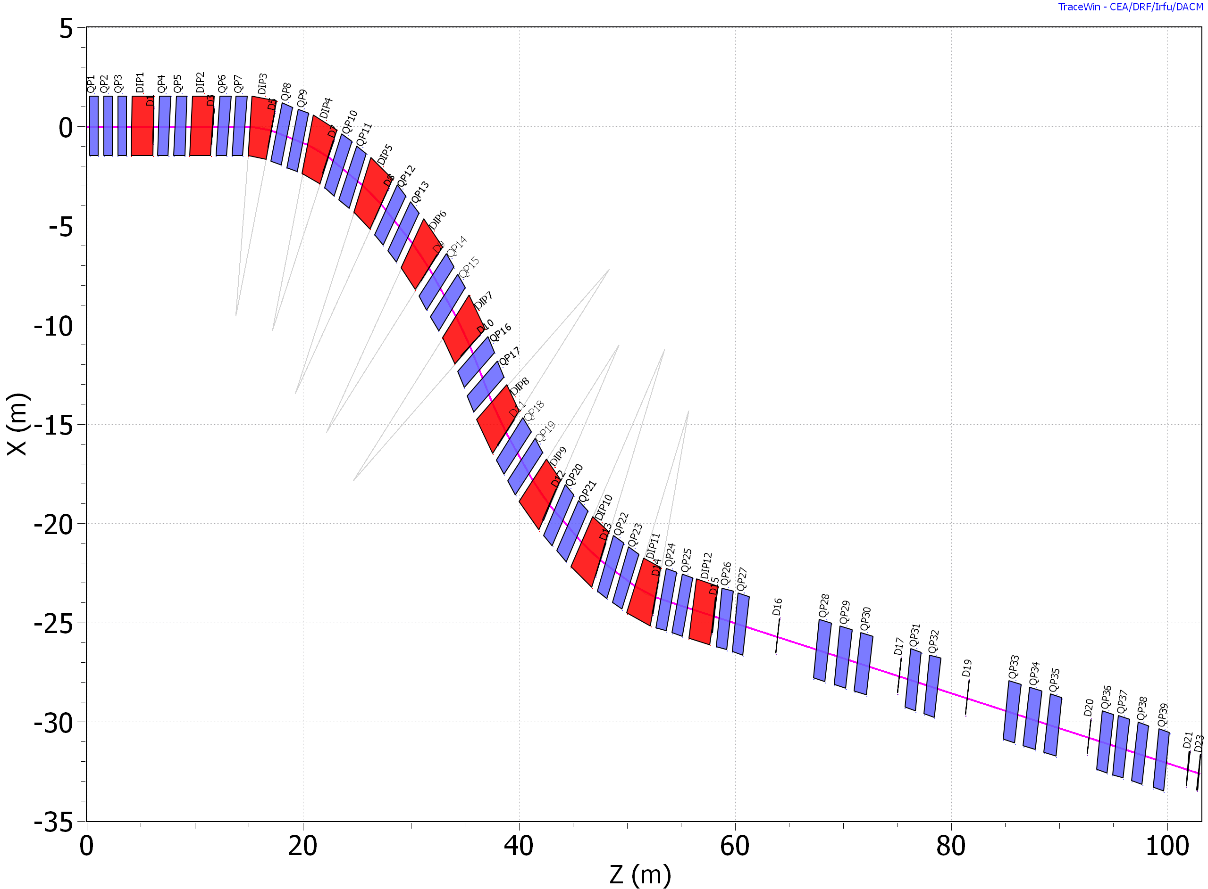
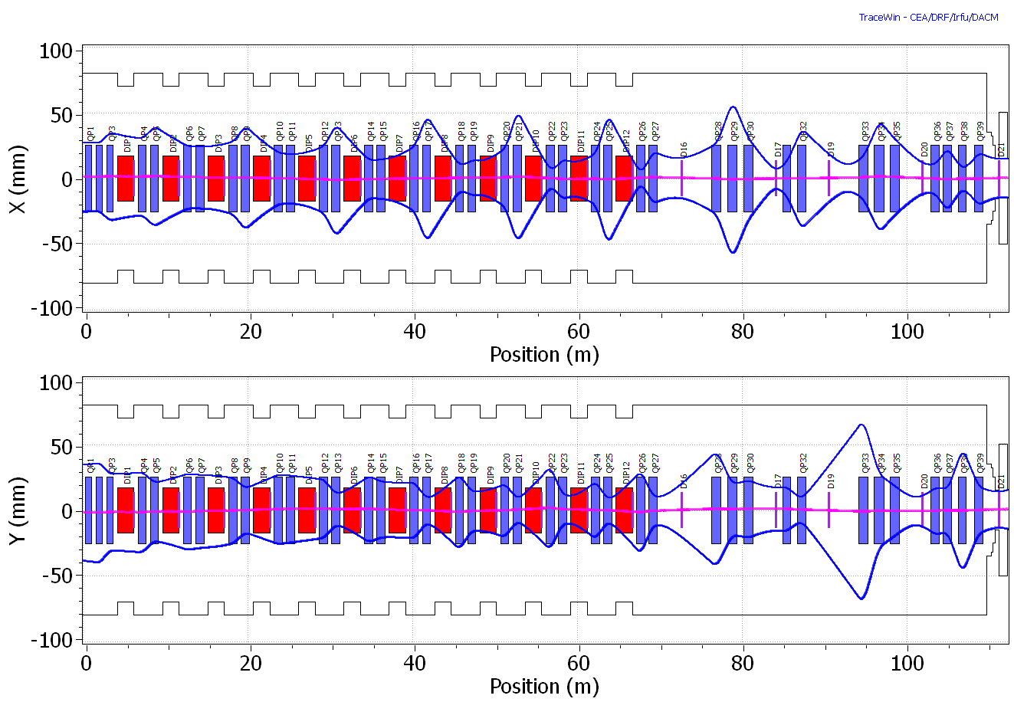
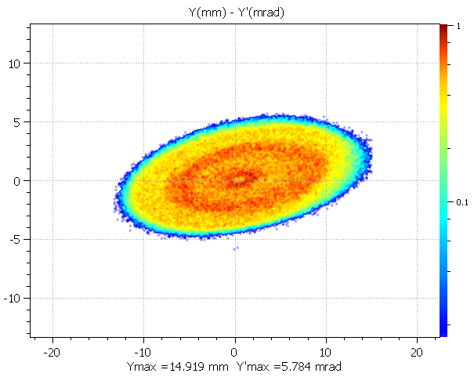
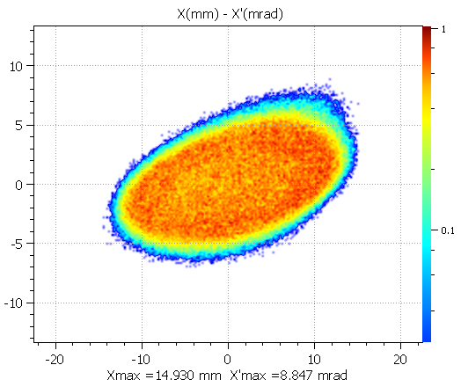
Other highlights
Elian Bouquerel
Ring to target transfer adapted for the single-target configuration in LEnuSTORM
Ring
Ring
Vertical plane
Horizontal plane
neutrino direction
neutrino direction
Target
Target
Optics Design
-Input from realistic beam (painting distribution)
-Matching at septum: (β, α, D, D′)
-Lattice: 8 horizontal + 4 vertical dipoles (2 m); < 40 quadrupoles;
-Total length: 115 m
-Beam size evolution:
Beam Dynamics Performance
-Smooth β-functions → no strong focusing peaks
-Controlled dispersion → partial suppression downstream
-Large acceptance along the line
-Envelope fully contained within apertures
-Efficient transport with minimal losses^{[2]}

Slide 18
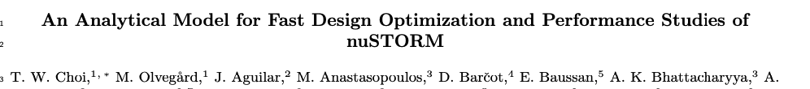
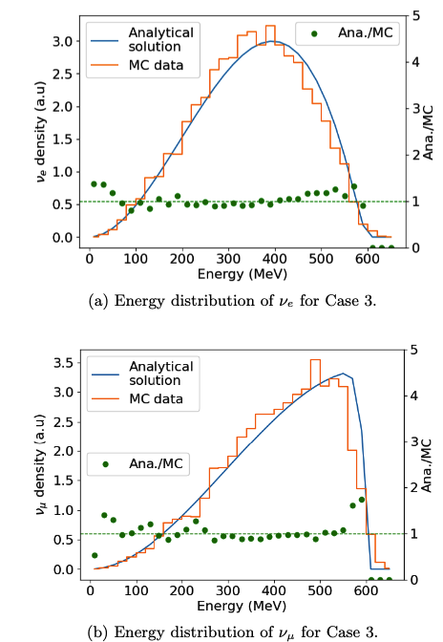
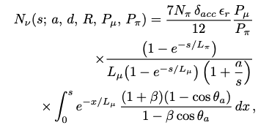
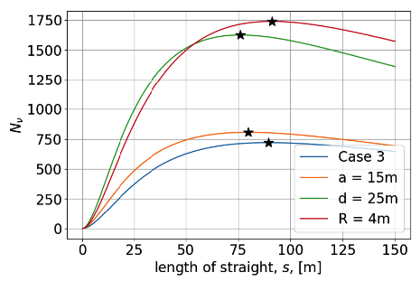
Analytical expression of neutrino flux
Prediction of neutrino flux and energy spectrum
Fast optimization of nuSTORM

Slide 19
Outlook
Start to end simulations
  Pions from the horn to neutrinos from LEnuSTORM
Modifications of transfer line and accumulator to accommodate
  Proton injection
  Laser stripping
Costing
Conceptual Design Report
Looking to the future: synergies with ESS, Muon Collider

Slide 20
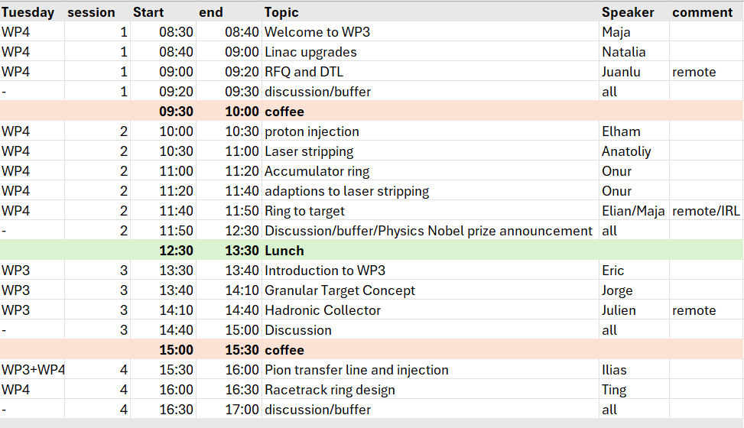
WP3 + WP4 session Tuesday 6/10, Anna’s room

Slide 21
Tasks
4.1: Coordination of the accelerator work package (UU, ESS)
4.2: Design an extraction line from the ring-to-target transfer line and a transfer line up to the special target station
4.3: Conceptual design of the racetrack ring for LEnuSTORM
4.4: Study the compatibility of LEnuSTORM and ESSνSB and modify the original design accordingly.

