Slide 1
WP2 Engineering & Infrastructure
ESSnuSB+ 4th Annual Meeting Summary Report
Dawid Patrzalek

Slide 2
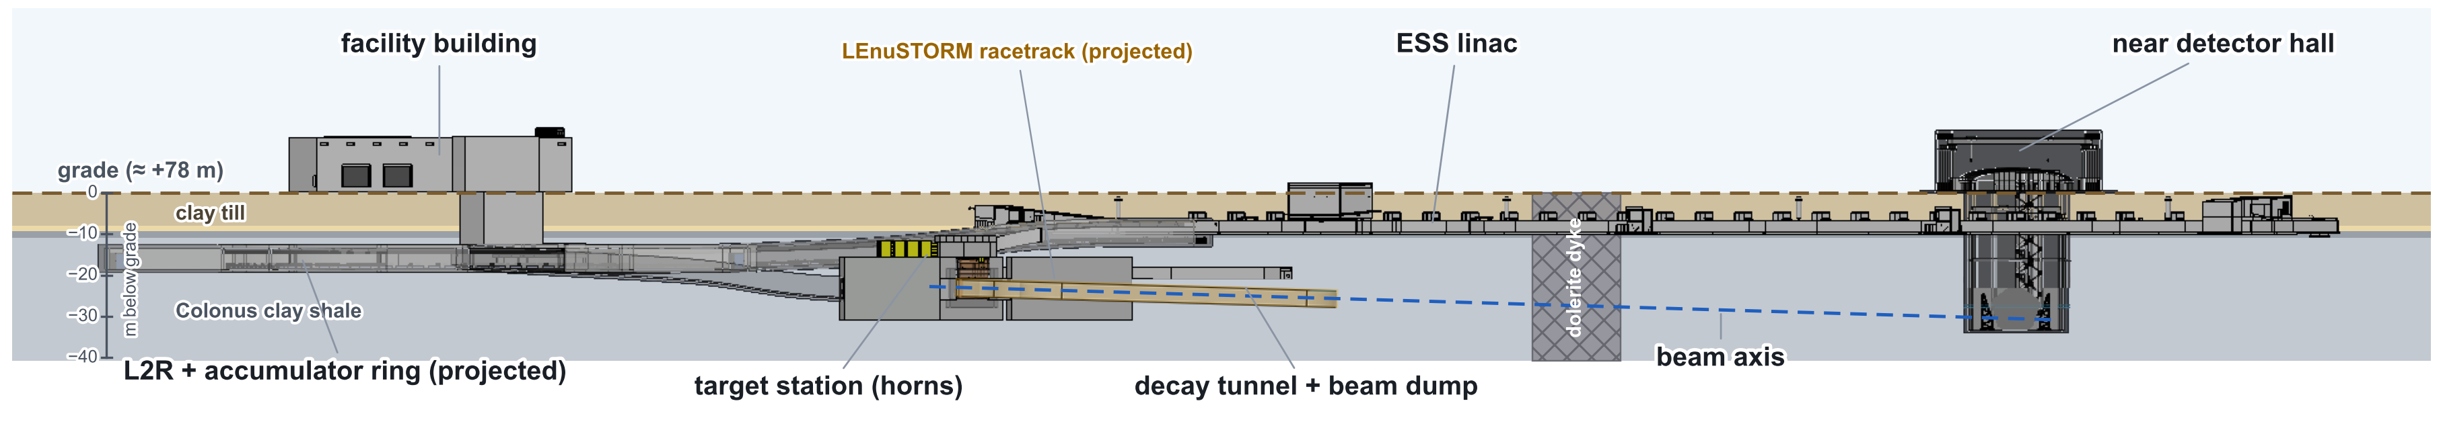
WP2 Deliverables
Plans until the end of 2026
  D2.2 - Machine Conceptual Design & Mechanical Design of Linac, 2nd Target Station, near and far detectors, auxiliary systems and infrastructure
  D2.3 - Deliverables for the far detector Civil Engineering Study including far detector site Feasibility Report and far detector Civil Engineering Study Report

Slide 3
Feedback collected
Implementation of changes requested
  Dimensions of tunnel cross-sections to be optimized, as they currently appear to be oversized – to be investigated in the project’s continuation.
  Costing evaluation shall be updated not to include the +80% accuracy by default
    Nominal values to be presented
    The accuracy of +80% (AACE Cost Class 5, concept screening) to be shown alongside the nominal values

Slide 4
Updated costing estimation
ESS site civil-works cost estimation
Structure type | ESS historical (€/m²) | nuSB+ overground (€/m²) | nuSB+ underground (€/m²)
Tunnel structures | 9 800 | 22 350 40 230 (+80%) | 27 100 48 780 (+80%)
Target / detector buildings | 12 500 | 17 100 30 780 (+80%) | 33 800 60 840 (+80%)
General buildings | 10 000 | 16 000 28 800 (+80%) | N/A
Utility buildings | 17 000 | 27 200 48 960 (+80%) | N/A
Electrical substation portion | 28 300 | 45 250 81 450 (+80%) | N/A

Slide 5
Cut-and-cover vs. underground construction
Major WP2 concern
  Conceptual design of the ESS site facility has been finalized.
  It should be discussed and decided at the project level whether the design approach should be changed to consider cut-and-cover construction instead of the current underground construction.
  Various pros and cons shall be considered, e.g.:
  Cost (approximately 35% less expensive if built overground)
  Influence on ESS site
  Influence on physics and necessary re-study
  etc.
  Considering the gravity of such a change, WP2 cannot make the decision on its own and will follow the decision taken by the project.

Slide 6
Whole project costing estimation
WPs’ homework
Every Work Package coordinator shall continue to:
  Identify major cost drivers
  Review configurations for:
  Stage I
  Stage II (only upgrade cost from stage I)
  Stage III (only upgrade cost from stage II)
  Optimize major cost drivers and decide on the scope
  Deliver a detailed level-4 Product Breakdown Structure (PBS) with cost estimation
  No input has been provided by the work packages!

