Slide 1


Low Energy nuSTORM
WP4 Summary
Maja Olvegård
Uppsala University
On behalf of WP4
4th Annual Meeting, Vik, October 8, 2026

Slide 2
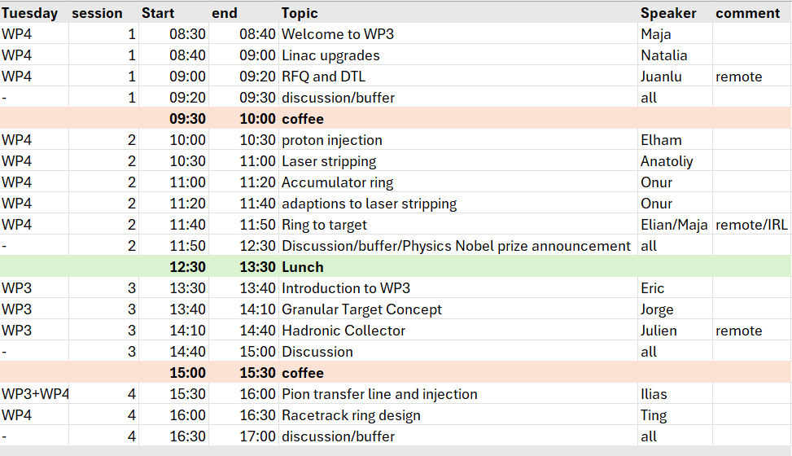
WP3 + WP4 session Tuesday 6/10

Slide 3
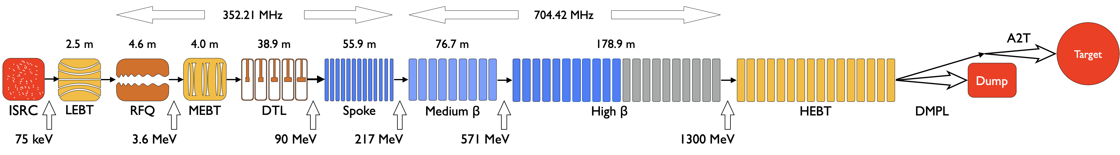
ESS Linac soon
RF power sources missing
1.3 GeV
2.0 GeV
3.0 MW
5.0 MW

Slide 4
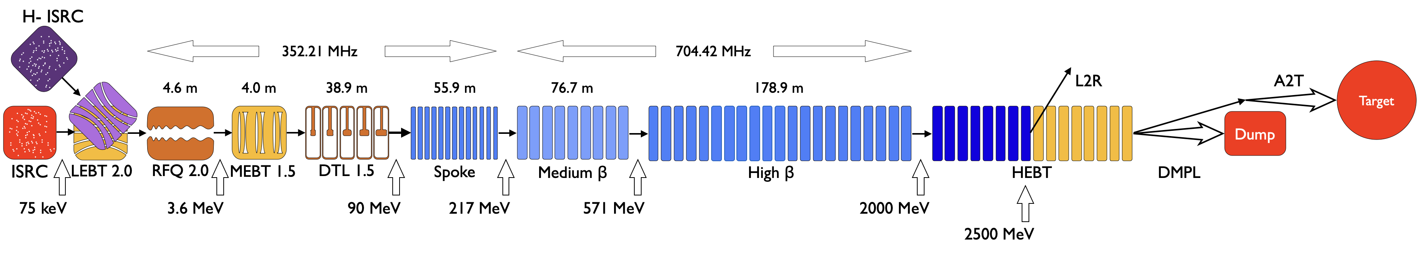
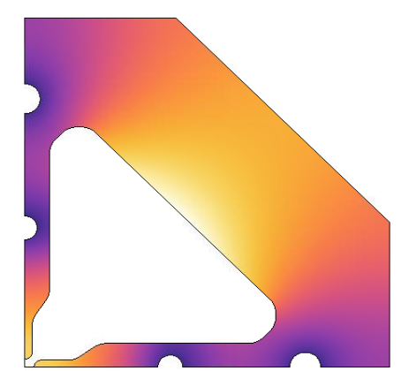
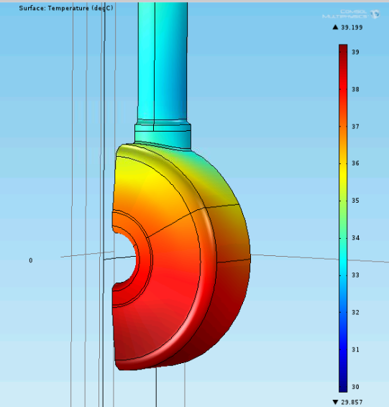
ESS Linac upgrades
Natalia Milas
5 MW
New source and LEBT
New RFQ, modified design
New DTL Skid (cooling)
New pulsed magnets and vacuum chamber for MEBT
New couplers for the superconducting cavities
New Modulators and Klystrons/Tetrodes
8 new cryomodules in the HEBT + extended cryo lines
New kicker dipole to extract beam
New diagnostics for beam commissioning
Juan Luis Muñoz

Slide 5
Linac-to-ring transfer line, L2R
Natalia Milas
Onur Gilanliogullari
New simplified design exists
Modifications under study:
  Control of longitudinal beam parameters for laser stripping
    Bunch length
    Energy spread
    Energy chirp
Modifications to be investigated
  Remove vertical drop to accumulator ring
  Reduce length

Slide 6
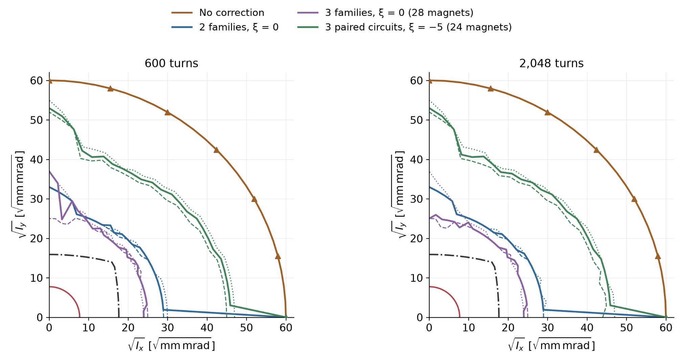
Accumulator ring
Onur Gilanliogullari
Quadrupole misalignment, gradient error and roll
  Dipole correctors + skew quadrupoles to correct errors
Sextupoles to reduce chromaticity
  Dynamic aperture
  Beta beating increases
  W. sextupoles: 10% loss
  W/o sextupoles: 4% loss

Slide 7
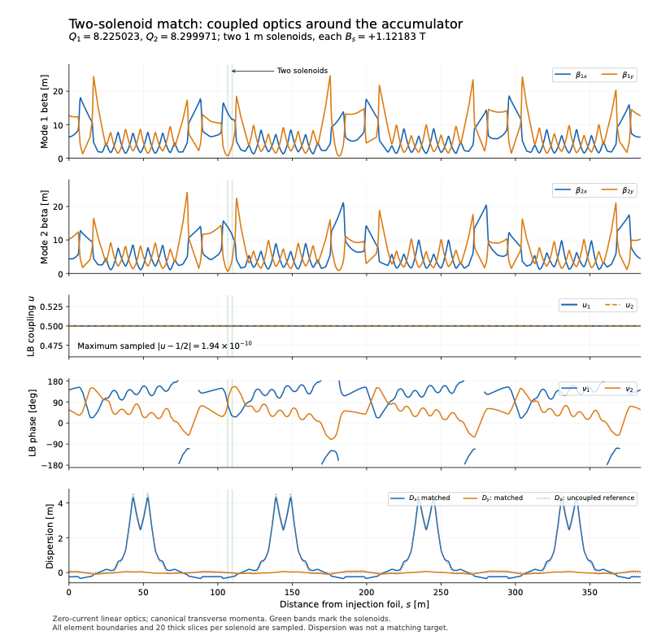
Accumulator: alternative optics
Onur Gilanliogullari
Fully coupled beam - Eigenmodes - Minimal space charge

Slide 8
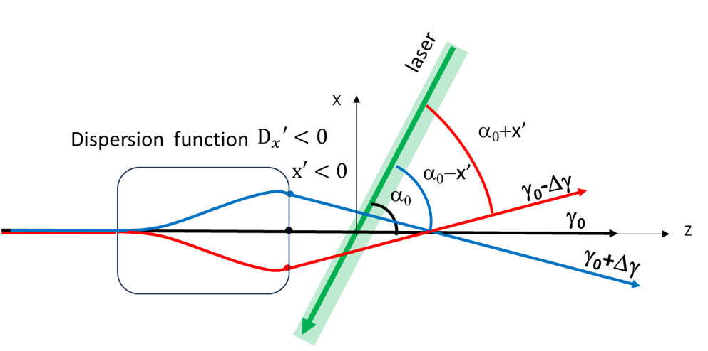
Injection: Laser stripping
Anatoliy Opanasenko
Dispersion correlates particle energy with crossing angle – maximize excitation probability
  Limits necessary laser peak power
Energy chirp and crab-crossing scheme reduces interaction time with laser pulse
  Limits necessary laser total energy
Chirp and Dispersion generated in L2R
  Matching in ring probably not needed
Collaboration with MuCol
Discuss with JPARC and SNS

Slide 9
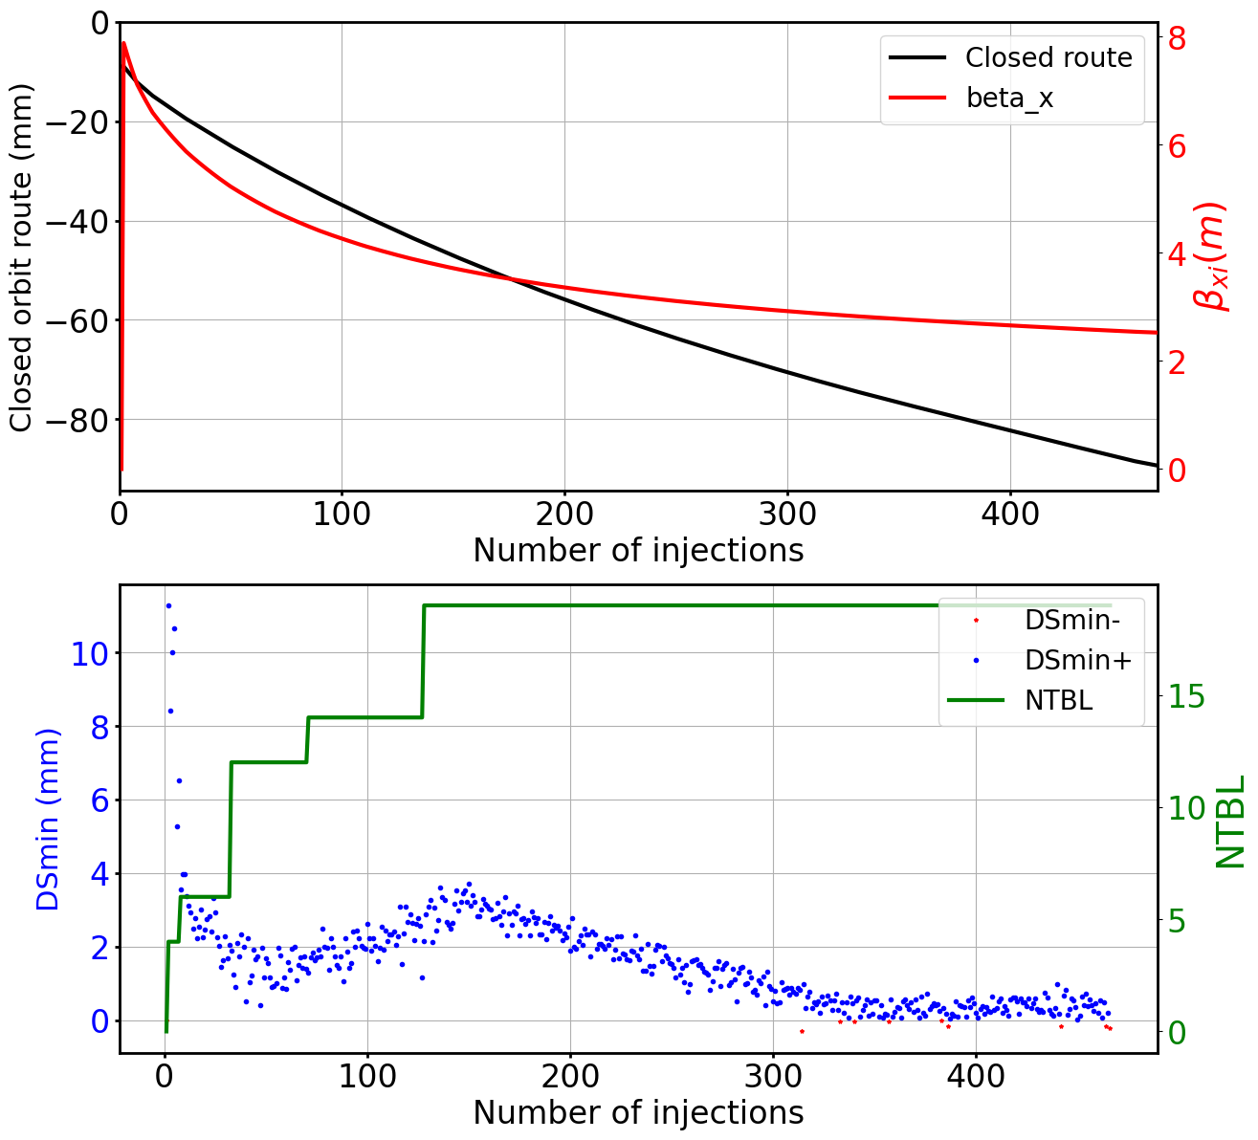
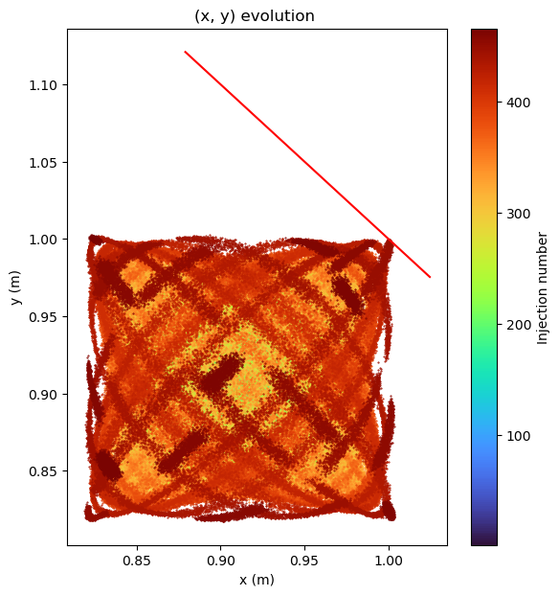


Injection: Proton injection
Elham Salehi
— Orbit route
— β of inj. beam
465 turns
$$\frac{ε_{r}}{ε_{i}}=210$$
Septum blade
$$ε_{r}≈600 mm mrad$$
y (m)
18 cm x 18 cm
x (m)
Min distance to septum

Slide 10






Injection: Proton injection
Elham Salehi
465 turns
$$ε_{r}≈600 mm mrad$$
$$≈10×emittance w. foil stripping$$
$$⟹ \sqrt{10}≈3×beam size$$
233 turns
$$ε_{r}≈240 mm mrad$$
$$≈4×emittance w. foil stripping$$
$$⟹ \sqrt{4}=2×beam size$$
2.86 ms
2.86 ms + 0.4 ms
Pulsing scheme

Slide 11
Proton injection: an opportunity
Elham Salehi
Natalia Milas
Reduced complexity in linac and transfer line (L2R)
  Reduced risk of losses since no stripping of H-
  No H- source
Very larger apertures
  Ring
    Extraction kickers and septum
  Ring-to-target transfer and switchyard
Beam on target
  Squeeze (square) beam to 3 cm diameter
Verify through experiments
Possible collaboration with HIAF in China

Slide 12
Ring-to-target transfer
Elian Bouquerel
Design exists for long baseline and LEnuSTORM
New design required if vertical positions changed
ESS site
Not ESS site

Slide 13
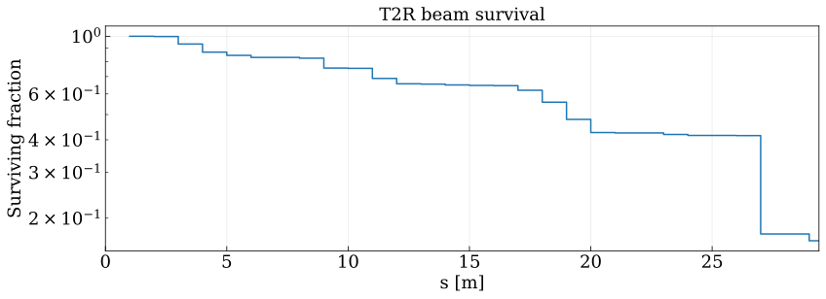
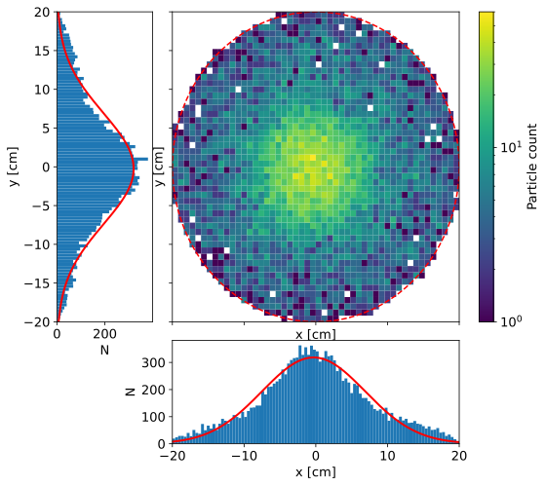
Pion transfer and injection
Ilias Efthymiopoulos
Stochastic injection of 1050 MeV pions -> 600 MeV muons
Pion distribution from the horn
16% transmission
Arc quadrupole
Nonlinear elements reduce transmission
7.2·10⁻⁵ pions at the start of the straight section, per protons on target

Slide 14
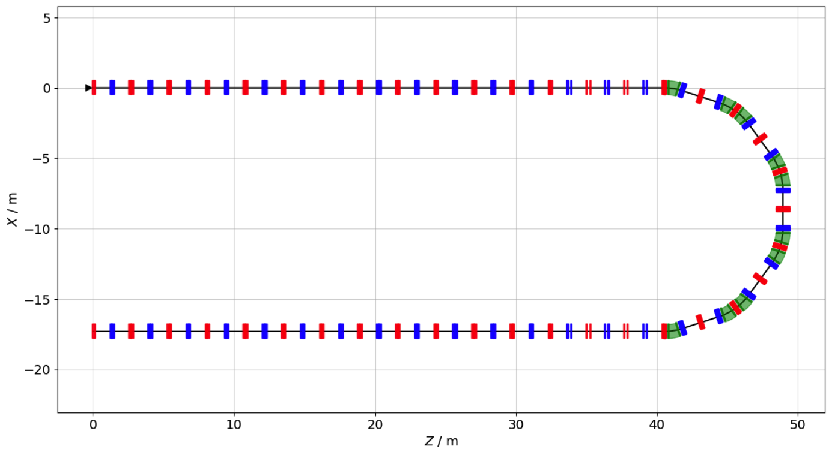
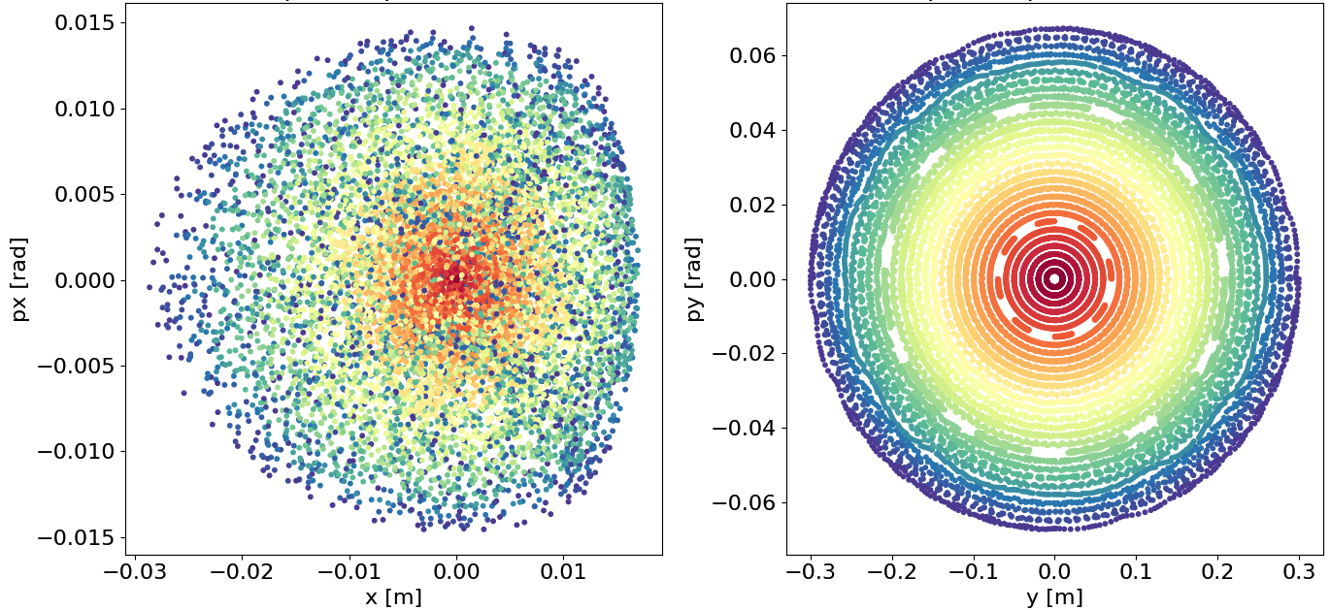
LEnuSTORM racetrack ring
Ting Wing Choi
FODO cells
Stochastic injection at ”missing bend”
8.9 mmrad linear transverse acceptance
classical magnets: B < 2 T
27m
81 m straight section
2-fold symmetry

Slide 15
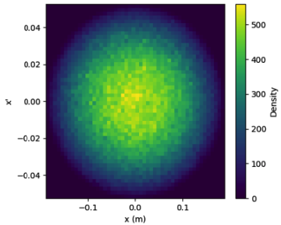
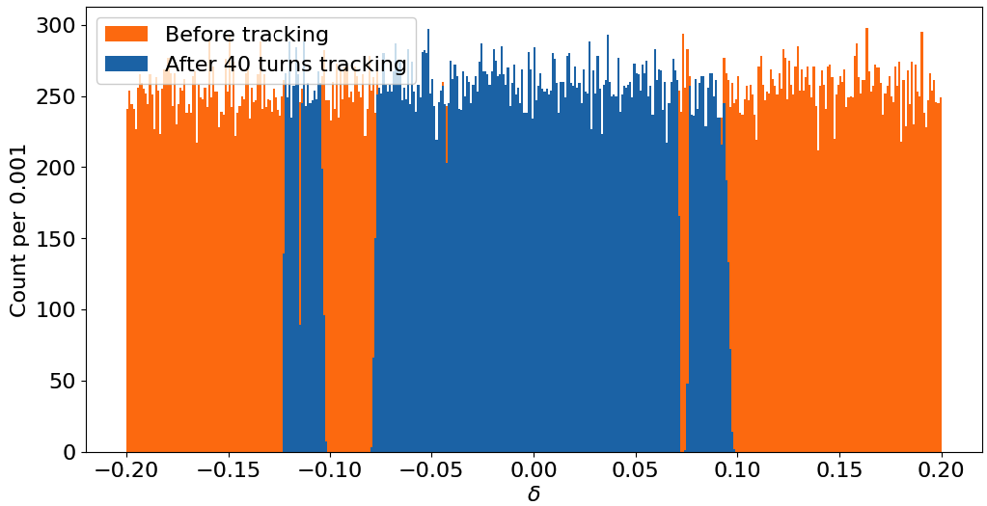
LEnuSTORM racetrack ring
Ting Wing Choi
99% survival of on-momentum particles, realistic transverse distribution
≈80% survival of off-momentum particles, pencil beam

Slide 16
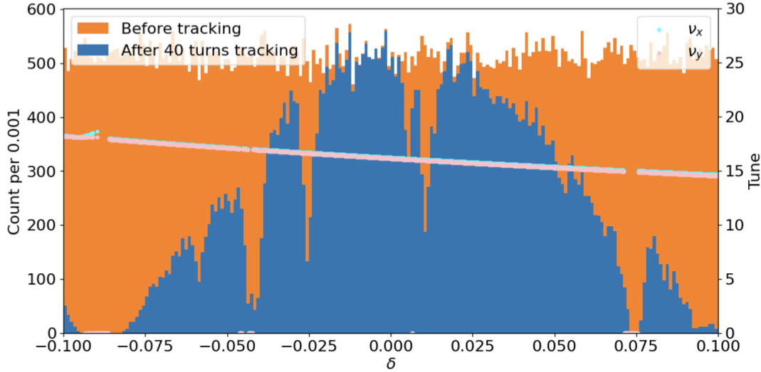
LEnuSTORM racetrack ring
Ting Wing Choi
Realistic transverse distribution + large uniform energy spread $±10\%$
Losses due to non-linearities

Slide 17
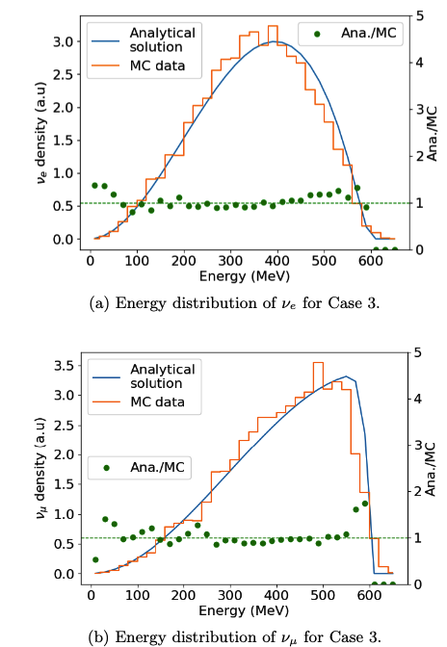

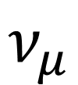
LEnuSTORM neutrino flux and spectrum
Ting Wing Choi
$$ν_{e}$$
$$ν_{μ}$$
$3×{10}^{−6}$ neutrinos of each flavor per proton on target

Slide 18
Costing the plus in ESSnuSBplus
Linac was covered in ESSnuSB
  Adjust numbers where we have new information
Transfer line
  Changes if beamlines are placed on ground level
  Changes required for laser stripping
Accumulator ring with foil-stripping covered in ESSnuSB
  Laser stripping system
  Liouvillean (proton) injection -> new ring?
Transfer line withut switchyard
Pion transfer and injection
Racetrack ring

Slide 19
CDR
Linac: RFQ and DTL study
Transfer line
  Changes if beamlines are placed on ground level
  Changes required for laser stripping
Accumulator
  Corrections, dynamic aperture, etc.
  Laser stripping
  Liouvillean (proton) injection
    Consequences for ring design
Transfer line withut switchyard
Pion transfer and injection
Racetrack ring

Slide 20
Outlook
Start to end simulations
  Pions from the horn to neutrinos from LEnuSTORM
Modifications of transfer line and accumulator to accommodate
  Proton injection
  Laser stripping
Costing
Conceptual Design Report
Looking to the future: synergies with ESS, Muon Collider

Slide 21
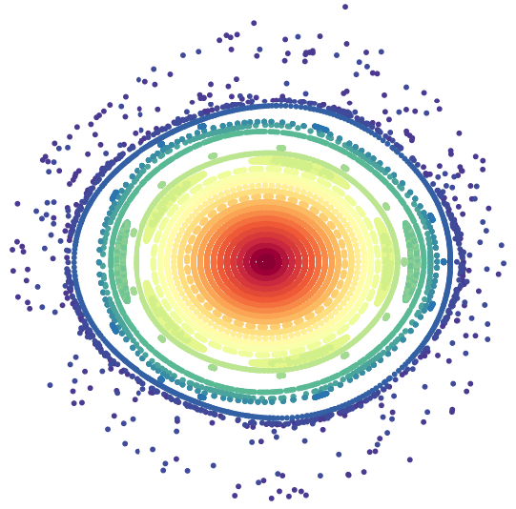
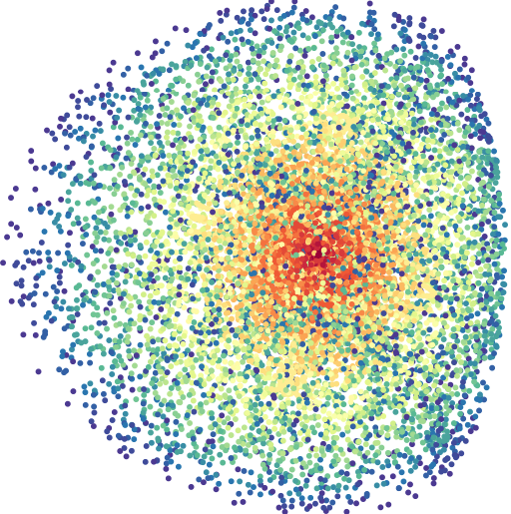
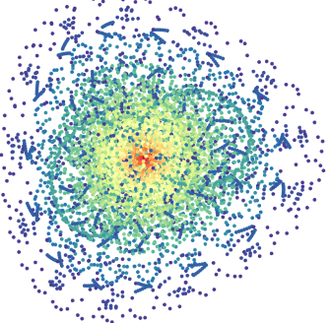
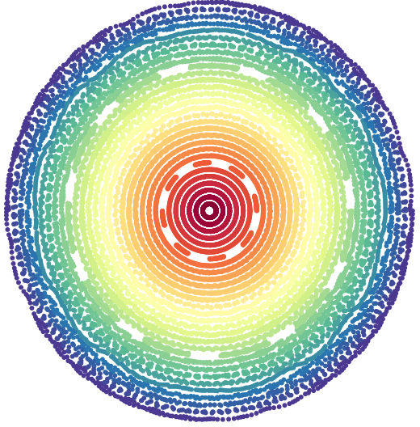
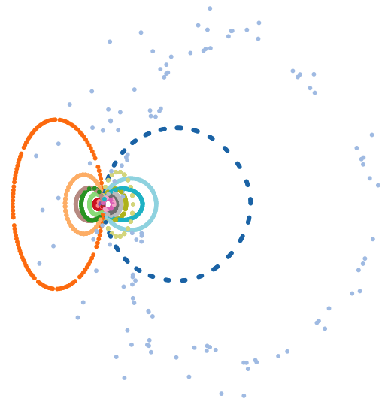
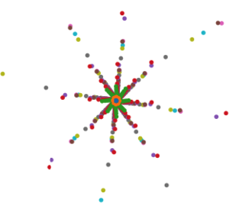
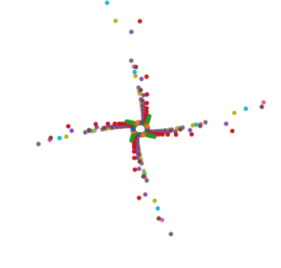
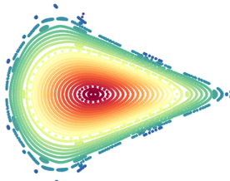


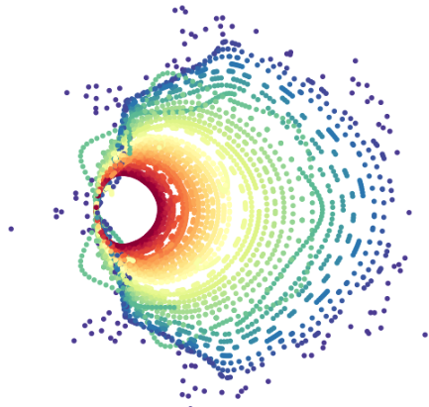

Slide 22
Tasks
4.1: Coordination of the accelerator work package (UU, ESS)
4.2: Design an extraction line from the ring-to-target transfer line and a transfer line up to the special target station
4.3: Conceptual design of the racetrack ring for LEnuSTORM
4.4: Study the compatibility of LEnuSTORM and ESSνSB and modify the original design accordingly.

