Slide 1


Essnusb Framework 6.10.2026
Georgi Petkov
Notes:
Hello everybody,
My name is Georgi Petkov.
Today I will present in a short overview what has been achieved in the essnusb framework in the second stage of development.

Slide 2
Content
Stage 1 - Migration essnusb v2
Stage 2 – Adding utilities
Stage 3 – Adding more geometry detectors
Stage 4 – Add support for Ubuntu
Stage 5 – Add docker support
Summary
Final words
Notes:
The content of the presentation
Quick overview of the previous framework
Than we will go in a quick overview of what has been added to essnusb v2 of the framework

Slide 3
Stage 1 – Migration to essnusb v2

Slide 4
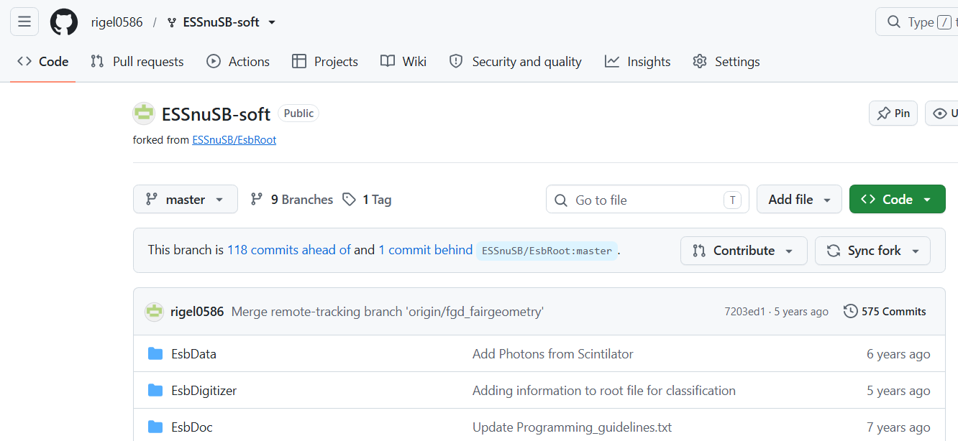
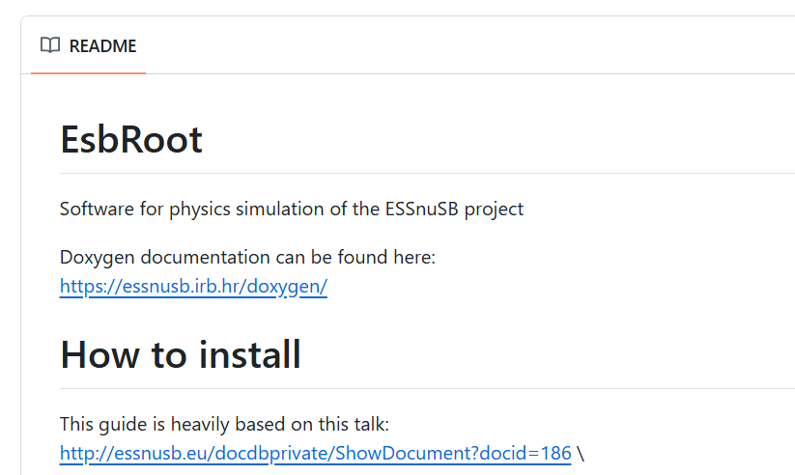
Migration to Essnusb v2
Previous version of the simulation software still is reachable on github - https://github.com/rigel0586/ESSnuSB-soft
Notes:
Initial framework was developed under linux mint 19.2. Mainly for the simulaton of the FGD (fine granular detector) detector.
As such the main third party libraries which were used were – FairSoft/FairRoot (utility framework to bridge cern root and geant4 geometry and simulation) , cern root, genie (for neutrino event generation), geant4 (for particle track simulation), genft (for particle track fitting)
Previous version of the software is still available on github, with build instructons.
But it no longer maintained – it is there for legacy purposes

Slide 5
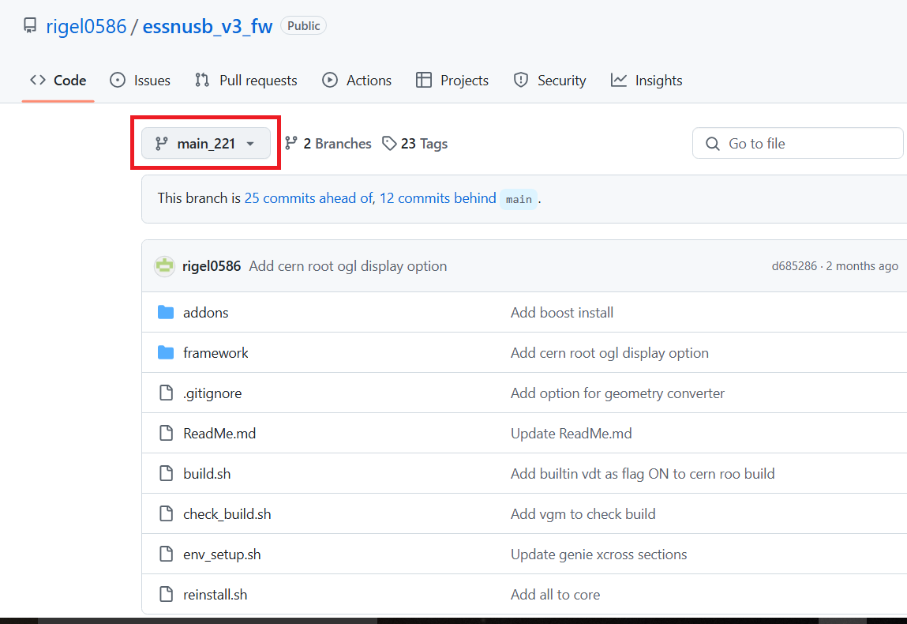
Upgrade to Linux Mint 22.1
A branch is created that can build the entire framework on Linux Mint 22.1 - https://github.com/rigel0586/essnusb_v3_fw/tree/main_221
Notes:
For the new version we choose to remove FairSoft/FairRoot – because they were quite heavy in terms of build time, runtime and unnecessary added complexity since they only provided a bridge between the geometry and the simulation itself. Also upgrading to newer versions of the other 3 main packages was difficult – due to version conflicts.
We decided to keep the core of the simulation engine – cern root (for scripts and geometry), geant4 (simulaton), genfit etc.
But to write the adapter part ourselves – thus we could also control more finely the simulation parameters.
The initial geometry to the framework was only FGD detector.

Slide 6
Stage 2 – Adding utilities
Notes:
Utilities are added to the essnusb v2 to easy its usage and help for faster

Slide 7
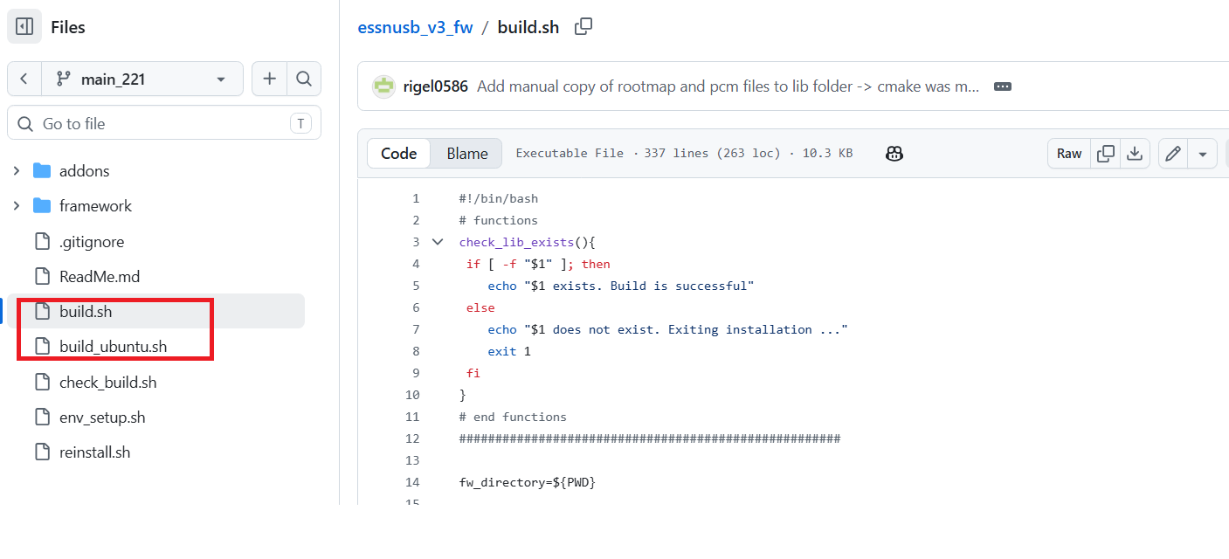
Framework utilities - automate the build
Notes:
One of the difficulties for using the framework was the long, and error prone, process of building the framework itself
A script was added to automate the process as much as possible. Thus simplifying at least the build steps
Also support was added to be able to build on Linux mint 22.1 and Ubuntu (the Ubuntu script also utilizes the stage for docker support)
The build itself takes ~5 to 8h (depending on the hardware used)

Slide 8
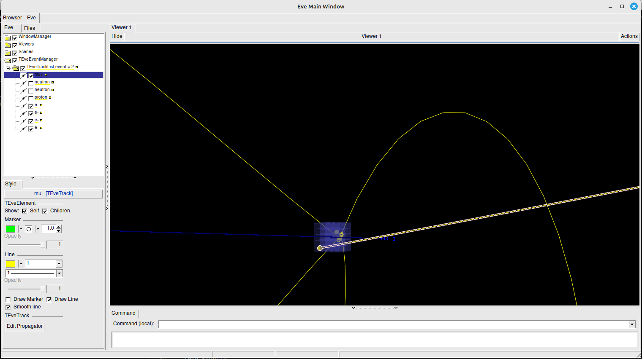
Framework utilities - Cern Root visualization of events
They can be turned on/off for better visualization
After running the simulation
track data is exported and then
for each event the tracks can
be visualized.
Notes:
Except for the simulation part, we wanted to add utilities that will make more expressing the usage of the framework – that is, the ability to be able to see what you have simulated.
Support was added for various cern root and geant4 visualizers - ROOT_EVE (cern root - the initial and default one used), ROOT_OGL (cern root - added), GEANT4 (added)
Some Geant4 visualizations use external third party libraries

Slide 9
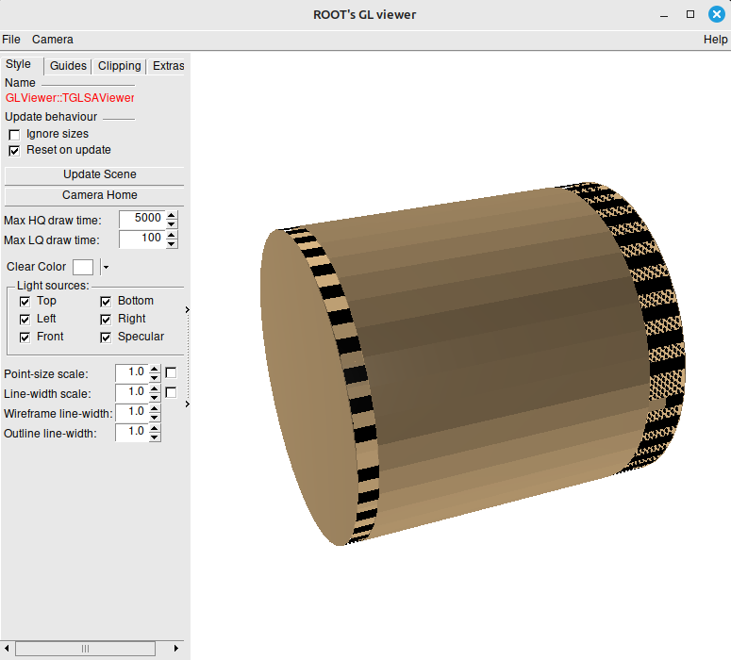
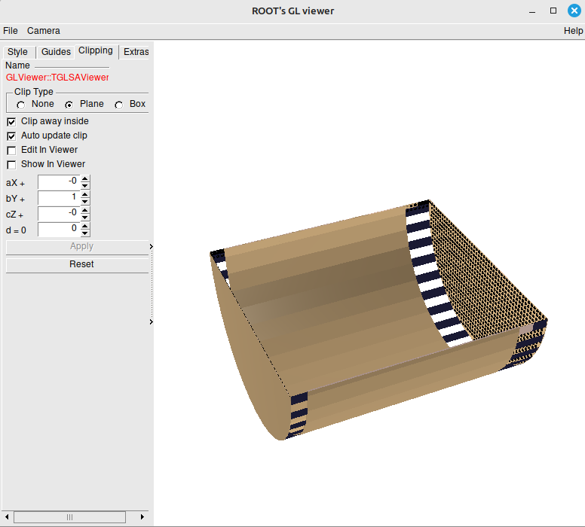
Framework utilities - WCSim geometry visualization with Cern root OGL

Slide 10
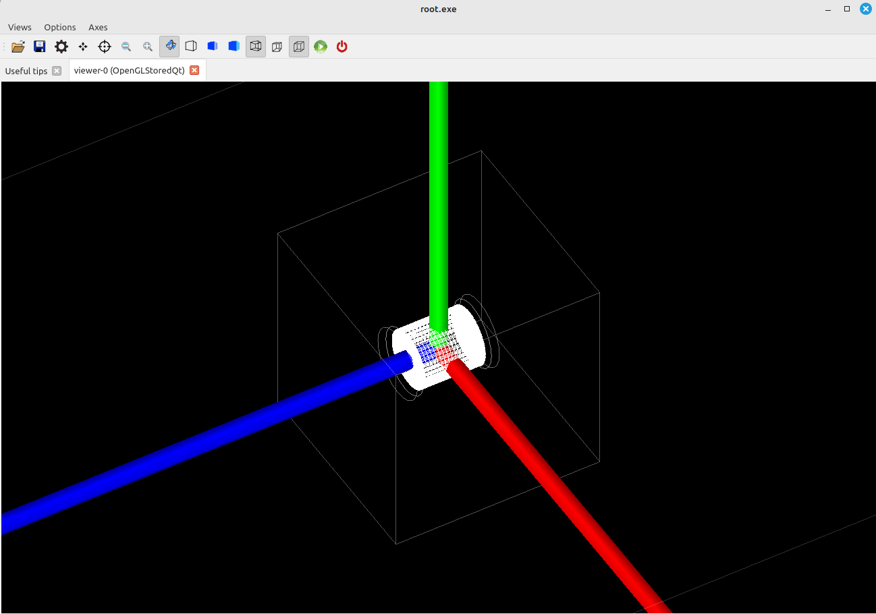
Framework utilities - Geometry visualization with Geant4
WCSim is created as a geant4 geometry

Slide 11
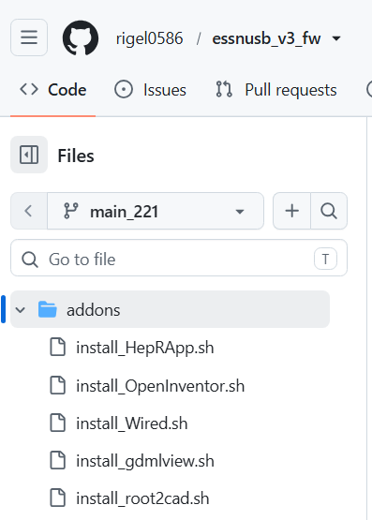
Notes:
Since some are Geant4 visualization tools are quite big, we decided to move them as addons to the framework itself and the user to decide whether he/she wants them.
For simplicity, the addons were added as scripts – so they just need to be executed.
The current addons are for visualizations – HepRapp (geant4), OpenInventor (geant4), etc.
There is also a simplified gdmlviewer – the essnusb framework also adds the possibility to export the constructed geometry as Geant4 or Cern root geometry, which then only the geometry can be visualized using the gdmlview or the Framework offline visualizer.
Of course addons, can be made not just for visualization. But these are the currently added ones

Slide 12
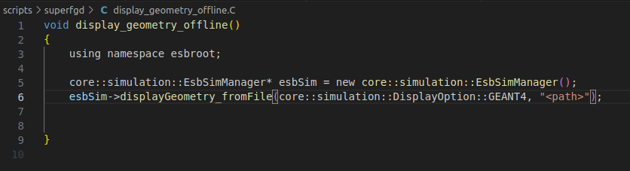
Framework utilities - Visualization of exported geometry files with Geant4 or CERN ROOT
When a simulation is made, the geometry is exported in a gdml and root file formats. This can be used to display the geometry if needed. Or any other geometrty created by third party apps who have exported the geometry to gdml or root file formats.
E.g

Slide 13
Stage 3 – Adding more detector geometries

Slide 14
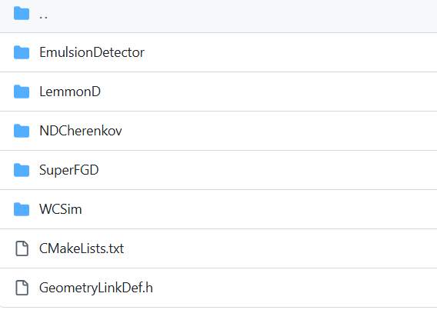
Added geometries
Notes:
Geometries were added for:
Viking detector (based on the geometry that was send) - EmulsionDetector
WCSim (based on the geometry of the WCSim framework itself)
Simple NDCherenkov (Sphere with only water and traces of other substances)
LemmonD detector

Slide 15
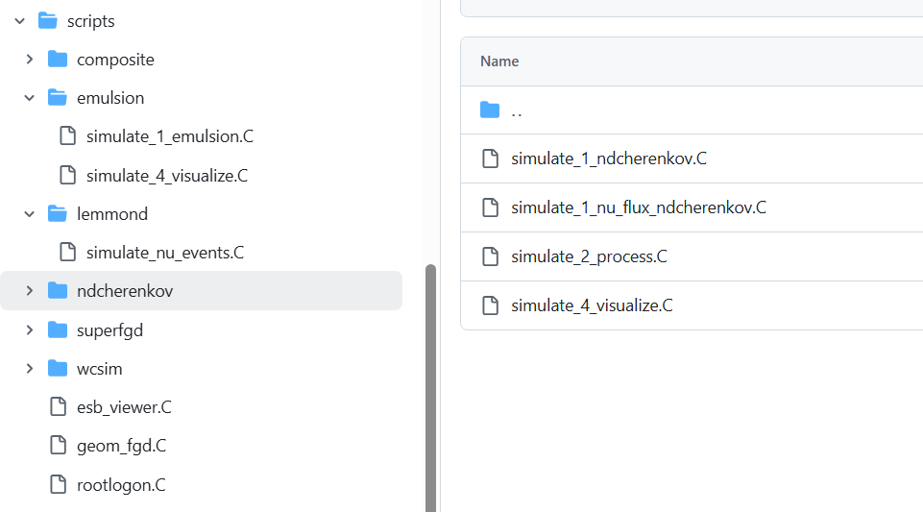
Added geometries
Notes:
For each geometry, initial script were added to run a simulation.
Based on the simulation itself – the user decides how to process the simulation data extracted.
Cern root macro scripts are supported which can easy the processing and subsequent steps.
The essnusb has genfit for track fitting using Monte carlo data.
Also TMVA – the cern root machine learning framework is supported, for data analysis.
Any other third party tool has to be added manually, simulation data has to be converted to the
Input format of the third party library.

Slide 16
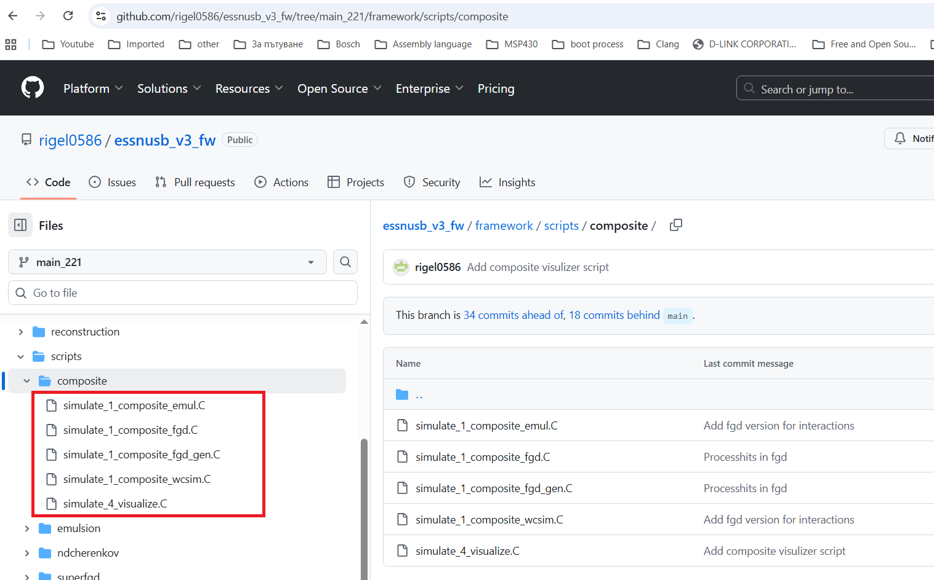
Multiple geometries simulation
Notes:
Also support is added to simulate composition geometries.
E.g. add fgd and WCSim in one simulation – using the geometries already constructed from individual simulations.
Events can be generated into the first, second, third etc. detector or only in of them – based on simulation requirements.

Slide 17
Stage 4 – Add support for Ubuntu OS

Slide 18
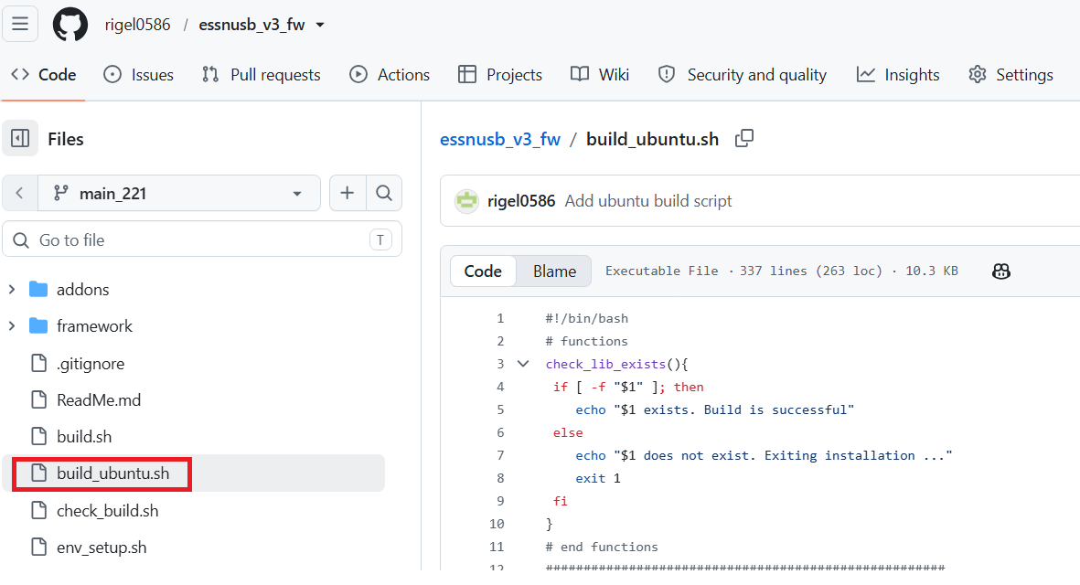
Notes:
Support got Ubuntu build was also added.
The steps are more or less the same as for Linux Mint, but to increase the compatibility to be able to used across multiple Oss
Ubuntu was also added.

Slide 19
Stage 5 – Add docker support
Notes:
To address issues with compiler versions, OS versions etc. framework to be moved to docker image

Slide 20
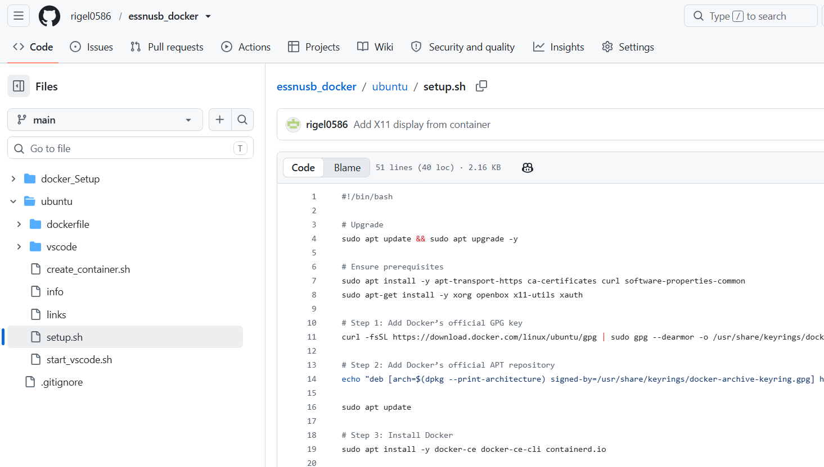
Docker github repository
Notes:
A separate github repository was added to support only docker image construction and
Installation, environment setup.
Again, scripts are added to easy get up and running

Slide 21
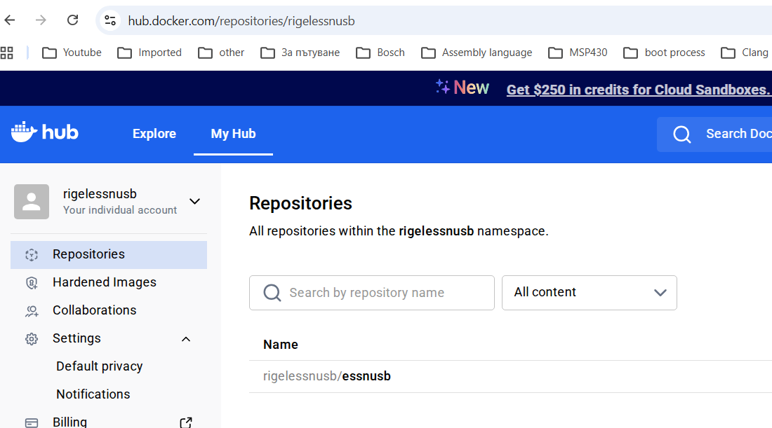
Docker hub repository
Notes:
The image is build and uploaded to the docker hub repository and is publicly available.
But the running utility scripts are in the github repository

Slide 22
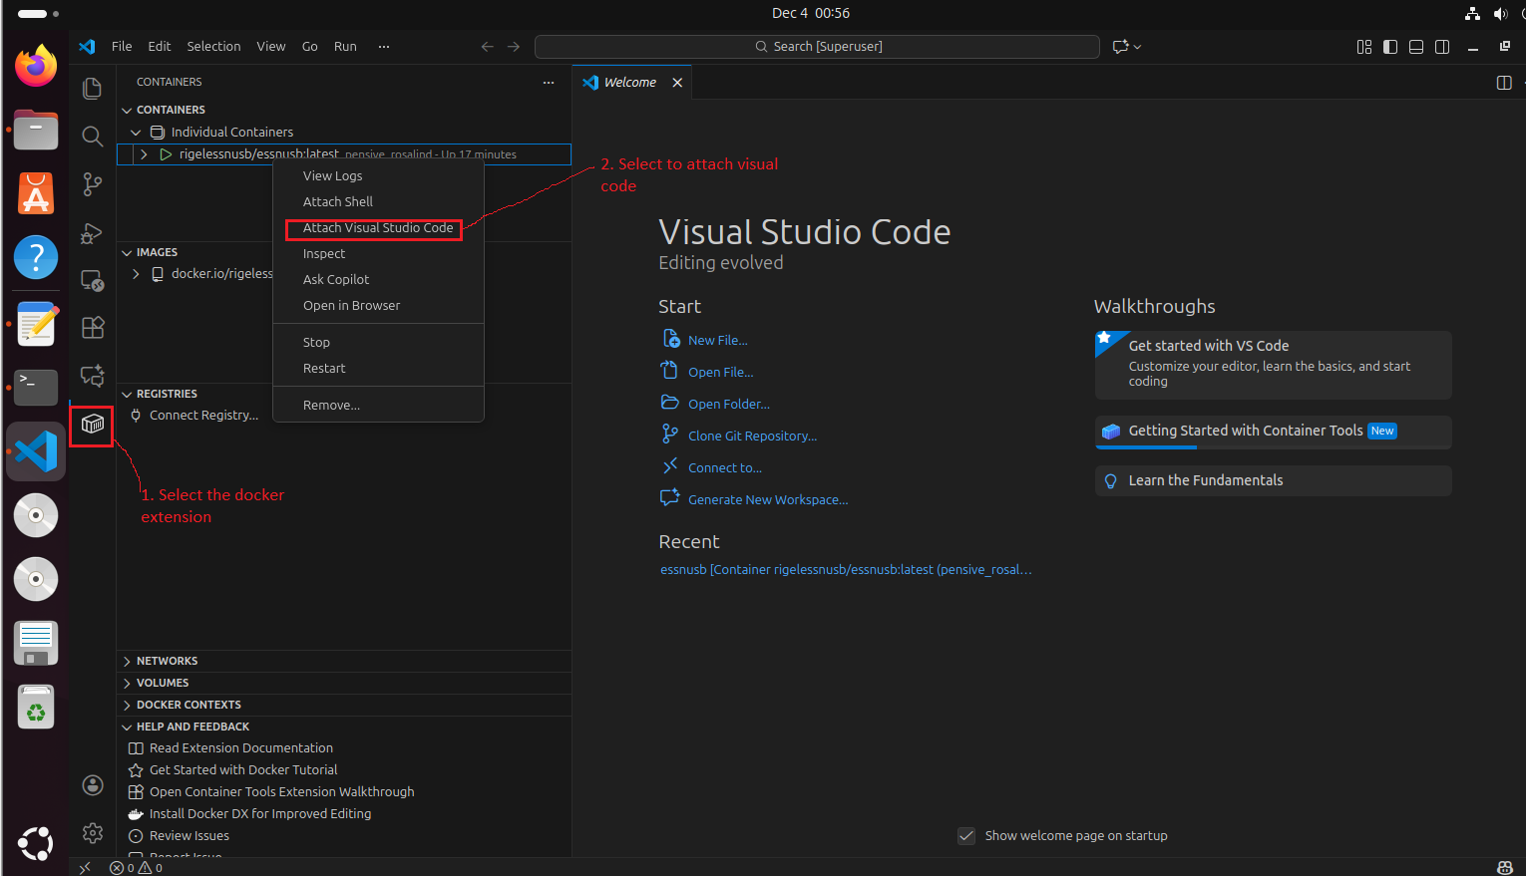
Notes:
The script setups:
Downloads the docker image
Installs vs code
Install vs code plugins (for docker support)

Slide 23
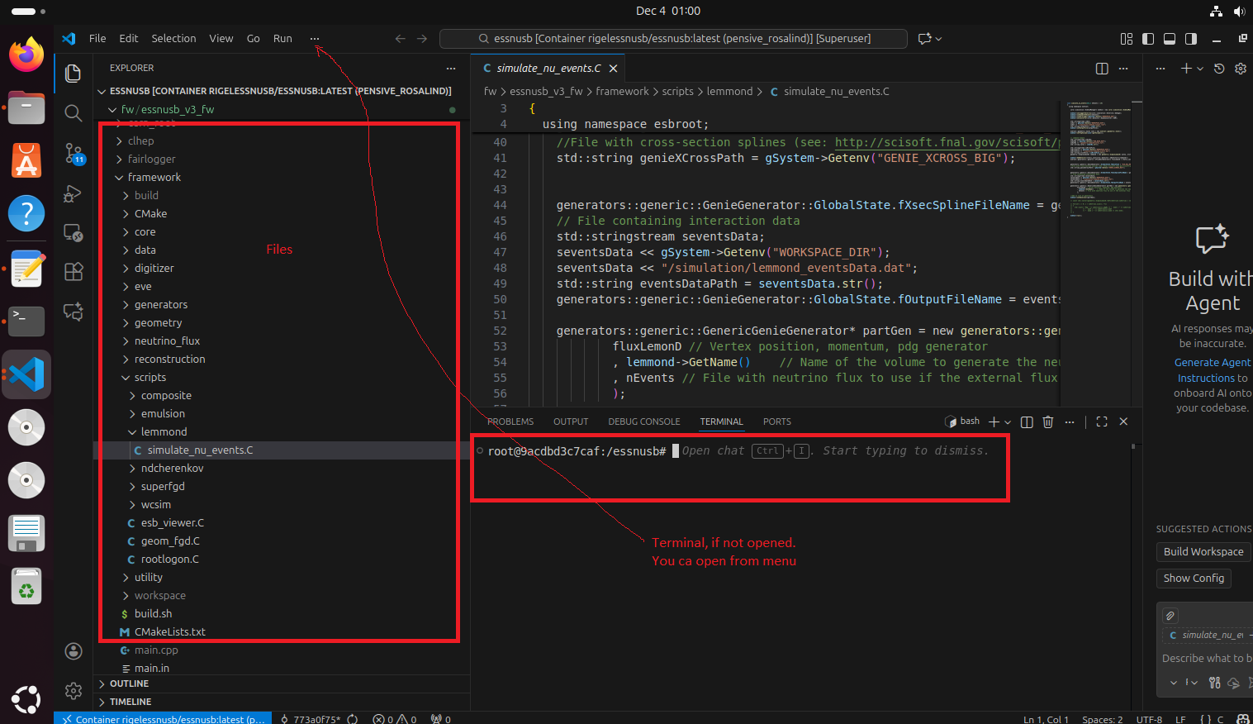
Notes:
Once the script finishes, everything is ready to run.
The environment is ready to run the simulations with all environtment variable setup and
The framework is build.
Here is an example of the docker instance running to make a simulation for the lemmonD detector.

Slide 24
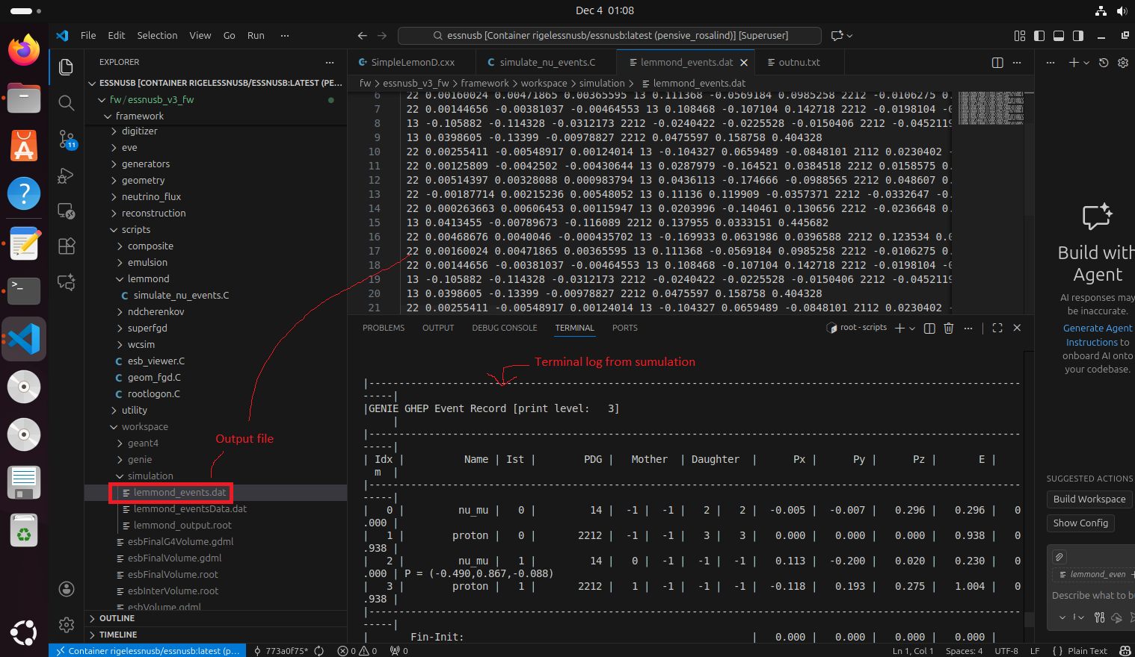
Notes:
And the result of the simulation.
Here an output data file is shown, which can be downloaded from the docker instance and can be used locally.

Slide 25
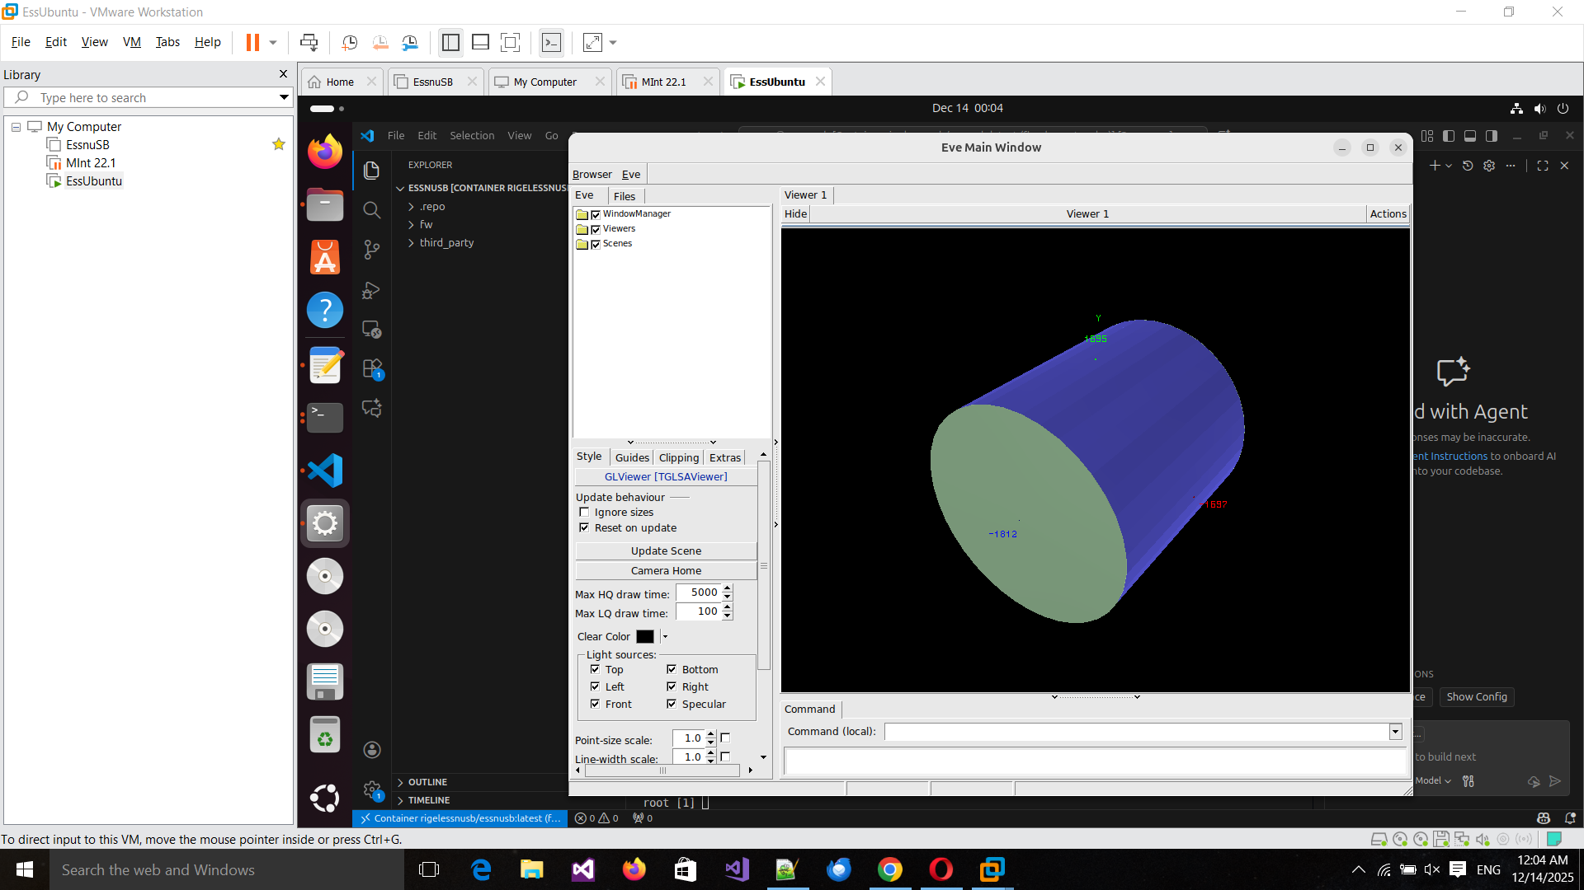
Notes:
One thing to note – GUI support was also added to the docker instances.
Meaning that you can use the visualization tools, and the result will be shown in a window.
Here is an example of the WCSim detector running in a docker inside a virtual machine

Slide 26
Summary
1. Stage 1 :
Framework was migrated to Linux mint 22.1 from Linux mint 19.2.
FairSoft/FairRoot has been removed
2. Stage 2 – Adding utilities
Visualization utilities
Build scripts
Addons for third party usage

Slide 27
Summary
3. Stage 3
WCSIm geometry
EmulsionDetector geometry
LemmonD geometry
4. Stage 4
Support for Ubuntu
5. Stage 5
Docker image build
Docker instance running on Ubuntu + Docker GUI

Slide 28
Final words on the essnusb framework
Notes:
In this presentations I have shown what has been implemented to the stage 2 part of the essnusb project for the framework itself.
Since there are no more requirements, or requests to additions the framework will be left it this condition.
Everything is added to public repositories and is freely available.
Thank you for your attention.

Slide 29

Questions?

