Slide 1


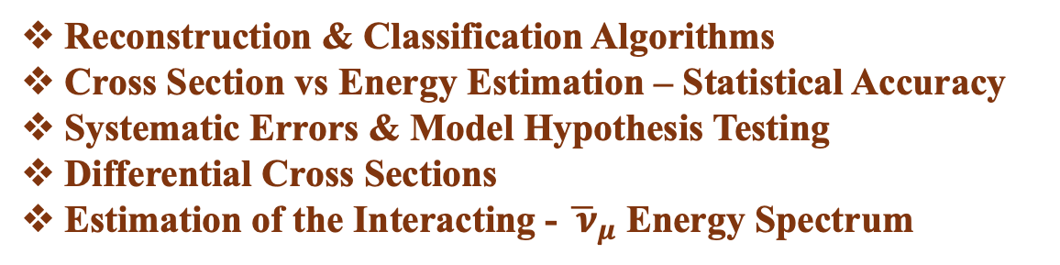
Tools & Methods
for Measuring $σ_{{\overline{ν}}_{μ}−H_{2}O}^{CC}\left(E_{{\overline{ν}}_{μ}}\right)$ with LEMMOND
Ioannis Karakoulias, George Fanourakis, Dimos Sampsonidis & Spyros Tzamarias
Reconstruction & Classification Algorithms
Cross Section vs Energy Estimation – Statistical Accuracy
Systematic Errors & Model Hypothesis Testing
Differential Cross Sections
Estimation of the Interacting - ${\overline{ ν}}_{μ}$ Energy Spectrum

Slide 2
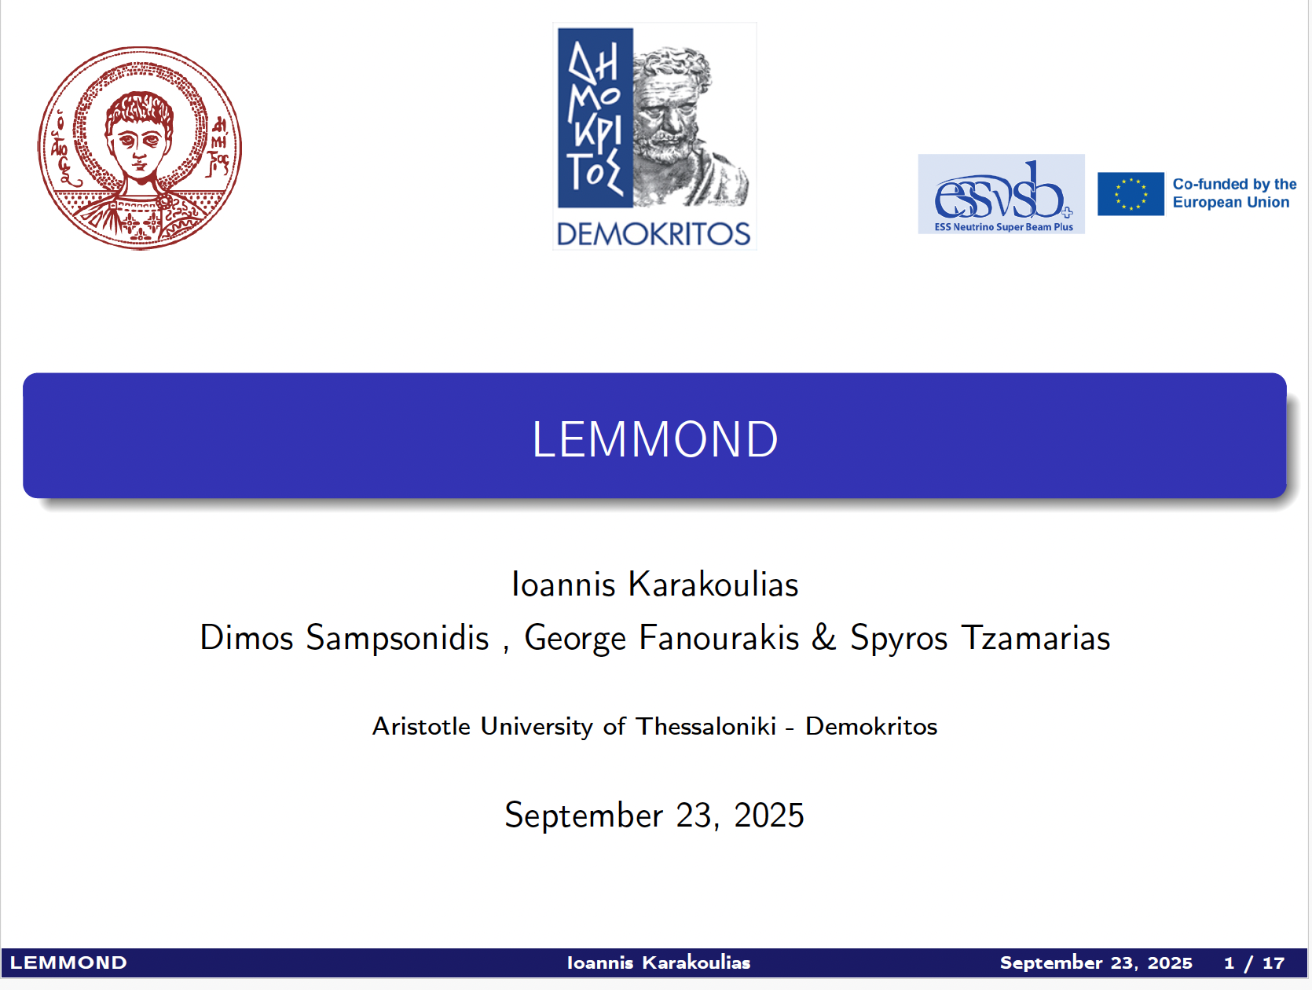
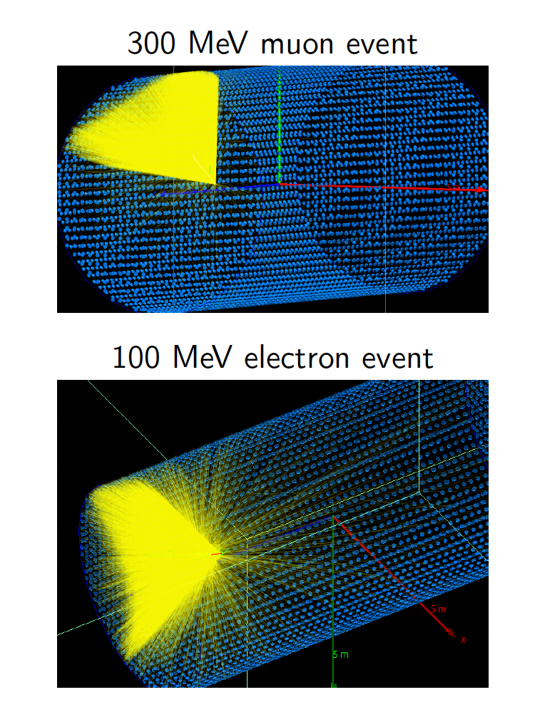
MILOS - 2025
Detailed Geant4-based simulation
Including water properties (Absorption, Rayleigh & Mie Scattering, Dispersion) and PMT signal formation (amplitude/charge distribution, time jitter etc)
NO electr. noise, NO abient light
A water tank of 10m length and 5m diameter
25% Coverage using 3’’ PMT’s

Slide 3
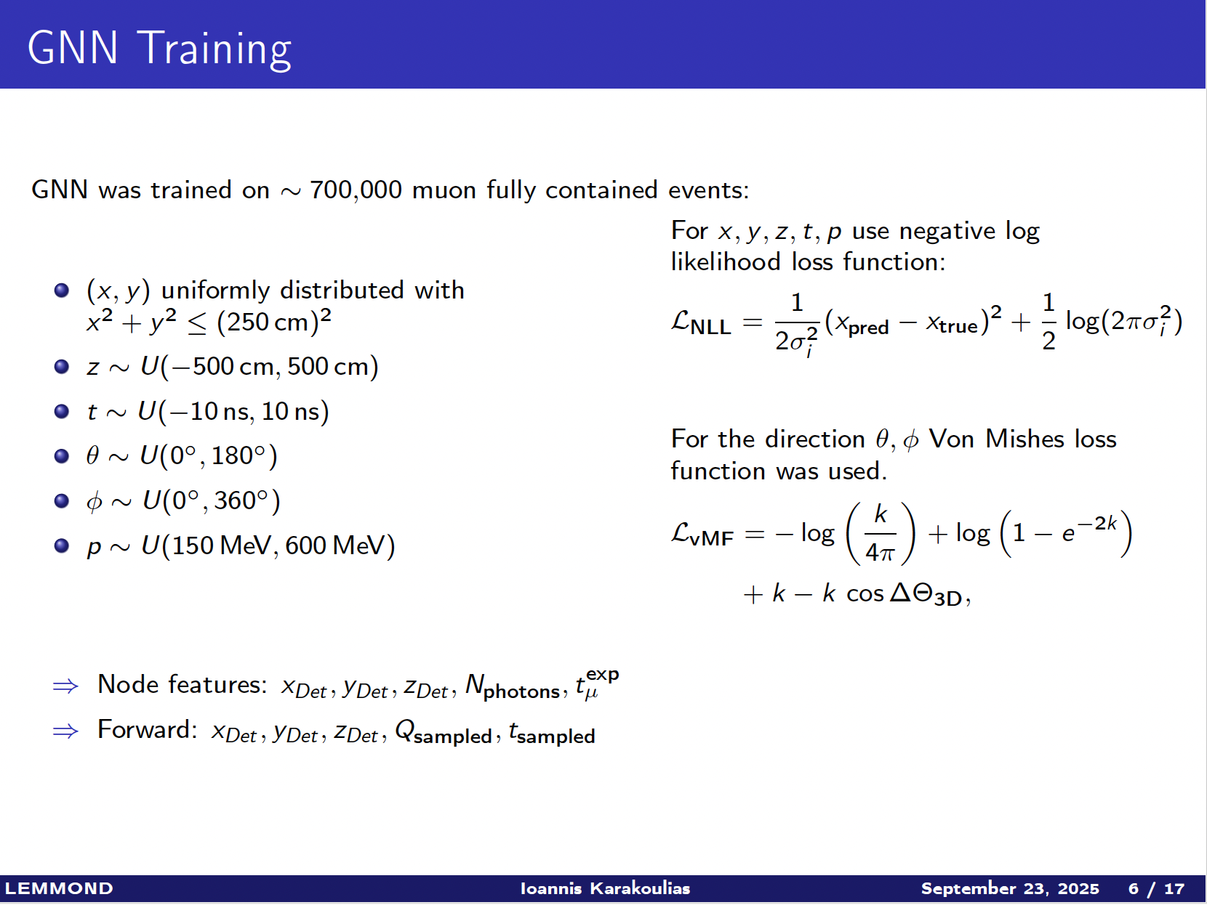
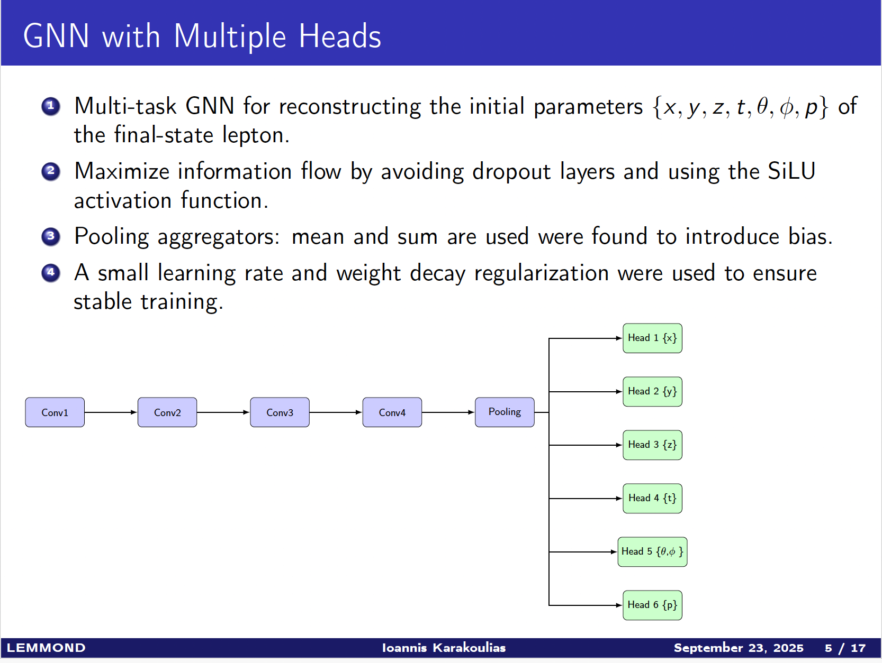

MILOS – 2025
GCN Reconstruction of Charge Lepton Track
$x_{V}, y_{V}$, $z_{V},t_{st}, θ, φ, \left|\vec{p}\right|$

Slide 4
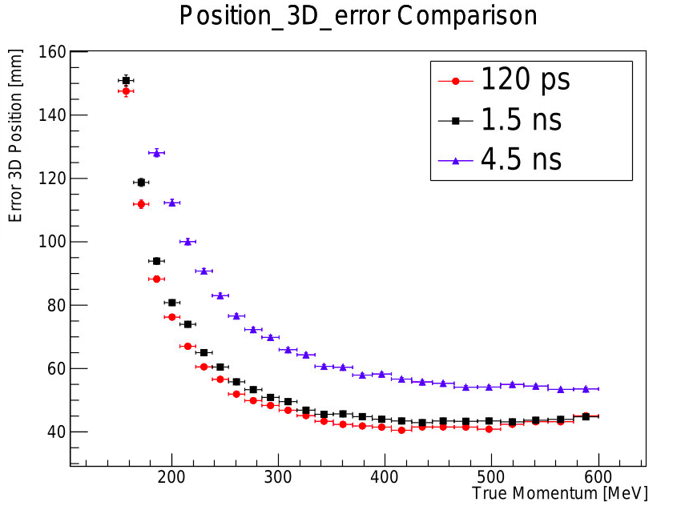
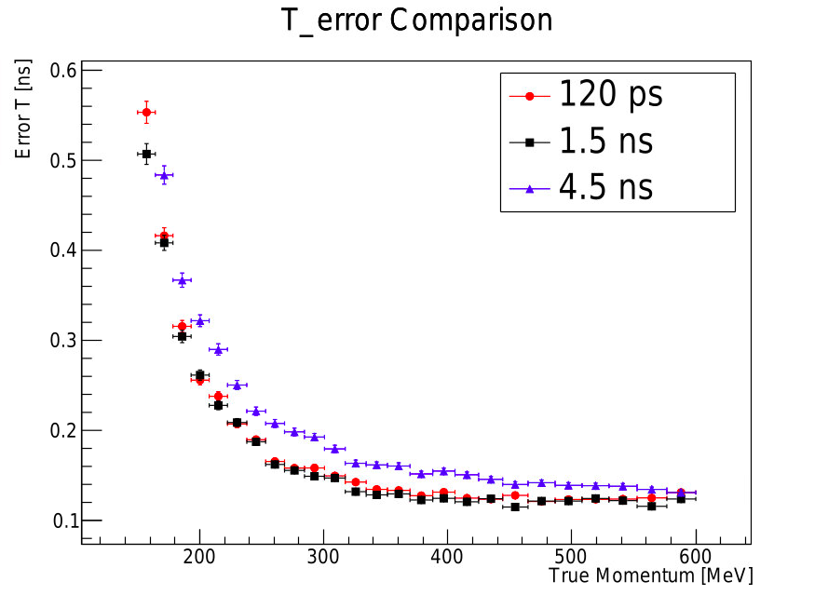
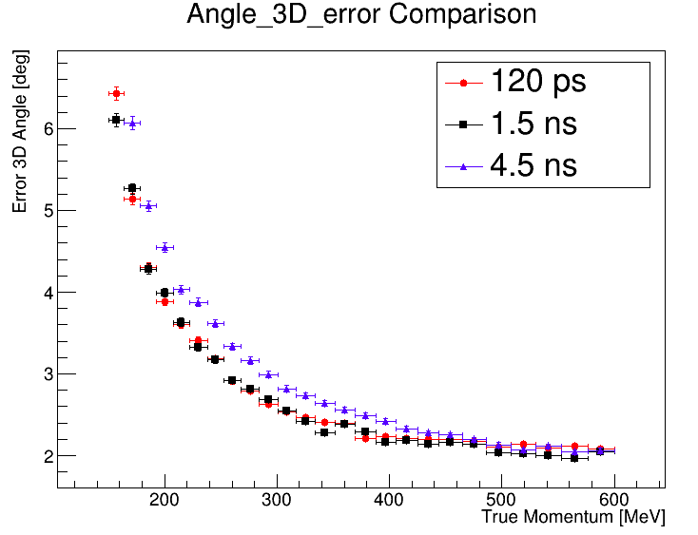
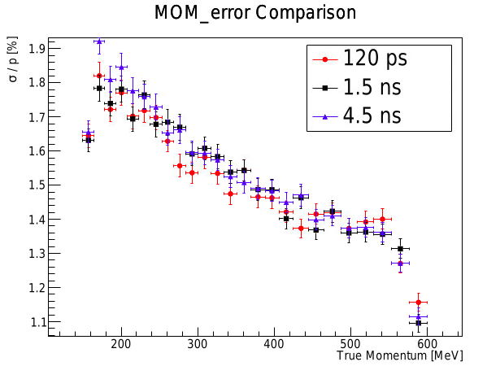
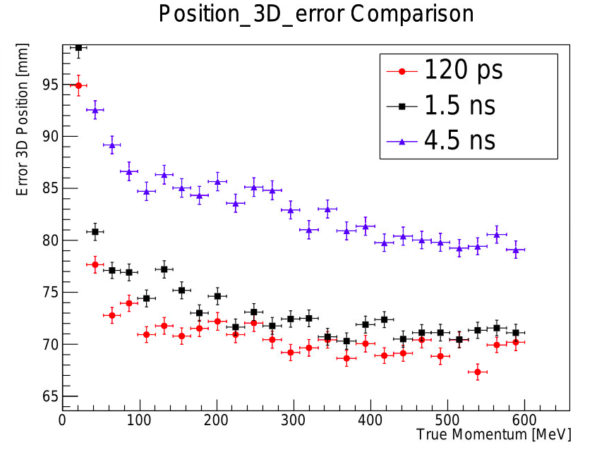
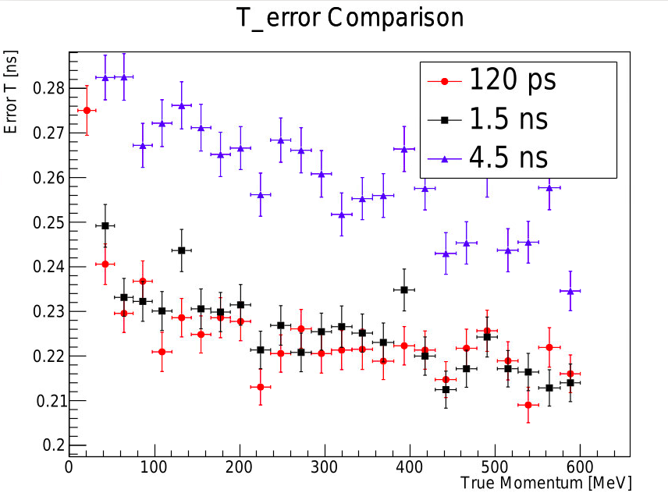
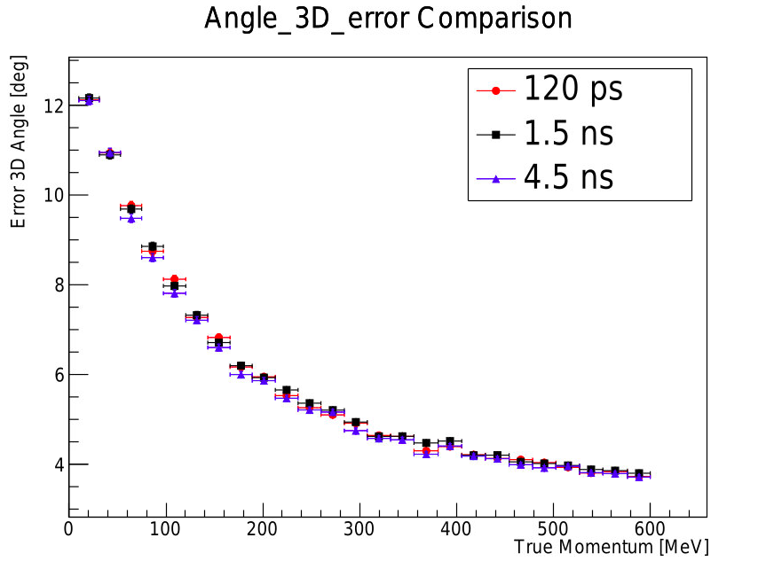
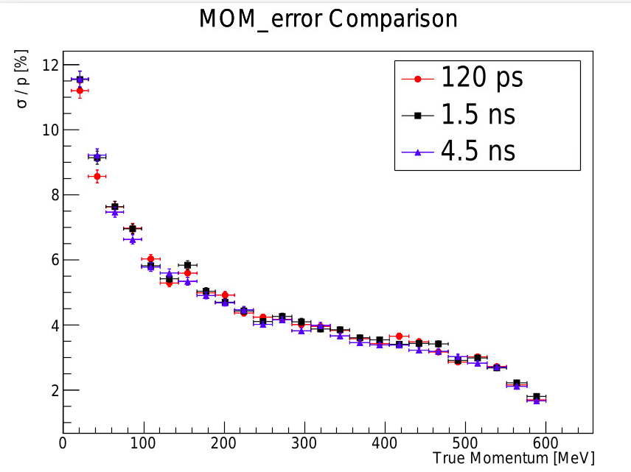
MILOS – 2025
GNN Reconstruction of Charge Lepton Track
Resolution

Slide 5
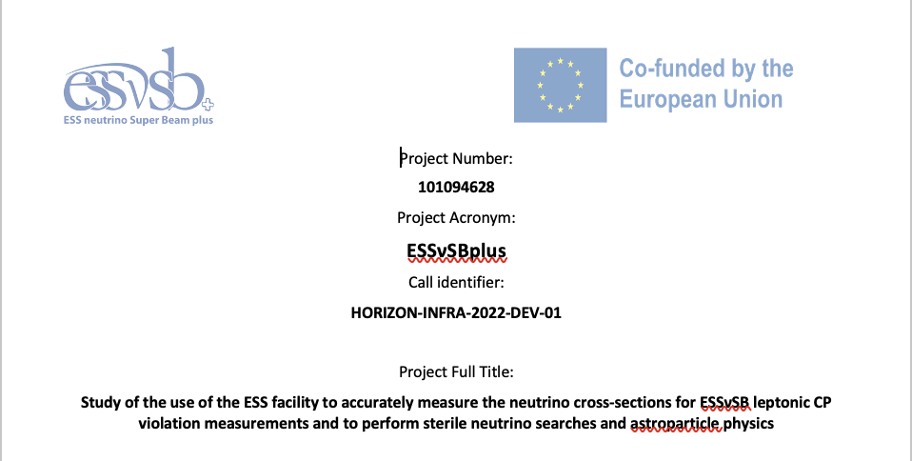
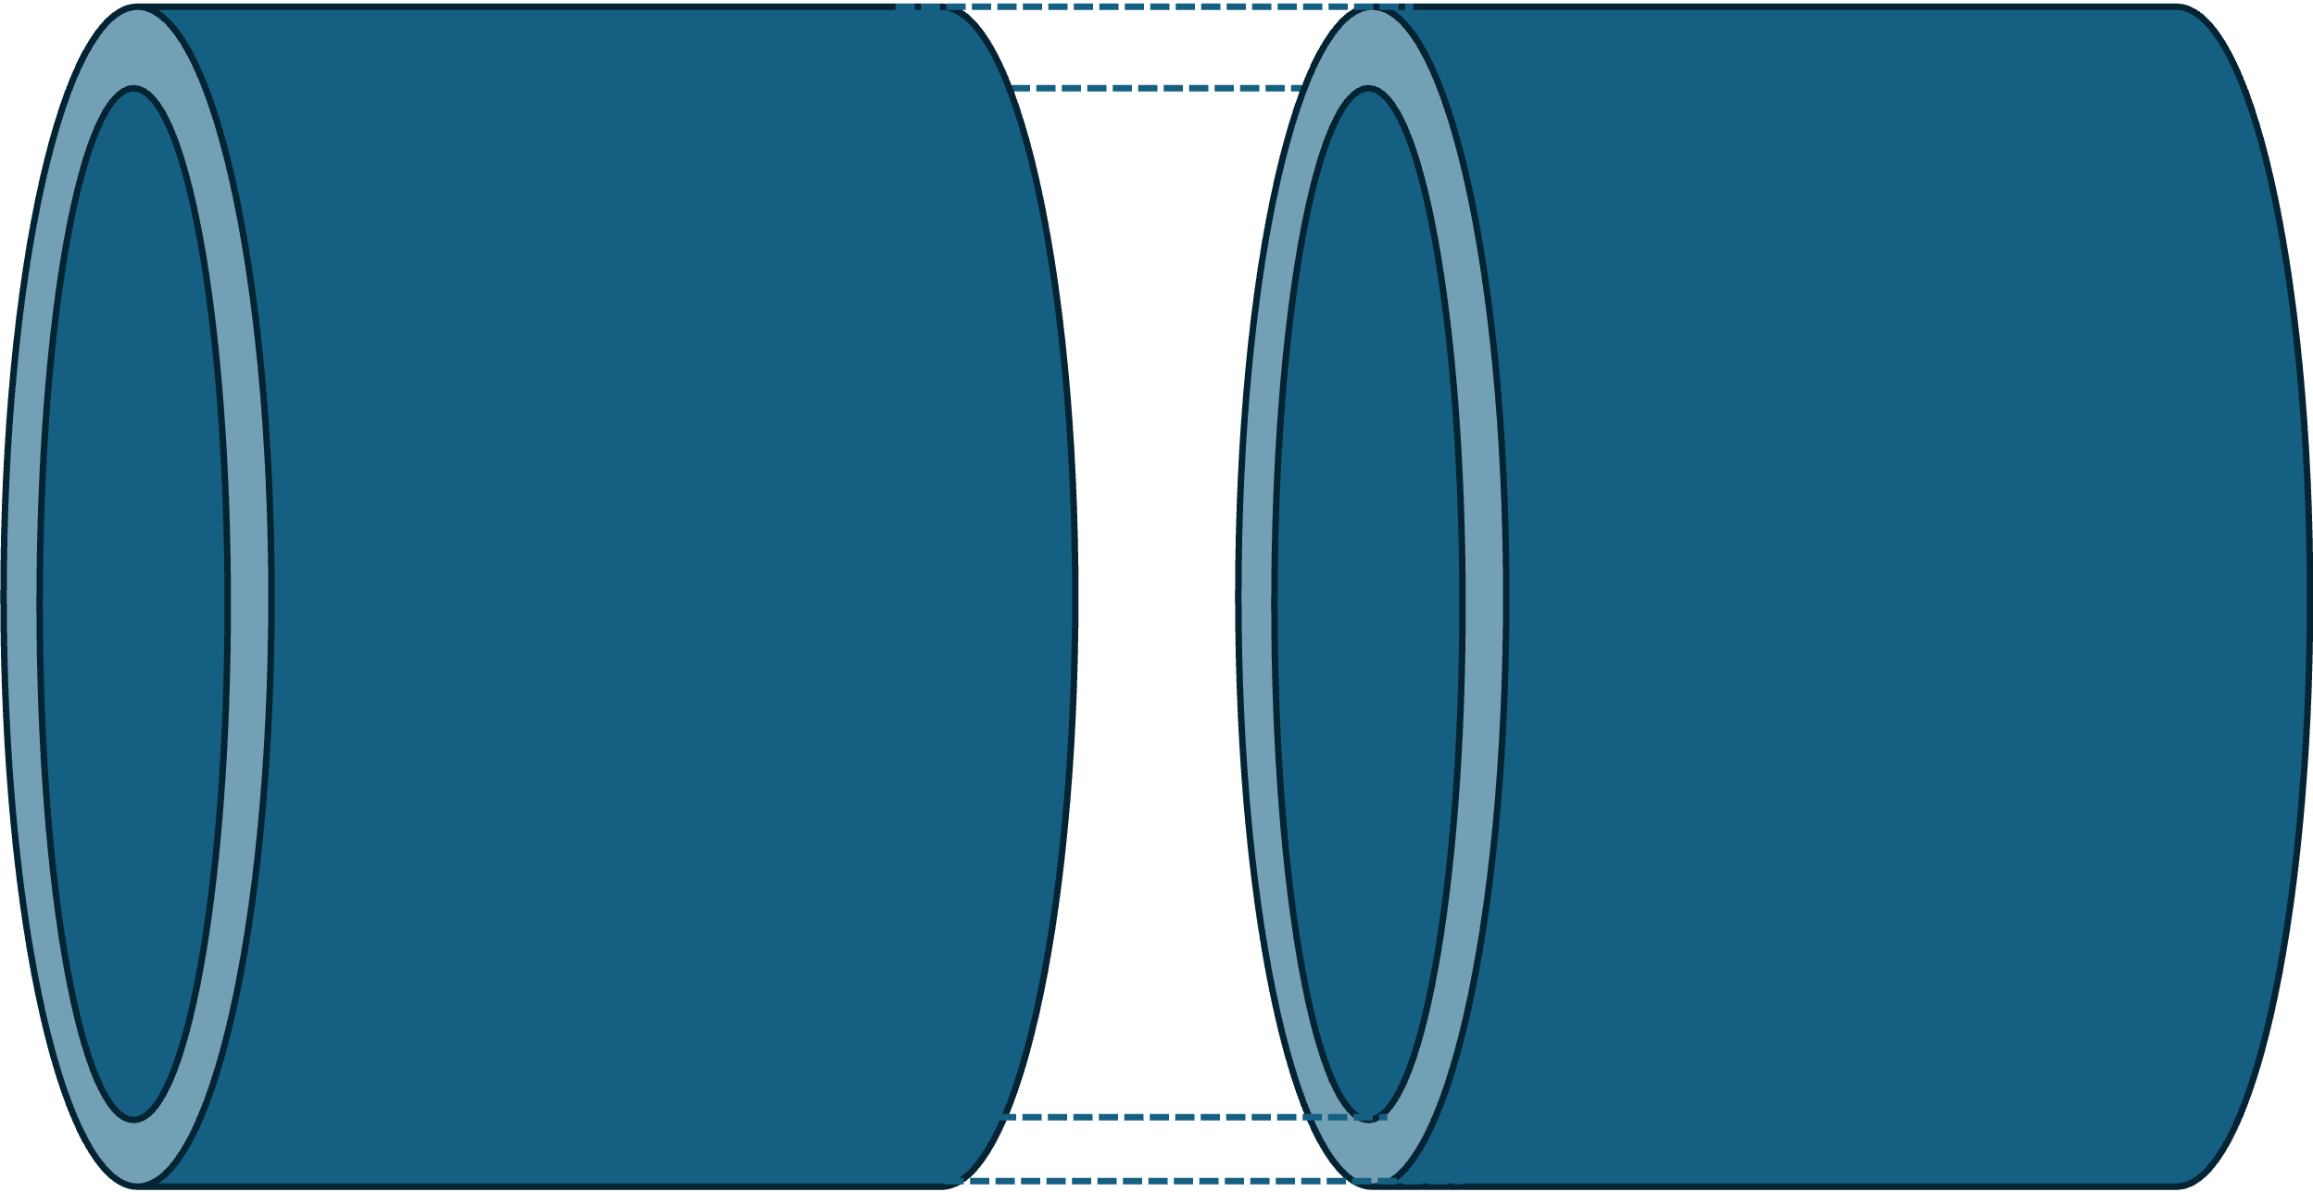
Tools & Methods
for measuring ν-xsections with LEMMOND
Total Detector Volume (TDV): 10.4 m length and 2.7m radius
Effective Detector Volume (EDV): 10 m length and 2.5 m radius
Accepted Interactions: the reconstructed interaction vertex inside the EVD
Fully Contained Tracks (FCT): the whole lepton track is inside the water volume, >25 PMT’s

Slide 6
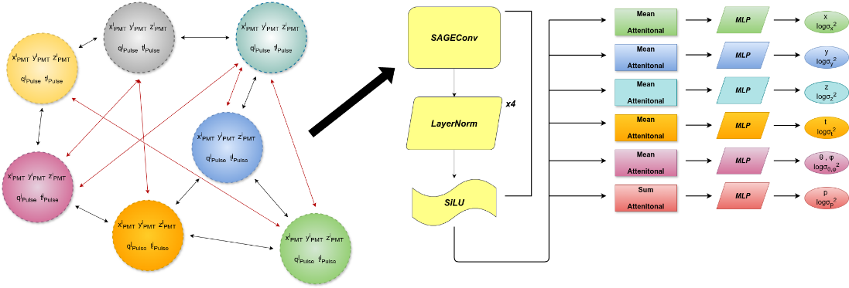
An (slightly) Improved GCN
for Charged Lepton reconstruction
Each node is connected with 10 other nodes (5 nodes according to their proximity in space and 5 more nodes according to their proximity in charge). The red and black lines in Fig. 3.1 (the edges) show examples of these connections. This information is finally submitted to the activation function SiLU four times.
This information is subsequently submitted to some operators known as Aggregators such as the “Mean”, “Sum” and the “Attentional” Aggregators.
Subsequently, the information goes through a Multi-Layer Perceptron (MLP), which is a 3 layer (input, hidden, output) feedforward artificial neural network of fully connected neurons which utilize non-linear activation functions. Output is each variable to be determined and its logvar. Logvar is preferred since it is more stable than the variance.

Slide 7
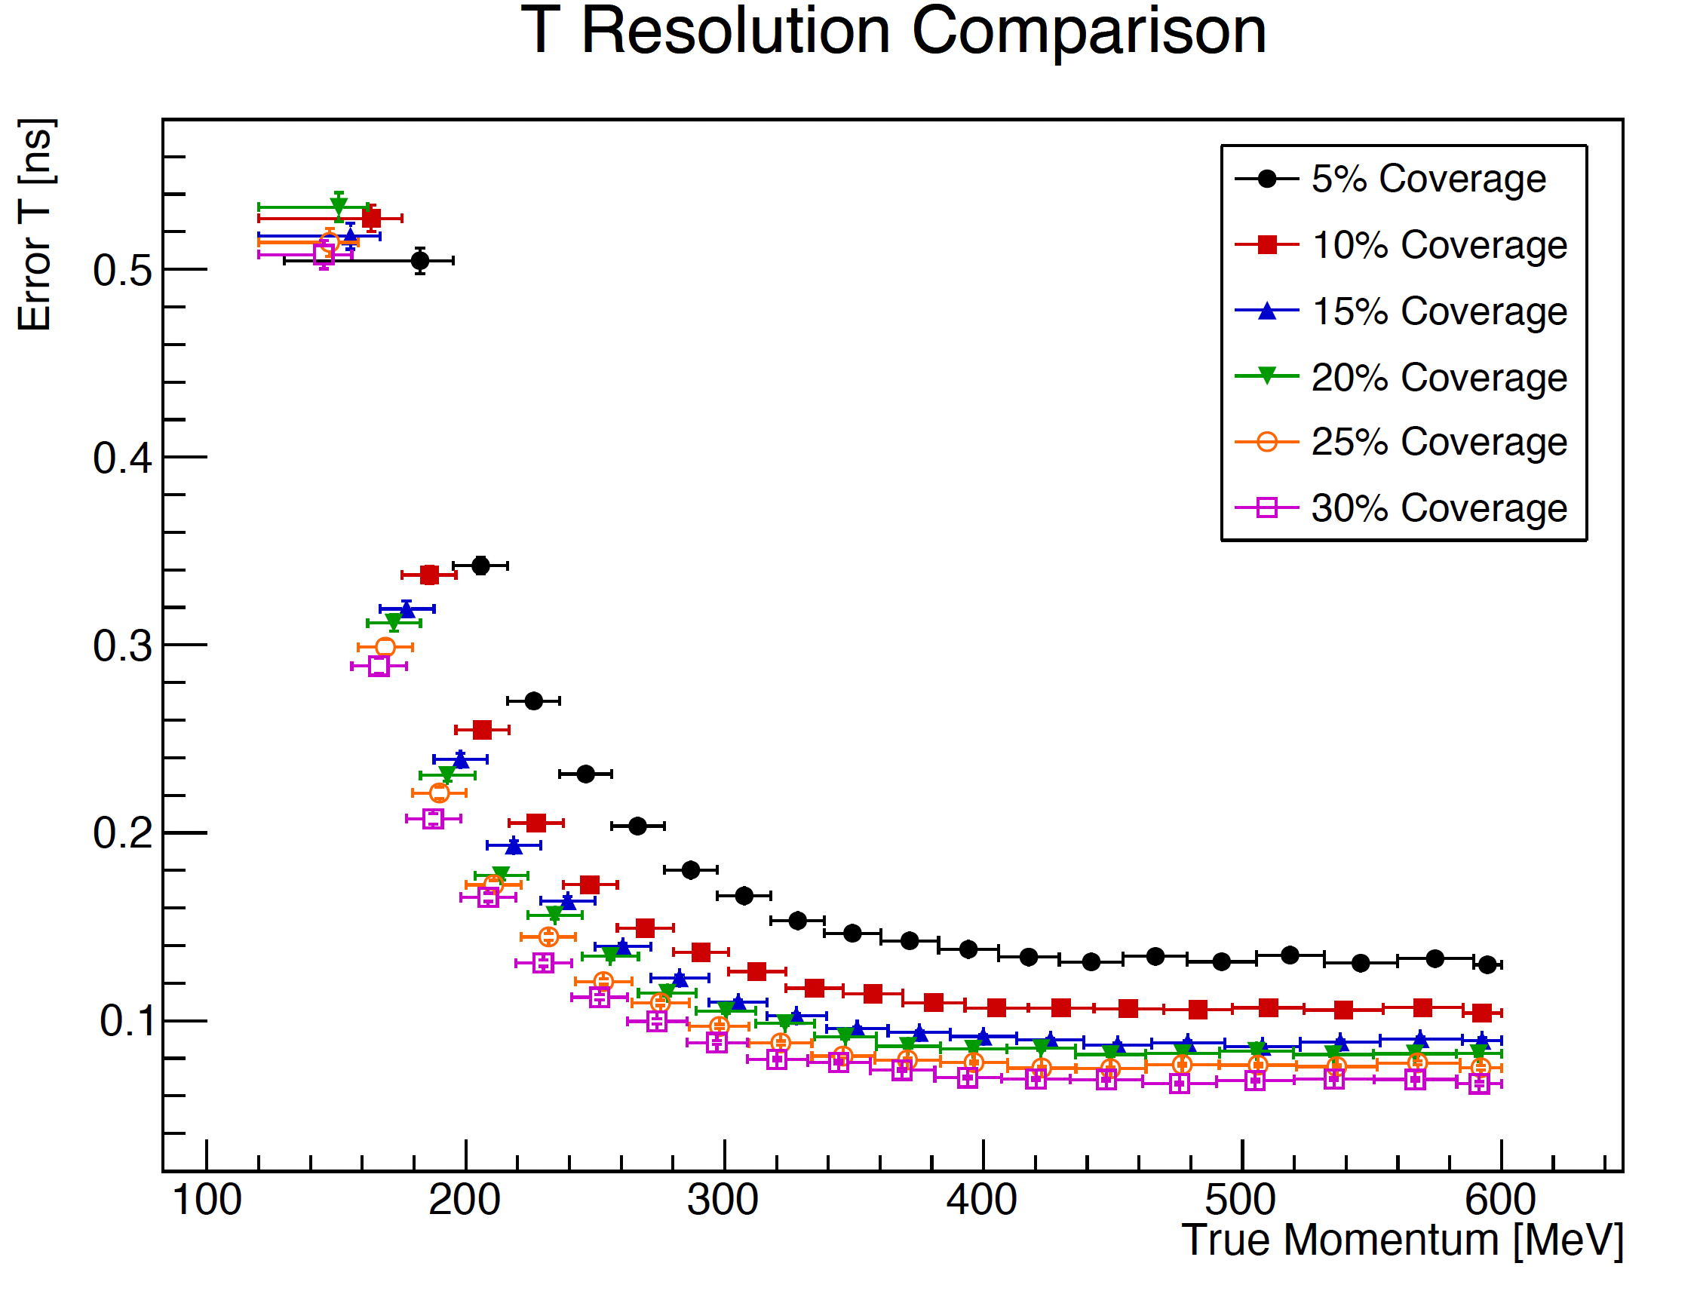
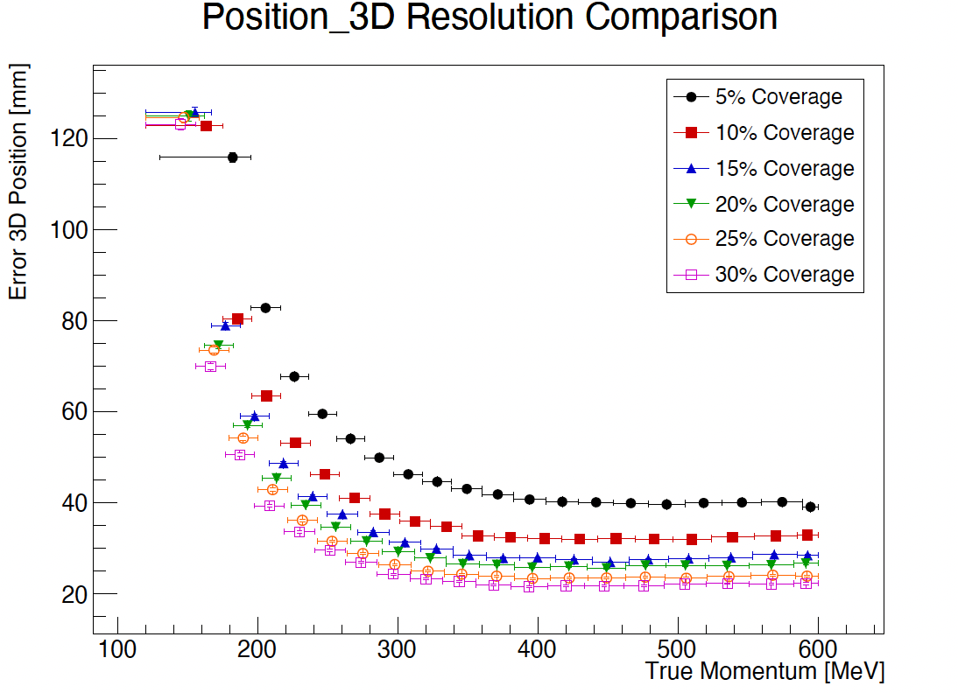
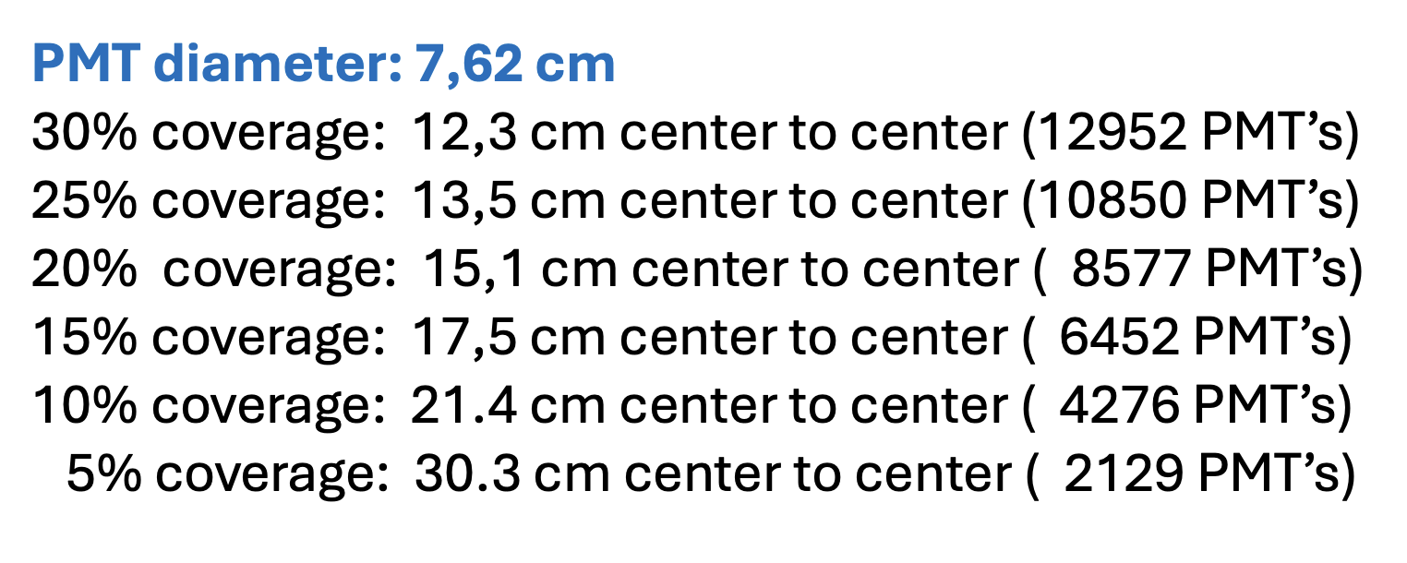
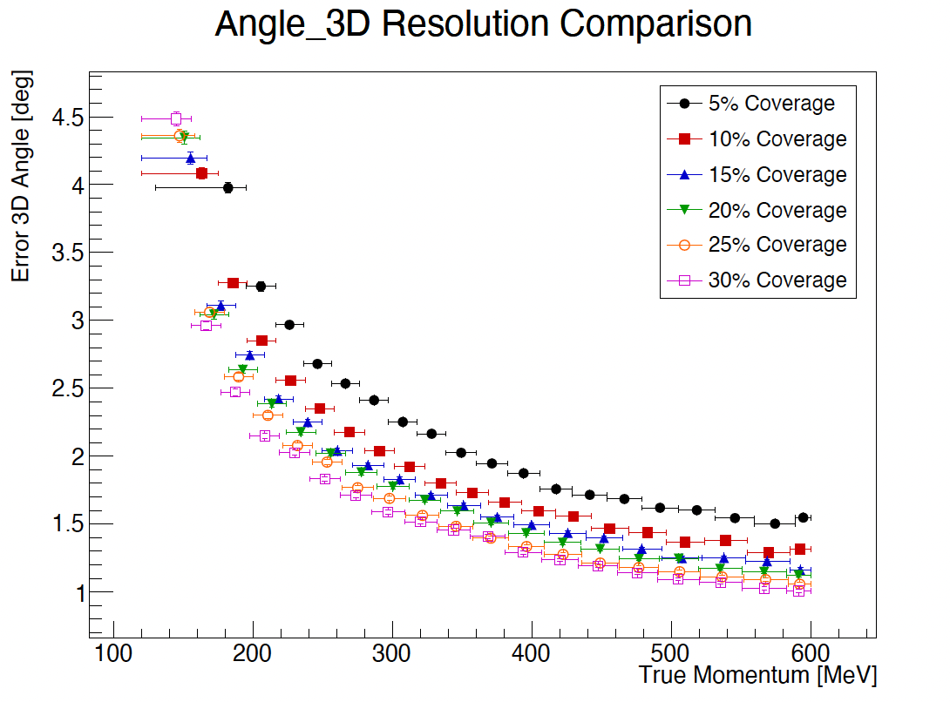
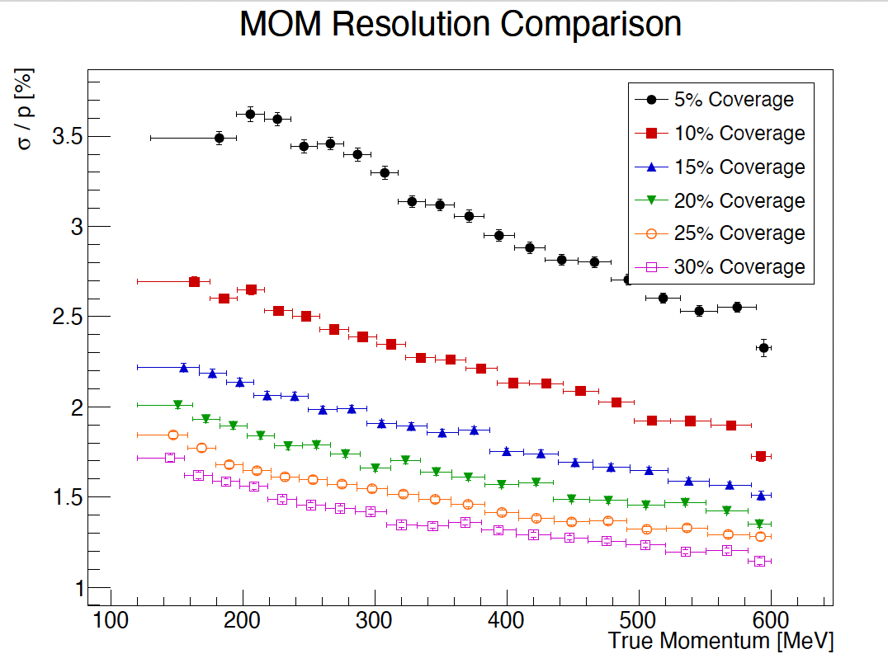
Reconstruction Resolution
for Fully Contained μ-tracks

Slide 8
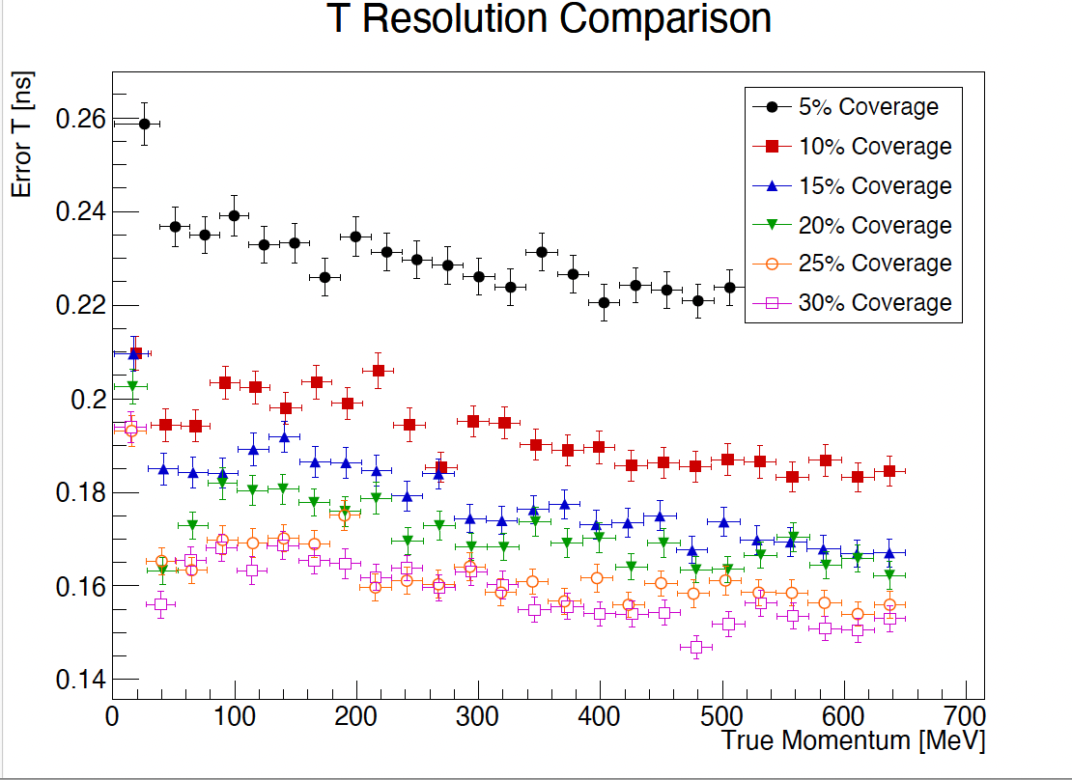
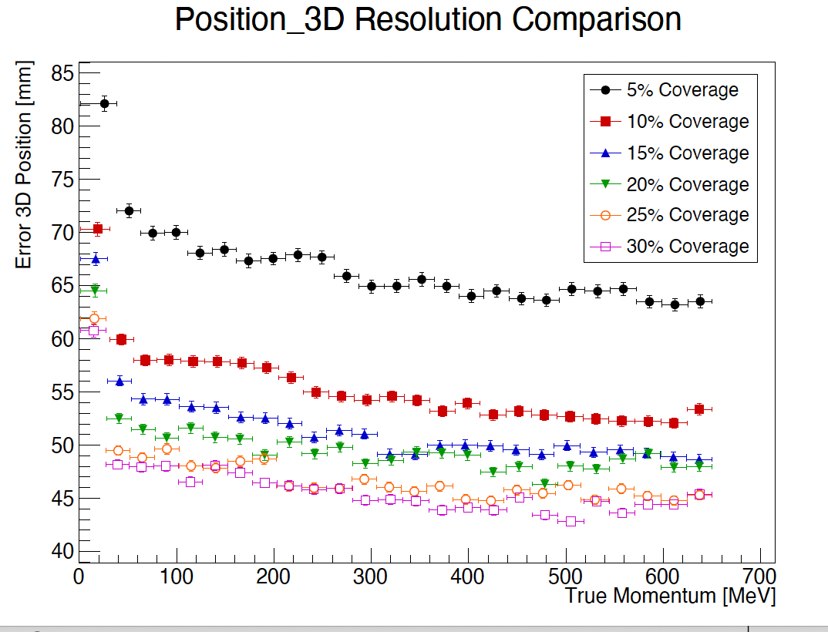
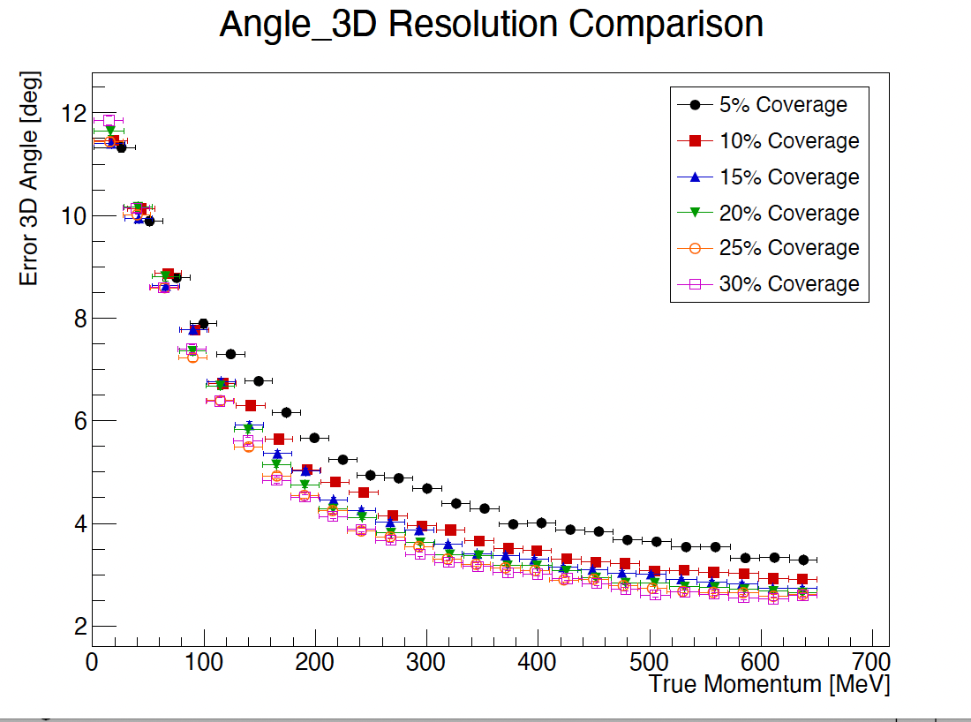
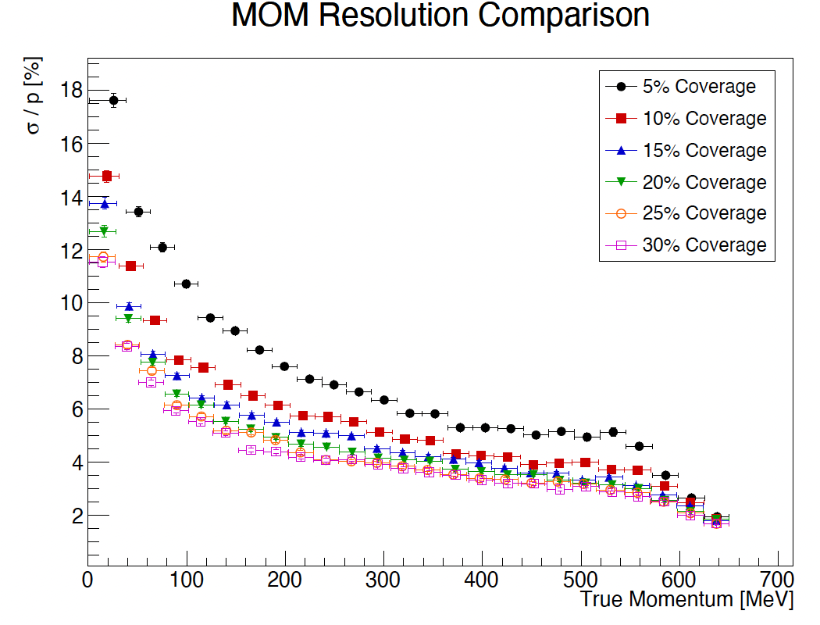
Reconstruction Resolution
for Fully Contained e-tracks
In the following…
25% Coverage

Slide 9
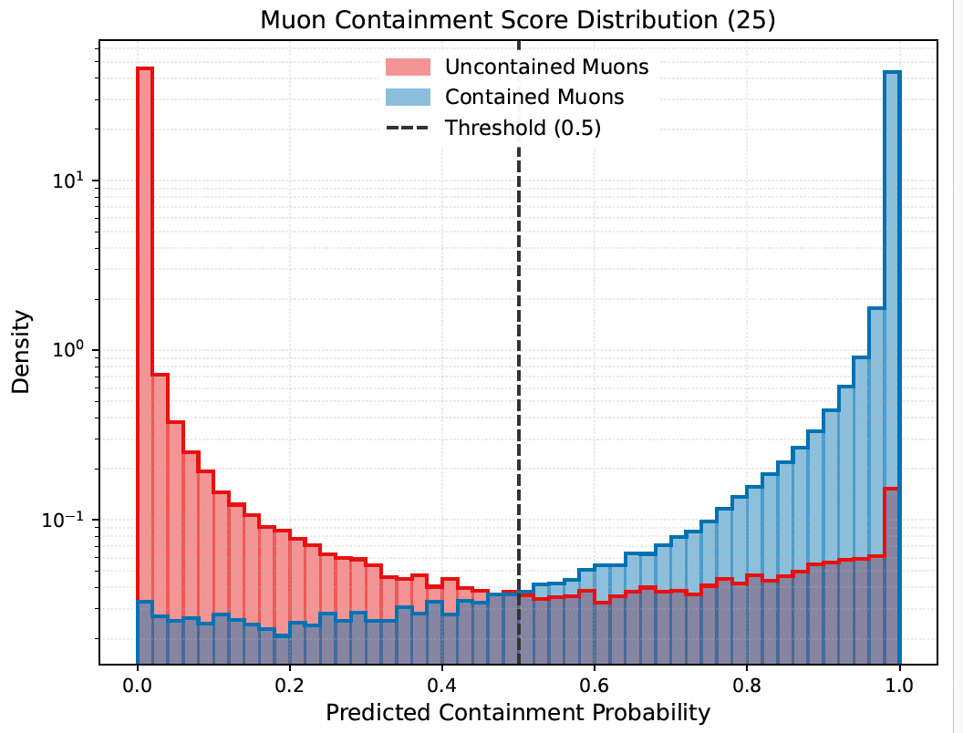
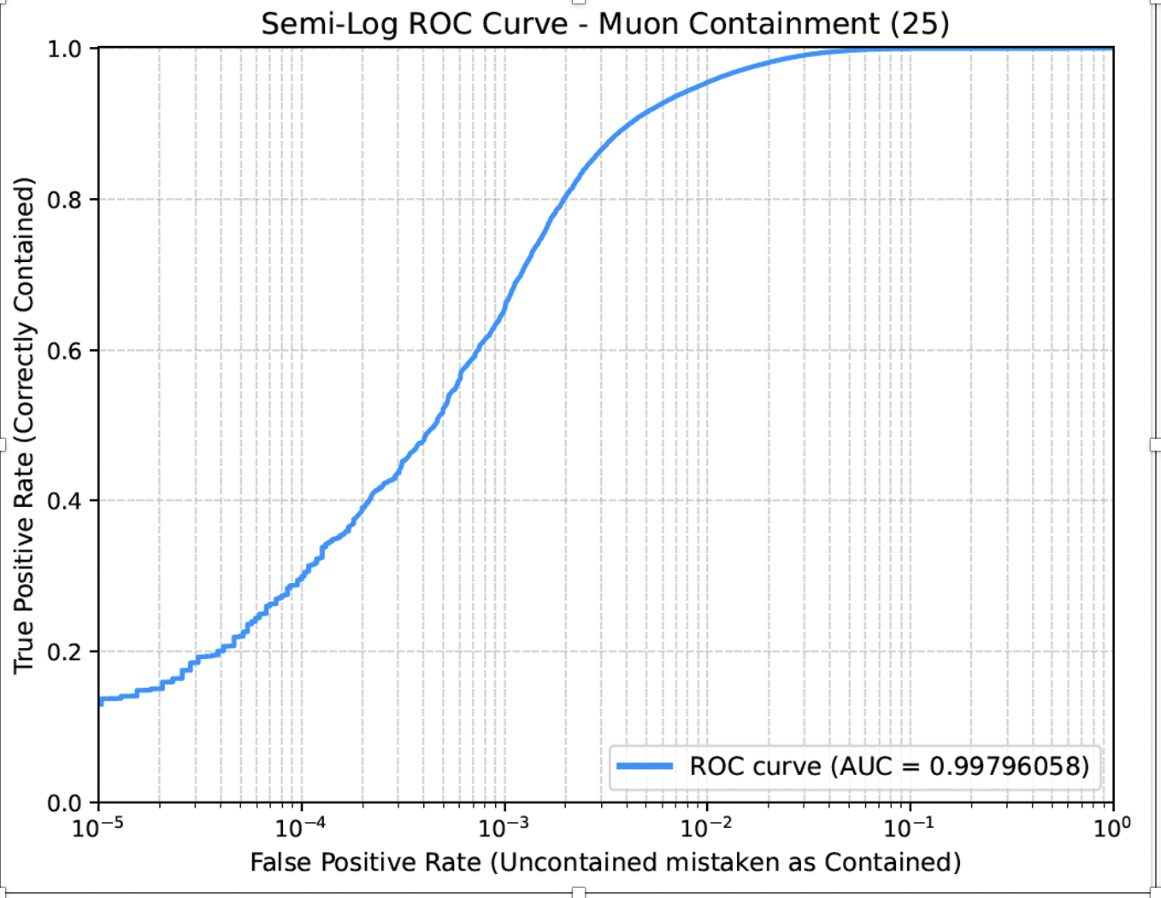
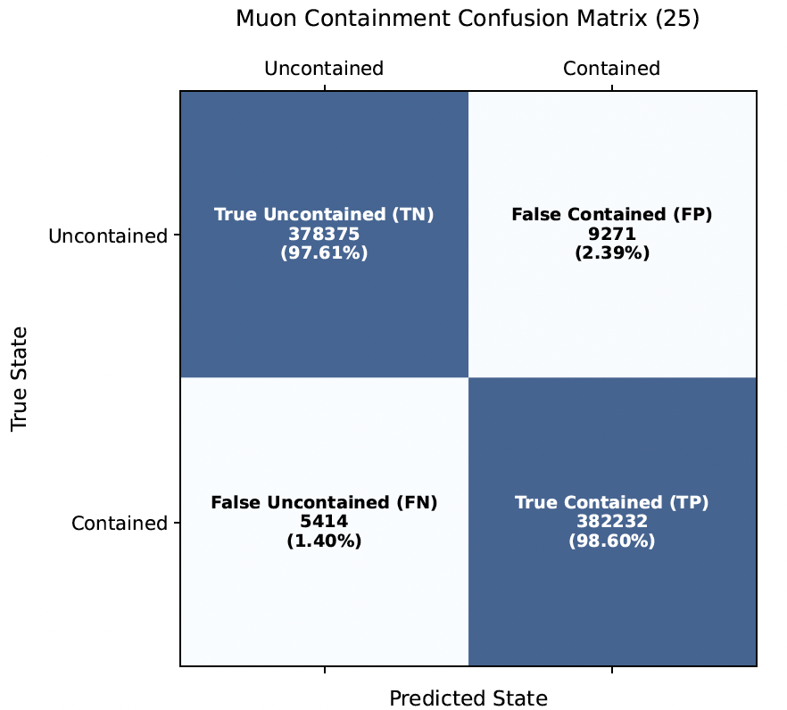
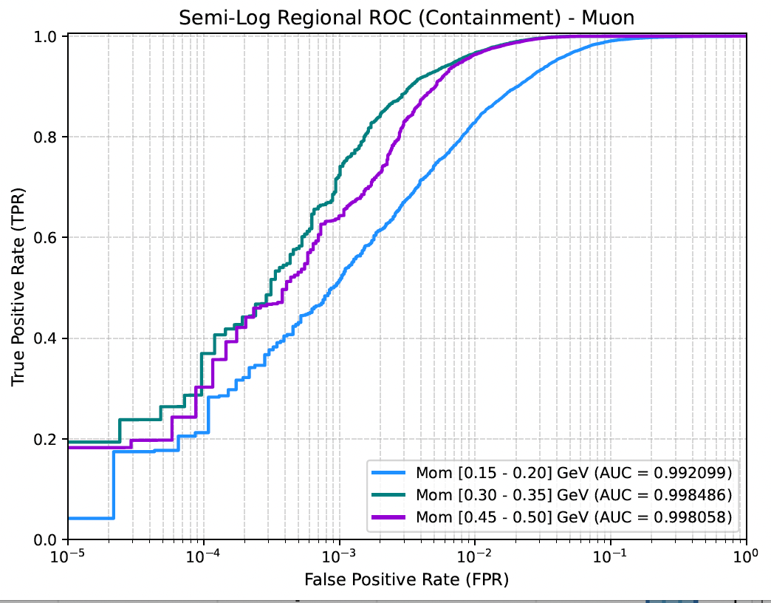
A GCN to Identify Fully Contained Tracks
(inputs and architecture similar to the Reconstruction GCN)
The interaction vertex inside the EDV
The last Cherenkov emission inside the EDV
>25 PMTs above threshold

Slide 10
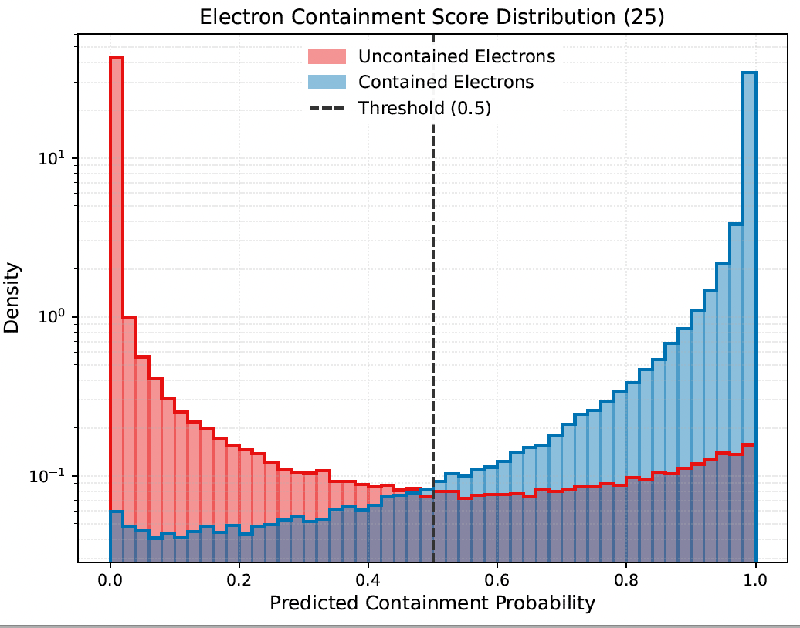
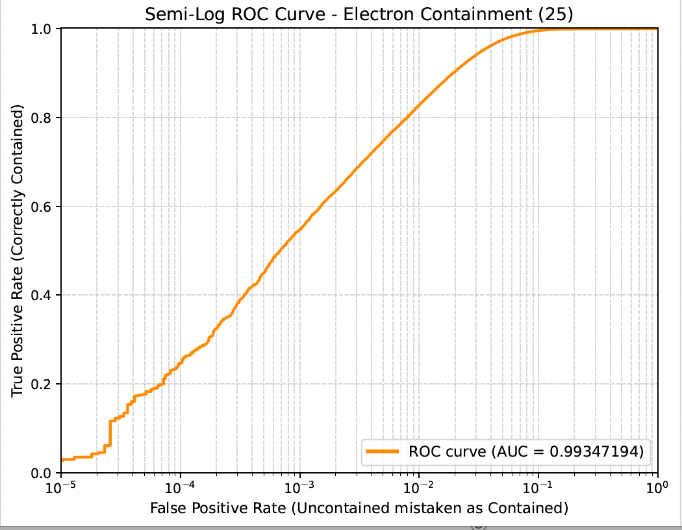
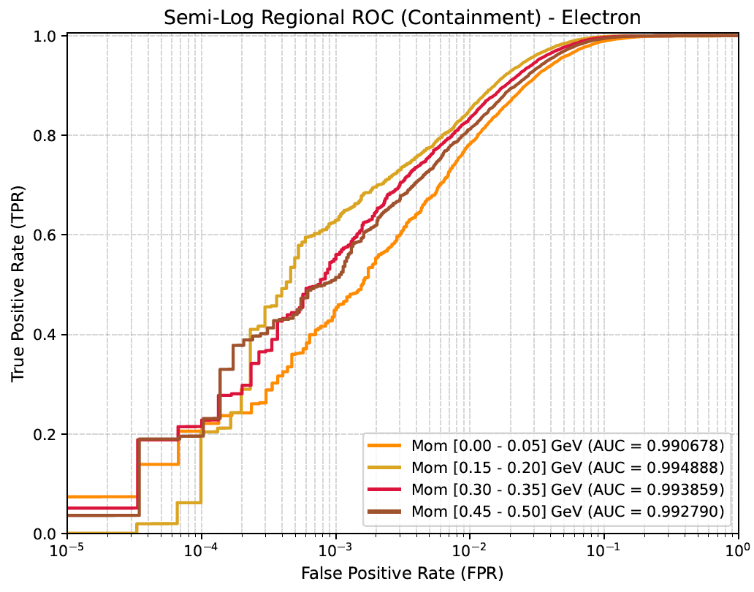
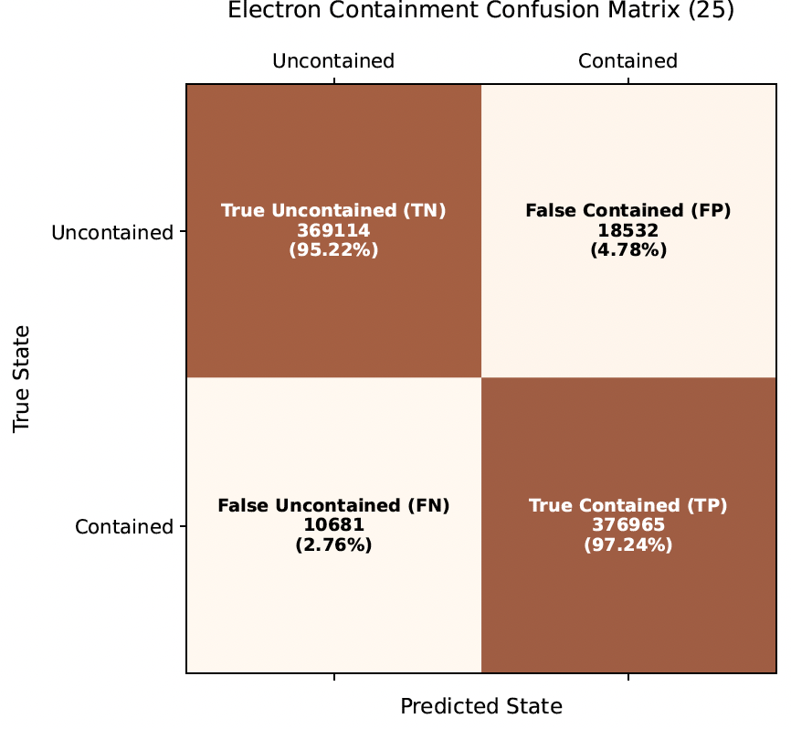
A GCN to Identify Fully Contained Tracks
(inputs and architecture similar to the Reconstruction GCN)

Slide 11
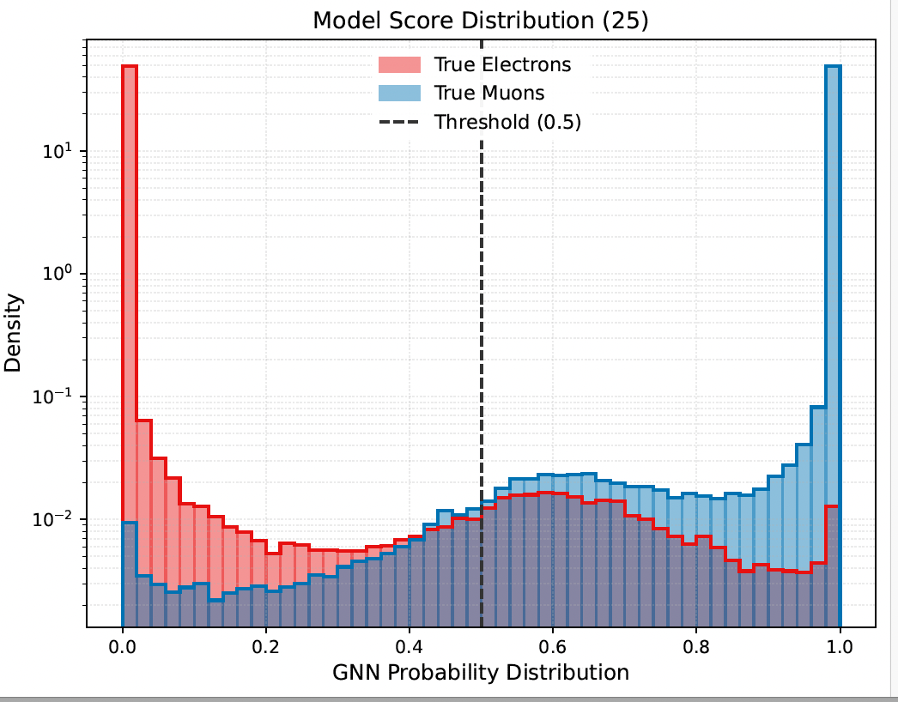
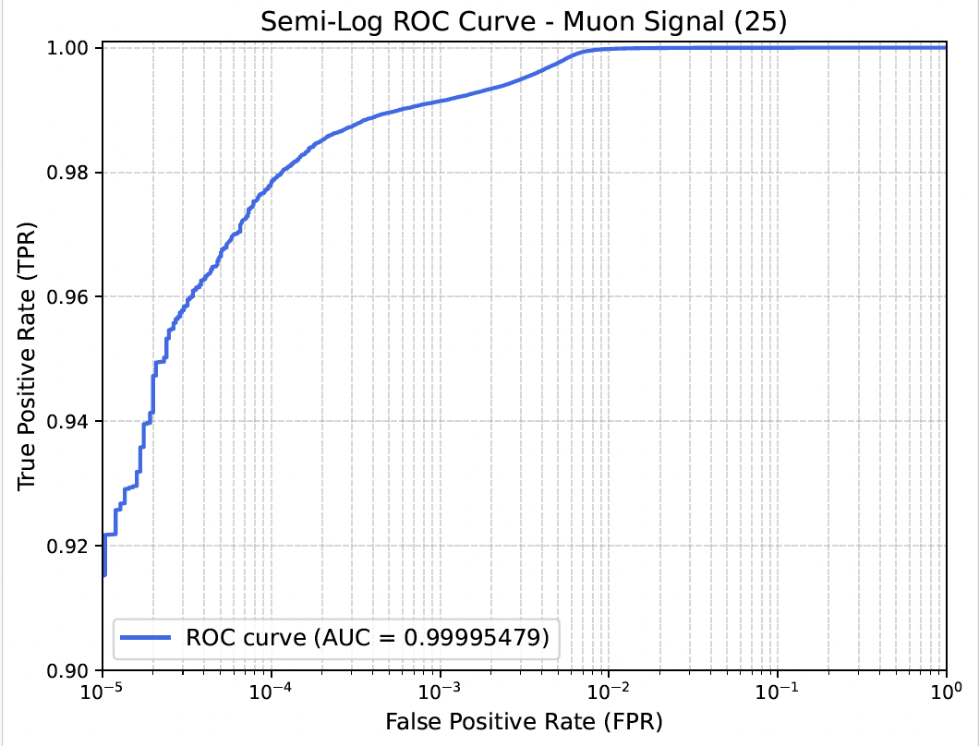
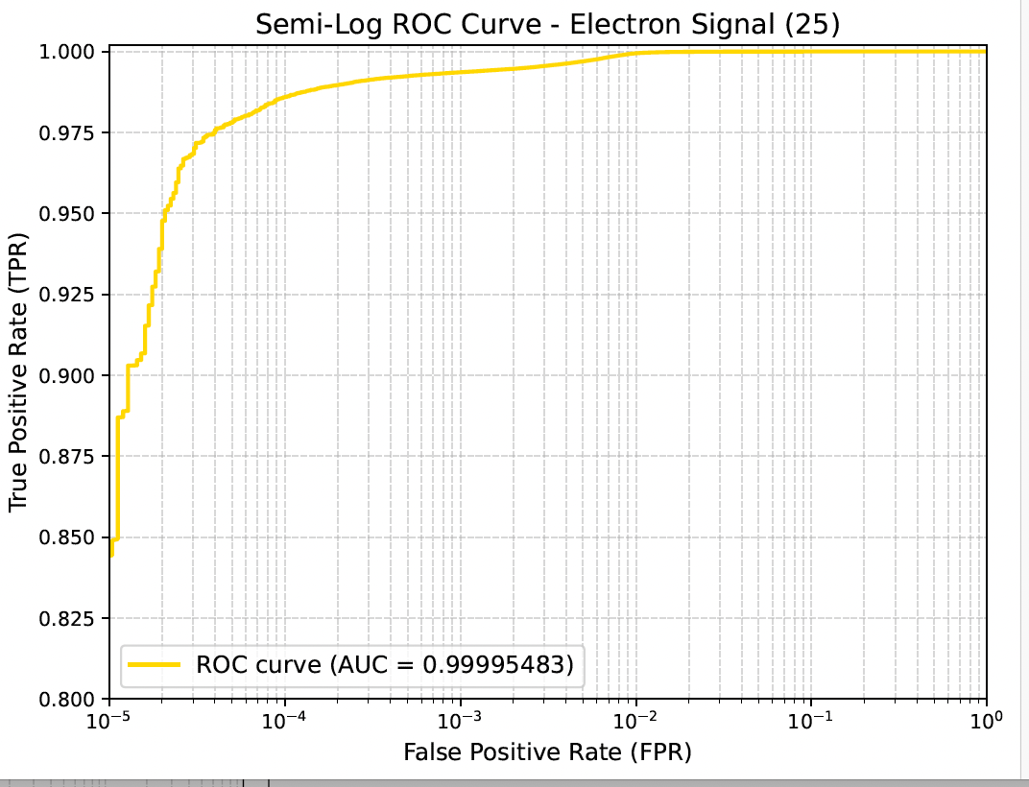
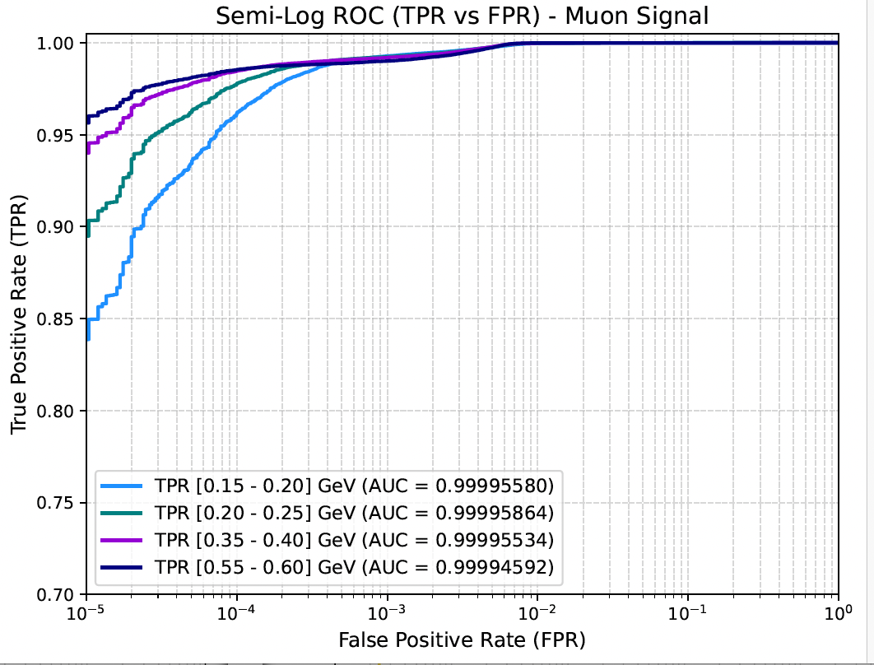
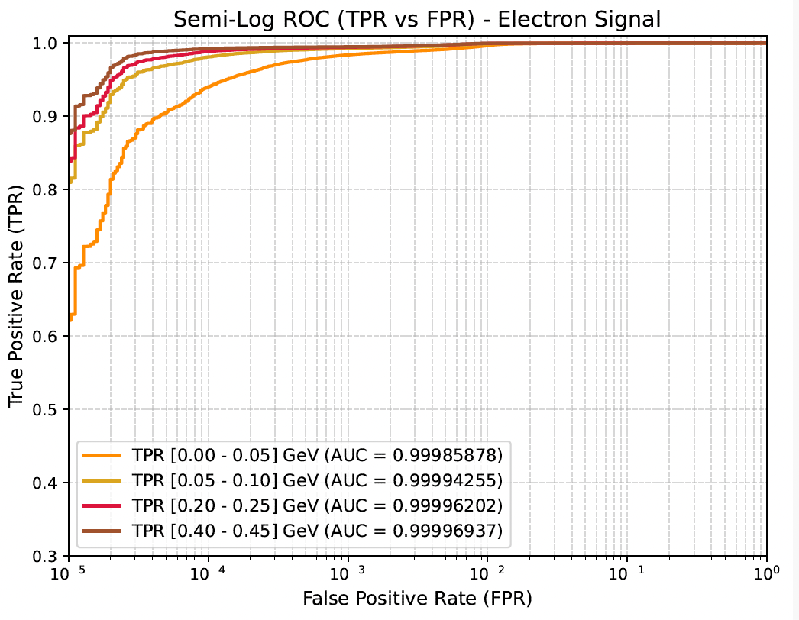
A GCN for Flavor Identification with LEMMOND - I

Slide 12
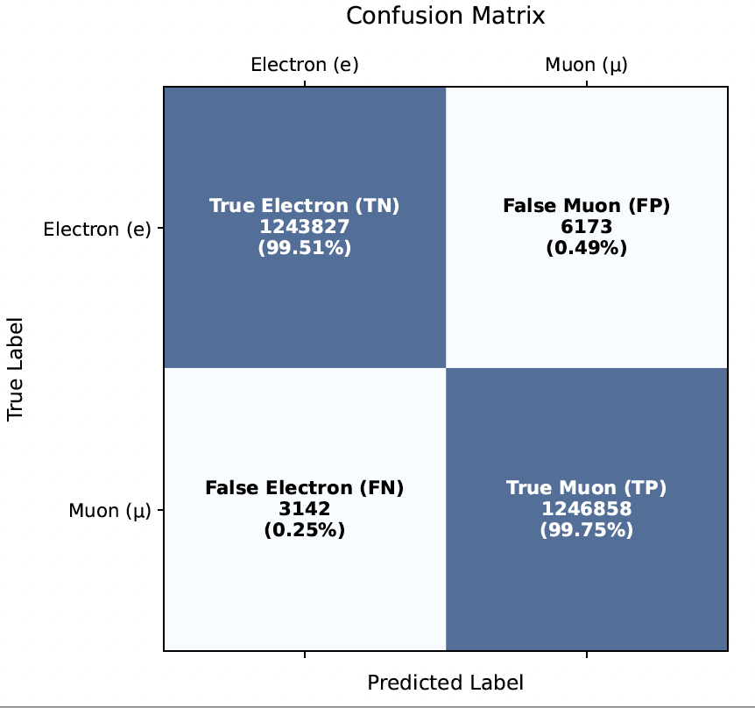
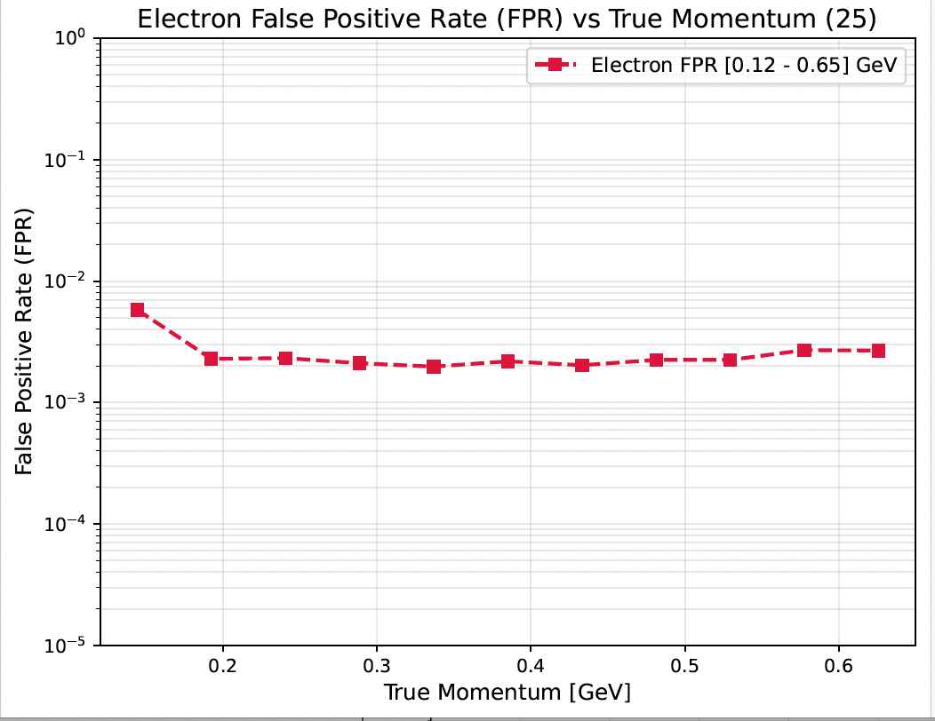
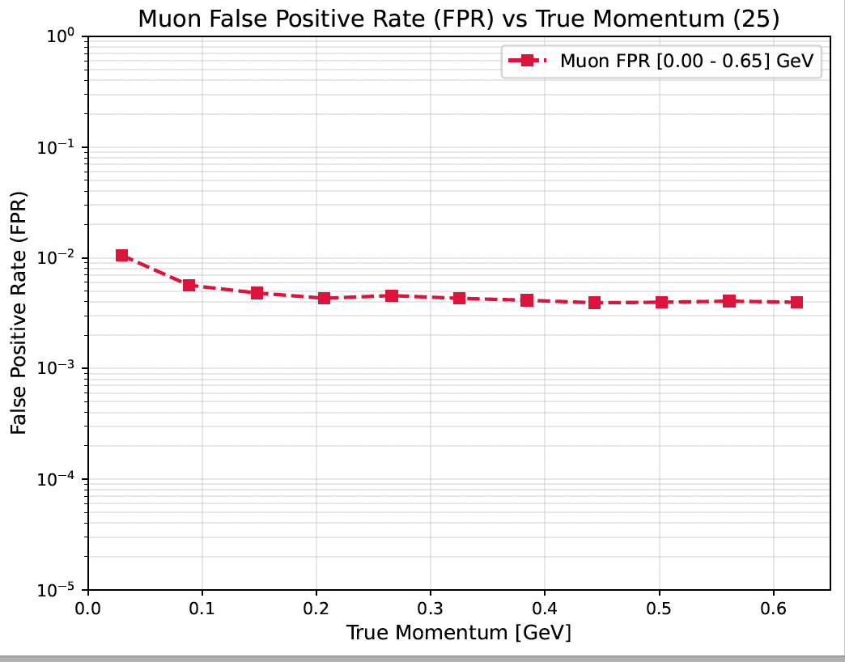
A GCN for Flavor Identification with LEMMOND - II

Slide 13
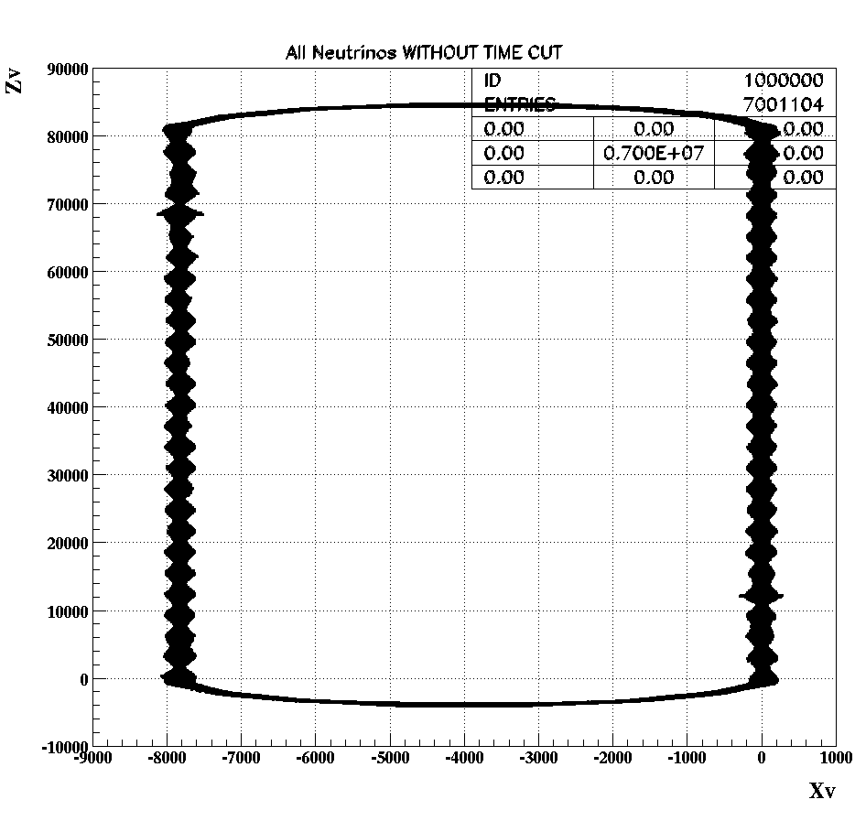
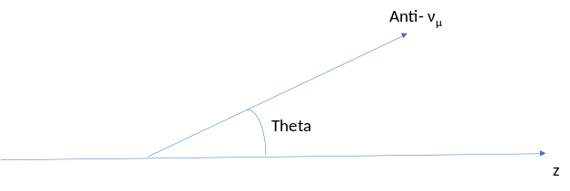
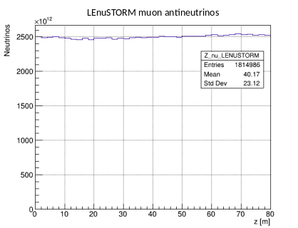
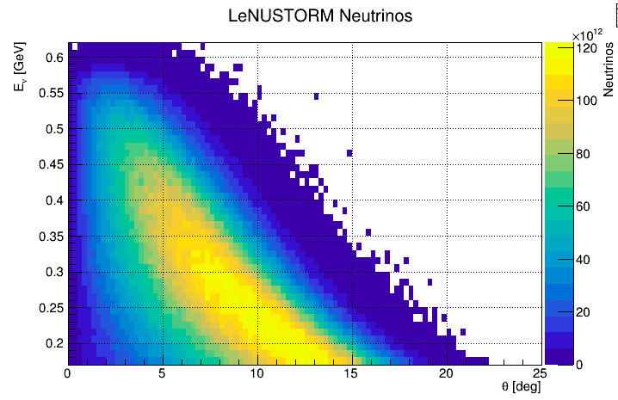
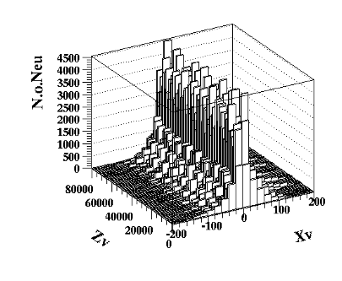
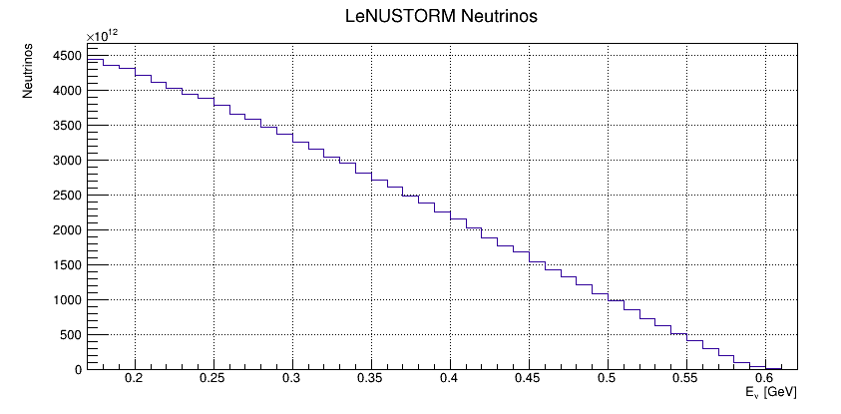

$ν \& \overline{ν}$ Beam Simulation
Muon antineutrinos from LEnuSTORM
We use simulated antineutrinos produced at LEnuSTORM from a focused, momentum-selected beam of π+ mesons with a momentum of 1000 MeV/c, which are injected and allowed to decay into muons.
The storage ring is considered tuned to store positive muons with a momentum of 600 MeV/c.
Muon decays produce muon antineutrinos and electron neutrinos in the energy range (200–600 MeV).
A timing cut of 2 μs is applied to reject muon neutrinos from pion decays
We HAVE NOT considered contamination from muon antineutrinos produced by muon decays in the arc sections, as well as all halo neutrinos arising from non-focused muons.
X-Z Vertex distribution
of muon antineutrinos

Slide 14
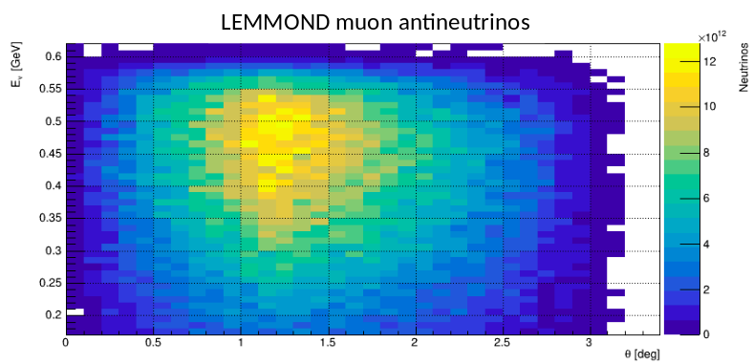
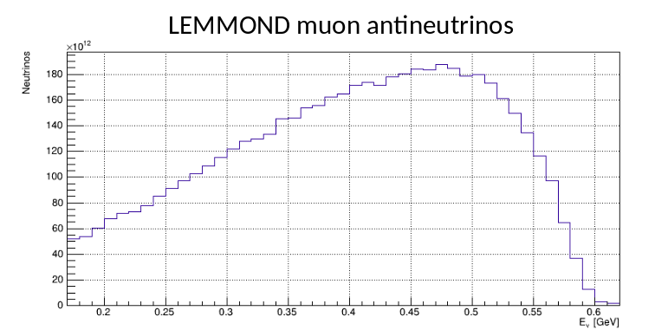
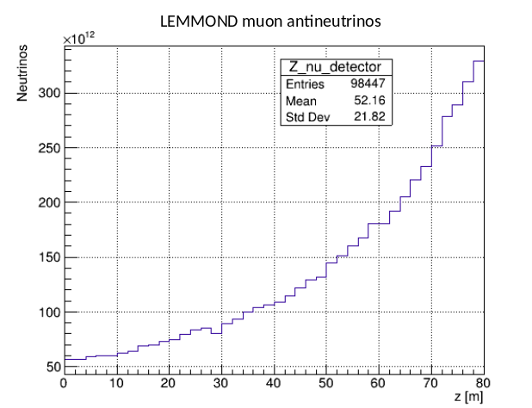


LEnuSTORM Beam Simulation
${\overline{ν}}_{μ}$ Entering the LEMMOND (50m downstream)
The important kinematical variables to be reconstructed are:
the lepton momentum and the opening angle Δ

Slide 15






Resolution in Reconstructing P and Δ
The resolution of reconstructing the muon momentum is 1.7%, 1.6% and 1.5% for the three shown different momentum ranges
The resolution of reconstructing the opening angle is 1.5º, 1.2º and 1.º for the three shown different momentum ranges
The resolution of reconstructing the opening angle is 1.3º, 1.4º and 1.5º for the three shown different opening angle ranges

Slide 16



Reconstruction Resolution vs Migration Matrices
Our goal is to measure differential cross sections (or inter. rates) as functions of p_{μ} and Δ. Owing to the good reconstruction performance achieved for both variables, no unfolding procedure is required.
Instead, events are binned directly in P_{reco} and/or Δ_{reco}, with bin widths chosen to be at least five times larger than the corresponding reconstruction resolutions.
Under these conditions, the distributions of reconstructed quantities provide a very good approximation to the corresponding distributions in P_{true} or/and Δ_{true}.

Slide 17
Simulation Studies of ${\overline{ν}}_{μ}$ Interactions in the LEMMOND EDV
In the following studies, a sample of 7,001,104 muon antineutrinos produced in the straight section of the LEnuSTORM storage ring was generated (Ting).
After applying a 2 μs timing cut to reject neutrinos originating from pion decays, the sample was reduced to 1,814,986 muon antineutrinos.
Of these, 100,739 entered the LEMMOND detector and were used to simulate interactions within the detector volume.
All results presented in this work are normalized to an exposure corresponding to 10¹⁷ (or 10¹⁸) muon antineutrinos produced in the LEnuSTORM straight section. To achieve this normalization, the simulated event sample was scaled by a factor of R_{scale}=5.51x10¹⁰ (of R_{scale}=5.51x10¹¹ ).
Our reference interaction model is GENIE v3.0.6 (G18_02a_00_000) with the Relativistic Fermi Gas (RFG) nuclear model, hereafter referred to as G1802.
To study systematic biases, we also use GENIE v3.0.6 with the Local Fermi Gas (LFG) nuclear model (tune G18_10a_02_11a), hereafter referred to as G1810.
The propagation of positive muons and the associated Cherenkov radiation, was simulated using GEANT4. The response of the photosensors, signal formation, and digitization were modeled in detail.
The interaction vertex and muon kinematic parameters were subsequently reconstructed using the Graph Convolutional Network (GCN) techniques described in the previous section.

Slide 18



MC Integration Including Acceptance and Reconstruction Efficiency
Produce N_{tries}(k)=L_{k}x50m⁻¹ “GENIE Interactions” and simulate (GEANT) the charged lepton propagation and detector response to Cherenkov Light
After applying the reconstruction algorithms N_{acc}(k) leptons have been reconstructed as Fully Contained
$ε=\frac{N_{acc}(k)}{N_{tries}(k)}$ is the acceptance factor
E_{k}
Then the kth ν participates to the MC integrations weighted by

Slide 19



Simulate “Data Sets”
Using the whole available LEnuSTORM simulated ${\overline{ν}}_{μ}$-sample properly weighted
Depend explicitly on the assumed $σ_{ν}^{CC}\left(E_{ν}\right)$ and R_{scale}
Depend on the GENIE production model (G1802 in this case), i.e. partonic and nuclear effects correlating the observed kinematical variable – P and Δ
Simulate “Data Sets” by Poissonian sampling, on a bin-by-bin basis

Slide 20





Estimate $σ_{{\overline{ν}}_{μ}−H_{2O}}^{CC}\left(E_{ν}\right)$ from the available “Data-Set” - I
“Data-Sets” , 1d (left) and 2D ( right), generated by Poissonian sampling per bin of the expected number of events (G1802 model)
Using the LEnuSTORM ${\overline{ν}}_{μ}−$simulated sample, the expected value of any (one)multidimensional bin content, B_{i ,} can be evaluated in terms of the $σ_{{\overline{ν}}_{μ}−H_{2O}}^{CC}\left(E_{ν}\right)$:
$$B_{i}=R_{scale}\frac{ρΝ_{Α}}{Μ_{Η2ο}}\sum_{\begin{aligned}j \\ {\vec{v}}_{j}∈Ω_{i}\end{aligned}}{\frac{L\left(k\right)}{N_{tries}\left(k\right)}}{σ_{{\overline{ν}}_{μ}−H_{2O}}^{CC}\left(E_{ν}\right)}_{}$$
where the sum is over all ν-interactions, of all incoming ν’s, that the relevant, final state kinematical vector, ${\vec{v}}_{j},$ belongs to the domain of bin i, i.e. ${\vec{v}}_{j}∈Ω_{i}$
Then, by expressing $σ_{{\overline{ν}}_{μ}−H_{2O}}^{CC}\left(E_{ν};\vec{a}\right)$ as an ”empirical” function of $E_{ν},$ in terms of some parameters $\vec{a}=\left\{a_{0},a_{1},a_{2},a_{3},…\right\} and comparing$ the $B_{i} content−expectations to$ the “data” bins the parameters could be estimated

Slide 21



A comment on the $σ_{{\overline{ν}}_{μ}−H_{2O}}^{CC}\left(E_{ν}\right)$ functional form
The orange line represents a 2nd degree polynomial fit of σ(E) as given by Genie (G1802) green points.
Residuals (left) and fractional residuals (right) of a 2nd degree polynomial fit to the Genie (G1802) x-sections with respect to the actual Genie x-sections
What if the x-section cannot be expressed as a polynomial function?
”Cures” and estimation of systematics due to the polynomial parameterization

Slide 22






Estimate $σ_{{\overline{ν}}_{μ}−H_{2O}}^{CC}\left(E_{ν}\right)$ from the available “Data-Set” - II
$$σ_{{\overline{ν}}_{μ}−H_{2O}}^{CC}\left(E_{ν};\vec{a}\right)=\sum_{λ=0}^{n}{α_{λ}∙}{\left(Ε\right)}^{λ}$$
$$B_{i}=R_{scale}\frac{ρΝ_{Α}}{Μ_{Η2ο}}\sum_{\begin{aligned}j \\ {\vec{v}}_{j}∈Ω_{i}\end{aligned}}{\frac{L\left(k\right)}{N_{tries}\left(k\right)}}{σ_{{\overline{ν}}_{μ}−H_{2O}}^{CC}\left(E_{ν};\vec{a}\right)}_{}$$
$$B_{i}\left(\vec{a}\right)=\sum_{λ=0}^{n}{a_{λ}\left[R_{scale}\frac{ρΝ_{Α}}{Μ_{Η2ο}}\sum_{\begin{aligned}j \\ {\vec{v}}_{j}∈Ω_{i}\end{aligned}}{\frac{L\left(k\right)}{N_{tries}\left(k\right)}} {\left(E_{k}\right)}^{λ}\right]}= \sum_{λ=0}^{n}{a_{λ}}ℑ_{λ,i}$$
$$where the factors{ ℑ}_{λ,i}=\left[R_{scale}\frac{ρΝ_{Α}}{Μ_{Η2ο}}\sum_{\begin{aligned}j \\ {\vec{v}}_{j}∈Ω_{i}\end{aligned}}{\frac{L\left(k\right)}{N_{tries}\left(k\right)}} {\left(E_{k}\right)}^{λ}\right]$$
$a$re independent of the x-section (i.e. the parameters, $\vec{a})$ and they can be evaluated using the LEnuSTORM ${\overline{ν}}_{μ}−$simulated sample
However, the $𝕴−$factors evaluation is heavily depented on the Genie model employed to simulate the anti-ν interactions, causing systematic biases (to be studied).

Slide 23






Results of $σ_{{\overline{ν}}_{μ}−H_{2O}}^{CC}\left(E_{ν}\right)$ Estimation (1d and 2d Fits)
$$B_{i}\left(\vec{a}\right)=\sum_{λ=0}^{n}{a_{λ}\left[R_{scale}\frac{ρΝ_{Α}}{Μ_{Η2ο}}\sum_{\begin{aligned}j \\ {\vec{v}}_{j}∈Ω_{i}\end{aligned}}{\frac{L\left(k\right)}{N_{tries}\left(k\right)}} {\left(E_{k}\right)}^{λ}\right]}= \sum_{λ=0}^{n}{a_{λ}}ℑ_{λ,i}$$
$−lnL=−ln\left[\prod_{i=1}^{N_{bins}}{\frac{{\left(B_{i}\left(\vec{a}\right)\right)}^{D_{i}}e^{−B_{i}\left(\vec{a}\right)}}{D_{i}!}}\right]=\sum_{i=1}^{N_{bins}}{\left[B_{i}\left(\vec{a}\right)−D_{i}ln\left(B_{i}\left(\vec{a}\right)\right)+ln\left(D_{i}!\right)\right]}$, where $D_{i}$ is the number of observed events in the bin-i
Muon antineutrino – water cross sections vs energy results for 1D and 2D fits. The solid line represents the total antineutrino cross sections according to G1802, while the shaded areas denote the 1σ confidence level around the fit results. (10¹⁷ ${LEnuSTORM \overline{ ν}}_{μ}$)

Slide 24





Results of $σ_{{\overline{ν}}_{μ}−H_{2O}}^{CC}\left(E_{ν}\right)$ Estimation (Statistical Resolution-I)
10¹⁷ ${LEnuSTORM \overline{ ν}}_{μ}$
1D Fits of 1000 “Data-Sets”
2D Fits of 1000 “Data-Sets”

Slide 25


Results of $σ_{{\overline{ν}}_{μ}−H_{2O}}^{CC}\left(E_{ν}\right)$ Estimation (Statistical Resolution-II)
10¹⁷ ${LEnuSTORM \overline{ ν}}_{μ}$
Energy (MeV) | 1D fit |  | 2D fit
 | Mean (%) | Sigma (%) | Mean (%) | Sigma (%)
200 | 7.3 | 72.6 | 6.9 | 63.5
250 | -3.2 | 20.4 | -3.1 | 18.5
300 | -3.5 | 8.3 | -3.1 | 8
350 | -1.4 | 6.7 | -1.2 | 6.3
400 | 0 | 5.7 | 0 | 5.2
450 | 1.4 | 4 | 1.4 | 3.9
500 | 1 | 4 | 1 | 3.8
550 | 0 | 6.8 | 0 | 6
600 | 0 | 10.7 | 0 | 9.5
10¹⁸ ${LEnuSTORM \overline{ ν}}_{μ}$
Energy (MeV) | 1D fit |  | 2D fit
 | Mean (%) | Sigma (%) | Mean (%) | Sigma (%)
200 | 5.7 | 23.7 | 6. | 20.
250 | -3.5 | 6.7 | -3.2 | 5.2
300 | -3.5 | 2.6 | -3.2 | 2.5
350 | -1.4 | 2. | -1.2 | 2.
400 | 0 | 1.7 | 0. | 1.6
450 | 1.3 | 1.2 | 1.4 | 1.2
500 | 0 | 1.3 | 0. | 1.2
550 | 0 | 2.1 | 0 | 1.9
600 | 0 | 3.4 | 0 | 3.

Slide 26




Results of $σ_{{\overline{ν}}_{μ}−H_{2}O}^{CC}\left(E_{ν}\right)$ Estimation
Systematic Bias due to the ${\overline{ν}}_{μ}−H_{2}O$ Interaction Model - I
Expected P_{reco} distributions using Genie with tune G1802 (blue) and tune G1810 (red).
Produce (Nature) “Data-Sets” using the G1810 Genie model
Estimate (Researcher) the x-section as a function of the anti-ν Energy by using the G1802 to evaluate $the 𝕴−$factors

Slide 27


Results of $σ_{{\overline{ν}}_{μ}−H_{2}O}^{CC}\left(E_{ν}\right)$ Estimation
Systematic Bias due to the ${\overline{ν}}_{μ}−H_{2}O$ Interaction Model - II
Energy (MeV) | 1D fit |  | 2D fit
 | Mean (%) | Sigma (%) | Mean (%) | Sigma (%)
200 | -248 | 57.3 | -160 | 55.2
250 | -88.4 | 17.4 | -66.5 | 18.6
300 | -25.2 | 9.5 | -5.8 | 9
350 | 3.5 | 9 | -4.4 | 7.1
400 | 16.5 | 7 | 7.9 | 5.7
450 | 21.1 | 47.8 | 15.3 | 4.2
500 | 21 | 4.7 | 19.9 | 4.6
550 | 18.4 | 8.1 | 22.6 | 7.4
600 | 14.8 | 12.7 | 24.2 | 11.1

Slide 28




Results of $σ_{{\overline{ν}}_{μ}−H_{2}O}^{CC}\left(E_{ν}\right)$ Estimation
Systematic Bias due to the ${\overline{ν}}_{μ}−H_{2}O$ Interaction Model - II
10¹⁷ ${LEnuSTORM \overline{ ν}}_{μ}$
P_{reco} distribution of a G1810 simulated “data” sample (points with error bars) fitted to extract cross sections using different Genie models
P_{reco} distribution in different Δ (angle between ν and μ) regions of a G1810 simulated “data” sample (points with error bars) fitted to extract cross sections using different Genie models .

Slide 29





Results of $σ_{{\overline{ν}}_{μ}−H_{2}O}^{CC}\left(E_{ν}\right)$ Estimation
Systematic Bias due to the ${\overline{ν}}_{μ}−H_{2}O$ Interaction Model - III
10¹⁷ ${LEnuSTORM \overline{ ν}}_{μ}$
Quality of the Fit
Hypothesis Testing
81%
19%
98%
<2%
Distributions of the ${NLL}_{LFG}−{NLL}_{RFG}$ statistic for 1D and 2D fits
p-value distribution for 1D and 2D fits employing the “correct” (left) or the “wrong” (right) Genie model for the J factors evaluation.

Slide 30






Results of $σ_{{\overline{ν}}_{μ}−H_{2}O}^{CC}\left(E_{ν}\right)$ Estimation
Systematic Bias due to the ${\overline{ν}}_{μ}−H_{2}O$ Interaction Model - IV
10¹⁸ ${LEnuSTORM \overline{ ν}}_{μ}$
Distributions of the ${NLL}_{LFG}−{NLL}_{RFG}$ statistic for 1D and 2D fits for 10¹⁸ muon antineutrinos.
0.3%

Slide 31



Results of $σ_{{\overline{ν}}_{μ}−H_{2}O}^{CC}\left(E_{ν}\right)$ Estimation
Systematic Bias (?) due to the Functional Form - I
In general, for a more flexible parameterization of $σ_{{\overline{ν}}_{μ}−H_{2}O}^{CC}\left(E_{ν}\right)$ we could use
$$σ_{{\overline{ν}}_{μ}−H_{2}O}^{CC}\left(E_{ν}\right)=\left\{\begin{matrix}\sum_{λ=0}^{2}{β_{λ}Ε^{λ}} Ε≤Ε_{c} \\ \sum_{λ=0}^{2}{α_{λ}Ε^{λ}} Ε>Ε_{c}\end{matrix}\right.$$
$$B_{i}\left(\vec{a}\right)=\sum_{λ=0}^{2}{β_{λ}\left[R_{scale}\frac{ρΝ_{Α}}{Μ_{Η2ο}}\sum_{\begin{aligned}j \\ {\vec{v}}_{j}∈Ω_{i} \\ Ε_{k}≤Ε_{c}\end{aligned}}{\frac{L\left(k\right)}{N_{tries}\left(k\right)}} {\left(E_{k}\right)}^{λ}\right]}+\sum_{λ=0}^{2}{a_{λ}\left[R_{scale}\frac{ρΝ_{Α}}{Μ_{Η2ο}}\sum_{\begin{aligned}j \\ {\vec{v}}_{j}∈Ω_{i} \\ Ε_{k}>Ε_{c}\end{aligned}}{\frac{L\left(k\right)}{N_{tries}\left(k\right)}} {\left(E_{k}\right)}^{λ}\right]} = \sum_{λ=0}^{2}{β_{λ}}ℱ_{λ,i} + \sum_{λ=0}^{2}{a_{λ}}ℑ_{λ,i}$$
and imposing (e.g. with Lagrange multipliers - constraints) that:
$σ_{{\overline{ν}}_{μ}−H_{2}O}^{CC}\left(E_{ν}\right)$ and $\frac{d}{dE_{ν}}\left(σ_{{\overline{ν}}_{μ}−H_{2}O}^{CC}\left(E_{ν}\right)\right)$ are continues at $E_{ν}$= $E_{c}$

Slide 32




Results of $σ_{{\overline{ν}}_{μ}−H_{2}O}^{CC}\left(E_{ν}\right)$ Estimation
Systematic Bias (?) due to the Functional Form - II
we tried:
$$σ_{{\overline{ν}}_{μ}−H_{2}O}^{CC}\left(E_{ν}\right)=\left\{\begin{matrix}\sum_{λ=0}^{1}{α_{λ}Ε^{λ}} Ε≤Ε_{c} \\ \sum_{λ=0}^{1}{α_{λ}Ε^{λ}+β{\left(Ε−Ε_{c}\right)}^{2}} Ε>Ε_{c}\end{matrix}\right.$$
$$B_{i}\left(\vec{a}\right)=\sum_{λ=0}^{1}{α_{λ}\left[R_{scale}\frac{ρΝ_{Α}}{Μ_{Η2ο}}\sum_{\begin{aligned}j \\ {\vec{v}}_{j}∈Ω_{i} \\ \end{aligned}}{\frac{L\left(k\right)}{N_{tries}\left(k\right)}} {\left(E_{k}\right)}^{λ}\right]}+β\left[R_{scale}\frac{ρΝ_{Α}}{Μ_{Η2ο}}\sum_{\begin{aligned}j \\ {\vec{v}}_{j}∈Ω_{i} \\ Ε_{k}>Ε_{c}\end{aligned}}{\frac{L\left(k\right)}{N_{tries}\left(k\right)}} {\left(E_{k}−Ε_{c}\right)}^{2}\right]$$
$= \sum_{λ=0}^{1}{a_{λ}}ℑ_{λ,i}$ +β $ℱ_{i}$
where $Ε_{c}$=400 MeV

Slide 33




Results of $σ_{{\overline{ν}}_{μ}−H_{2}O}^{CC}\left(E_{ν}\right)$ Estimation
Systematic Bias (?) due to the Functional Form - III
10¹⁷ ${LEnuSTORM \overline{ ν}}_{μ}$
Energy (MeV) | 1D fit |  | 2D fit
 | Mean (%) | Sigma (%) | Mean (%) | Sigma (%)
200 | 2.1 | 50.2 | 0.8 | 46.
250 | -0.4 | 20. | 0. | 18.
300 | 0.4 | 9.3 | 0. | 8.5
350 | 1.7 | 4.4 | 1.6 | 4.2
400 | 2. | 3.2 | 2.0 | 3.2
450 | 1.6 | 3.4 | 1.6 | 3.3
500 | 0.7 | 4.1 | 0. | 4.1
550 | 0. | 7.4 | 0. | 7.1
600 | 0. | 12. | 0. | 11.5
Second Degree Polynomial
10¹⁸ ${LEnuSTORM \overline{ ν}}_{μ}$
Energy (MeV) | 1D fit |  | 2D fit
 | Mean (%) | Sigma (%) | Mean (%) | Sigma (%)
200 | 2. | 16.1 | 1.2 | 14.4
250 | 0. | 6.4 | 0. | 5.7
300 | 0. | 3. | 0. | 2.7
350 | 1.7 | 1.4 | 1.6 | 1.3
400 | 2. | 1.0 | 2.0 | 1.0
450 | 1.5 | 1.1 | 1.6 | 1.1
500 | 0. | 1.3 | 0. | 1.3
550 | 0. | 2.3 | 0. | 2.2
600 | 0. | 3.8 | 0. | 3.6

Slide 34


Differential Cross Section
for the whole LEnuSTORM ${\overline{ν}}_{μ}$ Energy Spectrum - I
This correction factor (acceptance and reconstruction efficiency) is evaluated from the available MC sample, i.e. it depends on the chosen neutrino interaction model

Slide 35




Differential Cross Section
for the whole LEnuSTORM ${\overline{ν}}_{μ}$ Energy Spectrum -II
10¹⁷ ${LEnuSTORM \overline{ ν}}_{μ}$
Extracted dσ/dp from a G1802 “Data-Set” using two different Genie interaction models for acceptance etc corrections
Extracted dσ/dp in slices of Δ (μ-ν angle) from a G1802 “Data-Set” using two different iGenie interaction models for acceptance etc corrections

Slide 36




Differential Cross Section
for the whole LEnuSTORM ${\overline{ν}}_{μ}$ Energy Spectrum -III
10¹⁸ ${LEnuSTORM \overline{ ν}}_{μ}$

Slide 37










Estimating the Energy Spectrum
of the LEnuSTORM - ${\overline{ν}}_{μ}$ Interacting in LEMMOND
We reconstruct the coordinates (x_{V}, y_{V}, z_{V}) of the reconstruction vertex and the momentum vector (${\vec{p}}_{μ})$of the charged lepton.
In each event, we get information for the kinematical parameters θ, Δ and $\left|{\vec{p}}_{μ}\right|$
Δ
θ
$$\left|{\vec{p}}_{μ}\right|$$
The initial state is not completely defined (e.g. νp or νΟ ?)
The nuclear effects are not measured and the final state is not completely defined
e.g. in small {dx_{V}, dy_{V}, dz_{V,} d$\left|{\vec{p}}_{μ}\right|, dΔ$} bins and WITHOUT measurement errors
True ${\overline{ν}}_{μ}$Energy (GeV)

Slide 38


Estimating the Energy Spectrum of ${\overline{ν}}_{μ}$ Interacting in LEMMOND
A Probabilistic ANN - I
(15
15

Slide 39









Estimating the Energy Spectrum of ${\overline{ν}}_{μ}$ Interacting in LEMMOND
A Probabilistic ANN - II
The ANN has been trained with many ${\overline{ν}}_{μ}−H_{2}O$ interactions (Genie) in the LEMMOND Effective Volume.
Then, for each input vector corresponding to a reconstructed ${\overline{ν}}_{μ}−H_{2}O$ interaction, the ANN outputs the probabilities {P₁, P₂, …, P₁₅} that the ${\overline{ν}}_{μ}$ Energy falls into each of the 15 equal-width energy bins spanning the range 170–620 MeV.
$$\sum_{i=1}^{15}{P_{i}}=1$$
in small {dx_{V}, dy_{V}, dz_{V,} d$\left|{\vec{p}}_{μ}\right|, dΔ$} bins
The distribution of the true ${\overline{ν}}_{μ}$Energy (WITHOUT measurement errors)
The ANN prediction for the same events (using the reconstructed kinematical vector)

Slide 40








Estimating the Energy Spectrum of ${\overline{ν}}_{μ}$ Interacting in LEMMOND
A Probabilistic ANN - III
Given the input kinematic vector, the ANN provides the probabilities {P₁, P₂, …, P₁₅}, under the assumption that all the ${\overline{ν}}_{μ}$with energies in the range 170–620 MeV have the same probability of interacting within LEMMOND.
Having estimate $σ_{{\overline{ν}}_{μ}−H_{2}O}^{CC}\left(E_{ν}\right)$ we renormalize the outut vector:
$Π_{i}=\frac{P_{i}{\left\langle σ_{{\overline{ν}}_{μ}−H_{2}O}^{CC}\right\rangle }_{i}}{\sum_{i=1}^{15}{P_{i}{\left\langle σ_{{\overline{ν}}_{μ}−H_{2}O}^{CC}\right\rangle }_{i}}}$ where ${\left\langle σ_{{\overline{ν}}_{μ}−H_{2}O}^{CC}\right\rangle }_{i}$=$\frac{1}{E_{2}^{i}−E_{1}^{i}}\int_{E_{1}^{i}}^{E_{2}^{i}}{σ_{{\overline{ν}}_{μ}−H_{2}O}^{CC}\left(E\right)dE}$
x10
10¹⁷ ${LEnuSTORM \overline{ ν}}_{μ}$
10¹⁸ ${LEnuSTORM \overline{ ν}}_{μ}$
The “Expected Spectrum” is evaluated using the known LEnuSTORM flux (Ting), the ”true” ${\overline{ν}}_{μ}$ Energies and “true” interaction x-sections
The points represent the Energy Spectrum of interacting ${\overline{ν}}_{μ}$ as it has been evaluated by the ATN, using the reconstructed kinematical vectors of a “Data-Set” and the estimated $σ_{{\overline{ν}}_{μ}−H_{2}O}^{CC}\left(E_{ν}\right)$

Slide 41


