Slide 1


Linac Modifications and Upgrades
Natalia Milas, ESS𝜈SB Annual Meeting
Uppsala 2026

Slide 2
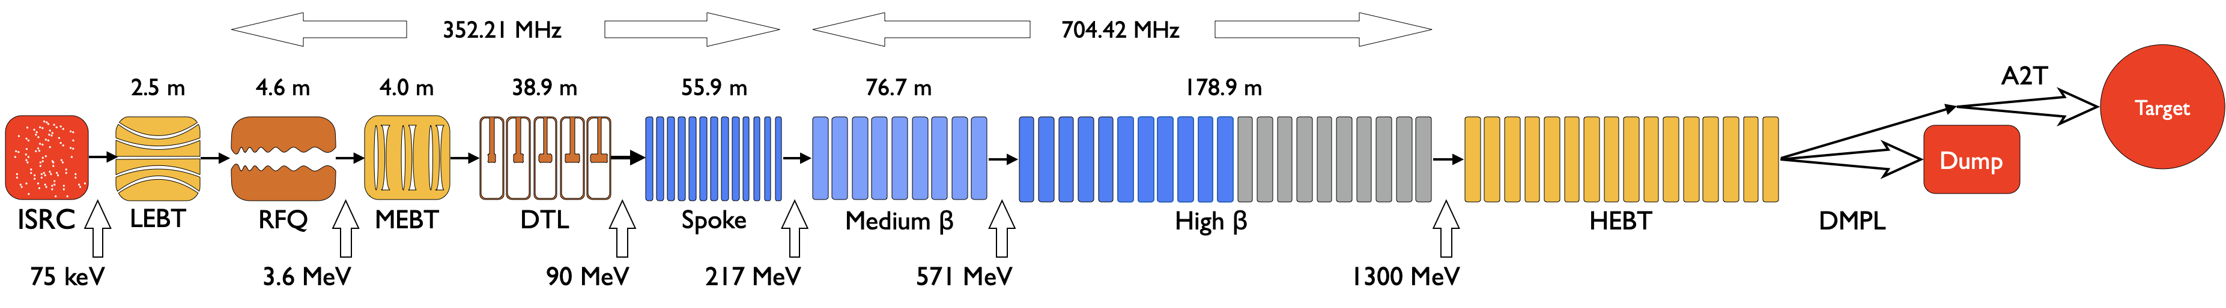
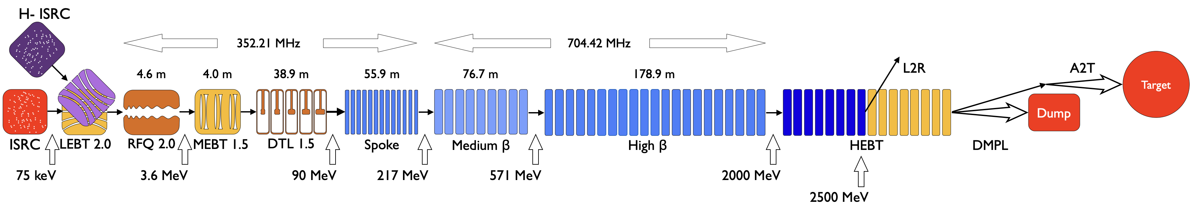
Linac Upgrade in a nutshell
3 MW Linac
New source and LEBT
New RFQ
New DTL
New magnets and vacuum chamber for MEBT
New couplers for SCL
New Modulators and Klystrons/Tetrodes
8 new cryomodules in the HEBT + cryo strutucture
New kicker dipole to extract beam
New diagnostics for beam commissioning
10 MW Linac

Slide 3
Linac Upgrade in a nutshell
3 MW Linac
New source and LEBT
New RFQ
New DTL
New magnets and vacuum chamber for MEBT
New couplers for SCL
New Modulators and Klystrons/Tetrodes
8 new cryomodules in the HEBT + cryo strutucture
New kicker dipole to extract beam
New diagnostics for beam commissioning
10 MW Linac

Slide 4
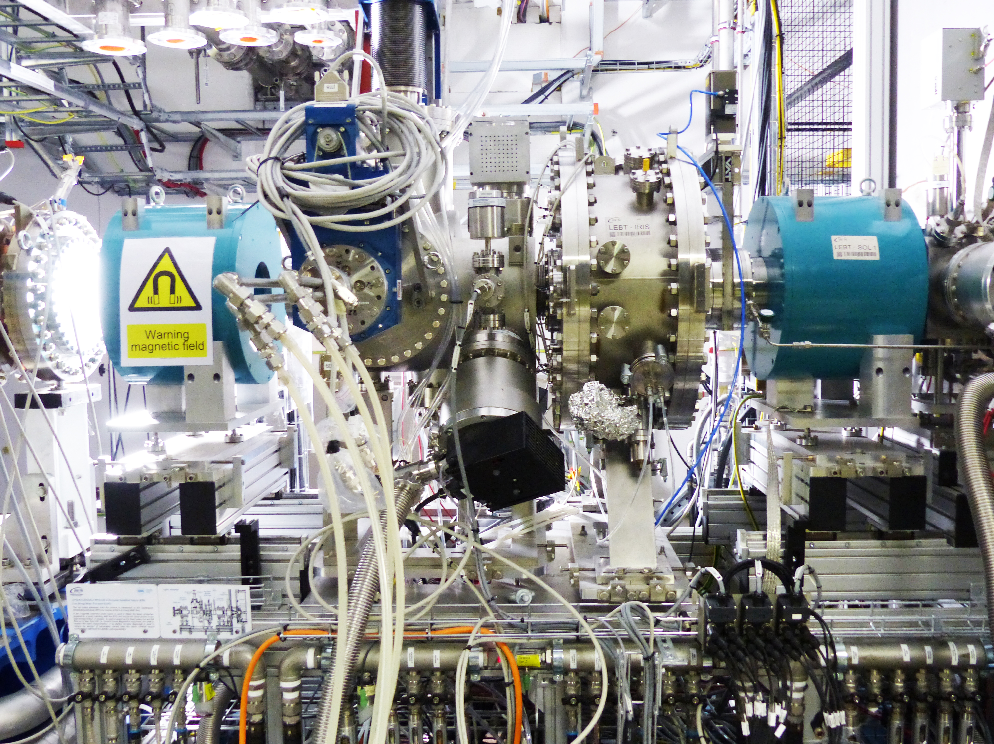
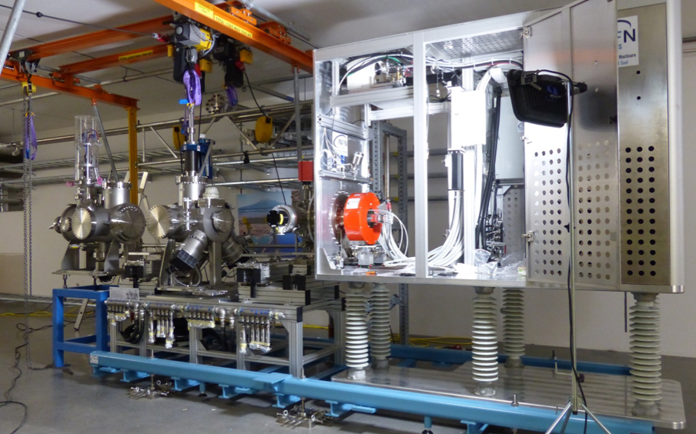
Front-end: Source
From the previous grant:
  We cannot fit a second RFQ in the tunnel, this means the mearing needs to be done in the LEBT level.
Needs:
  H- new source
  A whole new LEBT with a merging dipole
  Vacuum, SC compensation, gas injection
  New diagnostics
Price tag: 5.6 M€

Slide 5
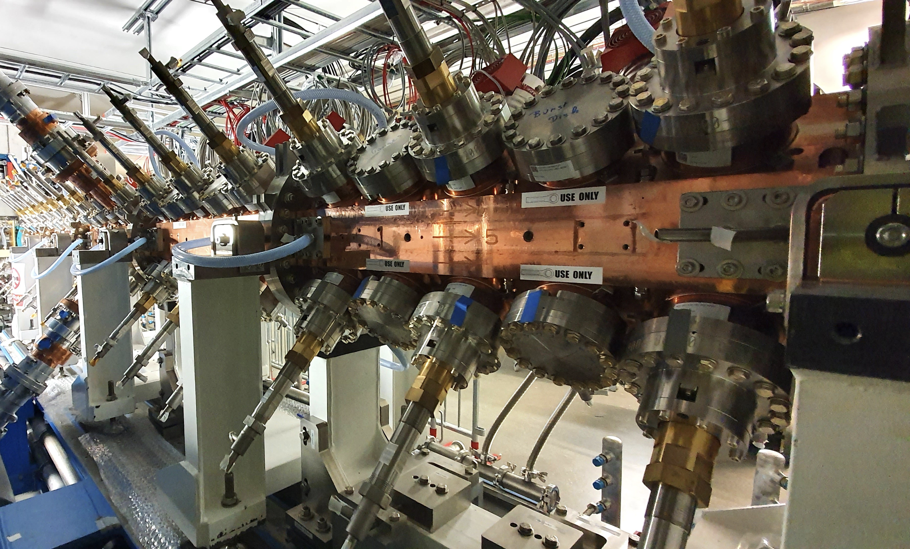
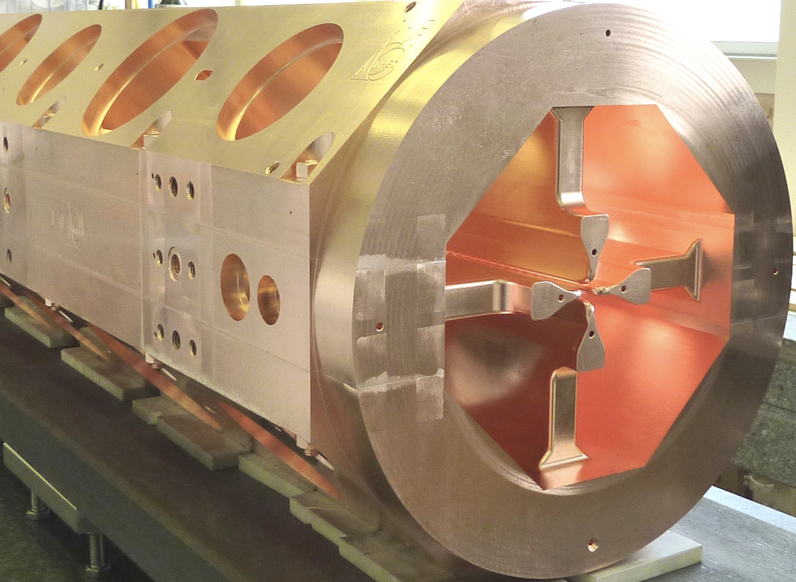
Front-end: RFQ
Current RFQ was not design to have cooling capacity to withstand double the rep rate.
Needs:
  New RFQ with new design for cooling.
  New modulator and klystron
New Skids?
Price tag: 8.2 M€

Slide 6
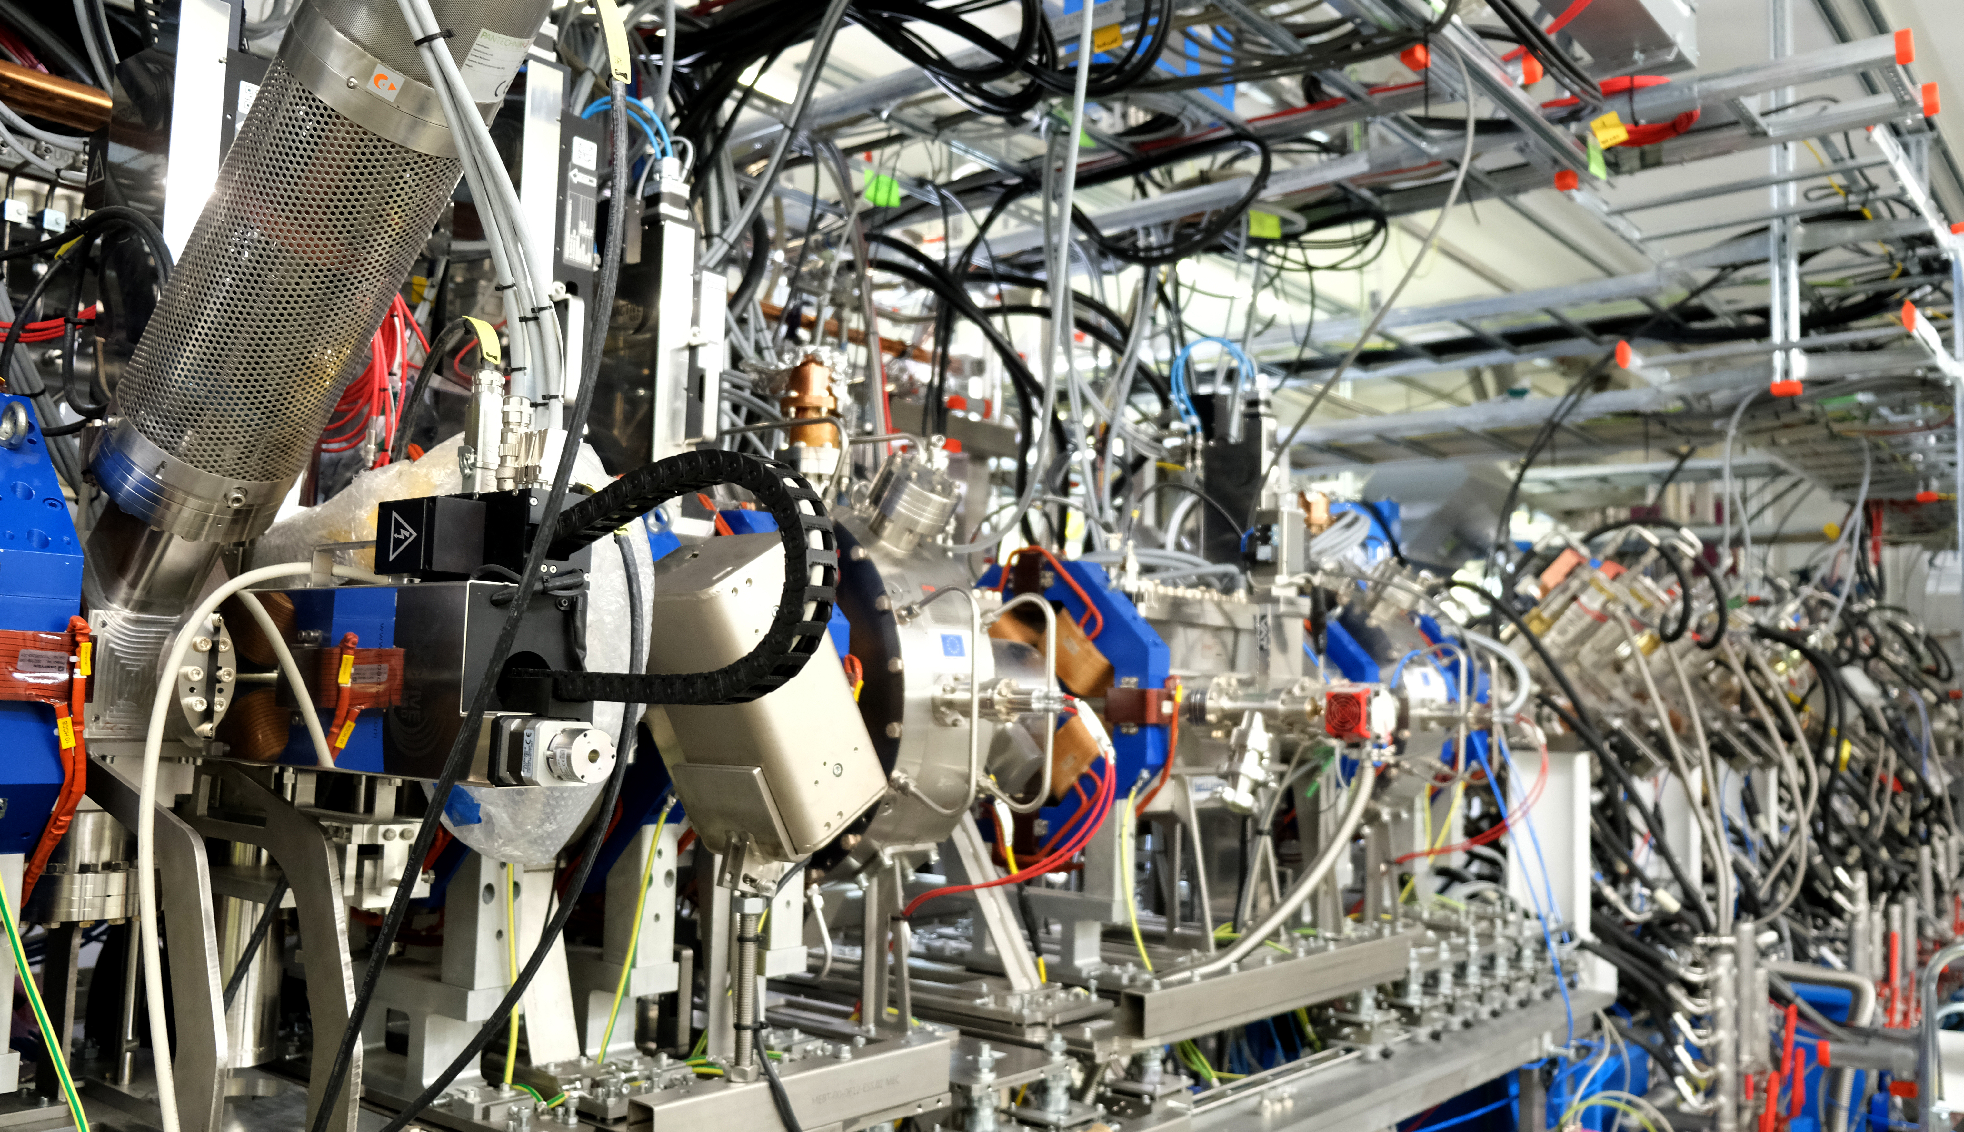
Front-end: MEBT
The MEBT will need to have pulsed magnets in order to work for both charge species.
Needs:
  New magnets, power supplies
  Ceramic vacuum chamber
  New diagnostics for H- beams
  Questions on how to fit everything
Price tag: 3.5 M€

Slide 7
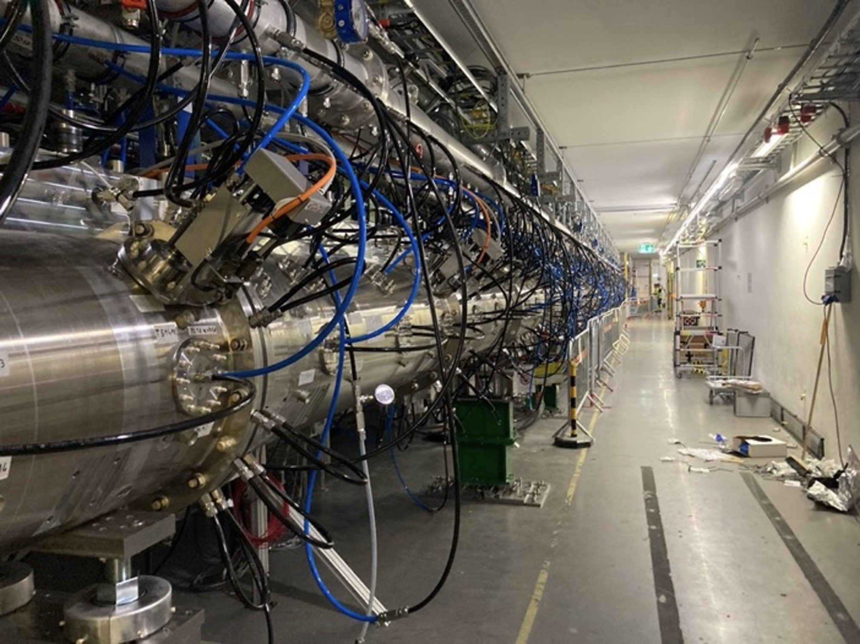
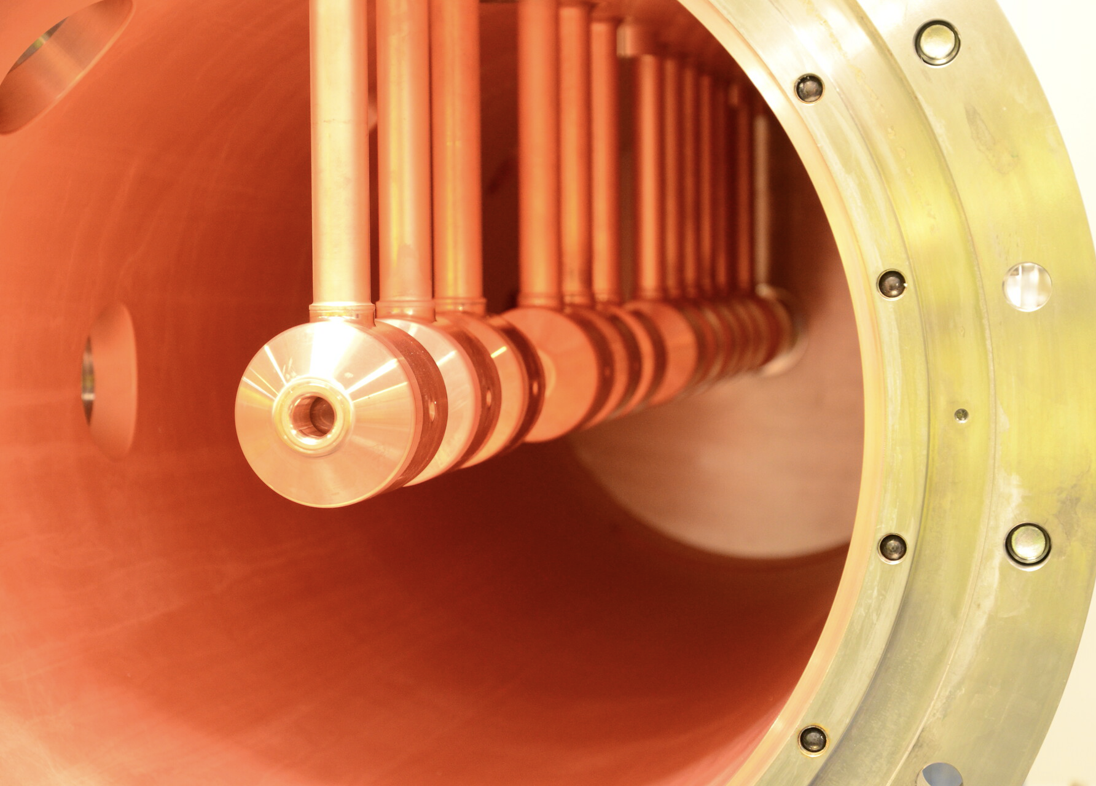
Front-end: DTL
DTLs also do not have cooling capacity to take in double the rep rate but we will assume an upgrade on the cooling power is enough for now
Needs:
  New DTLs (?)
  New Skids
  New modulator and klystrons
Price tag: 15.7 M€

Slide 8
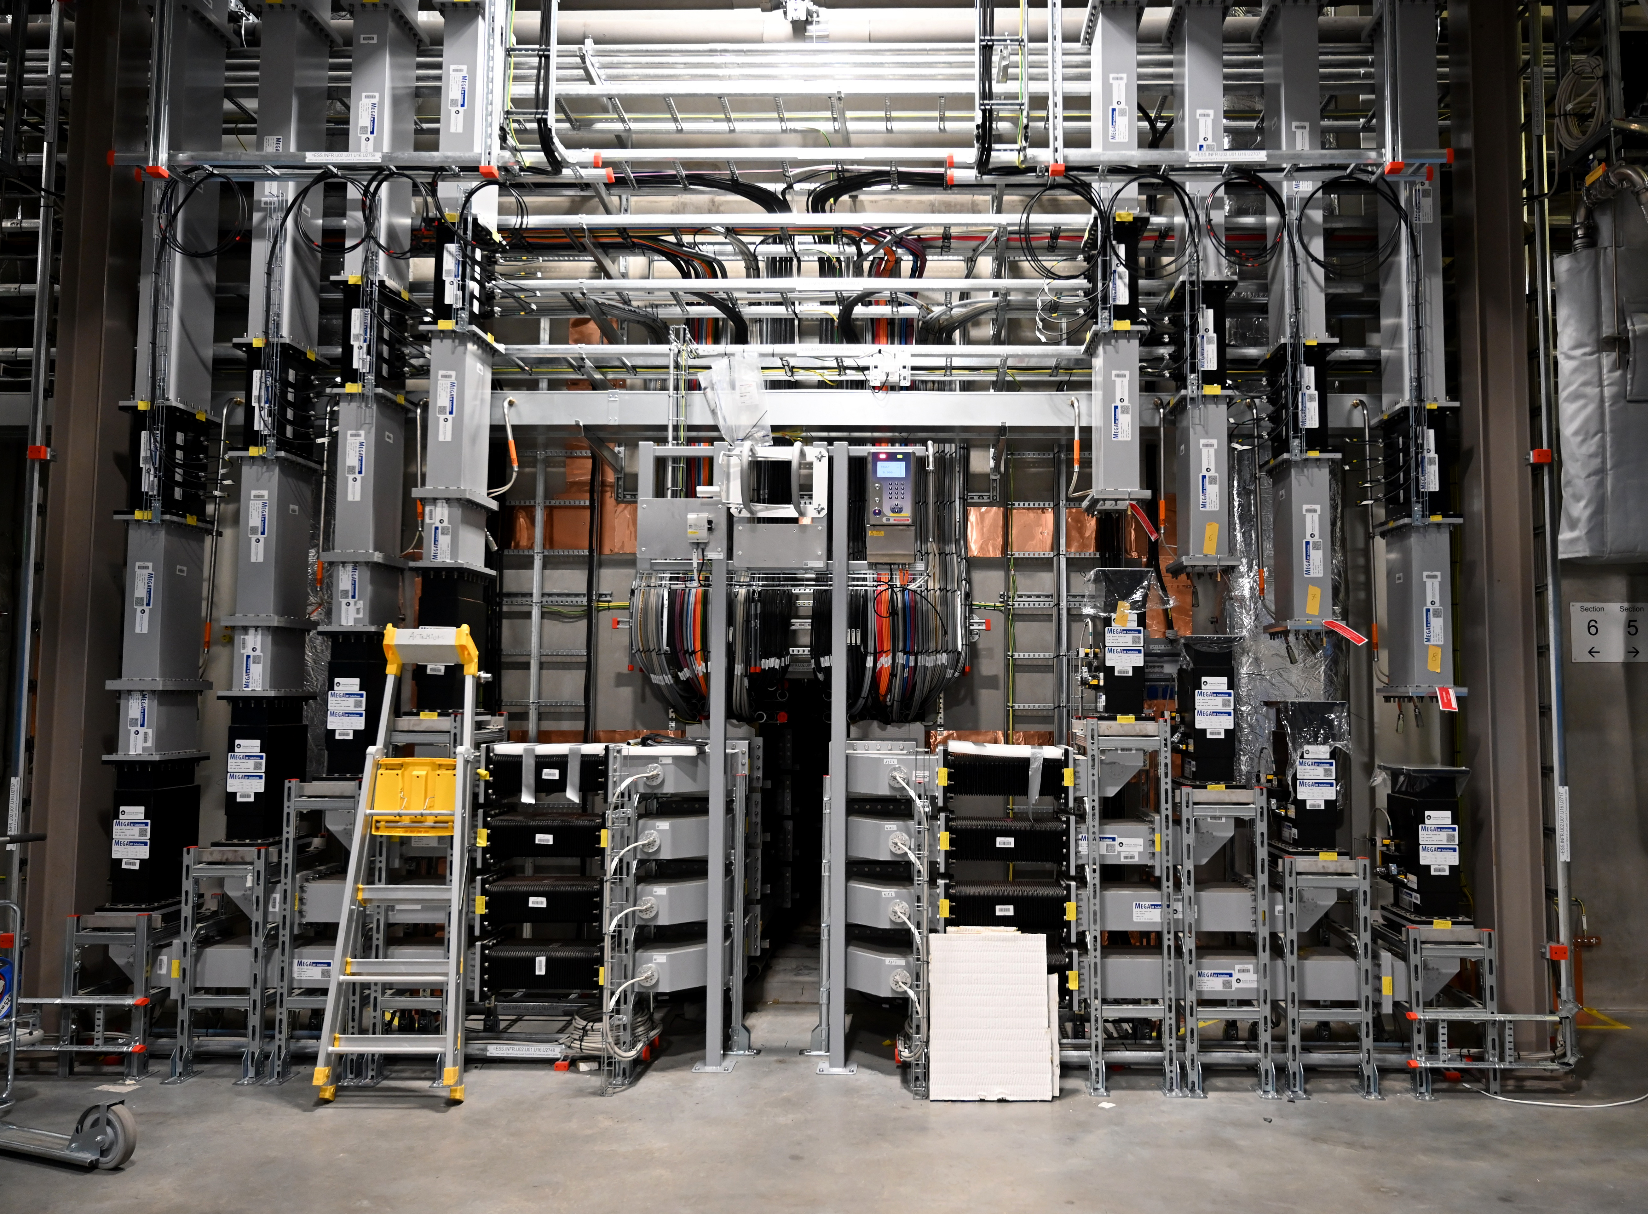
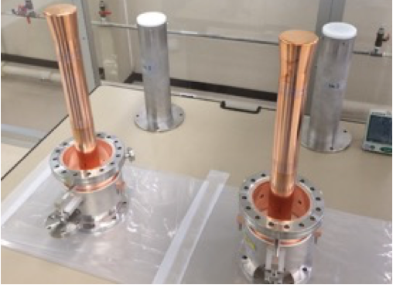
SCL: Cavities
All cavities will need new couplers in order to take in the doubling in rep rate.
Needs:
  New couplers
  New modulators and klystrons
  New tetrodes or SS amplifiers
Price tag: 78.2 M€

Slide 9
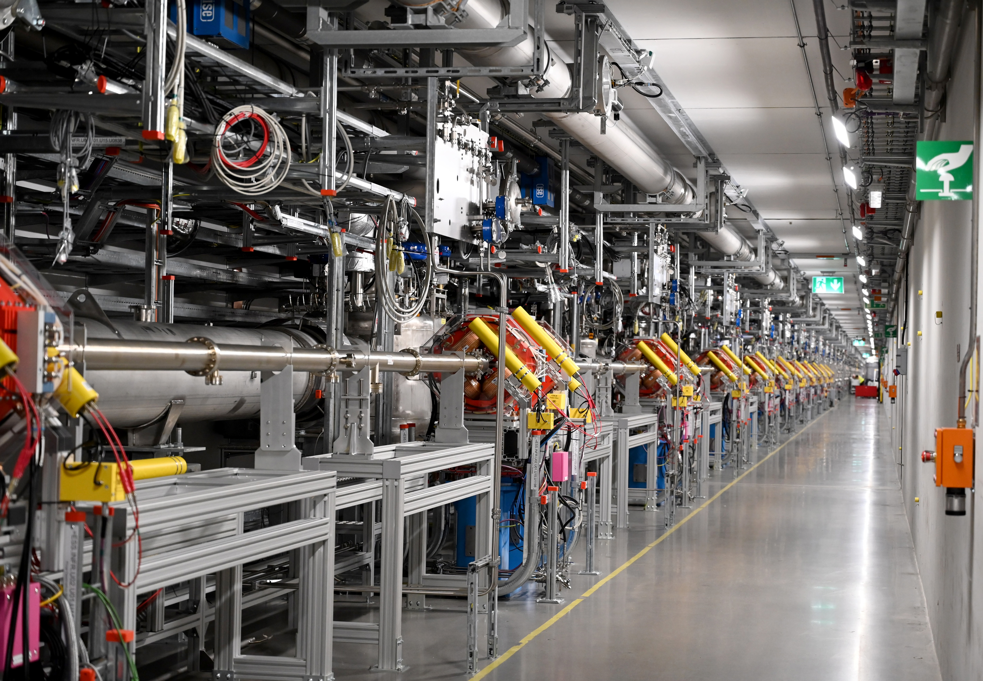
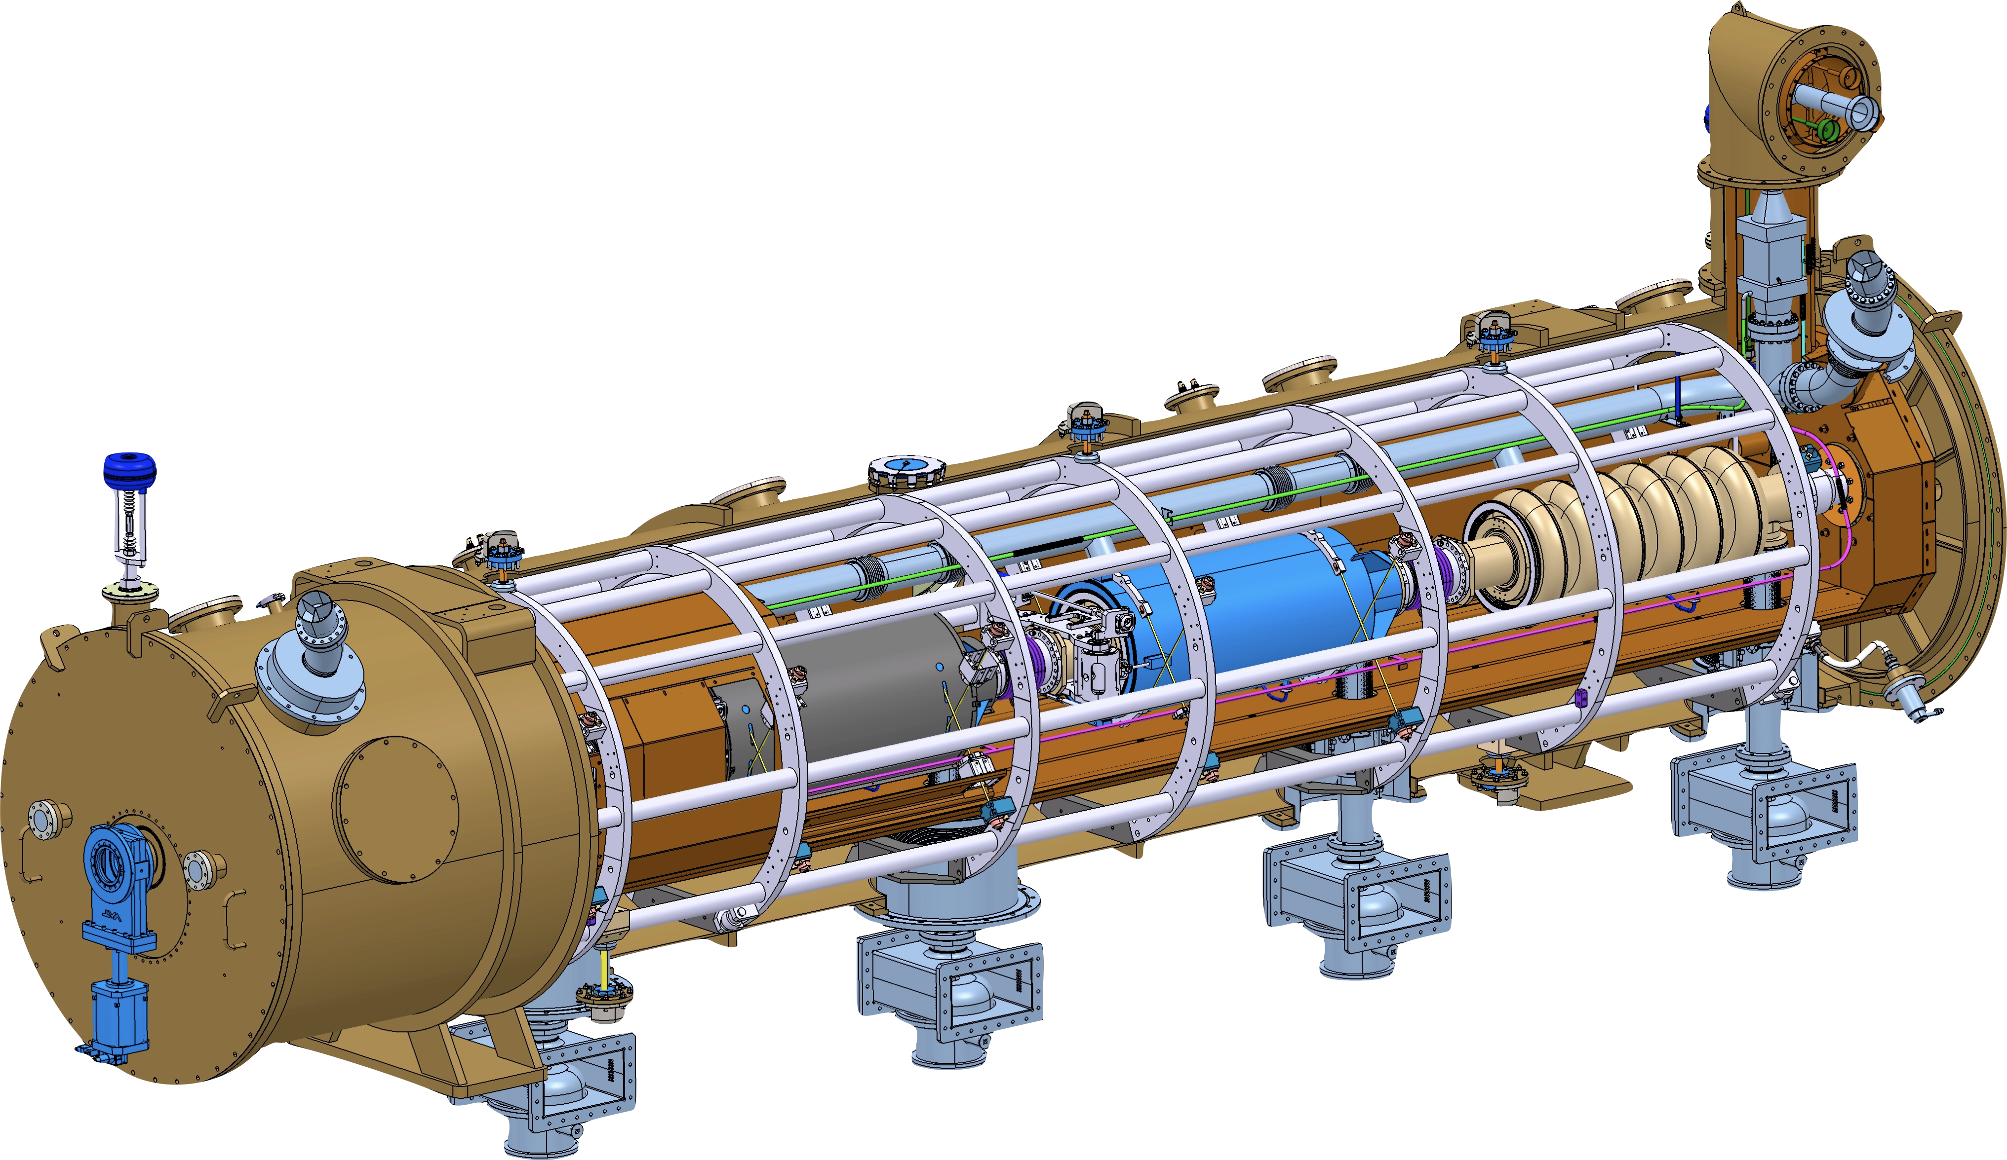
SCL: Extra cavities HEBT (HB+)
In order to take the beam energy up to 2.5 GeV a set of 8 new cryomodules are to be installed in the HEBT section
Needs:
  8 new Cryomodules
  Modulators and klystrons
  Extension of cryo line
Price tag: 48.3 M€

Slide 10
SCL: Extraction to L2R
We need a kicker to extract the beam toward the accumulator ring
If using H- the whole transfer line needs to be cooled between 100-200 K to allow room in the loss budget
Line is 270.6 m long and has 28 H/V dipoles, 64 quads and 4 bunchers. Could be reduced to ~145 m if vertical bends are removed.
Estimated cost: 20-25 M€ (not included cooling infrastructure, 7 M€ is just for cooling part)

Slide 11
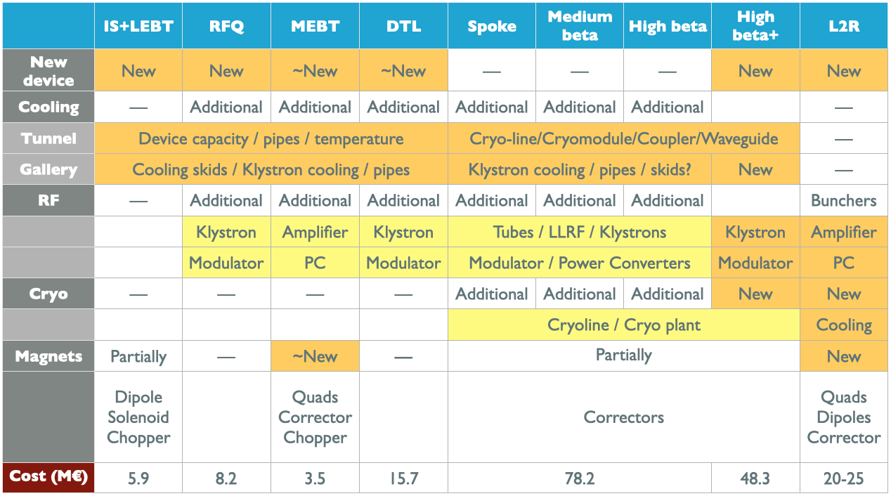
Summary
* Adjusted from 2022 by inflation in Sweden

