Slide 1


ESS-Bilbao contribution to ESSnuSB+ WP4,
06Oct2026 Meeting
J. L. Muñoz
ESS-Bilbao
06.Oct.2026

Slide 2
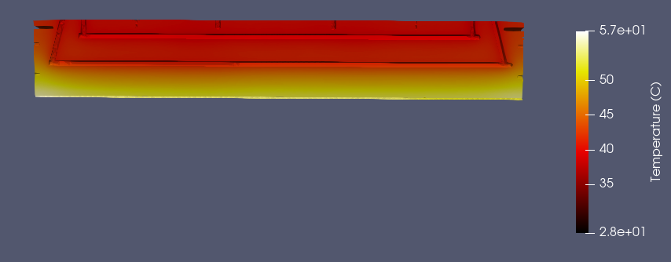
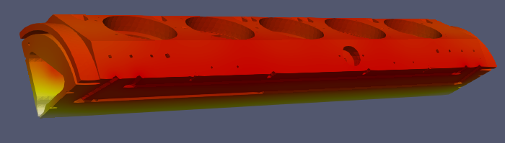
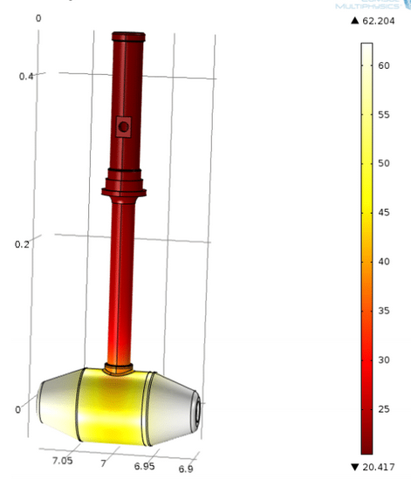
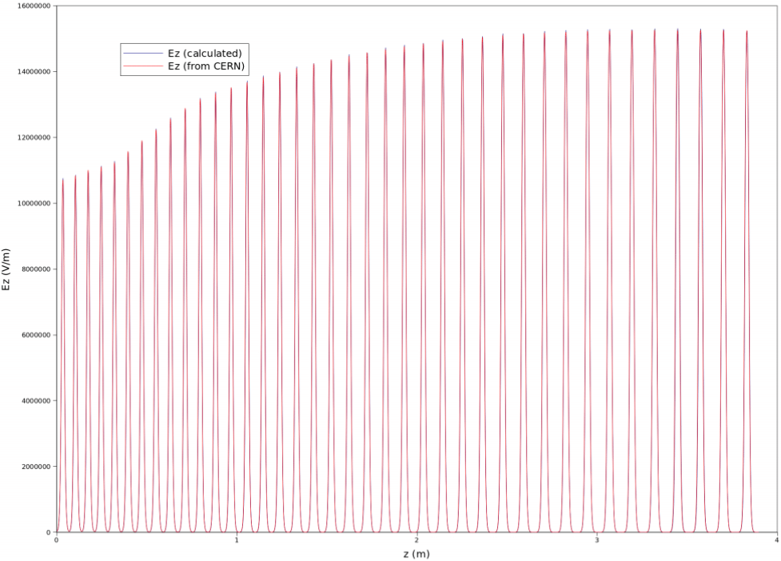
ESSnuSB+ WP4 ESS-Bilbao
Update of activities
RFQ:
  3D simulations of detuning
  Proposed modifications on current design for higher estability
DTL
  Drift Tube analysis at higher power

Slide 3
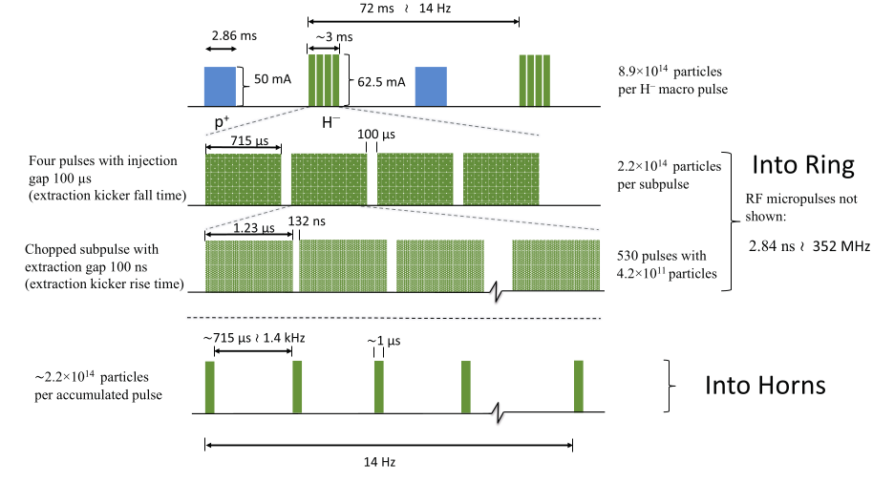
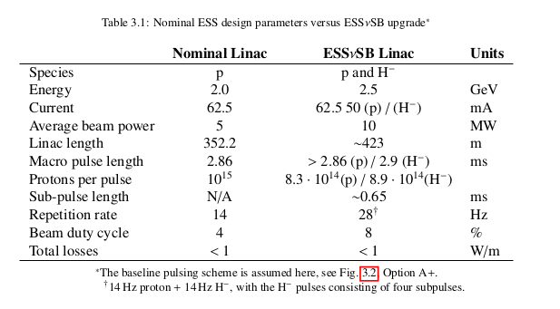
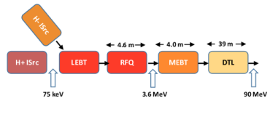
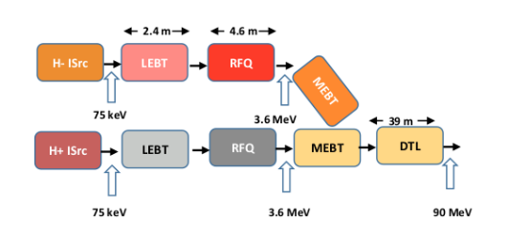
ESSnuSB+ WP4 ESS-Bilbao
For its use with ESSnuSB, the ESS Linac would need to operate at double power, to share the linac between neutron and neutrino production
Beam pulses of H⁻ will be interleaved with the p pulses for the generation of the neutrino superbeam

Slide 4
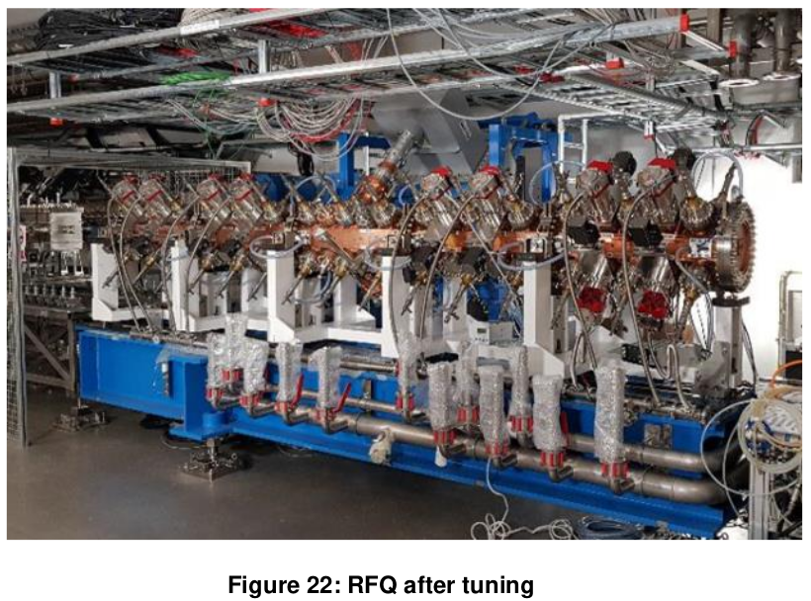
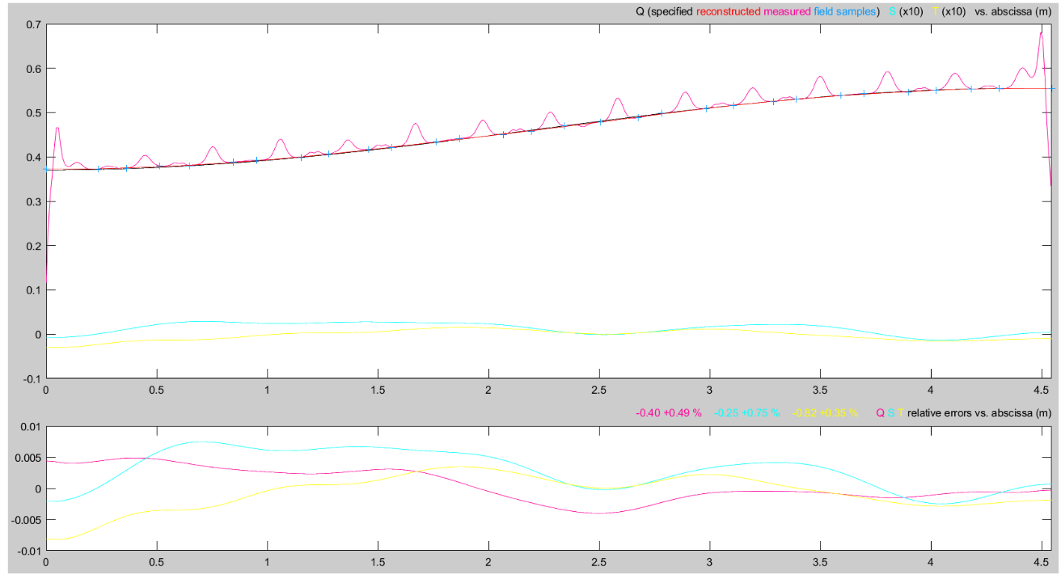
ESS RFQ quick review
Plunger tuners are used to compensate deviations in order to get the desired electric field profile along the beam axis. Tuners also set the adequate frequency in the cavity.
  This is a static tuning of the RFQ. Once all the tuners penetration are frozen, they do not change during operation. (A change in a tuner will change ω, but also Ez(z))
Dynamic tuning (frequency deviations correction during operation) is done by controlling the cooling water temperature or LLRF frequency tracking.

Slide 5
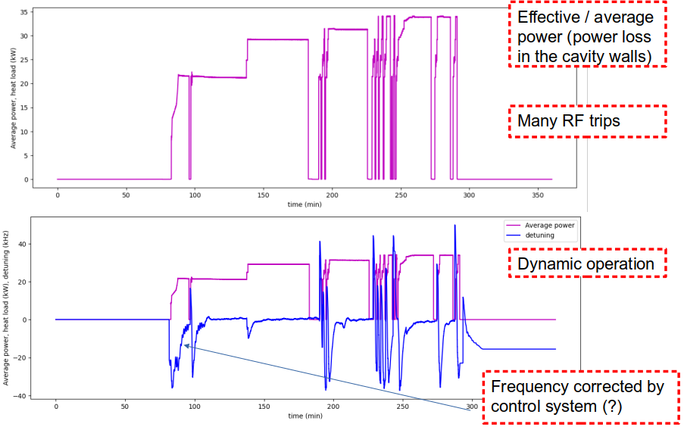
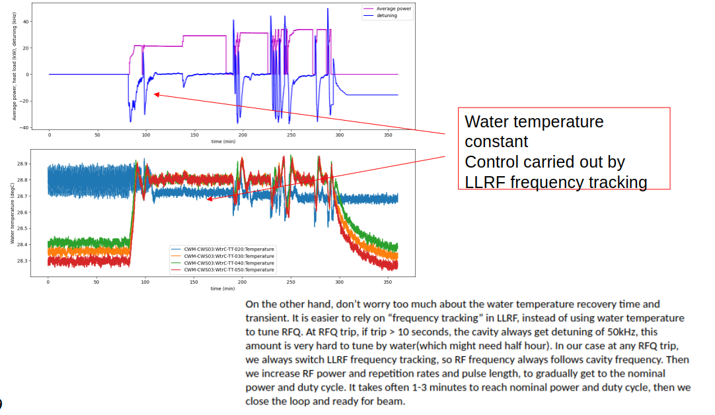
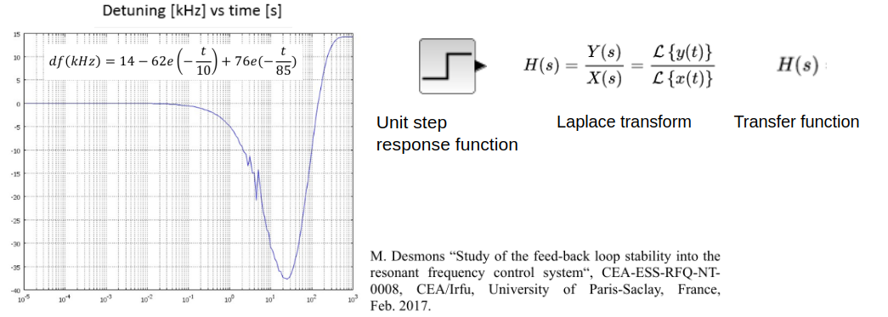
ESSnuSB+ WP4 ESS-Bilbao
ESS RFQ thermal detuning analysis at 5% and extrapolated to 10%

Slide 6
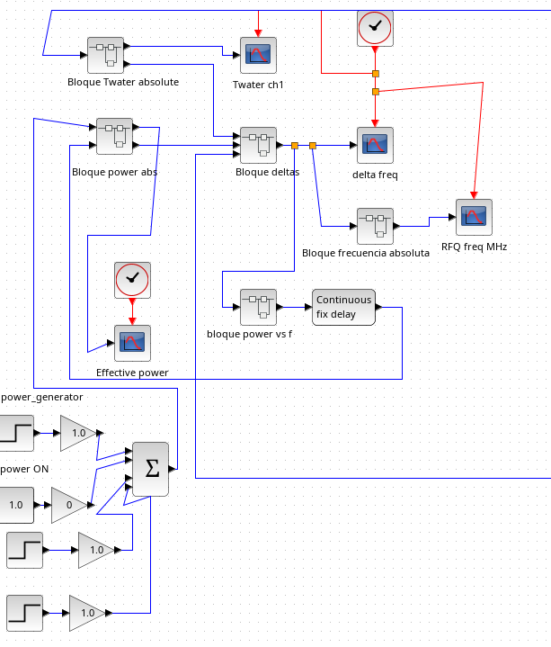
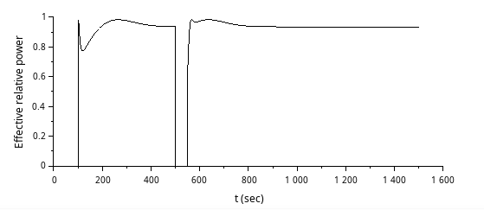
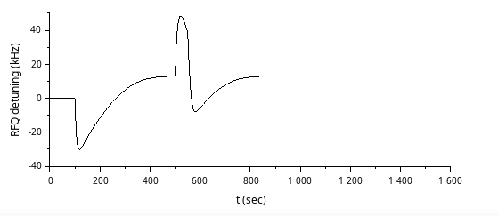
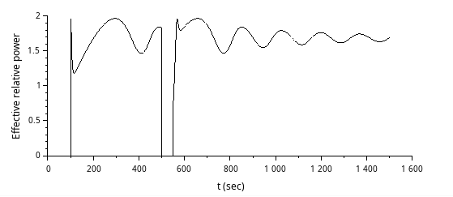
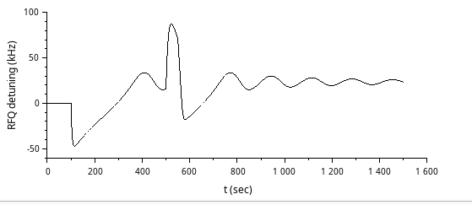
ESSnuSB+ WP4 ESS-Bilbao
ESS RFQ thermal detuning analysis at 5% and extrapolated to 10%
ESS RFQ seems to be unstable at 10% operation

Slide 7
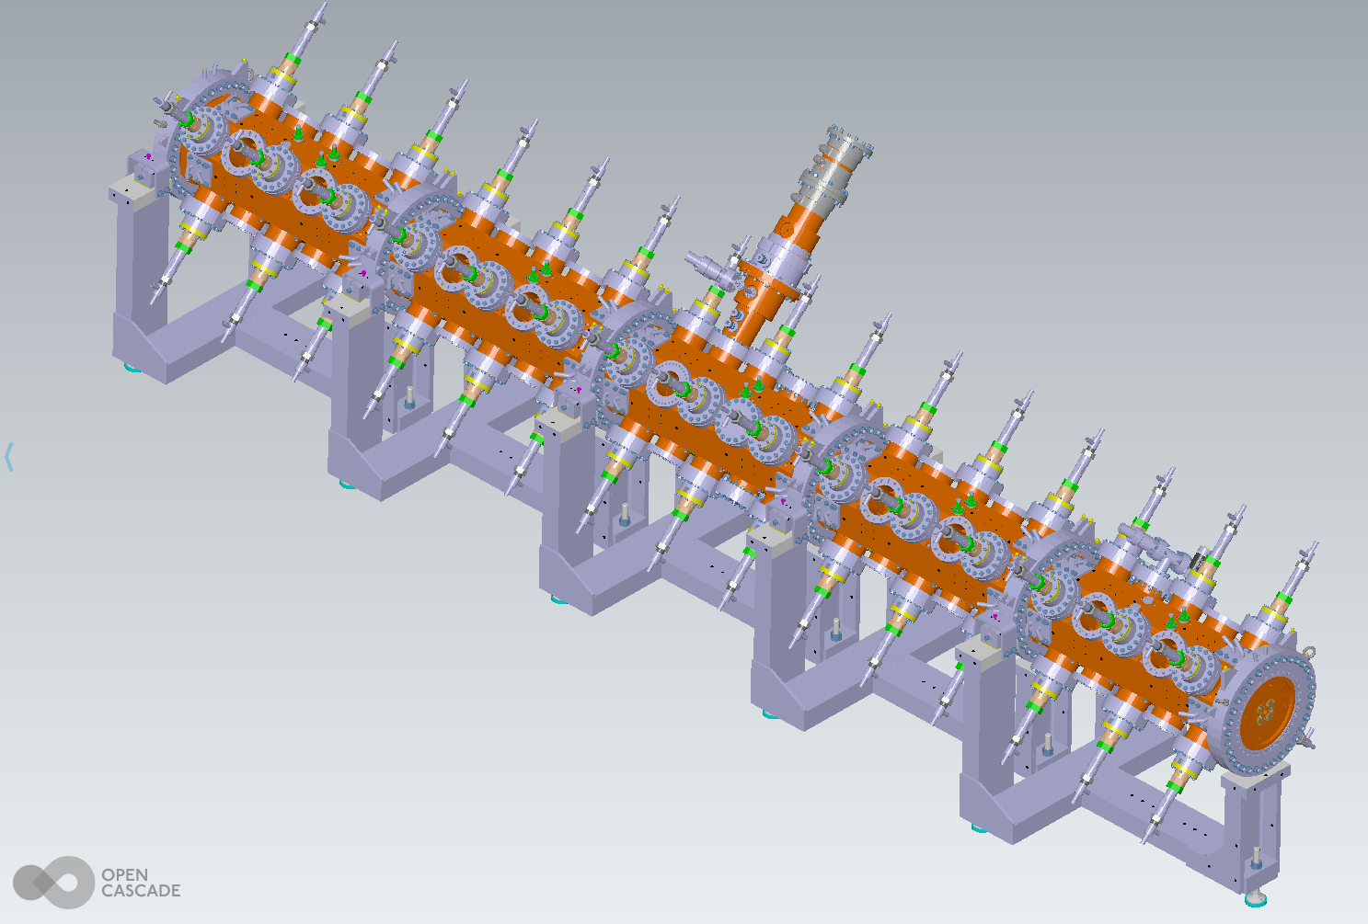
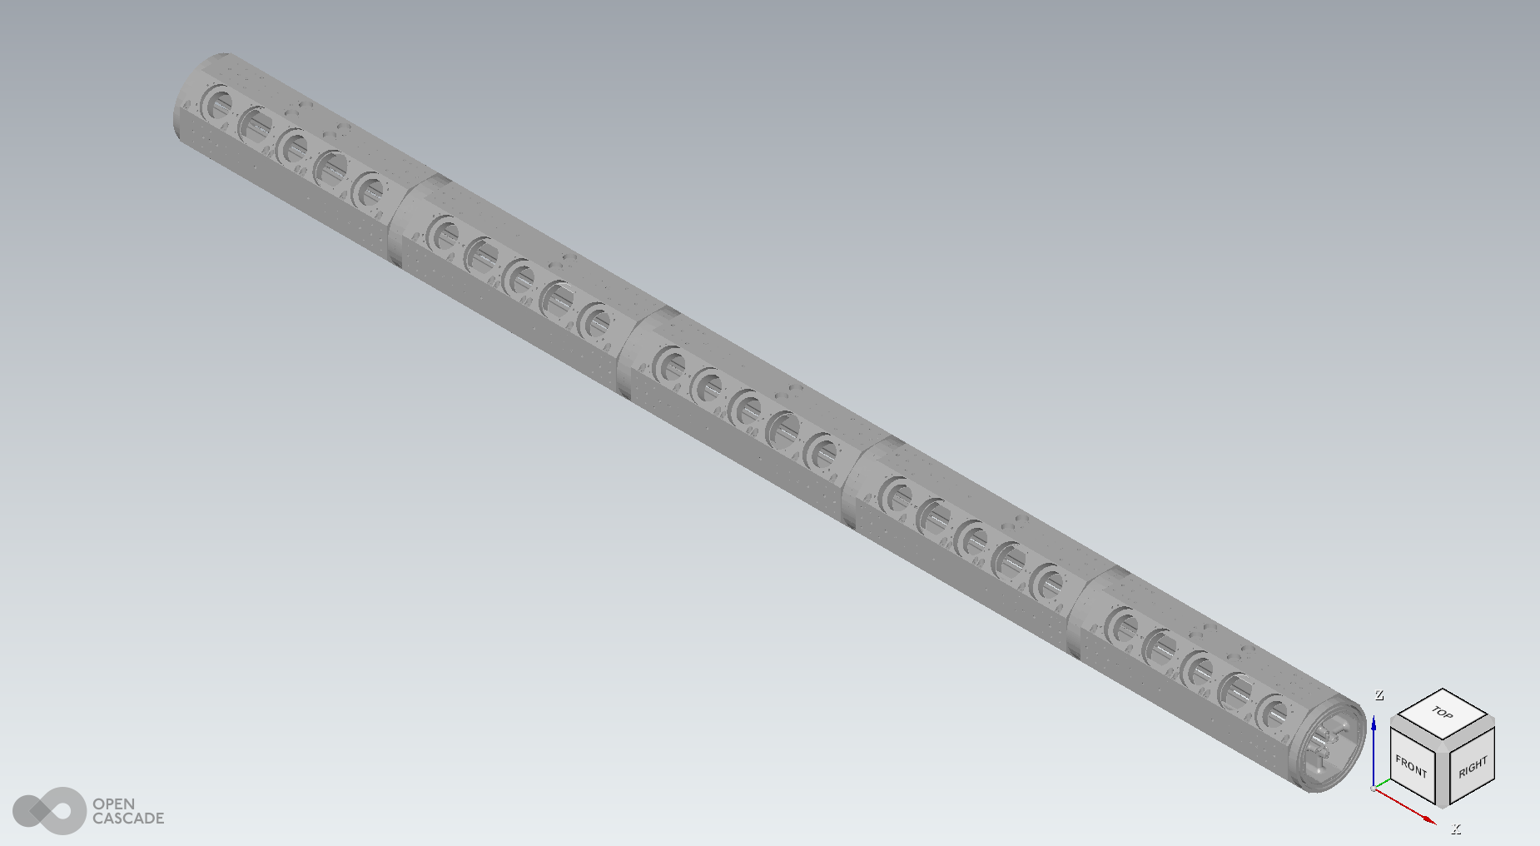
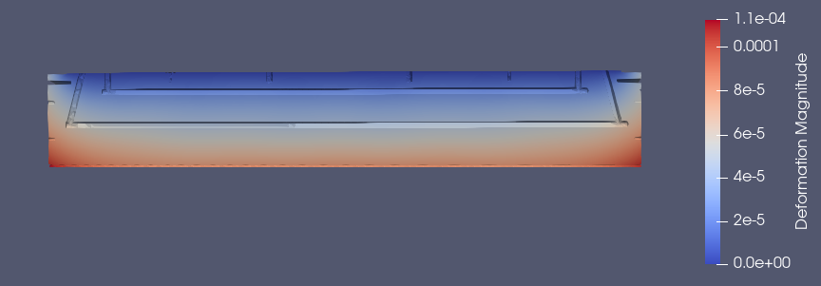
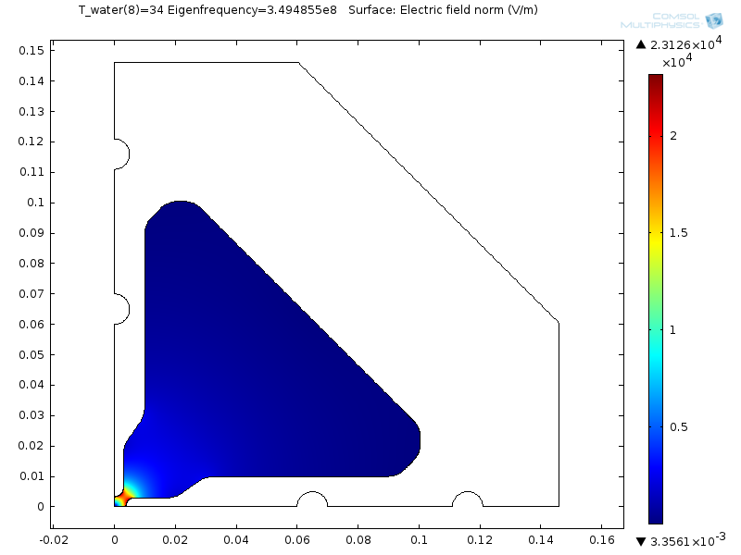
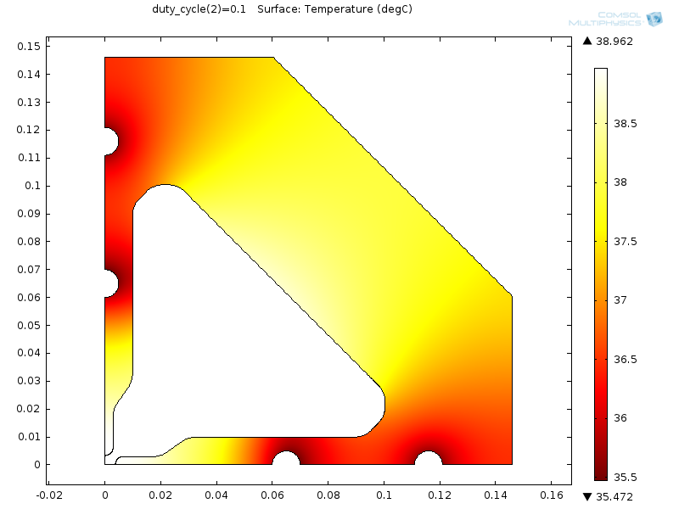
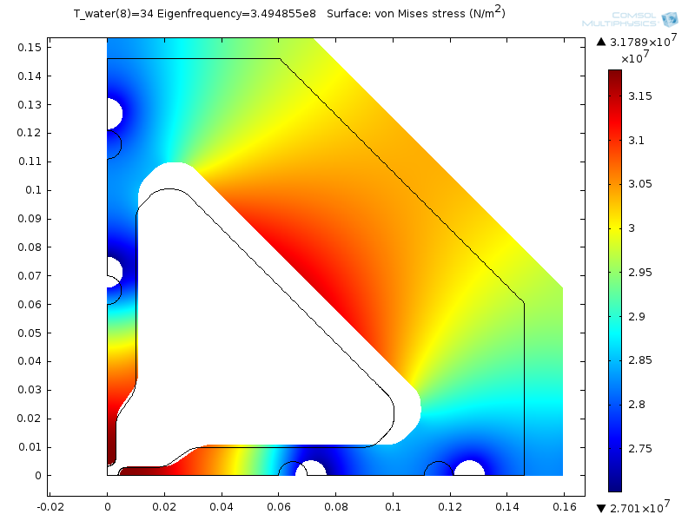
ESSnuSB+ WP4 ESS-Bilbao
Simulations RF → Thermo-mechanical → Deformed mesh → RF

Slide 8
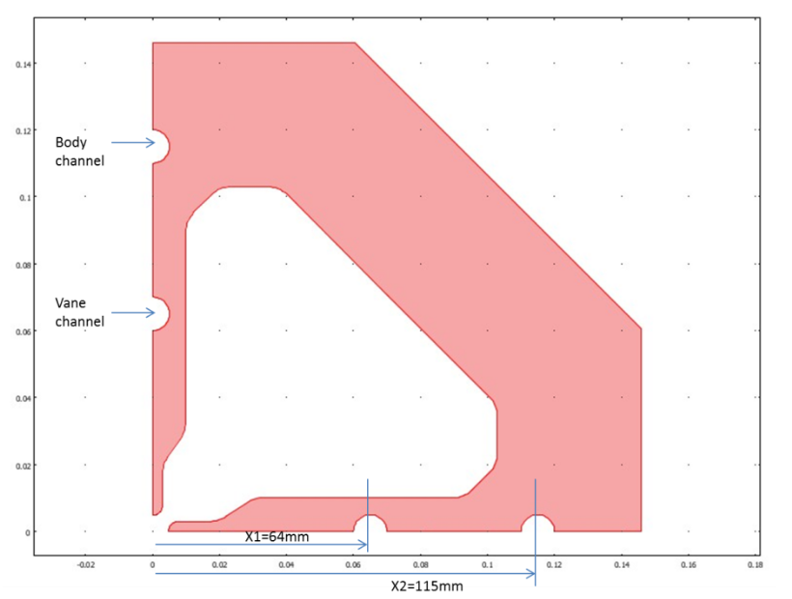
ESSnuSB+ WP4 ESS-Bilbao
Simulations RF → Thermo-mechanical → Deformed mesh → RF
  Boundary conditions as in “M. Desmonds ‘ESS RFQ Study of the feed-back loop stability into the resonant frequency control system’”

Slide 9
ESSnuSB+ WP4 ESS-Bilbao
Simulations RF → Thermo-mechanical → Deformed mesh → RF
Thick wall (f(z))
Far from vane tip

Slide 10
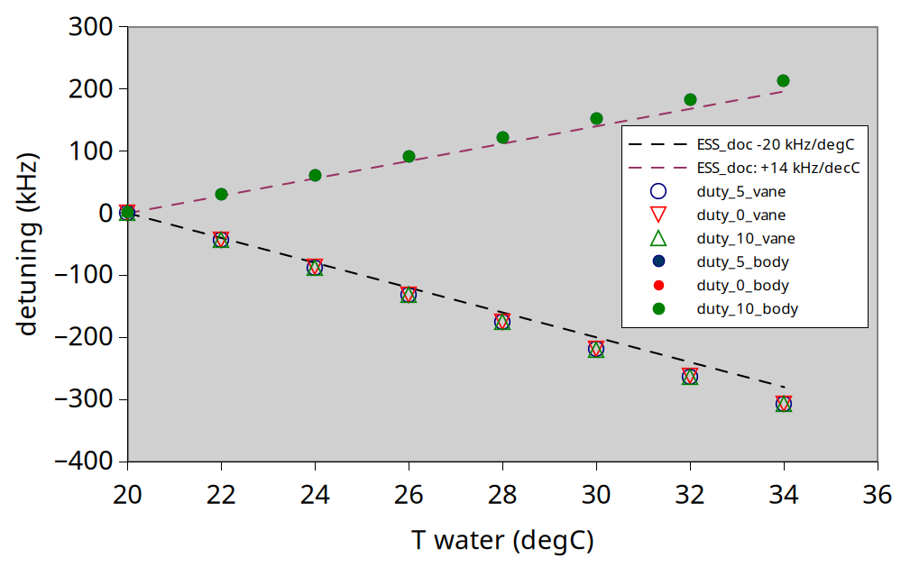
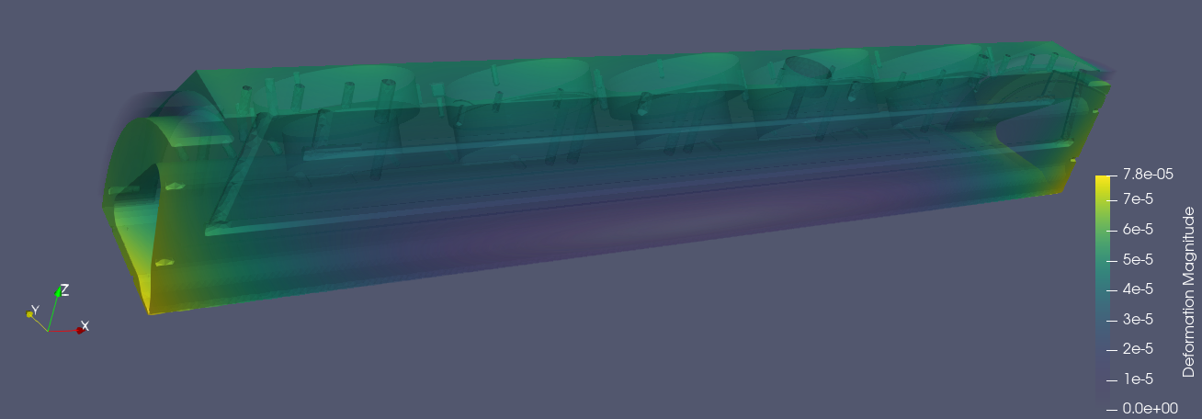
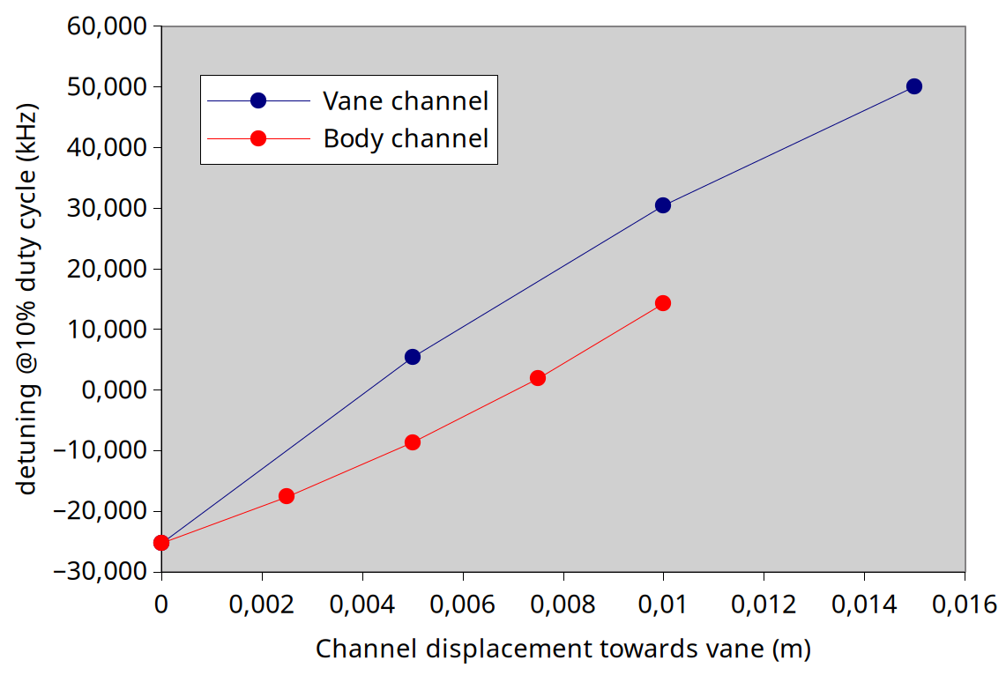
ESSnuSB+ WP4 ESS-Bilbao
Simulations RF → Thermo-mechanical → Deformed mesh → RF
  Steady state (3d simulations)
  Steady state (2d for optimization)

Slide 11
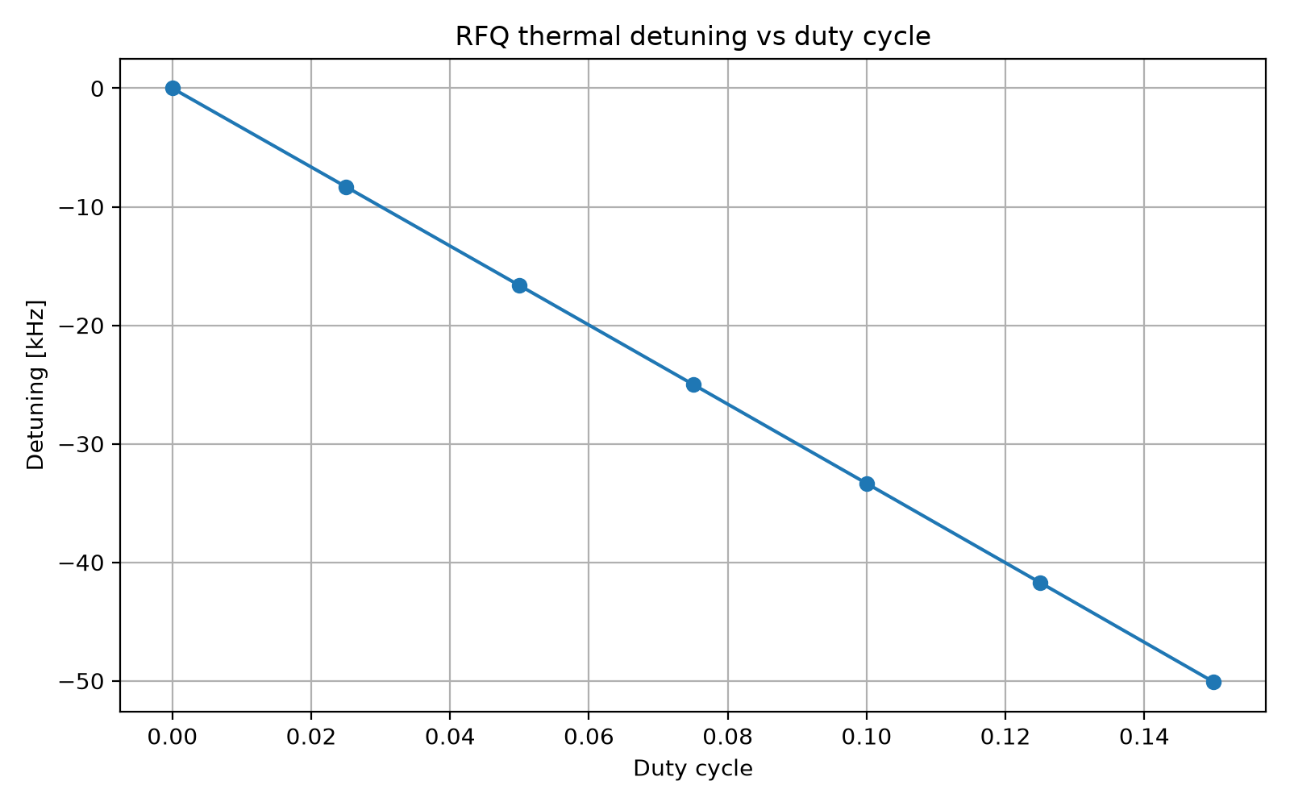
ESSnuSB+ WP4 ESS-Bilbao
- We focused in optimizing ESS RFQ response by minimizing detuning caused by a RF power change.
- This results in a proposed 3D RFQ design that should be tested as posible candidate for ESSnuSB+ RFQ

Slide 12
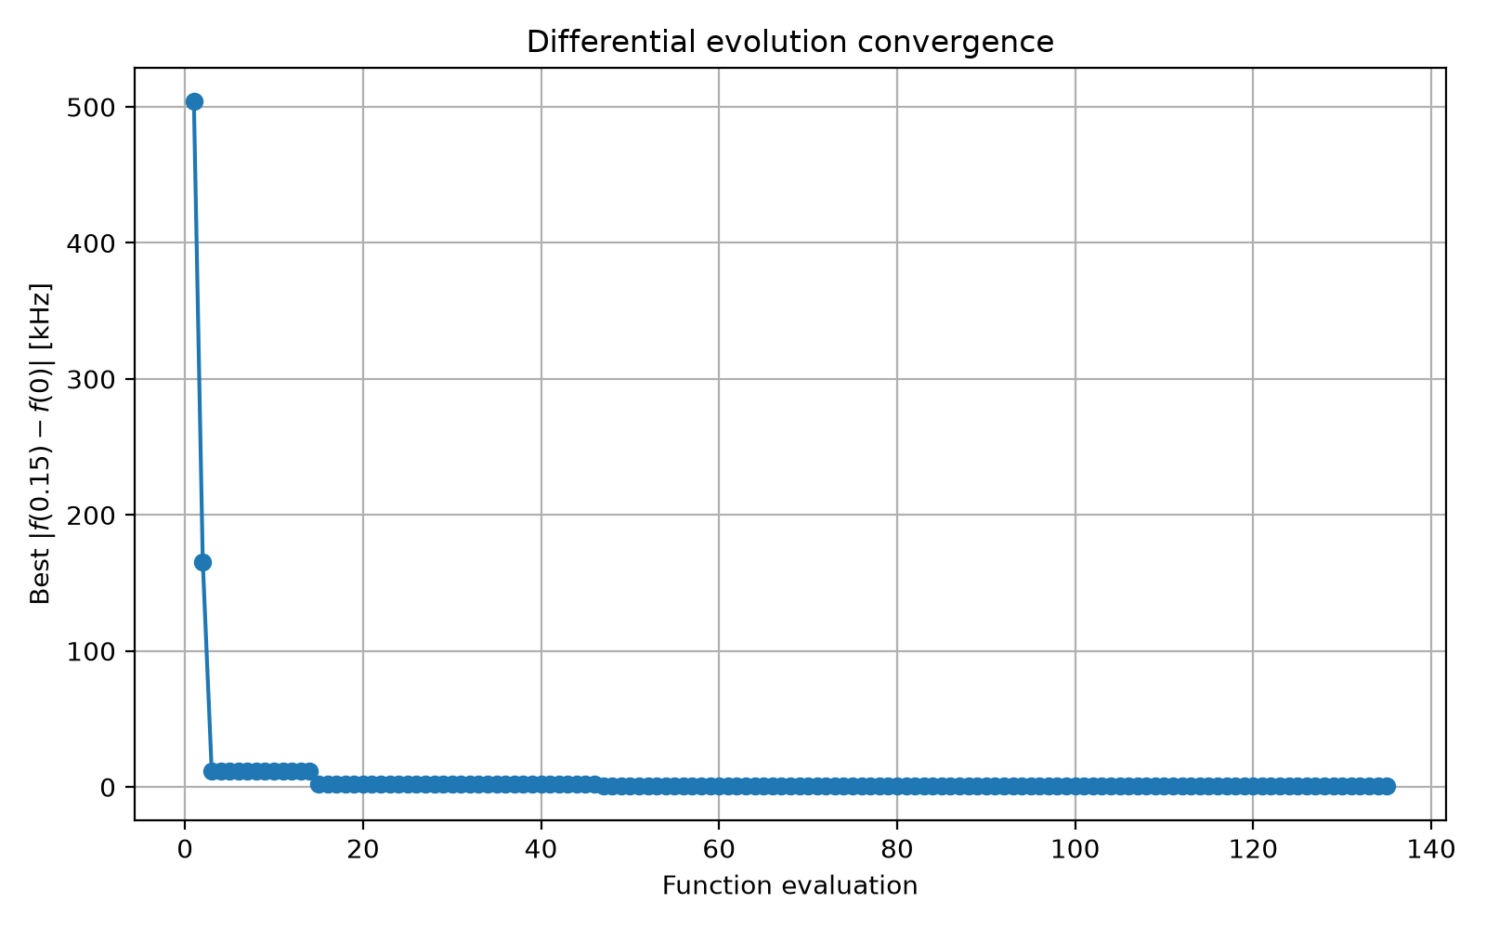
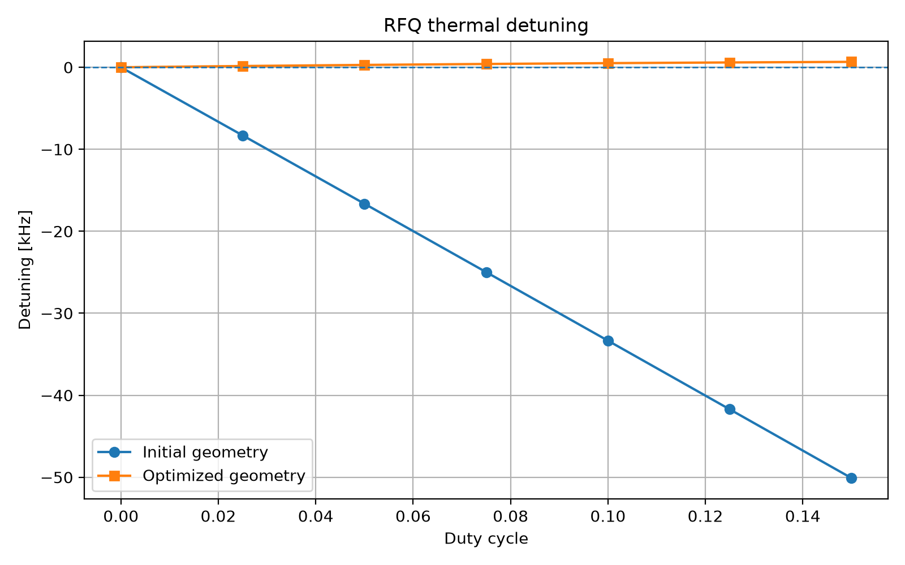
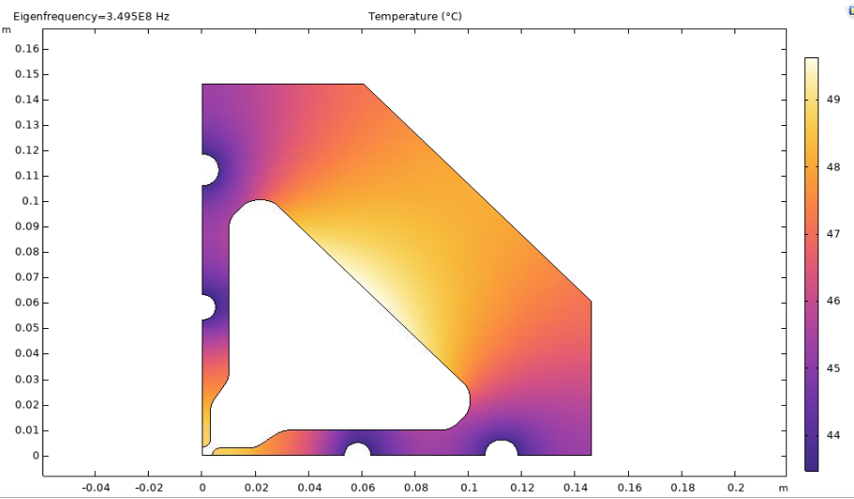
ESSnuSB+ WP4 ESS-Bilbao
- Differential Evolution algorithm to optimize channels placement and diameter (python SciPy + COMSOL (RF → thermomechanical → deformed mesh → RF))
- Differential Evolution algorithm to optimize channels placement and diameter (python SciPy + COMSOL (RF → thermomechanical → deformed mesh → RF))
- DE: Bounded parameter ranges but continuous variables
# Optimization bounds [m]
BOUNDS = [
(-0.020, 0.020), # delta_vane
(-0.020, 0.020), # delta_body
(0.005, 0.008), # radius_body]
Optimized
Current

Slide 13
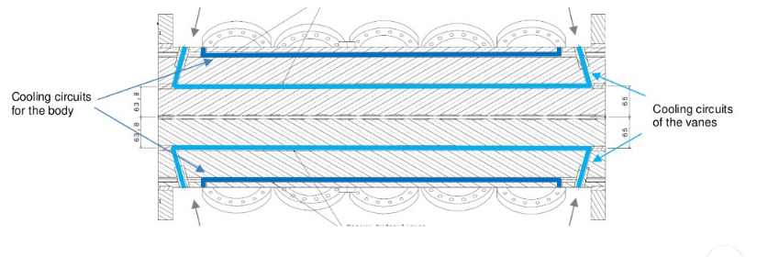
ESSnuSB+ WP4 ESS-Bilbao
- More stable RFQ, for 5% or 10% operation, with little mechanical modifications
- RFQ modulation, length, ports, etc remain the same as the current design (so beam dynamics for the LINAC is not modified)
- This approach should be validated with full cavity modelling

Slide 14
ESSnuSB+ WP4 ESS-Bilbao
Moving vane channel closer to the vane

Slide 15
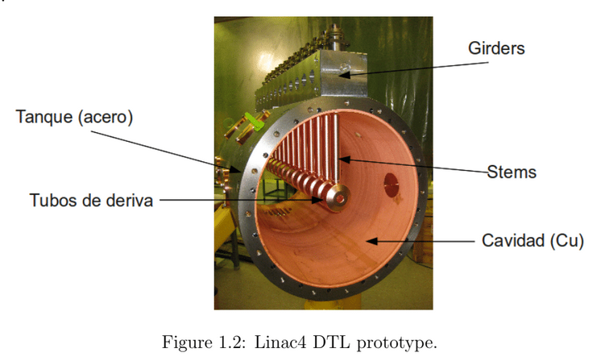
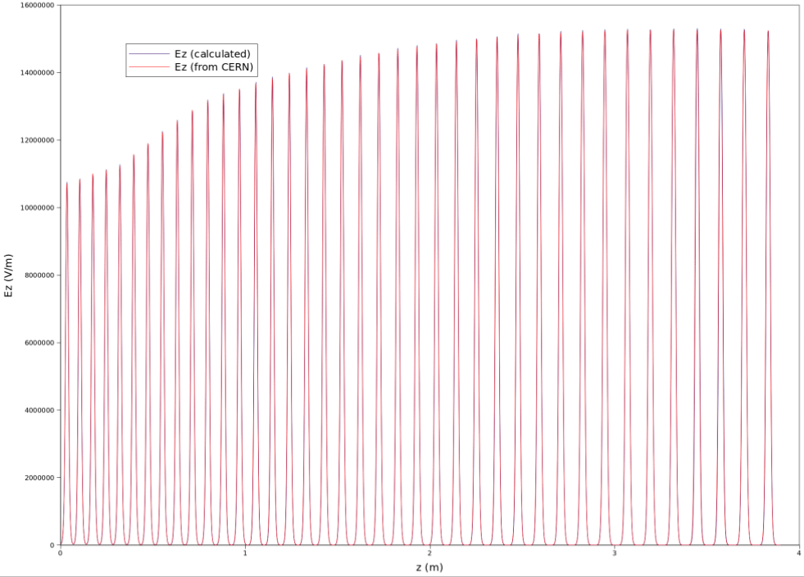
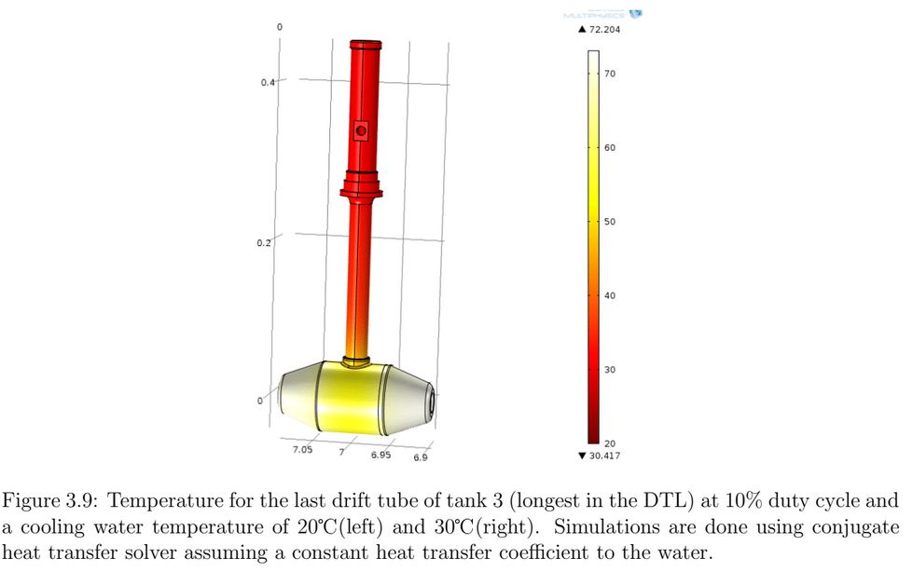
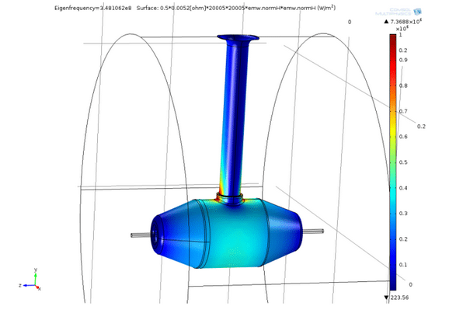
ESSnuSB+ WP4 ESS-Bilbao
ESS DTL analysis (ongoing). Using similar design (LINAC4) up to now
Initial meeting with F. Grespan (INFN), more activities on ESS DTL will follow

Slide 16
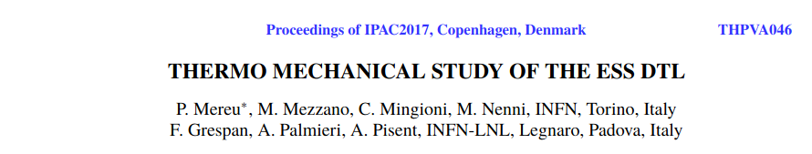
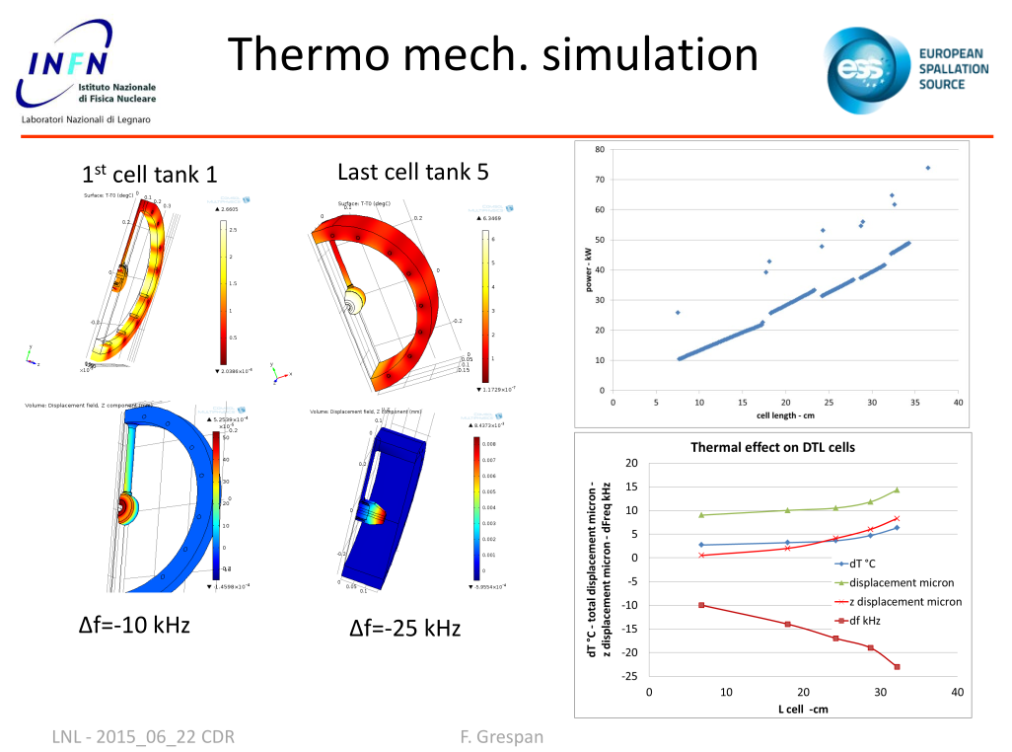
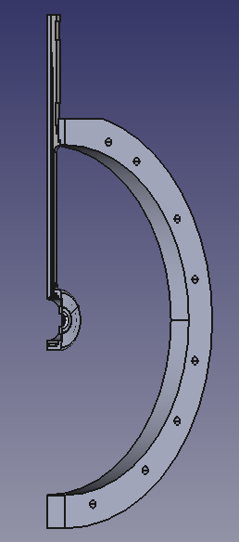
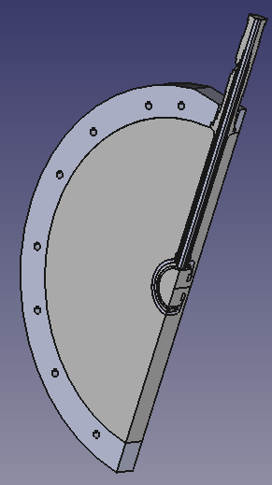
ESSnuSB+ WP4 ESS-Bilbao
Information kindly provided by F. Grespan (INFN)
3D models (STEP files) for the first cell of the DTL

Slide 17
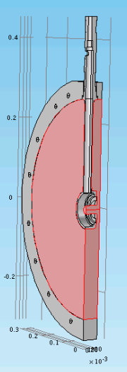
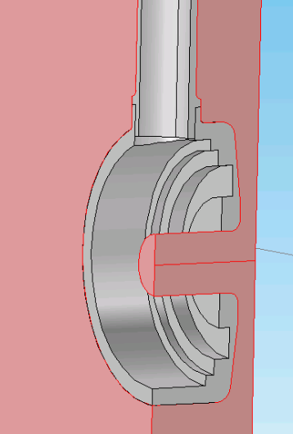
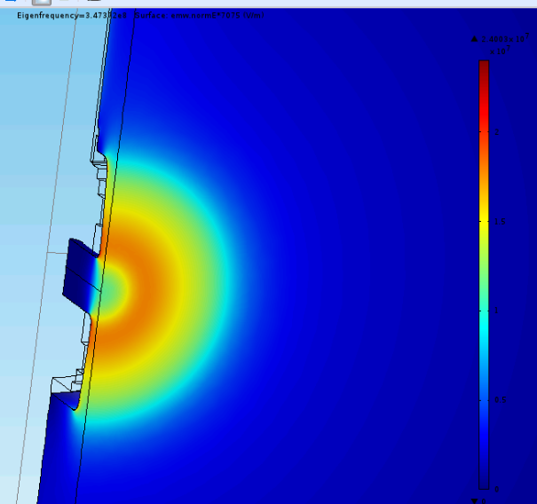
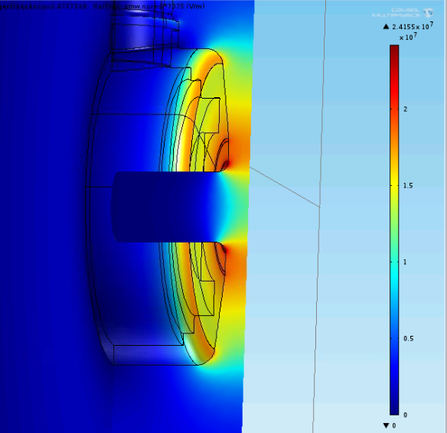
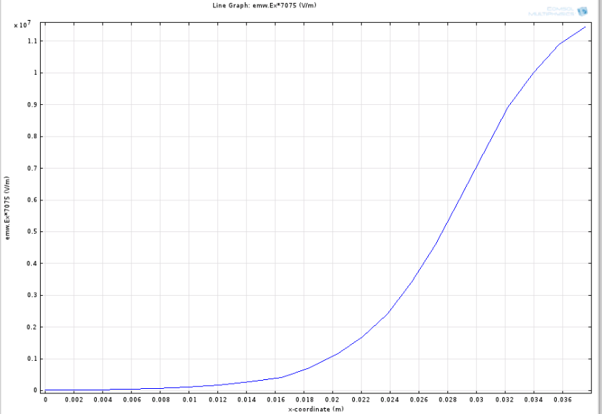
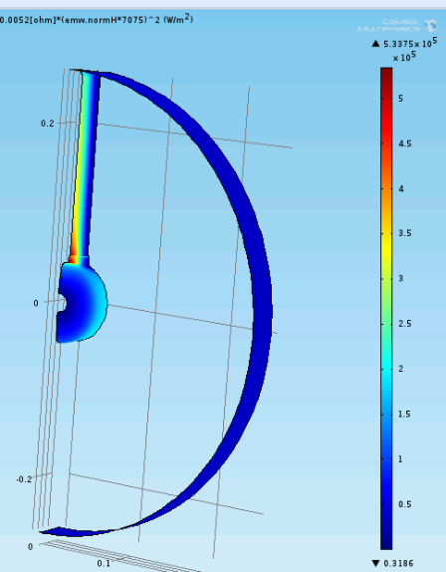
ESSnuSB+ WP4 ESS-Bilbao
ESS DTL analysis
Half DT (101):
- detuning effects

Slide 18
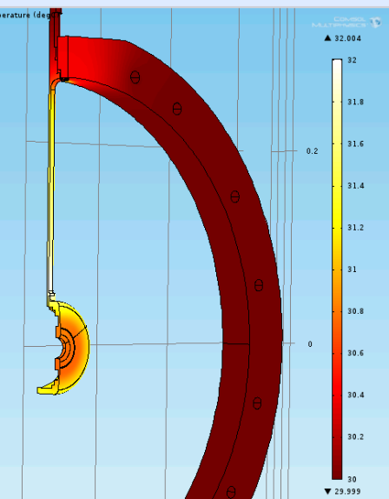
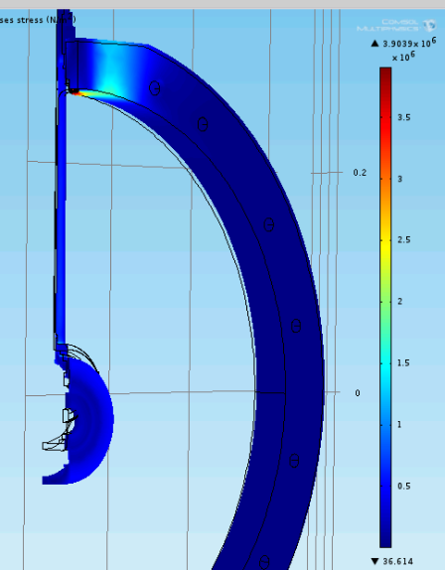
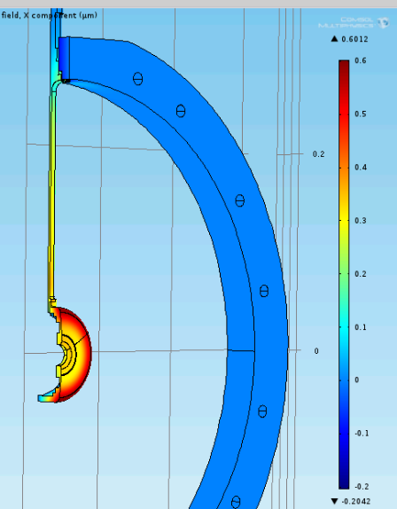
ESSnuSB+ WP4 ESS-Bilbao
ESS DTL analysis
Temperature
Stress
Deformation

Slide 19


ESSnuSB+ WP4 ESS-Bilbao
ESS DTL analysis using CHT (CFD+HT) for thermo-mechanical instead of a constant Heat Transfer coefficient

Slide 20



ESSnuSB+ WP4 ESS-Bilbao
ESS DTL detuning
Computed for duty 5% and 10%. Estimated Q0=43700
With these considerations, in principle no problem in increasing power (wrt detuning)
But power losses in the ceramic window, and other components (like PCs) should also be studied
doi: 10.18429/JACoW-LINAC2024-TUPB068

Slide 21


ESSnuSB+ WP4 ESS-Bilbao
Next steps:
  Post-couplers (play major role in stability) and whole cavity (tuner controlled)

Slide 22





ESSnuSB+ WP4 ESS-Bilbao
DTL post-couplers

Slide 23

ESSnuSB+ WP4 ESS-Bilbao
There is not a noticeable effect in the thermal distortion of the PCs

Slide 24
ESSnuSB+ WP4 ESS-Bilbao
Summary:
  RFQ
    Needs updated design for 10% operation
    Suggestion of design changes presented for a new, more stable RFQ
  DTL
    Simulations do not detect noticeable variations in DTL operation at 10%, provieded enough cooling water is supplied

