Slide 2



Liouvillian Injection Optimization
Elham Salehi, Natalia Milas
ESS$ν$SB+ 4th Annual meeting
October 6, 2026

Slide 3
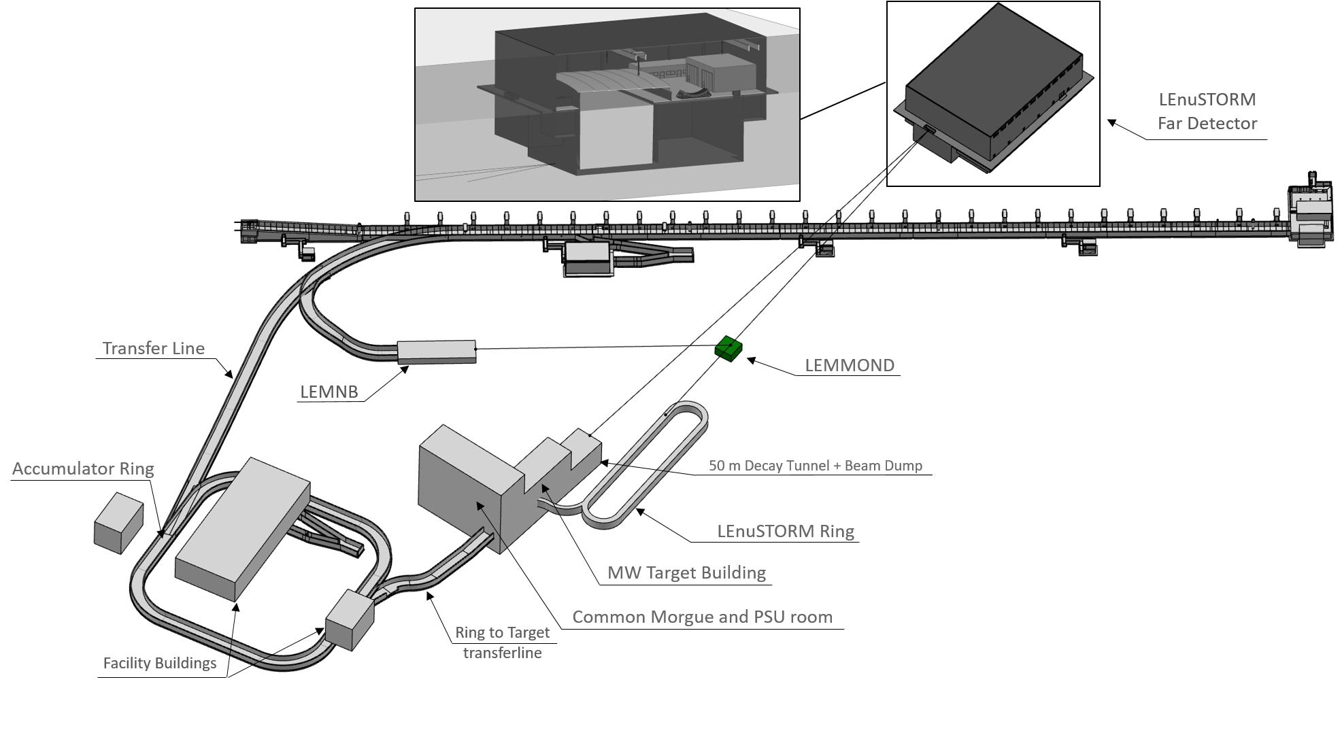
ESSnuSB₊

Slide 4
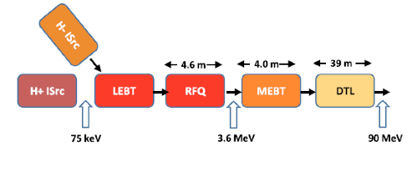
Why LIO?
The main goal of this study is to develop the the Liouvillian Injection Optimization (LIO) method for injecting protons from the linac directly into the accumulator using a 4D Liouvillian multi-turn accumulation process without stripping. This approach avoids the drawbacks of the H⁻ stripping injection, which is considered a ”dirty process” due to several issues
High activation caused by the unstripped H⁻ and H0.
Complex management of stripped electrons.
Limited foil lifetime and the foil replacement system is complicated.
H⁻ source has constraint for current and lifetime compared to proton sources.
A transfer line for protons is simpler.
In addition, if the choice is done to use H⁻ for ESSnuSB, the linac operation for both proton and H⁻ beams will require a substantial increase in complexity of the linac control system, low-level RF systems and safety systems.

Slide 5
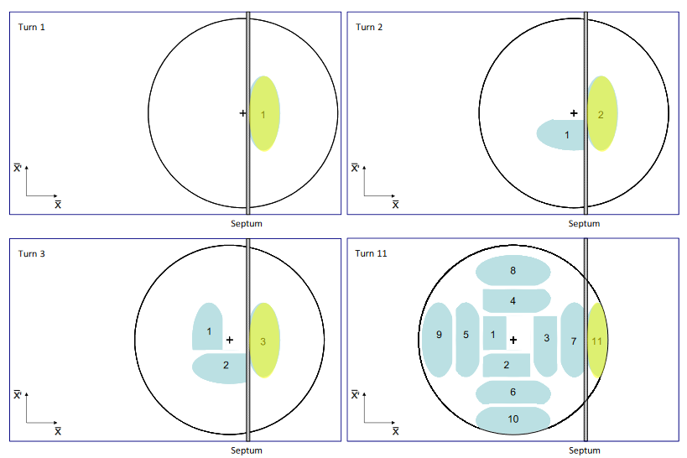
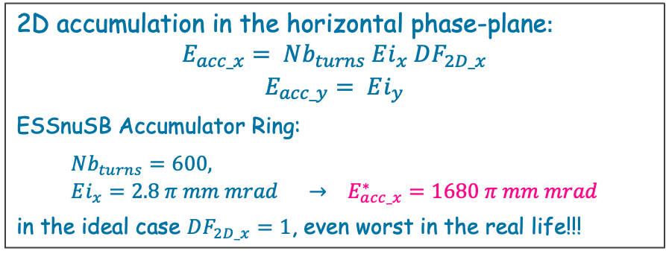
Multi-turn injection (2D)
Multi-turn injection is the process of stacking >1 bunch during multiple turns of stored beam.
The circulating beam position changes during injection. Cannot inject a new bunch directly on top of existing bunch due to conservation of emittance (Liouville’s Theorem)
2D accumulation in the horizontal phase-plane$:$
$$E_{acc_x}= Nb_{turns} Ei_{x} DF_{2D_x}$$
$$E_{acc_y}= Ei_{y}$$
ESSnuSB Accumulator Ring:
$$Nb_{turns}=600, Ei_{x}=2.8 π mm mrad → E_{acc_x}^{∗}=1680 π mm mrad$$
in the ideal case $DF_{2D_x}=1$, even worst in the real life!!!
Notes:
$DF_{2D_x}$ the dilution factor characterizing the horizontal phase-space waste induced by the accumulation process

Slide 6
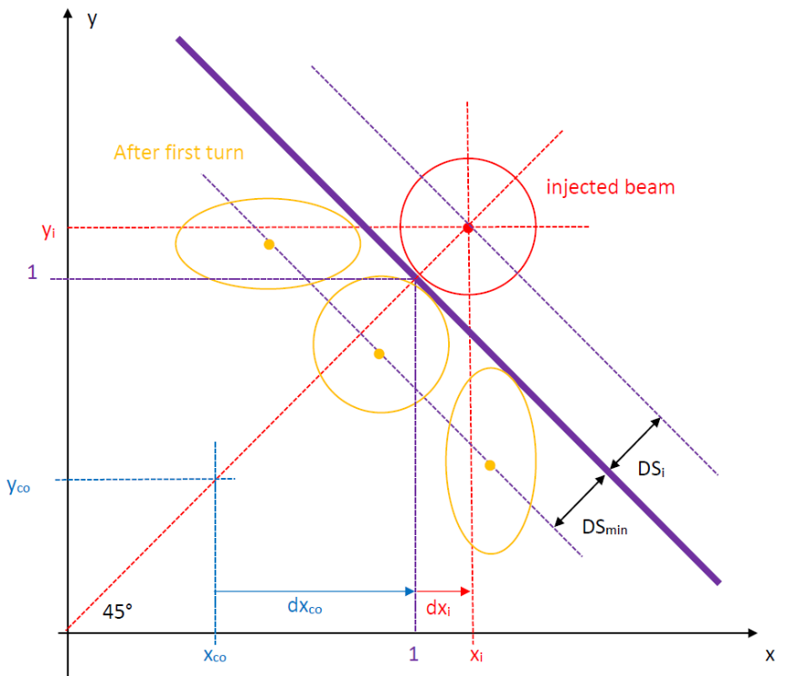
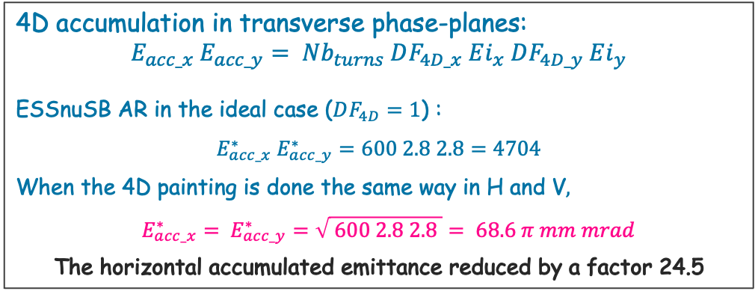
Multi-turn injection(4D)
Multi-turn injection is the process of stacking >1 bunch during multiple turns of stored beam.
The circulating beam position changes during injection. Cannot inject a new bunch directly on top of existing bunch due to conservation of emittance (Liouville’s Theorem)
4D accumulation in transverse phase-planes:
$$E_{acc_x} E_{acc_y}= Nb_{turns} DF_{4D_x} Ei_{x} DF_{4D_y} Ei_{y}$$
ESSnuSB AR in the ideal case ($DF_{4D}=1$) :
$$E_{acc_x}^{∗} E_{acc_y}^{∗}=600 2.8 2.8=4704$$
When the 4D painting is done the same way in H and V$,$
$$E_{acc_x}^{∗}= E_{acc_y}^{∗}=\sqrt{ 600 2.8 2.8 }= 68.6 π mm mrad$$
The horizontal accumulated emittance reduced by a factor 24.5
With multi-turn injection, we can paint the transverse phase space, (x, x’) (y, y’) in the receiving ring to obtain as low as possible stored emittances using a tilted septum. (“two plane painting injection”)

Slide 7
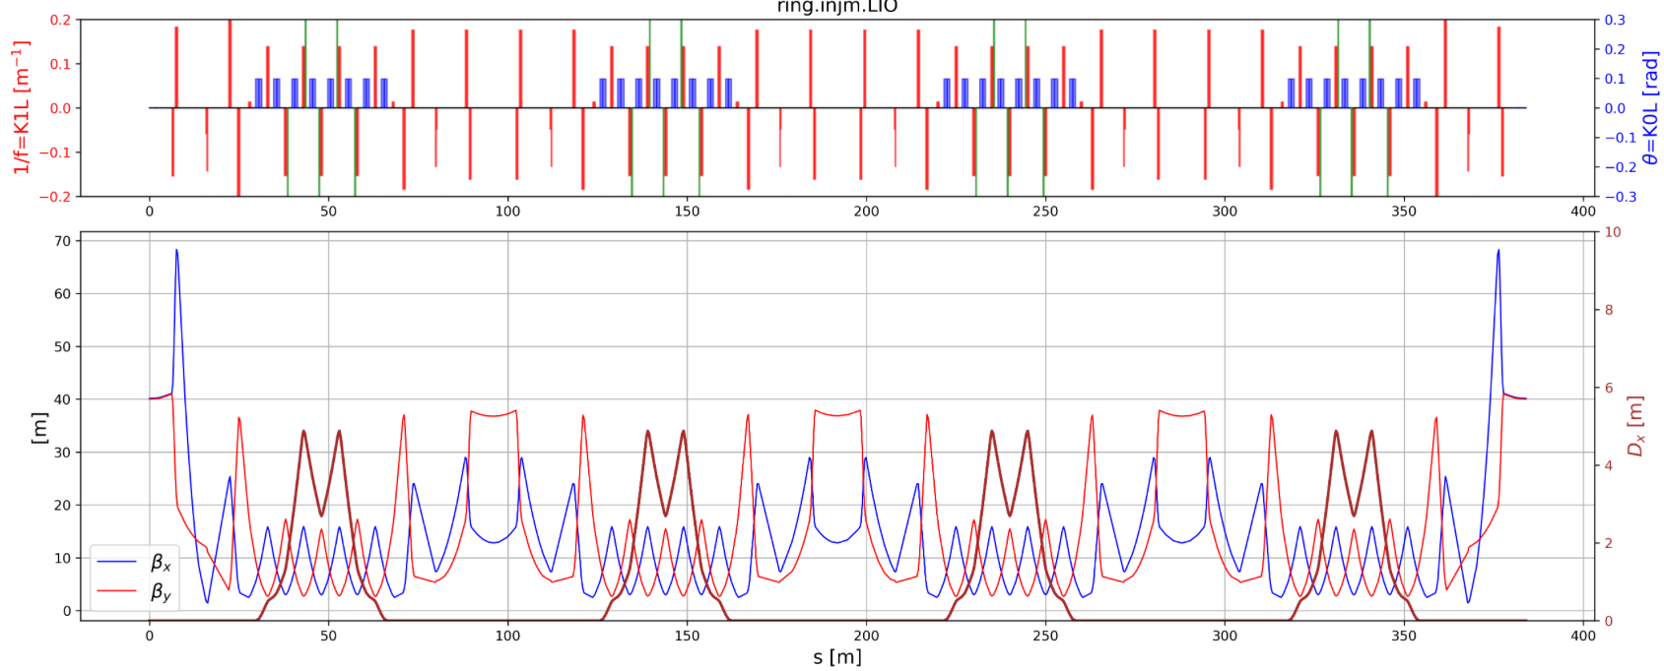
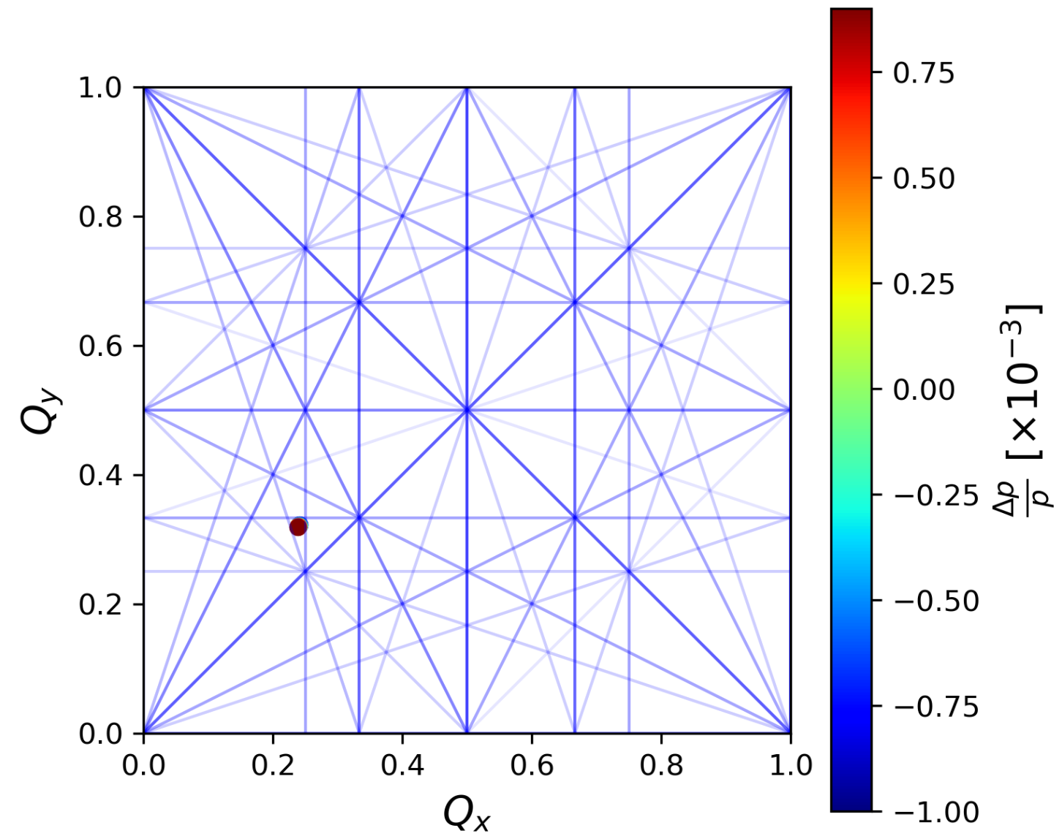
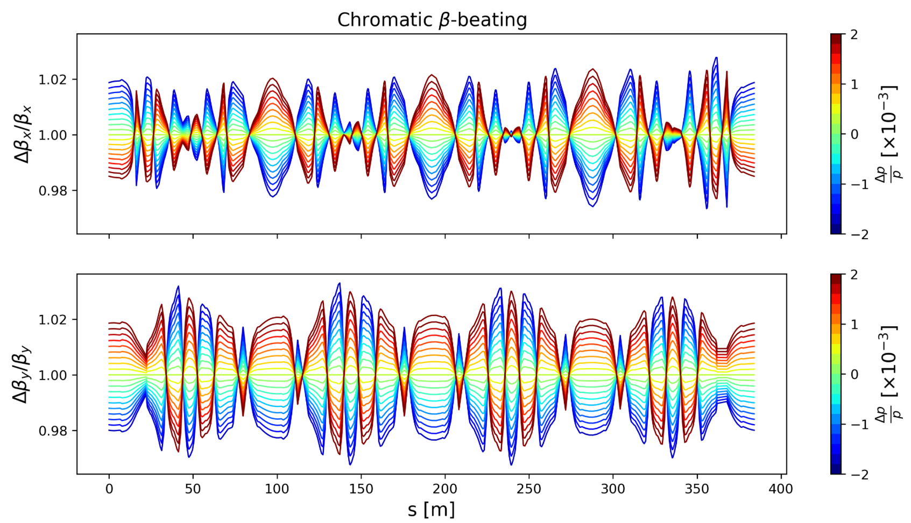
Accumulator Ring
Tracking injected particles through accumulator ring

Slide 8
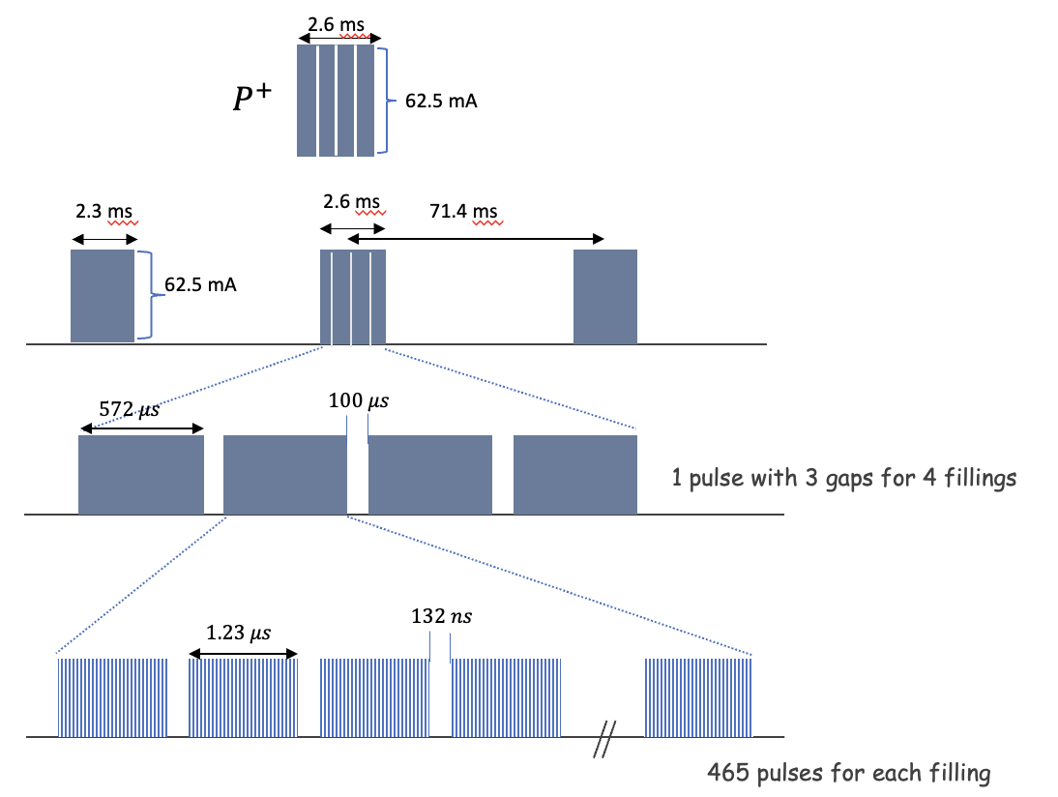
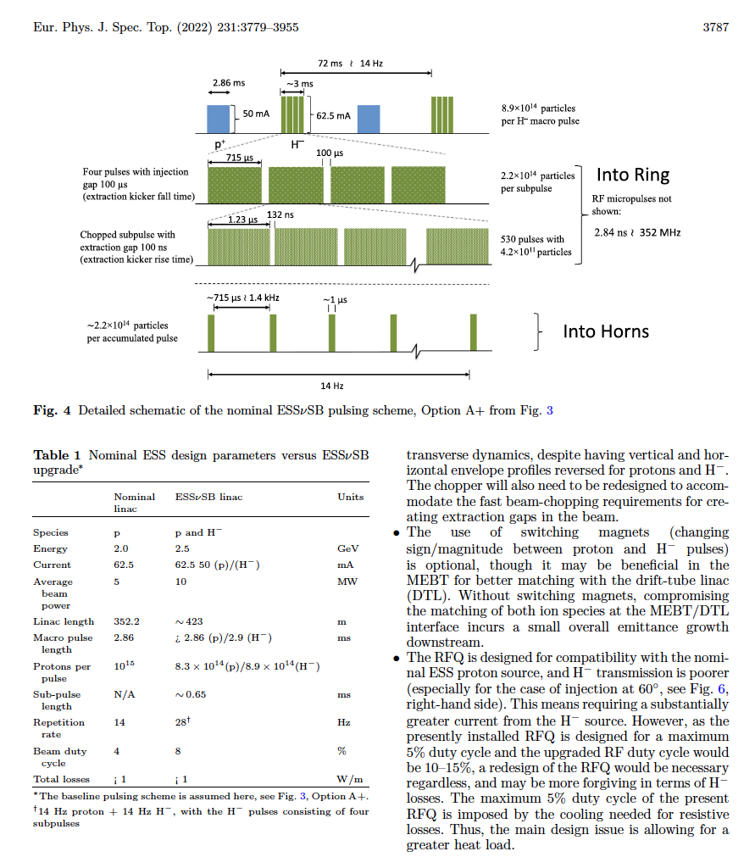
Baseline pulsing structure for proton
The main goal of this study is to develop the Liouvillian Injection Optimization (LIO) method for injecting protons from the linac directly into the accumulator using a 4D multi-turn accumulation process without stripping.

Slide 9
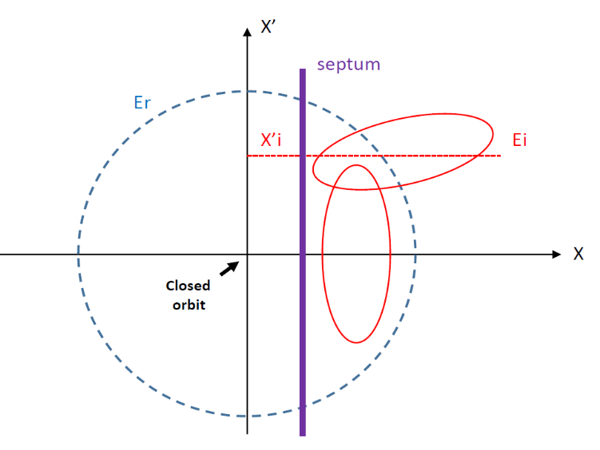
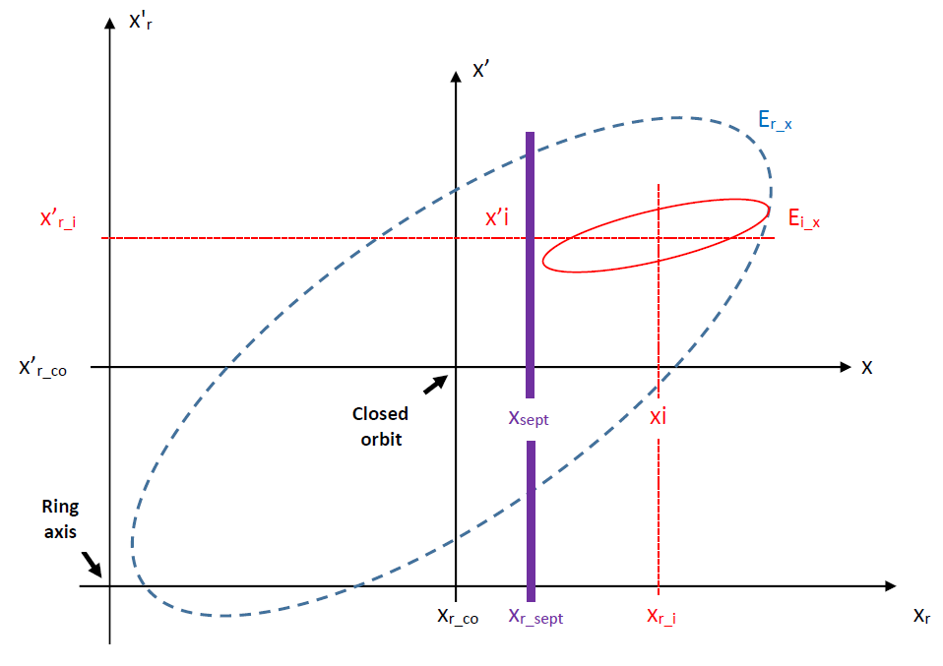
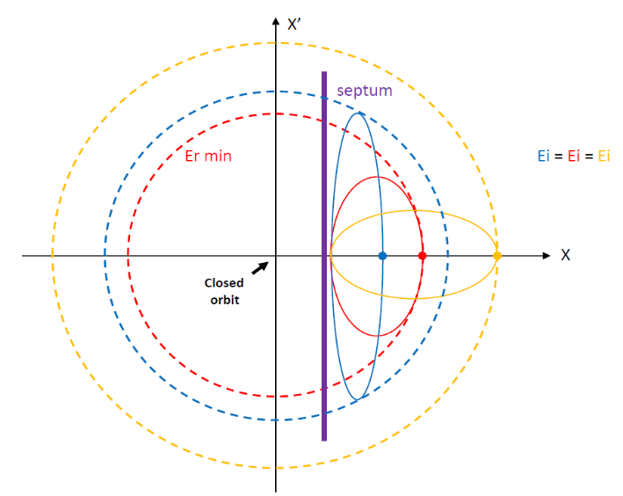
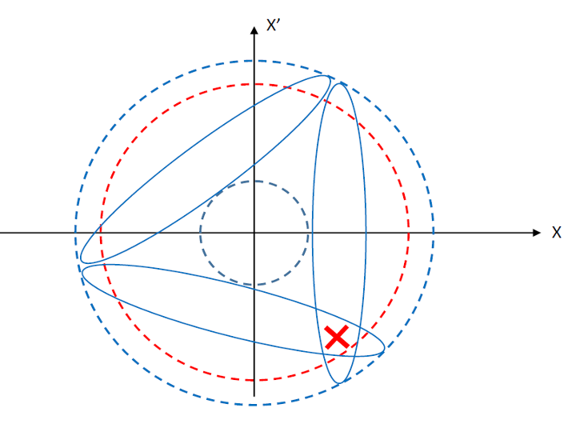
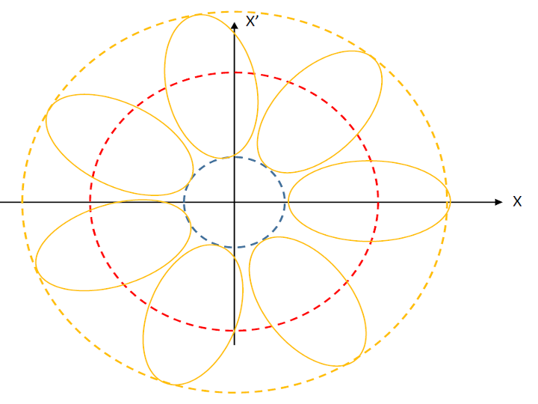
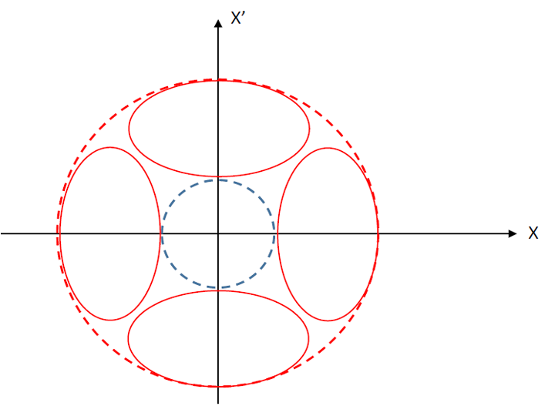
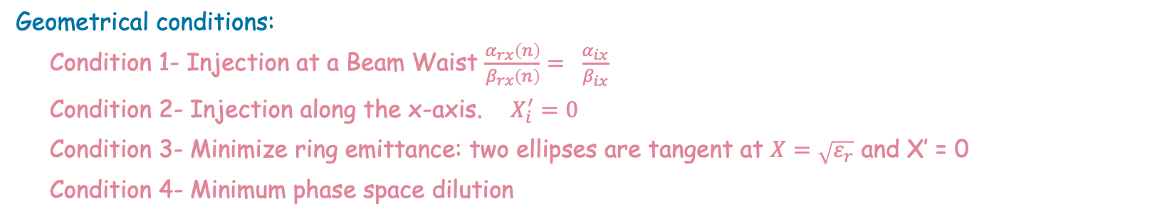
Normalized phase-space
Optimizing the injection parameters to accumulate the beam with no loss and as low as possible stored emittance.
Geometrical conditions:
Condition 1- Injection at a Beam Waist $\frac{α_{rx}\left(n\right)}{β_{rx}\left(n\right)}= \frac{α_{ix}}{β_{ix}}$
Condition 2- Injection along the x-axis. $X_{i}^{′}=0$
Condition 3- Minimize ring emittance: two ellipses are tangent at $X=\sqrt{ε_{r}}$ and X′ = 0
Condition 4- Minimum phase space dilution
Notes:
Condition 3-Minimize ring emittance: Fig. 3 compares some possible configurations in
the normalized phase space satisfying the first two conditions. The minimum ring emittance
is obtained when the injected beam is entirely enclosed within the ring acceptance and
the two ellipses are tangent at X = p(εr) and X′ = 0 (red dot in Fig. 3).
Condition 4- Minimum phase space dilution: Among all configurations satisfying Condition 3, the optimum choice corresponds to the smallest injected-beam β function compatible with tangency between the injected and ring ellipses. This situation is represented by
the red ellipse in Fig. 3. Increasing the injected beam β function enlarges the required ring
emittance and consequently leads to a less efficient occupation of phase space, yellow ellipse
in Fig. 3

Slide 10
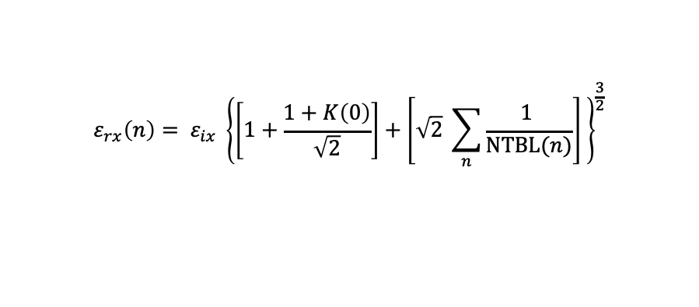
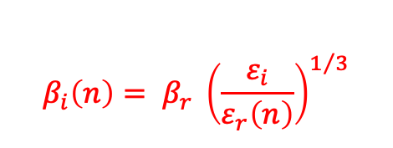
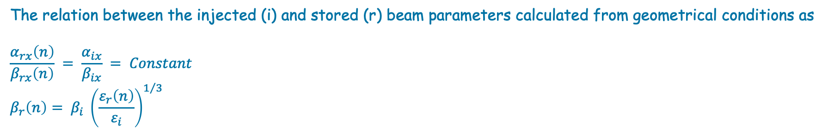
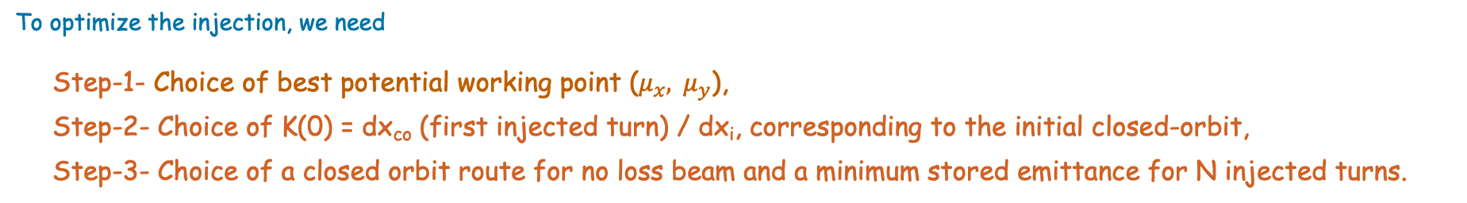

Optimization
The relation between the injected (i) and stored (r) beam parameters calculated from geometrical conditions as
$$\frac{α_{rx}\left(n\right)}{β_{rx}\left(n\right)} = \frac{α_{ix}}{β_{ix}} = Constant$$
$$β_{r}\left(n\right)= β_{i} {\left(\frac{ε_{r}\left(n\right)}{ε_{i}}\right)}^{1/3}$$
$$ε_{rx}\left(n\right)= ε_{ix} {\left\{\left[1+\frac{1+K\left(0\right)}{\sqrt{2}}\right]+\left[\sqrt{2} \sum_{n}{\frac{1 }{NTBL(n)}}\right] \right\}}^{\frac{3}{2}}$$
$$K\left(n\right)= \frac{{dx}_{co}\left(n\right)}{{dx}_{i}}$$
Initial closed orbit shift (K(0)) has been chosen small enough to minimize the first term [] and large enough to start in a region of high Number of Turns Before Loss (NTBL) to minimize second term in [].
$$β_{i}\left(n\right)= β_{r} {\left(\frac{ε_{i}}{ε_{r}\left(n\right)}\right)}^{1/3}$$
To optimize the injection, we need
Step-1- Choice of best potential working point ($μ_{x}, { μ}_{y}$),
Step-2- Choice of K(0) = dx_{co} (first injected turn) / dx_{i}, corresponding to the initial closed-orbit,
Step-3- Choice of a closed orbit route for no loss beam and a minimum stored emittance for N injected turns.
Notes:
for each selected working point with errors, the three most important parameters as a function of K are:
NTBL = Number of Turn Before Loss without closed-orbit shift,
DS = Distance to Septum when the beam is lost at NTBL + 1
-DS/NTBL = minimum closed-orbit shift per turn to avoid a loss at turn NTBL +1
The optimal injected beam parameters can be calculated from geometrical conditions as
Initial closed orbit shift (K(0)) has been chosen small enough to minimize the first term [] and large enough to start in a region of high Number of Turns Before Loss (NTBL) to minimize second term in [].

Slide 11
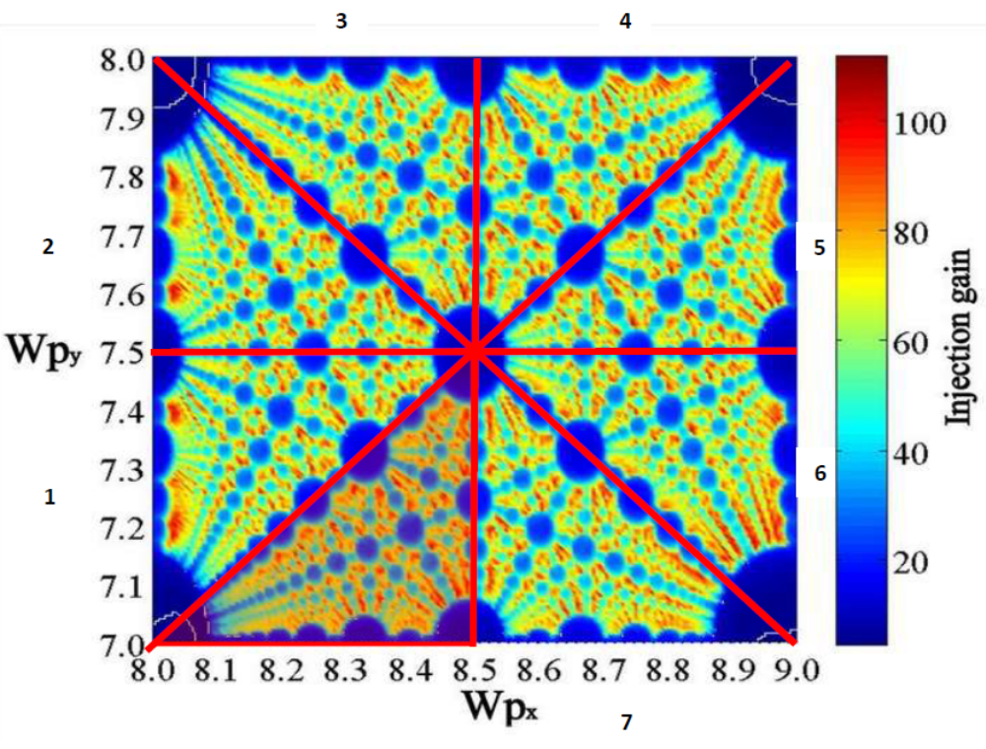
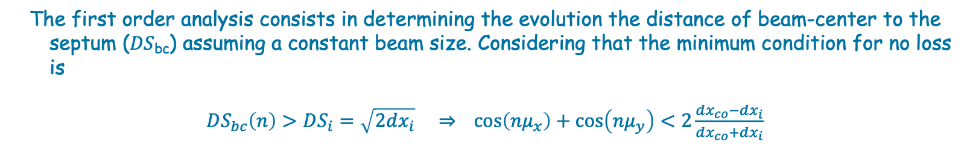
Step-1- Choice of best potential working point ($μ_{x}, μ_{y}$)
The first order analysis consists in determining the evolution the distance of beam-center to the septum (𝐷𝑆_{bc}) assuming a constant beam size. Considering that the minimum condition for no loss is
$DS_{bc}\left(n\right)>DS_{i}=\sqrt{2dx_{i}} ⇒$ $\cos\left(nμ_{x}\right)+\cos\left(nμ_{y}\right)<2\frac{dx_{co}−dx_{i}}{dx_{co}+dx_{i}}$

Slide 12
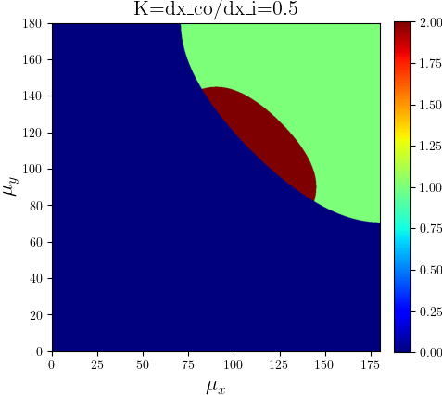
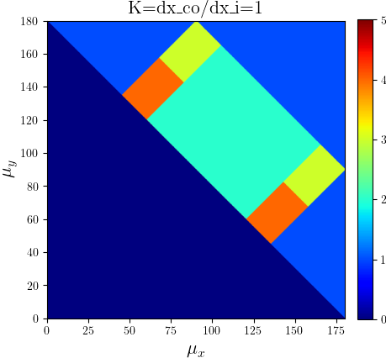
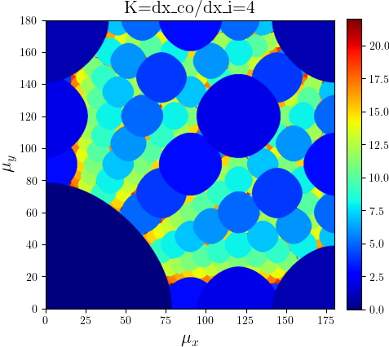
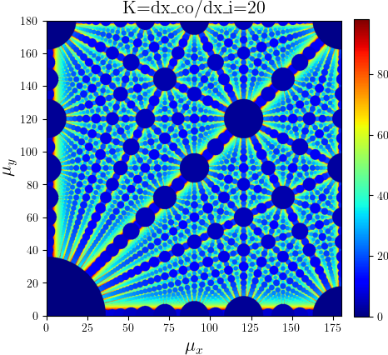
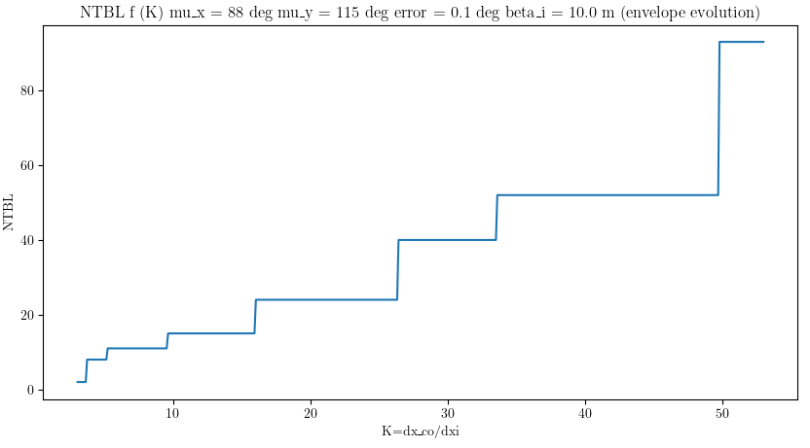
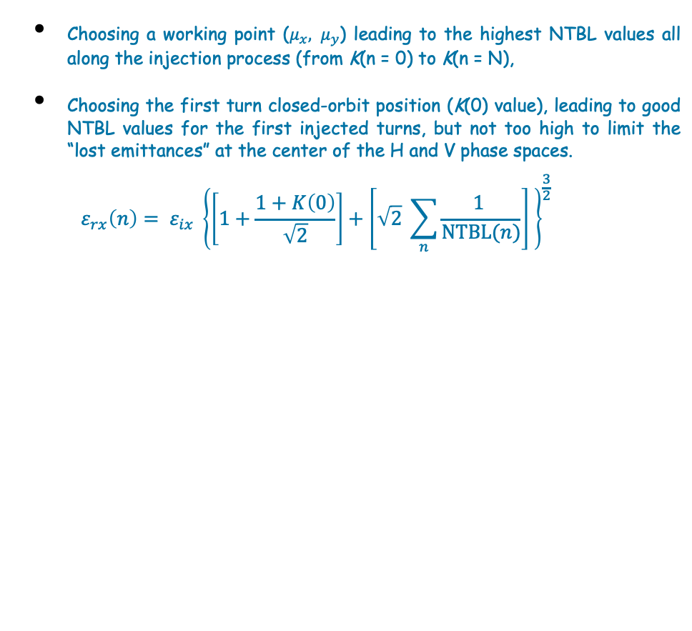
Step-2- Choice of K(0) corresponding to the initial closed-orbit
Choosing a working point ($μ_{x}, μ_{y}$) leading to the highest NTBL values all along the injection process (from K(n = 0) to K(n = N),
Choosing the first turn closed-orbit position (K(0) value), leading to good NTBL values for the first injected turns, but not too high to limit the “lost emittances” at the center of the H and V phase spaces.
$$ε_{rx}\left(n\right)= ε_{ix} {\left\{\left[1+\frac{1+K\left(0\right)}{\sqrt{2}}\right]+\left[\sqrt{2} \sum_{n}{\frac{1 }{NTBL(n)}}\right] \right\}}^{\frac{3}{2}}$$
Color: number of turns before loss

Slide 13
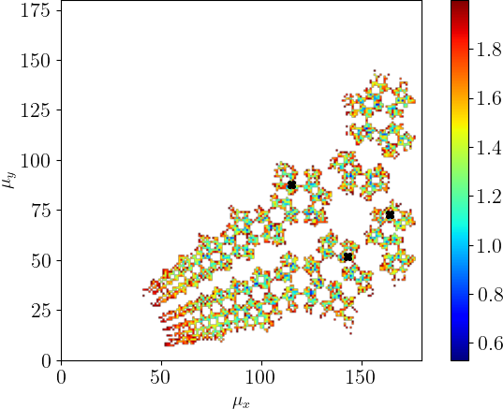
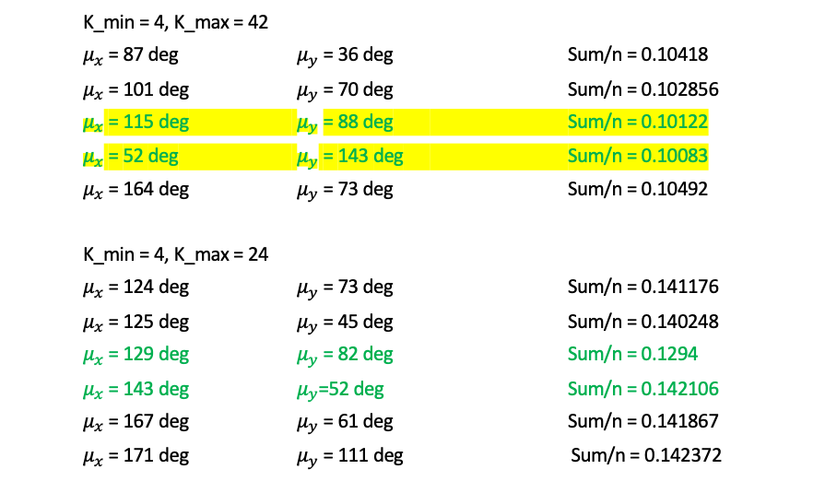
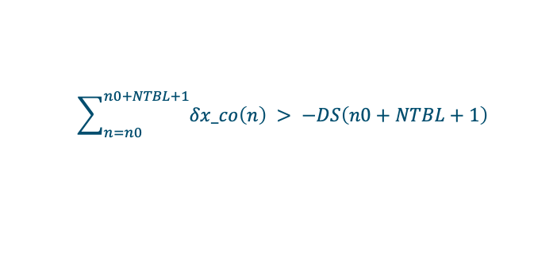
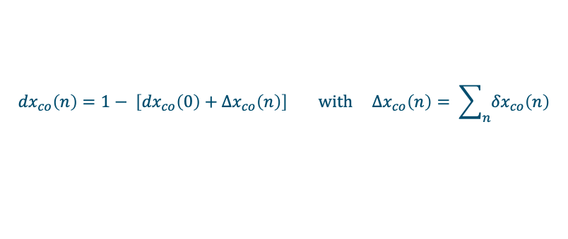
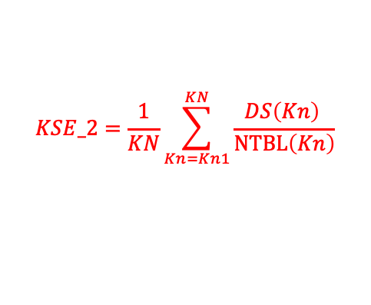
Step-2- Choice of K(0) corresponding to the initial closed-orbit
The NTBL is the key parameter to minimize the needs of large closed-orbit shift.
The distance to the septum DS when the beam is lost at turn NTBL + 1 can be also taken into account to adjust the closed-orbit shift per turn $δx_co\left(n\right)$ in order to avoid the loss at turn NTBL + 1
$${dx}_{co}\left(n\right)=1− \left[{dx}_{co}\left(0\right)+{∆x}_{co}\left(n\right)\right] with {∆x}_{co}\left(n\right)= \sum_{n}{{δx}_{co}\left(n\right)}$$
$$\sum_{n=n0}^{n0+NTBL+1}{δx_co\left(n\right)} > −DS\left(n0+NTBL+1\right)$$
K_min = 4, K_max = 42
$μ_{x}$ = 87 deg $μ_{y}$ = 36 deg Sum/n = 0.10418
$μ_{x}$ = 101 deg $μ_{y}$ = 70 deg Sum/n = 0.102856
$μ_{x}$ = 115 deg $μ_{y}$= 88 deg Sum/n = 0.10122
$μ_{x}$ = 52 deg $μ_{y}$ = 143 deg Sum/n = 0.10083
$μ_{x}$ = 164 deg $μ_{y}$= 73 deg Sum/n = 0.10492
K_min = 4, K_max = 24
$μ_{x}$ = 124 deg $μ_{y}$= 73 deg Sum/n = 0.141176
$μ_{x}$ = 125 deg $μ_{y}$= 45 deg Sum/n = 0.140248
$μ_{x}$ = 129 deg $μ_{y}$= 82 deg Sum/n = 0.1294
$μ_{x}$ = 143 deg $μ_{y}$=52 deg Sum/n = 0.142106
$μ_{x}$ = 167 deg $μ_{y}$= 61 deg Sum/n = 0.141867
$μ_{x}$ = 171 deg $μ_{y}$= 111 deg Sum/n = 0.142372
$$KSE_2=\frac{1}{KN}\sum_{Kn=Kn1}^{KN}{\frac{DS\left(Kn\right) }{NTBL\left(Kn\right)}}$$
Notes:
Last step is to compute an optimized closed-orbit route leading to minimum stored emittances for each point, without loss, and taking tune spreads into account.
minus DS because the “Distance to the Septum” is positive when the beam is below the septum and negative when the beam is lost.
This means that DS/NTBL, the minimum mean closed-orbit shift per turn necessary to ovoid a loss at turn
n0 + NTBL + 1, is another parameter to use to optimize the injection process.
for each working point (mu_x and mu_y from 0 to 180° step 1°), the z-axis is the value of “stored emittance coefficient”
DS/NTBL, the minimum mean closed-orbit shift per turn is necessary to avoid a loss at turn n0 + NTBL + 1, is another parameter to use to optimize the injection process.
1. Maintain the closed-orbit trajectory unchanged up to turn N0 to preserve the optimized
injection path and avoid beam losses of particles injected in previous turns.
2. Minimize the closed-orbit shift(s) during the interval from turn N0 + 1 to turn Nmin,
reducing the beam-septum distance DScb while maintaining sufficient clearance for the
circulating beam.

Slide 14
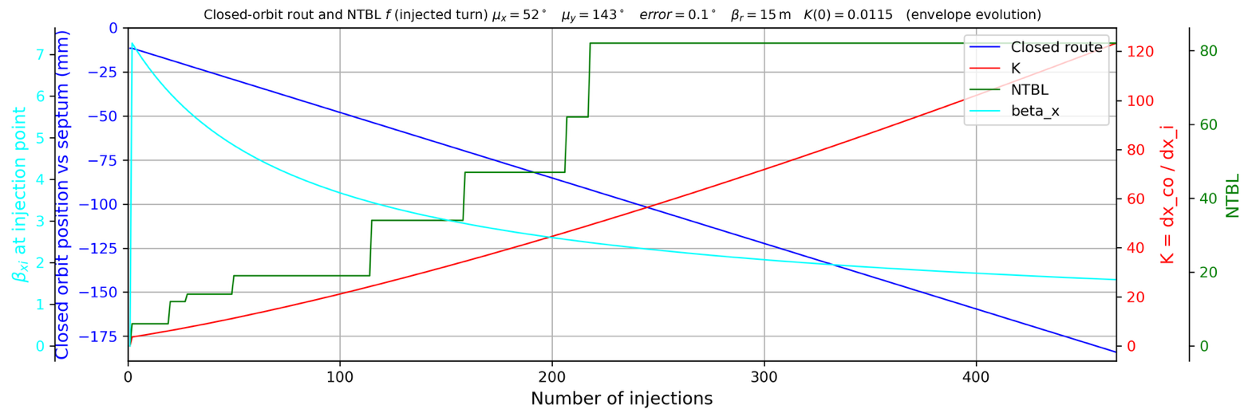
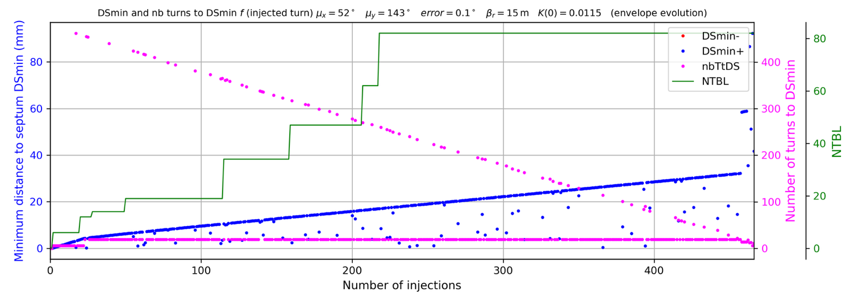

Step-3- Choice of a closed orbit route for no loss beam and a minimum stored emittance for n injected turns.
Closed-orbit rout and Ds_{min} along the injection of 100% emittance for working point $\left(8.244, 8.32\right)$
The “number of Turns to DS_{min}” (nbTtDS in pink line) follows the NTBL as K increases as expected,
As expected, the minimum Distance to the Septum (DS_{min}) is minimum for the first injected turns and increases as the closed-orbit is shifted (blue points for positive values, no loss then no red point)
The closed-orbit shift from septum increased linearly and it occurred large shift!!! And large final emittance.
The linear increases of DS_{min} with a slop shift at the NTBL shift should be studied to help the closed-orbit route optimization.
$$\frac{ε_{r}}{ε_{i}}=461.8 !$$
Notes:
The fast increase of DS_{min} suggests a large optimization margin reducing the closed-orbit shift per turn as the injected turn number increases.
Assuming that turn N0 is the turn at which the closed-orbit route is optimized for
the previous injected turns, and turn Nmin is the turn at which the injected turn Ni = N0 has a minimum distance to septum, then:
1. Maintain the closed-orbit trajectory unchanged up to turn N0 to preserve the optimized injection path and avoid beam losses of particles injected in previous turns.
2. Minimize the closed-orbit shift(s) during the interval from turn N0 + 1 to turn Nmin,
reducing the beam-septum distance DScb while maintaining sufficient clearance for the circulating beam.

Slide 15
Step-3- Choice of a closed orbit route for no loss beam and a minimum stored emittance for n injected turns.
Closed-orbit rout and Ds_{min} along the injection of 100% emittance for working point $\left(8.244, 8.32\right)$
Assuming that turn N0 is the turn at which the closed-orbit route is optimized for the previous injected turns, and turn Nmin is the turn at which the injected turn Ni = N0 has a minimum distance to septum, then:
Maintain the closed-orbit trajectory unchanged up to turn N0 to preserve the optimized injection path and avoid beam losses of particles injected in previous turns.
Minimize the closed-orbit shift(s) during the interval from turn N0 + 1 to turn Nmin,
reducing the beam-septum distance DScb while maintaining sufficient clearance for the circulating beam
Notes:
Assuming that turn N0 is the turn at which the closed-orbit route is optimized for the previous injected turns, and turn Nmin is the turn at which the injected turn Ni = N0 has a minimum distance to septum, then:

Slide 16
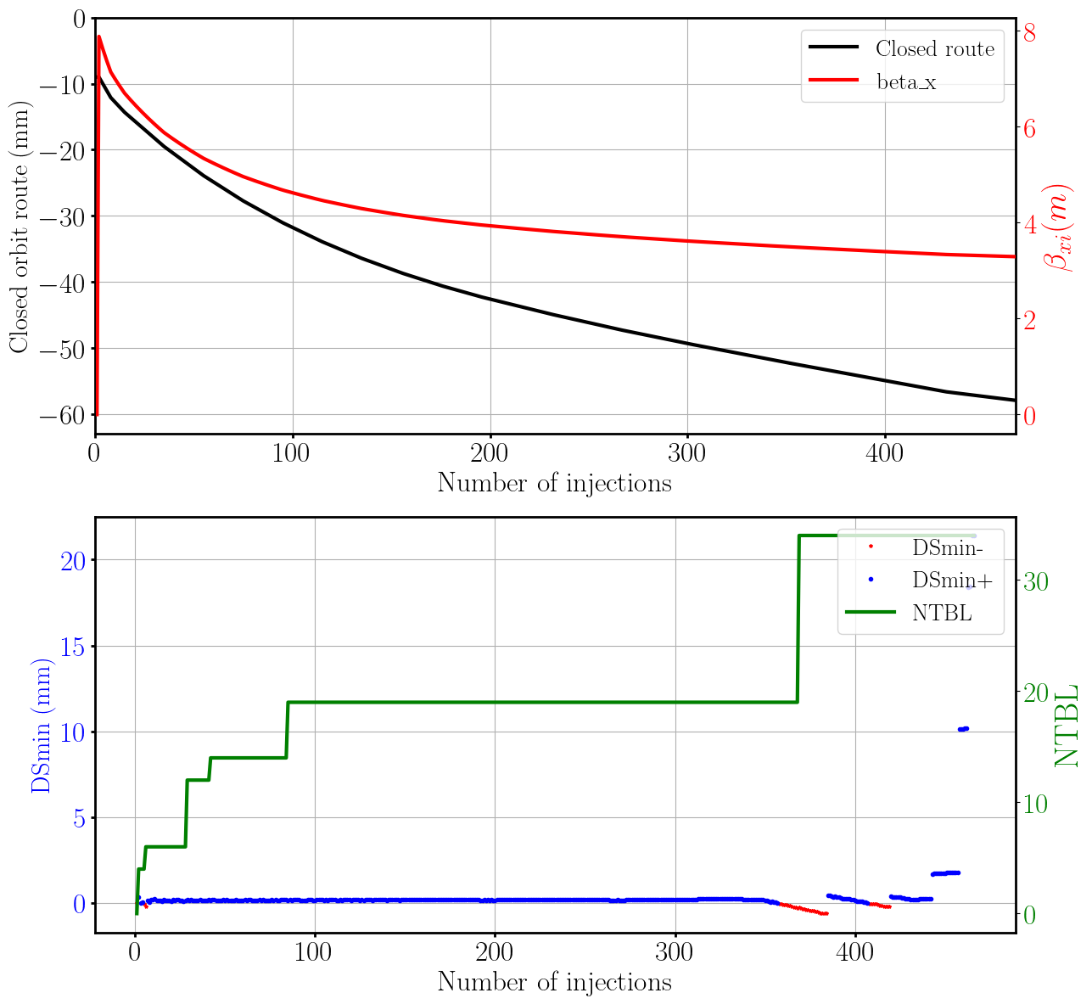
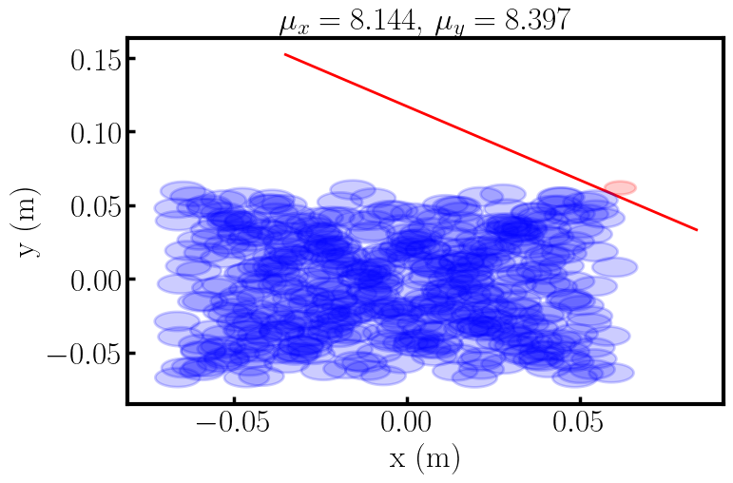
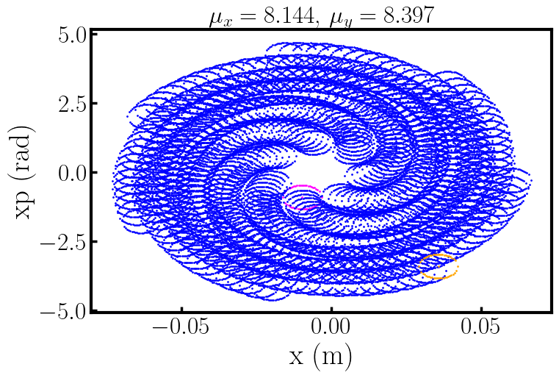
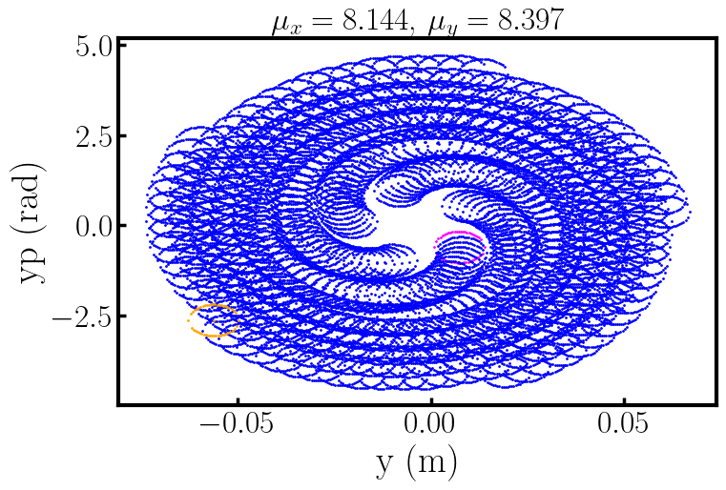
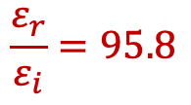
Linear calculation of LIO
Closed-orbit rout and Ds_{min} along the 465 injection of 100% emittance for working point $\left(8.144, 8.397\right)$
$$\frac{ε_{r}}{ε_{i}}=95.8$$
Particles at real & phase-space after 465 injections
Notes:
After identifying the optimal working points and initial parameter K(0), the close-orbit
route during injection process must be optimized to minimize the stored emittance while
avoiding particle losses, including the effect of tune spread in the calculations. This is
achieved through a step-by-step correction of the closed-orbit shift for groups of injected
turns [10]. Assuming that turn N0 is the turn at which the closed-orbit route is optimized for
the previous injected turns, and turn Nmin is the turn at which the injected turn Ni = N0 has a minimum distance to septum, then:
1. Maintain the closed-orbit trajectory unchanged up to turn N0 to preserve the optimized injection path and avoid beam losses of particles injected in previous turns.
2. Minimize the closed-orbit shift(s) during the interval from turn N0 + 1 to turn Nmin,
reducing the beam-septum distance DScb while maintaining sufficient clearance for the circulating beam.

Slide 17
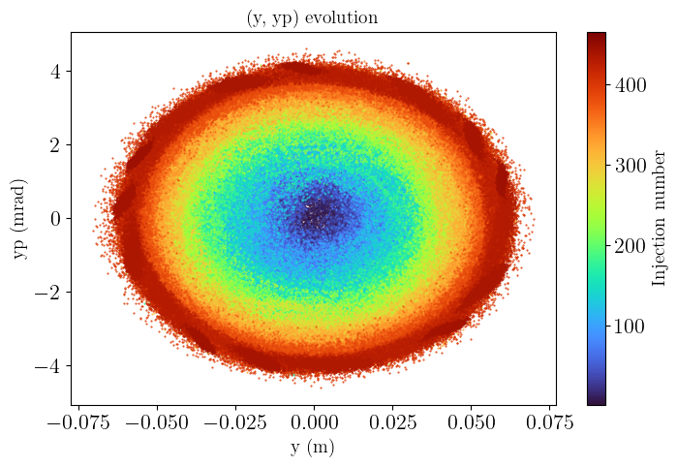
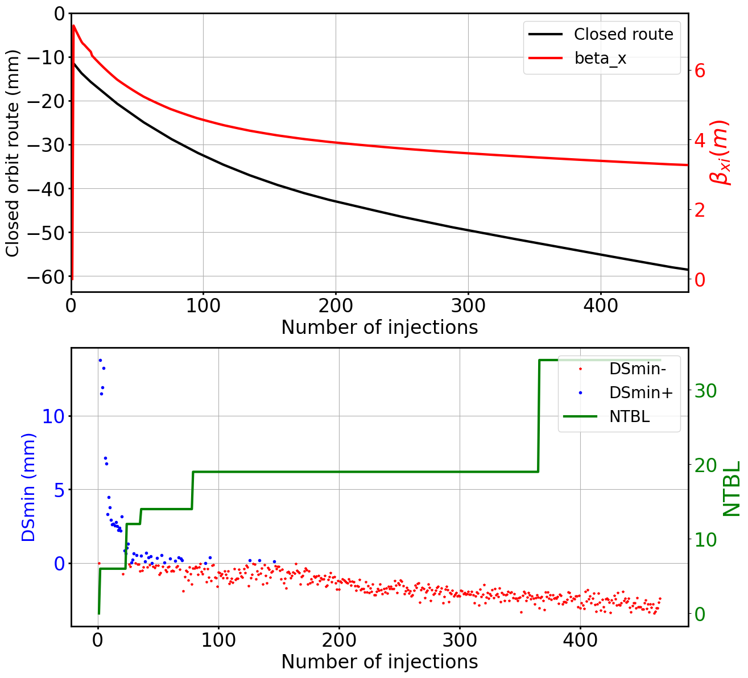
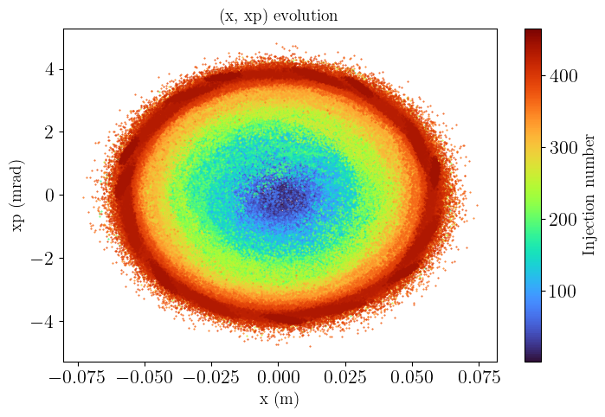
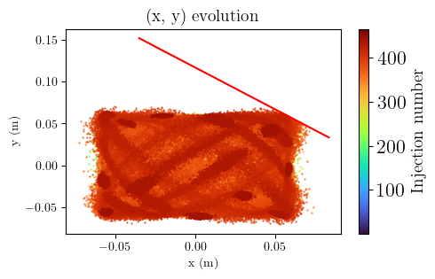

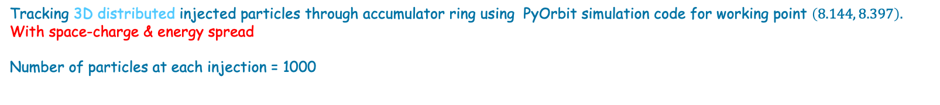
PyOrbit simulation of LIO
Tracking 3D distributed injected particles through accumulator ring using PyOrbit simulation code for working point $\left(8.144, 8.397\right).$ With space-charge & energy spread
Number of particles at each injection = 1000
Particles at real & phase-space after 465 injections
$\frac{ε_{r}}{ε_{i}}=95.8$ beam loss: 1.7%
Notes:
After identifying the optimal working points and initial parameter K(0), the close-orbit
route during injection process must be optimized to minimize the stored emittance while
avoiding particle losses, including the effect of tune spread in the calculations. This is
achieved through a step-by-step correction of the closed-orbit shift for groups of injected
turns [10]. Assuming that turn N0 is the turn at which the closed-orbit route is optimized for
the previous injected turns, and turn Nmin is the turn at which the injected turn Ni = N0 has a minimum distance to septum, then:
space charge effects for a Gaussian distribution are computed335
using a Particle-In-Cell (PIC) method with 3D solver
1. Maintain the closed-orbit trajectory unchanged up to turn N0 to preserve the optimized injection path and avoid beam losses of particles injected in previous turns.
2. Minimize the closed-orbit shift(s) during the interval from turn N0 + 1 to turn Nmin,
reducing the beam-septum distance DScb while maintaining sufficient clearance for the circulating beam.

Slide 18
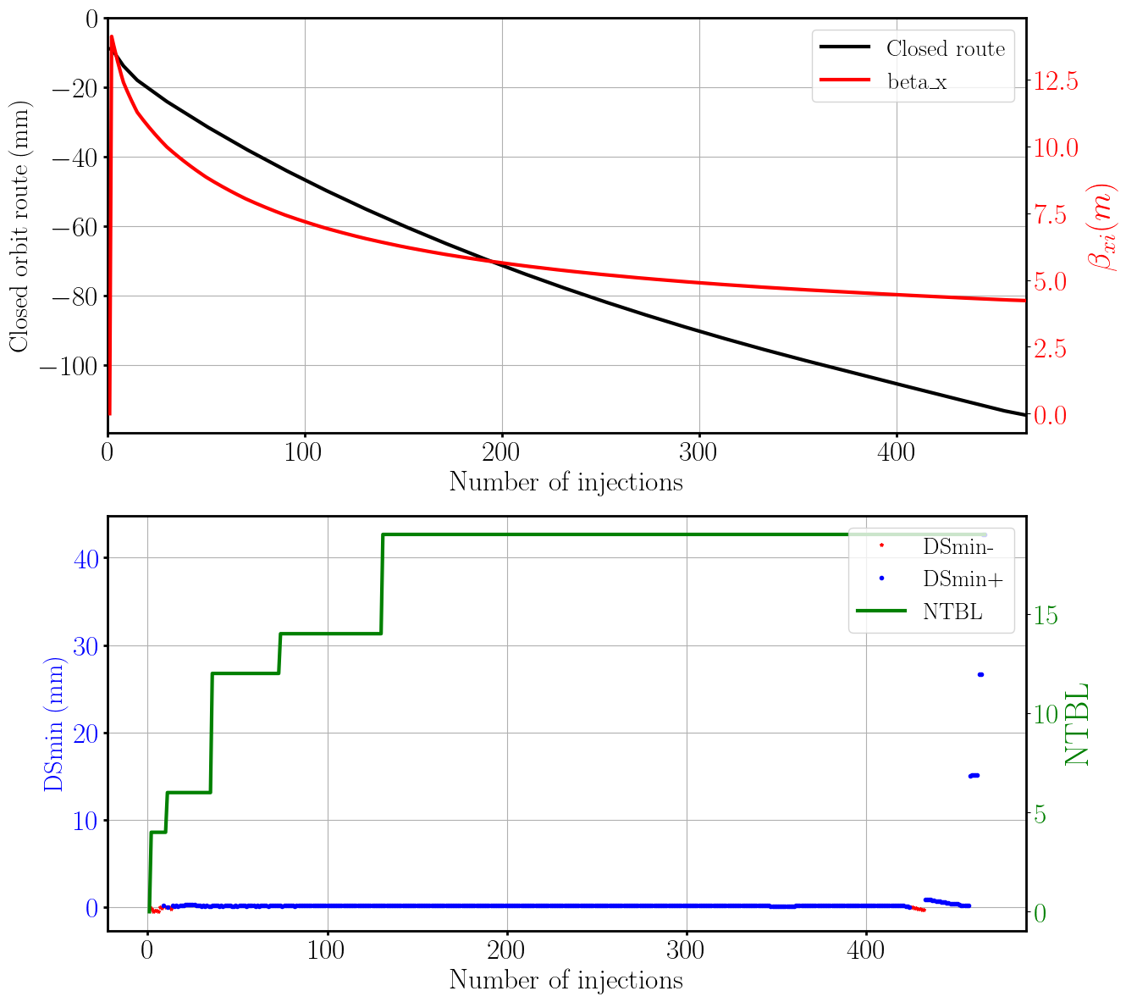
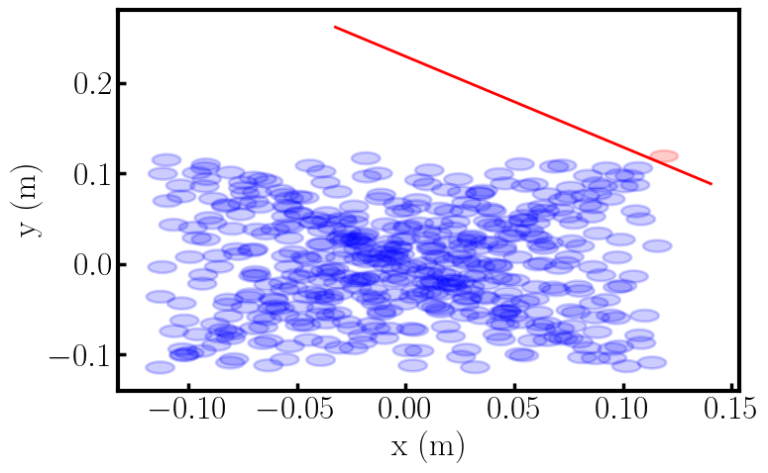
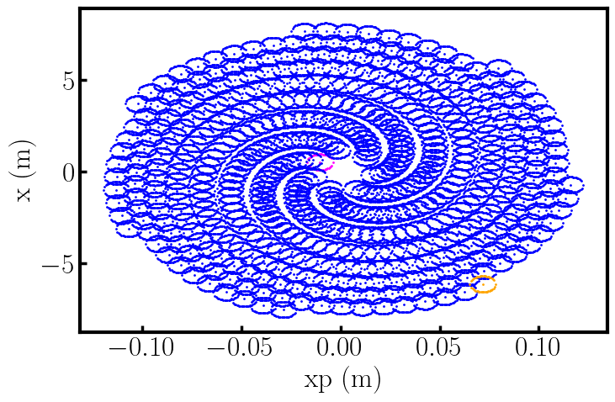


Linear calculation of LIO
Closed-orbit rout and Ds_{min} along the 465 injection of 100% emittance for working point $\left(8.144, 8.397\right)$
Considering higer tune-shift errors
$$\frac{ε_{r}}{ε_{i}}=210$$
Particles at real & phase-space after 465 injections
Notes:
Single turn matrix

Slide 19






PyOrbit simulation of LIO
Tracking 3D distributed injected particles through accumulator ring using PyOrbit simulation code for working point $\left(8.144, 8.397\right).$ With space-charge & energy spread
Number of particles at each injection = 1000
$$\frac{ε_{r}}{ε_{i}}=210$$

Slide 20






Comparison between LIO and stripping method
XSuite
unnormalized ring emittance at proton LIO method at 100% emittance
$${ ε}_{r}=\text{588 }πmm mrad$$
unnormalized ring emittance at H⁻ stripping method at 100% emittance
$${ ε}_{r}=\text{70} πmm mrad$$

Slide 21



233 injection turns
$$\frac{ε_{r}}{ε_{i}}=86$$

Slide 22

Summary
The optimizations was performed by selecting the best tree parameters for $μ_{x}, μ_{y}, and K\left(0\right)$, along with optimized closed-orbit shift using DS/NTBL.
The injected beam beta function varies for each injection, while the ring beta function keeps constant to simplify machine control.
The LIO method was implemented using the PyOrbit simulation code to account nonlinear effects.
The particle losses were controlled by including higher tune-sift errors in the linear calculations.
The study was performed with a constant ring beta function of 15m. Further optimization of the ring beta function, up to 50; could be explored improve ring emittance.
low-loss particle injection for ESS$ν$SB was achieved with ring emittance of $588πmm mrad$
Next steps:
Prepare a general paper describing the proposed method and its optimization
Contact with HIAF facility in China to explore the possibility of an experimental test of the LIO method

Slide 23
Thank You!
Questions?

Slide 24




Injection Strategy: Constant ring beta function with variable beta function of injected beam
Based on the relation between beta function of the ring and that at the injection point, fulfilling the injection conditions requires the ring beta function to vary at each injection, which can introduce difficulties for the ring elements.
${ β}_{r}\left(n\right)= β_{i} {\left(\frac{ε_{r}\left(n\right)}{ε_{i}}\right)}^{1/3} ⇒ β_{r}\left(n\right)= β_{i} \sqrt{1+ \frac{x_{i}−x_{co}(n)}{\sqrt{β_{i}ε_{i}}}}$
To address this issue, we consider that the beta function of the injected beam varies at each injection, while the beta function of the ring remains constant. This approach simplifies control in a real machine. Under this assumption, the beta function of the injected beam can be expressed as
$$β_{i}\left(n\right)= β_{r} {\left(\frac{ε_{i}}{ε_{r}(n)}\right)}^{1/3} ⇒ β_{r}^{4}ε_{i}=β_{i}^{3}(n)\left[ε_{i}β_{i}\left(n\right)\left(\frac{3}{2}+\sqrt{2}\right)+\sqrt{ε_{i}β_{i}\left(n\right)}\left(2+\sqrt{2}\right)\left(x_{r_{i}}(n)−x_{r_{co}}\left(n\right)\right)+{\left(x_{r_{i}}(n)−x_{r_{co}}\left(n\right)\right)}^{2}\right]$$
This condition prepare the injected beam size, K(n) and dx_{co}(n) depend on $β_{i}\left(n\right).$
September 24, 2025

