Slide 1


Evaluation of Laser-Assisted Charge-Exchange Injection into 5 MW ESSνSB+ Proton Accumulator
Anatoliy Opanasenko
Uppsala University

Slide 2
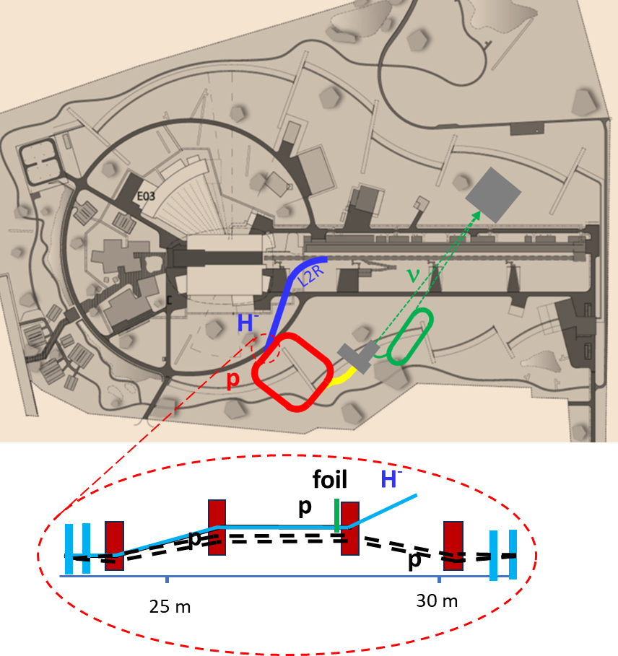
5 MW ESSnuSB+
Motivation
The carbon-foil stripping injection
Radioactivation
Heating
Beam Control losses

Slide 3
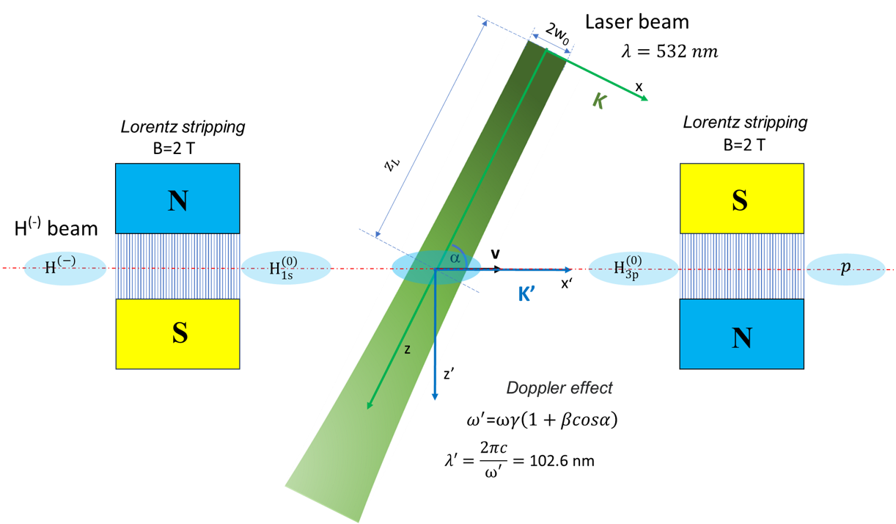
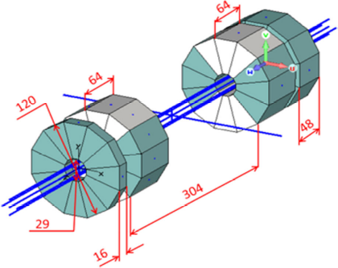
Three-step Laser-Assisted Charge-Exchange Injection
1998, I. Yamane, KEK, Japan; 2003, V. Danilov, et al. SNS, USA
ESSνSB accumulator chicane
0.87 m
Colliding parameters
Relativistic factor, γ | 3.664
Excitation wavelength (nm) | 102.6
Laser wavelength (nm) | 532
Angle, α (deg) | 64.4
0.6 T
0.6 T
Magnet system Prototype
0.06 m
0.14 m
0.14 m
0.06 m
A. Aleksandrov, A. Menshov. “Magnet design for the SNS laser stripping experiment”, IPAC2014, Dresden, Germany, doi:10.18429/JACoW-IPAC2014-TUPRO117
0.87 m
focus of the study

Slide 4
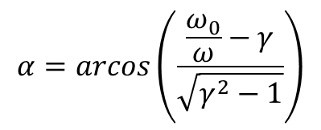
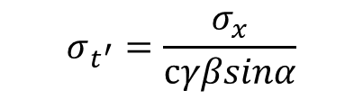



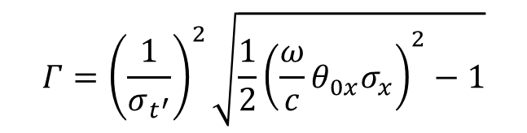

Elliptical Gaussian laser beam in the rest frame
$E_{y}^{′}\left(t^{′}\right)=Re\left\{\sqrt{\frac{2P}{πσ_{y}σ_{x}cε_{0}}}\frac{ω^{′}}{ω}e^{−\frac{{\left(t^{′}\right)}^{2}}{2{σ_{t^{′}}}^{2}}+i\left(ω′−\frac{{Γt}^{′}}{2}\right)t^{′}}\right\}$
$$ω^{′}=ωγ\left(1+βcosα\right)$$
$$ℏω_{0}=E_{1,3}=12.084 eV$$
Doppler laser frequency
excitation energy (1s$→3p$)
$$α=arcos\left(\frac{\frac{ω_{0}}{ω}−γ}{\sqrt{γ^{2}−1}}\right)$$
$$Γ={\left(\frac{1}{σ_{t^{′}}}\right)}^{2}\sqrt{{\frac{1}{2}\left(\frac{ω}{c}θ_{0x}σ_{x}\right)}^{2}−1}$$
$$σ_{t^{′}}=\frac{σ_{x}}{cγβsinα}$$
interaction time
frequency sweep rate

Slide 5

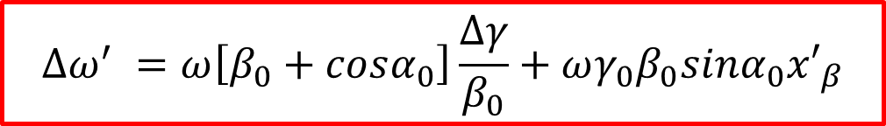







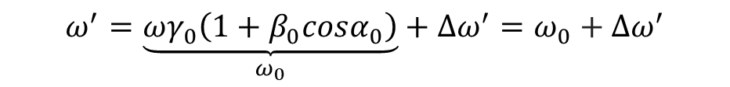

Laser stripping is powerful concept?
Doppler detuning
Dopler frequency transformation
$$ω^{′} =ωγ\left(1+βcosα\right)$$
Laser
Longitudinal phase space
$$γ=γ_{0}+Δγ$$
$$α=α_{0}−{x′}_{β}$$
$$\frac{Δγ}{γ_{0}}$$
$$α_{0}$$
$${x′}_{β}>0$$
$β=β_{0}$ $+$ $\frac{∆γ}{{γ_{0}}^{3}β_{0}}$
$$Δl$$
$${x′}_{β}<0$$
$$ω^{′}=\underset{ω_{0}}{\underbrace{ωγ_{0}\left(1+β_{0}cosα_{0}\right)}}+∆ω^{′}=ω_{0}+∆ω^{′}$$
$$∆ω^{′} =ω\left[β_{0}+cosα_{0}\right]\frac{∆γ}{β_{0}}+ωγ_{0}β_{0}sinα_{0}{x′}_{β}$$
Doppler frequency detuning is the obstacle to excitation of atoms

Slide 6
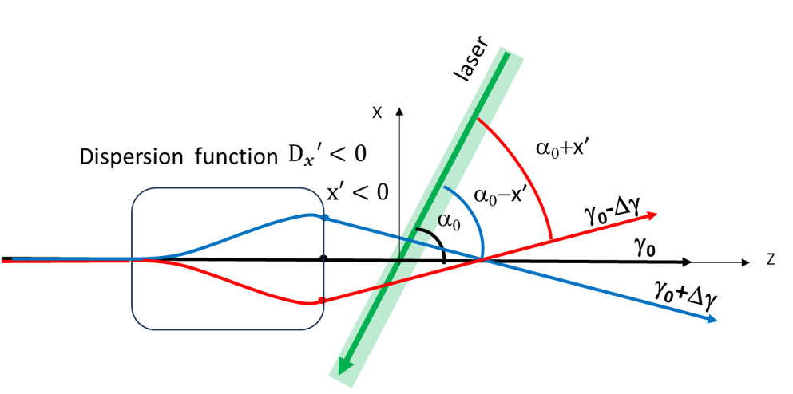
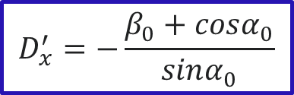

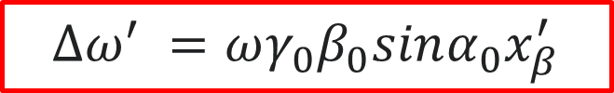
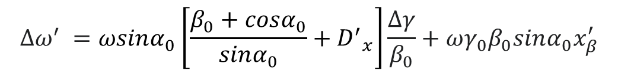
“Cancellation” of energy spread
V. Danilov, at al. Phys.Rev. STAB, Vol. 6, (2003)
L2R transfer line
$x^{′}={D′}_{x}$ $\frac{∆γ}{{β_{0}}^{2}γ_{0}}+{x′}_{β}$
$$∆ω^{′} =ωsinα_{0}\left[\frac{β_{0}+cosα_{0}}{sinα_{0}}+{D^{′}}_{x}\right]\frac{∆γ}{β_{0}}+ωγ_{0}β_{0}sinα_{0}x_{β}^{′}$$
Doppler frequency detuning
$$D_{x}^{′}=−\frac{β_{0}+cosα_{0}}{sinα_{0}}$$
Doppler frequency detuning caused by betatron oscillations
$$∆ω^{′} =ωγ_{0}β_{0}sinα_{0}x_{β}^{′}$$

Slide 7
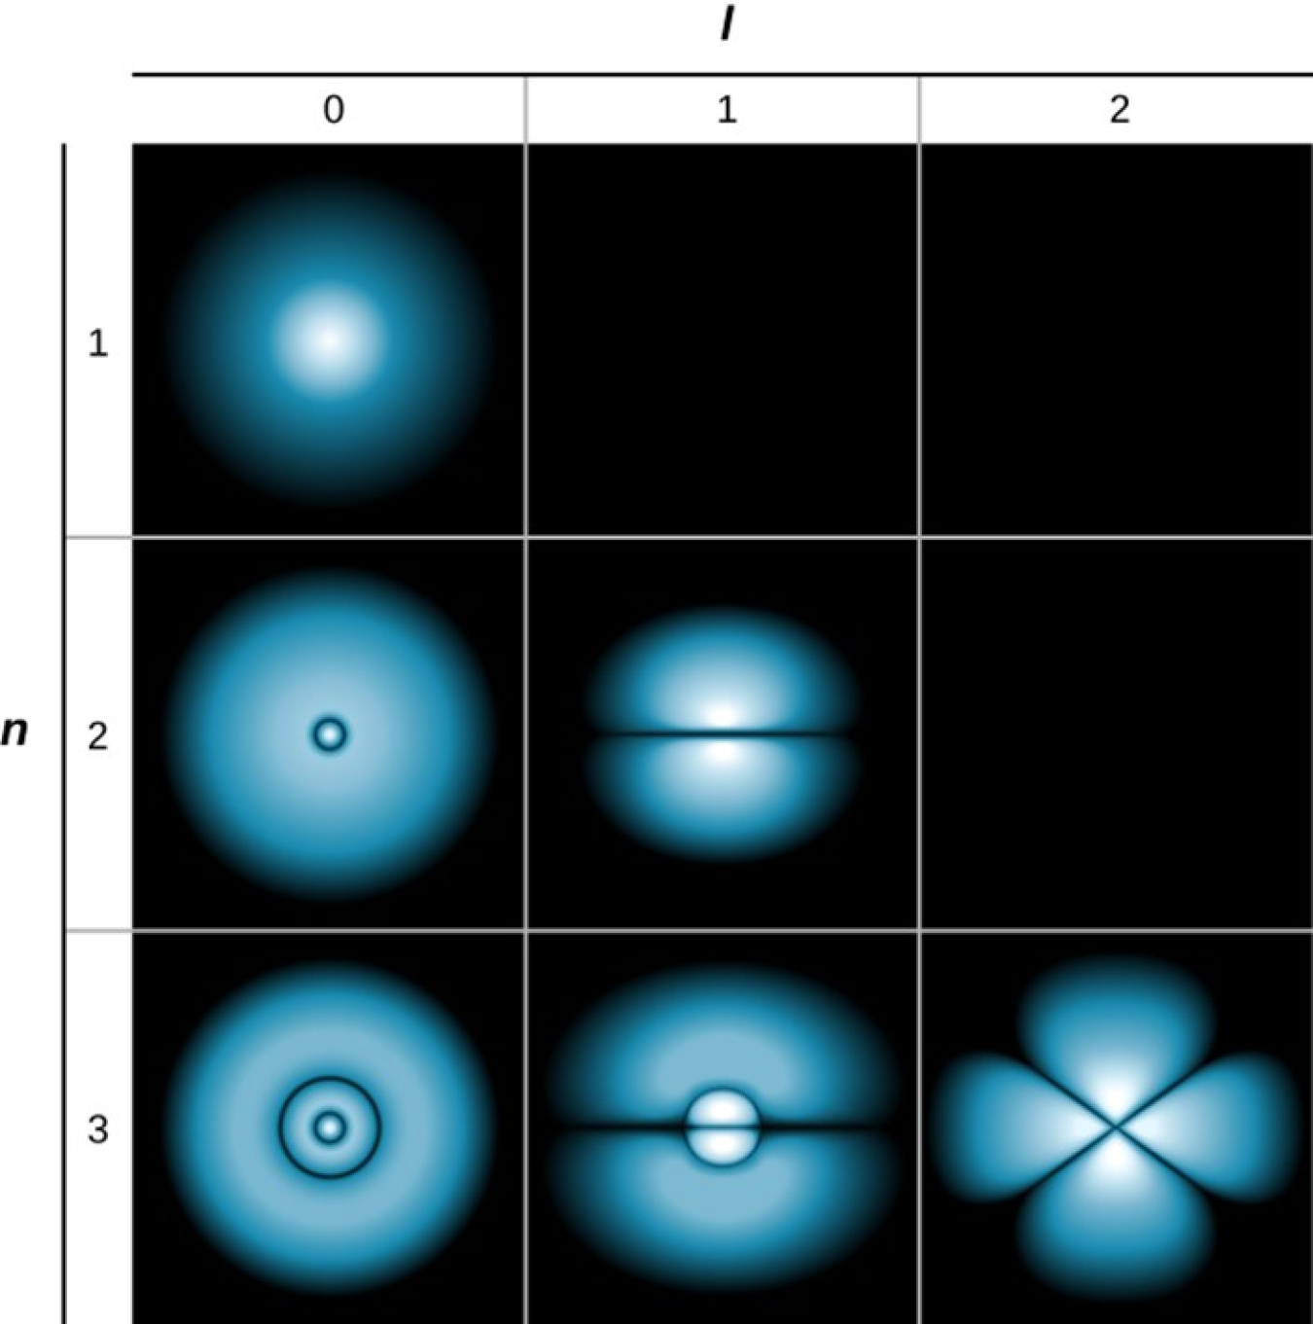


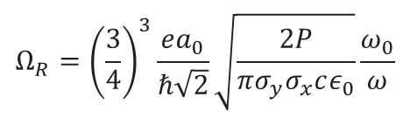

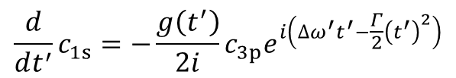


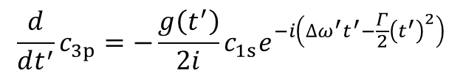

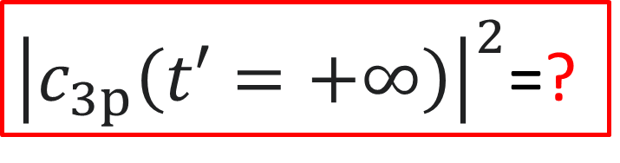
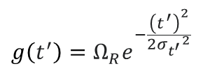
Two-level model of an atom ensemble in the rest frame
$$Ψ=c_{1s}\left(t′\right)ψ_{1}e^{−i\frac{E_{1}}{ℏ}t′}+c_{3p}\left(t′\right)ψ_{3}e^{−i\frac{E_{3}}{ℏ}t′}$$
$$∆ω^{′}≠0$$
is a problem
$$\frac{d}{dt^{′}}c_{1s}=−\frac{g\left(t^{′}\right)}{2i}{c_{3p}e}^{i\left(∆ω^{′}t^{′}−\frac{Γ}{2}{\left(t^{′}\right)}^{2}\right)}$$
3p
$$E_{3}$$
${ℏω}_{0}$=$12.084 eV$
N atoms
$$\frac{d}{dt^{′}}c_{3p}=−\frac{g\left(t^{′}\right)}{2i}{c_{1s}e}^{−i\left(∆ω^{′}t^{′}−\frac{Γ}{2}{\left(t^{′}\right)}^{2}\right)}$$
1S
$$E_{1}$$
$c_{1s}\left(t=−∞\right)=1, { c}_{3p}\left(t=−∞\right)=0$
${\left|c_{3p}\left(t′=+∞\right)\right|}^{2}$=?
$$Ω_{R}={\left(\frac{3}{4}\right)}^{3}\frac{ea_{0}}{ℏ\sqrt{2}}\sqrt{\frac{2P}{πσ_{y}σ_{x}cε_{0}}}\frac{ω_{0}}{ω}$$
$$g\left(t^{′}\right)=Ω_{R}e^{−\frac{{\left(t^{′}\right)}^{2}}{2{σ_{t^{′}}}^{2}}}$$
Rabi frequency

Slide 8
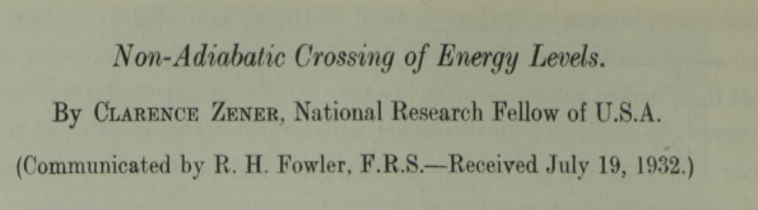
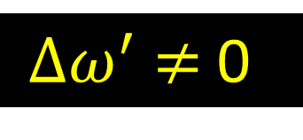

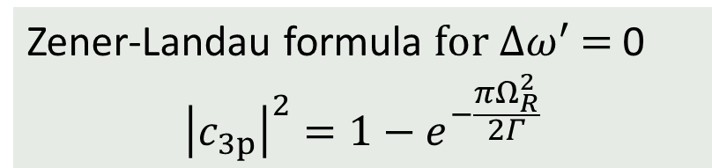
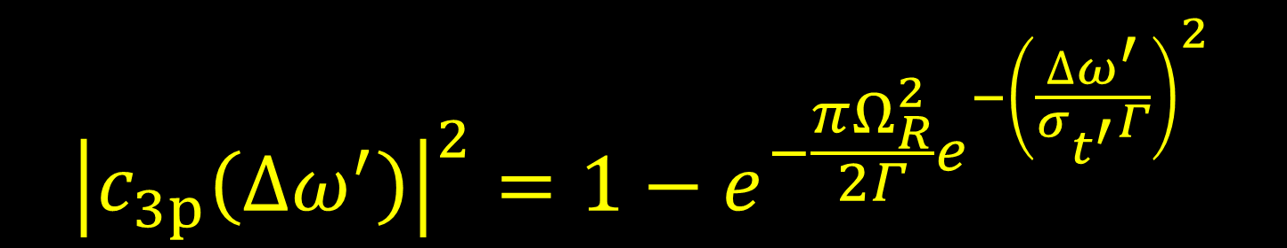
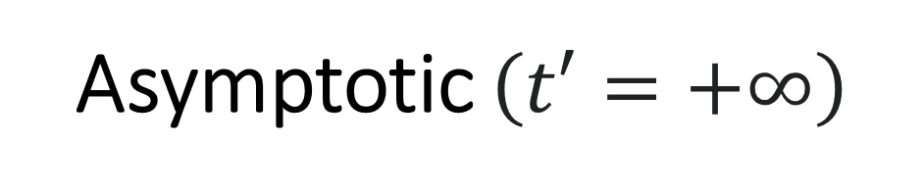
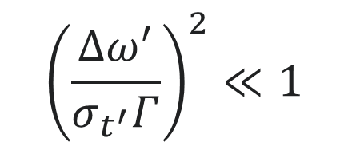
Asymptotic $\left(t′=+∞\right)$
Zener-Landau formula $for ∆ω^{′}$ $=$0
$${\left|c_{3p}\right|}^{2}=1−e^{−\frac{πΩ_{R}^{2}}{2Γ}}$$
GPT- Zener-Landau approach for
$∆ω^{′}$ $≠$0
$${\left|c_{3p}\left(∆ω^{′}\right)\right|}^{2}=1−e^{−\frac{πΩ_{R}^{2}}{2Γ}e^{−{\left(\frac{∆ω^{′}}{σ_{t^{′}}Γ}\right)}^{2}}}$$
$${\left(\frac{∆ω^{′}}{σ_{t^{′}}Γ}\right)}^{2}≪1$$
$${\left(σ_{t^{′}}\right)}^{2}Γ≫1$$

Slide 9
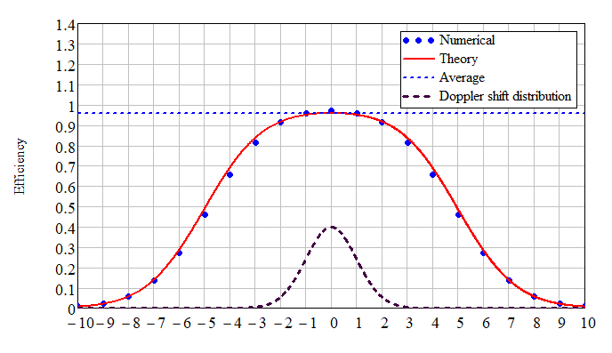


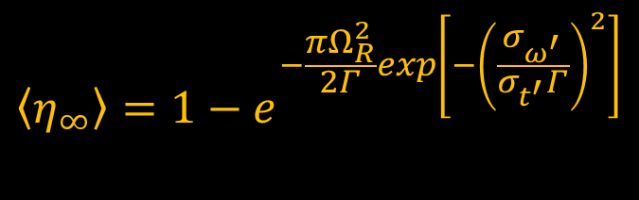
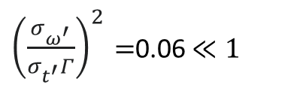
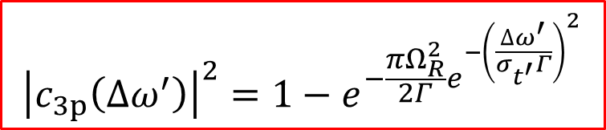
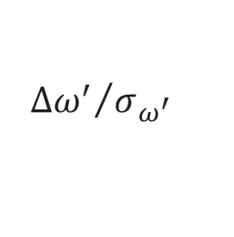
Excitation efficiency for an ensemble of atoms
$${\left|c_{3p}\left(∆ω^{′}\right)\right|}^{2}=1−e^{−\frac{πΩ_{R}^{2}}{2Γ}e^{−{\left(\frac{∆ω^{′}}{σ_{t^{′}}Γ}\right)}^{2}}}$$
${\left(\frac{σ_{ω^{′}}}{σ_{t^{′}}Γ}\right)}^{2}=$0.06$≪1$
$${\left(σ_{t^{′}}\right)}^{2}Γ=11.7≫1$$
$$\left\langle η_{∞}\right\rangle =1−e^{−\frac{πΩ_{R}^{2}}{2Γ}exp\left[−{\left(\frac{σ_{ω^{′}}}{σ_{t^{′}}Γ}\right)}^{2}\right]}$$
$${∆ω^{′}}/{σ_{ω^{′}}}$$

Slide 10
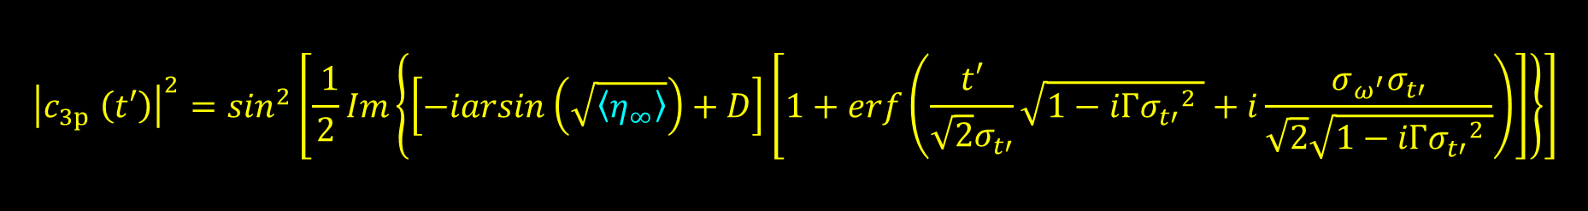
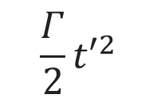


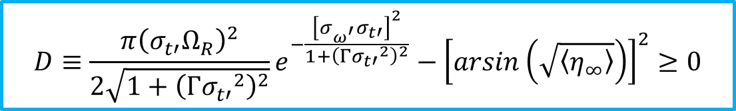

Time-dependant excitation probability
$$c_{1s}=\left|c_{1s}\right|e^{iφ_{1}}, c_{3p}=\left|c_{3p}\right|e^{iφ_{3}}$$
$${Δφ}_{31}=φ_{3}−φ_{1}$$
$$\frac{Γ}{2}{t′}^{2}$$
$${Δφ}_{31}\left(t′\right)$$
slowly variating compare with
$$∆ω^{′}=σ_{ω^{′}}$$
$${\left|c_{3p} \left(t′\right)\right|}^{2}=\sin^{2}\left[\frac{ 1}{2}Im\left\{\left[−iarsin\left(\sqrt{\left\langle η_{∞}\right\rangle }\right)+D\right]\left[1+erf\left(\frac{t′}{\sqrt{2}σ_{t′}}\sqrt{1−iΓ{σ_{t′}}^{2} }+i\frac{σ_{ω^{′}}σ_{t′}}{\sqrt{2}\sqrt{1−iΓ{σ_{t′}}^{2} }}\right)\right]\right\}\right]$$
$$D≡\frac{π{\left(σ_{t′}Ω_{R}\right)}^{2}}{2\sqrt{1+{\left(Γ{σ_{t′}}^{2}\right)}^{2}}}e^{−\frac{{\left[σ_{ω^{′}}σ_{t′}\right]}^{2}}{1+{\left(Γ{σ_{t′}}^{2}\right)}^{2}}}−{\left[arsin\left(\sqrt{\left\langle η_{∞}\right\rangle }\right)\right]}^{2}≥0$$
$D$ expands limits from ${ \left(σ_{t^{′}}\right)}^{2}Γ≫1$ ${ up to \left(σ_{t^{′}}\right)}^{2}Γ\sim 1$

Slide 11
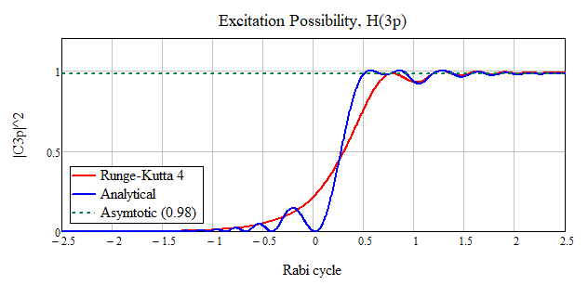
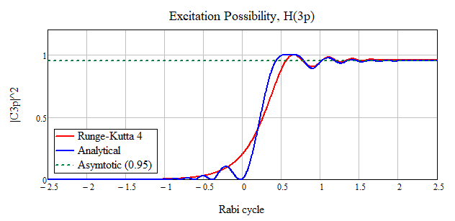
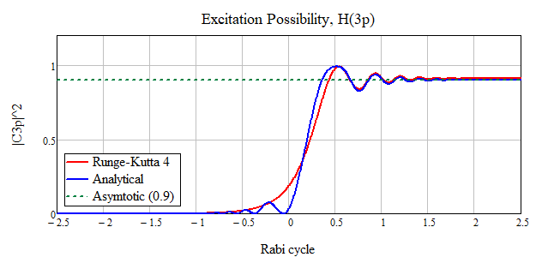
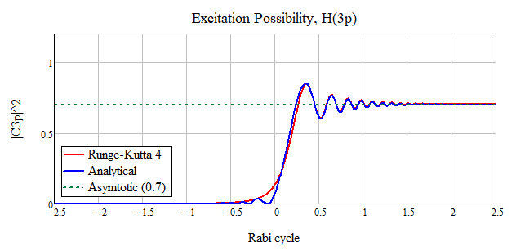
Analytical v.s. numerical excitation probability
⟨η⟩=0.98
⟨η⟩=0.95
⟨η⟩=0.9
⟨η⟩=0.7

Slide 12
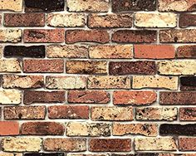
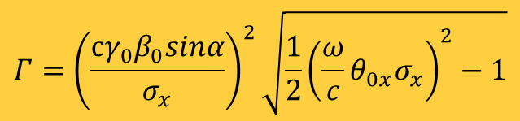
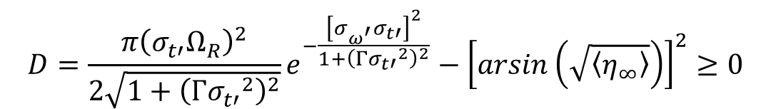
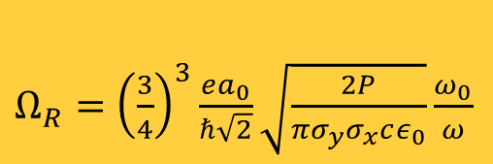
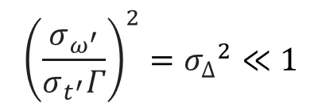
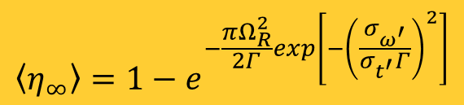
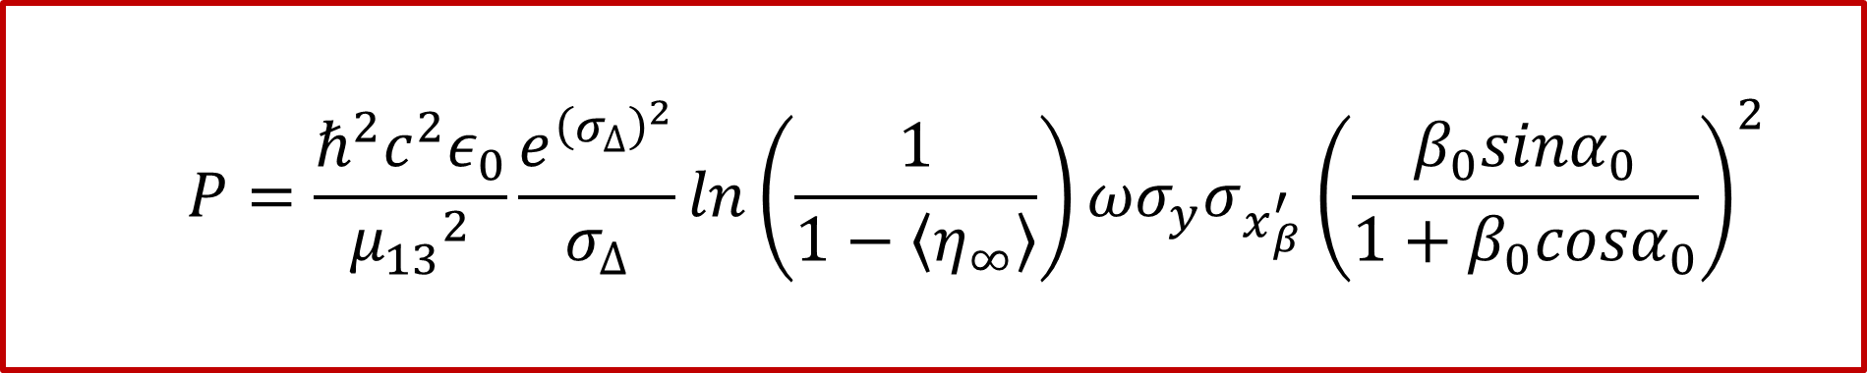
Laser Peak Power
$${\left(\frac{σ_{ω^{′}}}{σ_{t^{′}}Γ}\right)}^{2}={σ_{∆}}^{2}≪1$$
$$D=\frac{π{\left(σ_{t′}Ω_{R}\right)}^{2}}{2\sqrt{1+{\left(Γ{σ_{t′}}^{2}\right)}^{2}}}e^{−\frac{{\left[σ_{ω^{′}}σ_{t′}\right]}^{2}}{1+{\left(Γ{σ_{t′}}^{2}\right)}^{2}}}−{\left[arsin\left(\sqrt{〈η_{∞}〉}\right)\right]}^{2}≥0$$
$$P=\frac{ℏ^{2}c^{2}ε_{0}}{{μ_{13}}^{2}}\frac{e^{{\left(σ_{∆}\right)}^{2}}}{σ_{∆}}ln\left(\frac{1}{1−\left\langle η_{∞}\right\rangle }\right){ωσ}_{y}σ_{x_{β}^{′}}{\left(\frac{β_{0}sinα_{0}}{1+β_{0}cosα_{0}}\right)}^{2}$$
$$\left\langle η_{∞}\right\rangle =1−e^{−\frac{πΩ_{R}^{2}}{2Γ}exp\left[−{\left(\frac{σ_{ω^{′}}}{σ_{t^{′}}Γ}\right)}^{2}\right]}$$
$Ω_{R}={\left(\frac{3}{4}\right)}^{3}\frac{ea_{0}}{ℏ\sqrt{2}}\sqrt{\frac{2P}{πσ_{y}σ_{x}cε_{0}}}\frac{ω_{0}}{ω}$
$$Γ={\left(\frac{cγ_{0}β_{0}sinα}{σ_{x}}\right)}^{2}\sqrt{{\frac{1}{2}\left(\frac{ω}{c}θ_{0x}σ_{x}\right)}^{2}−1}$$

Slide 13
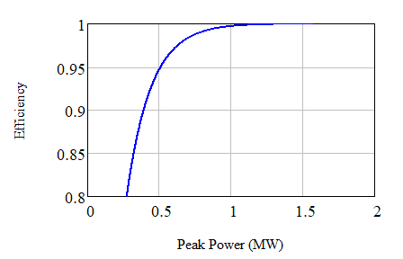


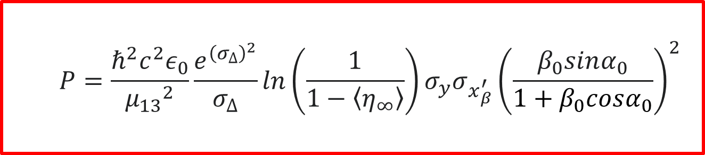


Peak Power
$$P=\frac{ℏ^{2}c^{2}ε_{0}}{{μ_{13}}^{2}}\frac{e^{{\left(σ_{∆}\right)}^{2}}}{σ_{∆}}ln\left(\frac{1}{1−\left\langle η_{∞}\right\rangle }\right)σ_{y}σ_{x_{β}^{′}}{\left(\frac{β_{0}sinα_{0}}{1+β_{0}cosα_{0}}\right)}^{2}$$
$$σ_{x_{β}^{′}}=0.03 mrad$$
$$σ_{by}=0.4 mm$$
$$\left\langle η_{∞}\right\rangle$$
$$σ_{bx}=1.5 mm$$

Slide 14
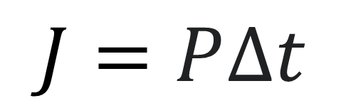
Laser pulse Energy
$$J=P∆t$$

Slide 15

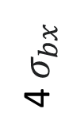
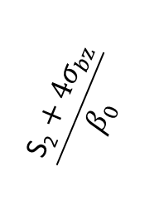
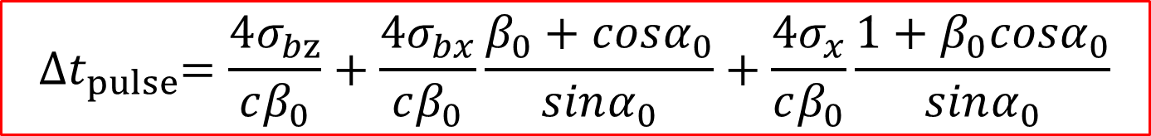
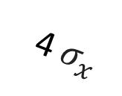


Laser pulse duration (FWHM)
$${∆t}_{pulse}=4\text{σ}\text{b,}\text{t}+{∆t}_{int}$$
laser
$$\frac{\text{S}\text{2}+4σ_{bz}}{β_{0}}$$
$$4σ_{bz}$$
4 $σ_{x}$
S₂
4 $σ_{bx}$
S₁
α₀
$${∆t}_{pulse}=\frac{4σ_{bz}}{cβ_{0}}+\frac{4σ_{bx}}{cβ_{0}}\frac{β_{0}+cosα_{0}}{sinα_{0}}+\frac{4σ_{x}}{cβ_{0}}\frac{1+β_{0}cosα_{0}}{sinα_{0}}$$
$${∆t}_{pulse}=\frac{4σ_{bz}}{cβ_{0}}+\frac{4σ_{bx}}{cβ_{0}}\frac{β_{0}+cosα_{0}}{sinα_{0}}+\frac{4σ_{x}}{cβ_{0}}\frac{1+β_{0}cosα_{0}}{sinα_{0}}$$
$${∆t}_{int}$$

Slide 16








L2R transfer line
Longitudinal phase space
$$\frac{Δγ}{γ_{0}}$$
$$\frac{Δγ}{γ_{0}}$$
$$\frac{Δγ}{γ_{0}}$$
$$Δl$$
$$Δl$$
$$Δl$$
σ_{b,t}=3.2 ps
L$≈270 m$
σ_{b,t}=27.7 ps
$$∆t=4\text{σ}\text{b,}\text{t}+{∆t}_{int}$$

Slide 17


“Cancellation” of bunch duration
Crab-Crossing Shema
A. Aleksandrov, S. Cousineau, T. Gorlov, Y. Liu, A. Rakhman, A. Shishlo. A CRAB-CROSSING SCHEME FOR LASER-ION BEAM APPLICATIONS // North American Particle Acc. Conf. NAPAC2019, Lansing, MI, USA; doi:10.18429/JACoW-NAPAC2019-WEYBB5
laser
Dispersion lattice
$$x$$
$$δp_{z}$$
γ₀+Δγ
α₀
γ₀
Δz
γ₀-Δγ

Slide 18
Crab-Crossing Shema
laser
Dispersion lattice
$$x$$
γ₀+Δγ
α₀
γ₀
Δz
γ₀-Δγ

Slide 19
Crab-Crossing Shema
laser
Dispersion lattice
α₀+Δα
$$x$$
γ₀+Δγ
ϕ₀
α₀
γ₀
Δz
α₀−Δα
γ₀-Δγ

Slide 20
Crab-Crossing Shema
laser
Dispersion lattice
$$x$$
γ₀+Δγ
α₀
γ₀
Δz
γ₀-Δγ

Slide 21

Crab-Crossing
laser
Dispersion lattice
$$x$$
γ₀+Δγ
α₀
γ₀
Δz
γ₀-Δγ

Slide 22
Crab-Crossing Shema
laser
Dispersion lattice
$$x$$
Δz

Slide 23




Crab-Crossing Shema
laser
Dispersion lattice
α₀+Δα
$$x$$
γ₀+Δγ
$$δp_{z}$$
ϕ₀
α₀
$\text{D}\text{x }$=$D_{x}δp_{z}=∆ztgφ_{0}$
Δz
Δz
γ₀
α₀−Δα
$$tgφ_{0}=\frac{\sin{α_{0}}}{β_{0}+cosα_{0}}$$
γ₀-Δγ
$$D_{x}=\frac{\left\langle {∆z}^{2}\right\rangle }{\left\langle δp_{z}∆z\right\rangle }tgφ_{0}$$

Slide 24



Dispersion Function at IP for CCS
L2R Transfer Line
PyORBIT3 parameters for RF-OFF, SC-ON at End of L2R transfer line
Quantity | σ_{t} (ps) | σ_{z} (mm) | $\left\langle δp_{z}∆z\right\rangle$ (m) | D_{x}(m) | σ_{E} (MeV) | $$ε\text{nx} /ε\text{ny} (π μ\text{m}\text{)}$$
PyORBIT3 | 31.8 | 9.2 | 6.324$∙$10⁻⁶ | 8.6 | 2.2 | $$\text{0.27}\text{/018}$$
$D_{x}=\frac{\left\langle {∆z}^{2}\right\rangle }{\left\langle δp_{z}∆z\right\rangle }tgφ_{0}$ $=8.6 m$
$φ_{0}=32.9 (deg)$

Slide 25










Laser Pulse Energy at Crab-Crossing Shema
laser
$$\frac{\text{S}\text{2}+4σ_{bz}}{β_{0}}$$
Pulse laser duration (FWHM)
$$\frac{\text{S}\text{2}}{β_{0}}$$
$${∆t}_{pulse}=\frac{4σ_{bz}}{cβ_{0}}+\frac{4\sqrt{ε_{x}β_{x}}}{cβ_{0}}\frac{β_{0}+cosα_{0}}{sinα_{0}}+\frac{4σ_{x}}{cβ_{0}}\frac{1+β_{0}cosα_{0}}{sinα_{0}}$$
$$4σ_{bz}$$
4 $σ_{x}$
S₂
4 $σ_{bx}$
$$4\sqrt{ε_{x}β_{x}}$$
S₁
$$J_{pulse}=P{∆t}_{laser}$$
α₀
$$J_{pulse}≈ω\frac{ℏ^{2}cε_{0}}{{μ_{13}}^{2}}\frac{e^{{\left(σ_{∆}\right)}^{2}}}{σ_{∆}}ln\left(\frac{1}{1−\left\langle η_{∞}\right\rangle }\right){\left(\frac{β_{0}sinα_{0}}{1+β_{0}cosα_{0}}\right)}^{2}\frac{{4σ}_{y}}{β_{0}}\left[ε_{x}\frac{β_{0}+cosα_{0}}{sinα_{0}}+{\sqrt{\frac{ε_{x}}{β_{x}}}σ}_{x}\frac{1+β_{0}cosα_{0}}{sinα_{0}}\right]$$
$$J_{min}=ω\frac{ℏ^{2}{cε}_{0}}{{μ_{13}}^{2}}\frac{e^{{\left(σ_{∆}\right)}^{2}}}{σ_{∆}}ln\left(\frac{1}{1−\left\langle η_{∞}\right\rangle }\right){\left(\frac{β_{0}sinα_{0}}{1+β_{0}cosα_{0}}\right)}^{2}{4σ}_{y}ε_{x}\frac{β_{0}+cosα_{0}}{β_{0}sinα_{0}}$$

Slide 26


Beam and Laser Parameters for $\left\langle η_{∞}\right\rangle$=0.95
 | Quantity | Values
 | injection scenarios | I | II | III | IV
 | rms energy spread, $σ_{E}$ (MeV) | 2.2 | 2.2 | 2.2 | 2.2
 | rms duration, $σ_{b,t}$ (ps) | 31.8 | 31.8 | 31.8 | 31.8
 | rms size, $σ_{bx}$/ $σ_{by}$ (mm) | 6.64/0.2 | 6.1/0.2 | 6.0/0.2 | 5.99/0.2
 | rms nor.emittance, $ε_{nx}$/ $ε_{ny}$ (um$∙$rad) | 0.7/0.33 | 0.33/0.33 | 0.27/0.18 | 0.18/0.18
 | Beta function $β_{x}$/ $β_{y}$ (m) | 45.3/0.427 | 24/0.427 | 18.8/0.783 | 15.9/0.783
 | Pulse power, P (MW) | 0.481 | 0.46 | 0.47 | 0.434
 | FWHM laser pulse duration, Δt (ps) | 72.9 | 40.8 | 34.4 | 28.0
 | Pulse energy, J_{mic} (μJ) | 35 | 18.8 | 16.2 | 12.2
 | Average power, $P_{ave}$ (W) | 549 | 294 | 253 | 190
 | Minimum average power, $P_{min}$ (W) | 484 | 232 | 189 | 130
 | Laser divergence, θ_{0x} / θ_{0y} (mrad) | 0.41/0.44 | 0.40/0.45 | 0.41/0.44 | 0.39/0.46
H⁽⁻⁾ bunch
accuracy ${δη}_{∞}$=$−1\%$
Laser
${D_{x} =8.6 m, D}_{x}^{′}=\text{−1.54}\text{7}$, $α_{x}$= $α_{y}$=0, $σ_{x}$=$σ_{y}$=0.4 mm

Slide 27
Summary
Uncorrelated betatron hydrogen beam divergence is unavoidable factor reducing excitation efficiency.
New asymptotic and time-dependent solutions of the Schrödinger equations for two-level model of relativistic atoms interacting with a laser beam has been obtained.
Analytical formulas of the laser peak power and pulse energy required for evaluating the laser stripping method were obtained.
Eliminating both energy spread and beam duration through dispersive control can reduce the required average laser power to a few hundred watts.
Laser-assisted charge-exchange injection appears feasible for ESSnuSB+, provided that the L2R transfer line lattice is configured to achieve the required dispersion and dispersion derivative at the interaction point.

Slide 28
Outlook
Verification of the analytical formulas for the required laser power and energy with full-scale simulation. (PyORBIT)
Redesign dispersion of the L2R transfer line to reach Dx = 8.6 m and D’x = -1.547 a t IP (PyORBIT)
Design-study of the L2R transfer line with longitudinal alternative focusing to reduce the dispersion function to Dx = 4÷5 m and D’x = -1.547 at IP. (PyORBIT).
Design-study of the L2R transfer line with longitudinal alternative focusing to maintain the bunch length at the initial value, with Dx = 0 m and D’x = -1.547 at IP (PyORBIT)
Design-study of a magnetic system for stripping (CST Studio, Ansys, COMSOL)
Design-study of a laser system

Slide 29
THANK YOU FOR YOUR ATTENTION

