Slide 1



Accumulator Ring
Onur Gilanliogullari
Department of Physics and Astronomy; FREIA Division
Uppsala University

Slide 2
Overview
Introduction & Ring Design
Possible L2R for Laser Stripping
Recap from previous results
Error Corrections and Performance
Dynamic Aperture & Chromaticity Corrections
Conclusion & Future Work for CDR.

Slide 3
Introduction & Ring Design

Slide 4
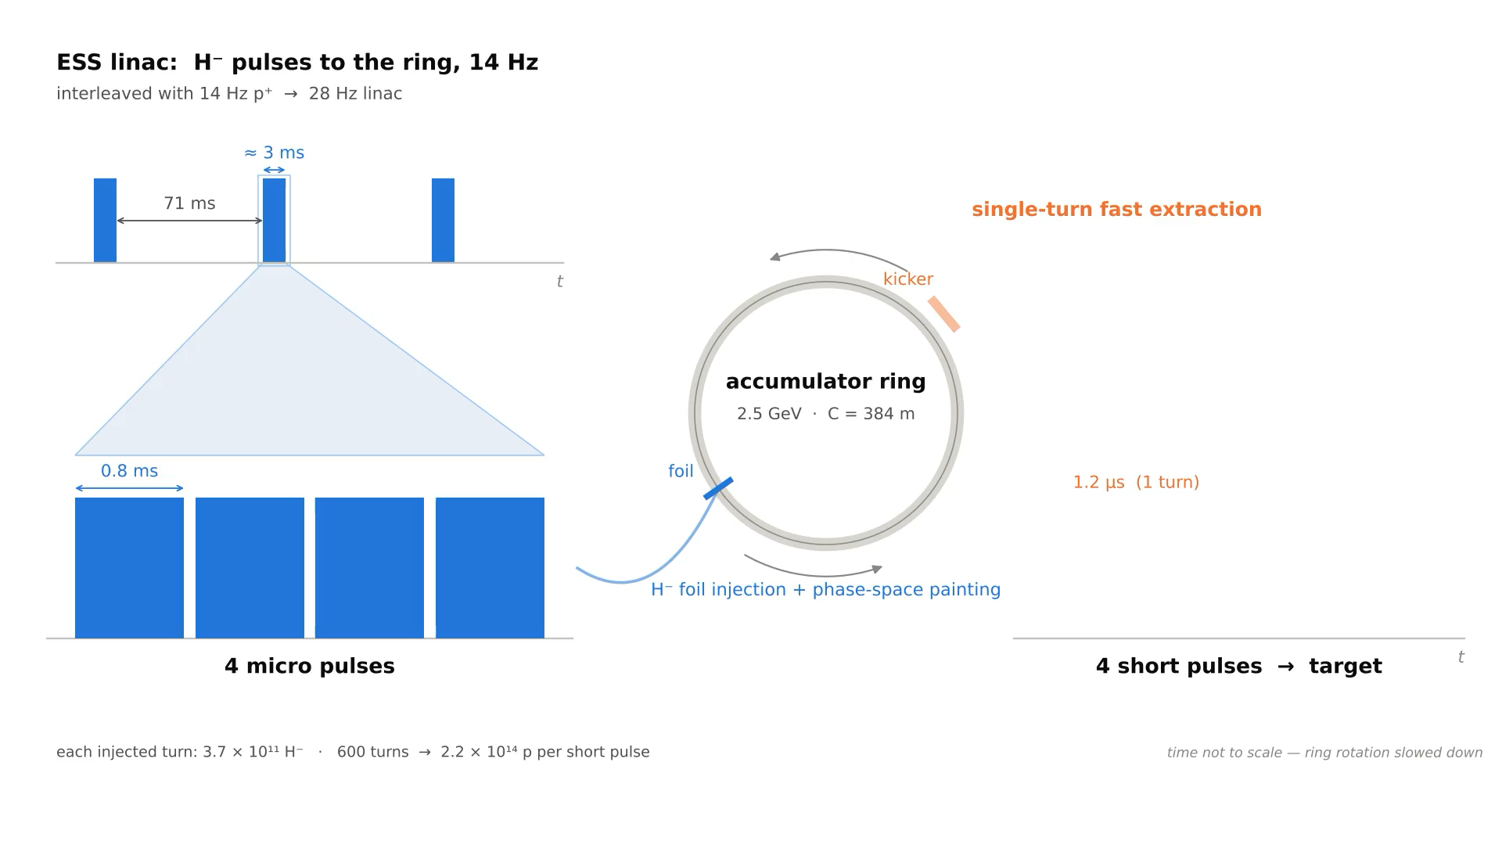
Introduction
Accumulator’s purpose is to accumulate long ESS pulses to produce short and dense pulse by fast extraction for target’s needs.
Main Design Physics:
  Space Charge Effects
  Multi-turn injection/ Phase space painting
  Stripping Efficiency/ Foil Hits
  Extraction mechanism/ Efficieny
  Chromatic/ Nonlinear effects
  Single particle effects/ Collective effects

Slide 5
Introduction
Accumulator’s purpose is to accumulate long ESS pulses to produce short and dense pulse by fast extraction for target’s needs.
Main Design Physics:
  Space Charge Effects Partially Addressed
  Multi-turn injection/ Phase space painting Addressed
  Stripping Efficiency/ Foil Hits Addressed
  Extraction mechanism/ Efficieny Addressed
  Chromatic/ Nonlinear effects Partially Addressed
  Single particle effects/ Collective effects Partially Addressed

Slide 6
L2R Side

Slide 7
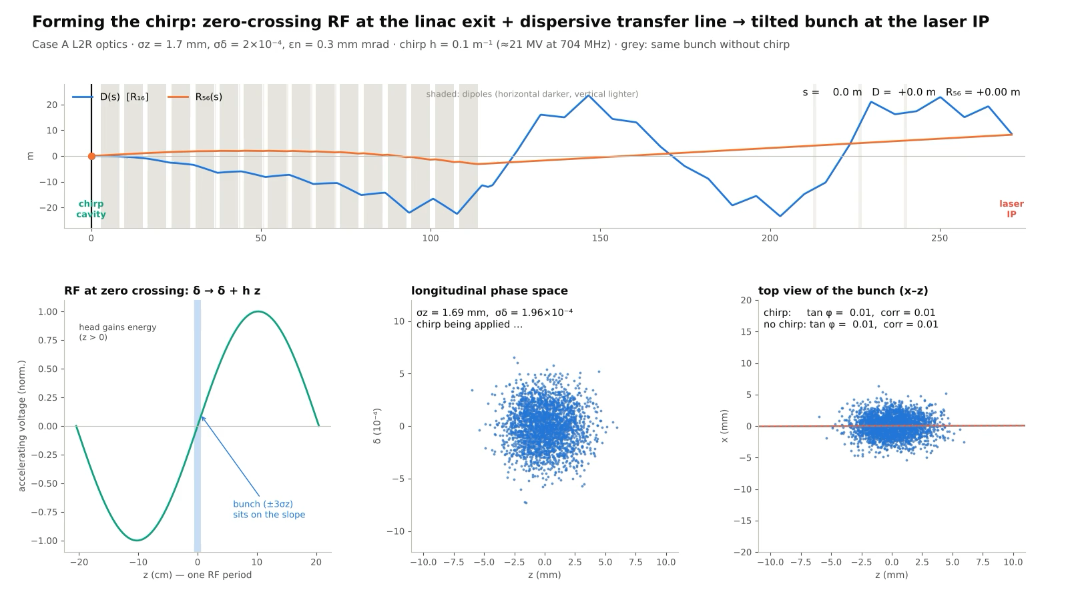
L2R Transfer Line
Imprinting chirp end of LINAC

Slide 8
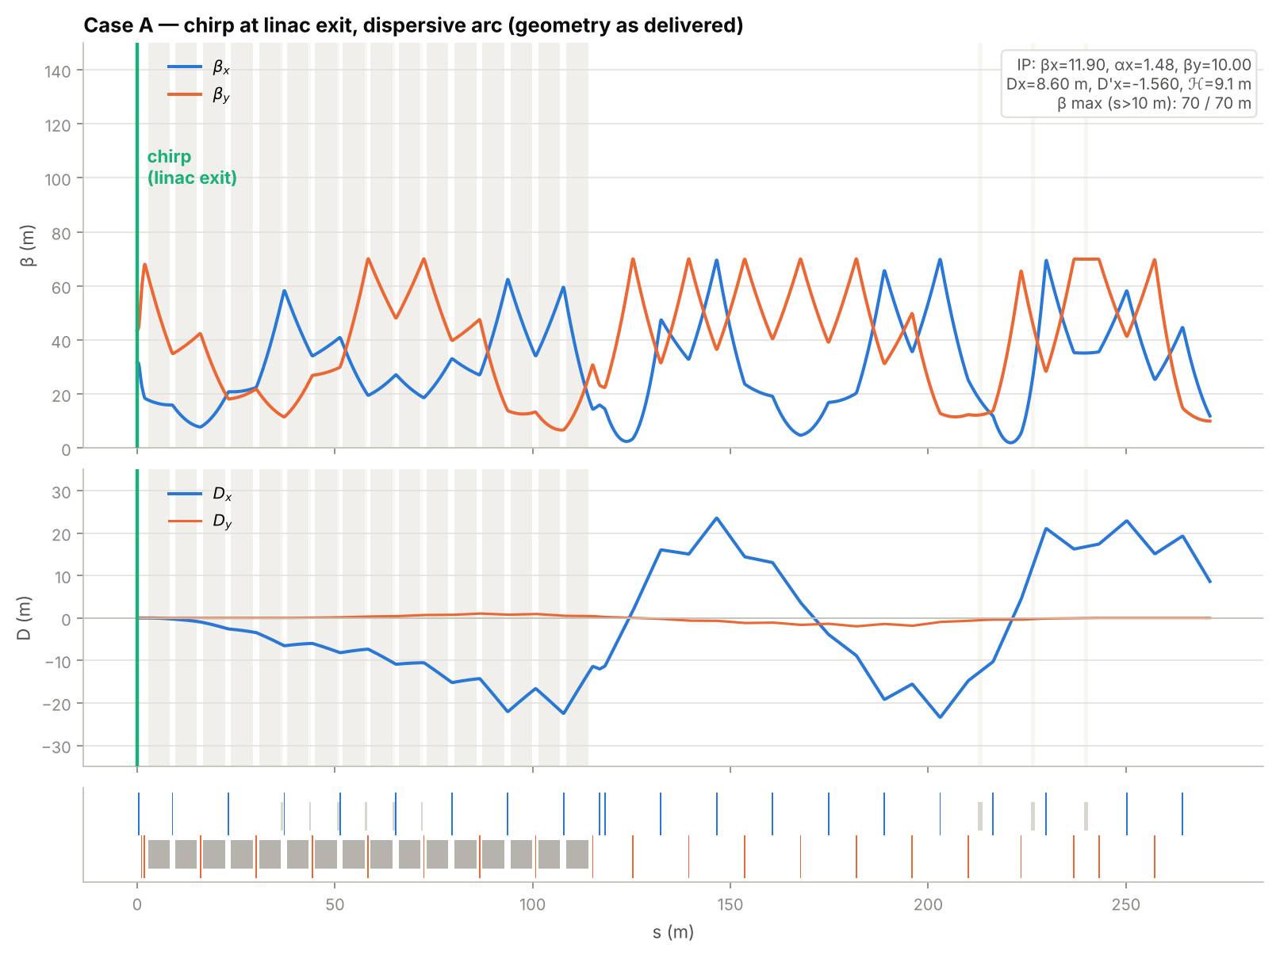
L2R Transfer Line
Matching for laser stripping

Slide 9
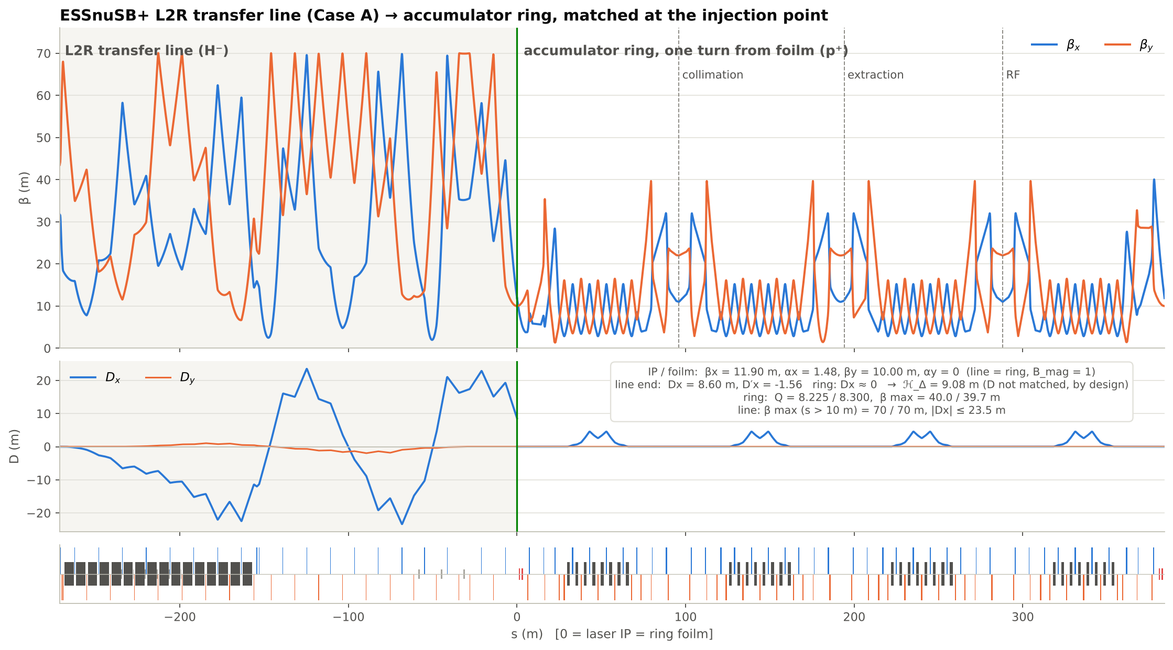
L2R Transfer Line
Matching for laser stripping

Slide 10
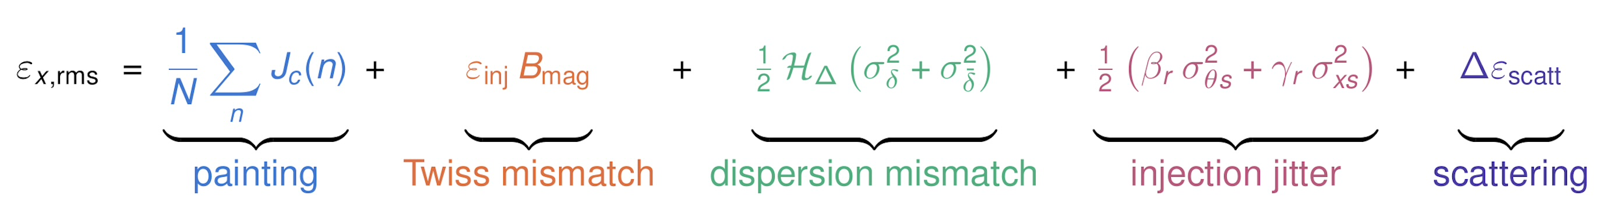
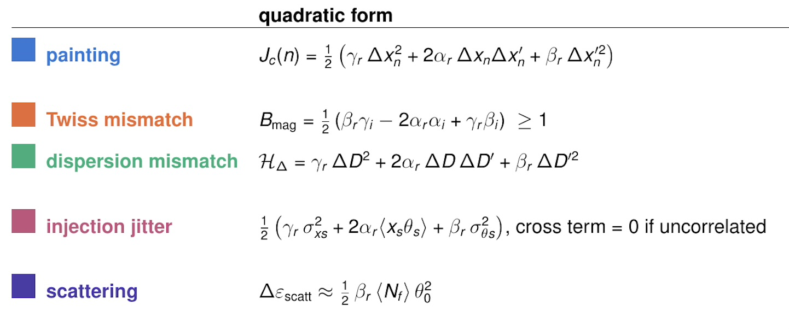
L2R Transfer Line
Emittance filamentation for multiturn injection

Slide 11
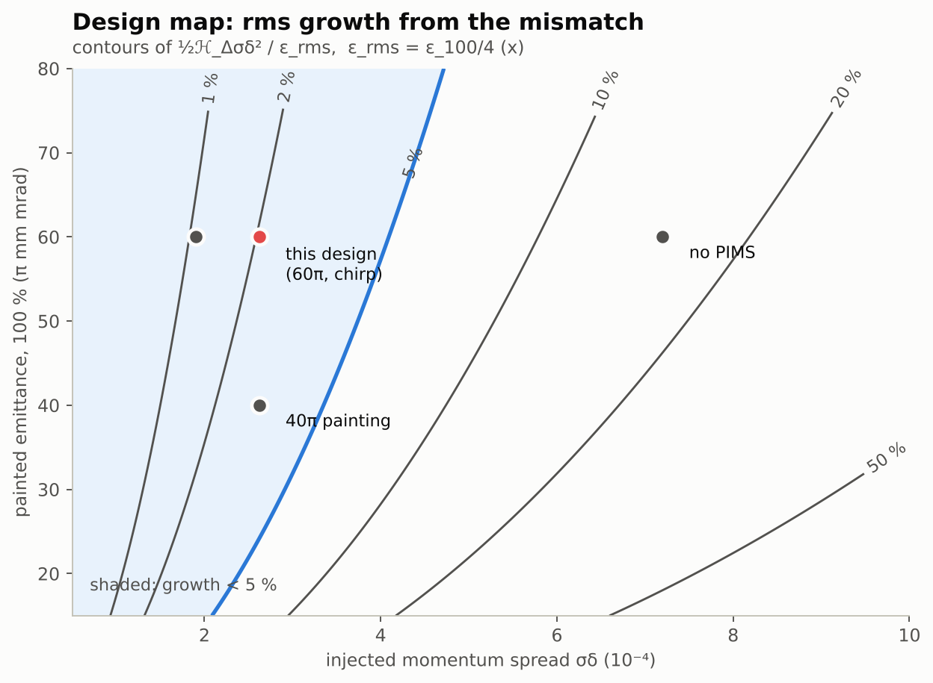
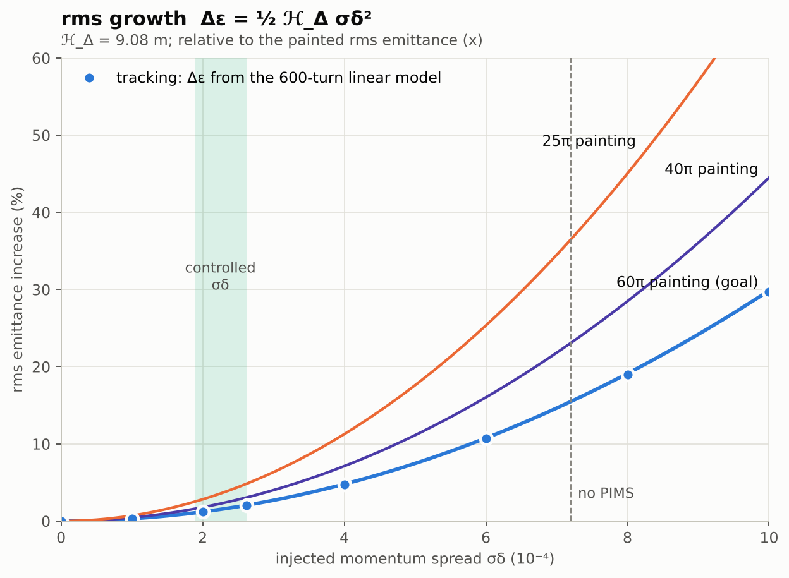
L2R Transfer Line
Emittance growth rate safety zones

Slide 12
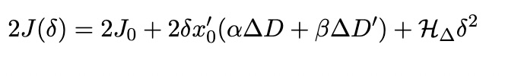
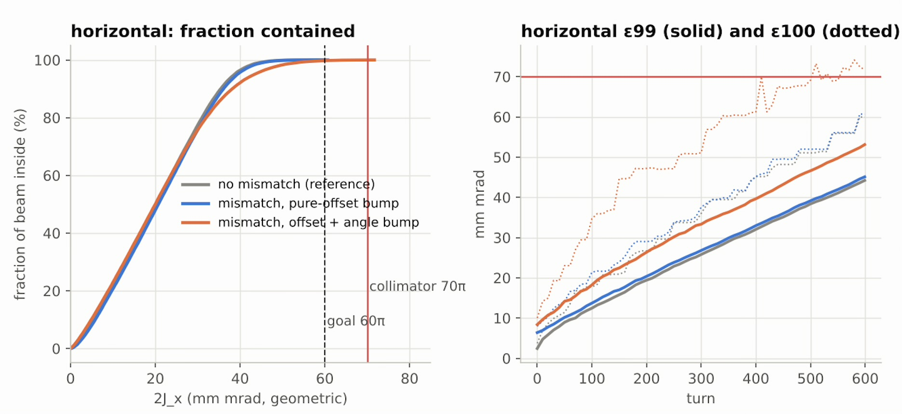
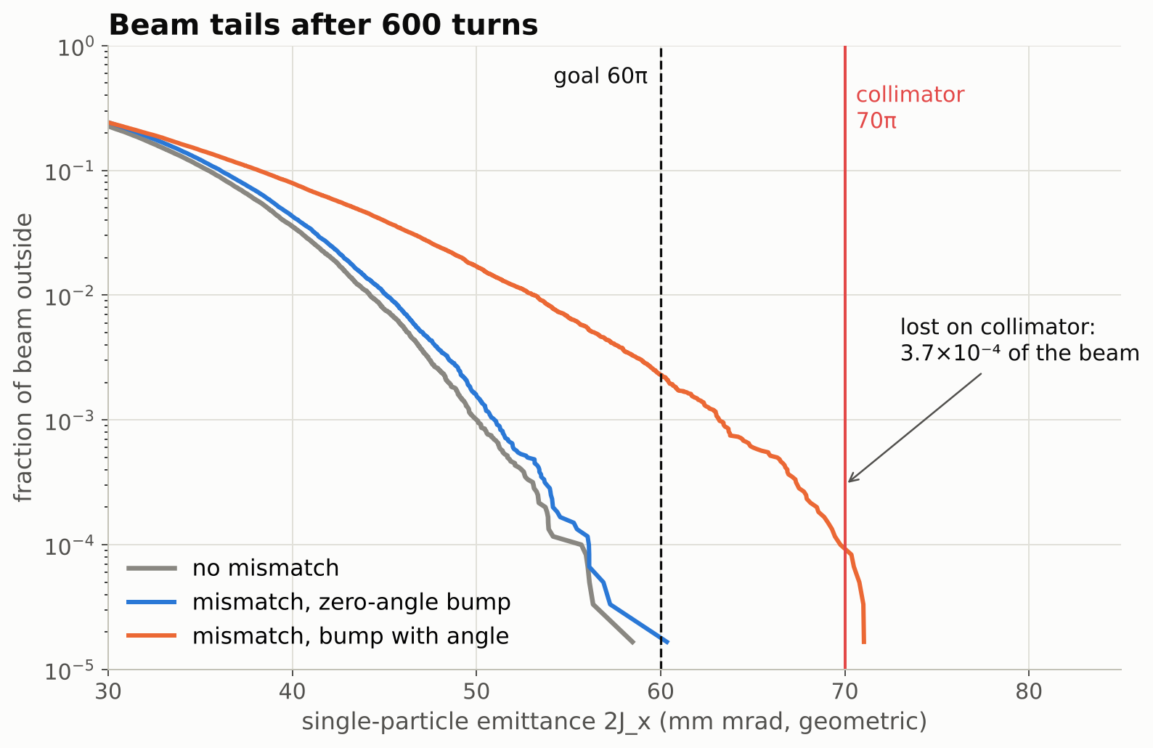
L2R Transfer Line
Growth due to dispersion mismatch:

Slide 13
L2R Transfer Line
The L2R transfer line can be matched to laser stripping needs if bends are no longer achromat.
The dispersion mismatch puts a constraint on momentum spread for less than 5% growth due to mismatch.
The transfer line cavities can be used for minimizing momentum spread.
After annual meeting, test runs.

Slide 14
Ring Side

Slide 15
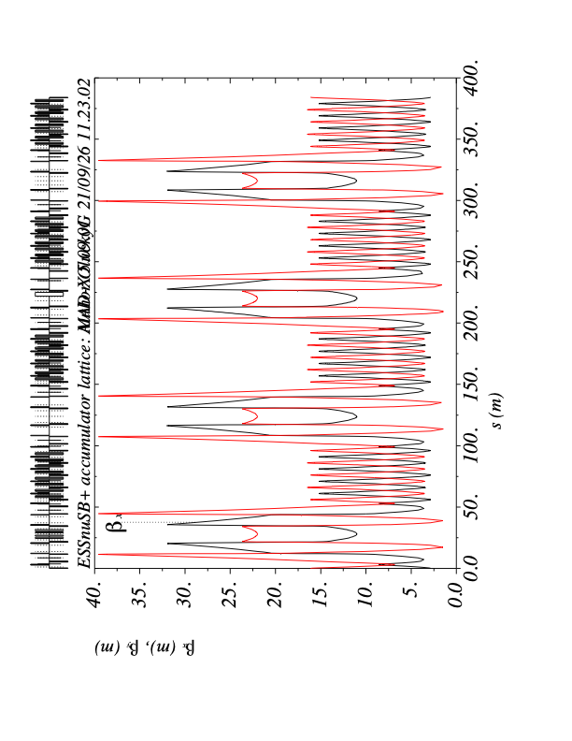
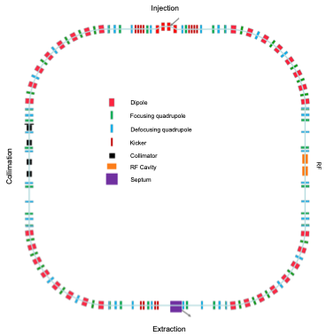
Ring Design
Accumulator ring’s design is inspired from the SNS with achromatic 4 superperiod ring design.
Straights are dedicated to:
  Injection
  Collimation
  RF
  Extraction
Optics
Ring Geometry

Slide 16
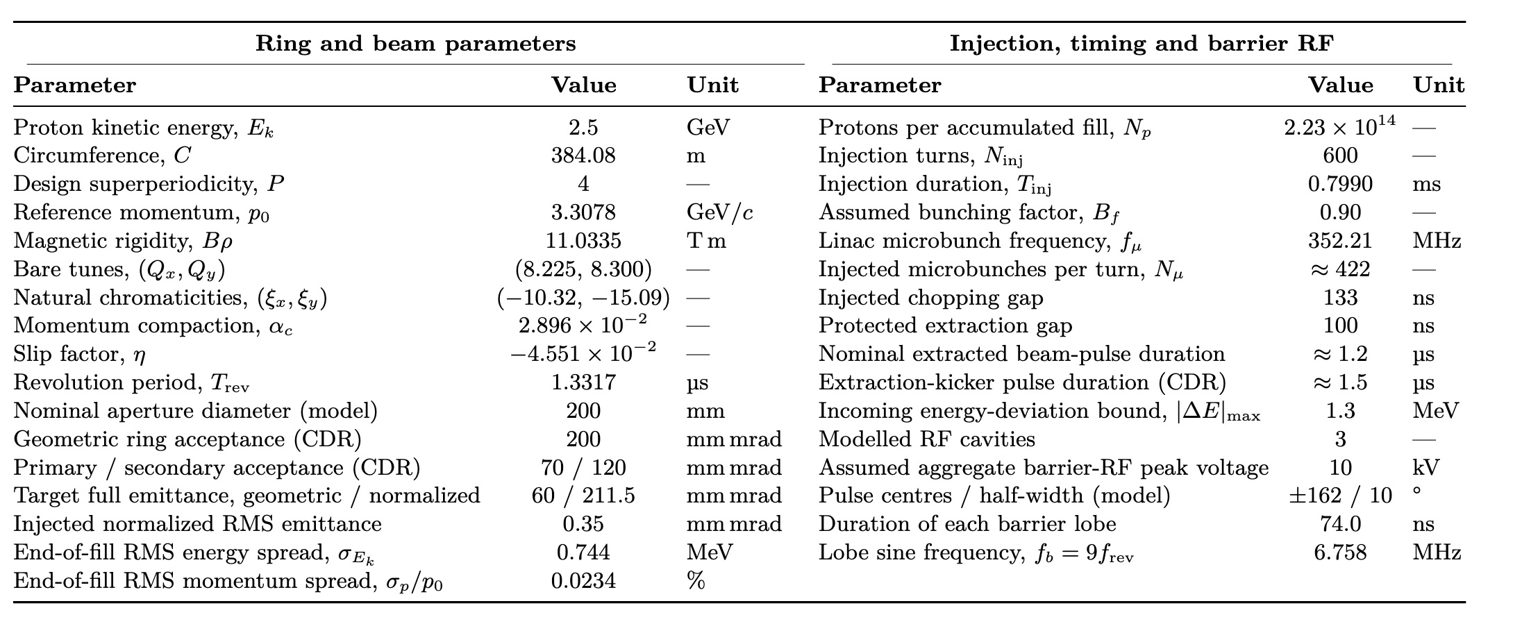
Ring Design
Parameter Table

Slide 17
Ring Design
Parameter Table

Slide 18
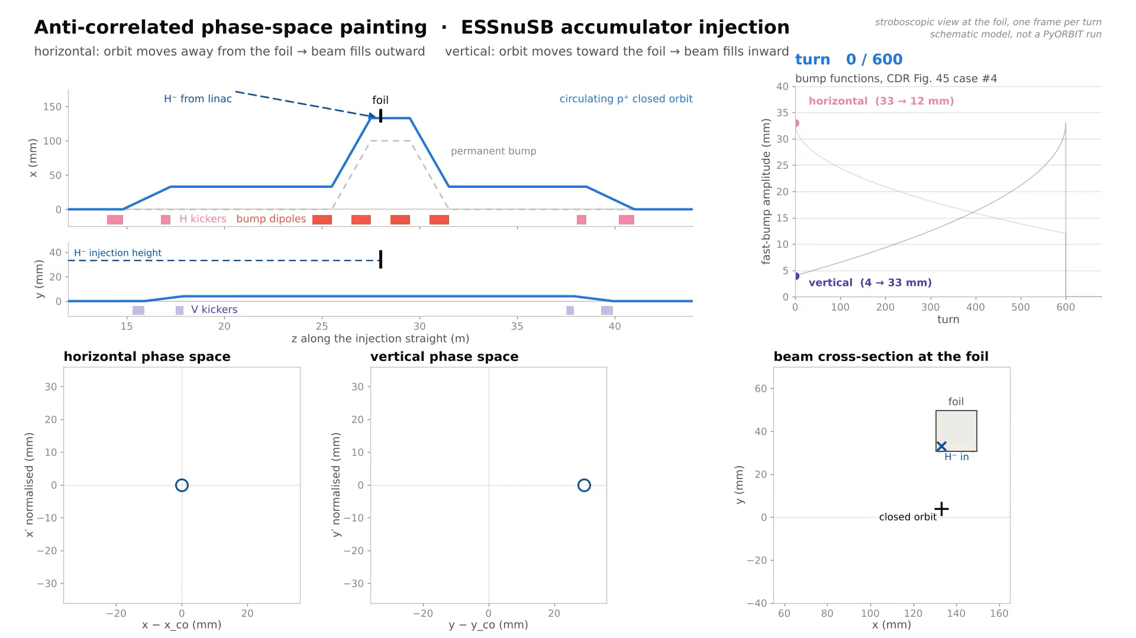
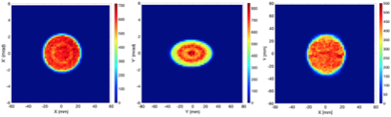
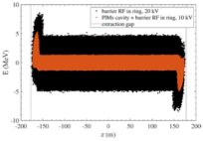
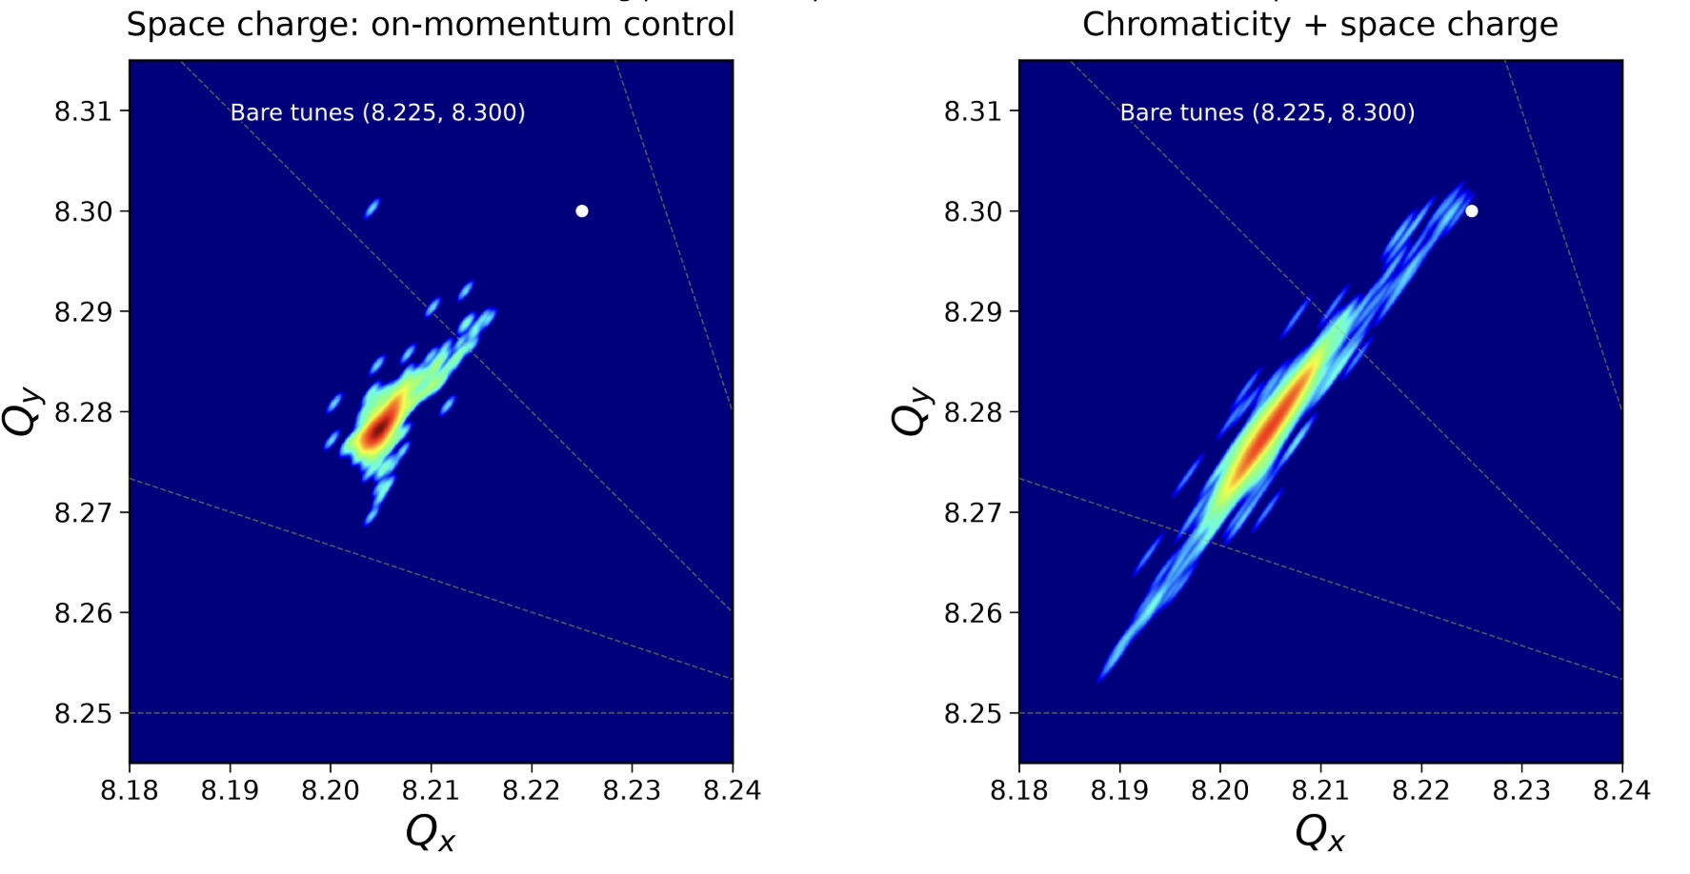
Recap
Multi-Turn Injection and Phase Space Painting
Resulting uniform beam profile from PyORBIT3
Resulting Space-Charge tune spread and chromatic spread

Slide 19
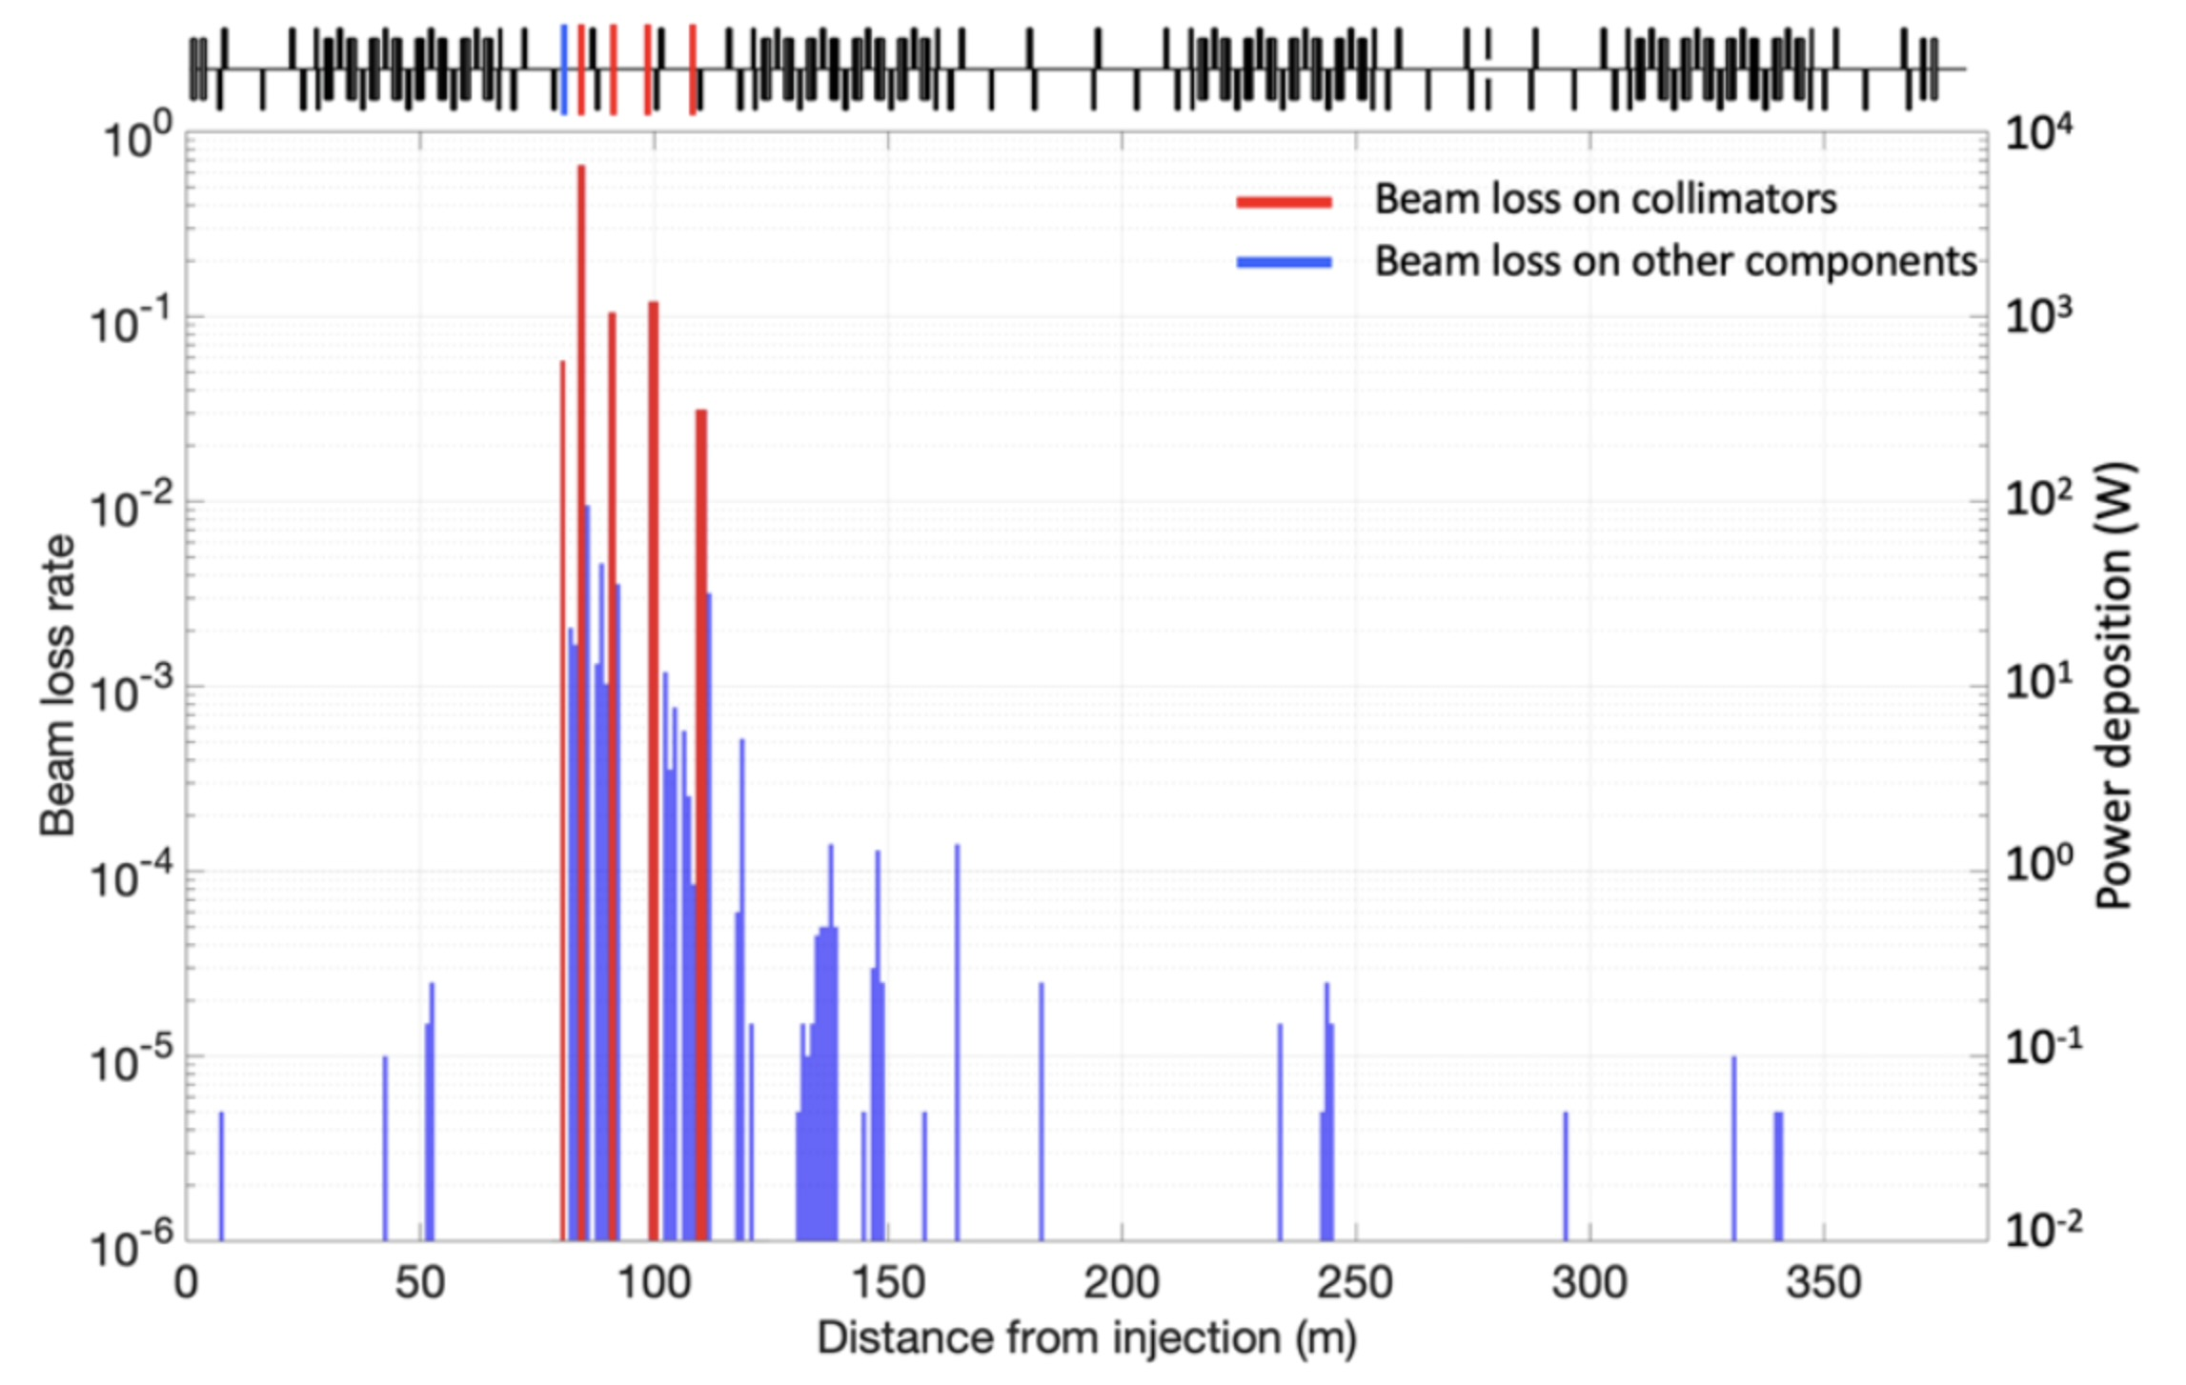
Recap
Collimation Efficiency
Two-stage collimation: a scattering primary followed by four secondary absorbers.
Published acceptance hierarchy: primary / secondary / ring = 70 / 120 / 200 π mm mrad.
PyORBIT halo-cleaning study achieved 97% collimation efficiency, using a prescribed halo with space charge off.

Slide 20
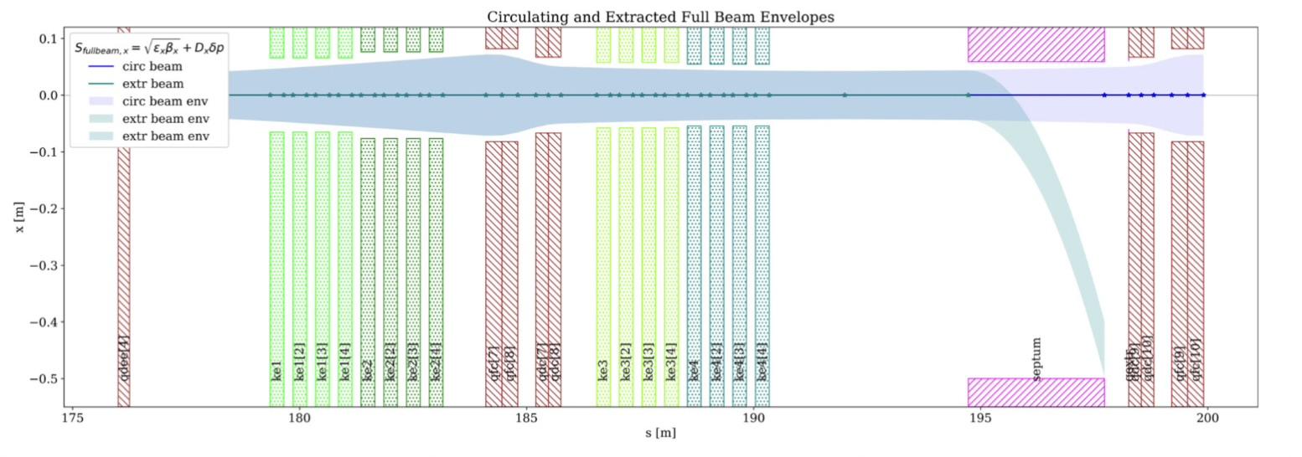
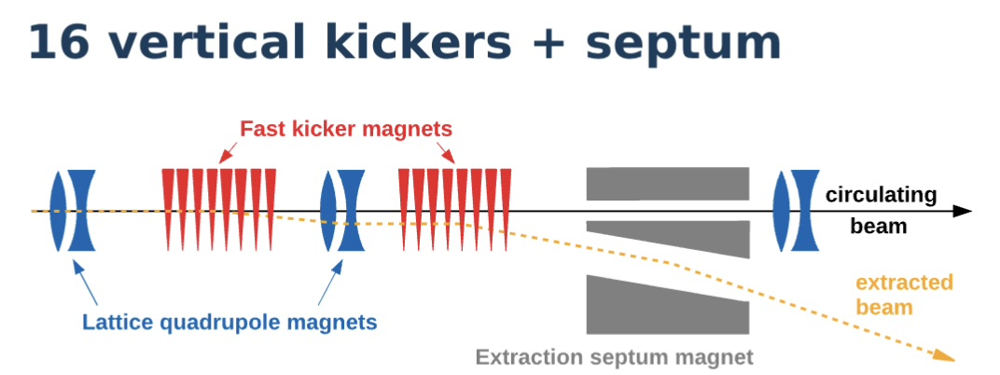
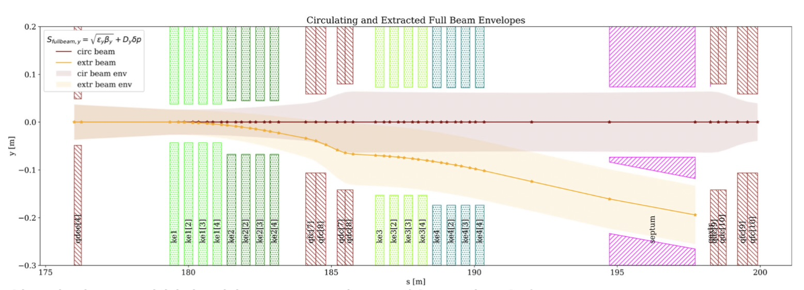
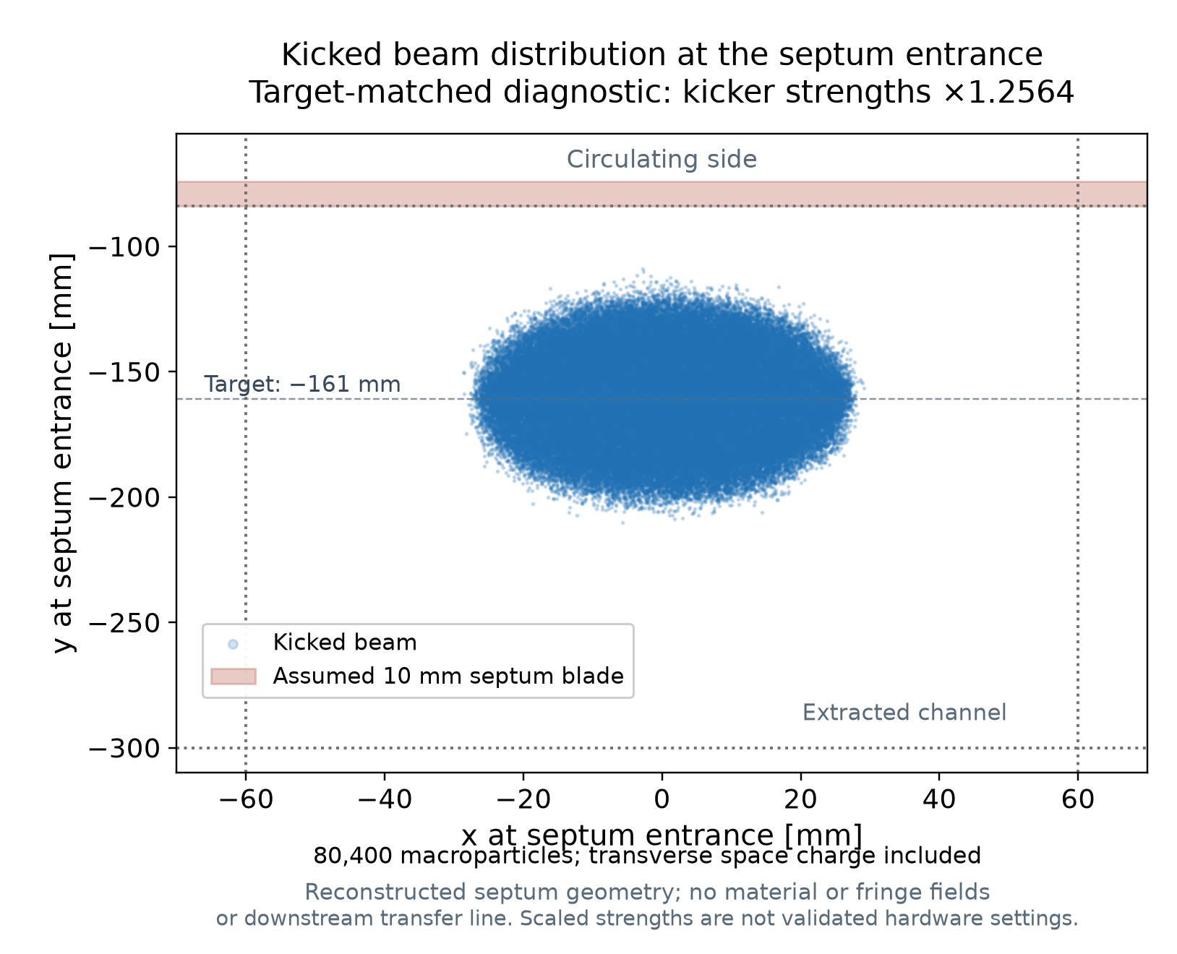
Recap
100 ns gap preserved by barrier RF
Four groups of four, 0.3 m per kicker
Total vertical kick: −21.9 mrad
Septum entry target: y = −161 mm
3 m Lambertson: horizontal deflection
100 ns gap / ~1.2 μs extracted beam
Kicker rise ≤100 ns; pulse ~1.5 μs
Envelope acceptance: 180 π mm mrad
Extraction

Slide 21
Error Corrections

Slide 22
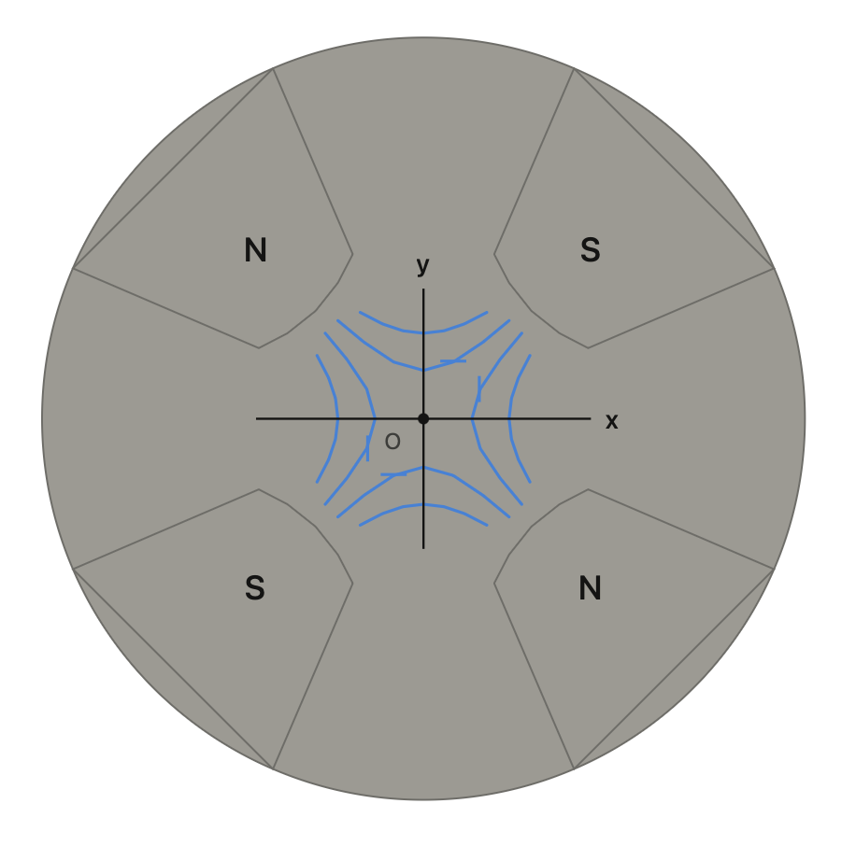
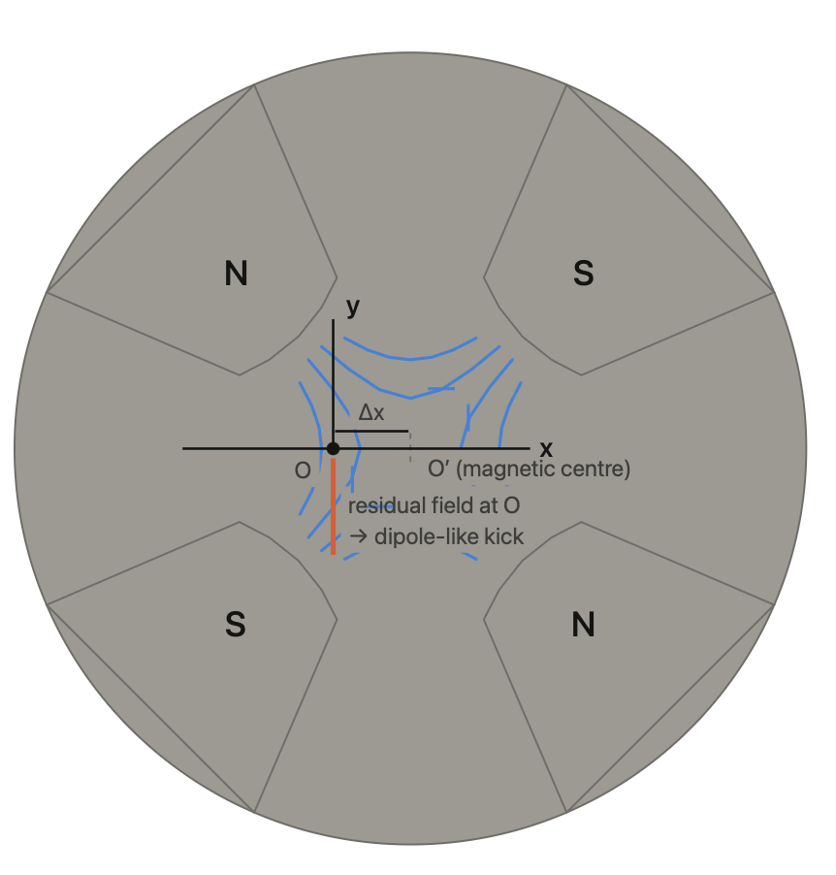
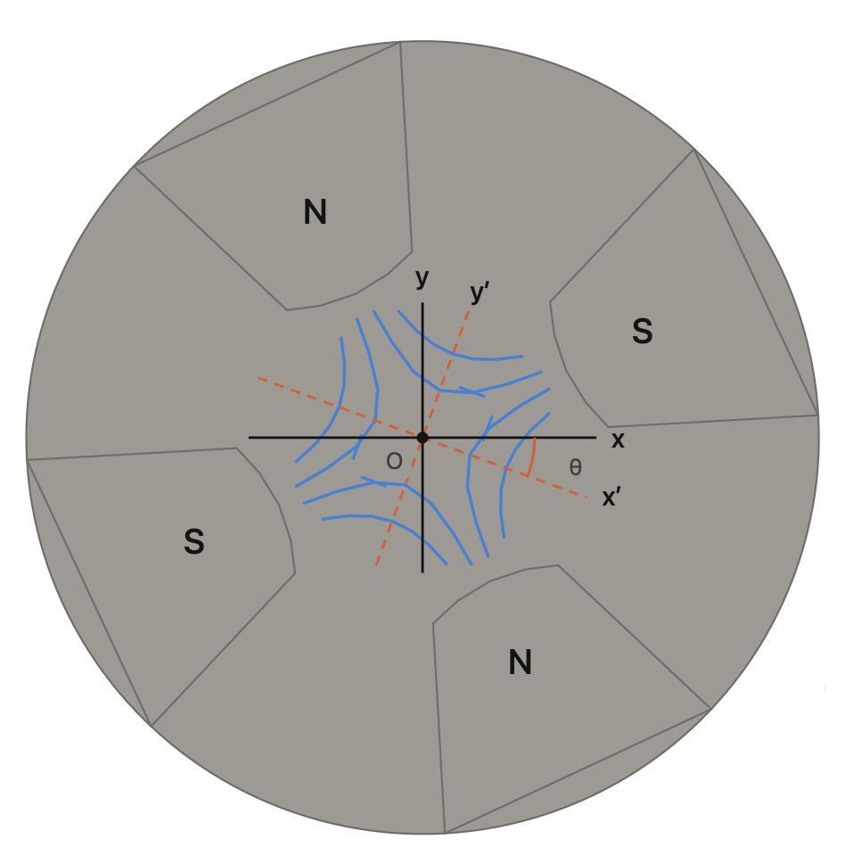
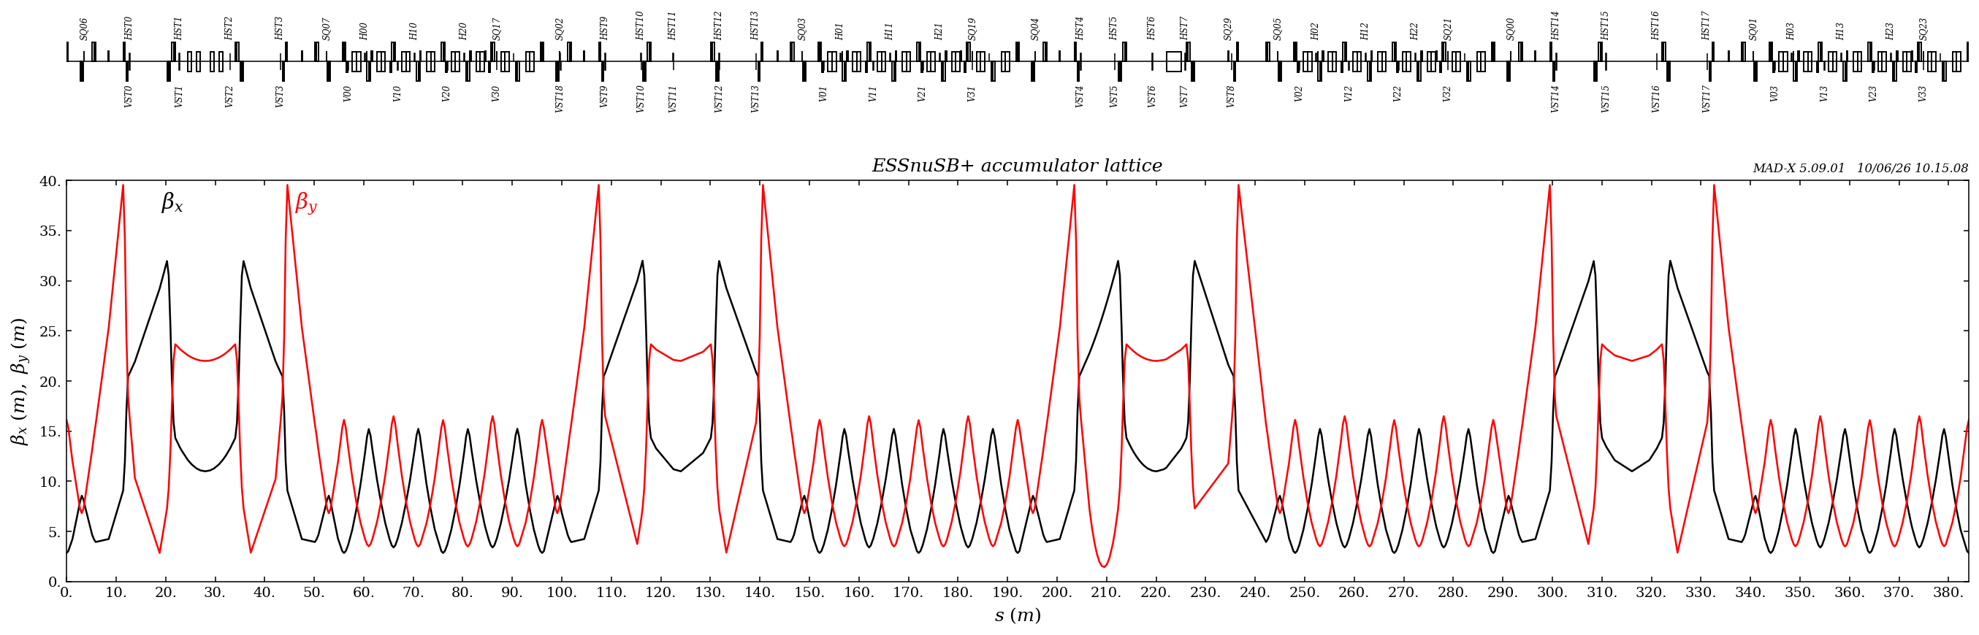
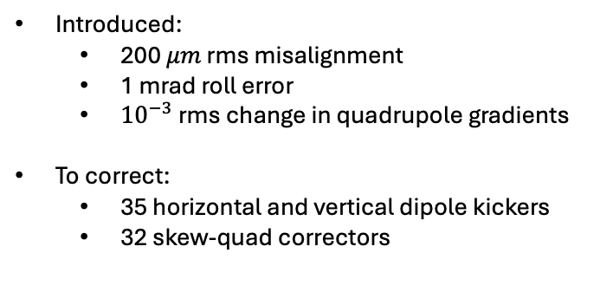
Error Corrections
There are 84 main quadrupoles.
Ideal
Misaligned
Roll
Introduced:
  200 $μm$ rms misalignment
  1 mrad roll error
  ${10}^{−3}$ rms change in quadrupole gradients
To correct:
  35 horizontal and vertical dipole kickers
  32 skew-quad correctors
Elements starting with “H” horizontal kicker, “V” vertical kicker, “SQ” skew-quad corrector

Slide 23
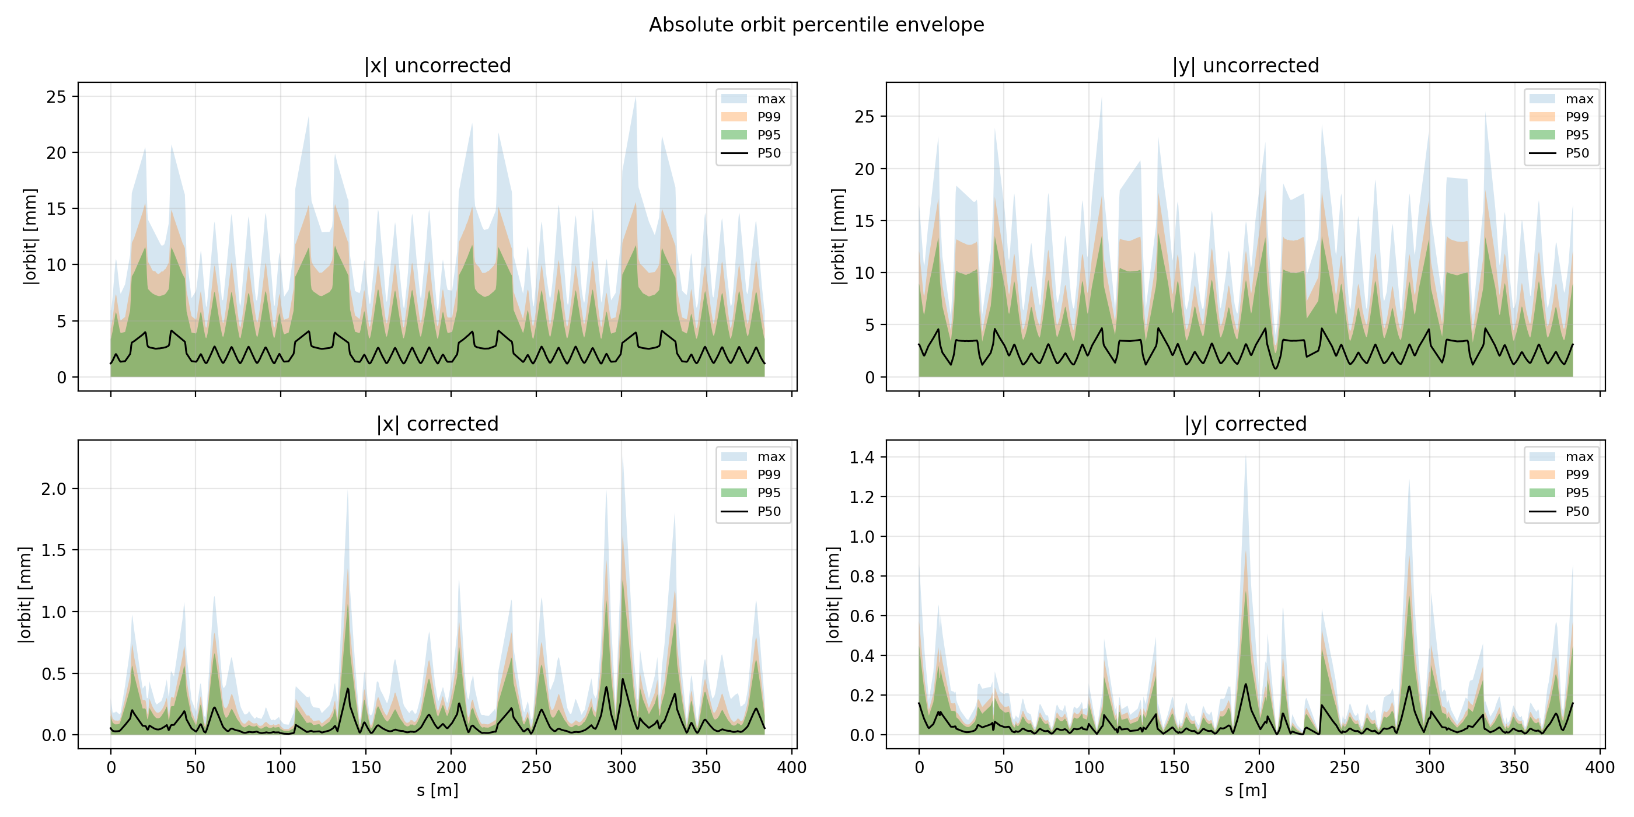
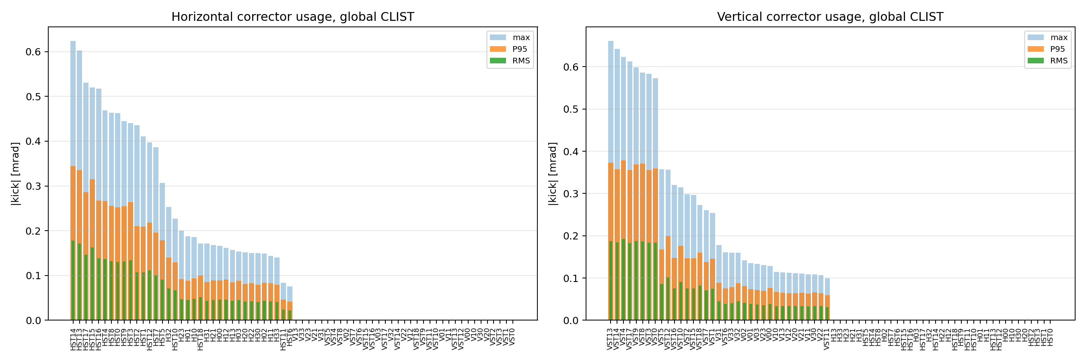
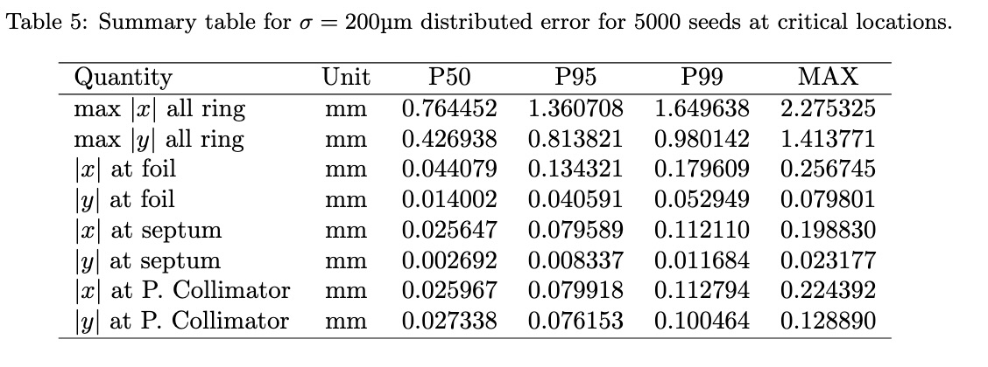
Error Corrections
There are 84 main quadrupoles.
Ideal
Misaligned
To correct:
  Each arc cell has one horizontal and one vertical kicker
  Injection straight: four horizontal and four vertical kickers.
  Extraction straight: five horizontal and five vertical kickers.
  Collimation straight: six horizontal and six vertical kickers.
  RF straight: four horizontal and four vertical kickers.
Ref: MS4.4 Milestone report

Slide 24
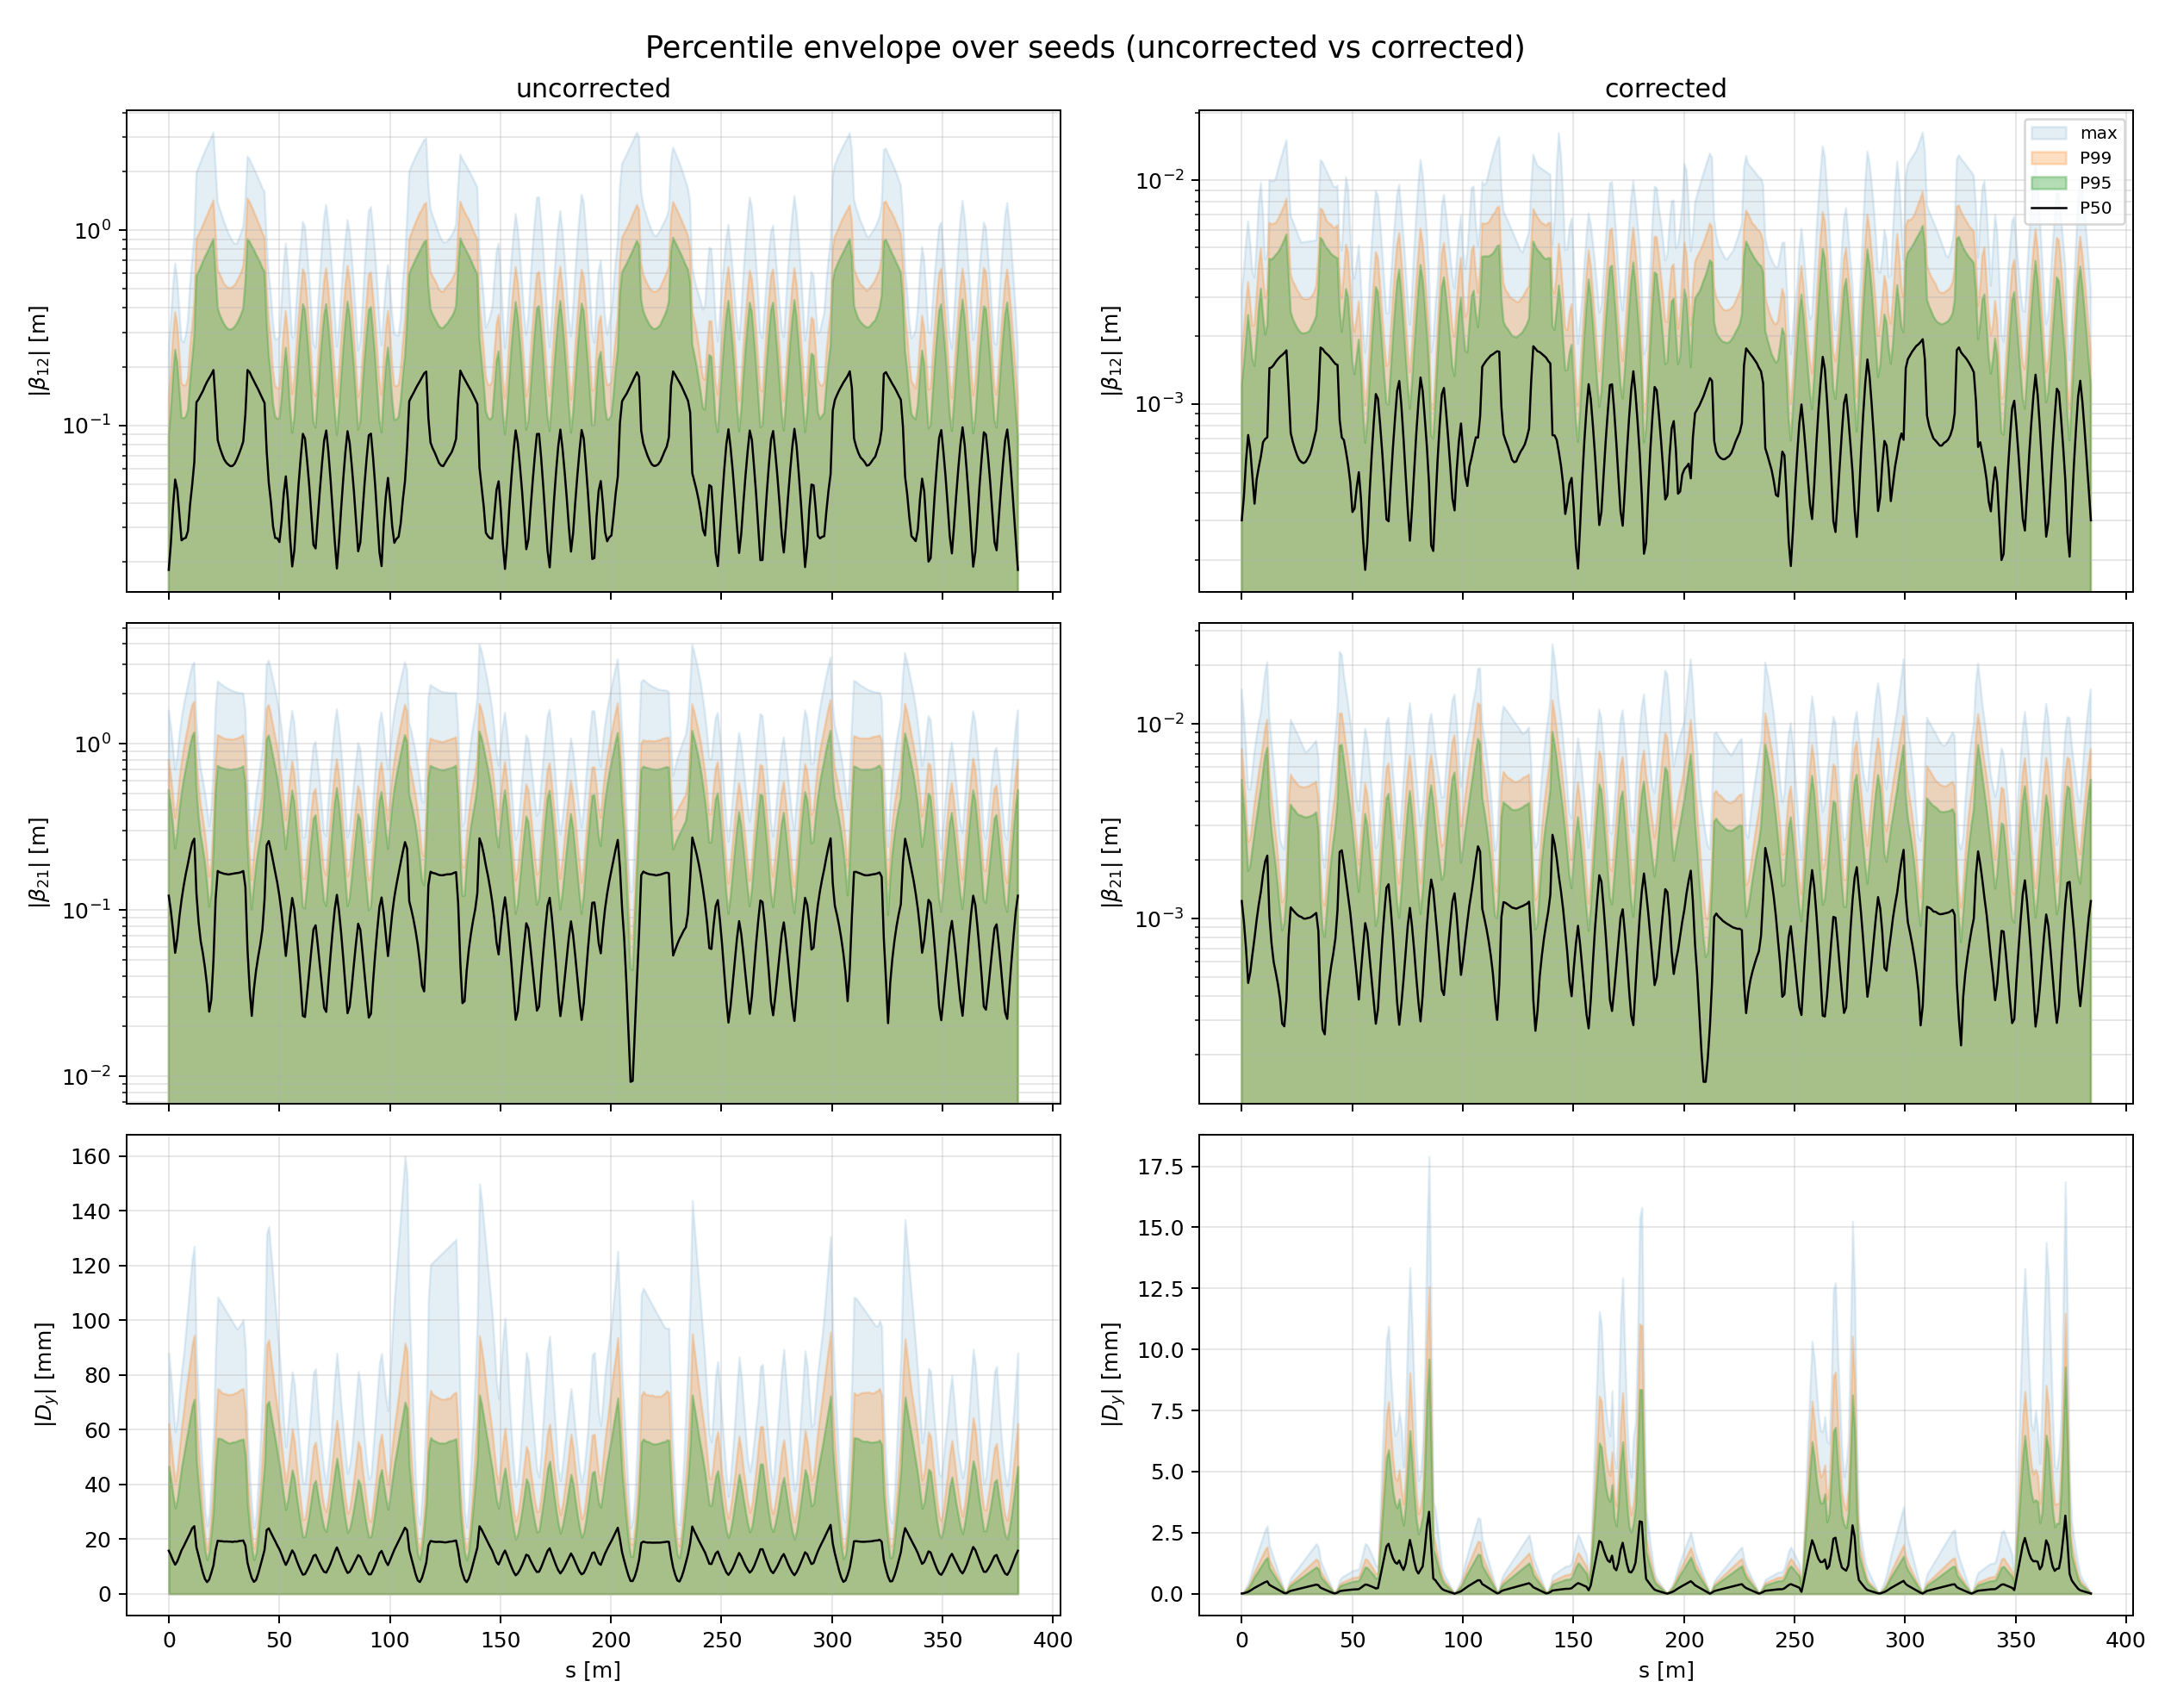
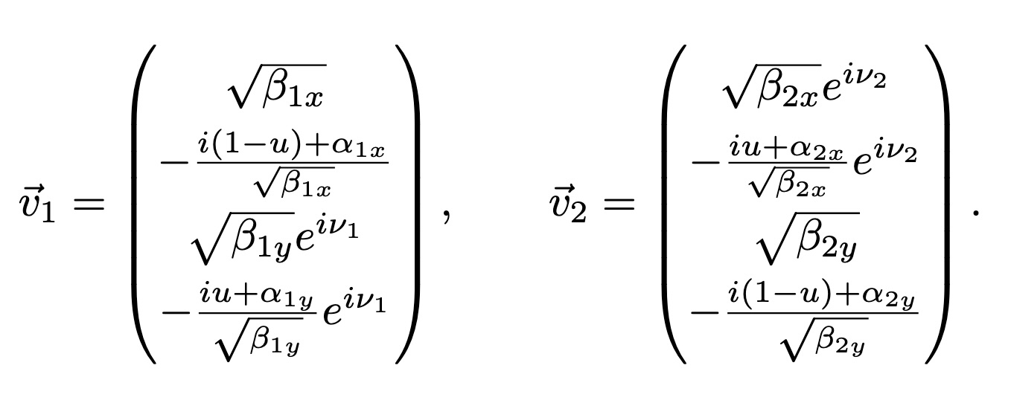
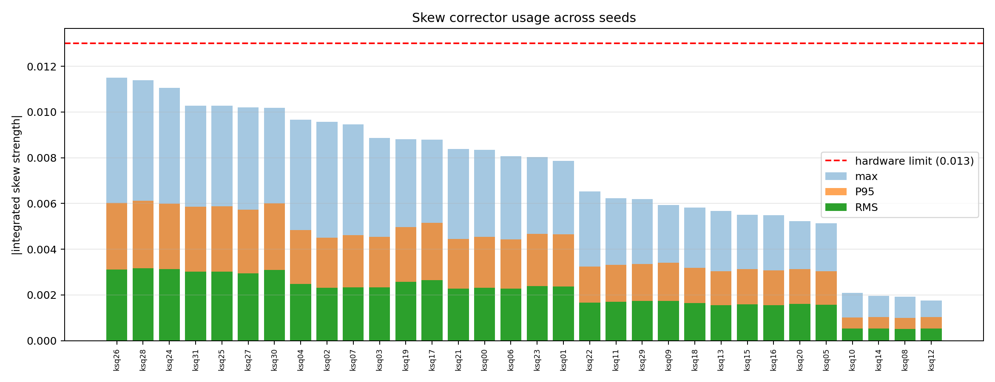
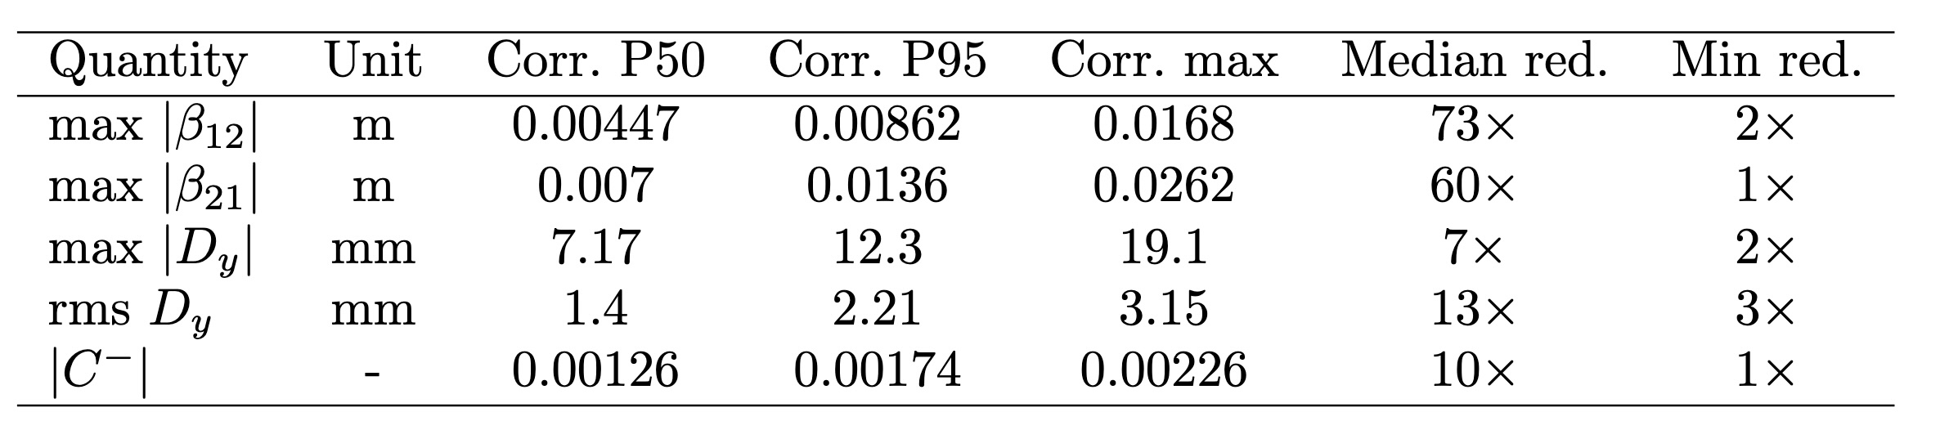
Error Corrections
There are 84 main quadrupoles.
Ideal
Roll Errors
To correct:
  32 skew correctors
  Lebedev-Bogacz parametrization for correction.

Slide 25
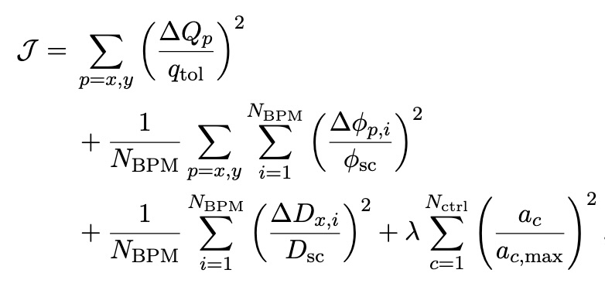
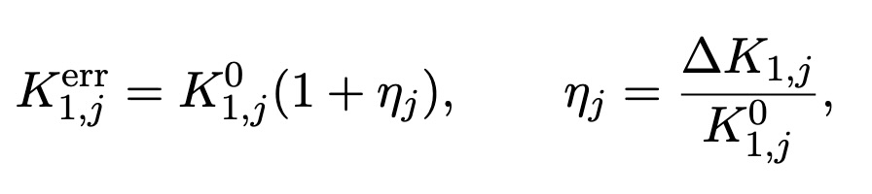
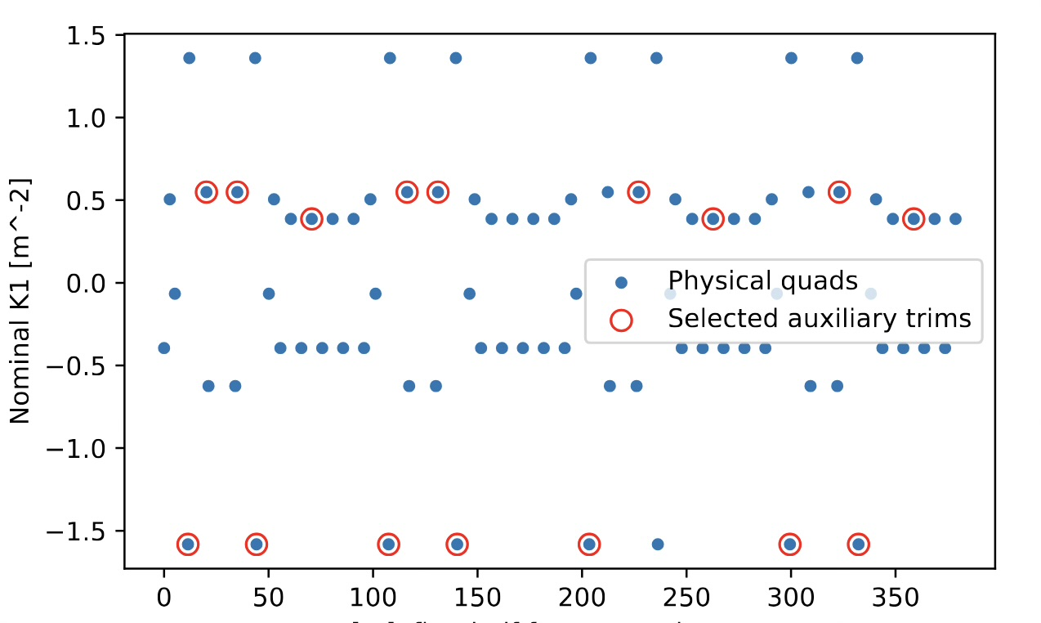
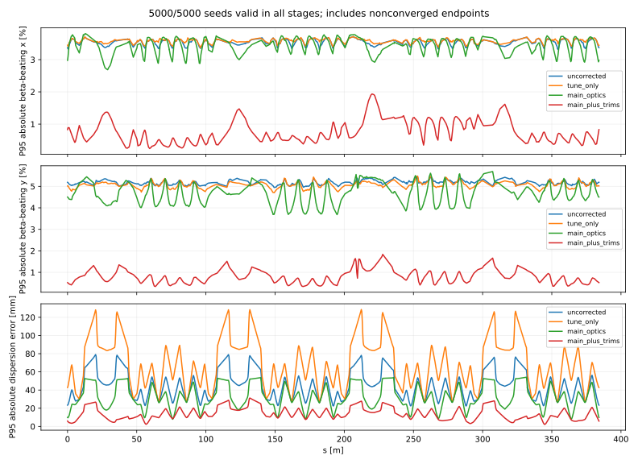
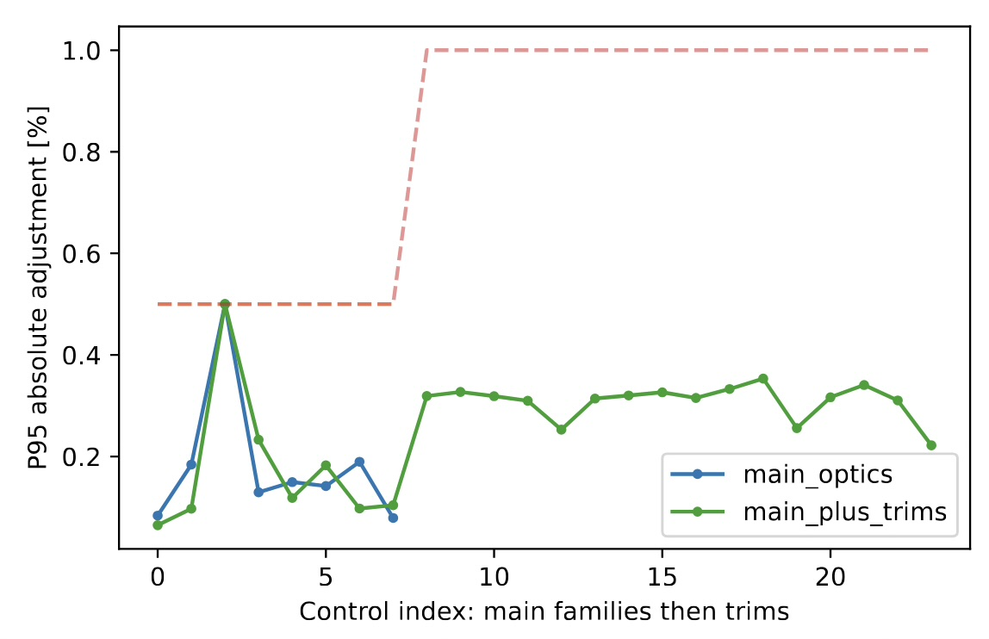
Error Corrections
There are 84 main quadrupoles. Introducing quadrupole field errors
Results in tune shifts and beta-beating.

Slide 26
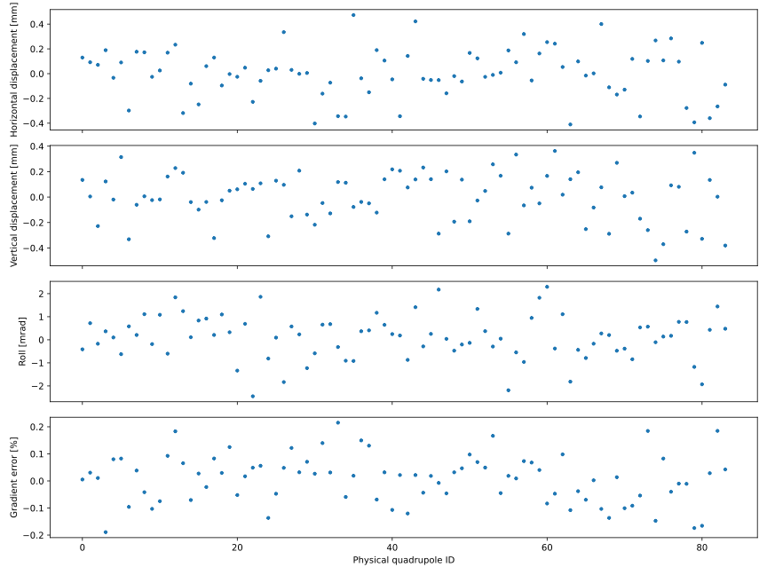
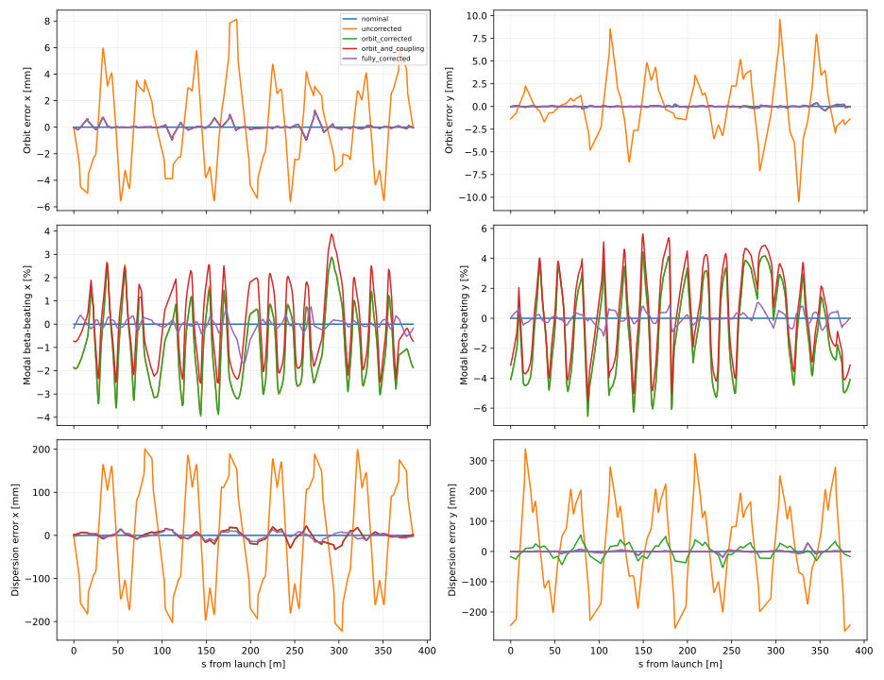
Error Corrections
There are 84 main quadrupoles. Combined Error Analysis
Combined errors for a specific seed shows corrected tunes, small beta-beat percentage and coupling effects

Slide 27
Error Corrections
Without correction the orbit reaches about 10–15 mm at P95 and up to about 25 mm in the worst seed. Global correction with the H/V kickers brings this down to 1.65 mm (H) and 0.98 mm (V) at P99 around the whole ring. At the critical locations the residual orbit is about 0.1–0.2 mm or less: at the foil, |x| is 0.18 mm and |y| is 0.05 mm (P99). Kicker strengths stay below about 0.35 mrad at P95 and about 0.66 mrad in the worst seed.
The 32 skew-quad correctors, set using the Lebedev–Bogacz parametrization, reduce the coupled beta functions by a median factor of 60–73×, rms D_y by 13×, and |C⁻| by 10×. The corrected |C⁻| is at most 2.3×10⁻³. Corrected vertical dispersion is 12 mm at P95 and 19 mm at maximum. The worst-case skew strength is about 0.0115, which is within the 0.013 hardware limit, and the P95 is about 0.006.
The three corrections work together without conflict when applied in sequence.

Slide 28
Chromaticity Correction and DA

Slide 29
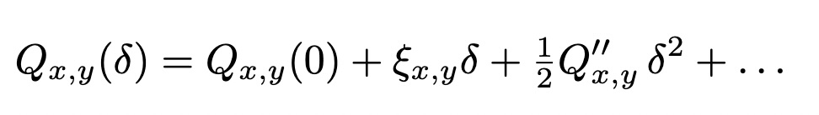
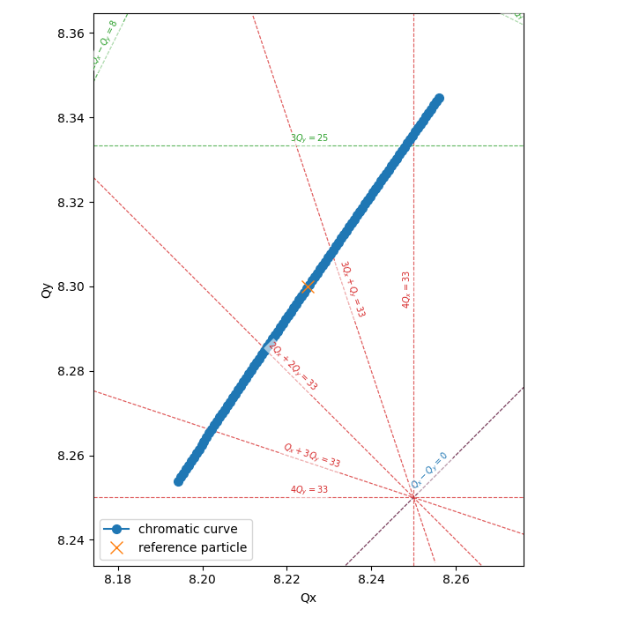
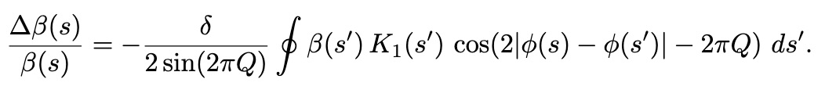
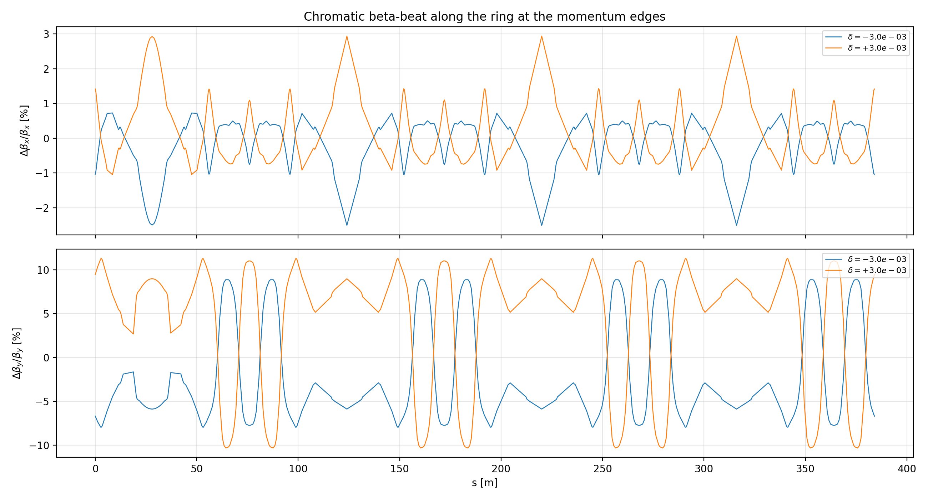
Dynamic Aperture and Chromaticity Correction
Off-momentum particles, different focusing structure

Slide 30
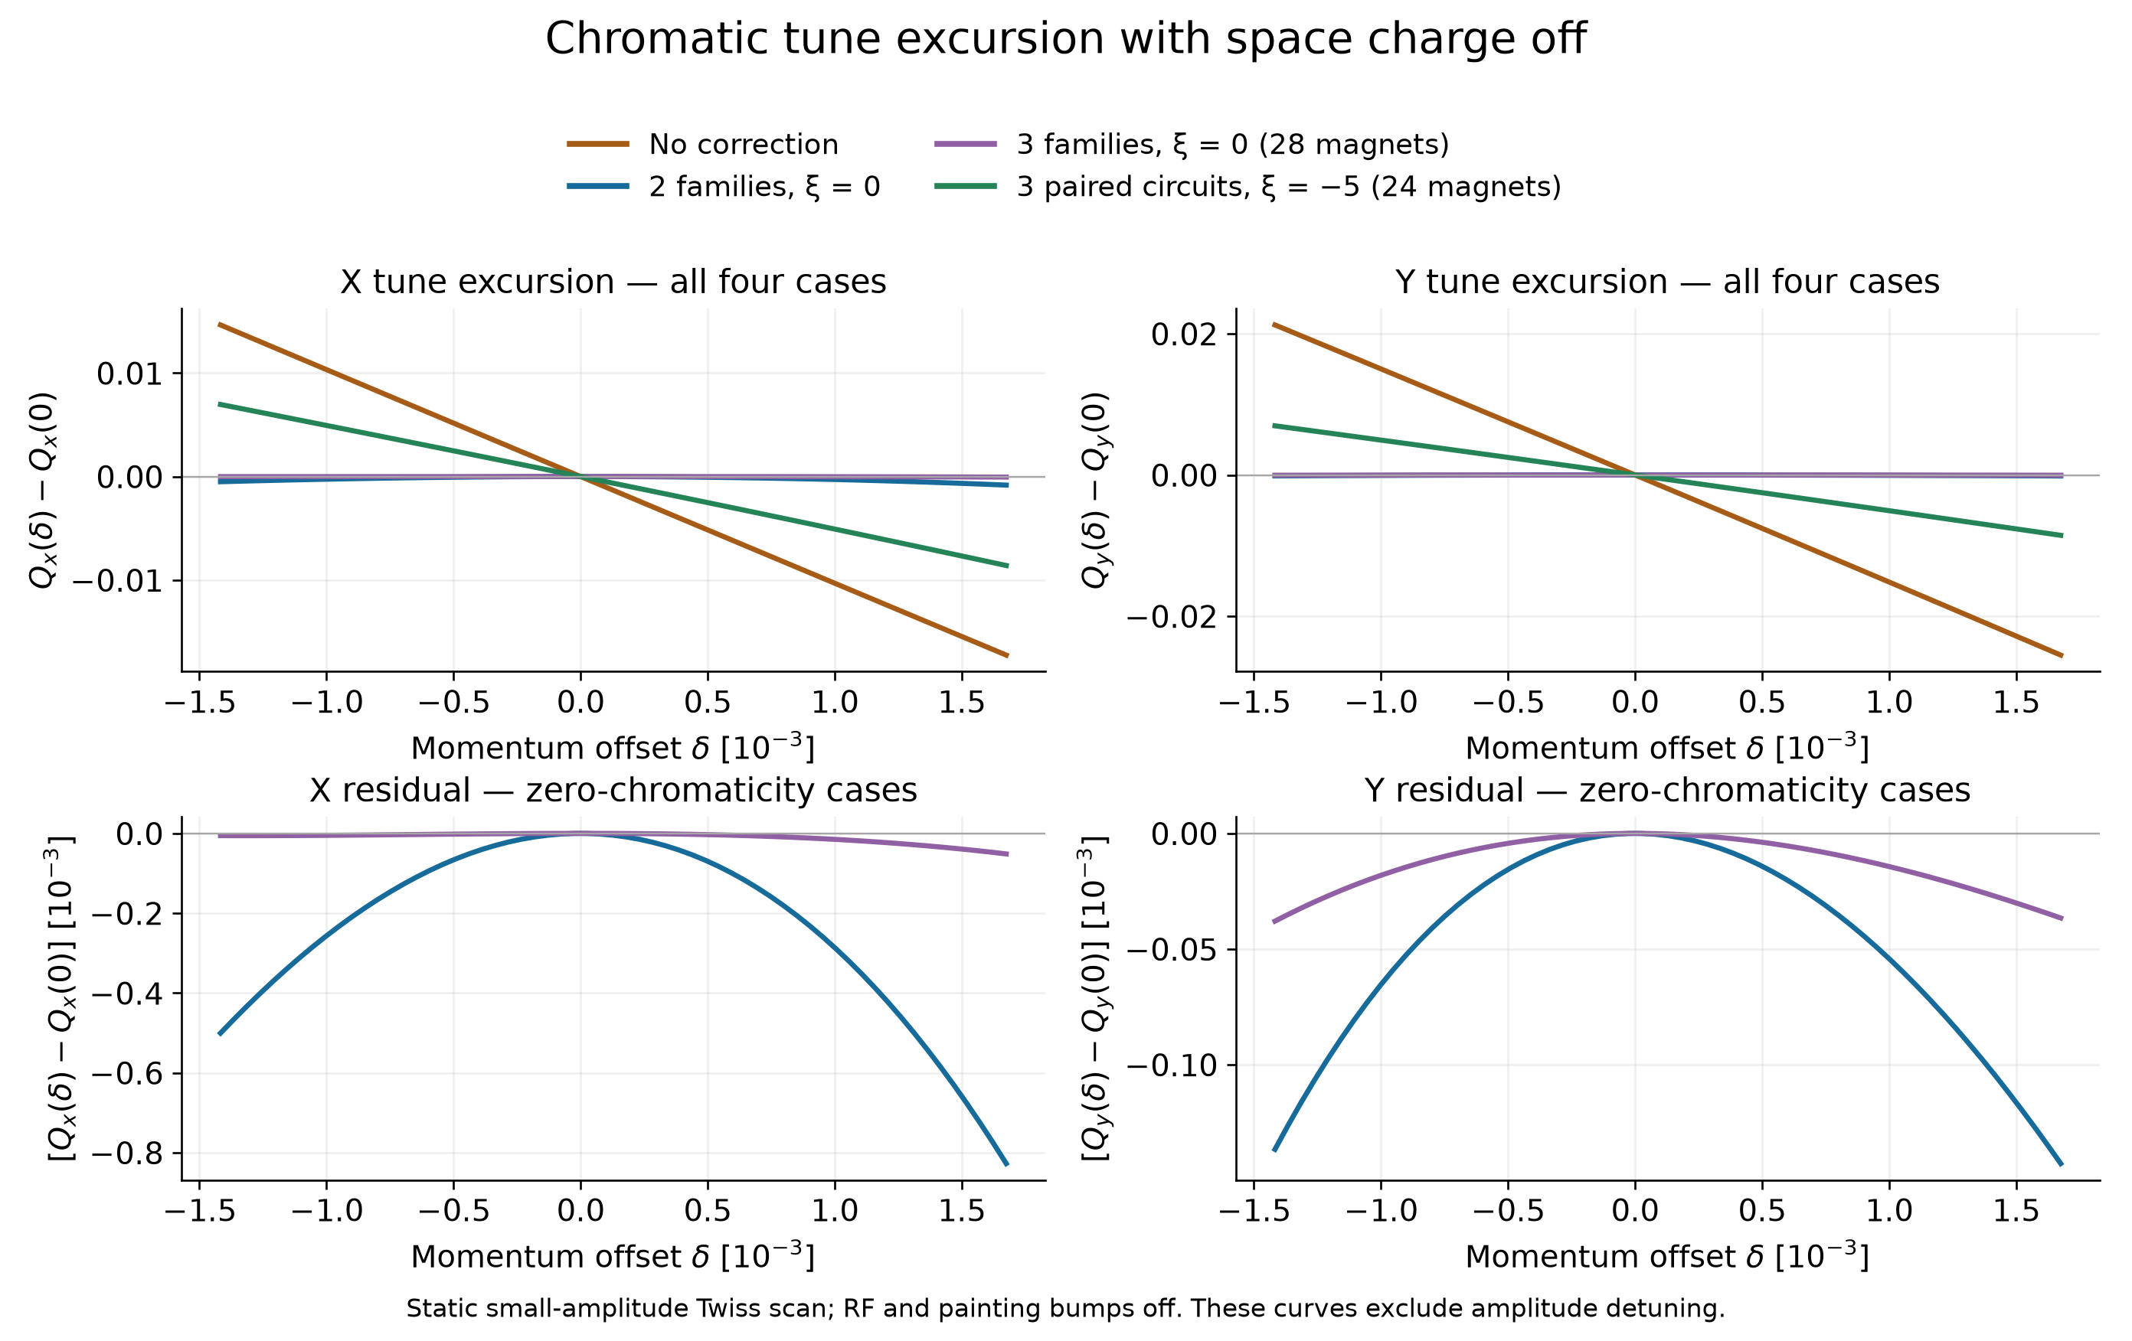
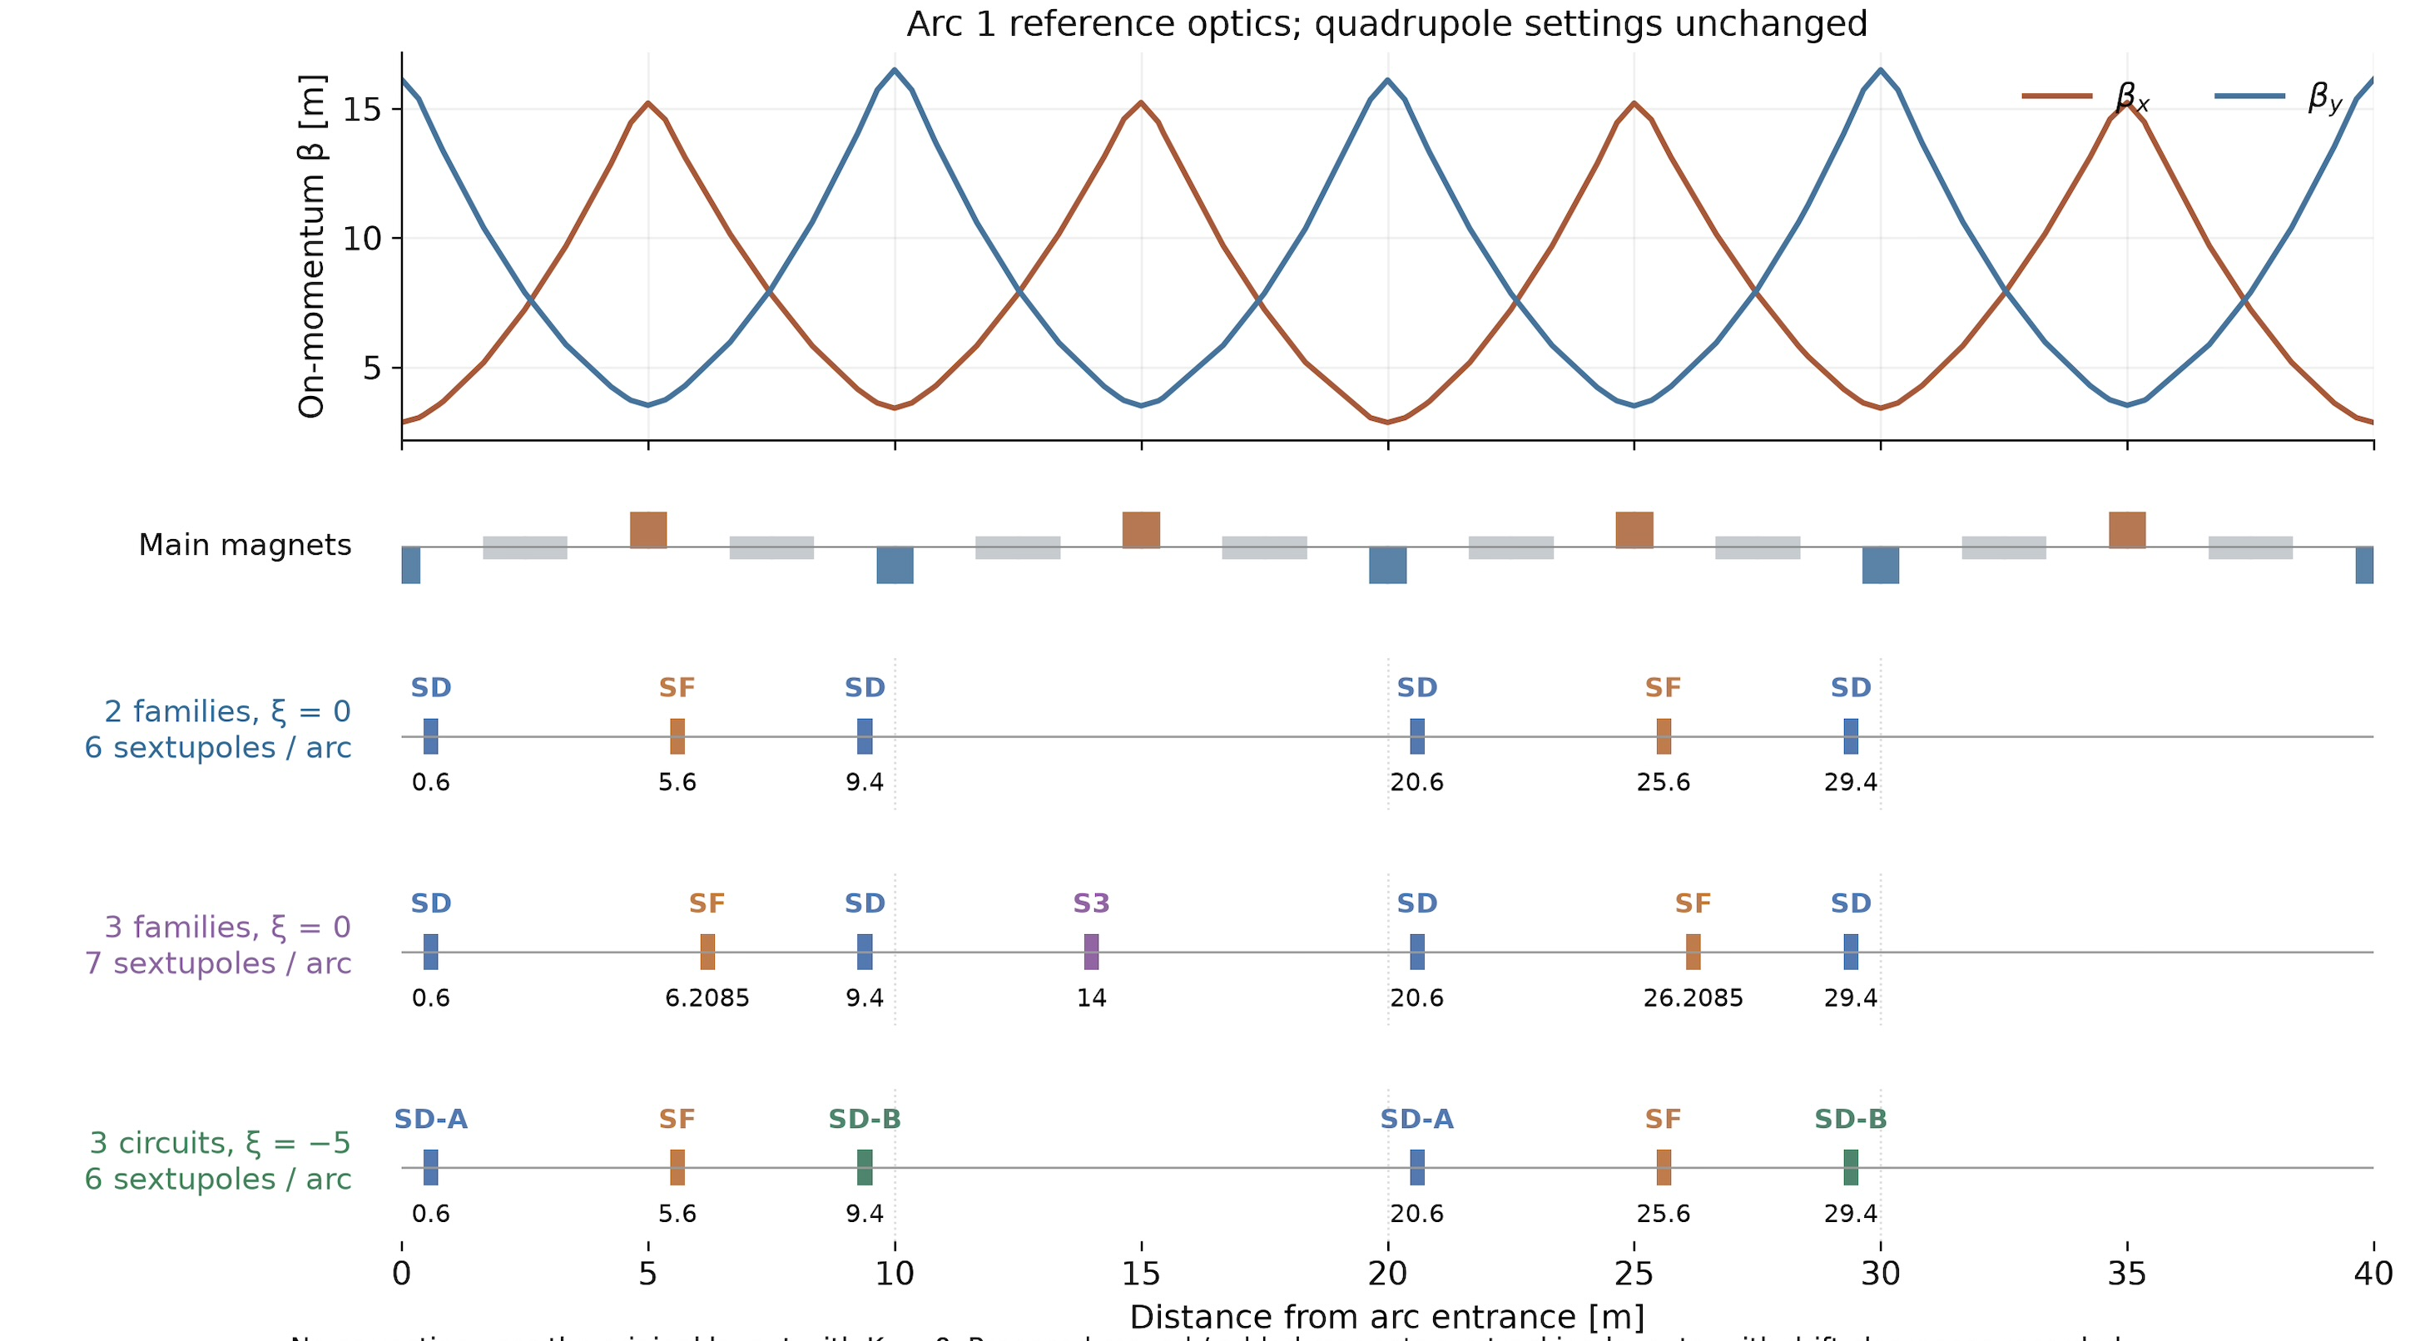
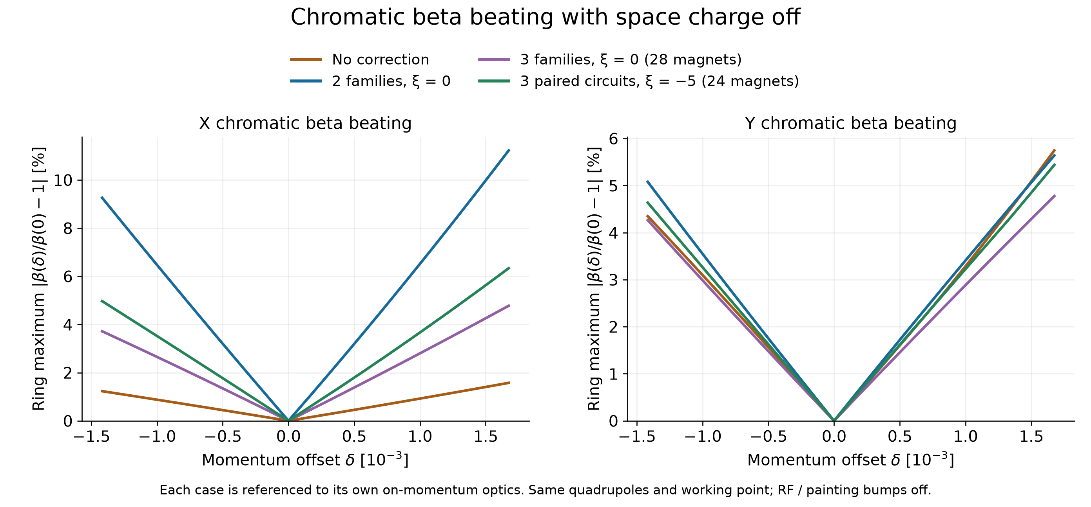
Dynamic Aperture and Chromaticity Correction
Testing different family corrections

Slide 31
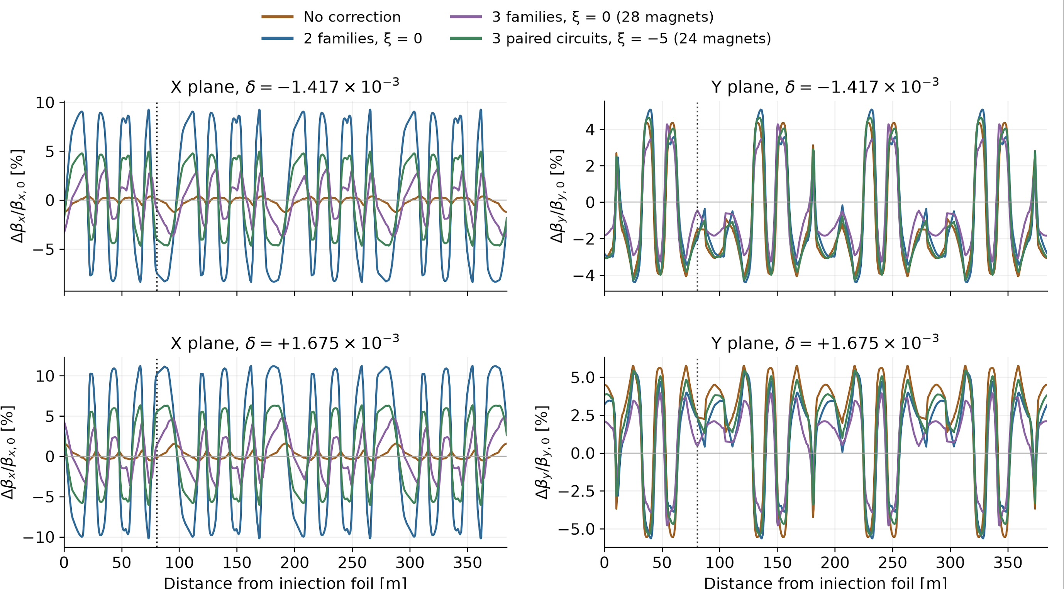



Dynamic Aperture and Chromaticity Correction
Testing 2 family, 3 family sextupole correction scheme
RDT values at the primary collimator and particles hitting “absorber”

Slide 32

Dynamic Aperture and Chromaticity Correction
Running space charge and chromaticity correction

Slide 33
Dynamic Aperture and Chromaticity Correction
Sextupoles on: 10% loss with space-charge.
Sextupoles off: 4% loss with space-charge.
Sextupoles off: smaller beta-beating by 1.5% in horizontal and 4% in vertical
It is better to not to correct for chromaticities in terms of beta-beat, DA, RDTs, and nonlinearities.

Slide 34
Eigenmode painting

Slide 35


Self-Consistent Danilov Distribution
4 kickers in each vertical and horizontal planes.

Slide 36

Self-Consistent Danilov Distribution

Slide 37




Self-Consistent Danilov Distribution
4 kickers in each vertical and horizontal planes.

Slide 38

Self-Consistent Danilov Distribution
4 kickers in each vertical and horizontal planes.

Slide 39
Conclusion and CDR Work

Slide 40
We have recapped the accumulator ring.
Introduced a possible design for the L2R transfer line for laser stripping process.
Performed error correction analysis and chromaticity correction with space charge (IAP Response)
Ran RDT analysis on the accumulator and picked the best choice of chromaticity correction scheme if needed
We observe losses due to nonlinearities + space-charge on 4% margin.
By CDR expect:
  Full scale simulation with proper loss dynamics
  Laser assisted stripping test.
  Better Danilov distribution matching

Slide 41
Thank you

Slide 42
Backup

