Slide 1

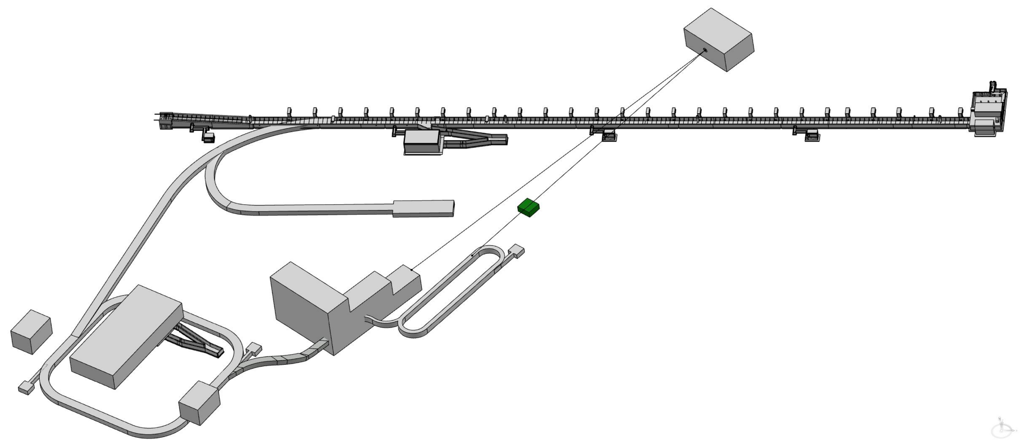
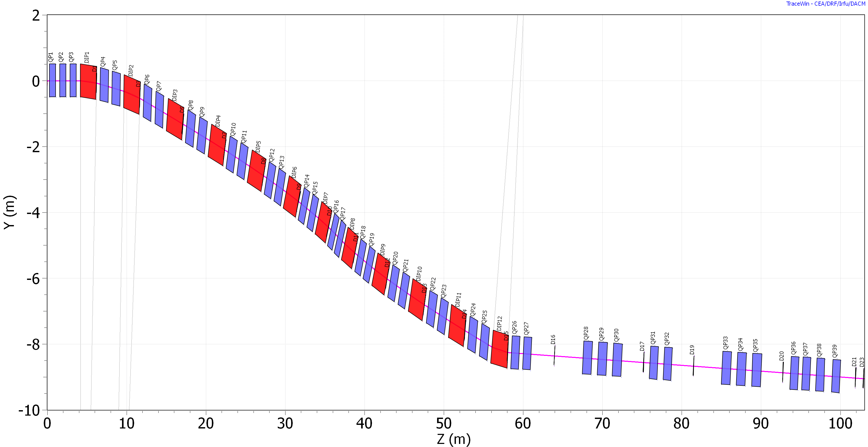
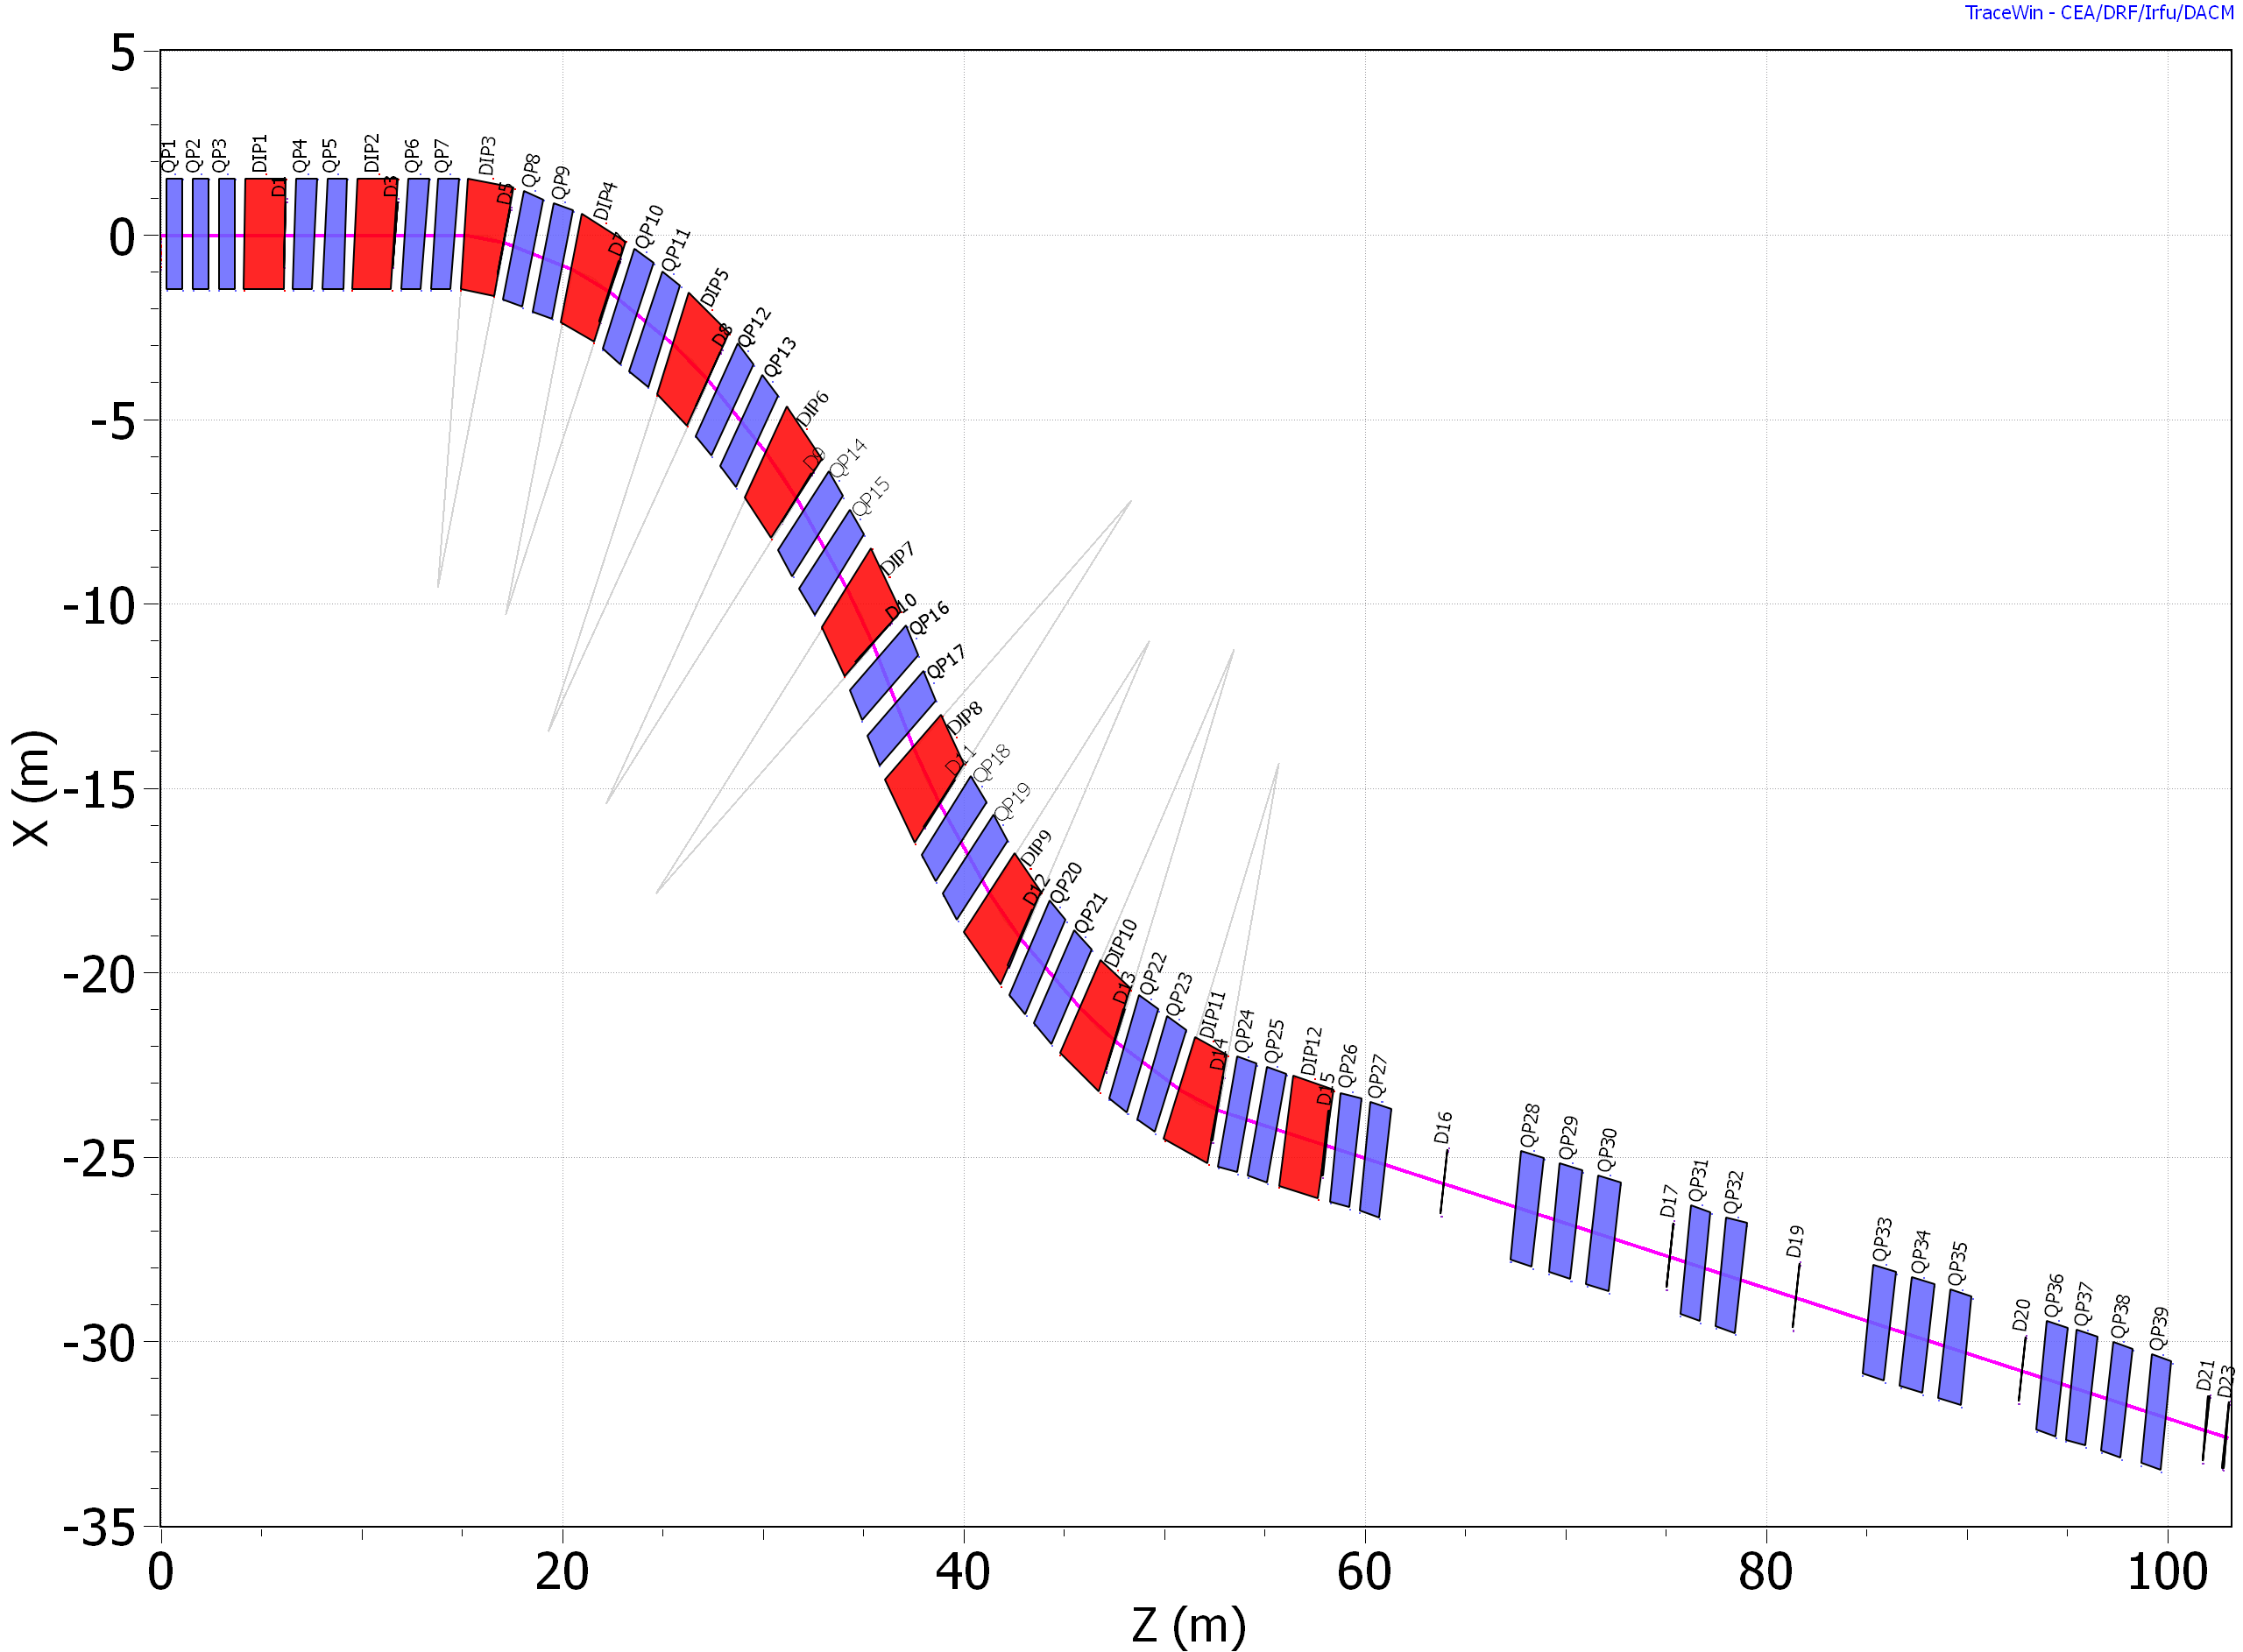
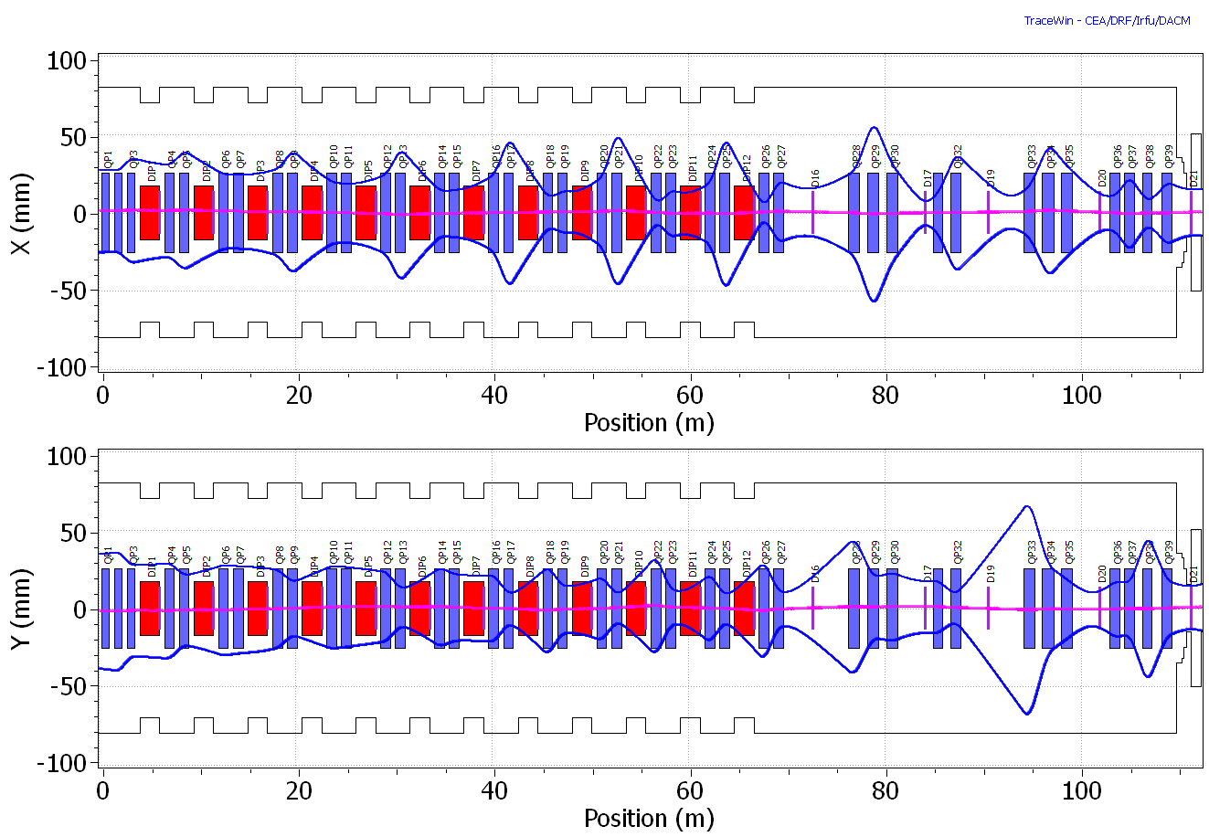
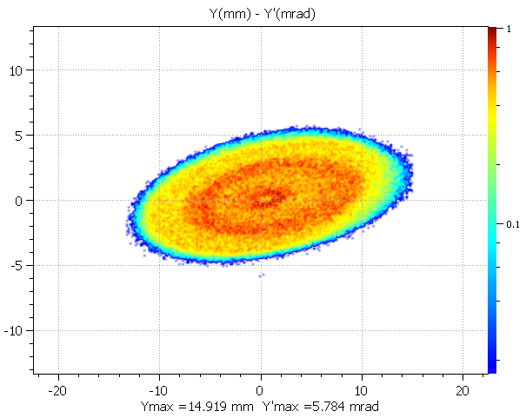
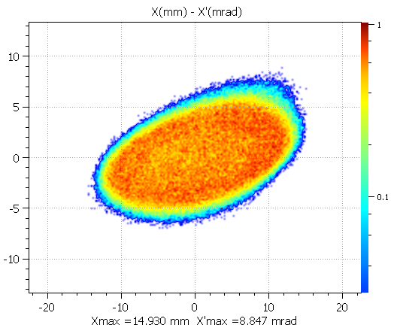


ACCUMULATOR-TO-TARGET BEAM TRANSFER LINE FOR ESSνSB+
Beam Requirements at Target
-Alignment with neutrino beam:
→ 16.8° (H), 2.29° (V)
-Compact line, low losses
-Beam size at target: < 15 mm
Beam Dynamics Performance
-Smooth β-functions → no strong focusing peaks
-Controlled dispersion → partial suppression downstream
-Large acceptance along the line
-Envelope fully contained within apertures
-Efficient transport with minimal losses^{[2]}
Ring-to-Target Beamline
Ring
Ring
Beam Extraction
-Single-turn fast extraction (~1.2 μs pulse)^{[1]}
-16 fast kickers + Lambertson septum
-Vertical kick + horizontal bending (SNS-like scheme)
-Optimized geometry (septum close to closed orbit)
Vertical plane
Horizontal plane
neutrino direction
neutrino direction
Target
Target
Parameter | Value | Unit
Kinetic energy | 2499.9 | MeV
Relativistic momentum | 3307.7 | MeV/c
Emittances ε_{x}/ε_{y} [rms] | 27.1/25.9 | π mm mrad
Emittances ε_{x}/ε_{y} [99.95%] | 244.0/233.8 | π mm mrad
σ_{x}/σ_{y} [rms] | 11.3/15.8 | mm
σ_{x’}/σ_{y’} [rms] | 1.1/0.7 | mrad
β_{x}/β_{y} | 9.9/20.3 | m
α_{x}/α_{y} | -0.0005/0.0032
Optics Design
-Input from realistic beam (painting distribution)
-Matching at septum: (β, α, D, D′)
-Lattice: 8 horizontal + 4 vertical dipoles (2 m); < 40 quadrupoles; Total length: 115 m
-Beam size evolution:
$$σ=\sqrt{βε+{\left(Dδ\right)}^{2}}$$
Beam parameters at extraction
[1] A. Alekou, I. Efthymiopoulos, CERN report CERN-ACC-2020-0027,2020, https://cds.cern.ch/record/2742888
[2] D. Uriot, TraceWin documentation, https://www.dacm-logiciels.fr/tracewin
E. Bouquerel, IPHC-CNRS

