Slide 1


ESSnuSB+ Fourth Annual Meeting
THERMOMECHANICAL DEVELOPMENT
OF A GRANULAR NEUTRINO TARGET
Presented by Jorge Aguilar
Jorge Aguilar
María López
Silvia Gago
Ricardo Sánchez
Bálint A. Nemes
Fernando Sordo
Notes:
Timing: 1 minute. Open by stating that this is a four-year WP3 Target progress story, with most of the presentation focused on the two advances achieved in 2026: the first ETTF campaign and the exploratory shell-bypass study. Make clear that the ETTF data reduction is still active and that the bypass study is not a final design.
Source citations:
- C:/Users/usuario/Desktop/ESSnuSB/Presentations/ESSnuSB+ TARGET 3rdAnnualMeeting R2.pptx
- C:/Users/usuario/Downloads/ETTF.pptx
- C:/Users/usuario/Consorcio ESS Bilbao Dropbox/Jorge Aguilar/Documento/main.pdf

Slide 2
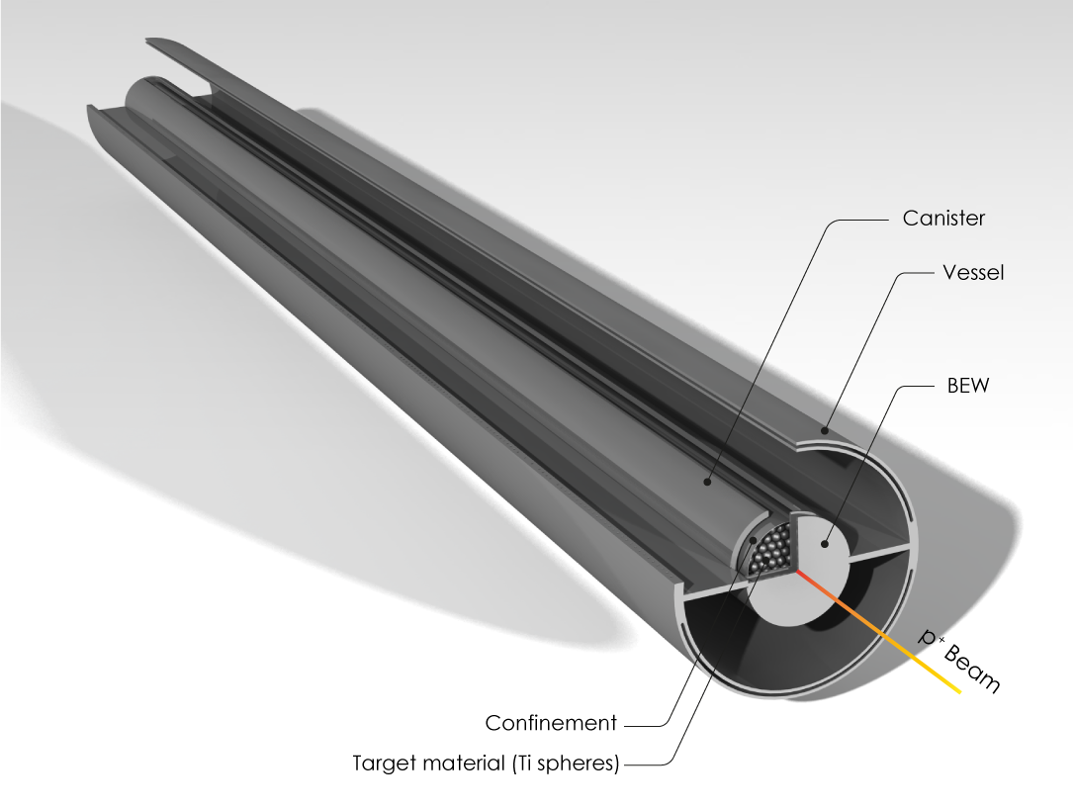
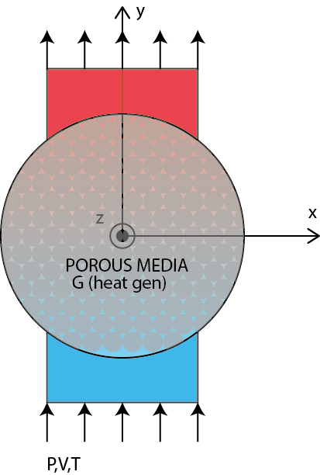
ESSnuSB+ Granular Target current parameters
Parameter | 2023 design basis |  | Current status
Beam power per target | 1.25 MW
Sphere diameter | 3 mm
Helium cooling | 10 bar, 200 g/s
Target dimensions | ≈777 mm length; Ø56 mm outer tube; Ø34 mm inner canister;
Geometric porosity | ε = 0.34 | ε ≈ 0.45–0.46 | ε ≈ 0.45–0.46
Flow distribution | 200g/s | 180 g/s bed, 20 g/s BEW 40 g/s shell bypass explored | 180 g/s bed, 20 g/s BEW 40 g/s shell bypass explored
Predicted pressure drop | ≈(0.5 bar) 0.7 bar | ≈0.5 bar, model dependent | ≈0.7–0.9 bar, model dependent
Peak bed temperature | (530ºC) ≈670 °C | ≈500 °C updated baseline | ≈500 °C updated baseline
Outer-wall temperature | ≈356 °C | ≈216 °C with mid-span bypass | ≈216 °C with mid-span bypass
06/10/2026
Jorge Aguilar ESS-BILBAO
2
Notes:
Timing: 2 minutes. Frame the target as a coupled thermo-hydraulic and structural problem. The beam parameters establish the heat load. The granular bed and the helium path determine pressure drop and heat removal. Those temperatures then drive shell gradients and bending. This coupling explains why the work moved from analytical assumptions to detailed packing models and finally to experiment.
Source citations:
- C:/Users/usuario/Desktop/ESSnuSB/Presentations/ESSnuSB+ TARGET 1stAnnualMeeting.pdf
- C:/Users/usuario/Desktop/ESSnuSB/Presentations/ESSnuSB+ TARGET 3rdAnnualMeeting R2.pdf

Slide 3
ESSnuSB+ Target Progress
The programme progressed from feasibility to experimentally anchored design decisions.
2023
2024
2025
2026
Feasibility
Validation route
Model fidelity
Evidence
Steady-state CFD and first mechanical screening
Dynamic response and ETTF concept
Random packing and resolved CFD
ETTF campaign and shell-bypass exploration
06/10/2026
Jorge Aguilar ESS-BILBAO
3
Notes:
Timing: 2 minutes. Use this slide as the map for the presentation. The annual milestones are cumulative. The 2023 design proved the concept could be cooled. The 2024 work identified the need for a dedicated validation experiment. The 2025 work quantified the limitations of the porous model. In 2026 the team operated ETTF and also explored a new flow path to address shell bending.
Source citations:
- C:/Users/usuario/Desktop/ESSnuSB/Presentations/ESSnuSB+ TARGET 1stAnnualMeeting.pdf
- C:/Users/usuario/Desktop/ESSnuSB/Presentations/ESSnuSB+ TARGET 2ndAnnualMeeting.pdf
- C:/Users/usuario/Desktop/ESSnuSB/Presentations/ESSnuSB+ TARGET 3rdAnnualMeeting R2.pdf
- C:/Users/usuario/Downloads/ETTF.pptx
- C:/Users/usuario/Consorcio ESS Bilbao Dropbox/Jorge Aguilar/Documento/main.pdf

Slide 4
ESSnuSB+ Target Progress
The programme progressed from feasibility to experimentally anchored design decisions.
2023
2024
2025
2026
Feasibility
Validation route
Model fidelity
Evidence
Steady-state CFD and first mechanical screening
Dynamic response and ETTF concept
Random packing and resolved CFD
ETTF campaign
Shell-bypass exploration
BEW cooling design explored with no dramatic impact in the packed bed temperatures.
Large shell temperature gradients remained → canister structure bending.
For the BEW and canister, a higher-strength titanium alloy is required→ No reliable stresses or fatigue-limit data is available for the candidate titanium alloys under the relevant irradiation and temperature conditions.
06/10/2026
Jorge Aguilar ESS-BILBAO
3
Notes:
Timing: 2 minutes. Use this slide as the map for the presentation. The annual milestones are cumulative. The 2023 design proved the concept could be cooled. The 2024 work identified the need for a dedicated validation experiment. The 2025 work quantified the limitations of the porous model. In 2026 the team operated ETTF and also explored a new flow path to address shell bending.
Source citations:
- C:/Users/usuario/Desktop/ESSnuSB/Presentations/ESSnuSB+ TARGET 1stAnnualMeeting.pdf
- C:/Users/usuario/Desktop/ESSnuSB/Presentations/ESSnuSB+ TARGET 2ndAnnualMeeting.pdf
- C:/Users/usuario/Desktop/ESSnuSB/Presentations/ESSnuSB+ TARGET 3rdAnnualMeeting R2.pdf
- C:/Users/usuario/Downloads/ETTF.pptx
- C:/Users/usuario/Consorcio ESS Bilbao Dropbox/Jorge Aguilar/Documento/main.pdf

Slide 5
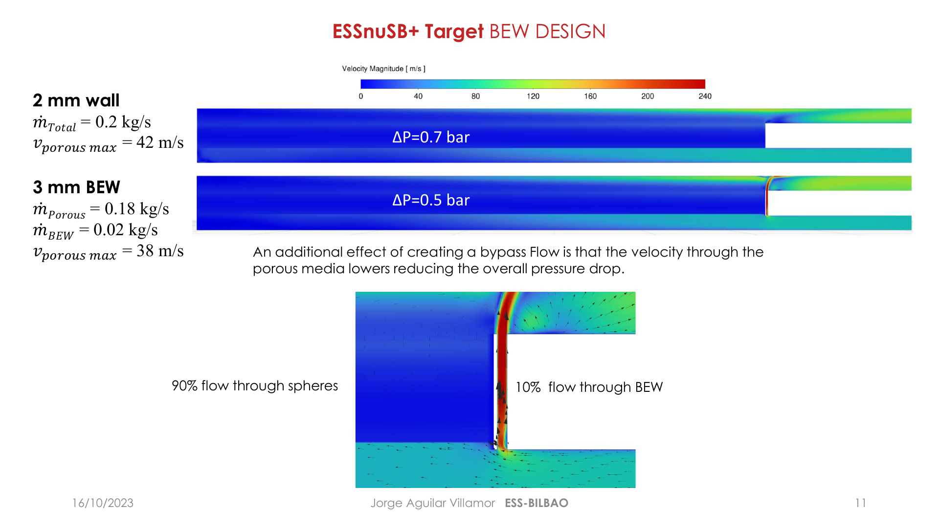
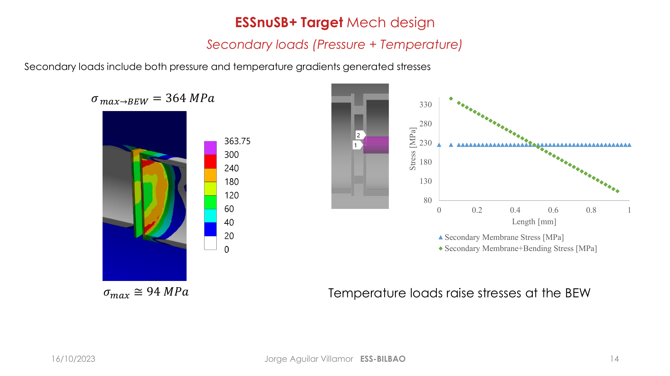
ESSnuSB+ Target 2023
Thermo-hydraulics: a 3 mm BEW channel diverted 0.02 kg/s and reduced total pressure drop to about 0.5 bar.
Mechanics: pressure plus thermal gradients drove the BEW stress estimate to about 364 MPa.
To compare against what?
The concept is viable, but shell gradients and transient fatigue remained open.
06/10/2026
Jorge Aguilar ESS-BILBAO
4
Notes:
Timing: 2 minutes. Summarise the first annual meeting results. The grooved beam entrance window created a small bypass that cooled the window and reduced pressure loss. This established a plausible steady-state operating point. The mechanical model also showed that temperature gradients, not pressure alone, dominate the BEW stress. Avoid presenting these as final allowables because supports, fatigue and transient loading were not yet closed.
Source citations:
- C:/Users/usuario/Desktop/ESSnuSB/Presentations/ESSnuSB+ TARGET 1stAnnualMeeting.pdf

Slide 6
ESSnuSB+ Target Progress
The programme progressed from feasibility to experimentally anchored design decisions.
2023
2024
2025
2026
Feasibility
Validation route
Model fidelity
Evidence
Steady-state CFD and first mechanical screening
Dynamic response and ETTF concept
Random packing and resolved CFD
ETTF campaign
Shell-bypass exploration
The isolated 3 mm sphere showed an acceptable single-pulse response
The prototype temperature gradient seemed too localized for reliable steady-state measurements.
BEW dynamics and sphere interactions remained open
06/10/2026
Jorge Aguilar ESS-BILBAO
3
Notes:
Timing: 2 minutes. Use this slide as the map for the presentation. The annual milestones are cumulative. The 2023 design proved the concept could be cooled. The 2024 work identified the need for a dedicated validation experiment. The 2025 work quantified the limitations of the porous model. In 2026 the team operated ETTF and also explored a new flow path to address shell bending.
Source citations:
- C:/Users/usuario/Desktop/ESSnuSB/Presentations/ESSnuSB+ TARGET 1stAnnualMeeting.pdf
- C:/Users/usuario/Desktop/ESSnuSB/Presentations/ESSnuSB+ TARGET 2ndAnnualMeeting.pdf
- C:/Users/usuario/Desktop/ESSnuSB/Presentations/ESSnuSB+ TARGET 3rdAnnualMeeting R2.pdf
- C:/Users/usuario/Downloads/ETTF.pptx
- C:/Users/usuario/Consorcio ESS Bilbao Dropbox/Jorge Aguilar/Documento/main.pdf

Slide 7
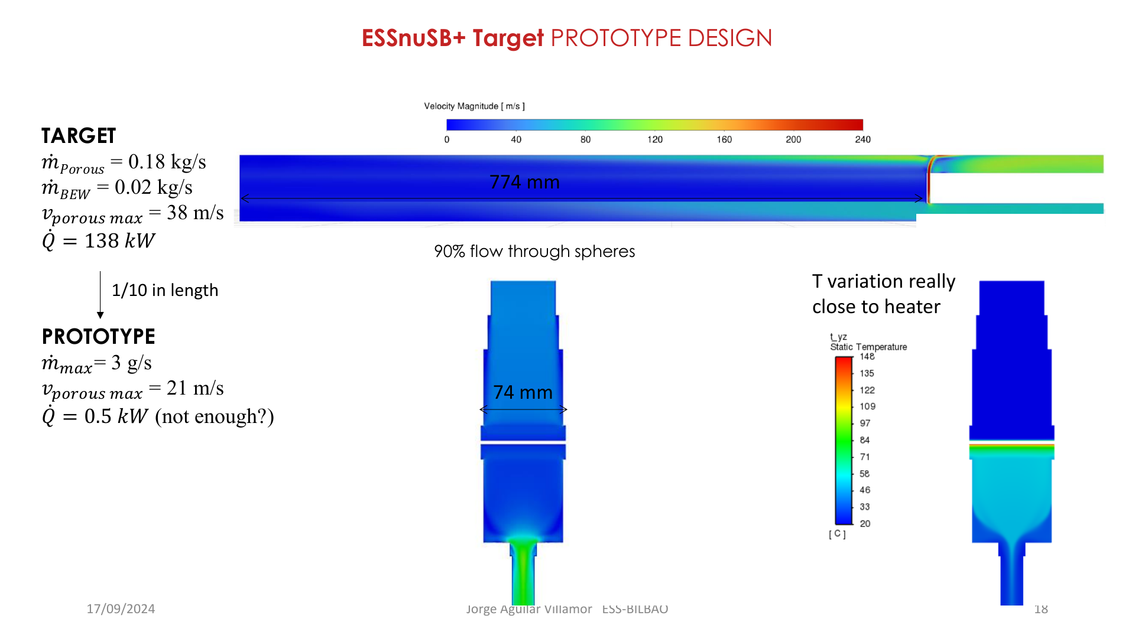
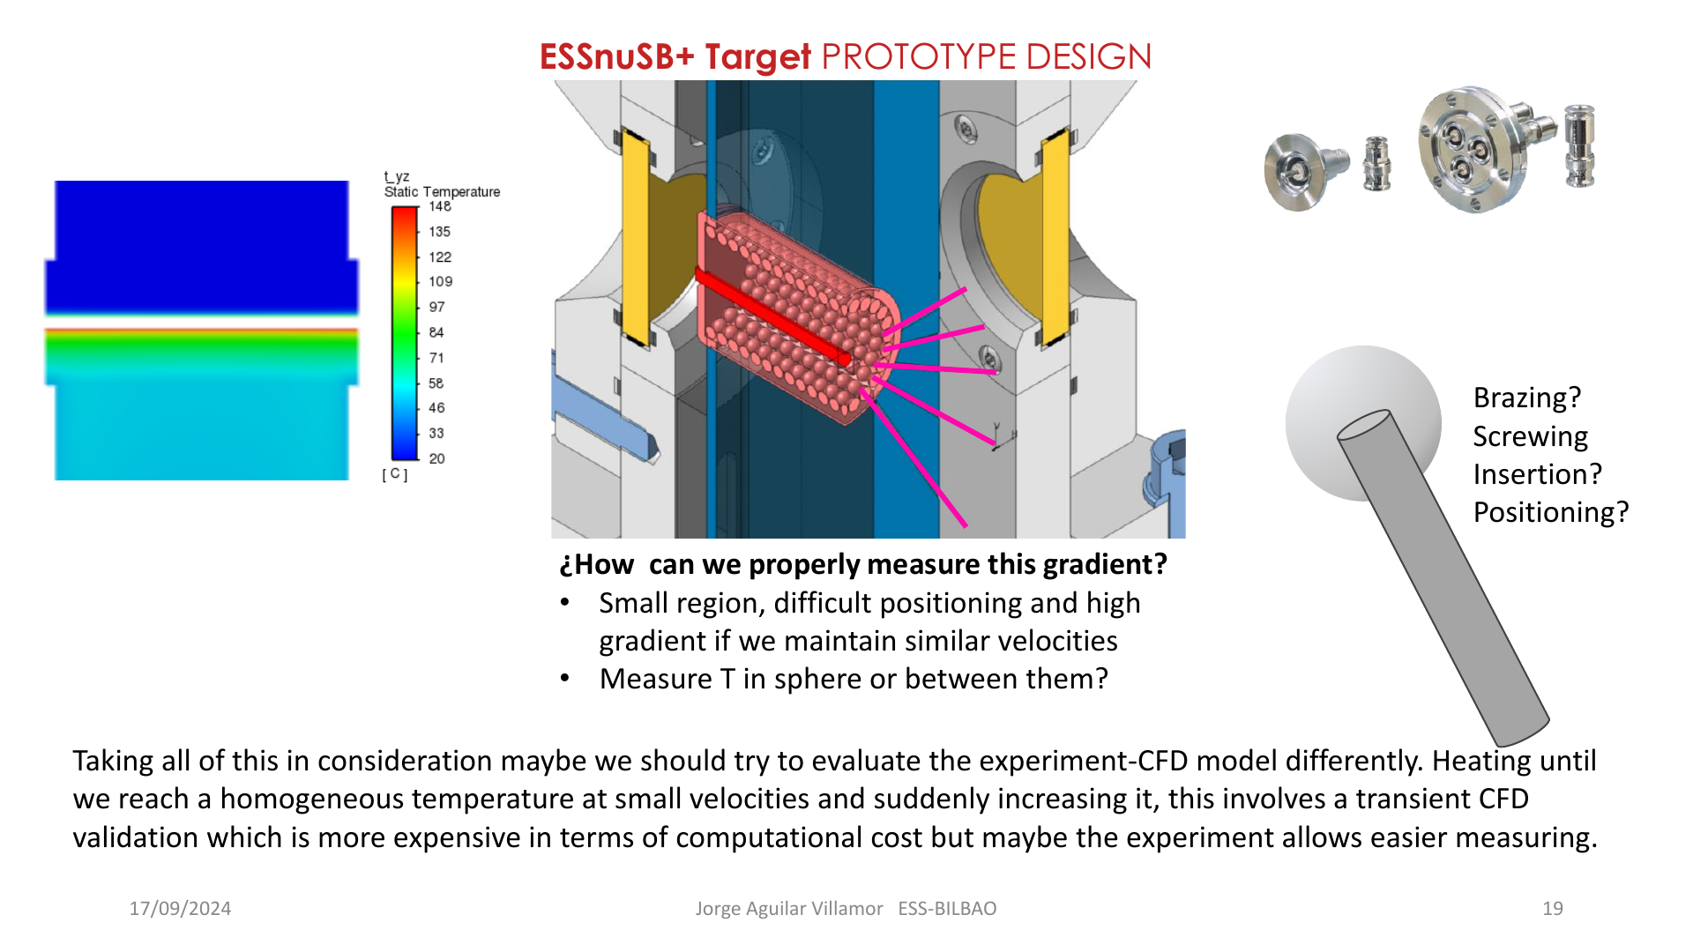
ESSnuSB+ Target 2024
3 g/s
21 m/s
0.5 kW
A transient heating and cooling method was selected because the steep local temperature gradient was difficult to instrument directly.
prototype design flow
porous-zone peak velocity
initial heater estimate
A dedicated loop for pressure loss and thermal response on the real granular geometry.
06/10/2026
Jorge Aguilar ESS-BILBAO
5
Notes:
Timing: 2 minutes. Explain the 2024 transition from design studies to a validation strategy. The prototype used roughly one tenth of the target length and a 3 g/s design flow. Instrumenting the narrow high-gradient region directly was judged too fragile and ambiguous. The team therefore selected transient heating and cooling as a more robust validation observable. This design choice directly shaped the 2026 campaign.
Source citations:
- C:/Users/usuario/Desktop/ESSnuSB/Presentations/ESSnuSB+ TARGET 2ndAnnualMeeting.pdf

Slide 8
ESSnuSB+ Target Progress
The programme progressed from feasibility to experimentally anchored design decisions.
2023
2024
2025
2026
Feasibility
Validation route
Model fidelity
Evidence
Steady-state CFD and first mechanical screening
Dynamic response and ETTF concept
Random packing and resolved CFD
ETTF campaign
Shell-bypass exploration
Realistic random packing seems to provide a higher porosity. ε ≈ 0.45, instead of ε = 0.34.
Wall effects and channelling were significant→ No single porosity reproduced both viscous and inertial resistance.
The geometry and porosity updates cooled the bed and lowered pressure drop, however it has its impact in the nuclear calculations.
At this point experimental checking was needed to properly calibrate the porous and packed bed models.
06/10/2026
Jorge Aguilar ESS-BILBAO
3
Notes:
Timing: 2 minutes. Use this slide as the map for the presentation. The annual milestones are cumulative. The 2023 design proved the concept could be cooled. The 2024 work identified the need for a dedicated validation experiment. The 2025 work quantified the limitations of the porous model. In 2026 the team operated ETTF and also explored a new flow path to address shell bending.
Source citations:
- C:/Users/usuario/Desktop/ESSnuSB/Presentations/ESSnuSB+ TARGET 1stAnnualMeeting.pdf
- C:/Users/usuario/Desktop/ESSnuSB/Presentations/ESSnuSB+ TARGET 2ndAnnualMeeting.pdf
- C:/Users/usuario/Desktop/ESSnuSB/Presentations/ESSnuSB+ TARGET 3rdAnnualMeeting R2.pdf
- C:/Users/usuario/Downloads/ETTF.pptx
- C:/Users/usuario/Consorcio ESS Bilbao Dropbox/Jorge Aguilar/Documento/main.pdf

Slide 9
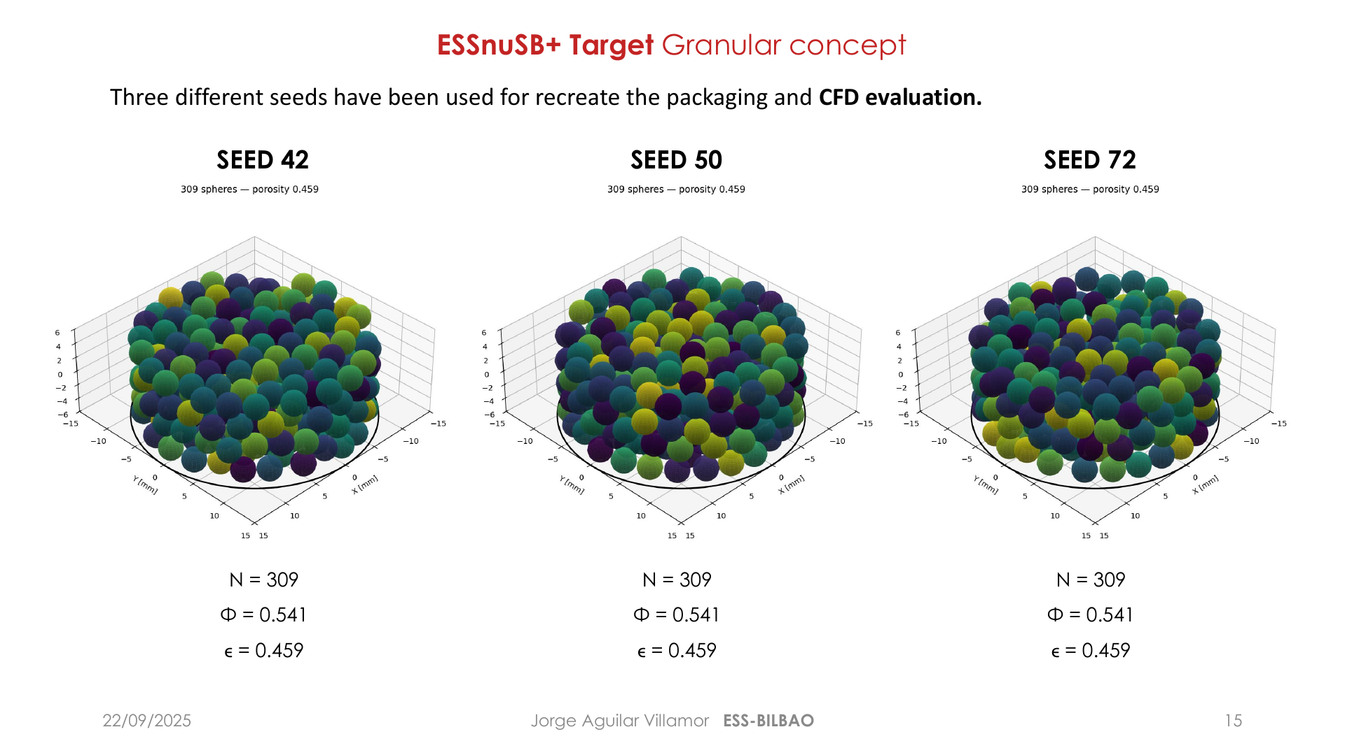
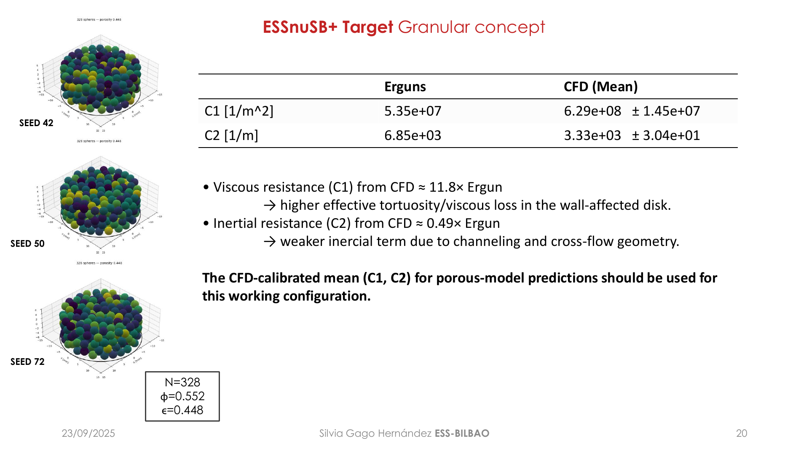
ESSnuSB+ Target 2025
309
ε = 0.459
C₁: 11.8×
C₂: 0.49×
spheres in the LS packing
geometric porosity
resolved CFD versus Ergun
resolved CFD versus Ergun
No single porosity reproduced both viscous and inertial resistance. Experimental calibration became essential.
06/10/2026
Jorge Aguilar ESS-BILBAO
6
Notes:
Timing: 2.5 minutes. Describe the Lubachevsky-Stillinger packing and the resolved CFD comparison. The real packing porosity in the ETTF-scale cylinder was about 0.459. Resolved CFD gave a much larger viscous coefficient and a smaller inertial coefficient than the standard Ergun prediction. The important conclusion is not one preferred porosity. It is that porosity alone cannot match both regimes, so measured pressure loss is needed to calibrate the reduced model.
Source citations:
- C:/Users/usuario/Desktop/ESSnuSB/Presentations/ESSnuSB+ TARGET 3rdAnnualMeeting R2.pdf

Slide 10
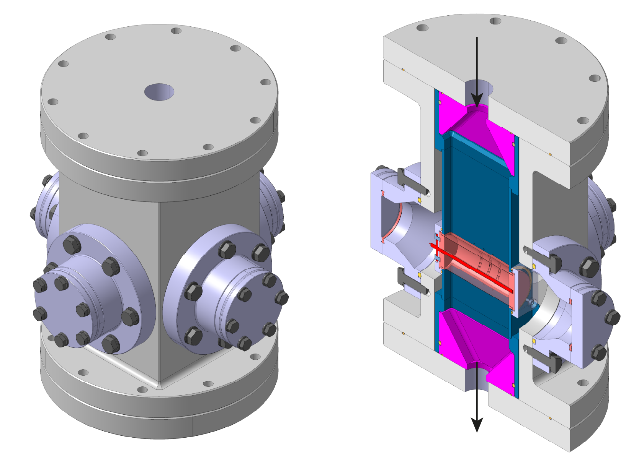
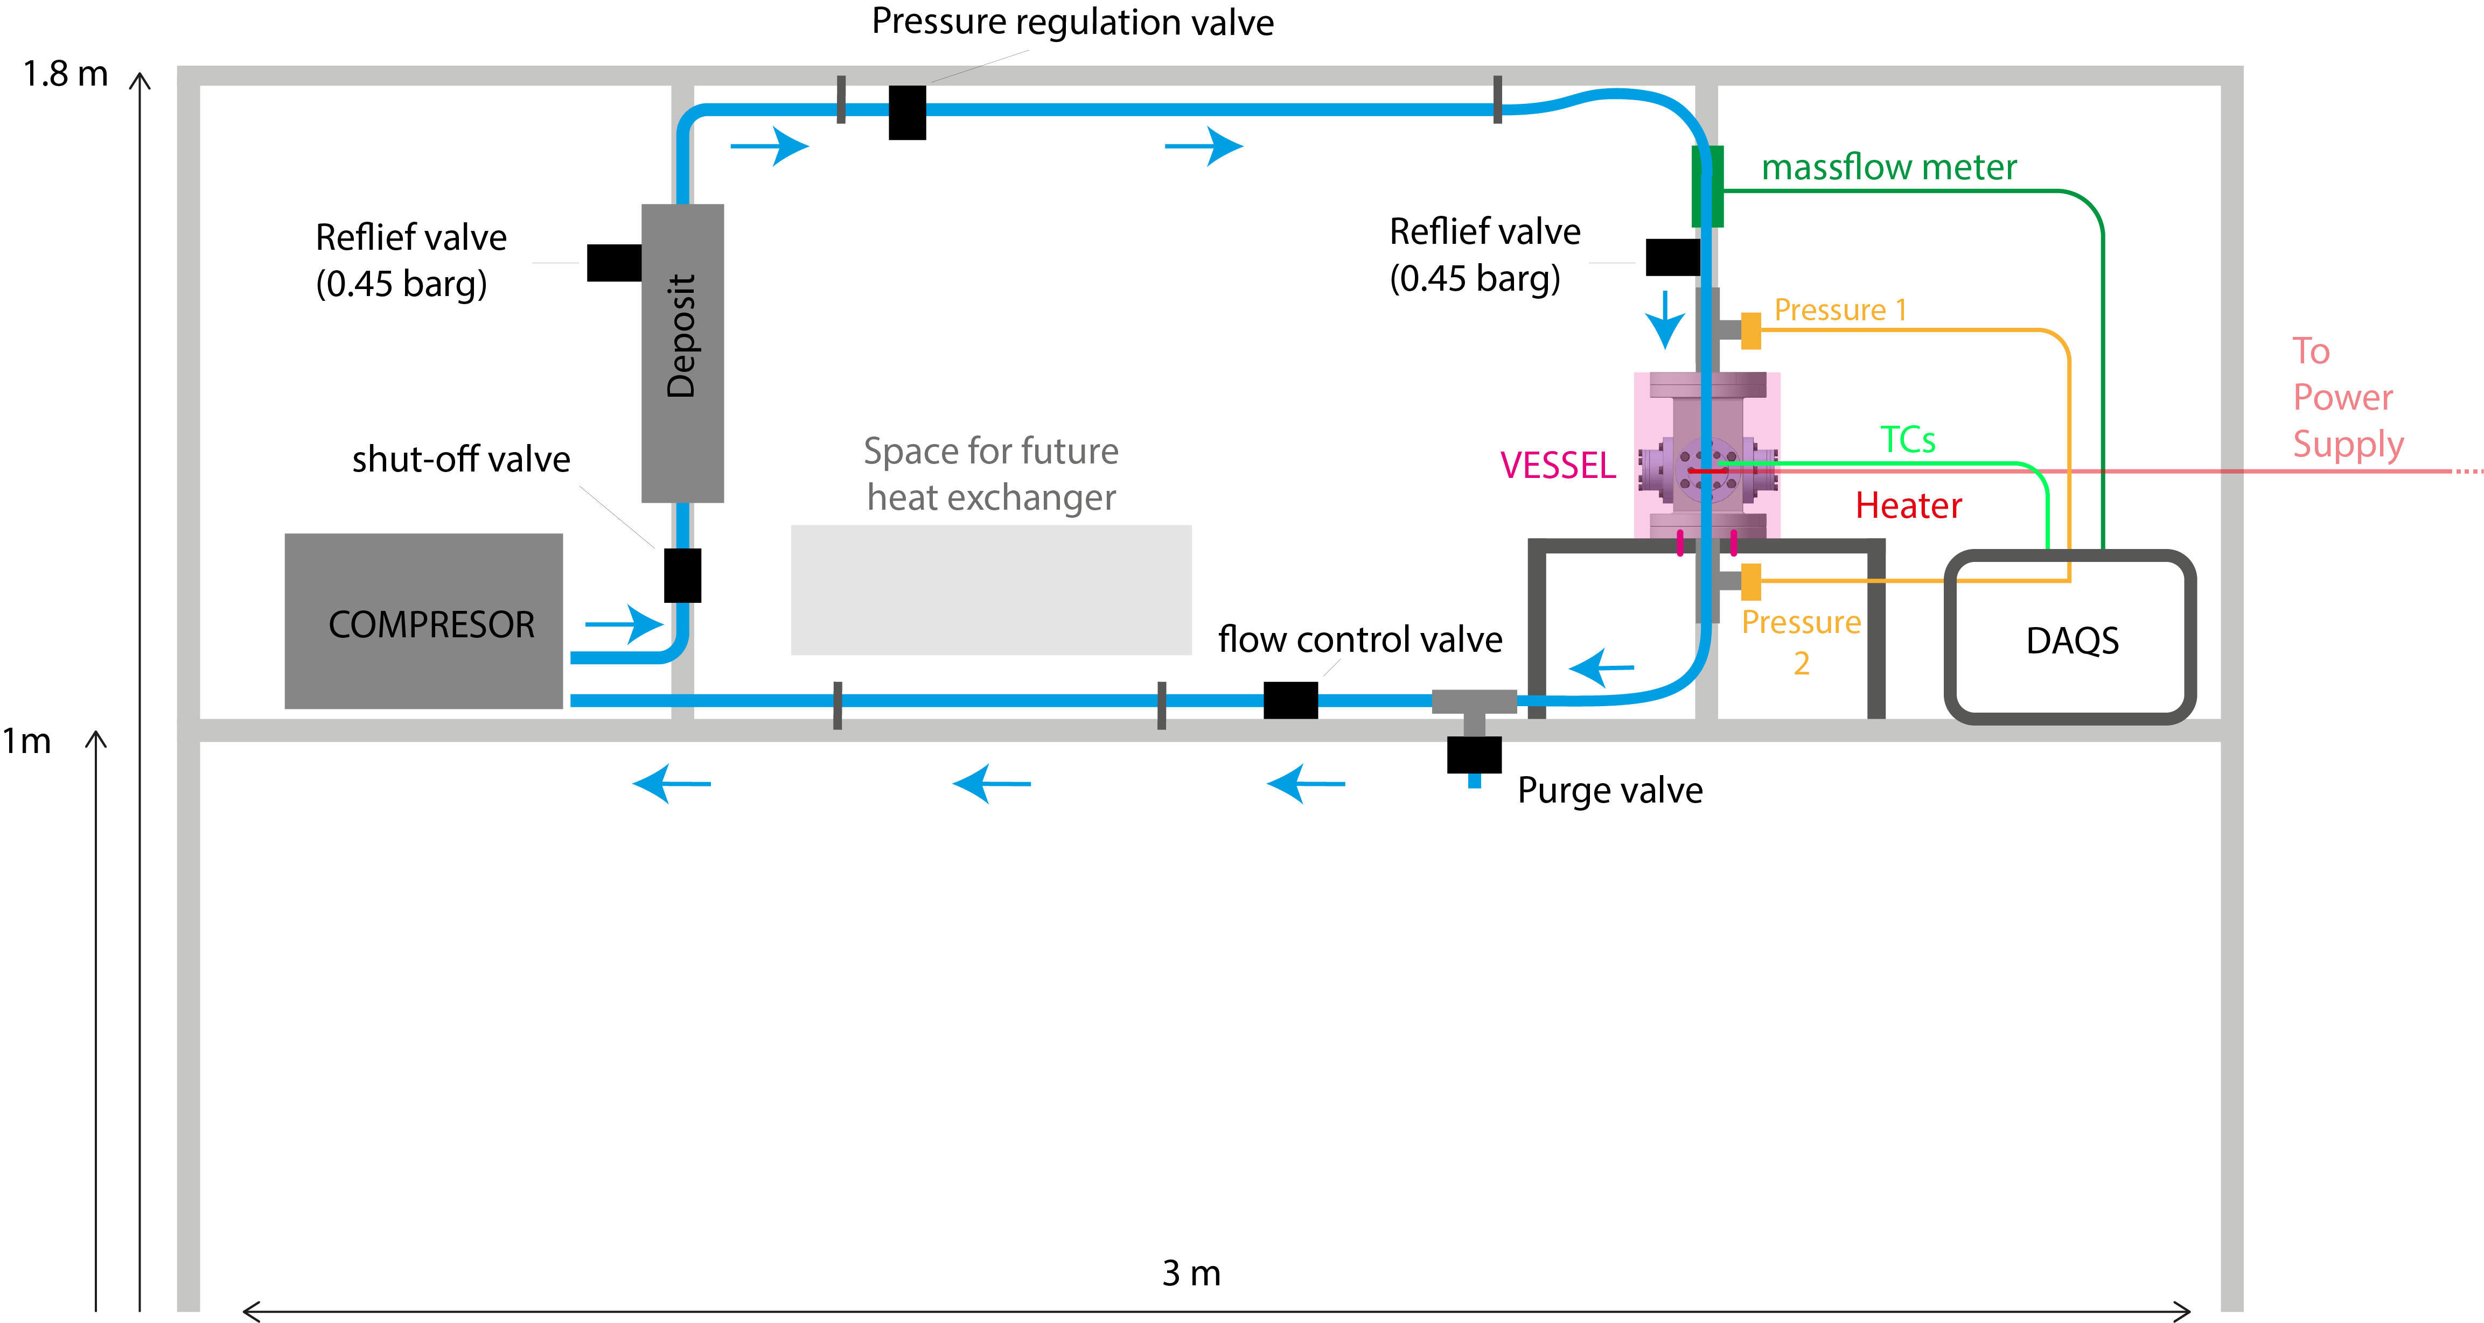
ESSnuSB+ Target 2025
06/10/2026
Jorge Aguilar ESS-BILBAO
7
Notes:
Timing: 2 minutes. Connect the modelling results to the independent assessment actions. ETTF was designed to measure the observables that were uncertain in the reduced model. The loop supports pressure-drop testing, controlled heating, multiple thermocouples and later helium operation. The experiment does not replace the target analysis. It supplies the calibration and uncertainty bounds that the analysis was missing.
Source citations:
- C:/Users/usuario/Desktop/ESSnuSB/IAP/ESSB-ESSNUSB-IAP2ndReport-WP3Target-answers.pdf
- C:/Users/usuario/Desktop/ESSnuSB/Presentations/ESSnuSB+ TARGET 3rdAnnualMeeting R2.pdf

Slide 11
ESSnuSB+ Target Progress
The programme progressed from feasibility to experimentally anchored design decisions.
2023
2024
2025
2026
Feasibility
Validation route
Model fidelity
Evidence
Steady-state CFD and first mechanical screening
Dynamic response and ETTF concept
Random packing and resolved CFD
ETTF air campaign
Shell-bypass exploration
ONGOING
06/10/2026
Jorge Aguilar ESS-BILBAO
3
Notes:
Timing: 2 minutes. Use this slide as the map for the presentation. The annual milestones are cumulative. The 2023 design proved the concept could be cooled. The 2024 work identified the need for a dedicated validation experiment. The 2025 work quantified the limitations of the porous model. In 2026 the team operated ETTF and also explored a new flow path to address shell bending.
Source citations:
- C:/Users/usuario/Desktop/ESSnuSB/Presentations/ESSnuSB+ TARGET 1stAnnualMeeting.pdf
- C:/Users/usuario/Desktop/ESSnuSB/Presentations/ESSnuSB+ TARGET 2ndAnnualMeeting.pdf
- C:/Users/usuario/Desktop/ESSnuSB/Presentations/ESSnuSB+ TARGET 3rdAnnualMeeting R2.pdf
- C:/Users/usuario/Downloads/ETTF.pptx
- C:/Users/usuario/Consorcio ESS Bilbao Dropbox/Jorge Aguilar/Documento/main.pdf

Slide 12
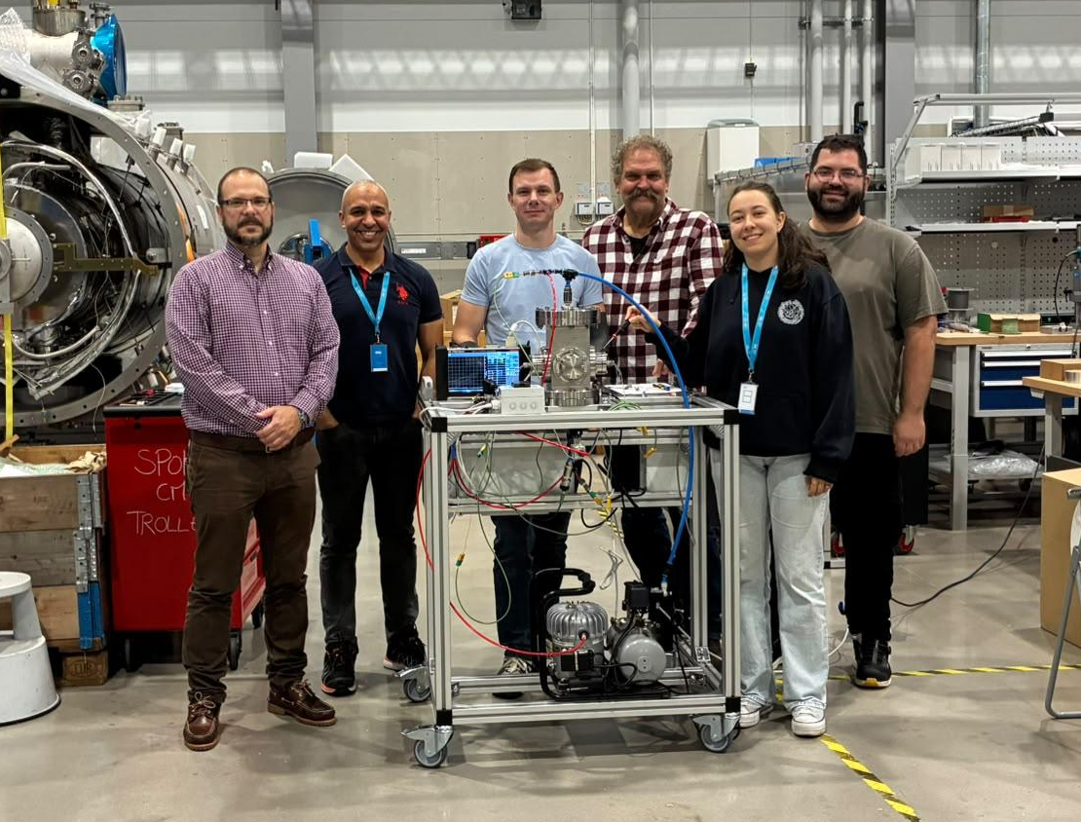
ESSnuSB+ Target 2026
MML-ESS, Lund 28 September to 2 October 2026
06/10/2026
Jorge Aguilar ESS-BILBAO
8
Notes:
Timing: 2 minutes. This is the central 2026 milestone. The detailed design became an operational test rig at MML-ESS in Lund. Point out the vessel, compressor loop, data acquisition, heater, thermocouples and titanium pellets. The campaign produced hydraulic and thermal time histories over the available operating range. Thank the collaborators shown in the original campaign material if appropriate during delivery.
Source citations:
- C:/Users/usuario/Downloads/ETTF.pptx

Slide 13
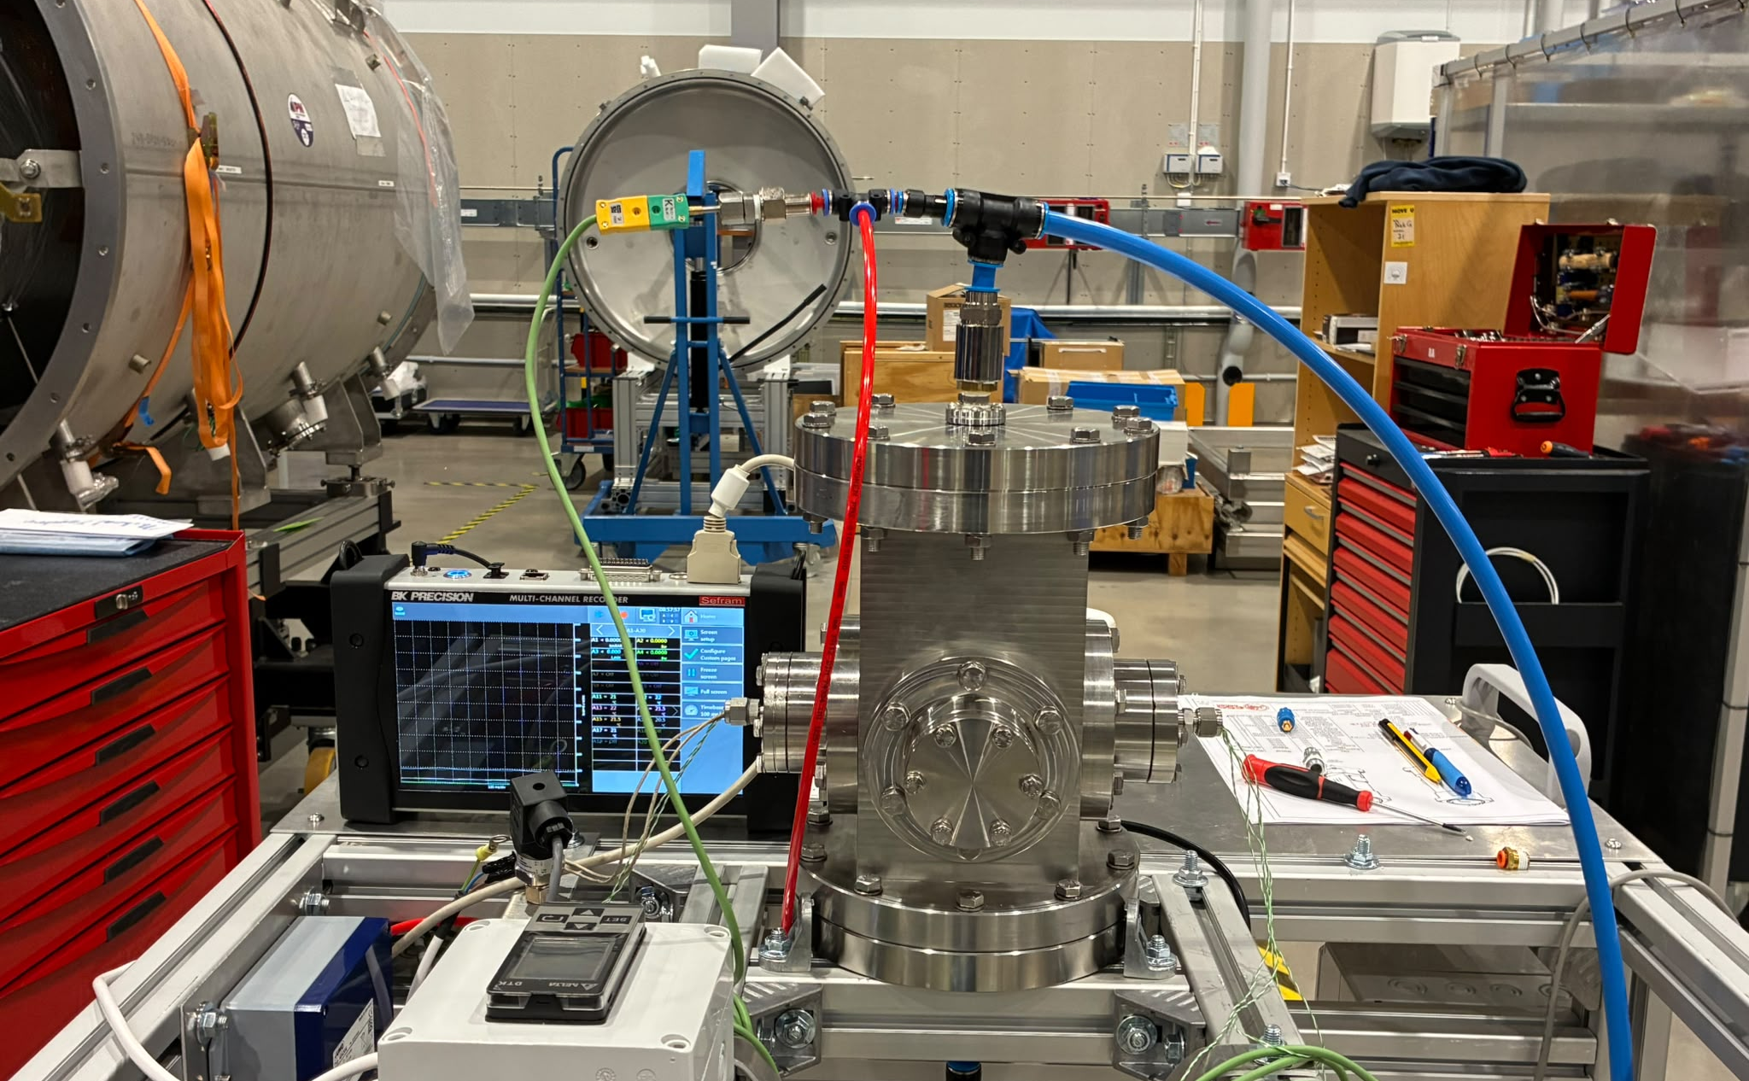
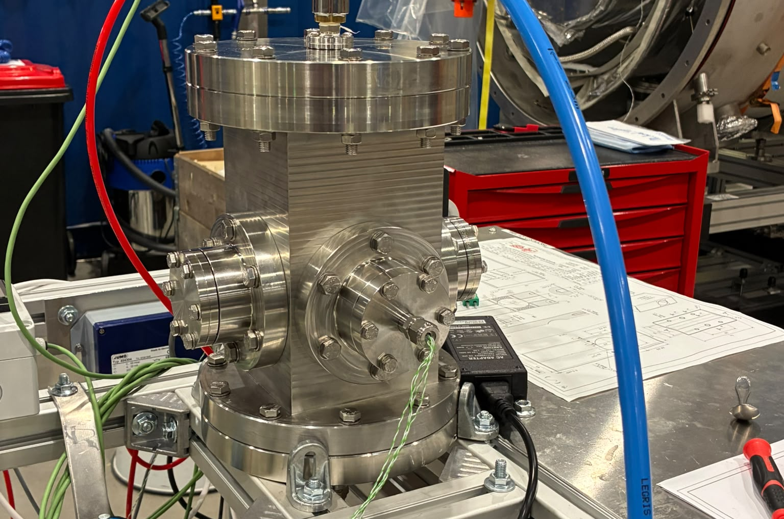
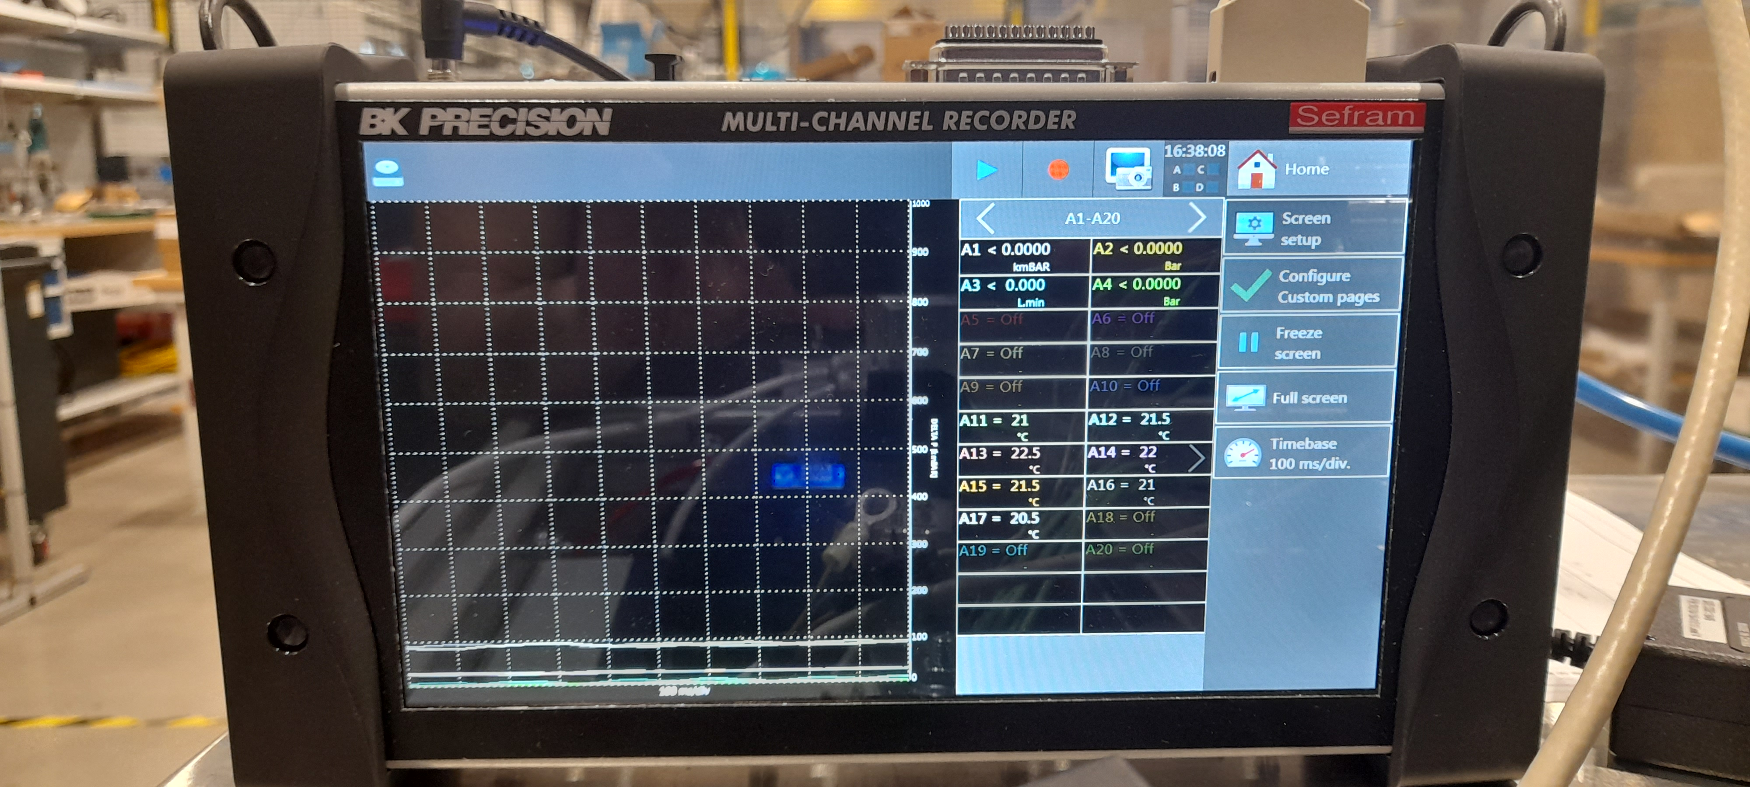
ESSnuSB+ Target 2026
MML-ESS, Lund 28 September to 2 October 2026
06/10/2026
Jorge Aguilar ESS-BILBAO
8
Notes:
Timing: 2 minutes. This is the central 2026 milestone. The detailed design became an operational test rig at MML-ESS in Lund. Point out the vessel, compressor loop, data acquisition, heater, thermocouples and titanium pellets. The campaign produced hydraulic and thermal time histories over the available operating range. Thank the collaborators shown in the original campaign material if appropriate during delivery.
Source citations:
- C:/Users/usuario/Downloads/ETTF.pptx

Slide 14
ESSnuSB+ Target 2026
The ETTF prototype was assembled and commissioned at MML-ESS in Lund.
Two experimental campaigns were completed:
Heated transient
Six thermal transient tests characterised the heating and cooling response at heater setpoints of 100, 250 and 400 °C, using cooling flows of approximately 1.0 and 3.5 g/s.
Room temperature
A room-temperature run measured the pressure drop across the packed-bed canister at operating pressures from 0.30 to 0.45 bar and flow rates from 1.0 to 3.9 g/s.
The campaign produced synchronized pressure, flow and temperature histories for comparison with the porous and resolved CFD models. Pressure-channel reconciliation, uncertainty assessment and transient analysis are now in progress.
MML-ESS, Lund 28 September to 2 October 2026
06/10/2026
Jorge Aguilar ESS-BILBAO
8
Notes:
Timing: 2 minutes. This is the central 2026 milestone. The detailed design became an operational test rig at MML-ESS in Lund. Point out the vessel, compressor loop, data acquisition, heater, thermocouples and titanium pellets. The campaign produced hydraulic and thermal time histories over the available operating range. Thank the collaborators shown in the original campaign material if appropriate during delivery.
Source citations:
- C:/Users/usuario/Downloads/ETTF.pptx

Slide 15
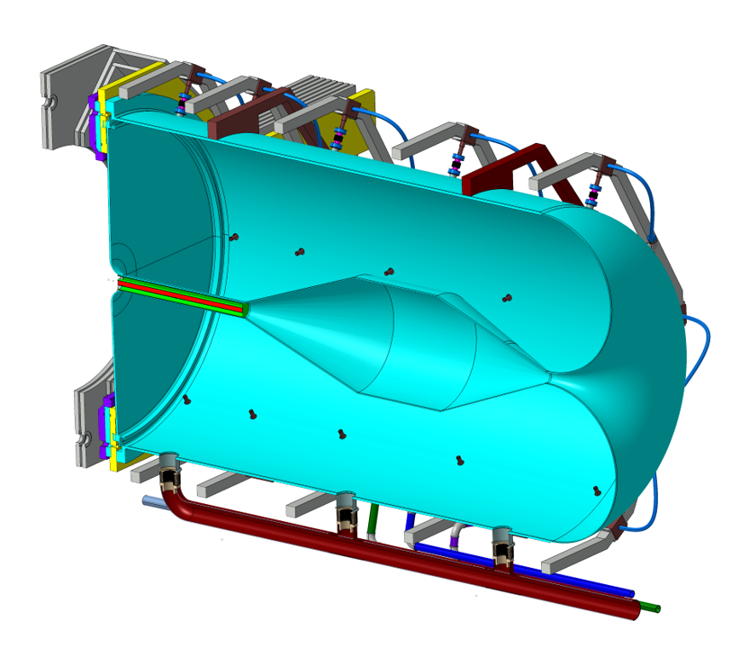
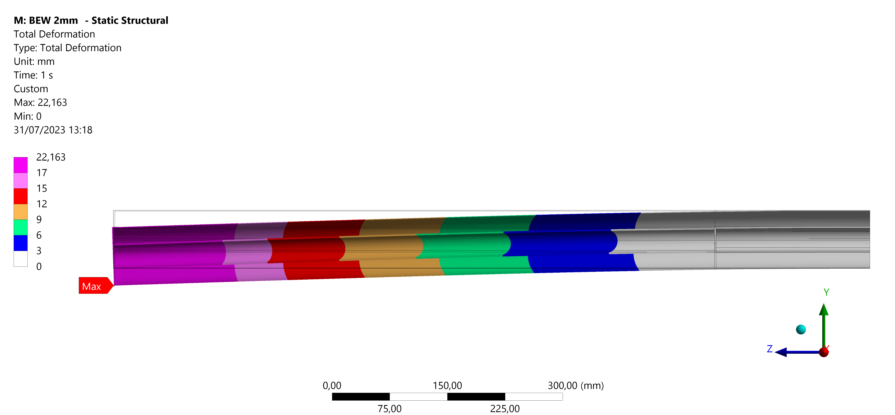
ESSnuSB+ Target 2026 Shell bypass study
Exploratory screening of three axial slot locations to cool the outer shell and reduce the asymmetric thermal load that drives target bending.
06/10/2026
Jorge Aguilar ESS-BILBAO
11
Notes:
Timing: 2 minutes. Introduce the internship study by Bálint and María as an exploratory response to target bending. The original porous-media porosity of 0.34 was intentionally kept for consistency with the baseline model. The study varied only the axial location of a simple slot array. The goal was to learn whether direct shell cooling could reduce the thermal asymmetry. Emphasise that the slot geometry and porous model are not a final design.
Source citations:
- C:/Users/usuario/Consorcio ESS Bilbao Dropbox/Jorge Aguilar/Documento/main.pdf

Slide 16
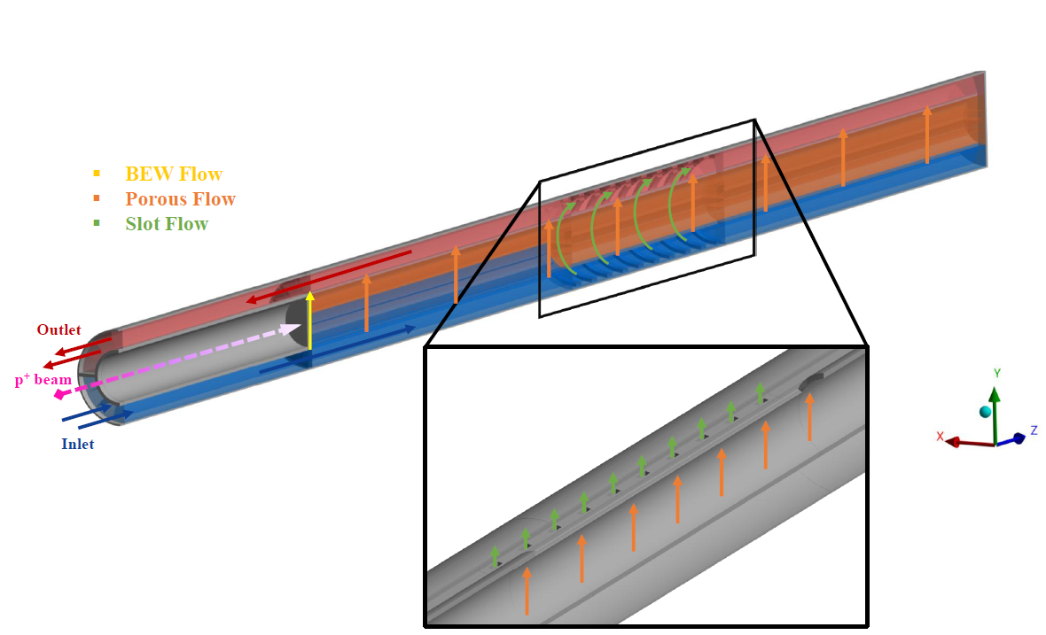
ESSnuSB+ Target shell bypass
Exploratory screening of three axial slot locations to cool the outer shell and reduce the asymmetric thermal load that drives target bending.
06/10/2026
Jorge Aguilar ESS-BILBAO
11
Notes:
Timing: 2 minutes. Introduce the internship study by Bálint and María as an exploratory response to target bending. The original porous-media porosity of 0.34 was intentionally kept for consistency with the baseline model. The study varied only the axial location of a simple slot array. The goal was to learn whether direct shell cooling could reduce the thermal asymmetry. Emphasise that the slot geometry and porous model are not a final design.
Source citations:
- C:/Users/usuario/Consorcio ESS Bilbao Dropbox/Jorge Aguilar/Documento/main.pdf

Slide 17
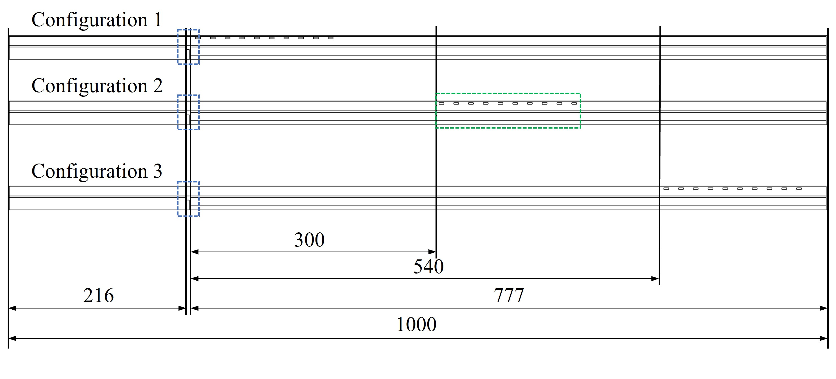
ESSnuSB+ Target 2026 Shell bypass study
Exploratory screening of three axial slot locations to cool the outer shell and reduce the asymmetric thermal load that drives target bending.
Variable slots position
Fixed slots geometry
Locations at Z= 0, 300, 600 mm
Ten rectangular slots, 6 × 2 mm, 18 mm pitch, 1 mm gap
06/10/2026
Jorge Aguilar ESS-BILBAO
11
Notes:
Timing: 2 minutes. Introduce the internship study by Bálint and María as an exploratory response to target bending. The original porous-media porosity of 0.34 was intentionally kept for consistency with the baseline model. The study varied only the axial location of a simple slot array. The goal was to learn whether direct shell cooling could reduce the thermal asymmetry. Emphasise that the slot geometry and porous model are not a final design.
Source citations:
- C:/Users/usuario/Consorcio ESS Bilbao Dropbox/Jorge Aguilar/Documento/main.pdf

Slide 18
ESSnuSB+ Target 2026 Shell bypass study
Similar slot flow gives very different shell cooling depending on where it enters.
Case | Slot location | Bed flow kg/s | Slot flow kg/s | ΔP bar | Bed Tmax °C | Outer Tmax °C | Outer gradient K/mm
Baseline | None | 0.18 | 0.00 | 0.90 | 500 | 356 | 55
Config. 1 | Upstream | 0.12 | 0.06 | 0.70 | 700 | 447 | 60
Config. 2 | Mid-span | 0.14 | 0.04 | 0.78 | 558 | 216 !!! | 25 !!!
Config. 3 | Downstream | 0.14 | 0.04 | 0.79 | 548 | 349 | 70
Upstream slots starve the bed.
Downstream slots arrive too late to cool the shell.
Mid-span preserves bed cooling while halving the outer-wall gradient.
06/10/2026
Jorge Aguilar ESS-BILBAO
12
Notes:
Timing: 2.5 minutes. Walk through the table by mechanism. Configuration 1 diverts too much flow before the bed and raises the particle temperature to about 700 degrees Celsius. Configuration 3 sends the bypass flow too far downstream, so it has little effect on the region that drives bending. Configuration 2 produces the strongest outer-shell cooling and reduces the reported gradient from 55 to 25 kelvin per millimetre, while the bed peak rises to about 558 degrees Celsius. The porosity remains 0.34 in every case.
Source citations:
- C:/Users/usuario/Consorcio ESS Bilbao Dropbox/Jorge Aguilar/Documento/main.pdf

Slide 19
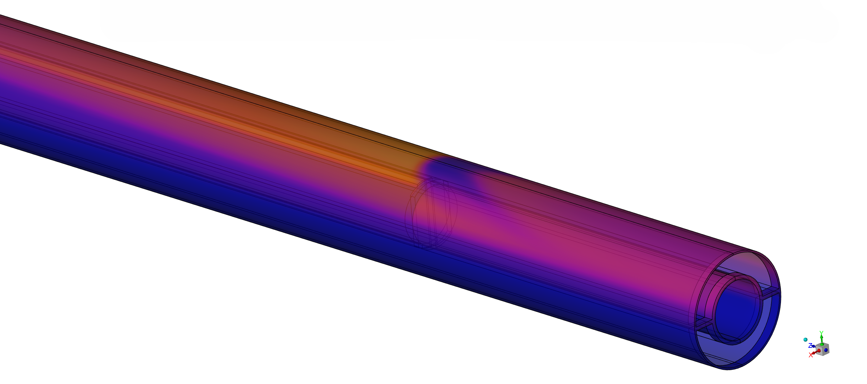
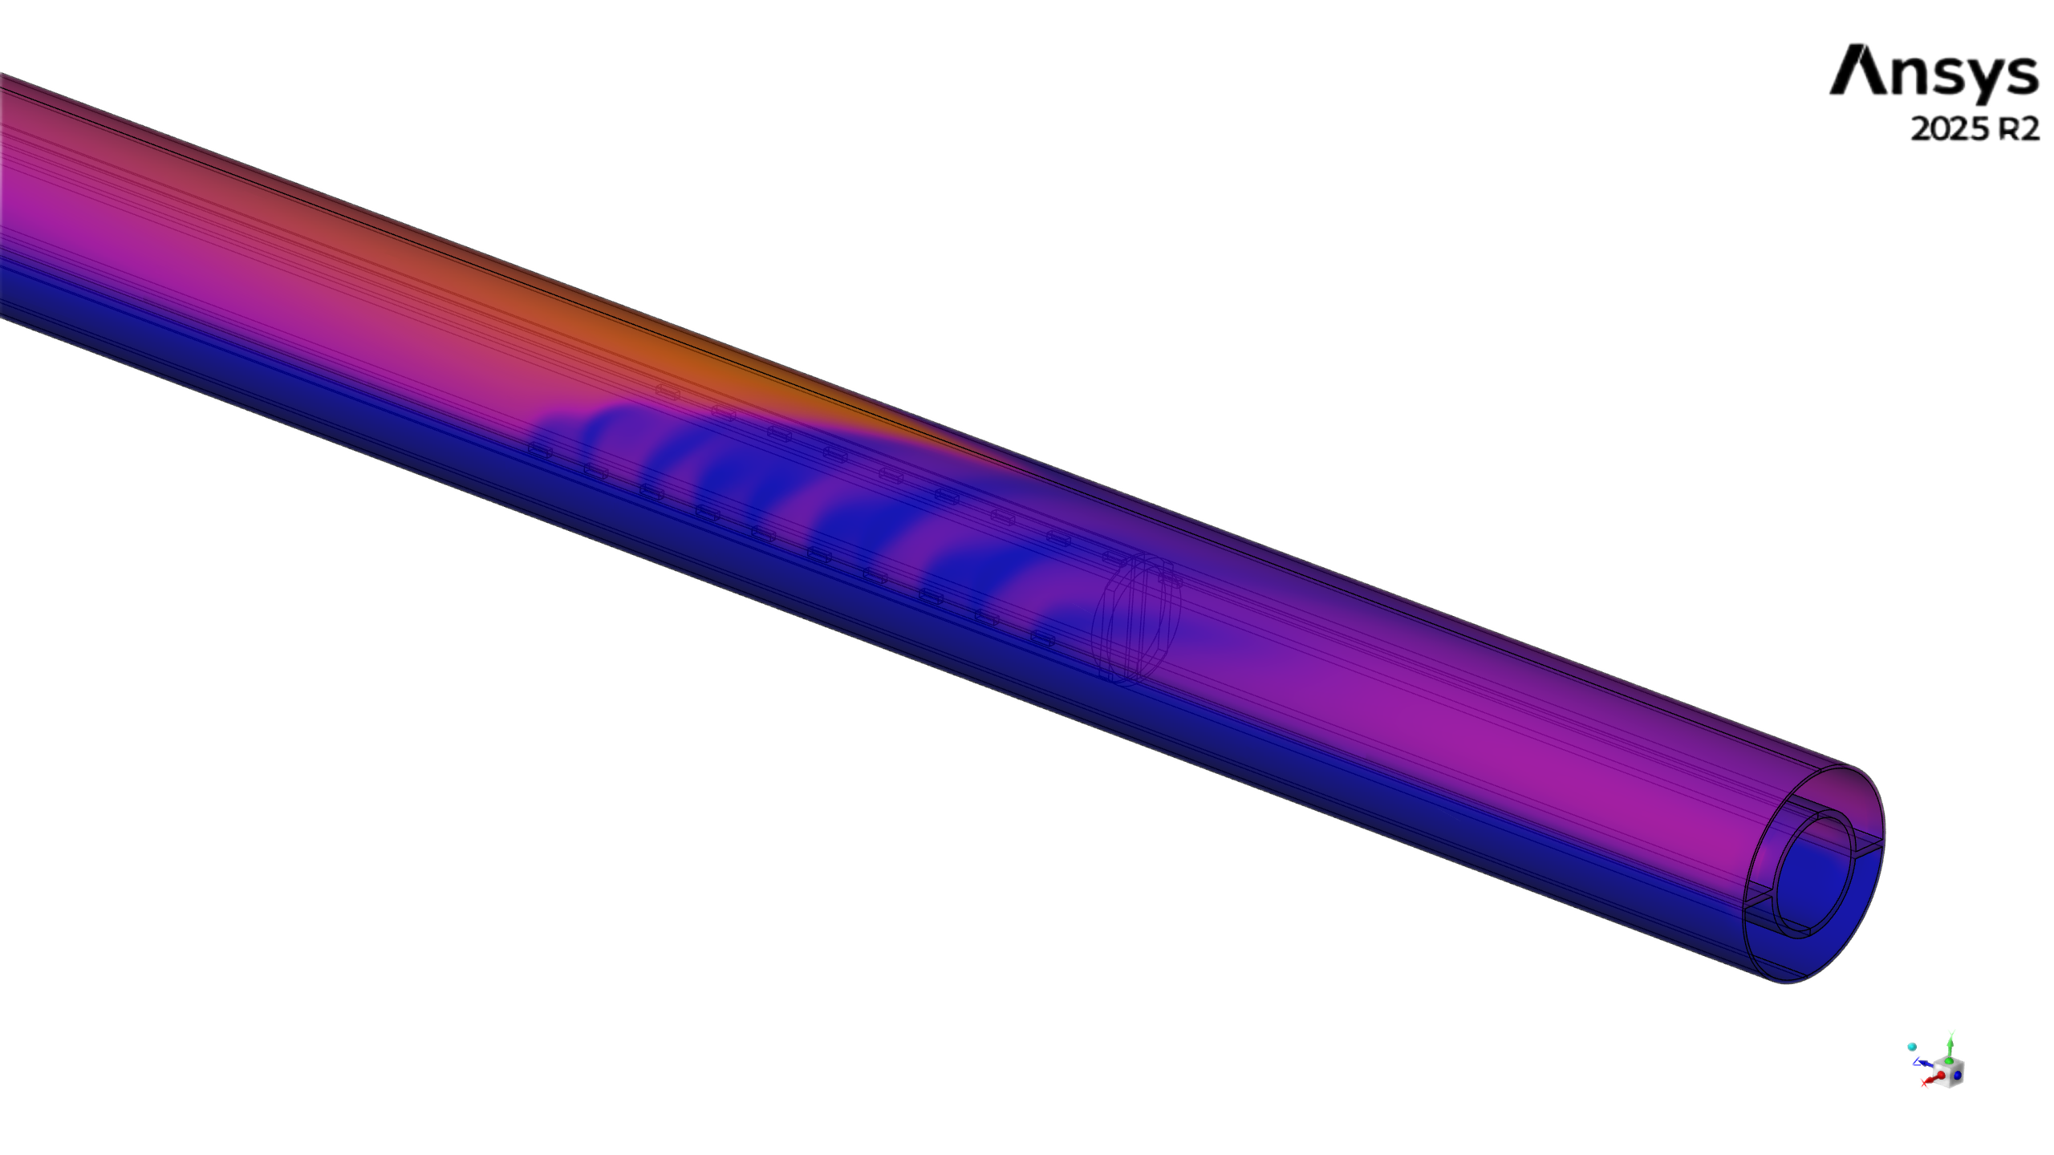
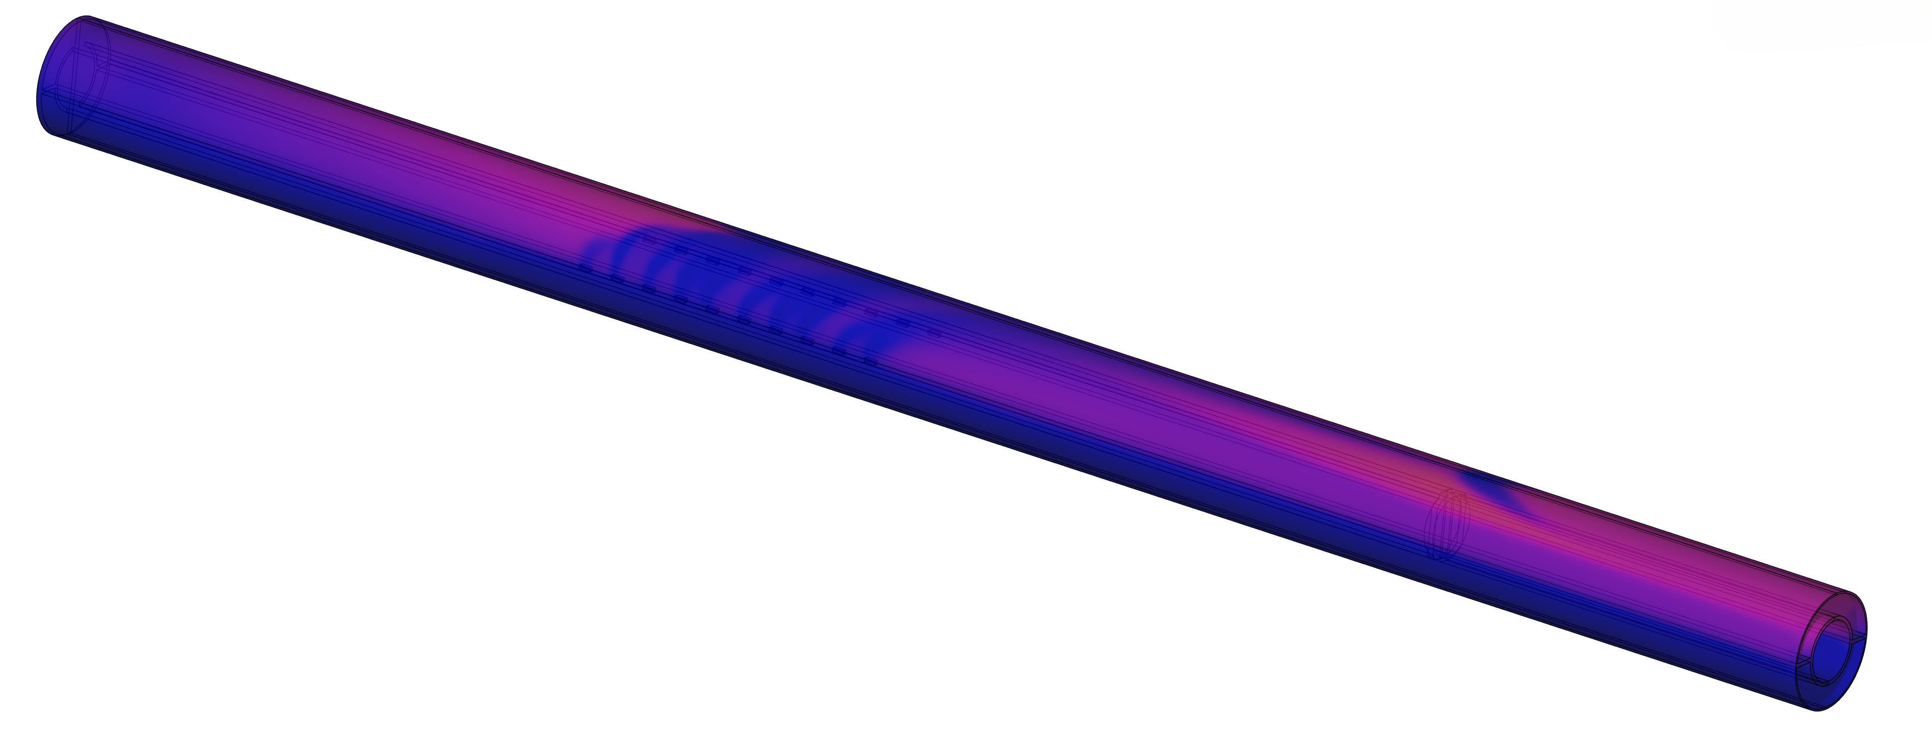
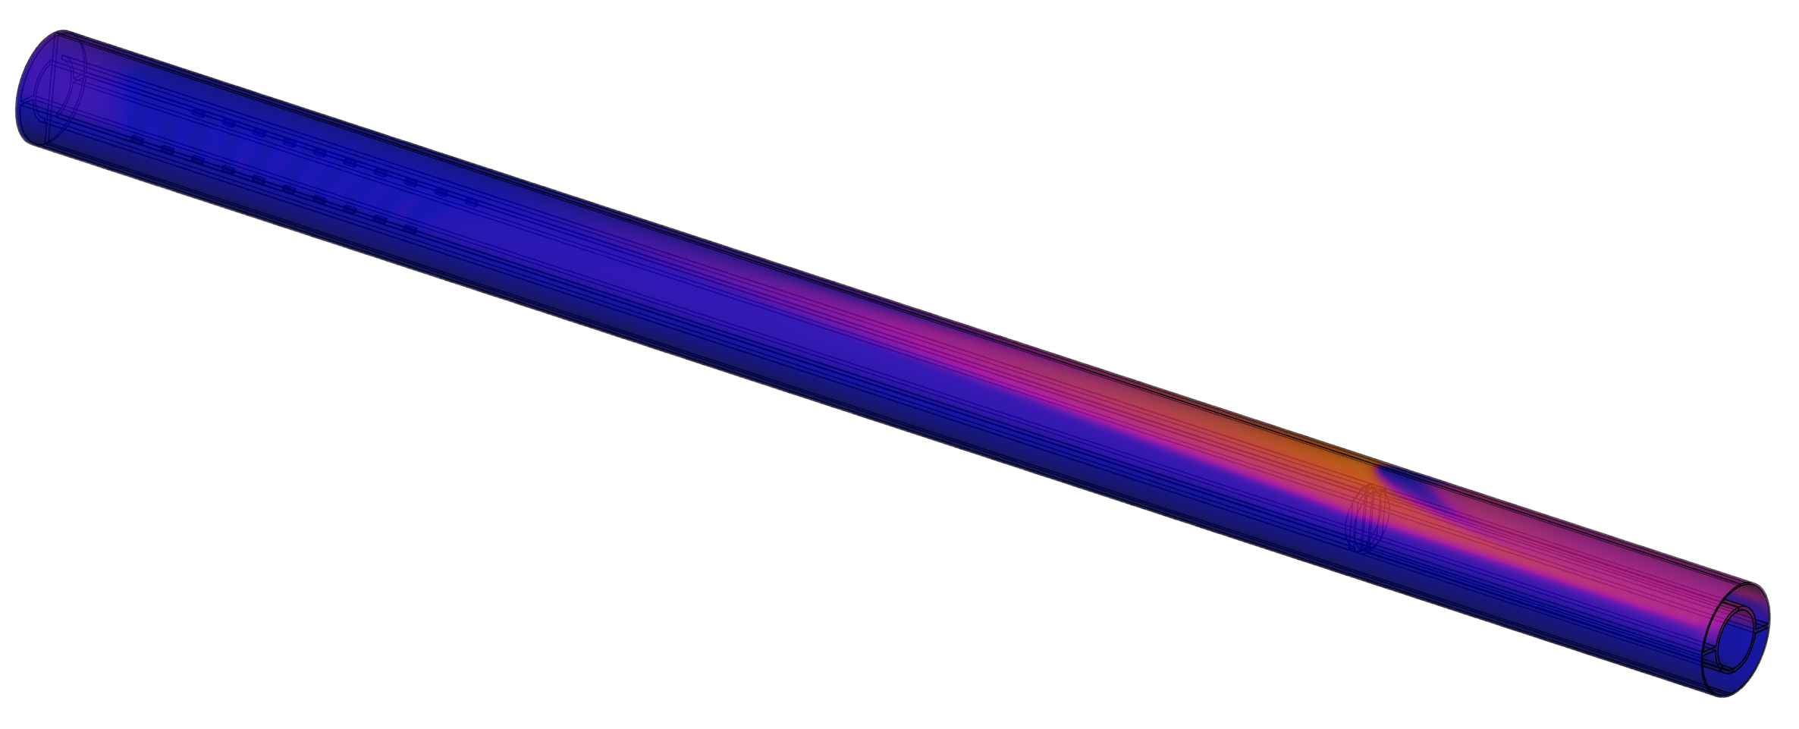
ESSnuSB+ Target 2026 Shell bypass study
T[ºC]
C1
C2
Baseline
C3
maximum outer-wall temperature
outer-wall gradient
bed peak temperature
356 → 216 °C
55 → 25 K/mm
500 → 558 °C
Configuration 2 substantially reduces the outer-shell temperature and gradient, at the cost of a moderate increase in bed temperature.
06/10/2026
Jorge Aguilar ESS-BILBAO
13
Notes:
Timing: 2.5 minutes. Present the mid-span case as the best trade-off in this screening, not as the final configuration. It strongly lowers the outer-shell temperature and gradient, and the calculated tip deformation drops from 10.5 to 9.7 millimetres. The bed gets hotter, and the linearized BEW stress components do not all improve. In fact, the reported total changes from 281.1 to 293.7 megapascals. The study indicates feasibility under provisional allowables, but it is not a formal RCC-MRx assessment.
Source citations:
- C:/Users/usuario/Consorcio ESS Bilbao Dropbox/Jorge Aguilar/Documento/main.pdf

Slide 20
ESSnuSB+ Target Progress Summary
Completed
Requires further developement
Baseline thermo-hydraulic and preliminary structural feasibility studied.
Isolated 3 mm sphere single-pulse response assessed.
Realistic packing generated and resolved CFD benchmark completed.
ETTF prototype designed, manufactured, instrumented and commissioned (Air).
Hydraulic and thermal test series completed.
Qualified fatigue life, due to the lack of reliable fatigue limits for irradiated titanium alloys.
Multi-sphere interactions and full-target pressure-wave response.
Detailed bypass optimization if the concept is retained / alternatives.
ETTF Helium testing.
Now in progress
ETTF results analysis.
Target Bending mitigation: assessment whether bypass merits detailed development.
06/10/2026
Jorge Aguilar ESS-BILBAO
14
Notes:
Timing: 2 minutes. Close with a precise status. The rig has operated and produced the data needed for calibration. The bypass study has identified a promising physical mechanism and the importance of slot location. The immediate work is analytical: reconcile the pressure channels, quantify uncertainty, compare the transient and hydraulic data with CFD, and continue fatigue assessment. Only then should the team choose resistance coefficients, decide whether to optimize a bypass, and freeze a target configuration.
Source citations:
- C:/Users/usuario/Downloads/ETTF.pptx
- C:/Users/usuario/Consorcio ESS Bilbao Dropbox/Jorge Aguilar/Documento/main.pdf
- C:/Users/usuario/Desktop/ESSnuSB/IAP/ESSB-ESSNUSB-IAP2ndReport-WP3Target-answers.pdf

