Slide 1



ESS$ν$SB+ - Annual Meeting, Uppsala 2026
06/10/2026
Target Station
WP3
Julien Hiegel

Slide 2
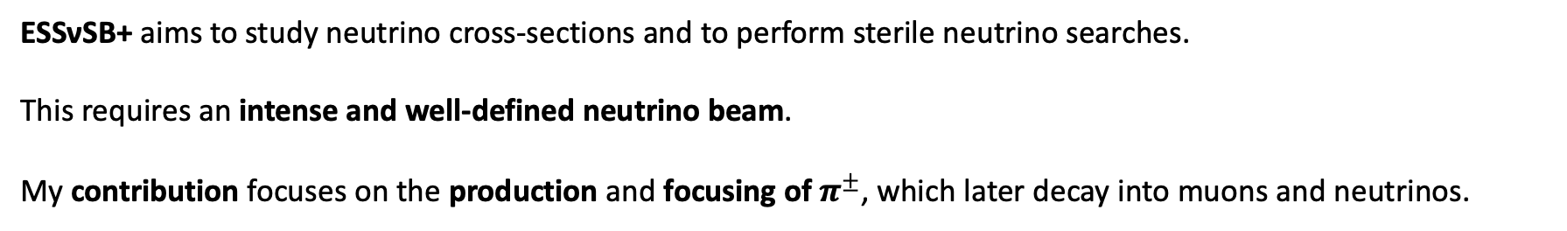
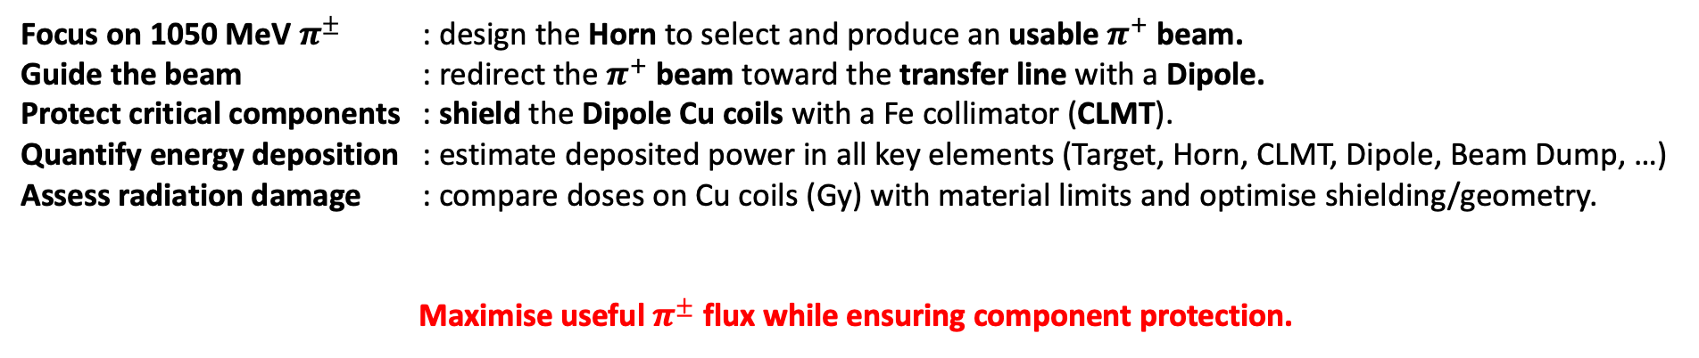
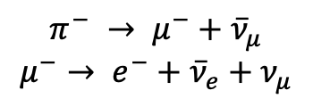
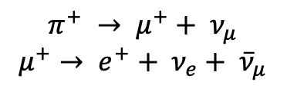
Introduction | Methods | Results – Particles Distribution | Results – Energy Deposition | Conclusion
Introduction
ESSνSB+ aims to study neutrino cross-sections and to perform sterile neutrino searches.
This requires an intense and well-defined neutrino beam.
My contribution focuses on the production and focusing of$π^{±}$, which later decay into muons and neutrinos.
$$π^{+} → μ^{+}+ ν_{μ}$$
$$μ^{+}→ e^{+}+ ν_{e}+ {\overline{ν}}_{μ}$$
$$π^{−} → μ^{−}+{\overline{ν}}_{μ}$$
$$μ^{−}→ e^{−}+{\overline{ν}}_{e}+ν_{μ}$$
Focus on 1050 MeV $π^{±}$ : design the Horn to select and produce an usable $π^{+}$ beam.
Guide the beam : redirect the $π^{+}$ beam toward the transfer line with a Dipole.
Protect critical components : shield the Dipole Cu coils with a Fe collimator (CLMT).
Quantify energy deposition : estimate deposited power in all key elements (Target, Horn, CLMT, Dipole, Beam Dump, …)
Assess radiation damage : compare doses on Cu coils (Gy) with material limits and optimise shielding/geometry.
Maximise useful $π^{±}$ flux while ensuring component protection.

Slide 3
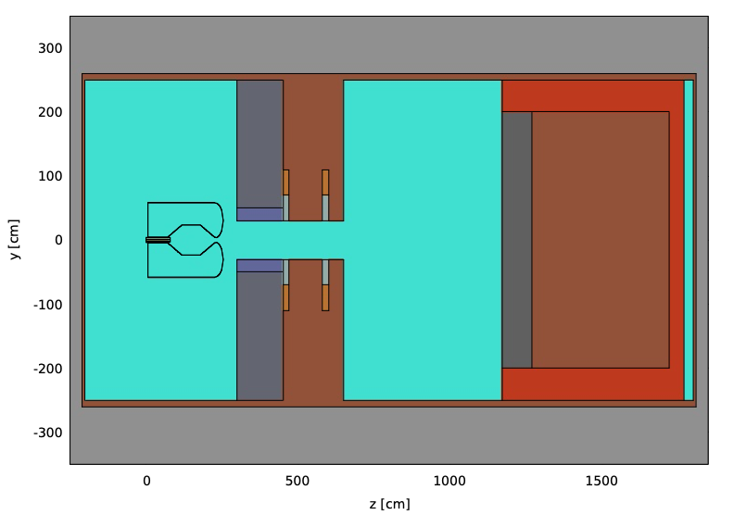
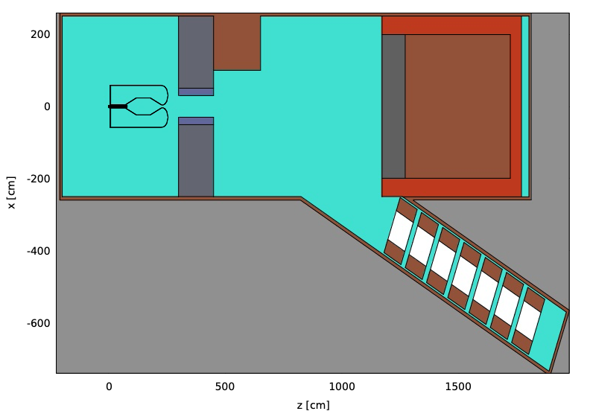
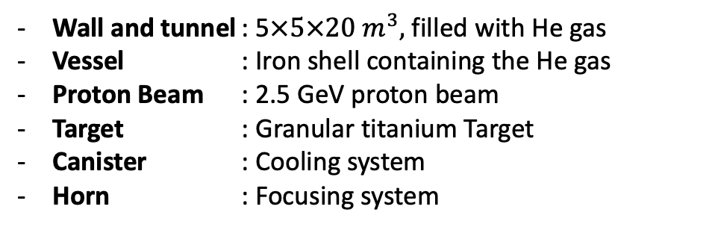
Introduction | Methods | Results – Particles Distribution | Results – Energy Deposition | Conclusion
FLUKA - Simulation Geometry
Wall and tunnel : 5$×5×20{ m}^{3},$ filled with He gas
Vessel : Iron shell containing the He gas
Proton Beam : 2.5 GeV proton beam
Target : Granular titanium Target
Canister : Cooling system
Horn : Focusing system
Collimator : Protects the dipole
Dipole : Deflects the pions toward TT line
Downstream Shield : Protects the dipole from radiation
Beam Dump : Stops remaining primary beam
Transfer line : Tunnel toward the muon ring
Quadrupoles : Guide the beam

Slide 4
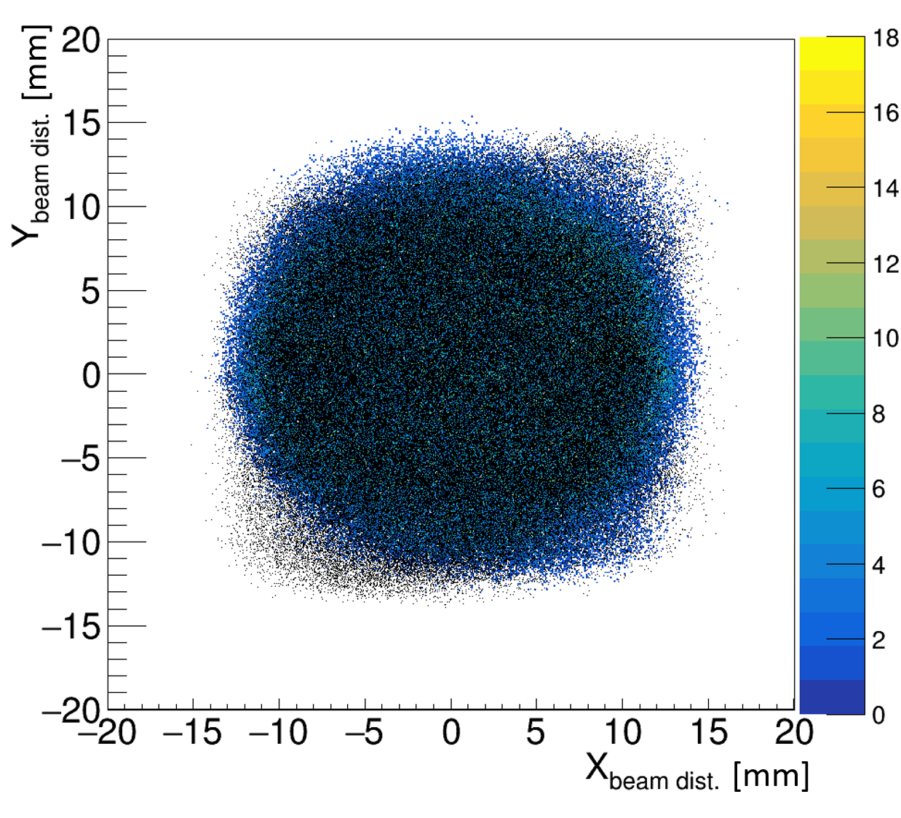
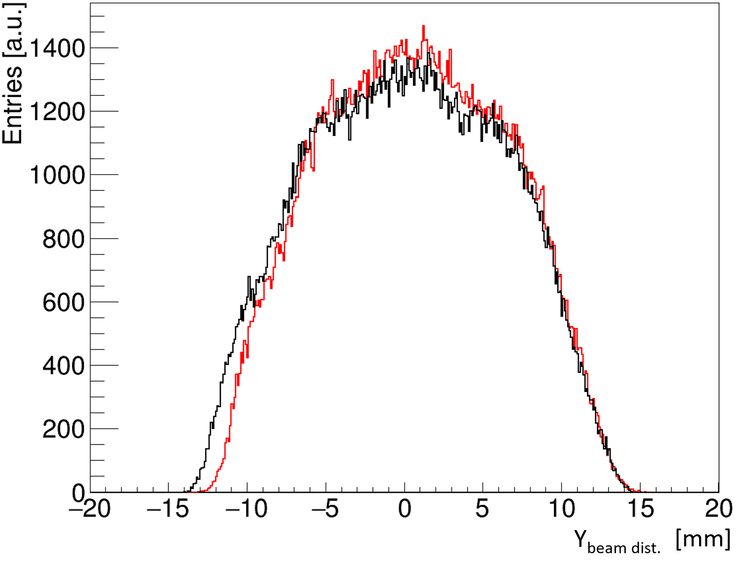
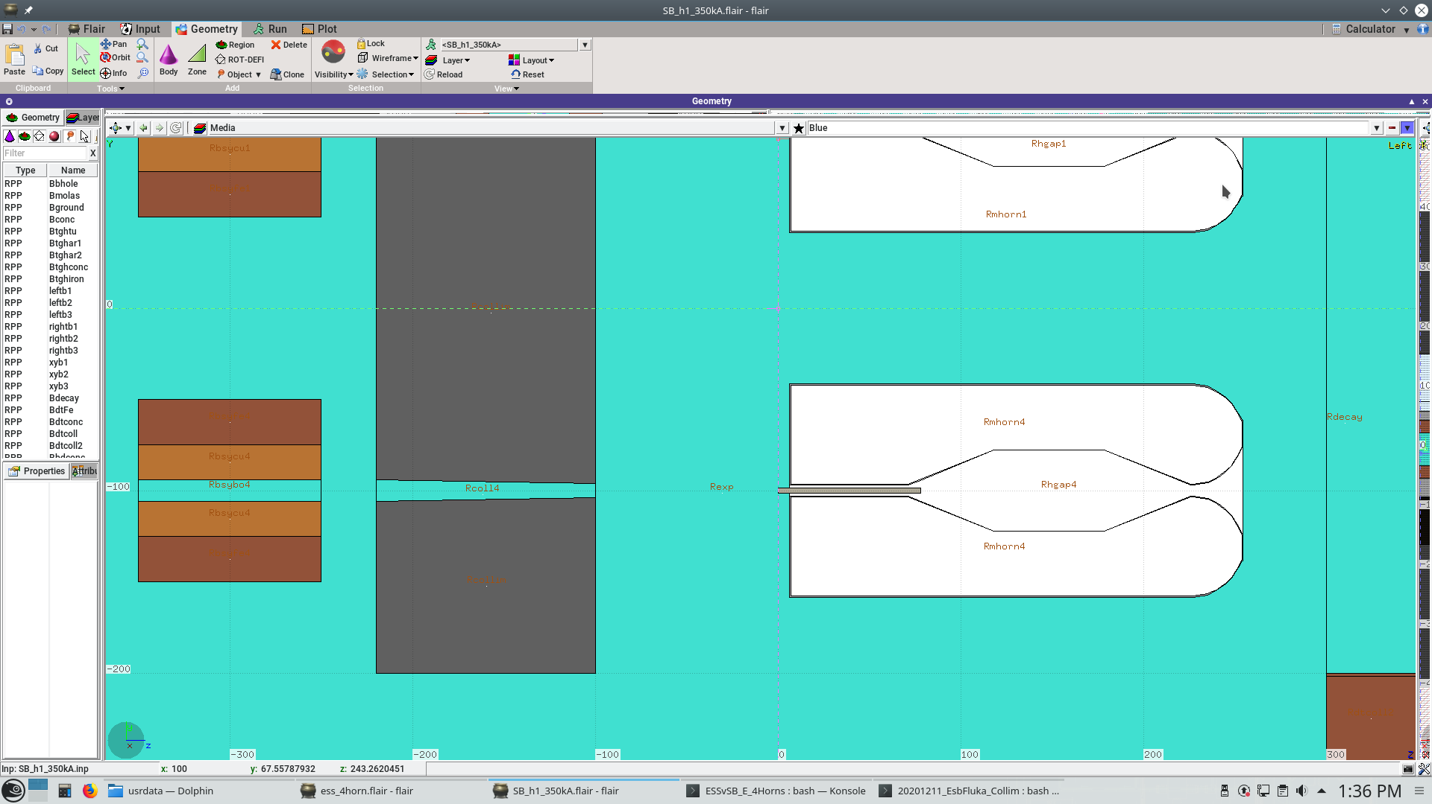
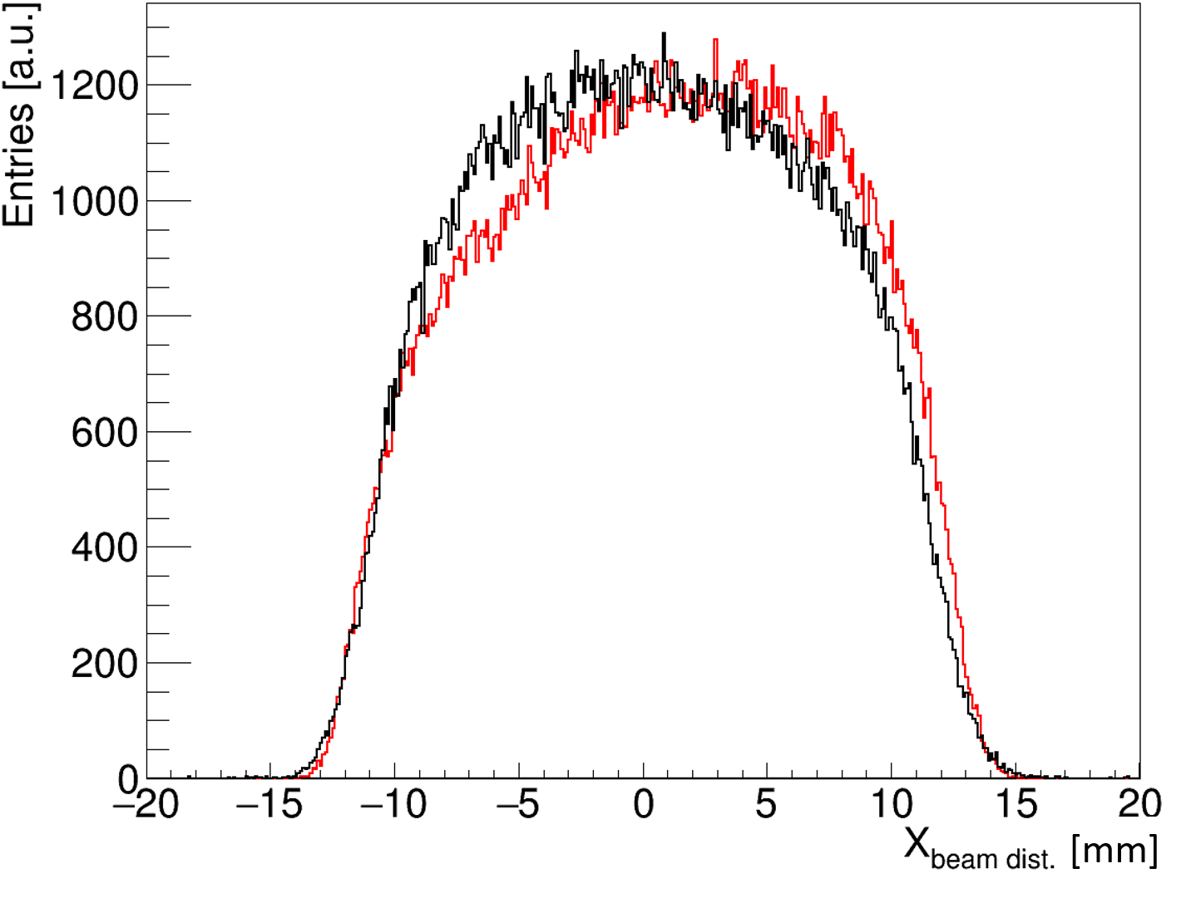
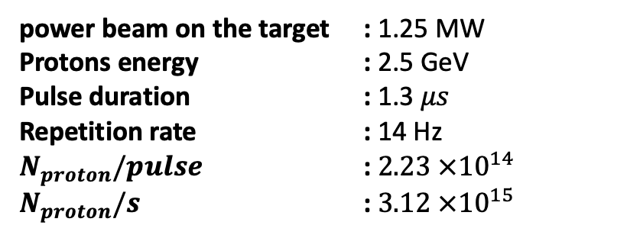
Introduction | Methods | Results – Particles Distribution | Results – Energy Deposition | Conclusion
Proton Beam
Beam profile at baffle and target entrance
power beam on the target : 1.25 MW
Protons energy : 2.5 GeV
Pulse duration : 1.3 $μs$
Repetition rate : 14 Hz
$N_{proton}/pulse$ : $2.23 ×{10}^{14}$
$N_{proton}/s$ : $3.12 ×{10}^{15}$
baffle
target
baffle
target
Baffle
Credit : Elian Bouquerel
– 01/07/2024

Slide 5
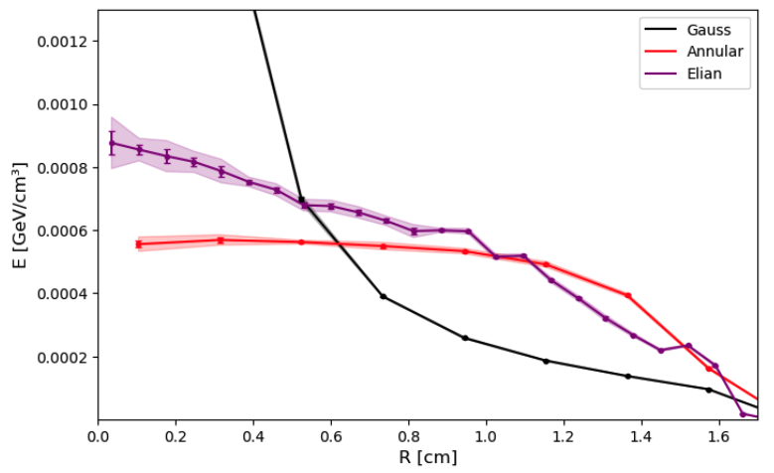
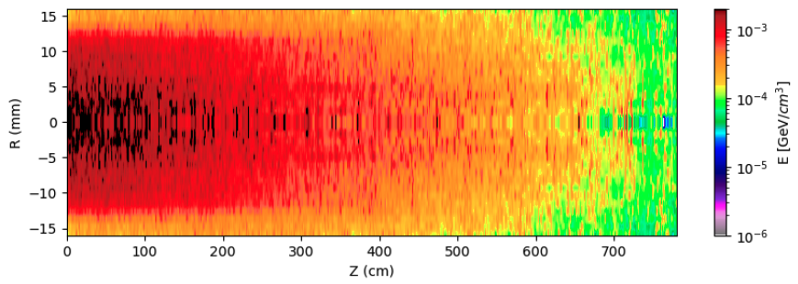
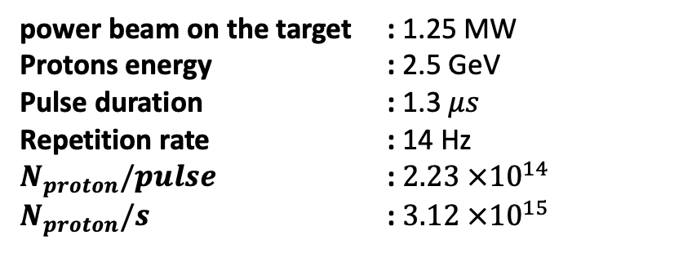
Introduction | Methods | Results – Particles Distribution | Results – Energy Deposition | Conclusion
Proton Beam
power beam on the target : 1.25 MW
Protons energy : 2.5 GeV
Pulse duration : 1.3 $μs$
Repetition rate : 14 Hz
$N_{proton}/pulse$ : $2.23 ×{10}^{14}$
$N_{proton}/s$ : $3.12 ×{10}^{15}$
Similar to last year's annular beam, but more realistic

Slide 6
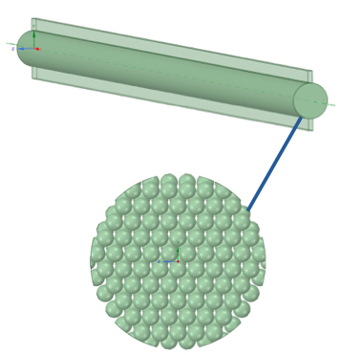
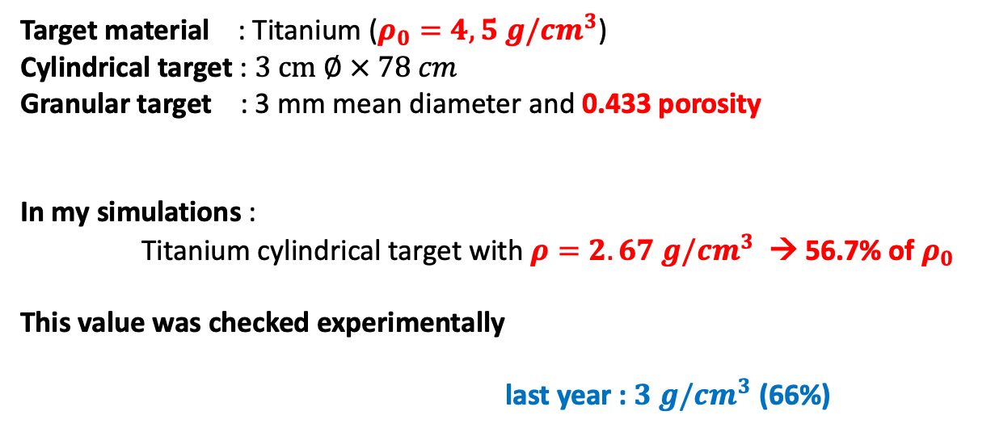
Introduction | Methods | Results – Particles Distribution | Results – Energy Deposition | Conclusion
Target
Target material : Titanium ($ρ_{0}=4,5 g/{cm}^{3}$)
Cylindrical target : $3 cm ∅ × 78 cm$
Granular target : 3 mm mean diameter and 0.433 porosity
In my simulations :
Titanium cylindrical target with $ρ=2.67 g/{cm}^{3}$ → 56.7% of $ρ_{0}$
This value was checked experimentally
last year : $3 g/{cm}^{3}$ (66%)
Credit : Lukasz Lacny – WP4 meeting – 15/07/2020

Slide 7
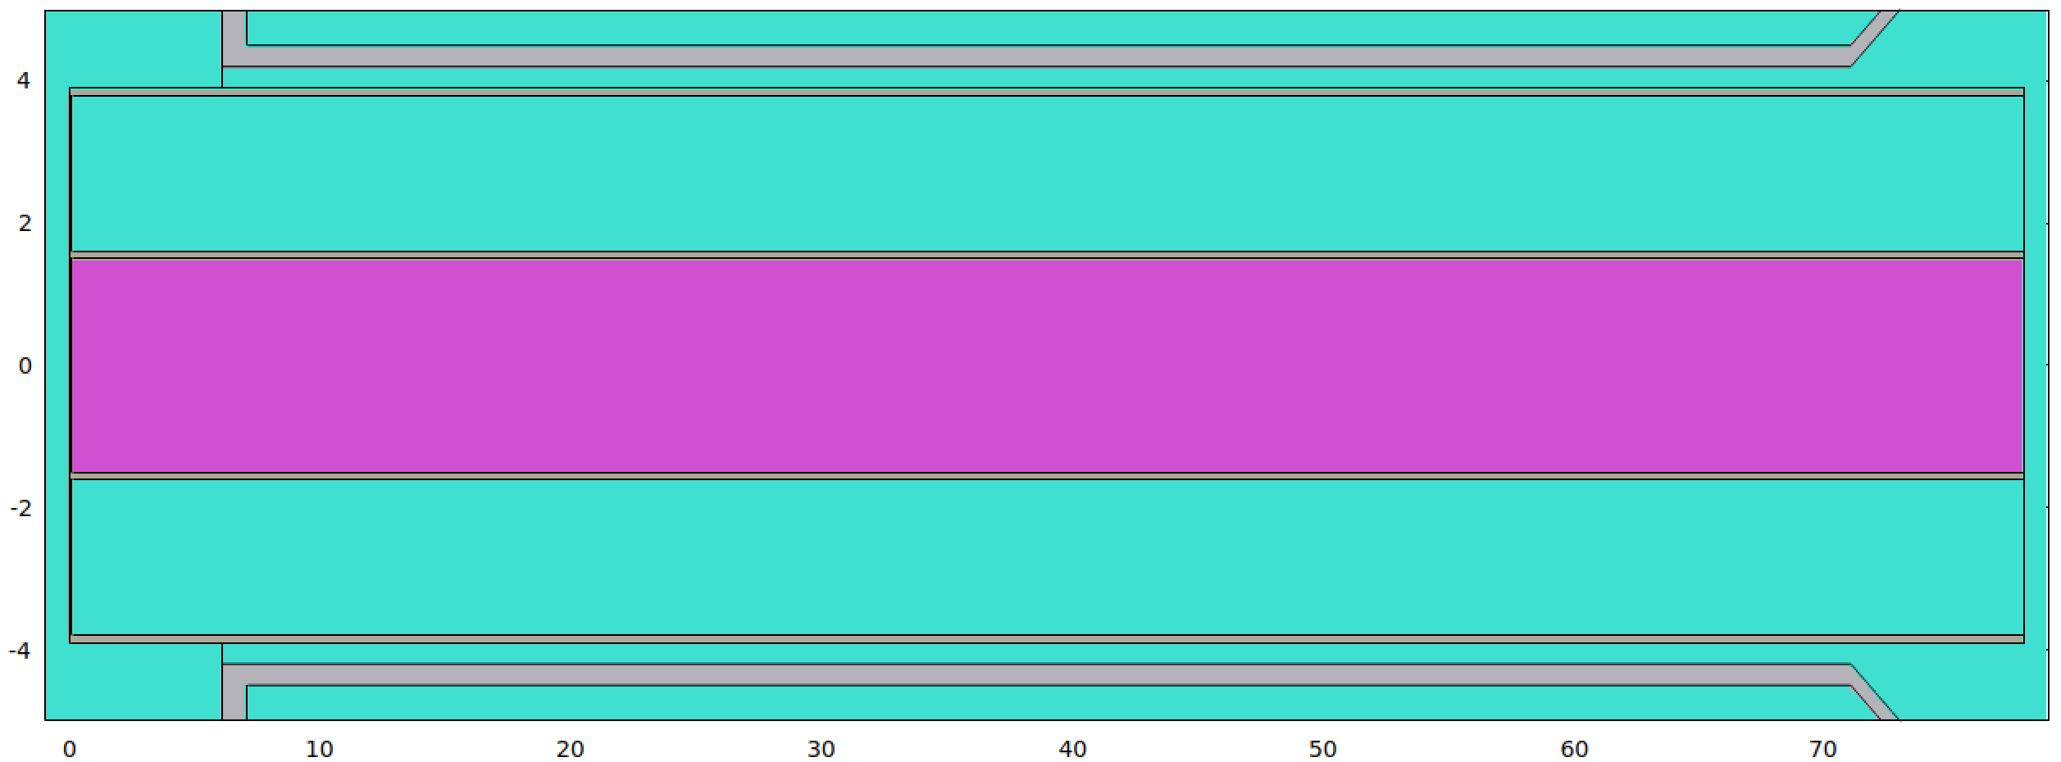
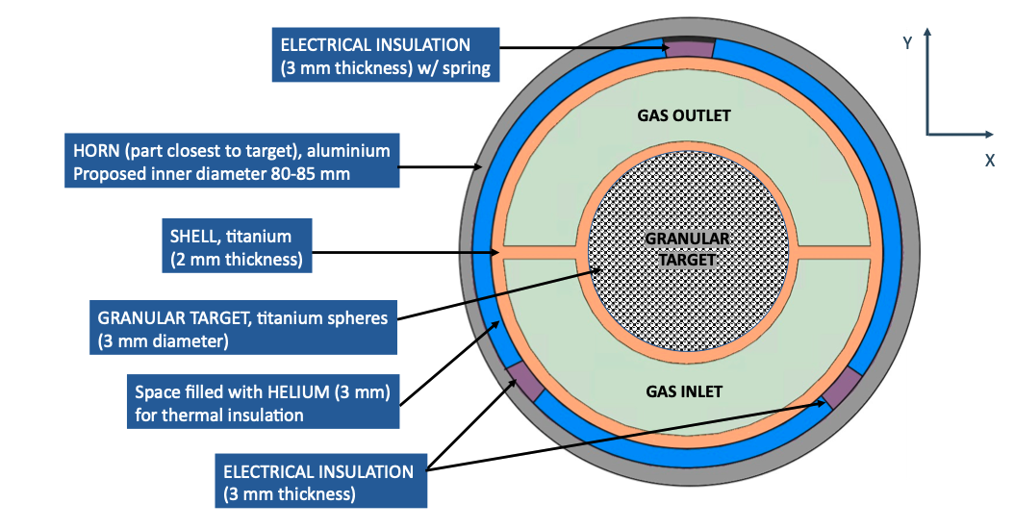
Introduction | Methods | Results – Particles Distribution | Results – Energy Deposition | Conclusion
Canister
Cooling system for the target
Credit : Lukasz Lacny – WP4 meeting – 16/09/2021

Slide 8
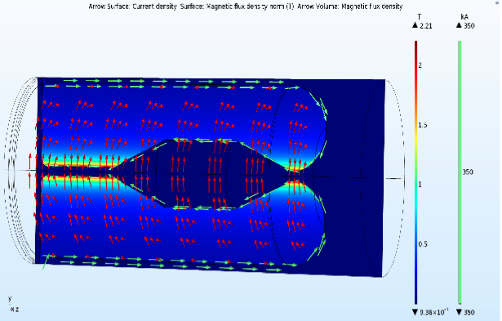
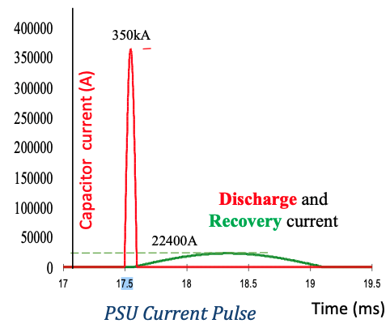
Introduction | Methods | Results – Particles Distribution | Results – Energy Deposition | Conclusion
Horn
Toroidal magnetic field direction
Direction of the 350 kA current
Credit : Pascal Pussot
3D AC/DC COMSOL simulation
Credit : Tamer Tolba– 01/07/2024

Slide 9
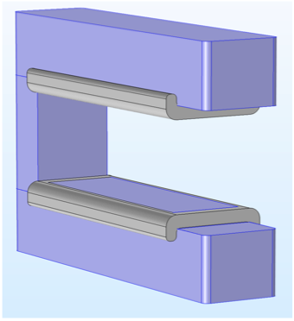
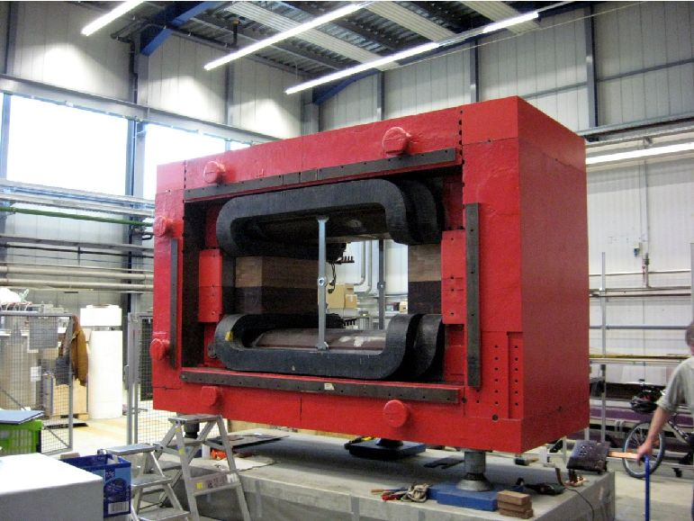
Introduction | Methods | Results – Particles Distribution | Results – Energy Deposition | Conclusion
Dipole
Operates @ I_{max} = 1340 A and a central magnetic field strength of B_{max} = 0.54T (∫B dl ≈ 0.74Tm)
1.5 m
3.9 m
A « U-shaped » dipole is considered to prevent particles from hitting
its edges.
0.84 m
2.8 m
1.5 m
1.5 m
Y
Z
Beam direction
X
BGO-OD @ at the ELSA facility in Bonn
x [cm]
Credit : Tamer Tolba talk - Nufact 2023 – 20/08/2023
Credit : Tamer Tolba - Annual Meeting 2024 – 15/10/2024

Slide 10
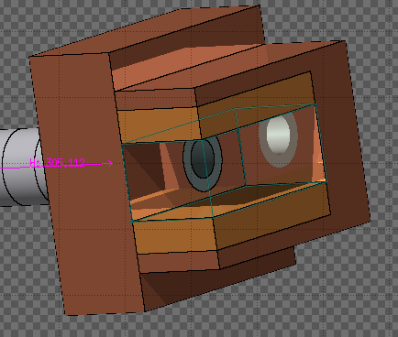
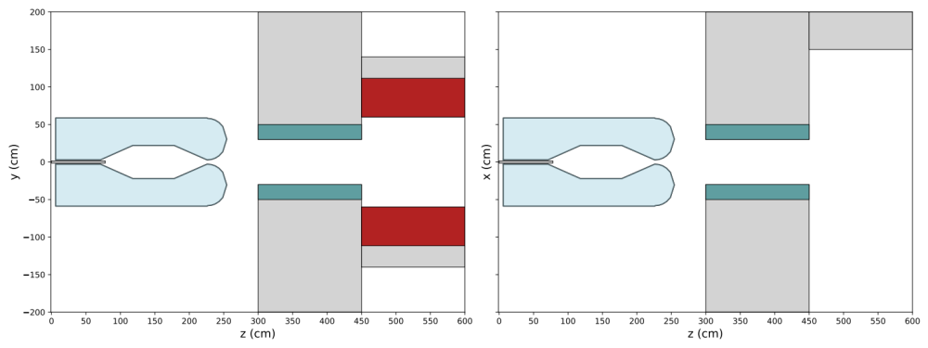

Introduction | Methods | Results – Particles Distribution | Results – Energy Deposition | Conclusion
Dipole – Collimator
- Last year geometry
Components
Materials
Iron
Magnet
He
CLMT
Iron
Target
Coils
Copper
W ring
Tungsten
$\vec{B} :by=1 .0 T$
He
He
Magnetic Horn
W ring
Tungsten
Coils
Legend:
CLMT : Collimator
W ring : Tungsten ring
CLMT
Magnet
Titanium (66%)
Iron

Slide 11
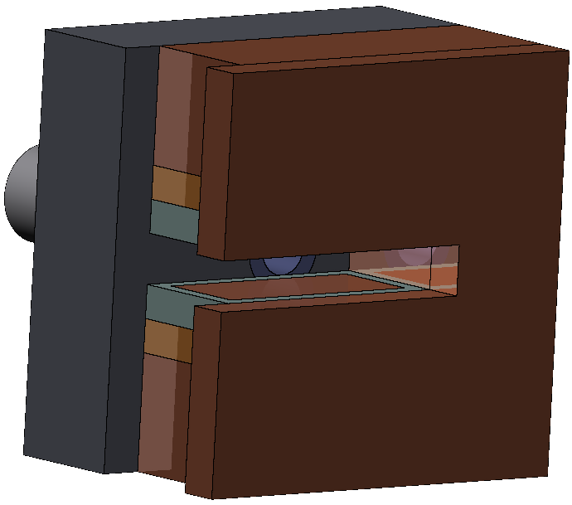
Introduction | Methods | Results – Particles Distribution | Results – Energy Deposition | Conclusion
Dipole – Collimator – Downstream shielding
New Geometry of the Dipole
Copper coils are located deeper, farther from the proton beam.
A tungsten shielding component has been added to provide further protection to the coils.
An Iron downstream shielding has been added to protect the dipole from indirect radiation coming from downstream, originating from the collision between the beam and the beam dump
The dipole magnetic field has been increased from 0.76 T to 1.0 T to optimise the beamline for the new pion energy range (1050 ± 10% MeV).

Slide 12
Introduction | Methods | Results – Particles Distribution | Results – Energy Deposition | Conclusion
Dipole – Collimator – Downstream shielding
New Materials for the CLMT
Last year, the collimator consisted of two parts:
An iron block, fully made of iron
A tungsten ring, fully made of tungsten
Now:
The CLMT is made of 90% stainless steel 316L and 10% H₂O
The tungsten ring is made of 85% tungsten, 5% tantalum, and 10% H₂O

Slide 13
Introduction | Methods | Results – Particles Distribution | Results – Energy Deposition | Conclusion
Beam Dump
The beam dump consists of three regions:
Graphite (C): Absorbs the beam impact
Iron block: Efficiently stops radiation
Copper shell: Helps with cooling
This is a first design, but see the IPAC paper* for more details.
* Johansen et al., presented at the 17th IPAC 2026, Deauville, France, May 2026, paper MOP7135. DOI: 10.18429/JACoW-IPAC2026-MOP7135.

Slide 14
Introduction | Methods | Results – Particles Distribution | Results – Energy Deposition | Conclusion
Transfer line
I also defined the transfer line.
It consists of a square cross-section, 1.8 m on each side.
The angle was changed from 29.5° to 24.5°.
I also added 7 quadrupoles, modelled as rings. I have not modelled the magnetic field yet. They are included here as references
The full simulation, generation, and input files are available on my GitHub profile:
24.5°
https://github.com/JulienHIEGEL/ESSnuSB---Target-Station

Slide 15
Introduction | Methods | Results – Particles Distribution | Results – Energy Deposition | Conclusion
Introduction summary
Since last year, the whole simulation has been revised, from the proton beam to the beam dump.
Several components have been added (Vessel, DSS, TT line, Quads, beam dump parts, tungsten protection)
Some materials have also changed, notably in the CLMT, as well as the target density.
In the following, all results will be presented using 10,500,000 primary protons.
1050 MeV pions will mean 1050 ± 10% MeV

Slide 16
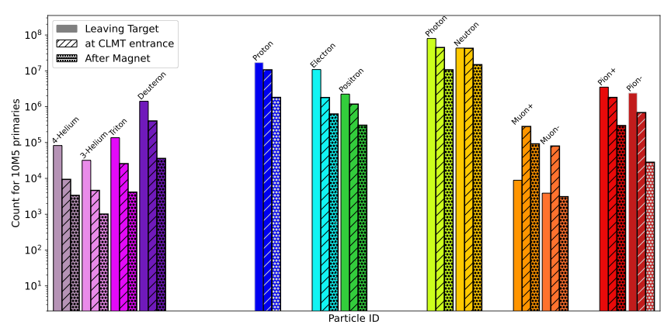
Introduction | Methods | Results – Particles Distribution | Results – Energy Deposition | Conclusion
All p-id distribution
150
(1)
(3)
Distributions are monitored at three locations:
(1) Leaving the target : Particle production
(2) CLMT entrance : Particles reaching the collimator,
whether inside the aperture or not
(3) After the magnet : Particles leaving the magnetic field of the dipole
(2)
A total of 3,505,011 pions are produced, including 135,166 π⁺ with energies in the 1050 ± 10% MeV range. This corresponds to 0.013 useful π⁺ per POT.
A large number of particles, especially neutrons and photons, are also produced.
→ Significant radiation levels require shielding to protect critical components.

Slide 17
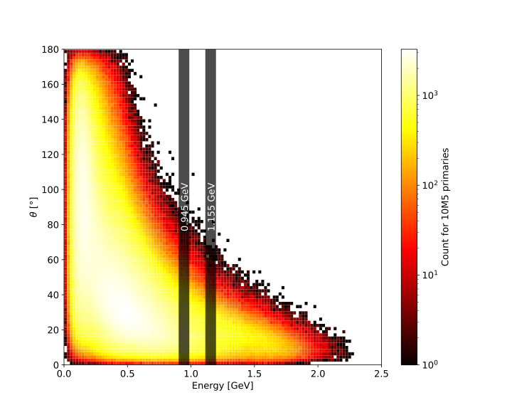
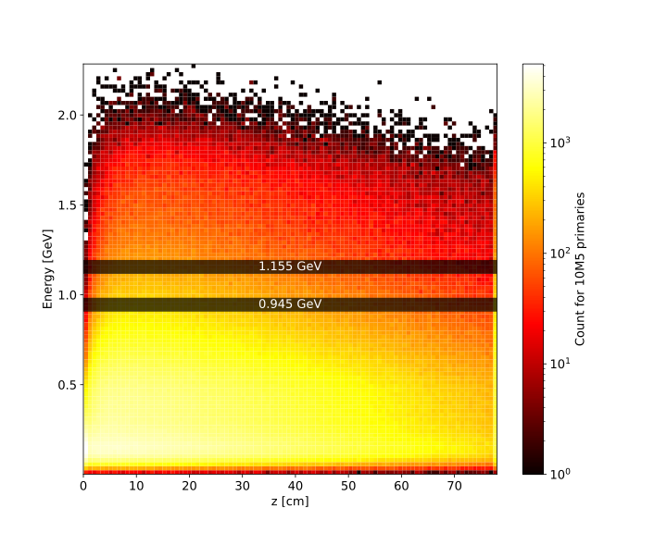
Introduction | Methods | Results – Particles Distribution | Results – Energy Deposition | Conclusion
Pion distribution at the target
Pion angle with respect to their energy
Fewer pions at 1050 MeV than at 700 MeV
However, they have a smaller deflection angle with respect to the beam trajectory
→ ”Easier” to transport along the beamline
Pion energy with respect to their leaving z
Now, we focus on the 1050 MeV pions, whose distribution is significant throughout the length of the target.
z [cm]

Slide 18
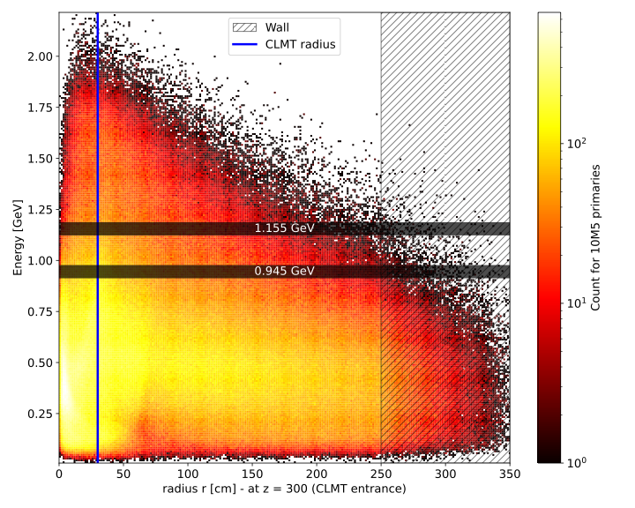
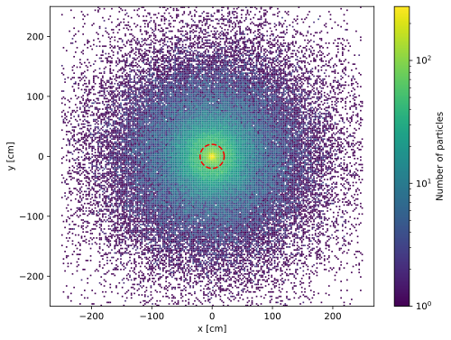
Introduction | Methods | Results – Particles Distribution | Results – Energy Deposition | Conclusion
Pion distribution at the CLMT
Pions reaching the CLMT surface
energy wrt impact radius
Only a few pions pass through the CLMT aperture :
The horn was optimised for 700 MeV /!\
150
1050 MeV pions distribution at the CLMT entrance
114 417 particles hit the CLMT (or enter its aperture)
Corresponding to 0.011 pions / pot

Slide 19
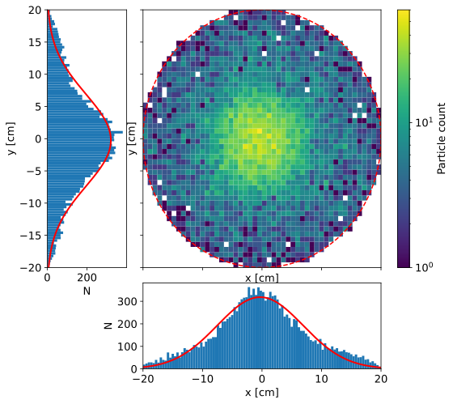
Introduction | Methods | Results – Particles Distribution | Results – Energy Deposition | Conclusion
Pion distribution at the CLMT
CLMT exit
Only 14,883 pions (1050 MeV) remain at the exit of the CLMT.
We have:
13.01% transmission (CLMT in → CLMT out)
11.01% transmission (Target → CLMT out)
This also corresponds to only 0.0014 pions/POT (1050 MeV).
→ And will probably lose more

Slide 20
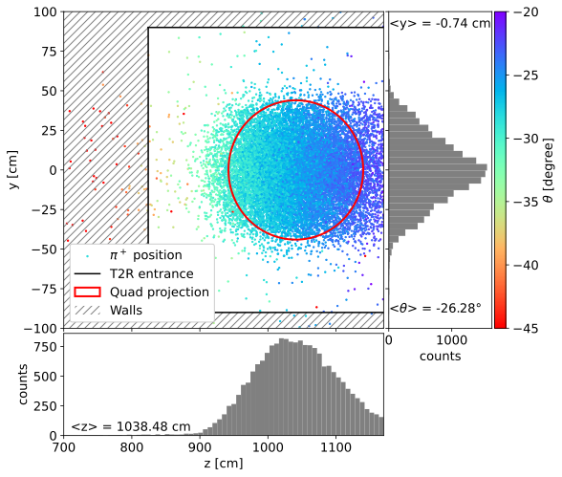
Introduction | Methods | Results – Particles Distribution | Results – Energy Deposition | Conclusion
Pion distribution at the transfer line entrance
150
The red ellipse is a projection of the quadrupole aperture onto the TT line entrance plane.
16,009 pions are found here
/!\ more than at the exit of the CLMT /!\
Additional particles may come from:
- Proton beam–beam dump interactions
- Particles passing through the CLMT outside the aperture
- Secondary radiation (e.g. at the downstream shielding)
The mean deflection angle is −26.28°.
→ The dipole magnetic field may be too strong (1 T).

Slide 21
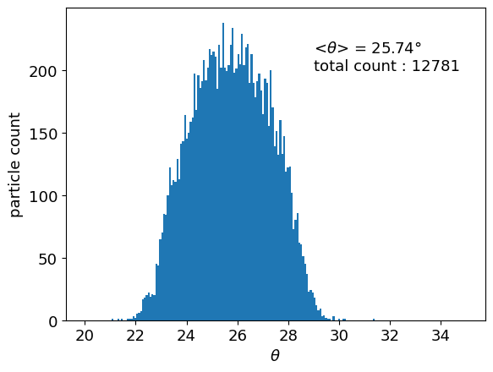
Introduction | Methods | Results – Particles Distribution | Results – Energy Deposition | Conclusion
Pion distribution at the first quadrupole
150
12,781 pions (1050 MeV)
Corresponding to:
0.0012 pions/POT
9.5% transmission (Target → 1st quadrupole)
Mean deflection angle: −25.74°

Slide 22
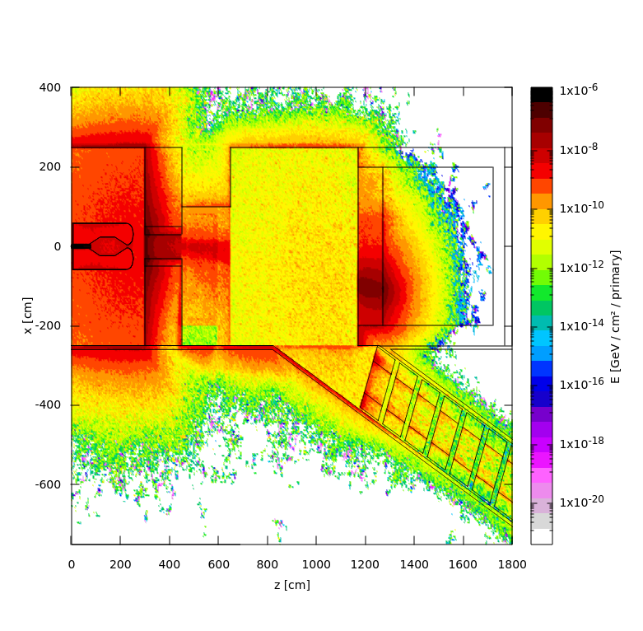
Introduction | Methods | Results – Particles Distribution | Results – Energy Deposition | Conclusion
Energy Deposition

Slide 23
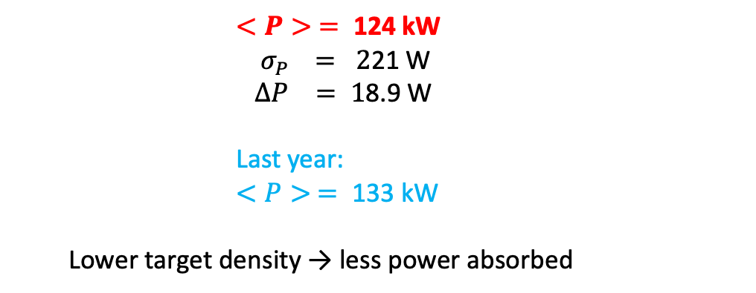
Introduction | Methods | Results – Particles Distribution | Results – Energy Deposition | Conclusion
Energy Deposition in the Target
        $$<P> = \text{1}\text{24} \text{k}\text{W}$$
        ${ σ}_{P} = 2$21 W
        $$∆P = \text{1}\text{8.}\text{9 }\text{W}$$
        Last year:
        $$<P> = \text{133 }\text{k}\text{W}$$
  Lower target density → less power absorbed

Slide 24
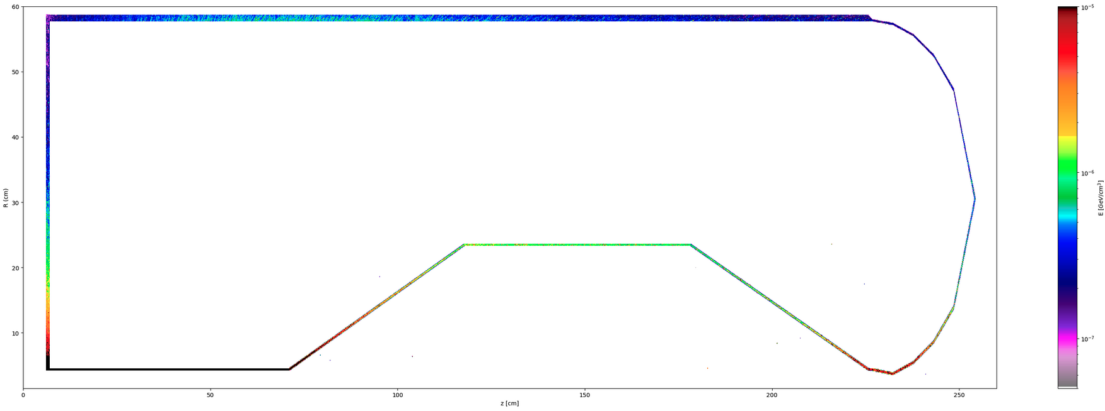
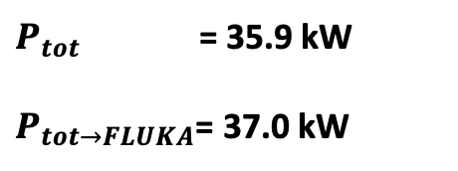

Introduction | Methods | Results – Particles Distribution | Results – Energy Deposition | Conclusion
Energy Deposition in the Horn
16.1 kW
45%
374 W
1%
$P_{tot}$ = 35.9 kW
$P_{tot→FLUKA}$= 37.0 kW
2.84 kW
8%
551 W
1%
$\sim$3% difference due to binning effects
1.77 kW
5%
2.73 kW
8%
1.52 kW
4%
9.02 kW
25%
1.04 kW
3%
$P_{tot}$ : Computed from the energy deposition in a 3D grid (USRBIN ENERGY card)
$P_{tot→FLUKA}$ : Computed from the value directly provided by FLUKA (SCORE ENERGY card)

Slide 25
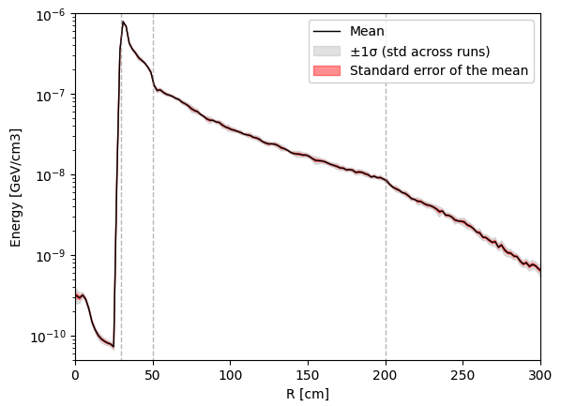
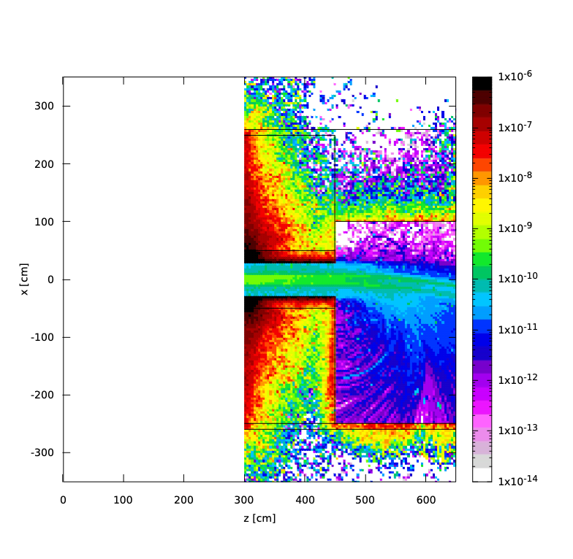
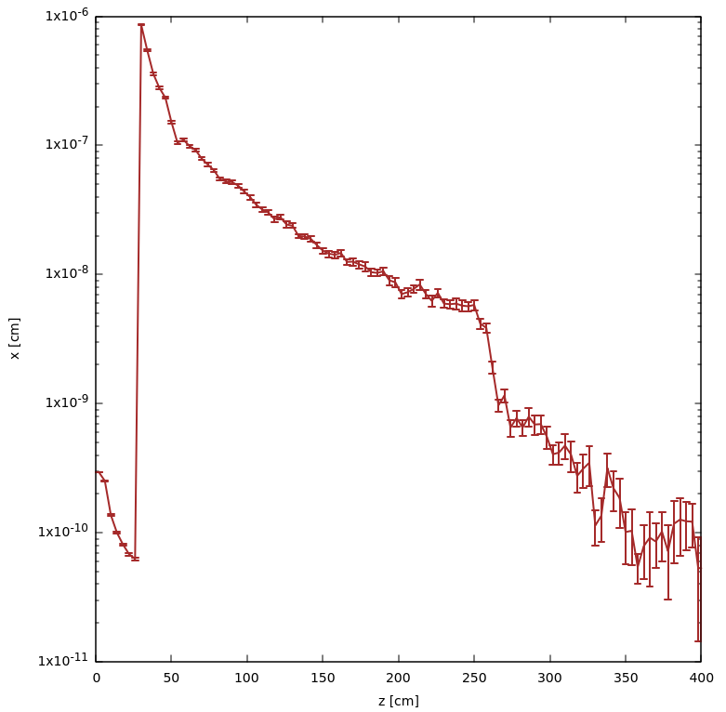
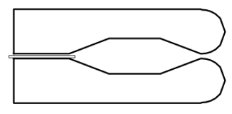
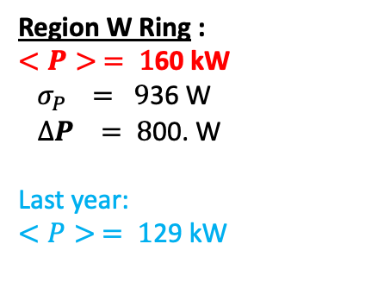
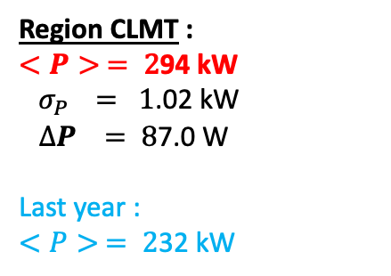
Introduction | Methods | Results – Particles Distribution | Results – Energy Deposition | Conclusion
Energy Deposition in the CLMT
The CLMT is larger (5m instead of 4m) than previously, explaining why it absorbs more power.
Last year
Region CLMT :
$$<P> = \text{2}\text{94} \text{k}\text{W}$$
${ σ}_{P} = 1$.02 kW
$∆P = \text{8}\text{7.0} \text{W}$
Last year :
$$<P> = \text{2}\text{32 }\text{k}\text{W}$$
He
Wall
(concrete)
CLMT
(SS 316L)
Region W Ring :
$$<P> = \text{1}\text{60 }\text{kW}$$
${ σ}_{P} = 9$36 W
$∆P = \text{8}\text{0}\text{0.} \text{W}$
Last year:
$$<P> = \text{1}\text{29 }\text{k}\text{W}$$
WR
(W)
R

Slide 26
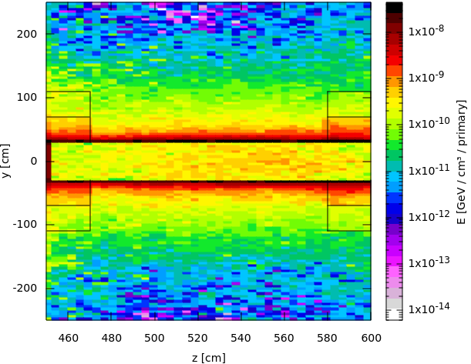
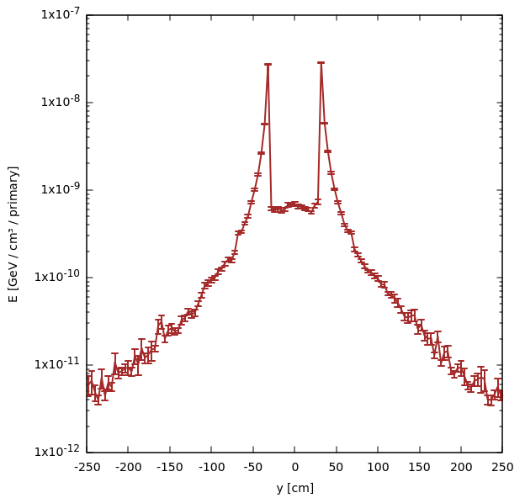
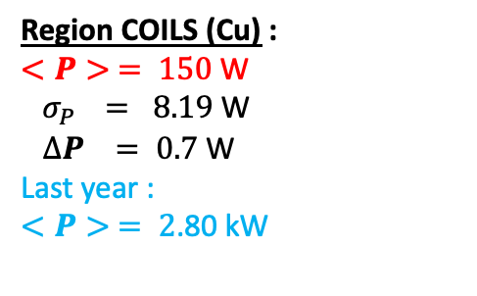
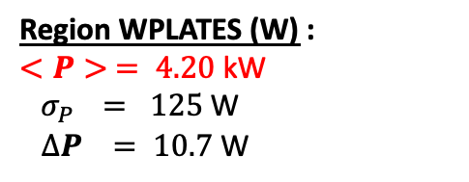
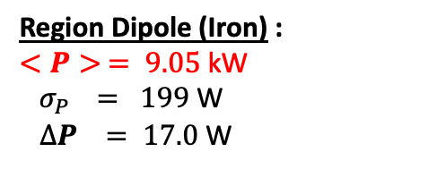
Introduction | Methods | Results – Particles Distribution | Results – Energy Deposition | Conclusion
Energy Deposition in the Dipole
Region Dipole (Iron) :
$$<P> = \text{9.05} \text{kW}$$
${ σ}_{P} = 199$W
$∆P = \text{17.0} \text{W}$
Region WPLATES (W) :
$$<P> = \text{4.20} \text{kW}$$
${ σ}_{P} = 125$W
$∆P = \text{10.7} \text{W}$
Region COILS (Cu) :
$$<P> = \text{150} \text{W}$$
${ σ}_{P} = 8.19$W
$∆P = \text{0.7} \text{W}$
Last year :
$$<P> = \text{2}\text{.}\text{80} \text{k}\text{W}$$

Slide 27
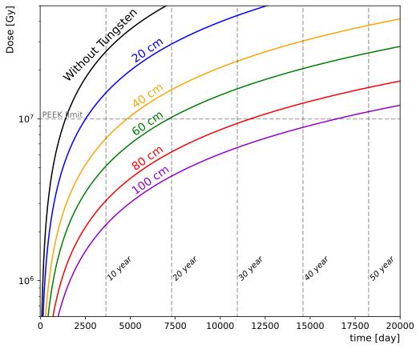
Introduction | Methods | Results – Particles Distribution | Results – Energy Deposition | Conclusion
Energy Deposition in the Dipole – Dose in the coils
Dose evolution with time for different tungsten thicknesses
These values were obtained assuming 365 operational days per year.
The dose study in the coils shows that the material may last at least 10 years with the current configuration (40 cm tungsten), when compared with the PEEK limit (P. Beynel et al. (1982), H. Schönbacher (1982)).
Note: The dose inside the region is, by definition, an average value. However, we can look at the voxel containing the maximum dose to estimate the local peak dose inside the coils:
5.67 × 10⁷ Gy after 10 years *, assuming 365 operational days per year and 40 cm tungsten. Above the PEEK limit !
* Approximately 10 times the average dose.
→ Last year it was 150 times the average dose.

Slide 28





Introduction | Methods | Results – Particles Distribution | Results – Energy Deposition | Conclusion
Energy Deposition in the Beam Dump
Region BDUMP (Graphite) :
$$<P> = \text{1}\text{4}\text{8 }\text{kW}$$
${ σ}_{P} = 9$57 W
$∆P =\text{ 8}\text{1.8} \text{W}$
Region FeBDUMP (Iron) :
$$<P> = \text{8}\text{2.4} \text{k}\text{W}$$
${ σ}_{P} = 6$49 W
$∆P = \text{55.}\text{4} \text{W}$
Region CuBDUMP (Copper) : total
$<P> = \text{8}\text{.}\text{22 }\text{kW}$ 238 kW
${ σ}_{P} = 1$73 W
$∆P = \text{1}\text{4.8 }\text{W}$

Slide 29
Introduction | Methods | Results – Particles Distribution | Results – Energy Deposition | Conclusion
Conclusion
The simulation has been fully revised
- Updated target, CLMT, Dpole and beam dump
- New geometry adapted to the 1050 MeV
Pion transport
- around 13 000 useful pions at the 1st quadrupole
- 9.5% transmission from the target to the 1st quadrupole
- Mean deflection angle slightly too large
Energy Deposition
- Strong reduction of the power deposition in the dipole coils
- Shielding is clearly improving the situation
- Maximal dose still above the peek limit (long term) : further optimisations are needed
Next steps
- Re-optimise the horn for 1050 MeV pions
- Full simulation of the facility

Slide 30
Additional slides

Slide 31


Pion distribution at the CLMT – No focus

Slide 32


Pion distribution at the CLMT – Positive focus

Slide 33


Pion distribution at the CLMT – Negative focus

Slide 34


Introduction | Methods | Results – Particles Distribution | Results – Energy Deposition | Conclusion
Pion distribution at the CLMT
Emittance of the 1050 MeV pion beam in both planes (CLMT exit)
(x, x′) on the left, (y, y′) on the right
The different circles correspond to 10%, 25%, 50%, 90%, and 100% of the closest pions.
For 100%, we obtain the following emittances:
(x, x′): 1935.6 mm·mrad (y, y′): 1906.1 mm·mrad
→ The emittances are very similar in both planes, as expected from the cylindrical horn geometry.
y’ [mrad]
y [mm]

Slide 35






Energy Deposition in the Target
Energy per proton
Gauss
  $$<P> = \text{1.}\text{52}\text{e}\text{+05 }\text{W}$$
  ${ σ}_{P} = 1$.08e+03 W
  $$∆P = \text{2.}\text{43}\text{e}\text{+02 }\text{W}$$
Averaged over the first 10 cm
Energy per proton
Annular
138.53 kW (Łukasz Łacny, 2020) ←→
  $$<P> = \text{1.33}\text{e}\text{+05 }\text{W}$$
  ${ σ}_{P} =$9.81e+02 W
  $$∆P = \text{2.19}\text{e}\text{+02 }\text{W}$$

Slide 36

Pion distribution at the CLMT
150

