Slide 1



Target 2 Ring (T2R)
Pion Transfer Line and Injection to nuSTORM
ESSnuSB+ Annual Meeting
Ilias Efthymiopoulos, Max Topp-Mugglestone
CERN
Wik’s Castle, Uppsala-Sweden

Slide 2
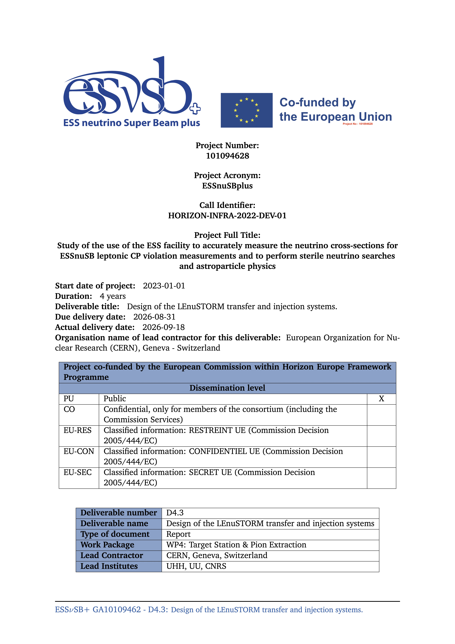
T2R Line & Injection
Design details reported in the recently published D4.3 deliverable
Design of the LEnuSTORM transfer and injection systems
In the following slides:
key aspects of the design,
performance estimates from tracking studies
remaining work for CDR

Slide 3
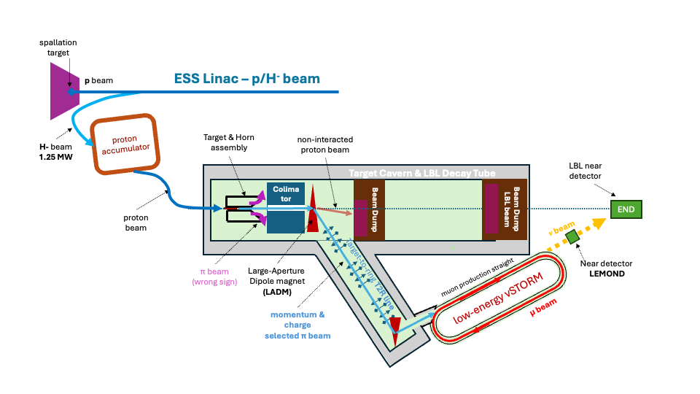
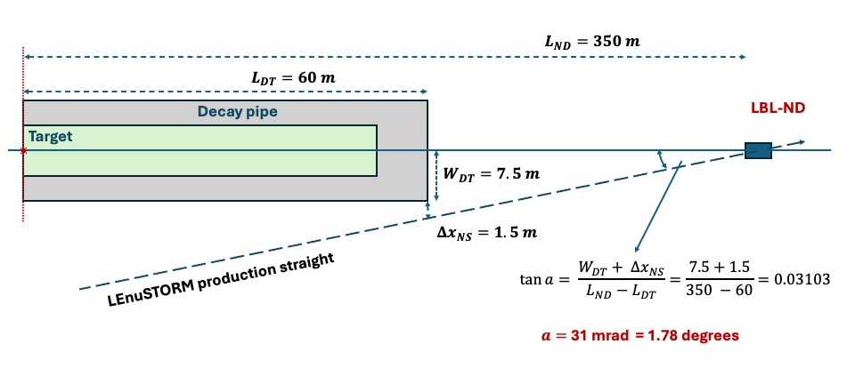
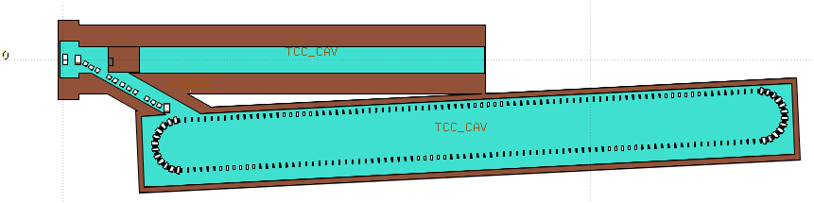
T2R line & nuSTORM
Layout
Constraints:
The nuSTORM production straight must point to the lbl-ND (END) at 350m from the target
Shorter possible length to minimize the pion decays in the line
31mrad

Slide 4
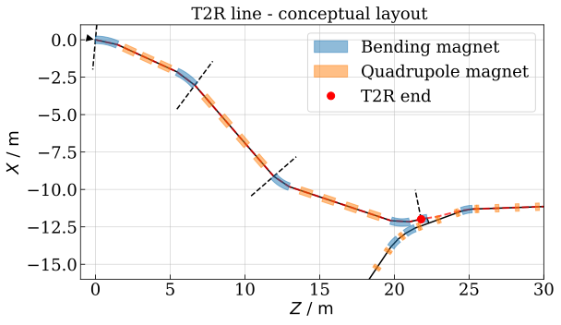
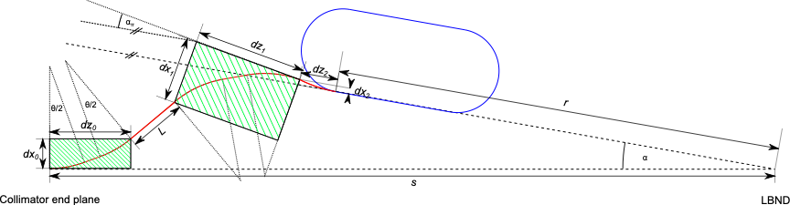
Target to Ring (T2R) pion transfer line
Design concept
Three segment design
Target-station arc: match to pion production from the horn/collimator
Injection-matching arc: match to the parameters of the pion beam in nuSTORM injection point and have zero dispersion at the start of the production straight
Dispersion-suppression straight: connect the optics between the two arcs
target-station arc
dispersion-suppression straight
Injection matching arc

Slide 5
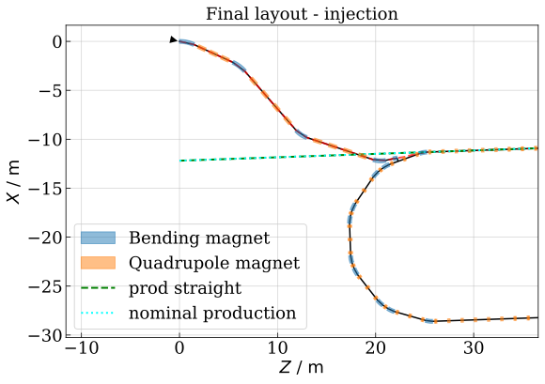
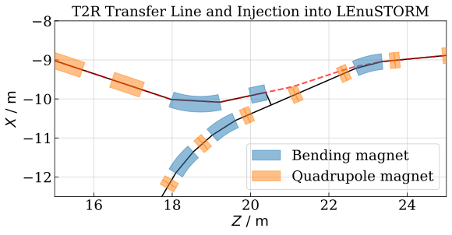
T2R Injection to the nuSTORM ring
Stochastic injection
Baseline option: pion beam 1.050 GeV/c – muon beam 0.600 GeV/c
T2R line
end marker
pion trajectory
production straight
injection septum
T2R pion line
nuSTORM ring
Key challenge: design of the septum and arc quadrupole to the available space and define apertures to accommodate both the circulating muon beam and the injected pion beam.
  A special magnet design will be required; one option under consideration is a combined-function quadrupole with an additional dipole winding.

Slide 6
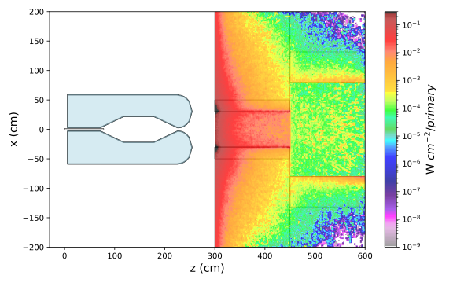
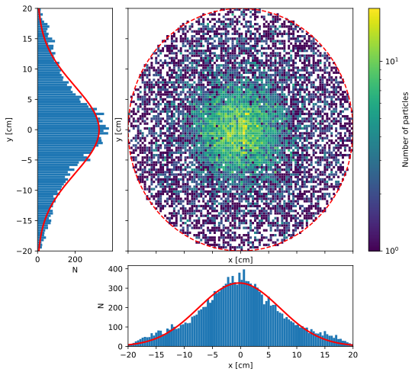
Target to Ring (T2R) pion transfer line
Pion source
Initial pion beam parameters at the exit of the collimator (Julien’s FLUKA simulation)
1.46 10⁻³ π/pot in the T2R momentum range of 1.050 GeV ± 10%

Slide 7
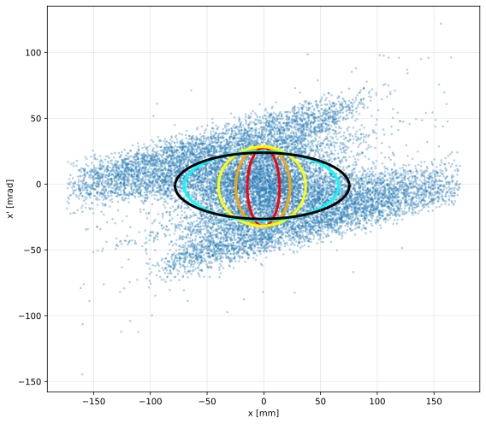
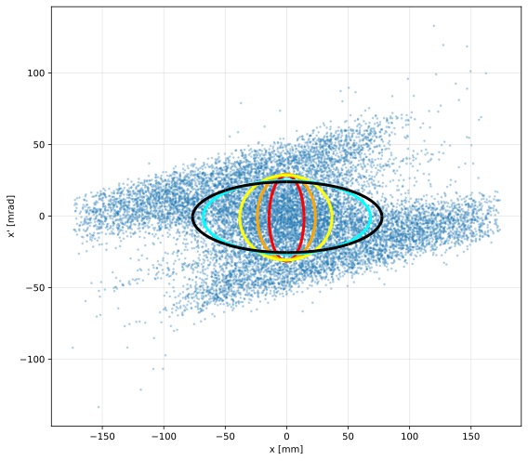
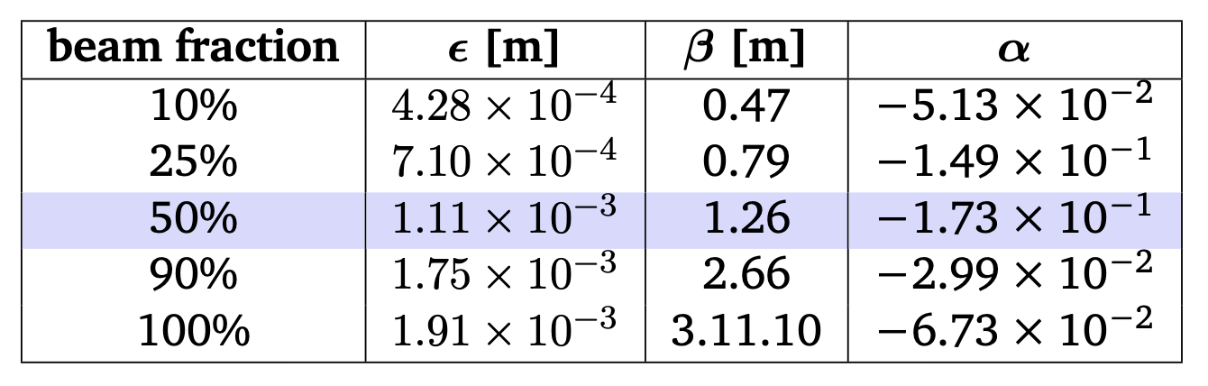
Target to Ring (T2R) pion transfer line
Pion source
Initial pion beam parameters at the exit of the collimator (Julien’s FLUKA simulation)
used in optics and tracking studies

Slide 8
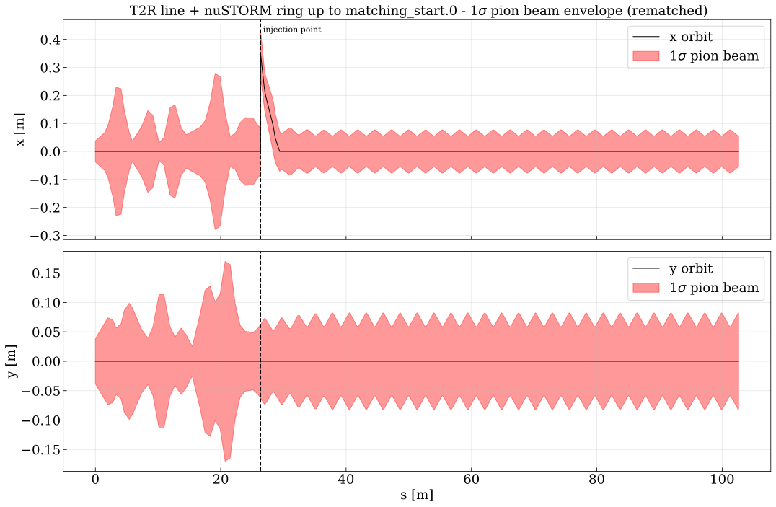
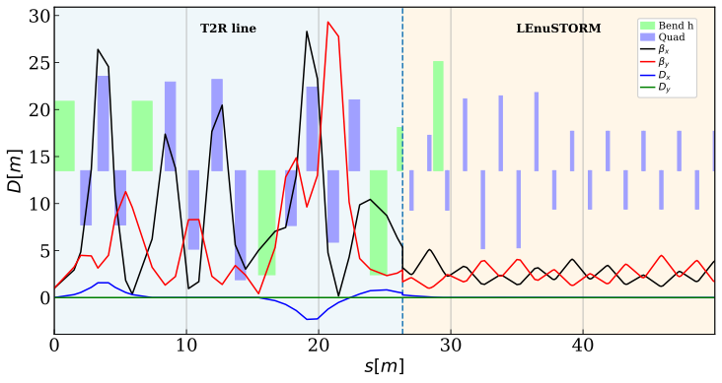
Target to Ring (T2R) pion transfer line & Injection
Optics
Final pion beam optics and 1σ envelope
B-field strengths (bends & quads) limited to 1.8 T, as for normal conducting magnets

Slide 9
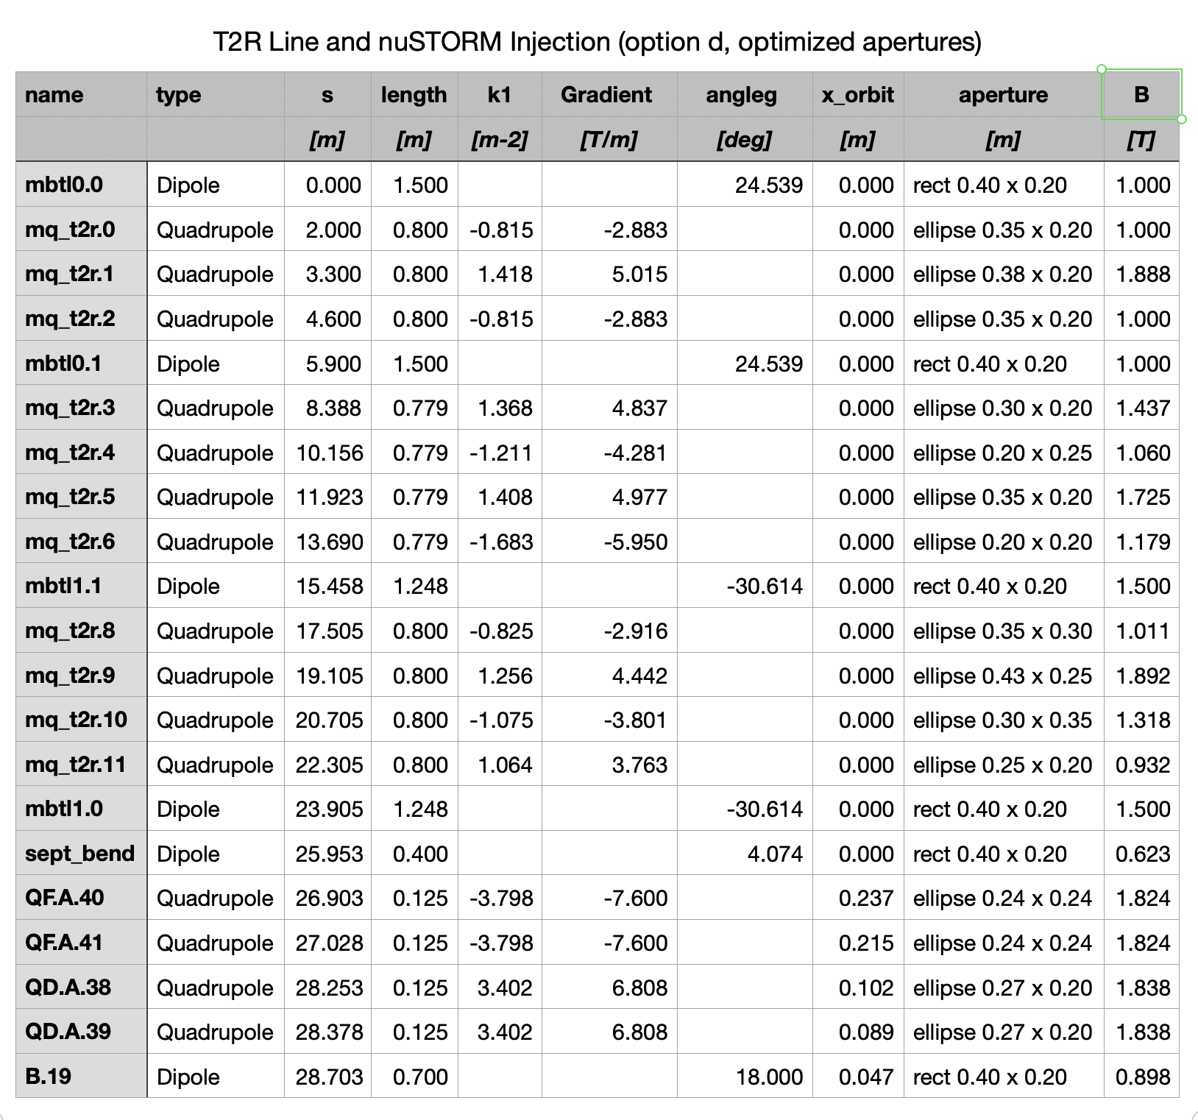
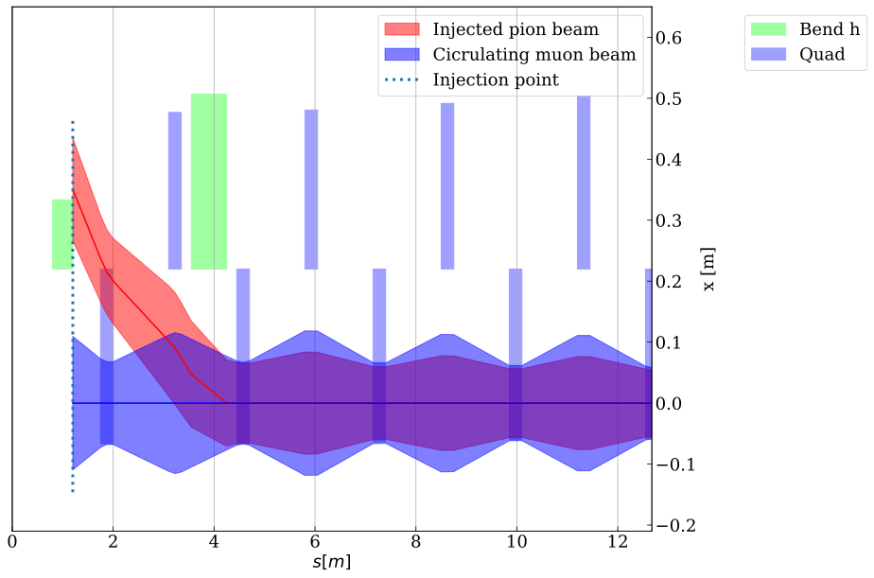
Target to Ring (T2R) pion transfer line
Apertures
Baseline aperture ⌀ 40 cm, already quite big!
Key challenge: design of the septum and arc quadrupole to accommodate both the circulating muon beam and the injected pion beam.
  For the first quad (QF.A.40), A special magnet design will be required; one option under consideration is a combined-function quadrupole with an additional dipole winding.
ε_{π} ~1000 mm.mrad
ε_{μ} ~3000 mm.mrad

Slide 10
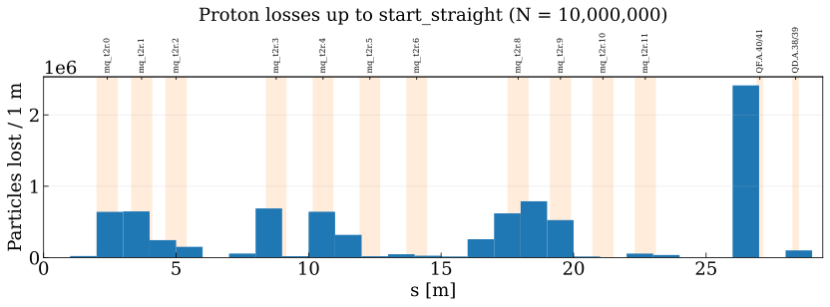
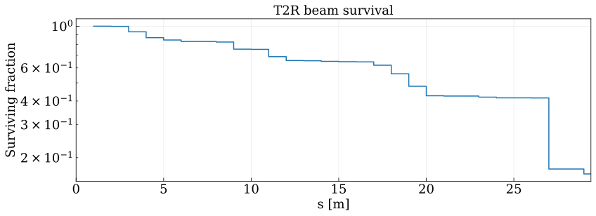
Target to Ring (T2R) pion transfer line
Performance
Tracking in xSuite with nominal pion emittance (50%) case
Transmission efficiency to the start of nuSTORM straight (29.4m from the target)
16.36% without accounting for pion decays
9.9% including decays (60.6% survival)
Expected pion flux at the start of nuSTORM:
1.46 10⁻³ ⨉ 50% ⨉ 16.4% ⨉ 60.6% → 7.2 10⁻⁵ π/pot
⨉ 3.22 10²² pot/y _{(200d, 60% eff)} → 2.33 10¹⁸ π/year
Pion (and muon) decays implemented in Xsuite, extend the tracking to the straight section to provide muon flux and distribution
Cross-check with Ting’s simulation and estimates, provide final flux numbers as input to the CDR

Slide 11
Target to Ring (T2R) pion transfer line & Injection
Full simulation
FLUKA framework for the complete facility
  Target/horn/LADM → Julien + Tamer
  Fully parametetric using the optics files
  Will be used to produce a set of final plots for the CDR, including radiation studies and backgrounds
(Temp repository: https://github.com/iefthymio/essnusbsim.git)

Slide 12
Backup Slides

Slide 13
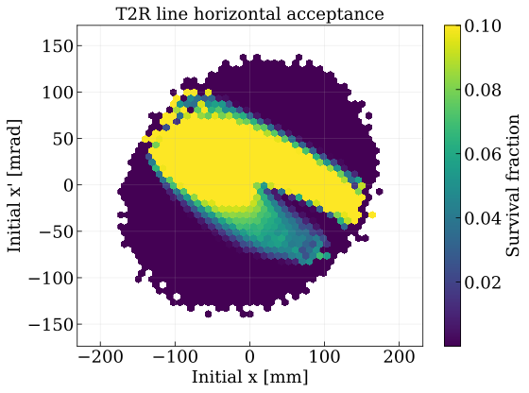
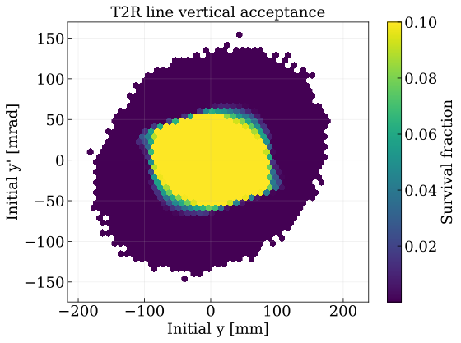
Target to Ring (T2R) pion transfer line
Performance
Tracking in xSuite with nominal pion emittance (50%) case

Slide 14
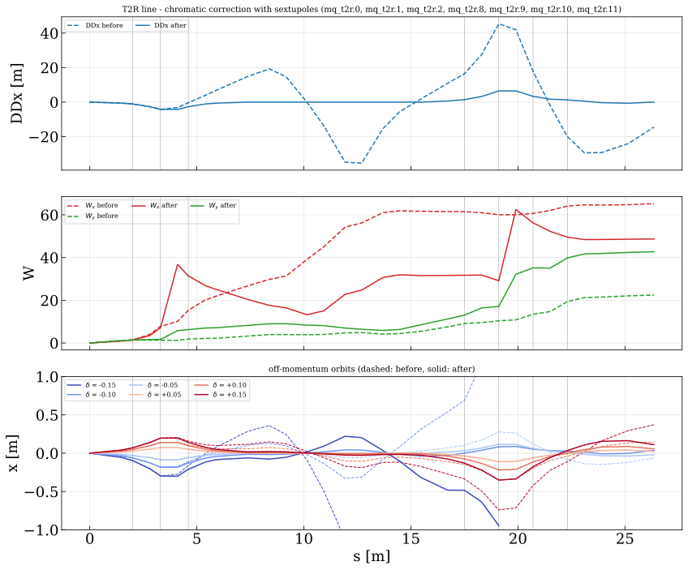
Target to Rin (T2R) Transfer Line Design & Injection
Non-linear corrections
Add sextupole components (combined function magnets) in the T2R arcs
Added sextupole components (combined-function magnets) in the T2R arcs
The chromatic corrections do make the off-momentum orbits much better:
  peak |DDx| drops from 45 to 6.5 m
  the off-momentum orbit at δ = −0.10 drops from 1.18 m (lost) to 0.18 m, and at δ = +0.15 from 0.74 to 0.35 m
  the strengths are modest, |k2L| ≤ 0.95 m⁻²
  W_y gets worse, rising from 22 to 43
but the tracked transmission drops down
and further, due to geometric aberrations, push particles to wider tails on both sides, increasing the losses in the critical QF.A.40 aperture at the entry in nuSTORM ring ➔ won’t be considered further
configuration | baseline | with sextupoles
b (enlarged apertures, δ = 0) | 84.5 % | 58.1 %
c (enlarged apertures, δ rms 0.10) | 37.4 % | 31.1 %
d (B_pole ≤ 1.9 T, δ rms 0.10) | 16.3 % | 10.2 %

