Slide 1
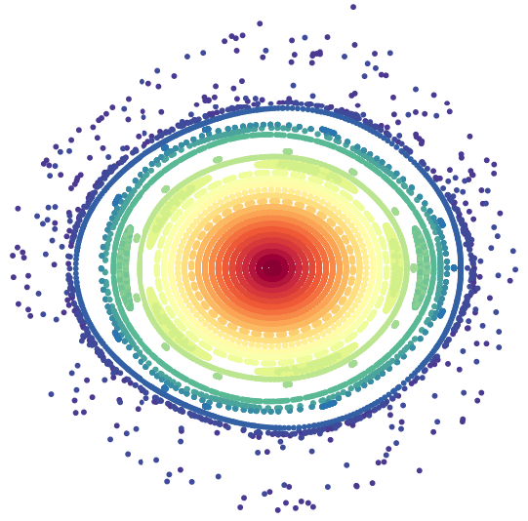
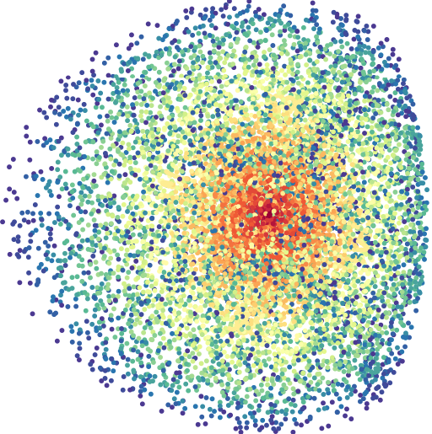
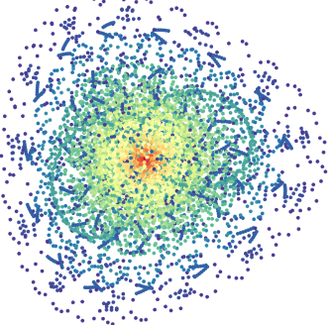



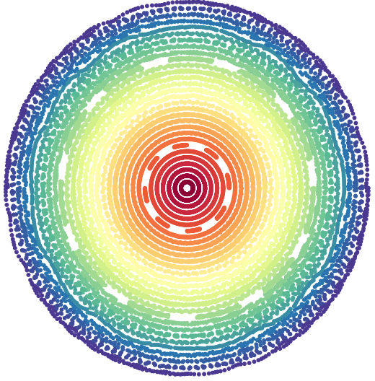
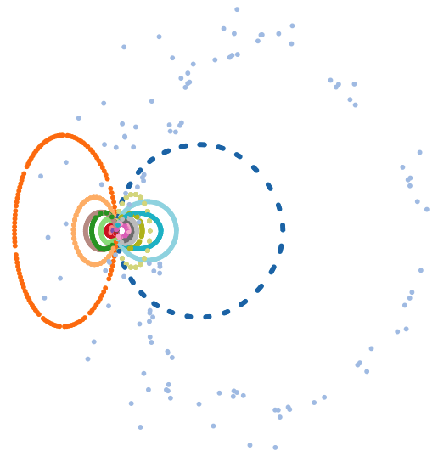
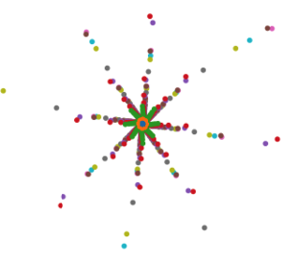
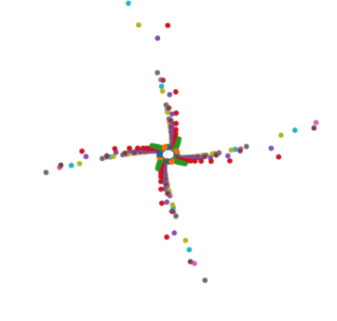
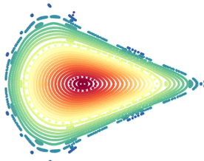
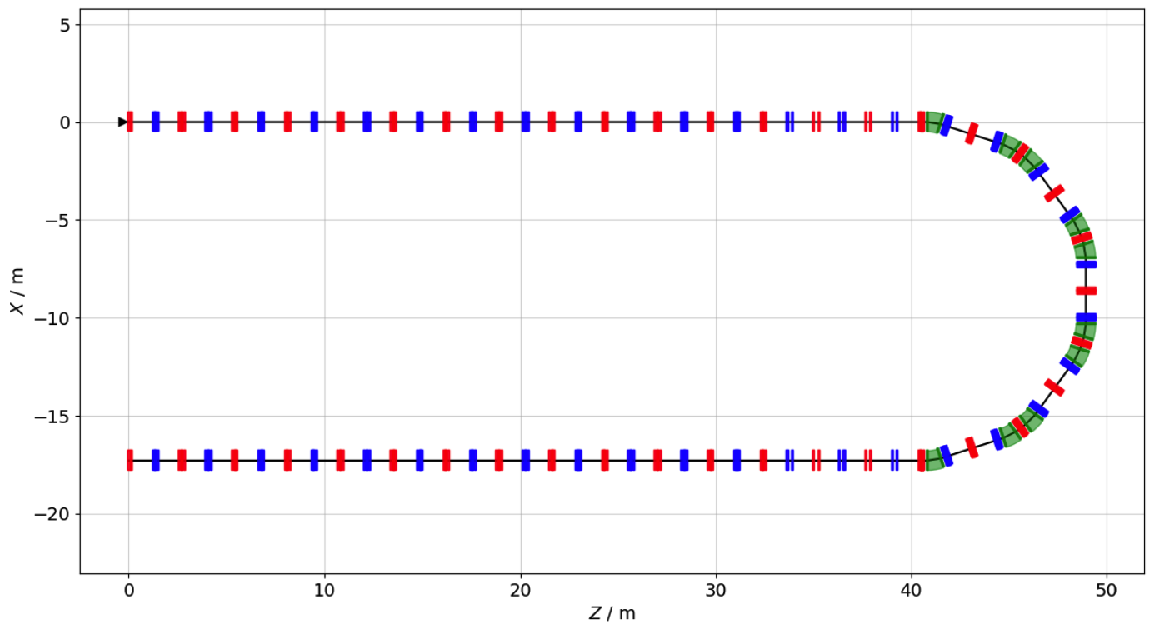

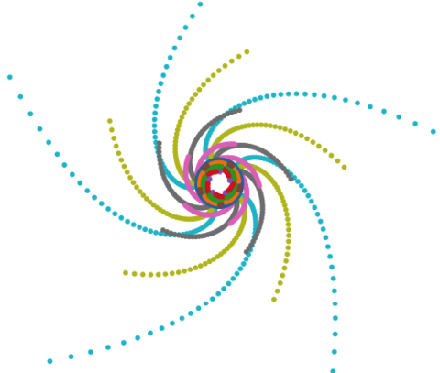
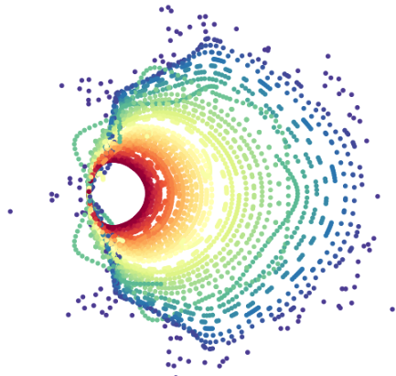
ESSnuSB+ 4th Annual Meeting
Parallel Section
Ring Design Summary and Update
Ting Wing Choi

Slide 2
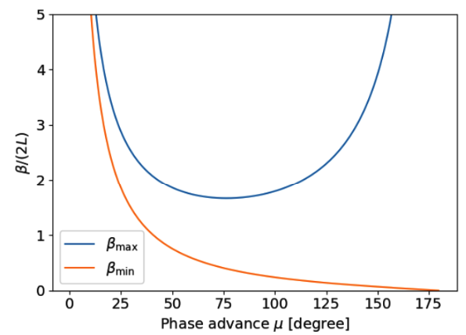
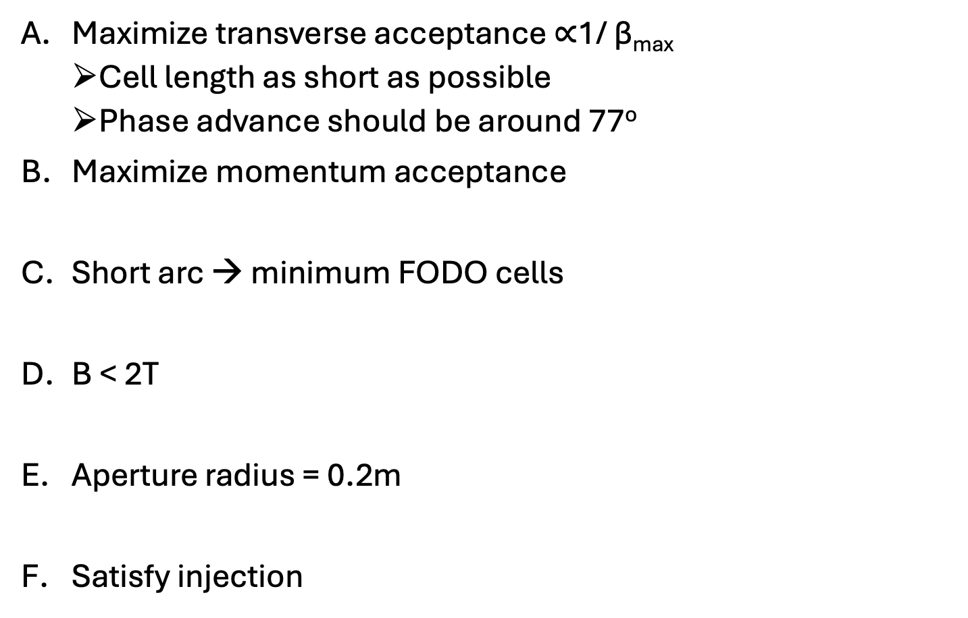
Design Requirements and foucs
Maximize transverse acceptance $∝$1/ β_{max}
  Cell length as short as possible
  Phase advance should be around 77º
Maximize momentum acceptance
Short arc → minimum FODO cells
B < 2T
Aperture radius = 0.2m
Satisfy injection
In a FODO cell (no dipole)
1

Slide 3
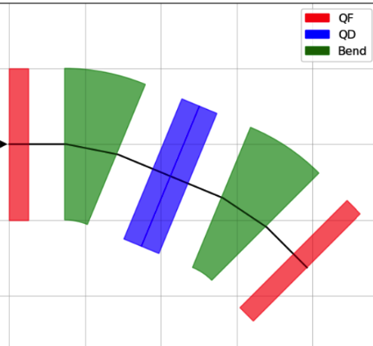
Arc FODO cell
Design idea: Short cell length
  L_{quad} = 0.25m
  L_{space} = 0.2 m
  L_{dipole} = 0.7 m
  to avoid non-linearity
2 (0.25 + 0.7) + 4*0.2 = 2.7 m / cell

Slide 4
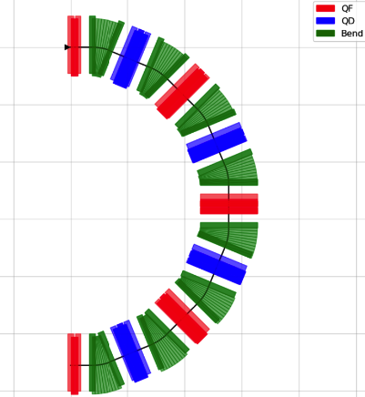

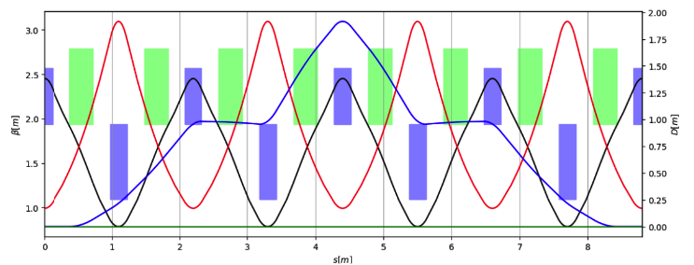
Arc
Design idea: Short ARC length
Disperson-free condition:
Phase advance : 90 degrees
Problem :
  Not favor injection
  Too much maximum disperion

Slide 5
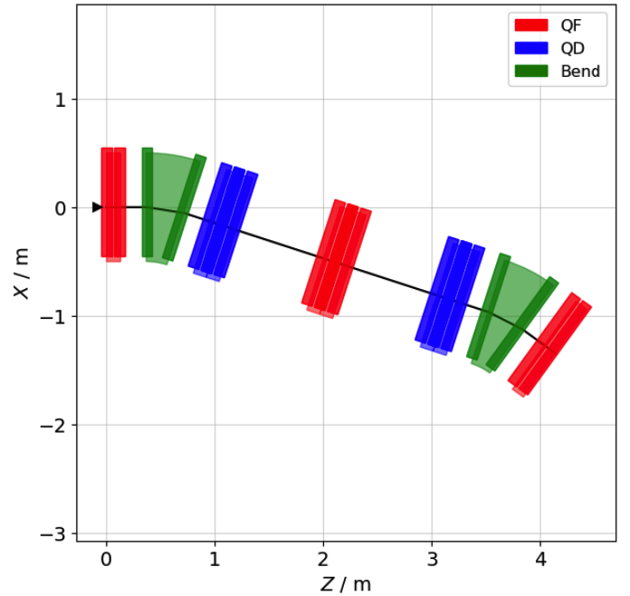
2nd Arc FODO cell
Total length: 5.4 m
phase advances: 144º
Magnetic strength
  Dipole : 0.9 T
  Q_{f, arc}: 1.36 T
  Q_{d,arc}: 1.52 T
A supercell

Slide 6
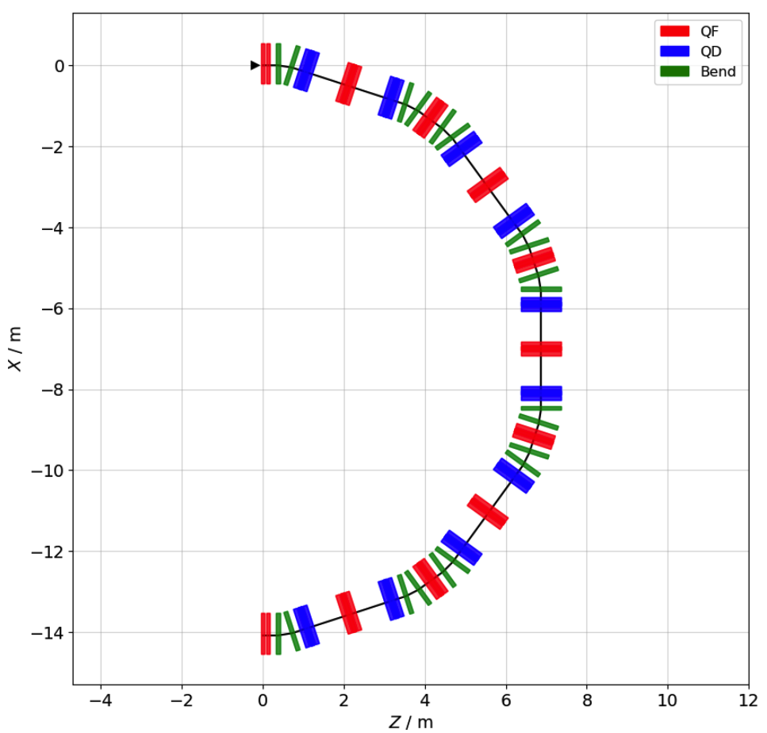
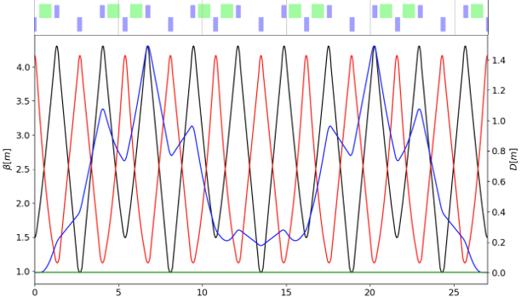
2nd Arc
Design idea: loosen arc length,
  favor injection
  reduce maximum dispersion
Phase advance : 144º/supercell (=72º/cell)
  n = 2
  N_{cell} = 5

Slide 7
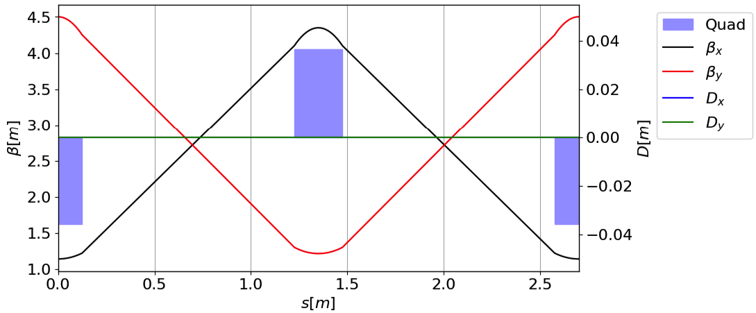
Straight FODO cell
Design idea: same length as the arc fodo cell → reduce design complexity
Phase advances: 77º, 77º ( +slight shift for tune optimisation)
Magnetic strength
  Q_{f, s} : 1.58 T
  Q_{d, s} : 1.58 T

Slide 8
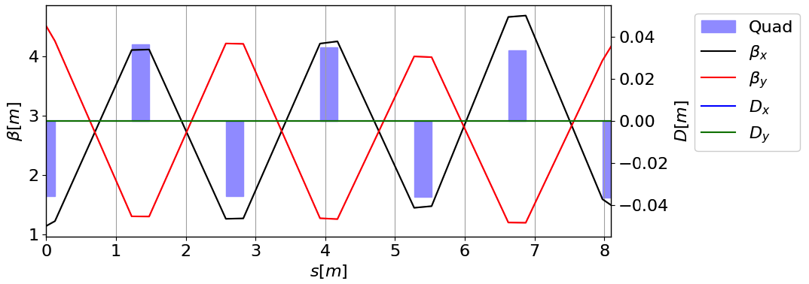
Matching cell
Five quadrupoles to produce smoothiest matching
Same length as 3 FODO cells.

Slide 9

The Ring
A = 8.9 mmrad, High linear transverse acceptance 👍
classical magnets : B < 2 T 👍
Injection 👍
FODO cells 👍
27m
2-fold symmetry

Slide 10
Long term particle tracking

Slide 11
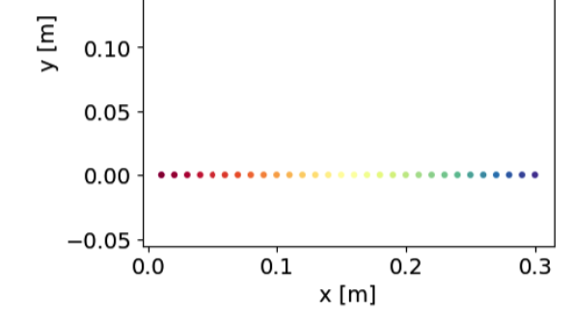
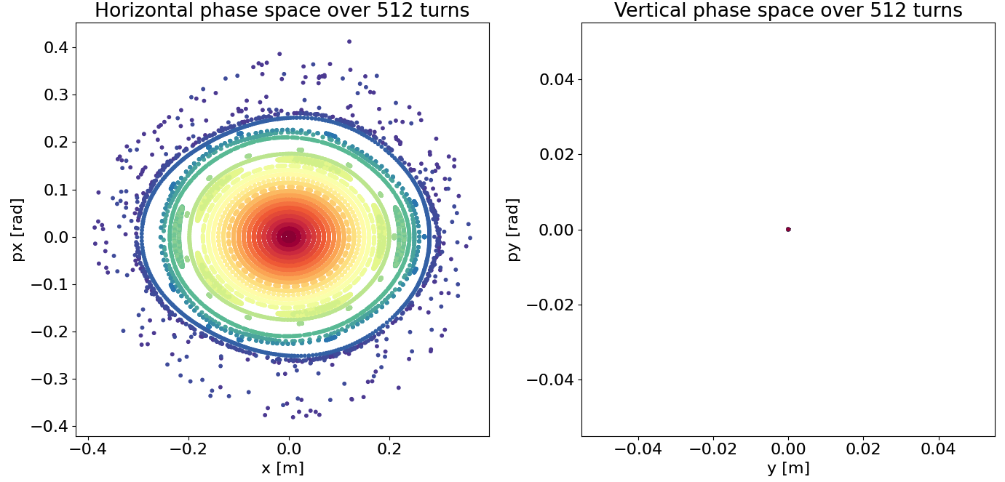
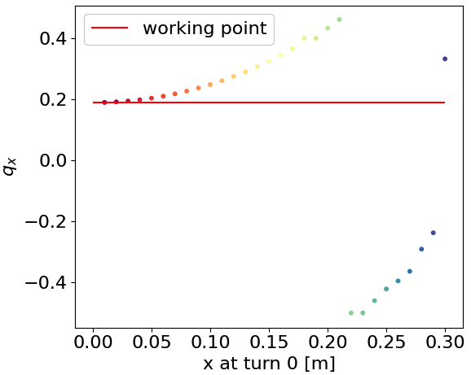
On momentum tracking
– horizontal phase space
Tracking for 512 turns, record at the same longitudinal position.
Initial distribution :
10

Slide 12
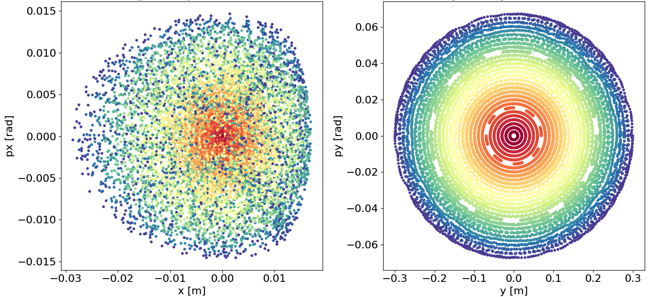
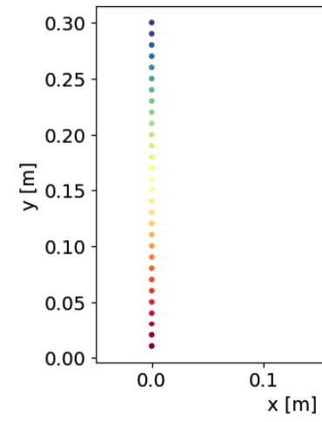
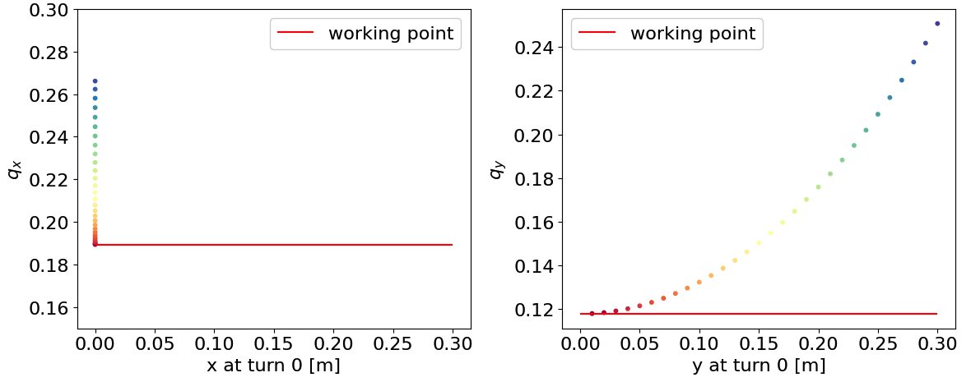
On momentum tracking
– vertical phase space
Initial distribution :
11

Slide 13
Short term particle tracking
- 40 turns

Slide 14
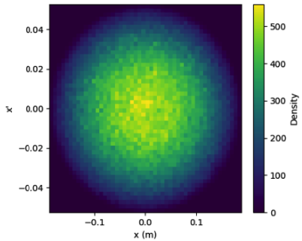
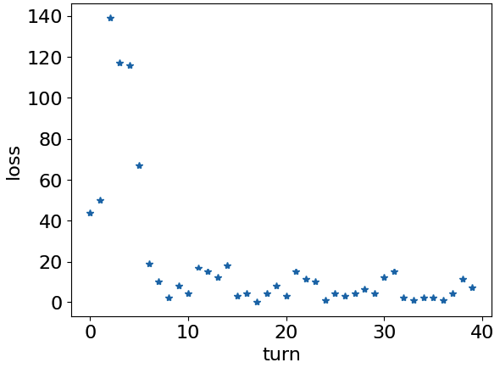
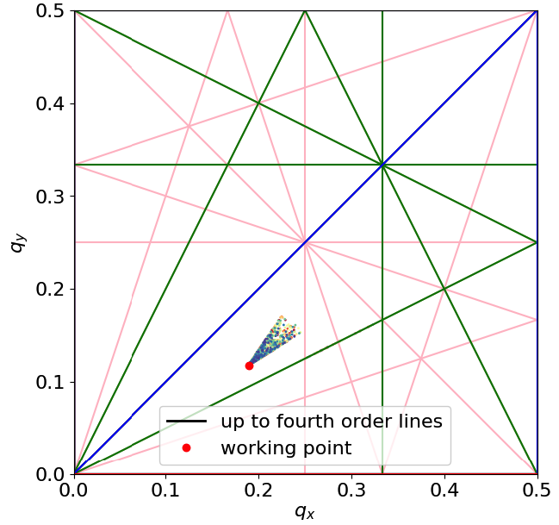
On momentum tracking
Waterbag distribution,
100k particles
100%emitt = 0.99 Acceptance
Aperture : 0.2 m
Survial rate: 99.2 %

Slide 15
Transverse acceptance is great.
Now momentum acceptance …

Slide 16
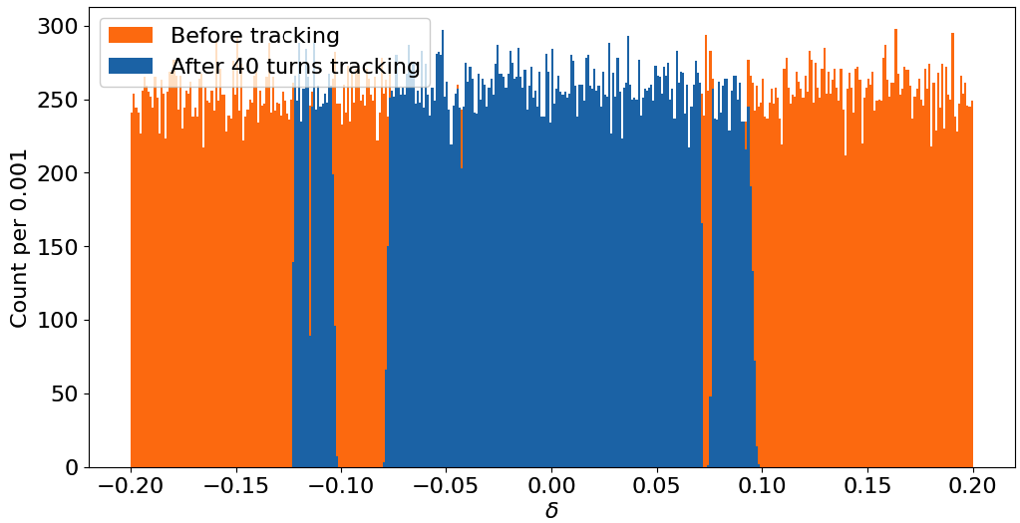
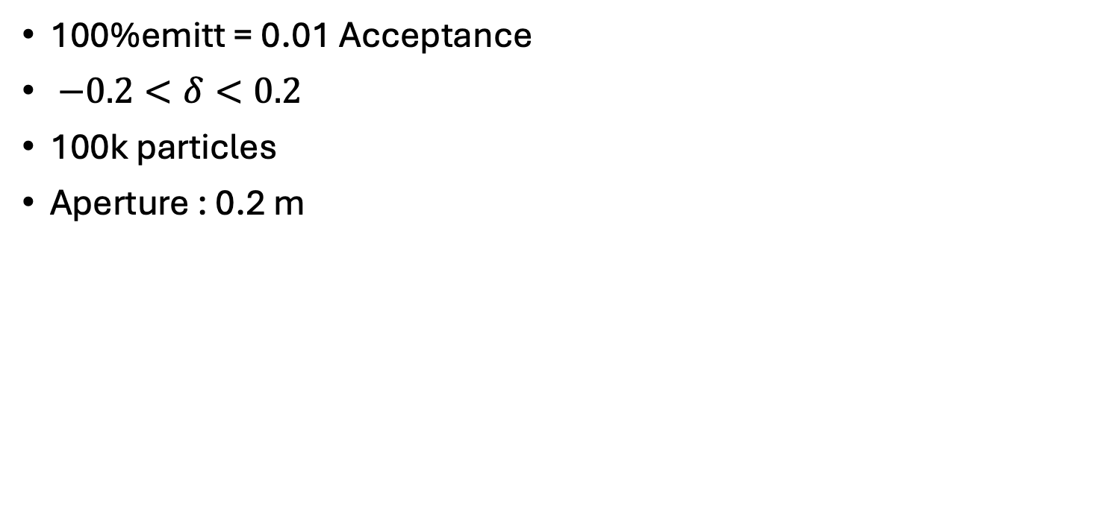
Off momentum pencil beam tracking
100%emitt = 0.01 Acceptance
$−0.2<δ<0.2$
100k particles
Aperture : 0.2 m

Slide 17
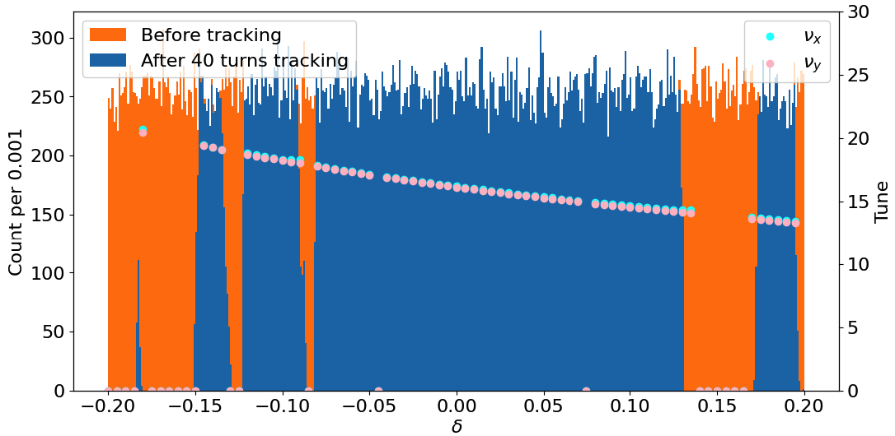
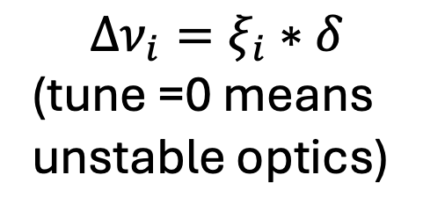
Off momentum pencil beam tracking
Let’s increase the aperture to 0.5m
Losses mostly due to unstable optics/ integer resonacnes
$$Δν_{i}=ξ_{i}∗δ$$
(tune =0 means unstable optics)

Slide 18
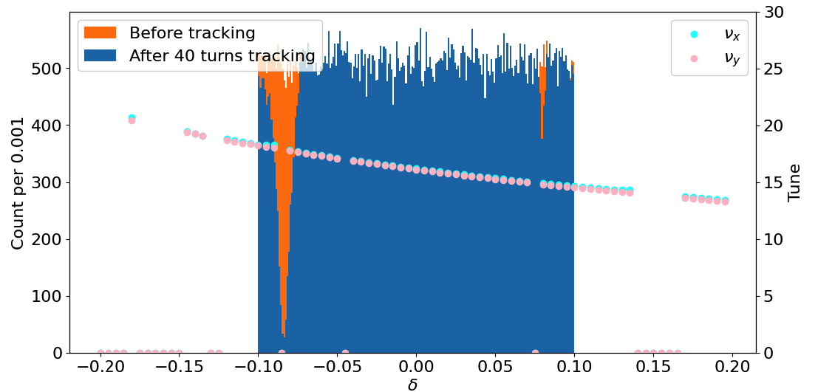
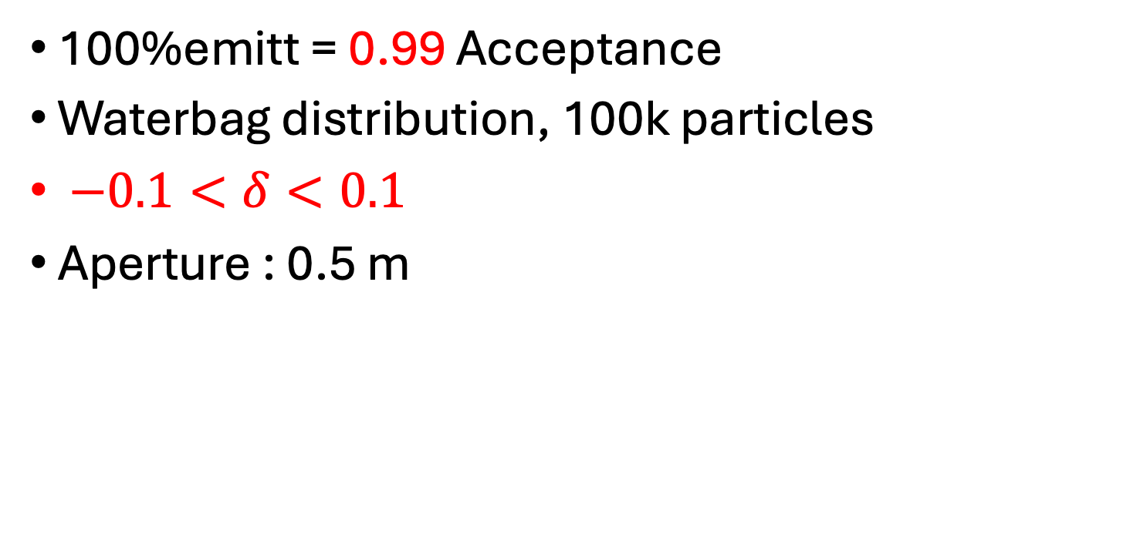
Off momentum beam tracking
100%emitt = 0.99 Acceptance
Waterbag distribution, 100k particles
$−0.1<δ<0.1$
Aperture : 0.5 m

Slide 19
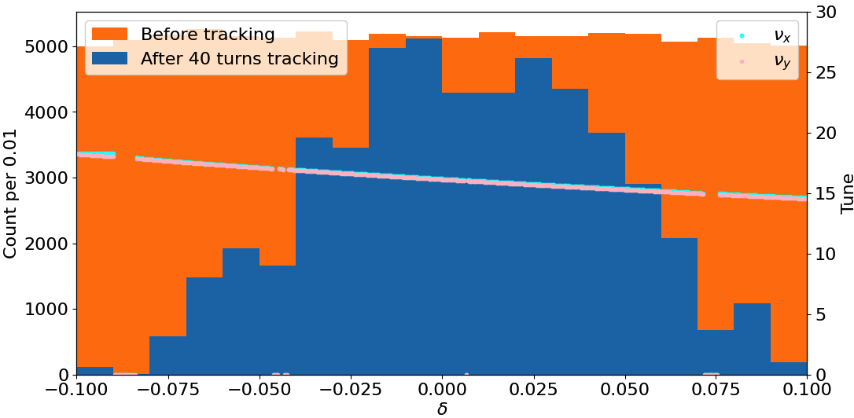
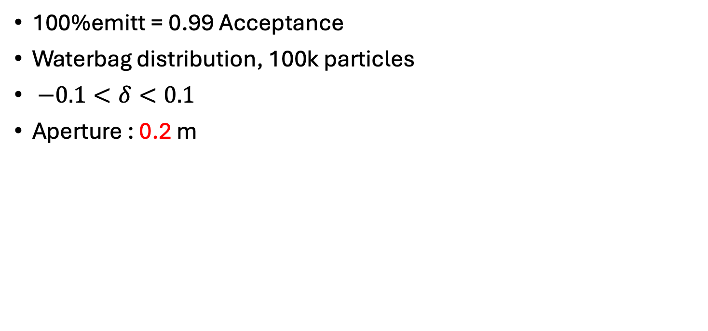
off momentum beam tracking
100%emitt = 0.99 Acceptance
Waterbag distribution, 100k particles
$−0.1<δ<0.1$
Aperture : 0.2 m

Slide 20
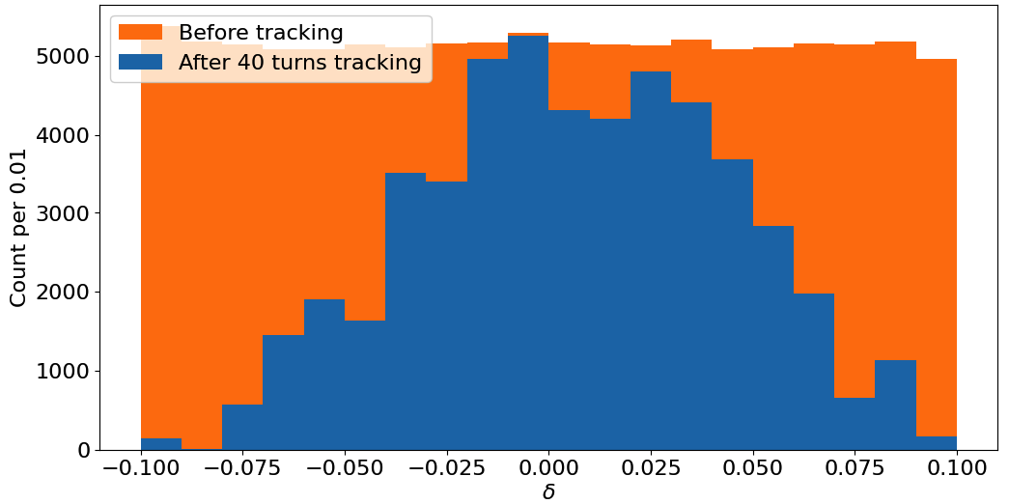
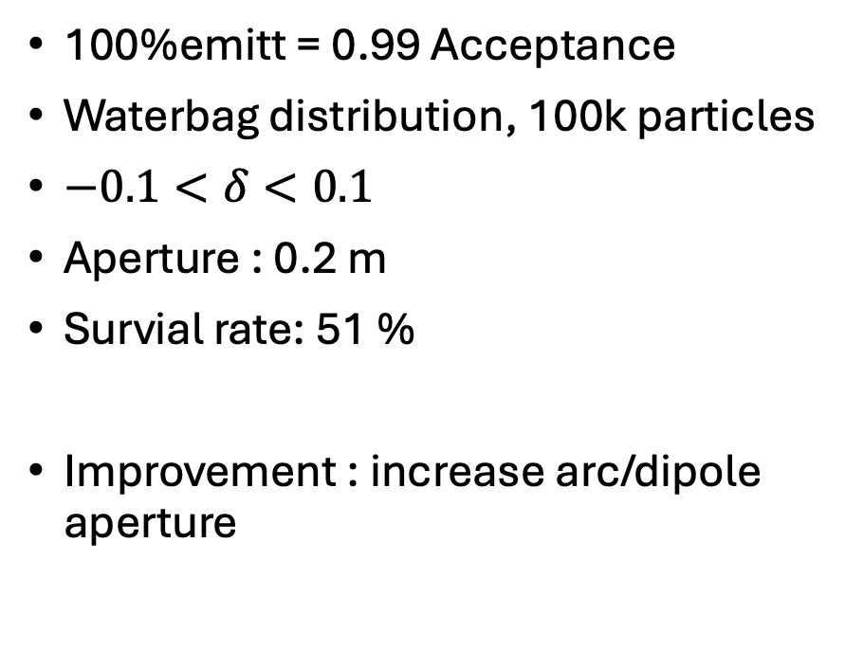
Realistic particle tracking
100%emitt = 0.99 Acceptance
Waterbag distribution, 100k particles
$−0.1<δ<0.1$
Aperture : 0.2 m
Survial rate: 51 %
Improvement : increase arc/dipole aperture
0.01 bin

Slide 21
Two other aspects

Slide 22
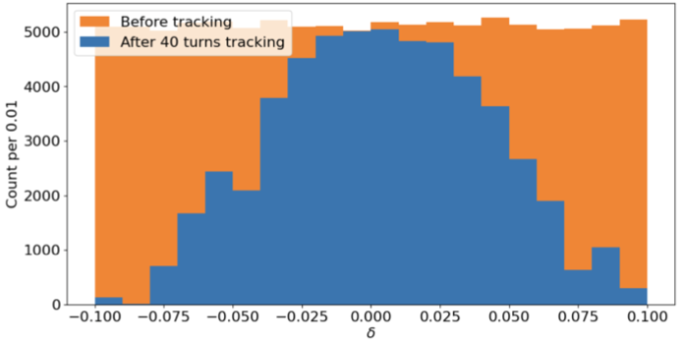
Fringe field off
Survial rate: 51 %
Survial rate: 54 %
Fringe field off

Slide 23
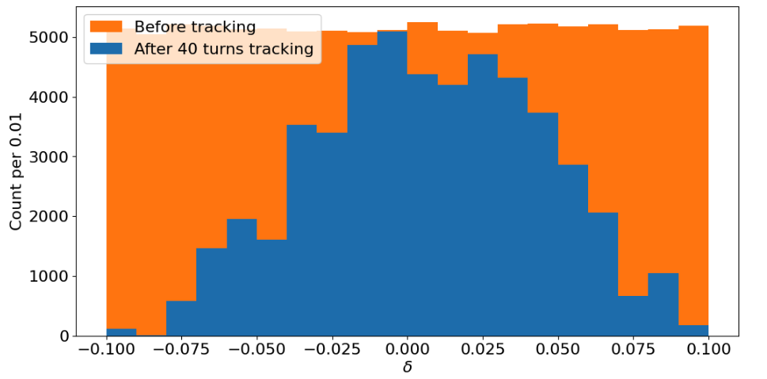
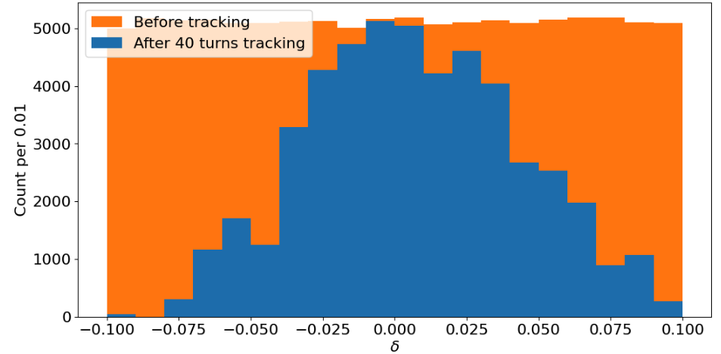
Sensitvity study :
Without errors: 51%
Quads
rms x and y shift : 0.1mm
rms rotational error : 0.01
Dipoles
rms rotational error : 0.01
rms k0 magnet error : 1e-4
rms k1 magnet error : 1e-4
With errors: 49%

Slide 24

Summary
81 m full straight
27m
A = 8.9 mmrad 👍
Injection 👍
classical magnets : B < 2 T 👍
FODO cells 👍
0.7 m dipoles reach 50 % muon survial rate in 40 turns. 👍
Stable against fringe field and magnets error 👍
Flexable design can be re-optimised quickly 👍
2-fold symmetry

Slide 25
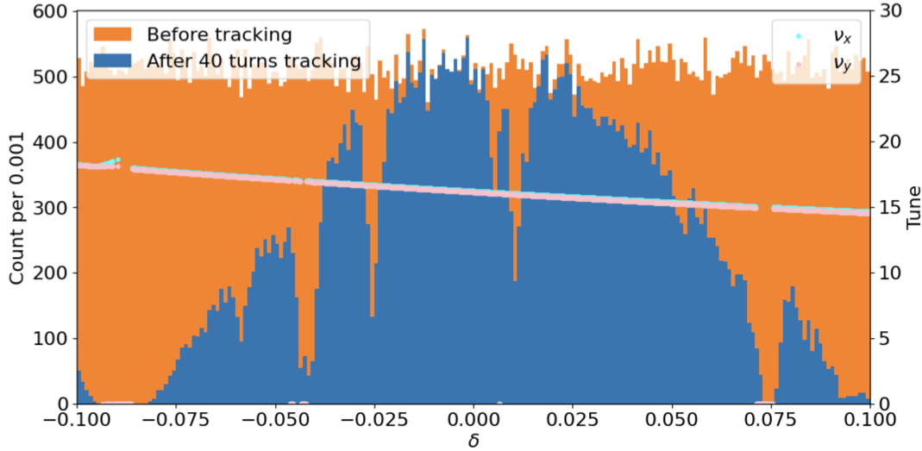
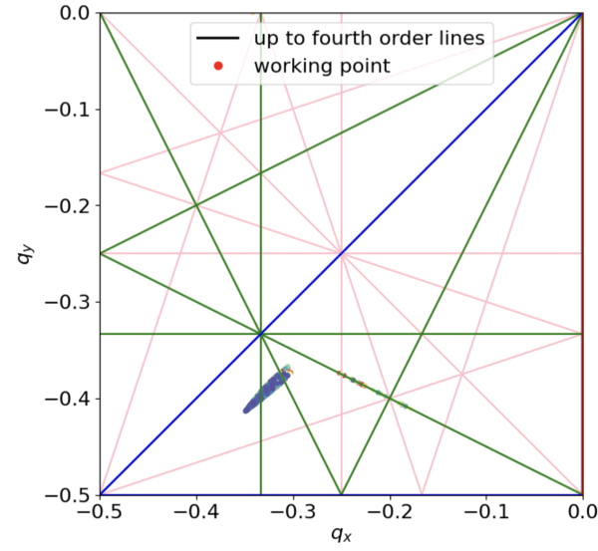
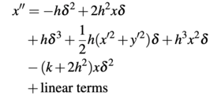
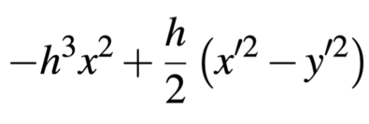

Of course this is not perfect

Slide 26
ESSnuSB+ 4th Annual Meeting
Parallel Section
Ring Design Summary and Update
Ting Wing Choi

Slide 27
Costing
Scale from FermiLab nuSTORM document
20 M dollars v.s. 140M

