Slide 1
The FREIA Test Program
Roger Ruber
for the Uppsala Accelerator Group & FREIA
20-21 November 2013, Uppsala
ESS-FREIA Spoke Cavity Testing Review and Planning Meeting

Slide 2
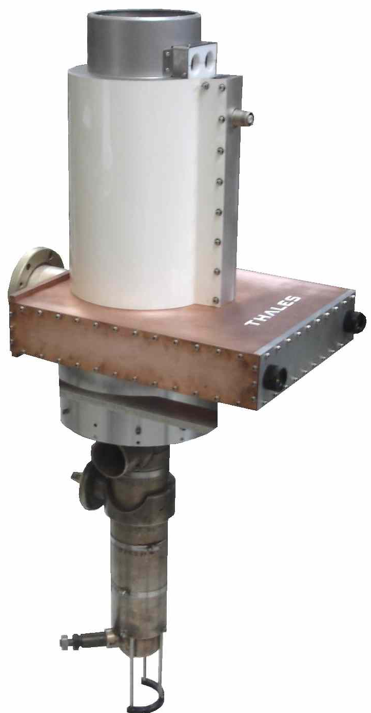
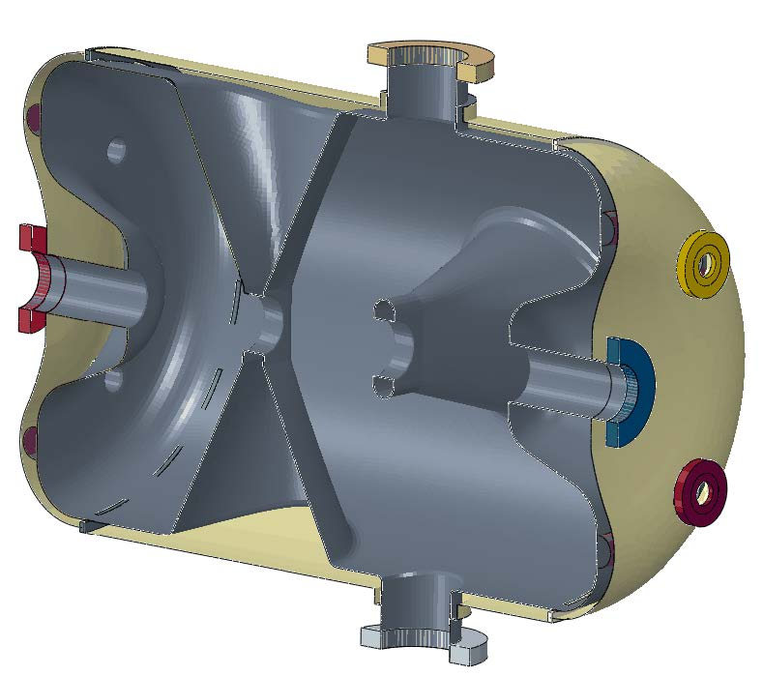
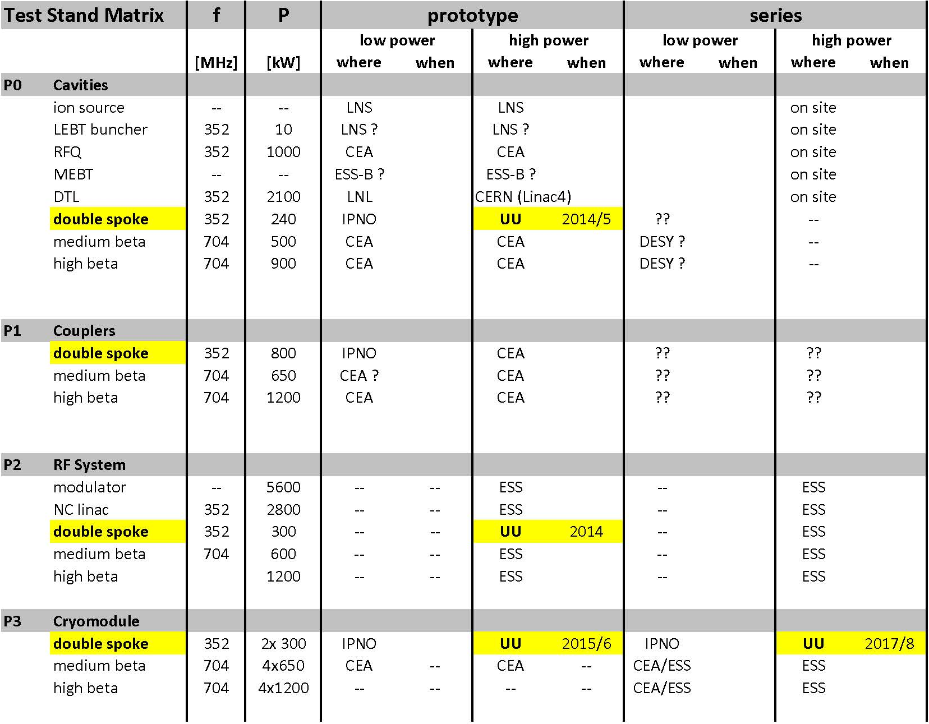
Responsibility for ESS Accelerator
Contribution to the technical design & construction effort
design concept spoke accelerating cavity power source
design concept radio-frequency (RF) power distribution
survey test stand infrastructure and requirements
study of upgrade scenarios RF systems for ESS power upgrade
Development power station for spoke cavities
soak test with water cooled load, then accelerating cavity, incl. controls
collaboration with industry to develop vacuum tube and solid-state based prototypes
System test, power station with spoke cavity and cryostat-module
fully dressed prototype cavity (in test cryostat)
complete prototype module (2 spoke cavities)
Acceptance test cryostat-modules (proposal submitted)
for all final modules before installation

Slide 3
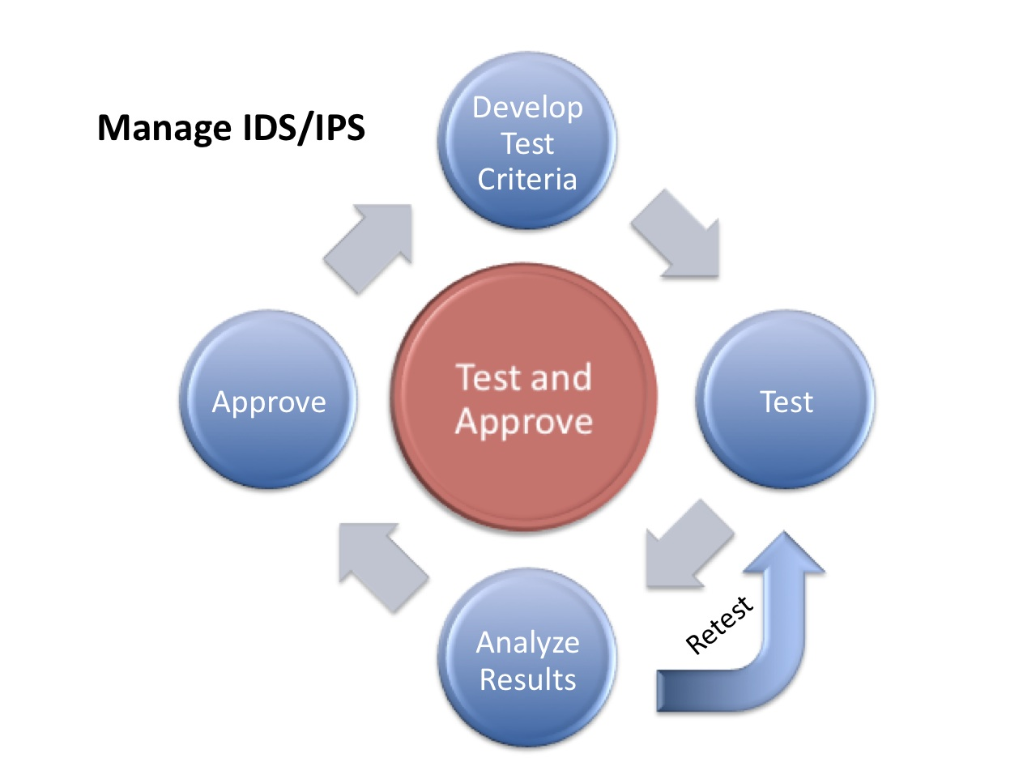
What (does this mean)?
Criteria to judge the test results
Efficiency
to reduce electricity costs
reuse cooling water
Stability
relative fast response to perturbations
predictability of the system
requires testing of extreme conditions
Reliability
slow variations such as drift and aging that affect parameters
abrupt failure of something
requires long-term soak testing

Slide 4
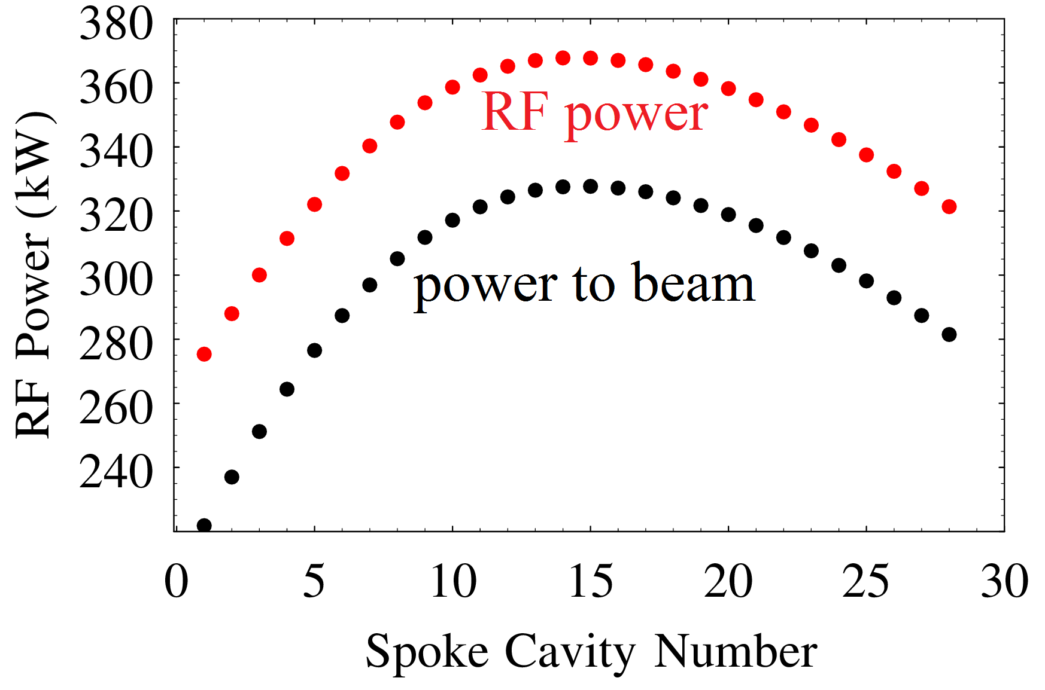
… for the sub-systems …
RF power station & RF distribution
achieve required performance: 14 Hz, 2.9+t_{fill} ms, power-to-beam+overhead kW_{peak}
stable long term operation
safe handling of reflections, sparking, interlocks and faults
LLRF and controls
RF control (1% amplitude, 1º phase)
compensation Lorentz detuning & microphonics
Spoke cavity
achieve required performance: E_{acc}, Q₀, f₀, losses
stable long term operation
Spoke cryo-module
as for single cavity
no undesirable coupling between cavities
achieve cryogenic requirements: cool down, losses

Slide 5
How ?
Helium Liquefier
RF Power Station
Spoke Cavity
LLRF
Cryo-module
2013 | 2014 |  |  |  |  |  |  |  |  | 2015
December | Jan | Feb | Mar | Apr | May | Jun |  |  |  |  | June |  | Dec.
today
HNOSS Horizontal Cryostat
2K pumps
General idea
commission and test infrastructure before arrival sub-systems
new facility, so must commission equipment to guarantee proper operation
personnel should have time to familiarize with equipment
commission and test each equipment before combining
limited time line towards arrival of cavity
limited learning curve towards prototype cryo-module testing
Will be first major test for FREIA & ESS (of a whole accelerator section)
critical for decision towards cavity series production
critical for decision towards RF & LLRF component design and procurement

Slide 6
Cryogenics & Cryostat
Helium Liquefier
2013 | 2014
December | Jan | Feb | Mar | Apr | May | June | July
today
HNOSS Horizontal Cryostat
2K pumps
Helium and Nitrogen Cryogenics: contract with Linde
factory test (cold box & controls): January
delivery & installation: February-March
commissioning & acceptance test (by Linde): March-April
HNOSS Cryostat and Transfer Lines: contracts with ACS and Cryo Diffusion
factory test (LN2): April
delivery & installation: May-June
commissioning (by UU and ACS): Summer
Sub-atmospheric pumps: tender launched last week
delivery & installation: May-June
commissioning: Summer

Slide 7
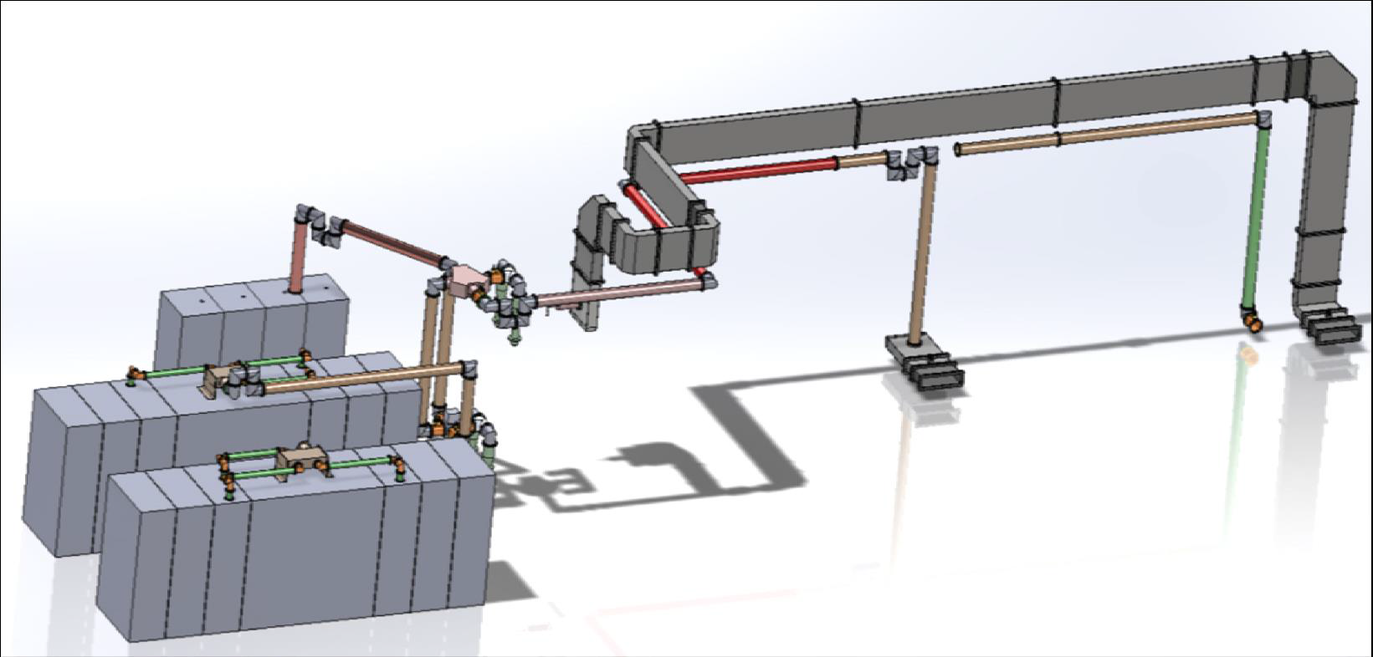
RF Power Station and Distribution
Tetrode
2013 | 2014
December | Jan | Feb | Mar | Apr | May | June | July
today
Solid State
Tetrode based: contract with Electrosys
factory test tetrodes (Thales, Thonon): this week
factory test (Electrosys):
delivery & installation: January-February
commissioning and acceptance test (by Electrosys): February-March
Solid-state based:Siemens development
on loan to Uppsala, expected delivery: February
RF Distrbution
circulator and loads ordered
tender of remaining parts now under preparation

Slide 8
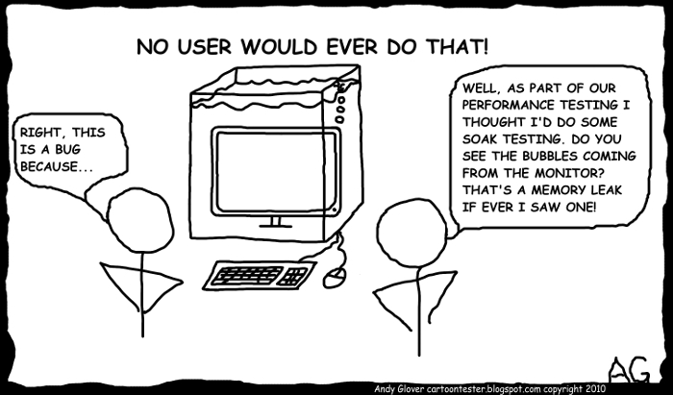
Controls and Monitoring
2013 | 2014
December | Jan | Feb | Mar | Apr | May | June | July
today
LLRF
Safety
radiation monitoring
personnel & equipment safety interlocks
Equipment controls
base controls included in contracts (Cryo Diffusion, Electrosys, Linde)
overall integration by Uppsala (EPICS based), working with equipment manufacturers
Data acquisition and monitoring
RF measurements (amplitude, phase)
infrastructure & environment monitoring (temperature, pressure & humidity)
… any special experiments …
LLRF
under development at Lund, updated as testing progresses…

Slide 9
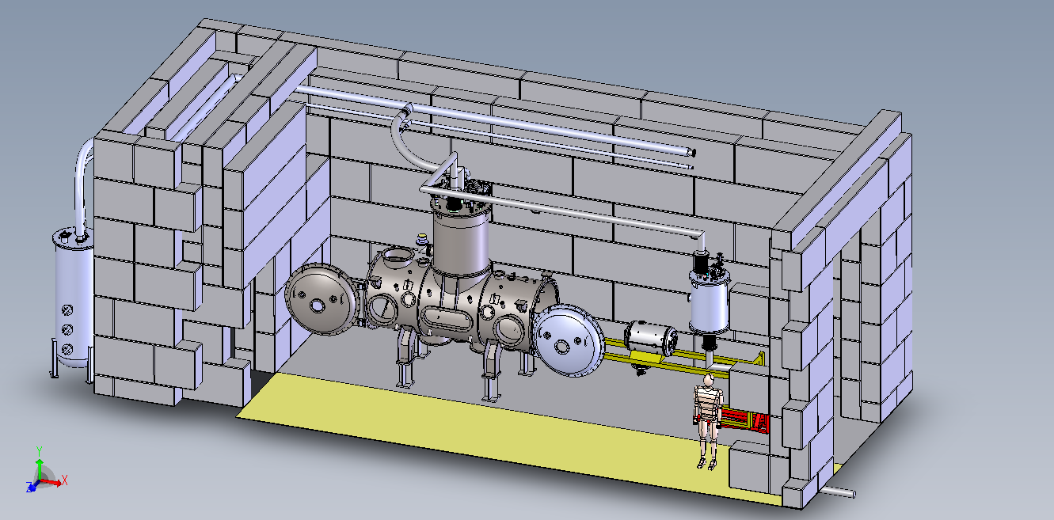
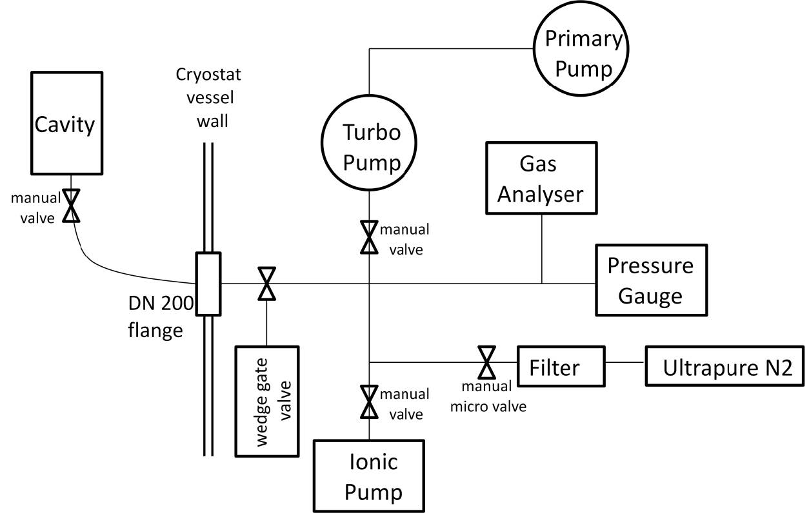
Single “Double Spoke” Cavity
Only after all other systems have been successfully commissioned
Then…
install cavity into cryostat
tooling under design by ACS
connect cavity vacuum pumping
always keep pumping if possible…
connect to cryogenics, RF etc.
connection & functionality test
RF couplers, tuners and instrumentation
Note that this will be the first time
(for cavity, cryostat and team)
Expect extra time for
connections
cool down, RF conditioning, testing…

Slide 10
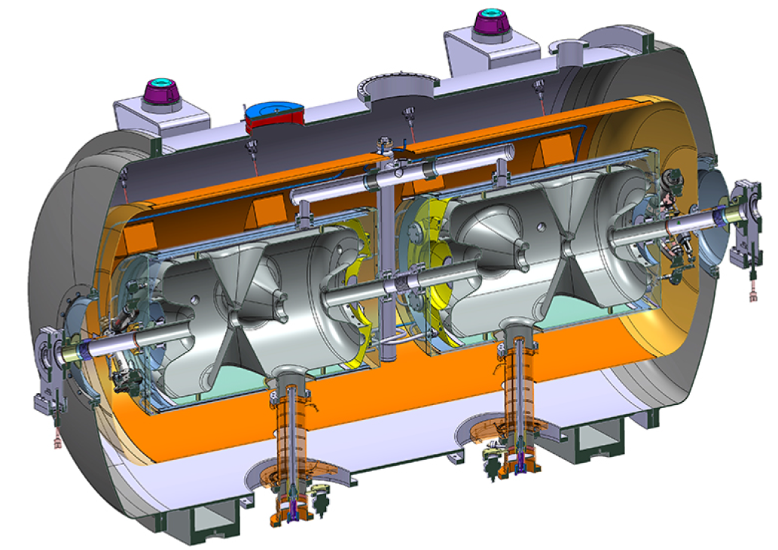
Spoke Cryo-module
We have one year to test the first spoke cavity
should make optimum use to do it careful
exhaustive testing for efficiency, stability and reliability
do it carefully and learn how to operate equipment and assembly
polish any issues
to prepare for order of series production
arrival of prototype cryo-module
Prototype spoke cryo-module
repeat the single cavity experience
test cryostat behaviour
search for any correlation and interactions between cavities
polish any issues and learn to install/test/remove
prepare for series testing of cryo-modules

Slide 11
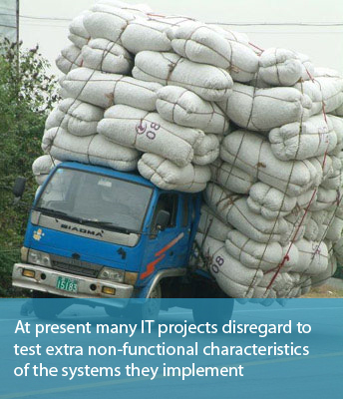
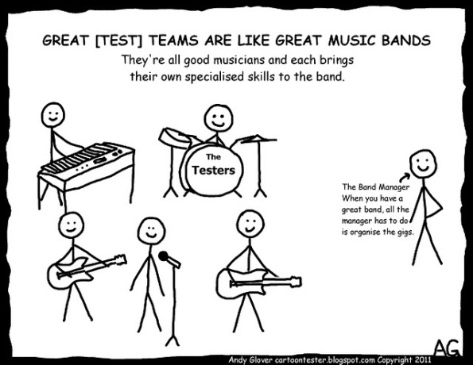
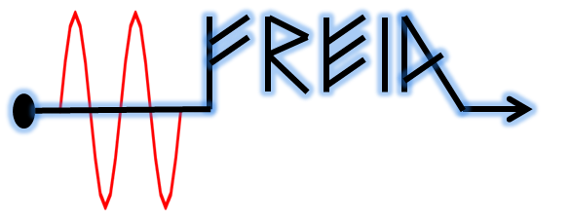
Summary
Further discussions during this meeting
We have ideas on the testing but want to discuss with you for your input and experience
Onset to a commonly agreed test program
Thanks to you all !
http://blog.qatestlab.com/2011/04/01/how-to-involve-non-functional-testing-in-your-project/

