Slide 1
High Power Model of Isolator
Rutambhara Yogi
www.europeanspallationsource.se
10 June 2015

Slide 2
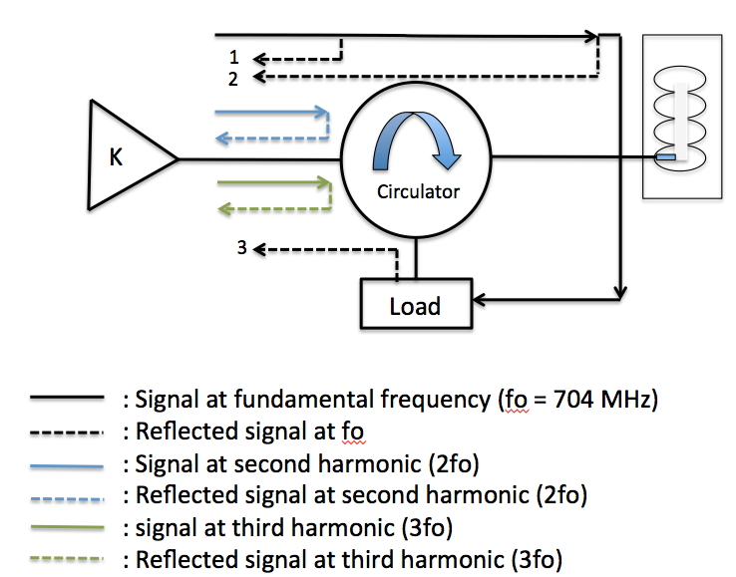
1: Finite return loss of circulator
2: Finite isolation of circulator
3: Finite return loss of load.
Even if we measure S11
of circulator as 30 dB using VNA,
at high power the value will
be lower than 30 dB
It depends on the
reflected signals reaching
port 1 of the circulator
K-Amplifier

Slide 3
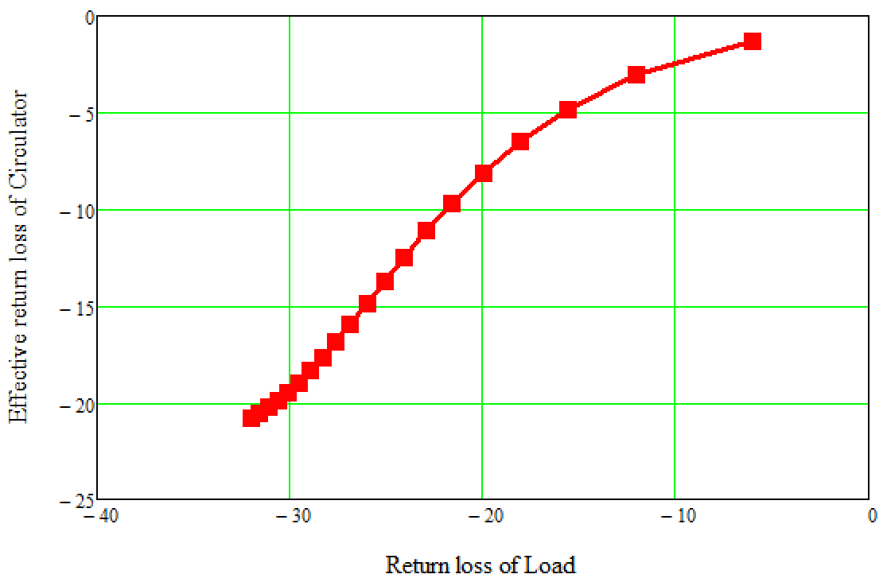
Variation of Effective return loss of Isolator with return loss of load
According to specifications
in SoW
RF Parameters of circulator
used for simulation:
S11= 30 dB
S12 = 26 dB
S21 = 0.15 dB
NO higher order harmonics
If amplifier needs at least
20 dB return loss (1.2 SWR),
return loss of load ≥ 30 dB

Slide 4
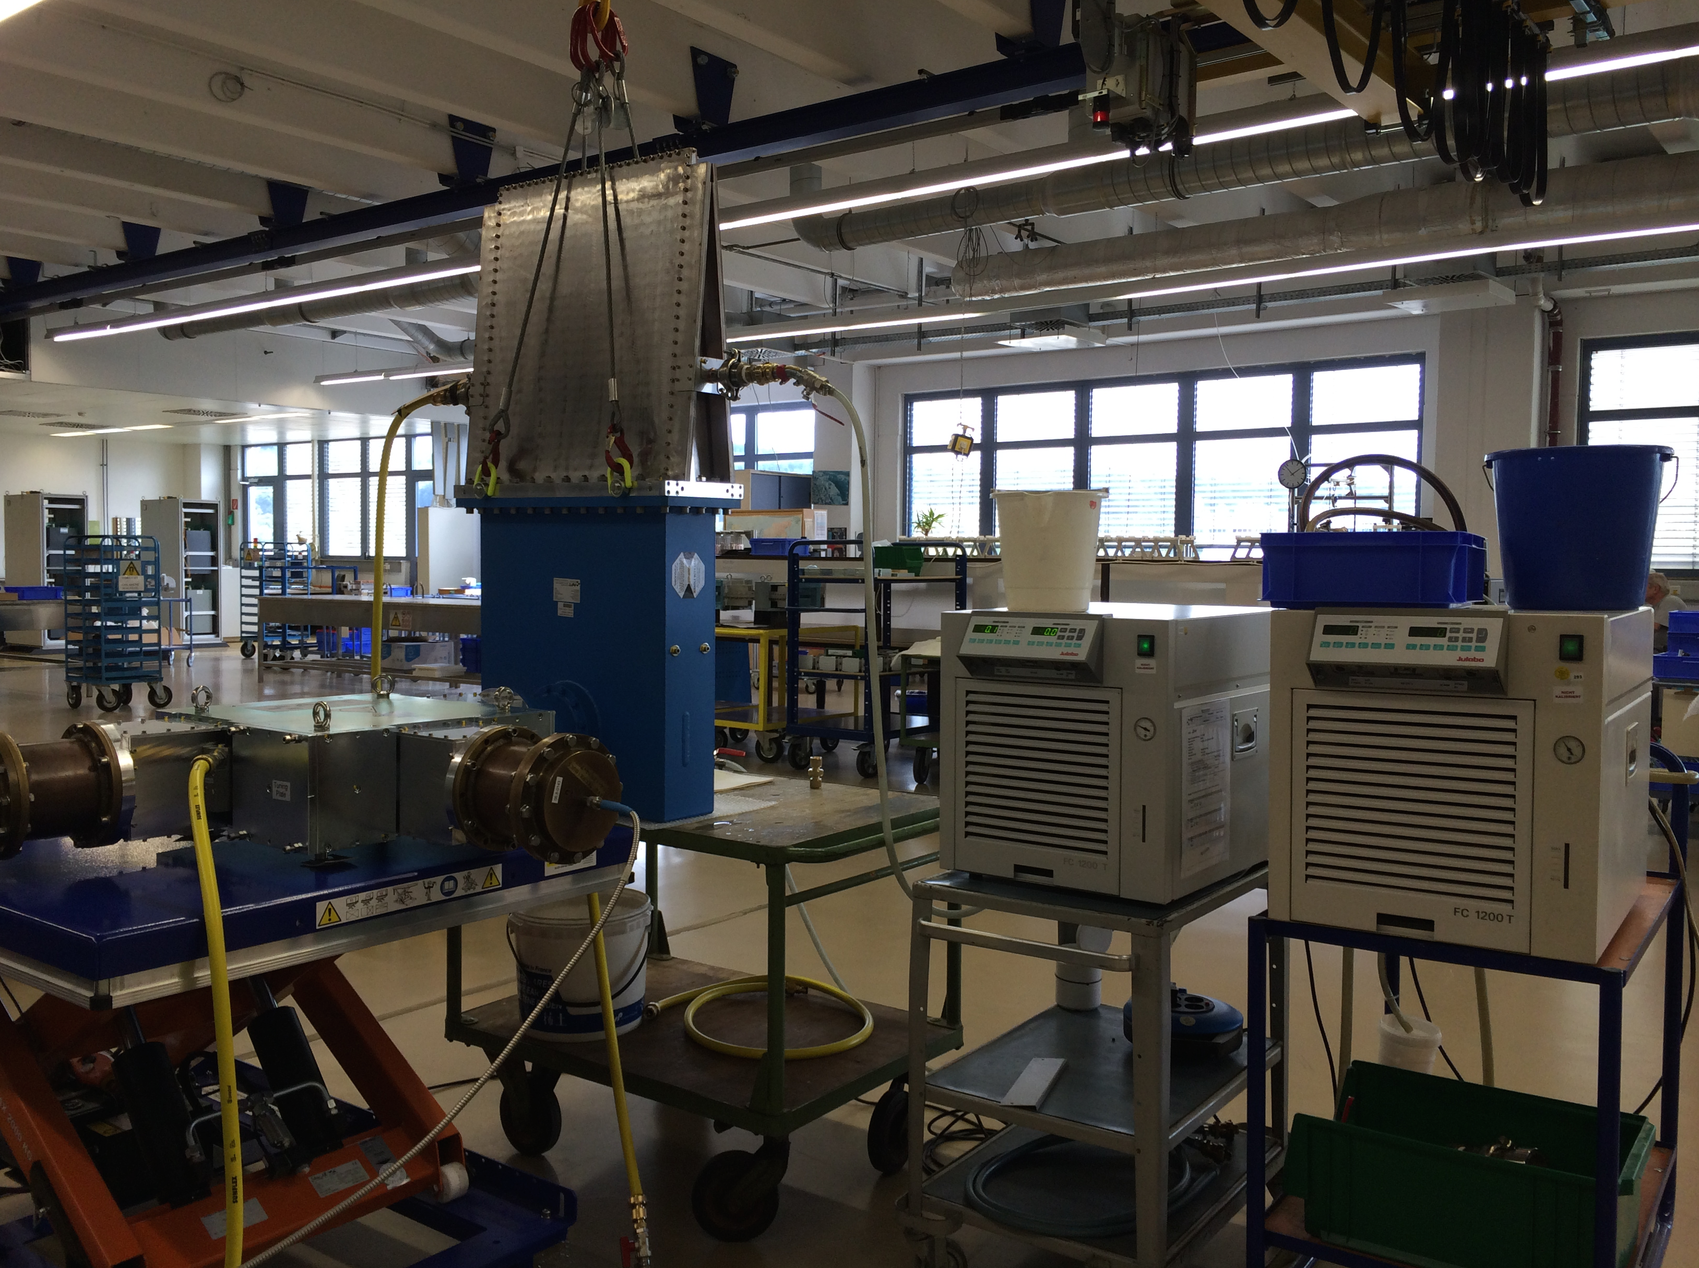
Arrangements for FAT at AFT
Load
Circulator

Slide 5
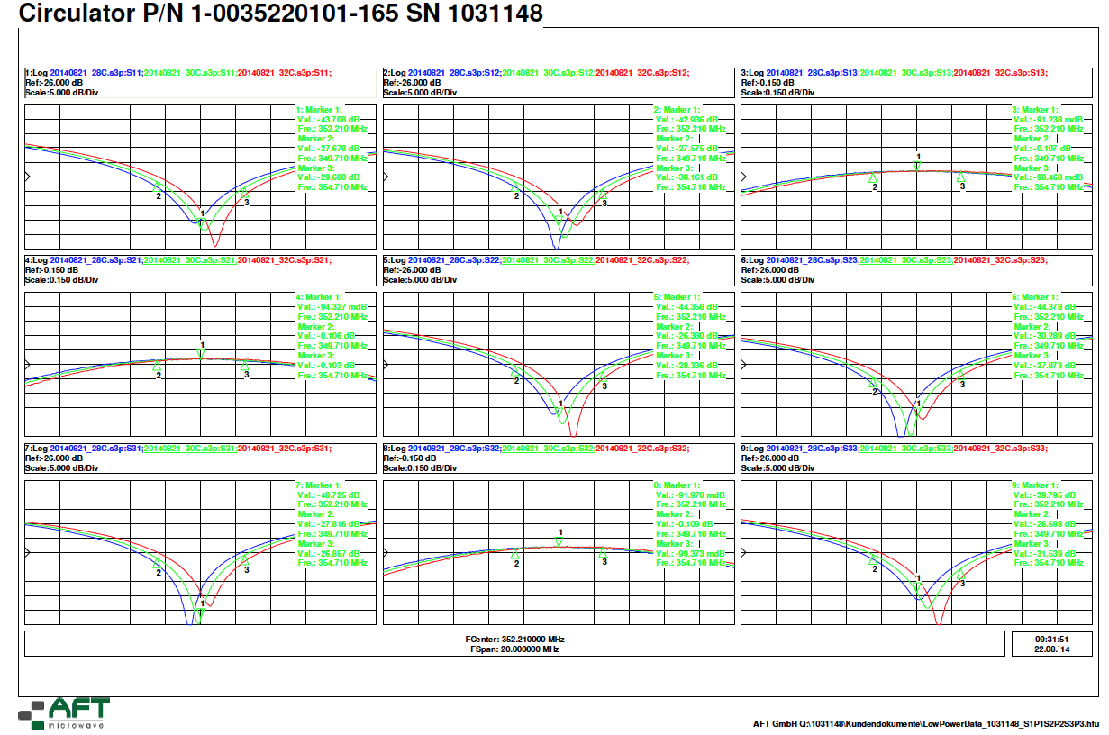
Specifications of Isolator by AFT (FAT)

Slide 6
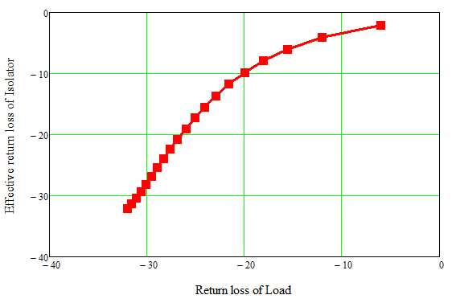
Variation of Effective return loss of Isolator with return loss of load (For AFT circulator and load)
RF Parameters of AFT circulator
used for simulation:
S11= 43 dB
S12 = 42 dB
S21 = 0.094 dB
NO higher order harmonics

Slide 7
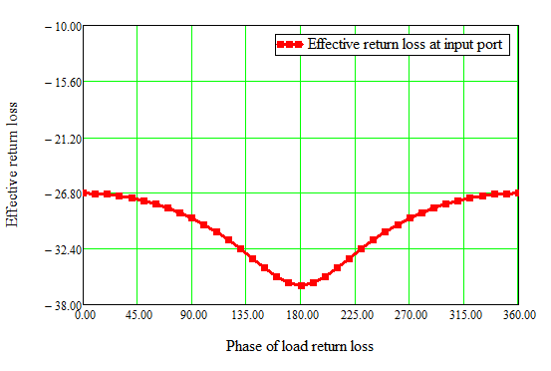
If the phase of load return is constant, Best possible case return loss = 36 dB
Please note: In this calculation, higher order harmonics are not considered.
Return loss -19 dB = 1.25 (excluding higher order harmonics)

Slide 8
Thank you !

