Slide 1
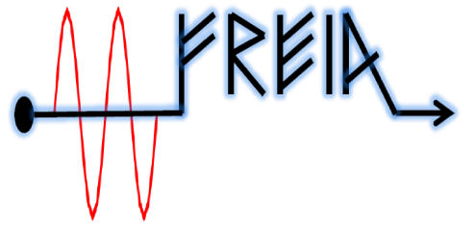

Summary of the cavity test results:
1st week
Krish, Han, Tor, Vitaliy
2015

Slide 2

Great Thanks from RF to Cryo

Slide 3
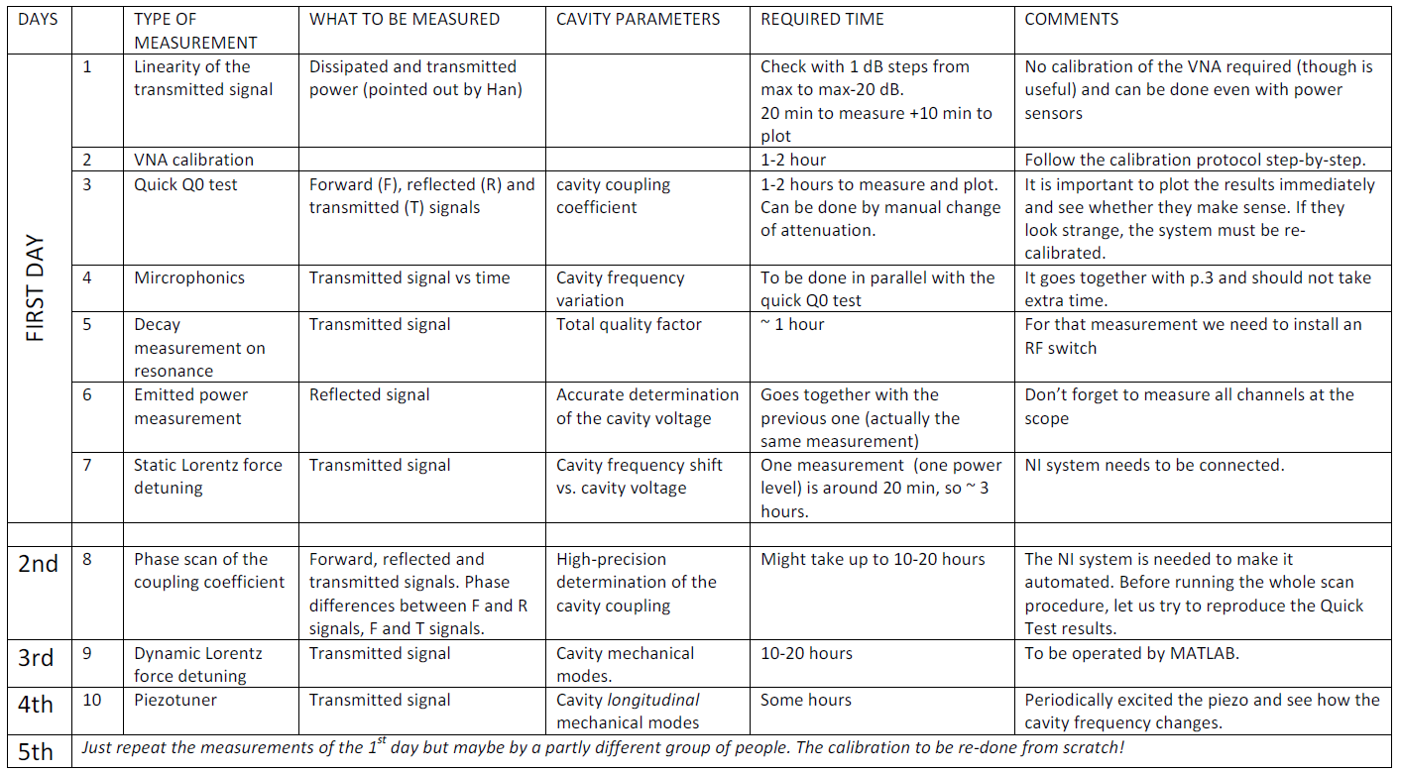
Test plan

Slide 4
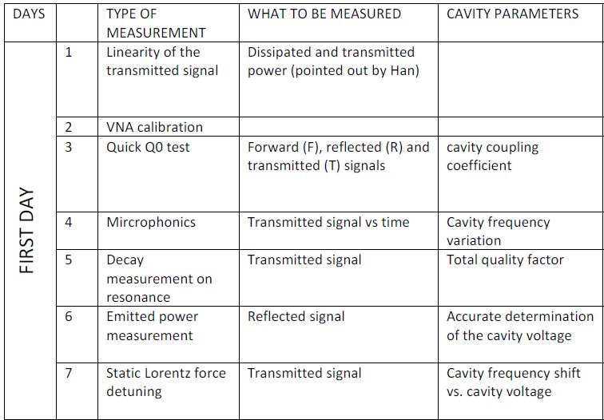

Day 1, zoomed in view

Slide 5
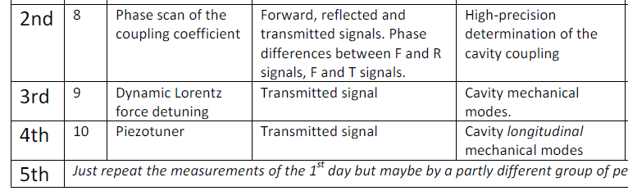
Day 2, zoomed in view
Makes use of the NI system
Time-consuming (~10 hours per test)
but fully automated by Krish

Slide 6
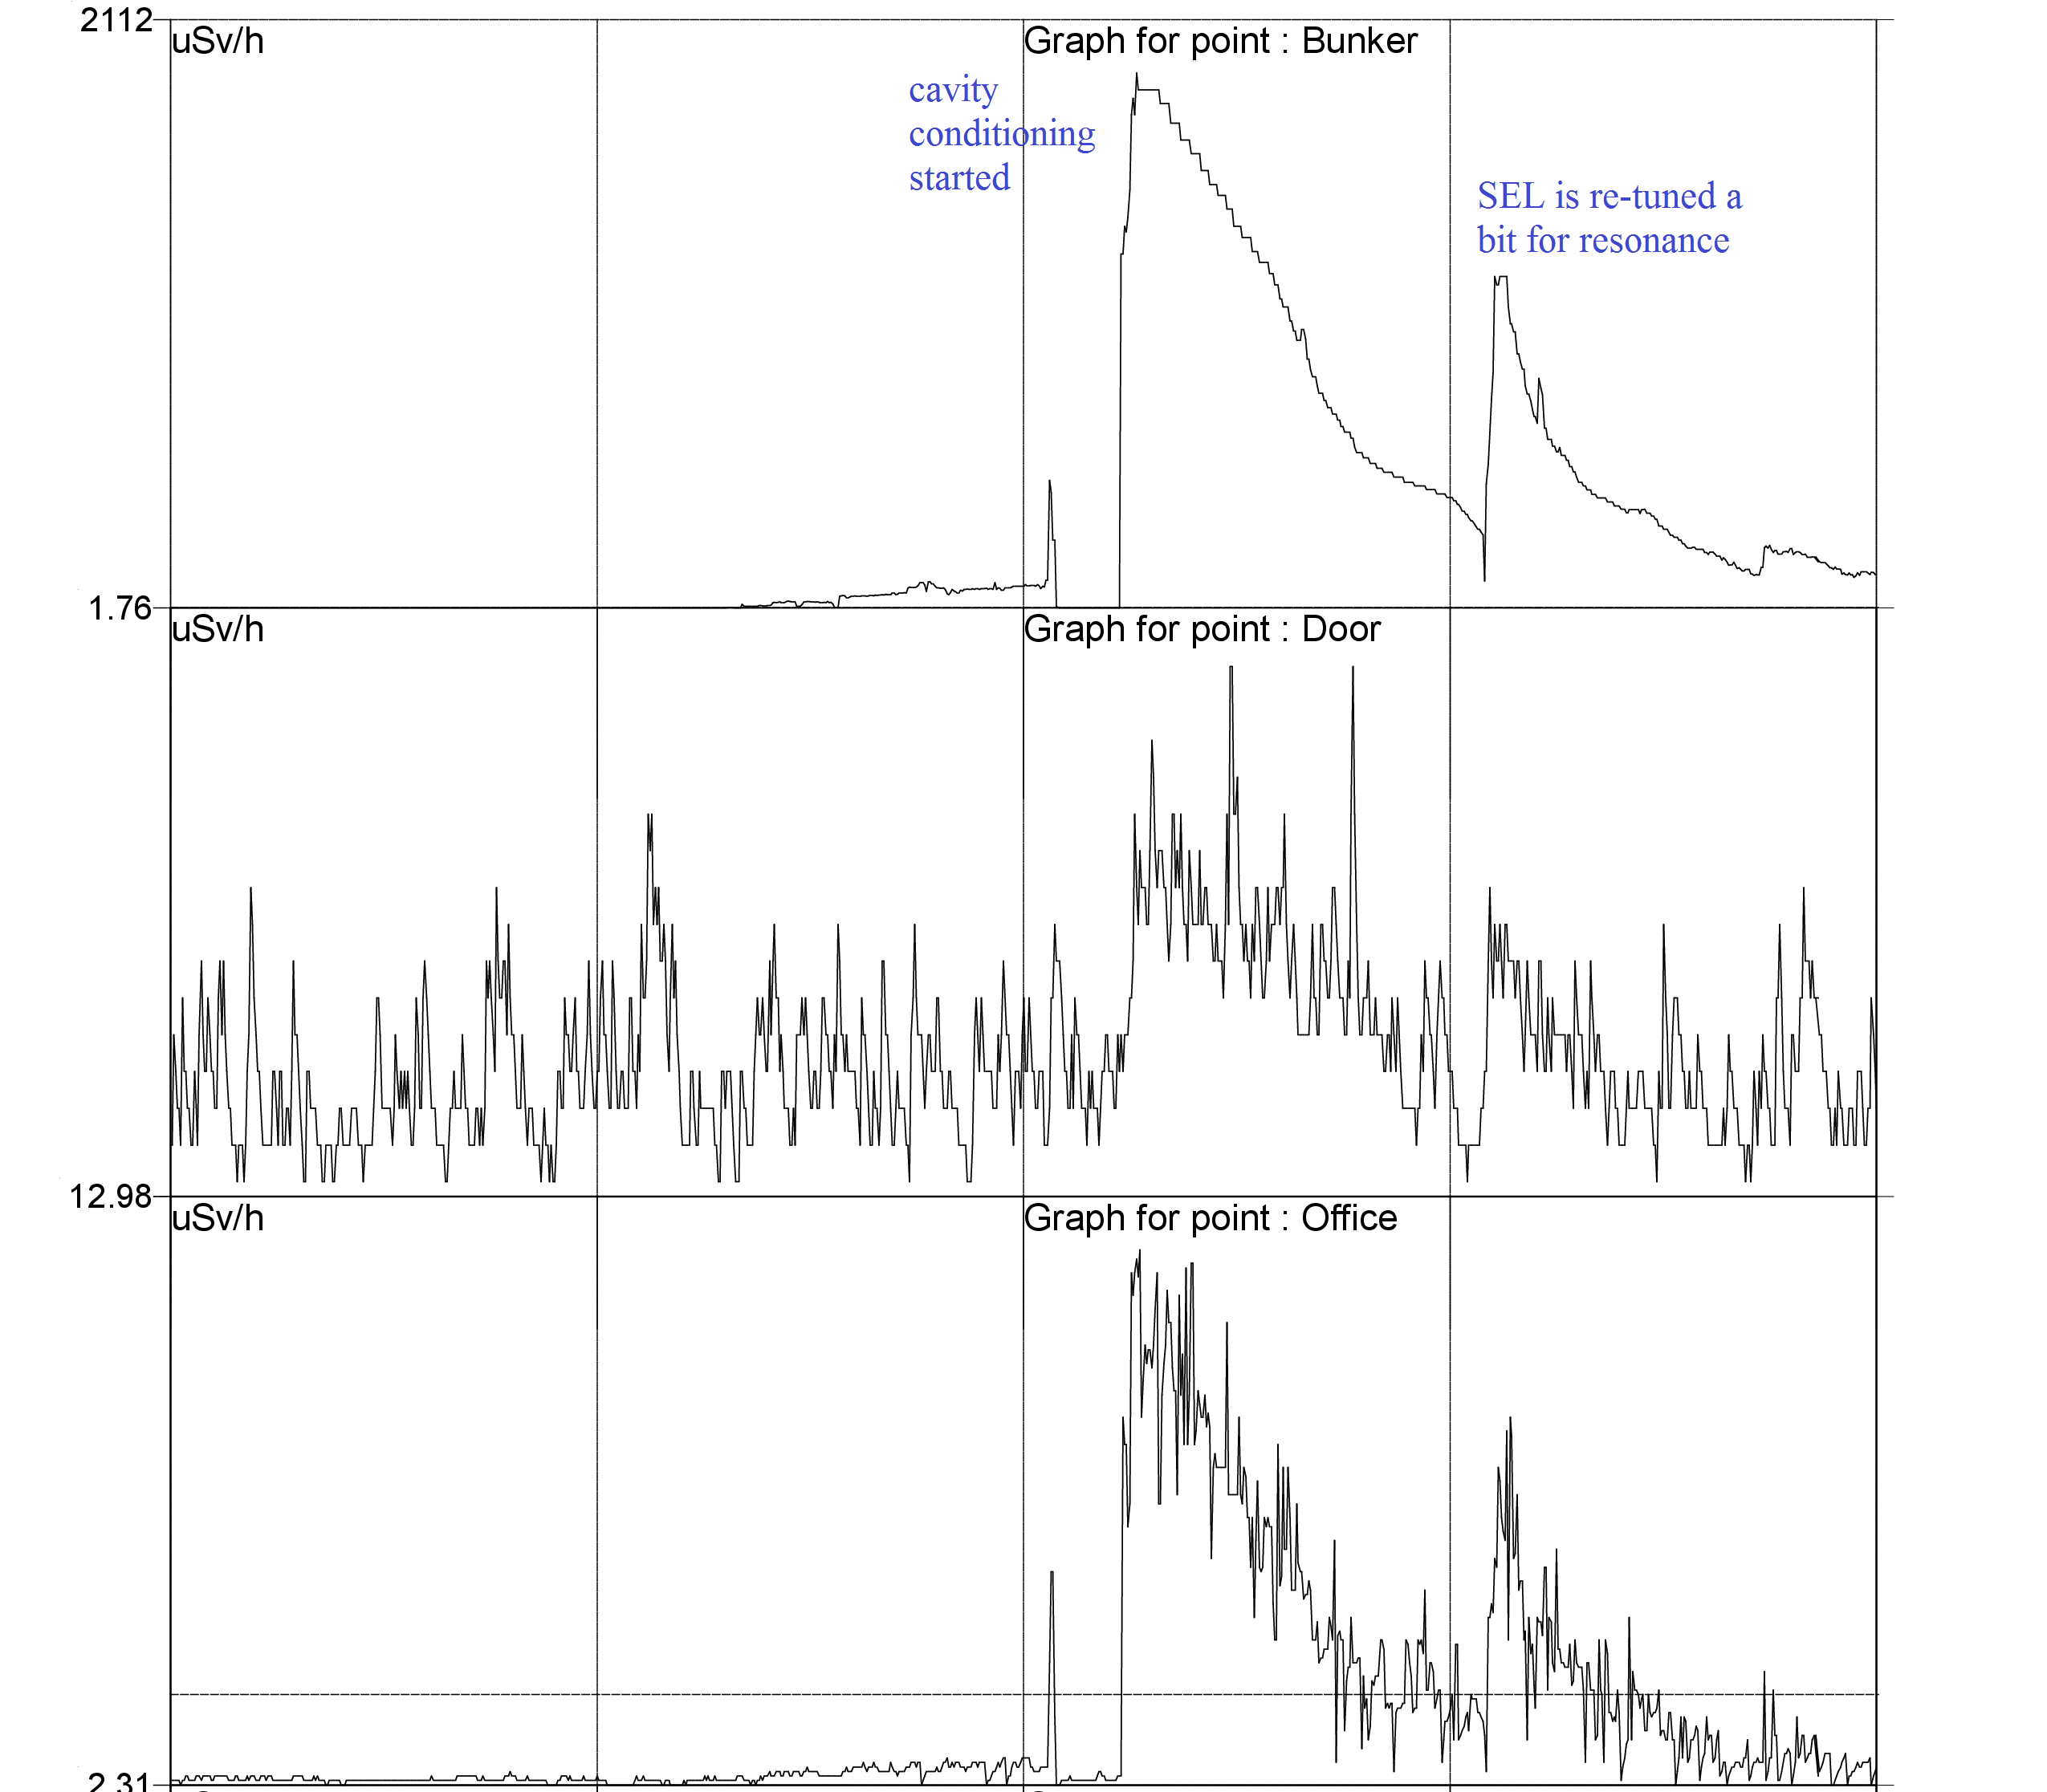
Cavity re-conditioning
1 hour

Slide 7
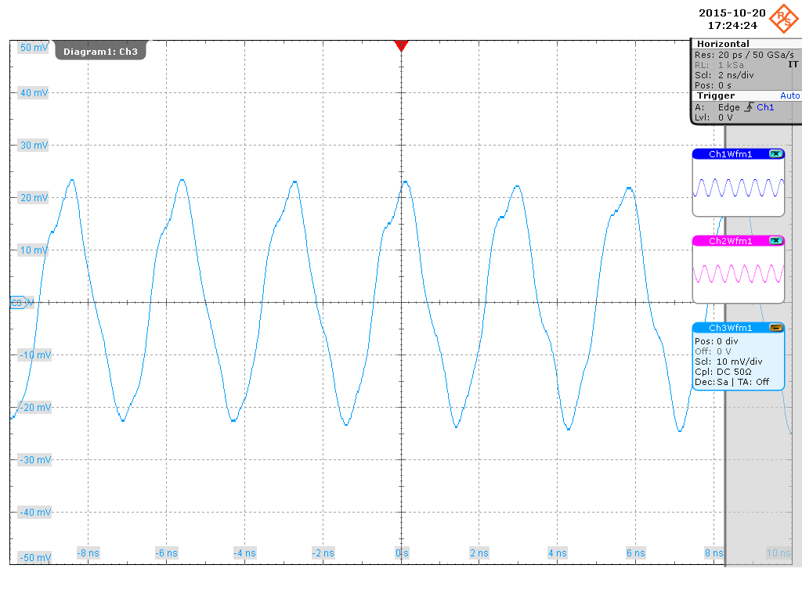

Transmitted signal
15 minutes later

Slide 8
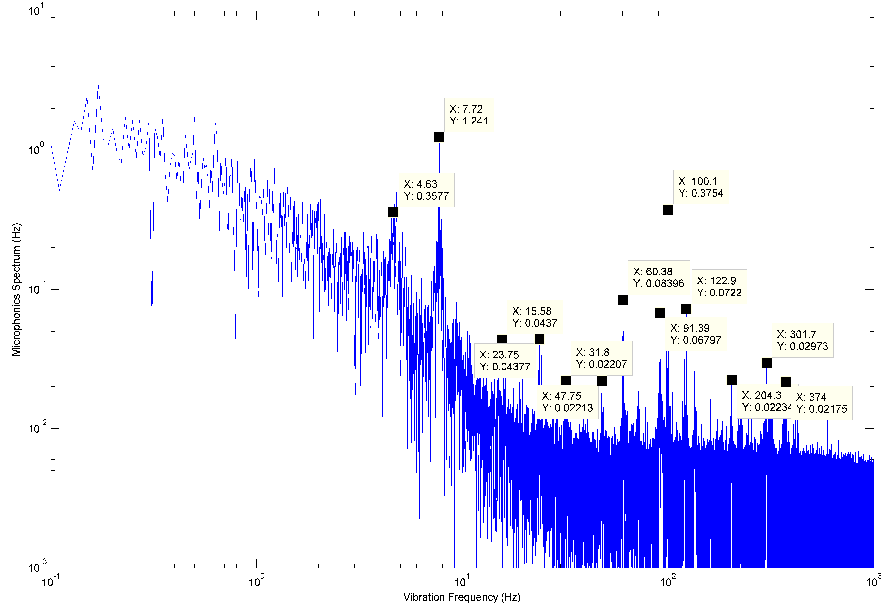
Microphonics spectrum

Slide 9
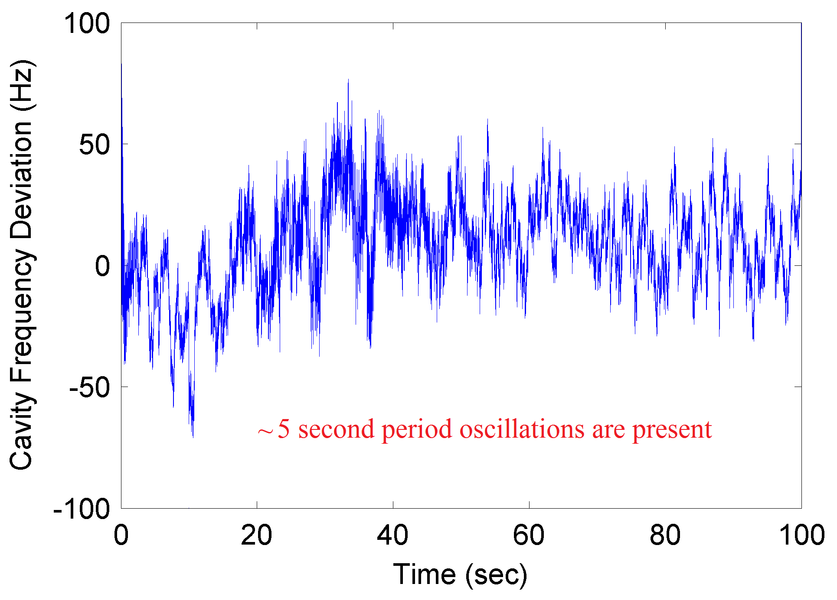
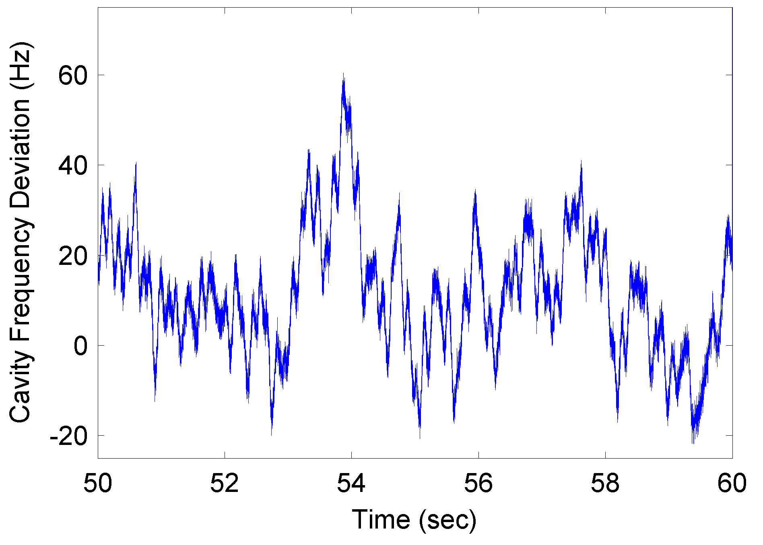
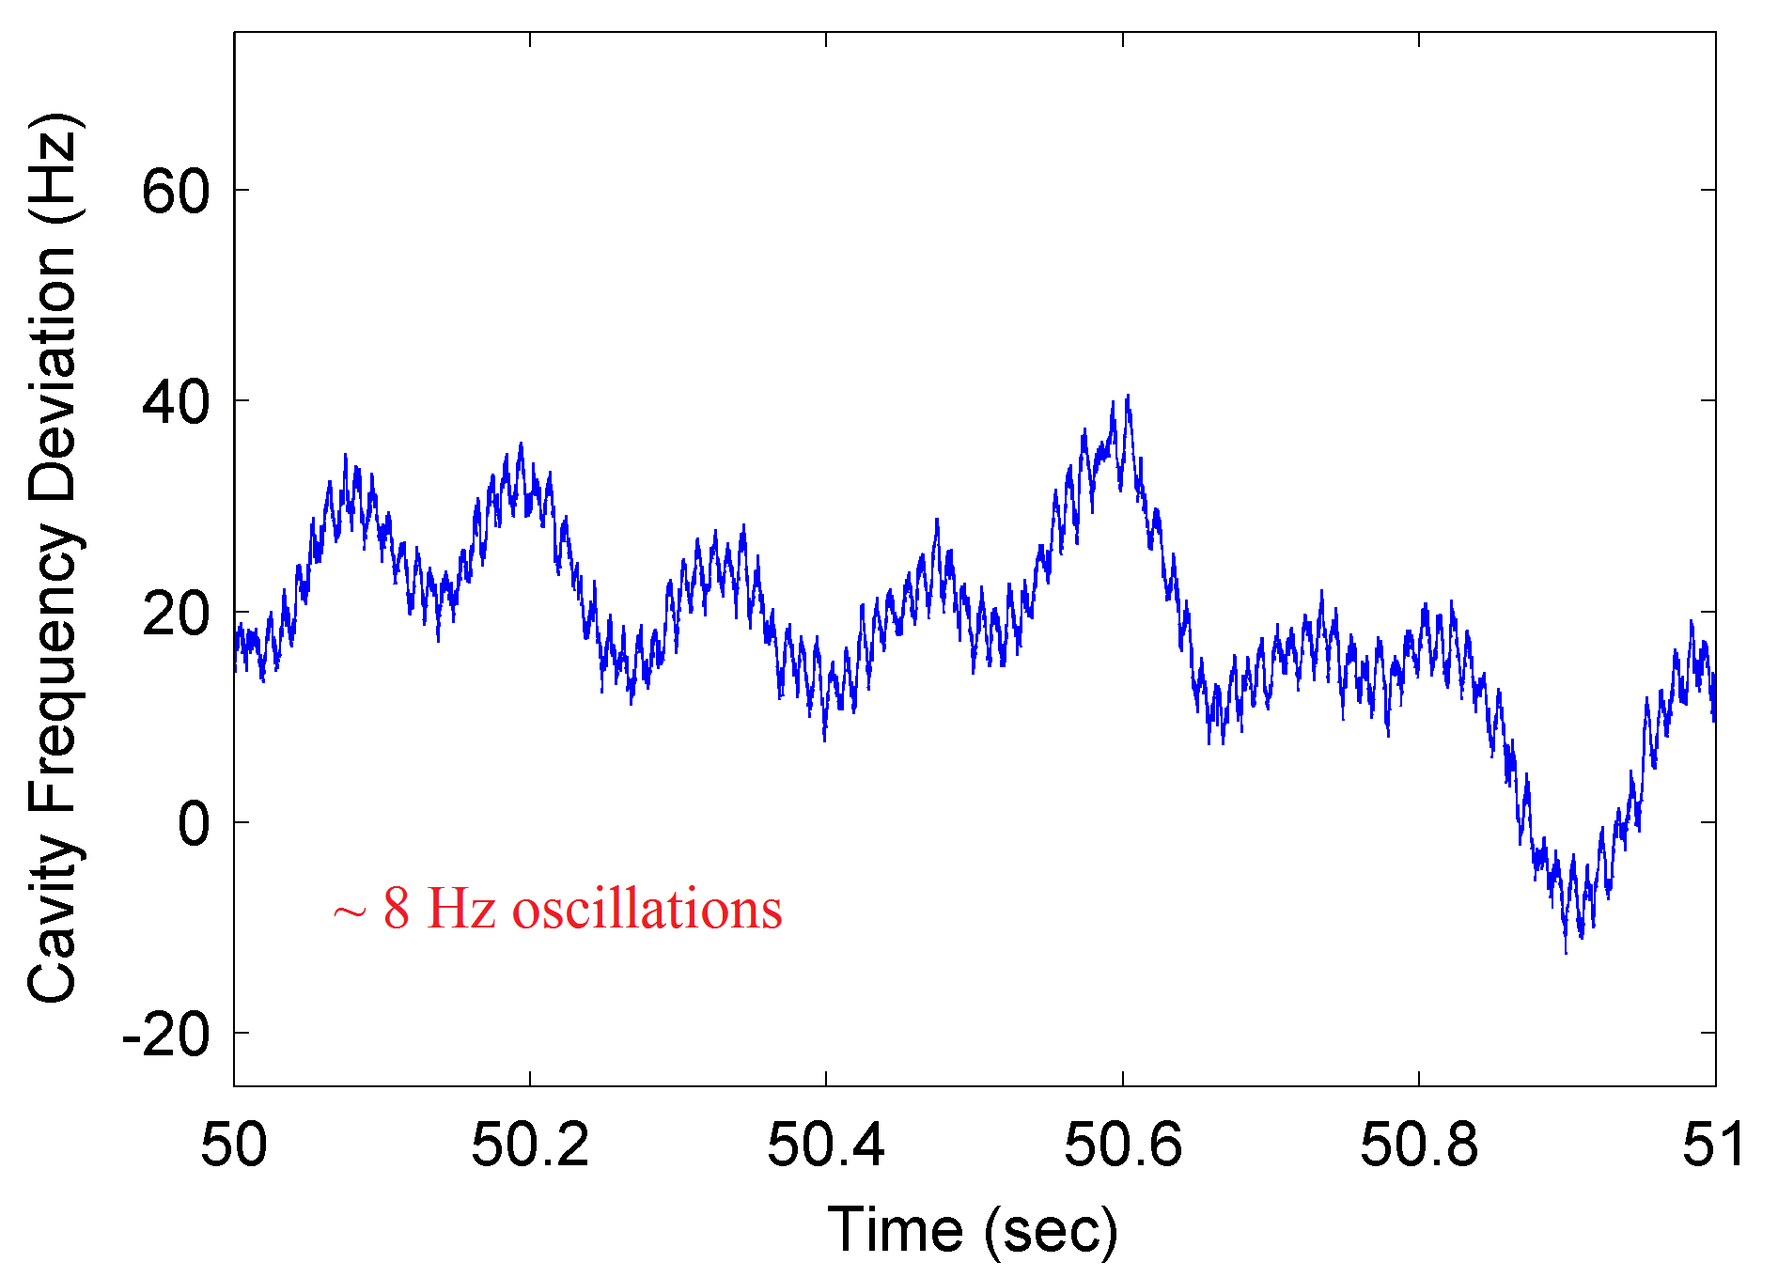
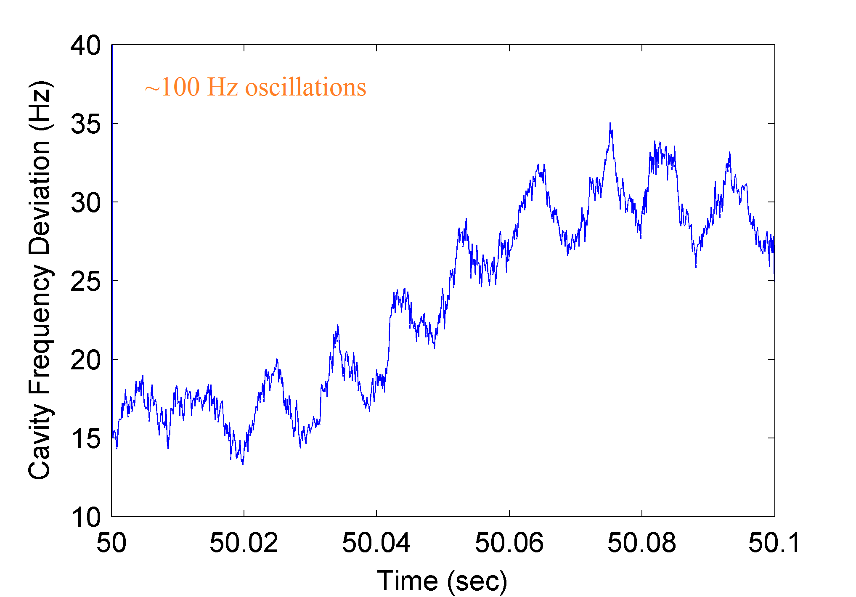
Microphonics in time domain

Slide 10
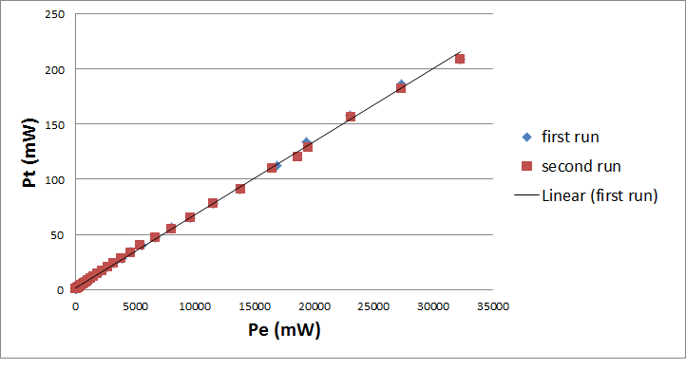
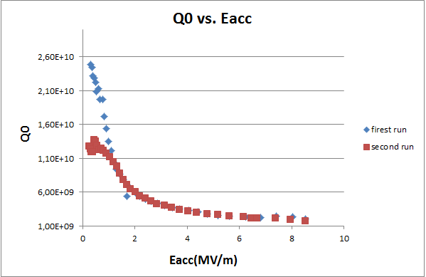
Q-slope

Slide 11
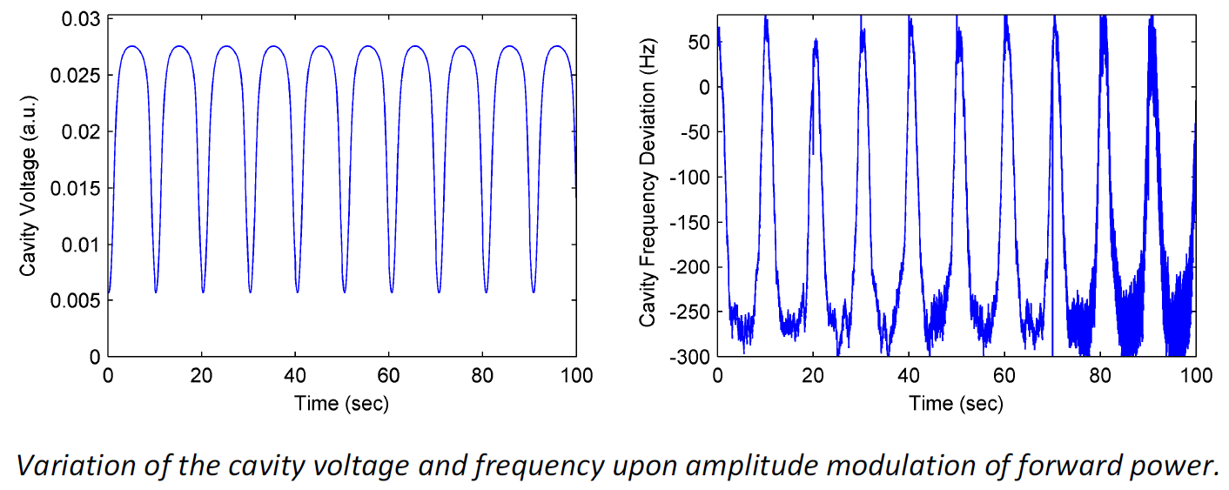
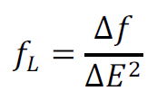

Quasi-static Lorentz force detuning

