Slide 1
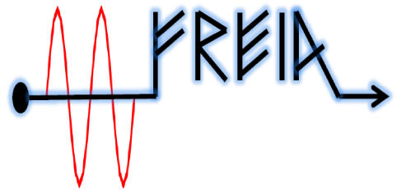

High-power test of the matching network
FREIA, Uppsala
November 2015

Slide 2
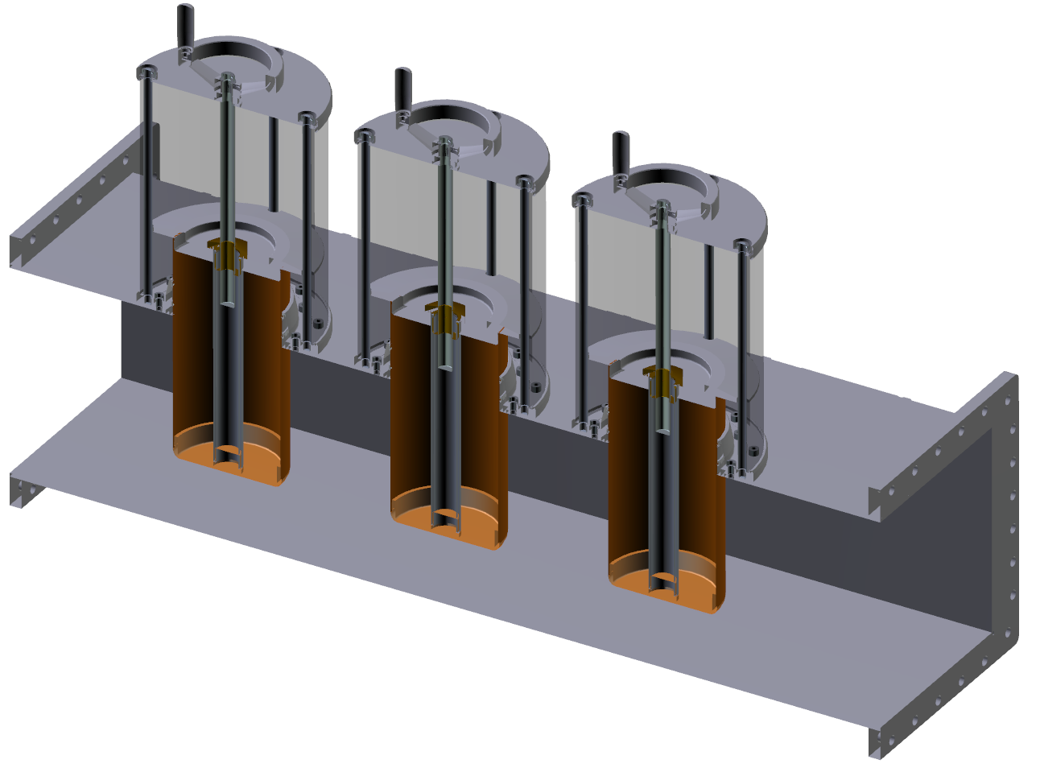
Matching network: drawing EXIR

Slide 3
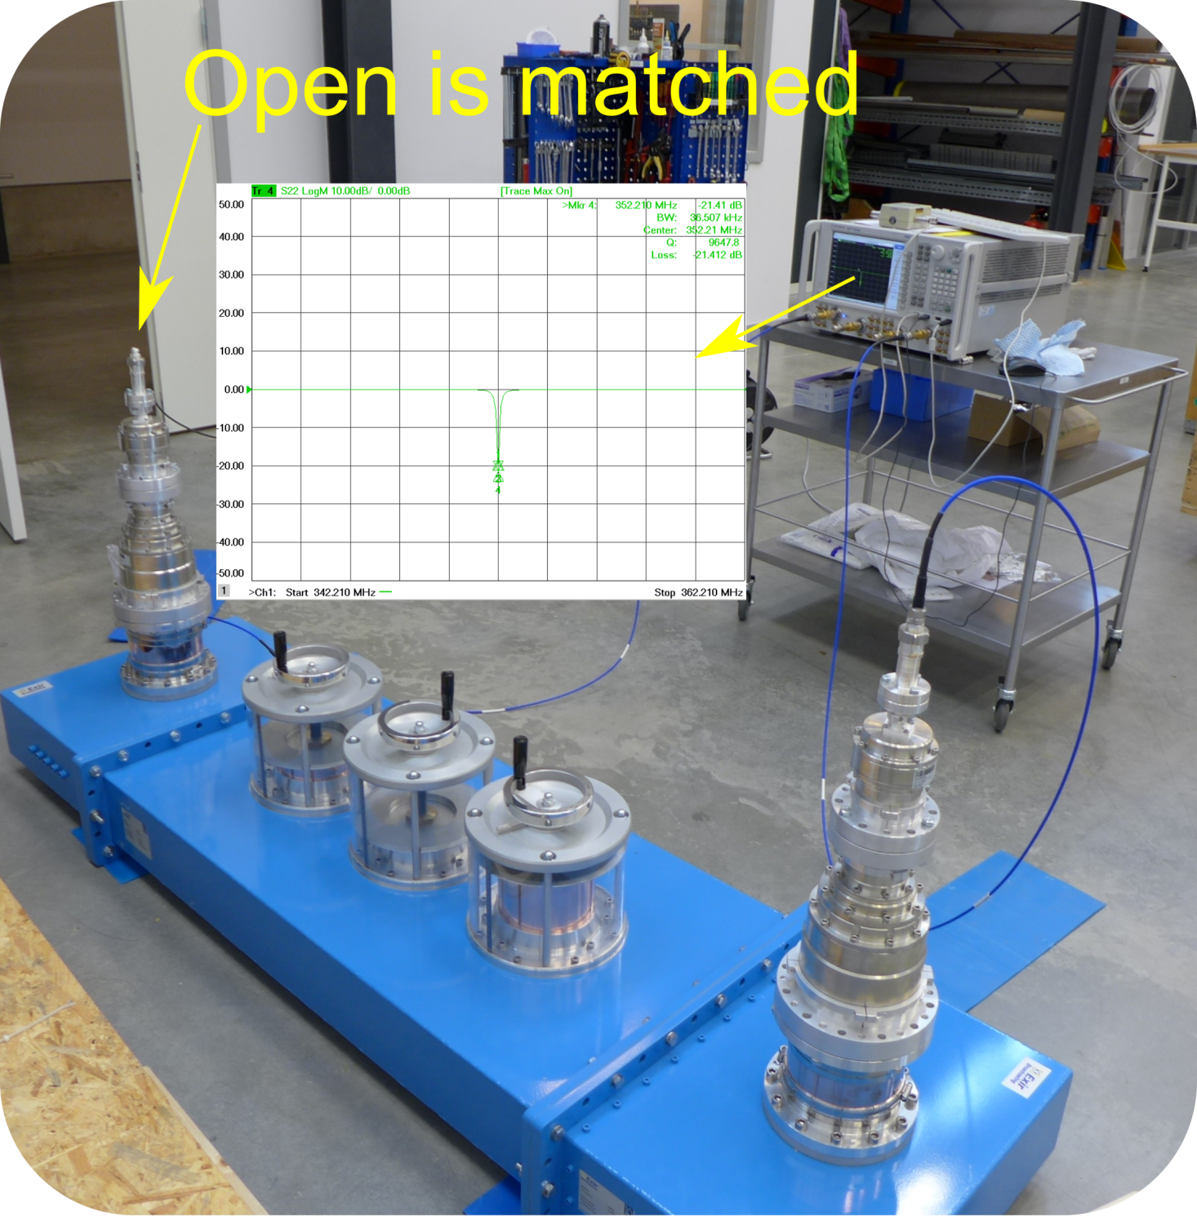
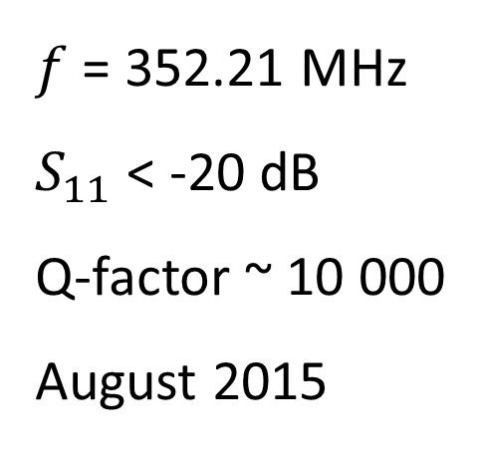
Matching network: low power, matched open
$f$ = 352.21 MHz
$S_{11}$ < -20 dB
Q-factor ~ 10 000
August 2015

Slide 4
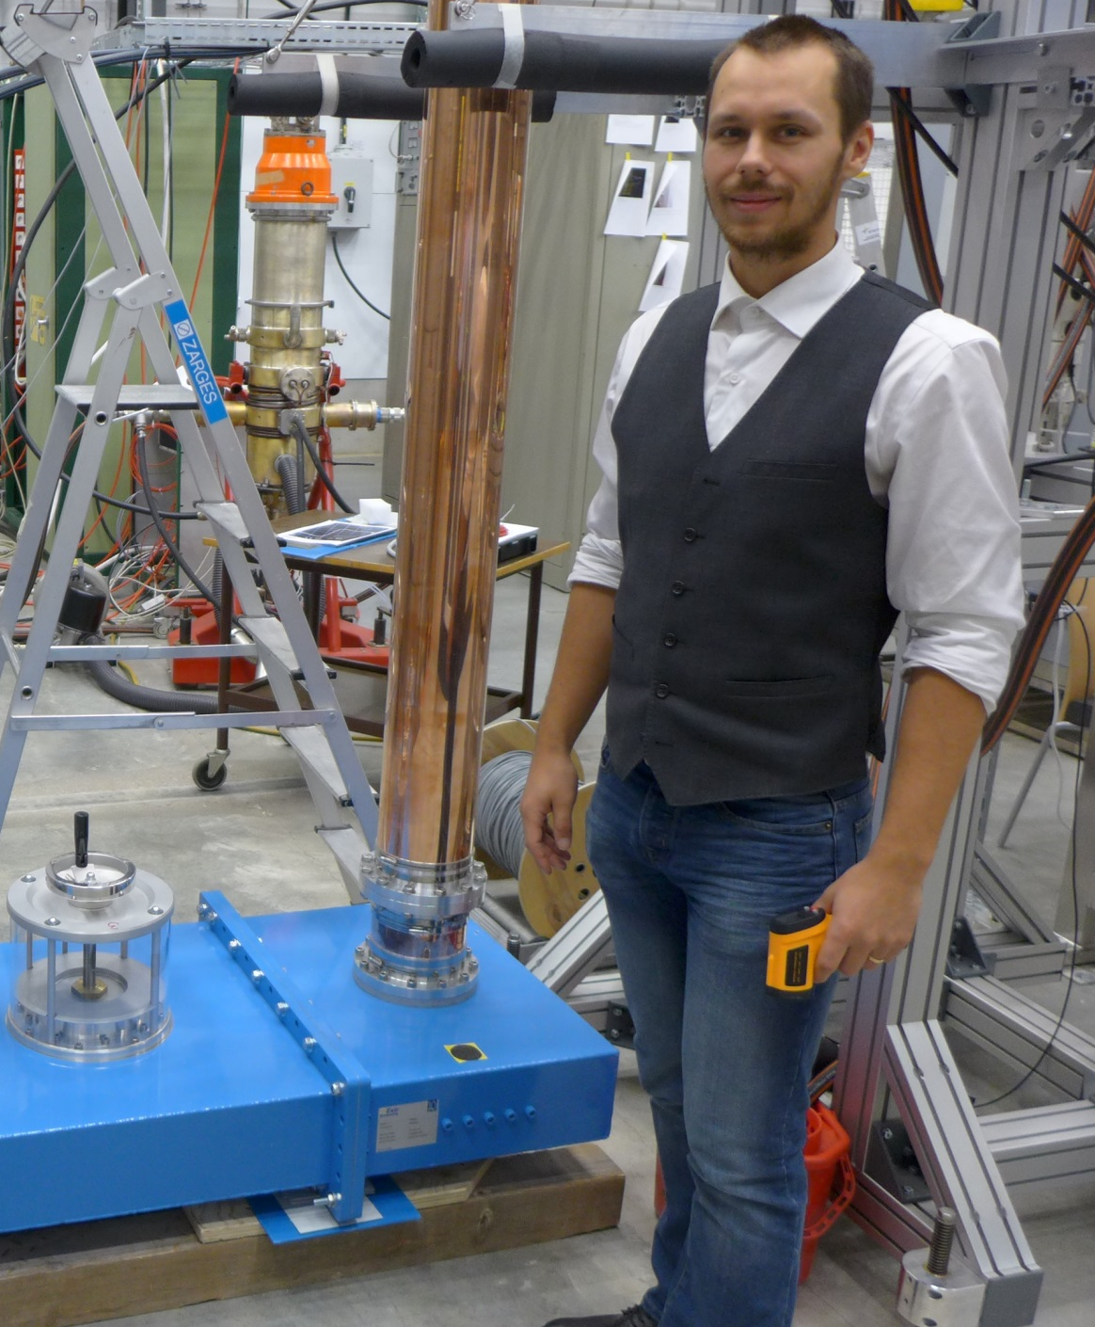
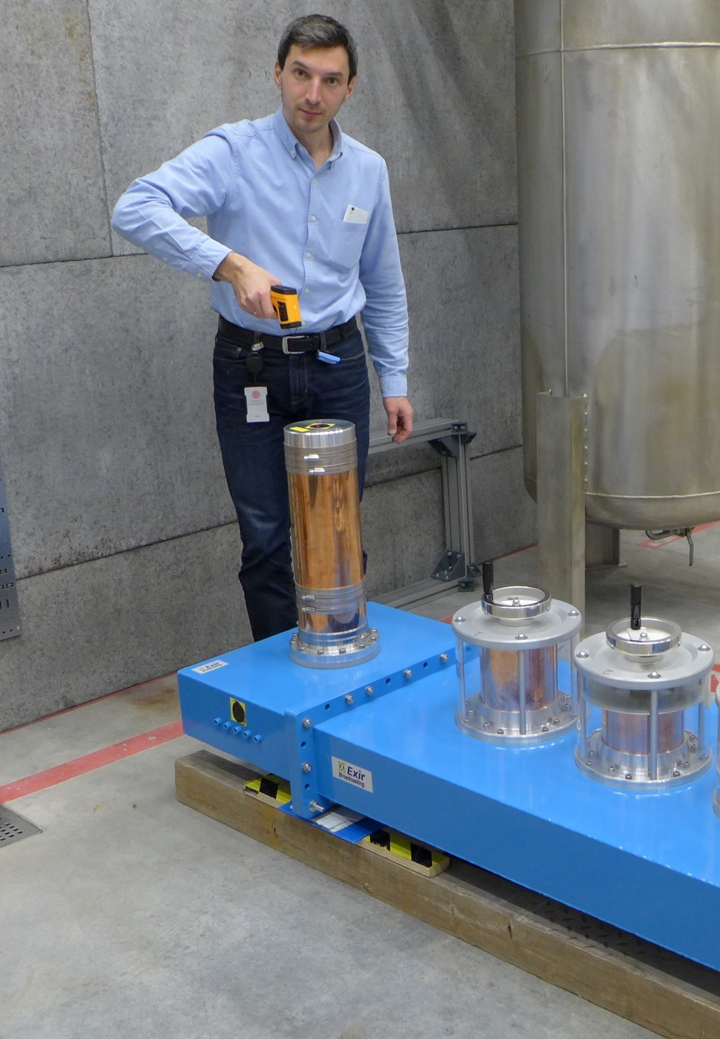
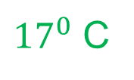

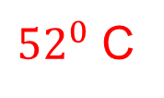
Matching network: high power, matched short
10 kW peak
500 W CW
-9 dB S11
1 hour
ARCING at 20 kW peak
${52}^{0}$ C
${38}^{0}$ C
${17}^{0}$ C
This is a well-coupled resonator.

