Slide 1
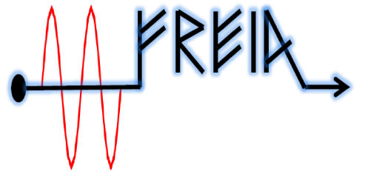

Dynamic Lorentz force detuning
and mechanical modes
FREIA, Uppsala
November 2015

Slide 2
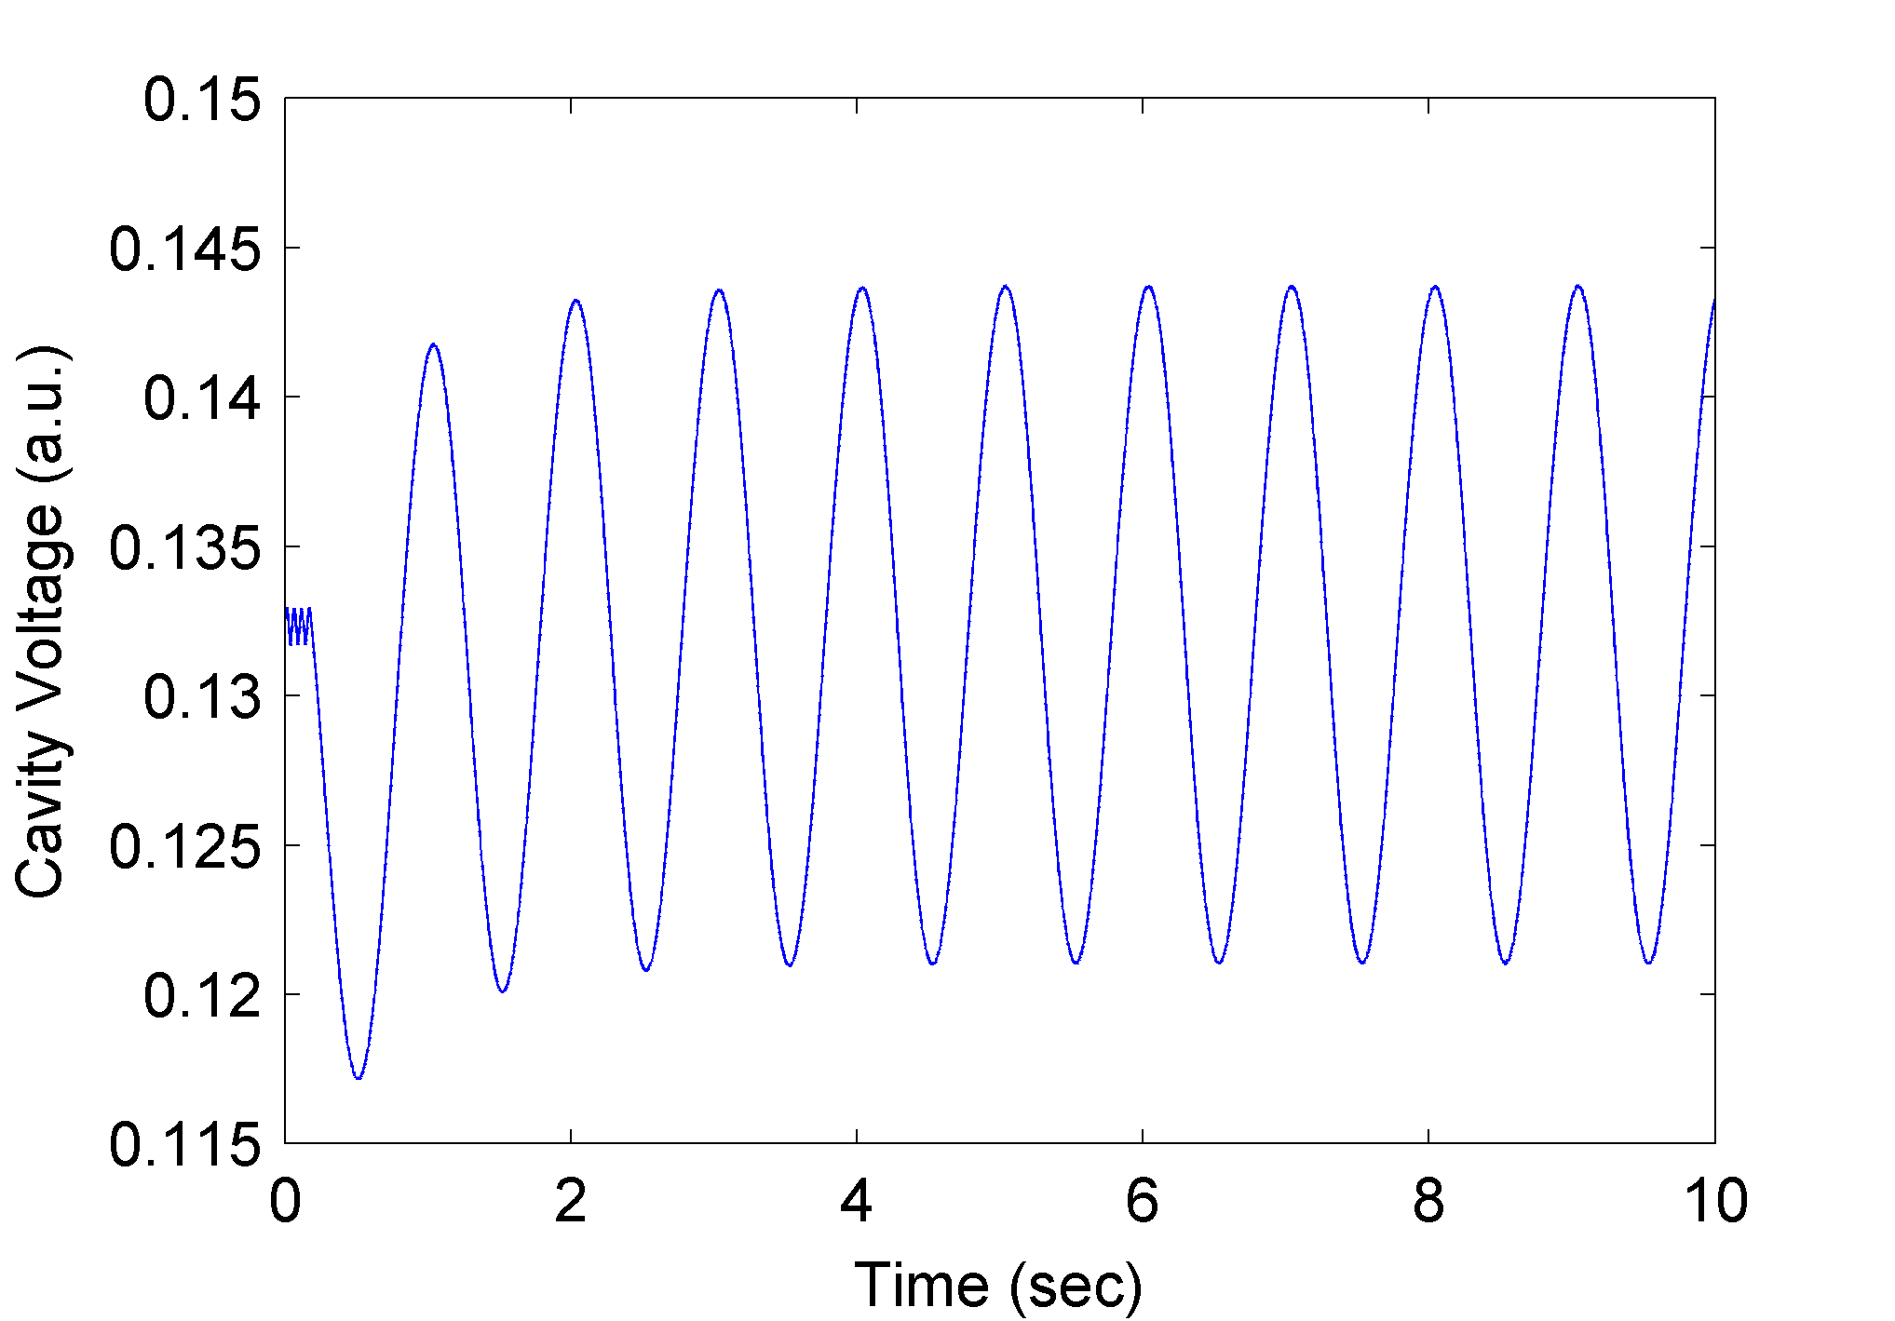
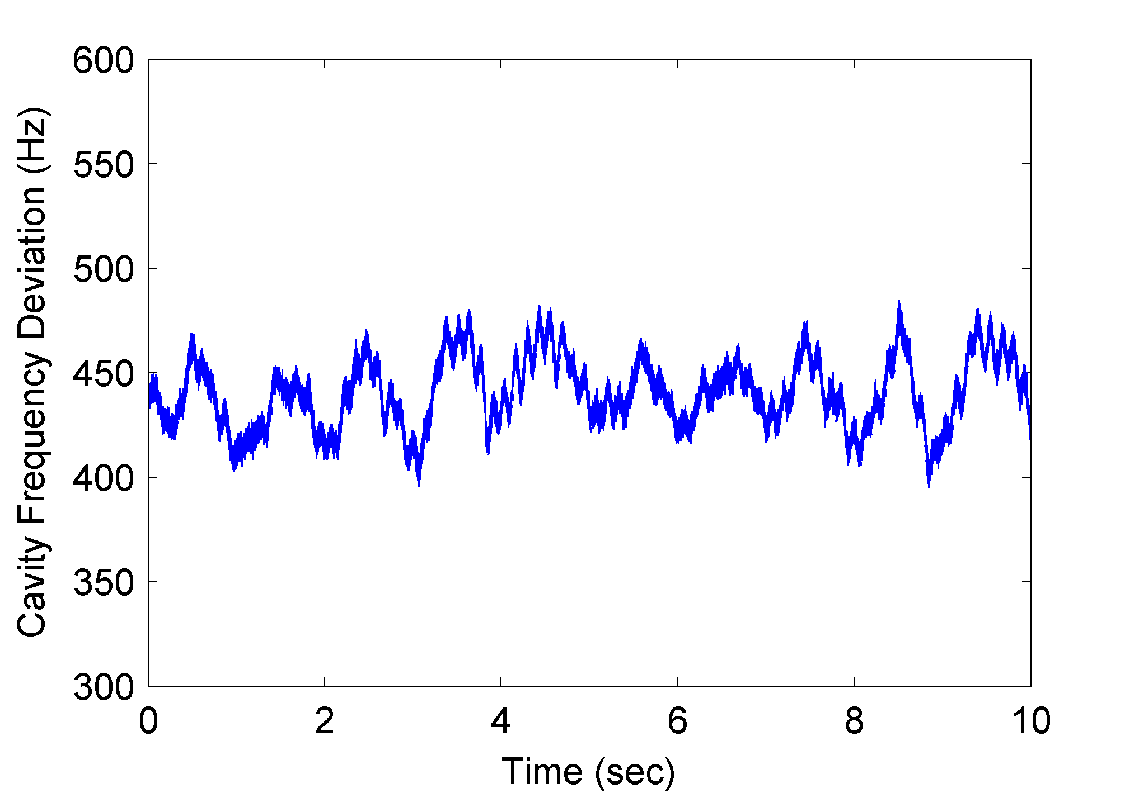
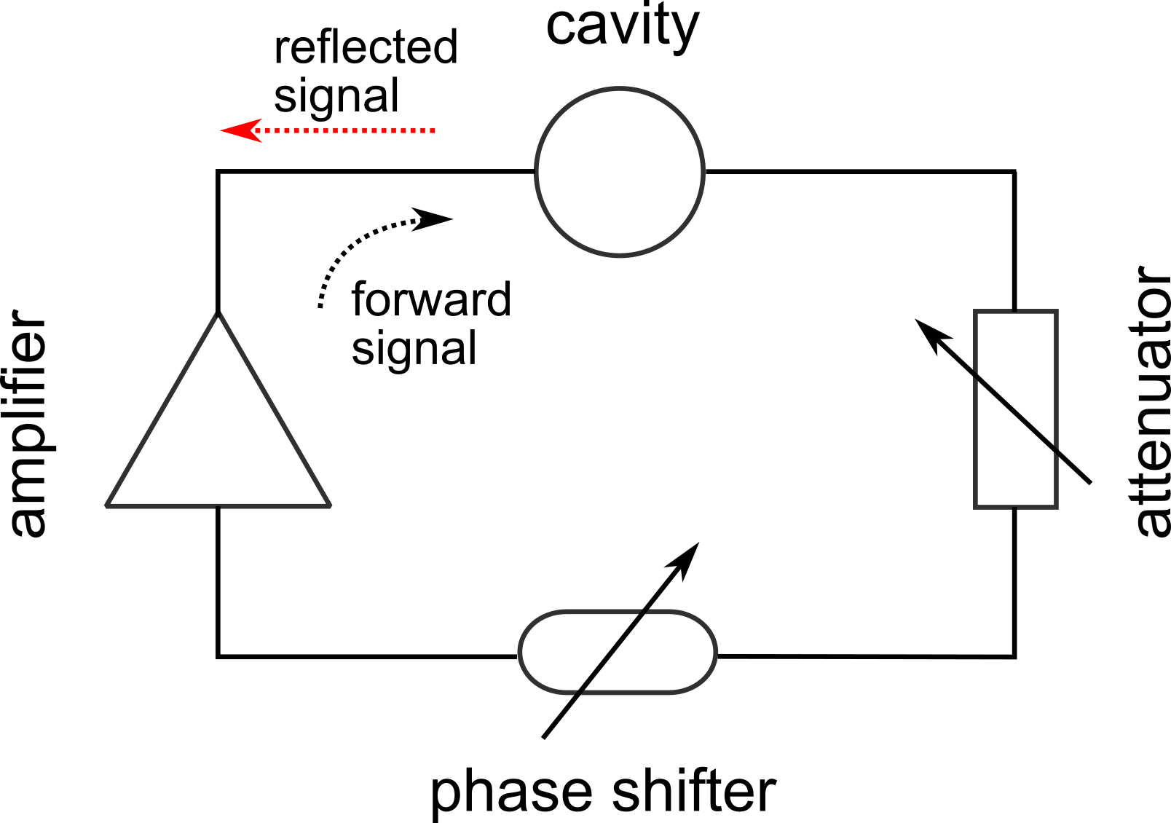
Amplitude modulation of the self-excited loop

Slide 3
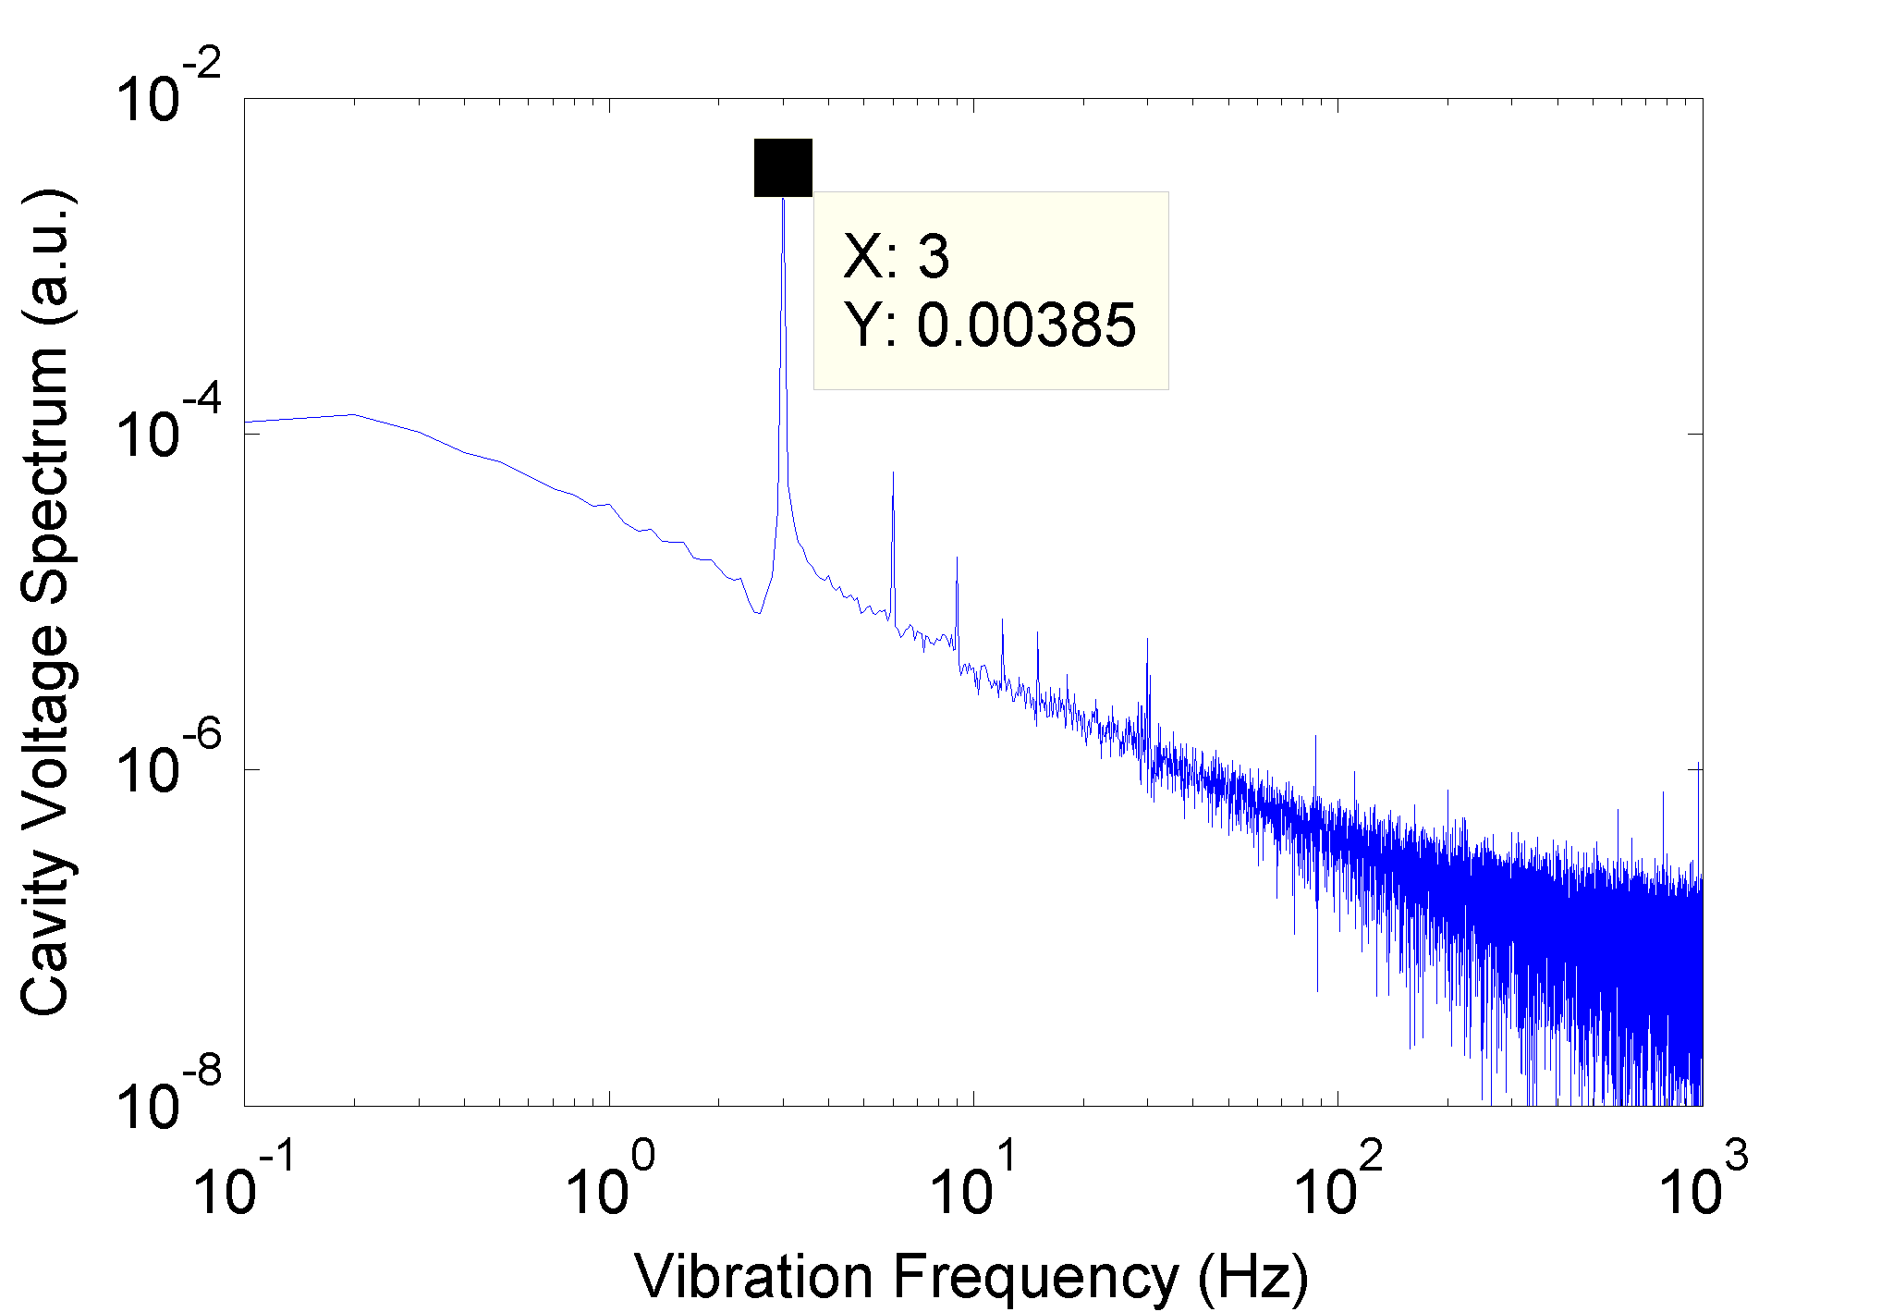
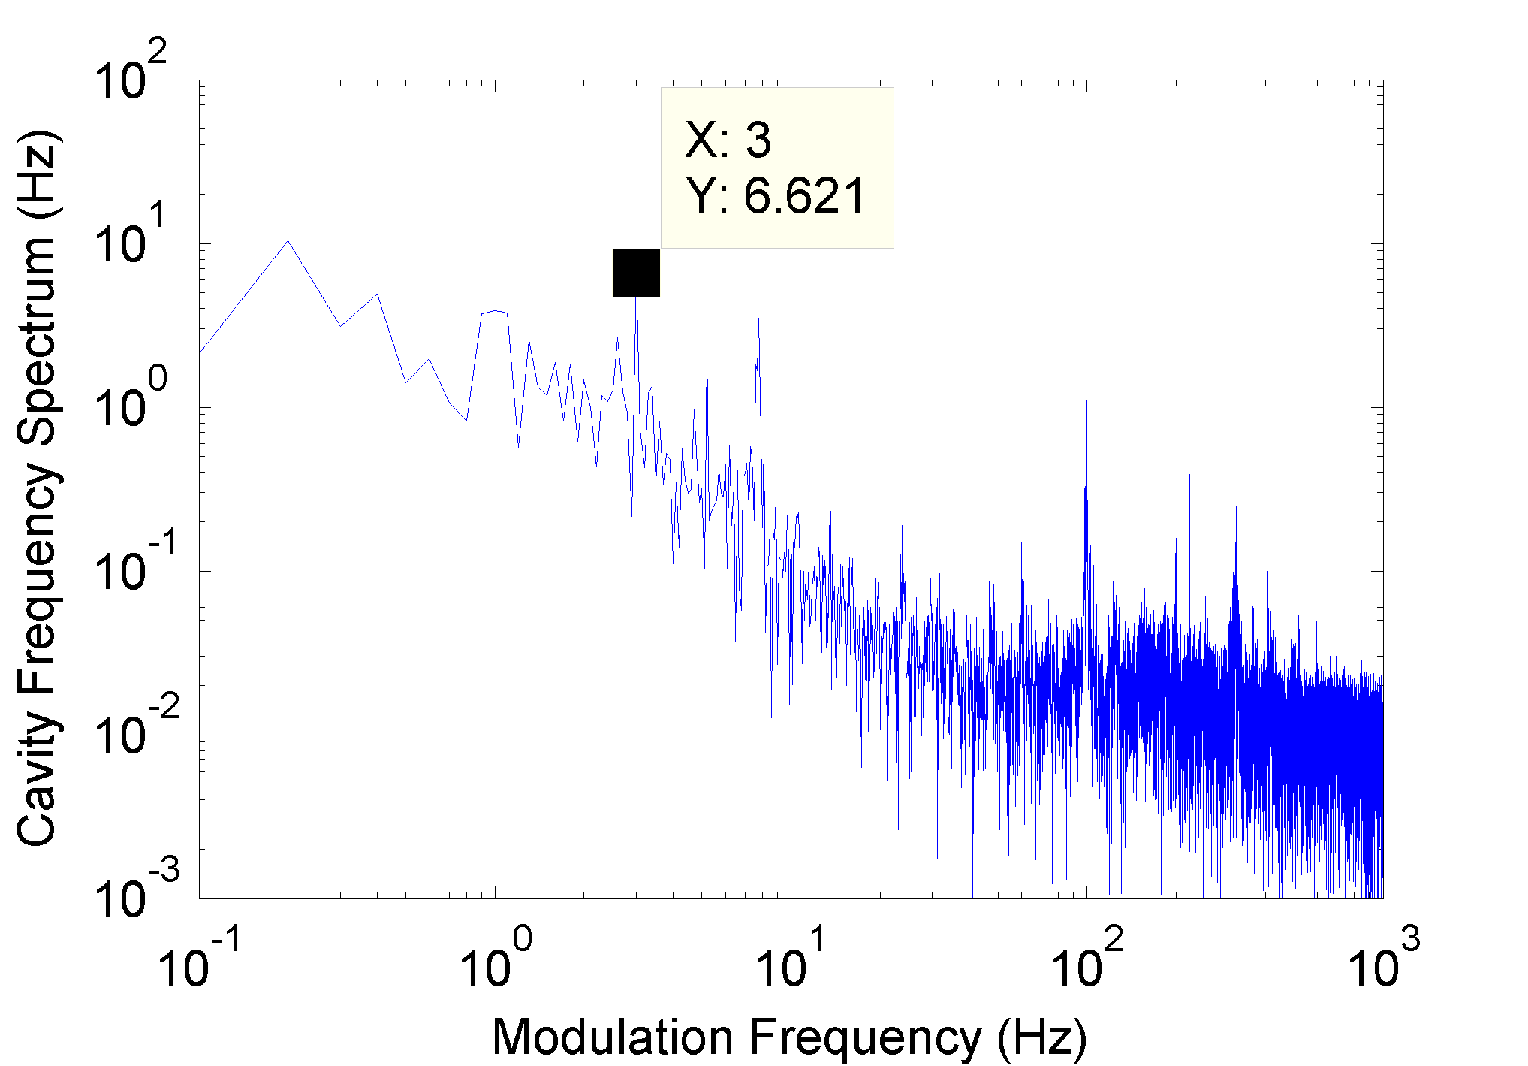
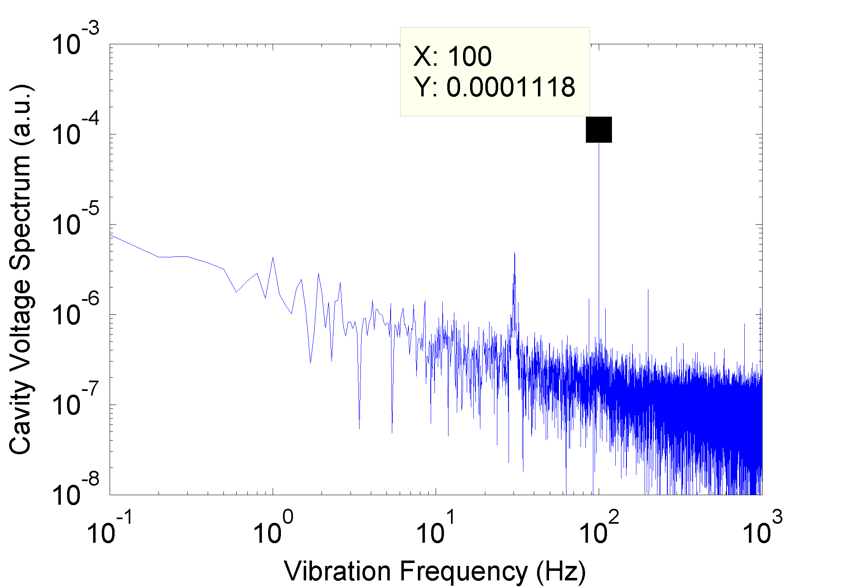
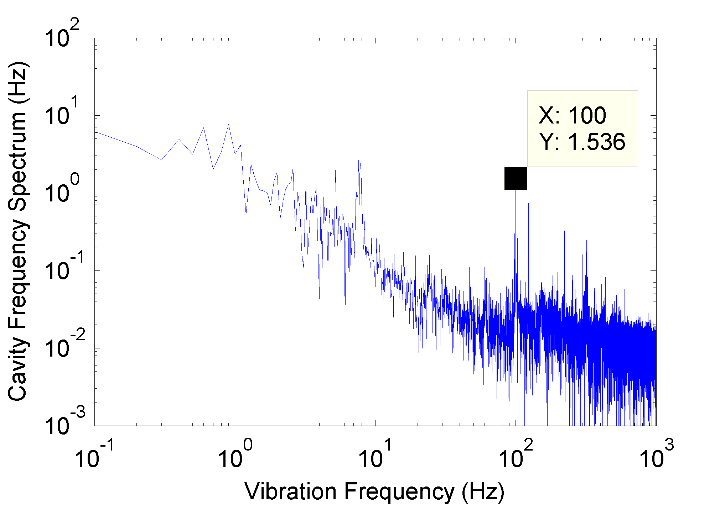
Cavity voltage and frequency modulation
3 Hz
3 Hz
100 Hz
100 Hz

Slide 4
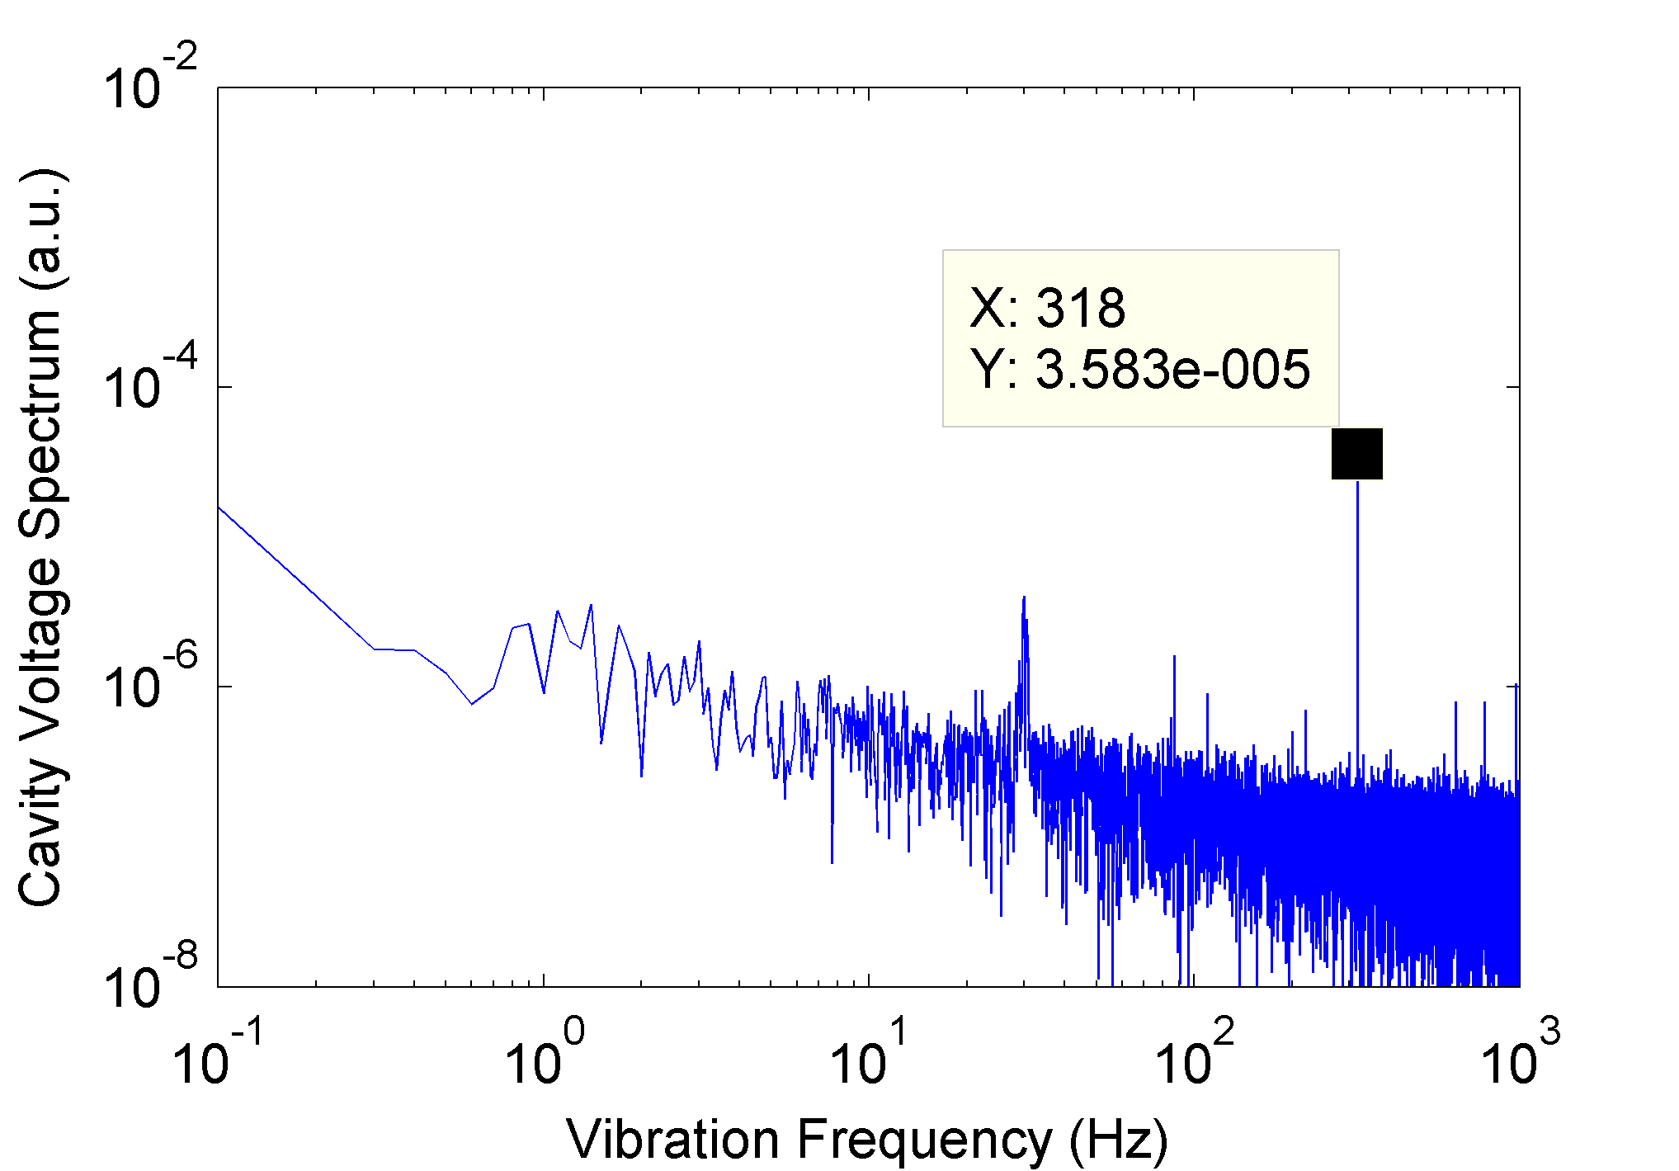
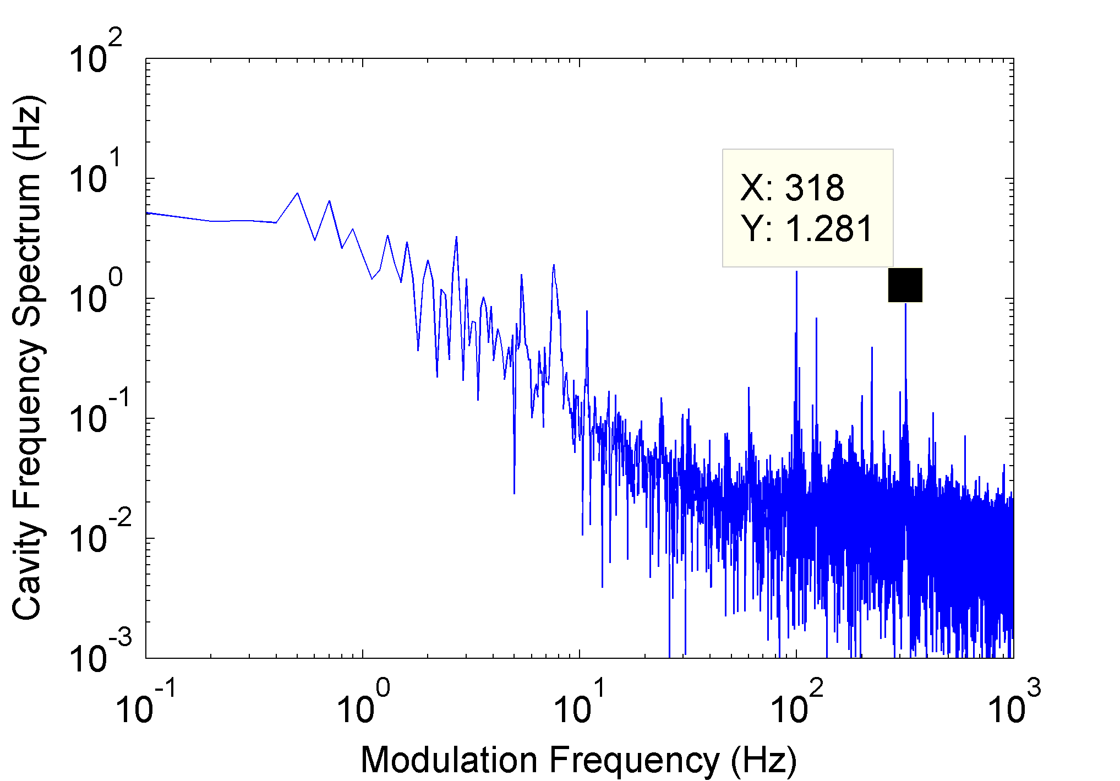
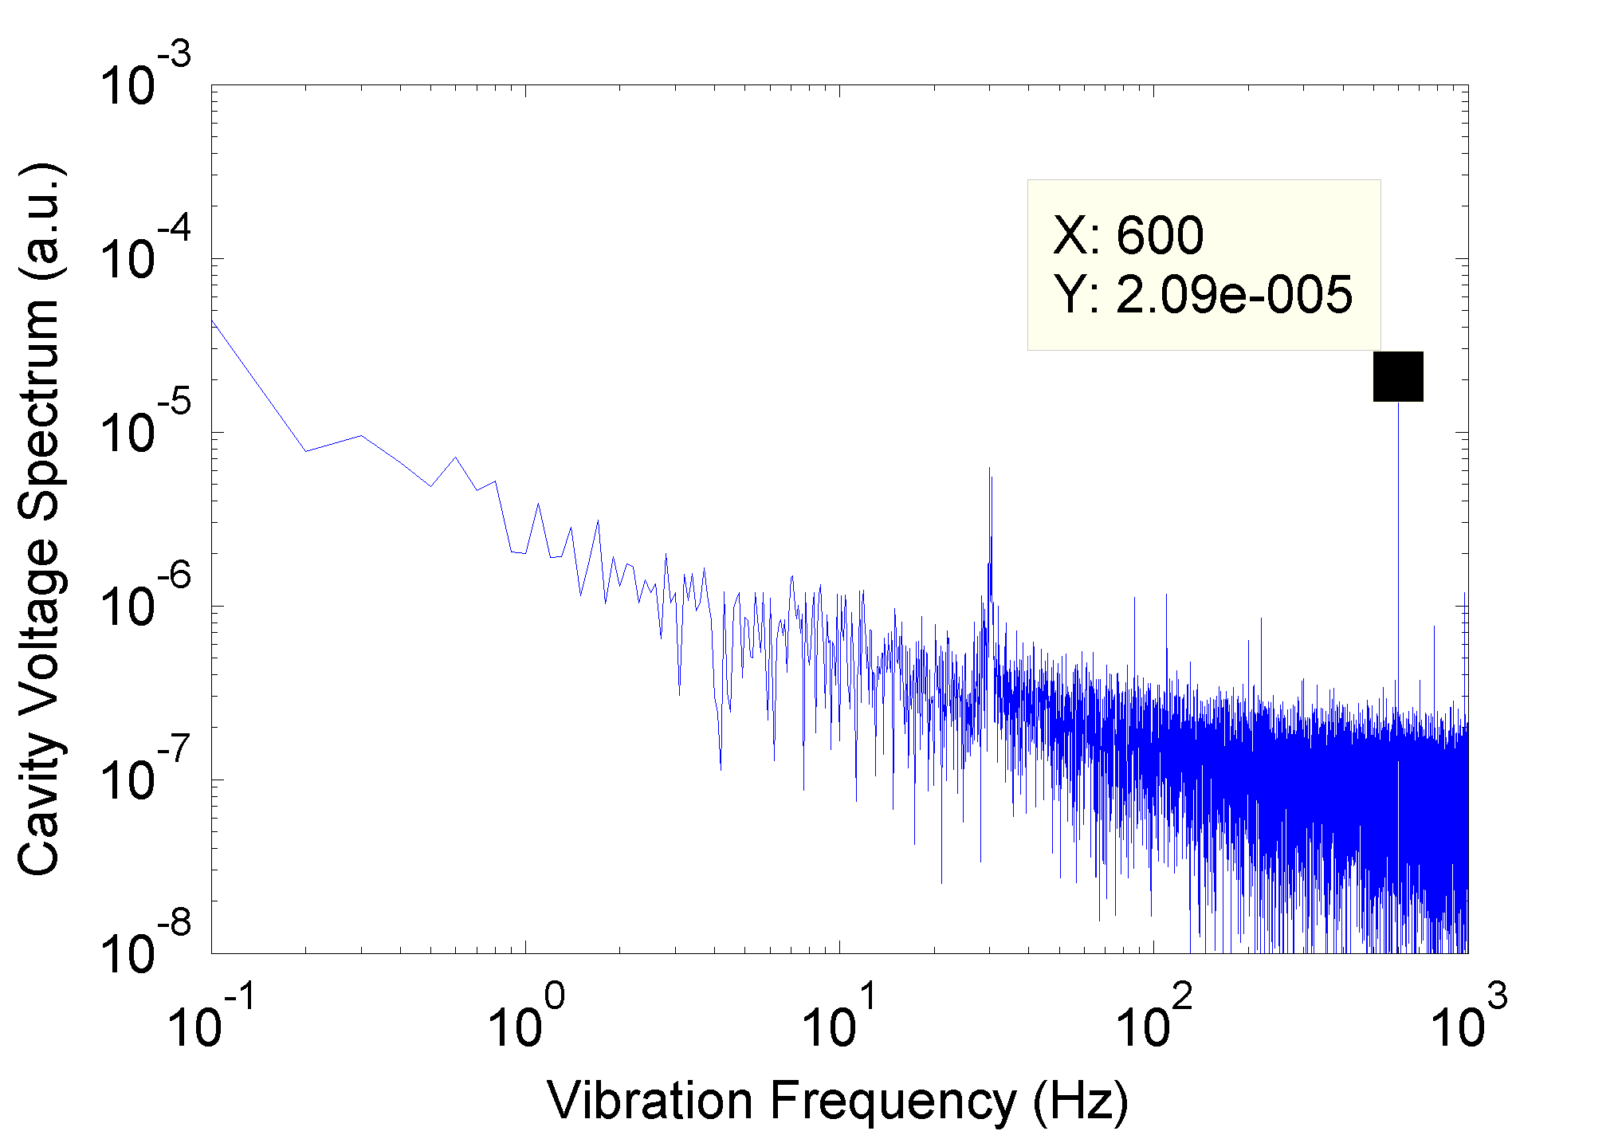
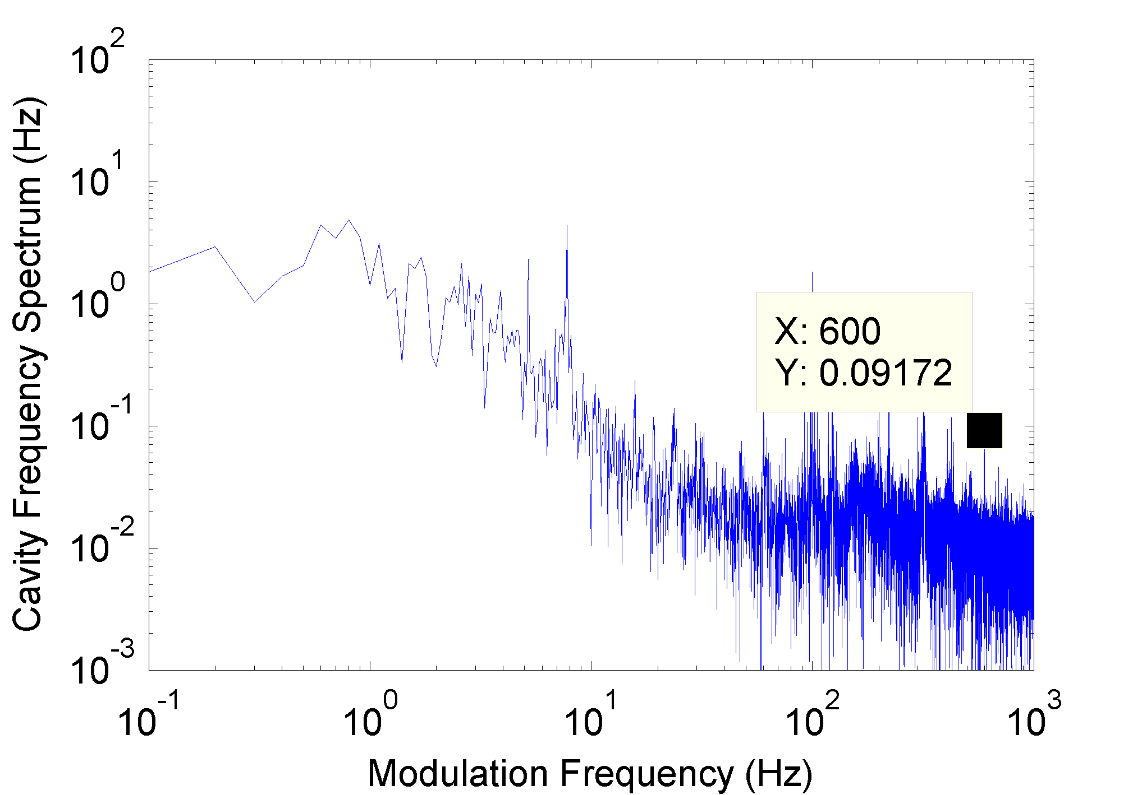
Cavity voltage and frequency modulation cont’d
318 Hz
318 Hz
600 Hz
600 Hz

Slide 5
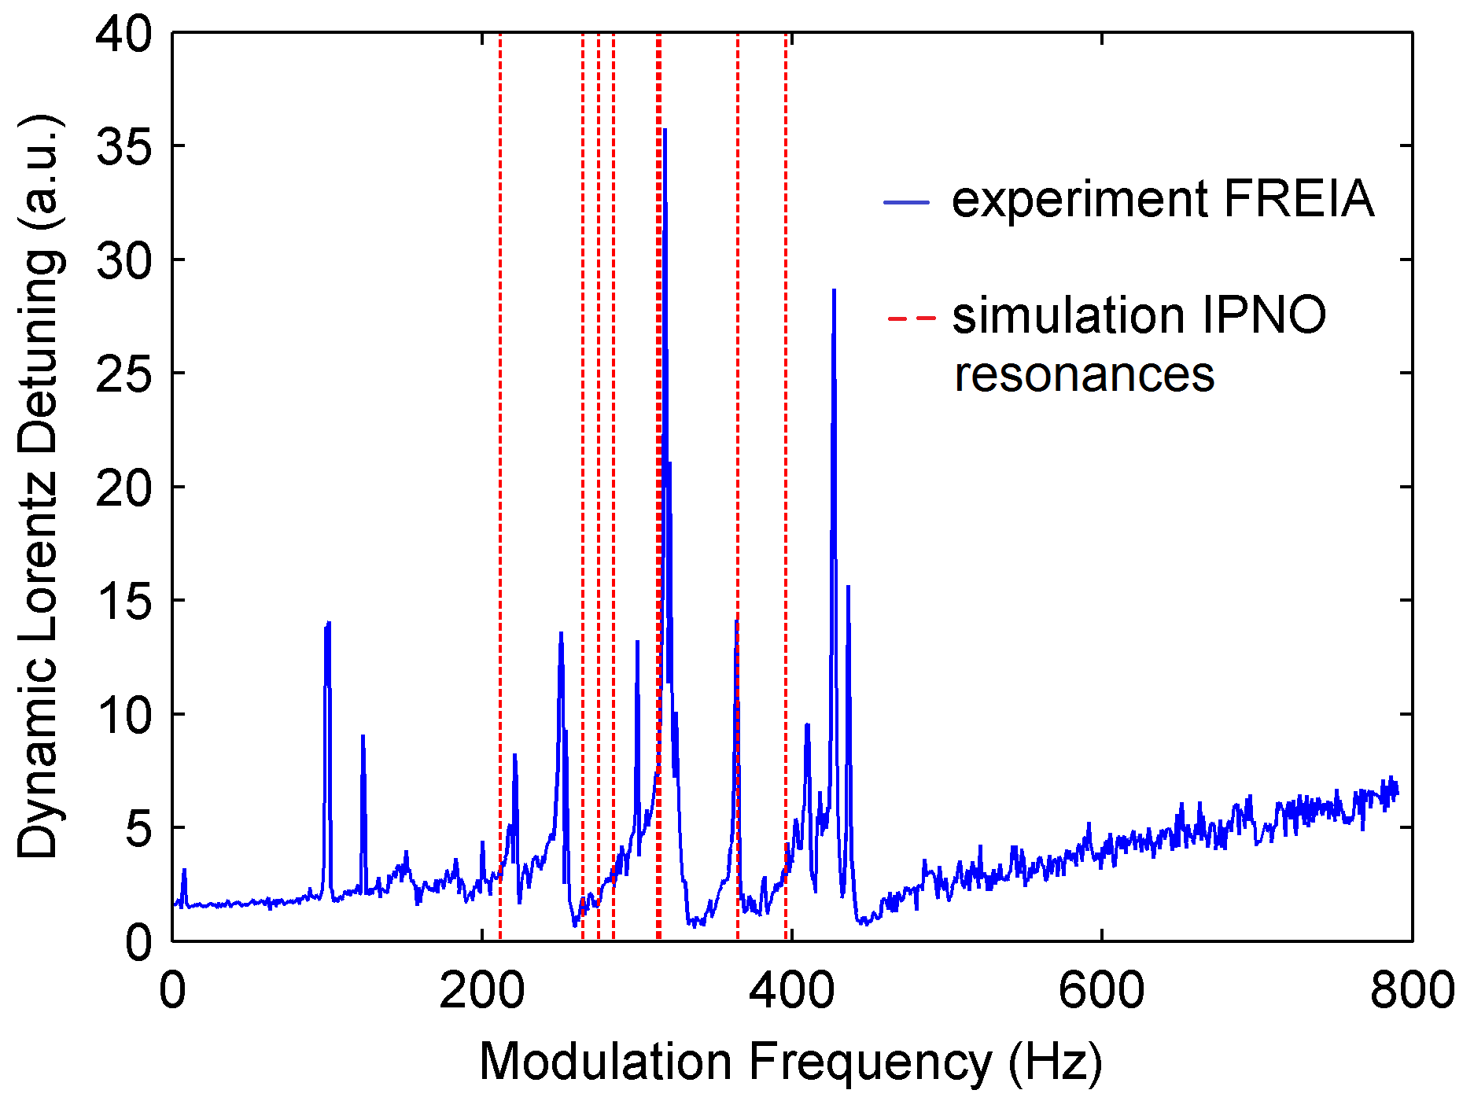
Transfer function of the dynamic Lorentz force detuning
noise goes up because the cavity voltage modulation goes down

Slide 6
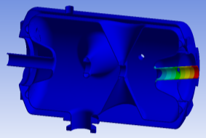
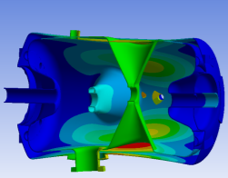
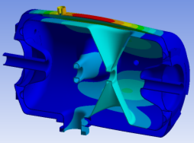
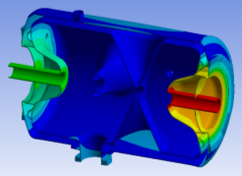
Guillaume’s simulations of the cavity mechanical modes
N° | Frequency | Mode
1 & 2 | 212Hz | Beam tube on CTS side
3 & 4 | 265Hz & 275Hz | Spoke bar/Helium vessel
5 & 6 | 285Hz | Coupled mode Cavity/Helium vessel
7 | 313Hz | Helium vessel
8 to 11 | 315Hz to 365Hz | Coupled mode Cavity/Helium vessel
12 | 396Hz | beam tubes
Mode 1: 212 Hz
Mode 3: 265 Hz
Mode 5: 285Hz
Mode 12: 396Hz

Slide 7
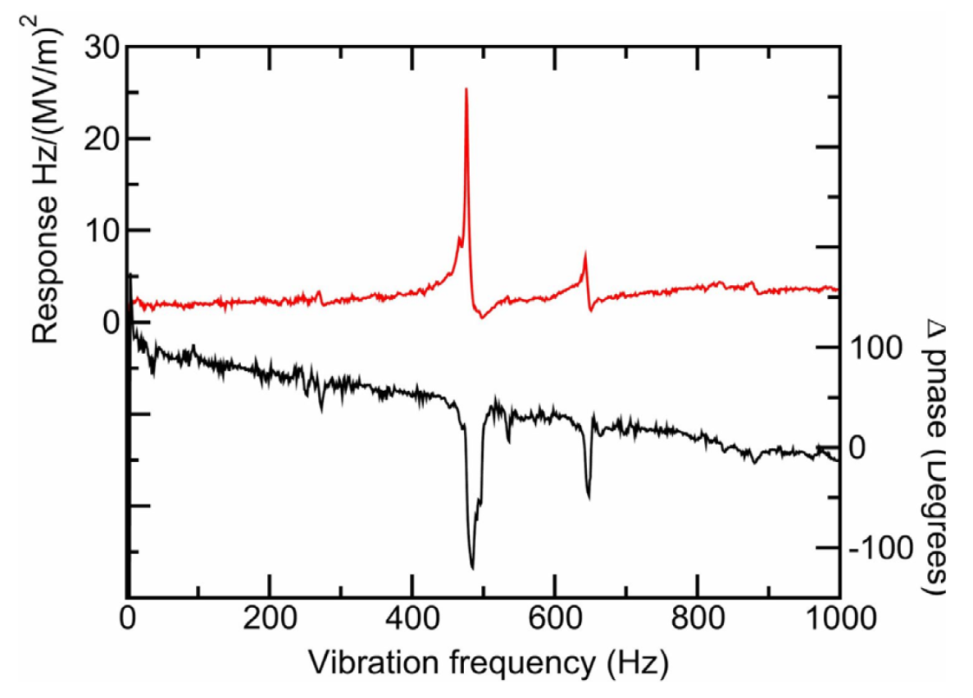
Comparison with the Argonne double spoke cavity
Argonne

Slide 8
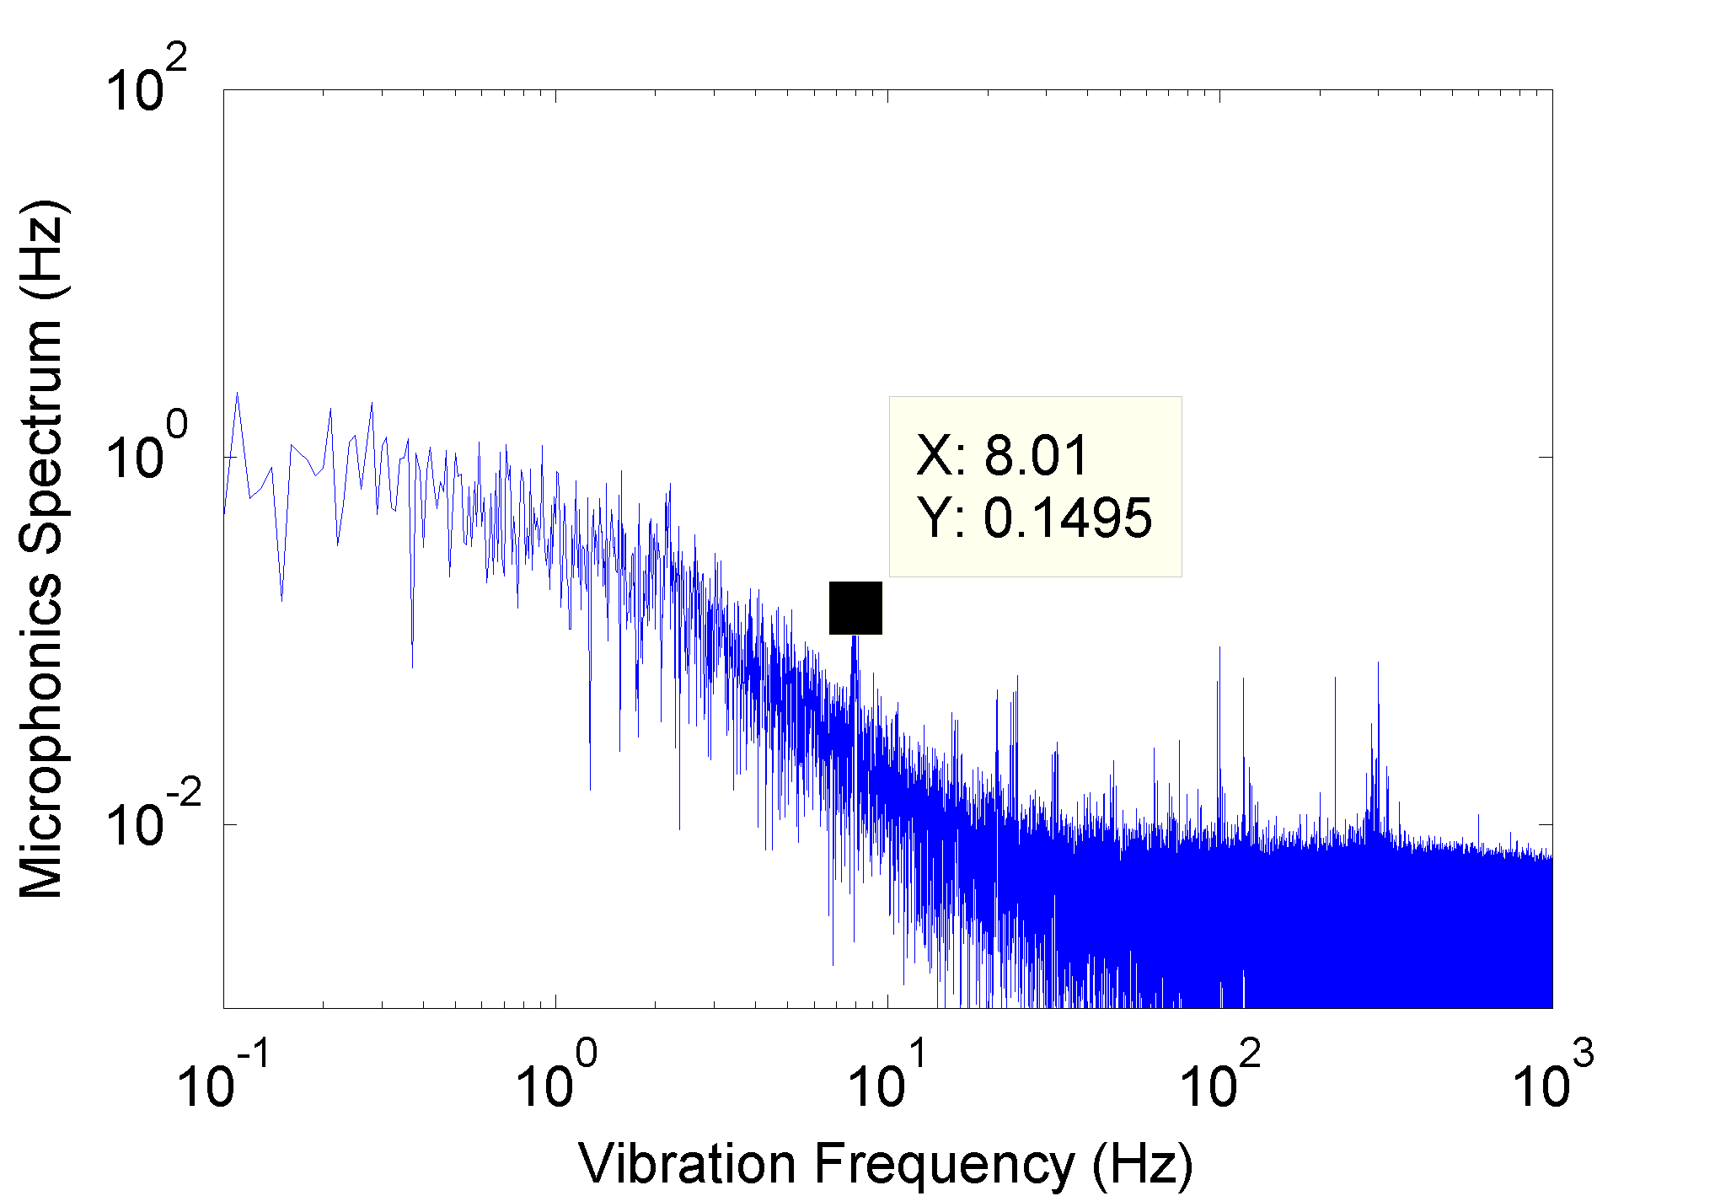
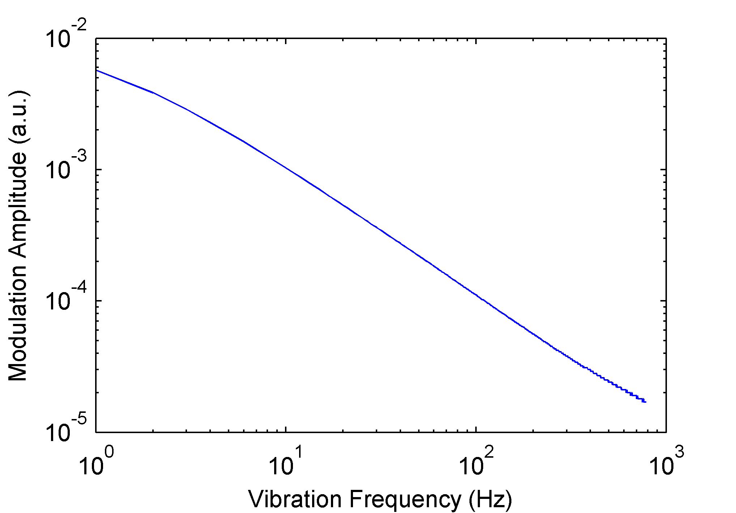
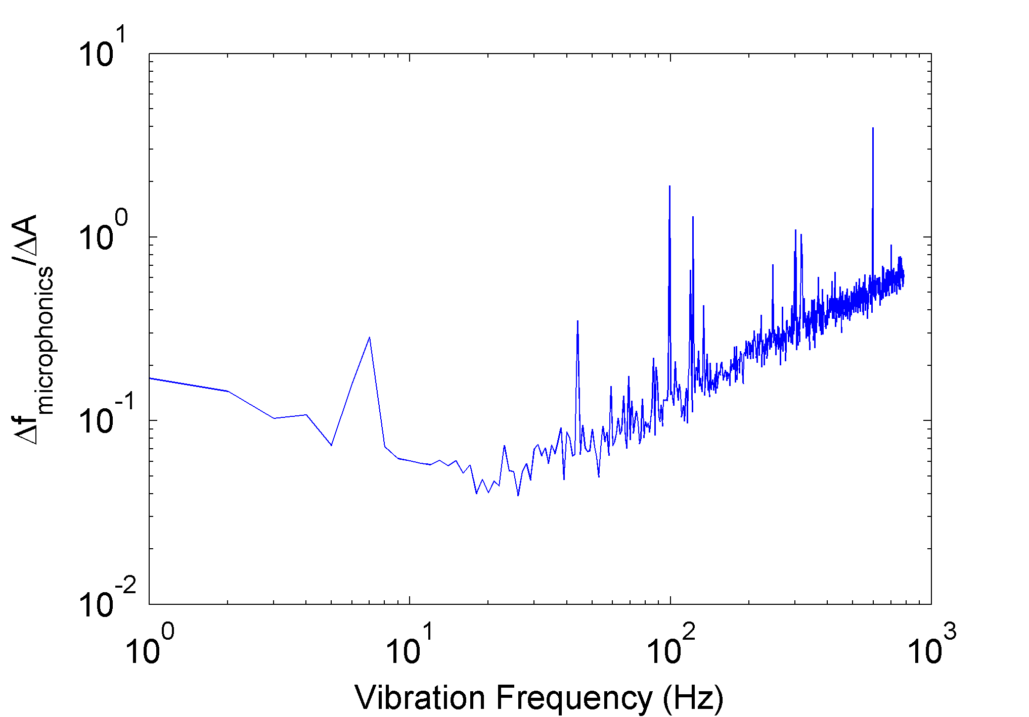
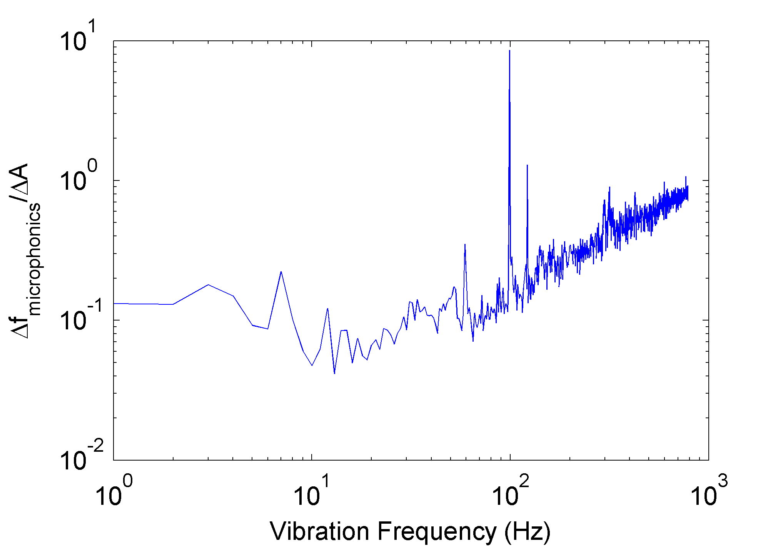
Contribution of microphonics
measurement no. 1
measurement no. 2

Slide 9
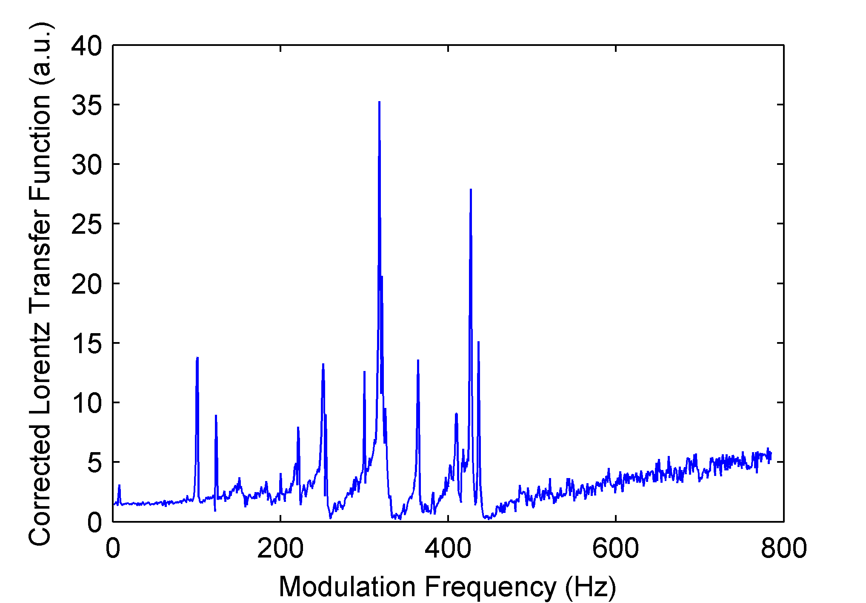
‘True’ transfer Lorentz function

Slide 10
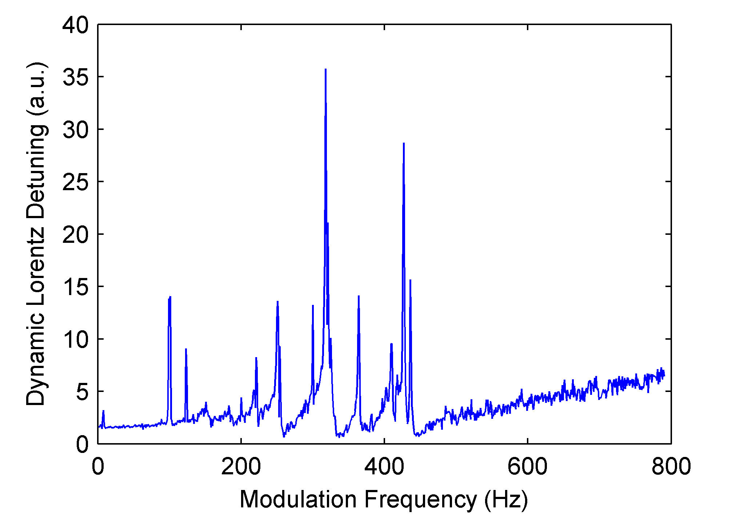
‘Raw’ transfer Lorentz function

