Slide 1

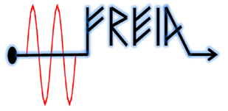
Q factor measurement of Double Spoke cavity at the FREIA Laboratory
30 Nov 2015
Han,Vitaliy
Department of Physics and Astronomy
Uppsala University

Slide 2
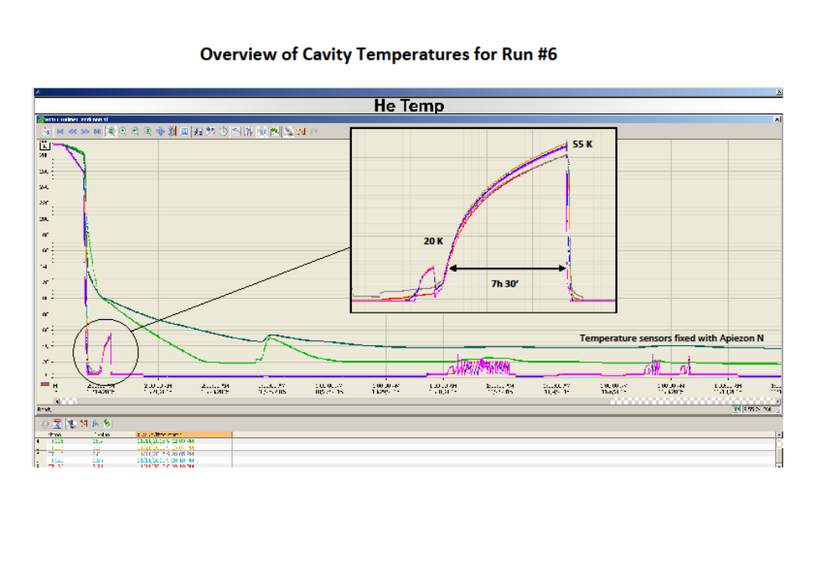
Early November cool down

Slide 3
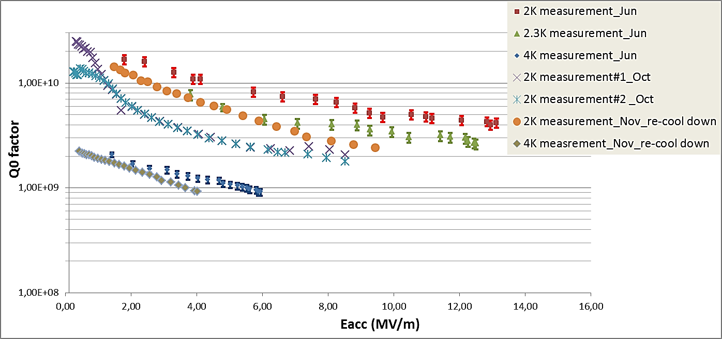
Q factor measurement
This run the Q-slop improve, the Q value at the lew field is almost the same as the first measurement in Jun. But Q factor is still worse at the high field level.

Slide 4
Results Compare
time | Q factor at low field | Qt | comment
Jun. | 1,79e10 | 9,23e15 | pick up anttenna was unscrewed and touched the cavity wall
Oct. | 1,36e10 | 3,3e11 | Anttenna repaired
Early Nov. | 4,5e9 | 1,2e11 | Went through twice 20K thermal cycle
Late Nov. | 1,6e10 | 1,2e11 | Re-cool down from 200K
The situation of pick up antenna changes during these tests.

