Slide 1
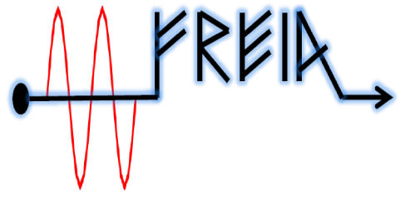

Impact of the cooldown of SC cavities
on the residual resistance:
experiment vs. experiment vs. theory
Vitaliy
February, 2016

Slide 2
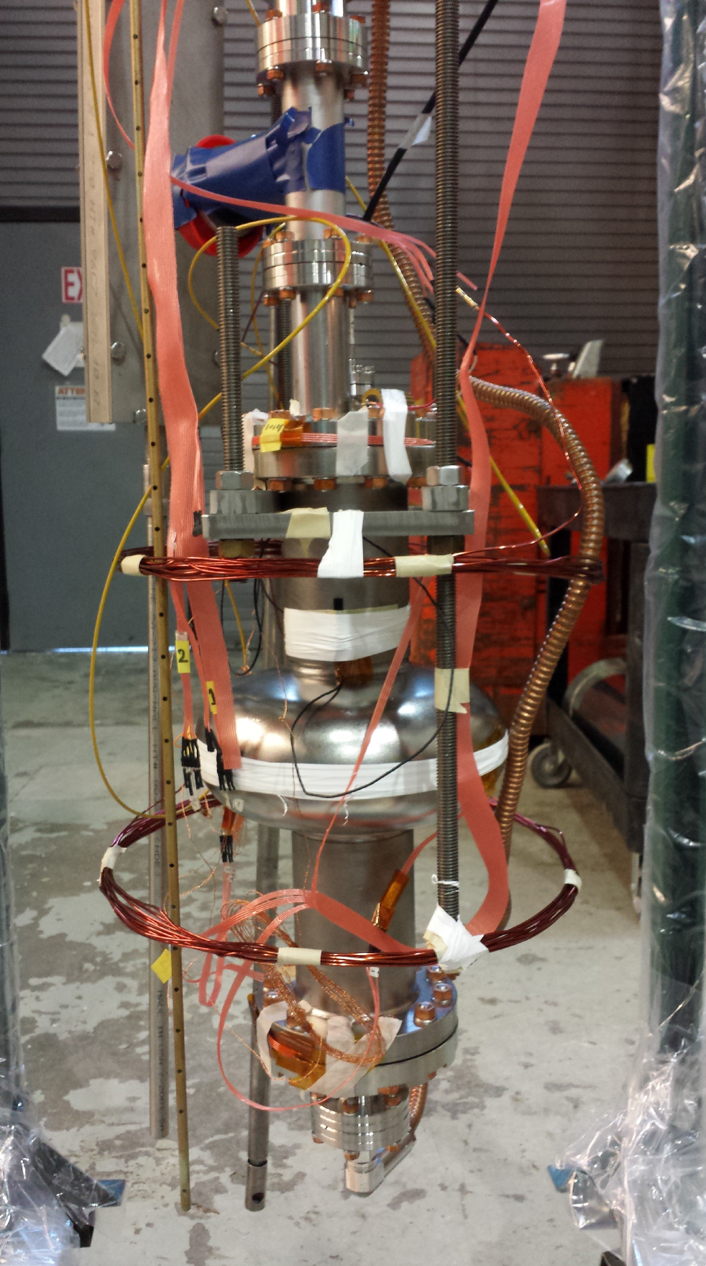
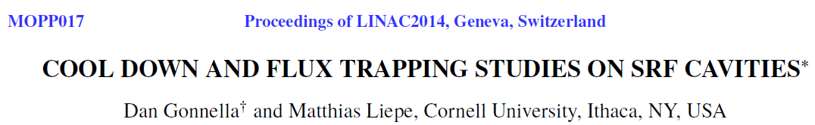
The tests are horizontal!
Magnetometer
Magnetic coils
Three temperature sensors:
on the bottom and top flanges, and on the equator.

Slide 3
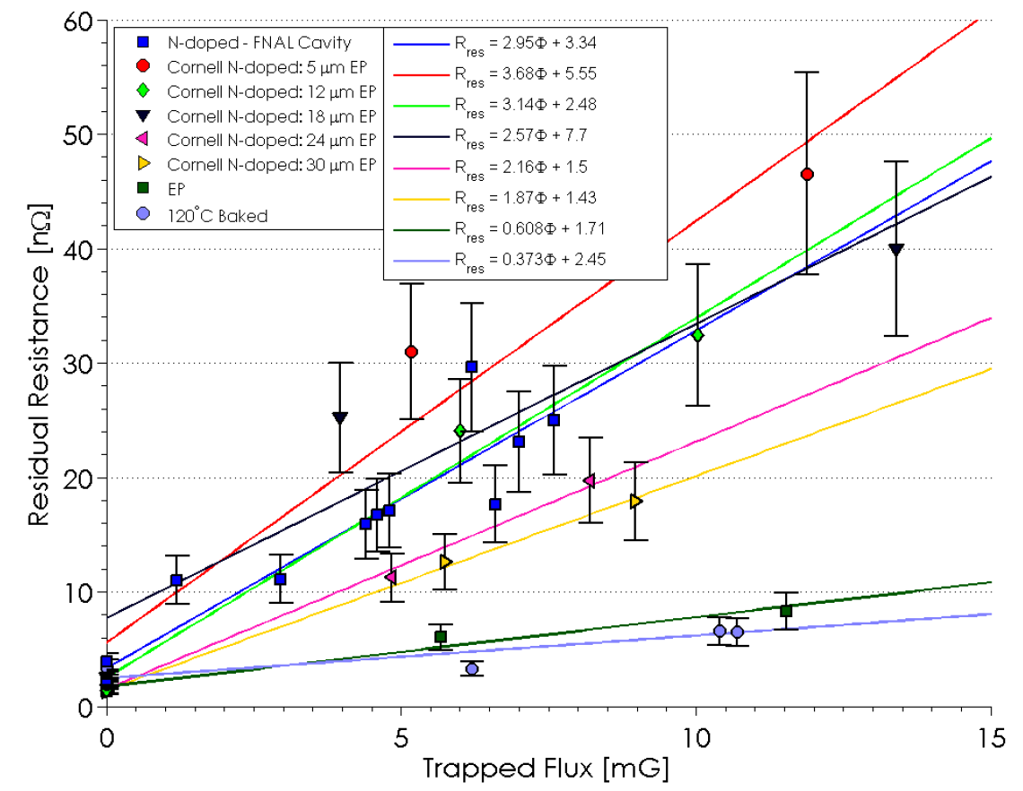
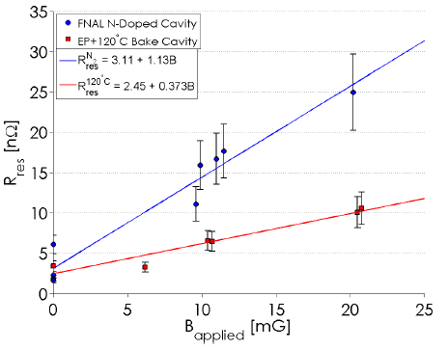
Dependence of the R_{res} on the trapped flux and B_{ext}
Rres as a function of trapped flux. The amount of flux trapped in the cavity walls depends on both applied field and cooldown rate.
Rres vs applied magnetic field under fast (>1 K/min) cool down conditions.
Although Rres strongly depends on the treatment history of the cavity, Rres is proportional to the trapped flux.

Slide 4
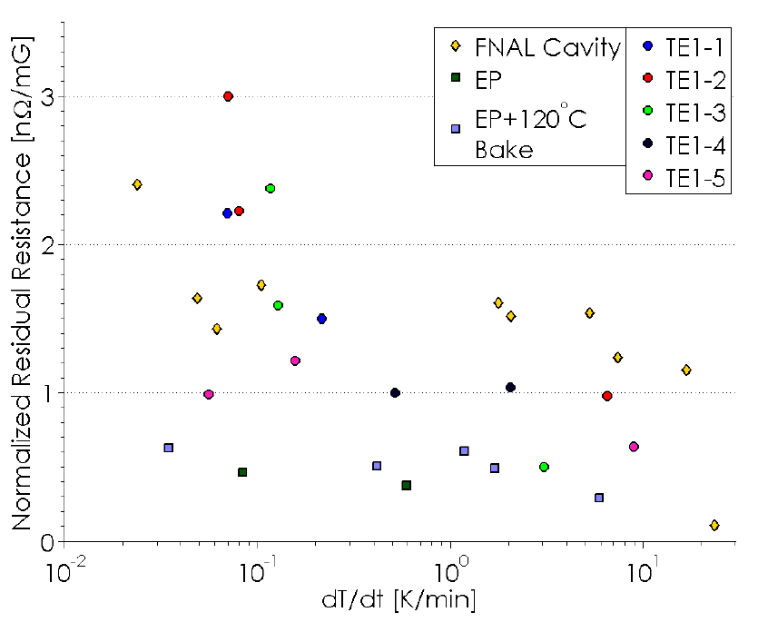
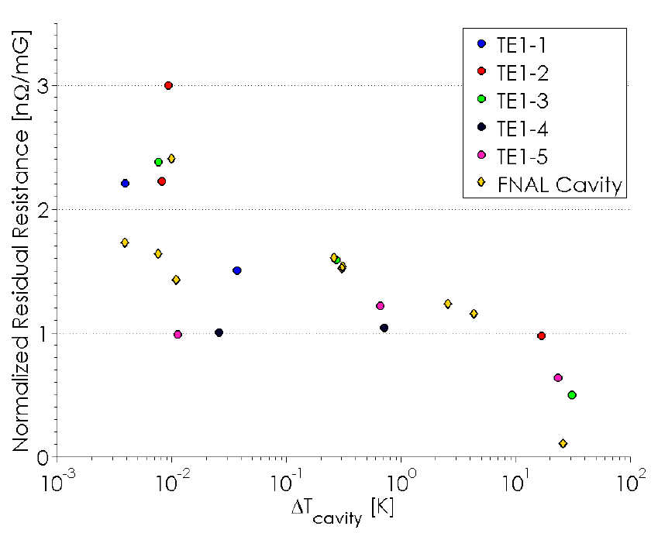
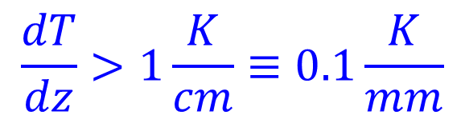
Cooldown rate and spatial temperature gradient
Rres normalized to the external field as a function of cool down rate through Tc for the eight cavities.
Rres normalized to the external field as a function of temperature gradient across the cavity when it transitions from normal to superconducting.
The gradient effect takes place for
$$\frac{dT}{dz}>1\frac{K}{cm}≡0.1\frac{K}{mm}$$

Slide 5
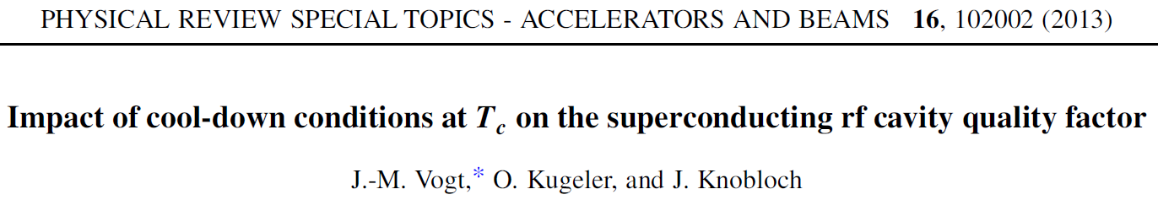
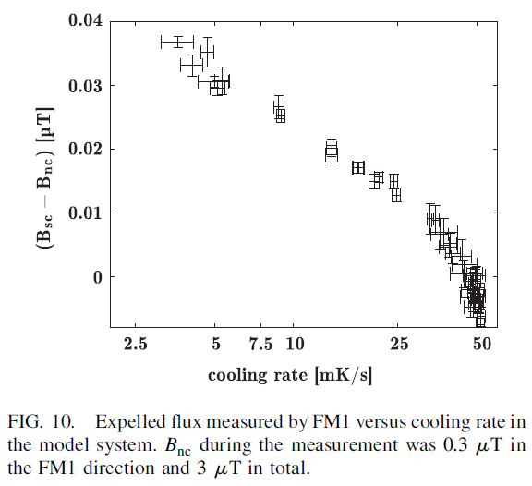
From the summary
“A high cooling rate leads to a suppressed Meissner effect. When the rate is reduced, more flux can be expelled. Both, thermal and spatial gradients, work in the same direction: The larger they are, the higher is the amount of trapped flux and hence the achieved Rres.”
The results of two studies are just opposite!
In both case the tests are horizontal.

Slide 6
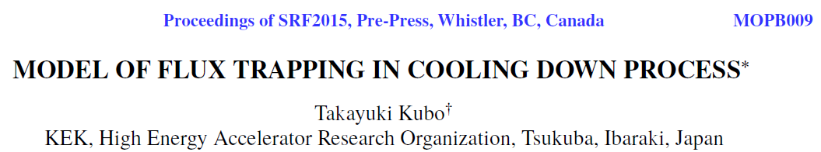
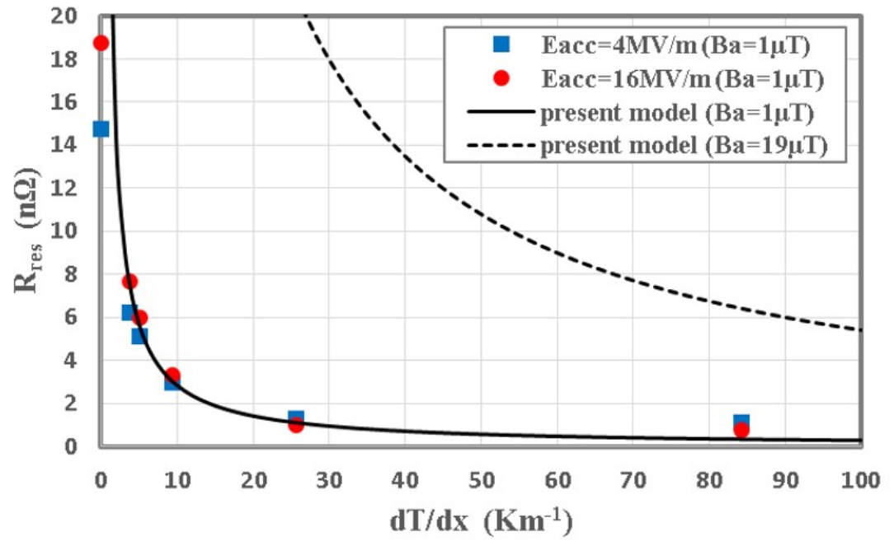
The theoretical model suggest that with the spatial gradient of 0.1 K/cm the flux can be expelled. Not consistent with the Cornel results but agrees with Argonne results.

Slide 7
Summary
Though the tests are performed under similar conditions, the results are the opposite.
The theoretical estimate is one order of magnitude off compared to Cornel experimental results.
Further work is need to understand the physical mechanism.
Let’s try to cooldown as fast as possible and the do thermal cycling as slow as possible.

