Slide 1
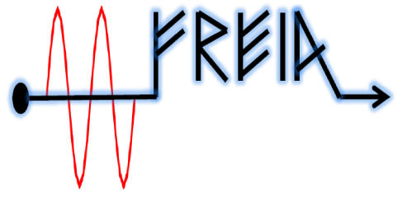

Physics of trapped magnetic fluxes
in SC cavities
Vitaliy
February, 2016

Slide 2
Superconductivity
Abrupt jump of DC resistance to zero at T < Tc
Meissner effect
Isotope effect
Second-order phase transition and supercurrent
Penetration depth
Coherence length
Cooper pairs
Ginzburg-Landau model

Slide 3
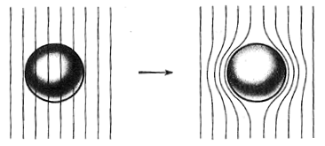
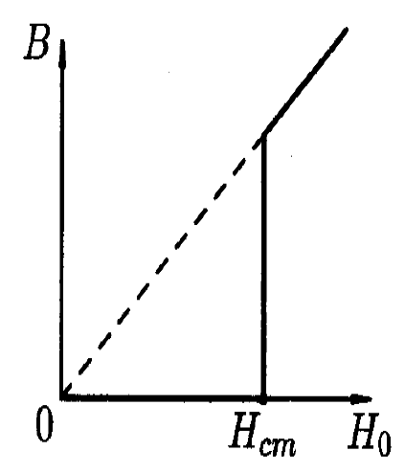
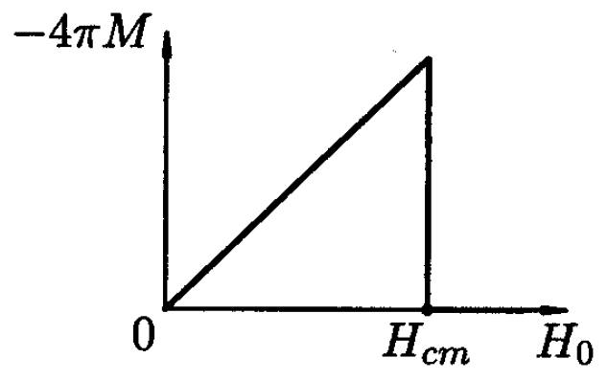
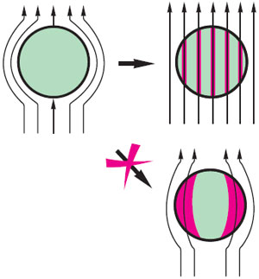
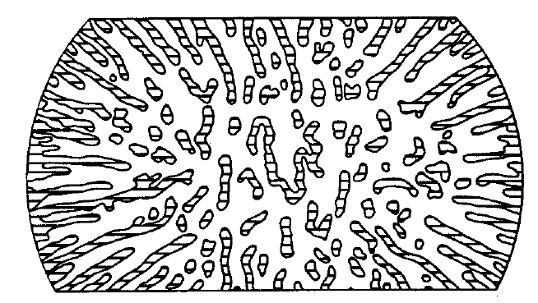

Meissner Effect: superconductors type-I
Beyond critical field: the intermediate state

Slide 4
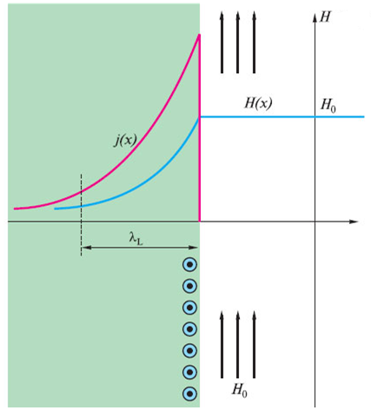

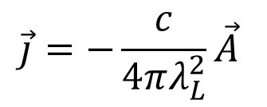


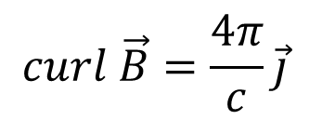

London penetration depth
For normal conductors
$$\vec{j}=σ\vec{E}$$
For superconductors
$$\vec{j}=−\frac{c}{4πλ_{L}^{2}}\vec{A}$$
Using the Maxwell equation
$$curl \vec{B}=\frac{4π}{c}\vec{j}$$
we obtain
$∇^{2}\vec{B}=\vec{B}/λ_{L}^{2}$,
whose
solution is
$$B\left(x\right)=B_{0}e^{−x/λ_{L}}$$
and the penetration depth reads
$$λ_{L}=\sqrt{mc^{2}/4πnq^{2}}$$
For niobium it is around 500 Å.

Slide 5
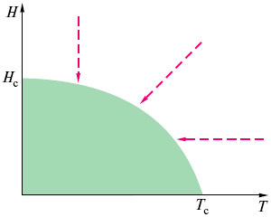
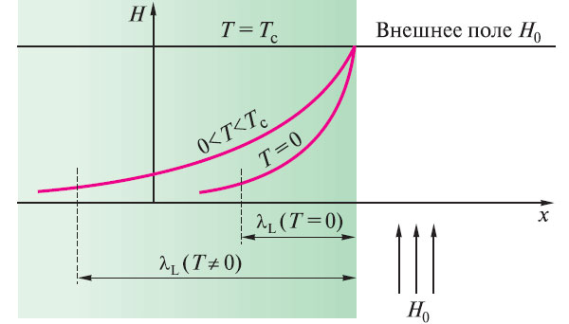
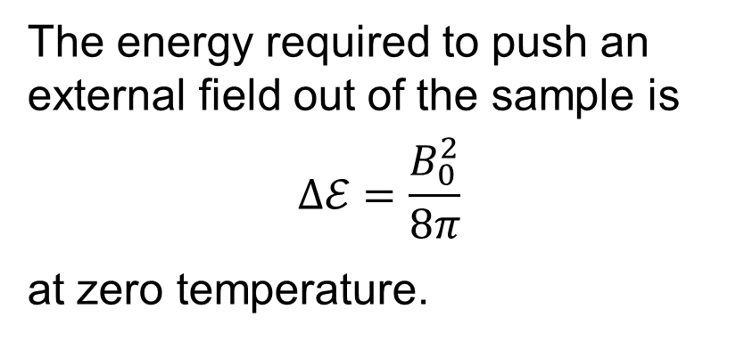
Critical Field
The energy required to push an external field out of the sample is
$$Δℰ=\frac{B_{0}^{2}}{8π}$$
at zero temperature.

Slide 6
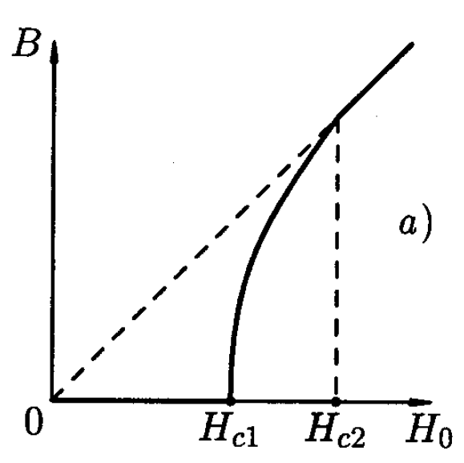
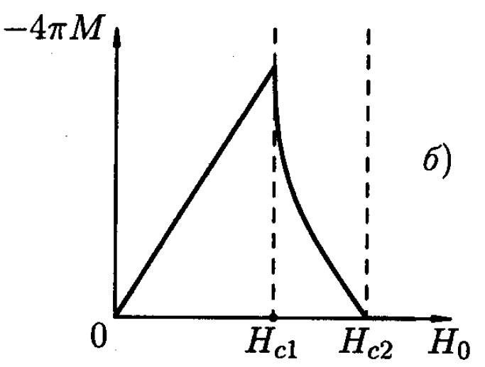
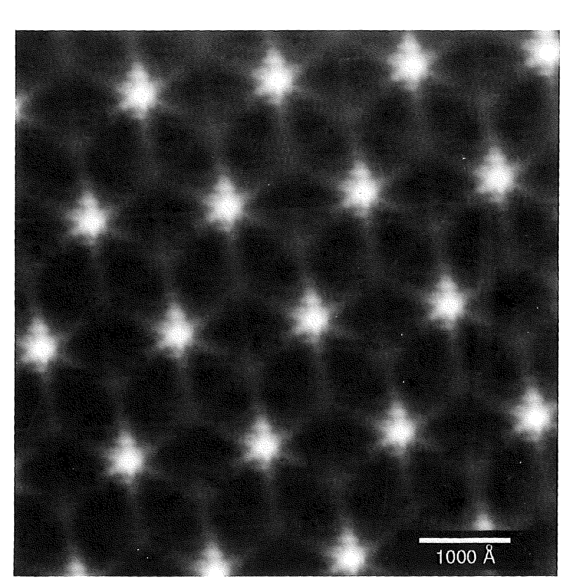
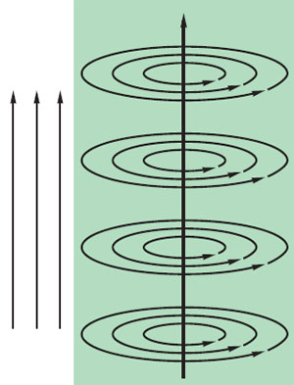
Meissner Effect: superconductors type-II

Slide 7
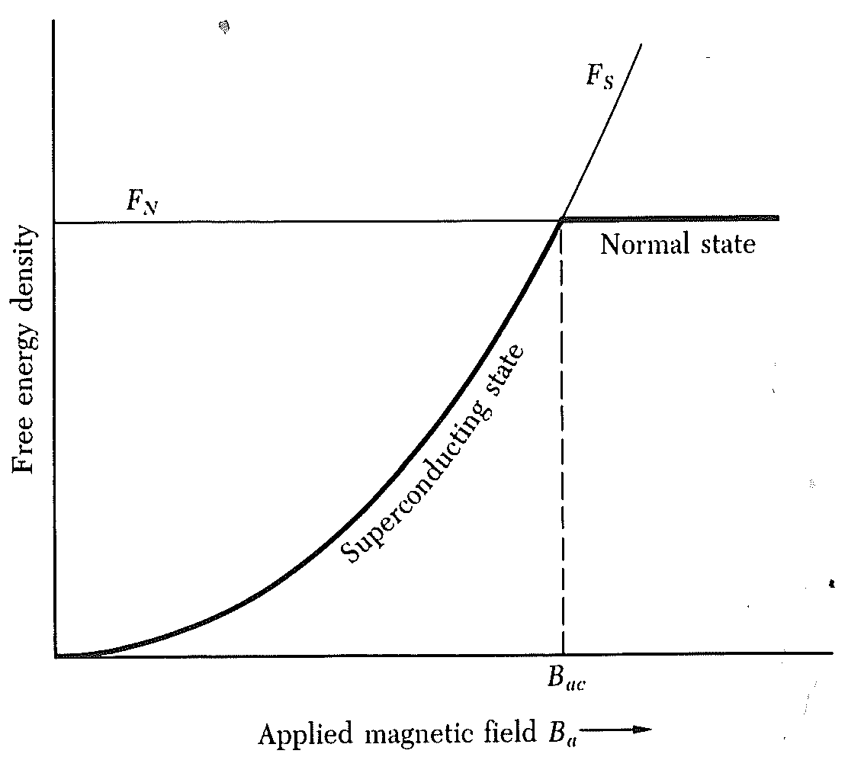
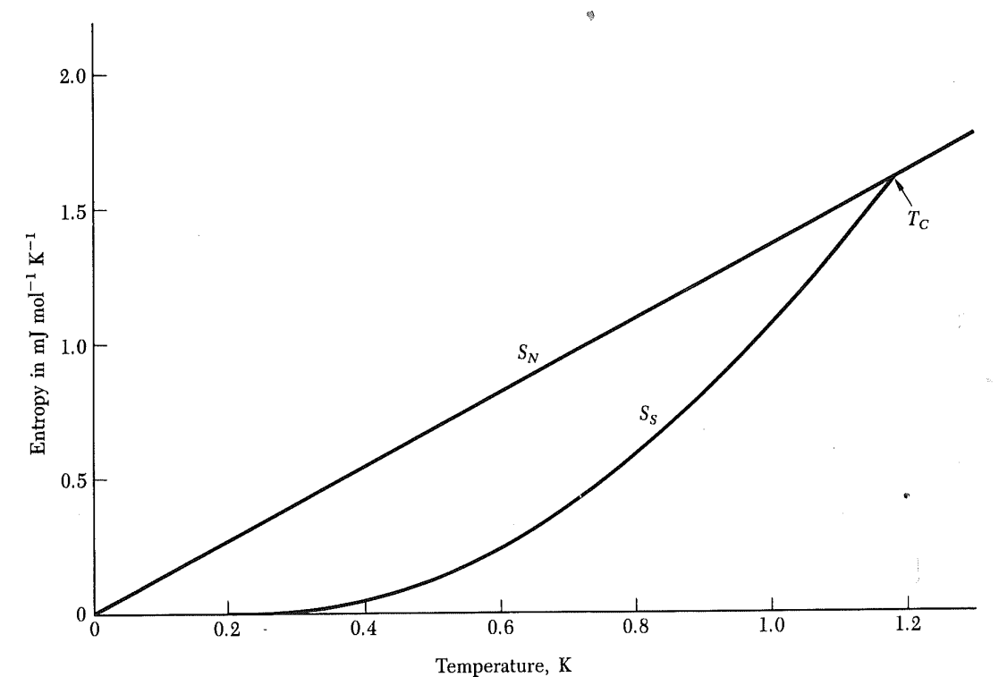
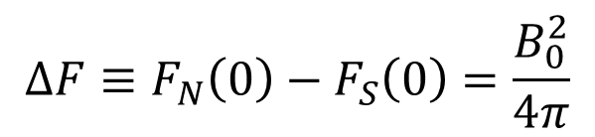
Thermodynamics of superconductors
$$ΔF≡F_{N}\left(0\right)−F_{S}\left(0\right)=\frac{B_{0}^{2}}{4π}$$

Slide 8
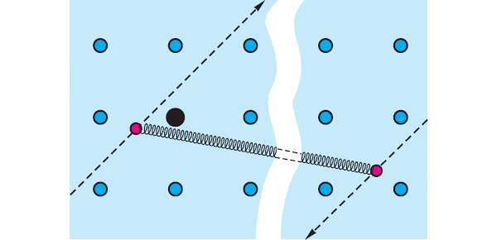
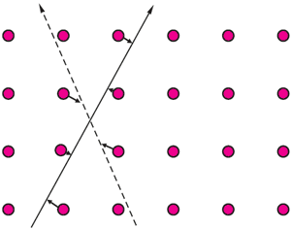
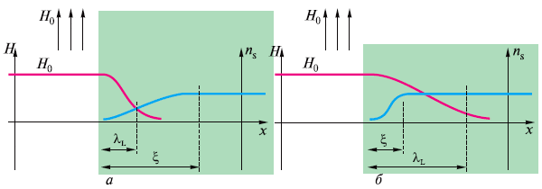
The origin of superconductivity: Cooper pair

Slide 9


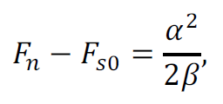
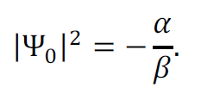
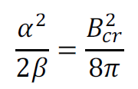



Slide 10
