Slide 1
AccMed
Accelerators for Medicine
An application in response to the SSF call for proposals for Industrial Research Centres

Slide 2
Industry and Institution Partners
Industry partners
General Electric Healthcare Gems Pet Systems, Uppsala - PET cyclotrons
Elekta Instrument, Uppsala - gamma therapy
ScandiNova, Uppsala - high voltage pulse modulators
Gammadata, Uppsala - radiation monitors
Scnditronix Magnets, Vislanda - beam line magnets
RFR Solutipons, Landskrona - stainless steel vacuum chambers
Institution partners
FREIA/Department of Physics and Astronomy, UU – Center Leader [huvudsökande] - liquid He cryogenics, vacuum and solid state radiofrequency high power sources, high vacuum, process control, GHz linac development, dosimetry
Department of Genetics and Pathology, UU and Academic Hospital - medical radiation physics and radiobiology
Center for Medical Technology, UU - diagnostics instrumentation
UU Innovation - Intellectual Property regulation
Skandion Clinic - clinical proton therapy
Department of Oncology and Pathology, Karolinska Institute - clinical oncology
CERN ENLIGHT Medical accelerator project - superconducting cyclotron coils

Slide 3
Main objective of AccMed:
To apply advanced accelerator and instrumentation techniques, developed for cutting-edge fundamental research in Big Science, for the urgent need of improving radionuclide availability for clinical PET diagnostics by designing and fabricating a prototype of a superconducting 15 MeV cyclotron for radionuclide production and to work towards the realization of a prototype for a combined superconducting cyclotron and linear accelerator for carbon ions of 400 MeV/nucleon for cancer therapy.

Slide 4
Superconducting cyclotron for radionuclide production
The AccMed project will have as a first goal to develop advanced equipment that is smaller, lighter and less costly than the equipment presently in use for radionuclide production, such that such equipment can be acquired by more hospitals than just a few and make possible the use of more short-lived isotopes in these hospitals, implying that the irradiation dose to the patient during PET diagnostics can be significantly decreased. This will enable direct local production of radionuclides like F18 and Tc99m in the hospital for nuclear medicine. In particular this will also eliminate the need for long distance transports of reactor produced radioactive Mo99/Tc99m generators.

Slide 5
Superconducting cyclotron with linac for carbon ion therapy
The AccMed project will have as a second goal to develop advanced equipment that can be used to produce carbon-ion beams for cancer therapy using a cyclotron-linac (cyclinac) combination, which will make it possible to strictly limit the irradiation to the tumor only, implying that the damage to the surrounding healthy tissue during tumor irradiation will be significantly reduced. There is a rapidly growing interest in systems that treat cancer effectively with carbon ions, which is needed for so called radio resistant tumors (tumors more resistant than the surrounding healthy tissue, 5% of the cases) and for small tumors located near vital organs in the patient body.

Slide 6
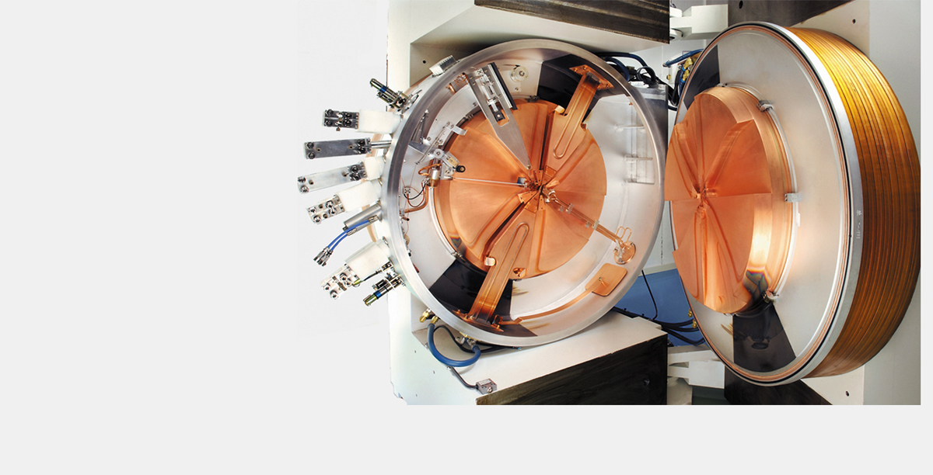
GEs MINItrace cyclotron for radioisotope production
¹⁸F-fluoride production
Proton acceleration capability up to 9.6 MeV
>99.9% beam extraction
Two resonators, RF Power Generator
Vertically oriented magnet design
Self-diagnostics and embedded control technique
High-grade radiation self-shielding
Fully automated sequence
Hollow-core, water-cooled copper conductor magnet coils
Fixed-position, internally mounted ion source
System dimensions
Cyclotron including self-shield
Length 2100 mm (83 in)
Width 3600 mm (142 in)
Height 2100 mm (83 in)
Weight 50 350 kg (111 000 lbs)

Slide 7
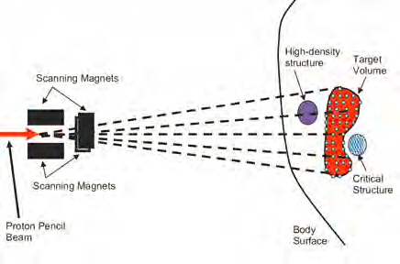
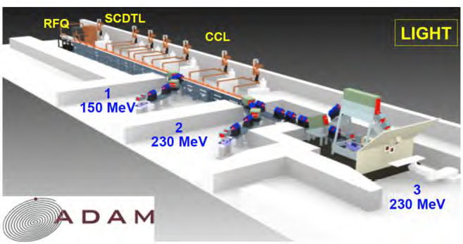
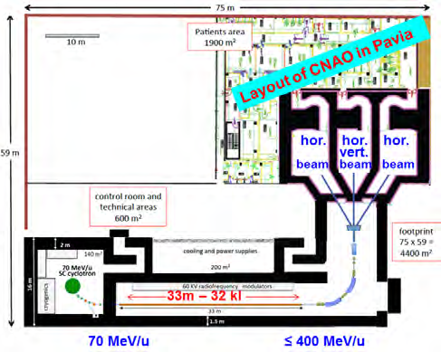
Proton linac and Carbon-ion cyclinac*
*cyclinac = cyclotron + linear accelerator
Proton linac LIGHT
Advantages of linac over cyclotron:
1. spot scanning (step and shoot)
2. volumetric multipainting (10-12 times)
3. tumor tracking (follow tumor movement)
Cabon-ion cyclinac
Advantages of carbon ions over protons:
1. Very sharp Bragg peak
2. 25 times higher ionization density
3. Causes clustered double strand-breaks
in the cell nucleus and thereby kills
radio resistant tumors (5% all tumors)
4. Small current enough spares healthy tissue

Slide 8
Relation of the project to state of the art in the area
A prototype for a superconducting proton cyclotron for radioisotope production has been produced by a company Ionetix in the US and two more such prototypes are currently being designed by a company PMB Alcen in France.
There is one company in Geneva AVO-ADAM which is currently producing a first linear accelerator LIGHT for proton therapy but, to our knowledge, no company is currently producing a prototype for a linear accelerator for carbon therapy.

Slide 9
Concluding remarks
- AccMed has IRC a complete set of institution and industry partners with the required research competence in accelerators and radiobiology/medical radiation-physics and in industrial technology and marketing.
- Neither of the two accelerators and methods are available on the commercial market, the PET SC cyclotron can be taken from design study to prototype fabrication and tests and to the market within the project period 6-8 years, the carbon cyclinac is a “disruptive” project and can be taken from design study to prototype fabrication and tests of some parts of the full scale cyclinac within the same period.
- The AccMed SSF-IRC Centre will provide FREIA with a substantial project beyond spring 2019 (when the current ESS commitment will be finished) together with the other accelerator development project for CERN (LHC upgrade) and instrumentation projects for CERN, MAX-IV, ITER and ESS.

