Slide 1
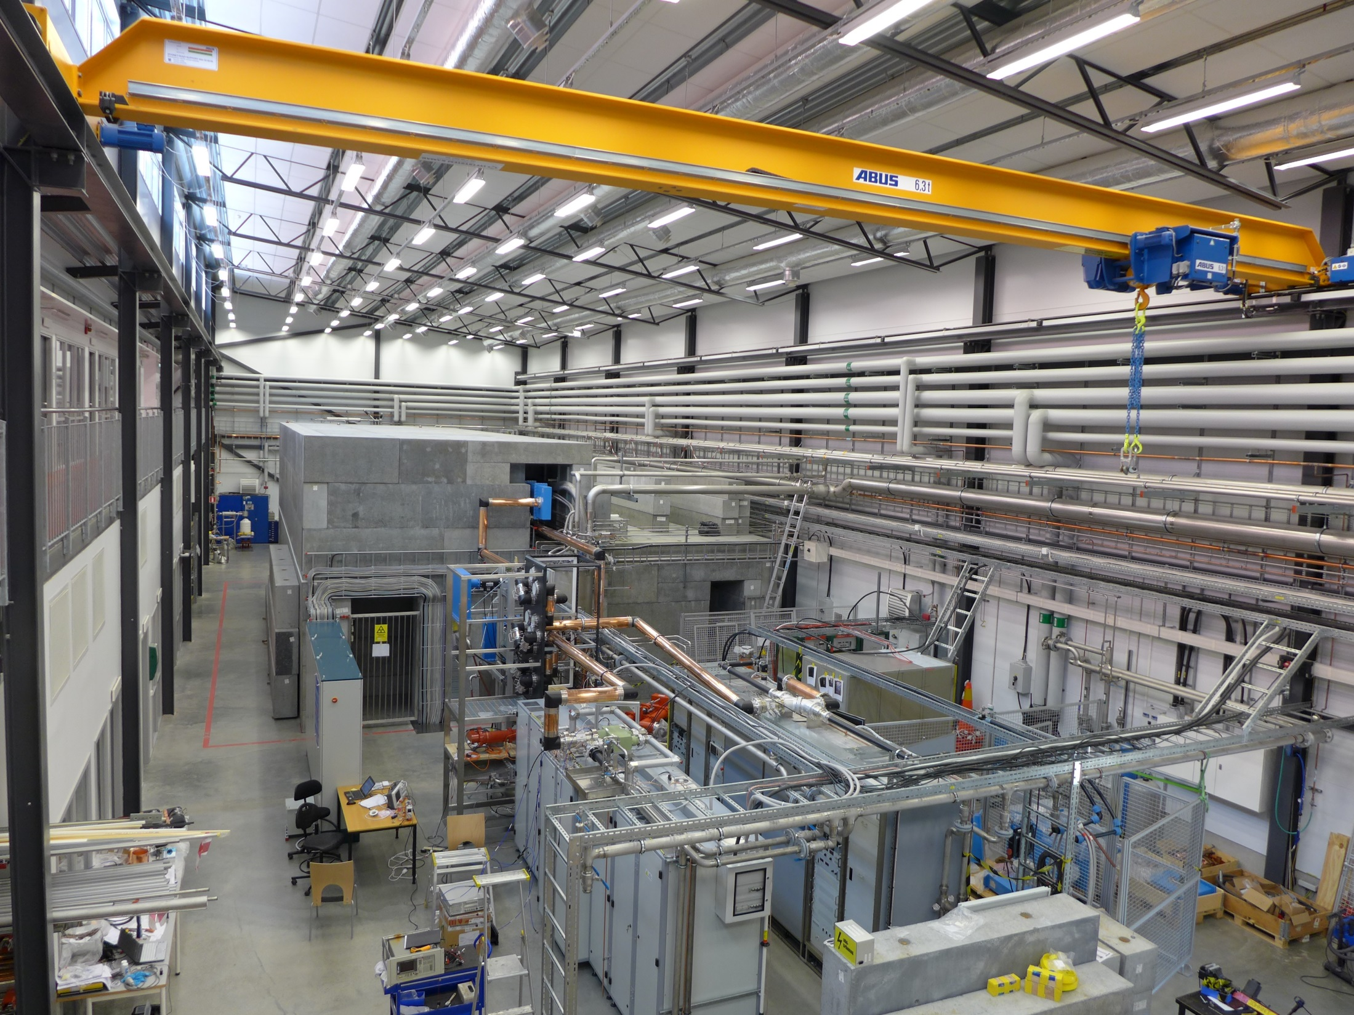
Accelerator Physics and Light Generation
at the FREIA Laboratory

Slide 2
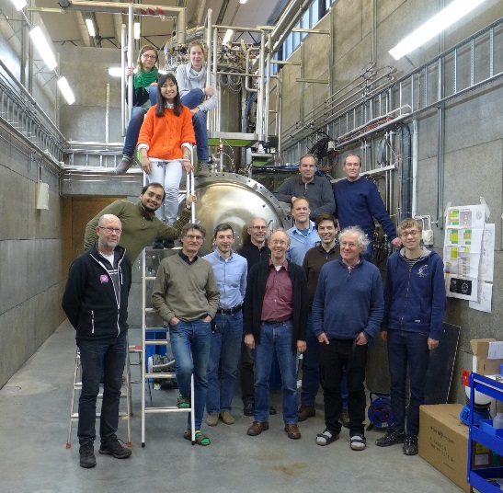
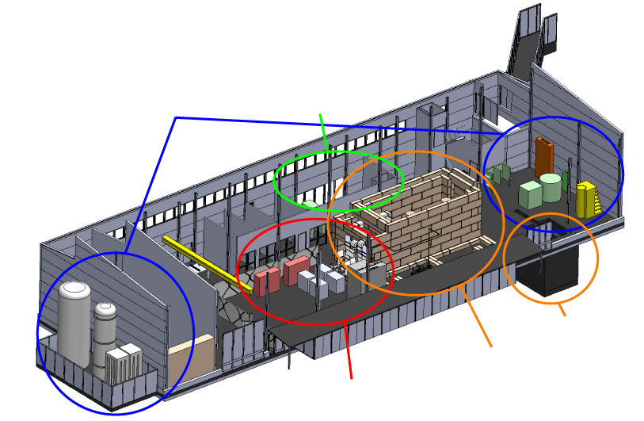
What & Whom?
Facility for Research Instrumentation and Accelerator Development
State-of-the-art Equipment
cryogenics
- liquid helium
- liquid nitrogen
control room
- equipment controls
- data acquisition
Competent and motivated staff
collaboration of physics (IFA)
and engineering (Teknikum).
Funded by
KAWS, Government, Uppsala Univ.
vertical cryostat
3 bunkers
with test stands
horizontal cryostat
radio-frequency (RF) power sources

Slide 3
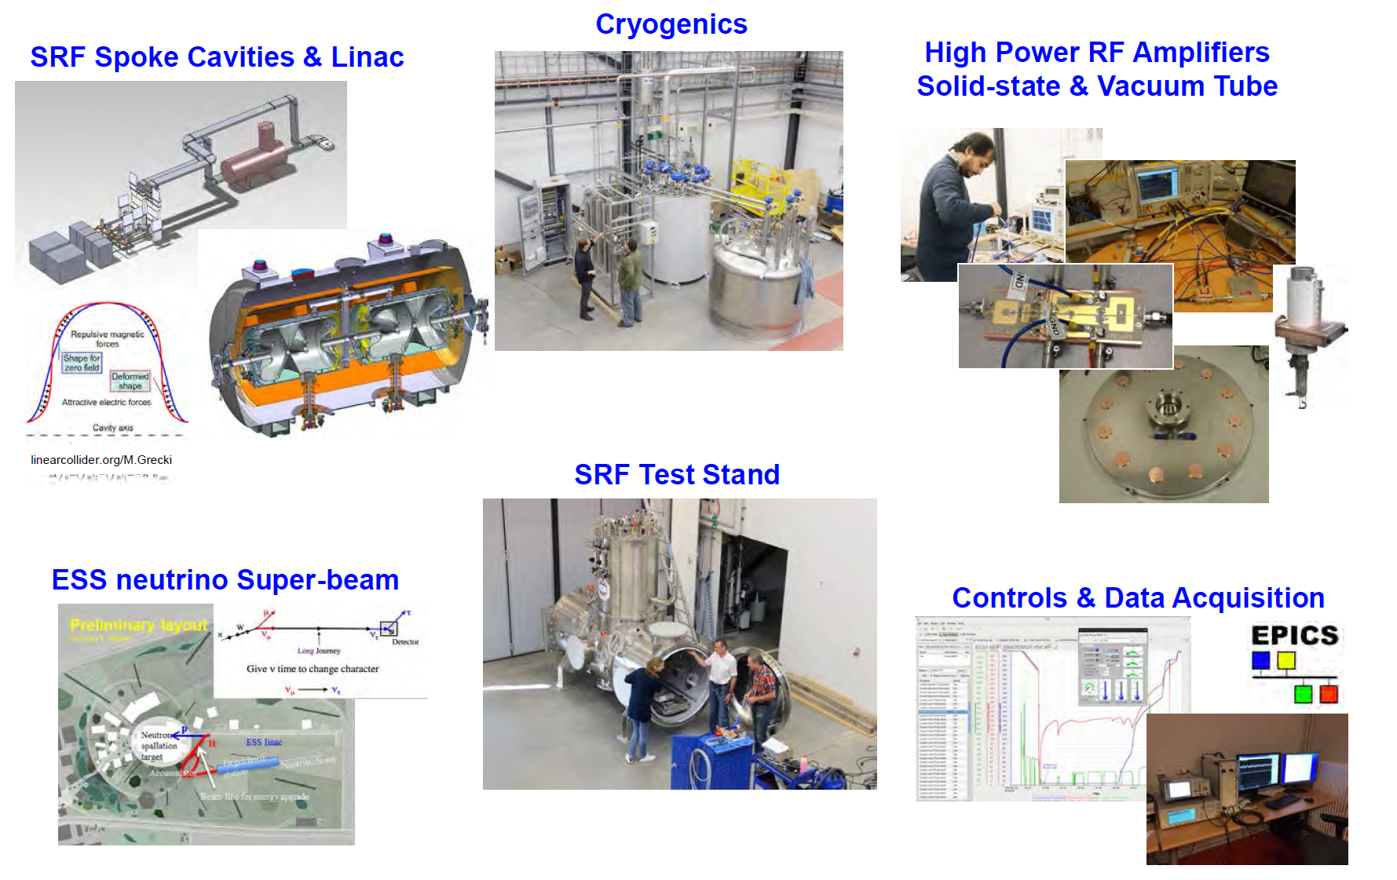
Accelerator development

Slide 4
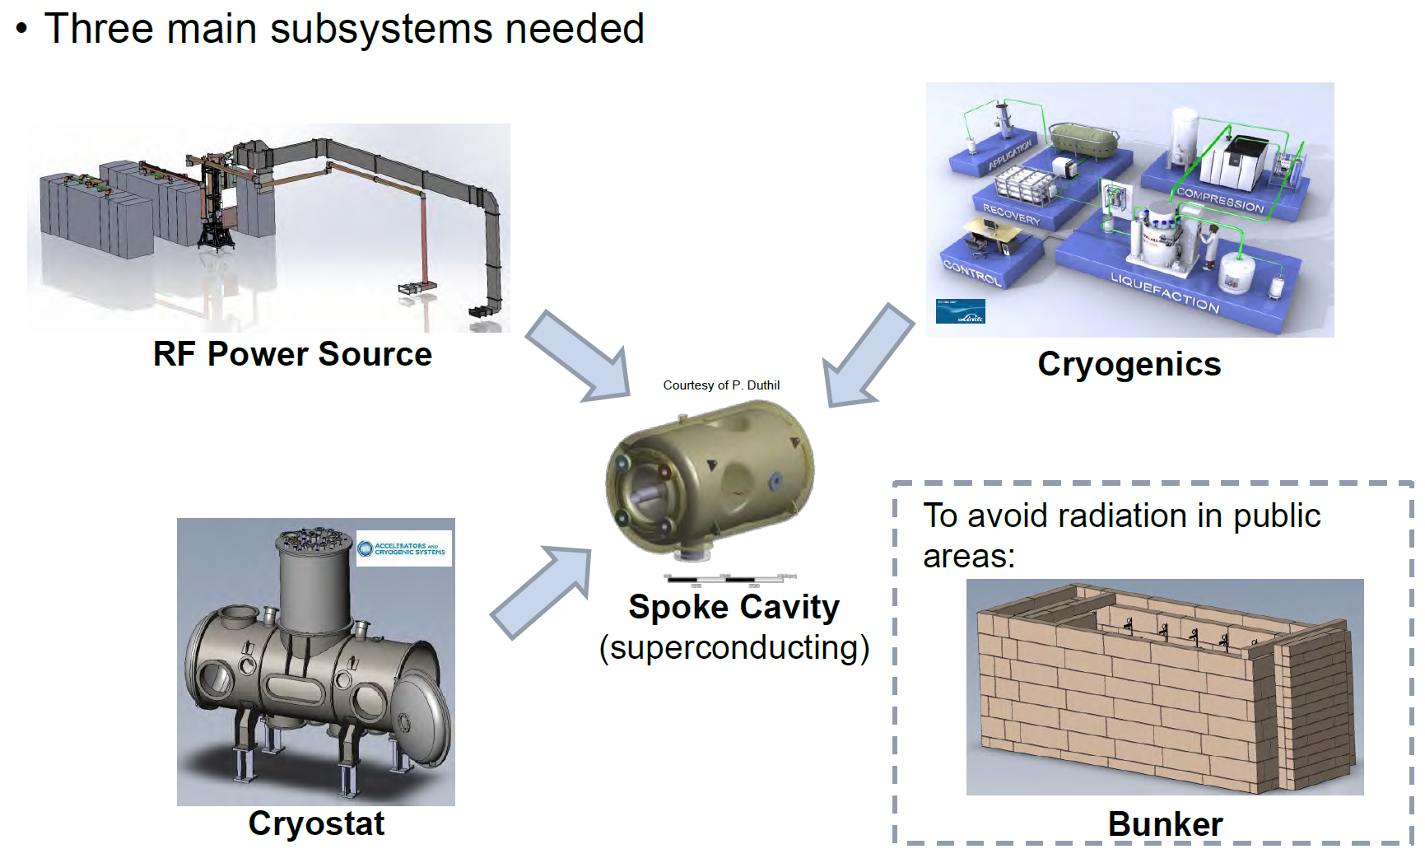
Characterization of superconducting cavity resonators

Slide 5
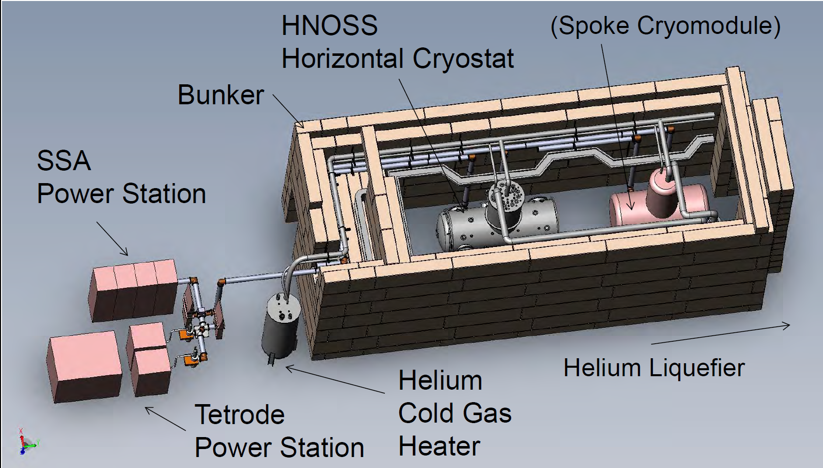
Test bench

Slide 6
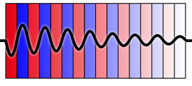
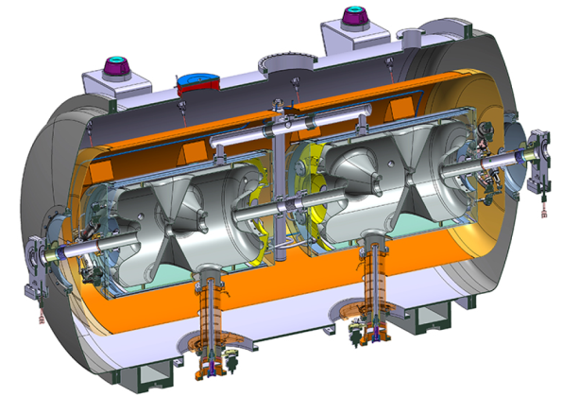
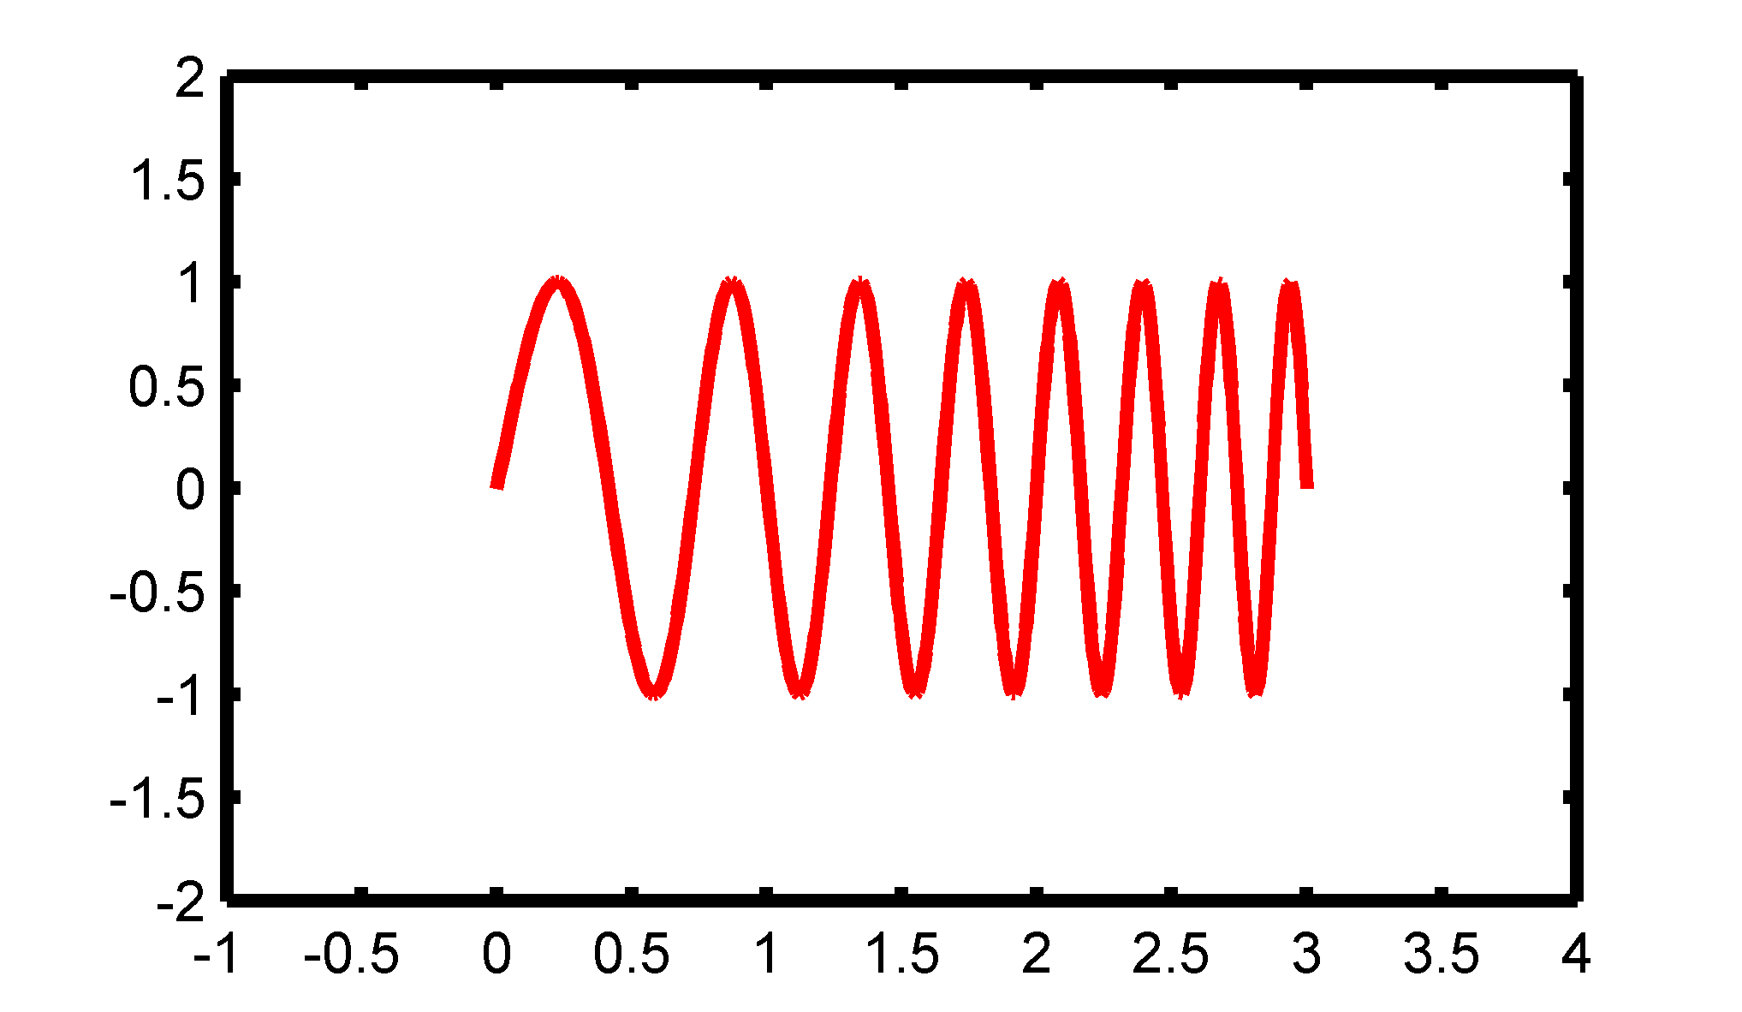

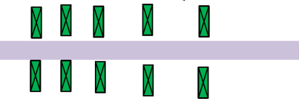
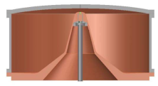
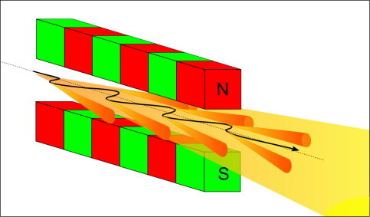
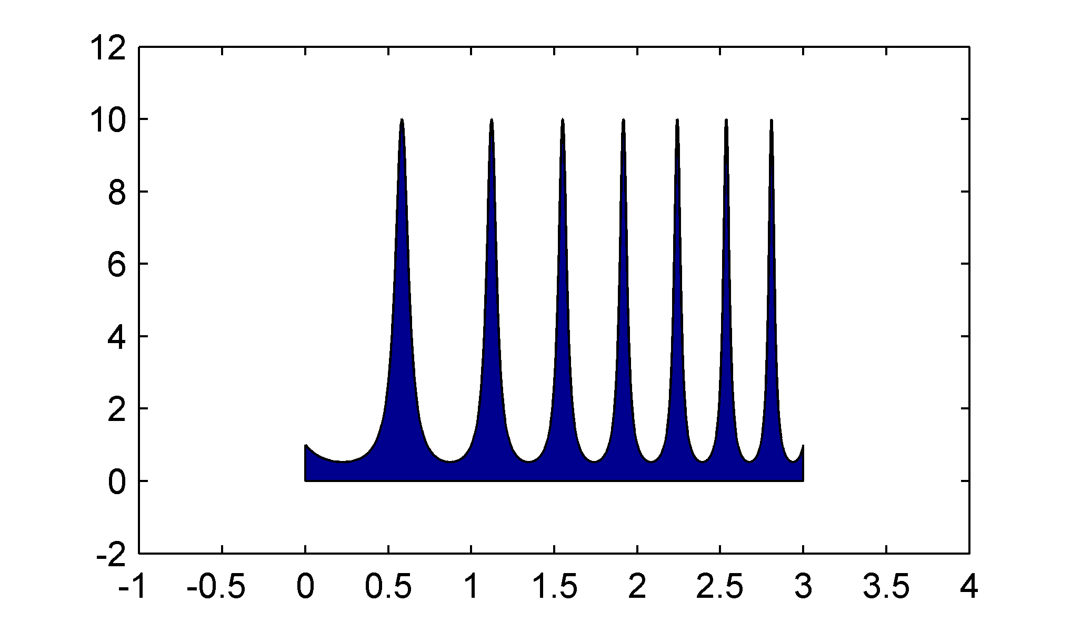
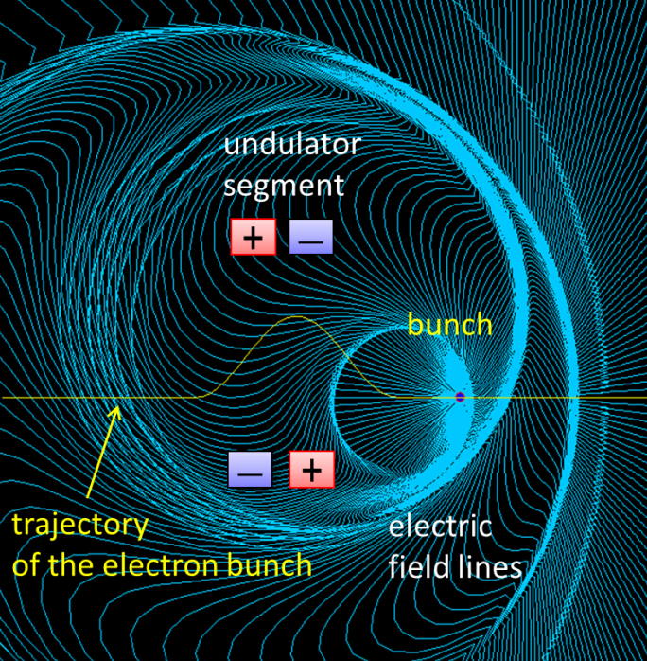
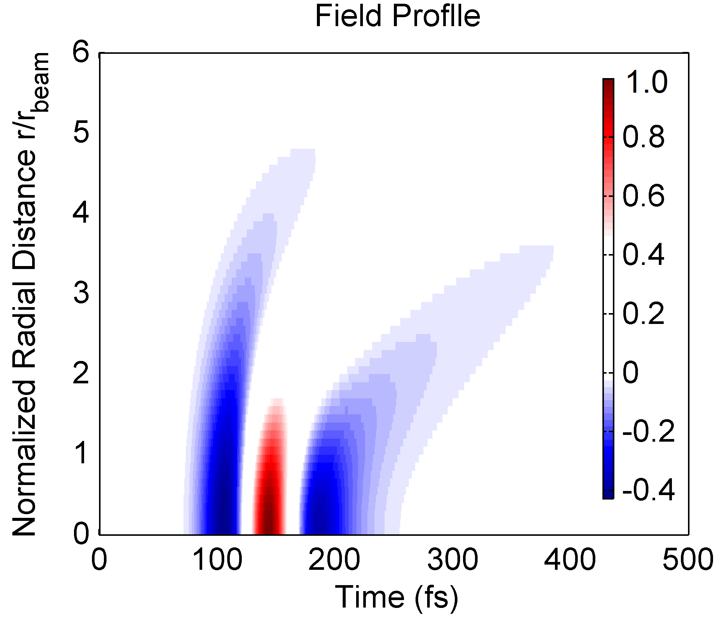
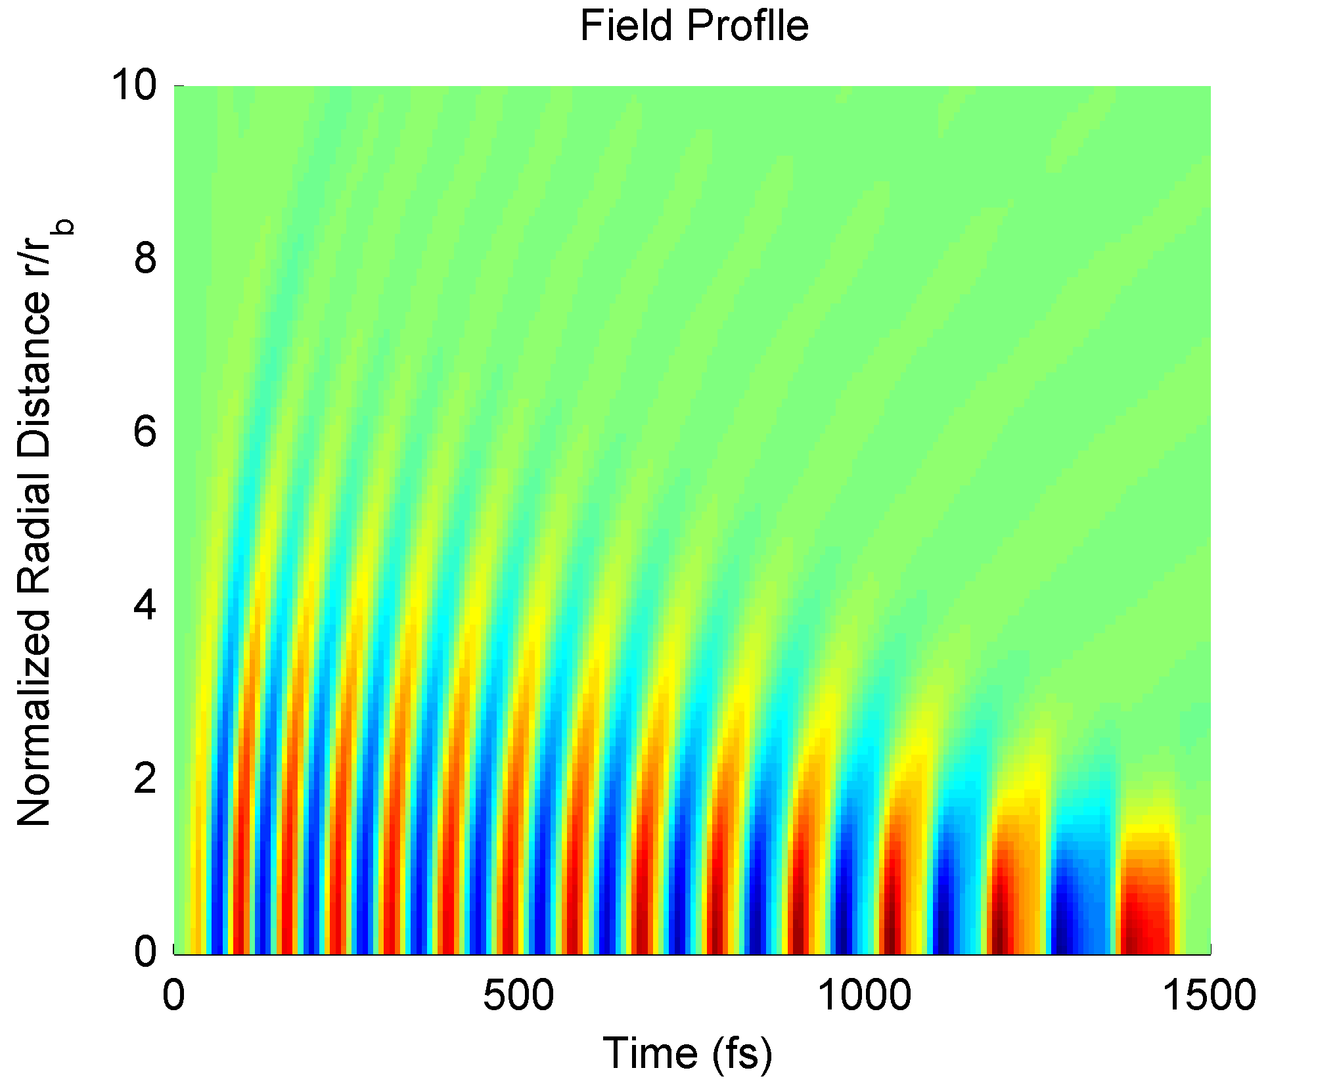
Extreme THz light source at UU
tunable IR/optical probe
OPA
Pump laser
laser
emittance
compensation
single-cycle THz pump
single-cycle THz probe
bunch
compressor
e-beam
accelerating
module
mutli-cycle THz pump
e-beam propagation
8 meters

Slide 7
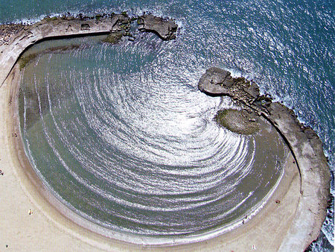
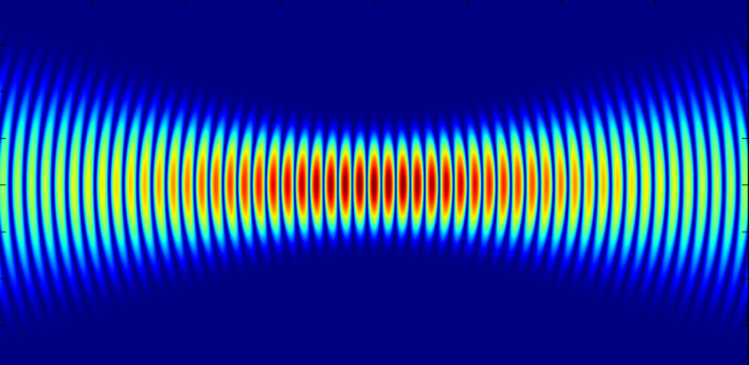
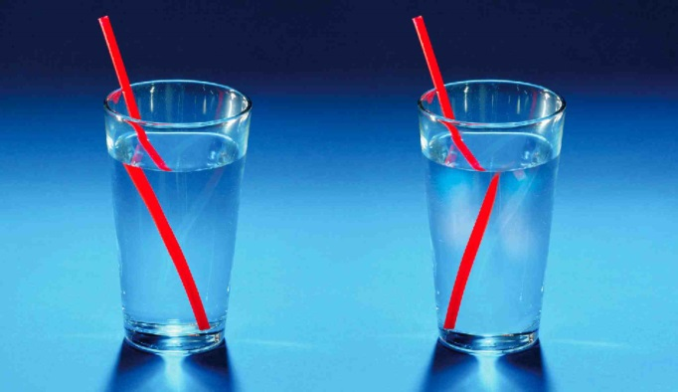
Courses for Master and PhD students
Accelerator Physics and Technology 2016/2017 (10 credits)
Autumn 2016 weeks 43-02 (late october - january)
Optics and Photonics 2016/2017 (10 credits)
Autumn 2016 weeks 35-42 (late august - mid-october)

Slide 8
Undergraduate and Graduate projects at FREIA
Expulsion of magnetic fluxes in type-II superconductors upon the transition from a normal- to superconducting state
Coupling of slow waveguide modes to surface plasmons of a subwavelength wire
Diffraction of single-cycle pulses of light
RF power measurement at FREIA
Electro-acoustic stability of superconducting accelerators
Data acquisition system for self-exited loop
Solid State Amplifiers development

Slide 9
Production of medical radioisotopes
Accelerators for cancer treatment
Accelerator-based light sources
Superconducting accelerator technology for Science and Society
Neutron sources without a nuclear reactor
Accelerator-driven sub-critical reactors
Nuclear waste transmutation
9

Slide 10
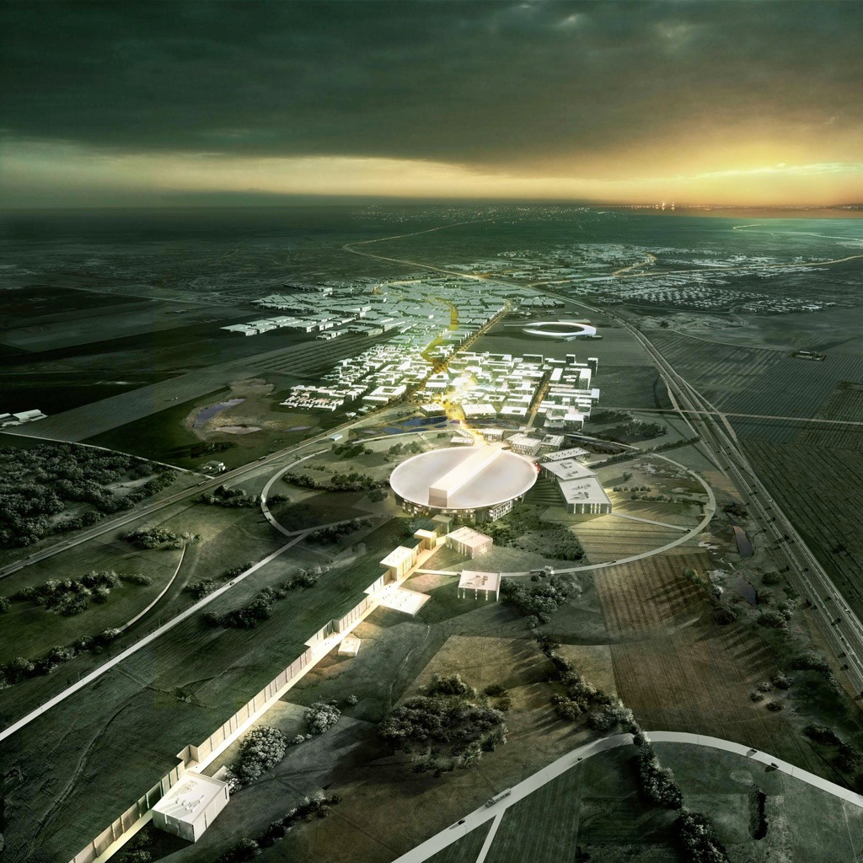
European Spallation Source (ESS), Sweden

Slide 11
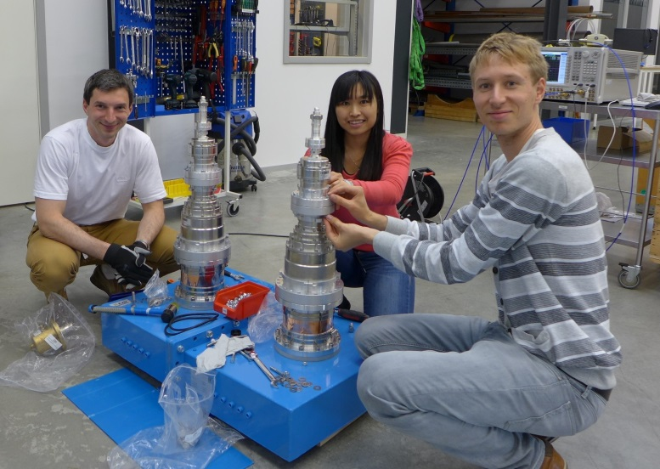
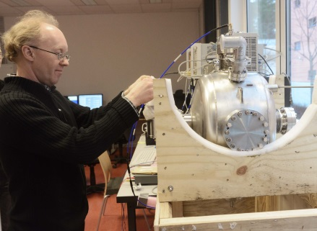
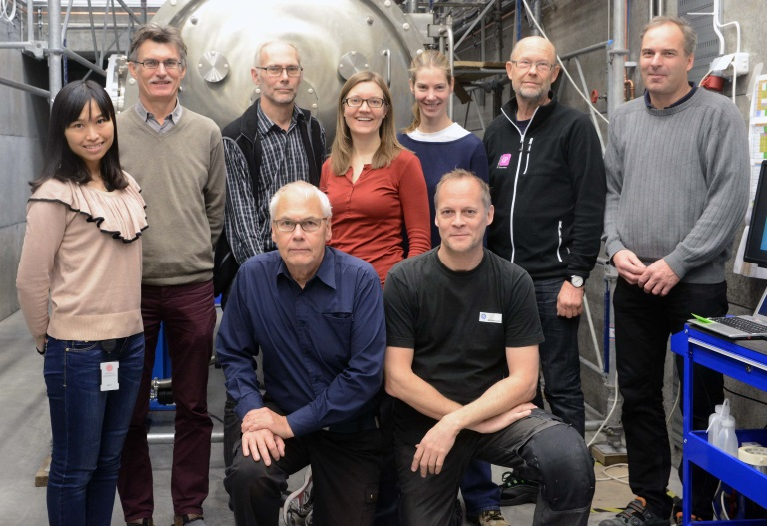
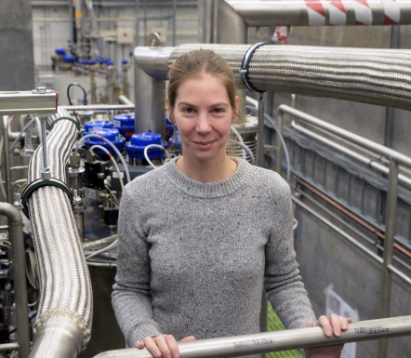
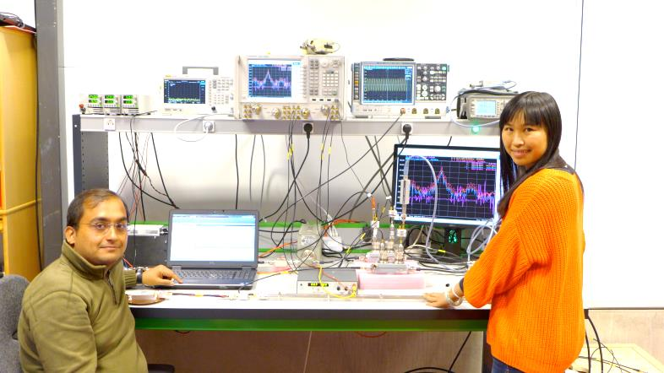
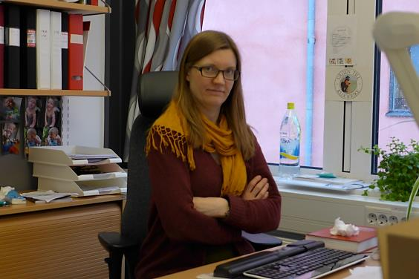
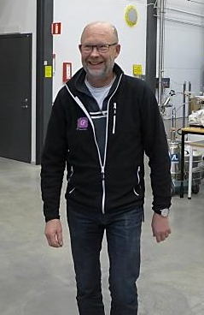
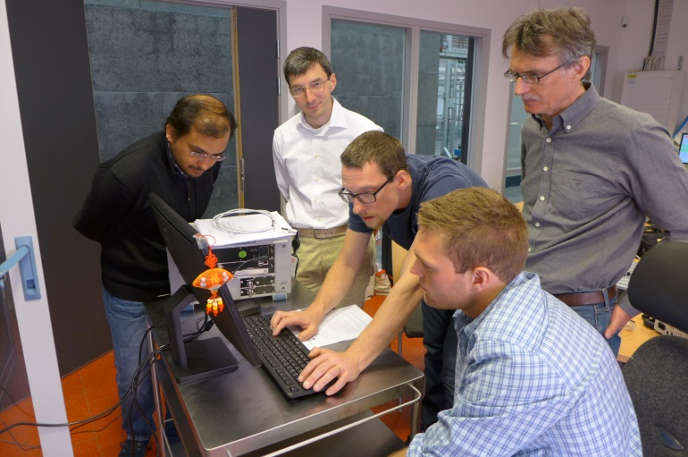
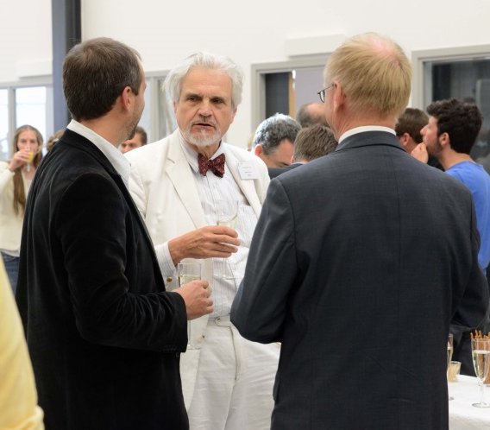
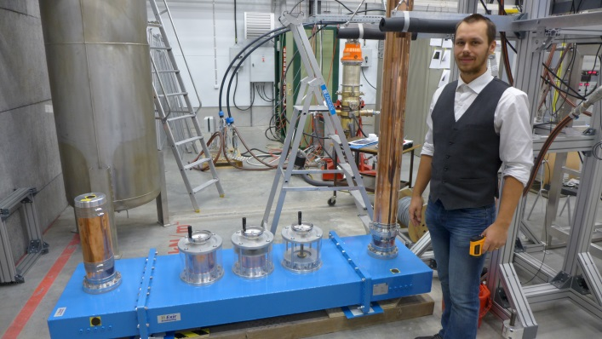
Research and fun
FREIA

